Slide 1



L
L Line
CSE 420
Computer Games
Organizational Issues

Slide 2
What is your expectation?
Is that what you expect?
  Assassins Creed III
Or that?
  Hitman 5
Perhaps that one?
  FIFA 13
Maybe this one?
  Civilization V

Slide 3
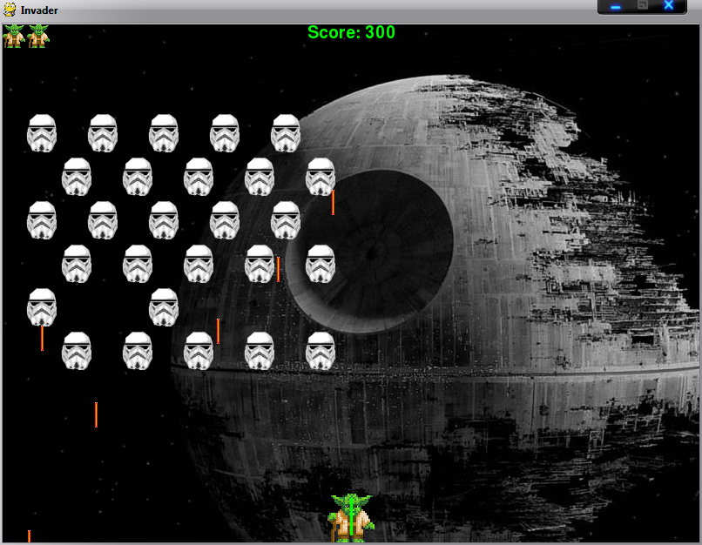
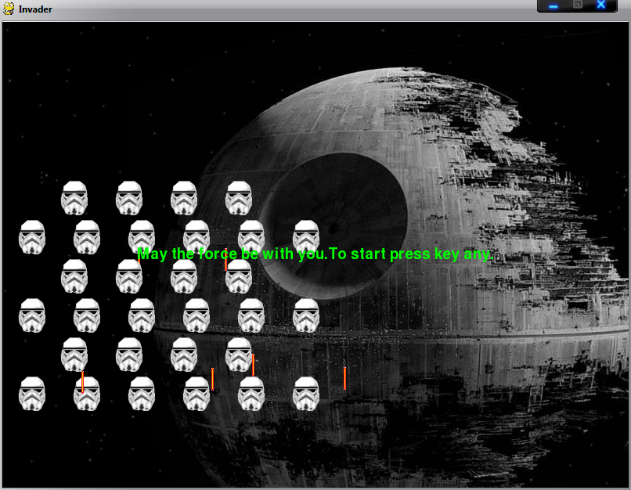
The truth is…
Forget it ☺
Long way to that point
What you be able to do at the end:

Slide 4
About this Course
Course Title | Course Code | Semester | Course Hour/Week |  | ADU Credit | ECTS
Computer Games | CSE 420 | Spring/Fall | Theory 2 | Practice 2 | 3 | 6
Course Type
1. Compulsory Courses
1.1. Programme Compulsory Courses
1.2. University Compulsory Courses (UFND)
1.3. YÖK (Higher Education Council) Compulsory Courses
2. Elective Courses
2.1. Program Elective Courses |  |  |  |  |  | X
2.2. University Elective Courses
3. Prerequisites Courses
3.1. Compulsory Prerequisites Courses
3.2. Elective Prerequisites Courses

Slide 5
About this Course (Cont.)
Language of Instruction | English
Level of Course | Associate Degree (Short Cycle) Undergraduate (First Cycle) Graduate (Second Cycle) Doctoral Course (Third Cycle)
Special Pre-Conditions of the Course (compulsory) | None
Special Pre-Conditions of the Course (recommended) | Students should have good programming skills. Having basic knowledge about object-oriented programming and Python is useful.
Course Instructor(s) | Dr. Samsun M. Başarıcı | Mail: sbasarici@adu.edu.tr Web: https://akademik.adu.edu.tr/fakulte/muhendislik/personel/sbasarici/anasayfa

Slide 6
Main Objective of this Course
In this course it is intended to introduce computer games and understand the design process and the logic behind computer games and game programming.

Slide 7
Learning Outcomes of this Course
Upon successful completion of this course, students will
  Know the essential elements of a game
  Differentiate types of games and identify game genres
  Build basic Python programs using a command-line interface
  Demonstrate mastery of essential programming structures (variables, functions, conditions, loops)

Slide 8
Learning Outcomes of this Course (Cont.)
  Incorporate essential data structures for game management
  Build user interfaces that combine ease of use with the game’s theme
  Generate a simple opponent, AI
  Create a library of reusable game objects for further exploration
  Demonstrate basic understanding of graphics and audio as used in games
  Employ object-oriented programming principles in game development

Slide 9
Course Content
This course studies basic game development principles with a focus on two-dimensional arcade games. Topics include an introduction to programming in Python, basic graphics and audio principles, creation of sprite objects, object-oriented programming in games, user-interaction concepts, game data structures, essential game physics, and the construction of a reusable game-development library.

Slide 10
Resources
Required Course Material (s) /Reading(s)/Text Book (s) | Andy Harris, “Game Programming, The L Line, The Express Line to Learning”; Wiley, 2007, ISBN: 978-0470068229 Ernest Adams, “Fundamentals of Game Design, 2nd Ed.”; New Riders, 2010, ISBN: 978-0321643377
Recommended Course Material (s)/Reading(s)/Other | http://www.python.org, main resource for python programming http://www.pygame.org, main resource for pygame Other sources will be announced

Slide 11
Course Schedule (Weekly)
Week | Topics | Preliminary Preparation | Methodology and Implementation (theory, practice, assignment etc)
1 | Introducing Computer Games and Game Programming | Adams Ch.1-3
2 | Genres of Computer Games | Adams Part II (Ch. 13-20)
3 | Genres of Computer Games (cont.) | Adams Part II (Ch. 13-20)
4 | Installing and using Python | Harris Ch. 1 | Writing a simple program in Python
5 | Handling the data | Harris Ch. 2 | Identifying and using different types of data in Python
6 | MIDTERM
7 | Controls and control structures | Harris Ch. 3 | Writing simple programs using control structures

Slide 12
Course Schedule (Weekly) (Cont.)
Week | Topics | Preliminary Preparation | Methodology and Implementation (theory, practice, assignment etc)
8 | Game Foundations | Harris Ch. 4
9 | Graphics, drawings and event handling | Harris Ch. 5 | Programming example event handlers
10 | Audio and sprites | Harris Ch. 6 | Creating and using sound and sprite objects
11 | Planning and building a working game | Harris Ch. 7 | Planning and writing a simple game using Python and Pygame
12 | Sprite animation | Harris Ch. 8 | Creating animated sprites
13 | Movement | Harris Ch. 9 | Basic physics and its use in games
14 | Game engine | Harris Ch. 10 & B-1 | Examining sample game engines and creating own game engine
15 | FINAL EXAM |  | FINAL EXAM

Slide 13
Assessment
Semester Activities/ Studies | NUMBER | WEIGHT in %
Mid- Term | 1 | 20
Attendance | - | -
Quiz | - | -
Assignment (s) | - | -
Project | 1 | 50 (20% Project report)
Laboratory | - | -
Field Studies (Technical Visits) | - | -
Presentation/ Seminar | - | -
Practice (Laboratory, Virtual Court, Studio Studies etc.) | - | -
Other (Placement/Internship etc.) | - | -
TOTAL |  | 70
Contribution of Semester Activities/Studies to the Final Grade |  | 70
Contribution of Final Examination/Final Project/ Dissertation to the Final Grade | 1 | 30
TOTAL |  | 100

Slide 14
Assessment (Cont.)
Final Grades will be determined according to the Adnan Menderes University Associate Degree, Bachelor Degree and Graduate Degree Education and Examination Regulation

Slide 15
Responsibilities of the Students
Obtaining the text book(s)
Coming to the course with a good preparation
Completing the exercises with individual efforts unless told otherwise
Following the rules set by the responsibles for the course and the implementation/lab. studies
HONESTY !!!

Slide 16
Plagiarism
Plagiarism will not be tolerated
Projects without references: a penalty of 20%
Submitting your own work that has been earlier submitted to satisfy the requirements of another course is (self)-plagiarism (also called double dipping)
Copying a journal article or a section of a book or code from an article or book and submitting it as your own is plagiarism

Slide 17
Plagiarism
Using significant ideas from someone else, but putting them in to your own words and not acknowledging the source of the ideas is plagiarism
Copying an essay, code, work etc. from another student and submitting it as your own is plagiarism
And PLAGIARISM is THEFT
So don’t steal (Nobody likes thieves)

