Slide 1


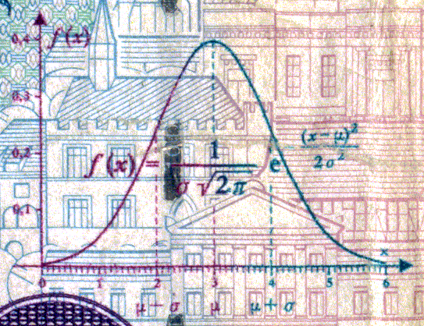
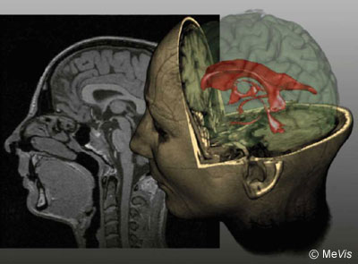
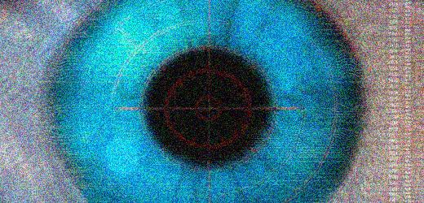
CSE 307
Basics of Image Processing
Lecture #0 Organizational Issues
Prepared & Presented by Asst. Prof. Dr. Samsun M. BAŞARICI

Slide 2
About this Course
Course Title | Course Code | Semester | Course Hour/Week |  | ADU Credit | ECTS
Introduction to Computer Applications | CSE 307 | Fall | Theory 2 | Practice 2 | 3 | 6
Course Type
1. Compulsory Courses
1.1. Programme Compulsory Courses
1.2. University Compulsory Courses (UFND)
1.3. YÖK (Higher Education Council) Compulsory Courses
2. Elective Courses
2.1. Program Elective Courses |  |  |  |  |  | X
2.2. University Elective Courses
3. Prerequisites Courses
3.1. Compulsory Prerequisites Courses
3.2. Elective Prerequisites Courses

Slide 3
About this Course (Cont.)
Language of Instruction | English
Level of Course | Associate Degree (Short Cycle) Undergraduate (First Cycle) Graduate (Second Cycle) Doctoral Course (Third Cycle)
Special Pre-Conditions of the Course (compulsory) | None
Special Pre-Conditions of the Course (recommended)
Course Instructor(s) | Dr. Samsun M. Başarıcı | Mail: sbasarici@adu.edu.tr Web: http://akademik.adu.edu.tr/fakulte/muhendislik/personel/sbasarici/anasayfa

Slide 4
Main Objective(s) of this Course
In this course it is intended to introduce the basic concepts of digital image processing and provide a foundation for implementing commonly used image processing algorithms.

Slide 5
Learning Outcomes of this Course
Upon successful completion of this course, students will
    Have a basic understanding of fundamental concepts of digital image processing
    Use basic image processing tools needed to analyze images in spatial and frequency domain
    Design and implement algorithms for the solution of broad class of problems in digital image processing
    Explain various image processing tools for smoothing, reconstruction and enhancement of images
    Understand the importance of strong mathematical tools for image processing and analysis in different application areas

Slide 6
Course Content
This course studies the fundamental topics in digital image processing like intensity transformations, filtering both in spatial and in frequency domain, image restoration and reconstruction, point, line, edge detection, morphological image processing, image segmentation.

Slide 7
Resources
Required Course Material (s) /Reading(s)/Text Book (s) | Rafael C. Gonzalez, Richard E. Woods “Digital Image Processing, 4th Ed.”; Pearson, 2018, ISBN: 978-1292223049 (DIP) Rafael C. Gonzalez, Richard E. Woods, Steven L. Eddins “Digital Image Processing Using MATLAB”; Pearson, 2004, ISBN: 013-0085197 (DIPUM) Oge Marques, “Practical Image and Video Processing Using MATLAB”; Wiley, 2011, ISBN: 978-0470048153 (PIVPUM)

Slide 8
Resources (cont.)
Recommended Course Material (s)/Reading(s)/Other | Maria Petrou, Costas Petrou “Image Processing: The Fundamentals, 2nd Ed.”; Wiley, 2010, ISBN: 978-0470745861 Chris Solomon, Toby Breckon “Fundamentals of Digital Image Processing: A Practical Approach with Examples in MATLAB”; Wiley, 2011, ISBN: 978-0470844731 http://www.mathworks.com, main resource for MATLAB Other sources will be announced during the course

Slide 9
Course Schedule (Weekly)
Week | Topics | Preliminary Preparation | Methodology and Implementation (theory, practice, assignment etc)
1 | Introducing image processing (IP) and MATLAB: historical background, the importance and application areas of IP | DIP & DIPUM (Ch. 1), PIVPUM (Ch. 1-4) | MATLAB Fundamentals
2 | IP Fundamentals: Definitions and basics | DIP & DIPUM (Ch. 2), PIVPUM (Ch. 2, 5, 6, 7) | MATLAB Fundamentals (cont.)
3 | Intensity transformations and spatial filtering | DIP & DIPUM (Ch. 3), PIVPUM (Ch. 8-10) | Histogram and neighborhood operations (implementing various filters)
4 | Intensity transformations and spatial filtering (cont.) | DIP & DIPUM (Ch. 3), PIVPUM (Ch. 8-10) | Histogram and neighborhood operations (implementing various filters) (cont.)
5 | Frequency domain filtering | DIP & DIPUM (Ch. 4), PIVPUM (Ch. 11) | Implementing low-pass, high-pass filter, FFT & DFT
6 | Frequency domain filtering (cont.) | DIP & DIPUM (Ch. 4), PIVPUM (Ch. 11) | Implementing low-pass, high-pass filter, FFT & DFT (cont.)
7 | MIDTERM EXAM | - | MIDTERM

Slide 10
Course Schedule (Weekly) (Cont.)
Week | Topics | Preliminary Preparation | Methodology and Implementation (theory, practice, assignment etc)
8 | Image restoration and reconstruction | DIP & DIPUM (Ch. 5), PIVPUM (Ch. 12) | Implementation of noise and noise models and various filters
9 | Image restoration and reconstruction (cont.) | DIP & DIPUM (Ch. 5), PIVPUM (Ch. 12) | Implementation of noise and noise models and various filters (cont.)
10 | Morphological image processing | DIP & DIPUM (Ch. 9), PIVPUM (Ch. 13) | Implementation of basic morphological tools like dilation, erosion etc. and grayscale morphology
11 | Morphological image processing (cont.) | DIP & DIPUM (Ch. 9), PIVPUM (Ch. 13) | Implementation of basic morphological tools like dilation, erosion etc. and grayscale morphology (cont.)
12 | Edge detection and image segmentation | DIP & DIPUM (Ch. 10), PIVPUM (Ch. 14-15) | Implementation of derivative edge filtering (LoG, Canny etc.), intensity- and region based filtering algorithms and watershed
13 | Edge detection and image segmentation (cont.) | DIP & DIPUM (Ch. 10), PIVPUM (Ch. 14-15) | Implementation of derivative edge filtering (LoG, Canny etc.), intensity- and region based filtering algorithms and watershed (cont.)
14 | Color image processing | DIP & DIPUM ((Ch. 6), PIVPUM (Ch. 16) | Color models and implementation of pseudo- and full-color IP algorithms
15 | Image representation, description and feature extraction and recognition | DIP & DIPUM (Ch. 11-12), PIVPUM (Ch. 18-19) | Implementation of feature extraction and representation and pattern classification algorithms

Slide 11
Assessment (tentative)
Semester Activities/ Studies | NUMBER | WEIGHT in %
Mid- Term | 1 | 20
Attendance | - | -
Quiz | 2 | 20
Assignment (s) | 4 | (20 see below)
Project | 1 | 20
Laboratory | - | -
Field Studies (Technical Visits) | - | -
Presentation/ Seminar | - | -
Practice (Laboratory, Virtual Court, Studio Studies etc.) | - | -
Other (Placement/Internship etc.) | - | -
TOTAL |  | 60
Contribution of Semester Activities/Studies to the Final Grade |  | 60
Contribution of Final Examination/Final Project/ Dissertation to the Final Grade |  | 40 (The written final exam will be 20% and the assignments will also count 20%)
TOTAL |  | 100

Slide 12
Assessment (Cont.)
Final Grades will be determined according to the Adnan Menderes University Associate Degree, Bachelor Degree and Graduate Degree Education and Examination Regulation

Slide 13
Responsibilities of the Students
Obtaining the text book(s)
Coming to the course with a good preparation
Completing the exercises with individual efforts unless told otherwise
Following the rules set by the responsibles for the course and the implementation/lab. studies
HONESTY !!!

Slide 14
Plagiarism
Plagiarism will not be tolerated
Projects without references: a penalty of 20%
Submitting your own work that has been earlier submitted to satisfy the requirements of another course is (self)-plagiarism (also called double dipping)
Copying a journal article or a section of a book or code from an article or book and submitting it as your own is plagiarism

Slide 15
Plagiarism (Cont.)
Using significant ideas from someone else, but putting them in to your own words and not acknowledging the source of the ideas is plagiarism
Copying an essay, code, work etc. from another student and submitting it as your own is plagiarism
And PLAGIARISM is THEFT
So don’t steal (Nobody likes thieves)

