Slide 1


CSE 414 Systems Analysis and Design
Lecture #9
Designing Forms and Reports
Prepared & Presented by Asst. Prof. Dr. Samsun M. BAŞARICI

Slide 2
Learning Objectives
Explain the process of designing forms and reports and the deliverables for their creation.
Apply the general guidelines for formatting forms and reports.
Use color and know when color improves the usability of information.
Format text, tables, and lists effectively.

Slide 3
Learning Objectives (Cont.)
Explain how to assess usability and describe how variations in users, tasks, technology, and environmental characteristics influence the usability of forms and reports.
Discuss guidelines for the design of forms and reports for Internet-based electronic commerce systems.

Slide 4
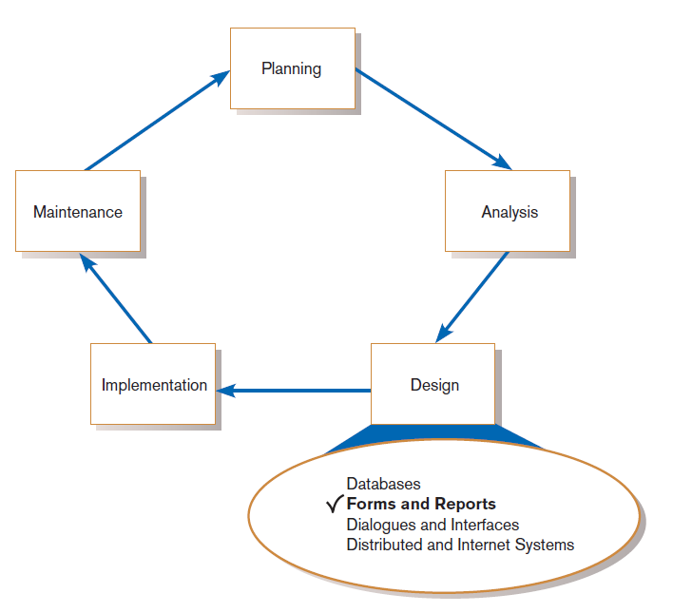
Designing Forms and Reports
FIGURE 10-1
Systems development life cycle with logical design phase highlighted
Notes:
In chapter 9 we discussed database design. You can consider that to be the “back end” of the system. In this chapter, and the next, we talk about the user inputs and outputs. This is the “front end”. This is the part that the user directly interacts with.

Slide 5
Designing Forms and Reports (Cont.)
Form: a business document that contains some predefined data and may include some areas where additional data are to be filled in
  An instance of a form is typically based on one database record.
Notes:
Actually, it’s possible for a single form to be based on multiple data from more than one database table, but these tables will usually be related to each other.
Forms are generally interactive. Users are able to enter data via the form, and submit that data to the system in order to enable inserts or updates to the database.

Slide 6
Designing Forms and Reports (Cont.)
Report: a business document that contains only predefined data
  It is a passive document used solely for reading or viewing data.
A report typically contains data from many unrelated records or transactions.
Notes:
Reports are not interactive. Users do not enter data.
Reports also tend to contain more data than forms.

Slide 7
Designing Forms and Reports (Cont.)
Common Types of Reports:
  Scheduled: produced at predefined time intervals for routine information needs
  Key-indicator: provides summary of critical information on regular basis
  Exception: highlights data outside of normal operating ranges
  Drill-down: provides details behind summary of key-indicator or exception reports
  Ad-hoc: responds to unplanned requests for non-routine information needs
Notes:
Reports are often used by managers to get an idea of what’s going on in the organization or in their departments and functions. Managers may get reports on a regular periodic basis or non demand. Some reports provide information about problems that pop up unexpectedly, or on important factors that the company wants to keep an eye on. Often reports are giving summary information, but sometimes a manager may want to get more detail and drill down. Reports often support managerial decision making.

Slide 8
The Process of Designing Forms and Reports
Is a user-focused activity.
Follows a prototyping approach.
  First steps are to gain an understanding of the intended user and task objectives by collecting initial requirements during requirements determination.
Wireframe
  A simple design to show the placement of information elements on a screen and the space needed for each element
Notes:
Remember our discussion of prototyping from previous chapters? Designing forms and reports are very amenable to the prototyping methodology because there are many CASE tools that make it very easy to quickly create and modify wireframes to decide the best layout of the form or report. You can even have business users by your side while you’re doing it, and get their opinions along the way.

Slide 9
The Process of Designing Forms and Reports (Cont.)
Requirements determination:
  Who will use the form or report?
  What is the purpose of the form or report?
  When is the report needed or used?
  Where does the form or report need to be delivered and used?
  How many people need to use or view the form or report?

Slide 10
The Process of Designing Forms and Reports (Cont.)
Prototyping
  Initial prototype is designed from requirements.
  Users review prototype design and either accept the design or request changes.
  If changes are requested, the construction-evaluation-refinement cycle is repeated until the design is accepted.

Slide 11
The Process of Designing Forms and Reports (Cont.)
A coding sheet is an “old” tool for designing forms and reports, usually associated with text-based forms and reports for mainframe applications.
Visual Basic and other development tools provide computer-aided GUI form and report generation.

Slide 12
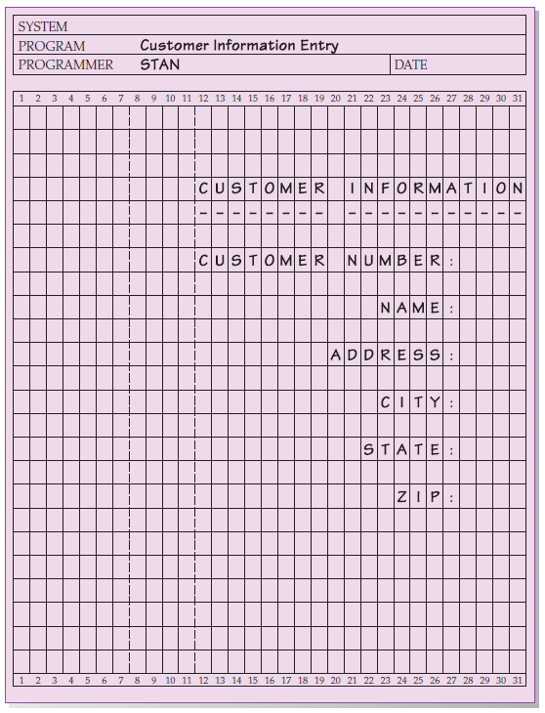
The Process of Designing Forms and Reports (Cont.)
FIGURE 10-2
The layout of a data input form
using a coding sheet
Notes:
Nobody uses these any more for interactive forms or reports, except maybe for old legacy systems. But these were the standard way of designing user interfaces in the old days. They may also be useful for large batch reports from impact printers, as we see later.

Slide 13
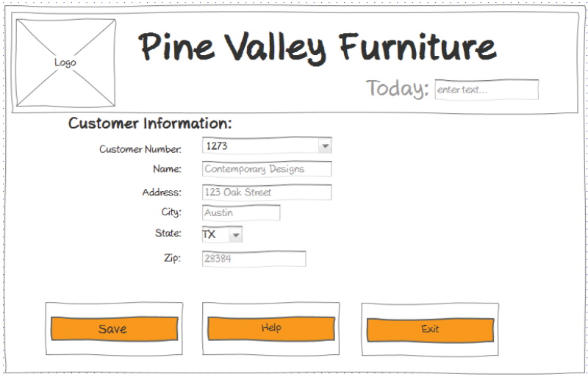
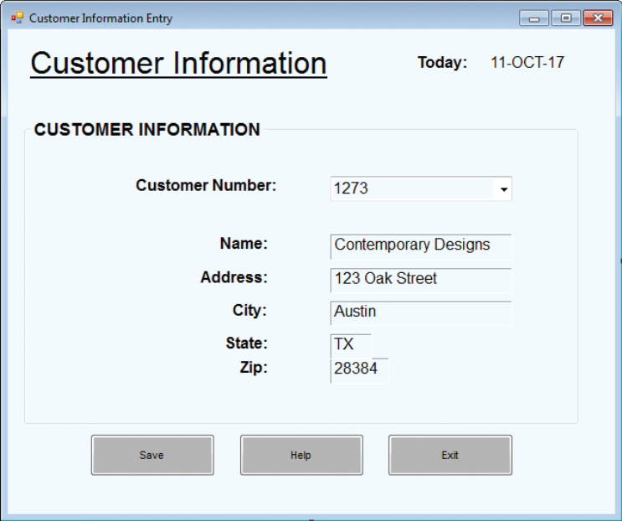
The Process of Designing Forms and Reports (Cont.)
FIGURE 10-3B
A data input screen designed in Microsoft’s Visual Basic .NET
(Source: Microsoft Corporation.)
Figure 10-3A
A data input screen designed as a wireframe
Notes:
On the left we see what may be a hand-written sketch. On the right we see a form that was build using Microsoft’s form builder tool, which is a standard part of it’s Visual Studio development environment. You can think of the form builder as a CASE tool.

Slide 14
Deliverables and Outcomes
Design specifications are the major deliverables and serve as inputs to the system implementation phase.
The forms, reports, and designed databases we’ve talked about so far are part of the design specifications.

Slide 15
Deliverables and Outcomes (Cont.)
Design specifications have three sections:
  Narrative overview: characterizes users, tasks, system, and environmental factors
  Sample design: image of the form (from coding sheet or form building development tool)
  Testing and usability assessment: measuring test/usability results (consistency, sufficiency, accuracy, etc.)

Slide 16
Formatting Forms and Reports
General Guidelines
  Meaningful titles — use clear, specific, version information, and current date
  Meaningful information — include only necessary information, with no need to modify
  Balanced layout — use adequate spacing, margins, and clear labels
  Easy navigation system — show how to move forward and backward, and where you are currently

Slide 17
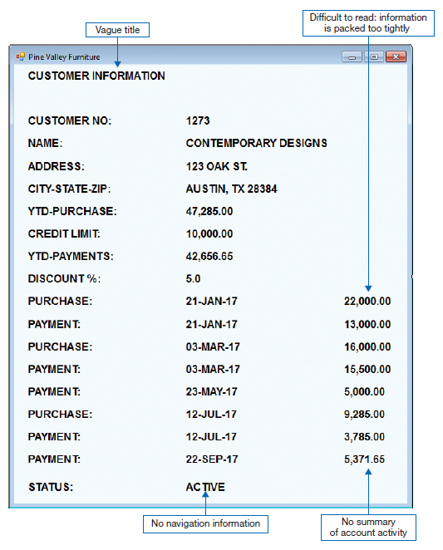
Formatting Forms and Reports (Cont.)
FIGURE 10-5
Contrasting customer information forms
(Pine Valley Furniture)
(Source: Microsoft Corporation.)
(a) Poorly designed form
Notes:
This violates all the guidelines.

Slide 18
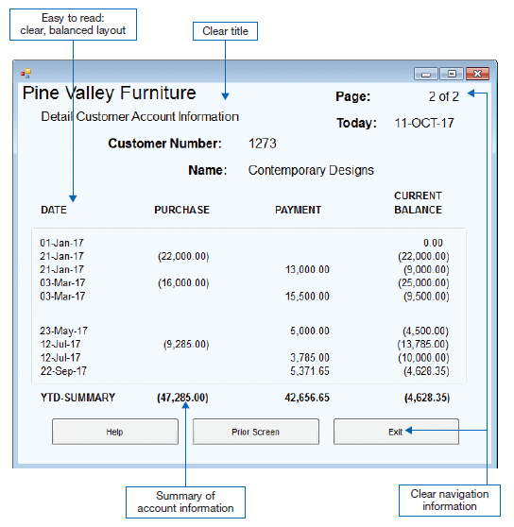
Formatting Forms and Reports (Cont.)
FIGURE 10-5 (continued)
(b) Improved design for form
Notes:
Much better. Note that reports should include summary as well as detailed information.

Slide 19
Highlighting Information
Notify users of errors in data entry or processing.
Provide warnings regarding possible problems.
Draw attention to keywords, commands, high-priority messages, unusual data values.
Notes:
The idea behind highlighting information is to point out things that need special attention.

Slide 20
Highlighting Information (Cont.)
Highlighting methods:
  Blinking and audible tones
  Color differences
  Intensity differences
  Size differences
  Font differences
  Reverse video
  Boxing
  Underlining
  All capital letters
  Offsetting the position of nonstandard information
Notes:
Here are some ways to do highlighting. Some are more “in-your-face” than others. For example, if you have blinking and beeps, that’s sure going to grab your attention more than, for example, simple underlining.

Slide 21
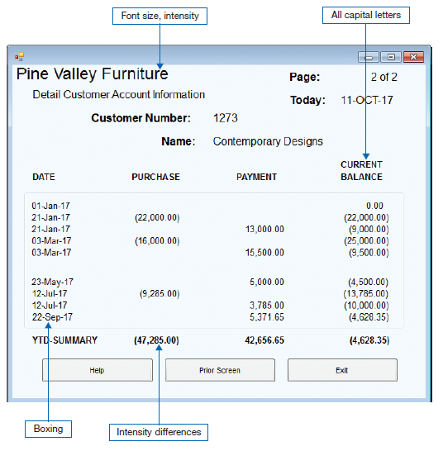
Highlighting Information (Cont.)
FIGURE 10-6
Customer account status display using various highlighting techniques
(Pine Valley Furniture)
(Source: Microsoft Corporation.)
Notes:
This is the same as the previous figure, but here we are focusing on the highlighting methods that were used. Here, the highlighting isn’t done to give a warning or an error so much as it is to just help show headers or summaries.
Discussion: Suppose we wanted to show that a negative balance was really a bad thing that needed our attention? What kind of highlighting might we do on this report if we wanted to really give a warning?

Slide 22
Color vs. No Color
Benefits — Color:
  Soothes or strikes the eye.
  Accents an uninteresting display.
  Facilitates subtle discriminations in complex displays.
  Emphasizes the logical organization of information.
  Draws attention to warnings.
  Evokes more emotional reactions.
Notes:
Color coding has pluses and minuses. Here are some plusses…

Slide 23
Color vs. No Color (Cont.)
Problems from Using Color
  Color pairings may wash out or cause problems for some users.
  Resolution may degrade with different displays.
  Color fidelity may degrade on different displays.
  Printing or conversion to other media may not easily translate.
Notes:
And here are some minuses.

Slide 24
Displaying Text
Case: display in mixed upper and lower case, use conventional punctuation
Spacing: use double spacing if possible, otherwise blank lines between paragraphs
Justification: left justify text, ragged right margins
Hyphenation: don’t hyphenate words between lines
Abbreviations: use only when widely understood and significantly shorter than full text
Notes:
It’s important to make text as easy to read and understand as possible, so the user can get the message with the least amount of effort.

Slide 25
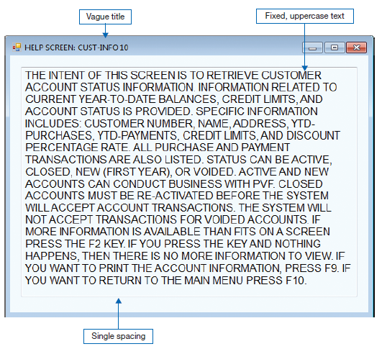
Displaying Text (Cont.)
FIGURE 10-7
Contrasting the display of textual help information
(Source: Microsoft Corporation.)
(a) Poorly designed help screen with many violations of the general guidelines for displaying text
Notes:
Obviously, this is not very easy to read.

Slide 26
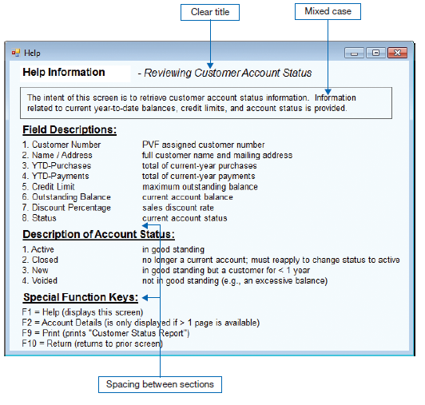
Displaying Text (Cont.)
FIGURE 10-7 (continued)
(b) An improved design for a help screen
Notes:
Much better. It’s not all upper case, it’s well structured into sections, and it provides shortcuts that quickly attract the eye to the relevant information for a user’s needs.

Slide 27
Designing Tables and Lists
Labels
  All columns and rows should have meaningful labels.
  Labels should be separated from other information by using highlighting.
  Redisplay labels when the data extend beyond a single screen or page.
Notes:
Unlike textual information, where context and meaning are derived through reading, the context and meaning of tables and lists are derived from the format of the information. Consequently, the usability of information displayed in tables and alphanumeric lists is likely to be much more heavily influenced by effective layout than most other types of information display.
The next few slides give some guidelines. Here we focus on the use of labels.

Slide 28
Designing Tables and Lists (Cont.)
Formatting columns, rows and text:
  Sort in a meaningful order.
  Place a blank line between every five rows in long columns.
  Similar information displayed in multiple columns should be sorted vertically.
  Columns should have at least two spaces between them.
  Allow white space on printed reports for user to write notes.
  Use a single typeface, except for emphasis.
  Use same family of typefaces within and across displays and reports.
  Avoid overly fancy fonts.
Notes:
Here we talk about placement, order, and visual effects in the rows of the list or table, and the columns of the table.

Slide 29
Designing Tables and Lists (Cont.)
Formatting numeric, textual and alphanumeric data:
  Right justify numeric data and align columns by decimal points or other delimiter.
  Left justify textual data. Use short line length, usually 30 to 40 characters per line.
  Break long sequences of alphanumeric data into small groups of three to four characters each.
Notes:
I’m sure you’re familiar with the fact that numeric data tends to be right-justified and text data tends to be left-justified.

Slide 30
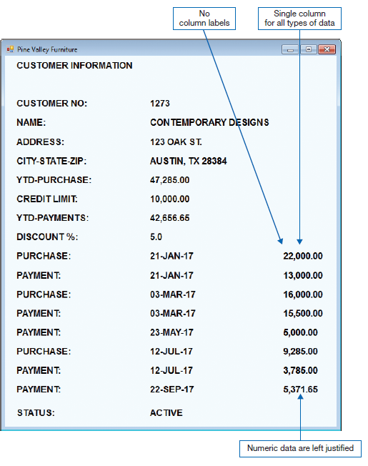
Designing Tables and Lists (Cont.)
FIGURE 10-8
Contrasting the display of tables and lists (Pine Valley Furniture)
(Source: Microsoft Corporation.)
(a) Poorly designed form
Notes:
Here’s the poor design. Let’s compare it to the good one on the next slide.
Here we see that a few problems. First, there’s no clear spatial distinction between overall information about the customer and information about each transaction. Second, we don’t group transactions by the type of transaction. Third, we see all upper-case and the wrong justification of numbers. As for the transactions themselves, we’re not seeing a distinction between a number that increases to what the customer owes (purchase) and one that decreases it (payment). And, we don’t know what the numbers mean really because there’s no label. Also, no summary information.

Slide 31
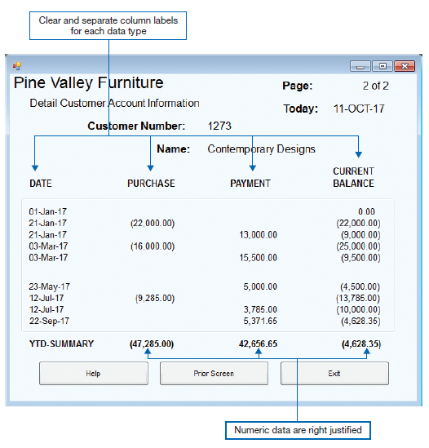
Designing Tables and Lists (Cont.)
FIGURE 10-8 (continued)
(b) Improved design for form
Notes:
Much better, much easier to read, and more informative.

Slide 32
Designing Tables and Lists (Cont.)
Use tables for reading individual data values.
Use graphs for:
  Providing quick summary.
  Displaying trends over time.
  Comparing points and patterns of variables.
  Forecasting activity.
  Simple reporting of vast quantities of information.

Slide 33
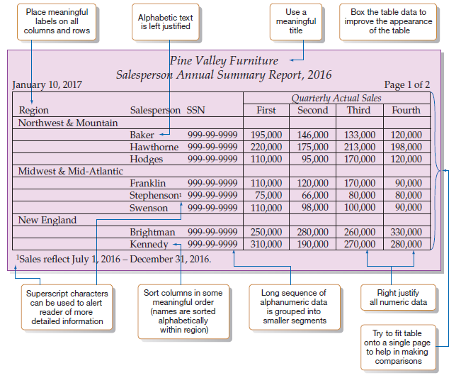
Designing Tables and Lists (Cont.)
FIGURE 10-9
Tabular report illustrating numerous design guidelines
(Pine Valley Furniture)
Notes:
Here we see a design that addresses many of the guidelines we talked about.

Slide 34
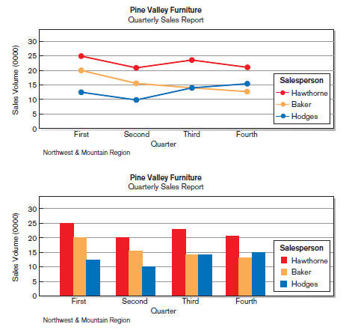
Designing Tables and Lists (Cont.)
FIGURE 10-10
Graphs for comparison
(a) Line graph
(b) Bar graph
Notes:
You’ve hear the phrase “a picture tells a thousand words”? Here’s an example of that.
Line graphs and bar graphs are just two examples. The field of data visualization is a very important aspect of information systems, and is especially important for giving decision makers a quick view of summary information. Most good software applications will provide information in a variety of ways, including tables and graphics.

Slide 35
Paper vs. Electronic Reports
Laser and ink-jet printers can print reports that look like display screen
  Same guidelines apply
High-speed impact printers are faster, but less user-friendly in appearance
  Good for large batch reports
  The coding sheet from figure 10-2 may be useful for these types of reports

Slide 36
Assessing Usability
Usability: an overall evaluation of how a system performs in supporting a particular user for a particular task
Three characteristics of usability:
  Speed — Can you complete a task efficiently?
  Accuracy — Does the output provide what you expect?
  Satisfaction — Do you like using the output?

Slide 37
Usability Success Factors
Consistency — of terminology, formatting, titles, navigation, response time
Organization — good text/data alignment for efficient navigation and entry
Ease — self-explanatory outputs and labels
Format — appropriate display of data and symbols
Flexibility — maximize user options for data input according to preference

Slide 38
Usability Success Factors (Cont.)
Characteristics for consideration:
  User: experience, skills, motivation, education, personality
  Task: time pressure, cost of errors, work durations
  System: platform
  Environment: social and physical issues

Slide 39
Measures of Usability
Learnability – how difficult to perform the task for the first time?
Efficiency – how quick can user perform task once learned?
Error rate – how frequent are errors, how easy to recover?
Memorability – how easy is it to remember task accomplishment steps?
Satisfaction and aesthetics – does the user enjoy the user experience?

Slide 40
Electronic Commerce Application: Designing Forms and Reports for Pine Valley Furniture WebStore
General guidelines for rapid deployment of Internet Web sites have resulted
Three possible solutions to the problem:
  Make it possible to design reasonably usable sites without having UI experience.
  Train more people in good Web design.
  Live with poorly designed sites that are hard to use.

Slide 41
Designing Forms and Reports at Pine Valley Furniture (Cont.)
PVF established the following guidelines:
  Use lightweight graphics.
  Establish forms and data integrity rules.
  Use stylesheet-based HTML.

Slide 42
Lightweight Graphics
Lightweight Graphics: the use of small, simple images to allow a Web page to more quickly be displayed
  Quick image download
  Quick feedback from the Web site will help to keep customers at the PVF WebStore longer
Notes:
High-resolution images are large files that take a long time to download from the Web site and load into the browser, so these should be avoided unless absolutely necessary.

Slide 43
Forms and Data Integrity Rules
All forms that request information should be clearly labeled and provide adequate room for input.
Specific fields requiring specific information must provide a clear example.
Forms must designate which fields are optional, required, and which have a range of values.
Notes:
Another important thing to do is data input validation. Form builders and CASE tools can help with this; you often don’t need programming.

Slide 44
Stylesheet-Based HTML
A web design approach that separates content from the way in which it is formatted and presented
Makes ongoing maintenance easier
Facilitates site-wide consistency
Notes:
Along with HTML, there is a style sheeting Web language called CSS, which stands for “cascading style sheets”. Good Web site design includes CSS.

Slide 45
Summary
Now you learned how to:
  Explain the process of designing forms and reports and the deliverables for their creation.
  Apply the general guidelines for formatting forms and reports.
  Use color and know when color improves the usability of information.

Slide 46
Summary (Cont.)
Now you learned how to:
  Format text, tables, and lists effectively.
  Explain how to assess usability and describe how variations in users, tasks, technology, and environmental characteristics influence the usability of forms and reports.
  Discuss guidelines for the design of forms and reports for Internet-based electronic commerce systems.

Slide 47
Next Lecture
Designing Interfaces and Dialogues

Slide 48
References
Joseph S. Valacich, Joey F. George, Modern Systems Analysis and Design, 8th Global Edition, Pearson, 2016

