Slide 1



L
L Line
CSE 420
Computer Games
Lecture #9 Working Game

Slide 2
Objectives
Planning a game
Preparing a strategy for complex
projects
Building sprites to implement the plan
Building an infinitely scrolling
background
Working with multiple sprite collisions
Making a scorekeeping sprite
Understanding state-transition diagrams
Building a multi-state game

Slide 3
Goal: Build a Complete Game
Instruction screen
Player avatar
Opponents and goals
Scrolling background
Scorekeeping
See mailPilot.py.

Slide 4
Game Design Essentials
An environment
Goals
Obstacles
Appropriate difficulty for user
Art and music assets
Reasonable scope of programming challenge

Slide 5
Game Sketch
Sketch the user's experience on paper.
Label everything.
Describe each object's key features.
Describe motion and boundary behavior for each object.
Plan for sound effects.
Show depth/overlaps.
Describe scorekeeping/game end.

Slide 6
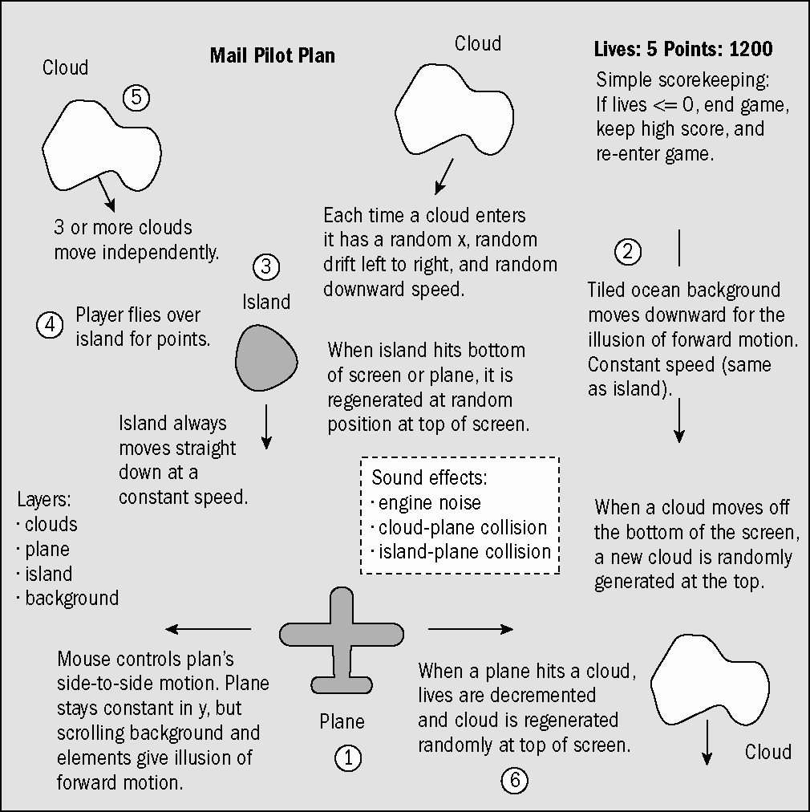
A Sample Game Sketch

Slide 7
Stepwise Refinement
Remember, this is a complex program.
You can't expect to finish it in one step.
Identify milestones to work towards.

Slide 8
Milestones for Mail Pilot
Basic plane sprite (mpPlane.py)
Island sprite (mpIsland.py)
Cloud sprite (mpCloud.py)
Collisions and sound effects (mpCollide.py)
Scrolling ocean background (mpOcean.py)
Multiple clouds (mpMultiClouds.py)
Scorekeeping (mpScore.py)
Intro screen (mpIntro.py)

Slide 9
Building the Basic Airplane Sprite
Standard sprite
Image from spritelib
Follows mouse's x value
class Plane(pygame.sprite.Sprite):
def __init__(self):
pygame.sprite.Sprite.__init__(self)
self.image = pygame.image.load("plane.gif")
self.rect = self.image.get_rect()
def update(self):
mousex, mousey = pygame.mouse.get_pos()
self.rect.center = (mousex, 430)

Slide 10
Testing the Plane Sprite
See mpPlane.py.
Create an instance of Plane.
Put it in the allSprites group.
Update the allSprites group.
plane = Plane()
allSprites = pygame.sprite.Group(plane)
allSprites.clear(screen, background)
allSprites.update()
allSprites.draw(screen)
pygame.display.flip()

Slide 11
Adding an Island
See mpIsland.py.
Define the island sprite.
The island moves down.
  dx = 0
  dy = 5
It resets on reaching the bottom of the screen.

Slide 12
Island Sprite Code
class Island(pygame.sprite.Sprite):
def __init__(self):
pygame.sprite.Sprite.__init__(self)
self.image = pygame.image.load("island.gif")
self.rect = self.image.get_rect()
self.reset()
self.dy = 5
def update(self):
self.rect.centery += self.dy
if self.rect.top > screen.get_height():
self.reset()
def reset(self):
self.rect.top = 0
self.rect.centerx = random.randrange(0,
screen.get_width())

Slide 13
Incorporating the Island
allSprites now includes both the island and plane.
Use allSprites for screen updates.
plane = Plane()
island = Island()
allSprites = pygame.sprite.Group(island, plane)
allSprites.clear(screen, background)
allSprites.update()
allSprites.draw(screen)
pygame.display.flip()

Slide 14
The Island Illusion
Add transparency.
Crop close.
Small targets are harder to hit.
Move down to give the illusion the plane is moving up.
Randomize to give the illusion of multiple islands.

Slide 15
Adding a Cloud
See mpCloud.py.
Add one cloud before using multiple clouds.
A cloud moves somewhat like the island.
Vertical and horizontal speed should be random within specific limits.
The cloud resets randomly when it leaves the bottom of the screen.

Slide 16
Cloud Sprite Code
class Cloud(pygame.sprite.Sprite):
def __init__(self):
pygame.sprite.Sprite.__init__(self)
self.image = pygame.image.load("Cloud.gif")
self.image = self.image.convert()
self.rect = self.image.get_rect()
self.reset()
def update(self):
self.rect.centerx += self.dx
self.rect.centery += self.dy
if self.rect.top > screen.get_height():
self.reset()
def reset(self):
self.rect.bottom = 0
self.rect.centerx = random.randrange(0,
screen.get_width())
self.dy = random.randrange(5, 10)
self.dx = random.randrange(-2, 2)

Slide 17
Using random.randrange()
The randrange() function allows you to pick random integers within a certain range.
This is useful to make the cloud's side-to-side motion vary between -2 and 2.
I also used it to vary vertical motion within the range 5 and 10.

Slide 18
Displaying the Cloud
Keep adding new sprites to allSprites.
If you start having overlap problems, use pygame.sprite.OrderedUpdate() rather than pygame.sprite.Group().
plane = Plane()
island = Island()
cloud = Cloud()
allSprites = pygame.sprite.Group(island, plane, cloud)

Slide 19
Adding Sound and Collisions
Collision detection is critical to game play.
Sound effects are often linked with collisions.
They provide a natural test for collisions.
Collisions and sound are often built together.

Slide 20
Sound Effects Strategy
Sound objects will be created for each sound indicated on the plan.
Each sound object will be stored as an attribute of the Plane object (because all sound objects are somewhat related to the plane).
Collisions will cause sounds to be played.
See mpCollision.py.

Slide 21
Creating the Sound Objects
The following code is in the Plane init method.
Check for mixer.
Initialize, if needed.
Load sounds.
if not pygame.mixer:
print "problem with sound"
else:
pygame.mixer.init()
self.sndYay = pygame.mixer.Sound("yay.ogg")
self.sndThunder = pygame.mixer.Sound("thunder.ogg")
self.sndEngine = pygame.mixer.Sound("engine.ogg")
self.sndEngine.play(-1)

Slide 22
Sound Effects Notes
See Appendix D on the Web site for details on creating sounds with Audacity.
The engine sound is designed to loop.
Use -1 as the loop parameter to make sound loop indefinitely.
You may have to adjust volume to make sure background sounds aren’t too loud.
Don't forget to turn sound off at end of the game.

Slide 23
Checking for Collisions
Code occurs right after event checking in the main loop.
Use colliderect() to check for collisions.
Reset the sprite and play sound.
#check collisions
if plane.rect.colliderect(island.rect):
plane.sndYay.play()
island.reset()
if plane.rect.colliderect(cloud.rect):
plane.sndThunder.play()
cloud.reset()

Slide 24
Why Reset the Sprites?
If two sprites collide, you need to move one immediately.
Otherwise, they’ll continue to collide, causing a series of events.
The island and cloud objects both have a reset() method, making them easy to move away from the plane.

Slide 25
Building a Scrolling Background
Arcade games frequently feature an endless landscape.
You can create the illusion of an endless seascape with a carefully constructed image.
Use some image trickery to fool the user into thinking the image never resets.

Slide 26
How Scrolling
Backgrounds Work
The background image is actually a sprite.
It's three times taller than the screen.
The top and bottom parts of the image are identical.
The image scrolls repeatedly, swapping the top for the bottom when it reaches the edge.

Slide 27
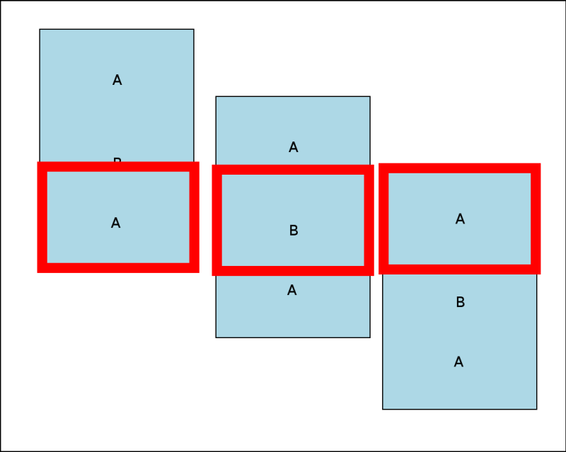
The Background Image

Slide 28
Building the Background Sprite
See mpOcean.py.
class Ocean(pygame.sprite.Sprite):
def __init__(self):
pygame.sprite.Sprite.__init__(self)
self.image = pygame.image.load("ocean.gif")
self.image = self.image.convert()
self.rect = self.image.get_rect()
self.dy = 5
self.reset()
def update(self):
self.rect.bottom += self.dy
if self.rect.top >= 0:
self.reset()
def reset(self):
self.rect.bottom = screen.get_height()

Slide 29
Changes to Screen Refresh
The background sprite is larger than the playing surface.
The background will always cover the screen.
There's no need to call the sprite group update() method!
#allSprites.clear(screen, background)
allSprites.update()
allSprites.draw(screen)

Slide 30
Using Multiple Clouds
All the basic objects are done.
Adding more clouds makes the game more challenging.
The code for the clouds is done.
Simply add code to control multiple clouds.
See mpClouds.py.

Slide 31
Creating Several Clouds
Create multiple cloud instances.
Put the clouds in their own group.
cloud1 = Cloud()
cloud2 = Cloud()
cloud3 = Cloud()
friendSprites = pygame.sprite.Group(ocean, island, plane)
cloudSprites = pygame.sprite.Group(cloud1, cloud2, cloud3)

Slide 32
Multiple Cloud Collisions
Modify the collision routine to use spritecollide().
spritecollide returns a list of hit sprites or the value False.
hitClouds = pygame.sprite.spritecollide(plane, cloudSprites, False)
if hitClouds:
plane.sndThunder.play()
for theCloud in hitClouds:
theCloud.reset()

Slide 33
Analyzing the List of Hit Clouds
If the hitClouds list isn’t empty:
  Play the thunder sound.
  Step through the hitClouds list.
  Reset any clouds that were hit.
if hitClouds:
plane.sndThunder.play()
for theCloud in hitClouds:
theCloud.reset()

Slide 34
Screen Refresh Modifications
Now there are two sprite groups.
Each group needs to be updated and drawn.
There's still no need for clear() because the screen background is always hidden by the ocean sprite.
friendSprites.update()
cloudSprites.update()
friendSprites.draw(screen)
cloudSprites.draw(screen)
pygame.display.flip()

Slide 35
Adding a Scorekeeping Mechanism
The game play is basically done.
The user needs feedback on progress.
At a minimum, count how many times the player has hit each type of target.
This will usually relate to the game-ending condition.
See mpScore.py.

Slide 36
Managing the Score
The score requires two numeric variables:
  self.planes counts how many planes (user lives) remain.
  self.score counts how many clouds the player has hit.
Both variables are stored as attributes of the Scoreboard class.

Slide 37
Building the
Scoreboard Class
The scoreboard is a new sprite with scorekeeping text rendered on it.
class Scoreboard(pygame.sprite.Sprite):
def __init__(self):
pygame.sprite.Sprite.__init__(self)
self.lives = 5
self.score = 0
self.font = pygame.font.SysFont("None", 50)
def update(self):
self.text = "planes: %d, score: %d" % (self.lives,
self.score)
self.image = self.font.render(self.text, 1,
(255, 255, 0))
self.rect = self.image.get_rect()

Slide 38
Adding the Scoreboard Class to the Game
Build an instance of the scoreboard.
Create its own sprite group so it appears above all other elements.
Modify screen-refresh code.
scoreboard = Scoreboard()
scoreSprite = pygame.sprite.Group(scoreboard)
friendSprites.update()
cloudSprites.update()
scoreSprite.update()
friendSprites.draw(screen)
cloudSprites.draw(screen)
scoreSprite.draw(screen)

Slide 39
Updating the Score
When the plane hits the island, add to the score.
When the plane hits a cloud, subtract a life.
if plane.rect.colliderect(island.rect):
plane.sndYay.play()
island.reset()
scoreboard.score += 100
hitClouds = pygame.sprite.spritecollide(plane, cloudSprites, False)
if hitClouds:
plane.sndThunder.play()
scoreboard.lives -= 1

Slide 40
Manage the Game-Ending Condition
The game ends when lives gets to zero.
For now, simply print "game over."
The actual end of game is handled in the next version of the program.
if hitClouds:
plane.sndThunder.play()
scoreboard.lives -= 1
if scoreboard.lives <= 0:
print "Game over!"
scoreboard.lives = 5
scoreboard.score = 0
for theCloud in hitClouds:
theCloud.reset()

Slide 41
Adding an Introduction State
Most games have more than one state.
So far, you've written the game play state.
Games often have states for introduction, instruction, and end of game.
For simplicity, mailPilot will have only two states.

Slide 42
Introducing State Transition Diagrams
State diagrams help programmers visualize the various states a system can have.
They also indicate how to transition from one state to another.
They can be useful for anticipating the flow of a program.

Slide 43
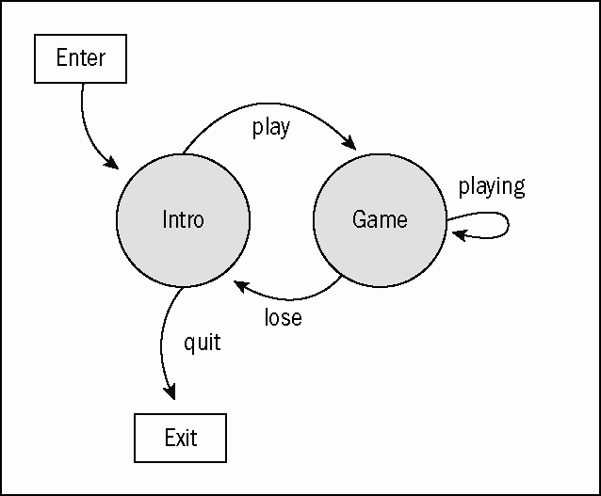
The mailPilot State Transition Diagram

Slide 44
Implementing State in pygame
The easiest way to manage game state is to think of each major state as a new IDEA framework.
Intro and game states each have their own semi-independent animation loops.
The main loop controls transition between the two states and exit from the entire system.

Slide 45
Design of mpIntro.py
Most of the code previously in main() is now in game().
instructions() is a new IDEA framework displaying the instructions, previous score, and animations.
main() now controls access between game() and instructions().

Slide 46
Changes to game()
All game code is moved to game().
Return the score back to the main function so it can be reported to instructions().

Slide 47
Building the instructions() Function
Build instances of plane and ocean.
Store them in a sprite group.
Create a font.
plane = Plane()
ocean = Ocean()
allSprites = pygame.sprite.Group(ocean, plane)
insFont = pygame.font.SysFont(None, 50)

Slide 48
Preparing the Instructions
Store instructions in a tuple.
Create a label for each line of instructions.
instructions = (
"Mail Pilot. Last score: %d" % score ,
"Instructions: You are a mail pilot,",
"other instructions left out for brevity"
)
insLabels = []
for line in instructions:
tempLabel = insFont.render(line, 1, (255, 255, 0))
insLabels.append(tempLabel)

Slide 49
Rendering the Instructions
The instructions aren't sprites.
They'll need to be blitted onto the screen after updating and drawing the sprites.
Use a loop to blit all labels.
allSprites.update()
allSprites.draw(screen)
for i in range(len(insLabels)):
screen.blit(insLabels[i], (50, 30*i))
pygame.display.flip()

Slide 50
Event-Handling in instructions()
Although instructions() isn't the full-blown game, it still has some event handling.
for event in pygame.event.get():
if event.type == pygame.QUIT:
keepGoing = False
donePlaying = True
if event.type == pygame.MOUSEBUTTONDOWN:
keepGoing = False
donePlaying = False
elif event.type == pygame.KEYDOWN:
if event.key == pygame.K_ESCAPE:
keepGoing = False
donePlaying = True

Slide 51
Data Flow through instructions()
instructions() expects a score parameter.
It uses this parameter to display the current score.
It sends a Boolean value, donePlaying.
  If the user wants to play again, donePlaying is False.
  If user is finished, donePlaying is True.

Slide 52
Managing the New main() Function
First time through, set donePlaying to False and score to zero.
Pass score to instructions().
If they want to play, run game(), then pass score to donePlaying.
def main():
donePlaying = False
score = 0
while not donePlaying:
donePlaying = instructions(score)
if not donePlaying:
score = game()

Slide 53
Discussion Questions
In a small group, create a game diagram for a familiar game (such as Asteroids or Pong).
What is parallax scrolling? How could it be implemented?
How can a state-transition diagram be used to describe a game you already know?

Slide 54
Summary
You should now understand
  Planning a game and preparing a strategy for complex projects
  Building sprites to implement the plan
  Building an infinitely scrolling background
  Working with multiple sprite collisions
  Making a scorekeeping sprite
  Understanding state-transition diagrams
  Building a multi-state game

Slide 55
Next Lecture
Animated Sprites

Slide 56
References
Andy Harris, “Game Programming, The L Line, The Express Line to Learning”; Wiley, 2007

