Slide 1


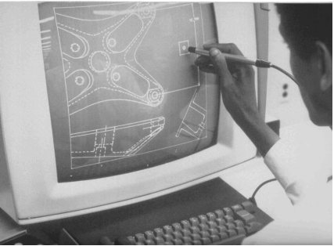
CSE 411
Computer Graphics
Lecture #9 3D Viewing
Prepared & Presented by Asst. Prof. Dr. Samsun M. BAŞARICI
Notes:
1

Slide 2
Objectives
HB Ch. 10
3D Viewing Concepts
3D Viewing Pipeline
3D Viewing Coordinate-Parameters
World to Viewing Coordinate Transformation
Projection Transformations
Projections
  Orthogonal Projections
  Oblique Parallel Projections
  Perspective Projections
Viewport Transformation and 3D Screen Coordinates
OpenGL 3D Viewing Functions
3D Clipping

Slide 3
3D Viewing
Procedures for displaying views of a three-dimensional scene on an output device involve many aspects:
  Generate a 3D scene with objects generally defined with a set of surfaces forming a closed boundary around the object interior.
  Generate interior of 3D objects, if needed.
  Project object surfaces views onto the surface of a display device with 3D viewing pipeline.
  Identification of visible parts.
  Lighting effects and surface characteristics.

Slide 4
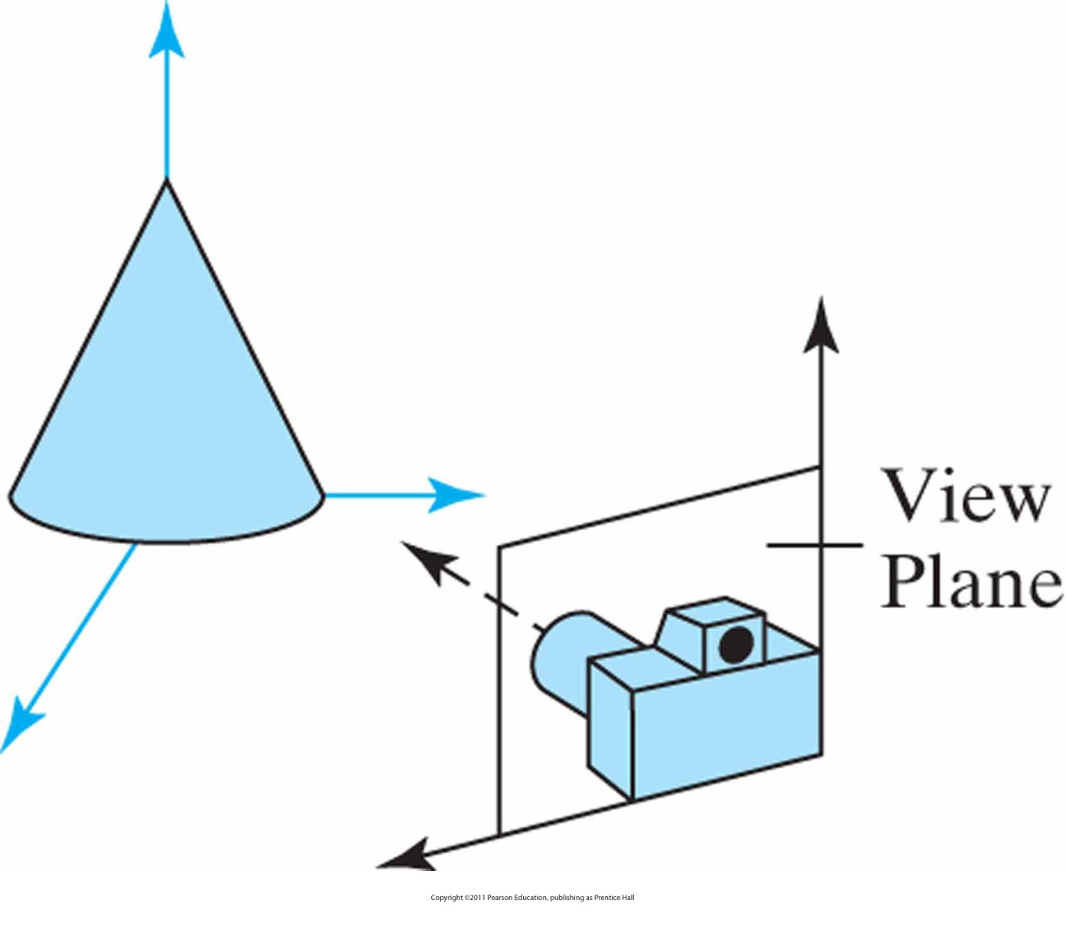
3D Viewing (cont.)
Coordinate reference for obtaining a selected view of a three-dimensional scene.

Slide 5
3D Viewing – Camera Analogy
The transformation process to produce the desired scene for viewing is analogous to taking a photograph with a camera. The steps with a camera (or a computer) might be the following.
  Set up your tripod and pointing the camera at the scene (viewing transformation)
  Arrange the scene to be photographed into the desired composition (modeling transformation)
  Choose a camera lens or adjust the zoom (projection transformation)
  Determine how large you want the final photograph to be - for example, you might want it enlarged (viewport transformation)
After these steps are performed, the picture can be snapped or the scene can be drawn.

Slide 6
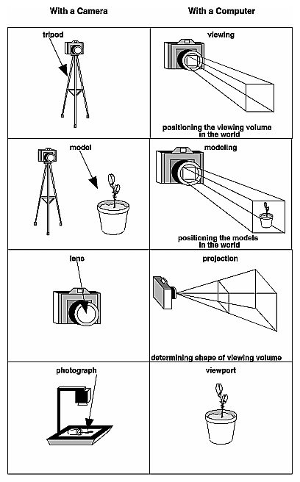
3D Viewing – Camera Analogy (cont.)

Slide 7
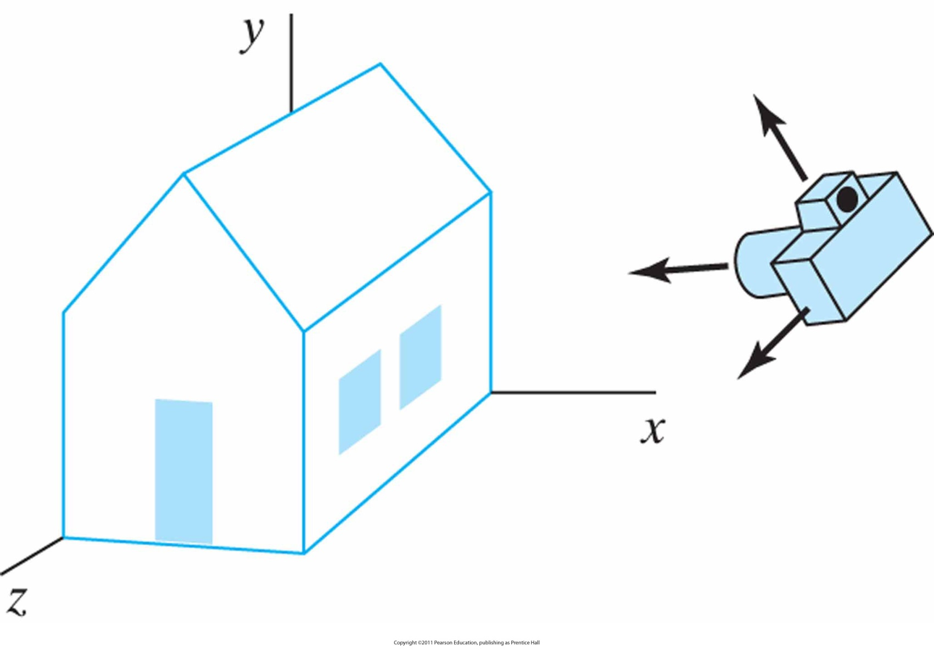
3D Viewing – Photographing
Photographing a scene involves selection of the camera position and orientation

Slide 8
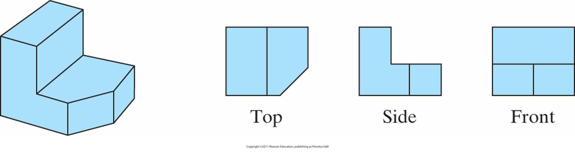
Projections
Three parallel-projection views of an object, showing relative proportions from different viewing positions.

Slide 9
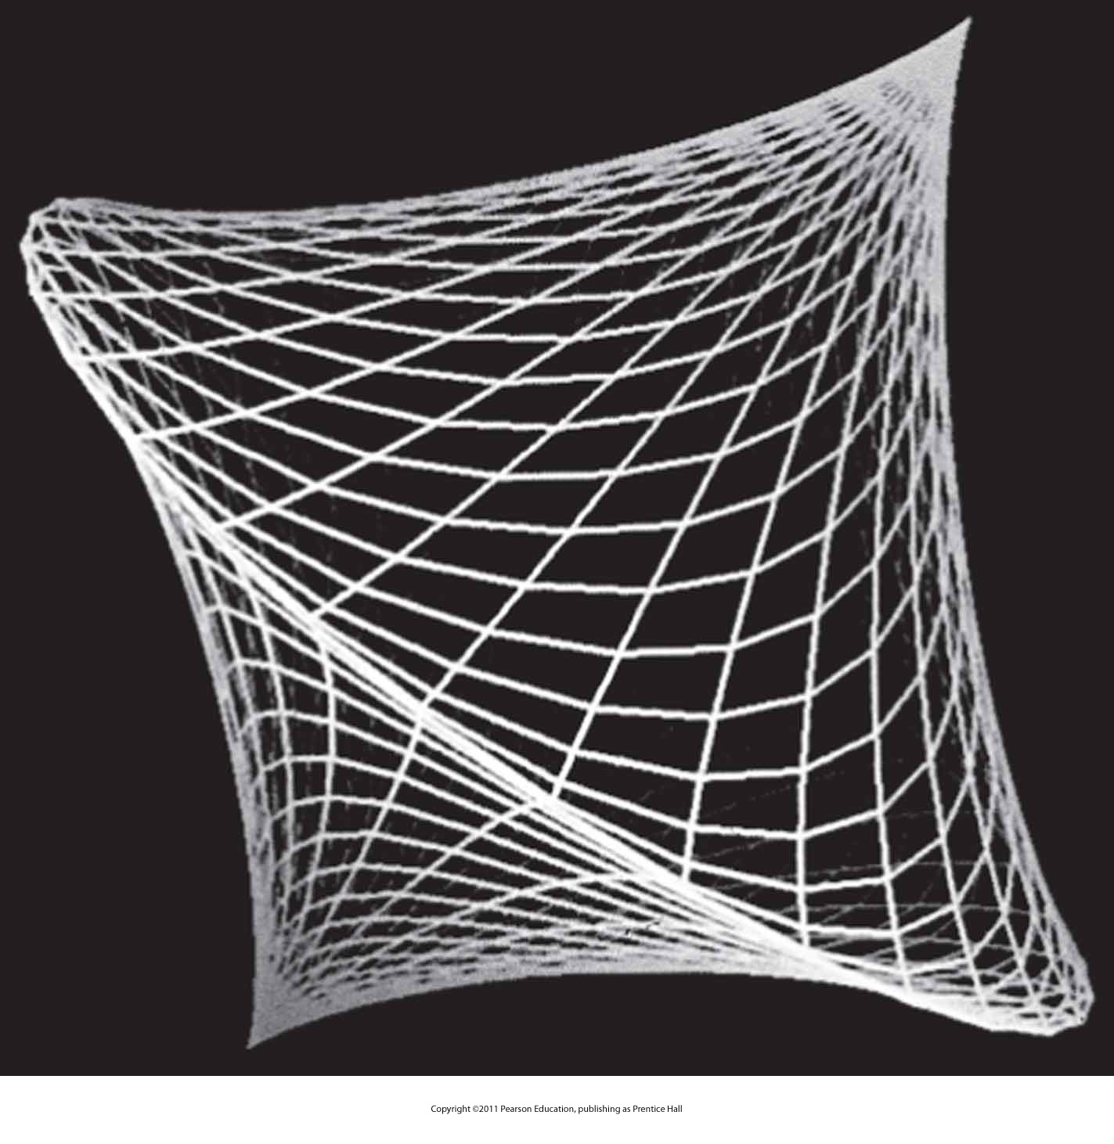
Wire-frame Representation & Depth Queing
A wire-frame object displayed with depth cueing, so that the brightness of lines decreases from the front of the object to the back.

Slide 10
Other 3D Viewing Concepts
Visible line and surface detection
Surface rendering
Exploded and cutaway views
3D and stereoscopic viewing

Slide 11
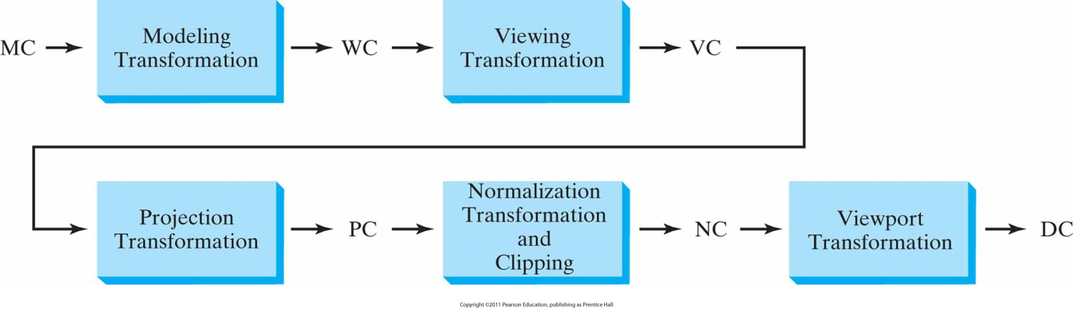
3D Viewing Pipeline
General three-dimensional transformation pipeline, from modeling coordinates (MC) to world coordinates (WC) to viewing coordinates (VC) to projection coordinates (PC) to normalized coordinates (NC) and, ultimately, to device coordinates (DC).

Slide 12
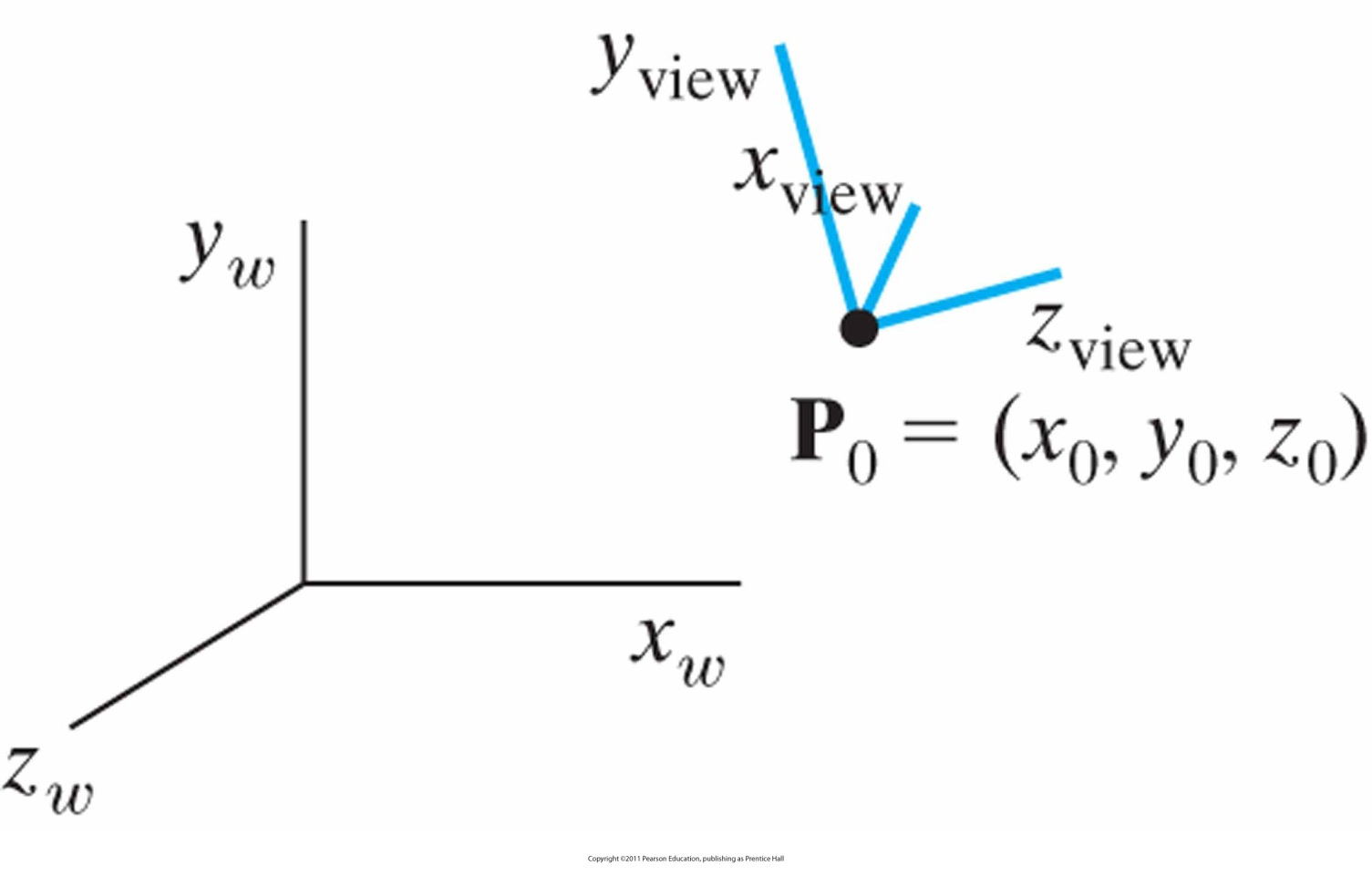
3D Viewing Coordinate Parameters: The View-Plane Normal Vector
A right-handed viewing-coordinate system, with axes x _{view}, y _{view}, and z _{view}, relative to a right-handed world-coordinate frame.

Slide 13
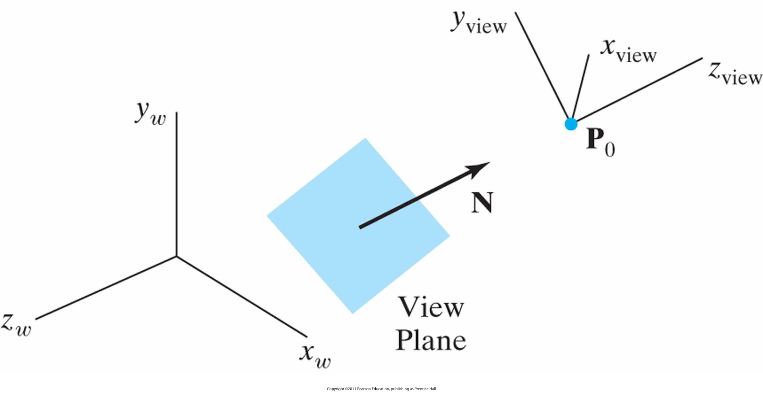
3D Viewing Coordinate Parameters: The View-Plane Normal Vector (cont.)
Orientation of the view plane and view-plane normal vector N.

Slide 14
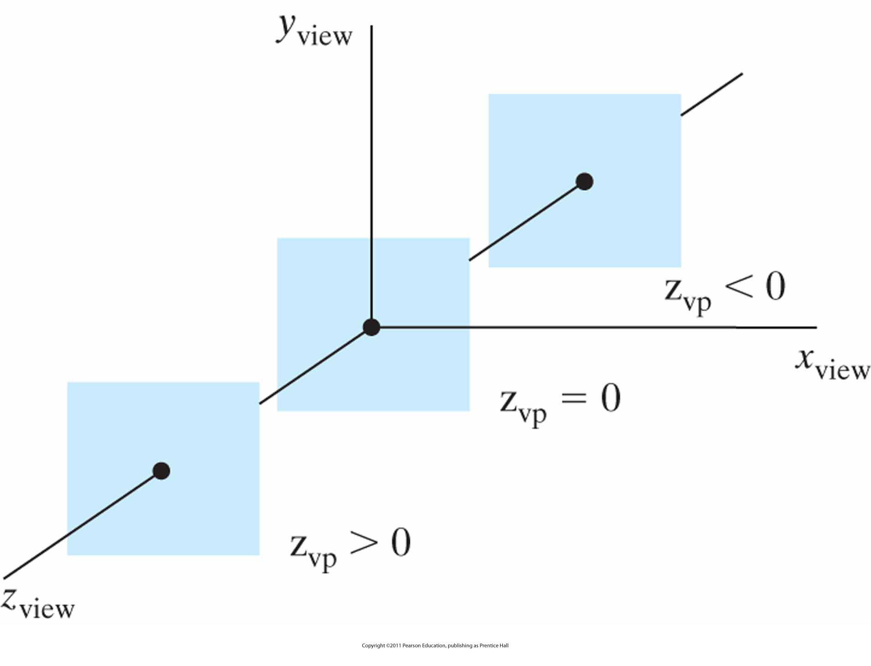
3D Viewing Coordinate Parameters: The View-Plane Normal Vector (cont.)
Three possible positions for the view plane along the z _{view} axis.

Slide 15
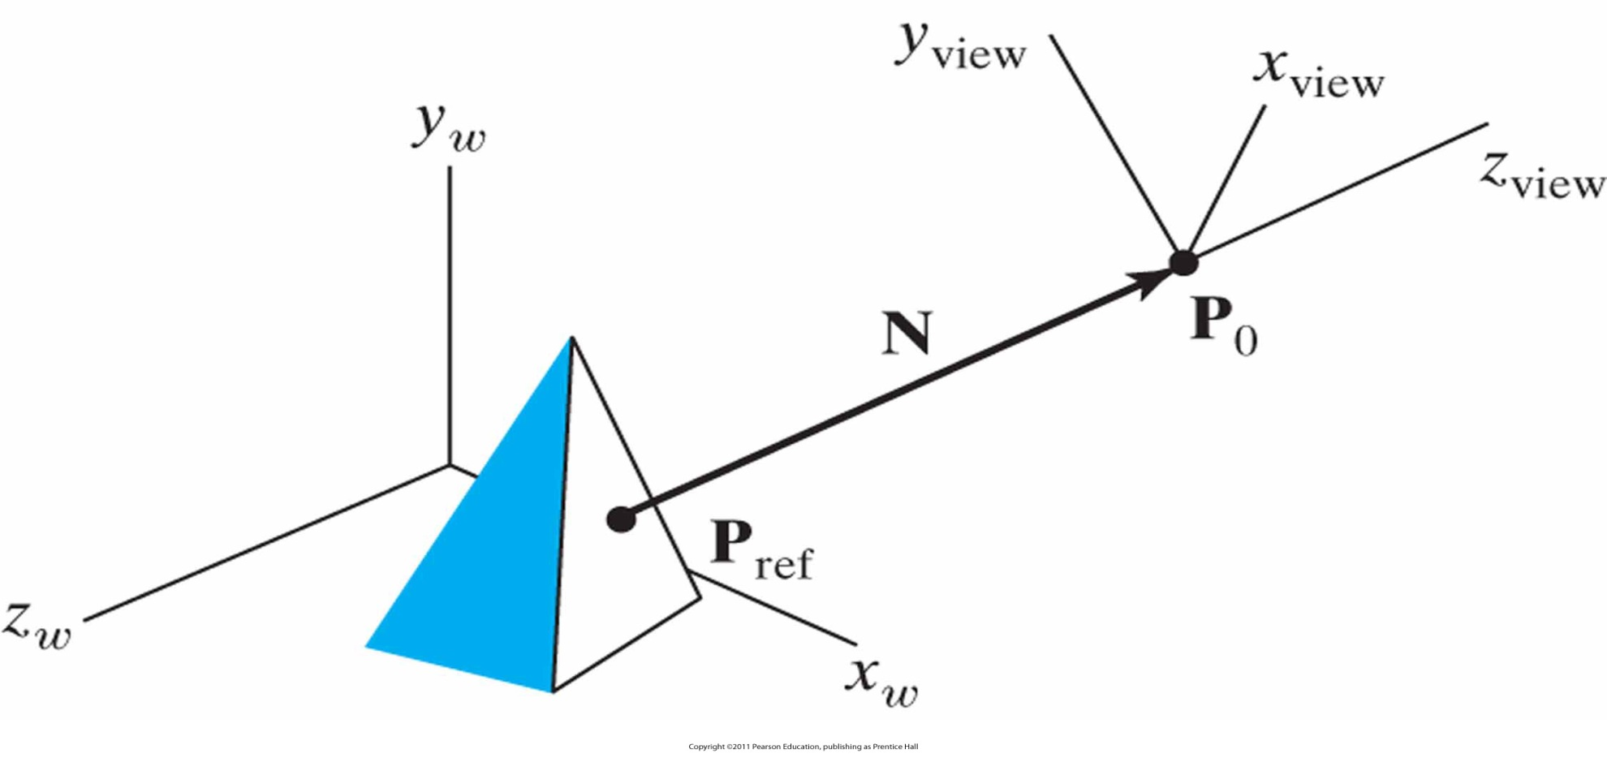
3D Viewing Coordinate Parameters: The View-Plane Normal Vector (cont.)
Specifying the view-plane normal vector N as the direction from a selected reference point P_{ref} to the viewing-coordinate origin P₀.

Slide 16
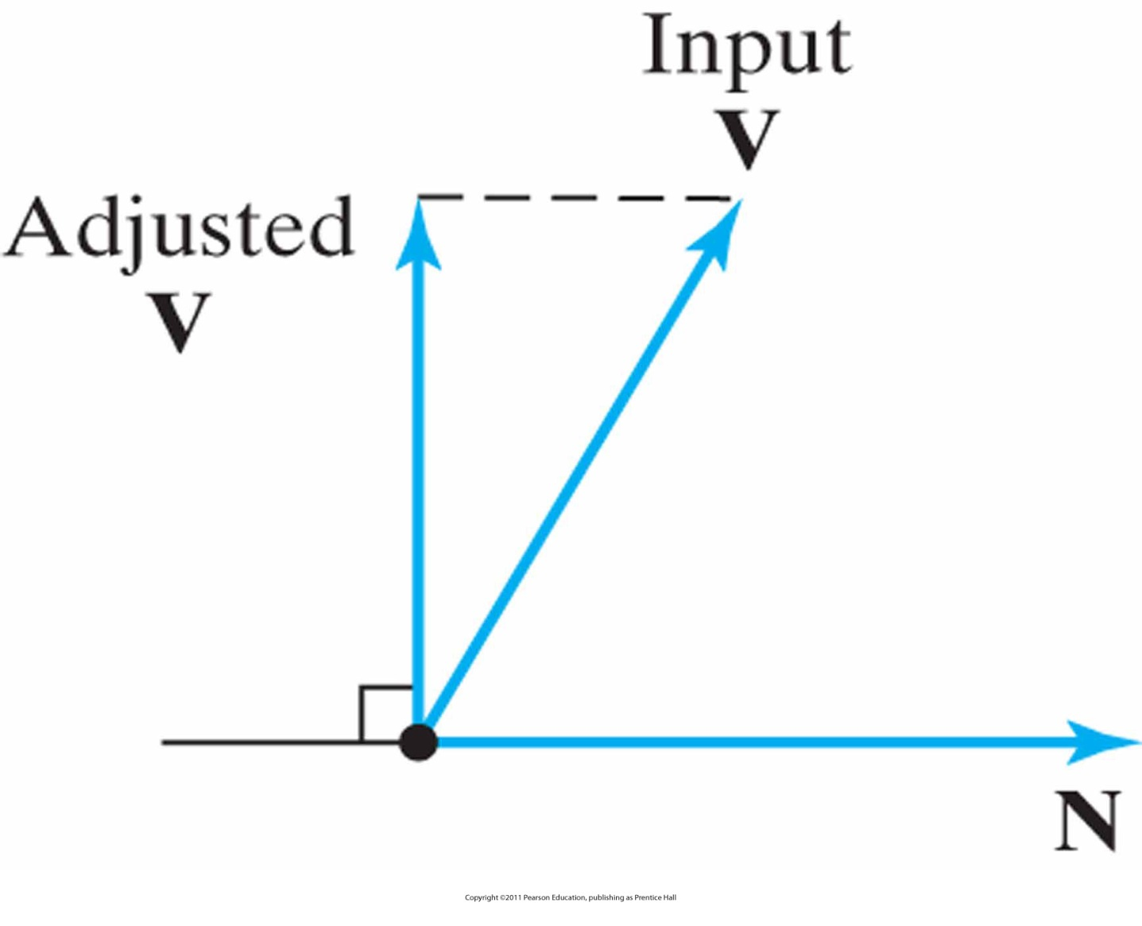
3D Viewing Coordinate Parameters: The View-Up Vector
Adjusting the input direction of the view-up vector V to an orientation perpendicular to the view-plane normal vector N.

Slide 17
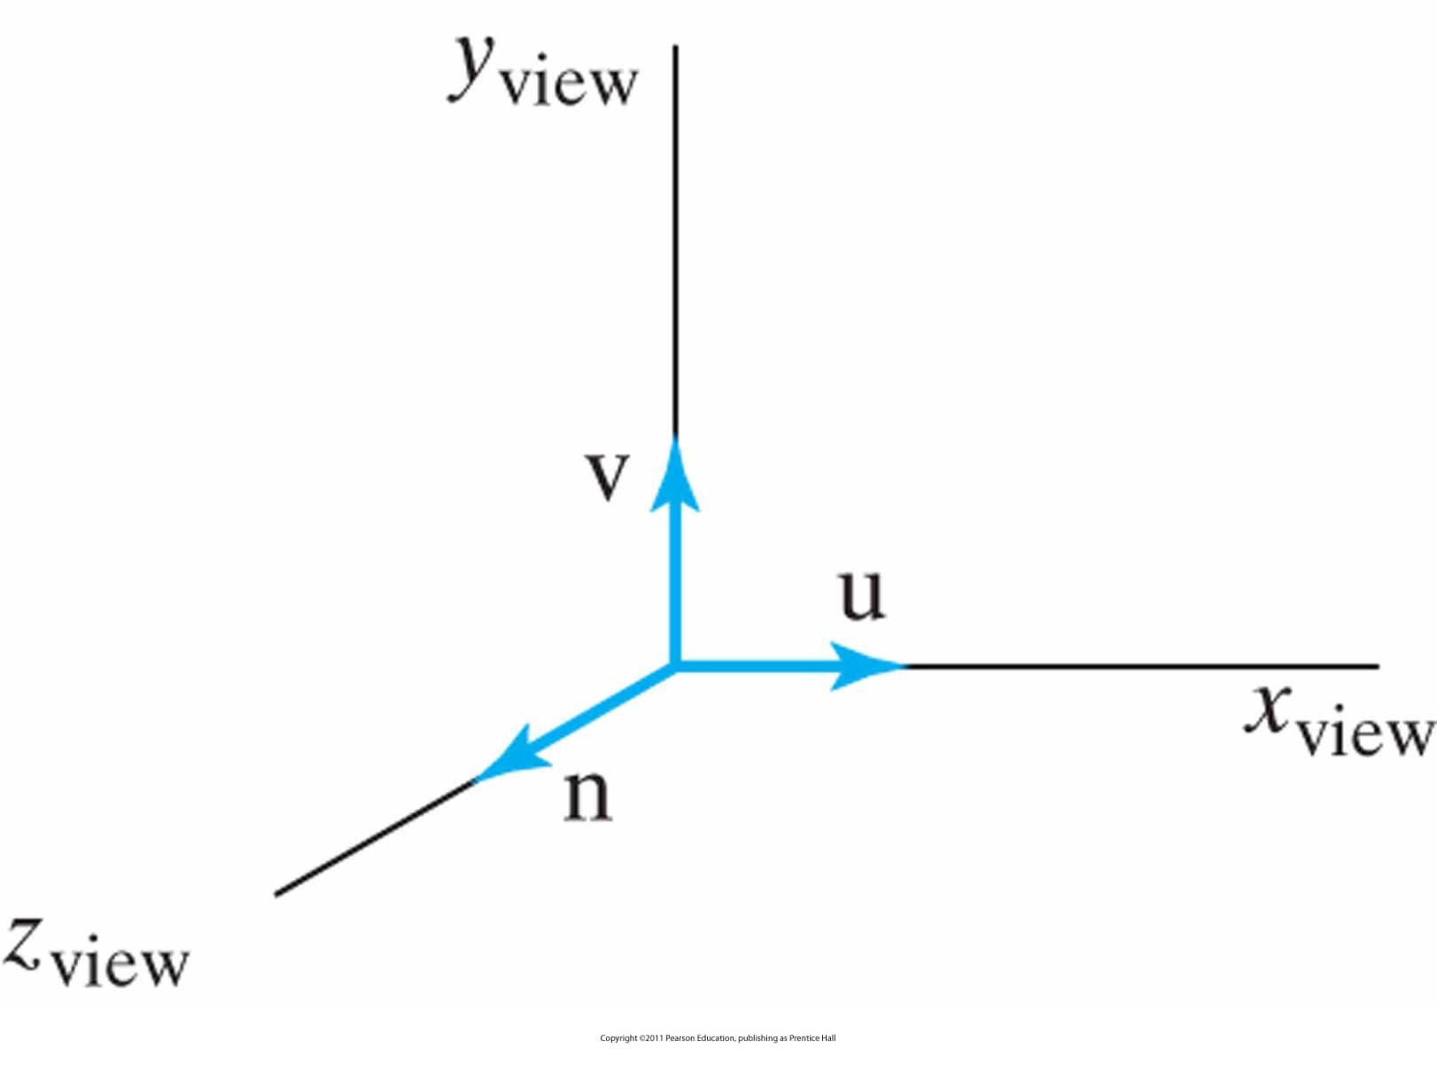
3D Viewing Coordinate Parameters: uvn Reference Frame
A right-handed viewing system defined with unit vectors u, v, and n.

Slide 18
Modeling Transformation
Use the modeling transformation to position and orient the model
  Rotate, scale and translate the model or perform some combination of these operations
  glScalef (1.0, 2.0, 1.0);
Note that instead of moving the camera (with a viewing transformation) so that the cube could be viewed, you could have moved the cube away from the camera (with a modeling transformation)

Slide 19
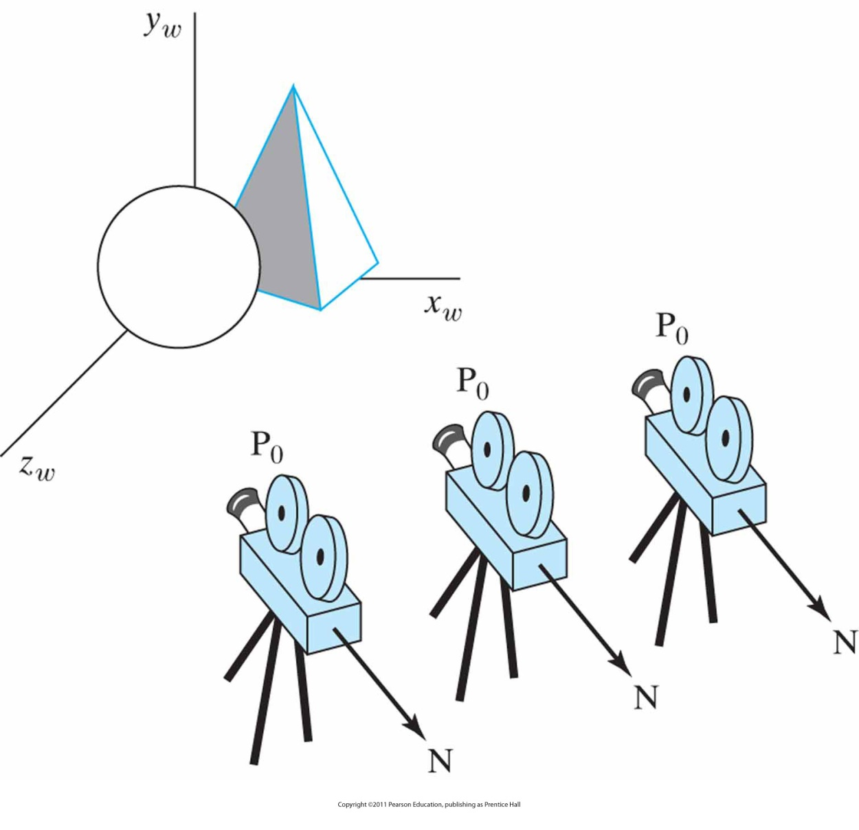
World to Viewing Coordinates
Panning across a scene by changing the viewing position, with a fixed direction for N.

Slide 20
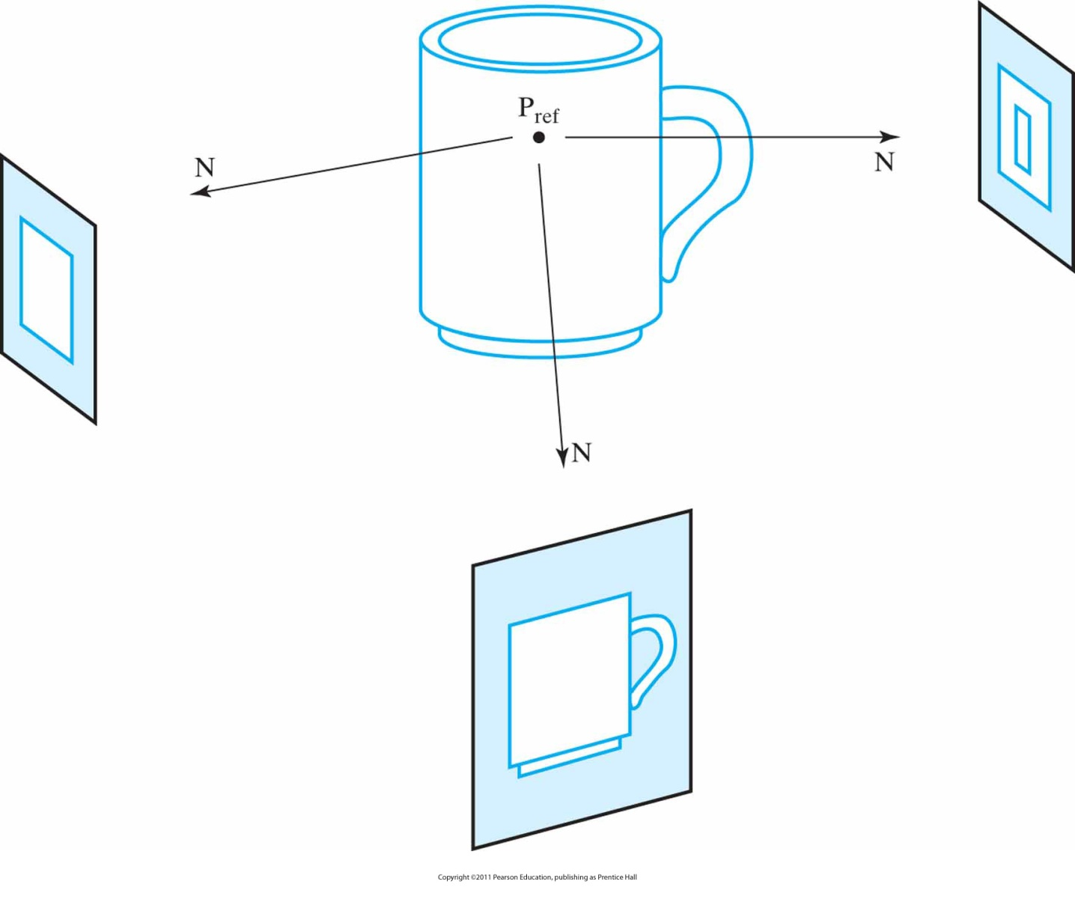
World to Viewing Coordinates (cont.)
Viewing an object from different directions using a fixed reference point.

Slide 21
World to Viewing Coordinates (cont.)
How is it achieved?
Find it out by yourself ☺

Slide 22
Projection Transformation
Specifying the projection transformation is like choosing a lens for a camera
You can think of this transformation as determining what the field of view or viewing volume is and therefore what objects are inside it
This is equivalent to choosing among wide-angle, normal, and telephoto lenses, for example
  With a wide-angle lens, you can include a wider scene in the final photograph than with a telephoto lens, but a telephoto lens allows you to photograph objects as though they're closer to you than they actually are

Slide 23
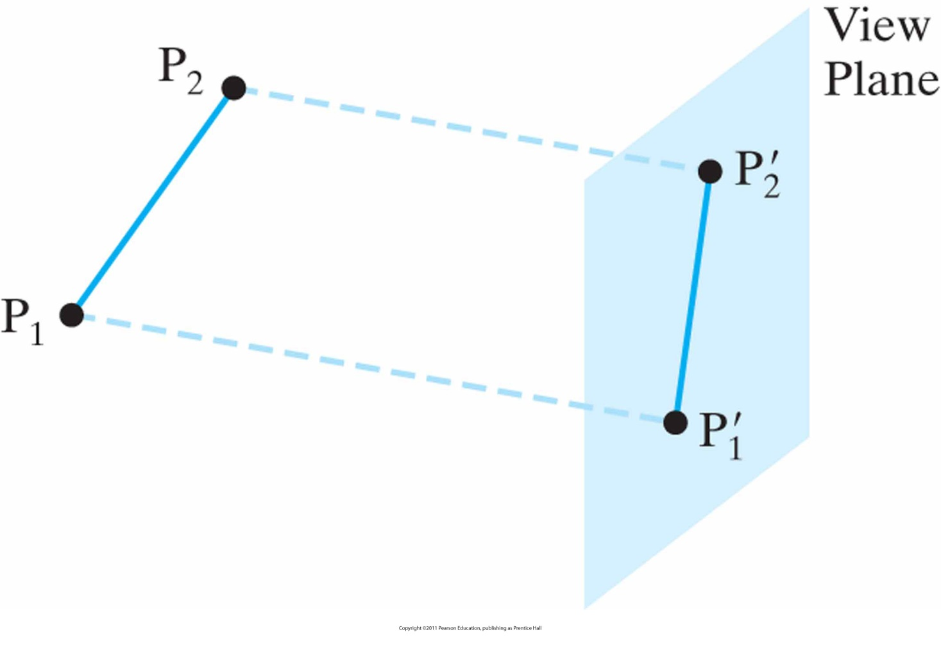
Projection Transformation (cont.)
Basic types of projections
  parallel projection, where proportions are preserved

Slide 24
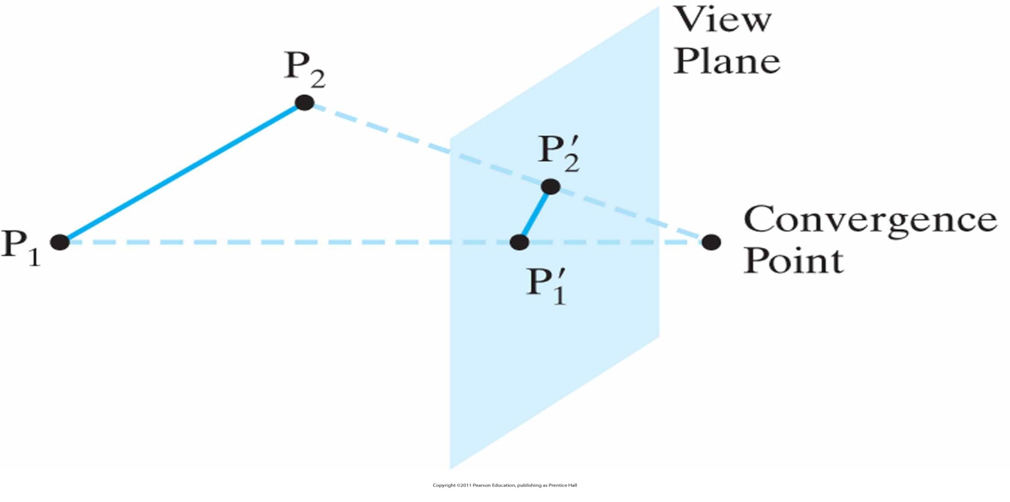
Projection Transformation (cont.)
Basic types of projections
  perspective projection, which matches how you see things in daily life. Perspective makes objects that are farther away appear smaller; for example, it makes railroad tracks appear to converge in the distance

Slide 25
Projection Transformation (cont.)
Basic types of projections
  orthographic, which maps objects directly onto the screen without affecting their relative size. Orthographic projection is used in architectural and computer-aided design applications where the final image needs to reflect the measurements of objects rather than how they might look
    Elevations: Side, front, rear orthogonal projection
    Plan view: Top orthogonal projection

Slide 26
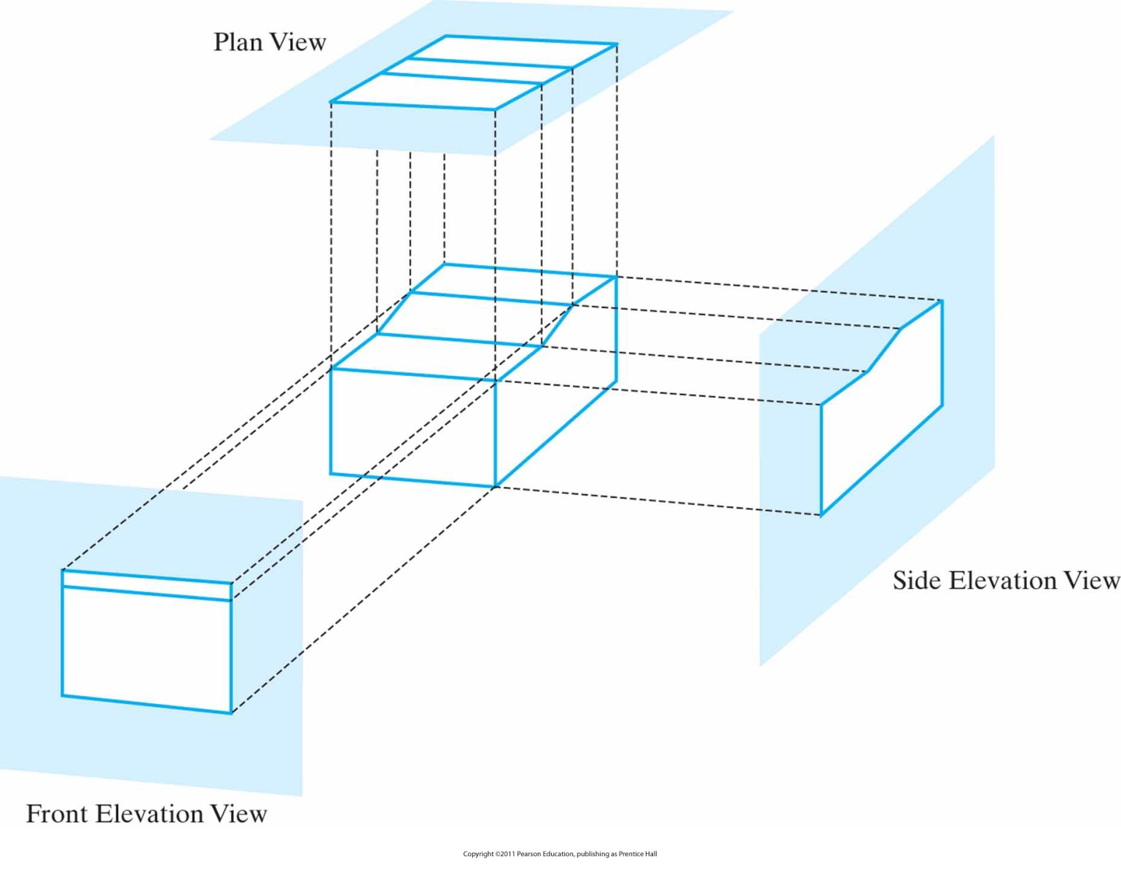
Example
Orthogonal projections of an object, displaying plan and elevation views.

Slide 27
Orthographic Projections
Axonometric and Isometric orthogonal projections
  Axonometric projections display more than one face of an object
  The most used axonometric projection type is isometric projection

Slide 28
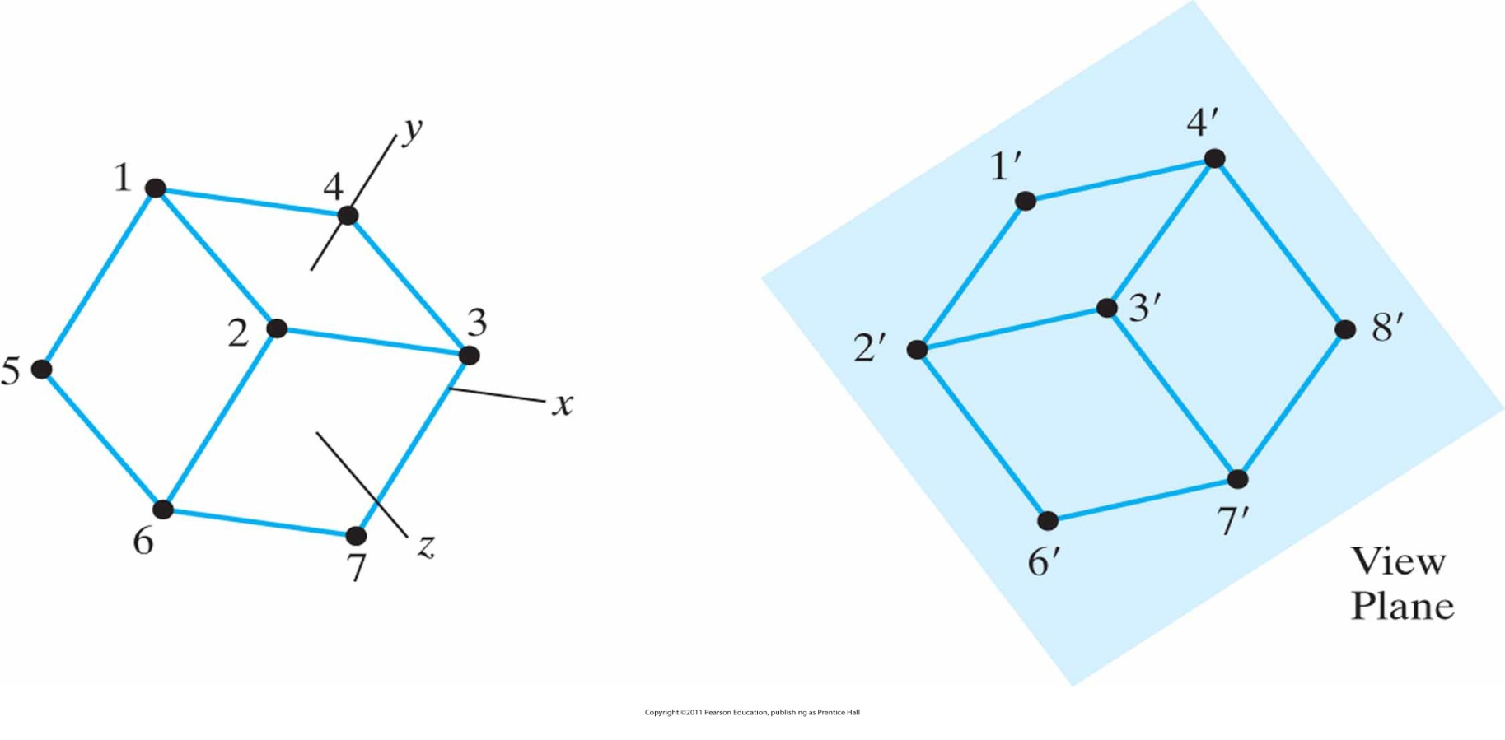
Isometric Projections
Isometric projection is obtained by aligning the projection or the object, so that the plane intersects each coordinate axis (called principal axes) in which the object is defined.

Slide 29
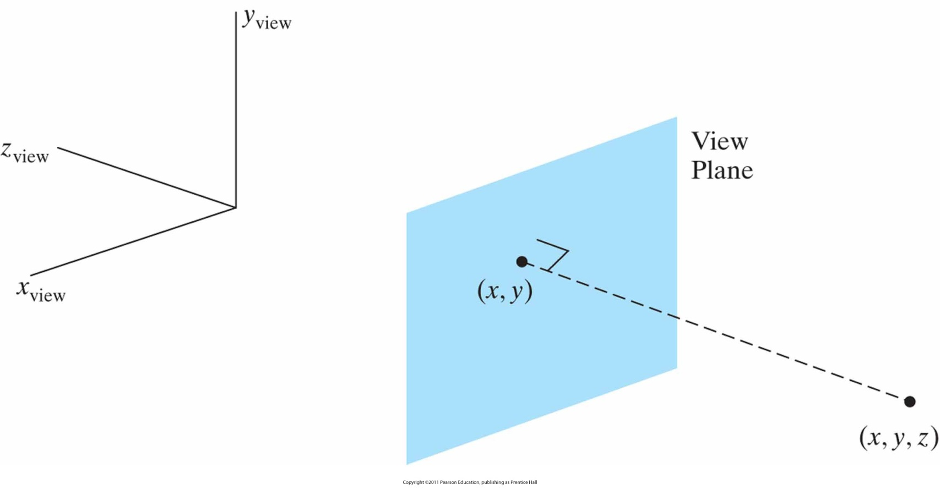
Orthogonal Projection Coordinates
With projection direction parallel to z_{view} axis, all transformation equations are trivial, i.e.
    x_{p} = x and y_{p} = y

Slide 30
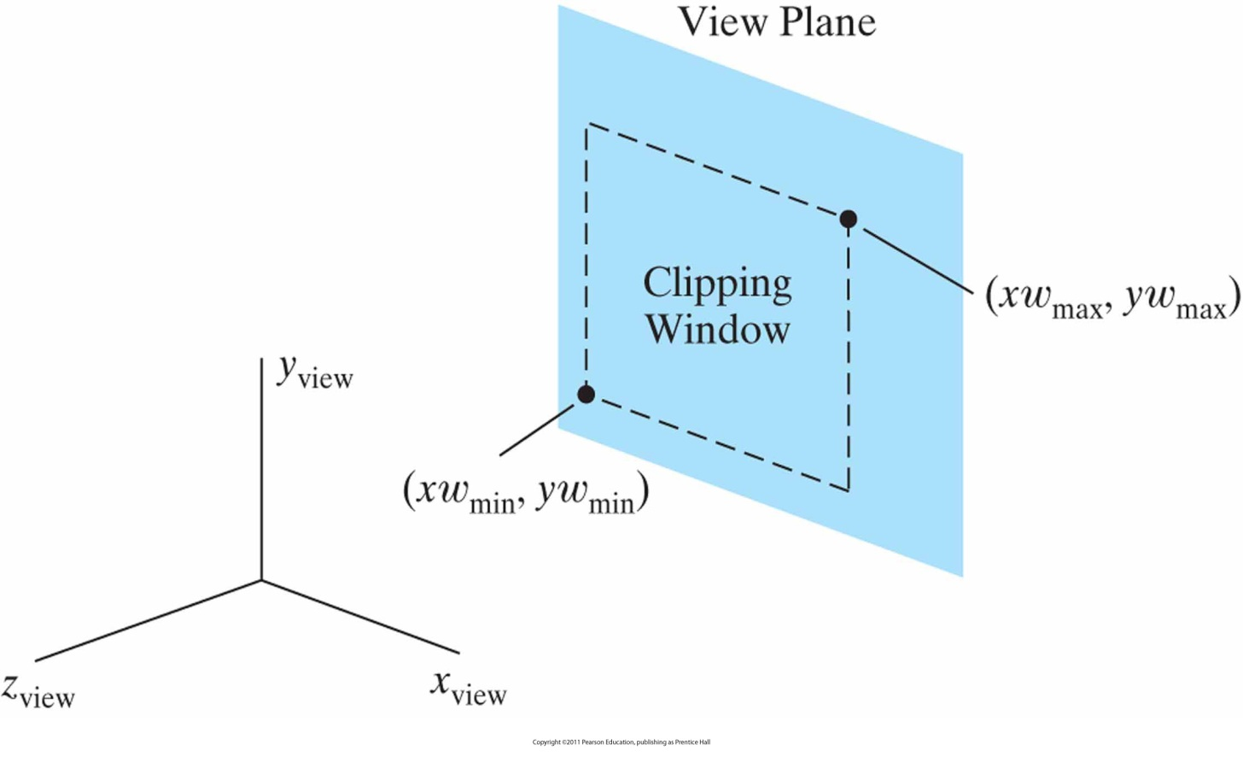
Clipping Window and Orthogonal Projection
In CG generally rectangular clipping windows are used.
In OpenGL

Slide 31
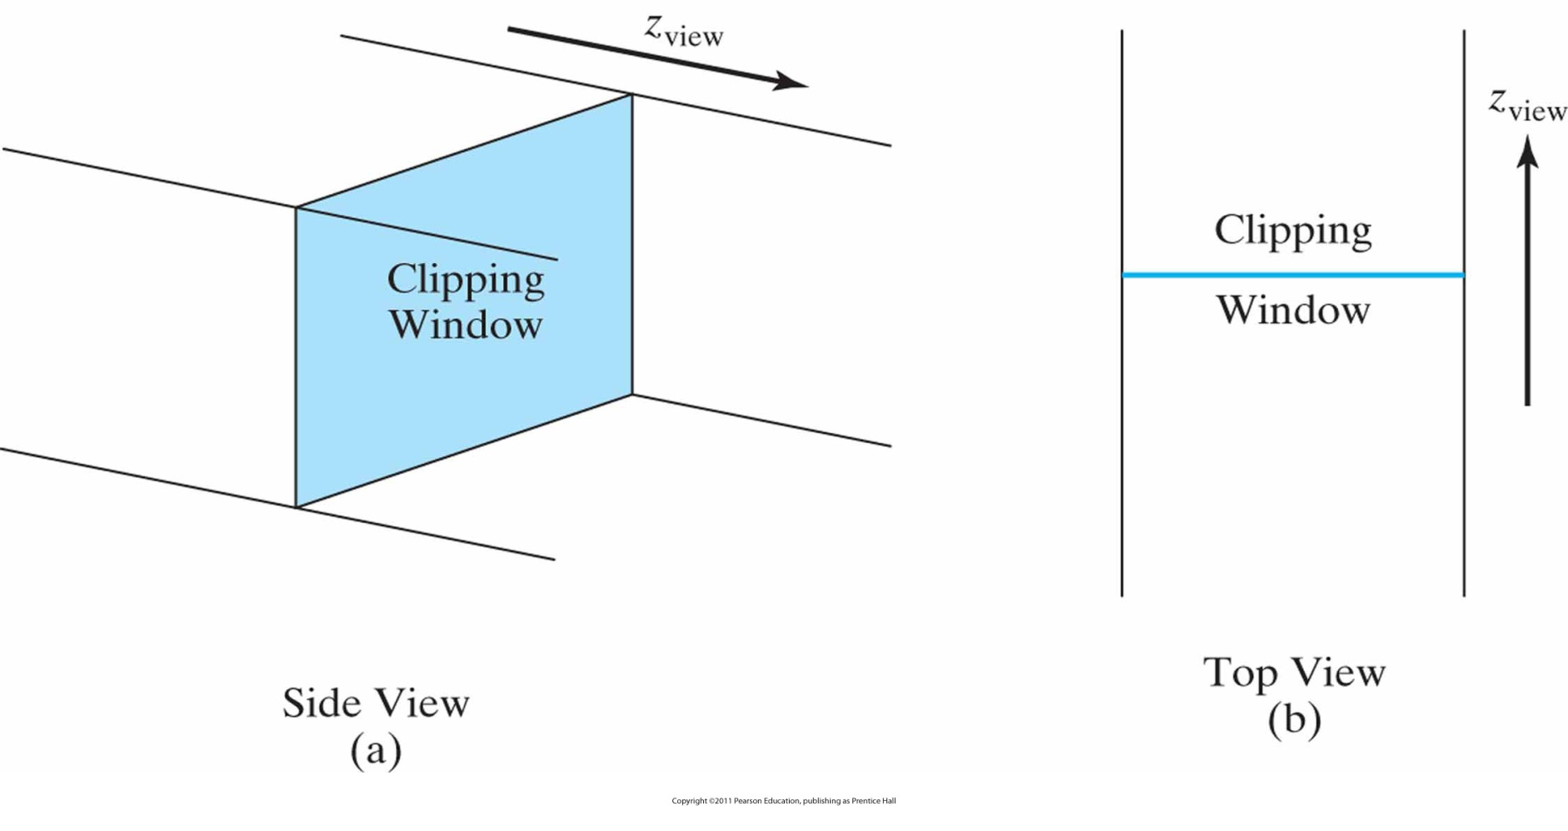
Clipping Window and Orthogonal Projection (cont.)
Limiting the volume with near-far or front-back clipping planes

Slide 32
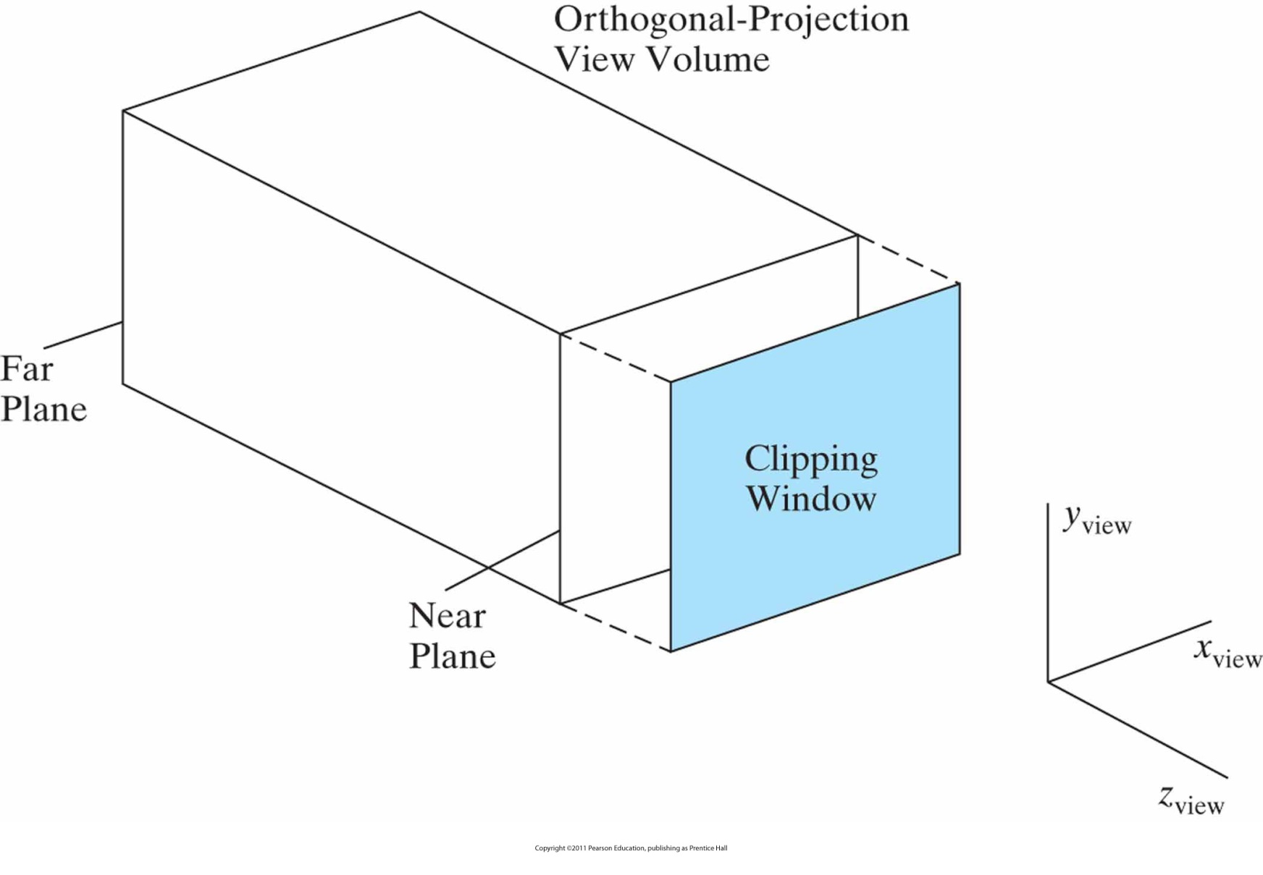
Finite Orthogonal View Volume
with the view plane “in front” of the near plane.

Slide 33
Other Projections
Oblique Parallel Projections
  Will be discussed later (when you apply for graduate studies and elect Advanced CG ☺)
Perspective Projections
  It’s up to you again ☺☺

Slide 34
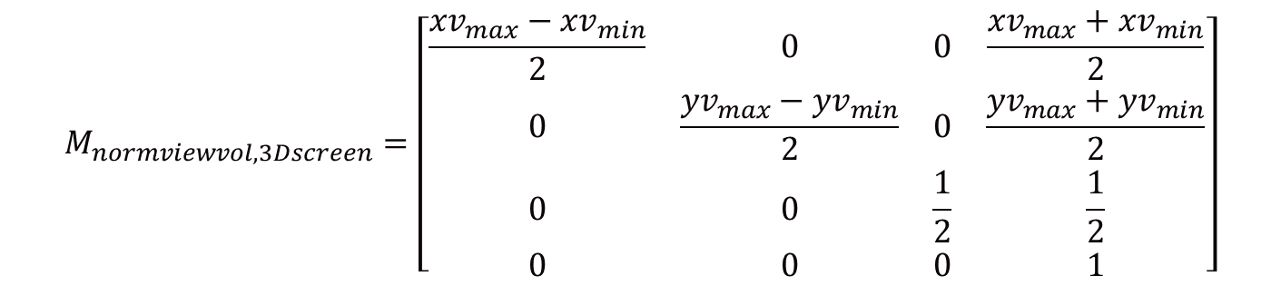
Viewport Transformation and 3D Screen Coordinates
Similar to 2D
Without further discussion and proof
$$M_{normviewvol, 3Dscreen}=\left[\begin{matrix}\frac{{xv}_{max}−{xv}_{min}}{2} & 0 & 0 & \frac{{xv}_{max}+{xv}_{min}}{2} \\ 0 & \frac{{yv}_{max}−{yv}_{min}}{2} & 0 & \frac{{yv}_{max}+{yv}_{min}}{2} \\ 0 & 0 & \frac{1}{2} & \frac{1}{2} \\ 0 & 0 & 0 & 1\end{matrix}\right]$$

Slide 35
Projection Transformation
Two basic types of projections are provided by OpenGL
  Perspective projection
  Orthographic / orthogonal projection

Slide 36
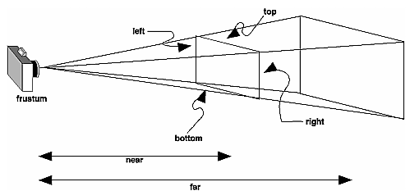
Perspective Projection
glFrustum(GLdouble left, GLdouble right, GLdouble bottom, GLdouble top, GLdouble near, GLdouble far)

Slide 37
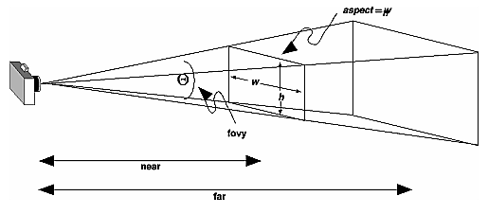
Perspective Projection (cont.)
gluPerspective(GLdouble fovy, GLdouble aspect, GLdouble near, GLdouble far)

Slide 38
Projection Transformation
glMatrixMode (GL_PROJECTION);
glLoadIdentity ();
glFrustum (-1.0, 1.0, -1.0, 1.0, 1.5, 20.0);

Slide 39
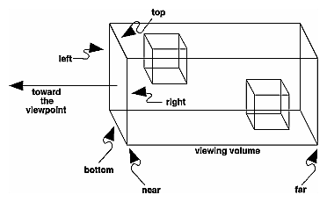
Orthographic Projection
glOrtho(GLdouble left, GLdouble right, GLdouble bottom,GLdouble top, GLdouble near, GLdouble far)

Slide 40
Viewport Transformation
Together, the projection transformation and the viewport transformation determine how a scene gets mapped onto the computer screen
The projection transformation specifies the mechanics of how the mapping should occur, and the viewport indicates the shape of the available screen area into which the scene is mapped

Slide 41
Viewport Transformation (cont.)
glViewport(GLint x, GLint y, GLsize width, GLsize height);
  The (x, y) parameter specifies the lower-left corner of the viewport, and width and height are the size of the viewport rectangle

Slide 42
Drawing the Scene
Once all the necessary transformations have been specified, you can draw the scene (that is, take the photograph)
As the scene is drawn, OpenGL transforms each vertex of every object in the scene by the modeling and viewing transformations.
Each vertex is then transformed as specified by the projection transformation and clipped if it lies outside the viewing volume described by the projection transformation.
Finally, the remaining transformed vertices are divided by w and mapped onto the viewport.

Slide 43
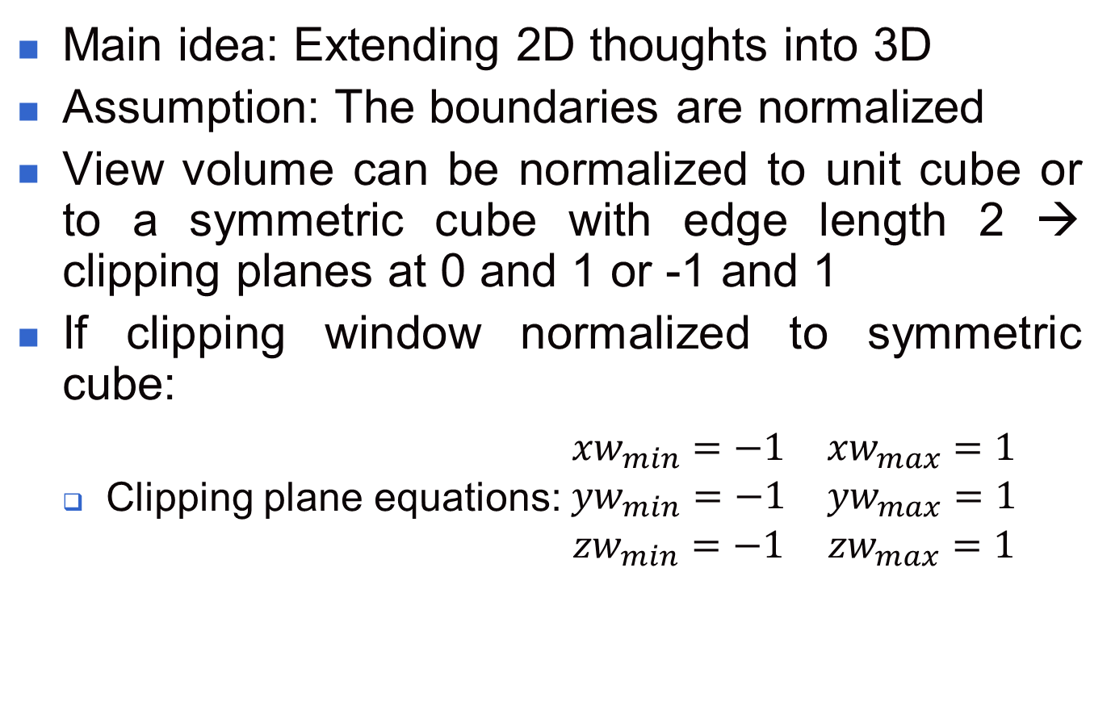
3D Clipping
Main idea: Extending 2D thoughts into 3D
Assumption: The boundaries are normalized
View volume can be normalized to unit cube or to a symmetric cube with edge length 2 → clipping planes at 0 and 1 or -1 and 1
If clipping window normalized to symmetric cube:
  Clipping plane equations: $\begin{matrix}{xw}_{min}=−1 & {xw}_{max}=1 \\ {yw}_{min}=−1 & {yw}_{max}=1 \\ {zw}_{min}=−1 & {zw}_{max}=1\end{matrix}$

Slide 44
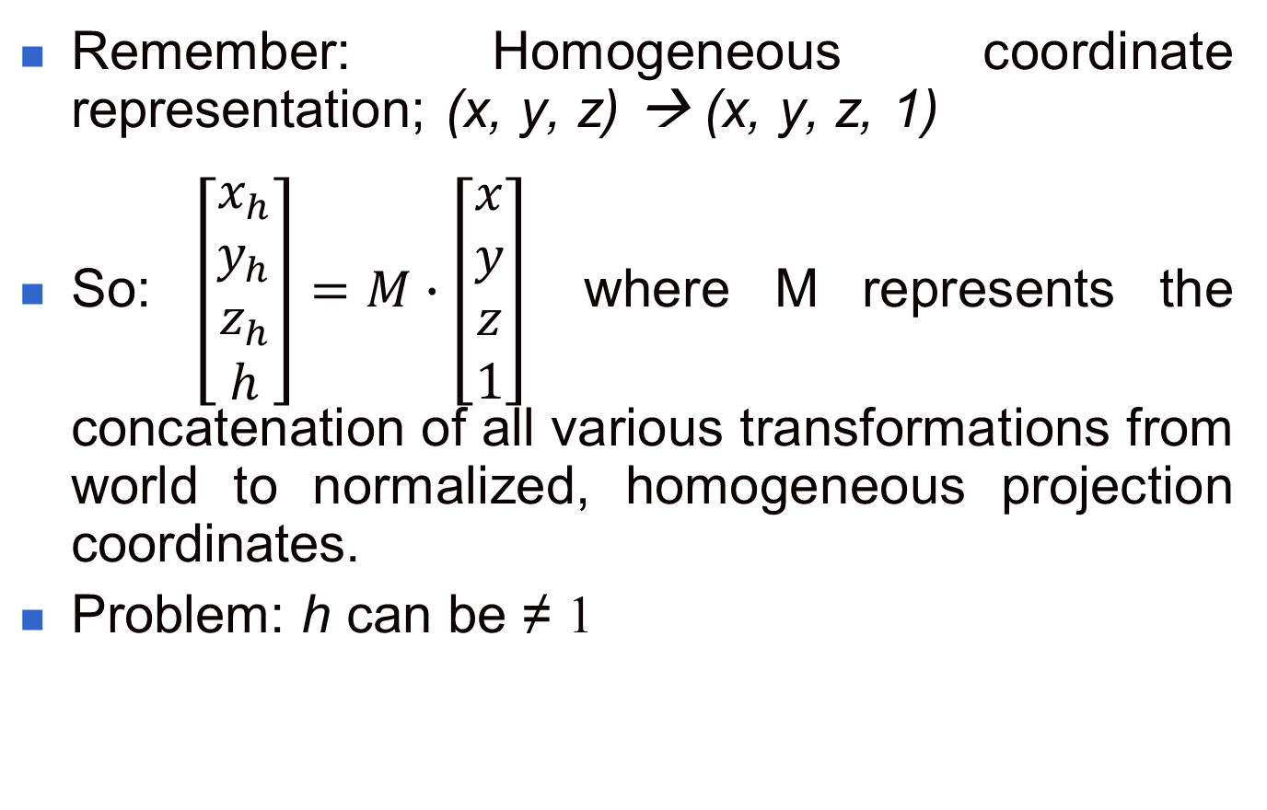
3D Clipping (cont.)
Remember: Homogeneous coordinate representation; (x, y, z) → (x, y, z, 1)
So: $\left[\begin{matrix}x_{h} \\ y_{h} \\ z_{h} \\ h\end{matrix}\right]=M∙\left[\begin{matrix}x \\ y \\ z \\ 1\end{matrix}\right]$ where M represents the concatenation of all various transformations from world to normalized, homogeneous projection coordinates.
Problem: h can be ≠ 1

Slide 45
3D Clipping (cont.)
If h=1 homogeneous parameters=Cartesian projection parameters, e.g. Parallel projection
If h ≠ 1 and clipping is done after division by h some coordinate information can be lost and objects may not be clipped correctly
How to solve this problem?
Answer: Apply clipping to homogeneous coordinate representation of spatial positions
But how?
See next slides

Slide 46
3D Clipping (cont.)
3D region codes: (Extending Cohen-Sutherland’s idea to 3D)
Bit 6
Bit 5
Bit 4
Bit 3
Bit 2
Bit 1
TOP
LEFT
FAR
NEAR
BOTTOM
RIGHT

Slide 47
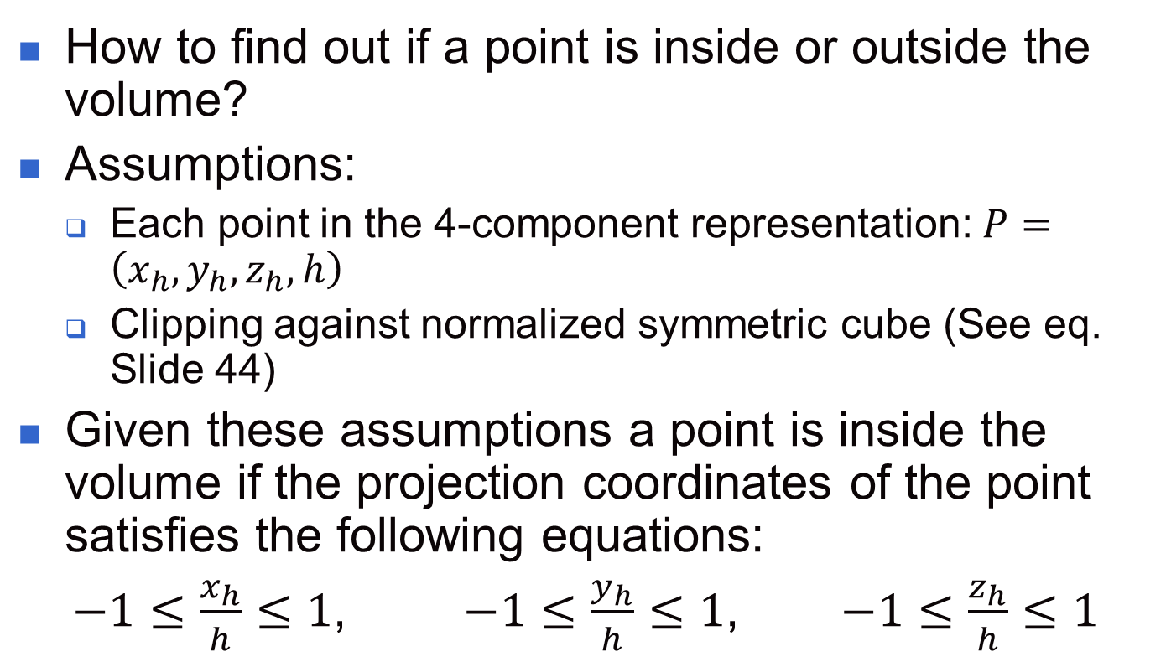
3D Clipping (cont.)
How to find out if a point is inside or outside the volume?
Assumptions:
  Each point in the 4-component representation: $P=\left(x_{h},y_{h},z_{h},h\right)$
  Clipping against normalized symmetric cube (See eq. Slide 44)
Given these assumptions a point is inside the volume if the projection coordinates of the point satisfies the following equations:
$−1≤\frac{x_{h}}{h}≤1$, $−1≤\frac{y_{h}}{h}≤1$, $−1≤\frac{z_{h}}{h}≤1$

Slide 48
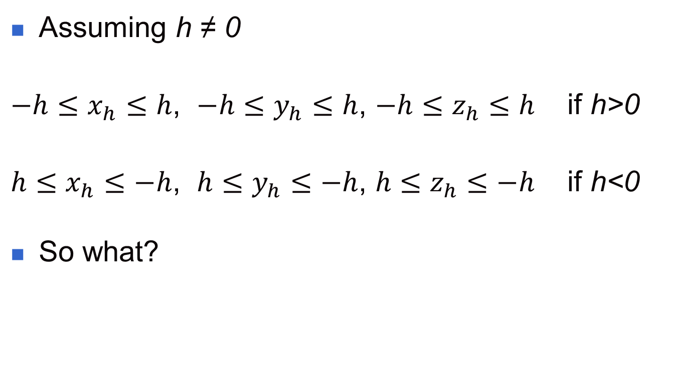
3D Clipping (cont.)
Assuming h ≠ 0
$−h≤x_{h}≤h$, $−h≤y_{h}≤h$, $−h≤z_{h}≤h$ if h>0
$h≤x_{h}≤−h$, $h≤y_{h}≤−h$, $h≤z_{h}≤−h$ if h<0
So what?

Slide 49
3D Clipping (cont.)
Testing region codes (for h > 0):
bit 1 = 1 if h + x_{h} < 0 (left)
bit 2 = 1 if h - x_{h} < 0 (right)
bit 3 = 1 if h + y_{h} < 0 (bottom)
bit 4 = 1 if h - y_{h} < 0 (top)
bit 5 = 1 if h + z_{h} < 0 (near)
bit 6 = 1 if h - z_{h} < 0 (far)

Slide 50
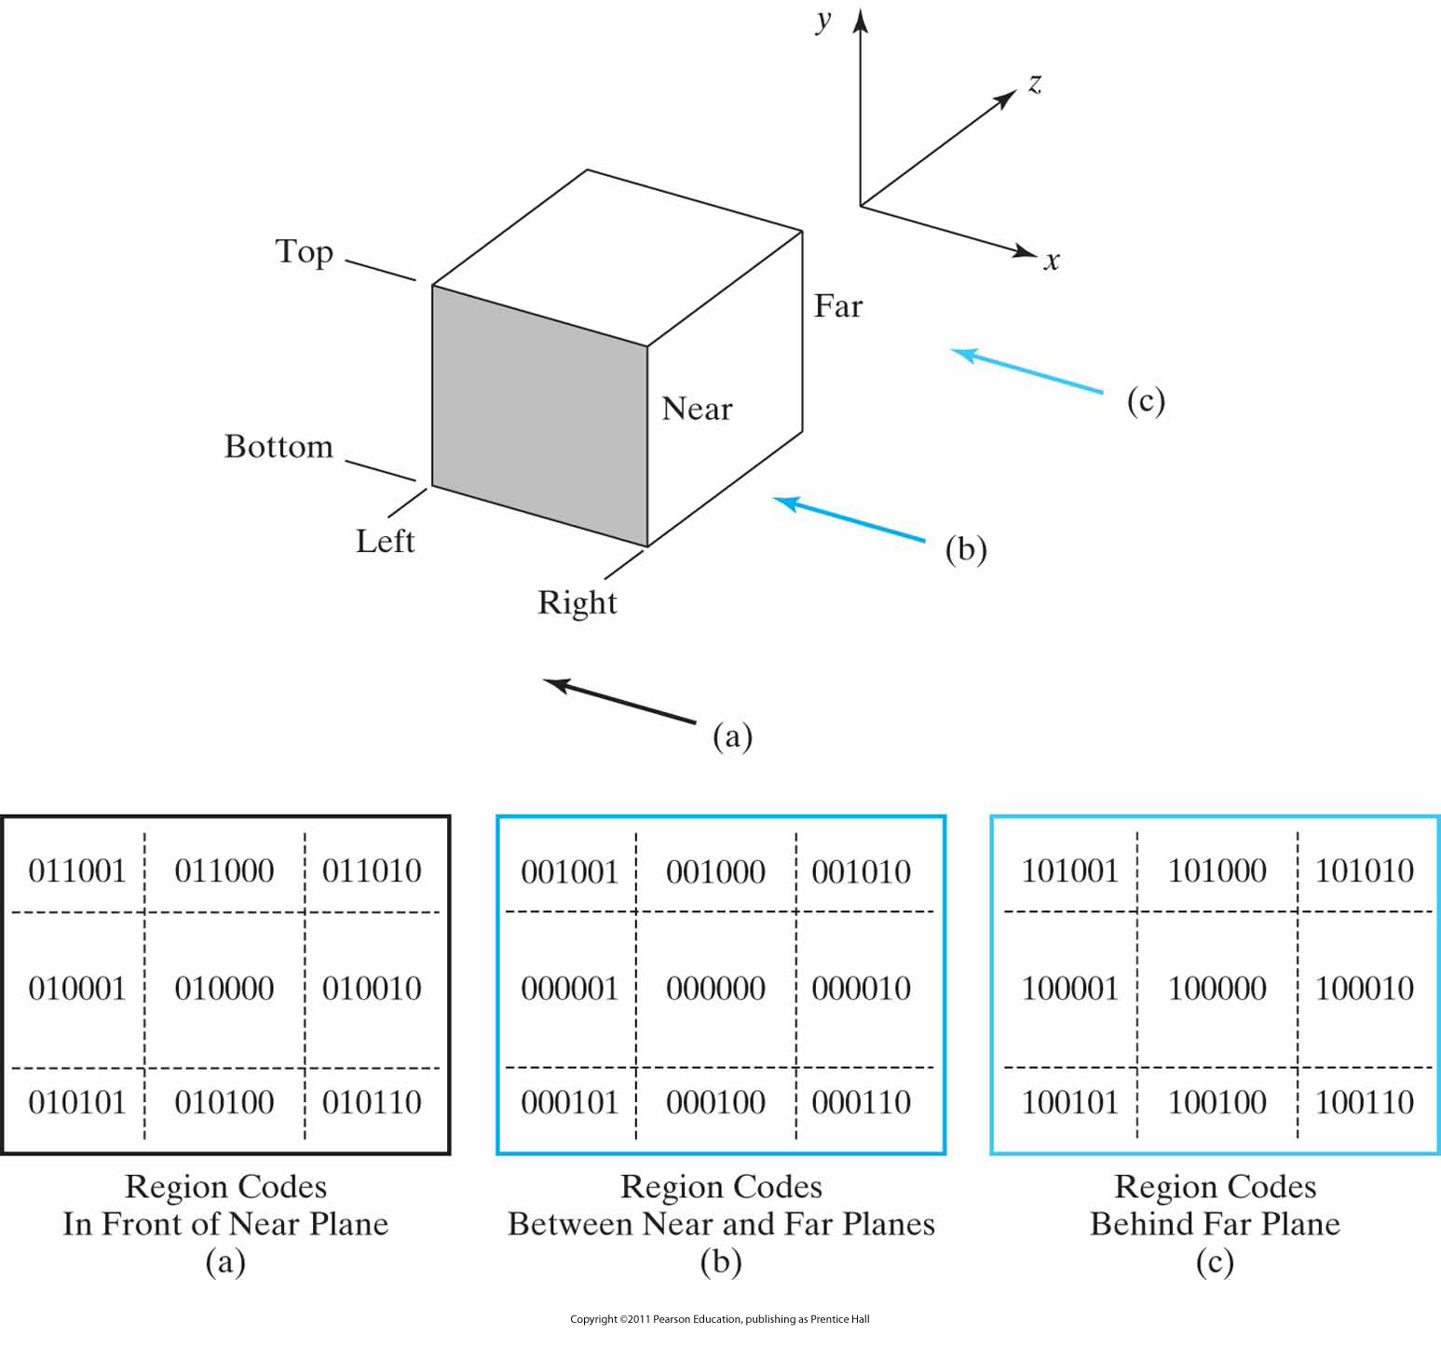
3D Clipping (cont.)
Values for the three-dimensional, six-bit region code that identifies spatial positions relative to the boundaries of a view volume.

Slide 51
3D Clipping (cont.)
And for h < 0?
Think about it ☺

Slide 52
3D Clipping Algorithm
For point clipping:
  Eliminate all points with region code ≠ 000000
For line clipping:
  Test trivial accepts and trivial rejects using region codes, e.g. for trivial accepts use logical OR and for trivial rejects use logical AND
  For other cases, use methods of Cyrus-Beck or Liang-Barsky. How????
3D Polygon and curve clipping
  Your turn ☺

Slide 53
3D Clipping in OpenGL
In OpenGL optional clipping planes can be defined and used
Defining and activating clip planes:
  glClipPlane (id, planeParameters );
  glEnable (id);
Deactivating:
  glDisable (id);
Plane parameters: A, B, C, D
Remember: Plane equation: Ax+By+Cz+D=0

Slide 54
3D Clipping in OpenGL
So what?
A point (x, y, z) with Ax+By+Cz+D<0 will be eliminated
Why?
Because it is ‘behind’ the clipping plane ☺

Slide 55
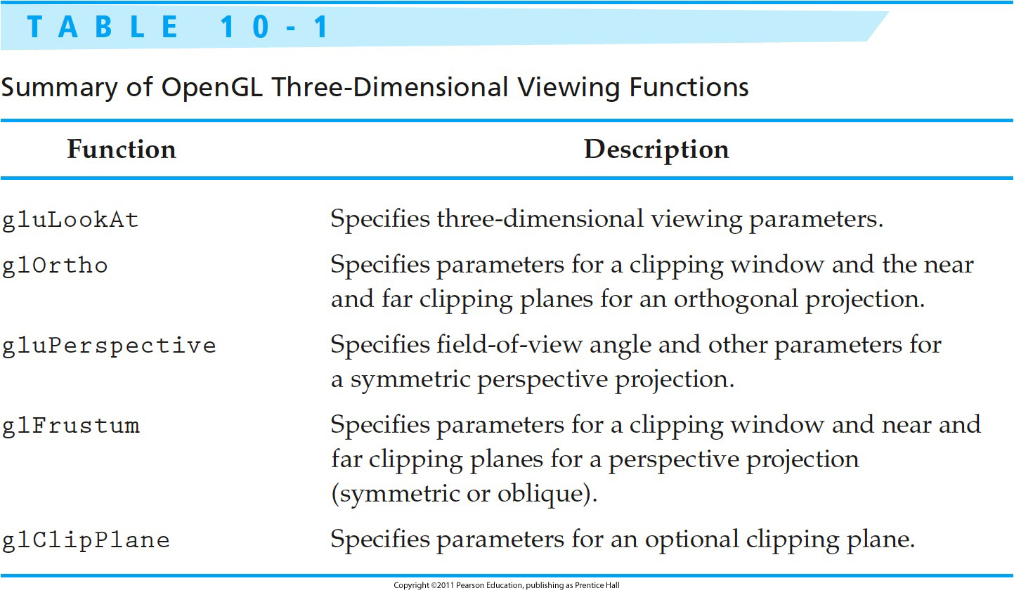
OpenGL 3D Viewing Functions

Slide 56

Next Lecture
3D Object Representations
56
Notes:
56

Slide 57
References
Donald Hearn, M. Pauline Baker, Warren R. Carithers, “Computer Graphics with OpenGL, 4th Edition”; Pearson, 2011
Sumanta Guha, “Computer Graphics Through OpenGL: From Theory to Experiments”, CRC Press, 2010
Edward Angel, “Interactive Computer Graphics. A Top-Down Approach Using OpenGL”, Addison-Wesley, 2005
57

