Slide 1
CSE202 Database Management Systems
Lecture #9
Prepared & Presented by Asst. Prof. Dr. Samsun M. BAŞARICI

Slide 2
Learning Objectives
Describe the concept of physical database design.
Describe how a disk device works.
Describe the principles of file organizations and access methods.
Describe how simple linear indexes and B+-tree indexes work.
Describe how hashed files work.
List and describe the inputs to the physical database design process.
Perform physical database design and improve database performance using a variety of techniques ranging from adding indexes to denormalization.

Slide 3
Outline
Concept of physical database design.
Working principles of disk devices
File organization and access methods
Simple linear indexes and B+-tree indexes
Hashed files
Physical DB design process
Physical DB design and performance issues

Slide 4
Database Performance
Factors Affecting Application and Database Performance
Application Factors
  Need for Joins
  Need to Calculate Totals
Data Factors
  Large Data Volumes
Database Structure Factors
  Lack of Direct Access
  Clumsy Primary Keys
Data Storage Factors
  Related Data Dispersed on Disk
Business Environment Factors
  Too Many Data Access Operations
  Overly Liberal Data Access

Slide 5
Physical Database Design
The process of modifying a database structure to improve the performance of the run-time environment.
We are going to modify the third normal form tables produced by the logical database design techniques to make the applications that will use them run faster.

Slide 6
Disk Storage
Primary (Main) Memory - where computers execute programs and process data
  Very fast
  Permits direct access
  Has several drawbacks
    relatively expensive
    not transportable
    is volatile

Slide 7
Disk Storage
Secondary Memory - stores the vast volume of data and the programs that process them
Data is loaded from secondary memory into primary memory when required for processing.

Slide 8

Primary and Secondary Memory
When a person needs some particular information that’s not in her brain at the moment, she finds a book in the library that has the information and, by reading it, transfers the information from the book into her brain.

Slide 9
How Disk Storage Works
Disks come in a variety of types and capacities
  Multi-platter, aluminum or ceramic disk units
  Removable, external hard drives.
Provide a direct access capability to the data.

Slide 10
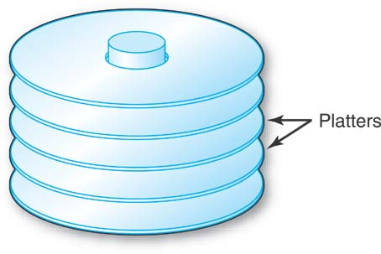
How Disk Storage Works (cont.)
Several disk platters are stacked together, and mounted on a central spindle, with some space in between them.
Referred to as “the disk.”

Slide 11
How Disk Storage Works (cont.)
The platters have a metallic coating that can be magnetized, and this is how the data is stored, bit-by-bit.

Slide 12
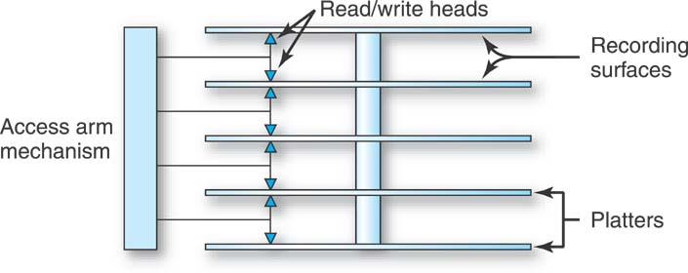
Access Arm Mechanism
The basic disk drive has one access arm mechanism with arms that can reach in between the disks.
At the end of each arm are two read/write heads.
The platters spin, all together as a single unit, on the central spindle, at a high velocity.

Slide 13
Disk Storage Devices
Preferred secondary storage device for high storage capacity and low cost.
Data stored as magnetized areas on magnetic disk surfaces.
A disk pack contains several magnetic disks connected to a rotating spindle.
Disks are divided into concentric circular tracks on each disk surface.
  Track capacities vary typically from 4 to 50 Kbytes or more

Slide 14
Disk Storage Devices (cont.)
A track is divided into smaller blocks or sectors
  because it usually contains a large amount of information
The division of a track into sectors is hard-coded on the disk surface and cannot be changed.
  One type of sector organization calls a portion of a track that subtends a fixed angle at the center as a sector.
A track is divided into blocks.
  The block size B is fixed for each system.
    Typical block sizes range from B=512 bytes to B=4096 bytes.
  Whole blocks are transferred between disk and main memory for processing.

Slide 15
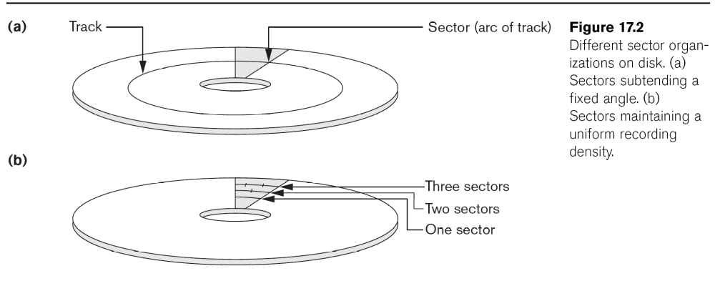
Disk Storage Devices (cont.)

Slide 16
Disk Storage Devices (cont.)
A read-write head moves to the track that contains the block to be transferred.
  Disk rotation moves the block under the read-write head for reading or writing.
A physical disk block (hardware) address consists of:
  a cylinder number (imaginary collection of tracks of same radius from all recorded surfaces)
  the track number or surface number (within the cylinder)
  and block number (within track).
Reading or writing a disk block is time consuming because of the seek time s and rotational delay (latency) rd.
Double buffering can be used to speed up the transfer of contiguous disk blocks.

Slide 17
Disk Storage Devices (cont.)

Slide 18
Typical Disk Parameters

Slide 19
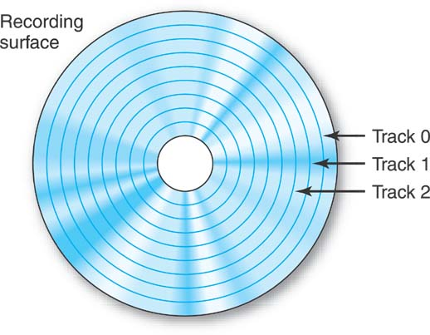
Tracks
Concentric circles on which data is stored, serially by bit.
Numbered track 0, track 1, track 2, and so on.

Slide 20
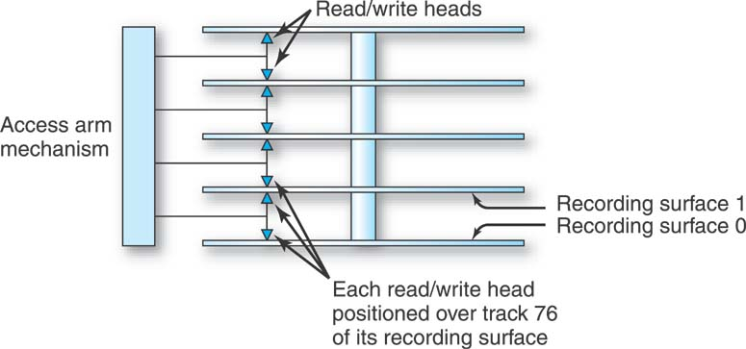
Cylinders
A collection of tracks, one from each recording surface, one directly above the other.
Number of cylinders in a disk = number of tracks on any one of its recording surfaces.

Slide 21
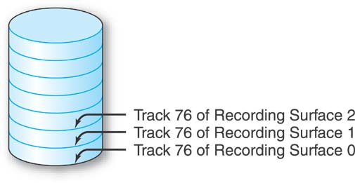
Cylinders (cont.)
The collection of each surface’s track 76, one above the other, seem to take the shape of a cylinder.
This collection of tracks is called cylinder 76.

Slide 22
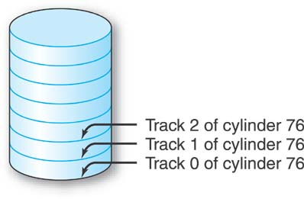
Cylinders (cont.)
Once we have established a cylinder, it is also necessary to number the tracks within the cylinder.
Cylinder 76’s tracks.

Slide 23
Steps in Finding and Transferring Data
Seek Time - The time it takes to move the access arm mechanism to the correct cylinder from whatever cylinder it’s currently positioned.
Head Switching - Selecting the read/write head to access the required track of the cylinder.
Rotational Delay - Waiting for the desired data on the track to arrive under the read/write head as the disk is spinning.

Slide 24
Steps in Finding and Transferring Data (cont.)
Transfer Time - The time to actually move the data from the disk to primary memory once the previous 3 steps have been completed.

Slide 25
Records
Fixed and variable length records
Records contain fields which have values of a particular type
  E.g., amount, date, time, age
Fields themselves may be fixed length or variable length
Variable length fields can be mixed into one record:
  Separator characters or length fields are needed so that the record can be “parsed.”

Slide 26
Blocking
Blocking:
  Refers to storing a number of records in one block on the disk.
Blocking factor (bfr) refers to the number of records per block.
There may be empty space in a block if an integral number of records do not fit in one block.
Spanned Records:
  Refers to records that exceed the size of one or more blocks and hence span a number of blocks.

Slide 27
Files of Records
A file is a sequence of records, where each record is a collection of data values (or data items).
A file descriptor (or file header) includes information that describes the file, such as the field names and their data types, and the addresses of the file blocks on disk.
Records are stored on disk blocks.
The blocking factor bfr for a file is the (average) number of file records stored in a disk block.
A file can have fixed-length records or variable-length records.

Slide 28
Files of Records (cont.)
File records can be unspanned or spanned
  Unspanned: no record can span two blocks
  Spanned: a record can be stored in more than one block
The physical disk blocks that are allocated to hold the records of a file can be contiguous, linked, or indexed.
In a file of fixed-length records, all records have the same format. Usually, unspanned blocking is used with such files.
Files of variable-length records require additional information to be stored in each record, such as separator characters and field types.
  Usually spanned blocking is used with such files.

Slide 29
File Organizations and Access Methods
File Organization - the way that we store the data for subsequent retrieval.
Access Method - The way that we retrieve the data, based on it being stored in a particular file organization.

Slide 30
Operation on Files
Typical file operations include:
  OPEN: Readies the file for access, and associates a pointer that will refer to a current file record at each point in time.
  FIND: Searches for the first file record that satisfies a certain condition, and makes it the current file record.
  FINDNEXT: Searches for the next file record (from the current record) that satisfies a certain condition, and makes it the current file record.
  READ: Reads the current file record into a program variable.
  INSERT: Inserts a new record into the file & makes it the current file record.
  DELETE: Removes the current file record from the file, usually by marking the record to indicate that it is no longer valid.
  MODIFY: Changes the values of some fields of the current file record.
  CLOSE: Terminates access to the file.
  REORGANIZE: Reorganizes the file records.
    For example, the records marked deleted are physically removed from the file or a new organization of the file records is created.
  READ_ORDERED: Read the file blocks in order of a specific field of the file.

Slide 31
Unordered Files
Also called a heap or a pile file.
New records are inserted at the end of the file.
A linear search through the file records is necessary to search for a record.
  This requires reading and searching half the file blocks on the average, and is hence quite expensive.
Record insertion is quite efficient.
Reading the records in order of a particular field requires sorting the file records.

Slide 32
Ordered Files
Also called a sequential file.
File records are kept sorted by the values of an ordering field.
Insertion is expensive: records must be inserted in the correct order.
  It is common to keep a separate unordered overflow (or transaction) file for new records to improve insertion efficiency; this is periodically merged with the main ordered file.
A binary search can be used to search for a record on its ordering field value.
  This requires reading and searching log₂ of the file blocks on the average, an improvement over linear search.
Reading the records in order of the ordering field is quite efficient.

Slide 33
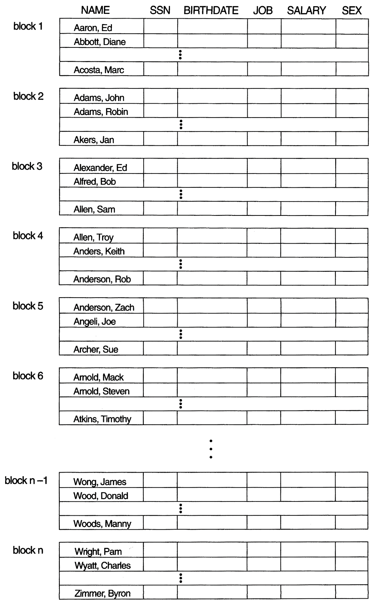
Ordered Files (cont.)

Slide 34
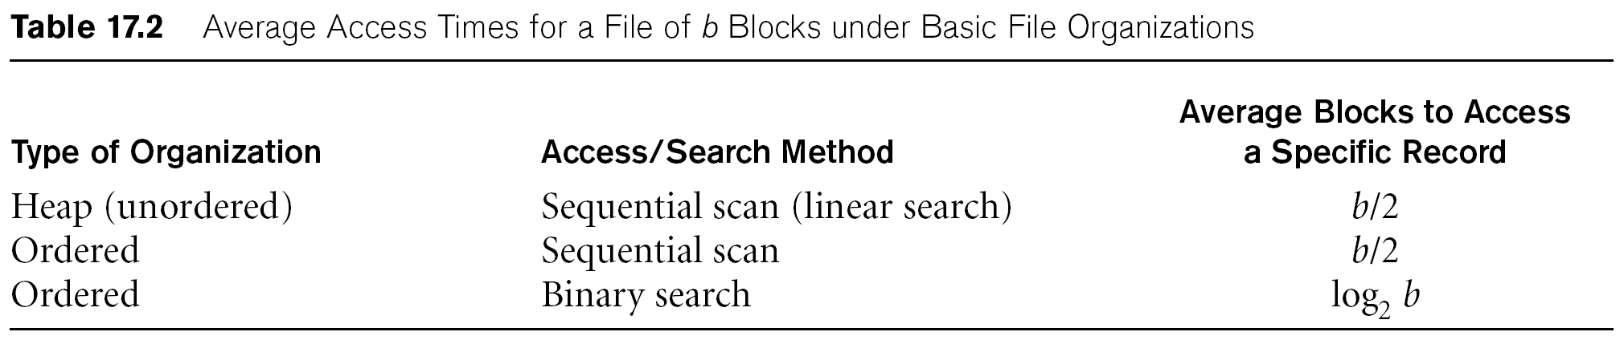
Average Access Times
The following table shows the average access time to access a specific record for a given type of file

Slide 35
Achieving Direct Access
An index tool.
Hashing Method - a way of storing and retrieving records.
If we know the value of a field of a record that we want to retrieve, the index or hashing method will pinpoint its location in the file and instruct the hardware mechanisms of the disk device where to find it.

Slide 36
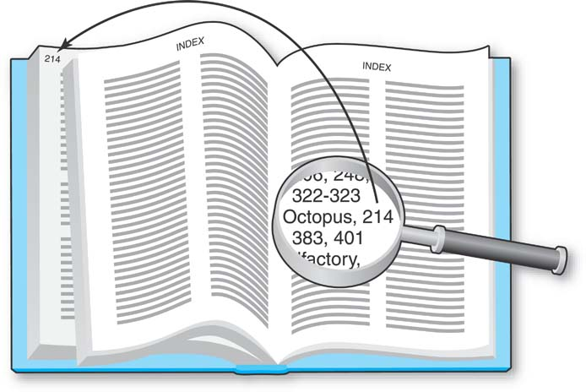
The Index
Principal is the same as that governing the index in the back of a book.

Slide 37
The Index (cont.)
The items of interest are copied over into the index, but the original text is not disturbed in any way.
The items in the index are sorted.
Each item in the index is associated with a “pointer.”

Slide 38
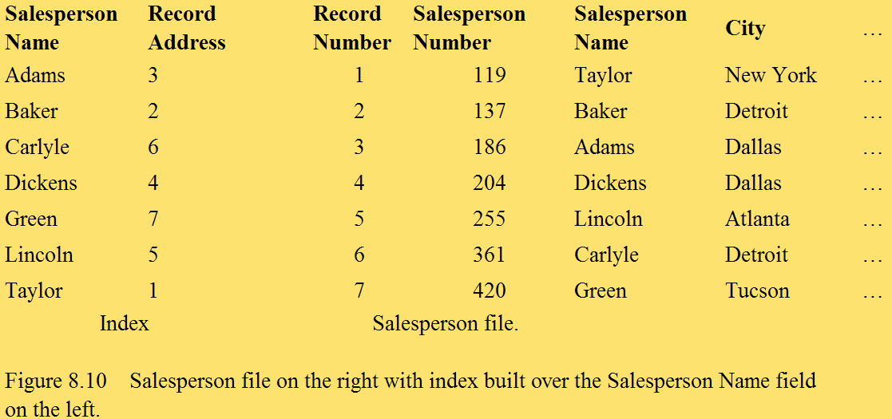
Simple Linear Index
Index is ordered by Salesperson Name field.
The first index record shows Adams 3 because the record of the Salesperson file with salesperson name Adams is at relative record location 3 in the Salesperson file.

Slide 39
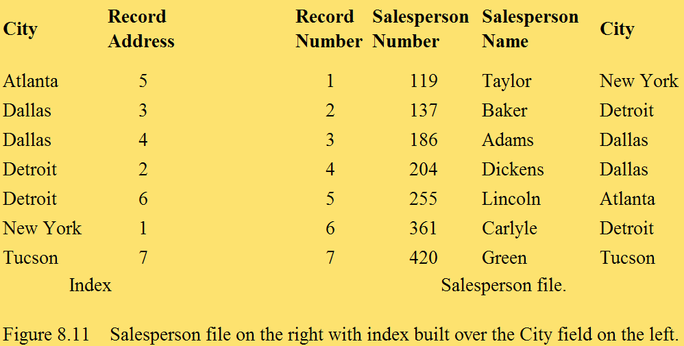
Simple Linear Index (cont.)
An index built over the City field.
An index can be built over a field with nonunique values.

Slide 40
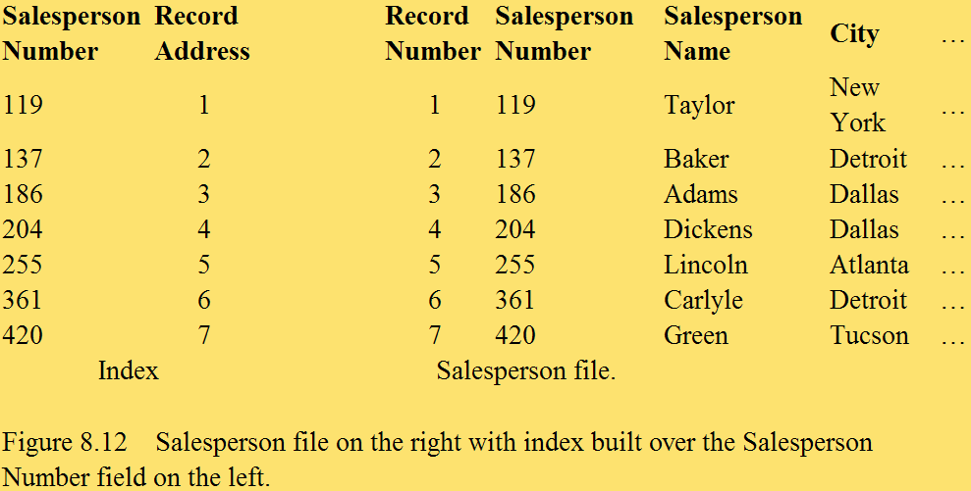
Simple Linear Index (cont.)
An index built over the Salesperson Number field.
Indexed sequential file - the file is stored on the disk in order based on a set of field values (salesperson numbers), and an index is built over that same field.

Slide 41
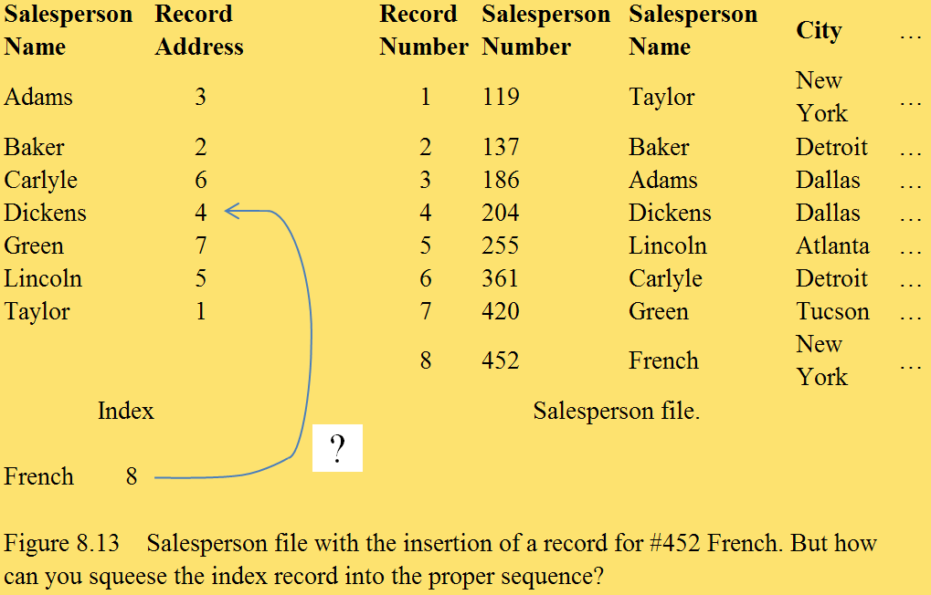
Simple Linear Index

Slide 42
Simple Linear Index (cont.)
French 8, would have to be inserted between the index records for Dickens and Green to maintain the crucial alphabetic sequence.
Would have to move all of the index records from Green to Taylor down one record position.
Not a good solution for indexing the records of a file.

Slide 43
B+-tree Index
The most common data indexing system in use today.
Unlike simple linear indexes, B+-trees are designed to comfortably handle the insertion of new records into the file and to handle record deletion.

Slide 44
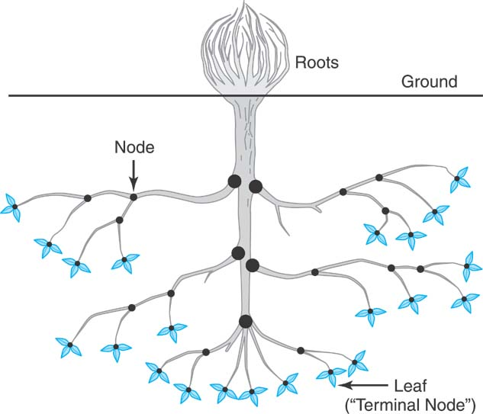
B+-tree Index (cont.)
An arrangement of special index records in a “tree.”
A single index record, the “root,” at the top, with “branches” leading down from it to other “nodes.”

Slide 45
B+-tree Index (cont.)
The lowest level nodes are called “leaves.”
Think of it as a family tree.

Slide 46
B+-tree Index (cont.)
Each key value in the tree is associated with a pointer that is the address of either a lower level index record or a cylinder containing the salesperson records.
The index records contain salesperson number key values copied from certain of the salesperson records.

Slide 47
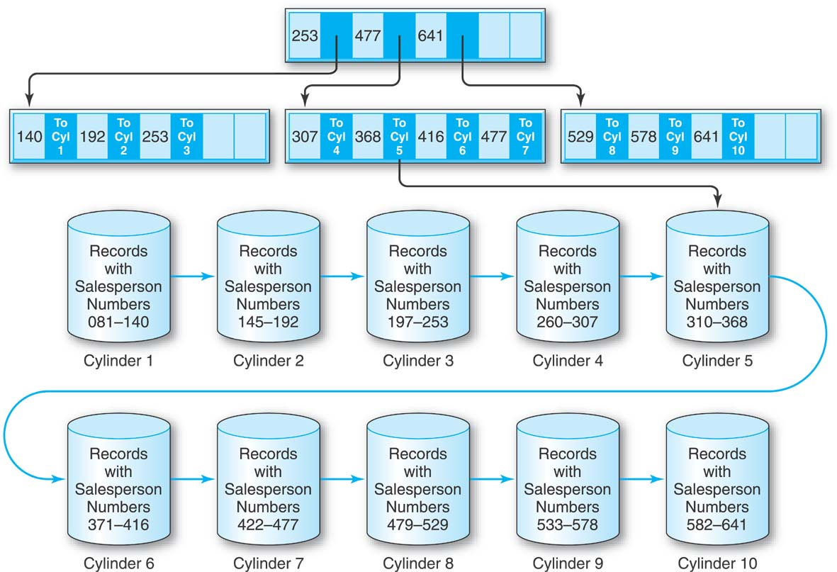
B+-tree Index (cont.)

Slide 48
B+-tree Index (cont.)
Each index record, at every level of the tree, contains space for the same number of key value/pointer pairs.
Each index record is at least half full.
The tree index is small and can be kept in main memory indefinitely for a frequently accessed file.

Slide 49
B+-tree Index (cont.)
This is an indexed-sequential file, because the file is stored in sequence by the salesperson numbers and the index is built over the Salesperson Number field.
B+-tree indexes can also be used to index nonkey, nonunique fields.
In general, the storage unit for groups of records can be the cylinder or any other physical device subunit.

Slide 50
B+-tree Index (cont.)
Say that a new record with salesperson number 365 must be inserted.
Suppose that cylinder 5 is completely full.

Slide 51
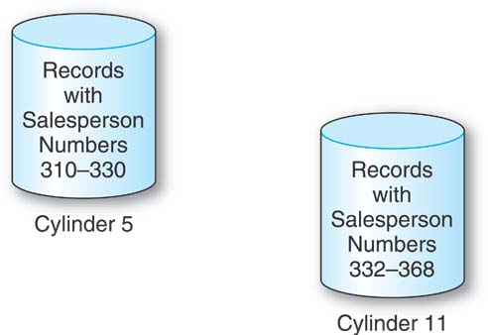
B+-tree Index (cont.)
The collection of records on the entire cylinder has to be split between cylinder 5 and an empty reserve cylinder, say cylinder 11.
There is no key value/pointer pair representing cylinder 11 in the tree index.

Slide 52
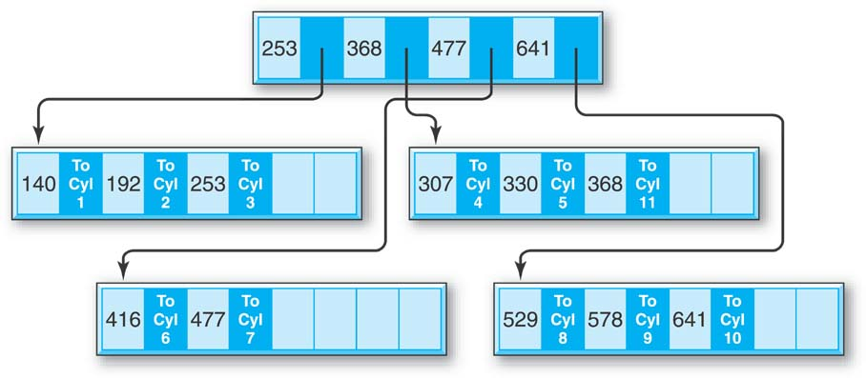
B+-tree Index (cont.)
The index record, into which the key for the new cylinder should go, which happens to be full, is split into two index records.
The now five key values and their associated pointers are divided between them.

Slide 53
Indexes
Can be built over any field (unique or nonunique) of a file.
Can also be built on a combination of fields.
In addition to its direct access capability, an index can be used to retrieve the records of a file in logical sequence based on the indexed field.

Slide 54
Indexes (cont.)
Many separate indexes into a file can exist simultaneously. The indexes are quite independent of each other.
When a new record is inserted into a file, an existing record is deleted, or an indexed field is updated, all of the affected indexes must be updated.

Slide 55
Hashed Files
The number of records in a file is estimated, and enough space is reserved on a disk to hold them.
Additional space is reserved for additional overflow records.

Slide 56
Hashed Files (cont.)
To determine where to insert a particular record of the file, the record’s key value is converted by a hashing routine into one of the reserved record locations on the disk.
To find and retrieve the record, the same hashing routine is applied to the key value during the search.

Slide 57
Hashed Files (cont.)
Hashing for disk files is called External Hashing
The file blocks are divided into M equal-sized buckets, numbered bucket₀, bucket₁, ..., bucket_{M-1}.
  Typically, a bucket corresponds to one (or a fixed number of) disk block.
One of the file fields is designated to be the hash key of the file.
The record with hash key value K is stored in bucket i, where i=h(K), and h is the hashing function.
Search is very efficient on the hash key.
Collisions occur when a new record hashes to a bucket that is already full.
  An overflow file is kept for storing such records.
  Overflow records that hash to each bucket can be linked together.

Slide 58
Hashed Files (cont.)
There are numerous methods for collision resolution, including the following:
  Open addressing: Proceeding from the occupied position specified by the hash address, the program checks the subsequent positions in order until an unused (empty) position is found.
  Chaining: For this method, various overflow locations are kept, usually by extending the array with a number of overflow positions. In addition, a pointer field is added to each record location. A collision is resolved by placing the new record in an unused overflow location and setting the pointer of the occupied hash address location to the address of that overflow location.
  Multiple hashing: The program applies a second hash function if the first results in a collision. If another collision results, the program uses open addressing or applies a third hash function and then uses open addressing if necessary.

Slide 59
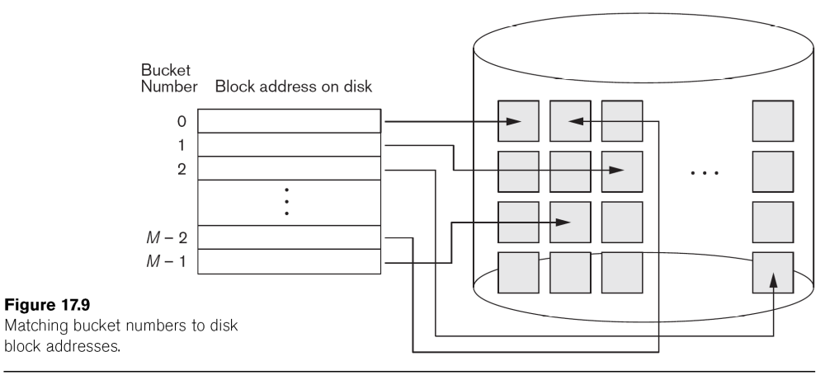
Hashed Files (cont.)

Slide 60
Hashed Files (cont.)
To reduce overflow records, a hash file is typically kept 70-80% full.
The hash function h should distribute the records uniformly among the buckets
  Otherwise, search time will be increased because many overflow records will exist.
Main disadvantages of static external hashing:
  Fixed number of buckets M is a problem if the number of records in the file grows or shrinks.
  Ordered access on the hash key is quite inefficient (requires sorting the records).

Slide 61
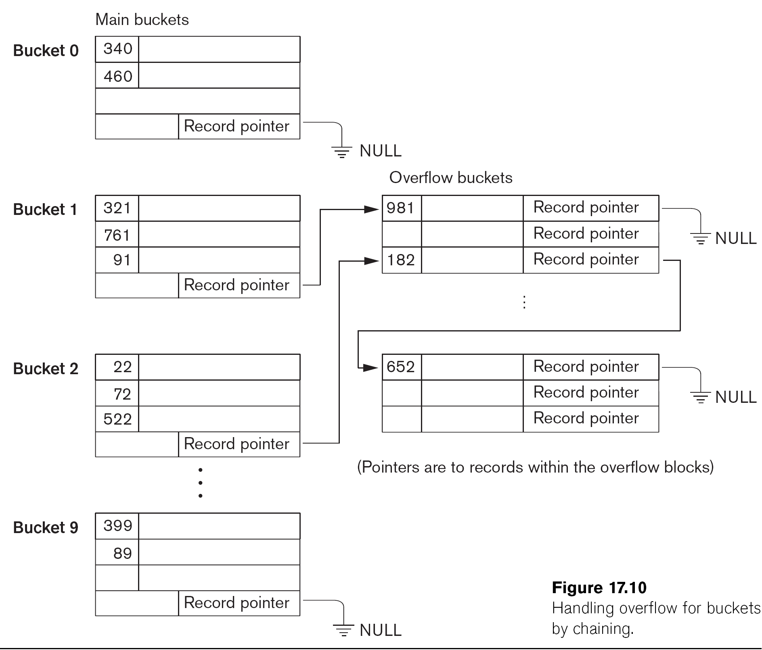
Hashed Files - Overflow Handling

Slide 62
Dynamic And Extendible Hashed Files
Dynamic and Extendible Hashing Techniques
  Hashing techniques are adapted to allow the dynamic growth and shrinking of the number of file records.
  These techniques include the following: dynamic hashing, extendible hashing, and linear hashing.
Both dynamic and extendible hashing use the binary representation of the hash value h(K) in order to access a directory.
  In dynamic hashing the directory is a binary tree.
  In extendible hashing the directory is an array of size 2^{d} where d is called the global depth.

Slide 63
Dynamic And Extendible Hashing (cont.)
The directories can be stored on disk, and they expand or shrink dynamically.
  Directory entries point to the disk blocks that contain the stored records.
An insertion in a disk block that is full causes the block to split into two blocks and the records are redistributed among the two blocks.
  The directory is updated appropriately.
Dynamic and extendible hashing do not require an overflow area.
Linear hashing does require an overflow area but does not use a directory.
  Blocks are split in linear order as the file expands.

Slide 64
Extendible Hashing

Slide 65
Division-Remainder Method
Divide the key value of the record that we want to insert or retrieve by the number of record locations that we have reserved.
Perform the division, discard the quotient, and use the remainder to tell us where to locate the record.

Slide 66
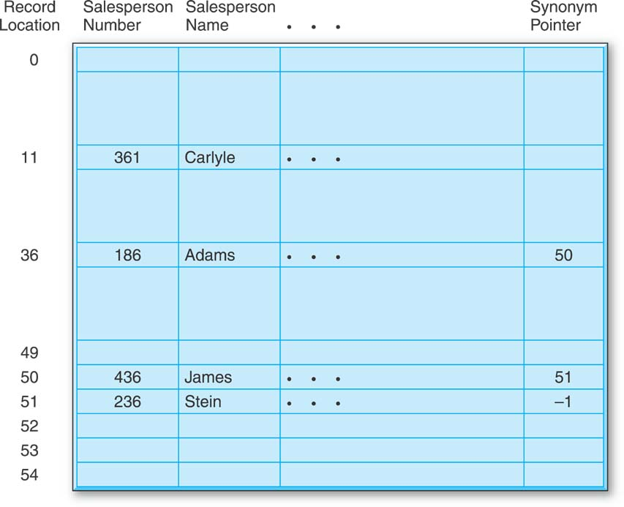
A Hashed File
Storage area for 50 records plus overflow records.
Collision - more than one key value hashes to the same location.
  The two key values are called “synonyms.”

Slide 67
Hashed Files
Hashing disallows any sequential storage based on a set of field values.
A file can only be hashed once, based on the values of a single field or a single combination of fields.
If a file is hashed on one field, direct access based on another field can be achieved by building an index on the other field.

Slide 68
Hashed Files (cont.)
Many hashing routines have been developed.
The goal is to minimize the number of collisions, which can slow down retrieval performance.
In practice, several hashing routines are tested on a file to determine the best “fit.”
Even a relatively simple procedure like the division-remainder method can be fine-tuned.

Slide 69
Hashed Files (cont.)
A hashed file must occasionally be reorganized after so many collisions have occurred that performance is degraded to an unacceptable level.
A new storage area with a new number of storage locations is chosen, and the process starts all over again.

Slide 70
Inputs to Physical Database Design
Physical database design starts where logical database design ends.
The well structured relational tables produced by the conversion from ERDs or by the data normalization process form the starting point for physical database design.

Slide 71
More Inputs to Physical Database Design
Inputs Into the Physical Database Design Process
The Tables Produced by the Logical Database Design Process
Business Environment Requirements
  Response Time Requirements
  Throughput Requirements
Data Characteristics
  Data Volume Assessment
  Data Volatility
Application Characteristics
  Application Data Requirements
  Application Priorities
Operational Requirements
  Data Security Concerns
  Backup and Recovery Concerns
Hardware and Software Characteristics
  DBMS Characteristics
  Hardware Characteristics

Slide 72
The Tables Produced by the Logical Database Design Process
Form the starting point of the physical database design process.
Reflect all of the data in the business environment.
Are likely to be unacceptable from a performance point of view and must be modified in physical database design.

Slide 73
Parallelizing Disk Access using RAID Technology.
Secondary storage technology must take steps to keep up in performance and reliability with processor technology.
A major advance in secondary storage technology is represented by the development of RAID, which originally stood for Redundant Arrays of Inexpensive Disks.
The main goal of RAID is to even out the widely different rates of performance improvement of disks against those in memory and microprocessors.

Slide 74
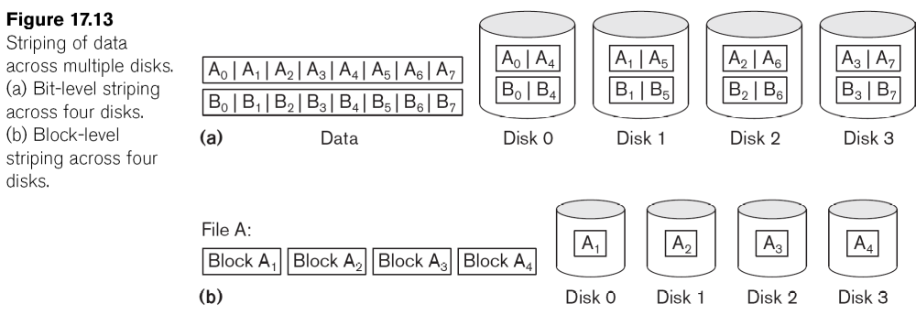
RAID Technology (cont.)
A natural solution is a large array of small independent disks acting as a single higher-performance logical disk.
A concept called data striping is used, which utilizes parallelism to improve disk performance.
Data striping distributes data transparently over multiple disks to make them appear as a single large, fast disk.

Slide 75
RAID Technology (cont.)
Different raid organizations were defined based on different combinations of the two factors of granularity of data interleaving (striping) and pattern used to compute redundant information.
  Raid level 0 has no redundant data and hence has the best write performance at the risk of data loss
  Raid level 1 uses mirrored disks.
  Raid level 2 uses memory-style redundancy by using Hamming codes, which contain parity bits for distinct overlapping subsets of components. Level 2 includes both error detection and correction.
  Raid level 3 uses a single parity disk relying on the disk controller to figure out which disk has failed.
  Raid Levels 4 and 5 use block-level data striping, with level 5 distributing data and parity information across all disks.
  Raid level 6 applies the so-called P + Q redundancy scheme using Reed-Soloman codes to protect against up to two disk failures by using just two redundant disks.

Slide 76
Use of RAID Technology (cont.)
Different raid organizations are being used under different situations
  Raid level 1 (mirrored disks) is the easiest for rebuild of a disk from other disks
    It is used for critical applications like logs
  Raid level 2 uses memory-style redundancy by using Hamming codes, which contain parity bits for distinct overlapping subsets of components.
    Level 2 includes both error detection and correction.
  Raid level 3 (single parity disks relying on the disk controller to figure out which disk has failed) and level 5 (block-level data striping) are preferred for Large volume storage, with level 3 giving higher transfer rates.
Most popular uses of the RAID technology currently are:
  Level 0 (with striping), Level 1 (with mirroring) and Level 5 with an extra drive for parity.
Design Decisions for RAID include:
  Level of RAID, number of disks, choice of parity schemes, and grouping of disks for block-level striping.

Slide 77
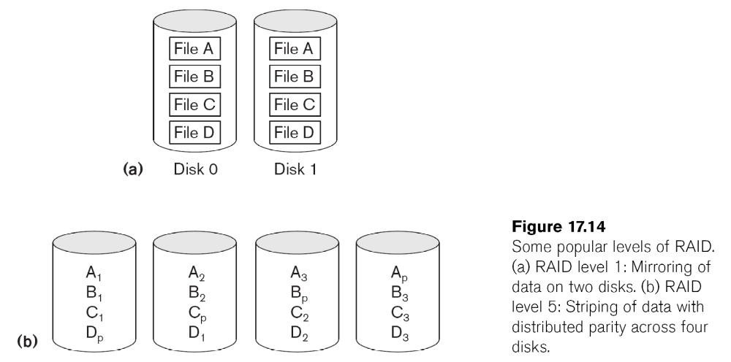
Use of RAID Technology (cont.)

Slide 78
Storage Area Networks
The demand for higher storage has risen considerably in recent times.
Organizations have a need to move from a static fixed data center oriented operation to a more flexible and dynamic infrastructure for information processing.
Thus they are moving to a concept of Storage Area Networks (SANs).
  In a SAN, online storage peripherals are configured as nodes on a high-speed network and can be attached and detached from servers in a very flexible manner.
This allows storage systems to be placed at longer distances from the servers and provide different performance and connectivity options.

Slide 79
Storage Area Networks (cont.)
Advantages of SANs are:
  Flexible many-to-many connectivity among servers and storage devices using fiber channel hubs and switches.
  Up to 10km separation between a server and a storage system using appropriate fiber optic cables.
  Better isolation capabilities allowing non-disruptive addition of new peripherals and servers.
SANs face the problem of combining storage options from multiple vendors and dealing with evolving standards of storage management software and hardware.

Slide 80
Business Environment Requirements
Response Time Requirements
Throughput Requirements

Slide 81
Business Environment Requirements: Response Time Requirements
Response time is the delay from the time that the Enter Key is pressed to execute a query until the result appears on the screen.
What are the response time requirements?

Slide 82
Business Environment Requirements: Throughput Requirements
Throughput is the measure of how many queries from simultaneous users must be satisfied in a given period of time by the application set and the database that supports it.

Slide 83
Data Characteristics
Data Volume Assessment
  How much data will be in the database?
  Roughly how many records is each table expected to have?
Data Volatility
  Refers to how often stored data is updated.

Slide 84
Application Characteristics
What is the nature of the applications that will use the data?
Which applications are the most important to the company?
Which data will be accessed by each application?

Slide 85
Application Characteristics
Application Data Requirements
Application Priorities

Slide 86
Application Characteristics: Data Requirements
Which database tables does each application require for its processing?
Do the applications require that tables be joined?
How many applications and which specific applications will share particular database tables?
Are the applications that use a particular table run frequently or infrequently?

Slide 87
Application Characteristics: Priorities
When a modification to a table proposed during physical design that’s designed to help the performance of one application hinders the performance of another application, which of the two applications is the more critical to the company?

Slide 88
Operational Requirements: Data Security, Backup and Recovery
Data Security
  Protecting data from theft or malicious destruction and making sure that sensitive data is accessible only to those employees of the company who have a “need to know.”
Backup and Recovery
  Being able to recover a table or a database that has been corrupted or lost due to hardware or software failure to the recovery of an entire information system after a natural disaster.

Slide 89
Hardware and Software Characteristics
DBMS Characteristics
  For example, exact nature of indexes, attribute data type options, and SQL query features, which must be known and taken into account during physical database design.
Hardware Characteristics
  Processor speeds and disk data transfer rates.

Slide 90
Physical Database Design Techniques
Physical Design Categories and Techniques That DO NOT Change the Logical Design
Adding External Features
  Adding Indexes
  Adding Views
Reorganizing Stored Data
  Clustering Files
Splitting a Table into Multiple Tables
  Horizontal Partitioning
  Vertical Partitioning
  Splitting-Off Large Text Attributes

Slide 91
Physical Database Design Techniques (cont.)
Physical Design Categories and Techniques That DO Change the Logical Design
Changing Attributes in a Table
  Substituting Foreign Keys
Adding Attributes to a Table
  Creating New Primary Keys
  Storing Derived Data
Combining Tables
  Combine Tables in One-to-One relationships
  Alternative for Repeating Groups
  Denormalization
Adding New Tables
  Duplicating Tables
  Adding Subset Tables

Slide 92
Adding External Features
Doesn’t change the logical design at all.
There is no introduction of data redundancy.
Adding Indexes
Adding Views

Slide 93
Adding External Features: Adding Indexes
Which attributes or combinations of attributes should you consider indexing in order to have the greatest positive impact on the application environment?
  Attributes that are likely to be prominent in direct searches
    Primary keys
    Search attributes
  Attributes that are likely to be major players in operations, such as joins, SQL SELECT ORDER BY clauses and SQL SELECT GROUP BY clauses.

Slide 94
Adding External Features: Adding Indexes (cont.)
What potential problems can be caused by building too many indexes?
Indexes are wonderful for direct searches. But when the data in a table is updated, the system must take the time to update the table’s indexes, too.

Slide 95
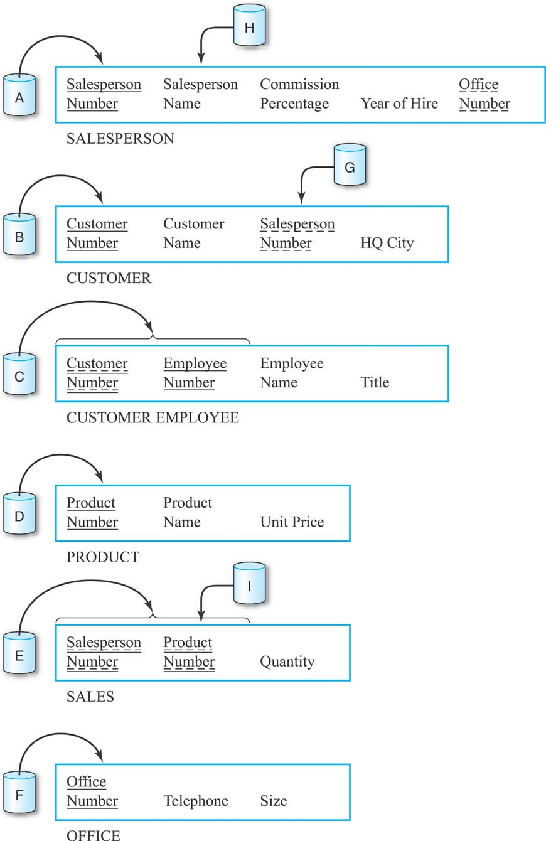
General Hardware Company With Some Indexes

Slide 96
Adding External Features: Adding Views
Doesn’t change the logical design.
No data is physically duplicated.
An important device in protecting the security and privacy of data.

Slide 97
Reorganizing Stored Data
Doesn’t change the logical design.
No data is physically duplicated.
Clustering Files
  Houses related records together on a disk.

Slide 98
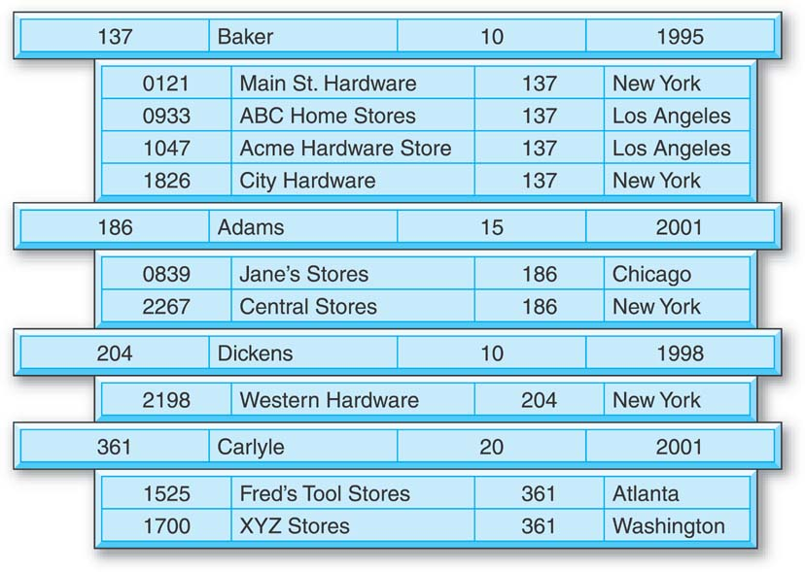
Reorganizing Stored Data: Clustering Files
The salesperson record for salesperson 137, Baker, is followed on the disk by the customer records for customers 0121, 0933, 1047, and 1826.

Slide 99
Splitting a Table Into Multiple Tables
Horizontal Partitioning
Vertical Partitioning
Splitting-Off Large Text Attributes

Slide 100
Splitting a Table Into
Multiple Tables: Horizontal Partitioning
The rows of a table are divided into groups, and the groups are stored separately on different areas of a disk or on different disks.
Useful in managing the different groups of records separately for security or backup and recovery purposes.
Improve data retrieval performance.
Disadvantage: retrieval of records from more than one partition can be more complex and slower.

Slide 101
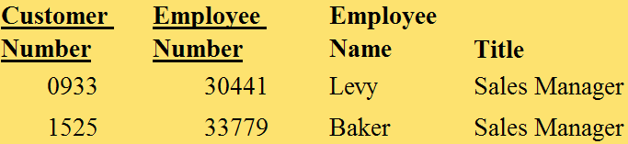
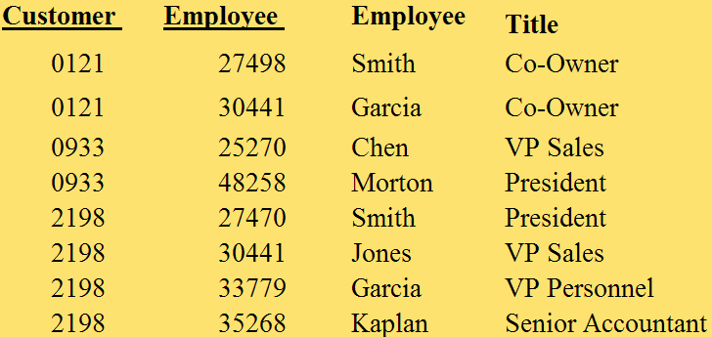
Splitting a Table Into
Multiple Tables: Horizontal Partitioning (cont.)

Slide 102
Splitting a Table Into
Multiple Tables: Vertical Partitioning
The separate groups, each made up of different columns of a table, are created because different users or applications require different columns.
Each partition must have a copy of the primary key.

Slide 103
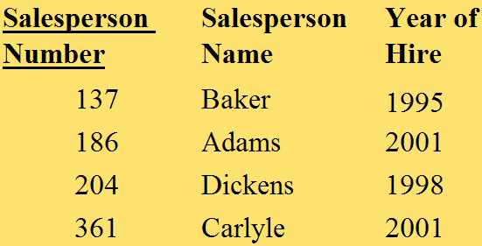
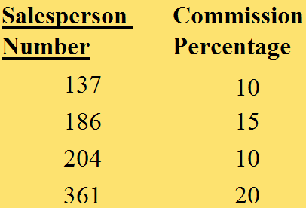
Splitting a Table Into
Multiple Tables: Vertical Partitioning (cont.)
The Salesperson table

Slide 104
Splitting a Table Into
Multiple Tables: Splitting Off Large Text Attributes
A variation on vertical partitioning involves splitting off large text attributes into separate partitions.
Each partition must have a copy of the primary key.

Slide 105

Changing Attributes in a Table
Changes the logical design.
Substituting a Foreign Key
  Substitute an alternate key (Salesperson Name, assuming it is a unique attribute) as a foreign key.
  Saves on the number of performance-slowing joins.

Slide 106
Adding Attributes to a Table
Creating New Primary Keys
Storing Derived Data

Slide 107
Adding Attributes to a Table: Creating New Primary Keys
Changes the logical design.
In a table with no single attribute primary key, indexing a multi-attribute key would likely be clumsy and slow.
Create a new serial number attribute primary key for the table.

Slide 108

Adding Attributes to a Table: Creating New Primary Keys (cont.)
The current two-attribute primary key of the CUSTOMER EMPLOYEE table can be replaced by one, new attribute.

Slide 109


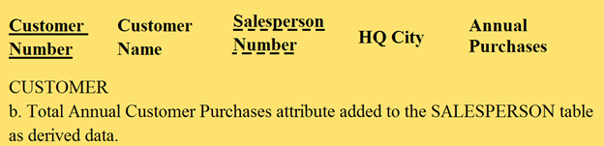
Adding Attributes to a Table: Storing Derived Data
Calculate answers to certain queries once and store them in the database.

Slide 110
Combining Tables
If two tables are combined into one, then there must surely be situations in which the presence of the new single table allows us to avoid joins that would have been necessary when there were two tables.
  Combination of Tables in One-to-One Relationships
  Alternatives for Repeating Groups
  Denormalization

Slide 111

Combining Tables: Combination of Tables in One-to-One Relationships
Advantage: if we ever have to retrieve detailed data about a salesperson and his office in one query, it can now be done without a join.

Slide 112
Combining Tables: Combination of Tables in One-to-One Relationships (cont.)
Disadvantages:
  the tables are no longer logically as well as physically independent.
  retrievals of salesperson data alone or of office data alone could be slower than before.
  storage of data about unoccupied offices is problematic and may require a reevaluation of which field should be the primary key.

Slide 113

Combining Tables: Alternatives for Repeating Groups
If repeating groups are well controlled, they can be folded into one table.

Slide 114
Combining Tables: Denormalization
It may be necessary to take pairs of related, third normal form tables and to combine them, introducing possibly massive data redundancy.
Unsatisfactory response times and throughput may mandate eliminating run-time joins.

Slide 115
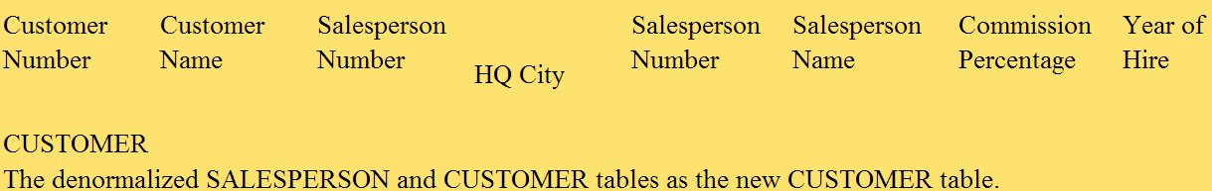
Combining Tables: Denormalization (cont.)
Since a salesperson can have several customers, a particular salesperson’s data will be repeated for each customer he has.

Slide 116
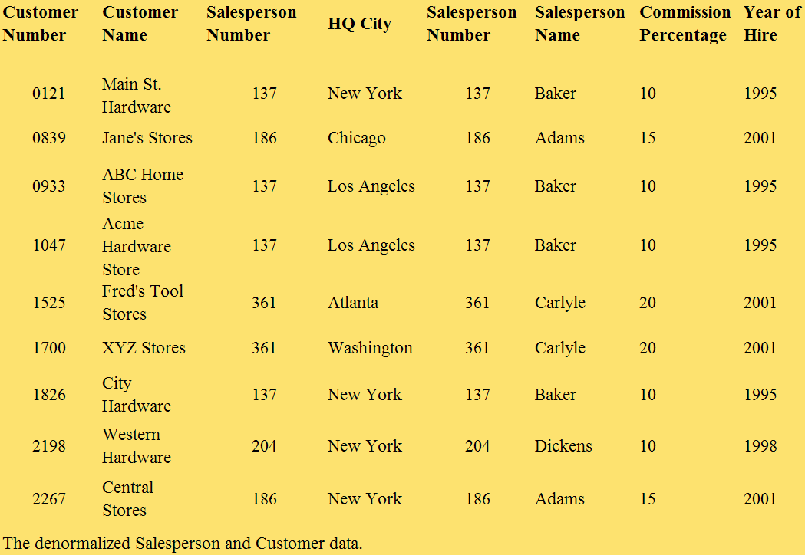
Combining Tables: Denormalization (cont.)

Slide 117
Adding New Tables
Duplicating Tables
  Duplicate tables and have different applications access the duplicates.
Adding Subset Tables
  Duplicate only those portions of a table that are most heavily accessed.
  Assign subsets to different applications to ease the performance crunch.

Slide 118
Good Reading Bookstores: Problem
Assume that Good Reading’s headquarters frequently needs to quickly find the details of a book, based on either its book number or its title, together with details about its publisher.
If a join takes too long, resulting in unacceptable response times, throughput, or both, what are the possibilities in terms of physical design that can improve the situation?

Slide 119
Good Reading Bookstores: Solutions
The Book Number attribute and the Book Title attributes in the PUBLISHER table can each have an index built on them to provide direct access, since the problem says that books are going to be searched for based on one of these two attributes.
The two join attributes—the Publisher Name attribute of the PUBLISHER table and the Publisher Name attribute of the BOOK table—can each have an index built on them to help speed up the join operation.

Slide 120
Good Reading Bookstores: Solutions (cont.)
If the DBMS permits it, the two tables can be clustered, with the book records associated with a particular publisher stored near that publisher’s record on the disk.
The two tables can be denormalized, with the appropriate publisher data being appended to each book record (and the PUBLISHER table being eliminated).

Slide 121
Additional Material (Going Deeper)
Indexing

Slide 123
Indexes as Access Paths
A single-level index is an auxiliary file that makes it more efficient to search for a record in the data file.
The index is usually specified on one field of the file (although it could be specified on several fields)
One form of an index is a file of entries <field value, pointer to record>, which is ordered by field value
The index is called an access path on the field.

Slide 124
Indexes as Access Paths (cont.)
The index file usually occupies considerably less disk blocks than the data file because its entries are much smaller
A binary search on the index yields a pointer to the file record
Indexes can also be characterized as dense or sparse
  A dense index has an index entry for every search key value (and hence every record) in the data file.
  A sparse (or nondense) index, on the other hand, has index entries for only some of the search values

Slide 125
Indexes as Access Paths (cont.)
Example: Given the following data file EMPLOYEE(NAME, SSN, ADDRESS, JOB, SAL, ... )
Suppose that:
  record size R=150 bytes block size B=512 bytes r=30000 records
Then, we get:
  blocking factor Bfr= B div R= 512 div 150= 3 records/block
  number of file blocks b= (r/Bfr)= (30000/3)= 10000 blocks
For an index on the SSN field, assume the field size V_{SSN}=9 bytes, assume the record pointer size P_{R}=7 bytes. Then:
  index entry size R_{I}=(V_{SSN}+ P_{R})=(9+7)=16 bytes
  index blocking factor Bfr_{I}= B div R_{I}= 512 div 16= 32 entries/block
  number of index blocks b= (r/ Bfr_{I})= (30000/32)= 938 blocks
  binary search needs log₂bI= log₂938= 10 block accesses
  This is compared to an average linear search cost of:
    (b/2)= 30000/2= 15000 block accesses
  If the file records are ordered, the binary search cost would be:
    log₂b= log₂30000= 15 block accesses

Slide 126
Types of Single-Level Indexes
Primary Index
  Defined on an ordered data file
  The data file is ordered on a key field
  Includes one index entry for each block in the data file; the index entry has the key field value for the first record in the block, which is called the block anchor
  A similar scheme can use the last record in a block.
  A primary index is a nondense (sparse) index, since it includes an entry for each disk block of the data file and the keys of its anchor record rather than for every search value.

Slide 127
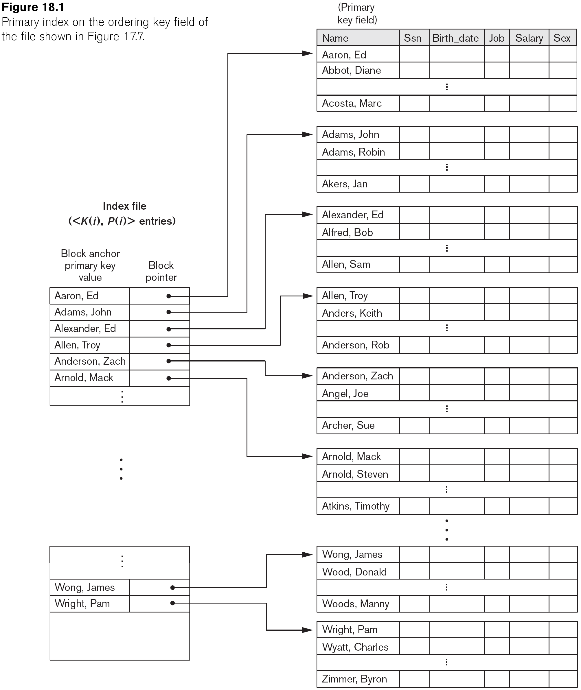
Primary Index on the Ordering Key Field

Slide 128
Types of Single-Level Indexes
Clustering Index
  Defined on an ordered data file
  The data file is ordered on a non-key field unlike primary index, which requires that the ordering field of the data file have a distinct value for each record.
  Includes one index entry for each distinct value of the field; the index entry points to the first data block that contains records with that field value.
  It is another example of nondense index where Insertion and Deletion is relatively straightforward with a clustering index.

Slide 129
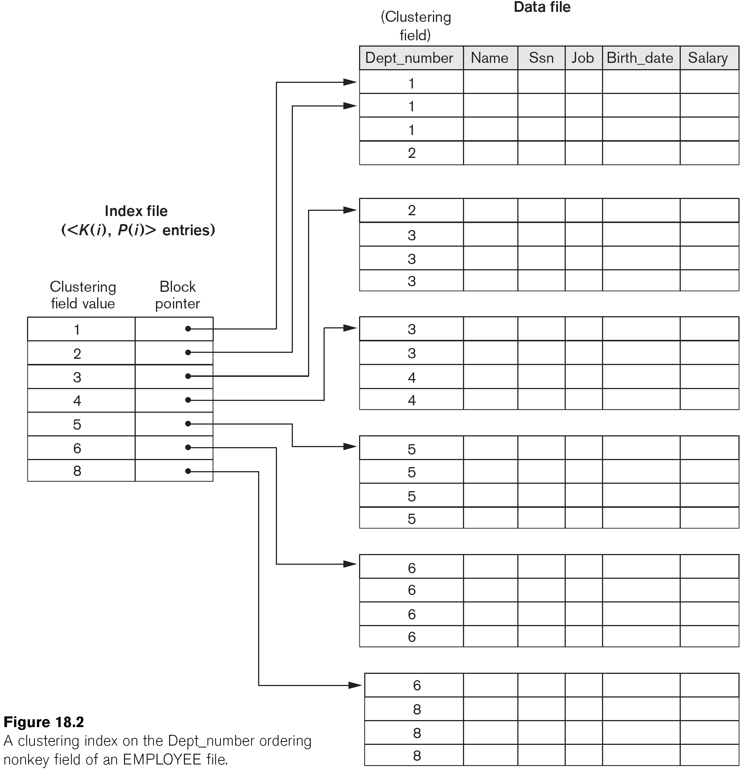
A Clustering Index Example

Slide 130
Another Clustering Index Example

Slide 131
Types of Single-Level Indexes
Secondary Index
  A secondary index provides a secondary means of accessing a file for which some primary access already exists.
  The secondary index may be on a field which is a candidate key and has a unique value in every record, or a non-key with duplicate values.
  The index is an ordered file with two fields.
    The first field is of the same data type as some non-ordering field of the data file that is an indexing field.
    The second field is either a block pointer or a record pointer.
    There can be many secondary indexes (and hence, indexing fields) for the same file.
  Includes one entry for each record in the data file; hence, it is a dense index

Slide 132
Example of a Dense Secondary Index

Slide 133
Example of a Secondary Index

Slide 134
Properties of Index Types

Slide 135
Multi-Level Indexes
Because a single-level index is an ordered file, we can create a primary index to the index itself;
  In this case, the original index file is called the first-level index and the index to the index is called the second-level index.
We can repeat the process, creating a third, fourth, ..., top level until all entries of the top level fit in one disk block
A multi-level index can be created for any type of first-level index (primary, secondary, clustering) as long as the first-level index consists of more than one disk block

Slide 136
A Two-Level Primary Index

Slide 137
Multi-Level Indexes
Such a multi-level index is a form of search tree
  However, insertion and deletion of new index entries is a severe problem because every level of the index is an ordered file.

Slide 138
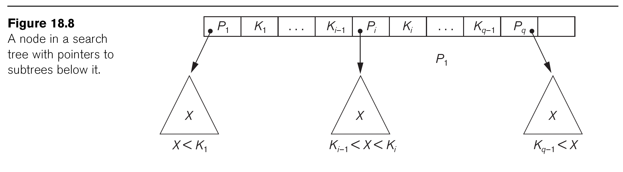
A Node in a Search Tree with Pointers to Subtrees Below It

Slide 139
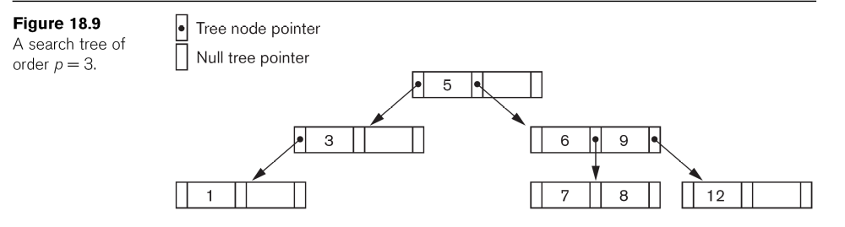

Slide 140
Dynamic Multilevel Indexes Using B-Trees and B+-Trees
Most multi-level indexes use B-tree or B+-tree data structures because of the insertion and deletion problem
  This leaves space in each tree node (disk block) to allow for new index entries
These data structures are variations of search trees that allow efficient insertion and deletion of new search values.
In B-Tree and B+-Tree data structures, each node corresponds to a disk block
Each node is kept between half-full and completely full

Slide 141
Dynamic Multilevel Indexes Using B-Trees and B+-Trees (cont.)
An insertion into a node that is not full is quite efficient
  If a node is full the insertion causes a split into two nodes
Splitting may propagate to other tree levels
A deletion is quite efficient if a node does not become less than half full
If a deletion causes a node to become less than half full, it must be merged with neighboring nodes

Slide 142
Difference between B-tree and B+-tree
In a B-tree, pointers to data records exist at all levels of the tree
In a B+-tree, all pointers to data records exists at the leaf-level nodes
A B+-tree can have less levels (or higher capacity of search values) than the corresponding B-tree

Slide 143
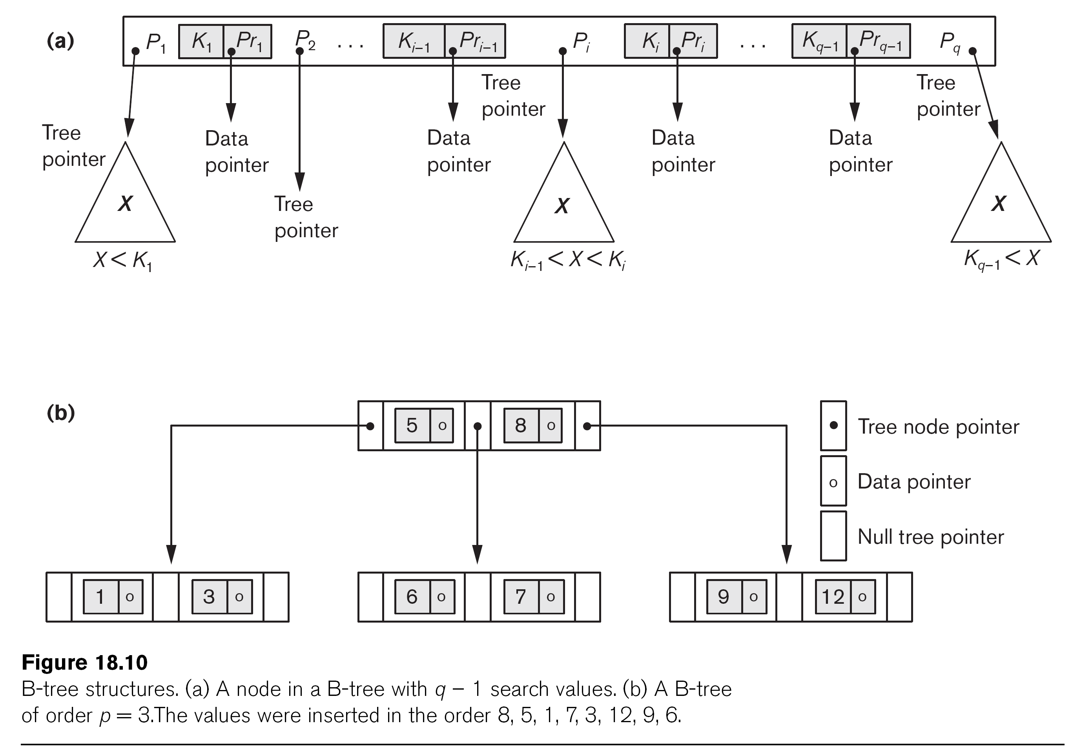
B-tree Structures

Slide 144
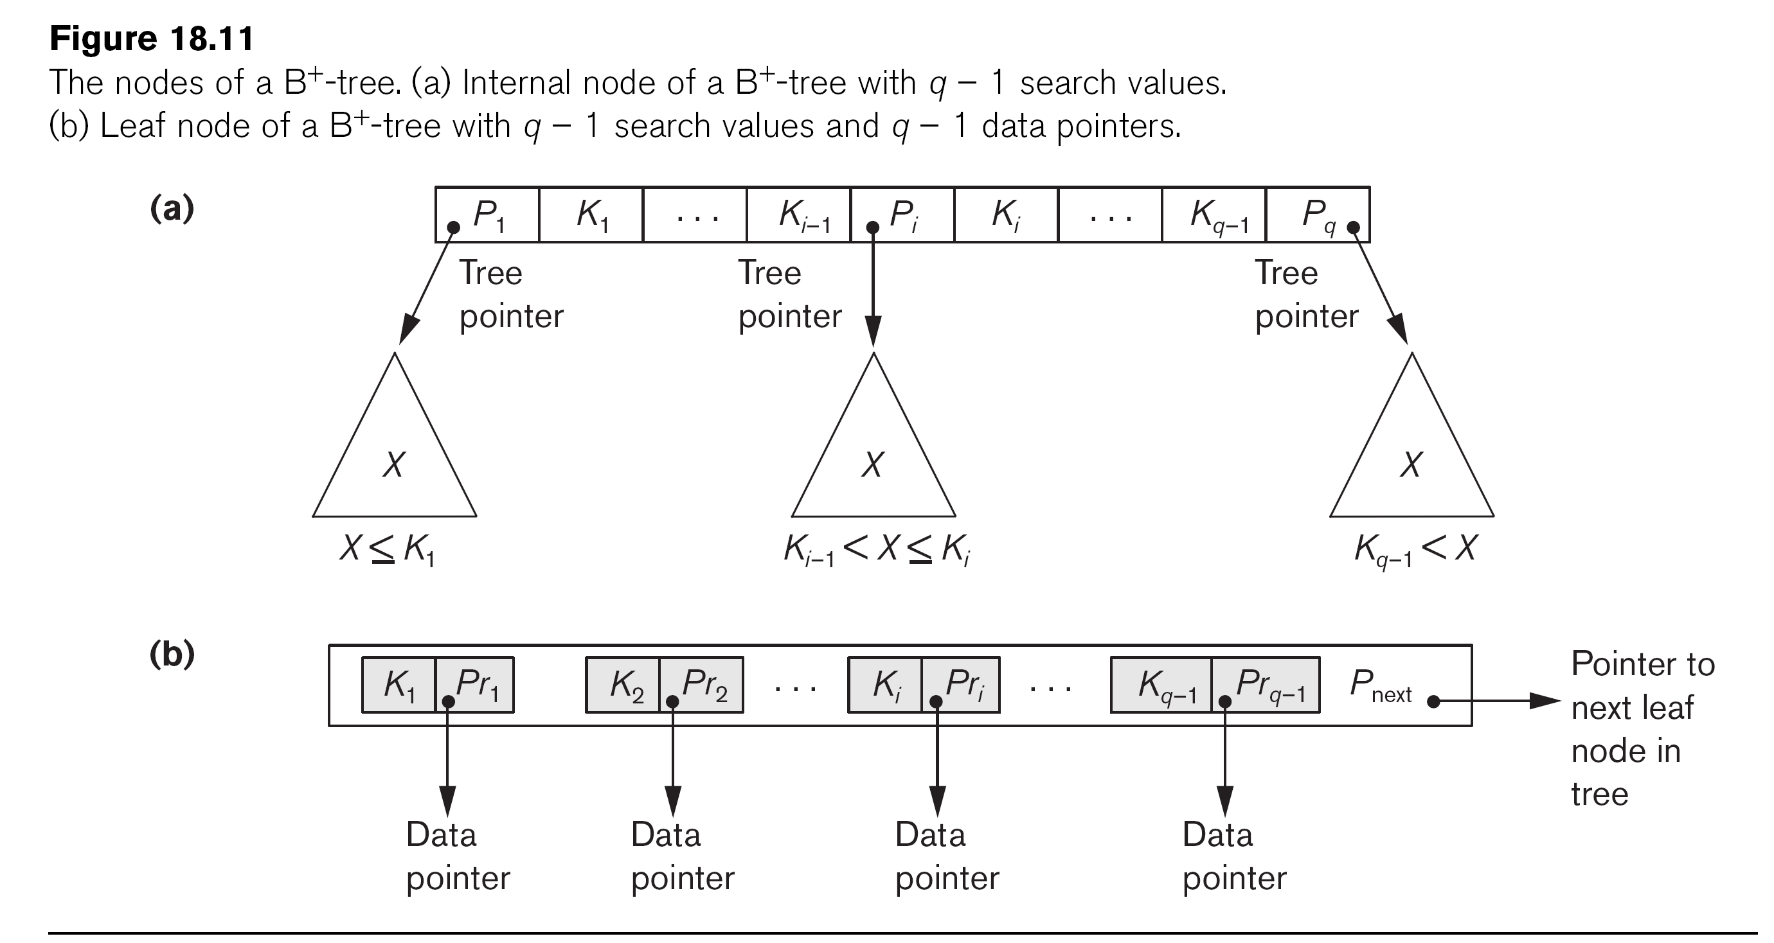
The Nodes of a B+-tree

Slide 145
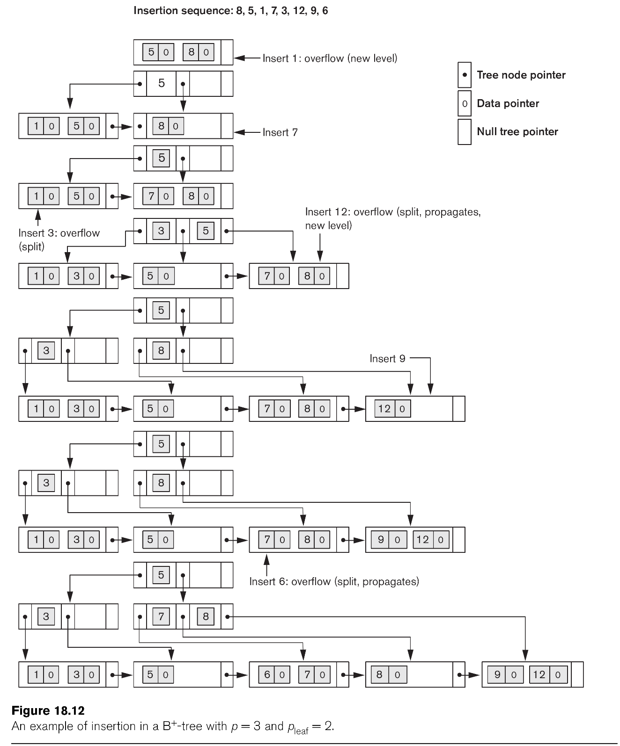
Example of an Insertion in a B+-tree

Slide 146
Example of a Deletion in a B+-tree

Slide 147
Summary
Types of Single-level Ordered Indexes
  Primary Indexes
  Clustering Indexes
  Secondary Indexes
Multilevel Indexes
Dynamic Multilevel Indexes Using B-Trees and B+-Trees
Indexes on Multiple Keys

Slide 148
Next Lecture
Query Optimization and DB Control Issues (Security, Backup, Recovery, Concurrency)

Slide 149
References
Ramez Elmasri, Shamkant Navathe; “Fundamentals of Database Systems”, 6th Ed., Pearson, 2014
Mark L. Gillenson; “Fundamentals of Database Management Systems”, 2nd Ed., John Wiley, 2012
Universität Hamburg, Fachbereich Informatik, Einführung in Datenbanksysteme, Lecture Notes, 1999

