Slide 1


CSE 414 Systems Analysis and Design
Lecture #8
Designing Databases
Prepared & Presented by Asst. Prof. Dr. Samsun M. BAŞARICI

Slide 2
Learning Objectives
Describe the database design process, its outcomes, and the relational database model.
Describe normalization and the rules for second and third normal form.
Transform an entity-relationship (E-R) diagram into an equivalent set of well-structured (normalized) relations.
Merge normalized relations from separate user views into a consolidated set of well-structured relations.

Slide 3
Learning Objectives (Cont.)
Describe physical database design concepts:
  Choose storage formats for fields in database tables.
  Translate well-structured relations into efficient database tables.
  Explain when to use different types of file organizations to store computer files.
  Describe the purpose of indexes and the important considerations in selecting attributes to be indexed.

Slide 4
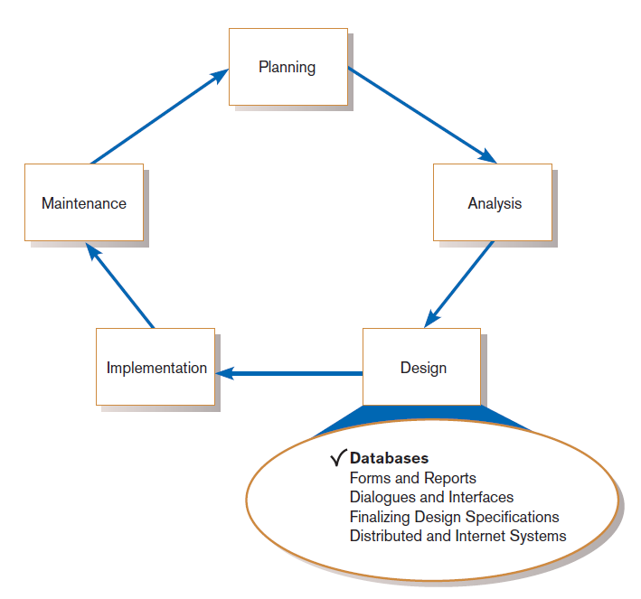
Introduction
FIGURE 9-1
Systems development life cycle with design phase highlighted
Notes:
At this point of the SDLC, we’ve concluded the analysis phase and we’re beginning design. Here we start with database design, and in the next few chapters we discuss user interface (forms, reports, dialogues, interfaces), finalizing design specs, and designing in an Internet environment.

Slide 5
Database Design
File and database design occurs in two steps.
  Develop a logical database model, which describes data using notation that corresponds to a data organization used by a database management system.
    Relational database model
  Prescribe the technical specifications for computer files and databases in which to store the data.
    Physical database design provides specifications
Logical and physical database design in parallel with other system design steps
Notes:
You typically do logical and physical database design in parallel with other systems design steps. Collect the logical database design specifications while designing system inputs and outputs.
The logical relational database design is derived from the E-R model you created during the analysis phase. There is a systematic method for transforming E-R diagrams into relational database structures. We’ll see an example shortly.

Slide 6
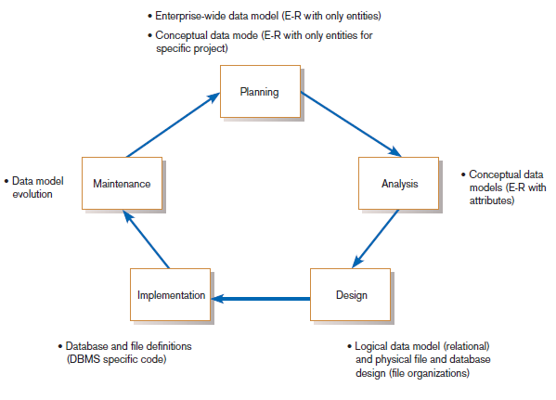
The Process of Database Design
FIGURE 9-2
Relationship between data modeling and the systems development life cycle
Notes:
As you can see from this figure, the SDLC cycle includes database-related activities in all phases. E-R modeling dominates the planning and analysis phase, and as we discussed earlier, this happens in conjunction with DFDs for the process elements of the analysis process.
These E-R models serve as inputs to the logical database design, in which we explore the relational database architecture. Although E-R models don’t necessarily need to be translated into a relational structure, this is the most common form of current database designs. There are other possible database architectures, but for transaction-processing intensive applications relational databases is the norm.
By the way, don’t confuse the word “relationship” (in the E-R model) with “relational” or “relation” (in the relational database model). These are different terms, as we will see. A “relationship” is a link between entities. A “relation” (in the relational model) is actually closer to an entity than it is to a “relationship”. In database parlance, a “relation” is a table. A “relationship” is implemented via primary and foreign keys in tables. “Primary keys” are “unique identifiers”.
We’ll see more of this shortly.

Slide 7
The Process of Database Design (Cont.)
Four key steps in logical database modeling and design:
  Develop a logical data model for each known user interface for the application using normalization principles.
  Combine normalized data requirements from all user interfaces into one consolidated logical database model (view integration).
  Translate the conceptual E-R data model for the application into normalized data requirements.
  Compare the consolidated logical database design with the translated E-R model and produce one final logical database model for the application.
Notes:
The word “normalize“ will need some explanation. We’ll get to that shortly, but in brief this means ensuring that the database is “well-structured”, guaranteeing minimal data redundancy and ensuring maximum data integrity.

Slide 8
Physical Database Design
Key physical database design decisions include:
  Choosing a storage format for each attribute from the logical database model.
  Grouping attributes from the logical database model into physical records.
  Arranging related records in secondary memory (hard disks and magnetic tapes) so that records can be stored, retrieved and updated rapidly.
  Selecting media and structures for storing data to make access more efficient.
Notes:
Logical database design is still somewhat “conceptual”, like E-R modeling. The main emphasis with logical design is to ensure a well-structured database
With physical database design, you actually begin to consider how this is actually going to be implemented on the computer. Whereas logical design is meant for ensuring data integrity, physical design is meant for ensuring the best system performance in terms of minimizing storage space and maximizing computational speed.

Slide 9
Deliverables and Outcomes
Logical database design
  Must account for every data element on a system input or output
    Normalized relations are the primary deliverable.
Physical database design
  Converts relations into database tables
    Programmers and database analysts code the definitions of the database.
    Written in Structured Query Language (SQL)
Notes:
Recall that the outputs of analysis (from a database perspective) was the set of E-R diagrams. These are inputs to the design phase.
The outputs from the database design phase, which is broken into two parts (logical and physical) are shown here.

Slide 10
Relational Database Model
Relational database model: data represented as a set of related tables or relations
Relation: a named, two-dimensional table of data; each relation consists of a set of named columns and an arbitrary number of unnamed rows
Notes:
Again, note the difference between “relation” and “relationship.” Two completely different concepts.

Slide 11
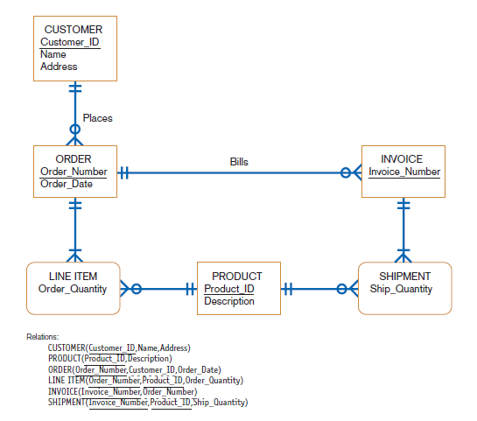
FIGURE 9-3 (d)
Conceptual data model and transformed relations
Notes:
This is an example of a transition from E-R model to relational database structure. See how each entity becomes a relation?
In this notation of the relational structure, each relation (table) is composed of fields (also called columns), which are shown within the parentheses. So, the fields are the same as attributes.
Do you see fields in the relations that are not shown in the E-R models? These are the foreign keys. For example, note Customer_ID in the ORDER relation. This is a foreign key, which is associated with the primary key (identifier) of the CUSTOMER relation. That’s how relationships between entities (in the E-R model) are implemented in the relational model. We see a similar foreign key in the INVOICE relation, which matches the primary key of the ORDER relation.
The LINE ITEM relation implements the LINE ITEM associative entity. Note that it has two foreign keys which implement its relationship to both ORDER and PRODUCT. Together these form a composite primary key.
So in general, if there is a one-to-many relationship between two entities, this means that the relation (table) on the many side of the relationship will have a foreign key matching the primary key of the relation on the one side of the relationship.
Again, don’t confuse “relation” or “relational” with “relationship”. A relation is a table that implement an entity. A relationship is implemented by primary-to-foreign key matchups.

Slide 12
Relational Database Model (Cont.)
Relations have several properties that distinguish them from nonrelational tables:
  Entries in cells are simple.
  Entries in columns are from the same set of values.
  Each row is unique.
  The sequence of columns can be interchanged without changing the meaning or use of the relation.
  The rows may be interchanged or stored in any sequence.
Notes:
Any data structure with rows and columns can be considered a “table”. For example, an Excel spreadsheet is a table.
All relations are tables. But not all tables are relations. For example, in an Excel spreadsheet it is possible for two rows to have completely identical values. That can’t happen in a relation. Each row has to be unique (this is guaranteed via the primary key). Also, in an Excel spreadsheet nothing stops you from putting a text value in column A of the first row and a numeric value in column A of the second row. You can’t do that in a relation.
All relations are in “1st normal form”. We’ll talk about the normal forms shortly.

Slide 13
Well-Structured Relation and Primary Keys
Well-Structured Relation (or table)
  A relation that contains a minimum amount of redundancy
  Allows users to insert, modify, and delete the rows without errors or inconsistencies
Primary Key
  An attribute whose value is unique across all occurrences of a relation
All relations have a primary key.
  This is how rows are ensured to be unique.
  A primary key may involve a single attribute or be composed of multiple attributes.
Notes:
As I said earlier, the main goal of logical database design is to ensure maximal data integrity and minimal data redundancy. If your tables are “well-structured”, this will be the result. That’s what normalization is all about.
Often, database designers will attempt to take data that has been stored in lots of spreadsheets and transform these into a database. The spreadsheets are typically not well structured. They have lots of data redundancy, which makes them very difficult to maintain. This is why normalization is so important in database design.

Slide 14
Normalization and Rules of Normalization
Normalization: the process of converting complex data structures into simple, stable data structures
The result of normalization is that every nonprimary key attribute depends upon the whole primary key.
Notes:
We’ll talk about “functional dependencies” very shortly.

Slide 15
Normalization and Rules of Normalization (Cont.)
First Normal Form (1NF)
  Unique rows, no multivalued attributes
  All relations are in 1NF
Second Normal Form (2NF)
  Each nonprimary key attribute is identified by the whole primary key (called full functional dependency)
Third Normal Form (3NF)
  Nonprimary key attributes do not depend on each other (i.e. no transitive dependencies)
Notes:
There are actually other normal forms beyond third. These include 4th, 5th, and something called “Boyce-Codd”. These other normal forms are theoretically interesting, but from a practical point of view the most important thing is to ensure that your database is in third normal form.
As you can see, all relations are in 1st normal form. That’s because they have primary keys. By “no multivalued attributes” we mean that a table can’t have a field that has multiple values. But, as we saw in chapter 8, it’s possible to define an entity with a multivalued attribute (such as an employee having many skills). Therefore, the original entity may need to be reconstructed into more than one relation.
If you reach 2nd normal form that means you have no “partial dependencies”. This only becomes an issue if the primary key is composite (composed of more than one field).
If you reach third normal form, which is the goal, this means you have no partial dependencies and no transitive dependencies. But what is a dependency?

Slide 16
Functional Dependencies and Primary Keys
Functional Dependency: a particular relationship between two attributes
  For a given relation, attribute B is functionally dependent on attribute A if, for every valid value of A, that value of A uniquely determines the value of B.
  The functional dependence of B on A is represented by A→B.
Notes:
For example consider an employee relation where each record represents a particular employee. Say that attribute A is the employee ID, which is a primary key, and that attribute B is the last name of the employee. Well, if you know A, then you know B, since there’s only one possible value for A (unique key). But just because you know B doesn’t necessarily mean you know A. There may be many employees named Smith.
But you don’t have to have a primary key in order to have a functional dependency. Consider a person’s address. If you know the zip code, you also know the city and state. So, city and state are functionally dependent on zip code.

Slide 17
Functional Dependencies and Primary Keys (Cont.)
Functional dependency is not a mathematical dependency.
Instances (or sample data) in a relation do not prove the existence of a functional dependency.
Knowledge of problem domain is most reliable method for identifying functional dependency.
Notes:
It can be tricky to identify functional dependencies in data. That’s one of the skills required of a good database designer.

Slide 18
Second Normal Form (2NF)
A relation is in second normal form (2NF) if any of the following conditions apply:
  The primary key consists of only one attribute.
  No nonprimary key attributes exist in the relation.
  Every nonprimary key attribute is functionally dependent on the full set of primary key attributes.
To convert a relation into 2NF, decompose the relation into new relations using the attributes, called determinants, that determine other attributes.
The determinants are the primary keys of the new relations.
Notes:
We’ll see an example of determinants and dependencies shortly.

Slide 19
Third Normal Form (3NF)
A relation is in third normal form (3NF) if it is in second normal form (2NF) and there are no functional (transitive) dependencies between two (or more) nonprimary key attributes.
Notes:
Ok we’ve defined 1st, 2nd, and 3rd normal form. And we introduced the concepts of determinants and dependencies. This is complicated. Let’s look at a couple figures to illustrate these ideas.

Slide 20

Emp_ID → Name,Dept,Salary (partial dependency)
Emp_ID,Course → Date_Completed (complete depencency)
Notes:
In figure 9-6 we see a relation (therefore 1st normal form), but this relation includes partial dependencies. Why is that?
First, we can tell that it’s a relation. Each row is unique, and none of the attributes have multiple values.
Question: Can you discern what the primary key would be here? In other words, what is the smallest set of attribute or attributes that can uniquely identify an EMPLYOEE2 row?
Answer: It’s a combination of the employee ID and the course. It’s not the employee ID by itself because we see duplicates of these. It’s also not the course by itself. But you can see there are no two rows with the same combination of employee ID and course.
But the problem is, there is a lot of duplicate data in this. For example, we see all the data about employee 100 (name, department, salary) being duplicated. What if the salary changes or the employee is transferred to another department. This would have to be changed in more than one record. We want to avoid that.
The problem is caused by partial dependencies. The name, department, and salary are dependent on only part of the primary key (the employee ID). Only the date completed is dependent on the full primary key.
The solution in this case is to separate into two tables. One would be an employee table and the other would be the Employee-Course table, as figure 9-7 shows.
The relations would look like this:
EMPLOYEE(Emp_ID, Name, Dept, Salary)
EMPCOURSE(Emp_ID, Course, Date_Completed)
The second table has a composite primary key of Emp_ID and Course. EMPCOURSE’s Emp_ID is also a foreign key to EMPLOYEE’s primary key, which implements the one-to-many relationship between the two tables.
From a simpler perspective, we can see that the original relation in figure 9-6 was not about a single entity. It was about two entities, the employee and the course taken. A good rule of thumb is to ensure that each relation is about exactly one entity only.
In this slide we see the notation of determinants and dependencies. Determinants are the attributes on the left side of the arrow. The attributes on the right side of the arrow are functionally dependent on the determinants.

Slide 21
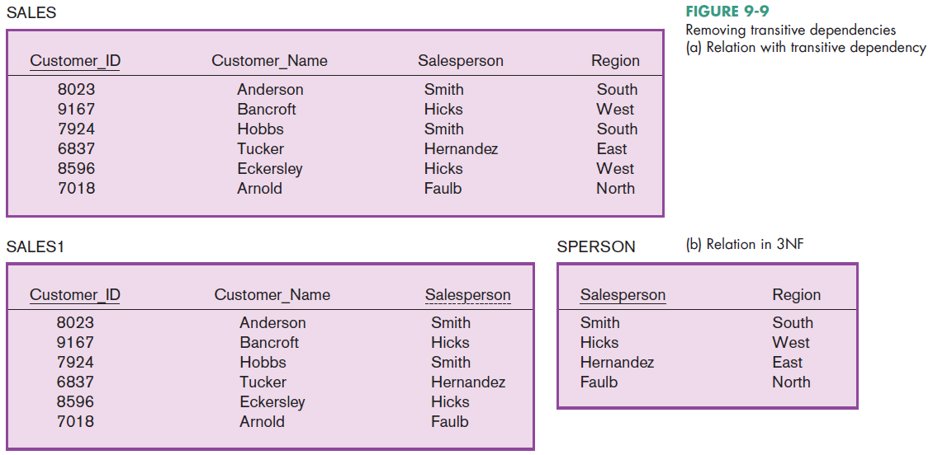
Customer_ID → Customer_Name,Salesperson,Region
Salesperson → Region
Notes:
Here we have a situation that doesn’t have partial dependencies, but does have a transitive dependency. The primary key is a single field, so partial dependencies are not a problem; hence figure 9-9(a) is in 2nd normal form. But Customer ID determines Salesperson which in turn determines Regions. This is a transitive dependency.
The solution, as you see in part (b) is to split into two tables. In this case the Salesperson field of the SALES1 table now becomes a foreign key to the SPERSON table. This way, we remove the transitive dependency and create a well structured table, one that has minimized data redundancy and that has split the two entities (customer and sales person).

Slide 22
Third Normal Form (3NF) (Cont.)
Foreign Key: an attribute that appears as a nonprimary key attribute (or part of a primary key) in one relation and as a primary key attribute in another relation
Referential Integrity: an integrity constraint specifying that the value (or existence) of an attribute in one relation depends on the value (or existence) of the same attribute in another relation
Notes:
The term referential integrity ensures that there can be no foreign key value in a dependent table (on the many side of a relationship) that does not have a corresponding identical value in the primary key in the dominant table (on the one side of the relationship). Foreign keys must ALWAYS match primary keys.

Slide 23
Transforming E-R Diagrams into Relations
It is useful to transform the conceptual data model into a set of normalized relations.
Steps
  Represent entities.
  Represent relationships.
  Normalize the relations.
  Merge the relations.
Notes:
If you want to design a database from the beginning in order to ensure 3rd normal form, the best way to do this is through a systematic transformation from the E-R diagram. As I said before, sometimes companies may have a bunch of spreadsheets and it’s tempting to just take those spreadsheets and convert them to database tables. But doing so can cause non-normalized databases. It’s better to follow sound database design principles, as we’ll see in the next few slides.

Slide 24
Representing Entities
Each regular entity is transformed into a relation.
The identifier of the entity type becomes the primary key of the corresponding relation.

Slide 25
Representing Entities
The primary key must satisfy the following two conditions.
  The value of the key must uniquely identify every row in the relation.
  The key should be nonredundant.
The entity type label is translated into a relation name.

Slide 26
Binary 1:N and 1:1Relationships
The procedure for representing relationships depends on both the degree of the relationship—unary, binary, ternary—and the cardinalities of the relationship.
Binary 1:N Relationship is represented by adding the primary key attribute (or attributes) of the entity on the one side of the relationship as a foreign key in the relation that is on the many side of the relationship.

Slide 27
Binary 1:N and 1:1Relationships (Cont.)
Binary or Unary 1:1 Relationship is represented by any of the following choices:
  Add the primary key of A as a foreign key of B.
  Add the primary key of B as a foreign key of A.
  Both of the above

Slide 28
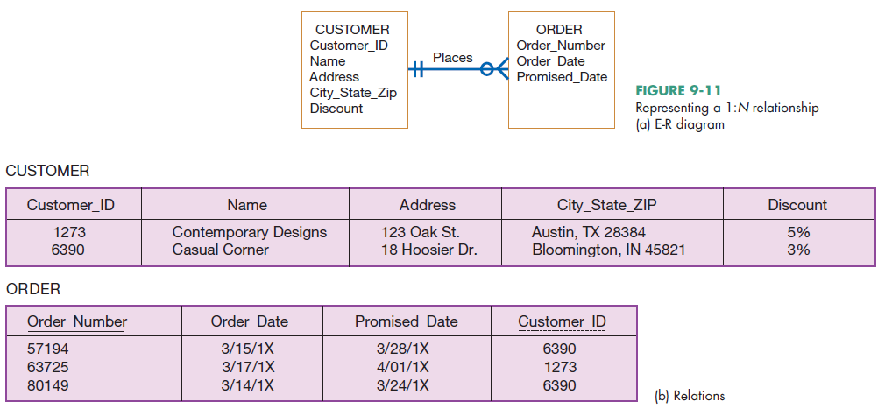
Notes:
See how simple it is to do this transformation? The relations come directly from the entities. Note the foreign key in the ORDER relation.

Slide 29
Binary and Higher-Degree M:N Relationships
Create another relation and include primary keys of all relations as primary key of new relation

Slide 30
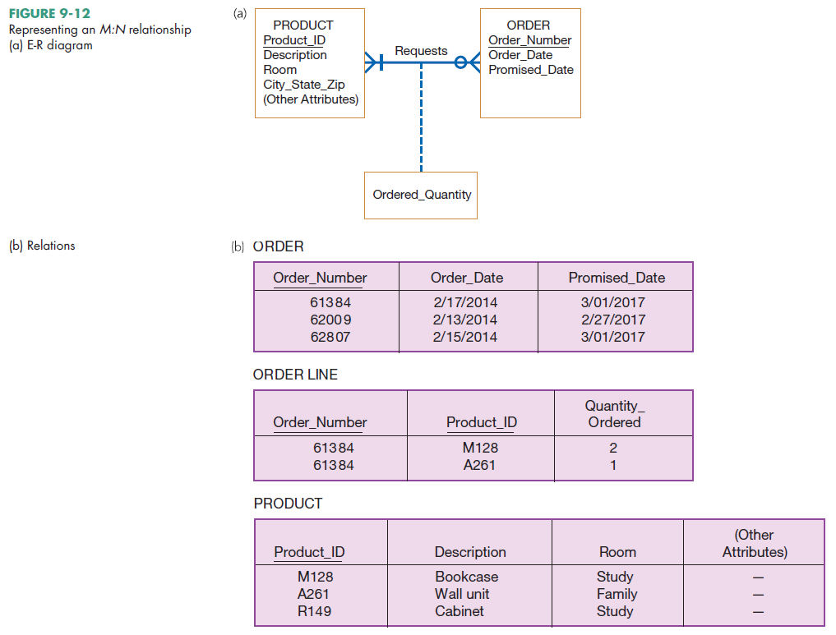
Notes:
In this case we actually created an additional relation. There are only two entities in the E-R diagram. But there are three relations. The ORDER LINE relation implements the many-to-many relationship. Any time you have a many-to-many relationship between entities, you need to add another table. Note that ORDER LINE has a composite primary key composed of two foreign keys, one to each of the other tables. Also, since the relationship itself has an attribute, you see this in the ORDER LINE relation.
Remember when we talked about associative entities in chapter 8? These are entities that also serve as relationships. Well, we could have represented the same thing in the E-R diagram instead of just a many-to-many relationship.
NOTE to instructor: it may be a good exercise to have students redraw the E-R diagram with an associative entity instead of the M:N relationship.

Slide 31
Unary Relationships
Unary 1:N Relationship
  Is modeled as a relation
  Primary key of that relation is the same as for the entity type
  Foreign key is added to the relation that references the primary key values
Recursive foreign key: a foreign key in a relation that references the primary key values of that same relation

Slide 32
Unary Relationships (Cont.)
Unary M:N Relationship
  Model as one relation, then
  Create a separate relation to represent the M:N relationship.
  The primary key of the new relation is a composite key of two attributes that both take their values from the same primary key.
  Any attribute associated with the relationship is included as a nonkey attribute in this new relation.

Slide 33
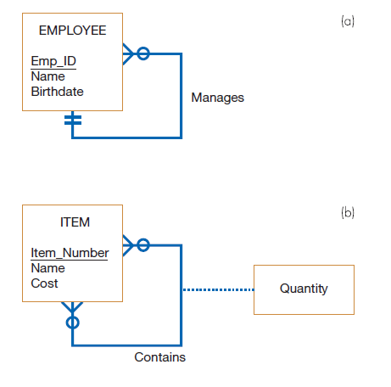

FIGURE 9-13
Two unary relationships
(a) EMPLOYEE with Manages
relationship (1:N)
(b) Bill-of-materials
structure (M:N)
Notes:
Note again the distinction between 1:N vs. M:N relationships, this time in a unary degree. With 1:N, the foreign key is in the same relation; the manager ID just points to another employee ID record in the same table.
But in the M:N case, we needed a separate relation. In ITEM-BILL, both Item_Number and Component_Number are foreign keys to different records in the ITEM table.

Slide 34
Merging Relations
Purpose is to remove redundant relations
The last step in logical database design
Redundant relations could come about due to multiple E-R diagrams and/or user interfaces
Prior to physical file and database design
Example: given two relations:
  EMPLOYEE1(Emp_ID,Name,Address,Phone)
  EMPLOYEE2(Emp_ID,Name,Address,Jobcode,Number_of_Years)
You can merge them together:
  EMPLOYEE(Emp_ID,Name,Address,Phone,Jobcode,Number_of_Years)
Notes:
When analyzing data needs and designing a database, especially in large projects with multiple analysts, you could wind up with redundant relations. So, a final part of logical database design is to identify these redundancies and merge them together when possible.
There are issues with this merging that need to be considered. These are often called “view integration problems”. We’ll discuss these in the next few slides.

Slide 35
View Integration Problems
Must understand the meaning of the data and be prepared to resolve any problems that arise in the process
Synonyms: two different names used for the same attribute
  When merging, get agreement from users on a single, standard name.
Example of two relations with synonym primary keys of different names:
  STUDENT1(Student_ID,Name)
  STUDENT2(Matriculation_Number,Name,Address)

Slide 36
View Integration Problems (Cont.)
Homonyms: a single attribute name that is used for two or more different attributes.
  Resolved by creating a new name
  Example: home address vs. local address?
    STUDENT1(Student_ID,Name,Address)
    STUDENT2(Student_ID,Name,Phone_Number,Address)

Slide 37
View Integration Problems (Cont.)
Dependencies between nonkeys— dependencies may be created as a result of view integration
Example: suppose we have these two relations:
  STUDENT1(Student_ID,Major)
  STUDENT2(Student_ID,Adviser)
You’d merge into this:
  STUDENT(Student_ID,Major,Adviser)
But if we have a transitive dependency like this:
  Major → Advisor
You need to normalize to remove the transitive dependency
  STUDENT(Student_ID,Major)
  MAJOR ADVISER(Major,Adviser)
Notes:
So as you can see, after merging relations, you need again to consider issues of normalization.

Slide 38
View Integration Problems (Cont.)
Class/Subclass — relationships may be hidden in user views or relations
Example: two relations
  PATIENT1(Patient_ID,Name,Address,Date_Treated)
  PATIENT2(Patient_ID,Room_Number)
In-patient vs. Out patient? Implies supertype/subtype
  PATIENT(Patient_ID,Name,Address)
  INPATIENT(Patient_ID,Room_Number)
  OUTPATIENT(Patient_ID,Date_Treated)
Notes:
Here, we see supertype/subtype relationships that may not have been apparent during conceptual modeling, since different people were creating different E-R diagrams.

Slide 39
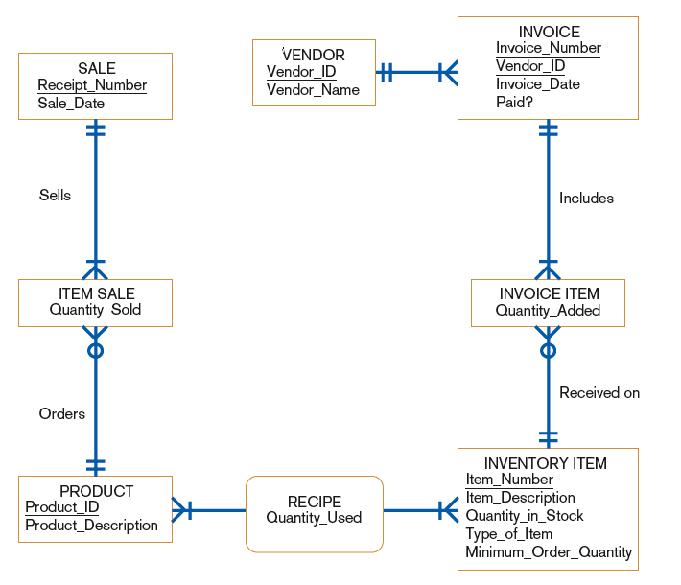
FIGURE 9-16
E-R diagram diagram corresponding to normalized relations of Hoosier Burger‘s inventory control system
Notes:
In this slide we see the E-R diagram that would have been generated during the requirements structuring analysis phase of the SDLC.

Slide 40

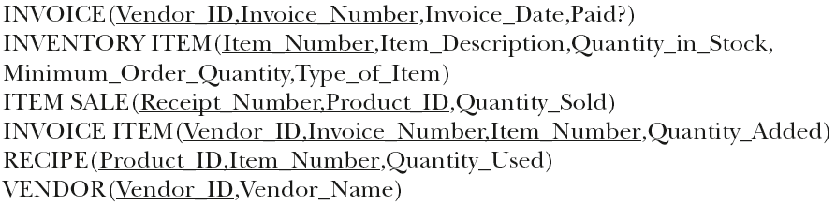
Relations for Hoosier Burger
Notes:
Here we see the relations that are created from transforming the E-R diagram.

Slide 41
Physical File and Database Design
The following information is required:
  Normalized relations, including volume estimates
  Definitions of each attribute
  Descriptions of where and when data are used, entered, retrieved, deleted, and updated (including frequencies)
  Expectations or requirements for response time and data integrity
  Descriptions of the technologies used for implementing the files and database
Notes:
Up until now, we’ve been talking about logical database design. This had to do with converting E-R diagrams (entities, attributes, relationships) into a relational database design (relations, columns, primary and foreign keys).
Next we proceed to physical design. We discuss this in the next few slides.

Slide 42
Designing Fields
Field: the smallest unit of named application data recognized by system software
  Attributes from relations will be represented as fields
Data Type: a coding scheme recognized by system software for representing organizational data
Notes:
A field is a column is an attribute. Often we use these terms interchangeably.
Of course, we discussed attributes in E-R models, and attributes/columns in logical design. But at that time, we weren’t so concerned with some details. For example, we didn’t concern ourselves with data types. Now we will consider these.

Slide 43
Choosing Data Types
Selecting a data type balances four objectives:
  Minimize storage space.
  Represent all possible values of the field.
  Improve data integrity of the field.
  Support all data manipulations desired on the field.

Slide 44
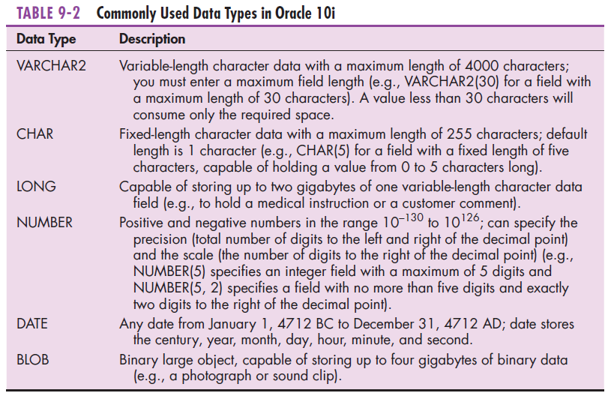
Notes:
Data types are textual, numeric, date, objects such as images, audio files, video files, Word documents, or other possible data formats. We can see similar data types in other database products, such as Microsoft Access, Microsoft SQL Server, MySql (an open source product), or IBM’s DB2.

Slide 45
Calculated Fields
Calculated (or computed or derived) field: a field that can be derived from other database fields
It is common for an attribute to be mathematically related to other data.
The calculate value is either stored or computed when it is requested.
Notes:
We talked about calculated attributes in chapter 7, so it is possible that the E-R model captures the fact that an attribute is calculated and not stored. But if it is calculated, we need to implement the calculation when doing physical design.
Age is a classic example of a calculated field. It shouldn’t be stored. After all, a person’s age changes every day. It’s better to calculate it based on birth date and current date. Birth date would be stored, and any system will have a function to give the current date.
Question: Can you think of another type of field in an Employee table that would be calculated?
Answer: “Years Employed” may be an example, based on “Hire Date”.
Another example may be “Tax to withdraw” based on stored data such as “Salary”, “Nbr Exemptions”, etc.

Slide 46
Controlling Data Integrity
Default Value: a value a field will assume unless an explicit value is entered for that field
Range Control: limits range of values that can be entered into field
  Both numeric and alphanumeric data
Referential Integrity: an integrity constraint specifying that the value (or existence) of an attribute in one relation depends on the value (or existence) of the same attribute in another relation
Null Value: a special field value, distinct from zero, blank, or any other value, that indicates that the value for the field is missing or otherwise unknown
Notes:
We talked about some of this in chapter 8. For example, default values and range control fall within the category of domain constraints. Referential integrity has to do with the consistency between primary and foreign keys.
Some fields will allow null values and some will not.
Question: What field of ANY relation can NEVER be null?
Answer: The primary key.

Slide 47
Designing Physical Tables
Relational database is a set of related tables.
Physical Table: a named set of rows and columns that specifies the fields in each row of the table
Denormalization: the process of splitting or combining normalized relations into physical tables based on affinity of use of rows and fields
Denormalization optimizes certain data processing activities at the expense of others.
Notes:
Ironically, we may want to compromise on the data integrity that we gained through normalization. In other words, there may be a reason to allow some data duplication. Why? Because it is faster to query data that is in a single table than data that is spread in different tables. So, after normalizing the data, sometimes we denormalize a bit in order to improve system performance.
As with everything in life, database design involves tradeoffs. Here, we have a tradeoff between data integrity and system performance.
By the way, a table is essentially the same as a relation. We often use the word “relation” when doing logical design and “table” when doing physical design.

Slide 48
Designing Physical Tables (Cont.)
Various forms of denormalization, which involves combining data from several normalized tables, can be done.
  No hard-and-fast rules for deciding
Three common situations where denormalization may be used:
  Two entities with a one-to-one relationship
  A many-to-many relationship (associative entity) with nonkey attributes
  Reference data

Slide 49
Designing Physical Tables (Cont.)
Partitioning: splitting a table into different physical files, perhaps stored on different disks or computer.
Helps speed up system performance.
Three types of table partitioning:
  Range partitioning: partitions are defined by nonoverlapping ranges of values for a specified attribute
  Hash partitioning: a table row is assigned to a partition by an algorithm and then maps the specified attribute value to a partition
  Composite partitioning: combines range and hash partitioning by first segregating data by ranges on the designated attribute, and then within each of these partitions

Slide 50
File Organizations
File organization: a technique for physically arranging the records of a file
Physical file: a named set of table rows stored in a contiguous section of secondary memory

Slide 51
Arranging Table Rows
Objectives for choosing file organization
  Fast data retrieval
  High throughput for processing transactions
  Efficient use of storage space
  Protection from failures or data loss
  Minimizing need for reorganization
  Accommodating growth
  Security from unauthorized use

Slide 52
File Organizations (Cont.)
Three common file organizations:
Sequential: rows are stored in sequence according to a primary key value
Indexed: rows can be stored sequentially or nonsequentially; an index allows quick access to rows
Hashed file organization: rows usually stored nonsequentially; the address for each row is determined using an algorithm

Slide 53
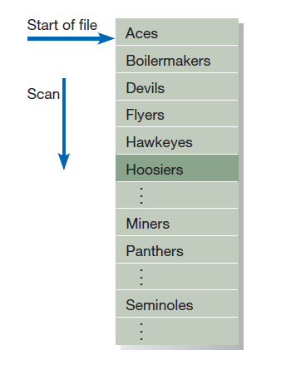
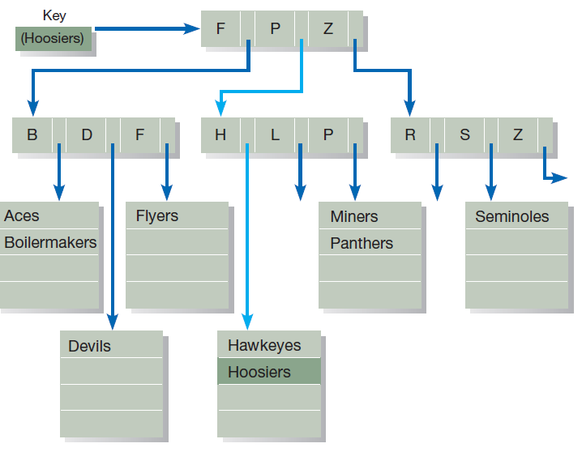
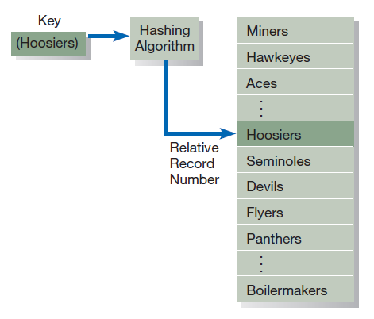
Figure 9-20 Comparison of file organizations
(a) Sequential
(b) Indexed
(c) Hashed

Slide 54
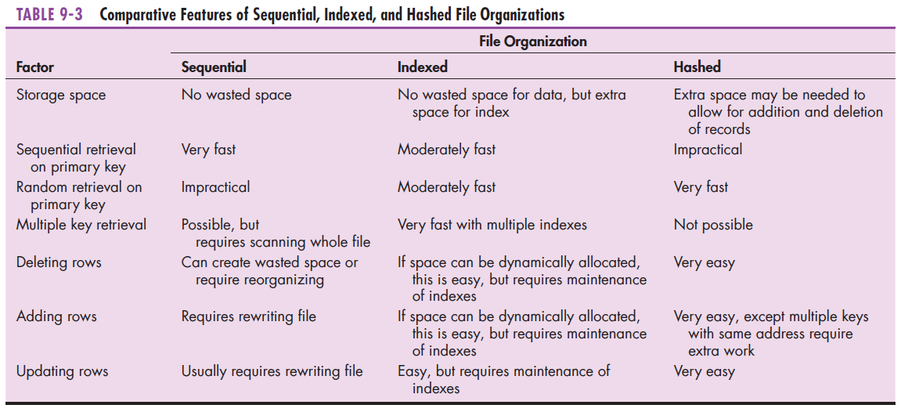
File Organizations (Cont.)
Notes:
As you can see, the file organization to use depends on how you want to query and manipulate the data. There are always tradeoffs.

Slide 55
Indexed File Organization
Indexed file organization: a file organization in which rows are stored either sequentially or nonsequentially, and an index is created that allows software to locate individual rows
Index: a table used to determine the location of rows in a file that satisfy some condition
Secondary keys: one or a combination of fields for which more than one row may have the same combination of values

Slide 56
Indexed File Organization (Cont.)
Main disadvantages:
  Extra space required to store the indexes
  Extra time necessary to access and maintain indexes
Main advantage:
  Allows for both random and sequential processing
Guidelines for choosing indexes
  Specify a unique index for the primary key of each table.
  Specify an index for foreign keys.
  Specify an index for nonkey fields that are referenced in qualification, sorting and grouping commands for the purpose of retrieving data.
Notes:
Part of physical design is to decide which columns of a table should be indexed. The primary key is almost always indexed, but you may want to index other columns as well.
Columns that are going to be used to select rows in a lot of queries should be indexed. Primary keys are like this.
Another candidate would be a person’s name or a product’s name. Often we query based on name rather than primary key.

Slide 57
Designing Controls for Files
Two of the goals of physical table design are protection from failure or data loss and security from unauthorized use.
These goals are achieved primarily by implementing controls on each file.
Two other important types of controls address file backup and security.

Slide 58
Designing Controls for Files (Cont.)
Techniques for file restoration include:
  Periodically making a backup copy of a file.
  Storing a copy of each change to a file in a transaction log or audit trail.
  Storing a copy of each row before or after it is changed.
Means of building data security into a file include:
  Coding, or encrypting, the data in the file.
  Requiring data file users to identify themselves by entering user names and passwords.
  Prohibiting users from directly manipulating any data in the file by forcing users to work with a copy (real or virtual).

Slide 59
Physical Database Design for Hoosier Burger
The following decisions need to be made:
  Decide to create one or more fields for each attribute and determine a data type for each field.
  For each field, decide if it is calculated; needs to be coded or compressed; must have a default value or picture; or must have range, referential integrity, or null value controls.
  For each relation, decide if it should be denormalized to achieve desired processing efficiencies.
  Choose a file organization for each physical file.
  Select suitable controls for each file and the database.

Slide 60
Electronic Commerce Application: Designing Databases
Designing databases for Pine Valley Furniture’s WebStore
  Review the conceptual model (E-R diagram).
  Examine the lists of attributes for each entity.
  Complete the database design.
  Share all design information with project team to be turned into a working database during implementation.

Slide 61
Summary
Now you learned how to:
  Describe the database design process, its outcomes, and the relational database model.
  Describe normalization and the rules for second and third normal form.
  Transform an entity-relationship (E-R) diagram into an equivalent set of well-structured (normalized) relations.
  Merge normalized relations from separate user views into a consolidated set of well-structured relations.

Slide 62
Summary (Cont.)
Now you learned how to:
  Describe physical database design concepts:
    Choose storage formats for fields in database tables.
    Translate well-structured relations into efficient database tables.
    Explain when to use different types of file organizations to store computer files.
    Describe the purpose of indexes and the important considerations in selecting attributes to be indexed.

Slide 63
Next Lecture
Designing Forms and Reports

Slide 64
References
Joseph S. Valacich, Joey F. George, Modern Systems Analysis and Design, 8th Global Edition, Pearson, 2016

