Slide 1



L
L Line
CSE 420
Computer Games
Lecture #8 Audio & Sprites

Slide 2
Objectives
Using the Ogg Vorbis audio format
Creating audio for your programs
Playing and manipulating sounds in pygame
Creating a sprite object
Building a sprite constructor

Slide 3
Objectives (cont.)
Setting a sprite's image attribute
Determining the sprite's rect attribute
Building an update() method for your
sprites
Adding sprites to a group
Creating specialty sprites
Building a library of classes
Checking for collisions between sprites

Slide 4
The Ogg Vorbis Audio Format
Non-proprietary format
Quality and compression are comparable to MP3
Works well with pygame
Free tools (such as Audacity) are available for recording and editing

Slide 5
Audacity
http://audacity.sourceforge.net
Works with Ogg natively
Can also work with MP3 and WAV
Record from microphone or input device
Multi-track recording and audio manipulation tools
Audacity is free.
Tutorials in Appendix D on Web site

Slide 6
Getting Audio Samples
It's not hard to find sound clips on the Web.
It's hard to know if such clips are completely unencumbered.
You must respect copyrighted materials.
Royalty-free CD-ROMs can be excellent starting places.
It may be easier to create your own audio clips.

Slide 7
Recording with Audacity
Attach and test the microphone.
Record a sample. Keep it as short as possible.
Apply any special effects.
Try recording multiple tracks.
Normalize.
Export in Ogg format.

Slide 8
Playing a Sound in Python/pygame
See playSound.py.
Begin with the IDEA framework.
Initialize the pygame mixer module.
Create a sound object.
Play the sound.
Modify the sound as desired.

Slide 9
Initializing the Mixer
Initialize the mixer right after pygame initialization:
Initialize the sound module.
No need to import the mixer – it’s part of pygame.
pygame.mixer.init()

Slide 10
Creating a Sound Object
This is part of the Entities step.
Create an object to house the sound:
The object assumes the Ogg file is in the same directory as the program.
Change the name to reflect the sound.
#create sound
wooHoo = pygame.mixer.Sound("wooHoo.ogg")

Slide 11
Playing a Sound
Can be done anywhere in the code after the sound object has been created
Normally happens as a response to some action
The following code plays sound when the spacebar is pressed:
elif event.type == pygame.KEYDOWN:
if event.key == pygame.K_SPACE:
wooHoo.play()

Slide 12
Modifying a Sound
The sound object can be looped.
You can also set the sound's volume.
You can fade a sound in or out.
You can fade the sound left to right.
See the pygame.mixer.Sound object in online help for details.

Slide 13
Sprite Basics
A sprite is a 2D representation.
A sprite represents some type of object on the playing field.
Most characters, enemies, and other objects in 2D games are made with sprites.
See basicSprite.py (it will be described fully later).

Slide 14
Characteristics of a Sprite
Visual representation
Position and size attributes
Ability to move
Ability to recognize collisions
Dynamic birth and death
Reasonably self-contained

Slide 15
Characteristics of an OOP Object
Properties: Characteristics of an object, such as its size, color, or position
Methods: Things an object can do, such as move, shoot, and bounce
Events: Stimuli the object responds to
Constructor: A special method that creates an instance of the object

Slide 16
Why Use OOP?
OOP is an optional programming style in Python.
Sprites are perfectly suited to the object model.
Rather than having separate variables for an object's x and y parameters (as described in Chapter 4), the sprite keeps track of its own position (and much more).

Slide 17
The pygame Sprite Object
Pygame has a built-in Sprite object.
This object has basic sprite functionality.
It’s usually placed in a sprite group for more power.
It can be extended in nearly infinite ways.

Slide 18
Built-In Sprite Attributes
image: An image surface; usually set with the pygame.image.load() function
rect: A pygame rect object; defines the sprite's size and position

Slide 19
Attributes of the Sprite rect
Most changes to the sprite happen by manipulating its rect attribute.
Change or view position: top, bottom, left, right, and so on.
Determine size with size, height, and width attributes.
Collision routines check for collisions with other rects.
Movement routines move the sprite.

Slide 20
Custom Sprite Attributes
You can add your own attributes.
You use dx and dy to control motion.
You can also add other custom attributes (attached variables) to your sprites.

Slide 21
Built-In Sprite Methods
Sprites have two important methods already built in:
  __init__(self) is the initializer, which acts like a constructor. It’s used to initialize the sprite.
  update(self) is automatically called once per frame. It's where you'll put code that controls the sprite's actions.

Slide 22
Custom Sprite Methods
As you get more proficient, you'll add your own methods to make your sprites do more work.
You might add turnLeft() and turnRight() methods, or a fireMissile() method.

Slide 23
Creating a Sprite Object
Code overview from basicSprite.py (described in detail in later slides ):
class Box(pygame.sprite.Sprite):
def __init__(self):
pygame.sprite.Sprite.__init__(self)
self.image = pygame.Surface((25, 25))
self.image = self.image.convert()
self.image.fill((255, 0, 0))
self.rect = self.image.get_rect()
self.rect.centerx = 0
self.rect.centery = 200
self.dx = 10
self.dy = 0
def update(self):
self.rect.centerx += self.dx
if self.rect.right > screen.get_width():
self.rect.left = 0

Slide 24
Building a Custom Sprite
Define the Sprite class.
Build the class initializer.
Set appropriate attributes.
Build the sprite's update() method.

Slide 25
Inheritance
If you're building a police car, you usually start with a make, such as sedan.
In programming, you do something similar, called inheritance. The new class (called Box in this example) is based on the existing pygame.sprite.Sprite class.
class Box(pygame.sprite.Sprite):

Slide 26
Creating an Initializer
A constructor is a special method that creates an instance of a class.
Python uses the initializer method for this purpose.
The initializer is always called __init__().
It begins and ends with two underscores.
It’s automatically called when you create your object.

Slide 27
Introducing the self Parameter
Methods in Python are simply functions defined in the context of a class.
A method always has an additional parameter, self.
This parameter allows the method to refer to the object itself:
In most OOP languages, self, or something like it, is assumed but not explicitly created.
def __init__(self):

Slide 28
Calling the pygame.sprite.Sprite() Constructor
Box is a subclass of Sprite (like a police car is a subclass of sedan).
You need to explicitly create the Sprite class to get access to its features:
class Box(pygame.sprite.Sprite):
def __init__(self):
pygame.sprite.Sprite.__init__(self)

Slide 29
Setting the Sprite's Image
The __init__() method is used to set up all the sprite's initial settings.
Begin by setting the sprite's image attribute.
For now, just create a simple pygame.Surface and fill it in with red:
self.image = pygame.Surface((25, 25))
self.image.fill((255, 0, 0))

Slide 30
Creating a rect for the Sprite
Normally, you'll just extract the rect from the image attribute:
self.rect = self.image.get_rect()

Slide 31
Giving the Sprite an Initial Position
Use the sprite's rect attributes to specify a starting position.
For now, use rect.centerx and rect.centery, but there are many other ways:
self.rect.centerx = 0
self.rect.centery = 200

Slide 32
Create dx and dy Attributes to Control Motion
dx and dy are custom attributes (explained in much more detail later).
They'll be used here to move the sprite 10 pixels to the right each frame:
self.dx = 10
self.dy = 0

Slide 33
Creating an update() Method
The update() method will be called once per frame.
All code that happens repeatedly (usually movement and collision code) goes here.
Like all methods, it includes the self parameter:
def update(self):

Slide 34
Moving the Sprite
Use dx and dy to move the sprite.
This extremely simple example adds dx to rect.centerx:
This moves the sprite dx pixels each frame.
How dx and dy work will be explained more fully later on.
self.rect.centerx += self.dx

Slide 35
Checking for Bounds
Whenever you change a variable, think of possible boundary conditions.
In this case, the box can move off the right side of screen.
When the box exits, make it reappear on the left side of the screen:
A more in-depth discussion of boundary checking will come later.
if self.rect.right > screen.get_width():
self.rect.left = 0

Slide 36
Using a Sprite within the IDEA Framework
The IDEA framework works well with sprites.
Build an instance of the Sprite class.
Place the instance in a sprite group.
Use group methods to update the display.

Slide 37
Making a Sprite Instance
Build an instance of the newly defined Sprite class:
Note you’re making an instance (box) of the previously defined class (Box).
box = Box()

Slide 38
Creating a Sprite Group
Not terribly interesting on their own, sprites belong in sprite groups.
The most commonly used group is pygame.sprite.Group().
When creating a group, you can place your sprite (or sprites) directly into it:
allSprites = pygame.sprite.Group(box)

Slide 39
Updating Your Sprites
Sprite groups improve the screen update process.
Rather than blitting each object, blit the background surface once.
The sprite group has methods to clear, update, and draw each sprite in the group.
allSprites.clear(screen, background)
allSprites.update()
allSprites.draw(screen)

Slide 40
Clearing the Sprites
The clear() method clears all sprites drawn in the previous frame.
It's more efficient than redrawing the entire background.
Sometimes this is called dirty rect updating.
It requires the screen and background objects as parameters.

Slide 41
Updating the Sprites
The Group.update() method calls the update() method of each sprite in the group.
This ensures all the code in your sprite's update() method is called once per frame.
update() is called immediately before the sprite is drawn to the surface.

Slide 42
Drawing the Sprites
The sprite group's draw() method blits each sprite image to the screen.
Sprite position is taken from the sprite's rect object.
The draw() method requires the screen as its only parameter.

Slide 43
Flipping the Display
With the sprite group's Clear, Update, Draw model, you no longer have to blit any surfaces to the screen (except the background one time).
You still must call pygame.display.flip() to implement double-buffering.

Slide 44
Sprite Variations
Sprites can be manipulated in various ways, such as the following:
  A circle that follows the mouse cursor
  A square that pops up in a random spot
  A label containing text

Slide 45
Building a Sprite that Follows the Mouse Cursor
See moveCircle.py:
The update() method has a rect center equal to the mouse cursor position.
class Circle(pygame.sprite.Sprite):
def __init__(self):
pygame.sprite.Sprite.__init__(self)
self.image = pygame.Surface((50, 50))
self.image.fill((255, 255, 255))
pygame.draw.circle(self.image, (0, 0, 255),
(25, 25), 25, 0)
self.rect = self.image.get_rect()
def update(self):
self.rect.center = pygame.mouse.get_pos()

Slide 46
Building a Label Class
class Label(pygame.sprite.Sprite):
""" Label Class (simplest version)
Attributes:
font: any pygame Font or SysFont objects
text: text to display
center: desired position of label center (x, y)
"""
def __init__(self):
pygame.sprite.Sprite.__init__(self)
self.font = pygame.font.SysFont("None", 30)
self.text = ""
self.center = (320, 240)
def update(self):
self.image = self.font.render(self.text, 1, (0, 0, 0))
self.rect = self.image.get_rect()
self.rect.center = self.center

Slide 47
Using the Label Class
See labelDemo.py:
label1 = Label()
label2 = Label()
labelEvent = Label()
allSprites = pygame.sprite.Group(label1, label2, labelEvent)
label1.text = "Hi. I'm a label."
label1.center = (100, 100)
label2.text = "I'm another label."
label2.center = (400, 400)

Slide 48
Building a Random Color and Position Square
class Square(pygame.sprite.Sprite):
""" makes a box with a random starting
position and the given color.
To make a red square, use
redSquare = Square((255, 0, 0))
requires screen be predefined and import random """
def __init__(self, color):
pygame.sprite.Sprite.__init__(self)
self.image = pygame.Surface((50, 50))
self.image.fill(color)
self.rect = self.image.get_rect()
self.rect.centerx = random.randrange(0,
screen.get_width())
self.rect.centery = random.randrange(0,
screen.get_height())

Slide 49
Using the Random Square
See boxes.py:
The square takes a color as a parameter.
Each time through the loop, a new box is made in a new color.
The position of each new square is randomized in the constructor.
boxes = []
for colorName in pygame.color.THECOLORS:
boxes.append(Square(pygame.color.Color(colorName)))

Slide 50
Creating a Class Module
Classes are designed to be re-used.
You can put several class definitions in one file.
You can then import this module just like the ones built into Python.
See collisionObjects.py and useCol.py.

Slide 51
Detecting Collisions between Sprites
See spriteSprite.py.
The rect object has a colliderect() method that tells whether that rect collides with another:
if circle.rect.colliderect(square.rect):
lblOutput.text = "Collision"
else:
lblOutput.text = "No collision"

Slide 52
Collisions with Multiple Sprites
You can check to see if a sprite collides with any member of a group.
See spriteGroup.py:
The last parameter indicates whether the collided sprite should be killed.
if pygame.sprite.spritecollide(circle, squareGroup, False):
lblOutput.text = "Collision"
else:
lblOutput.text = "No collision"

Slide 53
Bounding Boxes and Collisions
Python uses bounding boxes to check collisions.
All sprites are rectangular, even if they don’t appear to be so.
A bounding box is the smallest vertical and horizontal box that can be drawn around the sprite.

Slide 54
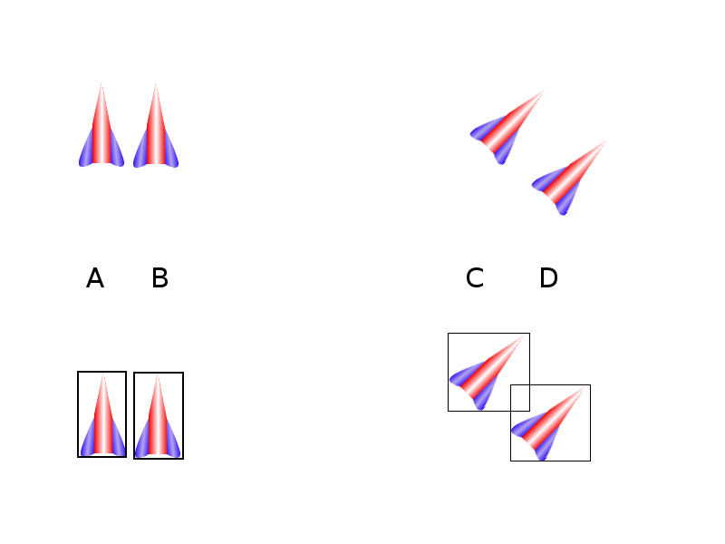
Which Ships Collide?

Slide 55
Setting a Color Key
Although sprites are rectangular, you often want them to look like some other shape.
Sprites based on GIF images can have transparency.
You can also set a color key that will be treated as transparent.
See colorkey.py.

Slide 56
Discussion Questions
How does object-oriented programming lend itself to game programming?
What other kinds of attributes will a game sprite need?
How does the color-key technique relate to TV meteorologists?

Slide 57
Summary
You should now understand
  Using the Ogg Vorbis audio format
  Creating audio for your programs and playing and manipulating sounds in pygame
  Creating a sprite object and building a sprite constructor
  Setting a sprite's image attribute
  Creating specialty sprites and building a library of classes
  Checking for collisions between sprites

Slide 58
Next Lecture
Working Game

Slide 59
References
Andy Harris, “Game Programming, The L Line, The Express Line to Learning”; Wiley, 2007

