Slide 1


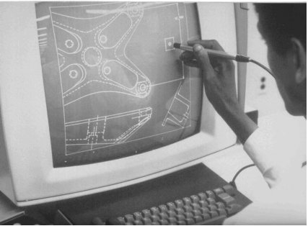
CSE 411
Computer Graphics
Lecture #8 2D Viewing
Prepared & Presented by Asst. Prof. Dr. Samsun M. BAŞARICI
Notes:
1

Slide 2
Objectives
HB Ch. 8
2D Viewing Pipeline
Clipping & Clipping Window
Normalization & Viewport Transformations
OpenGL 2D Viewing Functions
Clipping Algorithms
  2D Point Clipping
  2D Line Clipping
  2D Polygon Fill-Area Clipping
  2D Curve Clipping
  2D Text Clipping

Slide 3
2D Viewing
Any Cartesian coordinate system can be used to define a picture.
A view is selected by specifying a sub area of the total picture area.
The picture parts within the selected areas are mapped onto specific areas of the device coordinates.

Slide 4
2D Viewing (cont.)
Which part of a picture is to be displayed
  clipping window or world window or viewing window
Where that part will be displayed on the display device
  viewport

Slide 5
2D Viewing (cont.)
A world coordinate area selected for display is called a window
  The window defines what is to be viewed
An area on a display device to which a window is mapped is called a viewport
  The viewport defines where it is to be displayed

Slide 6
2D Viewing (cont.)
Clipping window selects what we want to see
Viewport indicates where it is to be viewed on the output device
Usually, clipping windows and viewport are rectangles

Slide 7
2D Viewing (cont.)
Viewing Coordinates
World Coordinates

Slide 8
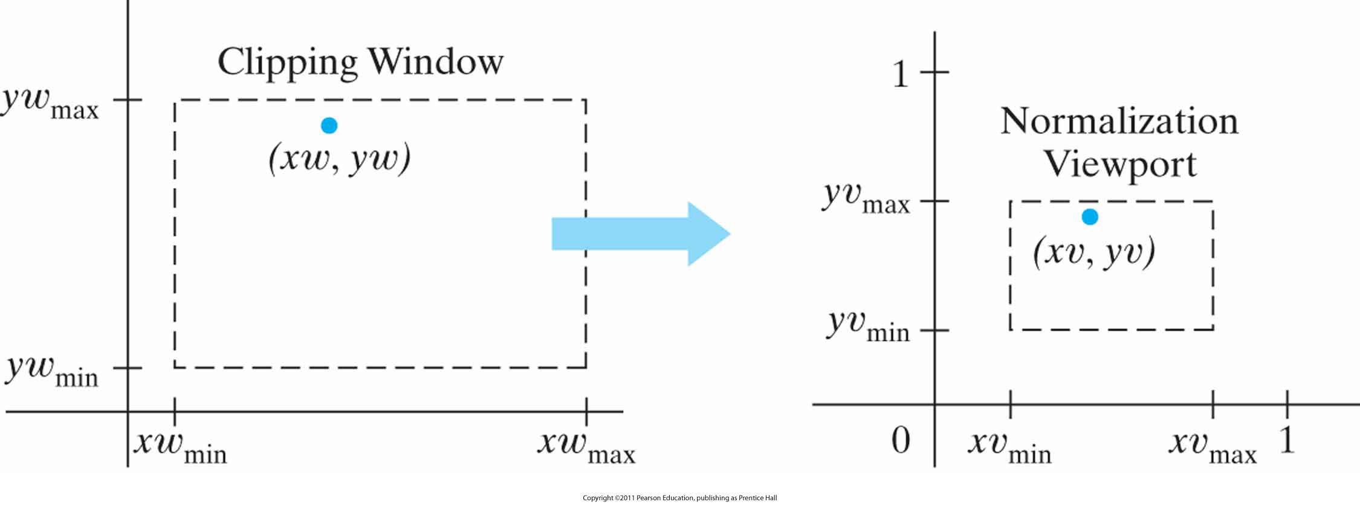
2D Viewing (cont.)
A point (xw, yw) in a world-coordinate clipping window is mapped to viewport coordinates (xv, yv), within a unit square, so that the relative positions of the two points in their respective rectangles are the same.

Slide 9
2D Viewing Pipeline
2D viewing pipeline
  Construct world-coordinate scene using modeling-coordinate transformations
  Convert world-coordinates to viewing coordinates
  Transform viewing-coordinates to normalized-coordinates (ex: between 0 and 1, or between -1 and 1)
  Map normalized-coordinates to device-coordinates.

Slide 10
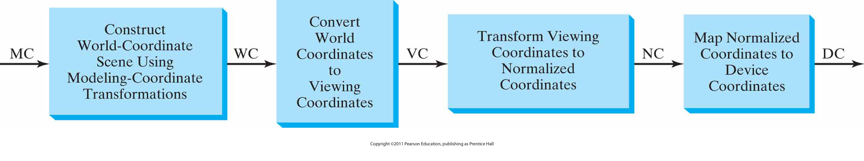
2D Viewing Pipeline (cont.)

Slide 11
Viewing coordinate reference system
Y-view
Y-world
X-world
X-view

Slide 12
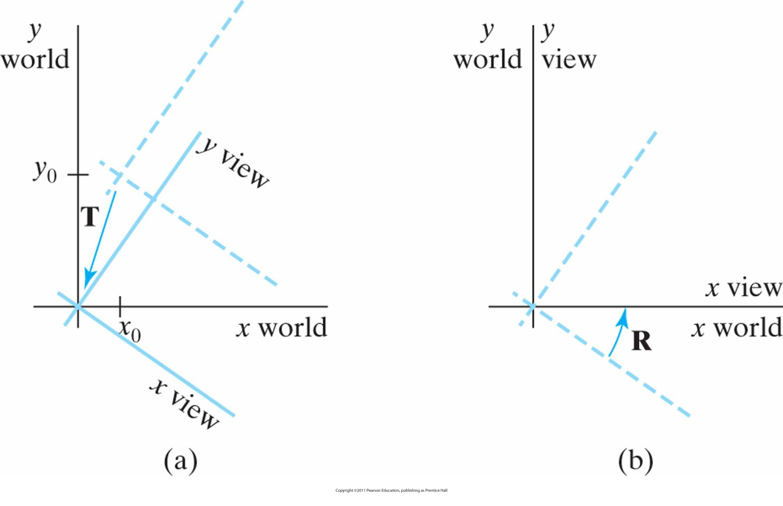
Viewing coordinate reference system (cont.)
A viewing-coordinate frame is moved into coincidence with the world frame by (a) applying a translation matrix T to move the viewing origin to the world origin, then (b) applying a rotation matrix R to align the axes of the two systems.

Slide 13
Viewing coordinate reference system (cont.)
That means:
  M_{WC,VC}= R·T
What about the matrix?
Think about it ☺

Slide 14
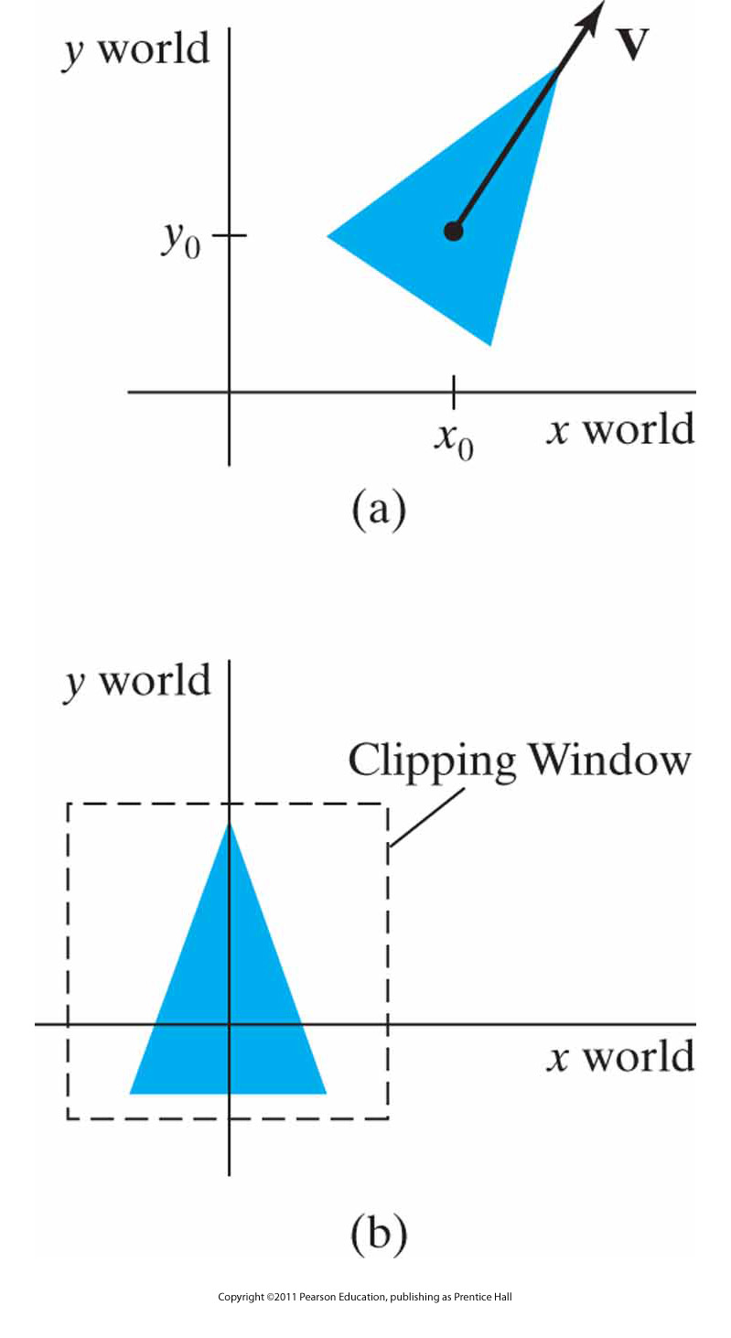
World-Coordinate Clipping Window
A triangle
(a), with a selected reference point and orientation vector, is translated and rotated to position
(b) within a clipping window.

Slide 15
Window-to-viewport coordinate transformation
Y-viewport
Y-world
Y-view
1
0
1
X-viewport
X-view
Viewport
X-world
Window

Slide 16
Normalization and Viewport Transformations
CLIPPING WINDOW
y_{wmax}
(x_{w} ,y_{w})
1
NORMALIZATION VIEWPORT
y_{vmax}
(x_{v} ,y_{v})
y_{wmin}
y_{vmin}
0
x_{wmin}
x_{wmax}
x_{vmin}
x_{vmax}
1
A point (xw, yw) in a world-coordinate clipping window is mapped to viewport coordinates (xv, yv), within a unit square, so that the relative positions of the two points in their respective rectangles are the same.

Slide 17
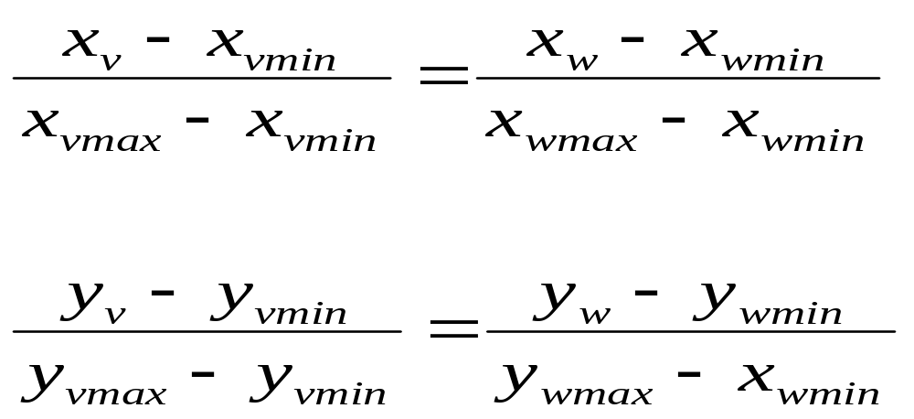
Mapping the Clipping Window into a Normalized Window
To transform the world-coordinate point into the same relative position within the viewport, we require that

Slide 18
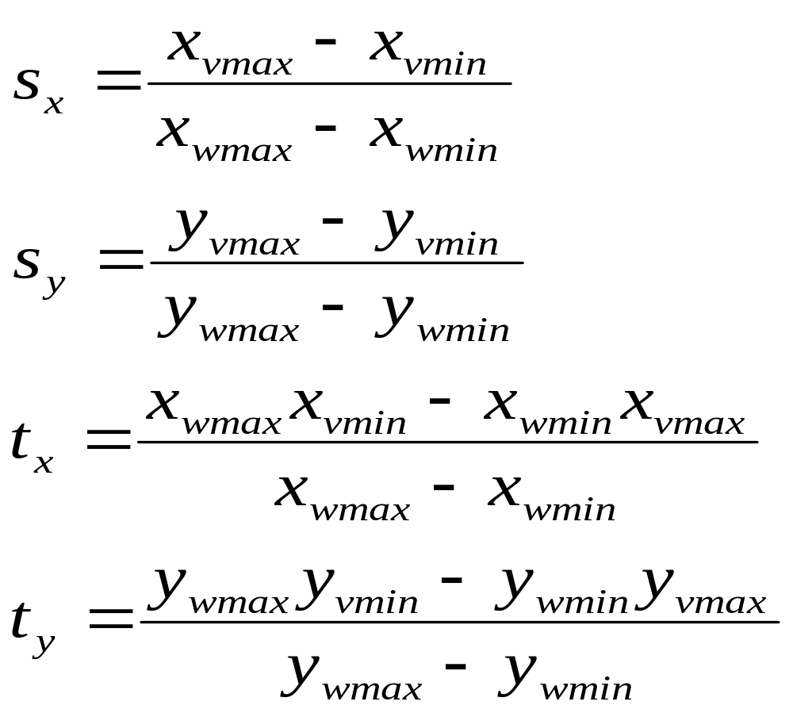
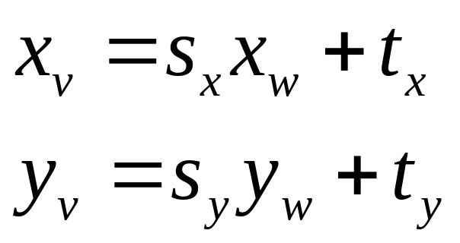
Mapping the Clipping Window into a Normalized Window
Solving these equations for the viewport position (x_{v} ,y_{v})

Slide 19
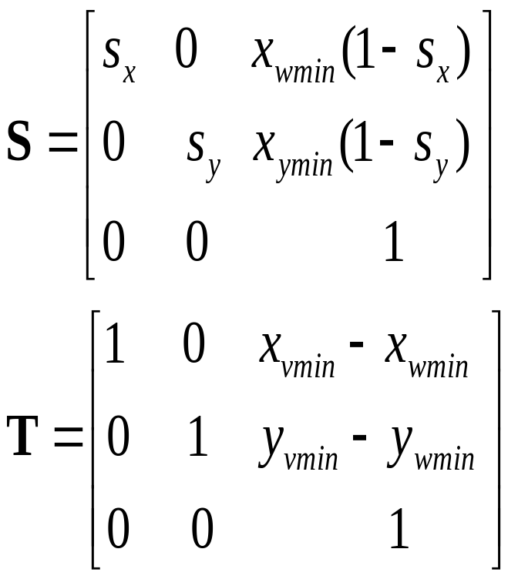
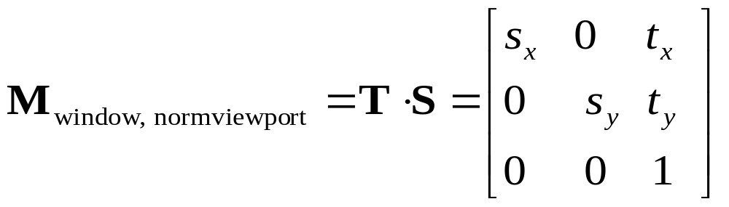
Mapping the Clipping Window into a Normalized Window
Using the matrix notation we have

Slide 20
World Coordinates to Viewport Coordinates
Scale the clipping window to the size of the viewport using a fixed point position of (xw_{min}, yw_{min})
Translate (xw_{min}, yw_{min}) to (xv_{min}, yv_{min})

Slide 21
2D Viewing Transformation Pipeline
Transform
viewing
coordinates
to
normalized
viewing
coordinates
Map
Normalized
viewport
to
device
coordinates
Construct
world
coordinates
Convert
world
coordinates
to
viewing
coordinates

Slide 22
OpenGL 2D viewing functions
Remember: OpenGL doesn’t directly support 2D
Projection mode
  glMatrixMode (GL_PROJECTION)
  glLoadIdentity()
GLU Clipping window function
  Orthogonal projection
  gluOrtho2D (xwmin, xwmax, ywmin, ywmax)
  If we do not specify a clipping window, the default coordinates are
  (xw_{min}, yw_{min})=(-1.0,-1.0) and (xw_{max},yw_{max}) = (1.0,1.0)

Slide 23
OpenGL 2D viewing functions (cont.)
Viewport
  glViewport (xvmin, yvmin, vpwidth, vpHeight)
  default is size of the display window
    xvmin and yvmin are the positions of the lower-left cornet of the viewport
    vpwidth, vpHeight are the pixel width and height of the viewport
    If we do not use glViewport, the default viewport size and position are the same as the display window

Slide 24
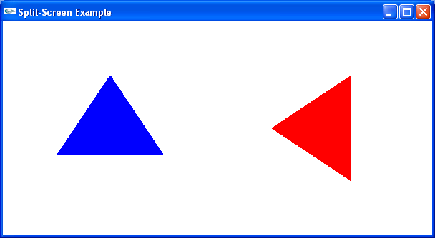
OpenGL 2D viewing program example
ch8ViewingProgram2D.cpp

Slide 25
Clipping
We’ve been assuming that all primitives (lines, triangles, polygons) lie entirely within the viewport
In general, this assumption will not hold:

Slide 26
Clipping (cont.)
Analytically calculating the portions of primitives within the viewport

Slide 27
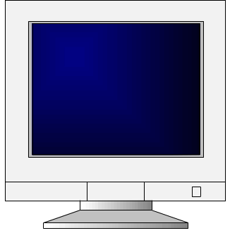

Why World→Camera before clipping?
_{Model→World}
_{Transform}
_{World→Camera}
_{Illuminate}
_{Transform}
_{Clip}
_{Project}
_{Rasterize}
_{Model & Camera}
_{Parameters}
_{Rendering Pipeline}
_{Framebuffer}
_{Display}

Slide 28
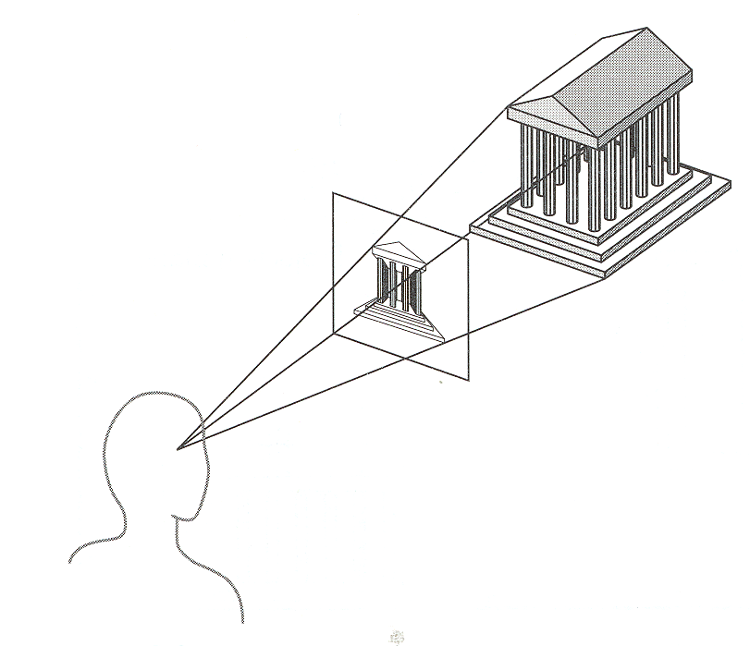
Clip to what?
View Window
Up
Eye position
(focal point)
Back
Towards
Right
Viewing Frustum

Slide 29
Why Clip?
Bad idea to rasterize outside of framebuffer bounds
Also, don’t waste time scan converting pixels outside window

Slide 30
Clipping
The naive approach to clipping lines:
for each line segment
for each edge of view_window
find intersection point
pick “nearest” point
if anything is left, draw it
What do we mean by “nearest”?
How can we optimize this?
B
D
C
A

Slide 31
Trivial Accepts
Big optimization: trivial accept/rejects
How can we quickly determine whether a line segment is entirely inside the viewport?
Answer: test both
endpoints.

Slide 32
Trivial Rejects
How can we know a line is outside viewport?
Answer: if both endpoints on wrong side of same edge, can
trivially reject line

Slide 33
Clipping Lines to Viewport
Discard segments of lines outside viewport
  Trivially accept lines with both endpoints inside all edges of the viewport
  Trivially reject lines with both endpoints outside the same edge of the viewport
  Otherwise, reduce to trivial
  cases by splitting
  into two segments

Slide 34
2D Point Clipping
Your turn ☺

Slide 35
Cohen-Sutherland Line Clipping
Divide viewplane into regions defined by viewport edges
Assign each region a 4-bit outcode:
1001
1000
1010
y_{max}
Bit 4
Bit 3
Bit 2
Bit 1
0001
0000
0010
x_{max}
TOP
RIGHT
LEFT
BOTTOM
0101
0100
0110

Slide 36
Cohen-Sutherland Line Clipping (cont.)
Any lines that
are completely contained within the window edges have a region code 0000 for both endpoints, and we save these line segments.
has a region code value of 1 in the same bit position for each endpoint, is completely outside the clipping rectangle, and we eliminate that line segment.
cannot be identified as being completely inside or completely outside clipping window are next checked for intersection with window border lines.

Slide 37
Cohen-Sutherland Line Clipping (cont.)
If line cannot be trivially accepted or rejected, subdivide so that one or both segments can be discarded
Pick an edge that the line crosses
  Check against edges in same order each time
For example:
top, bottom,
right, left
D
E
C
B
A

Slide 38
Cohen-Sutherland Line Clipping (cont.)
Intersect line with edge
D
E
C
B
A

Slide 39
Cohen-Sutherland Line Clipping (cont.)
Discard portion on wrong side of edge and assign outcode to new vertex
Apply trivial accept/reject tests and repeat if necessary
D
C
B
A

Slide 40
Other Line Clipping Algorithms
Liang-Barsky Line Clipping
Nicholl-Lee-Nicholl Line Clipping

Slide 41
Clipping Polygons
Clipping polygons is more complex than clipping the individual lines
  Input: polygon
  Output: original polygon, new polygon, or nothing
When can we trivially accept/reject a polygon as opposed to the line segments that make up the polygon?

Slide 42
Why Is Clipping Hard?
What happens to a triangle during clipping?
Possible outcomes:
_{triangletriangle}
_{trianglequad}
_{triangle5-gon}

Slide 43
Why Is Clipping Hard? (cont.)
A really tough case:
concave polygon multiple polygons

Slide 44
Sutherland-Hodgman Clipping
Basic idea:
  Consider each edge of the viewport individually
  Clip the polygon against the edge equation

Slide 45
Sutherland-Hodgman Clipping (cont.)
Basic idea:
  Consider each edge of the viewport individually
  Clip the polygon against the edge equation
  After doing all planes,
  the polygon is fully clipped

Slide 46
Sutherland-Hodgman Clipping (cont.)
Basic idea:
  Consider each edge of the viewport individually
  Clip the polygon against the edge equation
  After doing all planes,
  the polygon is fully clipped

Slide 47
Sutherland-Hodgman Clipping (cont.)
Basic idea:
  Consider each edge of the viewport individually
  Clip the polygon against the edge equation
  After doing all planes,
  the polygon is fully clipped

Slide 48
Sutherland-Hodgman Clipping (cont.)
Basic idea:
  Consider each edge of the viewport individually
  Clip the polygon against the edge equation
  After doing all planes,
  the polygon is fully clipped

Slide 49
Sutherland-Hodgman Clipping (cont.)
Basic idea:
  Consider each edge of the viewport individually
  Clip the polygon against the edge equation
  After doing all planes,
  the polygon is fully clipped

Slide 50
Sutherland-Hodgman Clipping (cont.)
Basic idea:
  Consider each edge of the viewport individually
  Clip the polygon against the edge equation
  After doing all planes,
  the polygon is fully clipped

Slide 51
Sutherland-Hodgman Clipping (cont.)
Basic idea:
  Consider each edge of the viewport individually
  Clip the polygon against the edge equation
  After doing all planes,
  the polygon is fully
  clipped

Slide 52
Sutherland-Hodgman Clipping (cont.)
Basic idea:
  Consider each edge of the viewport individually
  Clip the polygon against the edge equation
  After doing all planes,
  the polygon is fully
  clipped

Slide 53
Sutherland-Hodgeman Clipping (cont.)
Basic idea:
  Consider each edge of the viewport individually
  Clip the polygon against the edge equation
  After doing all planes,
  the polygon is fully clipped

Slide 54
Sutherland-Hodgman Clipping: The Algorithm
Basic idea: As each successsive pair of endpoints is passed to one of the four clippers, an output is generated for the next clipper according to the results of the following tests;
  If the first input vertex is outside this clipping-window border and the second vertex is inside, both the intersection point of the polygon edge with the window border and the second vertex are sent to the next clipper
  If both input vertices are inside this clipping-window border, only the second vertex is sent to the next clipper
  If the first vertex is inside this clipping-window border and the second vertex is outside, only the polygon edge-intersection position with the clipping-window border is sent to the next clipper
  If both input vertices are outside this clipping-window border, no vertices are sent to the next clipper

Slide 55
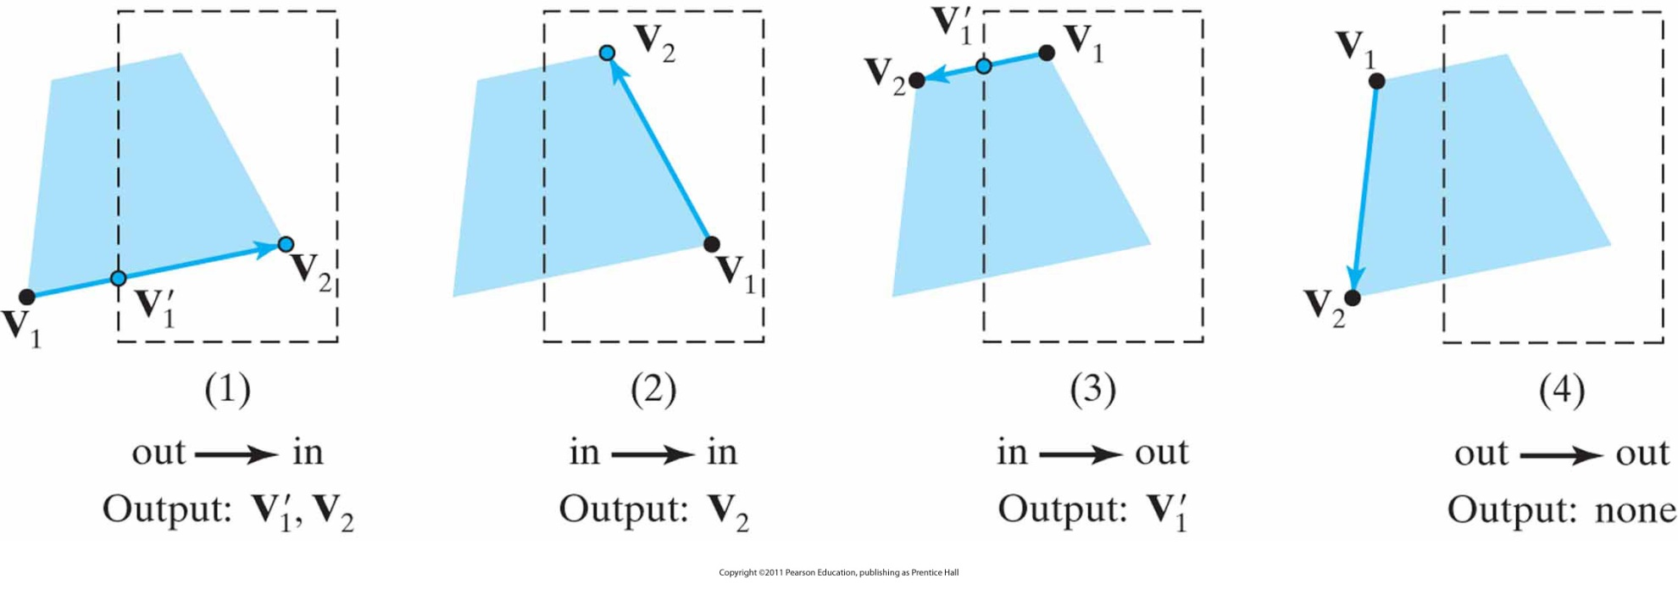
Example: Sutherland-Hodgman Clipping
The four possible outputs generated by the left clipper, depending on the position of a pair of endpoints relative to the left boundary of the clipping window.

Slide 56
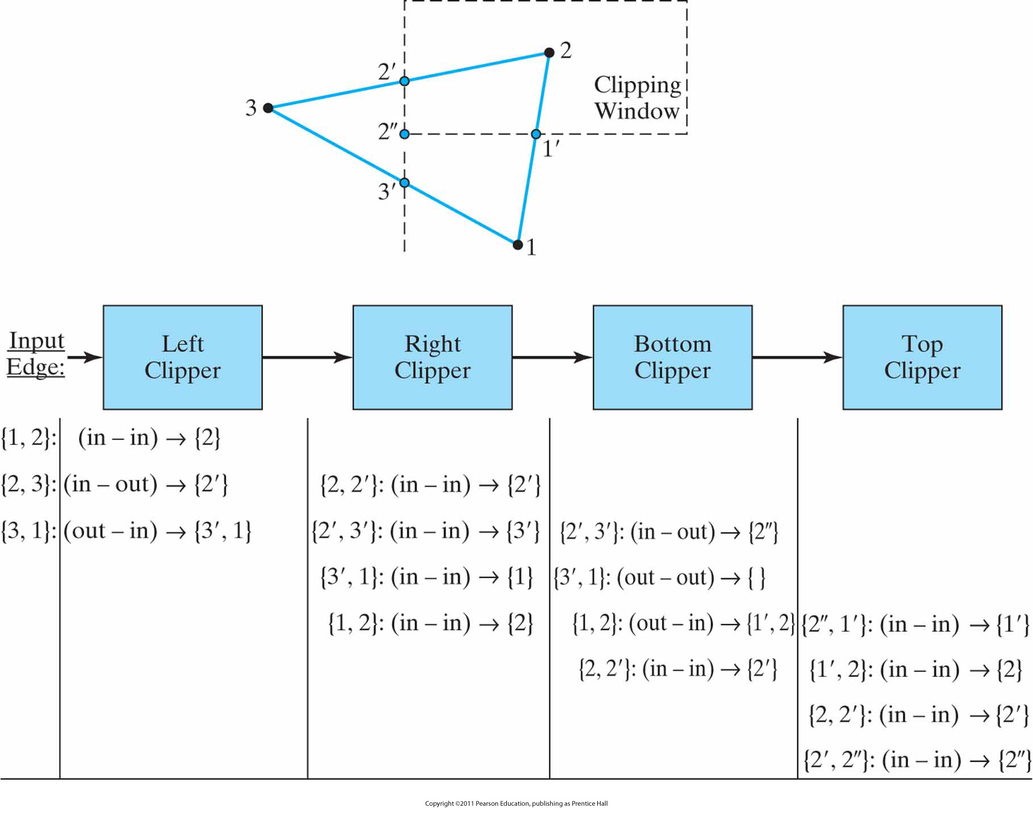
Example: Sutherland-Hodgman Clipping (cont.)
Processing a set of polygon vertices, {1, 2, 3}, through the boundary clippers using the Sutherland-Hodgman algorithm. The final set of clipped vertices is {1', 2, 2', 2''}.

Slide 57
Finding Line-Plane Intersections
Use parametric definition of edge:
  L(t) = L₀ + (L₁ - L₀)t
  If t = 0 then L(t) = L₀
  If t = 1 then L(t) = L₁
  Otherwise, L(t) is part way from L₀ to L₁

Slide 58
Finding Line-Plane Intersections (cont.)
Edge intersects plane P where E(t) is on P
  q is a point on P
  n is normal to P
  (L(t) - q) • n = 0
  t = [(q - L₀) • n] / [(L₁ - L₀) • n]
  The intersection point i = L(t) for this value of t
Note that the length of n doesn’t affect result:

Slide 59
Other Polygon Clipping Algorithms
Weiler-Atherton Polygon Clipping
Polygon clipping using nonrectangular polygon clip windows
Polygon clipping using nonlinear clipping-window boundaries

Slide 60
Curve and Text Clipping
Your responsibilty ☺

Slide 61
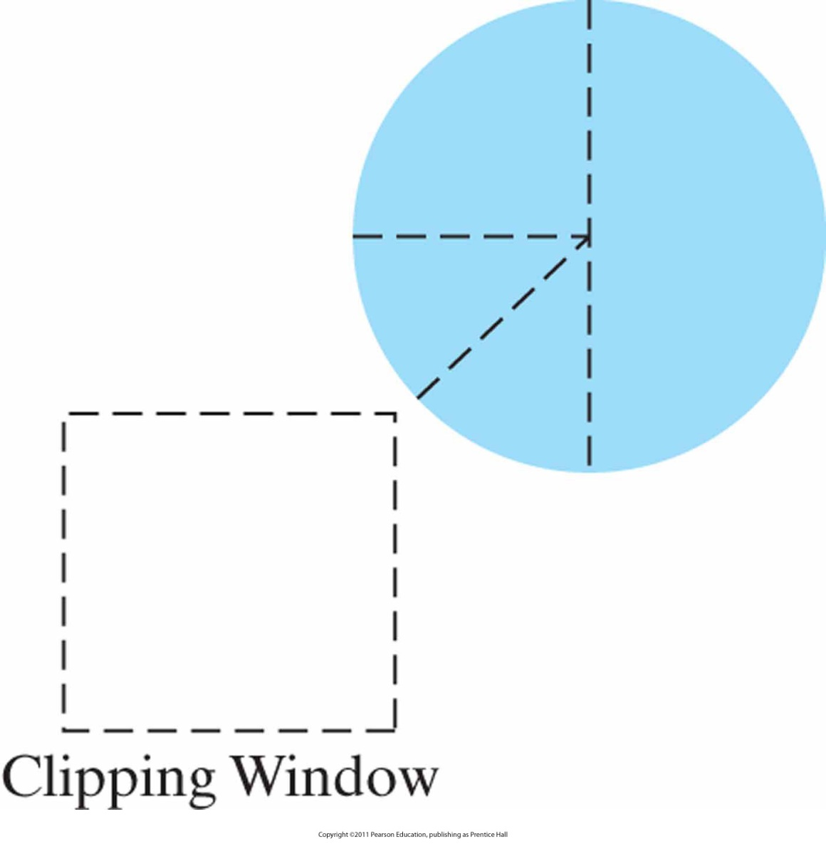
Curve and Text Clipping (cont.)
A circle fill area, showing the quadrant and octant sections that are outside the clipping-window boundaries.

Slide 62
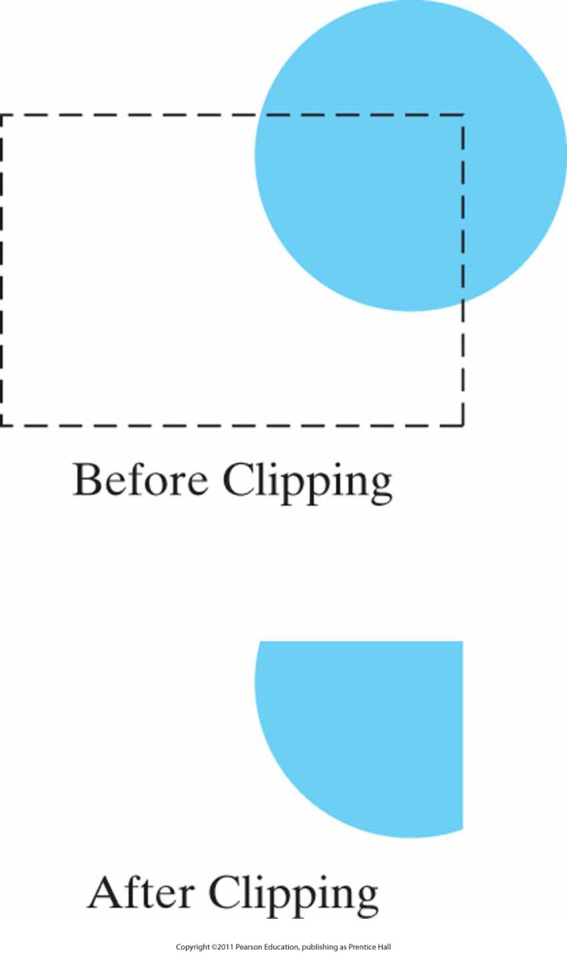
Curve and Text Clipping (cont.)
Clipping a circle fill area.

Slide 63
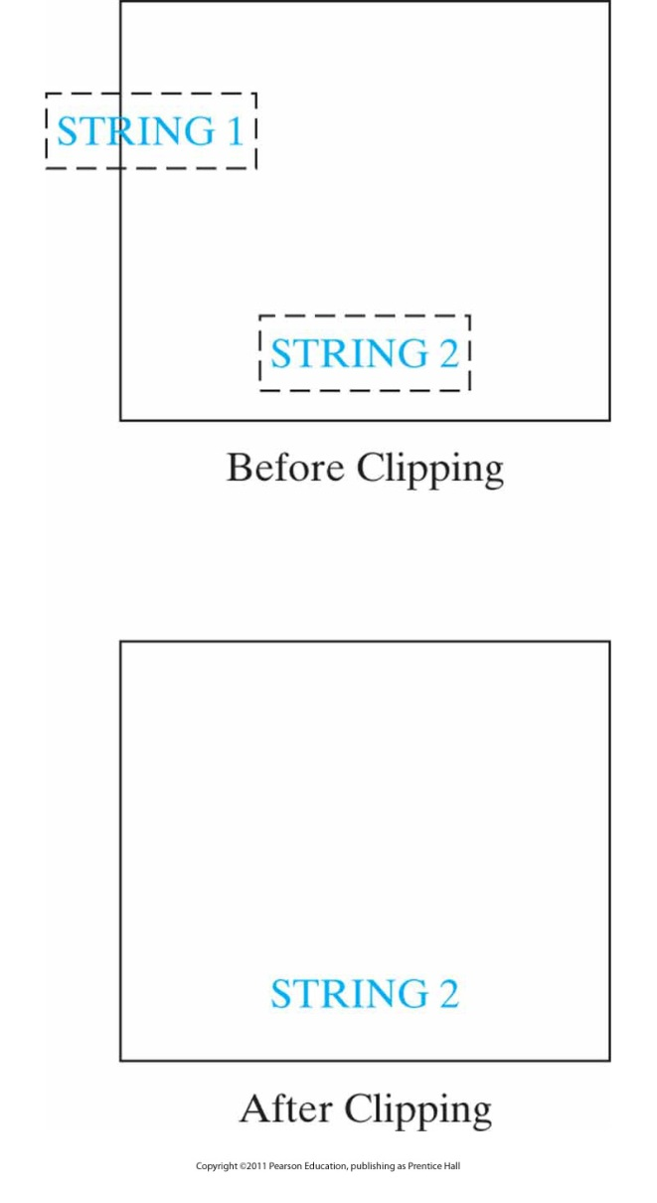
Curve and Text Clipping (cont.)
Text clipping using the coordinate extents for an entire string.

Slide 64
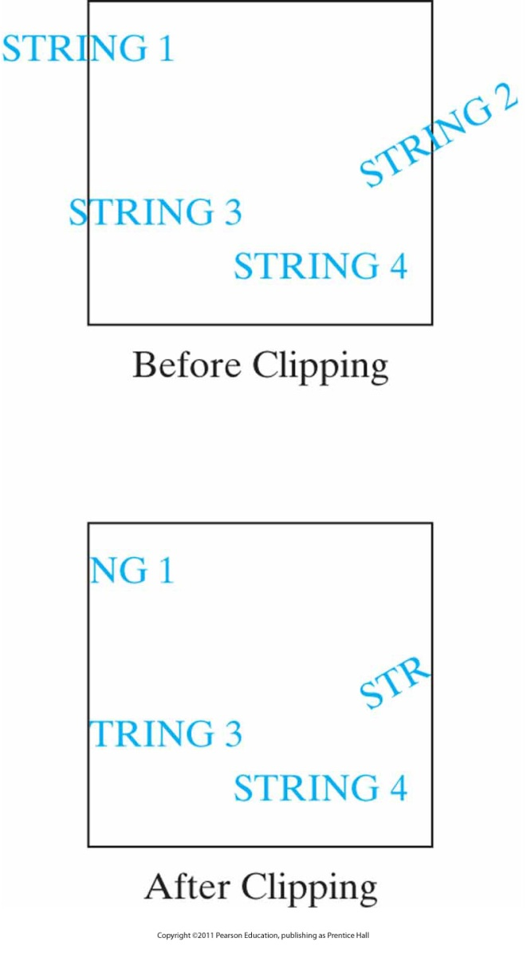
Curve and Text Clipping (cont.)
Text clipping using the bounding rectangle for individual characters in a string.

Slide 65
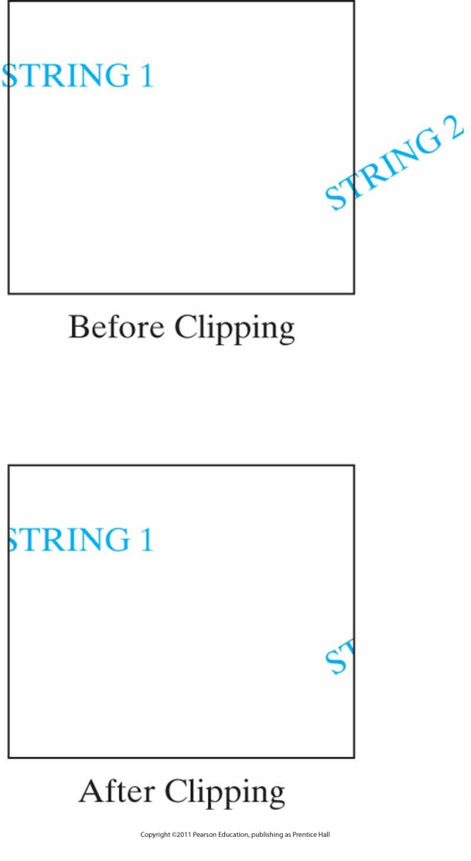
Curve and Text Clipping (cont.)
Text clipping performed on the components of individual characters.

Slide 66
Two Dimensional Viewing in OpenGL
Extra Slides

Slide 67
Libraries
OpenGL : Viewport functions,
GLU : Two-Dimensional clipping,
GLUT : Handling display windows.

Slide 68
OpenGL Projection Mode :
We must first select the projection matrix mode before any projection setting :
  glMatrixMode ( GL_PROJECTION );
  glLoadIdentity ( );
Remember: GL_MODELVIEW was the matrix mode for geometric transformations

Slide 69
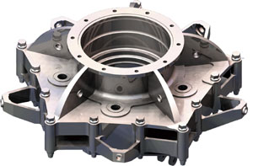
GLU Clipping-Window Function
For 2D Clipping :
  gluOrtho2D (xmin, xmax, ymin, ymax );
_{World Coordinates}

Slide 70
OpenGL Viewport Function
For 2D Clipping :
  glViewport ( xmin, ymin, width, height );
_{World Coordinates}

Slide 71
3D Viewing Example
#include <GL/glut.h>
void init(void)
{
glClearColor (0.0, 0.0, 0.0, 0.0);
glShadeModel (GL_FLAT);
}
void display(void)
{
glClear (GL_COLOR_BUFFER_BIT);
glColor3f (1.0, 1.0, 1.0);
glLoadIdentity (); /* clear the matrix */
/* viewing transformation */
gluLookAt (0.0, 0.0, 5.0, 0.0, 0.0, 0.0, 0.0, 1.0, 0.0);
glScalef (1.0, 2.0, 1.0); /* modeling transformation */
glutWireCube (1.0);
glFlush ();
}

Slide 72
3D Viewing Example cont.
void reshape (int w, int h)
{
glViewport (0, 0, (GLsizei) w, (GLsizei) h);
glMatrixMode (GL_PROJECTION);
glLoadIdentity ();
glFrustum (-1.0, 1.0, -1.0, 1.0, 1.5, 20.0);
glMatrixMode (GL_MODELVIEW);
}
int main(int argc, char** argv)
{
glutInit(&argc, argv);
glutInitDisplayMode (GLUT_SINGLE | GLUT_RGB);
glutInitWindowSize (500, 500);
glutInitWindowPosition (100, 100);
glutCreateWindow (argv[0]);
init ();
glutDisplayFunc(display);
glutReshapeFunc(reshape);
glutMainLoop();
return 0;
}

Slide 73
Viewing Transformation
gluLookAt
  gluLookAt (0.0, 0.0, 5.0, 0.0, 0.0, 0.0, 0.0, 1.0, 0.0);
    place the camera at (0, 0, 5), aim the camera lens towards (0, 0, 0), and specify the up-vector as (0, 1, 0)
  gluLookAt (x0, y0, z0, xref, yref, zref, Vx, Vy, Vz)
    where P0(x0, y0, z0) is viewing position in world-coordinates (camera position), Pref(xref, yref, zref) is reference position (look-at point), V(Vx, Vy, Vz) is the view-up vector (opposite to viewing direction)
    default P0=(0, 0, 0) and Pref=(0, 0, -1) and V=(0, 1, 0)

Slide 74
Creating a GLUT Display Window
  glutInit ( &argc, argv );
  glutInitDisplayPosition ( xpos, ypos );
  glutInitWindowSize ( width, height );
  glutCreateWindow ( “Homework-1” );
  glutInitDisplayMode ( GL_RGB | GL_DOUBLE );
  glClearColor ( red, green, blue, alpha );

Slide 75
GLUT Display-Window Identifier
We can use window-id to handle the window
  glutInit ( &argc, argv );
  glutInitDisplayPosition ( xpos, ypos );
  glutInitWindowSize ( width, height );
  winId=glutCreateWindow ( “Homework-1” );
  glutInitDisplayMode ( GL_RGB | GL_DOUBLE );
  glutDestroyWindow ( winId );
  glutSetWindow ( winId );
  current_winId = glutGetWindow ( );

Slide 76
Relocating and Resizing a GLUT Display Window
In the main( ) :
  glutInit ( &argc, argv );
  glutInitWindowSize ( width, height );
  glutCreateWindow ( “Homework-1” );
  glutInitDisplayMode ( GL_RGB | GL_DOUBLE );
  glutInitDisplayPosition ( xpos, ypos );
  glutReshapeFunc( myReshape );
  We can expand the window to fiil the screen :
  glutFullScreen ( );
In the function define section :
  void myReshape( int width, int height );

Slide 77
Managing Multiple GLUT Display Windows
Minimize window
  glutSetWindow ( windowId ); glutIconifyWindow ( );
  or
  glutHideWindow ( );
Restore window :
  glutSetWindow ( windowId ); glutShowWindow ( );
Swap windows :
  glutSetWindow ( windowId ); glutPushWindow ( );
  glutSetWindow ( windowId ); glutPopWindow ( );

Slide 78
Other GLUT Functions
Sub-windows
  glutSubWindow( windowId, xpos, ypos, width, height ); // windowId = 1,2,3,...
Selecting cursor type
  glutSetCursor ( shape );
    Shapes :
    GLUT_CURSOR_UP_DOWN
    GLUT_CURSOR_CYCLE
    GLUT_CURSOR_WAIT
    GLUT_CURSOR_DESTROY

Slide 79
Viewing Objects in a GLUT Display Window
In the main() :
  glutInit ( &argc, argv );
  glutInitDisplayPosition ( xpos, ypos );
  glutInitWindowSize ( width, height );
  glutCreateWindow ( “Homework-1” );
  glutInitDisplayMode ( GL_RGB | GL_DOUBLE );
  glutDisplayFunc( myDisplay );
In Display Function :
  glutSwapBuffers ( );
  // or glutFlush ( ); for display mode = GL_SINGLE
Calling display function to repaint the screen :
  glutPostRedisplay ( );

Slide 80
Other GLUT Functions
For animated re-displaying
  glutIdleFunction( myIdle ); // See Pong Hw
Getting information about system
  glutGet ( param );
    Information parameters :
    GLUT_WINDOW_WIDTH,
    GLUT_WINDOW_HEIGHT, etc.

Slide 81
Using GLUT Menus: Example [1/2]
The following is called in function init.
void make_main_menu() {
glutCreateMenu(handle_main_menu); glutAddMenuEntry("Toggle eye color", 1); glutAddMenuEntry("Toggle mouth motion", 2); glutAddMenuEntry("Quit", 3); glutAttachMenu(GLUT_RIGHT_BUTTON);
}
Value passed to handler callback can be the same for multiple entries.

Slide 82
Using GLUT Menus: Example [2/2]
Here is part of the handler callback function
void handle_main_menu(int value) {
switch (value) {
case 1: // Toggle eye color
blueeyes = !blueeyes;
glutPostRedisplay();
break;
…
case 3: // Quit
exit(0);
break;
Menu handlers, like keyboard functions, typically consist of one switch statement.

Slide 83

Next Lecture
3D Viewing
83
Notes:
83

Slide 84
References
Donald Hearn, M. Pauline Baker, Warren R. Carithers, “Computer Graphics with OpenGL, 4th Edition”; Pearson, 2011
Sumanta Guha, “Computer Graphics Through OpenGL: From Theory to Experiments”, CRC Press, 2010
Edward Angel, “Interactive Computer Graphics. A Top-Down Approach Using OpenGL”, Addison-Wesley, 2005
84

