Slide 1
CSE202 Database Management Systems
Lecture #8
Prepared & Presented by Asst. Prof. Dr. Samsun M. BAŞARICI

Slide 2
Learning Objectives
Overview of some informal design guidelines for relation schemas
Understanding functional dependencies
Recognizing normal forms based on primary keys
Defining and differentiating second and third normal forms
Understanding Boyce-Codd normal form
Discriminating multivalued dependency and fourth normal form
Understanding join dependencies and fifth normal form
Applying relational database design algorithms

Slide 3
Outline
Informal design guidelines for relation schemas
Functional dependencies
Normal forms based on primary keys
General definitions of second and third normal forms
Boyce-Codd normal form
Multivalued dependency and fourth normal form
Join dependencies and fifth normal form
Relational database design algorithms

Slide 4
Part 1
Dependencies & Normal Forms

Slide 5
Introduction
Levels at which we can discuss goodness of relation schemas
  Logical (or conceptual) level
  Implementation (or physical storage) level
Approaches to database design:
  Bottom-up or top-down

Slide 6
Informal Design Guidelines for Relation Schemas
Measures of quality
  Making sure attribute semantics are clear
  Reducing redundant information in tuples
  Reducing NULL values in tuples
  Disallowing possibility of generating spurious tuples

Slide 7
Imparting Clear Semantics to Attributes in Relations
Semantics of a relation
  Meaning resulting from interpretation of attribute values in a tuple
Easier to explain semantics of relation
  Indicates better schema design

Slide 8
Guideline 1
Design relation schema so that it is easy to explain its meaning
Do not combine attributes from multiple entity types and relationship types into a single relation
Example of violating Guideline 1: Figure 15.3

Slide 9
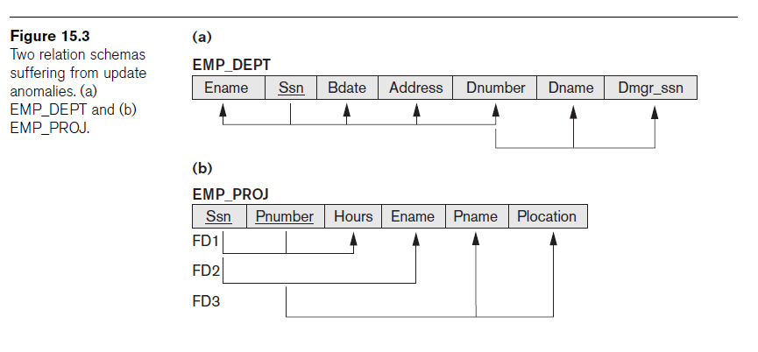
Guideline 1 (cont.)

Slide 10
Redundant Information in Tuples and Update Anomalies
Grouping attributes into relation schemas
  Significant effect on storage space
Storing natural joins of base relations leads to update anomalies
Types of update anomalies:
  Insertion
  Deletion
  Modification

Slide 11
Guideline 2
Design base relation schemas so that no update anomalies are present in the relations
If any anomalies are present:
  Note them clearly
  Make sure that the programs that update the database will operate correctly

Slide 12
NULL Values in Tuples
May group many attributes together into a “fat” relation
  Can end up with many NULLs
Problems with NULLs
  Wasted storage space
  Problems understanding meaning

Slide 13
Guideline 3
Avoid placing attributes in a base relation whose values may frequently be NULL
If NULLs are unavoidable:
  Make sure that they apply in exceptional cases only, not to a majority of tuples

Slide 14
Generation of Spurious Tuples
Figure 15.5(a)
  Relation schemas EMP_LOCS and EMP_PROJ1
NATURAL JOIN
  Result produces many more tuples than the original set of tuples in EMP_PROJ
  Called spurious tuples
  Represent spurious information that is not valid

Slide 15


Slide 16
Guideline 4
Design relation schemas to be joined with equality conditions on attributes that are appropriately related
  Guarantees that no spurious tuples are generated
Avoid relations that contain matching attributes that are not (foreign key, primary key) combinations

Slide 17
Summary and Discussion of Design Guidelines
Anomalies cause redundant work to be done
Waste of storage space due to NULLs
Difficulty of performing operations and joins due to NULL values
Generation of invalid and spurious data during joins

Slide 18
Functional Dependencies
Formal tool for analysis of relational schemas
Enables us to detect and describe some of the above-mentioned problems in precise terms
Theory of functional dependency

Slide 19
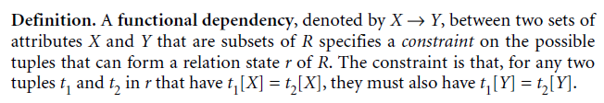
Definition of Functional Dependency
Constraint between two sets of attributes from the database
Property of semantics or meaning of the attributes
Legal relation states
  Satisfy the functional dependency constraints

Slide 20
Definition of Functional Dependency (cont.)
Given a populated relation
  Cannot determine which FDs hold and which do not
  Unless meaning of and relationships among attributes known
  Can state that FD does not hold if there are tuples that show violation of such an FD

Slide 21
Normal Forms Based on Primary Keys
Normalization process
Approaches for relational schema design
  Perform a conceptual schema design using a conceptual model then map conceptual design into a set of relations
  Design relations based on external knowledge derived from existing implementation of files or forms or reports

Slide 22

Normalization of Relations
Takes a relation schema through a series of tests
  Certify whether it satisfies a certain normal form
  Proceeds in a top-down fashion
Normal form tests

Slide 23
Normalization of Relations (cont.)
Properties that the relational schemas should have:
  Nonadditive join property
    Extremely critical
  Dependency preservation property
    Desirable but sometimes sacrificed for other factors

Slide 24
Practical Use of Normal Forms
Normalization carried out in practice
  Resulting designs are of high quality and meet the desirable properties stated previously
  Pays particular attention to normalization only up to 3NF, BCNF, or at most 4NF
Do not need to normalize to the highest possible normal form

Slide 25

Definitions of Keys and Attributes Participating in Keys
Definition of superkey and key
Candidate key
  If more than one key in a relation schema
    One is primary key
    Others are secondary keys

Slide 26
First Normal Form
Part of the formal definition of a relation in the basic (flat) relational model
Only attribute values permitted are single atomic (or indivisible) values
Techniques to achieve first normal form
  Remove attribute and place in separate relation
  Expand the key
  Use several atomic attributes

Slide 27
First Normal Form (cont.)
Does not allow nested relations
  Each tuple can have a relation within it
To change to 1NF:
  Remove nested relation attributes into a new relation
  Propagate the primary key into it
  Unnest relation into a set of 1NF relations

Slide 28
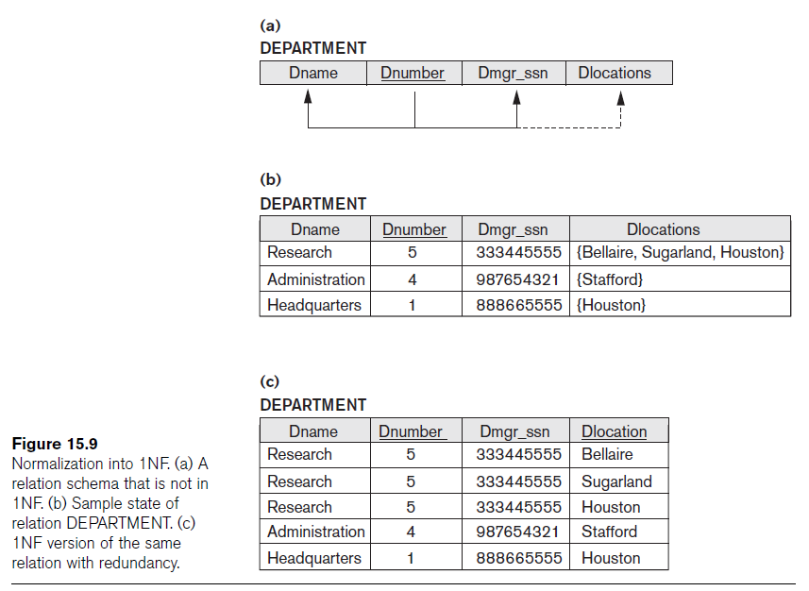

Slide 29
Second Normal Form
Based on concept of full functional dependency
  Versus partial dependency
Second normalize into a number of 2NF relations
  Nonprime attributes are associated only with part of primary key on which they are fully functionally dependent

Slide 30

Third Normal Form
Based on concept of transitive dependency
Problematic FD
  Left-hand side is part of primary key
  Left-hand side is a nonkey attribute

Slide 31
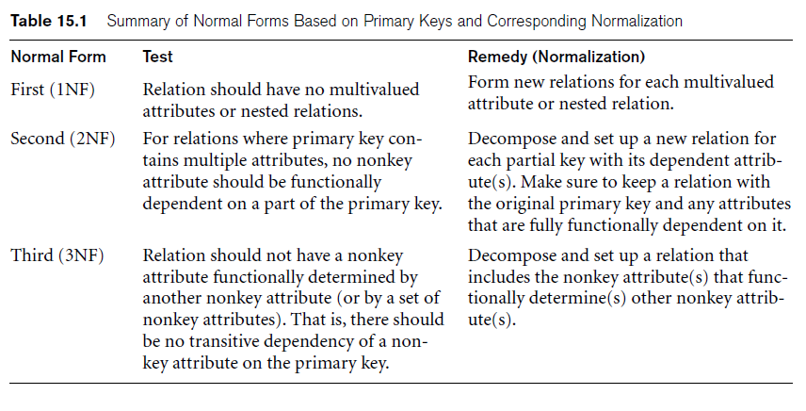
General Definitions of Second and Third Normal Forms

Slide 32
General Definitions of Second and Third Normal Forms (cont.)
Prime attribute
  Part of any candidate key will be considered as prime
Consider partial, full functional, and transitive dependencies with respect to all candidate keys of a relation

Slide 33
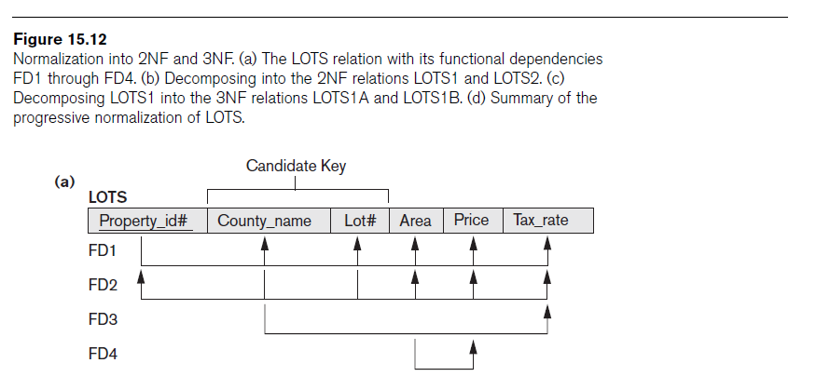
General Definition of Second Normal Form

Slide 34
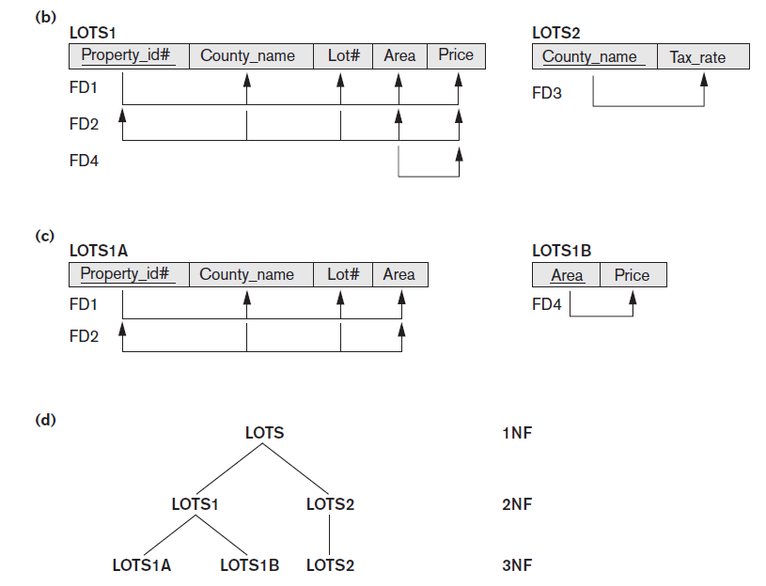

Slide 35

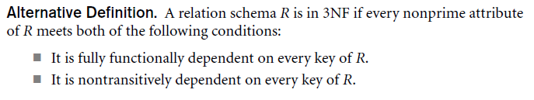
General Definition of Third Normal Form

Slide 36

Boyce-Codd Normal Form
Every relation in BCNF is also in 3NF
  Relation in 3NF is not necessarily in BCNF
Difference:
  Condition which allows A to be prime is absent from BCNF
Most relation schemas that are in 3NF are also in BCNF

Slide 37
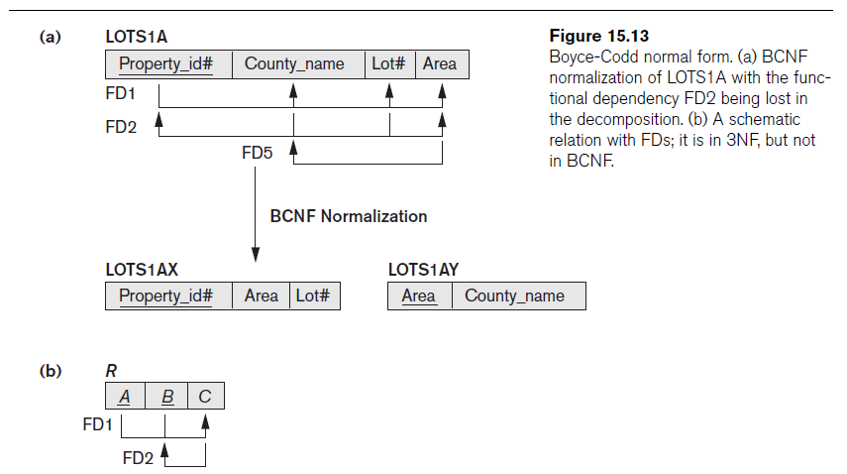

Slide 38
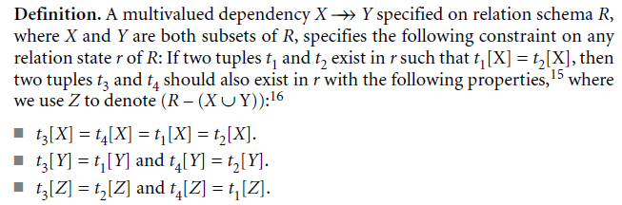
Multivalued Dependency and Fourth Normal Form
Multivalued dependency (MVD)
  Consequence of first normal form (1NF)

Slide 39

Multivalued Dependency and Fourth Normal Form (cont.)
Relations containing nontrivial MVDs
  All-key relations
Fourth normal form (4NF)
  Violated when a relation has undesirable multivalued dependencies

Slide 40
Join Dependencies and Fifth Normal Form
Join dependency
Multiway decomposition into fifth normal form (5NF)
Very peculiar semantic constraint
  Normalization into 5NF is very rarely done in practice

Slide 41
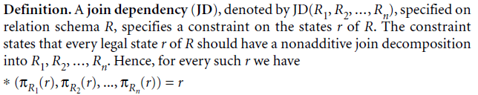
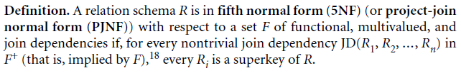
Join Dependencies and Fifth Normal Form (cont.)

Slide 42
Part 2
Relational DB Design Algorithms

Slide 43
Designing a Set of Relations (1)
The Approach of Relational Synthesis (Bottom-up Design):
  Assumes that all possible functional dependencies are known.
  First constructs a minimal set of FDs
  Then applies algorithms that construct a target set of 3NF or BCNF relations.
  Additional criteria may be needed to ensure the the set of relations in a relational database are satisfactory.

Slide 44
Designing a Set of Relations (2)
Goals:
  Lossless join property (a must)
    Algorithm 16.3 tests for general losslessness.
  Dependency preservation property
    Algorithm 16.5 decomposes a relation into BCNF components by sacrificing the dependency preservation.
  Additional normal forms
    4NF (based on multi-valued dependencies)
    5NF (based on join dependencies)

Slide 45
1. Properties of Relational Decompositions (1)
Relation Decomposition and Insufficiency of Normal Forms:
  Universal Relation Schema:
    A relation schema R = {A1, A2, …, An} that includes all the attributes of the database.
  Universal relation assumption:
    Every attribute name is unique.

Slide 46
Properties of Relational Decompositions (2)
Relation Decomposition and Insufficiency of Normal Forms (cont.):
  Decomposition:
    The process of decomposing the universal relation schema R into a set of relation schemas D = {R1,R2, …, Rm} that will become the relational database schema by using the functional dependencies.
  Attribute preservation condition:
    Each attribute in R will appear in at least one relation schema Ri in the decomposition so that no attributes are “lost”.

Slide 47
Properties of Relational Decompositions (2)
Another goal of decomposition is to have each individual relation Ri in the decomposition D be in BCNF or 3NF.
Additional properties of decomposition are needed to prevent from generating spurious tuples

Slide 48
Properties of Relational Decompositions (3)
Dependency Preservation Property of a Decomposition:
  Definition: Given a set of dependencies F on R, the projection of F on R_{i}, denoted by p_{Ri}(F) where R_{i} is a subset of R, is the set of dependencies X  Y in F⁺ such that the attributes in X υ Y are all contained in R_{i}.
  Hence, the projection of F on each relation schema R_{i} in the decomposition D is the set of functional dependencies in F⁺, the closure of F, such that all their left- and right-hand-side attributes are in R_{i}.

Slide 49
Properties of Relational Decompositions (4)
Dependency Preservation Property of a Decomposition (cont.):
  Dependency Preservation Property:
    A decomposition D = {R1, R2, ..., Rm} of R is dependency-preserving with respect to F if the union of the projections of F on each Ri in D is equivalent to F; that is
    ((π_{R1}(F)) υ . . . υ (π_{Rm}(F)))⁺ = F⁺
    (See examples in Fig 15.13a and Fig 15.12)
Claim 1:
  It is always possible to find a dependency-preserving decomposition D with respect to F such that each relation Ri in D is in 3nf.

Slide 50
Properties of Relational Decompositions (5)
Lossless (Non-additive) Join Property of a Decomposition:
  Definition: Lossless join property: a decomposition D = {R1, R2, ..., Rm} of R has the lossless (nonadditive) join property with respect to the set of dependencies F on R if, for every relation state r of R that satisfies F, the following holds, where * is the natural join of all the relations in D:
* (π _{R1}(r), ..., π_{Rm}(r)) = r
  Note: The word loss in lossless refers to loss of information, not to loss of tuples. In fact, for “loss of information” a better term is “addition of spurious information”

Slide 51
Properties of Relational Decompositions (6)
Lossless (Non-additive) Join Property of a Decomposition (cont.):
Algorithm 16.3: Testing for Lossless Join Property
  Input: A universal relation R, a decomposition D = {R1, R2, ..., Rm} of R, and a set F of functional dependencies.
1. Create an initial matrix S with one row i for each relation Ri in D, and one column j for each attribute Aj in R.
2. Set S(i,j):=bij for all matrix entries. (* each bij is a distinct symbol associated with indices (i,j) *).
3. For each row i representing relation schema Ri
{for each column j representing attribute Aj
{if (relation Ri includes attribute Aj) then set S(i,j):= aj;};};
  (* each aj is a distinct symbol associated with index (j) *)

Slide 52
Properties of Relational Decompositions (7)
Lossless (Non-additive) Join Property of a Decomposition (cont.):
Algorithm 16.3: Testing for Lossless Join Property
4. Repeat the following loop until a complete loop execution results in no changes to S
{for each functional dependency X Y in F
{for all rows in S which have the same symbols in the columns corresponding to attributes in X
{make the symbols in each column that correspond to an attribute in Y be the same in all these rows as follows:
If any of the rows has an “a” symbol for the column, set the other rows to that same “a” symbol in the column.
If no “a” symbol exists for the attribute in any of the rows, choose one of the “b” symbols that appear in one of the rows for the attribute and set the other rows to that same “b” symbol in the column ;};
};
};
5. If a row is made up entirely of “a” symbols, then the decomposition has the lossless join property; otherwise it does not.

Slide 53
Properties of Relational Decompositions (8)
Lossless (nonadditive) join test for n-ary decompositions.
(a) Case 1: Decomposition of EMP_PROJ into EMP_PROJ1 and EMP_LOCS fails test.
(b) A decomposition of EMP_PROJ that has the lossless join property.

Slide 54
Properties of Relational Decompositions (9)
Lossless (nonadditive) join test for n-ary decompositions.
(c) Case 2: Decomposition of EMP_PROJ into EMP, PROJECT, and WORKS_ON satisfies test.

Slide 55
Properties of Relational Decompositions (10)
Testing Binary Decompositions for Lossless Join Property
  Binary Decomposition: Decomposition of a relation R into two relations.
  PROPERTY LJ1 (lossless join test for binary decompositions): A decomposition D = {R1, R2} of R has the lossless join property with respect to a set of functional dependencies F on R if and only if either
    The f.d. ((R1 ∩ R2)  (R1- R2)) is in F⁺, or
    The f.d. ((R1 ∩ R2)  (R2 - R1)) is in F⁺.

Slide 56
Properties of Relational Decompositions (11)
Successive Lossless Join Decomposition:
  Claim 2 (Preservation of non-additivity in successive decompositions):
    If a decomposition D = {R1, R2, ..., Rm} of R has the lossless (non-additive) join property with respect to a set of functional dependencies F on R,
    and if a decomposition Di = {Q1, Q2, ..., Qk} of Ri has the lossless (non-additive) join property with respect to the projection of F on Ri,
      then the decomposition D2 = {R1, R2, ..., Ri-1, Q1, Q2, ..., Qk, Ri+1, ..., Rm} of R has the non-additive join property with respect to F.

Slide 57
2. Algorithms for Relational Database Schema Design (1)
Algorithm 16.4: Relational Synthesis into 3NF with Dependency Preservation (Relational Synthesis Algorithm)
  Input: A universal relation R and a set of functional dependencies F on the attributes of R.
1. Find a minimal cover G for F (use Algorithm 16.2);
2. For each left-hand-side X of a functional dependency that appears in G,
create a relation schema in D with attributes {X υ {A1} υ {A2} ... υ {Ak}},
where X  A1, X  A2, ..., X  Ak are the only dependencies in G with X as left-hand-side (X is the key of this relation) ;
3. Place any remaining attributes (that have not been placed in any relation) in a single relation schema to ensure the attribute preservation property.
  Claim 3: Every relation schema created by Algorithm 16.4 is in 3NF.

Slide 58
Algorithms for Relational Database Schema Design (2)
Algorithm 16.5: Relational Decomposition into BCNF with Lossless (non-additive) join property
  Input: A universal relation R and a set of functional dependencies F on the attributes of R.
1. Set D := {R};
2. While there is a relation schema Q in D that is not in BCNF
do {
choose a relation schema Q in D that is not in BCNF;
find a functional dependency X  Y in Q that violates BCNF;
replace Q in D by two relation schemas (Q - Y) and (X υ Y);
};
Assumption: No null values are allowed for the join attributes.

Slide 59
Algorithms for Relational Database Schema Design (3)
Algorithm 16.6 Relational Synthesis into 3NF with Dependency Preservation and Lossless (Non-Additive) Join Property
  Input: A universal relation R and a set of functional dependencies F on the attributes of R.
1. Find a minimal cover G for F (Use Algorithm 16.2).
2. For each left-hand-side X of a functional dependency that appears in G,
create a relation schema in D with attributes {X υ {A1} υ {A2} ... υ {Ak}},
where X  A1, X  A2, ..., X –>Ak are the only dependencies in G with X as left-hand-side (X is the key of this relation).
3. If none of the relation schemas in D contains a key of R, then create one more relation schema in D that contains attributes that form a key of R. (Use Algorithm 16.4a to find the key of R)

Slide 60
Algorithms for Relational Database Schema Design (4)
Algorithm 16.2a Finding a Key K for R Given a set F of Functional Dependencies
  Input: A universal relation R and a set of functional dependencies F on the attributes of R.
1. Set K := R;
2. For each attribute A in K {
Compute (K - A)+ with respect to F;
If (K - A)+ contains all the attributes in R,
then set K := K - {A};
}

Slide 61
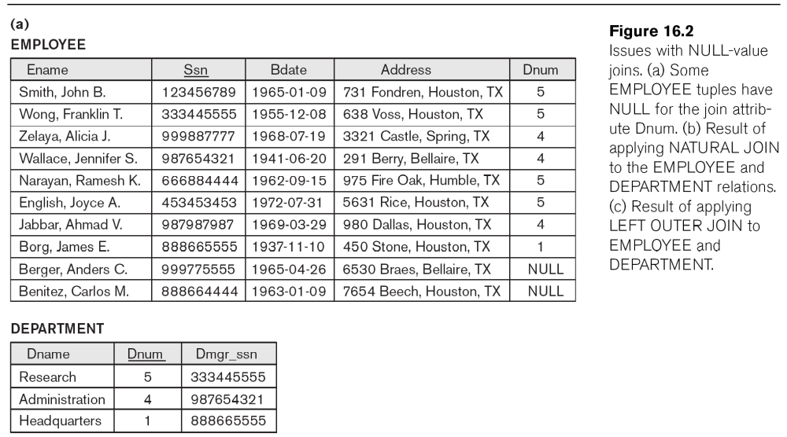
Algorithms for Relational Database Schema Design (5)

Slide 62
Algorithms for Relational Database Schema Design (5)

Slide 63
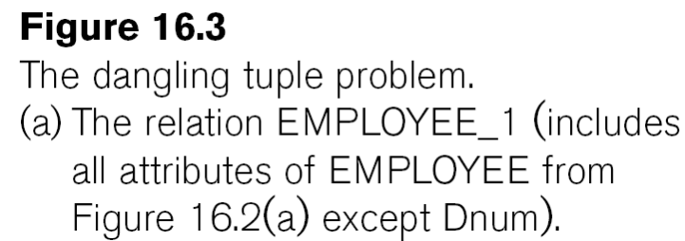
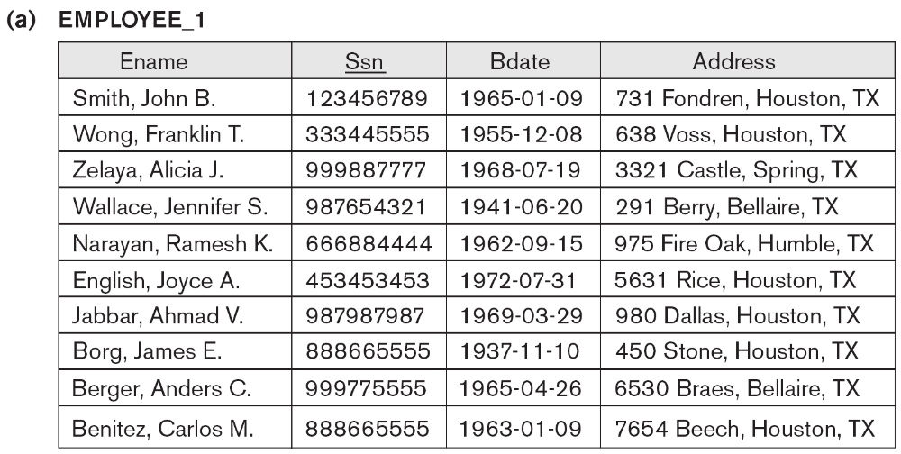
Algorithms for Relational Database Schema Design (6)

Slide 64
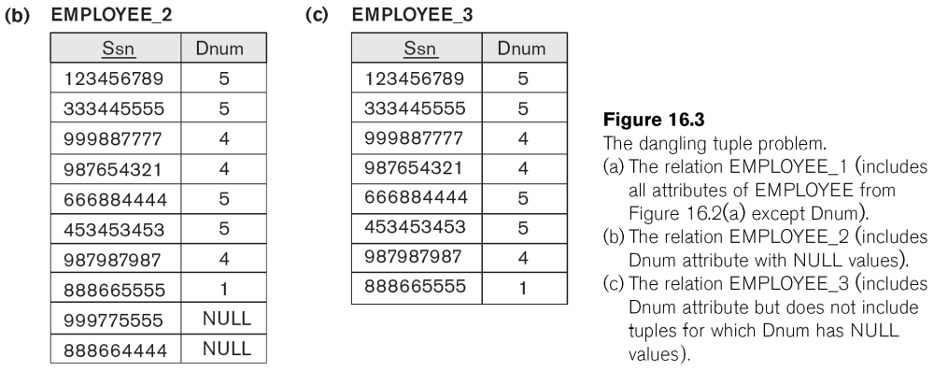
Algorithms for Relational Database Schema Design (7)

Slide 65
Algorithms for Relational Database Schema Design (8)
Discussion of Normalization Algorithms:
Problems:
  The database designer must first specify all the relevant functional dependencies among the database attributes.
  These algorithms are not deterministic in general.
  It is not always possible to find a decomposition into relation schemas that preserves dependencies and allows each relation schema in the decomposition to be in BCNF (instead of 3NF as in Algorithm 16.6).

Slide 66
Algorithms for Relational Database Schema Design (9)

Slide 67
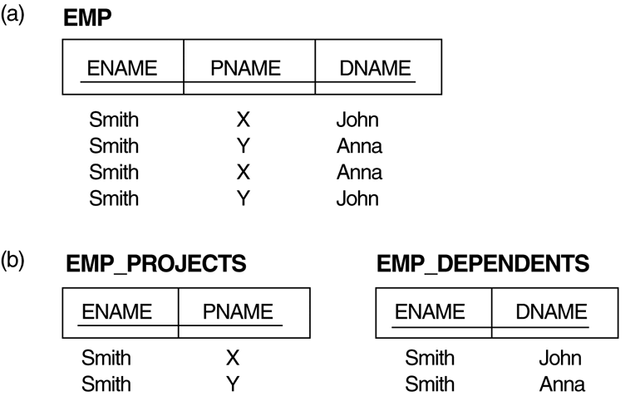
3. Multivalued Dependencies and Fourth Normal Form (1)
The EMP relation with two MVDs: ENAME —>> PNAME and ENAME —>> DNAME.
Decomposing the EMP relation into two 4NF relations EMP_PROJECTS and EMP_DEPENDENTS.

Slide 68
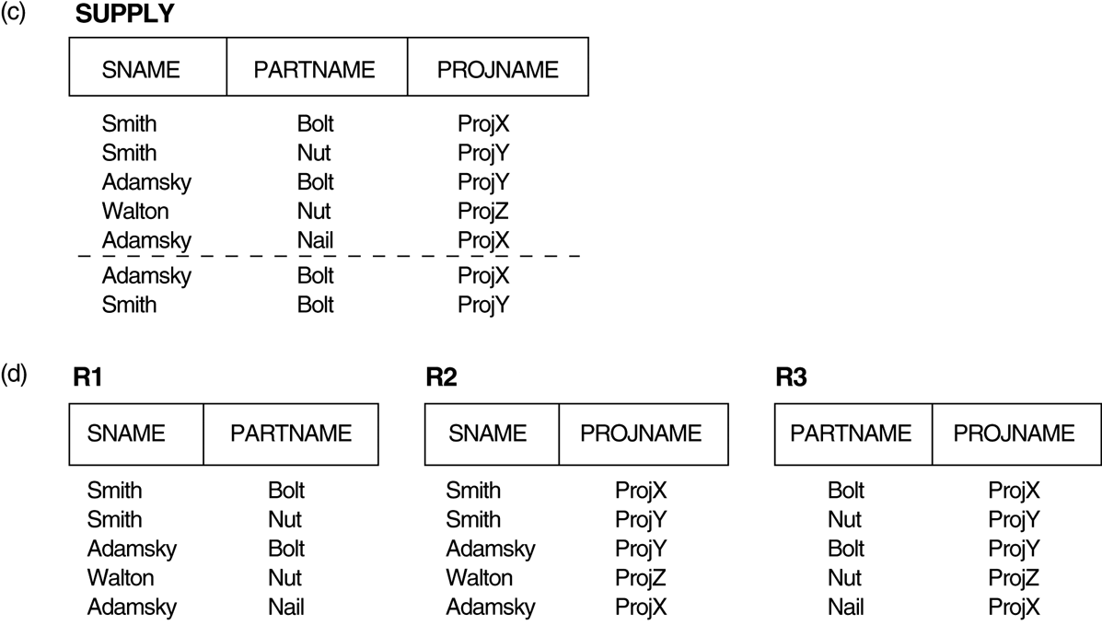
3. Multivalued Dependencies and Fourth Normal Form (2)
(c) The relation SUPPLY with no MVDs is in 4NF but not in 5NF if it has the JD(R1, R2, R3). (d) Decomposing the relation SUPPLY into the 5NF relations R1, R2, and R3.

Slide 69
Multivalued Dependencies and Fourth Normal Form (3)
Definition:
A multivalued dependency (MVD) X —>> Y specified on relation schema R, where X and Y are both subsets of R, specifies the following constraint on any relation state r of R: If two tuples t₁ and t₂ exist in r such that t₁[X] = t₂[X], then two tuples t₃ and t₄ should also exist in r with the following properties, where we use Z to denote (R 2 (X υ Y)):
  t₃[X] = t₄[X] = t₁[X] = t₂[X].
  t₃[Y] = t₁[Y] and t₄[Y] = t₂[Y].
  t₃[Z] = t₂[Z] and t₄[Z] = t₁[Z].
An MVD X —>> Y in R is called a trivial MVD if (a) Y is a subset of X, or (b) X υ Y = R.

Slide 70
Multivalued Dependencies and Fourth Normal Form (4)
Inference Rules for Functional and
Multivalued Dependencies:
  IR1 (reflexive rule for FDs): If X ⊇ Y, then X –> Y.
  IR2 (augmentation rule for FDs): {X –> Y} ⏐= XZ –> YZ.
  IR3 (transitive rule for FDs): {X –> Y, Y –>Z} ⏐= X –> Z.
  IR4 (complementation rule for MVDs): {X —>> Y} ⏐= X —>>
  (R – (X ∪ Y))}.
  IR5 (augmentation rule for MVDs): If X —>> Y and W ⊇ Z
  then WX —>> YZ.
  IR6 (transitive rule for MVDs): {X —>> Y, Y —>> Z} ⏐= X —>> (Z 2 Y).
  IR7 (replication rule for FD to MVD): {X –> Y} ⏐= X —>> Y.
  IR8 (coalescence rule for FDs and MVDs): If X —>> Y and there exists W with the properties that
    (a) W ∩ Y is empty, (b) W –> Z, and (c) Y ⊇ Z, then X –> Z.

Slide 71
Multivalued Dependencies and Fourth Normal Form (5)
Definition:
A relation schema R is in 4NF with respect to a set of dependencies F (that includes functional dependencies and multivalued dependencies) if, for every nontrivial multivalued dependency X —>> Y in F⁺, X is a superkey for R.
  Note: F⁺ is the (complete) set of all dependencies (functional or multivalued) that will hold in every relation state r of R that satisfies F. It is also called the closure of F.

Slide 72
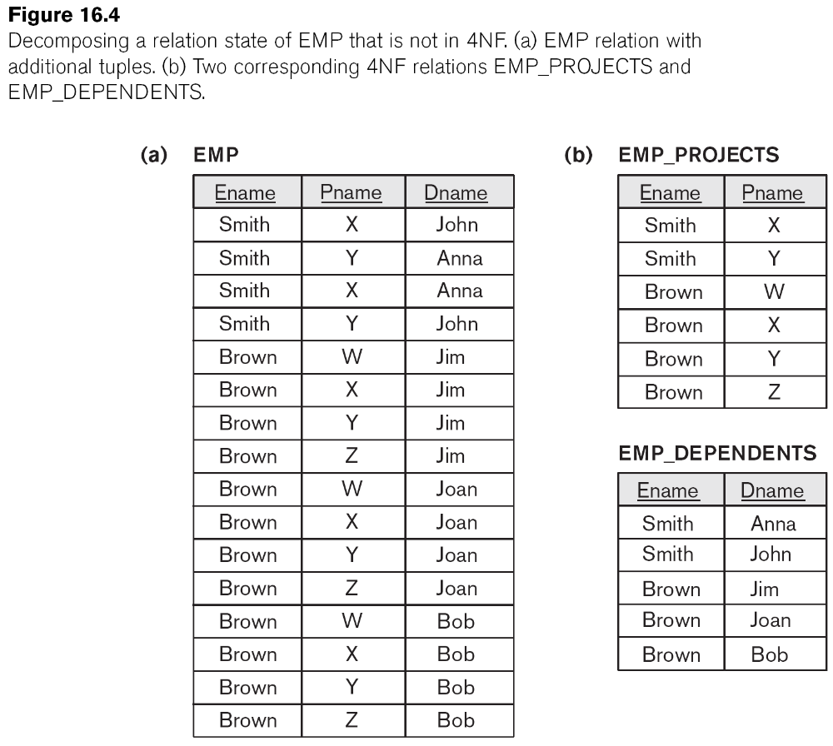
Multivalued Dependencies and Fourth Normal Form (6)

Slide 73
Multivalued Dependencies and Fourth Normal Form (7)
Lossless (Non-additive) Join Decomposition into 4NF Relations:
PROPERTY LJ1’
  The relation schemas R₁ and R₂ form a lossless (non-additive) join decomposition of R with respect to a set F of functional and multivalued dependencies if and only if
    (R₁ ∩ R₂) —>> (R₁ - R₂)
  or by symmetry, if and only if
    (R₁ ∩ R₂) —>> (R₂ - R₁)).

Slide 74
Multivalued Dependencies and Fourth Normal Form (8)
Algorithm 16.7: Relational decomposition into 4NF relations with non-additive join property
Input: A universal relation R and a set of functional and multivalued dependencies F.
Set D := { R };
While there is a relation schema Q in D that is not in 4NF do {
choose a relation schema Q in D that is not in 4NF;
find a nontrivial MVD X —>> Y in Q that violates 4NF;
replace Q in D by two relation schemas (Q - Y) and (X υ Y);
};

Slide 75
4. Join Dependencies and Fifth Normal Form (1)
Definition:
A join dependency (JD), denoted by JD(R₁, R₂, ..., R_{n}), specified on relation schema R, specifies a constraint on the states r of R.
  The constraint states that every legal state r of R should have a non-additive join decomposition into R₁, R₂, ..., R_{n}; that is, for every such r we have
  * (π_{R1}(r), π_{R2}(r), ..., π_{Rn}(r)) = r
Note: an MVD is a special case of a JD where n = 2.
A join dependency JD(R₁, R₂, ..., R_{n}), specified on relation schema R, is a trivial JD if one of the relation schemas R_{i} in JD(R₁, R₂, ..., R_{n}) is equal to R.

Slide 76
Join Dependencies and Fifth Normal Form (2)
Definition:
A relation schema R is in fifth normal form (5NF) (or Project-Join Normal Form (PJNF)) with respect to a set F of functional, multivalued, and join dependencies if,
  for every nontrivial join dependency JD(R₁, R₂, ..., R_{n}) in F⁺ (that is, implied by F),
    every R_{i} is a superkey of R.

Slide 77
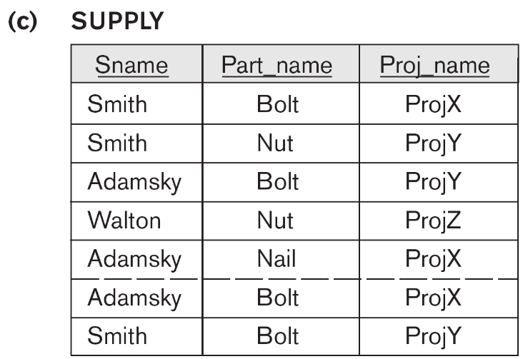
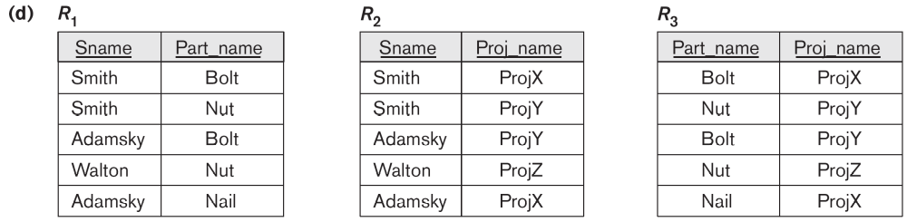
Relation SUPPLY with Join Dependency and Conversion to Fifth Normal Form

Slide 78
5. Inclusion Dependencies (1)
Definition:
An inclusion dependency R.X < S.Y between two sets of attributes—X of relation schema R, and Y of relation schema S—specifies the constraint that, at any specific time when r is a relation state of R and s a relation state of S, we must have
  π_{X}(r(R)) ⊇ π_{Y}(s(S))
Note:
  The ? (subset) relationship does not necessarily have to be a proper subset.
  The sets of attributes on which the inclusion dependency is specified—X of R and Y of S—must have the same number of attributes.
  In addition, the domains for each pair of corresponding attributes should be compatible.

Slide 79
Inclusion Dependencies (2)
Objective of Inclusion Dependencies:
  To formalize two types of interrelational constraints which cannot be expressed using F.D.s or MVDs:
    Referential integrity constraints
    Class/subclass relationships
Inclusion dependency inference rules
  IDIR1 (reflexivity): R.X < R.X.
  IDIR2 (attribute correspondence): If R.X < S.Y
    where X = {A₁, A₂ ,..., A_{n}} and Y = {B₁,
    B₂, ..., B_{n}} and A_{i} Corresponds-to B_{i}, then R.A_{i} < S.B_{i}
    for 1 ≤ i ≤ n.
  IDIR3 (transitivity): If R.X < S.Y and S.Y < T.Z, then R.X < T.Z.

Slide 80
6. Other Dependencies and Normal Forms (1)
Template Dependencies:
Template dependencies provide a technique for representing constraints in relations that typically have no easy and formal definitions.
The idea is to specify a template—or example—that defines each constraint or dependency.
There are two types of templates:
  tuple-generating templates
  constraint-generating templates.
A template consists of a number of hypothesis tuples that are meant to show an example of the tuples that may appear in one or more relations. The other part of the template is the template conclusion.

Slide 81
Other Dependencies and Normal Forms (2)

Slide 82
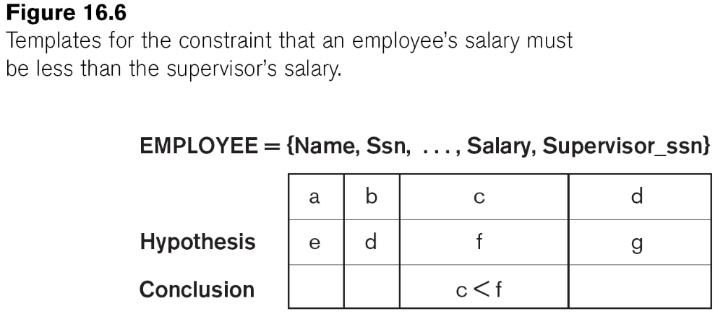
Other Dependencies and Normal Forms (3)

Slide 83
Other Dependencies and Normal Forms (4)
Domain-Key Normal Form (DKNF):
Definition:
  A relation schema is said to be in DKNF if all constraints and dependencies that should hold on the valid relation states can be enforced simply by enforcing the domain constraints and key constraints on the relation.
The idea is to specify (theoretically, at least) the “ultimate normal form” that takes into account all possible types of dependencies and constraints. .
For a relation in DKNF, it becomes very straightforward to enforce all database constraints by simply checking that each attribute value in a tuple is of the appropriate domain and that every key constraint is enforced.
The practical utility of DKNF is limited

Slide 84
Additional Material (Again)
Logical DB Design

Slide 85
Chapter 7
Logical Database Design
Fundamentals of Database Management Systems, 2nd ed.
by
Mark L. Gillenson, Ph.D.
University of Memphis
John Wiley & Sons, Inc.

Slide 86
Chapter Objectives
Describe the concept of logical database design.
Design relational databases by converting entity-relationship diagrams into relational tables.
Describe the data normalization process.

Slide 87
Chapter Objectives
Perform the data normalization process.
Test tables for irregularities using the data normalization process.

Slide 88
Logical Database Design
The process of deciding how to arrange the attributes of the entities in the business environment into database structures, such as the tables of a relational database.
The goal is to create well structured tables that properly reflect the company’s business environment.

Slide 89
Logical Design of Relational Database Systems
(1) The conversion of E-R diagrams into relational tables.
(2) The data normalization technique.
(3) The use of the data normalization technique to test the tables resulting from the E-R diagram conversions.

Slide 90
Converting E-R Diagrams into Relational Tables
Each entity will convert to a table.
Each many-to-many relationship or associative entity will convert to a table.
During the conversion, certain rules must be followed to ensure that foreign keys appear in their proper places in the tables.

Slide 91
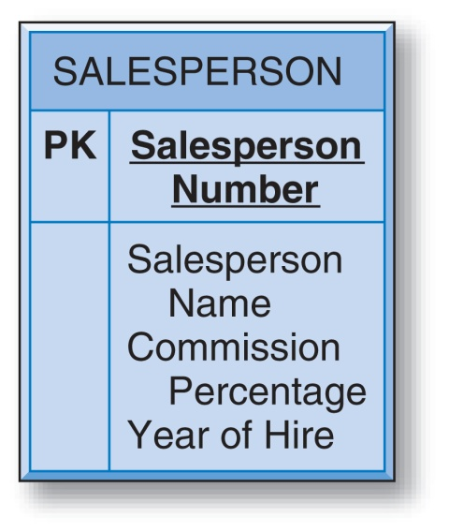

Converting a Simple Entity
The table simply contains the attributes that were specified in the entity box.
Salesperson Number is underlined to indicate that it is the unique identifier of the entity and the primary key of the table.

Slide 92
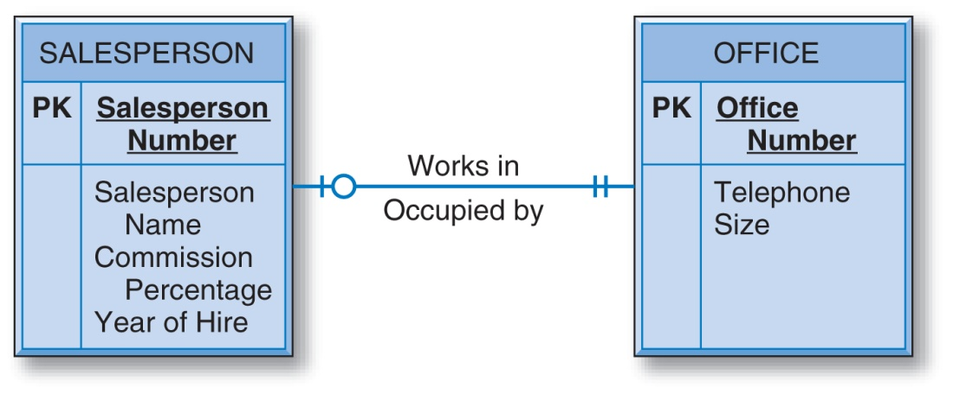
Converting Entities in Binary Relationships: One-to-One
There are three options for designing tables to represent this data.

Slide 93
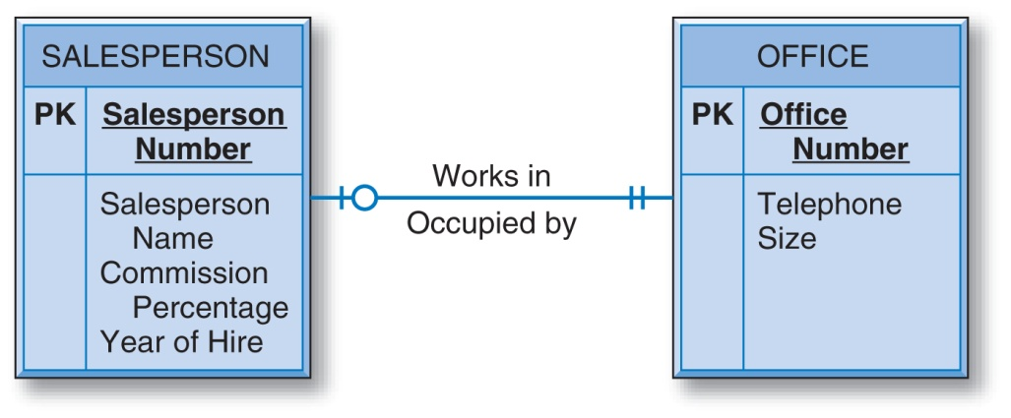
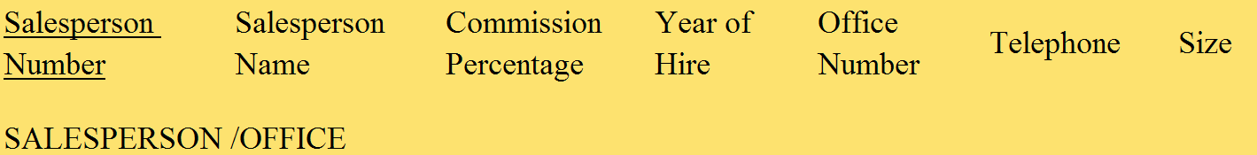
One-to-One: Option #1
The two entities are combined into one relational table.

Slide 94
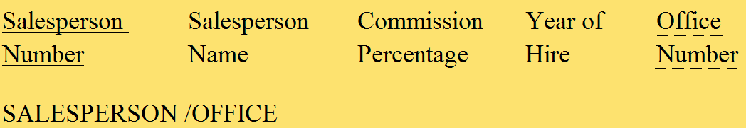
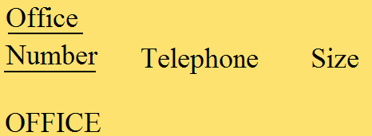
One-to-One: Option #2
Separate tables for the SALESPERSON and OFFICE entities, with Office Number as a foreign key in the SALESPERSON table.

Slide 95

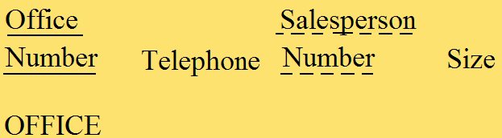
One-to-One: Option #3
Separate tables for the SALESPERSON and OFFICE entities, with Salesperson Number as a foreign key in the OFFICE table.

Slide 96
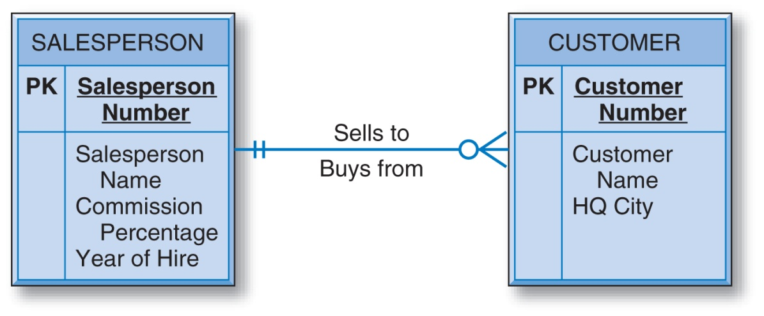
Converting Entities in Binary Relationships: One-to-Many
The unique identifier of the entity on the “one side” of the one-to-many relationship is placed as a foreign key in the table representing the entity on the “many side.”
So, the Salesperson Number attribute is placed in the CUSTOMER table as a foreign key.

Slide 97
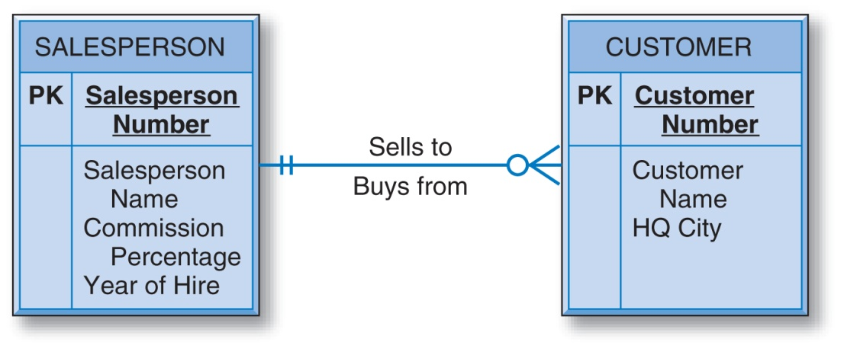

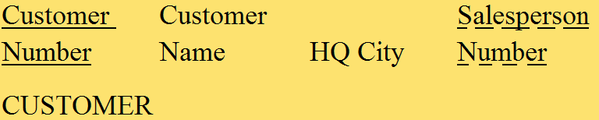
Converting Entities in Binary Relationships: One-to-Many

Slide 98
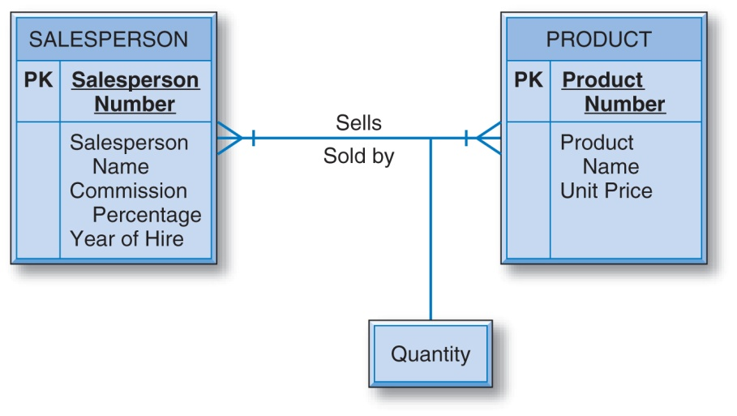
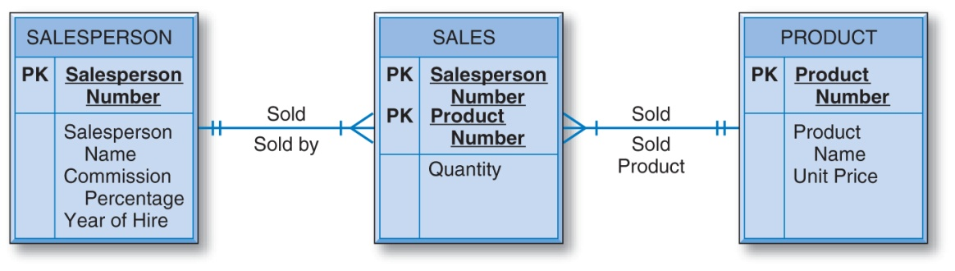
Converting Entities in Binary Relationships: Many-to-Many
E-R diagram with the many-to-many binary relationship and the equivalent diagram using an associative entity.

Slide 99
Converting Entities in Binary Relationships: Many-to-Many
An E-R diagram with two entities in a many-to-many relationship converts to three relational tables.
Each of the two entities converts to a table with its own attributes but with no foreign keys (regarding this relationship).
In addition, there must be a third “many-to-many” table for the many-to-many relationship.

Slide 100


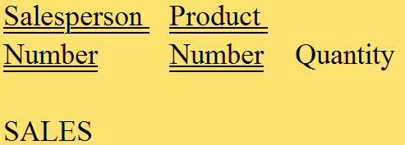
Converting Entities in Binary Relationships: Many-to-Many
The primary key of SALE is the combination of the unique identifiers of the two entities in the many-to-many relationship. Additional attributes are the intersection data.

Slide 101
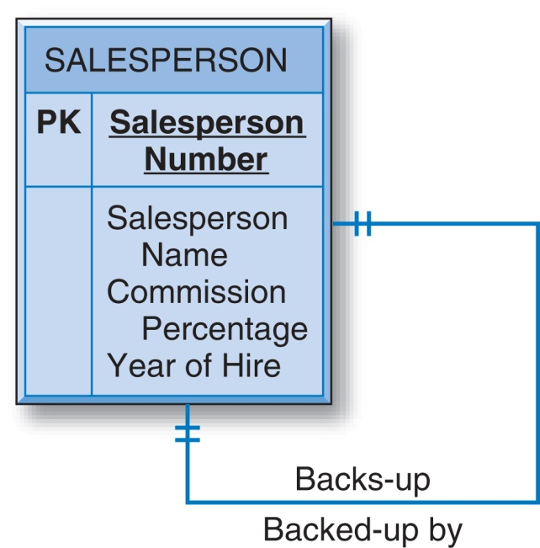
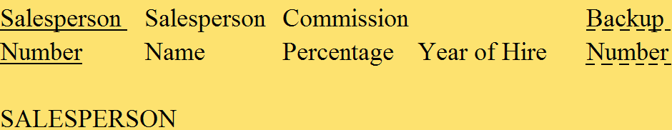
Converting Entities in Unary Relationships: One-to-One
With only one entity type involved and with a one-to-one relationship, the conversion requires only one table.

Slide 102
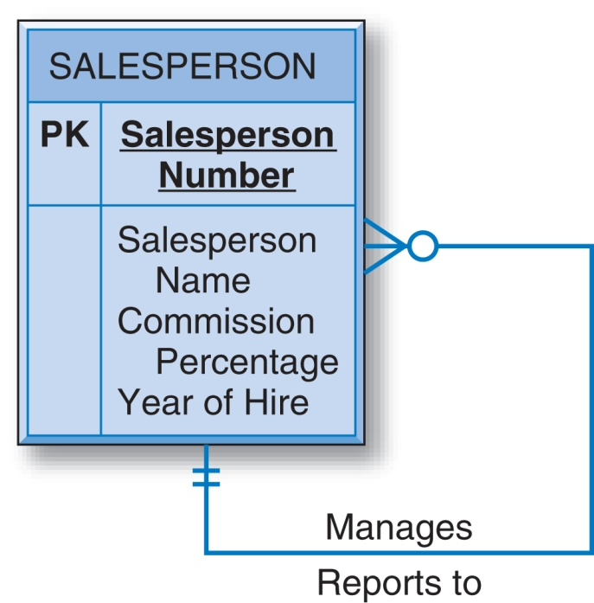
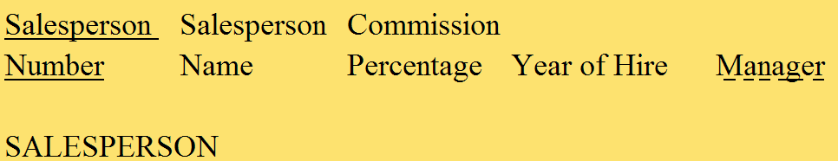
Converting Entities in Unary Relationships: One-to-Many
Very similar to the one-to-one unary case.

Slide 103
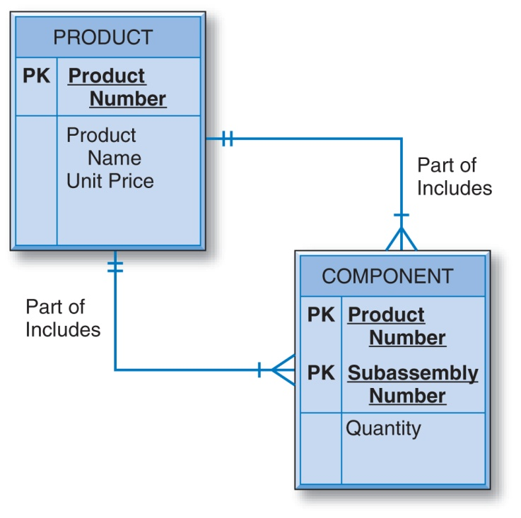
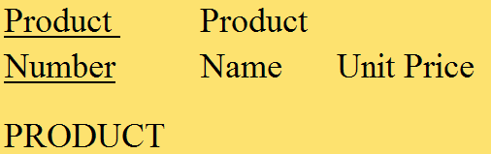
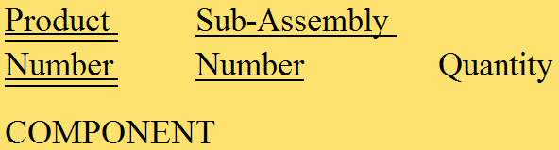
Converting Entities in Unary Relationships: Many-to-Many
This relationship requires two tables in the conversion.
The PRODUCT table has no foreign keys.

Slide 104
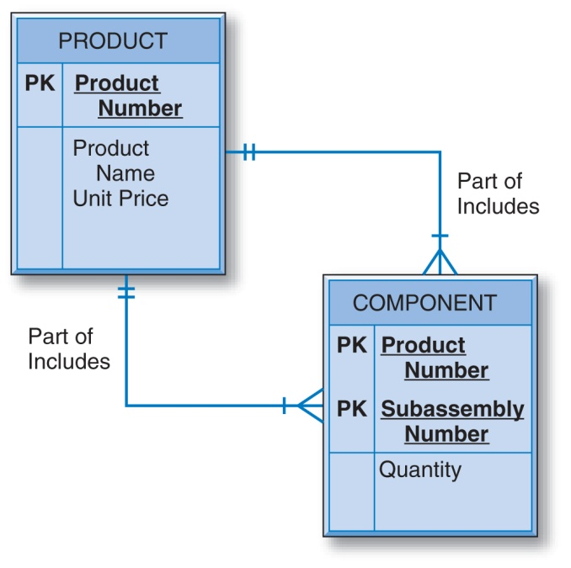
Converting Entities in Unary Relationships: Many-to-Many
A second table is created since in the conversion of a many-to-many relationship of any degree — unary, binary, or ternary — the number of tables will be equal to the number of entity types (one, two, or three, respectively) plus one more table for the many-to-many relationship.

Slide 105
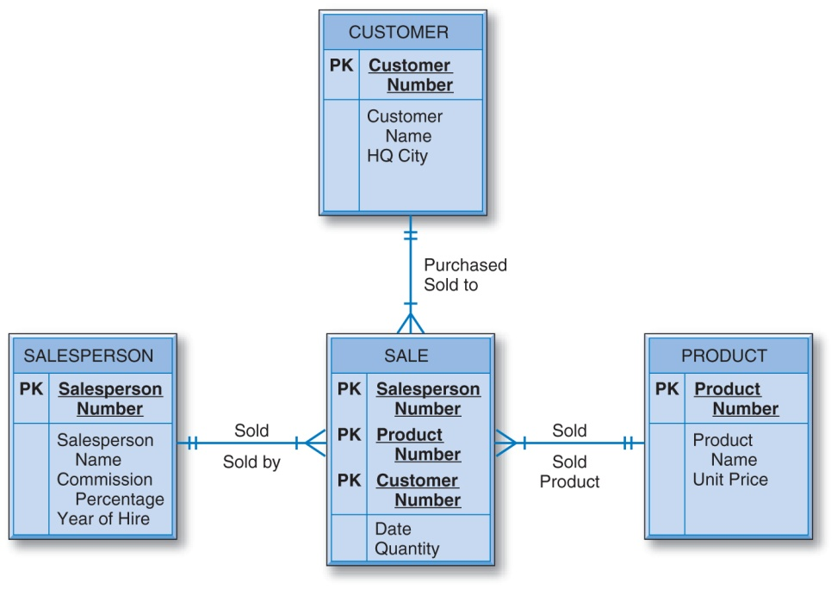




Converting Entities in
Ternary Relationships
The primary key of the SALE table is the combination of the unique identifiers of the three entities involved, plus the Date attribute.

Slide 106
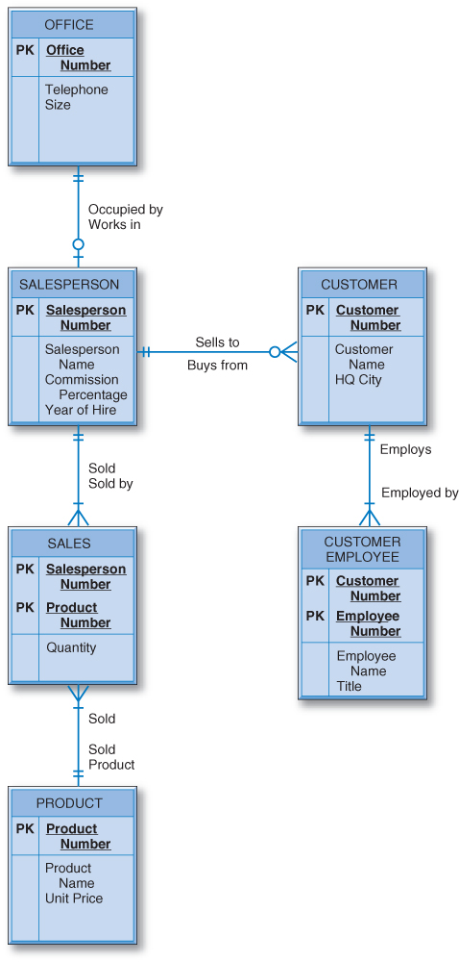
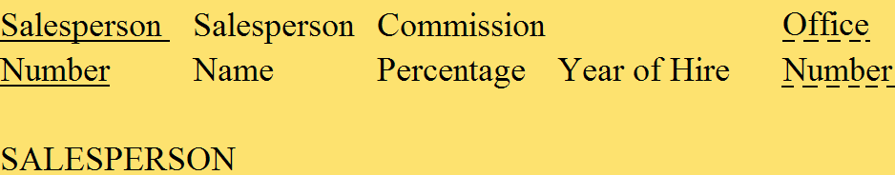

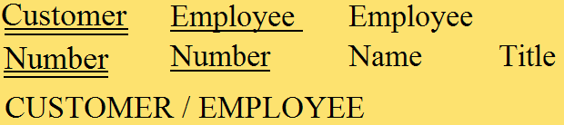
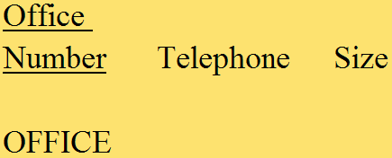
Designing the General Hardware Company Database

Slide 107
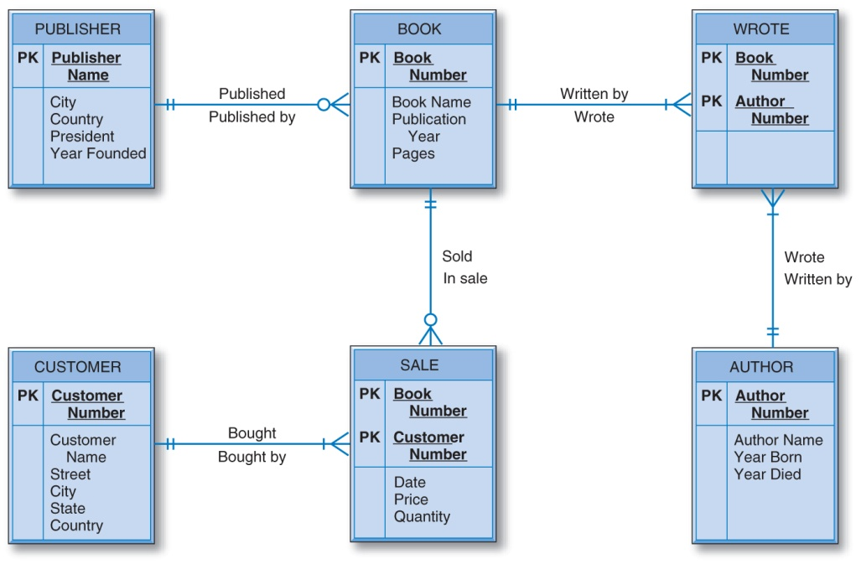

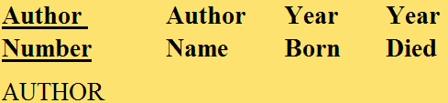


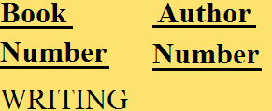

Designing the Good Reading Bookstores Database

Slide 108







Designing the World Music Association Database

Slide 109






Designing the Lucky
Rent-A-Car Database

Slide 110
The Data Normalization Process
A methodology for organizing attributes into tables so that redundancy among the nonkey attributes is eliminated.
The output of the data normalization process is a properly structured relational database.

Slide 111
The Data Normalization Technique
Input:
  all the attributes that must be incorporated into the database
  a list of all the defining associations between the attributes (i.e., the functional dependencies).
    a means of expressing that the value of one particular attribute is associated with a single, specific value of another attribute.
    If we know that one of these attributes has a particular value, then the other attribute must have some other value.

Slide 112
Functional Dependence
Salesperson Number
Salesperson Name
Salesperson Number is the determinant.
The value of Salesperson Number determines the value of Salesperson Name.
Salesperson Name is functionally dependent on Salesperson Number.

Slide 113


General Hardware Environment: SALESPERSON and PRODUCT

Slide 114
Steps in the Data Normalization Process
First Normal Form
Second Normal Form
Third Normal Form

Slide 115
The Data Normalization Process
Once the attributes are arranged in third normal form, the group of tables that they comprise is a well-structured relational database with no data redundancy.
A group of tables is said to be in a particular normal form if every table in the group is in that normal form.
The data normalization process is progressive.
  For example, if a group of tables is in second normal form, it is also in first normal form.

Slide 116

General Hardware Company: Unnormalized Data
Records contain multivalued attributes.

Slide 117

General Hardware Company: First Normal Form
The attributes under consideration have been listed in one table, and a primary key has been established.
The number of records has been increased so that every attribute of every record has just one value.
The multivalued attributes have been eliminated.

Slide 118

General Hardware Company: First Normal Form

Slide 119
General Hardware Company: First Normal Form
First normal form is merely a starting point in the normalization process.
First normal form contains a great deal of data redundancy.
  Three records involve salesperson 137, so there are three places in which his name is listed as Baker, his commission percentage is listed as 10, and so on.
  Two records involve product 19440 and this product’s name is listed twice as Hammer and its unit price is listed twice as 17.50.

Slide 120
General Hardware Company: Second Normal Form
No Partial Functional Dependencies
  Every nonkey attribute must be fully functionally dependent on the entire key of that table.
  A nonkey attribute cannot depend on only part of the key.

Slide 121



General Hardware Company: Second Normal Form
In SALESPERSON, Salesperson Number is the sole primary key attribute. Every nonkey attribute of the table is fully defined just by Salesperson Number.
Similar logic for PRODUCT and QUANTITY tables.

Slide 122



General Hardware Company: Second Normal Form

Slide 123
General Hardware Company: Third Normal Form
Does not allow transitive dependencies in which one nonkey attribute is functionally dependent on another.
Nonkey attributes are not allowed to define other nonkey attributes.

Slide 124




General Hardware Company: Third Normal Form

Slide 125



General Hardware Company: Third Normal Form

Slide 126
General Hardware Company: Third Normal Form
Important points about the third normal form structure are:
  It is completely free of data redundancy.
  All foreign keys appear where needed to logically tie together related tables.
  It is the same structure that would have been derived from a properly drawn entity-relationship diagram of the same business environment.

Slide 127
Candidate Keys as Determinants
There is one exception to the rule that in third normal form, nonkey attributes are not allowed to define other nonkey attributes.
The rule does not hold if the defining nonkey attribute is a candidate key of the table.
Candidate keys in a relation may define other nonkey attributes without violating third normal form.

Slide 128

General Hardware Company: Functional Dependencies

Slide 129


General Hardware Company: First Normal Form

Slide 130

Good Reading Bookstores: Functional Dependencies

Slide 131

World Music Association: Functional Dependencies

Slide 132

Lucky Rent-A-Car:
Functional Dependencies

Slide 133
Data Normalization Check
The basic idea in checking the structural worthiness of relational tables, created through E-R diagram conversion, with the data normalization rules is to:
  Check to see if there are any partial functional dependencies.
  Check to see if there are any transitive dependencies.

Slide 134
Creating a Table with SQL
CREATE TABLE SALESPERSON
(SPNUM CHAR(3) PRIMARY KEY,
SPNAME CHAR(12)
COMMPERCT DECIMAL(3,0)
YEARHIRE CHAR(4)
OFFNUM CHAR(3) );
Dropping a Table with SQL
DROP TABLE SALESPERSON;

Slide 135
Creating a View with SQL
CREATE VIEW EMPLOYEE AS
SELECT SPNUM, SPNAME, YEARHIRE
FROM SLAESPERSON;
Dropping a View with SQL
DROP VIEW EMPLOYEE ;

Slide 136
The SQL Update, Insert, and Delete Commands
UPDATE SALESPERSON
SET COMMPERCT = 12
WHERE SPNUM = ‘204’;
INSERT INTO SALESPERSON
VALUES
(‘489’, ‘Quinlan’, 15, ‘2011’, ‘59’);
DELETE FROM SALESPERSON
WHERE SPNUM = ‘186’;

Slide 137
Next Lecture
Physical DB Design, Files, Hashes, Indexing

Slide 138
References
Ramez Elmasri, Shamkant Navathe; “Fundamentals of Database Systems”, 6th Ed., Pearson, 2014
Mark L. Gillenson; “Fundamentals of Database Management Systems”, 2nd Ed., John Wiley, 2012
Universität Hamburg, Fachbereich Informatik, Einführung in Datenbanksysteme, Lecture Notes, 1999

