Slide 1


CSE 414 Systems Analysis and Design
Lecture #7
Structuring Systems Data Requirements
Prepared & Presented by Asst. Prof. Dr. Samsun M. BAŞARICI

Slide 2
Learning Objectives
Explain the role of conceptual data modeling in the overall analysis and design of an information system.
Describe the information gathering process for conceptual data modeling.
Describe how to represent an entity-relationship model and be able to define the terms: entity type, attribute, multivalued attribute, and relationship.

Slide 3
Learning Objectives (Cont.)
Distinguish among unary, binary, and ternary relationships as well as associative entities, providing an example of each.
Define supertypes and subtypes, showing how to represent these entity types with ER diagramming notation.
Define four basic types of business rules in a conceptual data model.
Explain the role of prepackaged database models (patterns) in data modeling.

Slide 4
Conceptual Data Modeling
Conceptual data modeling: a detailed model that captures the overall structure of data in an organization
  Independent of any database management system (DBMS) or other implementation considerations
Notes:
Note the distinction between the conceptual data model and the actual implementation of the database (or even the database design). The conceptual model makes no assumptions about underlying technology. It’s only about the entities, attributes, and relationships that are to be captured.
A similar distinction can be made between the DFD diagrams from the previous chapter and final software design and implementation.

Slide 5
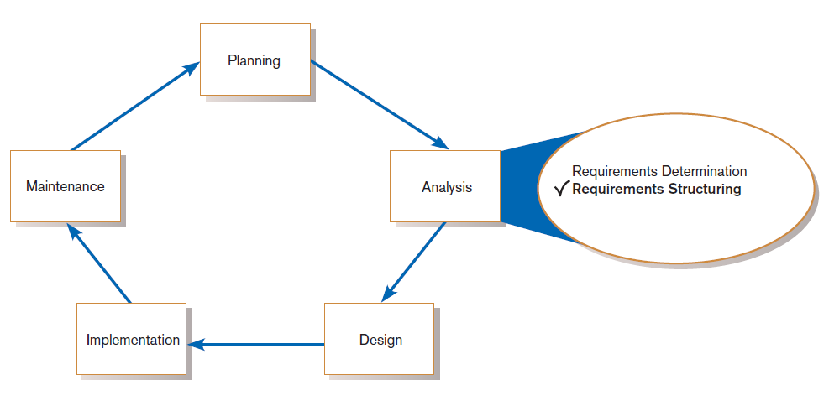
Conceptual Data Modeling (Cont.)
FIGURE 8-1
Systems development life cycle with analysis phase highlighted
Notes:
We are still doing requirements structuring. In the previous chapter we structured processes, and described the data flows between these processes. Now, we structure the data elements that will need to be stored. In a sense, you can say that we are focusing on what would be in the data store aspects of the DFD diagrams.
So, data modeling is typically done in parallel with other requirements analysis and structuring activities.

Slide 6
The Conceptual Data Modeling Process
Develop a data model for the current system.
Develop (or purchase) a new conceptual data model that includes all requirements of the new system.
In the design stage, the conceptual data model is translated into a physical design.
Project repository links all design and data modeling steps performed during SDLC.

Slide 7
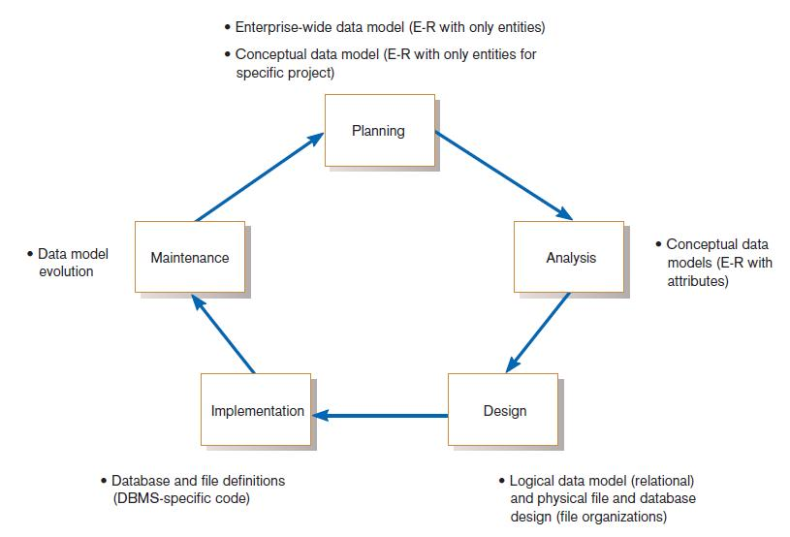
Conceptual Data Modeling (Cont.)
FIGURE 8-2
Relationship between data modeling and the SDLC
Notes:
Note that E-R modeling is useful for planning in addition to being used extensively with analysis. The E-R models done for the planning phase are typically at a much more general and less detailed level than in the analysis phase.

Slide 8
Deliverables and Outcome
Entity-relationship (E-R) diagram or UML class diagram
  Entities (or classes) – categories of data, represented as rectangles
  Relationships (or associations) – lines between the entities
Set of entries about data objects to be stored in repository project dictionary, or data modeling software
  Repository links data, process, and logic models of an information system.
  Data elements included in the data flow diagram (DFD) must appear in the data model and vice versa.
  Each data store in a process model must relate to business objects represented in the data model.

Slide 9
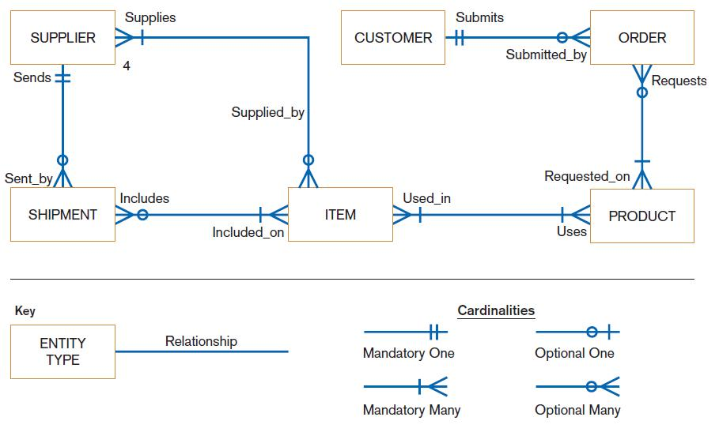
FIGURE 8-3
Sample conceptual data model
Notes:
This is an E-R diagram. The boxes represent entity types and the lines between boxes represent relationships between these entity types. Relationships can be one-to-one, one-to-many, or many-to-many.
For example, in this figure we see a one-to-many relationship between customers and orders. This means that a customer can have any number of orders, but that each order belongs to exactly one customer. On the other hand, there is a many-to-many relationship between orders and products. Each product may be included in many orders, and each order can have many products. These are called relationship cardinalities.
To add nuance to the relationship cardinalities, they can be either mandatory or optional. For example, in the relationship between products and orders, you see that a product may not be involved in any orders at all, but that an order must have at least one product.
We’ll go through several other diagrams and examples in this chapter, and define our terms in detail.

Slide 10
Gathering Information for Conceptual Data Modeling
Two perspectives on data modeling:
  Top-down approach for a data model is derived from an intimate understanding of the business.
  Bottom-up approach for a data model is derived by reviewing specifications and business documents.

Slide 11
Gathering Information for Conceptual Data Modeling (Cont.)
Requirements Determination Questions for Data Modeling:
  What are subjects/objects of the business?
    Data entities and descriptions
  What unique characteristics distinguish between subjects/objects of the same type?
    Primary keys

Slide 12
Gathering Information for Conceptual Data Modeling (Cont.)
  What characteristics describe each subject/object?
    Attributes and secondary keys
  How do you use the data?
    Security controls and user access privileges
    Who knows the meaning of the data?
  Over what period of time are you interested in the data?
    Cardinality and time dimensions

Slide 13
Gathering Information for Conceptual Data Modeling (Cont.)
  Are all instances of each object the same?
    Supertypes, subtypes, and aggregations
  What events occur that imply associations between objects?
    Relationships and cardinalities
  Are there special circumstances that affect the way events are handled?
    Integrity rules, minimum and maximum cardinalities, time dimensions

Slide 14
Introduction to Entity-Relationship (E-R) Modeling
Entity-Relationship data model (E-R model): a detailed, logical representation of the entities, associations and data elements for an organization or business area
Entity-relationship diagram (E-R diagram): a graphical representation of an E-R model

Slide 15
Introduction to E-R Modeling (Cont.)
The E-R model is expressed in terms of:
  Data entities in the business environment.
  Relationships or associations among those entities.
  Attributes or properties of both the entities and their relationships.
Notes:
Recall that with data flow models and DFDs, the key elements are processes, data stores, data flows, sources, and sinks.
The key elements of an E-R mode are entities, relationships and attributes. And the whole E-R model is describing a breakdown of what you would see have a data store of the DFD.

Slide 16
Introduction to E-R Modeling (Cont.)
Entity: a person, place, object, event or concept in the user environment about which data is to be maintained
Entity type: collection of entities that share common properties or characteristics
Entity instance: single occurrence of an entity type
Notes:
Note the distinction between an entity type and an entity instance. For example, if Employee is an entity type, then John Smith (a particular employee) would be an entity instance. When you see the word “entity” alone, it’s important to discern whether you are talking about an entity type or an entity instance. In the E-R diagrams we see, the boxes represent entity types.

Slide 17
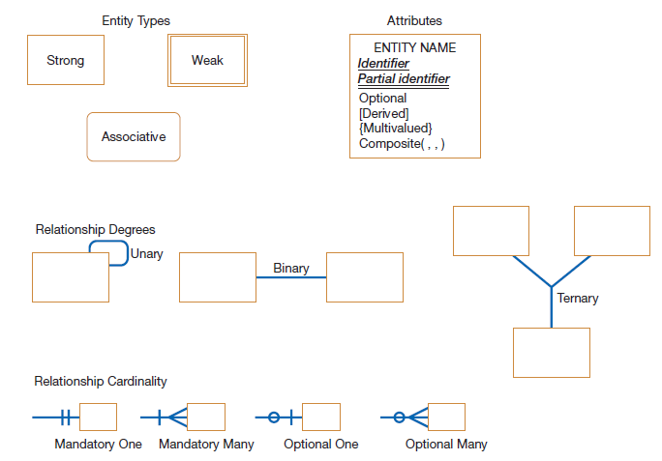
FIGURE 8-5 Basic E-R notation
Notes:
As you can see, there are different kinds of entity types. Entities can be strong, weak, or associative.
Also, in addition to cardinalities, relationships also have degrees, which indicate how many entities are involved in the relationship.
In this E-R notation, attributes are shown within the entity type rectangle. There are various types of attributes, including identifiers, derived, multivalued, and composite. An identifier uniquely identifies an entity instance; only one instance of the entity type can have a particular identifier value. Composite attributes can be decomposed; for example an address may include street number, street name, city, state, and zip code. Multivalued attributes are those that can contain many values. For example, maybe a person has more than one email address. Derived attributes are calculated, not stored in the database. For example, a person’s age is calculated based on birthdate and current date.
There are different notations for E-R diagrams, but this is a common one.
All of this will be explained more later.

Slide 18
Naming and Defining Entity Types
An entity type name should be:
  A singular noun.
  Descriptive and specific to the organization.
  Concise.
Event entity type should be named for the result of the event, not the activity or process of the event.
Notes:
An entity is a person, a place, an object, an event, or a concept in the user environment about which the organization wishes to maintain data.
Note: an entity should be about something that is being represented by the system.
An entity is NOT a user of the system, and an entity is not an output from the system. In other words, entities are not sources and sinks, nor are they reports or forms. simple rule to avoid such confusion is that a true data entity will have
many possible instances, each with a distinguishing characteristic, as well as one or more other descriptive pieces of data.

Slide 19
Naming and Defining Entity Types (Cont.)
An entity type definition:
  Includes a statement of what the unique characteristic(s) is (are) for each instance.
  Makes clear what entity instances are included and not included in the entity type.
  Often includes a description of when an instance of the entity type is created or deleted.

Slide 20
Naming and Defining Entity Types (Cont.)
For some entity types the definition must specify:
  When an instance might change into an instance of another entity type.
  What history is to be kept about entity instances.

Slide 21
Attributes
Attribute: a named property or characteristic of an entity that is of interest to the organization
  Naming an attribute: i.e. Vehicle_ID
  Place its name inside the rectangle for the associated entity in the E-R diagram.
Notes:
Entities have attributes. For example, if the entity is a person, then attributes might include the person’s name, gender, age, etc. Additional attributes may include address, phone number, email address, etc.

Slide 22
Naming and Defining Attributes
An attribute name is a noun and should be unique.
To make an attribute name unique and for clarity, each attribute name should follow a standard format.
Similar attributes of different entity types should use similar but distinguishing names.

Slide 23
Naming and Defining Attributes (Cont.)
An attribute definition:
  States what the attribute is and possibly why it is important.
  Should make it clear what is included and what is not included.
  Contains any aliases or alternative names.
  States the source of values for the attribute.

Slide 24
Naming and Defining Attributes (Cont.)
An attribute definition should indicate:
  If a value for the attribute is required or optional.
  If a value for the attribute may change.
  Any relationships that attribute has with other attributes.
Notes:
Some attributes may be optional. For example, a person may or may not have a phone number.

Slide 25
Candidate Keys and Identifiers
Candidate key: an attribute (or combination of attributes) that uniquely identifies each instance of an entity type
Identifier: a candidate key that has been selected as the unique, identifying characteristic for an entity type
Notes:
An identifier (or a candidate key) must is unique. So, for a person, his or her name doesn’t work as an identifier. But social security number, employee ID, credit card number are all candidate keys, and any one of these would work as an identifier.

Slide 26
Candidate Keys and Identifiers (Cont.)
Selection rules for an identifier
  Choose a candidate key that will not change its value.
  Choose a candidate key that will never be null.
  Avoid using intelligent keys.
  Consider substituting single value surrogate keys for large composite keys.
Notes:
An example of an “intelligent identifier” is the first two digits of a key for a PART entity may indicate the warehouse location. Such codes are often modified as conditions change, which renders the primary key values invalid.

Slide 27
Other Attribute Types
Multivalued attribute: an attribute that may take on more than one value for each entity instance
Repeating group: a set of two or more multivalued attributes that are logically related
Notes:
A repeating group can also be thought of as a multivalued-composite attribute. The group is a composite of several attributes, and the repetition of them makes it multivalued.

Slide 28
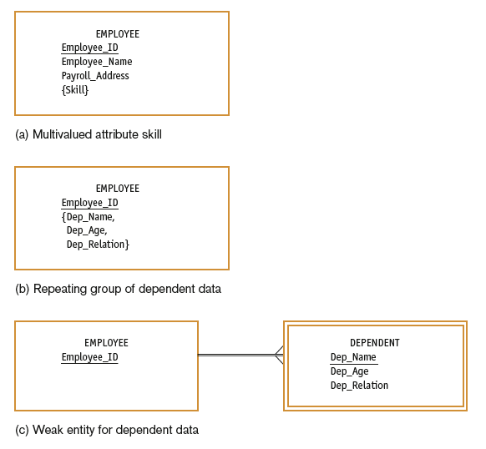
FIGURE 8-8
Multivalued attributes
and repeating groups
Notes:
See the notation for multivalued attributes with the curly braces. Underlined attributes are identifiers.
Note that (b) and (c) are alternative ways of representing the same thing. In (b) the information about an employee’s dependents is represented as a multivalued attribute. In (c), though, Dependent is another entity type and there is a relationship between Employee and Dependent. Note that the double lines indicate a weak entity with an identifying relationship. Weak entities cannot exist without a relationship to corresponding strong entities. In this case, there can be no Dependent without a related Employee. Also note that the Dependent’s identifier is only a partial identifier. The full identification of the dependent also includes the Employee’s ID.

Slide 29
Other Attribute Types (Cont.)
Required attribute: an attribute that must have a value for every entity instance
Optional attribute: an attribute that may not have a value for every entity instance
Composite attribute: an attribute that has meaningful component parts
Derived attribute: an attribute whose value can be computed from related attribute values
Notes:
Primary keys (identifiers) are always required. They must have a value. Other attributes may also be required (for example a person’s name), but others may be blank (optional).
We already discussed composite and derived attributes.

Slide 30
Relationships
Relationship: an association between the instances of one or more entity types that is of interest to the organization
Degree: the number of entity types that participate in a relationship
Notes:
One of the real strengths of the E-R model is that it depicts the relationships that exist between entities of various types.

Slide 31
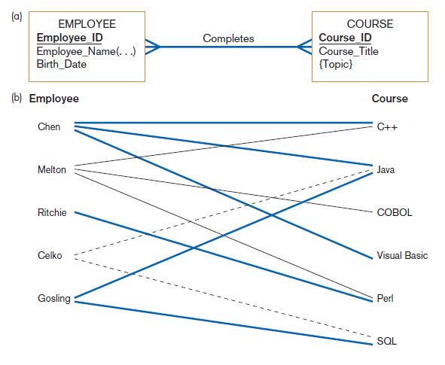
Figure 8-10
Relationship type and instances
(a) Relationship type (Completes)
(b) Relationship instances
Notes:
Here we see Employee as an entity type, and Chen, Melton, Ritchie, Celko, and Gosling are entity instances. Similarly, Course is an entity type, and we see six Course entity instances.
The many-to-many cardinality can be seen here. For most of the employees have completed multiple courses, and most of the courses were completed by multiple employees.
Notice that relationships can also have names. This is useful for describing what the relationship is depicting.

Slide 32
Conceptual Data Modeling and the E-R Model
Unary relationship: a relationship between the instances of one entity type
  Also called a recursive relationship
Binary relationship: a relationship between instances of two entity types
  Most common type of relationship encountered in data modeling
Ternary relationship: a simultaneous relationship among instances of three entity types
Notes:
All of this has to do with relationship degree. It’s possible to have a relationship between 4 or more entities, although this tends to be rare. In general, we call these n-ary relationships.

Slide 33
Cardinalities in Relationships
Cardinality: the number of instances of entity B that can (or must) be associated with each instance of entity A
Minimum Cardinality
  The minimum number of instances of entity B that may be associated with each instance of entity A
Maximum Cardinality
  The maximum number of instances of entity B that may be associated with each instance of entity A

Slide 34
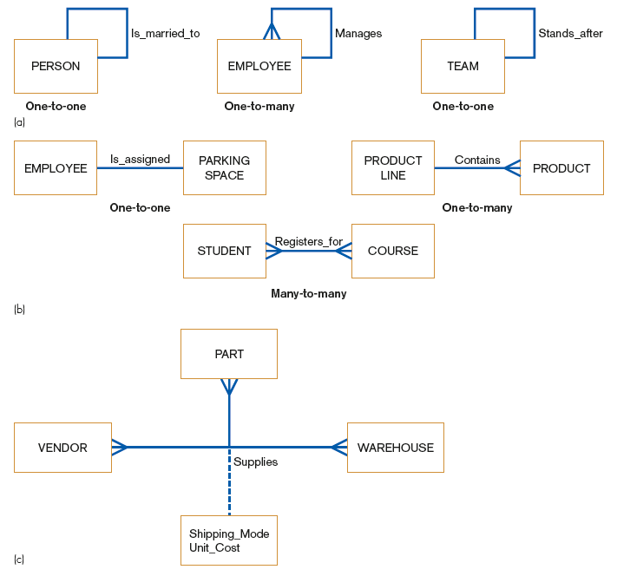
Unary relationships
FIGURE 8-11
Examples of relationships
of different degrees
Binary relationships
Ternary relationships
Notes:
You can see many assumptions and business rules in these relationships. For example, we are assuming that a person can be married to at most one other person. We also see that an employee may have several subordinates, but will only have one manager. In these diagrams, we are not seeing whether these are mandatory or optional cardinalities, though. What do you think?
Here, can have a discussion about optional vs. mandatory for each of the relationships.
Notice the ternary relationship, which is called “Supplies”. It is many-to-many-to-many in terms of cardinality. A given vendor may supply any number of parts to any number of warehouses. A given part can be supplied from any number of vendors to any number of warehouse. A given warehouse could be supplied any number of parts from any number of vendors.
In this case the relationship itself has attributes, represented by the dashed line to the box. Each supply instance (remember that relationships have instances just like entities do) has a shipping mode and a unit cost. If you have a relationship with attributes, you may want to consider representing this as an associative entity instead. We’ll talk about that later.

Slide 35
Cardinalities in Relationships (Cont.)
Mandatory vs. Optional Cardinalities
  Specifies whether an instance must exist or can be absent in the relationship
Notes:
As the E-R diagram becomes more refined and detailed, you may start to add indications of whether the cardinalities are mandatory or optional.

Slide 36
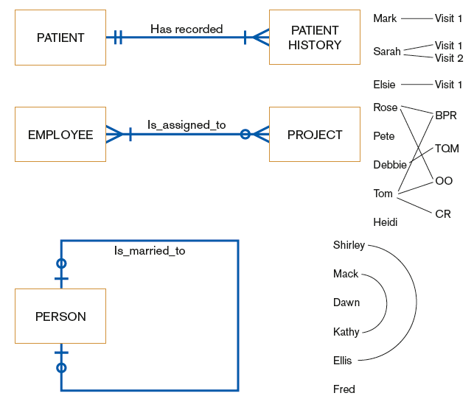
FIGURE 8-14 Examples of cardinality constraints
(a) Mandatory cardinalities
(b) One optional, one mandatory cardinality
(c) Optional cardinalities
Notes:
A patient must have at least one patient history, and could have more. A given patient history is related to exactly one patient.
A person may not be married, but if that person is married, he or she is married to only one other person.
Question: Is it possible to have an employee who is not assigned to a project?
Answer: Yes, because of the optional symbol on the Project side of the relationship.
Question: Is it possible to have a project with no employee assigned to it?
Answer: No, because of the mandatory symbol on the Employee side of the relationship.

Slide 37
Naming and Defining Relationships
A relationship name is a verb phrase; avoid vague names.
A relationship definition:
  Explains what action is to be taken and possibly why it is important.
  Gives examples to clarify the action.
Notes:
Unlike entity names and attribute names, which are nouns, relationship names are verbs.

Slide 38
Naming and Defining Relationships (Cont.)
A relationship definition should:
  Explain any optional participation.
  Explain the reason for any explicit maximum cardinality other than many.
  Explain any restrictions on participation in the relationship.
  Explain the extent of history that is kept in the relationship.
  Explain whether an entity instance involved in a relationship instance can transfer participation to another relationship instance.

Slide 39
Associative Entities
Associative Entity: an entity type that associates the instances of one or more entity types and contains attributes that are peculiar to the relationship between those entity instances
  Sometimes called a gerund
The data modeler chooses to model the relationship as an entity type.
Notes:
An associative entity is kind of a combination of entity and relationship. Remember the “Supplies” relationship from figure 8-11? This could have been represented as an associative entity.

Slide 40
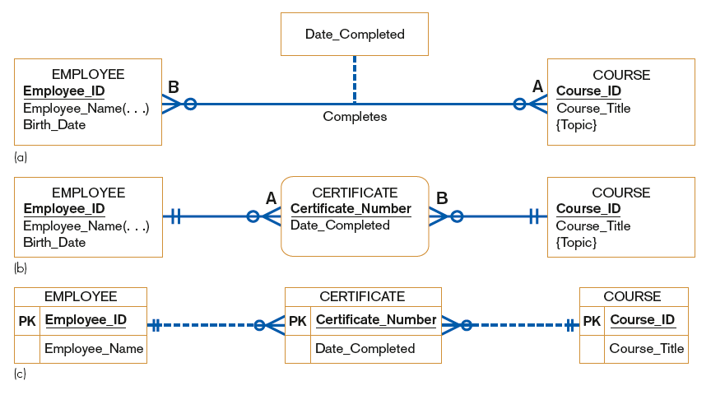
FIGURE 8-15 An associative entity
Attribute on a relationship
An associative entity (CERTIFICATE)
An associative entity using Microsoft Visio®
Notes:
In this figure, (a) shows a many-to-many relationship between employees and courses. This relationship has an attributes, the date completed.
By contrast, (b) shows an associative entity (note the curved corners) that links employees with courses. In (c) you see a Microsoft Visio version of this. As I said earlier, there are various notations for E-R diagrams, just like there are various notations for DFDs.

Slide 41
Summary of Conceptual Data Modeling with E-R Diagrams
The purpose of E-R diagramming is to capture the richest possible understanding of the meaning of the data necessary for an information system or organization.

Slide 42
Representing Supertypes and Subtypes
Subtype: a subgrouping of the entities in an entity type
  Is meaningful to the organization
  Shares common attributes or relationships distinct from other subgroupings
Supertype: a generic entity type that has a relationship with one or more subtypes
Notes:
After the original E-R model was created, it was enhanced into something often called EER (enhancer ER, or extended ER).
This allows for supertype/subtype representations, and we’ll look at some examples in the next few slides.

Slide 43
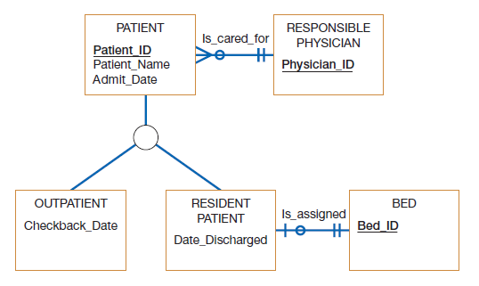
Figure 8-18
Supertype/subtype relationships in a hospital
Notes:
Here we see a supertype called Patient, with two subtypes called Outpatient and Resident Patient. All patients (including outpatients and resident patients) have a patient id, a patient name and an admit date. The subtypes inherit these attributes from the supertype. Also, All patients (including outpatients and residents) inherit the Is_cared_for relationship.
Outpatients include an additional attribute, the checkback date. No other types of patients have this. Similarly, resident patients have their own specialized discharge date and their own assigned beds; outpatients do not have these.

Slide 44
Representing Supertypes and Subtypes (Cont.)
Business Rules for Supertype/subtype Relationships:
  Total specialization specifies that each entity instance of the supertype must be a member of some subtype in the relationship.
  Partial specialization specifies that an entity instance of the supertype does not have to belong to any subtype, and may or may not be an instance of one of the subtypes.

Slide 45
Representing Supertypes and Subtypes (Cont.)
  Disjoint rule specifies that if an entity instance of the supertype is a member of one subtype, it cannot simultaneously be a member of any other subtype.
  Overlap rule specifies that an entity instance can simultaneously be a member of two (or more) subtypes.

Slide 46
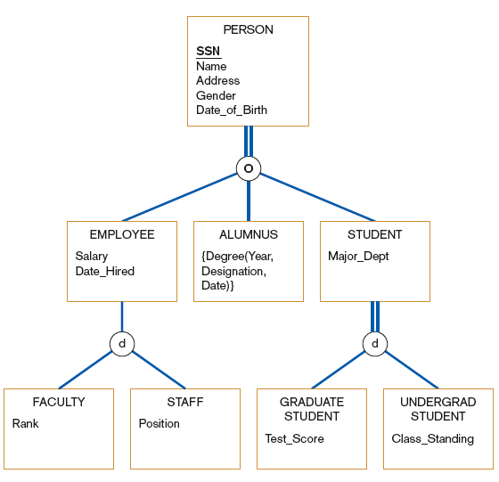
FIGURE 8-19
Example of supertype/subtype hierarchy
Notes:
Total specialization is represented by double lines. Single lines mean partial specialization.
Overlap is represented with “o” and disjoint is represented with “d”.
Question: can there be another type of person who is not an employee, alumnus, or student?
Answer: no, because of the total specialization.
Question: can a person be both an employee and a student?
Answer: yes, because of the overlap rule.
Question: can an employee be both faculty and staff?
Answer: no, only one of these, because of the disjoint rule.
Question: can an employee be something other than faculty or staff?
Answer: yes, because of partial specialization.
Question: what can you say about students?
Discussion here…

Slide 47
Business Rules
Business rules: specifications that preserve the integrity of the logical data model
  Captured during requirements determination
  Stored in CASE repository as they are documented
Notes:
Some of the business rules are represented in the E-R diagram, but some require other means of representation. The CASE repository will include all of these rules.

Slide 48
Business Rules (Cont.)
Four basic types of business rules are:
  Entity integrity: unique, non-null identifiers
  Referential integrity constraints: rules governing relationships between entity types
  Domains: constraints on valid values for attributes
  Triggering operations: other business rules that protect the validity of attribute values
Notes:
Entity integrity and referential integrity are both expressed in the E-R model.
But domains and triggers are not.

Slide 49
Domains
Domain: the set of all data types and values that an attribute can assume
Several advantages
  Verify that the values for an attribute are valid
  Ensure that various data manipulation operations are logical
  Help conserve effort in describing attribute characteristics
Notes:
Let’s talk about a couple examples of domains.
What would be the domain of a person’s birth date? Well, first of all, it must be a date type. It can’t be just a number or a piece of text. Second, you would think it must be a valid date. For example February 29, 2015 is not legitimate. Third, as a birth date, it should probably be a date that already happened. A person’s birth date shouldn’t be, for example January 1, 2050.
How about an employee’s salary? Well, obviously this is a number. But some numbers don’t make sense. For example, -1000 is not a valid salary.

Slide 50
Triggering Operations
Trigger: an assertion or rule that governs the validity of data manipulation operations such as insert, update and delete
Notes:
Triggers are actually implemented in databases as “event-driven actions”. When an update is attempted to the database, this might “trigger” further actions.

Slide 51
Triggering Operations (Cont.)
Includes the following components:
  User rule: statement of the business rule to be enforced by the trigger
  Event: data manipulation operation that initiates the operation
  Entity Name: name of entity being accessed or modified
  Condition: condition that causes the operation to be triggered
  Action: action taken when the operation is triggered

Slide 52
Role of Packaged Conceptual Data Models – Database Patterns
Packaged data models provide generic models that can be customized for a particular organization’s business rules.
Universal data models are templates for
  one or more core subject areas such as:
    Customers, products, accounts, documents
  and/or core business functions such as:
    Purchasing, accounting, receiving, etc.
Notes:
There are a lot of similarities between the data needs of different organizations. For example, most companies have need to store employee and customer data. So, to simplify the conceptual modeling process, you may want to make use of pre-existing packaged or universal models.

Slide 53
Role of Packaged Conceptual Data Models – Database Patterns (Cont.)
Industry-specific data models are designed to be used by organizations within specific industries.
These models are based on the premise that data model patterns for organizations are similar within a particular industry.

Slide 54
Benefits of Database Patterns and Packaged Data Models
Dramatically reduced implementation times and costs
  Provides a starting point for asking requirements questions
Higher-quality models
  Represent “best practice” data modeling techniques and data model components whose quality often exceeds that which can be achieved by internal development teams, given typical organizational pressures

Slide 55
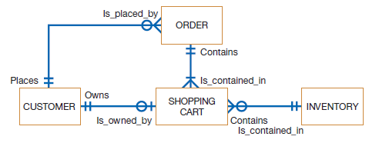
Electronic Commerce Application: Conceptual Data Modeling
Five general categories of information were identified for Pine Valley Furniture’s WebStore.
Next step was to define each item.
The final step was to identify the interrelationships between the four entities.
Figure 8-22
E-R diagram for the WebStore system

Slide 56
Summary
Now you learned how to:
  Explain the role of conceptual data modeling in the overall analysis and design of an information system.
  Describe the information gathering process for conceptual data modeling.
  Describe how to represent an entity-relationship model and be able to define the terms: entity type, attribute, multivalued attribute, and relationship.

Slide 57
Summary (Cont.)
Now you learned how to:
  Distinguish among unary, binary, and ternary relationships as well as associative entities, providing an example of each.
  Define supertypes and subtypes, showing how to represent these entity types with ER diagramming notation.
  Define four basic types of business rules in a conceptual data model.
  Explain the role of prepackaged database models (patterns) in data modeling.

Slide 58
Next Lecture
Designimg Databases

Slide 59
References
Joseph S. Valacich, Joey F. George, Modern Systems Analysis and Design, 8th Global Edition, Pearson, 2016

