Slide 1


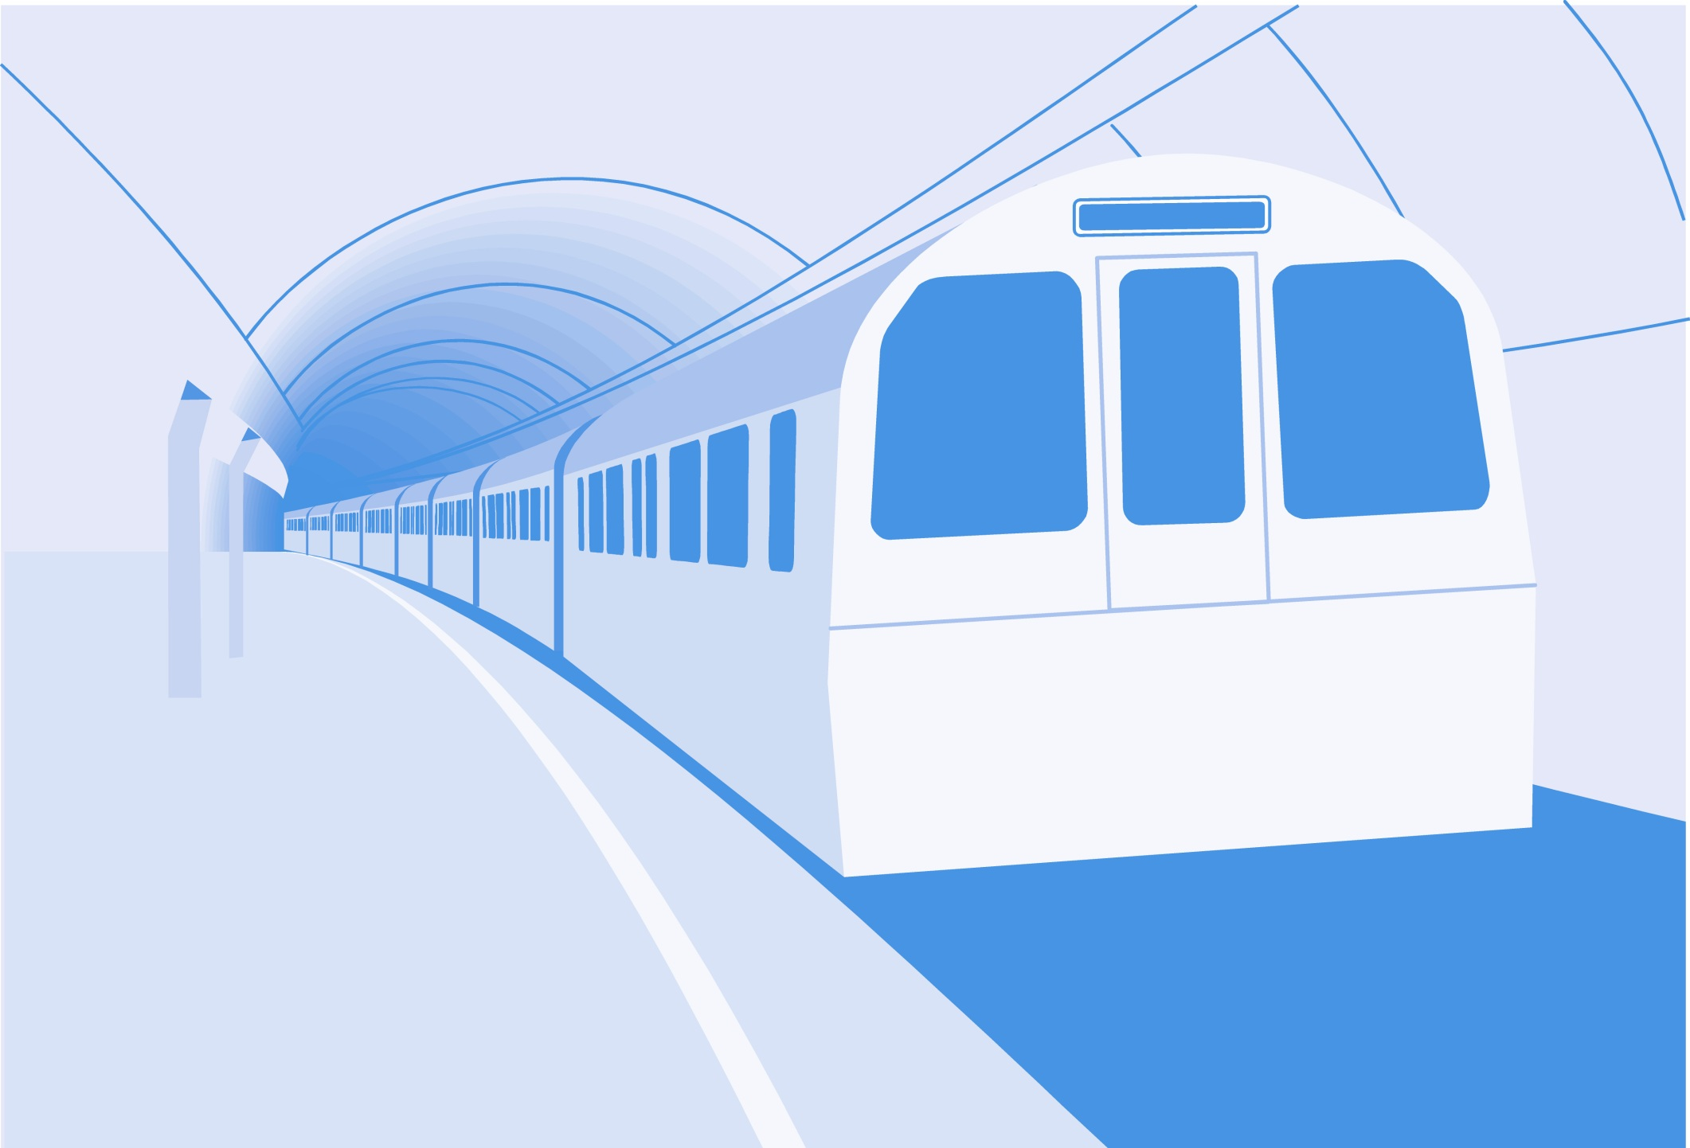
L
L Line
CSE 420
Computer Games
Lecture #7 Drawing and Event Handling

Slide 2
Objectives
Using functions with pygame
Learning a more sophisticated editor
Drawing with the pygame.draw module
Responding to basic events
Saving and loading images
Building a painting program

Slide 3
Goal: A Drawing Program
See paint.py.
Draw with the mouse.
Keyboard changes colors, pen size.
Rudimentary save and load features.

Slide 4
How paint.py Works
Gets various kinds of input from the user (keyboard, mouse).
Uses draw routines to paint on the screen.
Saves and loads images with pygame routines.
The code will be described in detail later in this chapter.

Slide 5
Creating Image Surfaces in pygame
Use drawing functions from the pygame.draw module.
Import an externally created image.
Use text to make a label.

Slide 6
Using a Main Function
So far, all your code has been written at the program scope.
It's better to have all code stored in functions.
Functions protect and organize code.
Use a special mechanism to call the main function only when it's needed.

Slide 7
Modifying IDEA for Functions
See mainFunc.py.
I from IDEA goes outside main.
DEA/ALTER is all part of main.
The following code is at the end of the program:
#Run main if this is the primary program
if __name__ == "__main__":
main()

Slide 8
How the __name__ == "__main__" Code Works
Each module has a name property called __name__ (double underscores mark special variables in Python).
If the module is the program that's currently running (as it will be in all your early examples), it’s the __main__ module for that program.
If __name__ == "__main__“, this program is running as a stand-alone, and its main method should execute.

Slide 9
Introducing SPE
IDLE is great for smaller programs.
It has some side effects when running pygame.
More sophisticated editors are available.
Stani's Python Editor (SPE) is a good option.
http://developer.berlios.de/projects/python

Slide 10
Features of SPE
Syntax completion
Auto hints
Smart overview
Multiple documents
Debugging suite
Other advanced features

Slide 11
Installing SPE
You’ll need wxPython2.6.
  Later versions don’t seem to work as well.
Install SPE using the installer.

Slide 12
Drawing with Python
See drawDemo.py.
It uses Python code to draw:
  Lines
  Rectangles (filled and unfilled)
  Circles
  Ellipses
  Arcs
  Polygons (filled and unfilled)

Slide 13
Setting Up drawDemo.py
Start with a standard IDEA/ALTER framework.
Import the math module (you'll use pi later).
Add a drawStuff() function.
Pass the background surface to drawStuff().
Call in main method before loop.
Don't draw inside the loop if you can avoid it.

Slide 14
Drawing a Line
Determine the drawing surface (background).
Pick a drawing color (255, 0, 0).
Choose a starting point (5, 100).
Choose an ending point (100, 100).
#draw a line from (5, 100) to (100, 100)
pygame.draw.line(background, (255, 0, 0), (5, 100), (100, 100))

Slide 15
Drawing a Rectangle
It has same parameters as a line.
The points determine diagonal opposites.
The last parameter is width (in pixels).
A width of 0 indicates a filled rectangle.
#draw an unfilled rectangle
pygame.draw.rect(background, (0, 255, 0), ((200, 5), (100, 100)), 3)

Slide 16
Drawing a Circle
Specify the drawing surface.
Determine color.
Indicate center.
Indicate radius.
Line width is optional (0 is filled).
#draw a filled circle
pygame.draw.circle(background, (0, 0, 255), (400, 50), 45)

Slide 17
Drawing an Ellipse
Drawing an ellipse is much like drawing a rectangle.
Determine the diagonal opposites of the bounding box.
The ellipse will fit inside this box.
If the box is square, the ellipse will be a circle.
#draw an ellipse
pygame.draw.ellipse(background, (0xCC, 0xCC, 0x00), ((150, 150), (150, 100)), 0)

Slide 18
Drawing an Arc
Create an ellipse.
Specify the starting and ending points in radians.
Radians are expressed in fractions of pi.
#draw an arc
pygame.draw.arc(background, (0, 0, 0), ((5, 150), (100, 100)), 0, math.pi/2, 5)

Slide 19
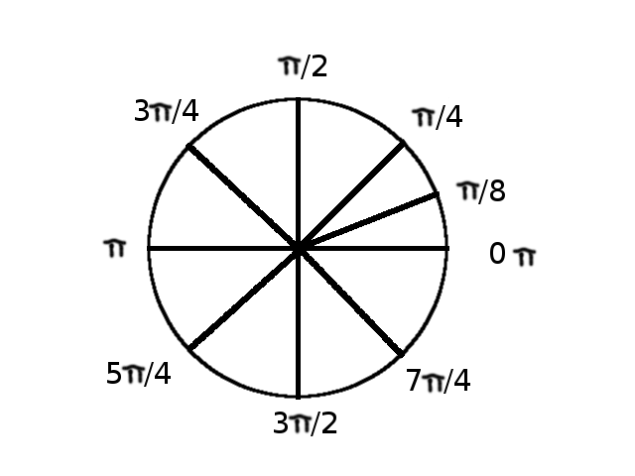
Common Angles in Radians
Use math.py to specify pi.

Slide 20
Drawing a Series of Lines
Each point is a tuple.
All points are in another tuple.
Draws a line connecting each point.
#draw lines,
points = (
(370, 160), (370, 237), (372, 193),
(411, 194), (412, 237), (412, 160),
(412, 237), (432, 227), (436, 196),
(433, 230)
)
pygame.draw.lines(background, (0xFF, 0x00, 0x00), False, points, 3)

Slide 21
Drawing a Polygon
Just like drawing lines.
A polygon is always closed (the last point connects to the first).
#draw polygon
points = (
(137, 372), (232, 319), (383, 335),
(442, 389), (347, 432), (259, 379),
(220, 439), (132, 392)
)
pygame.draw.polygon(background, (0x33, 0xFF, 0x33), points)

Slide 22
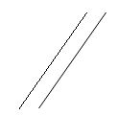
Exploring Anti-Aliasing
Anti-aliasing makes smoother-appearing lines.
The second line (using anti-aliasing) seems much smoother.

Slide 23
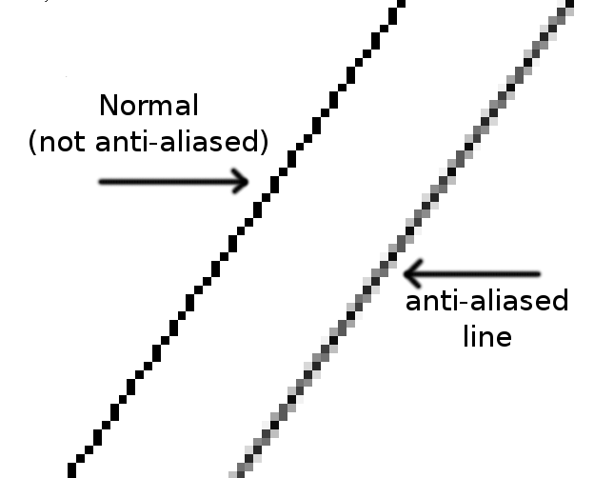
A Closer Look at Anti-Aliasing
Zoomed-in image:

Slide 24
How Anti-Aliasing Works
.aaline() creates an anti-aliased line.
The line is drawn in the indicated color.
Halo fading to the background creates the illusion of smoothness.
#compare normal and anti-aliased diagonal lines
pygame.draw.line(background, (0, 0, 0), (480, 425), (550, 325), 1)
pygame.draw.aaline(background, (0, 0, 0), (500, 425), (570, 325), 1)

Slide 25
Getting Mouse Data
Let Python help you get coordinate pairs with this code:
Prints when the mouse is pressed and released.
Print the current mouse position.
Prints to console, not pygame app.
for event in pygame.event.get():
if event.type == pygame.QUIT:
keepGoing = False
elif event.type == pygame.MOUSEBUTTONUP:
print pygame.mouse.get_pos()

Slide 26
Importing an Image
See face.py.
Prepare the image (JPG, BMP, GIF, or PNG format).
Put the image in the same directory as the code, if possible.
Use pygame.image.load() function to create a surface displaying the image.

Slide 27
Saving an Image
See saveCircles.py.
It has no display at all.
It draws to a surface.
It uses the pygame.image.save() method to save the image.
Save to BMP or TGA format.

Slide 28
Creating a Text Surface
Text in pygame is actually created on image surfaces.
Define a font object (typeface and size).
Render text in that font.
The result is a surface that can be blitted to the screen.

Slide 29
Using a System Font
See showText.py.
A system font is already installed in the host machine.
You don't have to supply a font.
Use the pygame.font.SysFont() function to build a system font.
There's no guarantee the user has the font.

Slide 30
Using a Custom Font
You can create a pygame font by using a TrueType (ttf) font file.
Many excellent free fonts are available online.
Use the pygame.font.Font() command to use a custom ttf font.
This is a more reliable technique if you’ll be distributing your game.
See customFont.py.

Slide 31
Responding to Basic Events
Event-handling is already built into the IDEA/ALTER framework.
for event in pygame.event.get(): checks each event that occurs.
event.type indicates the event that occurred.
A special object is also created describing the status of various input objects (mouse, key, joystick).

Slide 32
Checking Key Presses
If a key was pressed, event.type will be equal to pygame.KEYDOWN.
Event.key has the keycode (hardware code) related to which key was pressed.
Use pygame.key.name(event.key) to get an English-language name for the key that was pressed.

Slide 33
Checking for Specific Keys
Special keys (arrows, spacebar, Escape key) have special constants.
Use the following code to test for the Escape key:
Type help("pygame") in the console to see other key constants.
if event.key == pygame.K_ESCAPE:
keepGoing = False

Slide 34
Checking for Mouse Events
When a mouse button is pressed, event.type will be pygame.MOUSE-BUTTONDOWN.
Use pygame.mouse.get_pos() to determine mouse position.
You can also use pygame.mouse.get_pressed() to determine which button is down.
elif event.type == pygame.MOUSEBUTTONDOWN:
print "mouse down:", pygame.mouse.get_pos()

Slide 35
Drawing Interactive Lines
See lines.py.
When the mouse is clicked, store its position to lineStart.
When the mouse is released, store its position in lineEnd.
Draw a line from lineStart to lineEnd.

Slide 36
Code for Line Drawing
See linePrev.py for a version that previews the line in real time before you release the mouse.
for event in pygame.event.get():
if event.type == pygame.QUIT:
keepGoing = False
elif event.type == pygame.MOUSEBUTTONDOWN:
lineStart = pygame.mouse.get_pos()
elif event.type == pygame.MOUSEBUTTONUP:
lineEnd = pygame.mouse.get_pos()
pygame.draw.line(background, (0, 0, 0), lineStart, lineEnd, 3)

Slide 37
paint.py Strategy
The mouse draws on the screen.
Keyboard changes color, pen size.
Save and load a single image.
Map drawing size, color to variables.
If the mouse is dragged, draw a short line from the previous point to the current point.
Very short straight lines will look curved.

Slide 38
Main Variables of paint.py
background: The surface being modified
event: pygame event
drawColor: The color for the current drawing
lineWidth: The width of the pen line
lineBegin: The beginning point of the line
lineEnd: The end point of the line
myData: Used to transfer information

Slide 39
Functions in paint.py
checkKeys(): Gets all keyboard input, changes variables
showStats(): Creates a label displaying pen size and color
main(): Like any other IDEA/ALTER framework

Slide 40
Background and Screen
Both are surfaces.
The background is permanent.
The screen changes every frame.
Make permanent changes to the background.
Blit background onto screen.
Make temporary changes to screen after background has been drawn.

Slide 41
Transferring Data
checkKeys() modifies several variables.
Pack the variables into the myData tuple to send them all at once.
checkKeys() returns a tuple.
Store this value back to myData.
Copy back to individual variables.
elif event.type == pygame.KEYDOWN:
myData = (event, background, drawColor, lineWidth,
keepGoing)
myData = checkKeys(myData)
(event, background, drawColor, lineWidth,
keepGoing) = myData

Slide 42
Discussion Questions
Why is it worth learning a higher-powered editor such as SPE?
What side effects happen when you don't use the __name__ trick?
How does Python support passing by reference/value?
What improvements could be made to paint.py?

Slide 43
Summary
You should now understand
  Using functions with pygame
  Learning a more sophisticated editor
  Drawing with the pygame.draw module
  Responding to basic events
  Saving and loading images
  Building a painting program

Slide 44
Next Lecture
Audio & Sprites

Slide 45
References
Andy Harris, “Game Programming, The L Line, The Express Line to Learning”; Wiley, 2007

