Slide 1


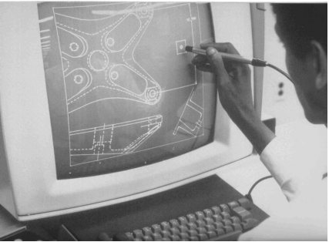
CSE 411
Computer Graphics
Lecture #7 3D Geometric Transformations
Prepared & Presented by Asst. Prof. Dr. Samsun M. BAŞARICI
Notes:
1

Slide 2
Objectives
HB Ch. 9
Extending 2D Transformation into 3D, i.e.
  3D Translation
  3D Rotation
  3D Scaling
  3D Reflection
  3D Shear
3D Composite Transformations
Transformations between 3D Coordinate Systems
Affine Transformations
OpenGL Matrix Stacks

Slide 3
Geometric Transformations in 3D Space
3D transformation methods are extended from 2D methods by including considerations for the z coordinate
A 3D homogenous coordinate is represented as a four-element column vector
  Each geometric transformation operator is a 4 by 4 matrix

Slide 4
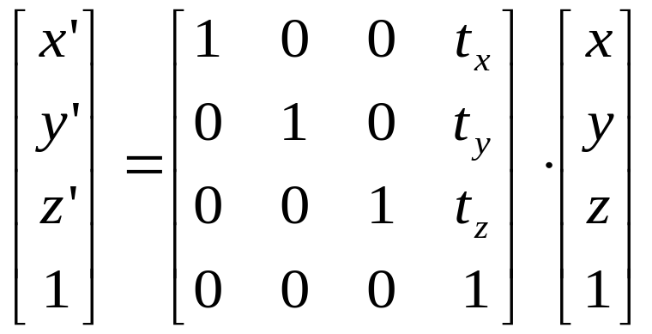
3D Translation
x’ = x + t_{x} , y’ = y + t_{y} , z’ = z + t_{z}
P’=P·T

Slide 5
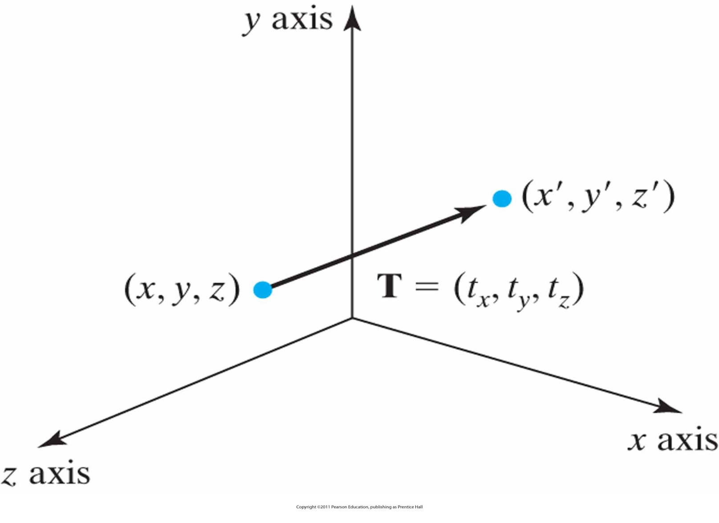
Simple Translation
Moving a coordinate position with translation vector T = (t_{x} , t_{y} , t_{z} )

Slide 6
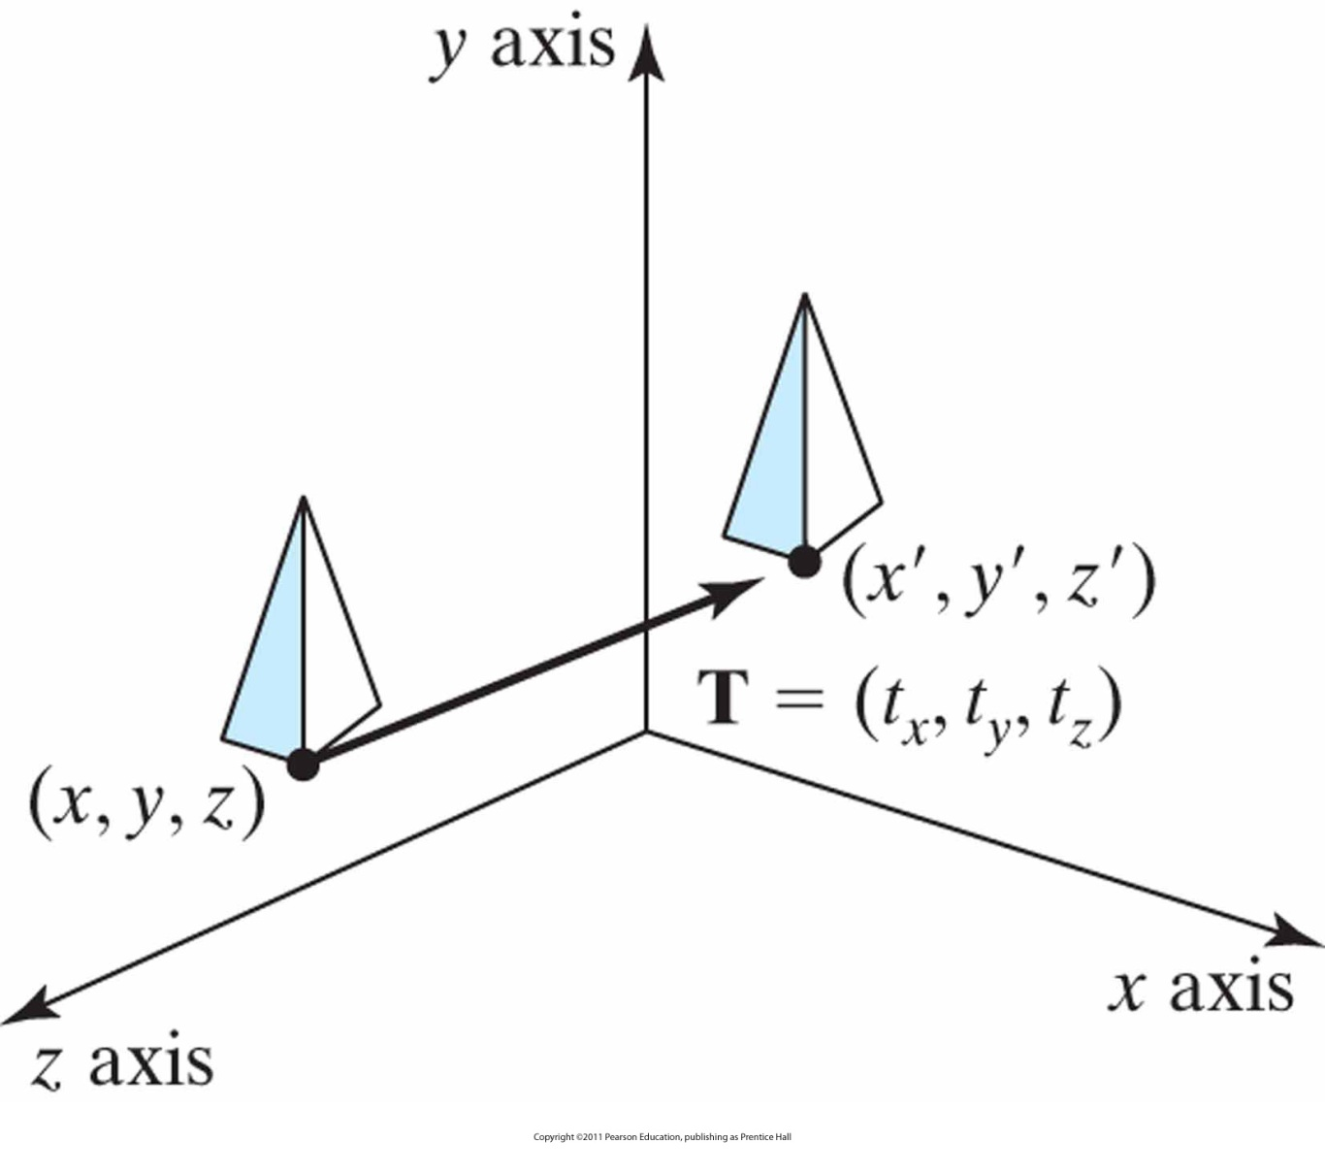
Translating a 3D Object
Shifting the position of a three-dimensional object using translation vector T.

Slide 7
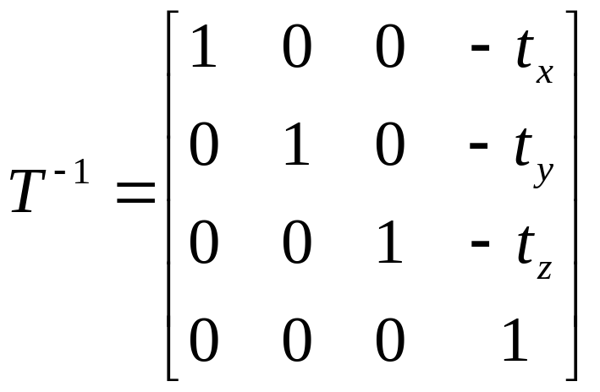
3D Inverse Translation

Slide 8
3D Rotation
Most complex 3D transforms
Positive rotation angles produce counterclockwise rotations about a coordinate axis, assuming that we are looking in the negative direction along that coordinate axis
The convention:
  Looking in the negative direction along the coordinate axis →
    Positive rotation angle means counterclockwise rotation

Slide 9
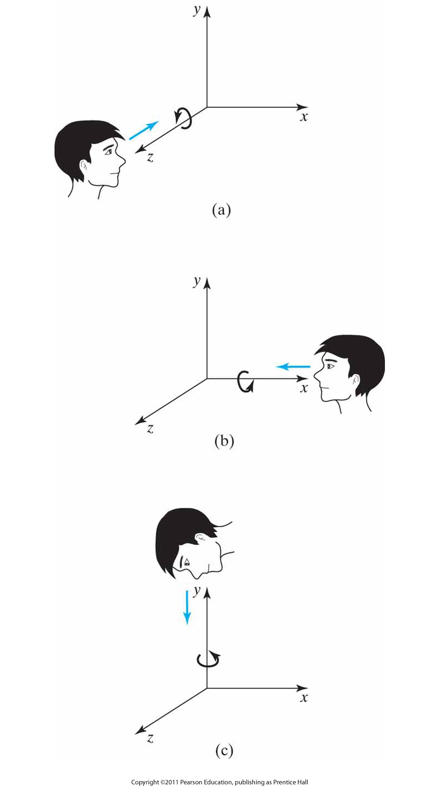
3D Rotation (cont.)
Positive rotations about a coordinate axis are counterclockwise, when looking along the positive half of the axis toward the origin.

Slide 10
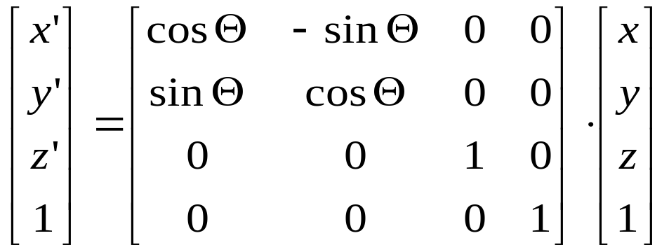
3D Rotation (cont.)
z-axis rotation
  x’=x cos θ - y sin θ
  y’=x sin θ + y cos θ
  z’=z
or, P’ = R_{z}(θ)·P

Slide 11
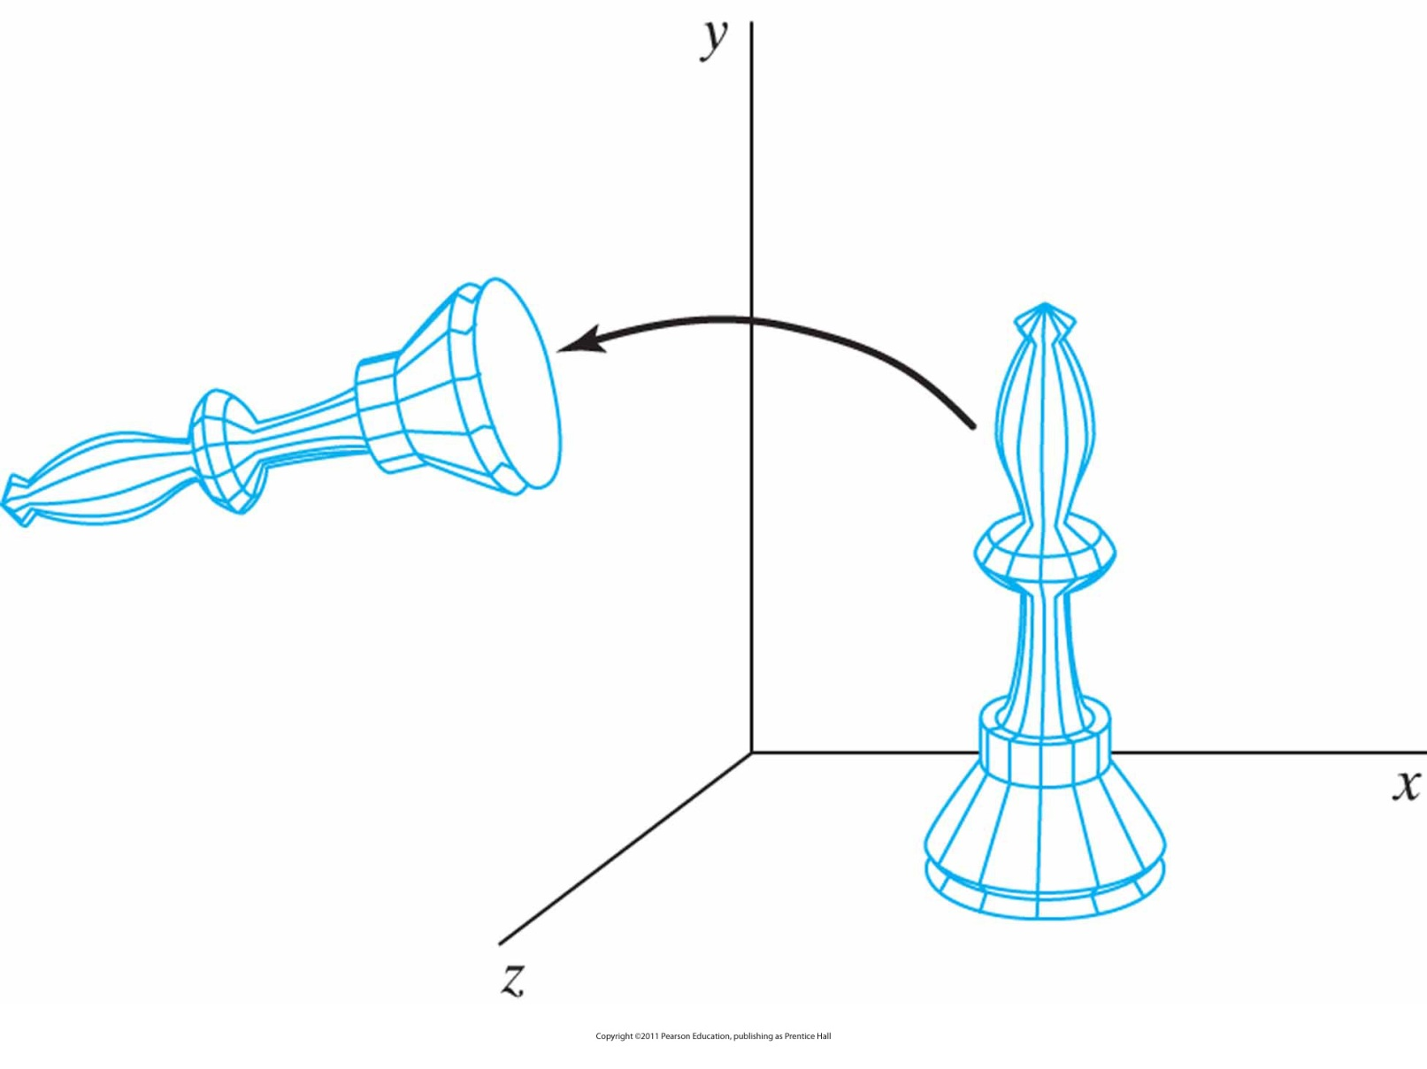
Example:
Rotation of an object about the z axis.

Slide 12
3D Rotation (cont.)
z-axis rotation
  x’=x cos θ - y sin θ
  y’=x sin θ + y cos θ
  z’=z
Other axis rotations
  x→ y→ z→ x
x-axis rotation
  y’=y cos θ - z sin θ
  z’=y sin θ + z cos θ
  x’=x
y-axis rotation
  z’=z cos θ - x sin θ
  x’=z sin θ + x cos θ
  y’=y

Slide 13
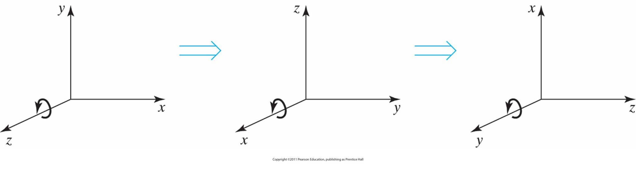
The Permutations
Cyclic permutation of the Cartesian-coordinate axes to produce the three sets of coordinate-axis rotation equations.

Slide 14
3D Rotation(z-axis)
z-axis rotation
y
P=(x,y,z)
x
z

Slide 15
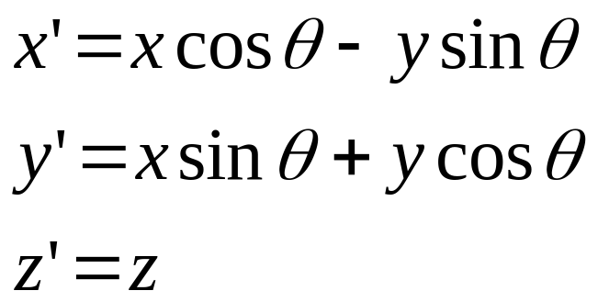
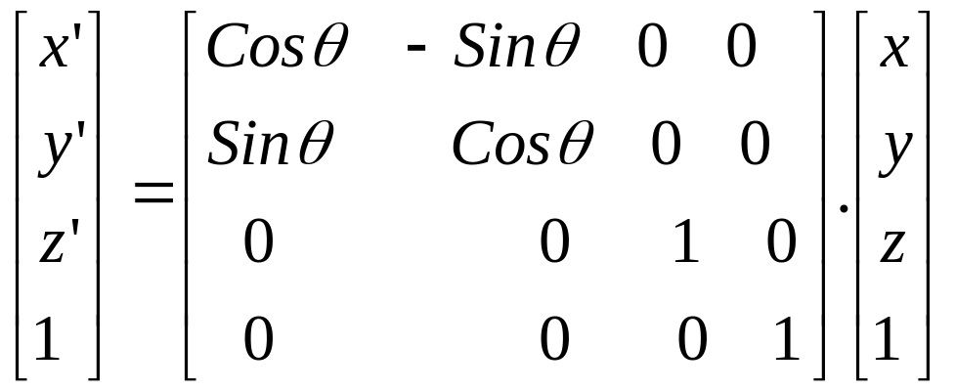
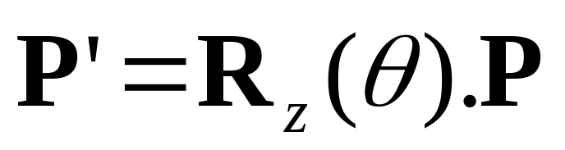
3D Rotation (z-axis)

Slide 16
3D Rotation (x-axis)
x-axis rotation
y
P=(x,y,z)
x
z

Slide 17
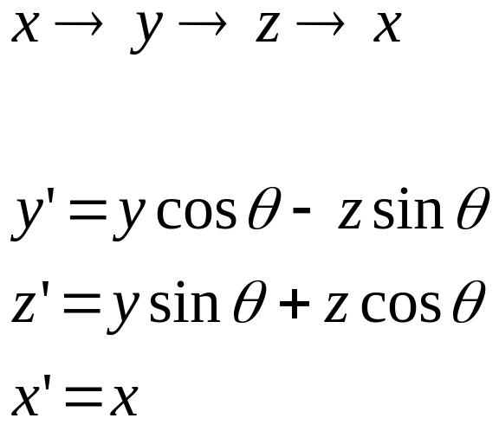
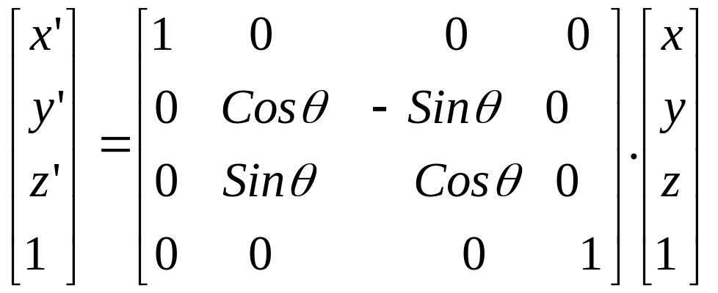
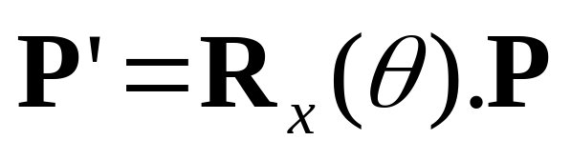
3D Rotation (x-axis) (cont.)

Slide 18
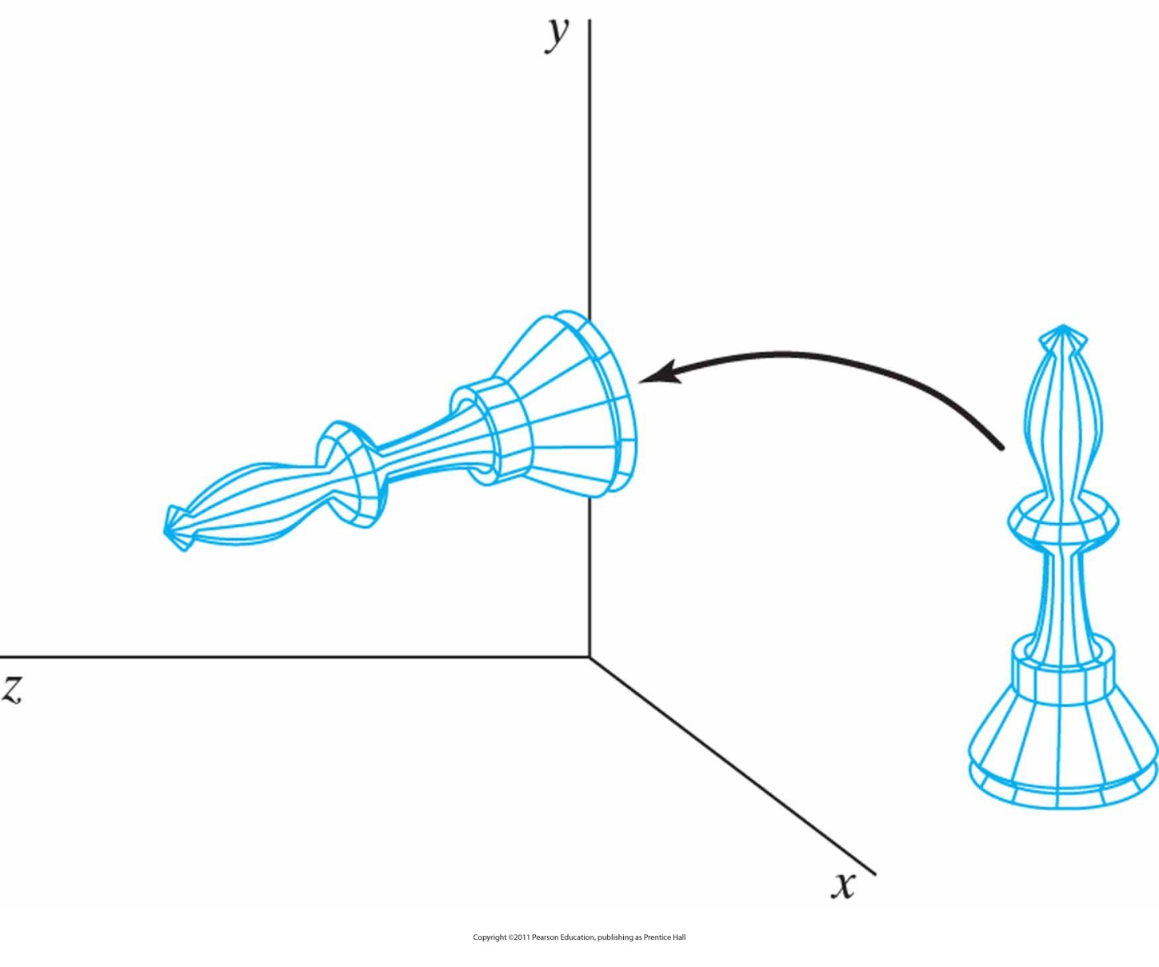
Example:
Rotation of an object about the x axis.

Slide 19
3D Rotation(y-axis)
y-axis rotation
y
P=(x,y,z)
x
z

Slide 20
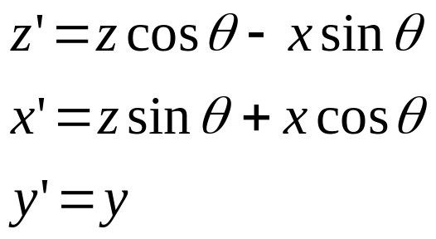
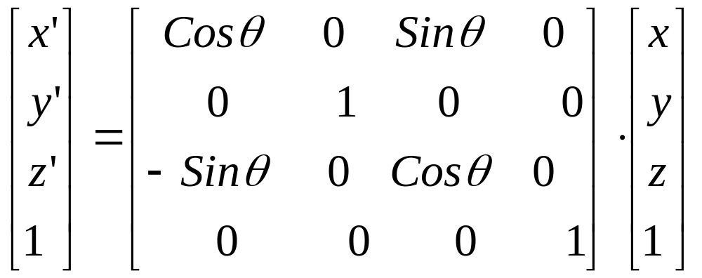
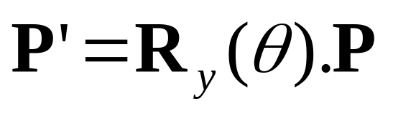
3D Rotation(y-axis) (cont.)

Slide 21
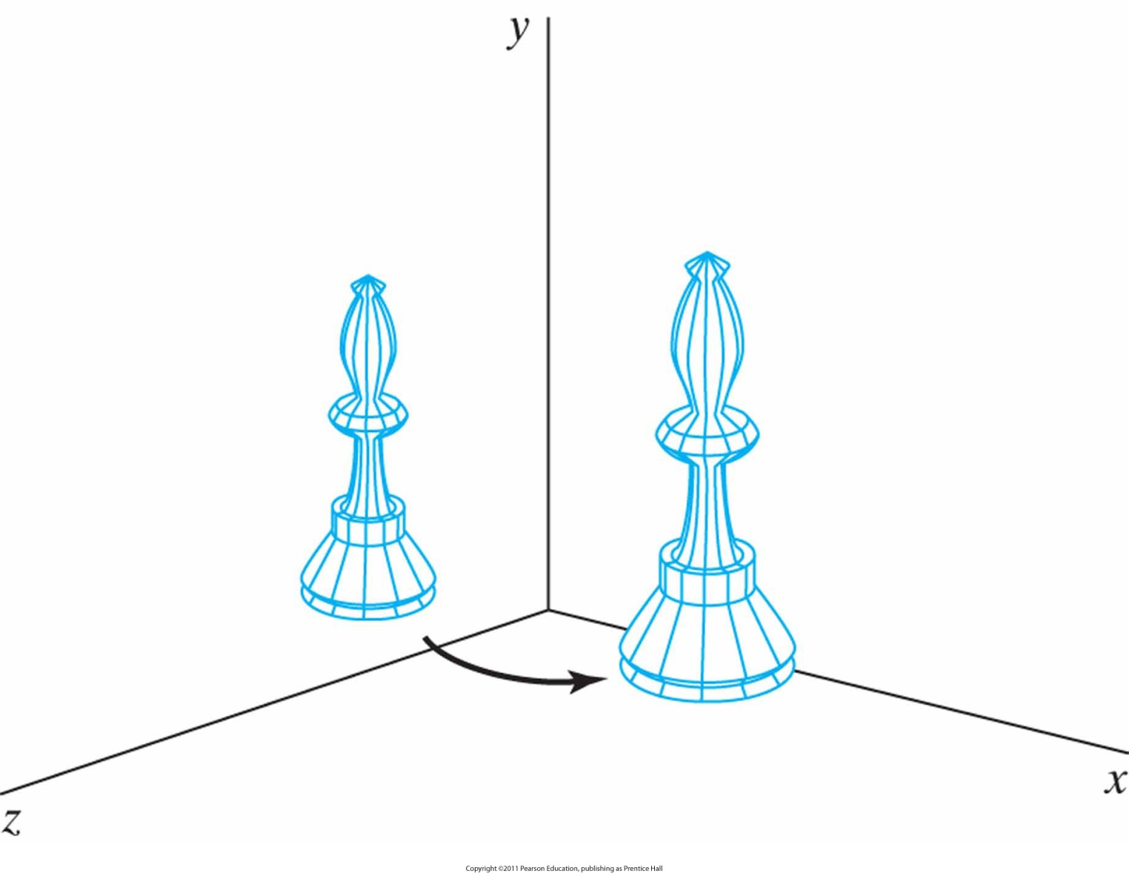
Example:
Rotation of an object about the y axis.

Slide 22
3D Inverse Rotations
Look at 2D inverse rotations
No idea?
Replace θ with –θ ☺
Again: R⁻¹ = R^{T}
Why?
Answer: Only sine functions are affected
???
Remember and look at 2D inverse rotations

Slide 23
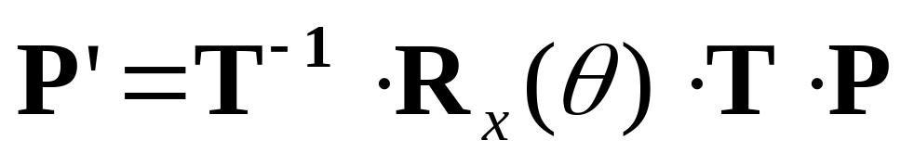
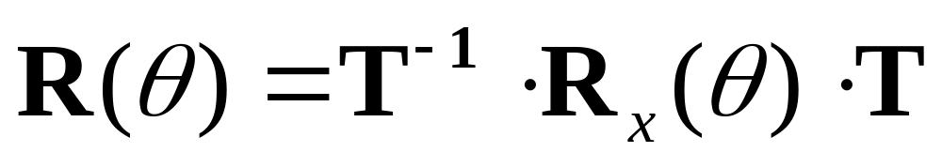
3D Rotation (cont.)
General Three-Dimensional Rotations
  Special case where an object is to be rotated about an axis that is parallel to one of the coordinate axes
    Translate the object so that the rotation axis coincides with parallel coordinate axis
    Perform the specified rotation about the axis
    Translate the object so that the rotation axis is moved back to its original position
    and (composite rotation matrix)

Slide 24
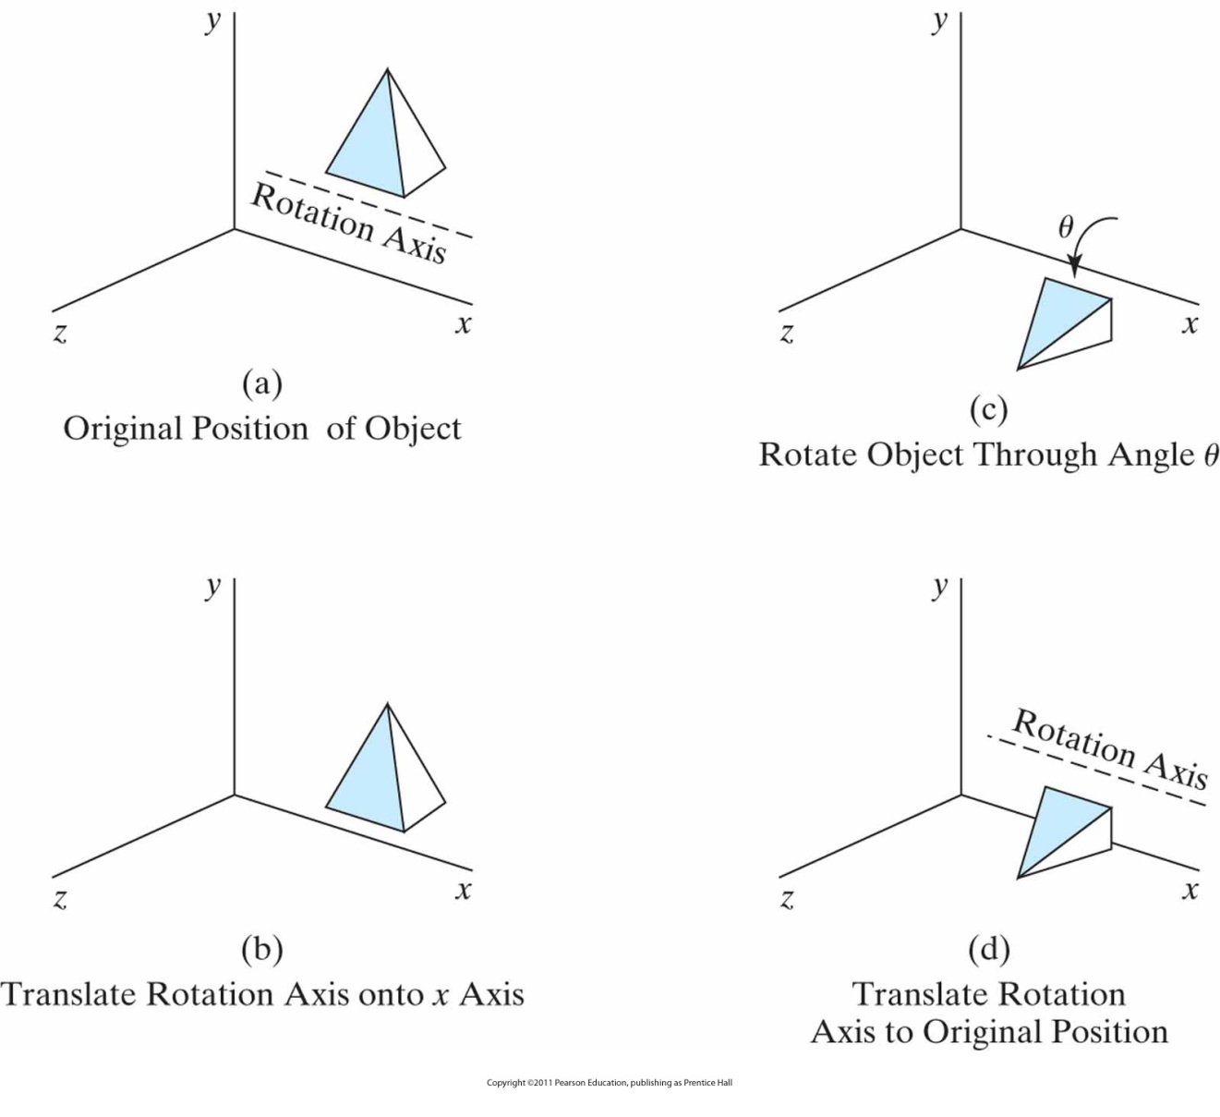
Example:
Sequence of transformations for rotating an object about an axis that is parallel to the x axis.

Slide 25
3D Rotation (cont.)
When an object is to rotated about an axis that is not parallel to one of the coordinate axes
  Translate the object so that the rotation axis passes through the coordinate origin
  Rotate the object so that the axis of rotation coincides with one of the coordinate axes (General convention: z-axis!)
  Perform the specified rotation about the selected coordinate axis
  Apply inverse rotations to bring the rotation axis back to its original position
  Apply the inverse translation to bring the rotation axis back to its original spatial position

Slide 26
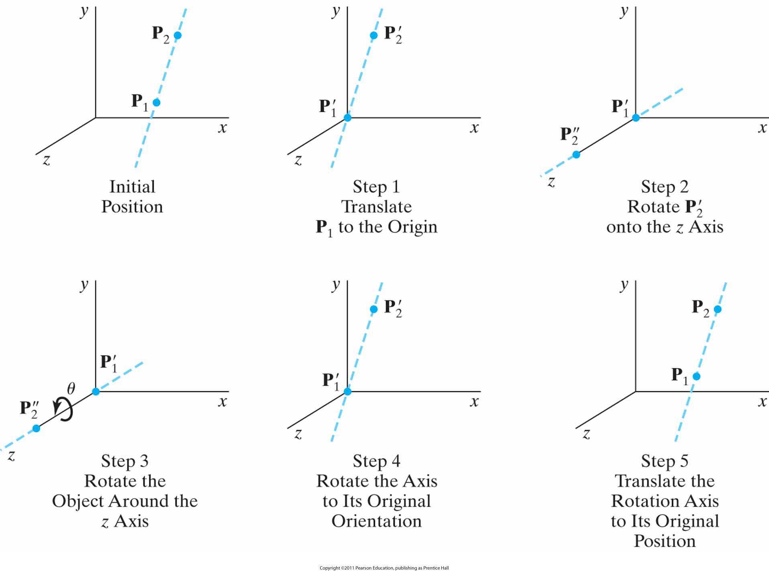
Arbitrary Rotation in 3D
Five transformation steps for obtaining a composite matrix for rotation about an arbitrary axis, with the rotation axis projected onto the z axis.

Slide 27
Arbitrary Rotation in 3D (cont.)
y
P2
Rotation axis
P1
x
z
Initial Position

Slide 28
Arbitrary Rotation in 3D (cont.)
y
P2
P1
x
z
Translate P₁ to the origin

Slide 29
Arbitrary Rotation in 3D (cont.)
y
P2
x
P1
z
Rotate P2 onto the z-axis and rotate the object around it

Slide 30
Arbitrary Rotation in 3D (cont.)
y
P2
P1
x
z
Rotate the axis to the original orientation

Slide 31
Arbitrary Rotation in 3D (cont.)
y
P2
P1
x
z
Translate the rotation axis to the original position

Slide 32
Arbitrary Rotation in 3D (detailed)
Assumptions:
  Rotation axis is defined by two points
  Counterclockwise rotation
  Looking from P₂ to P₁

Slide 33
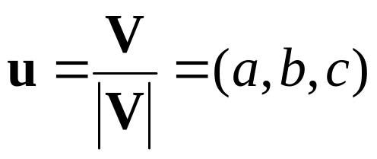
Arbitrary Rotation in 3D (detailed) (cont.)
An axis vector is defined by two points as
A unit (rotation-axis) vector is defined as

Slide 34
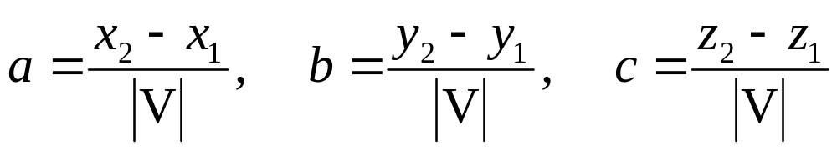
Unit Vector?
In a normed vector space, a vector (often a spatial vector) whose length is 1 (the unit length)
The components a, b, and c are direction cosines for the rotation axis
Remember Calculus II?

Slide 35
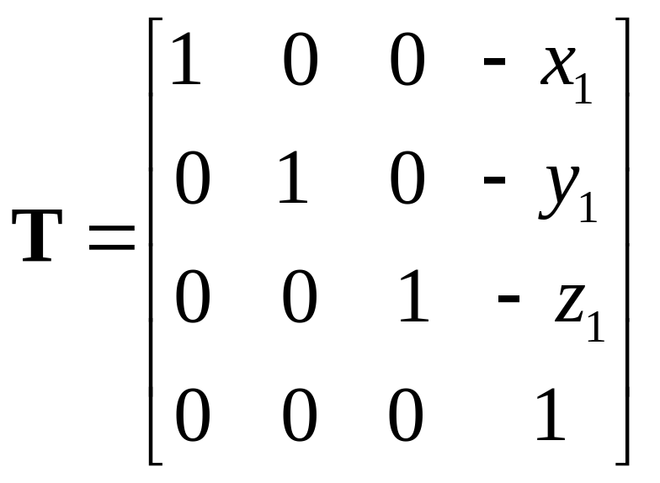
Arbitrary Rotation in 3D (detailed) (cont.)
The first step is to set up the translation matrix

Slide 36
Arbitrary Rotation in 3D (detailed) (cont.)
The next step is to put the rotation axis on the z-axis.
y
u
x
z

Slide 37
Arbitrary Rotation in 3D (detailed) (cont.)
First, we rotate about the x-axis to transform u into the x-z plane.
y
u
x
α
z

Slide 38
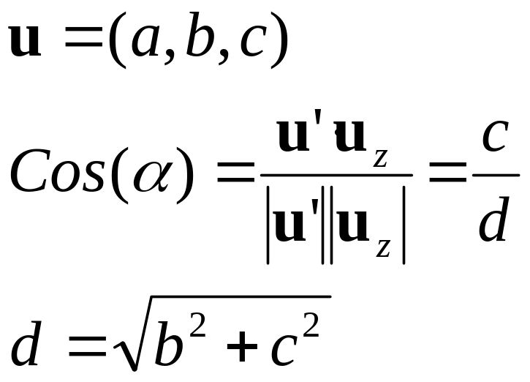
Arbitrary Rotation in 3D (detailed) (cont.)
Then “swing” around y-axis to bring u to the z-axis
y
u
u′
α
x
_{α}
Uz=(0,0,1)
z

Slide 39
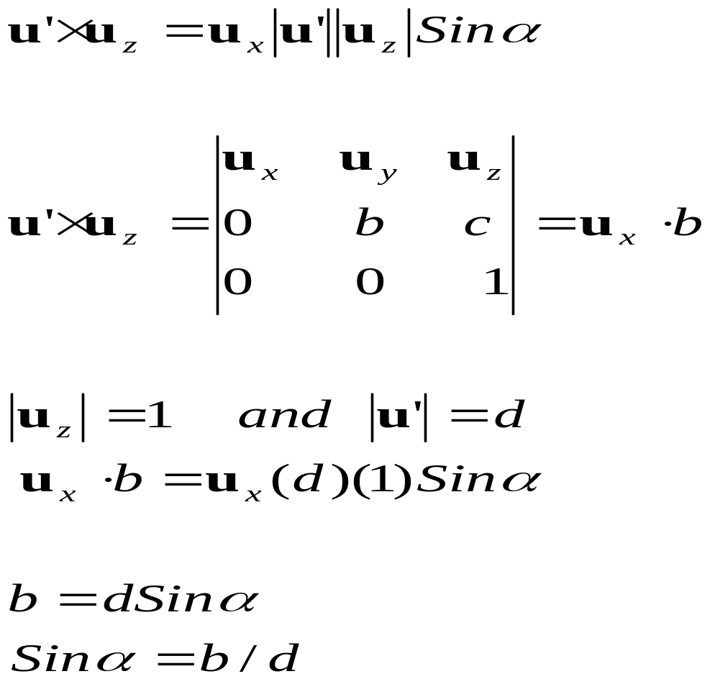
Arbitrary Rotation in 3D (detailed) (cont.)
We can define the sine of α from the cross product of u and u_{z}

Slide 40
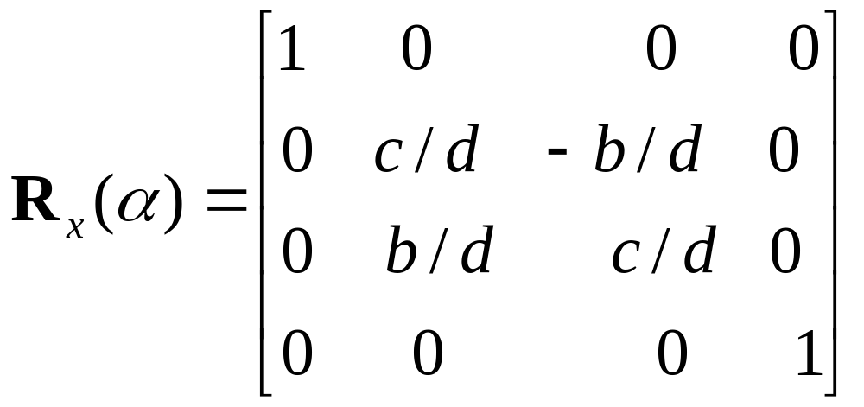
Arbitrary Rotation in 3D (detailed) (cont.)
The rotation matrix is

Slide 41
Arbitrary Rotation in 3D (detailed) (cont.)
y
u
β
x
z

Slide 42
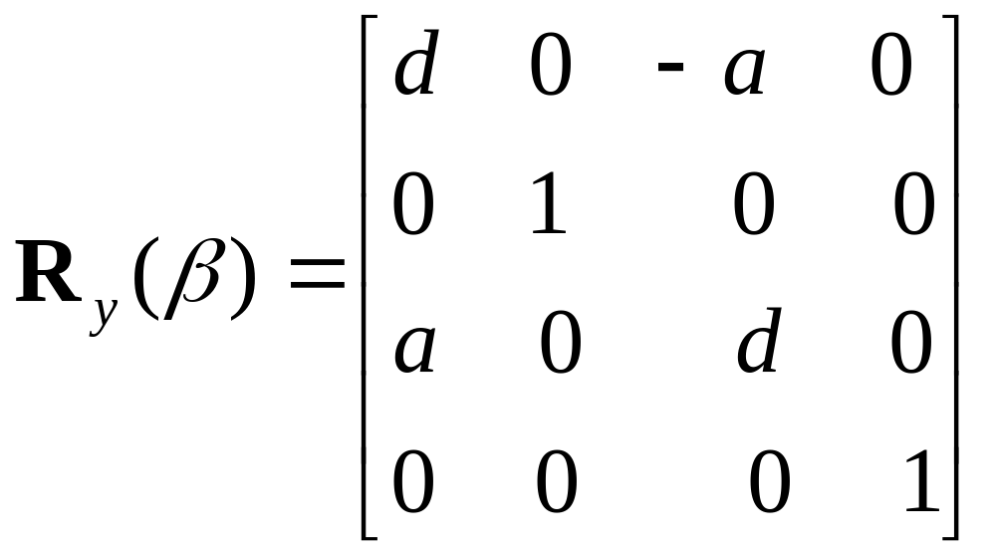
Arbitrary Rotation in 3D (detailed) (cont.)

Slide 43
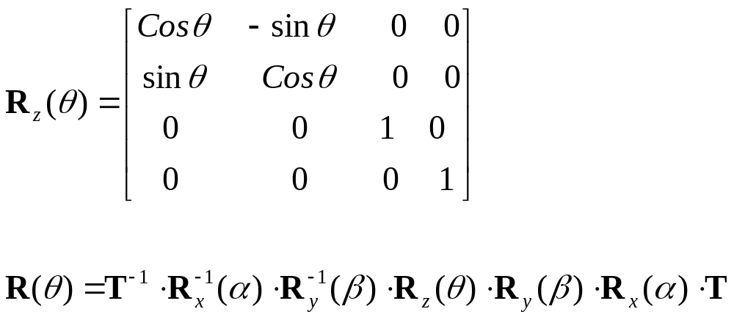
Arbitrary Rotation in 3D (detailed) (cont.)

Slide 44
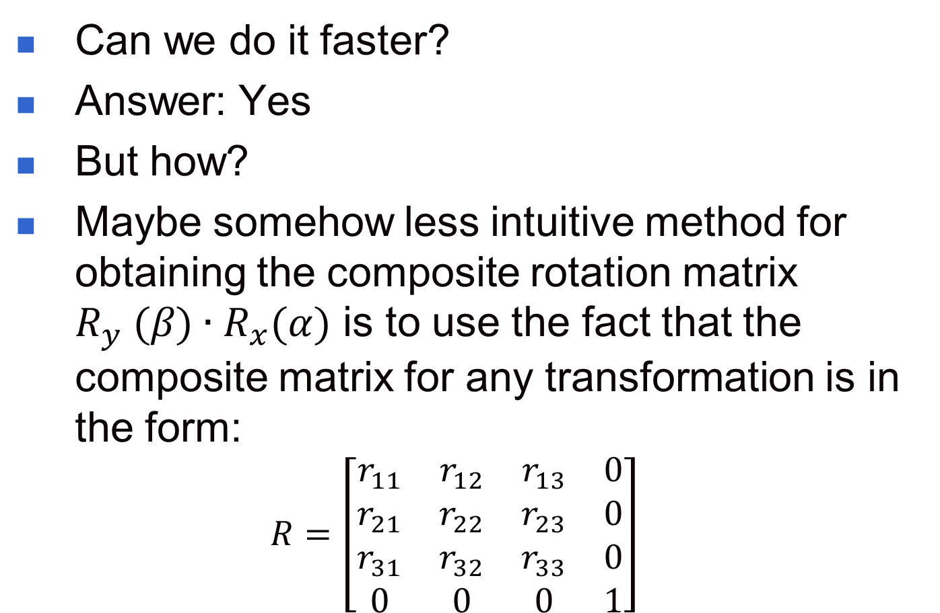
3D Rotation (cont.)
Can we do it faster?
Answer: Yes
But how?
Maybe somehow less intuitive method for obtaining the composite rotation matrix $R_{y} (β)∙R_{x}(α)$ is to use the fact that the composite matrix for any transformation is in the form:
  $$R=\left[\begin{matrix}r_{11} & r_{12} & r_{13} & 0 \\ r_{21} & r_{22} & r_{23} & 0 \\ r_{31} & r_{32} & r_{33} & 0 \\ 0 & 0 & 0 & 1\end{matrix}\right]$$

Slide 45
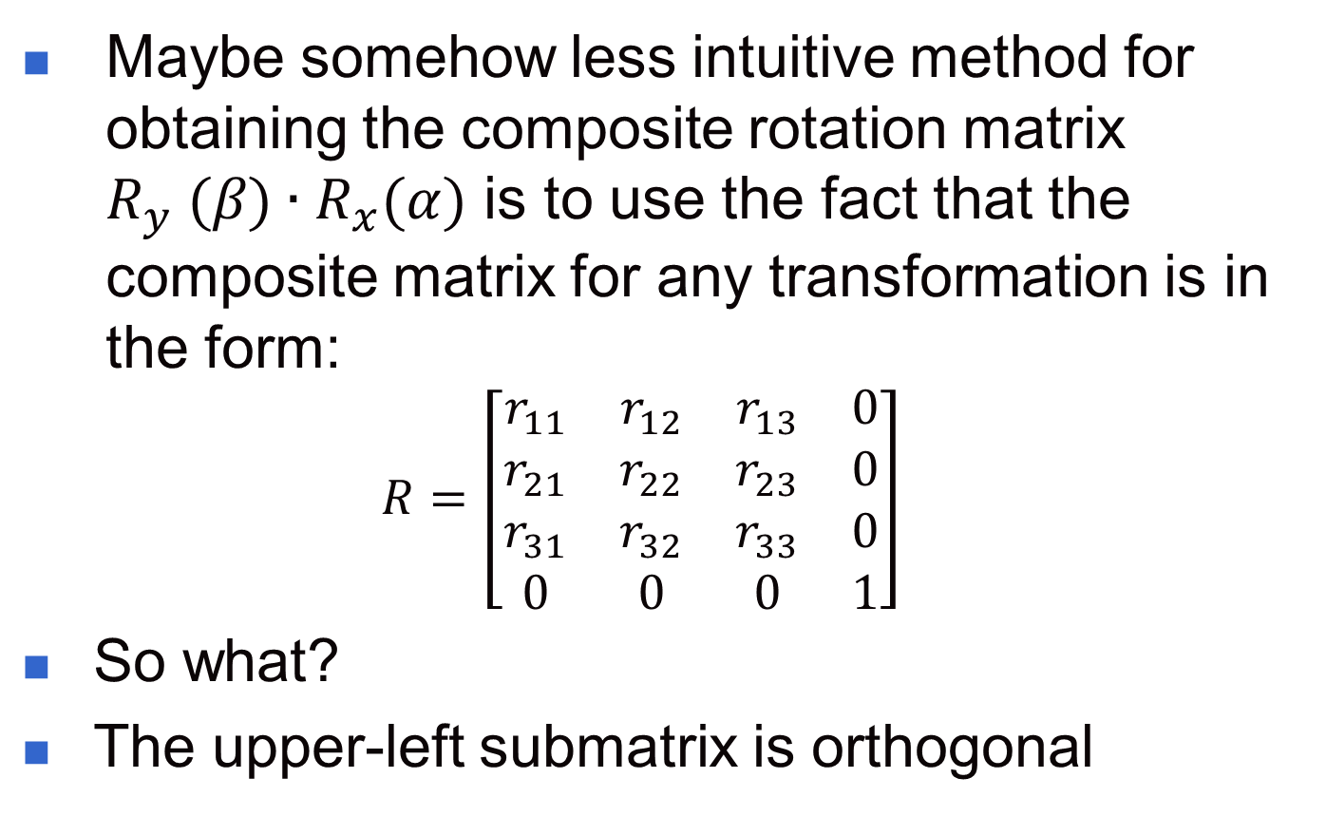
3D Rotation (cont.)
Maybe somehow less intuitive method for obtaining the composite rotation matrix $R_{y} (β)∙R_{x}(α)$ is to use the fact that the composite matrix for any transformation is in the form:
  $$R=\left[\begin{matrix}r_{11} & r_{12} & r_{13} & 0 \\ r_{21} & r_{22} & r_{23} & 0 \\ r_{31} & r_{32} & r_{33} & 0 \\ 0 & 0 & 0 & 1\end{matrix}\right]$$
So what?
The upper-left submatrix is orthogonal

Slide 46
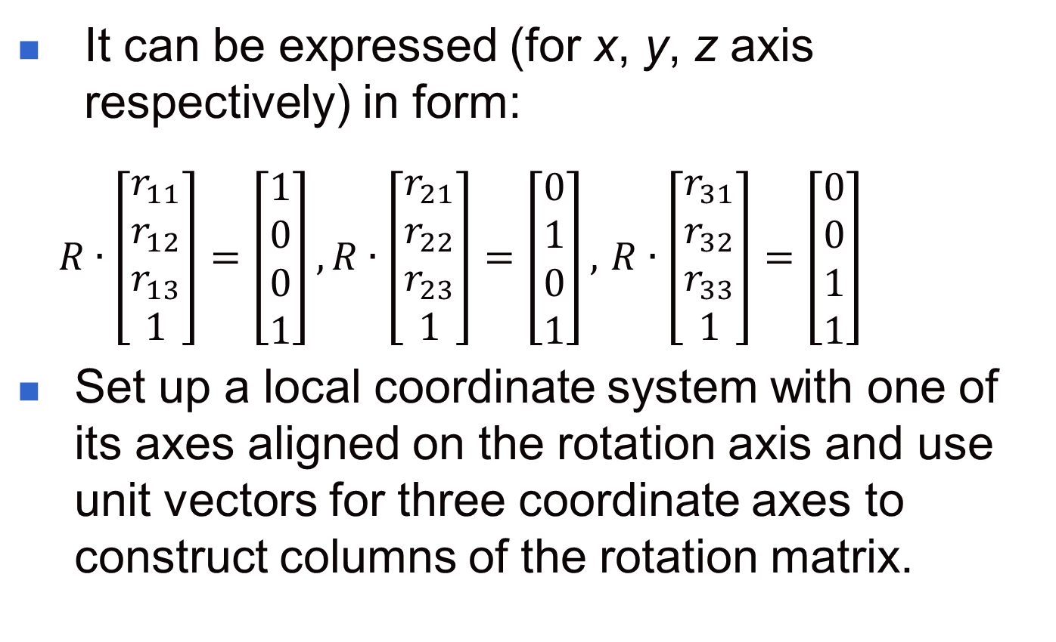
3D Rotation (cont.)
It can be expressed (for x, y, z axis respectively) in form:
  $R∙\left[\begin{matrix}r_{11} \\ r_{12} \\ r_{13} \\ 1\end{matrix}\right]=\left[\begin{matrix}1 \\ 0 \\ 0 \\ 1\end{matrix}\right],R∙\left[\begin{matrix}r_{21} \\ r_{22} \\ r_{23} \\ 1\end{matrix}\right]=\left[\begin{matrix}0 \\ 1 \\ 0 \\ 1\end{matrix}\right],$ $R∙\left[\begin{matrix}r_{31} \\ r_{32} \\ r_{33} \\ 1\end{matrix}\right]=\left[\begin{matrix}0 \\ 0 \\ 1 \\ 1\end{matrix}\right]$
Set up a local coordinate system with one of its axes aligned on the rotation axis and use unit vectors for three coordinate axes to construct columns of the rotation matrix.

Slide 47
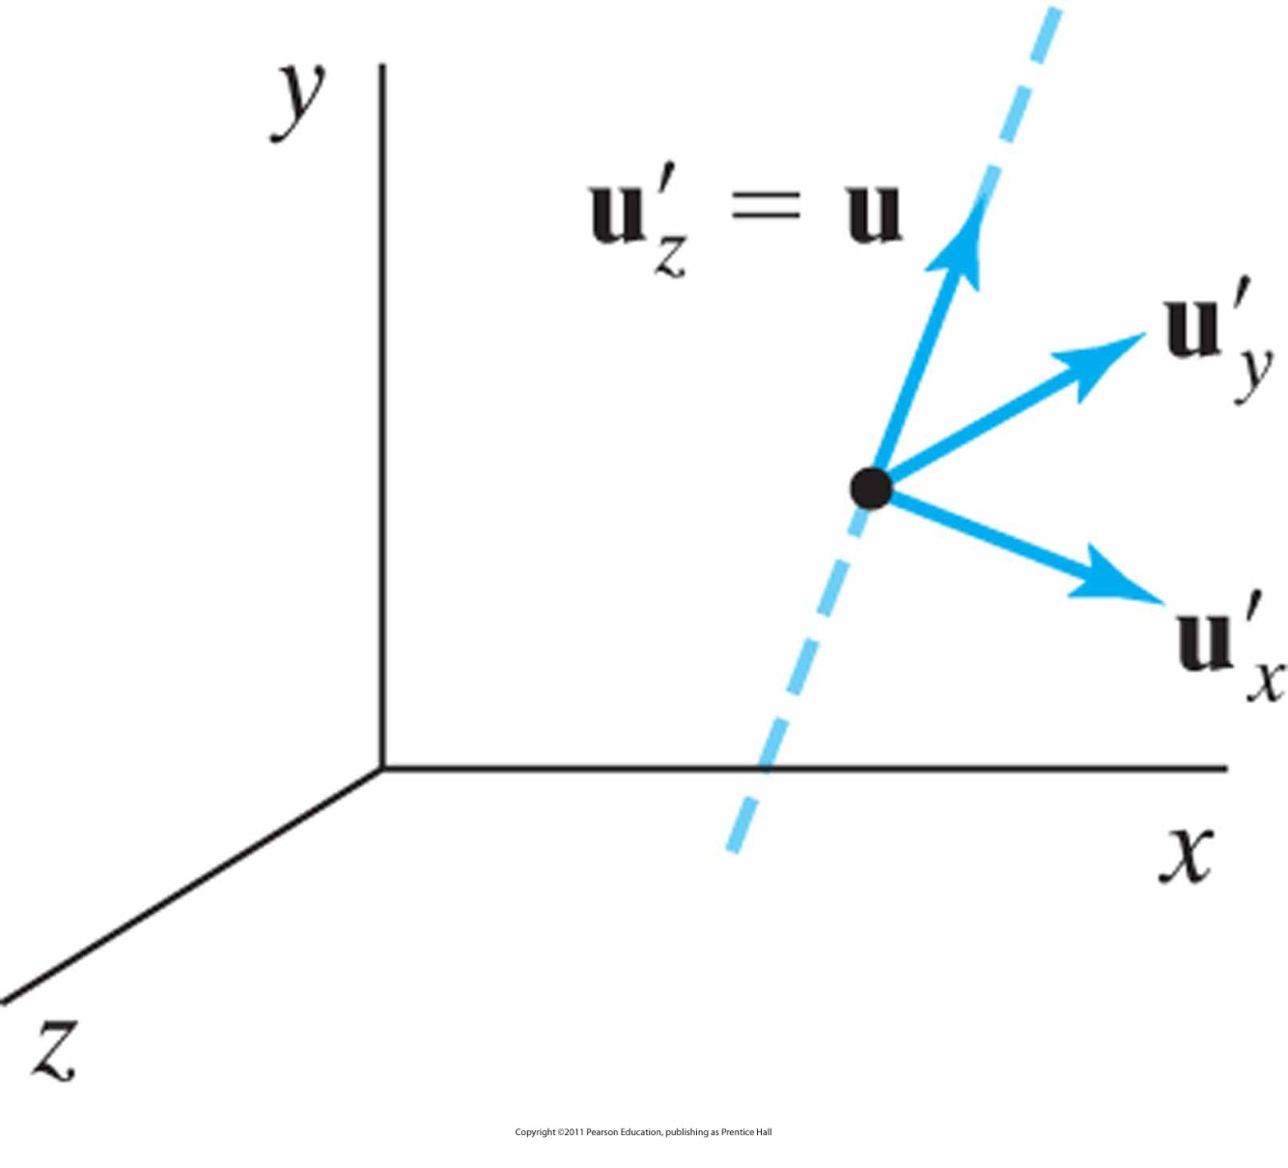
Local coordinate system
For a rotation axis defined by unit vector u.

Slide 48
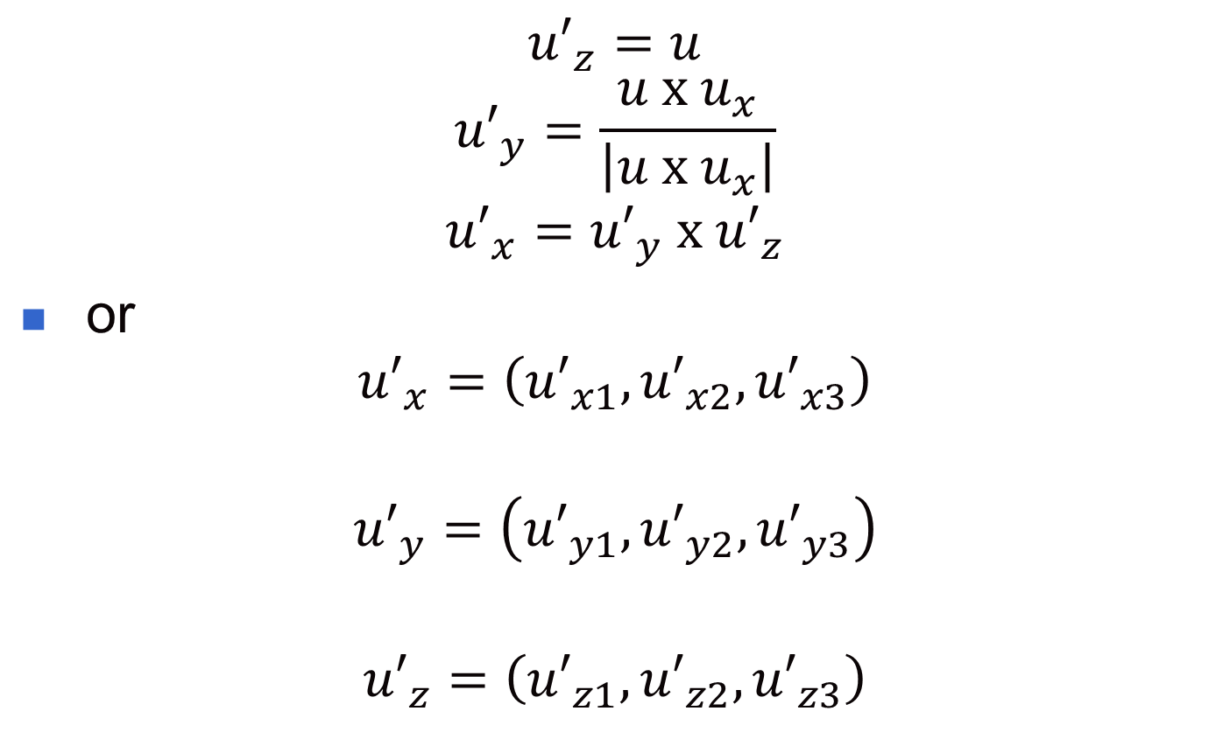
The Local Unit Vectors
$${u′}_{z}=u$$
$${u′}_{y}=\frac{u \text{x} u_{x}}{\left|u \text{x} u_{x}\right|}$$
$${u′}_{x}={u′}_{y} \text{x} {u′}_{z}$$
or
$${u′}_{x}=\left({u′}_{x1},{u′}_{x2},{u′}_{x3}\right)$$
$${u′}_{y}=\left({u′}_{y1},{u′}_{y2},{u′}_{y3}\right)$$
$${u′}_{z}=\left({u′}_{z1},{u′}_{z2},{u′}_{z3}\right)$$

Slide 49
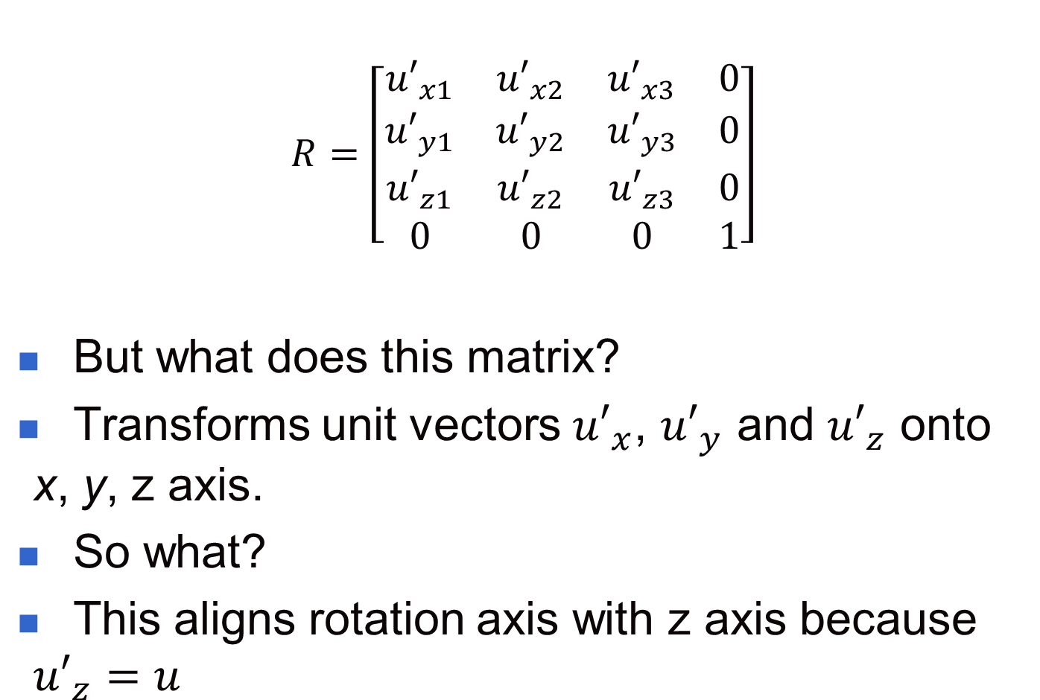
Finally: The Rotation Matrix
  $$R=\left[\begin{matrix}{u′}_{x1} & {u′}_{x2} & {u′}_{x3} & 0 \\ {u′}_{y1} & {u′}_{y2} & {u′}_{y3} & 0 \\ {u′}_{z1} & {u′}_{z2} & {u′}_{z3} & 0 \\ 0 & 0 & 0 & 1\end{matrix}\right]$$
But what does this matrix?
Transforms unit vectors ${u′}_{x}$, ${u′}_{y}$ and ${u′}_{z}$ onto x, y, z axis.
So what?
This aligns rotation axis with z axis because ${u′}_{z}=u$

Slide 50
3D Rotation (cont.)
Quaternion method:
  Quaternions are extensions of 2D complex numbers
  Method extensively used in computer games and high level CG applications

Slide 51
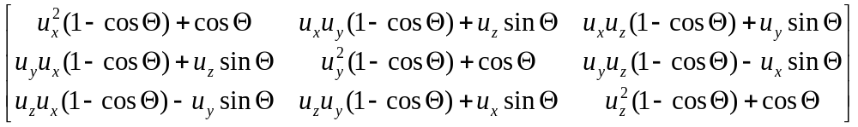
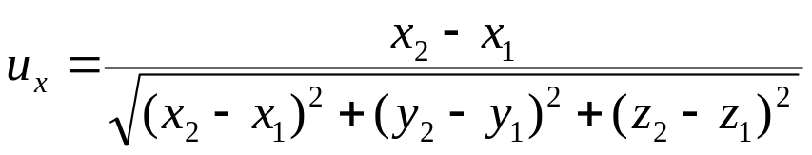
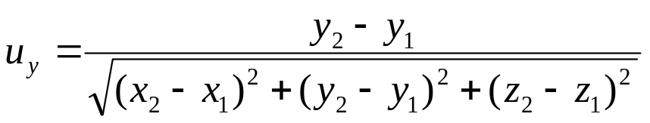

Quaternions?
where

Slide 52
Quaternions?
How does it work?
Coming soon (when you apply for an M.Sc.) ☺ ☺

Slide 53
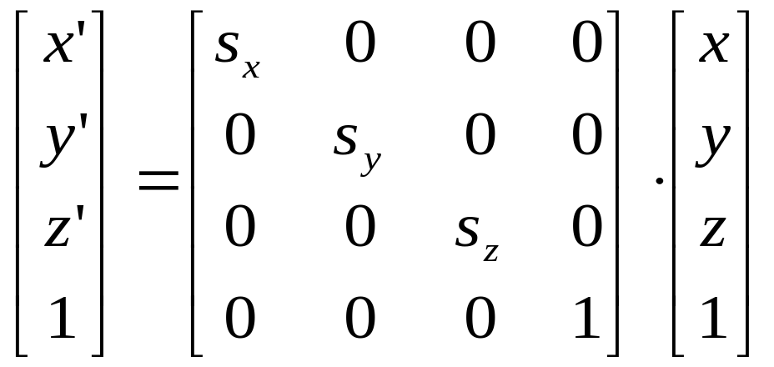
3D Scaling
Extending 2D scaling with z-coordinate
Scaling relative to the coordinate origin
or, P’ = S·P

Slide 54
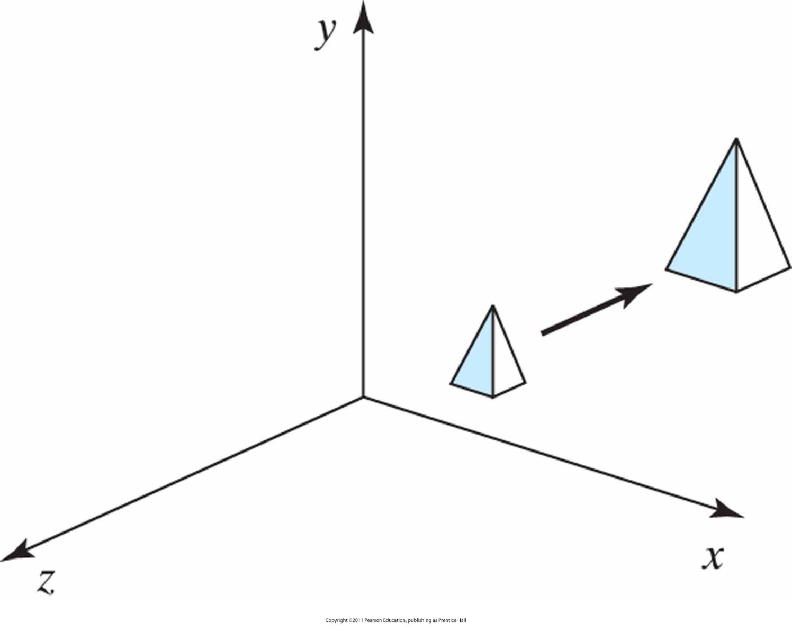
3D Scaling (cont.)
Doubling the size of an object with transformation on previous Slide also moves the object farther from the origin.

Slide 55
3D Scaling (cont.)
General 3D Scaling (with respect to any fixed point)
  Translate the object to the origin
  Apply scaling transformation
  Translate the fixed point back to its original position

Slide 56
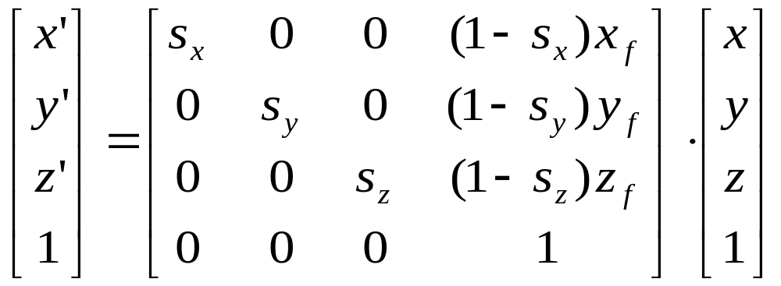
3D Scaling (cont.)
Scaling with respect to a fixed point (x_{f}, y_{f ,} z_{f})

Slide 57
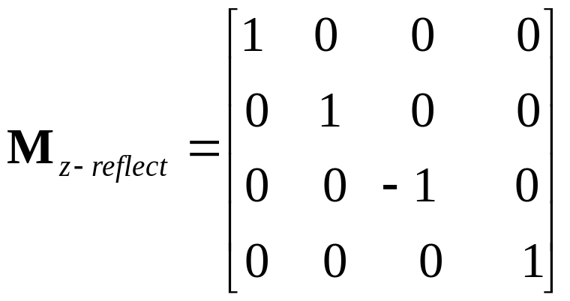
Other 3D Transformations
3D Reflections
Reflection Relative to the xy Plane
(Lefthand-Right hand)
y
y
z
P=(x,y,z)
P=(x,y,z)
x
x
z

Slide 58
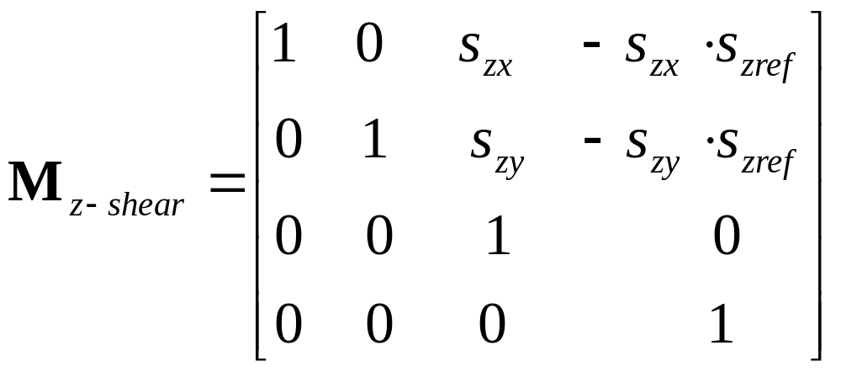
Other 3D Transformations (cont.)
3D Shears
  A general z-axis shearing relative to a selected reference point (s_{zx}, s_{zy} , s_{zref})

Slide 59
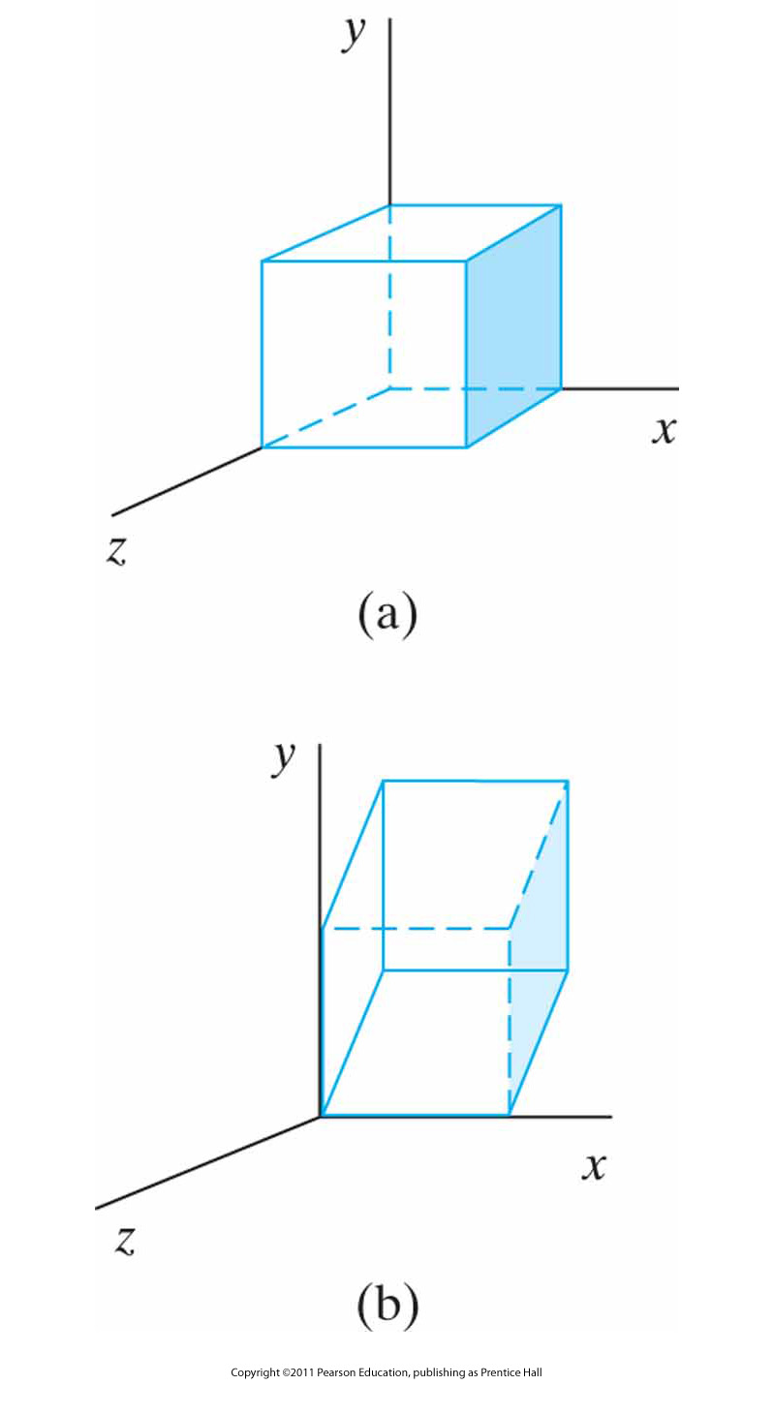
Example:
A unit cube (a) is sheared relative to the origin
(b) by the previous matrix, with sh_{zx} = sh_{zy} = 1
(Distortion of the image is due to scaling of the picture not the effect of the matrix)

Slide 60
3D Inverse and Composite Transformations
Generally:
  Extending 2D thoughts
  But how?
  Your turn ☺

Slide 61
Transformation between 3D Coordinate Systems
Also your responsibility ☺ ☺ ☺

Slide 62
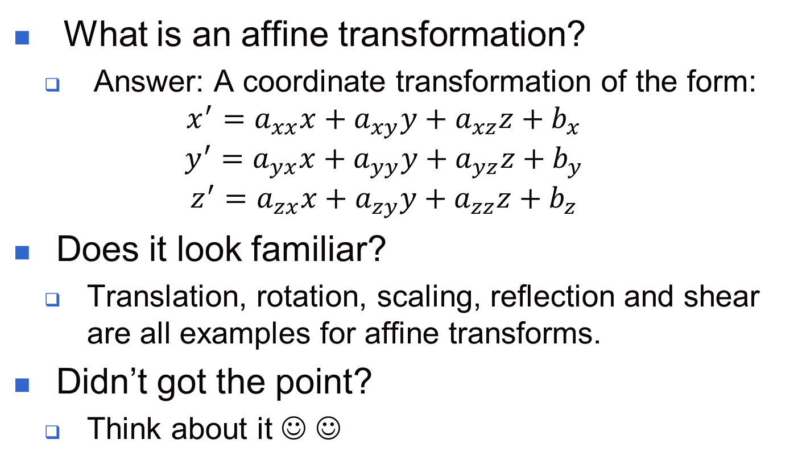
Affine Transformations
What is an affine transformation?
  Answer: A coordinate transformation of the form:
  $$x^{′}=a_{xx}x+a_{xy}y+a_{xz}z+b_{x}$$
  $$y^{′}=a_{yx}x+a_{yy}y+a_{yz}z+b_{y}$$
  $$z^{′}=a_{zx}x+a_{zy}y+a_{zz}z+b_{z}$$
Does it look familiar?
  Translation, rotation, scaling, reflection and shear are all examples for affine transforms.
Didn’t got the point?
  Think about it ☺ ☺

Slide 63
OpenGL Matrix Stacks
Remember OpenGL modes:
  Modelview
  Projection
  Texture
  Color
OpenGL maintains a stack for each mode

Slide 64
OpenGL Matrix Stacks (cont.)
OpenGL maintains a matrix stack for transformations
Initially the modelview stack contains only the identity matrix (the top matrix on the stack)
To copy the current matrix at the top of the stack
  glPushMatrix( );
To destroy the matrix at the top of the stack
  glPopMatrix( );

Slide 65
OpenGL Matrix Stacks (cont.)
To get the number of positions available in the modelview stack
  glGetIntegerv(GL_MAX_MODELVİEW_STACK_DEPTH, stackSize);
To find the number of matrices in the stack
  glGetIntegerv(GL_MAX_MODELVİEW_STACK_DEPTH, numMats);

Slide 66

Next Lecture
2D Viewing
66
Notes:
66

Slide 67
References
Donald Hearn, M. Pauline Baker, Warren R. Carithers, “Computer Graphics with OpenGL, 4th Edition”; Pearson, 2011
Sumanta Guha, “Computer Graphics Through OpenGL: From Theory to Experiments”, CRC Press, 2010
Edward Angel, “Interactive Computer Graphics. A Top-Down Approach Using OpenGL”, Addison-Wesley, 2005
67

