Slide 1


CSE309 Computer Architecture and Organization
Lecture #7
Control Unit
Prepared & Presented by Asst. Prof. Dr. Samsun M. BAŞARICI

Slide 2
Part 1
Control Unit Operation

Slide 3

Micro-Operations
The functional, or atomic, operations of a processor
Series of steps, each of which involves the processor registers
Micro refers to the fact that each step is very simple and accomplishes very little
The execution of a program consists of the sequential execution of instructions
  Each instruction is executed during an instruction cycle made up of shorter subcycles (fetch, indirect, execute, interrupt)
  The execution of each subcycle involves one or more shorter operations (micro-operations)
Notes:
We have seen that the operation of a computer, in executing a program, consists of a
sequence of instruction cycles, with one machine instruction per cycle. Of course, we
must remember that this sequence of instruction cycles is not necessarily the same
as the written sequence of instructions that make up the program, because of the
existence of branching instructions. What we are referring to here is the execution
time sequence of instructions.
We have further seen that each instruction cycle is made up of a number of
smaller units. One subdivision that we found convenient is fetch, indirect, execute,
and interrupt, with only fetch and execute cycles always occurring.
To design a control unit, however, we need to break down the description
further. In our discussion of pipelining in Chapter 14, we began to see that a further
decomposition is possible. In fact, we will see that each of the smaller cycles
involves a series of steps, each of which involves the processor registers. We will
refer to these steps as micro-operations . The prefix micro refers to the fact that each
step is very simple and accomplishes very little,
Micro-operations are the functional, or atomic, operations of a processor. In this
section, we will examine micro-operations to gain an understanding of how the events
of any instruction cycle can be described as a sequence of such micro-operations.
A simple example will be used. In the remainder of this chapter, we then show how the
concept of micro-operations serves as a guide to the design of the control unit.

Slide 4
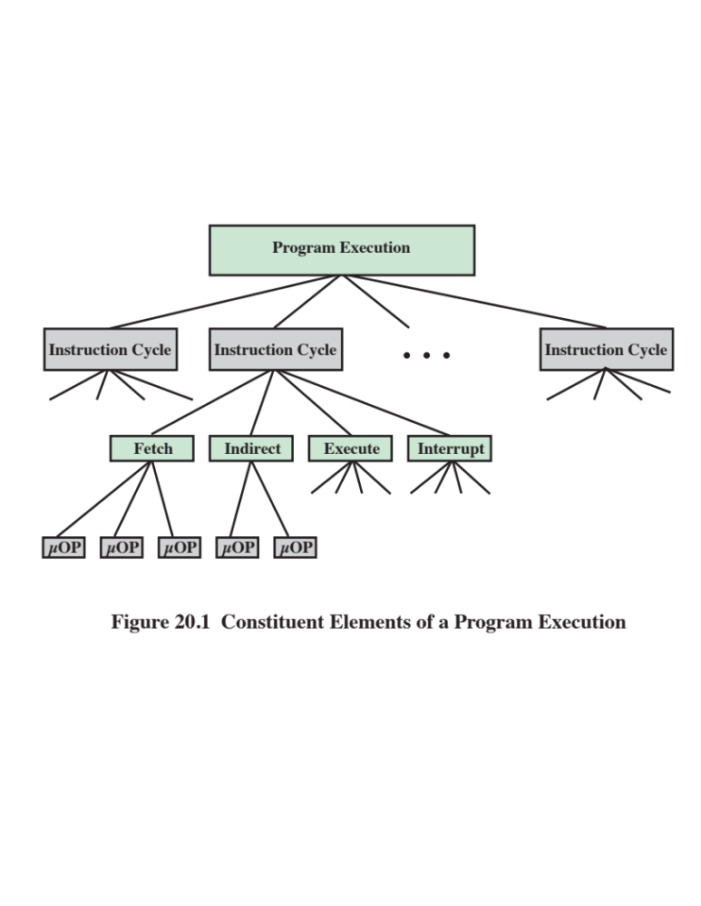
Notes:
Figure 20.1 depicts the relationship
among the various concepts we have been discussing. To summarize, the execution
of a program consists of the sequential execution of instructions. Each instruction
is executed during an instruction cycle made up of shorter subcycles (e.g., fetch,
indirect, execute, interrupt). The execution of each subcycle involves one or more
shorter operations, that is, micro-
operations.

Slide 5

The Fetch Cycle
Occurs at the beginning of each instruction cycle and causes an instruction to be fetched from memory
Four registers are involved:
  Memory Address Register (MAR)
    Connected to address bus
    Specifies address for read or write operation
  Memory Buffer Register (MBR)
    Connected to data bus
    Holds data to write or last data read
  Program Counter (PC)
    Holds address of next instruction to be fetched
  Instruction Register (IR)
    Holds last instruction fetched
Notes:
We begin by looking at the fetch cycle, which occurs at the beginning of each instruction
cycle and causes an instruction to be fetched from memory. For purposes of
discussion, we assume the organization depicted in Figure 14.6 (Data Flow , Fetch
Cycle ). Four registers are involved:
■ Memory address register (MAR): Is connected to the address lines of the system
bus. It specifies the address in memory for a read or write operation.
■ Memory buffer register (MBR): Is connected to the data lines of the system bus.
It contains the value to be stored in memory or the last value read from memory.
■ Program counter (PC): Holds the address of the next instruction to be
fetched.
■ Instruction register (IR): Holds the last instruction fetched.

Slide 6
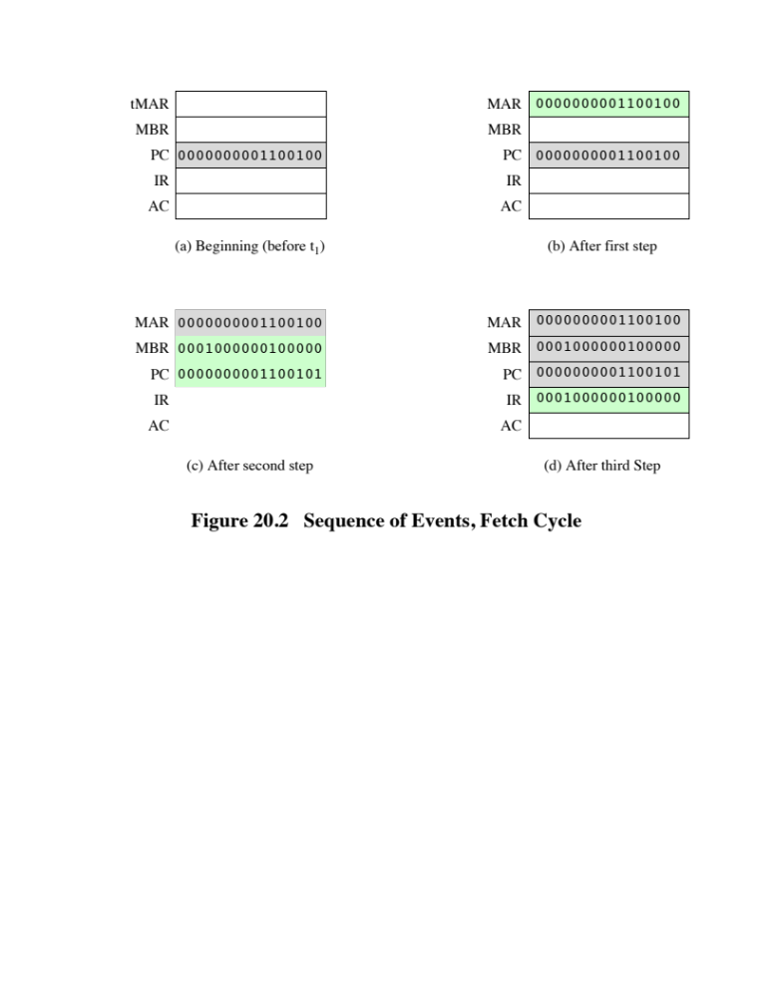
Notes:
Let us look at the sequence of events for the fetch cycle from the point of view
of its effect on the processor registers. An example appears in Figure 20.2. At the
beginning of the fetch cycle, the address of the next instruction to be executed is in
the program counter (PC); in this case, the address is 1100100. The first step is to
move that address to the memory address register (MAR) because this is the only
register connected to the address lines of the system bus. The second step is to bring
in the instruction. The desired address (in the MAR) is placed on the address bus,
the control unit issues a READ command on the control bus, and the result appears
on the data bus and is copied into the memory buffer register (MBR). We also need
to increment the PC by the instruction length to get ready for the next instruction.
Because these two actions (read word from memory, increment PC) do not interfere
with each other, we can do them simultaneously to save time. The third step is
to move the contents of the MBR to the instruction register (IR). This frees up the
MBR for use during a possible indirect cycle.
Thus, the simple fetch cycle actually consists of three steps and four micro-operations.
Each micro-operation involves the movement of data into or out of a
register. So long as these movements do not interfere with one another, several of
them can take place during one step, saving time.

Slide 7

Rules for Micro-Operations Grouping
Proper sequence must be followed
  MAR ⬅ (PC) must precede MBR ⬅ (memory)
Conflicts must be avoided
  Must not read and write same register at same time
  MBR ⬅ (memory) and IR ⬅ (MBR) must not be in same cycle
One of the micro-operations involves an addition
  To avoid duplication of circuitry, this addition could be performed by the ALU
  The use of the ALU may involve additional micro-operations, depending on the functionality of the ALU and the organization of the processor
Notes:
The groupings of micro-operations must follow two simple rules:
1. The proper sequence of events must be followed. Thus (MAR ⬅ (PC)) must
precede (MBR ⬅ Memory) because the memory read operation makes use of
the address in the MAR.
2. Conflicts must be avoided. One should not attempt to read to and write from
the same register in one time unit, because the results would be unpredictable.
For example, the micro-operations (MBR ⬅ Memory) and (IR ⬅ MBR)
should not occur during the same time unit.
A final point worth noting is that one of the micro-operations
involves an addition. To avoid duplication of circuitry, this addition could be performed by
the ALU. The use of the ALU may involve additional micro-operations,
depending on the functionality of the ALU and the organization of the processor. We defer a
discussion of this point until later in this chapter.
It is useful to compare events described in this and the following subsections to
Figure 3.5 (Example of Program Execution ). Whereas micro-operations
are ignored in that figure, this discussion shows the micro-operations
needed to perform the subcycles of the instruction cycle.

Slide 8
Indirect Cycle
Once an instruction is fetched, the next step is to fetch source operands
Assuming a one-address instruction format, with direct and indirect addressing allowed:
  If the instruction specifies an indirect address, then an indirect cycle must precede the execute cycle
  The address field of the instruction is transferred to the MAR
  This is then used to fetch the address of the operand
  Finally, the address field of the IR is updated from the MBR, so that it now contains a direct rather than an indirect address
  The IR is now in the same state as if indirect addressing had not been used, and it is ready for the execute cycle
Notes:
Once an instruction is fetched, the next step is to fetch source operands. Continuing our
simple example, let us assume a one-address instruction format, with direct and indirect
addressing allowed. If the instruction specifies an indirect address, then an indirect cycle
must precede the execute cycle. The data flow differs somewhat from that indicated in
Figure 14.7 (Data Flow , Indirect Cycle ) and includes the following micro-operations:
t₁: MAR ⬅ (IR(Address))
t₂: MBR ⬅ Memory
t₃: IR(Address) ⬅ (MBR(Address))
The address field of the instruction is transferred to the MAR. This is then used
to fetch the address of the operand. Finally, the address field of the IR is updated
from the MBR, so that it now contains a direct rather than an indirect address.
The IR is now in the same state as if indirect addressing had not been used,
and it is ready for the execute cycle. We skip that cycle for a moment, to consider
the interrupt cycle.

Slide 9
Interrupt Cycle
At the completion of the execute cycle, a test is made to determine whether any enabled interrupts have occurred, and if so, the interrupt cycle occurs
The nature of this cycle varies greatly from one machine to another
In a simple sequence of events:
  In the first step the contents of the PC are transferred to the MBR so that they can be saved for return from the interrupt
  Then the MAR is loaded with the address at which the contents of the PC are to be saved, and the PC is loaded with the address of the start of the interrupt-processing routine
    These two actions may each be a single micro-operation
    Because most processors provide multiple types and/or levels of interrupts, it may take one or more additional micro-operations to obtain the Save_Address and the Routine_Address before they can be transferred to the MAR and PC respectively
  Once this is done, the final step is to store the MBR, which contains the old value of the PC, into memory
  The processor is now ready to begin the next instruction cycle
Notes:
At the completion of the execute cycle, a test is made to determine whether any
enabled interrupts have occurred. If so, the interrupt cycle occurs. The nature of this
cycle varies greatly from one machine to another. We present a very simple sequence
of events, as illustrated in Figure 14.8 (Data Flow, Indirect Cycle ). We have
t₁: MBR ⬅ (PC)
t₂: MAR ⬅ Save_Address
PC ⬅ Routine_Address
t₃: Memory ⬅ (MBR)
In the first step, the contents of the PC are transferred to the MBR, so that
they can be saved for return from the interrupt. Then the MAR is loaded with
the address at which the contents of the PC are to be saved, and the PC is loaded
with the address of the start of the interrupt-processing routine. These two actions
may each be a single micro-operation. However, because most processors provide
multiple types and/or levels of interrupts, it may take one or more additional micro-
operations to obtain the Save_Address and the Routine_Address before they can
be transferred to the MAR and PC, respectively. In any case, once this is done, the
final step is to store the MBR, which contains the old value of the PC, into memory.
The processor is now ready to begin the next instruction cycle.

Slide 10
Execute Cycle
Because of the variety of opcodes, there are a number of different sequences of micro-operations that can occur
Instruction decoding
  The control unit examines the opcode and generates a sequence of micro-operations based on the value of the opcode
A simplified add instruction:
  ADD R1, X (which adds the contents of the location X to register R1)
    In the first step the address portion of the IR is loaded into the MAR
    Then the referenced memory location is read
    Finally the contents of R1 and MBR are added by the ALU
    Additional micro-operations may be required to extract the register reference from the IR and perhaps to stage the ALU inputs or outputs in some intermediate registers
Notes:
The fetch, indirect, and interrupt cycles are simple and predictable. Each involves
a small, fixed sequence of micro-operations and, in each case, the same micro-operations
are repeated each time around.
This is not true of the execute cycle. Because of the variety of opcodes, there
are a number of different sequences of micro-operations that can occur. The control
unit examines the opcode and generates a sequence of micro-operations based on
the value of the opcode. This is referred to as instruction decoding.
Let us consider several hypothetical examples.
First, consider an add instruction:
ADD R1, X
which adds the contents of the location X to register R1. The following sequence of
Micro-operations might occur:
t₁: MAR ⬅ (IR(address))
t₂: MBR ⬅ Memory
t₃: R1 ⬅ (R1) + (MBR)
We begin with the IR containing the ADD instruction. In the first step, the
address portion of the IR is loaded into the MAR. Then the referenced memory
location is read. Finally, the contents of R1 and MBR are added by the ALU. Again,
this is a simplified example. Additional micro-operations may be required to extract
the register reference from the IR and perhaps to stage the ALU inputs or outputs
in some intermediate registers.

Slide 11
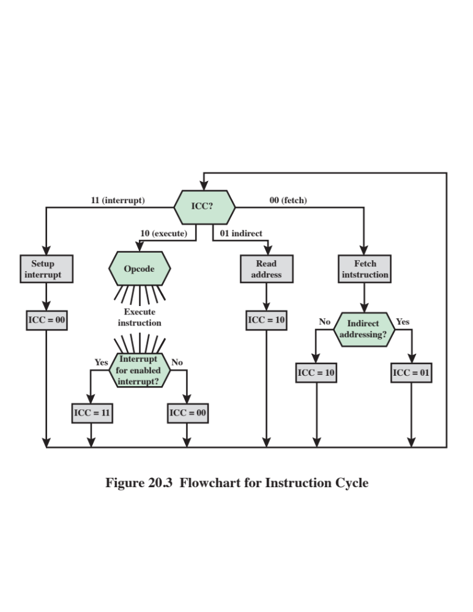
Notes:
We have seen that each phase of the instruction cycle can be decomposed into a
sequence of elementary micro-operations. In our example, there is one sequence
each for the fetch, indirect, and interrupt cycles, and, for the execute cycle, there is
one sequence of micro-operations for each opcode.
To complete the picture, we need to tie sequences of micro-operations
together, and this is done in Figure 20.3. We assume a new 2-bit register called the
instruction cycle code (ICC). The ICC designates the state of the processor in terms
of which portion of the cycle it is in:
00: Fetch
01: Indirect
10: Execute
11: Interrupt
At the end of each of the four cycles, the ICC is set appropriately. The indirect
cycle is always followed by the execute cycle. The interrupt cycle is always followed
by the fetch cycle (see Figure 14.4, The Instruction Cycle ). For both the fetch and
execute cycles, the next cycle depends on the state of the system.
Thus, the flowchart of Figure 20.3 defines the complete sequence of micro-operations,
depending only on the instruction sequence and the interrupt pattern.
Of course, this is a simplified example. The flowchart for an actual processor would
be more complex. In any case, we have reached the point in our discussion in which
the operation of the processor is defined as the performance of a sequence of micro-
operations.
We can now consider how the control unit causes this sequence to occur.

Slide 12
Control Unit
Functional Requirements
By reducing the operation of the processor to its most fundamental level we are able to define exactly what it is that the control unit must cause to happen
Three step process to lead to a characterization of the control unit:
  Define basic elements of processor
  Describe micro-operations processor performs
  Determine the functions that the control unit must perform to cause the micro-operations to be performed
The control unit performs two basic tasks:
  Sequencing
  Execution
Notes:
As a result of our analysis in the preceding section, we have decomposed the behavior
or functioning of the processor into elementary operations, called micro-
operations. By reducing the operation of the processor to its most fundamental level, we are
able to define exactly what it is that the control unit must cause to happen. Thus, we
can define the functional requirements for the control unit: those functions that the
control unit must perform. A definition of these functional requirements is the basis
for the design and implementation of the control unit.
With the information at hand, the following three-step process leads to a characterization
of the control unit:
1. Define the basic elements of the processor.
2. Describe the micro-operations that the processor performs.
Determine the functions that the control unit must perform to cause the micro-operations
to be performed.
We have already performed steps 1 and 2. Let us summarize the results. First,
the basic functional elements of the processor are the following:
■ ALU
■ Registers
■ Internal data paths
■ External data paths
■ Control unit
Some thought should convince you that this is a complete list. The ALU is the
functional essence of the computer. Registers are used to store data internal to the
processor. Some registers contain status information needed to manage instruction
sequencing (e.g., a program status word). Others contain data that go to or come
from the ALU, memory, and I/O modules. Internal data paths are used to move
data between registers and between register and ALU. External data paths link
registers to memory and I/O modules, often by means of a system bus. The control
unit causes operations to happen within the processor.
The execution of a program consists of operations involving these processor
elements. As we have seen, these operations consist of a sequence of
micro-operations. Upon review of Section 20.1, the reader should see that all micro-operations
fall into one of the following categories:
■ Transfer data from one register to another.
■ Transfer data from a register to an external interface (e.g., system bus).
■ Transfer data from an external interface to a register.
■ Perform an arithmetic or logic operation, using registers for input and output.
All of the micro-operations needed to perform one instruction cycle, including all
of the micro-operations to execute every instruction in the instruction set, fall into
one of these categories.
We can now be somewhat more explicit about the way in which the control
unit functions. The control unit performs two basic tasks:
■ Sequencing: The control unit causes the processor to step through a series
of micro-operations in the proper sequence, based on the program being executed.
■ Execution: The control unit causes each micro-operation to be performed.
The preceding is a functional description of what the control unit does. The
key to how the control unit operates is the use of control signals.

Slide 13
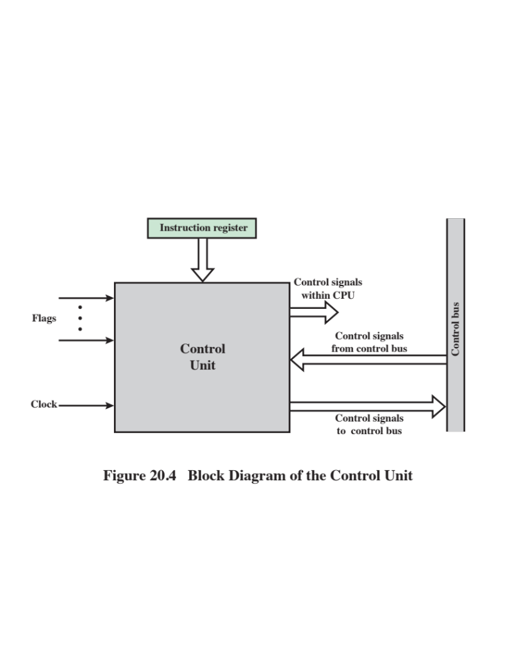
Notes:
We have defined the elements that make up the processor (ALU, registers, data
paths) and the micro-operations that are performed. For the control unit to perform
its function, it must have inputs that allow it to determine the state of the system and
outputs that allow it to control the behavior of the system. These are the external
specifications of the control unit. Internally, the control unit must have the logic
required to perform its sequencing and execution functions. We defer a discussion
of the internal operation of the control unit to Section 20.3 and Chapter 21. The
remainder of this section is concerned with the interaction between the control unit
and the other elements of the processor.
Figure 20.4 is a general model of the control unit, showing all of its inputs and
outputs. The inputs are:
■ Clock: This is how the control unit “keeps time.” The control unit causes one
micro-operation (or a set of simultaneous micro-operations) to be performed
for each clock pulse. This is sometimes referred to as the processor cycle time,
or the clock cycle time.
■ Instruction register: The opcode and addressing mode of the current instruction
are used to determine which micro-operations to perform during the execute cycle.
■ Flags: These are needed by the control unit to determine the status of the
processor and the outcome of previous ALU operations. For example, for the
Increment-and-skip-if-zero (ISZ) instruction, the control unit will increment
the PC if the zero flag is set.
■ Control signals from control bus: The control bus portion of the system bus
provides signals to the control unit.
The outputs are as follows:
■ Control signals within the processor: These are two types: those that cause
data to be moved from one register to another, and those that activate specific
ALU functions.
■ Control signals to control bus: These are also of two types: control signals to
memory, and control signals to the I/O modules.
Three types of control signals are used: those that activate an ALU function;
those that activate a data path; and those that are signals on the external system bus
or other external interface. All of these signals are ultimately applied directly as
binary inputs to individual logic gates.
Let us consider again the fetch cycle to see how the control unit maintains
control. The control unit keeps track of where it is in the instruction cycle. At a
given point, it knows that the fetch cycle is to be performed next. The first step is to
transfer the contents of the PC to the MAR. The control unit does this by activating
the control signal that opens the gates between the bits of the PC and the bits of
the MAR. The next step is to read a word from memory into the MBR and increment
the PC. The control unit does this by sending the following control signals
simultaneously:
■ A control signal that opens gates, allowing the contents of the MAR onto the
address bus;
■ A memory read control signal on the control bus;
■ A control signal that opens the gates, allowing the contents of the data bus to
be stored in the MBR;
■ Control signals to logic that add 1 to the contents of the PC and store the
result back to the PC.
Following this, the control unit sends a control signal that opens gates between the
MBR and the IR.
This completes the fetch cycle except for one thing: The control unit must
decide whether to perform an indirect cycle or an execute cycle next. To decide this,
it examines the IR to see if an indirect memory reference is made.
The indirect and interrupt cycles work similarly. For the execute cycle, the
control unit begins by examining the opcode and, on the basis of that, decides which
sequence of micro-operations to perform for the execute cycle.

Slide 14
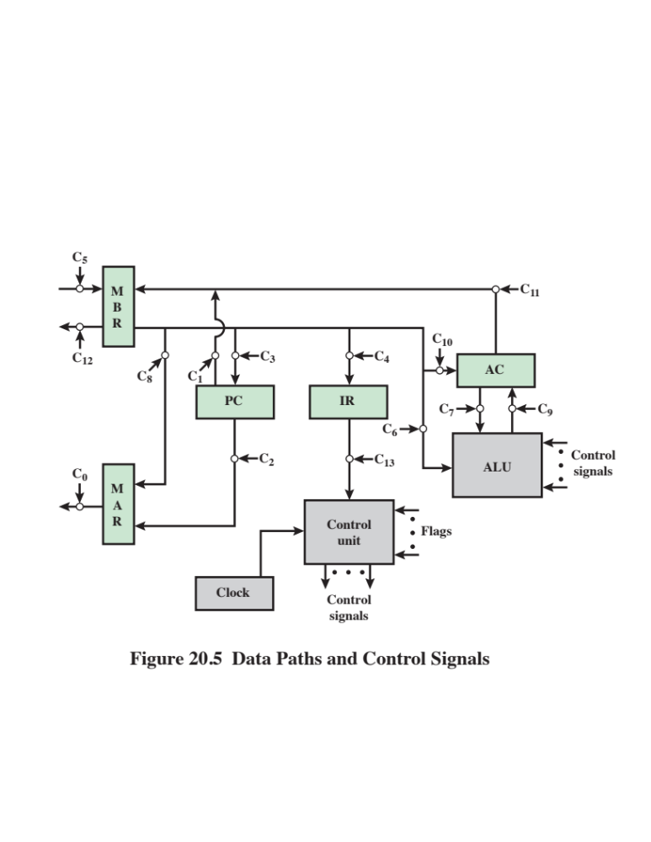
Notes:
To illustrate the functioning of the control unit, let us examine a simple example.
Figure 20.5 illustrates the example. This is a simple processor with a single accumulator
(AC). The data paths between elements are indicated. The control paths
for signals emanating from the control unit are not shown, but the terminations of
control signals are labeled C_{i} and indicated by a circle. The control unit receives
inputs from the clock, the IR, and flags. With each clock cycle, the control unit
reads all of its inputs and emits a set of control signals. Control signals go to three
separate destinations:
■ Data paths: The control unit controls the internal flow of data. For example, on
instruction fetch, the contents of the memory buffer register are transferred to
the IR. For each path to be controlled, there is a switch (indicated by a circle in
the figure). A control signal from the control unit temporarily opens the gate
to let data pass.
■ ALU: The control unit controls the operation of the ALU by a set of control
signals. These signals activate various logic circuits and gates within the ALU.
■ System bus: The control unit sends control signals out onto the control lines of
the system bus (e.g., memory READ).

Slide 15
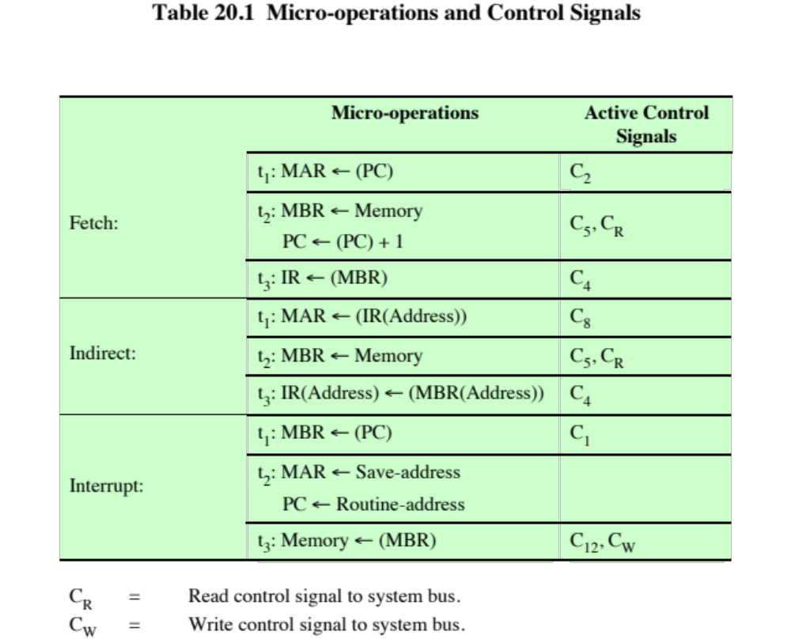
(Table can be found on page 719 in the textbook.)
Notes:
The control unit must maintain knowledge of where it is in the instruction
cycle. Using this knowledge, and by reading all of its inputs, the control unit emits
a sequence of control signals that causes micro-operations to occur. It uses the
clock pulses to time the sequence of events, allowing time between events for signal
levels to stabilize. Table 20.1 indicates the control signals that are needed for
some of the micro-operation sequences described earlier. For simplicity, the data
and control paths for incrementing the PC and for loading the fixed addresses into
the PC and MAR are not shown.
It is worth pondering the minimal nature of the control unit. The control unit
is the engine that runs the entire computer. It does this based only on knowing the
instructions to be executed and the nature of the results of arithmetic and logical
operations (e.g., positive, overflow, etc.). It never gets to see the data being processed
or the actual results produced. And it controls everything with a few control
signals to points within the processor and a few control signals to the system bus.

Slide 16
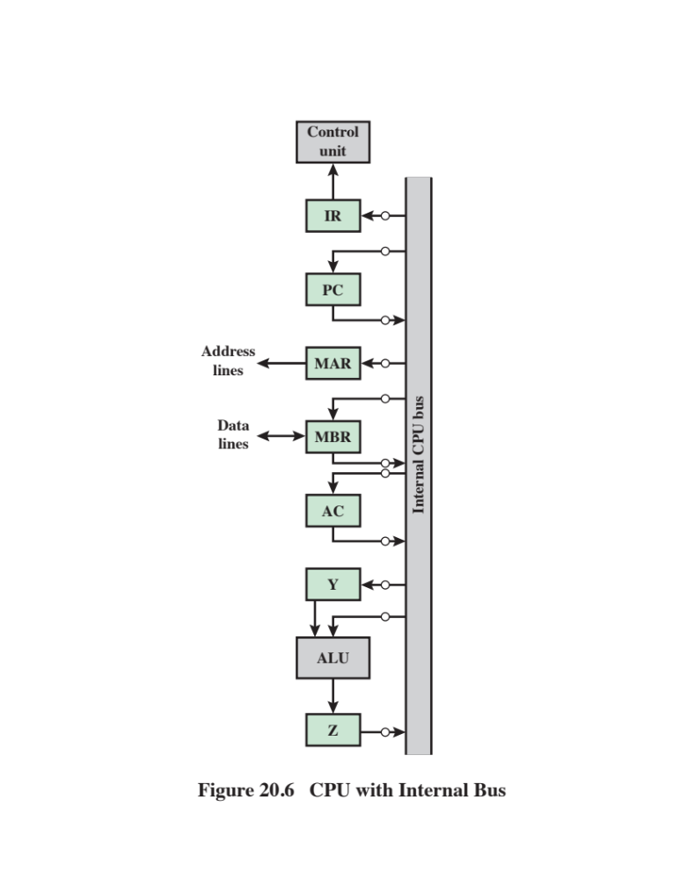
Notes:
Figure 20.5 indicates the use of a variety of data paths. The complexity of this type of
organization should be clear. More typically, some sort of internal bus arrangement,
as was suggested in Figure 14.2 (Internal Structure of the CPU ), will be used.
Using an internal processor bus, Figure 20.5 can be rearranged as shown in
Figure 20.6. A single internal bus connects the ALU and all processor registers.
Gates and control signals are provided for movement of data onto and off the bus
from each register. Additional control signals control data transfer to and from the
system (external) bus and the operation of the ALU.
Two new registers, labeled Y and Z, have been added to the organization.
These are needed for the proper operation of the ALU. When an operation involving
two operands is performed, one can be obtained from the internal bus, but the
other must be obtained from another source. The AC could be used for this purpose,
but this limits the flexibility of the system and would not work with a processor
with multiple general-purpose registers. Register Y provides temporary storage
for the other input. The ALU is a combinatorial circuit (see Chapter 11) with no
internal storage. Thus, when control signals activate an ALU function, the input to
the ALU is transformed to the output. Therefore, the output of the ALU cannot
be directly connected to the bus, because this output would feed back to the input.
Register Z provides temporary output storage.

Slide 17
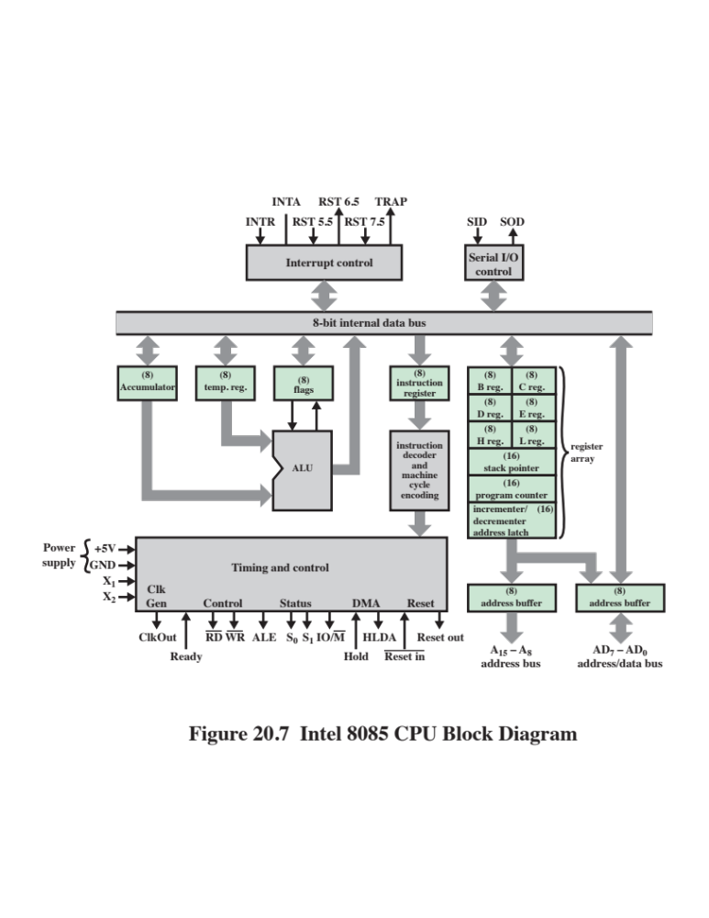
Notes:
To illustrate some of the concepts introduced thus far in this chapter, let us consider
the Intel 8085. Its organization is shown in Figure 20.7. Several key components that
may not be self-explanatory are:
■ Incrementer/decrementer address latch: Logic that can add 1 to or subtract 1
from the contents of the stack pointer or program counter. This saves time by
avoiding the use of the ALU for this purpose.
■ Interrupt control: This module handles multiple levels of interrupt signals.
■ Serial I/O control: This module interfaces to devices that communicate 1 bit
at a time.

Slide 18
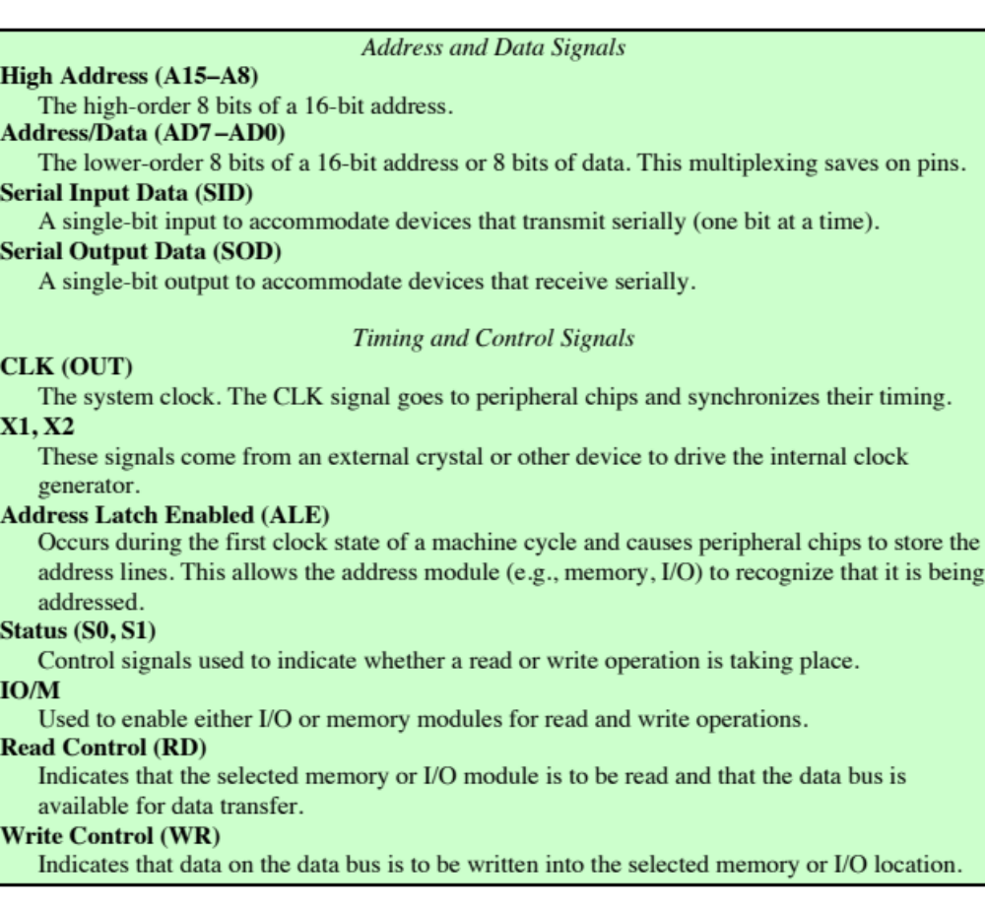
Table 20.2
Intel
8085 External Signals (page 1 of 2)
(Table can be found on page 722 in the textbook.)
Notes:
Table 20.2 describes the external signals into and out of the 8085. These are
linked to the external system bus.

Slide 19
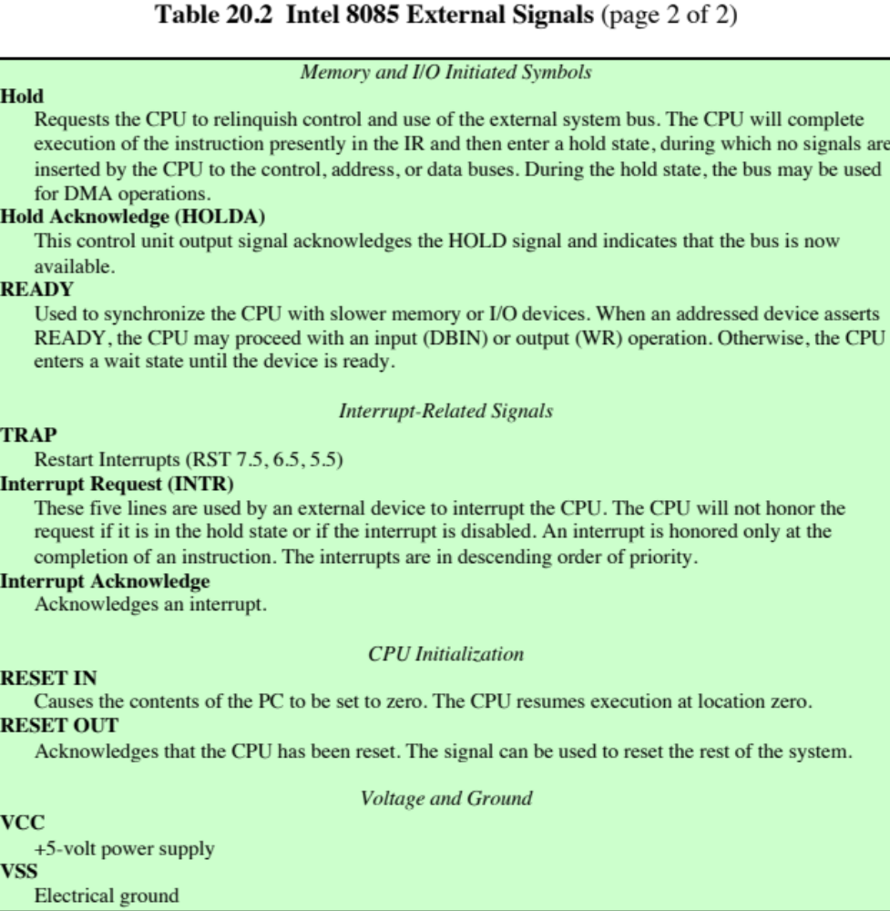
Table 20.2
Intel
8085 External Signals (page 2 of 2)

Slide 20
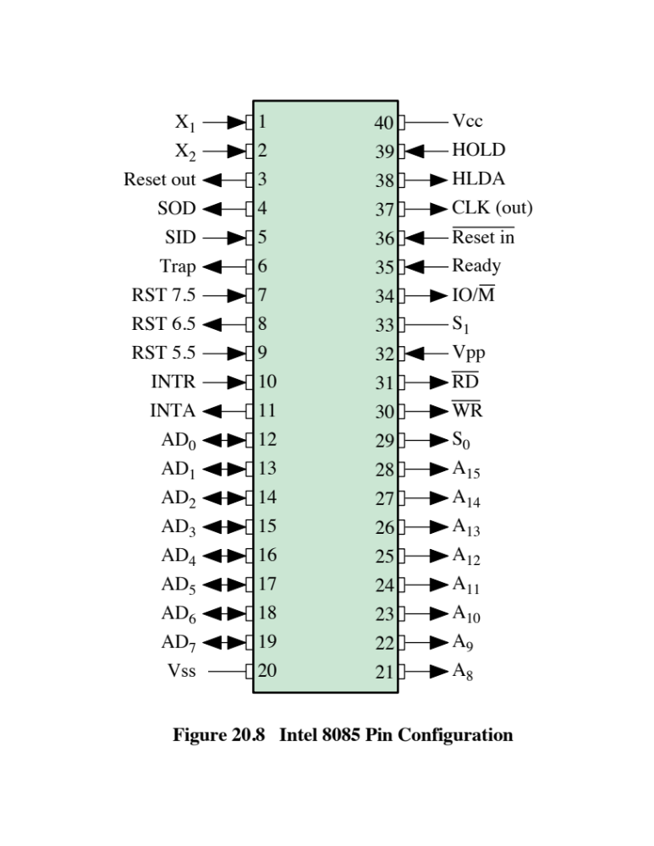
Notes:
These signals are the interface between the 8085
processor and the rest of the system (Figure 20.8).
The control unit is identified as having two components labeled (1) instruction
decoder and machine cycle encoding and (2) timing and control. A discussion
of the first component is deferred until the next section. The essence of the control
unit is the timing and control module. This module includes a clock and accepts as
inputs the current instruction and some external control signals. Its output consists
of control signals to the other components of the processor plus control signals to
the external system bus.
The timing of processor operations is synchronized by the clock and controlled
by the control unit with control signals. Each instruction cycle is divided into from
one to five machine cycles ; each machine cycle is in turn divided into from three to
five states. Each state lasts one clock cycle. During a state, the processor performs
one or a set of simultaneous micro-operations as determined by the control signals.
The number of machine cycles is fixed for a given instruction but varies
from one instruction to another. Machine cycles are defined to be equivalent to
bus accesses. Thus, the number of machine cycles for an instruction depends on
the number of times the processor must communicate with external devices. For
example, if an instruction consists of two 8-bit portions, then two machine cycles are
required to fetch the instruction. If that instruction involves a 1-byte memory or I/O
operation, then a third machine cycle is required for execution.

Slide 21
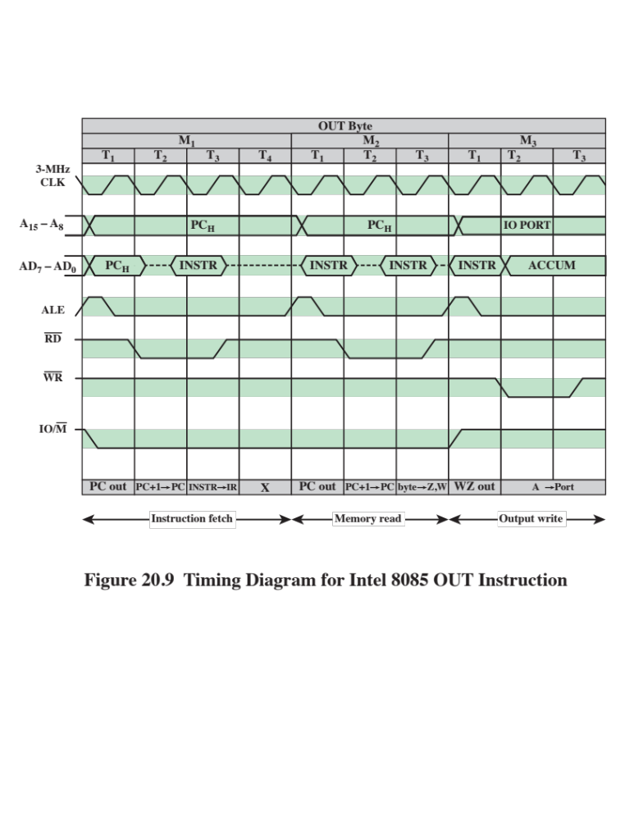
Notes:
Figure 20.9 gives an example of 8085 timing, showing the value of external
control signals. Of course, at the same time, the control unit generates internal control
signals that control internal data transfers. The diagram shows the instruction
cycle for an OUT instruction. Three machine cycles (M₁ , M₂ , M₃ ) are needed. During
the first, the OUT instruction is fetched. The second machine cycle fetches the
second half of the instruction, which contains the number of the I/O device selected
for output. During the third cycle, the contents of the AC are written out to the
selected device over the data bus.
The Address Latch Enabled (Ale ) pulse signals the start of each machine
cycle from the control unit. The Ale pulse alerts external circuits. During timing
state T₁ of machine cycle M₁ , the control unit sets the IO/M signal to indicate that
this is a memory operation. Also, the control unit causes the contents of the PC
to be placed on the address bus (A₁₅ through A₈ ) and the address/data bus (AD₇
through AD₀ ). With the falling edge of the Ale pulse, the other modules on the
bus store the address.
During timing state T₂ , the addressed memory module places the contents of the
addressed memory location on the address/data bus. The control unit sets the Read
Control (RD) signal to indicate a read, but it waits until T₃ to copy the data from the
bus. This gives the memory module time to put the data on the bus and for the signal
levels to stabilize. The final state, T₄ , is a bus idle state during which the processor
decodes the instruction. The remaining machine cycles proceed in a similar fashion.

Slide 22
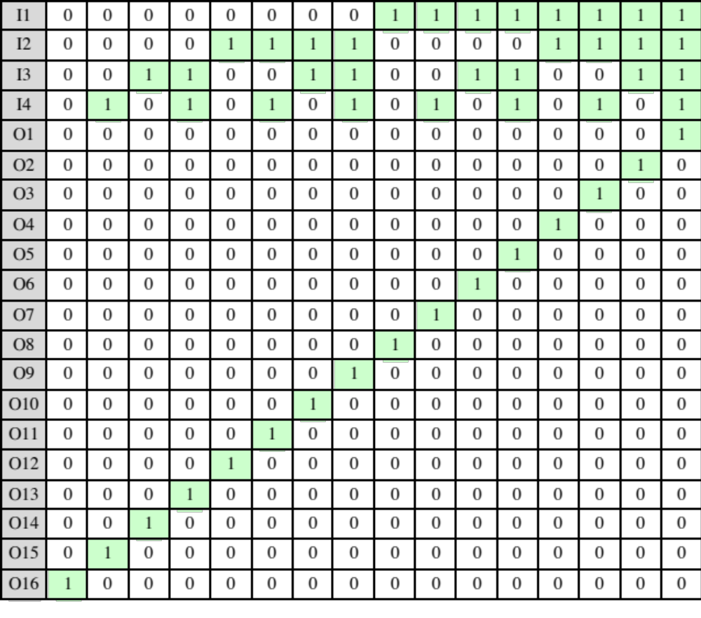
Table 20.3
A Decoder With
Four Inputs
and Sixteen Outputs
(Table can be found on page 725 in the textbook.)
Notes:
Figure 20.4 depicts the control unit as we have so far discussed it. The key inputs are
the IR, the clock, flags, and control bus signals. In the case of the flags and control
bus signals, each individual bit typically has some meaning (e.g., overflow). The other
two inputs, however, are not directly useful to the control unit.
First consider the IR. The control unit makes use of the opcode and will perform
different actions (issue a different combination of control signals) for different
instructions. To simplify the control unit logic, there should be a unique logic input for
each opcode. This function can be performed by a decoder , which takes an encoded
input and produces a single output. In general, a decoder will have n binary inputs and
2^{n} binary outputs. Each of the 2^{n} different input patterns will activate a single unique
output. Table 20.3 is an example for n = 4. The decoder for a control unit will typically
have to be more complex than that, to account for variable-length opcodes. An
example of the digital logic used to implement a decoder is presented in Chapter 11.

Slide 23
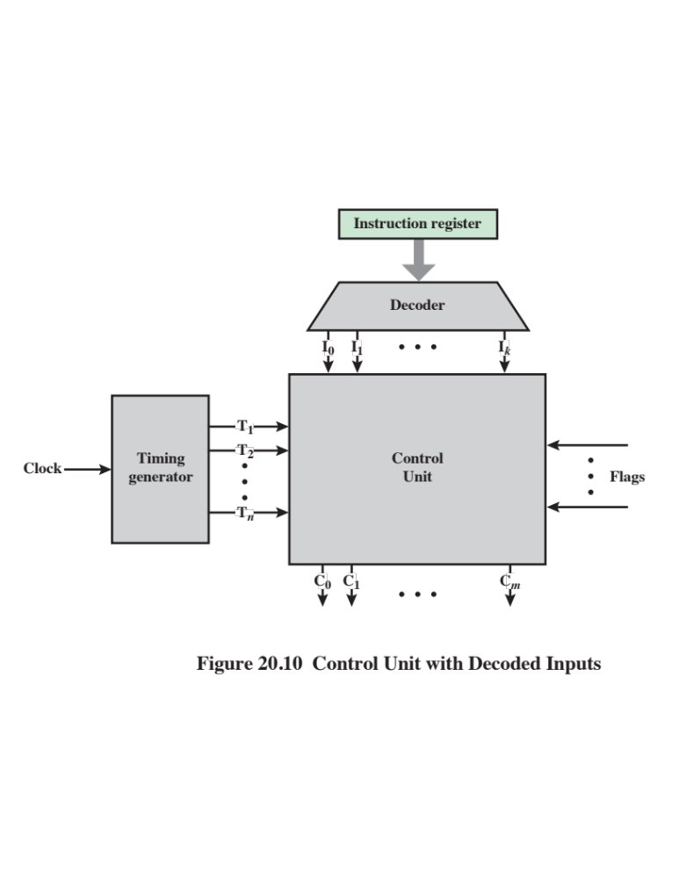
Notes:
The clock portion of the control unit issues a repetitive sequence of pulses.
This is useful for measuring the duration of micro-operations. Essentially, the period
of the clock pulses must be long enough to allow the propagation of signals along
data paths and through processor circuitry. However, as we have seen, the control
unit emits different control signals at different time units within a single instruction
cycle. Thus, we would like a counter as input to the control unit, with a different
control signal being used for T₁ ,T₂ , and so forth. At the end of an instruction cycle,
the control unit must feed back to the counter to reinitialize it at T₁ .
With these two refinements, the control unit can be depicted as in Figure 20.10.

Slide 24
Summary
Control Unit Operation
Control of the processor
  Functional requirements
  Control signals
  Internal processor organization
  The Intel 8085
Hardwired implementation
  Control unit inputs
  Control unit logic
Micro-operations
  The fetch cycle
  The indirect cycle
  The interrupt cycle
  The execute cycle
  The instruction cycle
Notes:
Chapter 20 summary.

Slide 25
Part 2
Microprogrammed Control

Slide 26
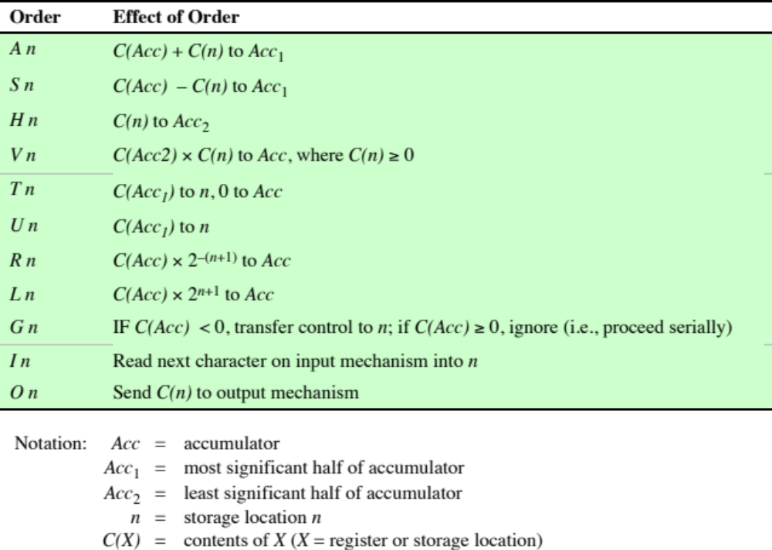
Table 21.1
Machine Instruction Set for Wilkes Example
Notes:
The control unit seems a reasonably simple device. Nevertheless, to implement a control
unit as an interconnection of basic logic elements is no easy task. The design must
include logic for sequencing through micro-operations, for executing micro-operations,
for interpreting opcodes, and for making decisions based on ALU flags. It is difficult to
design and test such a piece of hardware. Furthermore, the design is relatively inflexible.
For example, it is difficult to change the design if one wishes to add a new machine
instruction.
An alternative, which has been used in many CISC processors, is to implement
a microprogrammed control unit .
Consider Table 21.1. In addition to the use of control signals, each microoperation
is described in symbolic notation. This notation looks suspiciously like
a programming language. In fact it is a language, known as a microprogramming
language . Each line describes a set of micro-operations occurring at one time and
is known as a microinstruction . A sequence of instructions is known as a microprogram ,
or firmware . This latter term reflects the fact that a microprogram is midway
between hardware and software. It is easier to design in firmware than hardware,
but it is more difficult to write a firmware program than a software program.

Slide 27
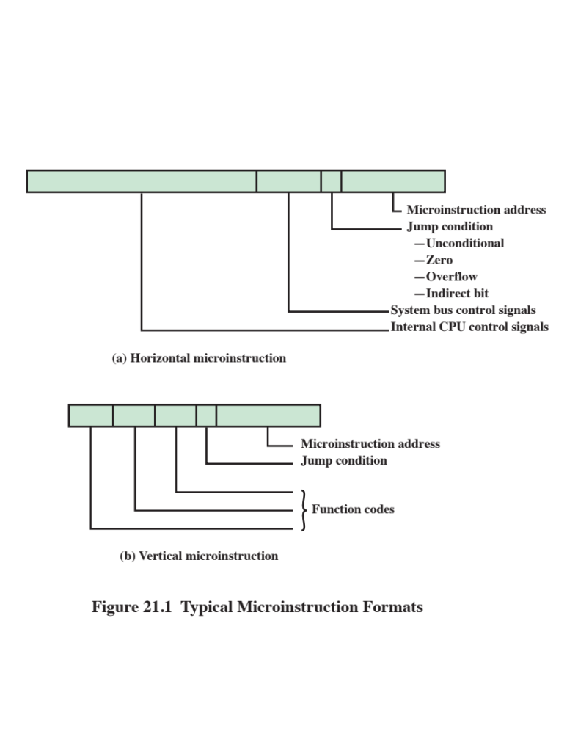
Notes:
How can we use the concept of microprogramming to implement a control
unit? Consider that for each micro-operation, all that the control unit is allowed
to do is generate a set of control signals. Thus, for any micro-operation, each control
line emanating from the control unit is either on or off. This condition can, of
course, be represented by a binary digit for each control line. So we could construct
a control word in which each bit represents one control line. Then each micro-operation
would be represented by a different pattern of 1s and 0s in the control word.
Suppose we string together a sequence of control words to represent the
sequence of micro-operations performed by the control unit. Next, we must recognize
that the sequence of micro-operations is not fixed. Sometimes we have an
indirect cycle; sometimes we do not. So let us put our control words in a memory,
with each word having a unique address. Now add an address field to each control
word, indicating the location of the next control word to be executed if a certain
condition is true (e.g., the indirect bit in a memory-reference instruction is 1). Also,
add a few bits to specify the condition.
The result is known as a horizontal microinstruction , an example of which
is shown in Figure 21.1a. The format of the microinstruction or control word is as
follows. There is one bit for each internal processor control line and one bit for each
system bus control line. There is a condition field indicating the condition under
which there should be a branch, and there is a field with the address of the microinstruction
to be executed next when a branch is taken. Such a microinstruction is
interpreted as follows:
1. To execute this microinstruction, turn on all the control lines indicated by a 1
bit; leave off all control lines indicated by a 0 bit. The resulting control signals
will cause one or more micro-operations to be performed.
2. If the condition indicated by the condition bits is false, execute the next microinstruction
in sequence.
3. If the condition indicated by the condition bits is true, the next microinstruction
to be executed is indicated in the address field.

Slide 28
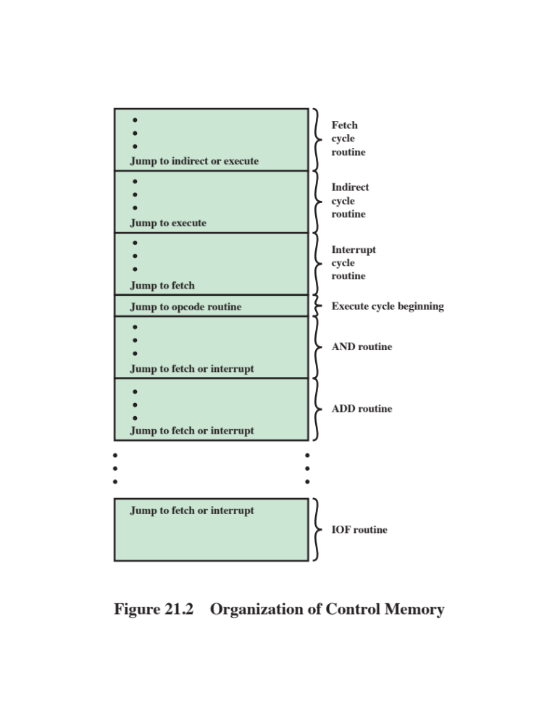
Notes:
Figure 21.2 shows how these control words or microinstructions could be
arranged in a control memory . The microinstructions in each routine are to be executed
sequentially. Each routine ends with a branch or jump instruction indicating
where to go next. There is a special execute cycle routine whose only purpose is to
signify that one of the machine instruction routines (AND, ADD, and so on) is to
be executed next, depending on the current opcode.
The control memory of Figure 21.2 is a concise description of the complete
operation of the control unit. It defines the sequence of micro-operations to be
performed during each cycle (fetch, indirect, execute, interrupt), and it specifies the
sequencing of these cycles. If nothing else, this notation would be a useful device
for documenting the functioning of a control unit for a particular computer. But it is
more than that. It is also a way of implementing the control unit.

Slide 29
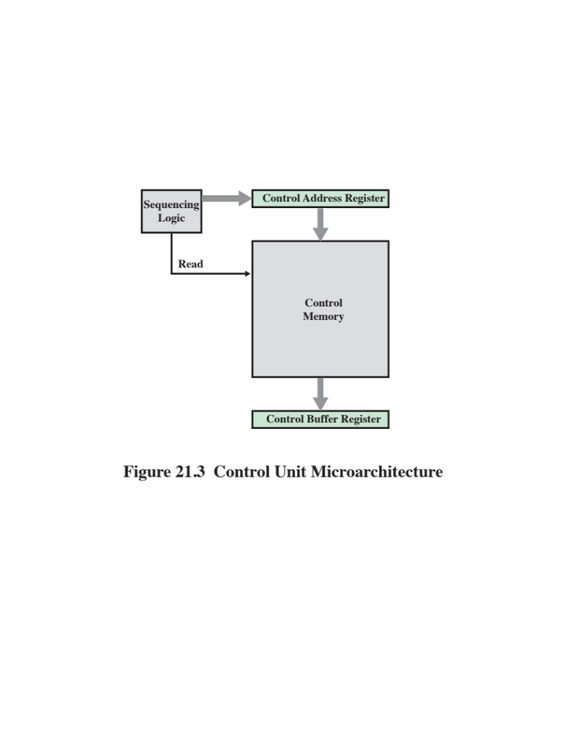
Notes:
The control memory of Figure 21.2 contains a program that describes the behavior
of the control unit. It follows that we could implement the control unit by simply
executing that program.
Figure 21.3 shows the key elements of such an implementation. The set of
microinstructions is stored in the control memory . The control address register contains
the address of the next microinstruction to be read. When a microinstruction is
read from the control memory, it is transferred to a control buffer register . The lefthand
portion of that register (see Figure 21.1a) connects to the control lines emanating
from the control unit. Thus, reading a microinstruction from the control memory
is the same as executing that microinstruction. The third element shown in the figure is
a sequencing unit that loads the control address register and issues a read command.

Slide 30
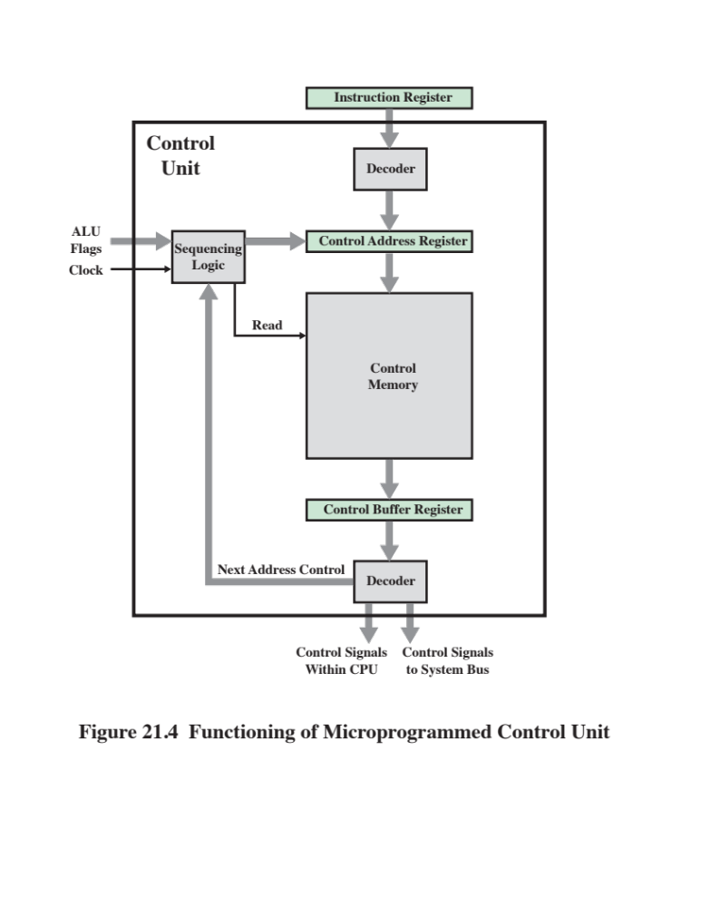
Notes:
Let us examine this structure in greater detail, as depicted in Figure 21.4. Comparing
this with Figure 21.3, we see that the control unit still has the same inputs (IR,
ALU flags, clock) and outputs (control signals). The control unit functions as follows:
1. To execute an instruction, the sequencing logic unit issues a READ command
to the control memory.
2. The word whose address is specified in the control address register is read into
the control buffer register.
3. The content of the control buffer register generates control signals and
next-address information for the sequencing logic unit.
4. The sequencing logic unit loads a new address into the control address register
based on the next-address information from the control buffer register and the
ALU flags.
All this happens during one clock pulse.
The last step just listed needs elaboration. At the conclusion of each microinstruction,
the sequencing logic unit loads a new address into the control address
register. Depending on the value of the ALU flags and the control buffer register,
one of three decisions is made:
■ Get the next instruction: Add 1 to the control address register.
■ Jump to a new routine based on a jump microinstruction: Load the address
field of the control buffer register into the control address register.
■ Jump to a machine instruction routine: Load the control address register
based on the opcode in the IR.
Figure 21.4 shows two modules labeled decoder . The upper decoder translates
the opcode of the IR into a control memory address. The lower decoder is
not used for horizontal microinstructions but is used for vertical microinstructions
(Figure 21.1b). As was mentioned, in a horizontal microinstruction every bit in the
control field attaches to a control line. In a vertical microinstruction, a code is used
for each action to be performed [e.g., MAR ⬅ (PC)], and the decoder translates
this code into individual control signals. The advantage of vertical microinstructions
is that they are more compact (fewer bits) than horizontal microinstructions,
at the expense of a small additional amount of logic and time delay.

Slide 31
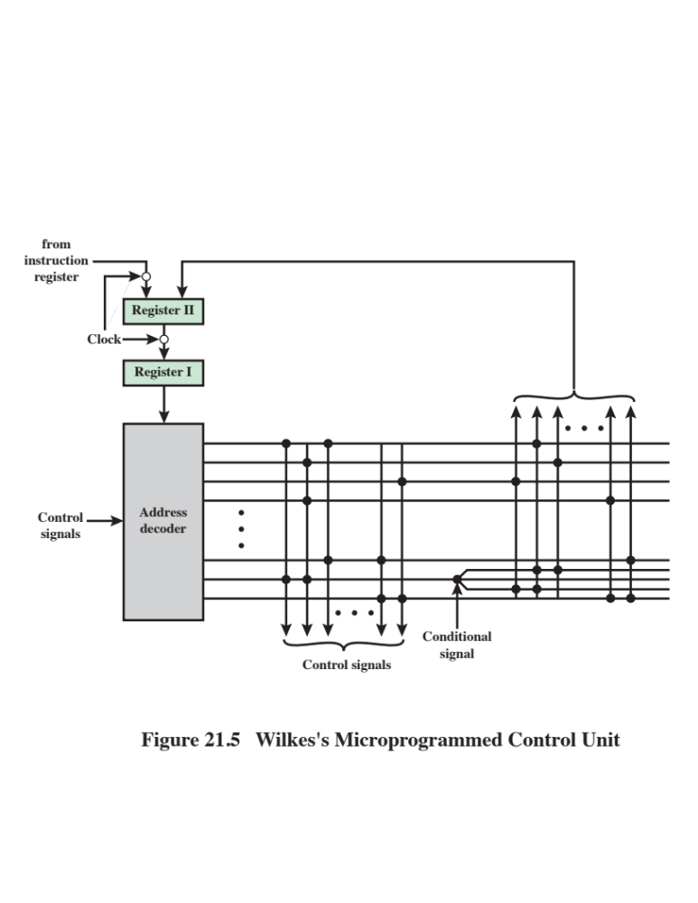
Notes:
As was mentioned, Wilkes first proposed the use of a microprogrammed control unit
in 1951 [WILK51]. This proposal was subsequently elaborated into a more detailed
design [WILK53]. It is instructive to examine this seminal proposal.
The configuration proposed by Wilkes is depicted in Figure 21.5. The heart of the
system is a matrix partially filled with diodes. During a machine cycle, one row of the
matrix is activated with a pulse. This generates signals at those points where a diode is
present (indicated by a dot in the diagram). The first part of the row generates the control
signals that control the operation of the processor. The second part generates the
address of the row to be pulsed in the next machine cycle. Thus, each row of the matrix
is one microinstruction, and the layout of the matrix is the control memory.
At the beginning of the cycle, the address of the row to be pulsed is contained
in Register I. This address is the input to the decoder, which, when activated by
a clock pulse, activates one row of the matrix. Depending on the control signals,
either the opcode in the instruction register or the second part of the pulsed row is
passed into Register II during the cycle. Register II is then gated to Register I by
a clock pulse. Alternating clock pulses are used to activate a row of the matrix and
to transfer from Register II to Register I. The two-register arrangement is needed
because the decoder is simply a combinatorial circuit; with only one register, the
output would become the input during a cycle, causing an unstable condition.
This scheme is very similar to the horizontal microprogramming approach
described earlier (Figure 21.1a). The main difference is this: In the previous description,
the control address register could be incremented by one to get the next
address. In the Wilkes scheme, the next address is contained in the microinstruction.
To permit branching, a row must contain two address parts, controlled by a
conditional signal (e.g., flag), as shown in the figure.
Having proposed this scheme, Wilkes provides an example of its use to implement
the control unit of a simple machine. This example, the first known design of a
microprogrammed processor, is worth repeating here because it illustrates many of
the contemporary principles of microprogramming.

Slide 32
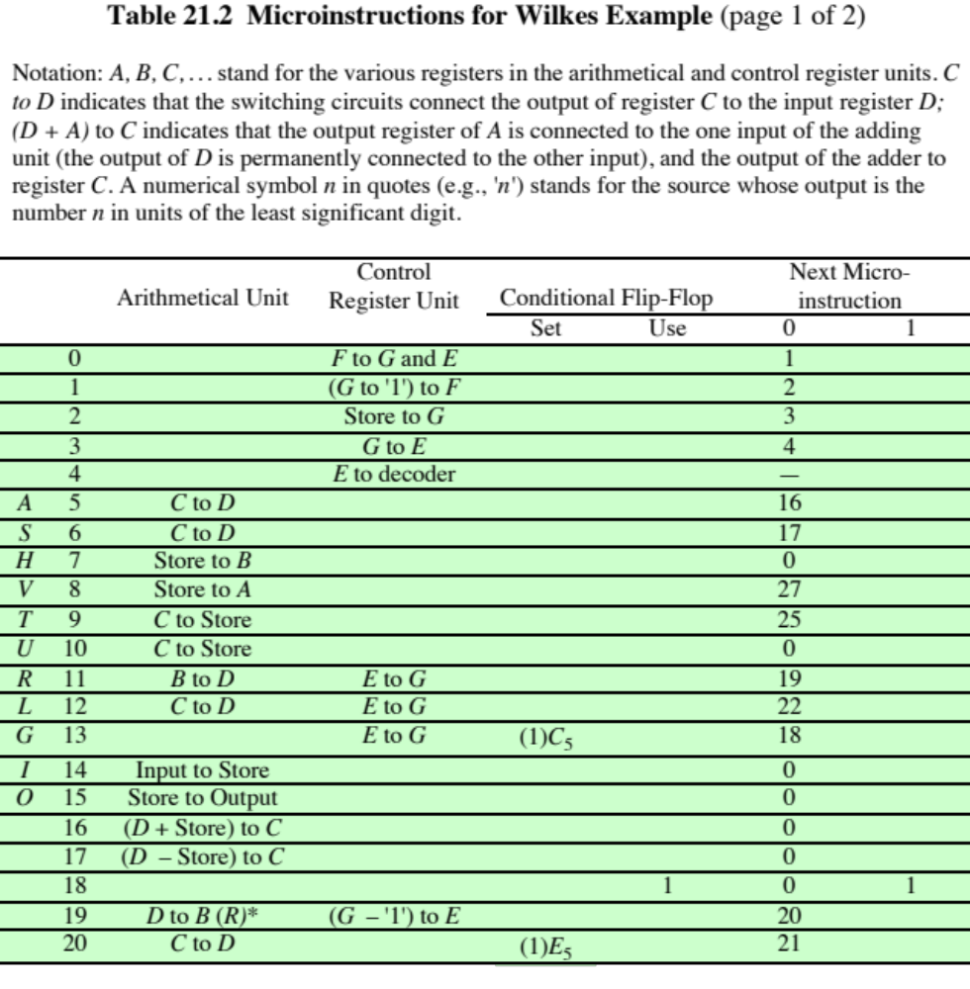
(Table can be found on page 738 in the textbook.)
Notes:
Table 21.2 is the
complete set of microinstructions, expressed in symbolic form, that implements
the control unit. Thus, a total of 38 microinstructions is all that is required to define
the system completely.
The first full column gives the address (row number) of each microinstruction.
Those addresses corresponding to opcodes are labeled. Thus, when the opcode for
the add instruction (A) is encountered, the microinstruction at location 5 is executed.
Columns 2 and 3 express the actions to be taken by the ALU and control
unit, respectively. Each symbolic expression must be translated into a set of control
signals (microinstruction bits). Columns 4 and 5 have to do with the setting and
use of the two flags (flip-flops). Column 4 specifies the signal that sets the flag. For
example, (1)Cs means that flag number 1 is set by the sign bit of the number in register
C. If column 5 contains a flag identifier, then columns 6 and 7 contain the two
alternative microinstruction addresses to be used. Otherwise, column 6 specifies the
address of the next microinstruction to be fetched.
Instructions 0 through 4 constitute the fetch cycle. Microinstruction 4 presents
the opcode to a decoder, which generates the address of a microinstruction corresponding
to the machine instruction to be fetched. The reader should be able to
deduce the complete functioning of the control unit from a careful study of Table 21.2.

Slide 33
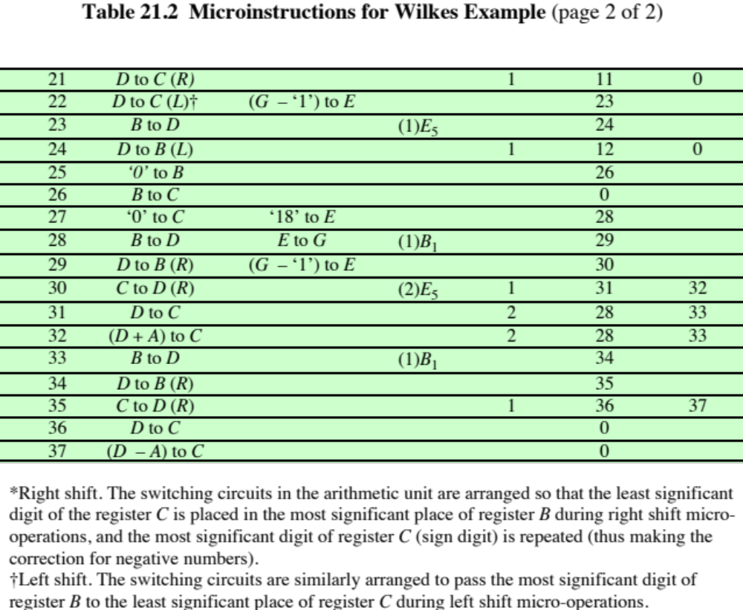
Notes:
The principal advantage of the use of microprogramming to implement a control
unit is that it simplifies the design of the control unit. Thus, it is both cheaper and
less error prone to implement. A hardwired control unit must contain complex logic
for sequencing through the many micro-operations of the instruction cycle. On the
other hand, the decoders and sequencing logic unit of a microprogrammed control
unit are very simple pieces of logic.
The principal disadvantage of a microprogrammed unit is that it will be somewhat
slower than a hardwired unit of comparable technology. Despite this, microprogramming
is the dominant technique for implementing control units in pure
CISC architectures, due to its ease of implementation. RISC processors, with their
simpler instruction format, typically use hardwired control units. We now examine
the microprogrammed approach in greater detail.

Slide 34
Microinstruction Sequencing
The two basic tasks performed by a microprogrammed control unit are:
  Microinstruction sequencing
    Get the next microinstruction from the control memory
  Microinstruction execution
    Generate the control signals needed to execute the microinstruction
    In designing a control unit, these tasks must be considered together because both affect the format of the microinstruction and the timing of the control unit
Notes:
The two basic tasks performed by a microprogrammed control unit are as follows:
■ Microinstruction sequencing: Get the next microinstruction from the control
memory.
■ Microinstruction execution: Generate the control signals needed to execute
the microinstruction.
In designing a control unit, these tasks must be considered together, because
both affect the format of the microinstruction and the timing of the control unit. In
this section, we will focus on sequencing and say as little as possible about format
and timing issues. These issues are examined in more detail in the next section.

Slide 35
Design Considerations
Two concerns are involved in the design of a microinstruction sequencing technique:
The size of the microinstruction
Minimizing the size of the control memory reduces the cost of that component
The address-generation time
Execute microinstruction as fast as possible
In executing a microprogram the address of the next microinstruction to be executed is in one of these categories:
Determined by instruction register
Occurs only once per instruction cycle, just after an instruction is fetched
Next sequential address
Most common in most designs
Branch
Are a necessary part of a microprogram
Notes:
Two concerns are involved in the design of a microinstruction sequencing technique:
the size of the microinstruction and the address-generation time. The first concern
is obvious; minimizing the size of the control memory reduces the cost of that component.
The second concern is simply a desire to execute microinstructions as fast
as possible.
In executing a microprogram, the address of the next microinstruction to be
executed is in one of these categories:
■ Determined by instruction register
■ Next sequential address
■ Branch
The first category occurs only once per instruction cycle, just after an instruction is
fetched. The second category is the most common in most designs. However, the
design cannot be optimized just for sequential access. Branches, both conditional
and unconditional, are a necessary part of a microprogram. Furthermore, microinstruction
sequences tend to be short; one out of every three or four microinstructions
could be a branch [SIEW82]. Thus, it is important to design compact, time-efficient
techniques for microinstruction branching.

Slide 36
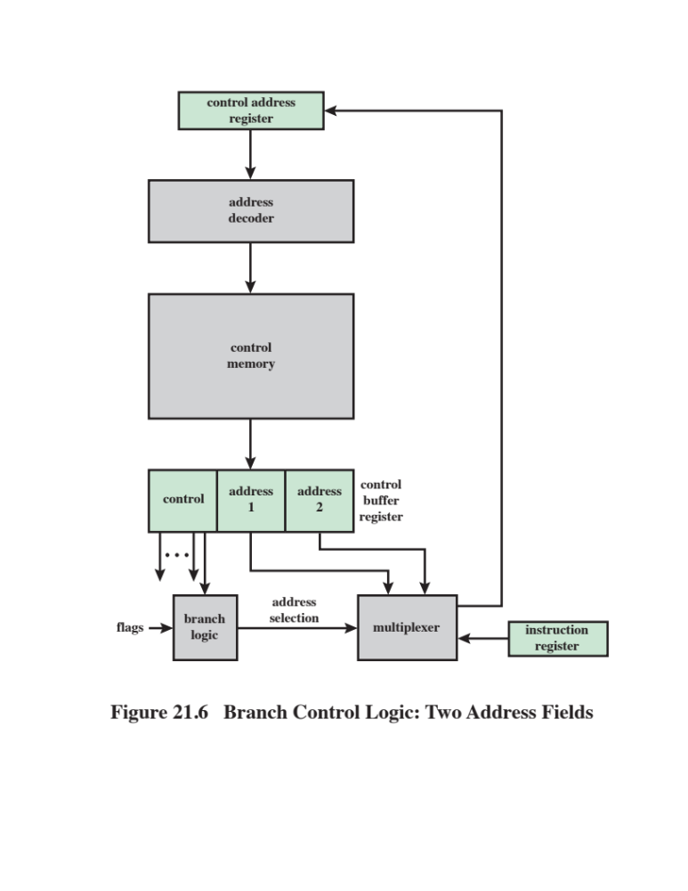
Notes:
Based on the current microinstruction, condition flags, and the contents of the
instruction register, a control memory address must be generated for the next microinstruction.
A wide variety of techniques have been used. We can group them into
three general categories, as illustrated in Figures 21.6 to 21.8. These categories are
based on the format of the address information in the microinstruction:
■ Two address fields
■ Single address field
■ Variable format
The simplest approach is to provide two address fields in each microinstruction.
Figure 21.6 suggests how this information is to be used. A multiplexer is provided
that serves as a destination for both address fields plus the instruction register.
Based on an address-selection input, the multiplexer transmits either the opcode
or one of the two addresses to the control address register (CAR). The CAR is
subsequently decoded to produce the next microinstruction address. The address-selection
signals are provided by a branch logic module whose input consists of control
unit flags plus bits from the control portion of the microinstruction

Slide 37
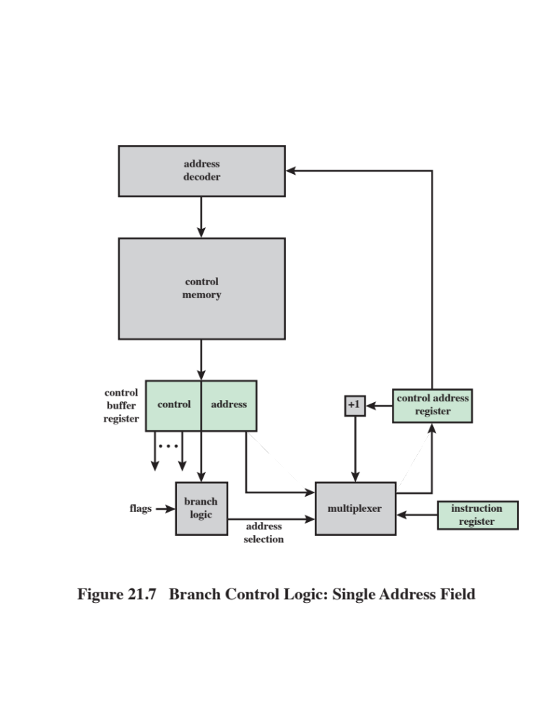
Notes:
Although the two-address approach is simple, it requires more bits in the
microinstruction than other approaches. With some additional logic, savings can be
achieved. A common approach is to have a single address field (Figure 21.7). With
this approach, the options for next address are as follows:
■ Address field
■ Instruction register code
■ Next sequential address
The address-selection signals determine which option is selected. This approach
reduces the number of address fields to one. Note, however, that the address field
often will not be used. Thus, there is some inefficiency in the microinstruction coding
scheme.

Slide 38
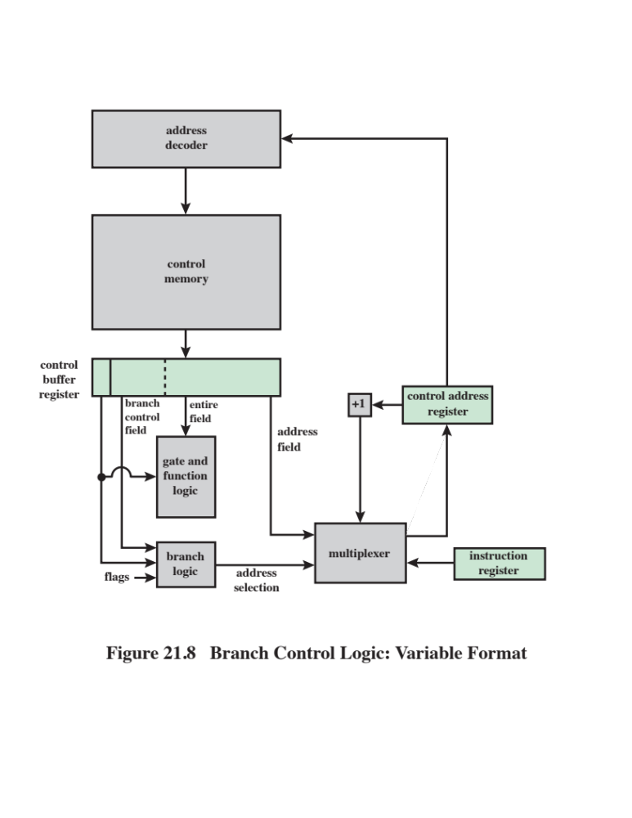
Notes:
Another approach is to provide for two entirely different microinstruction
formats (Figure 21.8). One bit designates which format is being used. In one
format, the remaining bits are used to activate control signals. In the other format,
some bits drive the branch logic module, and the remaining bits provide
the address. With the first format, the next address is either the next sequential
address or an address derived from the instruction register. With the second
format, either a conditional or unconditional branch is being specified. One
disadvantage of this approach is that one entire cycle is consumed with each
branch microinstruction. With the other approaches, address generation occurs
as part of the same cycle as control signal generation, minimizing control memory
accesses.
The approaches just described are general. Specific implementations will
often involve a variation or combination of these techniques.

Slide 39

Table 21.3
Microinstruction Address Generation Techniques
Notes:
We have looked at the sequencing problem from the point of view of format considerations
and general logic requirements. Another viewpoint is to consider the
various ways in which the next address can be derived or computed.
Table 21.3 lists the various address generation techniques. These can be
divided into explicit techniques, in which the address is explicitly available in the
microinstruction, and implicit techniques, which require additional logic to generate
the address.
The final approach listed in Table 21.3 is termed residual control . This
approach involves the use of a microinstruction address that has previously been
saved in temporary storage within the control unit. For example, some microinstruction
sets come equipped with a subroutine facility. An internal register or stack
of registers is used to hold return addresses. An example of this approach is taken
on the LSI-11, which we now examine.

Slide 40
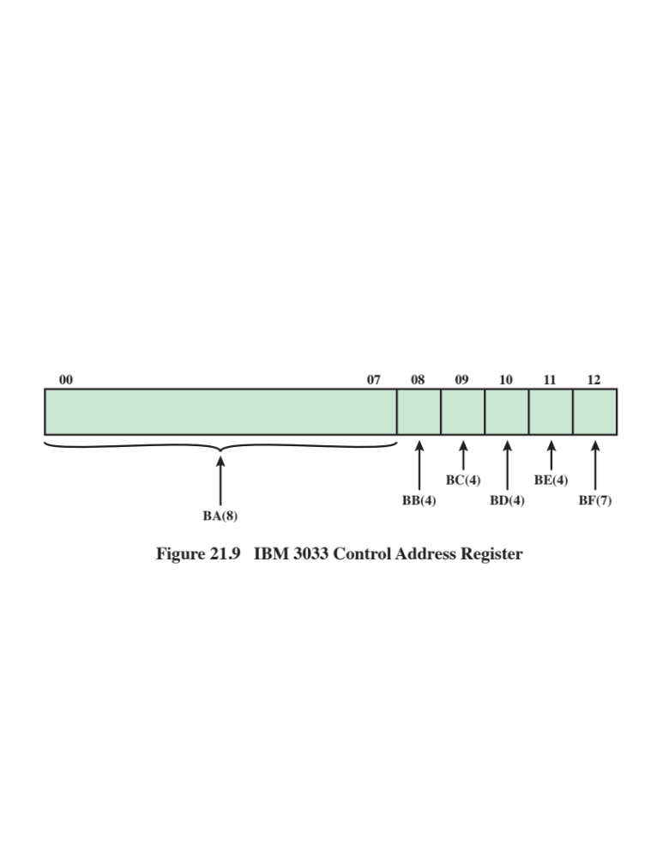
Notes:
The control address register on the IBM 3033 is 13 bits long and is illustrated
in Figure 21.9. Two parts of the address can be distinguished. The highest-order
8 bits (00–07) normally do not change from one microinstruction cycle to the next.
During the execution of a microinstruction, these 8 bits are copied directly from
an 8-bit field of the microinstruction (the BA field) into the highest-order 8 bits of
the control address register. This defines a block of 32 microinstructions in control
memory. The remaining 5 bits of the control address register are set to specify the
specific address of the microinstruction to be fetched next. Each of these bits is
determined by a 4-bit field (except one is a 7-bit field) in the current microinstruction;
the field specifies the condition for setting the corresponding bit. For example,
a bit in the control address register might be set to 1 or 0 depending on whether a
carry occurred on the last ALU operation.

Slide 41
LSI-11 Microinstruction Sequencing
LSI-11 is a microcomputer version of a PDP-11, with the main components of the system residing on a single board
The LSI-11 is implemented using a microprogrammed control unit
Makes use of a 22-bit microinstruction and a control memory of 2K 22-bit words
The next microinstruction address is determined in one of five ways:
  Next sequential address
  Opcode mapping
  Subroutine facility
  Interrupt testing
  Branch
Notes:
The LSI-11 is a microcomputer version of a PDP-11, with the main components of
the system residing on a single board. The LSI-11 is implemented using a microprogrammed
control unit [SEBE76].
The LSI-11 makes use of a 22-bit microinstruction and a control memory of
2K 22-bit words. The next microinstruction address is determined in one of five
ways:
■ Next sequential address: In the absence of other instructions, the control unit’s
control address register is incremented by 1.
■ Opcode mapping: At the beginning of each instruction cycle, the next microinstruction
address is determined by the opcode.
■ Subroutine facility: Explained presently.
■ Interrupt testing: Certain microinstructions specify a test for interrupts. If an
interrupt has occurred, this determines the next microinstruction address.
■ Branch: Conditional and unconditional branch microinstructions are used.
A one-level subroutine facility is provided. One bit in every microinstruction
is dedicated to this task. When the bit is set, an 11-bit return register is loaded with
the updated contents of the control address register. A subsequent microinstruction
that specifies a return will cause the control address register to be loaded from the
return register.
The return is one form of unconditional branch instruction. Another form of
unconditional branch causes the bits of the control address register to be loaded
from 11 bits of the microinstruction. The conditional branch instruction makes use
of a 4-bit test code within the microinstruction. This code specifies testing of various
ALU condition codes to determine the branch decision. If the condition is not true,
the next sequential address is selected. If it is true, the 8 lowest-order bits of the
control address register are loaded from 8 bits of the microinstruction. This allows
branching within a 256-word page of memory.
As can be seen, the LSI-11 includes a powerful address sequencing facility
within the control unit. This allows the microprogrammer considerable flexibility
and can ease the microprogramming task. On the other hand, this approach requires
more control unit logic than do simpler capabilities.

Slide 42
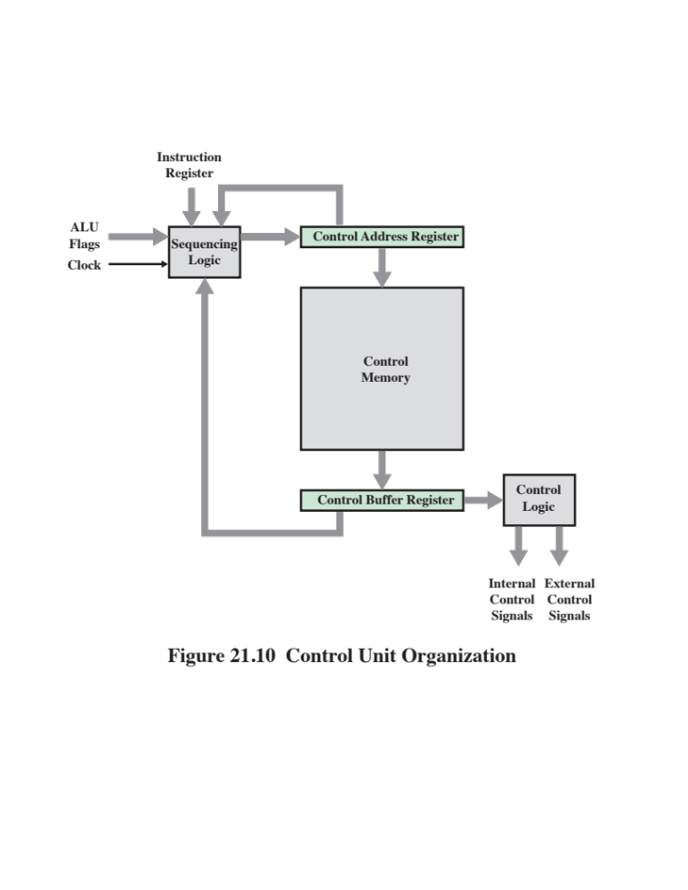
Notes:
The microinstruction cycle is the basic event on a microprogrammed processor. Each
cycle is made up of two parts: fetch and execute. The fetch portion is determined by
the generation of a microinstruction address, and this was dealt with in the preceding
section. This section deals with the execution of a microinstruction.
Recall that the effect of the execution of a microinstruction is to generate
control signals. Some of these signals control points internal to the processor. The
remaining signals go to the external control bus or other external interface. As an
incidental function, the address of the next microinstruction is determined.
The preceding description suggests the organization of a control unit shown in
Figure 21.10. This slightly revised version of Figure 21.4 emphasizes the focus of this
section. The major modules in this diagram should by now be clear. The sequencing
logic module contains the logic to perform the functions discussed in the preceding
section. It generates the address of the next microinstruction, using as inputs the
instruction register, ALU flags, the control address register (for incrementing), and
the control buffer register. The last may provide an actual address, control bits, or
both. The module is driven by a clock that determines the timing of the microinstruction
cycle.
The control logic module generates control signals as a function of some of
the bits in the microinstruction. It should be clear that the format and content of the
microinstruction determines the complexity of the control logic module.

Slide 43
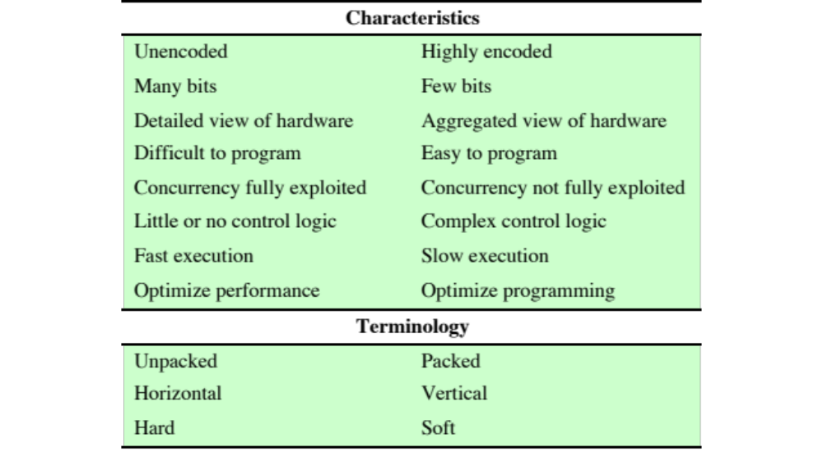
Table 21.4
The Microinstruction Spectrum
Notes:
Based on the preceding, we can see that the control signal portion of the
microinstruction format falls on a spectrum. At one extreme, there is one bit for
each control signal; at the other extreme, a highly encoded format is used. Table 21.4
shows that other characteristics of a microprogrammed control unit also fall along a
spectrum and that these spectra are, by and large, determined by the degree-of-encoding
spectrum.
The second pair of items in the table is rather obvious. The pure Wilkes scheme
will require the most bits. It should also be apparent that this extreme presents the
most detailed view of the hardware. Every control signal is individually controllable
by the microprogrammer. Encoding is done in such a way as to aggregate functions
or resources, so that the microprogrammer is viewing the processor at a higher, less
detailed level. Furthermore, the encoding is designed to ease the microprogramming
burden. Again, it should be clear that the task of understanding and orchestrating
the use of all the control signals is a difficult one. As was mentioned, one of
the consequences of encoding, typically, is to prevent the use of certain otherwise
allowable combinations.
The preceding paragraph discusses microinstruction design from the microprogrammer’s
point of view. But the degree of encoding also can be viewed from its
hardware effects. With a pure unencoded format, little or no decode logic is needed;
each bit generates a particular control signal. As more compact and more aggregated
encoding schemes are used, more complex decode logic is needed. This, in
turn, may affect performance. More time is needed to propagate signals through
the gates of the more complex control logic module. Thus, the execution of encoded
microinstructions takes longer than the execution of unencoded ones.
Therefore, all of the characteristics listed in Table 21.4 fall along a spectrum
of design strategies. In general, a design that falls toward the left end of the spectrum
is intended to optimize the performance of the control unit. Designs toward
the right end are more concerned with optimizing the process of microprogramming.
Indeed, microinstruction sets near the right end of the spectrum look very much like
machine instruction sets. A good example of this is the LSI-11 design, described later
in this section. Typically, when the objective is simply to implement a control unit,
the design will be near the left end of the spectrum. The IBM 3033 design, discussed
presently, is in this category. As we shall discuss later, some systems permit a variety
of users to construct different microprograms using the same microinstruction facility.
In the latter cases, the design is likely to fall near the right end of the spectrum.
We can now deal with some of the terminology introduced earlier. Table 21.4 indicates
how three of these pairs of terms relate to the microinstruction spectrum. In essence,
all of these pairs describe the same thing but emphasize different design characteristics.
The degree of packing relates to the degree of identification between a given
control task and specific microinstruction bits. As the bits become more packed , a
given number of bits contains more information. Thus, packing connotes encoding.
The terms horizontal and vertical relate to the relative width of microinstructions.
[SIEW82] suggests as a rule of thumb that vertical microinstructions have lengths in
the range of 16 to 40 bits and that horizontal microinstructions have lengths in the
range of 40 to 100 bits. The terms hard and soft microprogramming are used to suggest
the degree of closeness to the underlying control signals and hardware layout.
Hard microprograms are generally fixed and committed to read-only memory. Soft
microprograms are more changeable and are suggestive of user microprogramming.
The other pair of terms mentioned at the beginning of this subsection refers to
direct versus indirect encoding, a subject to which we now turn.

Slide 44
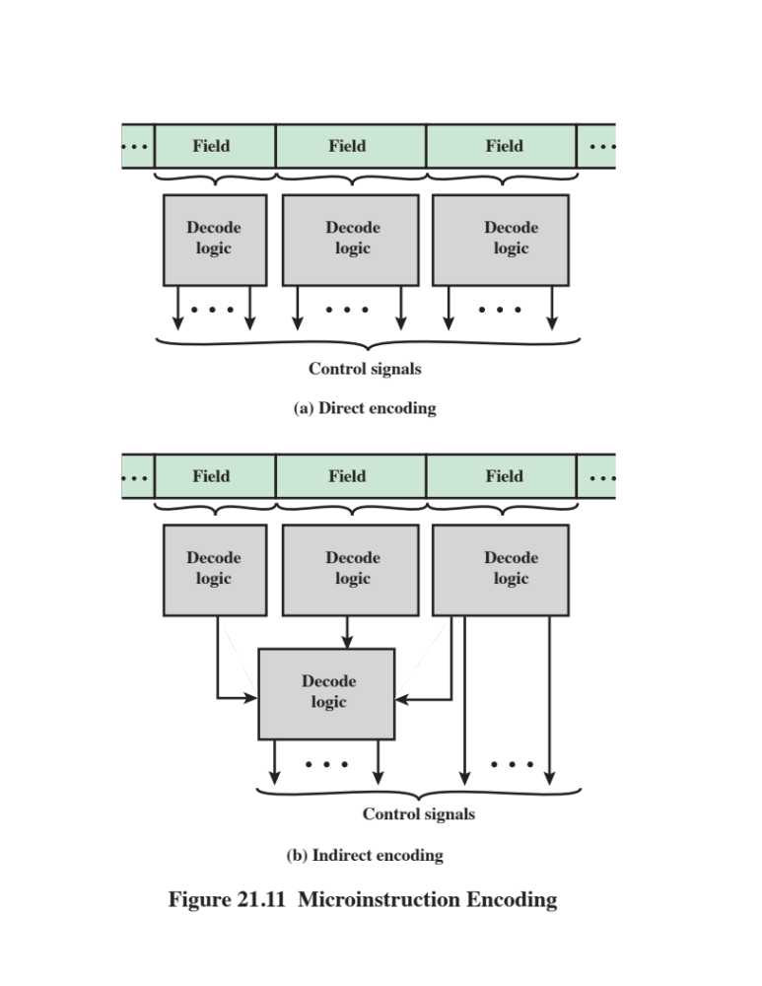
Notes:
In practice, microprogrammed control units are not designed using a pure unencoded
or horizontal microinstruction format. At least some degree of encoding is
used to reduce control memory width and to simplify the task of microprogramming.
The basic technique for encoding is illustrated in Figure 21.11a. The microinstruction
is organized as a set of fields. Each field contains a code, which, upon
decoding, activates one or more control signals.
Let us consider the implications of this layout. When the microinstruction
is executed, every field is decoded and generates control signals. Thus, with N
fields, N simultaneous actions are specified. Each action results in the activation
of one or more control signals. Generally, but not always, we will want to design
the format so that each control signal is activated by no more than one field.
Clearly, however, it must be possible for each control signal to be activated by at
least one field.
Now consider the individual field. A field consisting of L bits can contain one
of 2^{L} codes, each of which can be encoded to a different control signal pattern.
Because only one code can appear in a field at a time, the codes are mutually exclusive,
and, therefore, the actions they cause are mutually exclusive.
The design of an encoded microinstruction format can now be stated in simple
terms:
■ Organize the format into independent fields. That is, each field depicts a set of
actions (pattern of control signals) such that actions from different fields can
occur simultaneously.
■ Define each field such that the alternative actions that can be specified by the
field are mutually exclusive. That is, only one of the actions specified for a
given field could occur at a time.
Two approaches can be taken for organizing the encoded microinstruction
into fields: functional and resource. The functional encoding method identifies functions
within the machine and designates fields by function type. For example, if various
sources can be used for transferring data to the accumulator, one field can be
designated for this purpose, with each code specifying a different source. Resource
encoding views the machine as consisting of a set of independent resources and
devotes one field to each (e.g., I/O, memory, ALU).
Another aspect of encoding is whether it is direct or indirect (Figure 21.11b).
With indirect encoding, one field is used to determine the interpretation of another
field. For example, consider an ALU that is capable of performing eight different
arithmetic operations and eight different shift operations. A 1-bit field could be
used to indicate whether a shift or arithmetic operation is to be used; a 3-bit field
would indicate the operation. This technique generally implies two levels of decoding,
increasing propagation delays.

Slide 45
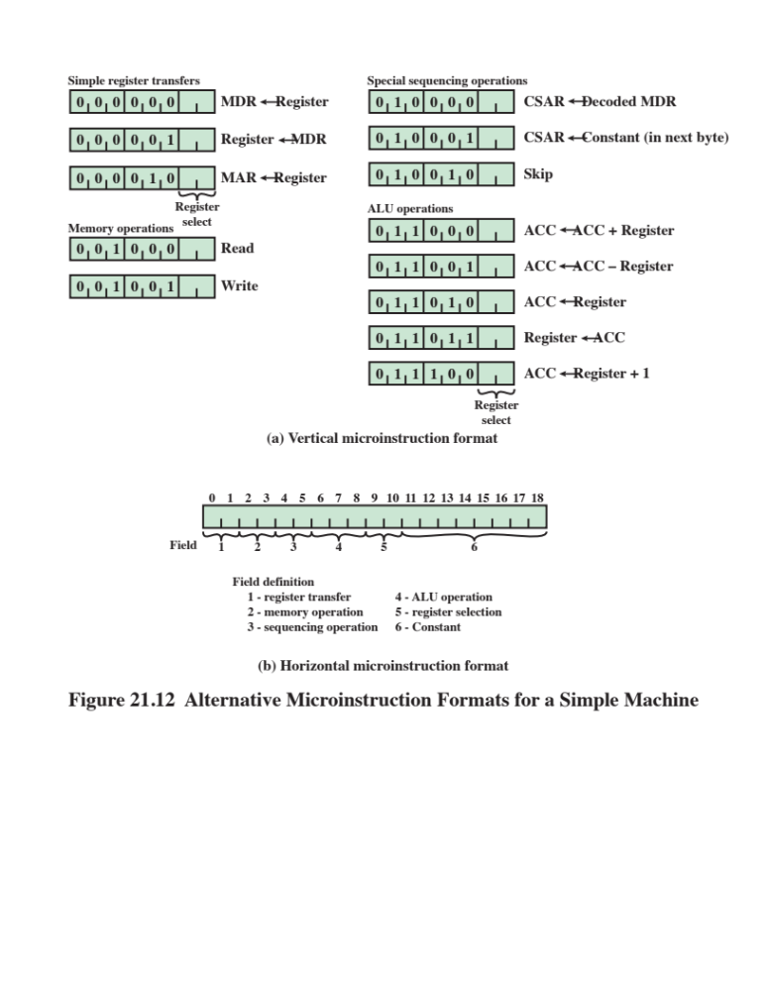
Notes:
Figure 21.12 is a simple example of these concepts. Assume a processor with a
single accumulator and several internal registers, such as a program counter and a temporary
register for ALU input. Figure 21.12a shows a highly vertical format. The first
3 bits indicate the type of operation, the next 3 encode the operation, and the final
2 select an internal register. Figure 21.12b is a more horizontal approach, although
encoding is still used. In this case, different functions appear in different fields.

Slide 46
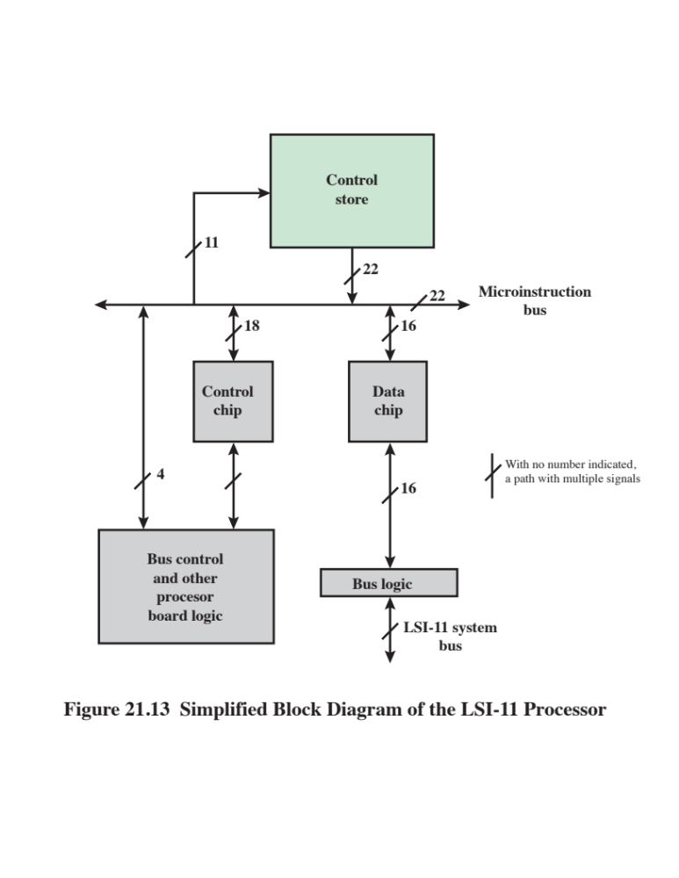
Notes:
The LSI-11 [SEBE76] is a good example of a vertical microinstruction approach. We
look first at the organization of the control unit, then at the microinstruction format.
The LSI-11 is the first member of the
PDP-11 family that was offered as a single-board processor. The board contains
three LSI chips, an internal bus known as the microinstruction bus (MIB), and some
additional interfacing logic.
Figure 21.13 depicts, in simplified form, the organization of the LSI-11 processor.
The three chips are the data, control, and control store chips. The data chip
contains an 8-bit ALU, twenty-six 8-bit registers, and storage for several condition
codes. Sixteen of the registers are used to implement the eight 16-bit general-purpose
registers of the PDP-11. Others include a program status word, memory
address register (MAR), and memory buffer register. Because the ALU deals with
only 8 bits at a time, two passes through the ALU are required to implement a
16-bit PDP-11 arithmetic operation. This is controlled by the microprogram.
The control store chip or chips contain the 22-bit-wide control memory. The
control chip contains the logic for sequencing and executing microinstructions. It
contains the control address register, the control data register, and a copy of the
machine instruction register.
The MIB ties all the components together. During microinstruction fetch, the
control chip generates an 11-bit address onto the MIB. Control store is accessed,
producing a 22-bit microinstruction, which is placed on the MIB. The low-order
16 bits go to the data chip, while the low-order 18 bits go to the control chip. The
high-order 4 bits control special processor board functions.

Slide 47
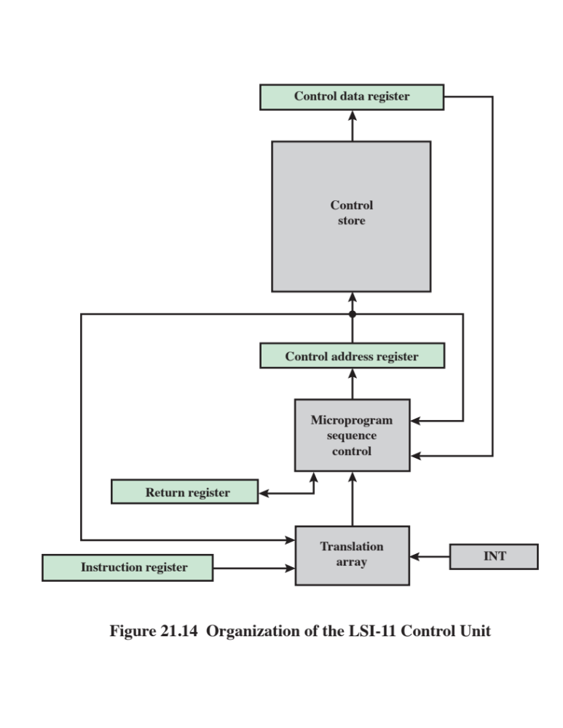
Notes:
Figure 21.14 provides a still simplified but more detailed look at the LSI-11
control unit: the figure ignores individual chip boundaries. The address sequencing
scheme described in Section 21.2 is implemented in two modules. Overall sequence
control is provided by the microprogram sequence control module, which is capable
of incrementing the microinstruction address register and performing unconditional
branches. The other forms of address calculation are carried out by a separate translation
array. This is a combinatorial circuit that generates an address based on the
microinstruction, the machine instruction, the microinstruction program counter,
and an interrupt register.
The translation array comes into play on the following occasions:
■ The opcode is used to determine the start of a microroutine.
■ At appropriate times, address mode bits of the microinstruction are tested to
perform appropriate addressing.
■ Interrupt conditions are periodically tested.
■ Conditional branch microinstructions are evaluated.

Slide 48
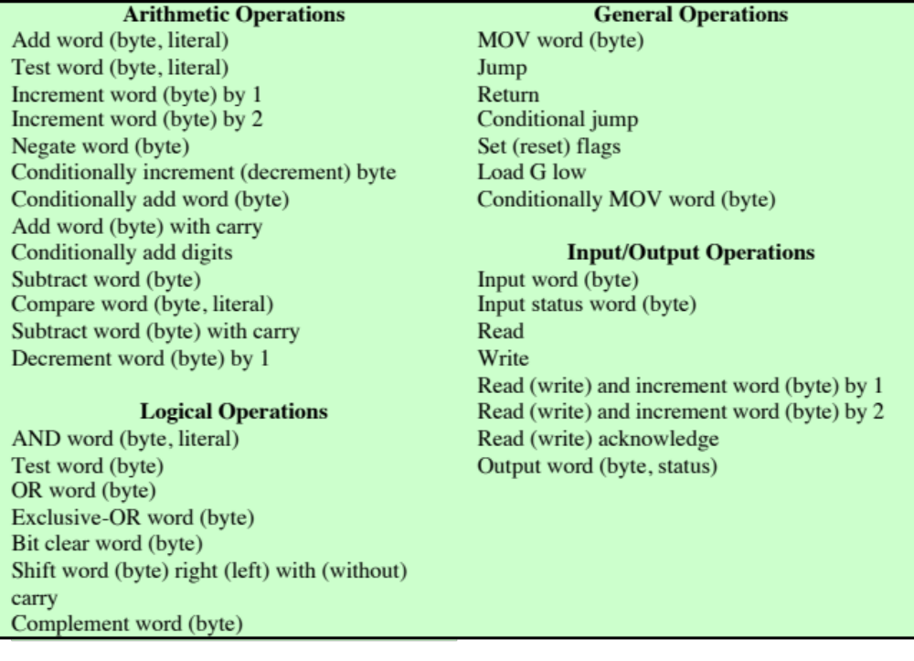
Table 21.5
Some LSI-11 Microinstructions
Notes:
The LSI-11 uses an extremely vertical
microinstruction format, which is only 22 bits wide. The microinstruction set strongly
resembles the PDP-11 machine instruction set that it implements. This design was
intended to optimize the performance of the control unit within the constraint of a
vertical, easily programmed design. Table 21.5 lists some of the LSI-11 microinstructions.

Slide 49
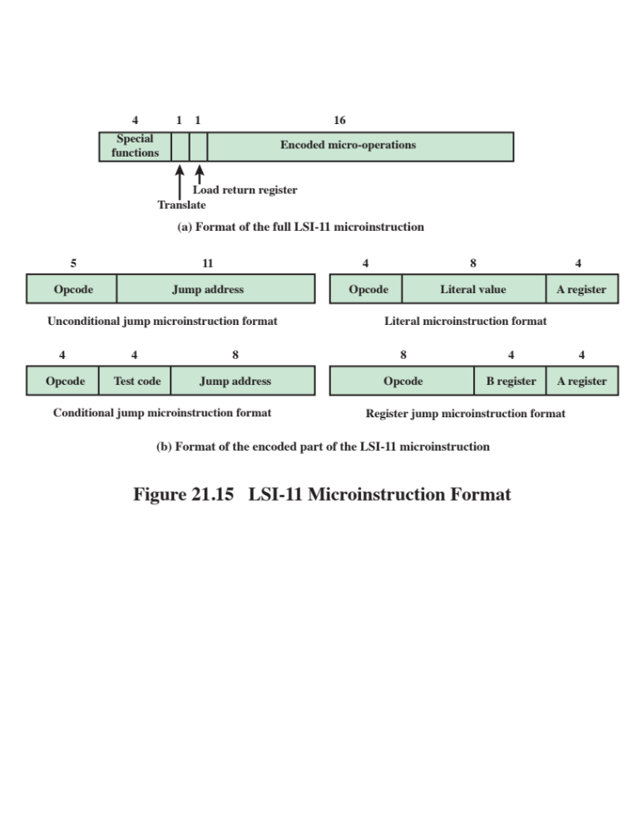
Notes:
Figure 21.15 shows the 22-bit LSI-11 microinstruction format. The high-order
4 bits control special functions on the processor board. The translate bit enables the
translation array to check for pending interrupts. The load return register bit is used
at the end of a microroutine to cause the next microinstruction address to be loaded
from the return register.
The remaining 16 bits are used for highly encoded micro-operations. The format
is much like a machine instruction, with a variable-length opcode and one or
more operands.

Slide 50
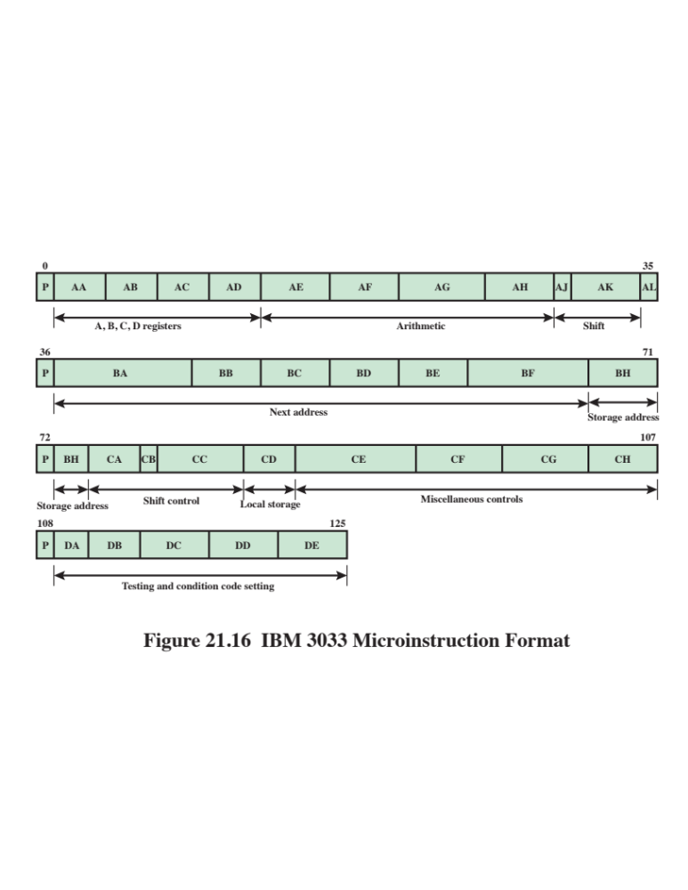
Notes:
The standard IBM 3033 control memory consists of 4K words. The first half of these
(0000–07FF) contain 108-bit microinstructions, while the remainder (0800–0FFF)
are used to store 126-bit microinstructions. The format is depicted in Figure 21.16.

Slide 51
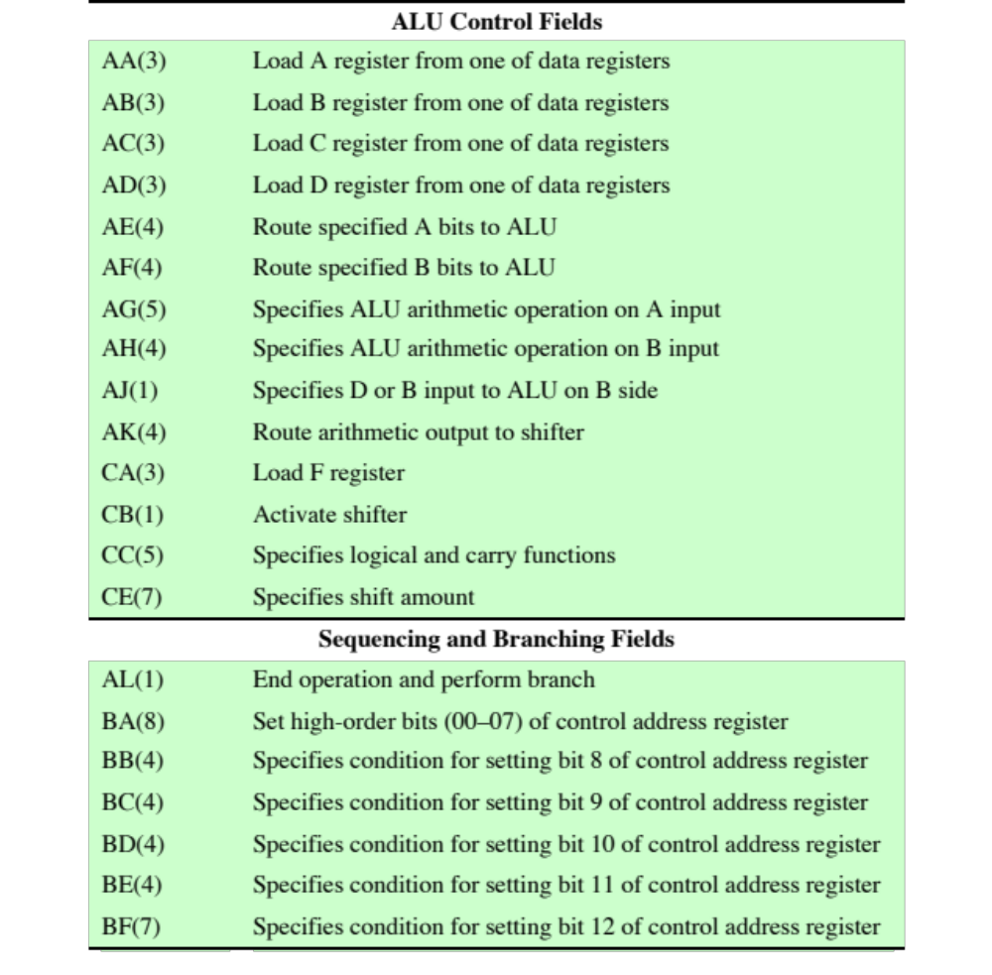
Table 21.6
IBM 3033 Microinstruction Control
Fields
(Table can be found on page 755 in the textbook.)
Notes:
Although this is a rather horizontal format, encoding is still extensively used. The
key fields of that format are summarized in Table 21.6.
The ALU operates on inputs from four dedicated, non-user-visible registers,
A, B, C, and D. The microinstruction format contains fields for loading these registers
from user-visible registers, performing an ALU function, and specifying a
user-visible register for storing the result. There are also fields for loading and storing
data between registers and memory.
The sequencing mechanism for the IBM 3033 was discussed in Section 21.2.

Slide 52
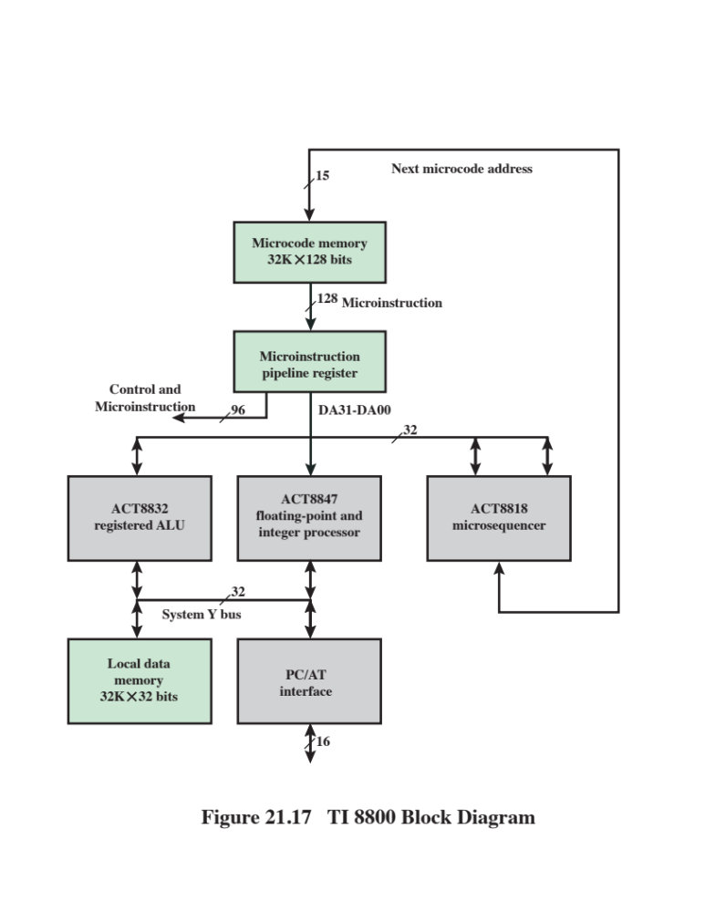
Notes:
The Texas Instruments 8800 Software Development Board (SDB) is a microprogrammable
32-bit computer card. The system has a writable control store, implemented
in RAM rather than ROM. Such a system does not achieve the speed or
density of a microprogrammed system with a ROM control store. However, it is
useful for developing prototypes and for educational purposes.
The 8800 SDB consists of the following components (Figure 21.17):
■ Microcode memory
■ Microsequencer
■ 32-bit ALU
■ Floating-point and integer processor
■ Local data memory
Two buses link the internal components of the system. The DA bus provides
data from the microinstruction data field to the ALU, the floating-point processor,
or the microsequencer. In the latter case, the data consists of an address to be used
for a branch instruction. The bus can also be used for the ALU or microsequencer to
provide data to other components. The system Y bus connects the ALU and floating-
point processor to local memory and to external modules via the PC interface.
The board fits into an IBM PC-compatible host computer. The host computer
provides a suitable platform for microcode assembly and debug.

Slide 53
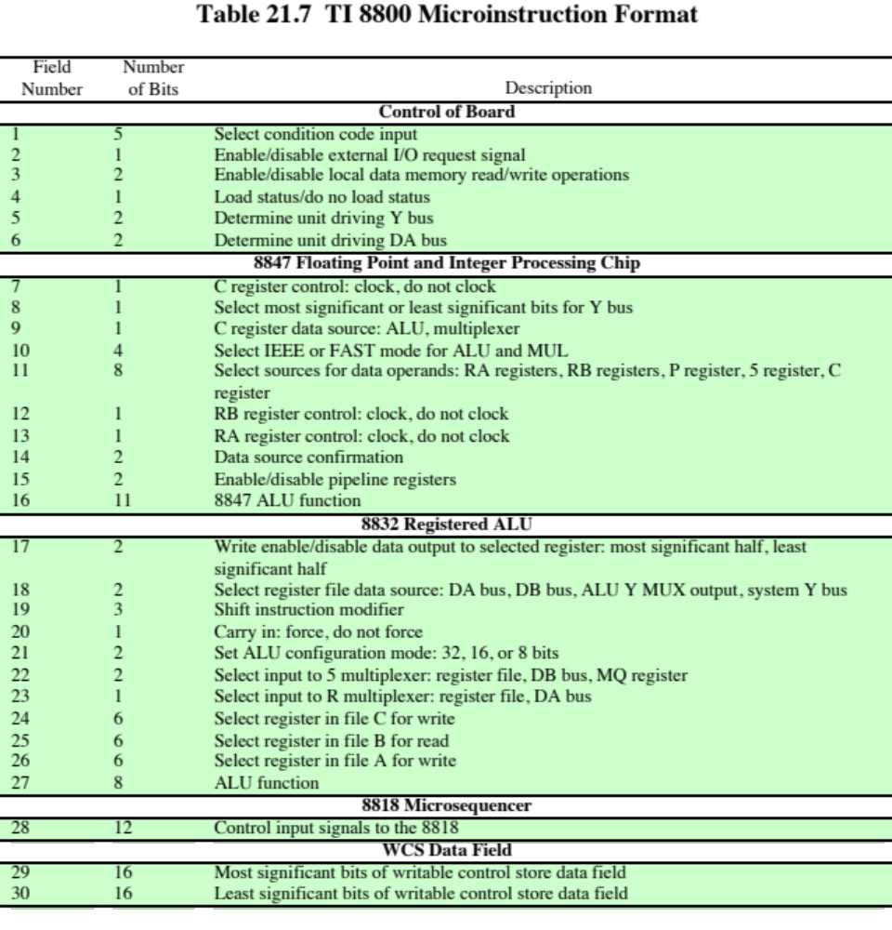
(Table can be found on page 758 in the textbook.)
Notes:
The microinstruction format for the 8800 consists of 128 bits broken down into 30
functional fields, as indicated in Table 21.7. Each field consists of one or more bits,
and the fields are grouped into five major categories:
■ Control of board
■ 8847 floating-point and integer processor chip
■ 8832 registered ALU
■ 8818 microsequencer
■ WCS data field
As indicated in Figure 21.17, the 32 bits of the WCS data field are fed into the DA
bus to be provided as data to the ALU, floating-point processor, or microsequencer.
The other 96 bits (fields 1–27) of the microinstruction are control signals that are
fed directly to the appropriate module. For simplicity, these other connections are
not shown in Figure 21.17.
The first six fields deal with operations that pertain to the control of the board,
rather than controlling an individual component. Control operations include the
following:
■ Selecting condition codes for sequencer control. The first bit of field 1 indicates
whether the condition flag is to be set to 1 or 0, and the remaining 4 bits
indicate which flag is to be set.
■ Sending an I/O request to the PC/AT.
■ Enabling local data memory read/write operations.
■ Determining the unit driving the system Y bus. One of the four devices
attached to the bus (Figure 21.17) is selected.
The last 32 bits are the data field, which contain information specific to a particular
microinstruction.
The remaining fields of the microinstruction are best discussed in the context
of the device that they control. In the remainder of this section, we discuss the
microsequencer and the registered ALU. The floating-point unit introduces no new
concepts and is skipped.

Slide 54
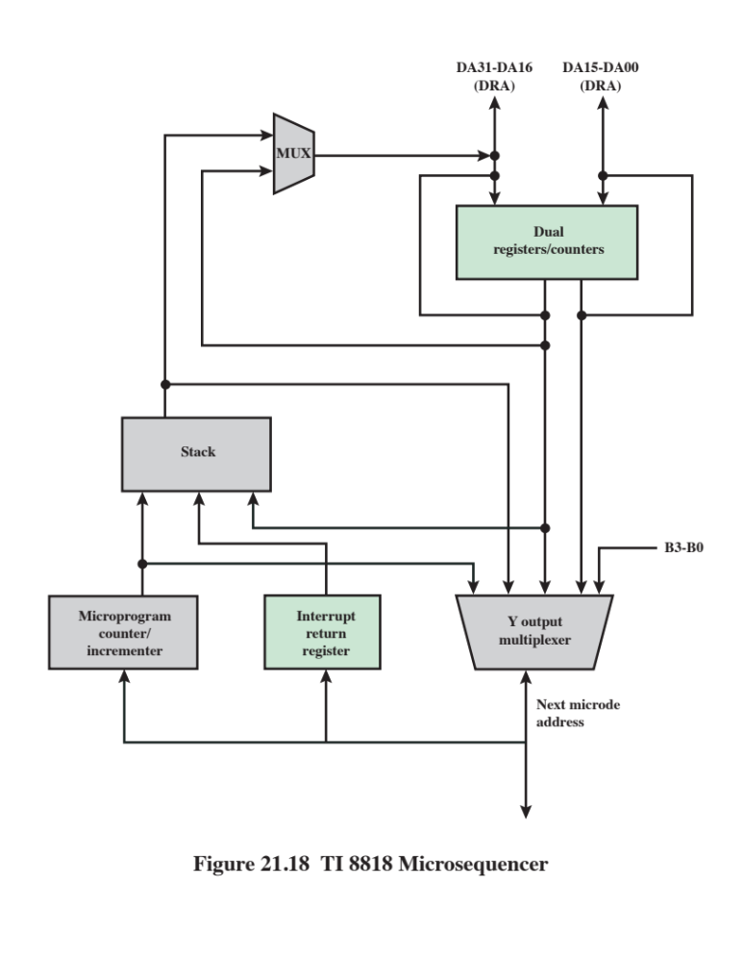
Notes:
The principal function of the 8818 microsequencer is to generate the next microinstruction
address for the microprogram. This 15-bit address is provided to the microcode
memory (Figure 21.17).
The next address can be selected from one of five sources:
1. The microprogram counter (MPC) register, used for repeat (reuse same
address) and continue (increment address by 1) instructions.
2. The stack, which supports microprogram subroutine calls as well as iterative
loops and returns from interrupts.
3. The DRA and DRB ports, which provide two additional paths from external
hardware by which microprogram addresses can be generated. These
two ports are connected to the most significant and least significant 16 bits of
the DA bus, respectively. This allows the microsequencer to obtain the next
instruction address from the WCS data field of the current microinstruction or
from a result calculated by the ALU.
4. Register counters RCA and RCB, which can be used for additional address
storage.
5. An external input onto the bidirectional Y port to support external interrupts.
Figure 21.18 is a logical block diagram of the 8818. The device consists of the
following principal functional groups:
■ A 16-bit microprogram counter (MPC) consisting of a register and an incrementer.
■ Two register counters, RCA and RCB, for counting loops and iterations, storing
branch addresses, or driving external devices.
■ A 65-word by 16-bit stack, which allows microprogram subroutine calls and
interrupts.
■ An interrupt return register and Y output enable for interrupt processing at
the microinstruction level.
■ A Y output multiplexer by which the next address can be selected from MPC,
RCA, RCB, external buses DRA and DRB, or the stack.

Slide 55
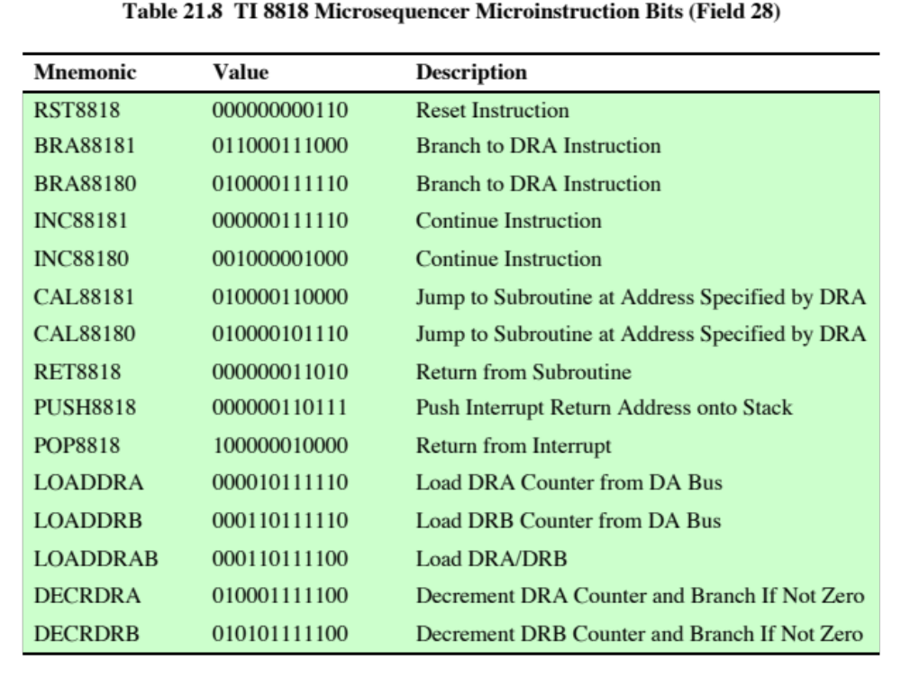
(Table can be found on page 761 in the textbook.)
Notes:
The microsequencer is controlled primarily
by the 12-bit field of the current microinstruction, field 28 (Table 21.7). This field
consists of the following subfields:
■ OSEL (1 bit): Output select. Determines which value will be placed on the output
of the multiplexer that feeds into the DRA bus (upper-left-hand corner of
Figure 21.18). The output is selected to come from either the stack or from register
RCA. DRA then serves as input to either the Y output multiplexer or to
register RCA.
■ SELDR (1 bit): Select DR bus. If set to 1, this bit selects the external DA bus
as input to the DRA/DRB buses. If set to 0, selects the output of the DRA
multiplexer to the DRA bus (controlled by OSEL) and the contents of RCB
to the DRB bus.
■ ZEROIN (1 bit): Used to indicate a conditional branch. The behavior of the
microsequencer will then depend on the condition code selected in field 1
(Table 21.7).
■ RC2–RC0 (3 bits): Register controls. These bits determine the change in the
contents of registers RCA and RCB. Each register can either remain the same,
decrement, or load from the DRA/DRB buses.
■ S2–S0 (3 bits): Stack controls. These bits determine which stack operation is
to be performed.
■ MUX2–MUX0: Output controls. These bits, together with the condition code
if used, control the Y output multiplexer and therefore the next microinstruction
address. The multiplexer can select its output from the stack, DRA, DRB,
or MPC.
These bits can be set individually by the programmer. However, this is typically
not done. Rather, the programmer uses mnemonics that equate to the bit patterns
that would normally be required. Table 21.8 lists the 15 mnemonics for field 28. A
microcode assembler converts these into the appropriate bit patterns.

Slide 56
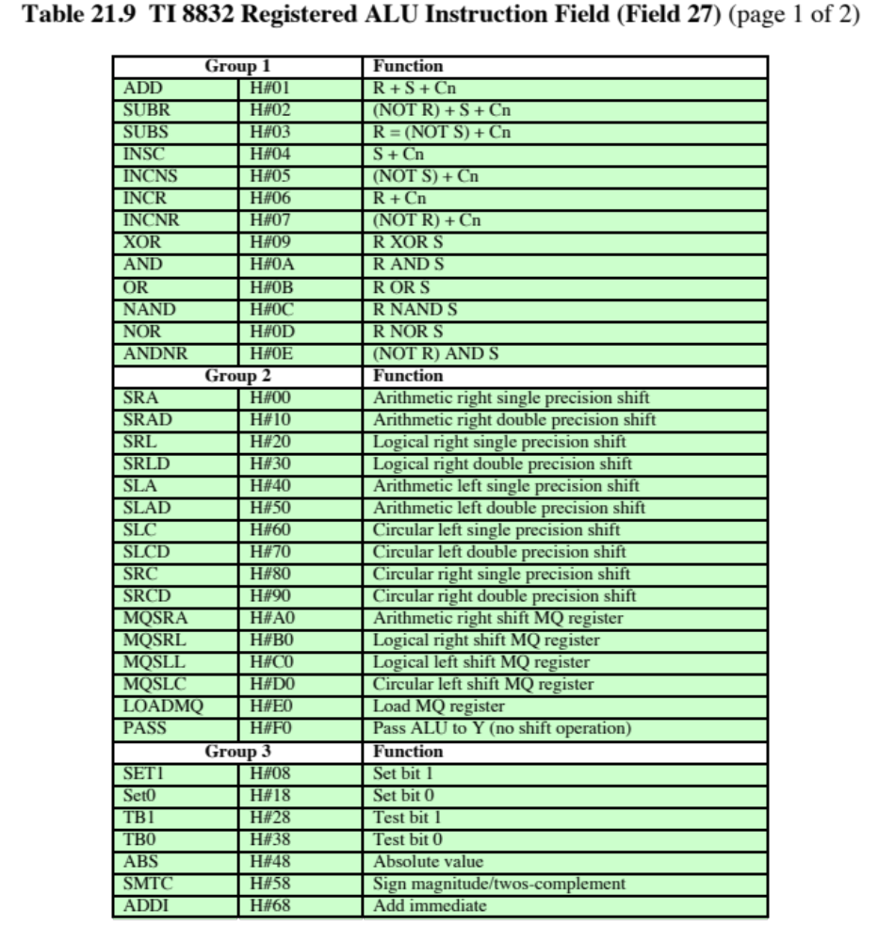
(Table can be found on page 764 in the textbook.)
Notes:
The 8832 is a 32-bit ALU with 64 registers that can be configured to operate as four
8-bit ALUs, two 16-bit ALUs, or a single 32-bit ALU.
The 8832 is controlled by the 39 bits that make up fields 17 through 27 of
the microinstruction (Table 21.7); these are supplied to the ALU as control signals.
In addition, as indicated in Figure 21.17, the 8832 has external connections to the
32-bit DA bus and the 32-bit system Y bus. Inputs from the DA can be provided
simultaneously as input data to the 64-word register file and to the ALU logic module.
Input from the system Y bus is provided to the ALU logic module. Results of
the ALU and shift operations are output to the DA bus or the system Y bus. Results
can also be fed back to the internal register file.
Three 6-bit address ports allow a two-operand fetch and an operand write to
be performed within the register file simultaneously. An MQ shifter and MQ register
can also be configured to function independently to implement double-precision
8-bit, 16-bit, and 32-bit shift operations.
Fields 17 through 26 of each microinstruction control the way in which data
flows within the 8832 and between the 8832 and the external environment. The
fields are as follows:
17. Write Enable. These two bits specify write 32 bits, 16 most significant bits, 16
least significant bits, or do not write into register file. The destination register
is defined by field 24.
18. Select Register File Data Source. If a write is to occur to the register file, these
two bits specify the source: DA bus, DB bus, ALU output, or system Y bus.
19. Shift Instruction Modifier. Specifies options concerning supplying end fill bits
and reading bits that are shifted during shift instructions.
20. Carry In. This bit indicates whether a bit is carried into the ALU for this
Operation.
21. ALU Configuration Mode. The 8832 can be configured to operate as a single
32-bit ALU, two 16-bit ALUs, or four 8-bit ALUs.
22. S Input. The ALU logic module inputs are provided by two internal multiplexers
referred to as the S and R multiplexers. This field selects the input to
be provided by the S multiplexer: register file, DB bus, or MQ register. The
source register is defined by field 25.
23. R Input. Selects input to be provided by the R multiplexer: register file or DA bus.
24. Destination Register. Address of register in register file to be used for the
destination operand.
25. Source Register. Address of register in register file to be used for the source
operand, provided by the S multiplexer.
26. Source Register. Address of register in register file to be used for the source
operand, provided by the R multiplexer.
Finally, field 27 is an 8-bit opcode that specifies the arithmetic or logical function
to be performed by the ALU. Table 21.9 lists the different operations that can
be performed.
ALU instructions from Group 1 of Table 21.9 must always be used in conjunction
with Group 2. ALU instructions from Groups 3 to 5 must not be used with
Group 2.

Slide 57
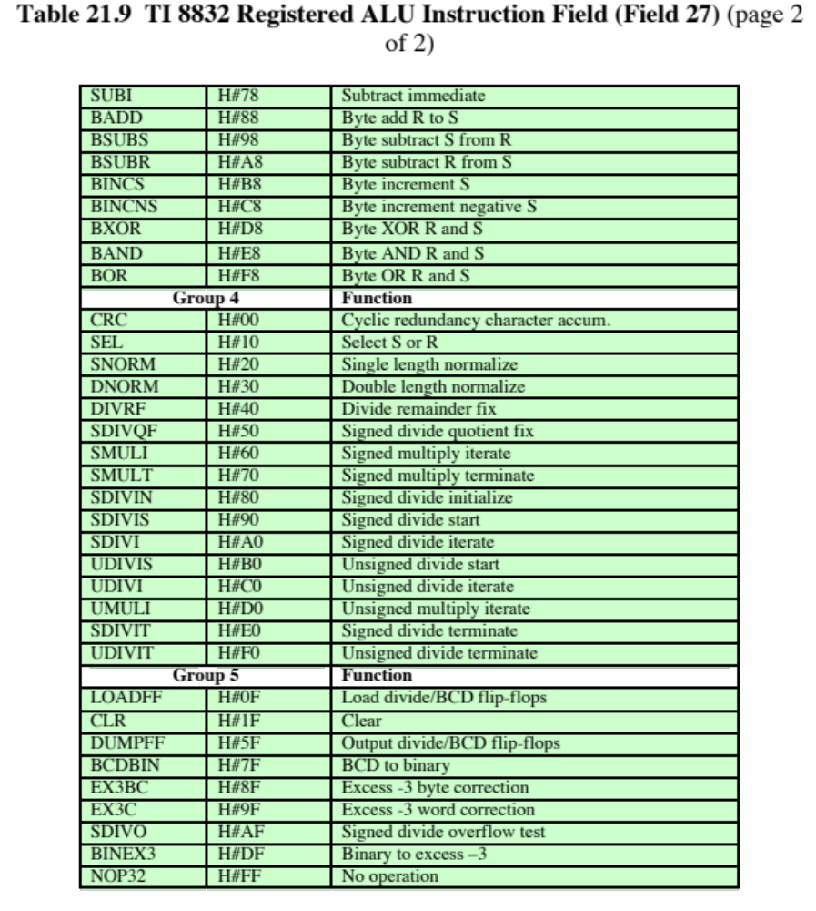
(Table can be found on page 765 in the textbook.)

Slide 58
Summary
Microprogrammed Control
Microinstruction sequencing
  Design considerations
  Sequencing techniques
  Address generation
  LSI-11 microinstruction sequencing
Microinstruction execution
  Taxonomy of microinstructions
  Microinstruction encoding
  LSI-11 Microinstruction execution
  IBM 3033 Microinstruction execution
Basic concepts
  Microinstructions
  Microprogrammed control unit
  Wilkes control
  Advantages and disadvantages
TI 8800
  Microinstruction format
  Microsequencer
  Registered ALU
Notes:
Chapter 21 summary.

Slide 59
Next Lecture
CPU: RISC & Superscalar Processors

Slide 60
References
William Stallings; “Computer Organization and Architecture, Designing for Performance”, 10th Global Ed., Pearson, 2016.
Douglas E. Comer; “Essentials of Computer Architecture”, 2nd Ed., Taylor & Francis, 2017.
Computer Organization and Design, The Hardware/Software Interface, by David Patterson and John Hennessy, 4th Edition, Morgan Kaufmann Publishers, 2011.

