Slide 1


CSE305 Software Engineering
Lecture #7
Prepared & Presented by Asst. Prof. Dr. Samsun M. BAŞARICI

Slide 2
Topics covered
Risk management
Managing people
Teamwork

Slide 3
Software project management
Concerned with activities involved in ensuring
that software is delivered on time and on
schedule and in accordance with the
requirements of the organisations developing
and procuring the software.
Project management is needed because software development is always subject to budget and schedule constraints that are set by the organisation developing the software.

Slide 4
Success criteria
Deliver the software to the customer at the agreed time.
Keep overall costs within budget.
Deliver software that meets the customer’s expectations.
Maintain a coherent and well-functioning development team.

Slide 5
Software management distinctions
The product is intangible.
  Software cannot be seen or touched. Software project managers cannot see progress by simply looking at the artefact that is being constructed.
Many software projects are 'one-off' projects.
  Large software projects are usually different in some ways from previous projects. Even managers who have lots of previous experience may find it difficult to anticipate problems.
Software processes are variable and organization specific.
  We still cannot reliably predict when a particular software process is likely to lead to development problems.

Slide 6
Factors influencing project management
Company size
Software customers
Software size
Software type
Organizational culture
Software development processes
These factors mean that project managers in different organizations may work in quite different ways.

Slide 7
Universal management activities
Project planning
  Project managers are responsible for planning. estimating and scheduling project development and assigning people to tasks.
  Covered in Chapter 23.
Risk management
  Project managers assess the risks that may affect a project, monitor these risks and take action when problems arise.
People management
  Project managers have to choose people for their team and establish ways of working that leads to effective team performance.

Slide 8
Management activities
Reporting
  Project managers are usually responsible for reporting on the progress of a project to customers and to the managers of the company developing the software.
Proposal writing
  The first stage in a software project may involve writing a proposal to win a contract to carry out an item of work. The proposal describes the objectives of the project and how it will be carried out.

Slide 9
Risk management

Slide 10
Risk management
Risk management is concerned with identifying risks and drawing up plans to minimise their effect on a project.
Software risk management is important because of the inherent uncertainties in software development.
  These uncertainties stem from loosely defined requirements, requirements changes due to changes in customer needs, difficulties in estimating the time and resources required for software development, and differences in individual skills.
You have to anticipate risks, understand the impact of these risks on the project, the product and the business, and take steps to avoid these risks.

Slide 11
Risk classification
There are two dimensions of risk classification
  The type of risk (technical, organizational, ..)
  what is affected by the risk:
Project risks affect schedule or resources;
Product risks affect the quality or performance of the software being developed;
Business risks affect the organisation developing or procuring the software.

Slide 12
Examples of project, product, and business risks
Risk | Affects | Description
Staff turnover | Project | Experienced staff will leave the project before it is finished.
Management change | Project | There will be a change of organizational management with different priorities.
Hardware unavailability | Project | Hardware that is essential for the project will not be delivered on schedule.
Requirements change | Project and product | There will be a larger number of changes to the requirements than anticipated.
Specification delays | Project and product | Specifications of essential interfaces are not available on schedule.
Size underestimate | Project and product | The size of the system has been underestimated.
CASE tool underperformance | Product | CASE tools, which support the project, do not perform as anticipated.
Technology change | Business | The underlying technology on which the system is built is superseded by new technology.
Product competition | Business | A competitive product is marketed before the system is completed.

Slide 13
The risk management process
Risk identification
  Identify project, product and business risks;
Risk analysis
  Assess the likelihood and consequences of these risks;
Risk planning
  Draw up plans to avoid or minimise the effects of the risk;
Risk monitoring
  Monitor the risks throughout the project;

Slide 14
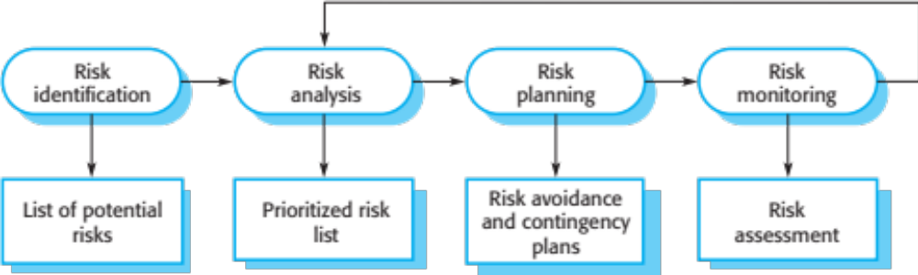
The risk management process

Slide 15
Risk identification
May be a team activities or based on the individual project manager’s experience.
A checklist of common risks may be used to identify risks in a project
  Technology risks.
  Organizational risks.
  People risks.
  Requirements risks.
  Estimation risks.

Slide 16
Examples of different risk types
Risk type | Possible risks
Estimation | The time required to develop the software is underestimated. (12) The rate of defect repair is underestimated. (13) The size of the software is underestimated. (14)
Organizational | The organization is restructured so that different management are responsible for the project. (6) Organizational financial problems force reductions in the project budget. (7)
People | It is impossible to recruit staff with the skills required. (3) Key staff are ill and unavailable at critical times. (4) Required training for staff is not available. (5)
Requirements | Changes to requirements that require major design rework are proposed. (10) Customers fail to understand the impact of requirements changes. (11)
Technology | The database used in the system cannot process as many transactions per second as expected. (1) Reusable software components contain defects that mean they cannot be reused as planned. (2)
Tools | The code generated by software code generation tools is inefficient. (8) Software tools cannot work together in an integrated way. (9)

Slide 17
Risk analysis
Assess probability and seriousness of each risk.
Probability may be very low, low, moderate, high or very high.
Risk consequences might be catastrophic, serious, tolerable or insignificant.

Slide 18
Risk types and examples
Risk | Probability | Effects
Organizational financial problems force reductions in the project budget (7). | Low | Catastrophic
It is impossible to recruit staff with the skills required for the project (3). | High | Catastrophic
Key staff are ill at critical times in the project (4). | Moderate | Serious
Faults in reusable software components have to be repaired before these components are reused. (2). | Moderate | Serious
Changes to requirements that require major design rework are proposed (10). | Moderate | Serious
The organization is restructured so that different management are responsible for the project (6). | High | Serious
The database used in the system cannot process as many transactions per second as expected (1). | Moderate | Serious

Slide 19
Risk types and examples
Risk | Probability | Effects
The time required to develop the software is underestimated (12). | High | Serious
Software tools cannot be integrated (9). | High | Tolerable
Customers fail to understand the impact of requirements changes (11). | Moderate | Tolerable
Required training for staff is not available (5). | Moderate | Tolerable
The rate of defect repair is underestimated (13). | Moderate | Tolerable
The size of the software is underestimated (14). | High | Tolerable
Code generated by code generation tools is inefficient (8). | Moderate | Insignificant

Slide 20
Risk planning
Consider each risk and develop a strategy to manage that risk.
Avoidance strategies
  The probability that the risk will arise is reduced;
Minimization strategies
  The impact of the risk on the project or product will be reduced;
Contingency plans
  If the risk arises, contingency plans are plans to deal with that risk;

Slide 21
What-if questions
What if several engineers are ill at the same time?
What if an economic downturn leads to budget cuts of 20% for the project?
What if the performance of open-source software is inadequate and the only expert on that open source software leaves?
What if the company that supplies and maintains software components goes out of business?
What if the customer fails to deliver the revised requirements as predicted?

Slide 22
Strategies to help manage risk
Risk | Strategy
Organizational financial problems | Prepare a briefing document for senior management showing how the project is making a very important contribution to the goals of the business and presenting reasons why cuts to the project budget would not be cost-effective.
Recruitment problems | Alert customer to potential difficulties and the possibility of delays; investigate buying-in components.
Staff illness | Reorganize team so that there is more overlap of work and people therefore understand each other’s jobs.
Defective components | Replace potentially defective components with bought-in components of known reliability.
Requirements changes | Derive traceability information to assess requirements change impact; maximize information hiding in the design.

Slide 23
Strategies to help manage risk
Risk | Strategy
Organizational restructuring | Prepare a briefing document for senior management showing how the project is making a very important contribution to the goals of the business.
Database performance | Investigate the possibility of buying a higher-performance database.
Underestimated development time | Investigate buying-in components; investigate use of a program generator.

Slide 24
Risk monitoring
Assess each identified risks regularly to decide whether or not it is becoming less or more probable.
Also assess whether the effects of the risk have changed.
Each key risk should be discussed at management progress meetings.

Slide 25
Risk indicators
Risk type | Potential indicators
Estimation | Failure to meet agreed schedule; failure to clear reported defects.
Organizational | Organizational gossip; lack of action by senior management.
People | Poor staff morale; poor relationships amongst team members; high staff turnover.
Requirements | Many requirements change requests; customer complaints.
Technology | Late delivery of hardware or support software; many reported technology problems.
Tools | Reluctance by team members to use tools; complaints about CASE tools; demands for higher-powered workstations.

Slide 26
Managing people

Slide 27
Managing people
People are an organisation’s most important assets.
The tasks of a manager are essentially people-oriented. Unless there is some understanding of people, management will be unsuccessful.
Poor people management is an important contributor to project failure.

Slide 28
People management factors
Consistency
  Team members should all be treated in a comparable way without favourites or discrimination.
Respect
  Different team members have different skills and these differences should be respected.
Inclusion
  Involve all team members and make sure that people’s views are considered.
Honesty
  You should always be honest about what is going well and what is going badly in a project.

Slide 29
Motivating people
An important role of a manager is to motivate the people working on a project.
Motivation means organizing the work and the working environment to encourage people to work effectively.
  If people are not motivated, they will not be interested in the work they are doing. They will work slowly, be more likely to make mistakes and will not contribute to the broader goals of the team or the organization.
Motivation is a complex issue but it appears that their are different types of motivation based on:
  Basic needs (e.g. food, sleep, etc.);
  Personal needs (e.g. respect, self-esteem);
  Social needs (e.g. to be accepted as part of a group).

Slide 30
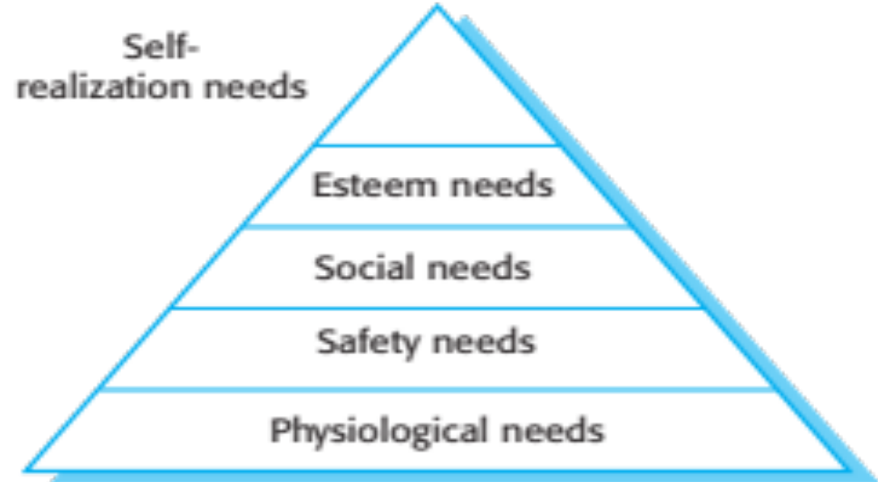
Human needs hierarchy

Slide 31
Need satisfaction
In software development groups, basic physiological and safety needs are not an issue.
Social
  Provide communal facilities;
  Allow informal communications e.g. via social networking
Esteem
  Recognition of achievements;
  Appropriate rewards.
Self-realization
  Training - people want to learn more;
  Responsibility.

Slide 32
Case study: Individual motivation
Alice is a software project manager working in a company that develops alarm systems. This company wishes to enter the growing market of assistive technology to help elderly and disabled people live independently. Alice has been asked to lead a team of 6 developers than can develop new products based around the company’s alarm technology.
Alice’s assistive technology project starts well. Good working relationships develop within the team and creative new ideas are developed. The team decides to develop a peer-to-peer messaging system using digital televisions linked to the alarm network for communications. However, some months into the project, Alice notices that Dorothy, a hardware design expert, starts coming into work late, the quality of her work deteriorates and, increasingly, that she does not appear to be communicating with other members of the team.
Alice talks about the problem informally with other team members to try to find out if Dorothy’s personal circumstances have changed, and if this might be affecting her work. They don’t know of anything, so Alice decides to talk with Dorothy to try to understand the problem.
Notes:
Just let student’s read this. Don’t try to read it out in class. Talk around the issues discussed in the book.

Slide 33
Case study: Individual motivation
After some initial denials that there is a problem, Dorothy admits that she has lost interest in the job. She expected that she would be able to develop and use her hardware interfacing skills. However, because of the product direction that has been chosen, she has little opportunity for this. Basically, she is working as a C programmer with other team members.
Although she admits that the work is challenging, she is concerned that she is not developing her interfacing skills. She is worried that finding a job that involves hardware interfacing will be difficult after this project. Because she does not want to upset the team by revealing that she is thinking about the next project, she has decided that it is best to minimize conversation with them.

Slide 34
Comments on case study
If you don’t sort out the problem of unacceptable work, the other group members will become dissatisfied and feel that they are doing an unfair share of the work.
Personal difficulties affect motivation because people can’t concentrate on their work. They need time and support to resolve these issues, although you have to make clear that they still have a responsibility to their employer.
Alice gives Dorothy more design autonomy and organizes training courses in software engineering that will give her more opportunities after her current project has finished.

Slide 35
Personality types
The needs hierarchy is almost certainly an over-simplification of motivation in practice.
Motivation should also take into account different personality types:
  Task-oriented people, who are motivated by the work they do. In software engineering.
  Interaction-oriented people, who are motivated by the presence and actions of co-workers.
  Self-oriented people, who are principally motivated by personal success and recognition.

Slide 36
Personality types
Task-oriented.
  The motivation for doing the work is the work itself;
Self-oriented.
  The work is a means to an end which is the achievement of individual goals - e.g. to get rich, to play tennis, to travel etc.;
Interaction-oriented
  The principal motivation is the presence and actions of
  co-workers. People go to work because they like to go to
  work.

Slide 37
Motivation balance
Individual motivations are made up of elements
of each class.
The balance can change depending on personal
circumstances and external events.
However, people are not just motivated by personal factors but also by being part of a group and culture.
People go to work because they are motivated by the people that they work with.

Slide 38
Teamwork

Slide 39
Teamwork
Most software engineering is a group activity
  The development schedule for most non-trivial software projects is such that they cannot be completed by one person working alone.
A good group is cohesive and has a team spirit. The people involved are motivated by the success of the group as well as by their own personal goals.
Group interaction is a key determinant of group performance.
Flexibility in group composition is limited
  Managers must do the best they can with available people.

Slide 40
Group cohesiveness
In a cohesive group, members consider the group to be more important than any individual in it.
The advantages of a cohesive group are:
  Group quality standards can be developed by the group members.
  Team members learn from each other and get to know each other’s work; Inhibitions caused by ignorance are reduced.
  Knowledge is shared. Continuity can be maintained if a group member leaves.
  Refactoring and continual improvement is encouraged. Group members work collectively to deliver high quality results and fix problems, irrespective of the individuals who originally created the design or program.

Slide 41
Team spirit
Alice, an experienced project manager, understands the importance of creating a cohesive group. As they are developing a new product, she takes the opportunity of involving all group members in the product specification and design by getting them to discuss possible technology with elderly members of their families. She also encourages them to bring these family members to meet other members of the development group.
Alice also arranges monthly lunches for everyone in the group. These lunches are an opportunity for all team members to meet informally, talk around issues of concern, and get to know each other. At the lunch, Alice tells the group what she knows about organizational news, policies, strategies, and so forth. Each team member then briefly summarizes what they have been doing and the group discusses a general topic, such as new product ideas from elderly relatives.
Every few months, Alice organizes an ‘away day’ for the group where the team spends two days on ‘technology updating’. Each team member prepares an update on a relevant technology and presents it to the group. This is an off-site meeting in a good hotel and plenty of time is scheduled for discussion and social interaction.
Notes:
Same as before – best not to read this out. Talk around the issues after students have had 2 minutes to read it.

Slide 42
The effectiveness of a team
The people in the group
  You need a mix of people in a project group as software development involves diverse activities such as negotiating with clients, programming, testing and documentation.
The group organization
  A group should be organized so that individuals can contribute to the best of their abilities and tasks can be completed as expected.
Technical and managerial communications
  Good communications between group members, and between the software engineering team and other project stakeholders, is essential.

Slide 43
Selecting group members
A manager or team leader’s job is to create a cohesive group and organize their group so that they can work together effectively.
This involves creating a group with the right balance of technical skills and personalities, and organizing that group so that the members work together effectively.

Slide 44
Assembling a team
May not be possible to appoint the ideal people to work on a project
  Project budget may not allow for the use of highly-paid staff;
  Staff with the appropriate experience may not be available;
  An organisation may wish to develop employee skills on a software project.
Managers have to work within these constraints especially when there are shortages of trained staff.

Slide 45
Group composition
Group composed of members who share the
same motivation can be problematic
  Task-oriented - everyone wants to do their own thing;
  Self-oriented - everyone wants to be the boss;
  Interaction-oriented - too much chatting, not enough work.
An effective group has a balance of all types.
This can be difficult to achieve software engineers are often task-oriented.
Interaction-oriented people are very important as they can detect and defuse tensions that arise.

Slide 46
Group composition
In creating a group for assistive technology development, Alice is aware of the importance of selecting members with complementary personalities. When interviewing potential group members, she tried to assess whether they were task-oriented, self-oriented, or interaction-oriented. She felt that she was primarily a self-oriented type because she considered the project to be a way of getting noticed by senior management and possibly promoted. She therefore looked for one or perhaps two interaction-oriented personalities, with task-oriented individuals to complete the team. The final assessment that she arrived at was:
Alice—self-oriented
Brian—task-oriented
Bob—task-oriented
Carol—interaction-oriented
Dorothy—self-oriented
Ed—interaction-oriented
Fred—task-oriented
Notes:
Same as before – discuss the issues around this rather than reading it out.

Slide 47
Group organization
The way that a group is organized affects the decisions that are made by that group, the ways that information is exchanged and the interactions between the development group and external project stakeholders.
  Key questions include:
    Should the project manager be the technical leader of the group?
    Who will be involved in making critical technical decisions, and how will these be made?
    How will interactions with external stakeholders and senior company management be handled?
    How can groups integrate people who are not co-located?
    How can knowledge be shared across the group?

Slide 48
Group organization
Small software engineering groups are usually organised informally without a rigid structure.
For large projects, there may be a hierarchical structure where different groups are responsible for different sub-projects.
Agile development is always based around an informal group on the principle that formal structure inhibits information exchange

Slide 49
Informal groups
The group acts as a whole and comes to a consensus on decisions affecting the system.
The group leader serves as the external interface of the group but does not allocate specific work items.
Rather, work is discussed by the group as a whole and tasks are allocated according to ability and experience.
This approach is successful for groups where all members are experienced and competent.

Slide 50
Group communications
Good communications are essential for effective group working.
Information must be exchanged on the status of work, design decisions and changes to previous decisions.
Good communications also strengthens group cohesion as it promotes understanding.

Slide 51
Group communications
Group size
  The larger the group, the harder it is for people to communicate with other group members.
Group structure
  Communication is better in informally structured groups than in hierarchically structured groups.
Group composition
  Communication is better when there are different personality types in a group and when groups are mixed rather than single sex.
The physical work environment
  Good workplace organisation can help encourage communications.

Slide 52
Key points
Good project management is essential if software engineering projects are to be developed on schedule and within budget.
Software management is distinct from other engineering management. Software is intangible. Projects may be novel or innovative with no body of experience to guide their management. Software processes are not as mature as traditional engineering processes.
Risk management involves identifying and assessing project risks to establish the probability that they will occur and the consequences for the project if that risk does arise. You should make plans to avoid, manage or deal with likely risks if or when they arise.

Slide 53
Key points
People management involves choosing the right people to work on a project and organizing the team and its working environment.
People are motivated by interaction with other people, the recognition of management and their peers, and by being given opportunities for personal development.
Software development groups should be fairly small and cohesive. The key factors that influence the effectiveness of a group are the people in that group, the way that it is organized and the communication between group members.
Communications within a group are influenced by factors such as the status of group members, the size of the group, the gender composition of the group, personalities and available communication channels.

Slide 54
Next Lecture
Project Planning

Slide 55
References
Ian Sommerville; “Software Engineering”, 10th Global Ed., Pearson, 2016.

