Slide 1
CSE202 Database Management Systems
Lecture #7
Prepared & Presented by Asst. Prof. Dr. Samsun M. BAŞARICI

Slide 2
Learning Objectives
Differentiate between structured, semistructured, and unstructured data
Understand the XML hierarchical (tree) data model
Understand XML documents, DTD, and XML schema
Store and extract XML documents from databases
Understand and use XML languages
Extract XML documents from relational databases
Understand database programming techniques and related issues
Differentiate between embedded SQL, dynamic SQL, and SQLJ
Apply database programming with function calls: SQL/CLI and JDBC
Implement database stored procedures and SQL/PSM
Compare the three approaches

Slide 3
Outline
Structured, Semistructured,
and Unstructured Data
XML Hierarchical (Tree) Data Model
XML Documents, DTD, and XML Schema
Storing and Extracting XML Documents from Databases
XML Languages
Extracting XML Documents from Relational Databases
Database Programming: Techniques and Issues
Embedded SQL, Dynamic SQL, and SQLJ
Database Programming with Function Calls: SQL/CLI and JDBC
Database Stored Procedures
and SQL/PSM
Comparing the Three Approaches

Slide 4
Part 1
XML: Extensible Markup Language

Slide 5
XML: Extensible Markup Language
Data sources
  Database storing data for Internet applications
Hypertext documents
  Common method of specifying contents and formatting of Web pages
XML data model

Slide 6
Structured, Semistructured, and Unstructured Data
Structured data
  Represented in a strict format
  Example: information stored in databases
Semistructured data
  Has a certain structure
  Not all information collected will have identical structure

Slide 7
Structured, Semistructured, and Unstructured Data (cont.)
  Schema information mixed in with data values
  Self-describing data
  May be displayed as a directed graph
    Labels or tags on directed edges represent:
      Schema names
      Names of attributes
      Object types (or entity types or classes)
      Relationships

Slide 8
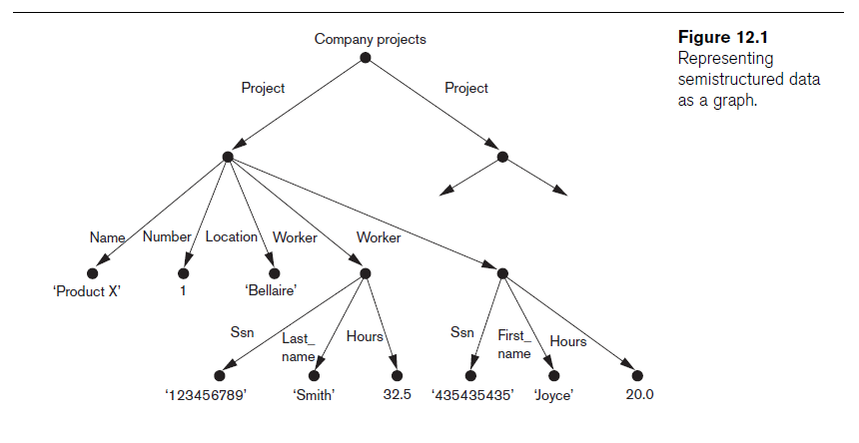
Structured, Semistructured, and Unstructured Data (cont.)

Slide 9
Structured, Semistructured, and Unstructured Data (cont.)
Unstructured data
  Limited indication of the of data document that contains information embedded within it
HTML tag
  Text that appears between angled brackets: <...>
End tag
  Tag with a slash: </...>

Slide 10
Structured, Semistructured, and Unstructured Data (cont.)
HTML uses a large number of predefined tags
HTML documents
  Do not include schema information about type of data
Static HTML page
  All information to be displayed explicitly spelled out as fixed text in HTML file

Slide 11
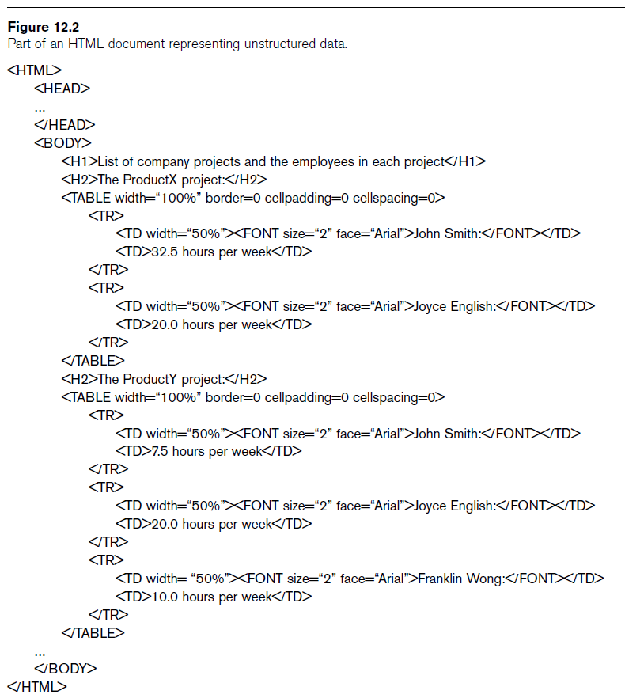

Slide 12
XML Hierarchical (Tree) Data Model
Elements and attributes
  Main structuring concepts used to construct an XML document
Complex elements
  Constructed from other elements hierarchically
Simple elements
  Contain data values
XML tag names
  Describe the meaning of the data elements in the document

Slide 13
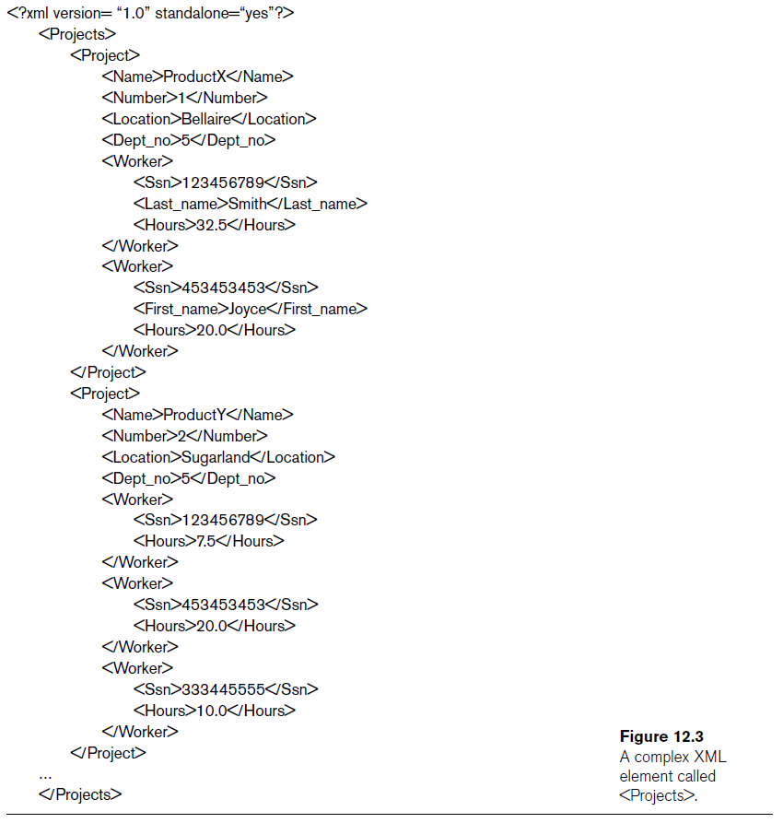

Slide 14
XML Hierarchical (Tree) Data Model (cont.)
Tree model or hierarchical model
Main types of XML documents
  Data-centric XML documents
  Document-centric XML documents
  Hybrid XML documents
Schemaless XML documents
  Do not follow a predefined schema of element names and corresponding tree structure

Slide 15
XML Hierarchical (Tree) Data Model (cont.)
XML attributes
  Describe properties and characteristics of the elements (tags) within which they appear
May reference another element in another part of the XML document
  Common to use attribute values in one element as the references

Slide 16
XML Documents, DTD, and XML Schema
Well formed
  Has XML declaration
    Indicates version of XML being used as well as any other relevant attributes
  Every element must matching pair of start and end tags
    Within start and end tags of parent element
DOM (Document Object Model)
  Manipulate resulting tree representation corresponding to a well-formed XML document

Slide 17
XML Documents, DTD, and XML Schema (cont.)
SAX (Simple API for XML)
  Processing of XML documents on the fly
    Notifies processing program through callbacks whenever a start or end tag is encountered
  Makes it easier to process large documents
  Allows for streaming

Slide 18
XML Documents, DTD, and XML Schema (cont.)
Valid
  Document must be well formed
  Document must follow a particular schema
  Start and end tag pairs must follow structure specified in separate XML DTD (Document Type Definition) file or XML schema file

Slide 19
XML Documents, DTD, and XML Schema (cont.)
Notation for specifying elements
XML DTD
  Data types in DTD are not very general
  Special syntax
    Requires specialized processors
  All DTD elements always forced to follow the specified ordering of the document
    Unordered elements not permitted

Slide 20
XML Schema
XML schema language
  Standard for specifying the structure of XML documents
  Uses same syntax rules as regular XML documents
    Same processors can be used on both

Slide 21
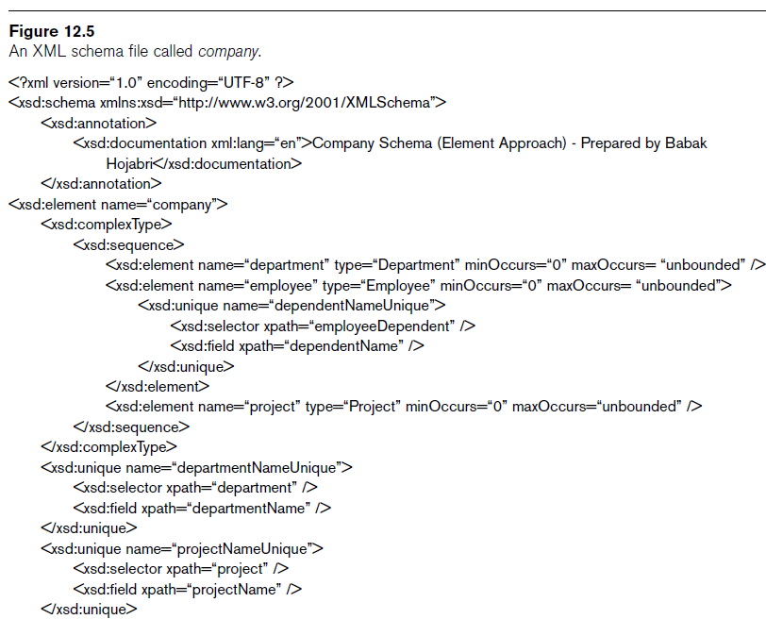

Slide 22
XML Schema (cont.)
Identify specific set of XML schema language elements (tags) being used
  Specify a file stored at a Web site location
XML namespace
  Defines the set of commands (names) that can be used

Slide 23
XML Schema (cont.)
XML schema concepts:
  Description and XML namespace
  Annotations, documentation, language
  Elements and types
  First level element
  Element types, minOccurs, and maxOccurs
  Keys
  Structures of complex elements
  Composite attributes

Slide 24
Storing and Extracting XML Documents from Databases
Most common approaches
  Using a DBMS to store the documents as text
    Can be used if DBMS has a special module for document processing
  Using a DBMS to store document contents as data elements
    Require mapping algorithms to design a database schema that is compatible with XML document structure

Slide 25
Storing and Extracting XML Documents from Databases (cont.)
  Designing a specialized system for storing native XML data
    Called Native XML DBMSs
  Creating or publishing customized XML documents from preexisting relational databases
    Use a separate middleware software layer to handle conversions

Slide 26
XML Languages
Two query language standards
  XPath
    Specify path expressions to identify certain nodes (elements) or attributes within an XML document that match specific patterns
  XQuery
    Uses XPath expressions but has additional constructs

Slide 27
XPath: Specifying Path Expressions in XML
XPath expression
  Returns a sequence of items that satisfy a certain pattern as specified by the expression
  Either values (from leaf nodes) or elements or attributes
  Qualifier conditions
    Further restrict nodes that satisfy pattern
Separators used when specifying a path:
  Single slash (/) and double slash (//)

Slide 28
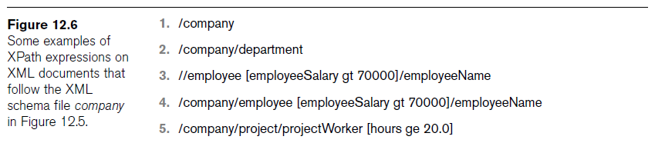
XPath: Specifying Path Expressions in XML (cont.)

Slide 29
XPath: Specifying Path Expressions in XML (cont.)
Attribute name prefixed by the @ symbol
Wildcard symbol *
  Stands for any element
  Example: /company/*

Slide 30
XPath: Specifying Path Expressions in XML (cont.)
Axes
  Move in multiple directions from current node in path expression
  Include self, child, descendent, attribute, parent, ancestor, previous sibling, and next sibling

Slide 31
XPath: Specifying Path Expressions in XML (cont.)
Main restriction of XPath path expressions
  Path that specifies the pattern also specifies the items to be retrieved
  Difficult to specify certain conditions on the pattern while separately specifying which result items should be retrieved

Slide 32
XQuery: Specifying Queries in XML
XQuery FLWR expression
  Four main clauses of XQuery
  Form:
    FOR <variable bindings to individual nodes (elements)>
    LET <variable bindings to collections of nodes (elements)>
    WHERE <qualifier conditions>
    RETURN <query result specification>
  Zero or more instances of FOR and LET clauses

Slide 33
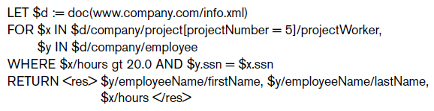
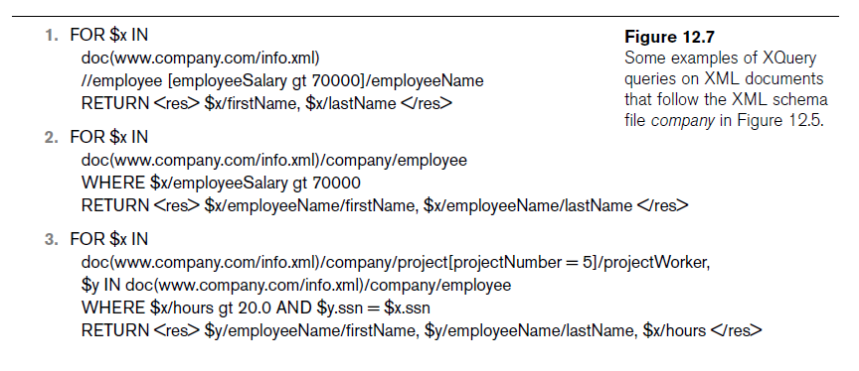

Slide 34
XQuery: Specifying Queries in XML (cont.)
XQuery contains powerful constructs to specify complex queries
www.w3.org
  Contains documents describing the latest standards related to XML and XQuery

Slide 35
Other Languages and Protocols Related to XML
Extensible Stylesheet Language (XSL)
  Define how a document should be rendered for display by a Web browser
Extensible Stylesheet Language for Transformations (XSLT)
  Transform one structure into different structure
Web Services Description Language (WSDL)
  Description of Web Services in XML

Slide 36
Other Languages and Protocols Related to XML (cont.)
Simple Object Access Protocol (SOAP)
  Platform-independent and programming language-independent protocol for messaging and remote procedure calls
Resource Description Framework (RDF)
  Languages and tools for exchanging and processing of meta-data (schema) descriptions and specifications over the Web

Slide 37
Extracting XML Documents from Relational Databases
Creating hierarchical XML views over flat or graph-based data
  Representational issues arise when converting data from a database system into XML documents
UNIVERSITY database example

Slide 38
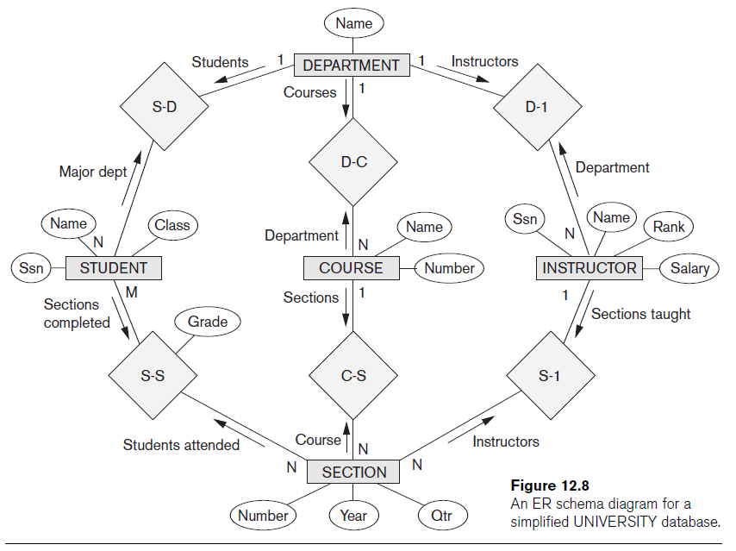

Slide 39
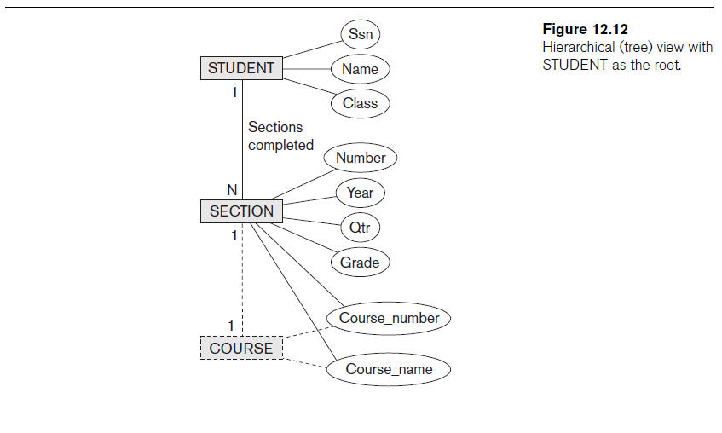

Slide 40
Breaking Cycles to Convert Graphs into Trees
Complex subset with one or more cycles
  Indicate multiple relationships among the entities
  Difficult to decide how to create the document hierarchies
Can replicate the entity types involved to break the cycles

Slide 41
Other Steps for Extracting XML Documents from Databases
Create correct query in SQL to extract desired information for XML document
Restructure query result from flat relational form to XML tree structure
Customize query to select either a single object or multiple objects into document

Slide 42
Part 2
SQL Programming

Slide 43
Introduction to SQL Programming Techniques
Database applications
  Host language
    Java, C/C++/C#, COBOL, or some other programming language
  Data sublanguage
    SQL
SQL standards
  Continually evolving
  Each DBMS vendor may have some variations from standard

Slide 44
Database Programming: Techniques and Issues
Interactive interface
  SQL commands typed directly into a monitor
Execute file of commands
  @<filename>
Application programs or database applications
  Used as canned transactions by the end users access a database
  May have Web interface

Slide 45
Approaches to Database Programming
Embedding database commands in a general-purpose programming language
  Database statements identified by a special prefix
  Precompiler or preprocessor scans the source program code
    Identify database statements and extract them for processing by the DBMS
  Called embedded SQL

Slide 46
Approaches to Database Programming (cont.)
Using a library of database functions
  Library of functions available to the host programming language
  Application programming interface (API)
Designing a brand-new language
  Database programming language designed from scratch
First two approaches are more common

Slide 47
Impedance Mismatch
Differences between database model and programming language model
Binding for each host programming language
  Specifies for each attribute type the compatible programming language types
Cursor or iterator variable
  Loop over the tuples in a query result

Slide 48
Typical Sequence of Interaction in Database Programming
Open a connection to database server
Interact with database by submitting queries, updates, and other database commands
Terminate or close connection to database

Slide 49
Embedded SQL, Dynamic SQL, and SQLJ
Embedded SQL
  C language
SQLJ
  Java language
Programming language called host language

Slide 50
Retrieving Single Tuples with Embedded SQL
EXEC SQL
  Prefix
  Preprocessor separates embedded SQL statements from host language code
  Terminated by a matching END-EXEC
    Or by a semicolon (;)
Shared variables
  Used in both the C program and the embedded SQL statements
  Prefixed by a colon (:) in SQL statement

Slide 51
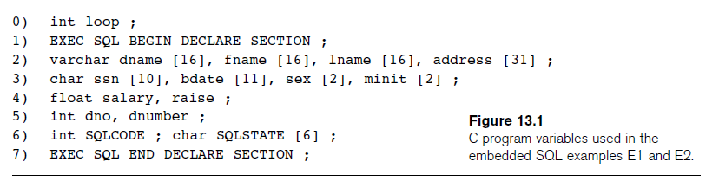
Retrieving Single Tuples with Embedded SQL (cont.)

Slide 52
Retrieving Single Tuples with Embedded SQL (cont.)
Connecting to the database
  CONNECT TO <server name>AS <connection name>
  AUTHORIZATION <user account name and password> ;
Change connection
  SET CONNECTION <connection name> ;
Terminate connection
  DISCONNECT <connection name> ;

Slide 53
Retrieving Single Tuples with Embedded SQL (cont.)
SQLCODE and SQLSTATE communication variables
  Used by DBMS to communicate exception or error conditions
SQLCODE variable
  0 = statement executed successfully
  100 = no more data available in query result
  < 0 = indicates some error has occurred

Slide 54
Retrieving Single Tuples with Embedded SQL (cont.)
SQLSTATE
  String of five characters
  ‘00000’ = no error or exception
  Other values indicate various errors or exceptions
  For example, ‘02000’ indicates ‘no more data’ when using SQLSTATE

Slide 55
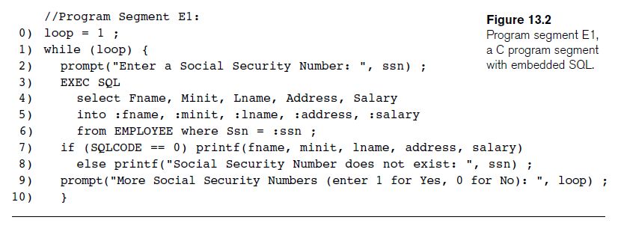
Retrieving Single Tuples with Embedded SQL (cont.)

Slide 56
Retrieving Multiple Tuples with Embedded SQL Using Cursors
Cursor
  Points to a single tuple (row) from result of query
OPEN CURSOR command
  Fetches query result and sets cursor to a position before first row in result
  Becomes current row for cursor
FETCH commands
  Moves cursor to next row in result of query

Slide 57
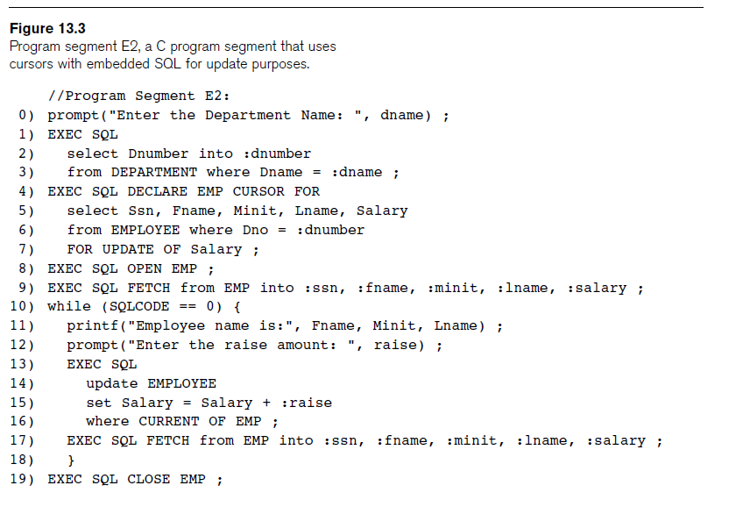

Slide 58
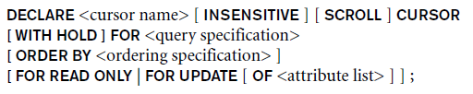
Retrieving Multiple Tuples with Embedded SQL Using Cursors (cont.)
FOR UPDATE OF
  List the names of any attributes that will be updated by the program
Fetch orientation
  Added using value: NEXT, PRIOR, FIRST, LAST, ABSOLUTE i, and RELATIVE i

Slide 59
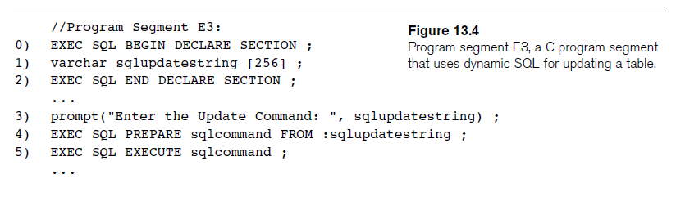
Specifying Queries at Runtime Using Dynamic SQL
Dynamic SQL
  Execute different SQL queries or updates dynamically at runtime
Dynamic update
Dynamic query

Slide 60
SQLJ: Embedding SQL Commands in Java
Standard adopted by several vendors for embedding SQL in Java
Import several class libraries
Default context
Uses exceptions for error handling
  SQLException is used to return errors or exception conditions

Slide 61
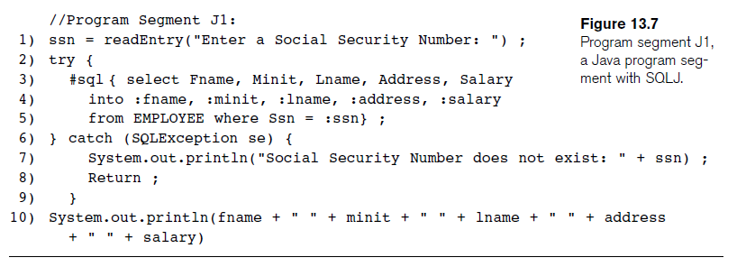
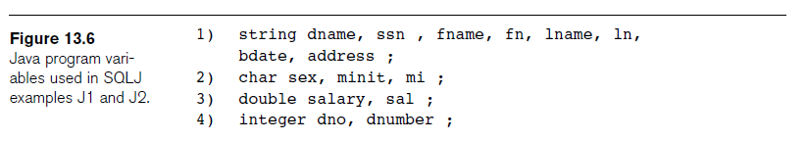
SQLJ: Embedding SQL Commands in Java (cont.)

Slide 62
Retrieving Multiple Tuples in SQLJ Using Iterators
Iterator
  Object associated with a collection (set or multiset) of records in a query result
Named iterator
  Associated with a query result by listing attribute names and types in query result
Positional iterator
  Lists only attribute types in query result

Slide 63
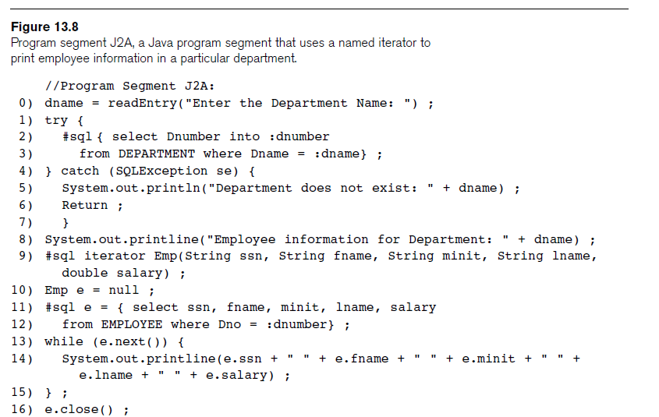

Slide 64
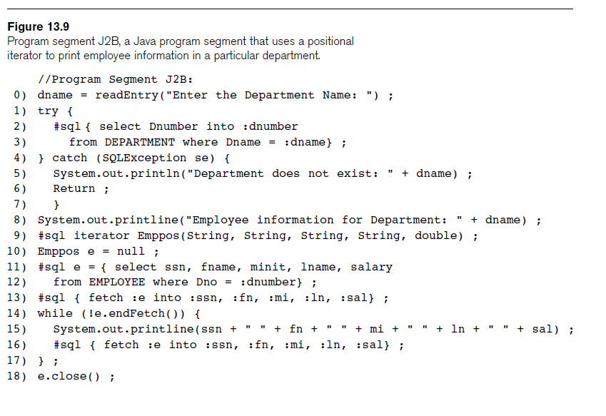
Retrieving Multiple Tuples in SQLJ Using Iterators (cont.)

Slide 65
Database Programming with Function Calls: SQL/CLI & JDBC
Use of function calls
  Dynamic approach for database programming
Library of functions
  Also known as application programming interface (API)
  Used to access database
SQL Call Level Interface (SQL/CLI)
  Part of SQL standard

Slide 66
SQL/CLI: Using C as the Host Language
Environment record
  Track one or more database connections
  Set environment information
Connection record
  Keeps track of information needed for a particular database connection
Statement record
  Keeps track of the information needed for one SQL statement

Slide 67
SQL/CLI: Using C as the Host Language (cont.)
Description record
  Keeps track of information about tuples or parameters
Handle to the record
  C pointer variable makes record accessible to program

Slide 68
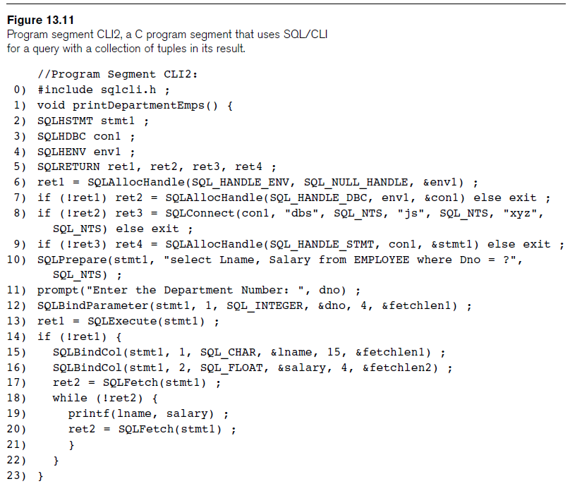

Slide 69
JDBC: SQL Function Calls for Java Programming
JDBC
  Java function libraries
Single Java program can connect to several different databases
  Called data sources accessed by the Java program
Class.forName("oracle.jdbc.driver.OracleDriver")
  Load a JDBC driver explicitly

Slide 70
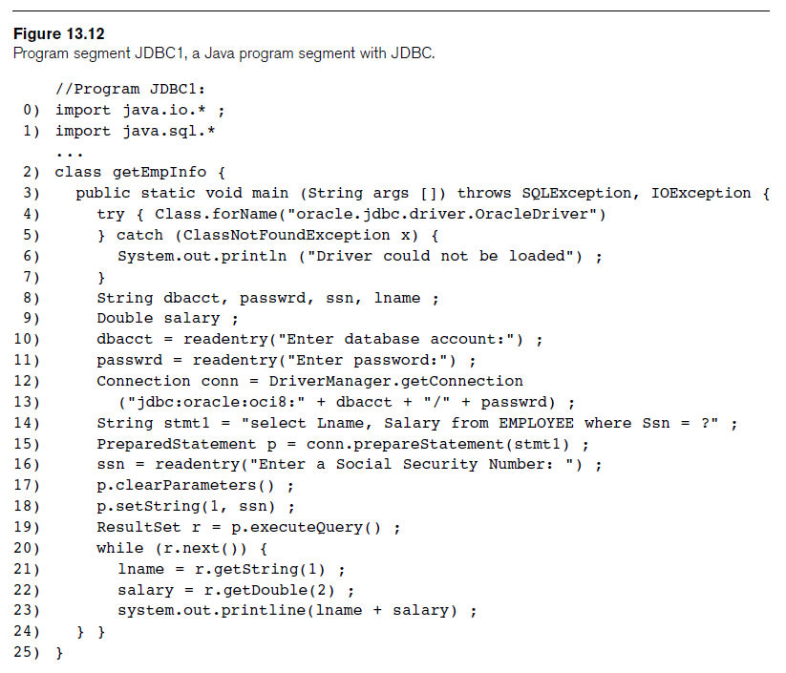

Slide 71
JDBC: SQL Function Calls for Java Programming
Connection object
Statement object has two subclasses:
  PreparedStatement and CallableStatement
Question mark (?) symbol
  Represents a statement parameter
  Determined at runtime
ResultSet object
  Holds results of query

Slide 72
Database Stored Procedures and SQL/PSM
Stored procedures
  Program modules stored by the DBMS at the database server
  Can be functions or procedures
SQL/PSM (SQL/Persistent Stored Modules)
  Extensions to SQL
  Include general-purpose programming constructs in SQL

Slide 73
Database Stored Procedures and Functions
Persistent stored modules
  Stored persistently by the DBMS
Useful:
  When database program is needed by several applications
  To reduce data transfer and communication cost between client and server in certain situations
  To enhance modeling power provided by views

Slide 74
Database Stored Procedures and Functions (cont.)
Declaring stored procedures:
  CREATE PROCEDURE <procedure name> (<parameters>)
  <local declarations>
  <procedure body> ;
  declaring a function, a return type is necessary, so the declaration form is
  CREATE FUNCTION <function name> (<parameters>)
  RETURNS <return type>
  <local declarations>
  <function body> ;

Slide 75
Database Stored Procedures and Functions (cont.)
Each parameter has parameter type
  Parameter type: one of the SQL data types
  Parameter mode: IN, OUT, or INOUT
Calling a stored procedure:
  CALL <procedure or function name> (<argument list>) ;

Slide 76
SQL/PSM: Extending SQL for Specifying Persistent
Stored Modules
Conditional branching statement:
  IF <condition> THEN <statement list>
  ELSEIF <condition> THEN <statement list>
  ...
  ELSEIF <condition> THEN <statement list>
  ELSE <statement list>
  END IF ;

Slide 77
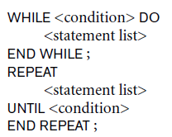

SQL/PSM (cont.)
Constructs for looping

Slide 78
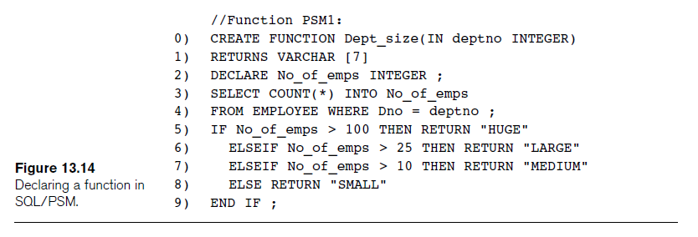
SQL/PSM (cont.)

Slide 79
Comparing the Three Approaches
Embedded SQL Approach
  Query text checked for syntax errors and validated against database schema at compile time
  For complex applications where queries have to be generated at runtime
    Function call approach more suitable

Slide 80
Comparing the Three Approaches (cont.)
Library of Function Calls Approach
  More flexibility
  More complex programming
  No checking of syntax done at compile time
Database Programming Language Approach
  Does not suffer from the impedance mismatch problem
  Programmers must learn a new language

Slide 81
Next Lecture
Dependencies, Normalization and Relational DB Design

Slide 82
References
Ramez Elmasri, Shamkant Navathe; “Fundamentals of Database Systems”, 6th Ed., Pearson, 2014
Universität Hamburg, Fachbereich Informatik, Einführung in Datenbanksysteme, Lecture Notes, 1999

