Slide 1


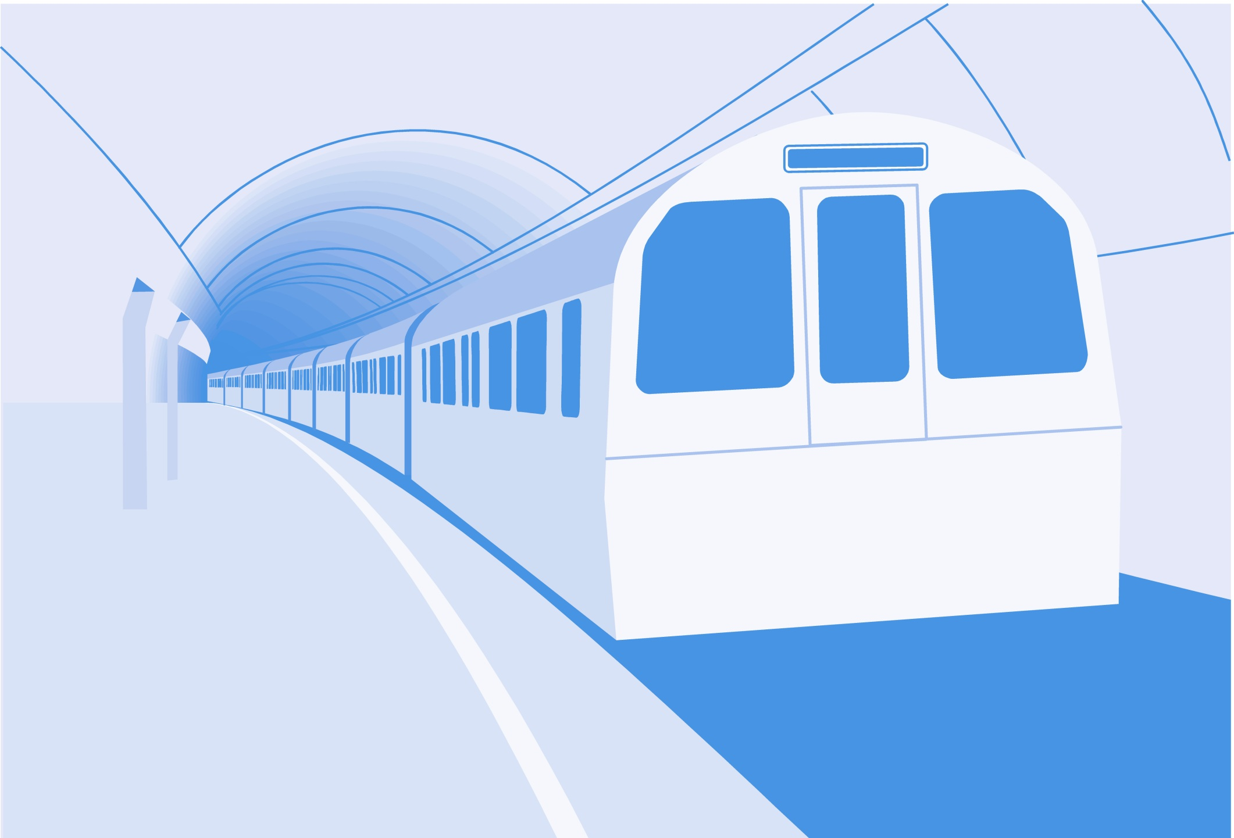
L
L Line
CSE 420
Computer Games
Lecture #6 Game Foundations

Slide 2
Objectives
Understanding the need for a graphic toolkit such as SDL
Understanding space and time in games
Creating a general game loop
Installing and using the pygame library
Using the IDEA framework to set up a game overview

Slide 3
Objectives (cont.)
Using the ALTER framework to manage a game loop
Handling screen displays
Managing colors
Moving objects on the screen

Slide 4
Games and Time
Most programs run more slowly than the underlying computer.
Games are run as quickly as possible.
This is demanding on the processor and graphics capabilities.

Slide 5
The Importance of Frame Rate
Frame rate is the speed at which the visual display updates.
A faster frame rate leads to more fluid animation and is more computationally intensive.
The goal is to have a fast, consistent frame rate.

Slide 6
Games and Space
Games are often run in different display modes than typical programs.
Each dot is a pixel.
640 x 480 and 800 x 600 pixels are common screen resolutions.
The pixels are often stretched to fill the entire screen.
Games often use custom user interfaces.

Slide 7
Introducing the Gaming Loop
Most games have the same general programming structure.
  It begins with initialization (setting up the computer to display game-style information).
  It continues with a display loop.
  It terminates when the user indicates (directly or by losing) the end of the game.

Slide 8
Setting Up Game Resources
Most games involve multimedia resources:
  2D images
  3D models
  Background images
  Sound effects
Resources are usually created in specialized authoring tools.
Games are often constructed with temporary "placeholder" media.

Slide 9
Creating the Game Entities
2D games are made up of objects that move around on the screen.
The objects are usually created once at the beginning of the program.
Objects may be introduced to the user much later during the game play.
As much preparation as possible is done before the user begins playing the game.

Slide 10
Building the (Almost) Endless Loop
The game play itself occurs inside a loop.
The loop repeats quickly and at a consistent rate.
The loop ends when the user or game situation demands an end to the game.

Slide 11
Frame Rate = Loop Speed
The frame rate is dependant on the speed of the main loop.
Realistic animation requires the loop to happen many times a second.
If there’s too much computation, the game will slow down.
Python games normally run at 30 FPS (frames per second).

Slide 12
Getting Input from the User
A game has to interact with the user; otherwise, it's an animation.
Get input from the mouse, joystick, keyboard, or other devices.
Discern user intention from these input devices.
Get input from the system (passage of time, collision of objects).

Slide 13
Updating Game Entities
Change entity characteristics according to input:
  Speed and direction changes
  Damage or death of objects
  Boundary collisions (leaving the stage)
Real change is done on invisible variables.
Change will be reflected to the user via a visual update.

Slide 14
Refreshing the Screen
The visual display is the primary output to the user.
Essentially you create a new image every frame.
Erase (or partially erase) the previous position of each entity.
Draw the entity in its new state or position.
Display the new image to the screen.

Slide 15
Introducing Graphics APIs
Working with graphics and input technology is complex.
APIs (Application Programming Interfaces) gather common tools.
Popular Graphics APIs:
  DirectX (Windows 2D and 3D)
  OpenGL (open-source 3D)
  SDL (open-source 2D)

Slide 16
SDL and Pygame
SDL is free, powerful, multi-platform, and open-source.
SDL is written in C, so it runs very quickly.
Pygame is a Python wrapper to SDL.
It allows everything you need for 2D gaming.

Slide 17
Installing Pygame
Download binaries from www.pygame.org.
Our course textbook uses pygame 1.7 with Python 2.4.4.
Other versions may not work in the same way.

Slide 18
Primary Features of Pygame
Display mechanism (screen)
Surface object (images)
Rect object (shapes)
Input modules (key, mouse, joystick)
Output modules (images, audio)
Utility modules (time, transformation)

Slide 19
IDEA / ALTER
Framework
Easy to remember
Encapsulates main ideas of game loop
IDEA - initialization
ALTER - main loop

Slide 20
IDEA
Import and Initialize
Display configuration
Entities
Action

Slide 21
IDEA Code
See idea.py
#I - Import and initialize
import pygame
pygame.init()
#D - Display configuration
screen = pygame.display.set_mode((640, 480))
pygame.display.set_caption("Hello, world!")
#E - Entities (just background for now)
background = pygame.Surface(screen.get_size())
background = background.convert()
background.fill((0, 0, 255))
#A - Action (broken into ALTER steps)

Slide 22
Initialize
Import the pygame module.
Run pygame's initialization routine.
#I - Import and initialize
import pygame
pygame.init()

Slide 23
Display
Configure the display.
Set the display mode.
Set screen size.
Set the window caption.
#D - Display configuration
screen = pygame.display.set_mode((640, 480))
pygame.display.set_caption("Hello, world!")

Slide 24
Entities
Create game entities (backgrounds, images, sounds).
The background is a Surface object.
Same size as screen.
Convert to pygame format.
Fill to change color.
#E - Entities (just background for now)
background = pygame.Surface(screen.get_size())
background = background.convert()
background.fill((0, 0, 255))

Slide 25
Action
Set up the primary game loop.
Action steps are detailed in the ALTER acronym

Slide 26
ALTER
Assign values to key variables
Loop
Timing
Events
Refresh display

Slide 27
ALTER Code
From idea.py
#A - Assign values to key variables
clock = pygame.time.Clock()
keepGoing = True
#L - Set up main loop
while keepGoing:
#T - Timer to set frame rate
clock.tick(30)
#E – Event handling
for event in pygame.event.get():
if event.type == pygame.QUIT:
keepGoing = False
#R - Refresh display
screen.blit(background, (0, 0))
pygame.display.flip()

Slide 28
Assign Values
Create a clock to manage frame rate.
Set a Boolean sentry variable.
Initialize keepGoing to True.
#A - Assign values to key variables
clock = pygame.time.Clock()
keepGoing = True

Slide 29
Main Loop
Create a loop based on the keepGoing variable.
For all code that’s executed, each frame goes inside this loop.
#L - Set up main loop
while keepGoing:

Slide 30
Timing
Call clock variable’s tick() method.
The parameter sets the game’s maximum frame rate.
30 FPS is typical for Python games.
#T - Timer to set frame rate
clock.tick(30)

Slide 31
Handle Events
Get all events that happened in this frame with event.get().
If any of the events are QUIT events:
  Set keepGoing to False.
  This setting will end the loop on its next cycle.
Catch other events (mouse, keyboard) here, as well.
#Event Handling
for event in pygame.event.get():
if event.type == pygame.QUIT:
keepGoing = False

Slide 32
Refresh Display
Update the background.
For now, blit the background onto the screen.
Set the background position to (0, 0) to completely cover the screen.
Use flip() to double-buffer.
#R - Refresh display
screen.blit(background, (0, 0))
pygame.display.flip()

Slide 33
Blitting an Image
blit is a shortening of bitblit, which is a type of binary block transfer.
It’s a memory technique used to quickly copy a rectangular chunk of memory to another location.
Blit functionality is built into modern graphics cards.
Copying an image is blitting it to a new position.

Slide 34
Double-Buffering
Displaying graphics to screen is a slow process.
It's faster to assemble graphics in memory, then blit the resulting image to display memory.
Pygame uses the flip() method to copy the background image to the display memory.
This process is called double-buffering.
Double-buffering reduces flicker and improves animation quality.

Slide 35
Colors in Pygame
Pygame (like most computing applications) uses additive color models.
Colors are determined by three numbers indicating the amount of red, green, and blue light in a pixel.
Each value ranges between 0 and 255 (base 10) or between 0x00 and 0xFF (base 16).

Slide 36
More on Color
Web developers are often more comfortable with hex color schemes.
See colorViewer.py for an interactive example of colors in Python.
Look at the code to preview more complex pygame programs.
Use arrows to pick a color.
Use spacebar to switch between decimal and hex numbering.

Slide 37
Moving an Object
Begin with the IDEA/ALTER framework.
Add a box entity.
Add variables to describe box position.
Inside the loop, manipulate variables.
Redraw the background.
Redraw the box in a new position.

Slide 38
Creating the Box
See moveBox.py.
Begin with a copy of idea.py.
The following code is added to the Entities section:
#make a red 25 x 25 box
box = pygame.Surface((25, 25))
box = box.convert()
box.fill((255, 0, 0))

Slide 39
Setting Up Position Variables
The box has variables to control its X and Y positions.
The following code is also in the Entities section:
# set up some box variables
box_x = 0
box_y = 200

Slide 40
Moving the Box
After checking events, update the box variables:
  Increase the box_x variable by five.
  This doesn't actually move the box!
  The actual motion happens in the refresh step.
#Events
for event in pygame.event.get():
if event.type == pygame.QUIT:
keepGoing = False
#modify box value
box_x += 5

Slide 41
Checking for Boundaries
In general, whenever you change a variable, think about boundary conditions.
If the box leaves the right side of the screen, set its X value to 0.
  This setting causes the box to wrap around the screen.
#check boundaries
if box_x > screen.get_width():
box_x = 0

Slide 42
Refreshing the Screen
Use the blit() method to draw the box on the screen.
Use (updated) box_x and box_y variables to determine the box's position.
To appear, the box must be drawn after the background.
#Refresh screen
screen.blit(background, (0, 0))
screen.blit(box, (box_x, box_y))
pygame.display.flip()

Slide 43
Discussion Questions
Why use an API such as SDL/pygame?
In what ways are games approximations of normal space and time?
Why learn a framework such as IDEA/ALTER?
How do pygame colors relate to the Web-safe color palette?
Why do modern graphics cards contain built-in bitblit functions?

Slide 44
Summary
You should now understand
  The need for a graphic toolkit such as SDL
  Space and time in games
  Creating a general game loop
  Installing and using the pygame library
  Using the IDEA framework to set up a game overview and the ALTER framework to manage a game loop
  Handling screen displays and managing colors
  Moving objects on the screen

Slide 45
Next Lecture
Drawing and Event Handling

Slide 46
References
Andy Harris, “Game Programming, The L Line, The Express Line to Learning”; Wiley, 2007

