Slide 1


CSE 414 Systems Analysis and Design
Lecture #6
Structuring Systems Process Requirements
Prepared & Presented by Asst. Prof. Dr. Samsun M. BAŞARICI

Slide 2
Learning Objectives
Understand the logical modeling of processes by studying examples of data flow diagrams (DFDs).
Draw data flow diagrams following specific rules and guidelines that lead to accurate and well-structured process models.
Decompose data flow diagrams into lower-level diagrams.
Balance higher-level and lower-level data flow diagrams.

Slide 3
Learning Objectives (Cont.)
Use data flow diagrams as a tool to support the analysis of information systems.
Discuss process modeling for electronic commerce applications.
Use decision tables to represent the logic of choice in conditional statements.

Slide 4
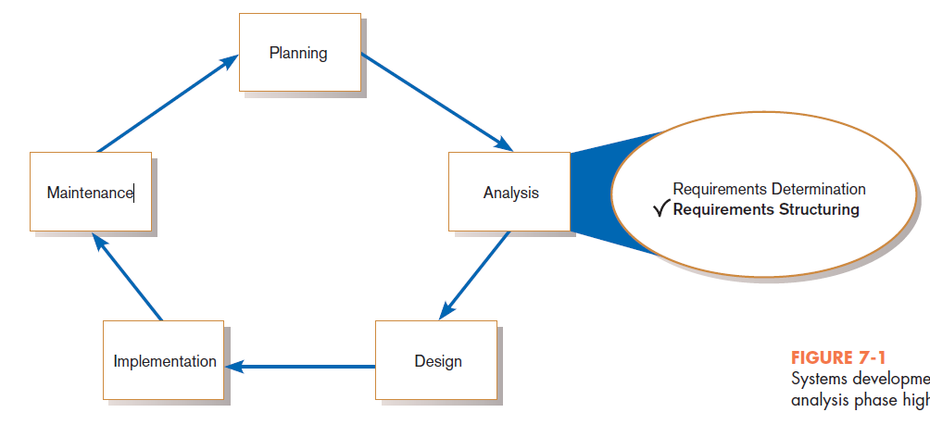
Process Modeling for Structured Analysis
FIGURE 7-1
Systems development life cycle with the analysis phase highlighted
Notes:
In chapter 6, we discussed techniques for determining the users’ requirements for the system that you’re hoping to develop. This involves interviewing the various stakeholders, observing people at work, and studying existing business and technical documents. It also includes more modern techniques including JAD sessions, prototyping, and of course agile methodologies.
In this chapter, we focus on taking these requirements and structuring them in a way that allows us to design and implement the system. After all, the system is supposed to satisfy the requirements. In order to design it, we need those requirements to be organized in a “computable” manner.
We’ll look at two particular requirements structuring techniques: (1) data flow diagrams (DFDs) and (2) decision tables. What we are doing is creating a model of the business processes. The DFDs and decision tables, along with other outputs are the deliverables from the Analysis phase, which provide the inputs to the system Design phase.
Keep in mind that, when using prototyping and agile methodologies, the “requirements determination” and the “requirements structuring” kind of go hand in hand, almost in a parallel fashion, and this process is less formal than the traditional SDLC waterfall. Nevertheless, DFDs and decision tables are both very useful tools regardless of which type of development cycle we adopt.

Slide 5
Process Modeling (Cont.)
Graphically represent the processes that capture, manipulate, store, and distribute data between a system and its environment and among system components.
Utilize information gathered during requirements determination.
Model processes and data structures.
Notes:
DFDs have symbols for processes, data stores, and external environmental agents, as we’ll see soon.

Slide 6
Deliverables and Outcomes
Context data flow diagram (DFD)
  Scope of system
DFDs of current physical system
  Adequate detail only
DFDs of current logical system
  Enables analysts to understand current system

Slide 7
Deliverables and Outcomes (Cont.)
DFDs of new logical system
  Technology independent
  Show data flows, structure, and functional requirements of new system
Thorough description of each DFD component

Slide 8
Data Flow Diagramming Mechanics
Represent both physical and logical information systems
Only four symbols are used
Useful for depicting purely logical information flows
DFDs that detail physical systems differ from system flowcharts which depict details of physical computing equipment.
Notes:
The primitives of DFD diagramming are very simple.

Slide 9
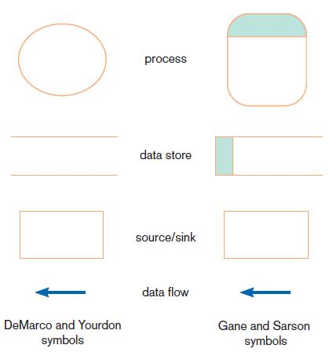
Definitions and Symbols
FIGURE 7-2
Comparison of DeMarco and Yourdon
and Gane and Sarson DFD symbol sets
Notes:
Here are two versions of DFD symbols for processes, data stores, sources and sinks, and data flows.
As in all types of diagrams (E-R diagrams included) data flow diagrams come in different flavors of symbol notation. But whatever symbols you use, the key in DFDs is that you are representing processes, data stores, sources and sinks, and data flows.
E-R means entity-relationship. Those types of diagrams are important for designing databases, and we’ll talk about them starting in chapter 8. In this chapter we focus on data flow diagrams (DFDs), which are more important for analyzing process flows and designing application systems.

Slide 10
Definitions and Symbols (Cont.)
Process: work or actions performed on data (inside the system)
Data store: data at rest (inside the system)
Source/sink: external entity that is the origin or destination of data (outside the system)
Data flow: arrows depicting movement of data
Notes:
The process is some task taking place. We generally think of DFDs are representing computer systems, but it can also represent work flows in an organization. So, processes could represent computer activities or human activities, or a combination of both.
The data store will generally be a file or a database. Unless, of course, this is a manual system. In that case, the data store could be a file cabinet containing paper documents.

Slide 11
Developing DFDs
Context diagram is an overview of an organizational system that shows:
  the system boundaries.
  external entities that interact with the system.
  major information flows between the entities and the system.
Note: only one process symbol, and no data stores shown
Notes:
DFDs can be drawn at various levels of detail. The “context diagram” is at the highest level. In this case, the one process represents the system as a whole, and the only other entities are sources and sinks.

Slide 12
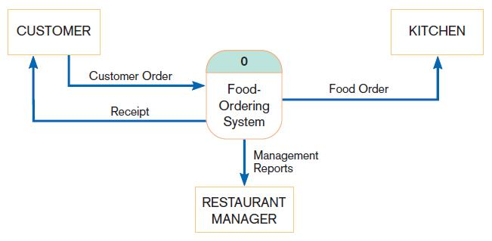
Context Diagram
FIGURE 7-4
Context diagram of Hoosier Burger’s food-ordering system
Notes:
So, this figure shows a birds-eye view of the system and the other entities that it interacts with. A customer sends an order to the system, which then sends a food order to the kitchen, a report to the restaurant manager, and a receipt back to the customer.
In this diagram, and in subsequent diagrams, the processes are computer activities, as we’ll see. The sources and sinks, though, are generally people, or groups of people. That’s not always the case, though. A source or sink could also be an external computer system.

Slide 13
Developing DFDs (Cont.)
Level-0 diagram is a data flow diagram that represents a system’s major processes, data flows, and data stores at a high level of detail.
  Processes are labeled 1.0, 2.0, etc. These will be decomposed into more primitive (lower-level) DFDs.
Notes:
After the highest-level context diagram, there are more detailed diagrams of various levels. The next highest level is Level-0, which depicts the main processes of the system as a whole. Each of these processes can in turn be represented in more detail in Level-1 diagrams, which can be refined in Level-2, etc.

Slide 14
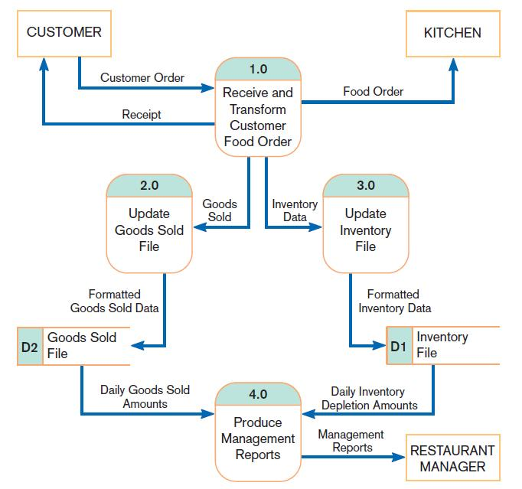
Level-0 Diagram
FIGURE 7-5
Level-0 DFD of Hoosier Burger’s food-ordering system
Notes:
So, for the food ordering system we see four main processes and two data stores.
We can see that process 1.0 is taking the customer’s order as input and “transforming” it to a food order which it sends to the kitchen. We also see that this is the only process in the system that directly interacts with customers or kitchen staff users.
The data stores identify the type of data that must be maintained in the system. They provide the inputs to process 4.0. So, whereas process 1.0 inputs its data from external sources, process 4.0 inputs its data from an internal data store. Every single process inputs data and outputs data. It makes no sense to have a process that inputs data and produces nothing, or one that produces data out of nothing.
These data stores may wind up being tables in a database. We’ll talk more about this when we get to chapters 8 and 9.

Slide 15
Data Flow Diagramming Rules
There are two DFD guidelines that apply:
  The inputs to a process are different from the outputs of that process.
    Processes purpose is to transform inputs into outputs.
  Objects on a DFD have unique names.
    Every process has a unique name.
Notes:
These next few slides give some guidelines and rules for good data flow diagramming.
Once you understand these rules, you will be able to draw good DFDs.

Slide 16
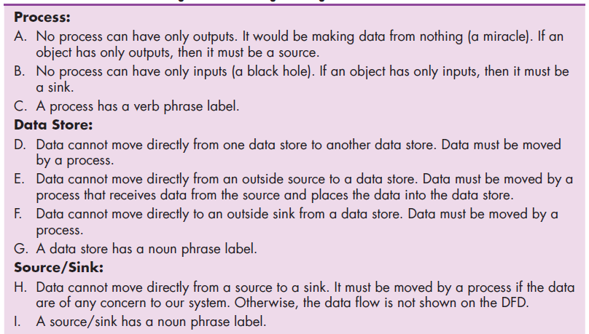
Data Flow Diagramming Rules (Cont.)
TABLE 7-2 Rules Governing Data Flow Diagramming

Slide 17
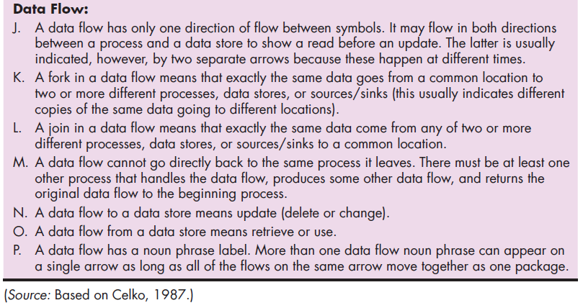
Data Flow Diagramming Rules (Cont.)
TABLE 7-2 Rules Governing Data Flow Diagramming (cont.)

Slide 18
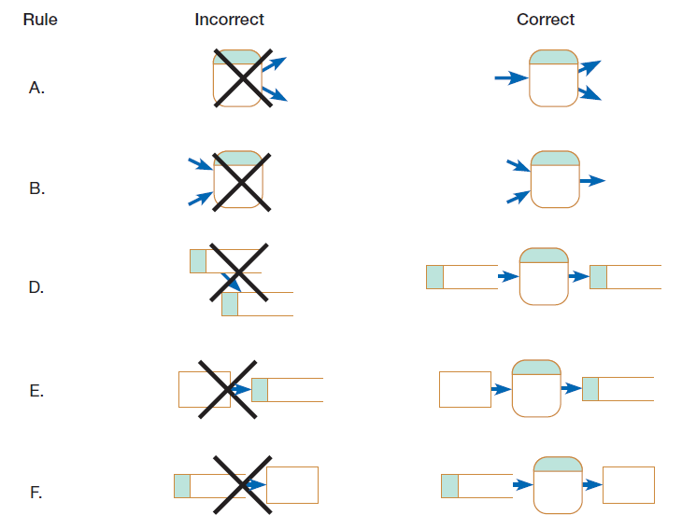
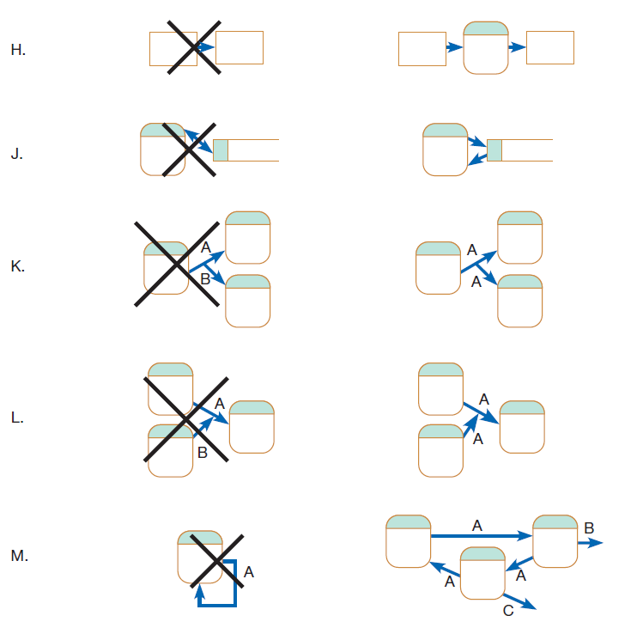
Data Flow Diagramming Rules (Cont.)
Figure 7-6
Incorrect and correct ways to draw DFDs
Notes:
These pictures each correspond to one of the rules of Table 7.2. We can go back and forth to read the rule and show the picture.

Slide 19
Decomposition of DFDs
Functional decomposition is an iterative process of breaking a system description down into finer and finer detail.
  Creates a set of charts in which one process on a given chart is explained in greater detail on another chart.
  Continues until no subprocess can logically be broken down any further.
Notes:
So, as I said, after the context diagram you have diagrams at deeper and deeper levels of detail. The term for this is “functional decomposition”. We take a large task and divide it into subtasks. We then take each of these subtasks and divide them further into “sub-sub-tasks”. This approach helps to ensure a modular design.
In principle, you could go as deep as the “program code” level, where each “process” is a single line of code. But in practice, you wouldn’t be doing that, especially during the analysis phase.

Slide 20
Decomposition of DFDs (Cont.)
Level-1 diagram results from decomposition of Level-0 diagram.
Level-n diagram is a DFD diagram that is the result of n nested decompositions from a process on a level-0 diagram.
Primitive DFD is the lowest level of a DFD.
Notes:
If Level-5 is the lowest level, then the Level-5 diagram is a “primitive DFD”.

Slide 21
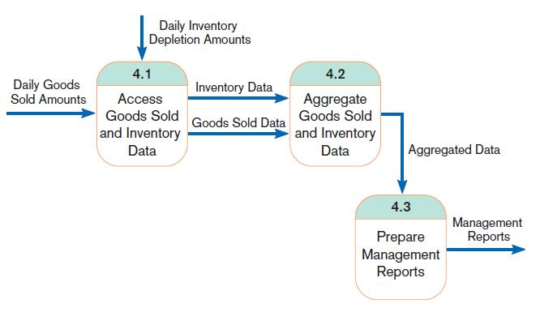
Level-1 DFD
FIGURE 7-8
Level-1 diagram showing the decomposition of Process 4.0 from the level-0 diagram for Hoosier Burger’s food-ordering system
Level-1 DFD shows the sub-processes of one of the processes in the Level-0 DFD.
This is a Level-1 DFD for Process 4.0.
Processes are labeled 4.1, 4.2, etc. These can be further decomposed in more primitive (lower-level) DFDs if necessary.
Notes:
If you go back up to the Level 0 diagram, you’ll see that process 4.0 produces the management reports for the restaurant manager. Here we see this broken into three sub-processes. Note the use of the decimal place, as in 4.1, 4.2, 4.3. We’ll see this broken down even more in the next diagram.
Note also that whatever data flows that went into or out of 4.0 in the Level-0 diagram also must go into or out of one of the processes of the Level-1 diagram.

Slide 22
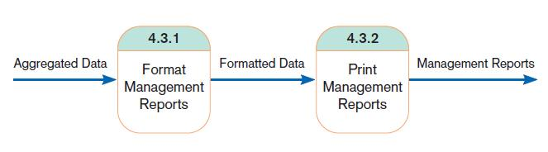
Level-n DFD
FIGURE 7-9
Level-2 diagram showing the decomposition of Process 4.3 from the level-1 diagram for Process 4.0 for Hoosier Burger’s food-ordering system
Level-n DFD shows the sub-processes of one of the processes in the Level n-1 DFD.
This is a Level-2 DFD for Process 4.3.
Processes are labeled 4.3.1, 4.3.2, etc. If this is the lowest level of the hierarchy, it is called a primitive DFD.
Notes:
So, at Level-2, we break a Level-1 process down further. Again, note the use of decimals for the process identifications: 4.3.1 and 4.3.2.
You can also see that this way every single process in the entire system (no matter which diagram you are looking at) has a unique identifier.

Slide 23
Balancing DFDs
Conservation Principle: conserve inputs and outputs to a process at the next level of decomposition
Balancing: conservation of inputs and outputs to a data flow diagram process when that process is decomposed to a lower level
Notes:
Because you have so many different diagrams at differing levels, it is important that they are consistent with each other. To do this, you need to make sure that the diagrams are balanced.

Slide 24
Balancing DFDs (Cont.)
Balanced means:
  Number of inputs to lower level DFD equals number of inputs to associated process of higher-level DFD
  Number of outputs to lower level DFD equals number of outputs to associated process of higher-level DFD

Slide 25
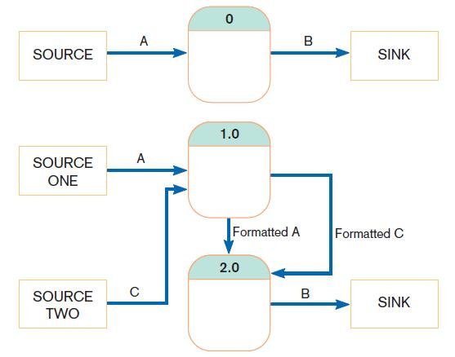
Balancing DFDs (Cont.)
FIGURE 7-10 An unbalanced set of data flow diagrams
(a) Context diagram
1 input
1 output
This is unbalanced because the process of the context diagram has only one input but the Level-0 diagram has two inputs.
(b) Level-0 diagram
2 inputs
1 output
Notes:
Sometimes when you draw a DFD at a particular level, you discover that you forgot something at the higher level. If so, you need to go back and correct the higher-level diagram.

Slide 26
Balancing DFDs (Cont.)
Data flow splitting is when a composite data flow at a higher level is split and different parts go to different processes in the lower level DFD.
The DFD remains balanced because the same data is involved, but split into two parts.

Slide 27
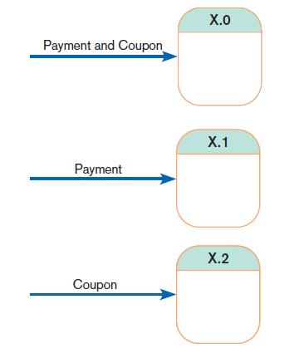
Balancing DFDs (Cont.)
FIGURE 7-11
Example of data flow splitting
(a) Composite data flow
(b) Disaggregated data flows
Notes:
At high levels, you try to keep the diagram simple. Rather than having two arrows coming into process X.0, it’s less cluttered to have a single arrow (composite data flow) with appropriate labeling. At the lower level, you split it out, especially if the two data flows are going into two separate sub-processes. Thus, the data flows become disaggregated.

Slide 28
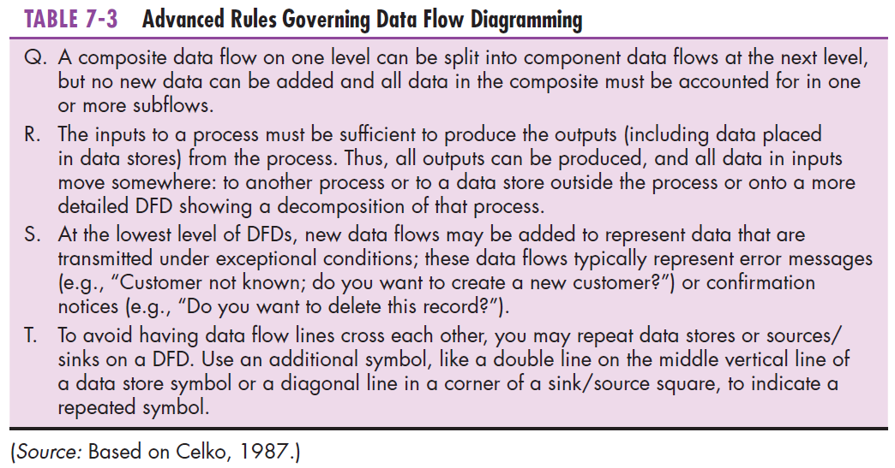
Balancing DFDs: More DFD Rules
Notes:
The bottom line is this. For a DFD to be balanced, any inputs that come into the lower level diagram MUST also be coming into the corresponding process of its higher level diagram. The same is true for outputs.

Slide 29
Four Different Types of DFDs
Current Physical
  Process labels identify technology (people or systems) used to process the data.
  Data flows and data stores identify actual name of the physical media.
Current Logical
  Physical aspects of system are removed as much as possible.
  Current system is reduced to data and processes that transform them.

Slide 30
Four Different Types of DFDs (Cont.)
New Logical
  Includes additional functions
  Obsolete functions are removed.
  Inefficient data flows are reorganized.
New Physical
  Represents the physical implementation of the new system
Notes:
As you can see, DFDs are useful for telling many stories. We can model the current logical or physical systems, as well as modeling the hoped for future logical and physical systems. In this respect, DFD is a very versatile instrument.

Slide 31
Guidelines for Drawing DFDs
Completeness
  DFD must include all components necessary for system.
  Each component must be fully described in the project dictionary or CASE repository.
Consistency
  The extent to which information contained on one level of a set of nested DFDs is also included on other levels

Slide 32
Guidelines for Drawing DFDs (Cont.)
Timing
  Time is not represented well on DFDs.
  Best to draw DFDs as if the system has never started and will never stop.
Iterative Development
  Analyst should expect to redraw diagram several times before reaching the closest approximation to the system being modeled.

Slide 33
Guidelines for Drawing DFDs (Cont.)
Primitive DFDs
  Lowest logical level of decomposition
  Decision has to be made when to stop decomposition

Slide 34
Guidelines for Drawing DFDs (Cont.)
Rules for stopping decomposition
  When each process has been reduced to a single decision, calculation or database operation
  When each data store represents data about a single entity
Notes:
Well, ok. If you want to get really detailed about this. But at some point you can give it to the programmer and let them figure it out. These two items bring you right down to the code level and into database design, which may be more detailed than necessary.

Slide 35
Guidelines for Drawing DFDs (Cont.)
Rules for stopping decomposition, cont.
  When the system user does not care to see any more detail
  When every data flow does not need to be split further to show that data are handled in various ways
Notes:
This is probably a more realistic level, at least for the purposes of requirements structuring. This is what’s actually capturing the user’s needs for documentation.

Slide 36
Guidelines for Drawing DFDs (Cont.)
Rules for stopping decomposition, cont.
  When you believe that you have shown each business form or transaction, online display and report as a single data flow
  When you believe that there is a separate process for each choice on all lowest-level menu options
Notes:
These are other good guidelines. They relate more to the designer’s point of view.
Good data flow diagramming is as much an art as a science. You should keep decomposing as long as it’s bringing you a benefit. But almost nobody does it all the way to the code level.

Slide 37
Using DFDs as Analysis Tools
Gap Analysis is the process of discovering discrepancies between two or more sets of data flow diagrams or discrepancies within a single DFD.
Inefficiencies in a system can often be identified through DFDs.
Notes:
Once the DFDs are complete, you can examine the details of individual DFDs for problems like redundant data flows, unused captured data, and redundant data updates. These problems may not have been evident to the analysts or users earlier in the analysis process when.

Slide 38
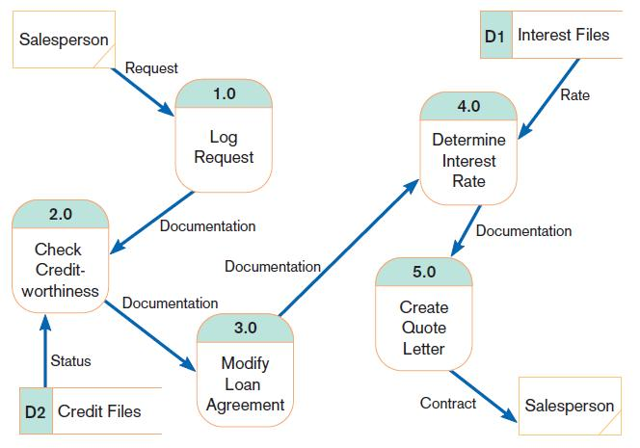
Using DFDs in BPR
FIGURE 7-16
IBM Credit Corporation’s primary work process before BPR
(Source: Based on Hammer and Champy, 1993.)
Notes:
We talked about business process reengineering in chapter 6, as a “radical” systems requirements determination approach. DFDs are useful for illustrating this. This figure and the next one shows a “before” and “after” for IBM. Note how five separate processes were reduced to one in the after picture.
Notice also that an additional external source was added, the “specialists”.

Slide 39
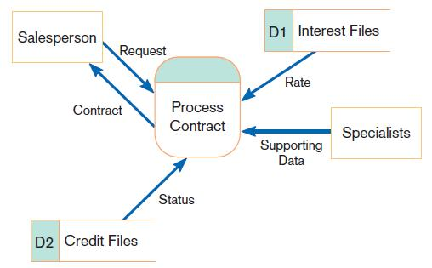
Using DFDs in BPR (Cont.)
FIGURE 7-17
IBM Credit Corporation’s primary work process after BPR
(Source: Based on Hammer and Champy, 1993.)
Notes:
The old system took six days to complete a loan agreement, although processing the loan itself was only 90 minutes. The new system is much faster, with fewer people involved. Specialists are just used for special cases; usually the salesperson does the job alone without so much time that documentation is spending in somebody’s in-basket like before.

Slide 40
Modeling Logic with Decision Tables
Decision table: a matrix representation of the logic of a decision which specifies the possible conditions for the decision and the resulting actions
Best used for complicated decision logic
Notes:
So far we’ve discussed DFDs and we see how useful they can be. Another important thing to represent is the decision logic of the process. DFDs are not sufficient for this. A decision table can be used for this task.
The decision table is another way of structuring the requirements, and the information that goes into it came from interviews, documents, observation, etc.

Slide 41
Modeling Logic with Decision Tables (Cont.)
Condition stubs: that part of a decision table that lists the conditions relevant to the decision
Action stubs: that part of a decision table that lists the actions that result for a given set of conditions
Rules: that part of a decision table that specifies which actions are to be followed for a given set of conditions
Indifferent condition: in a decision table, a condition whose value does not affect which actions are taken for two or more rules

Slide 42
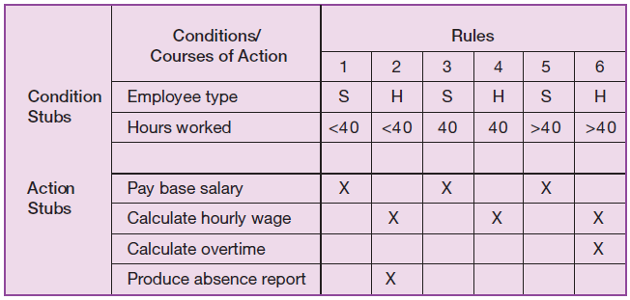
Modeling Logic with Decision Tables (Cont.)
FIGURE 7-18
Complete decision table for payroll system example
Notes:
In this decision table the condition stubs involve the employee type and the number of hours worked. These form conditions for the decision rules. The action stubs specify what to do for each set of conditions. For example, if the employee is salaried and worked less than 40 hours we pay the base salary.
Question: What do we do for an hourly employee who worked more than 40 hours?
Answer: calculate the hourly wage and calculate overtime.

Slide 43
Modeling Logic with Decision Tables (Cont.)
Procedure for Creating Decision Tables
  Name the condition and the values that each condition can assume.
  Name all possible actions that can occur.
  List all possible rules.
  Define the actions for each rule.
  Simplify the table.
Notes:
A decision table can get quite complex, and may include unnecessary or irrelevant conditions or actions. Make the decision table as simple as possible by removing any rules with impossible actions. Consult users on the rules where system actions aren’t clear and either decide on an action or remove the rule. Look for patterns in the rules, especially for indifferent conditions.

Slide 44
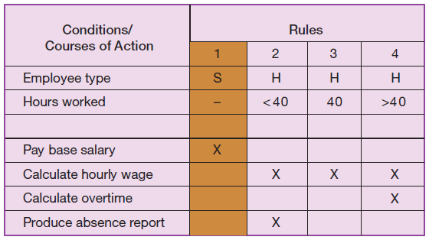
Modeling Logic with Decision Tables (Cont.)
FIGURE 7-19
Reduced decision table for payroll system example
Notes:
We can simplify the table by recognizing indifferent conditions. For salaried employees, it doesn’t matter how many hours were worked. So three rules got reduced to one.

Slide 45
Electronic Commerce Application: Process Modeling using Data Flow Diagrams
Process modeling for Pine Valley Furniture’s WebStore
  Completed JAD session
  Began translating the WebStore system structure into data flow diagrams
    Identified six high-level processes
Notes:
Now we can apply the things we learned to the Pine Valley Furniture case. So, after the JAD session has ended, the PVF analysts created their DFDs.

Slide 46
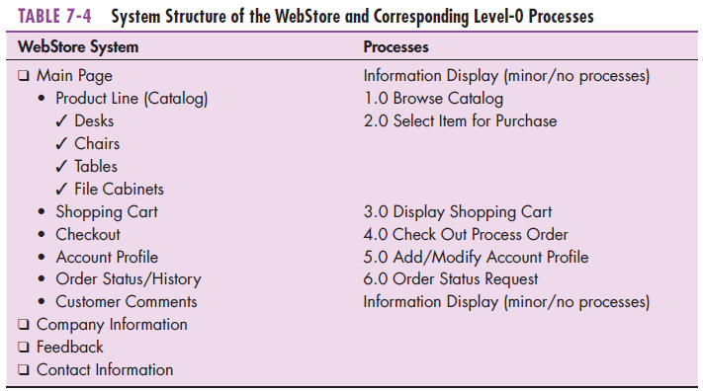
Electronic Commerce Application: Process Modeling using Data Flow Diagrams (Cont.)

Slide 47
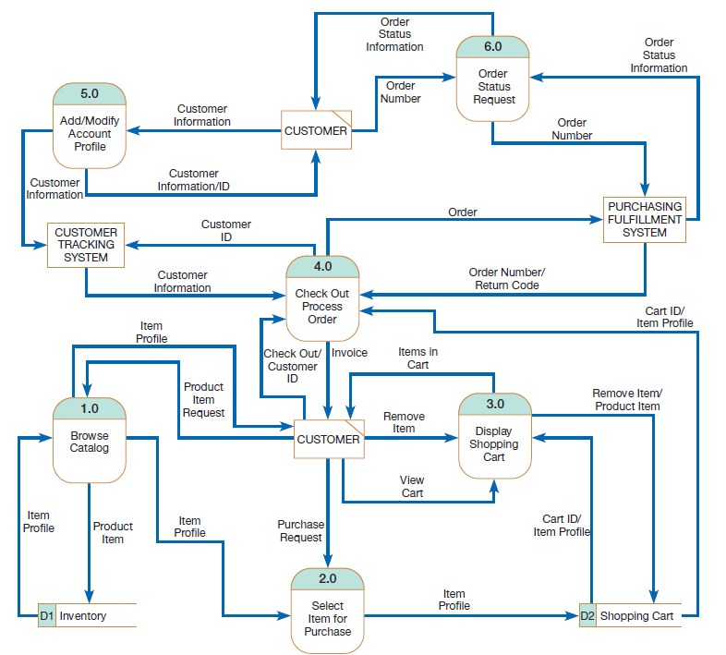
Electronic Commerce Application: Process Modeling using Data Flow Diagrams
FIGURE 7-22
Level-0 data flow diagram for the
WebStore
Notes:
Here is the Level-0 DFD of the Web Store. Notice that in this case, some external entities (sources, sinks) are other computer systems, specifically the customer tracking and purchasing fulfillment systems. The other external entity is the customer, a human user of WebStore. You can imagine each of the data flows from the customer to a process as the customer entering and submitting data in the browser. Any data going from a process to the customer is stuff the customer would see in the web pages, or perhaps something that would be sent to the customer in an email.
Notice also that there are two data stores, one for the customers shopping cart and one for the product inventory.
This DFD shows six processes. Typically that’s a pretty good number. If it gets two busy, it may mean you’re at too much detail for the particular level you are at in the diagram.

Slide 48
Summary
Now you learned how to:
  Understand logical process modeling via data flow diagrams (DFDs).
  Draw data flow diagrams of well-structured process models.
  Decompose data flow diagrams into lower-level diagrams.

Slide 49
Summary (Cont.)
  Balance high-level and low-level data flow diagrams.
  Use data flow diagrams for analyzing information systems.
  Use decision tables to represent the logic of choice in conditional statements.

Slide 50
Next Lecture
Structuring System Data Requirements

Slide 51
References
Joseph S. Valacich, Joey F. George, Modern Systems Analysis and Design, 8th Global Edition, Pearson, 2016

