Slide 1


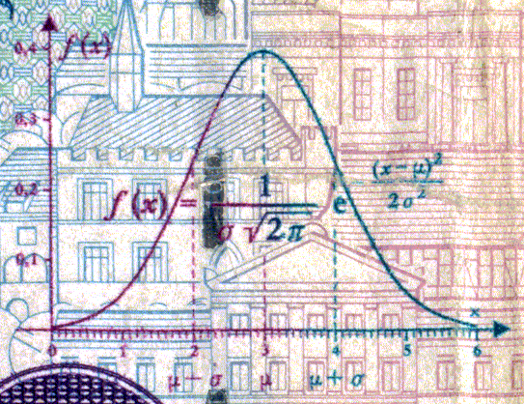
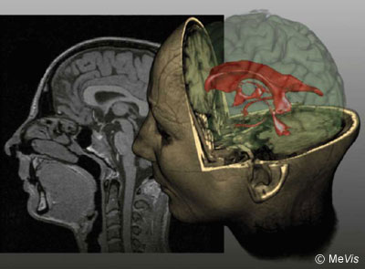
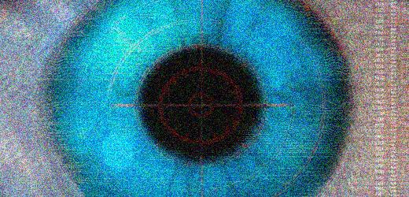
CSE 307
Fundamentals of Image Processing
Lecture #6 Morphological Image Processing
Prepared & Presented by Asst. Prof. Dr. Samsun M. BAŞARICI

Slide 2


Objectives
What is mathematical morphology and how is it used in image processing?
What are the main morphological operations and what is the effect of applying them to binary and grayscale images?
What is a structuring element and how does it impact the result of a morphological operation?
What are some of the most useful morphological image processing algorithms?

Slide 3
What is mathematical morphology?
Morphology: gr.
  μορφή, morphé = form, shape
  λόγος, lógos = word, doctrine, rational
Mathematical morphology is a branch of image processing which has been successfully used to provide tools for representing, describing, and analyzing shapes in images.
Initially developed by Jean Serra in the early 1980s
Named after the branch of biology that deals with the form and structure of animals and plants.

Slide 4

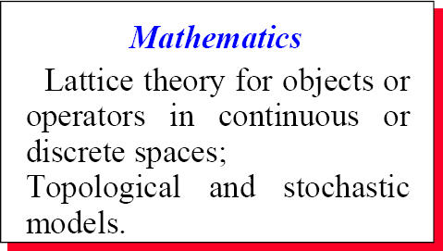

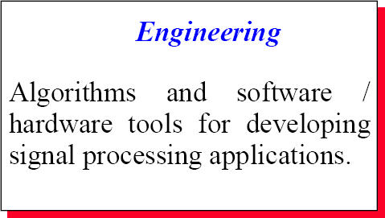
What is mathematical morphology? (cont.)

Slide 5
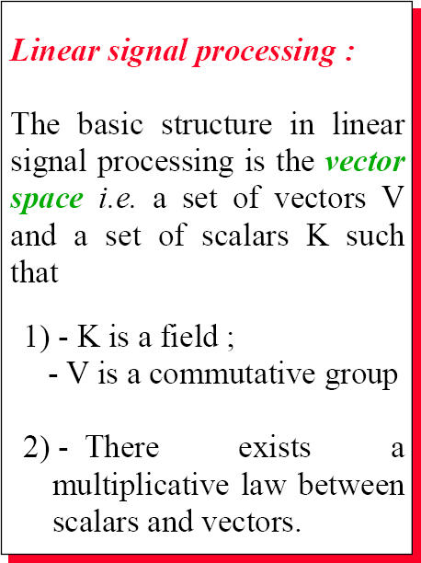
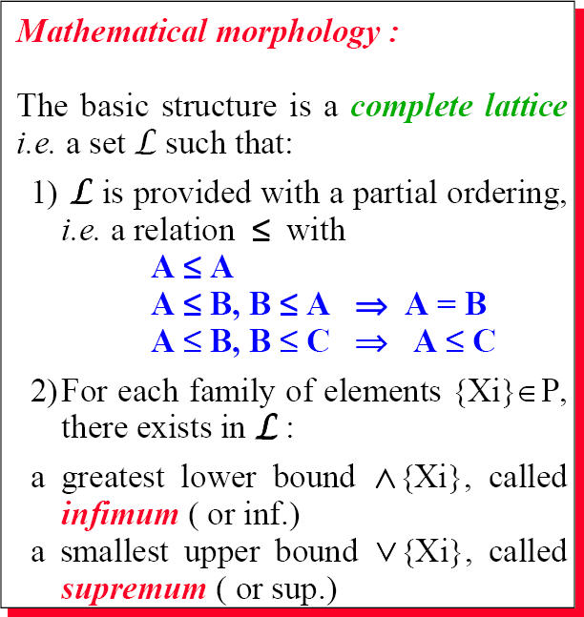
What is mathematical morphology? (cont.)

Slide 6
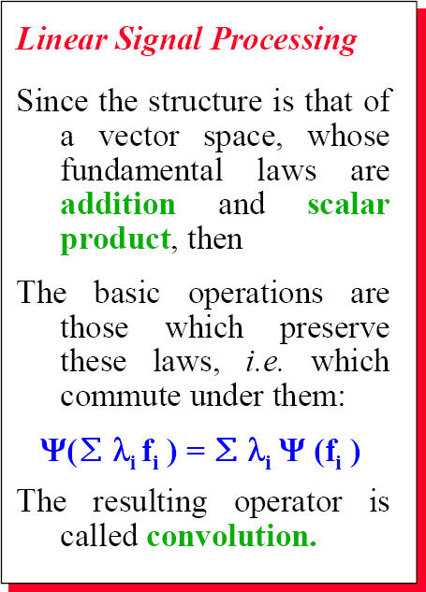
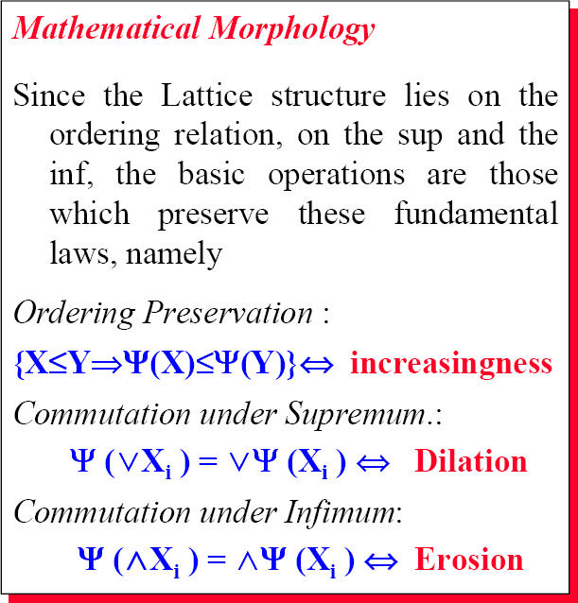
What is mathematical morphology? (cont.)

Slide 7
What is mathematical morphology? (cont.)
Basic principle: the extraction of geometrical and topological information from an unknown set (an image) through transformations using another, well-defined, set, known as structuring element (SE).
In morphological image processing, the design of SEs, their shape and size, is crucial to the success of the morphological operations that use them.

Slide 8
Morphological Image Processing:
A little bit Set Theory (remember?)
Basically:
  Let Z be the set of integers.
  A function f (x, y) is a digital image
    if (x, y) integer from Z² and f a mapping assigning a number from R (set of real numbers), intensity value, to each distinct pair of coordinates (x, y)

Slide 9
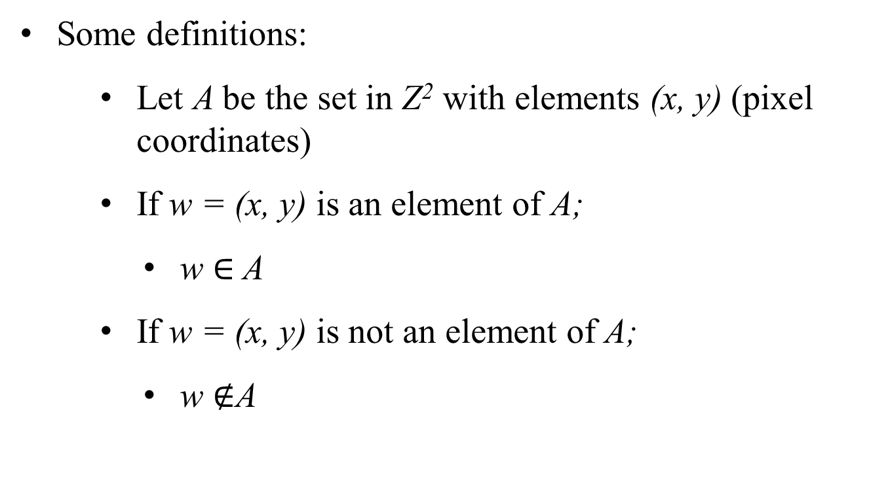
A little bit Set Theory (cont.)

Slide 10
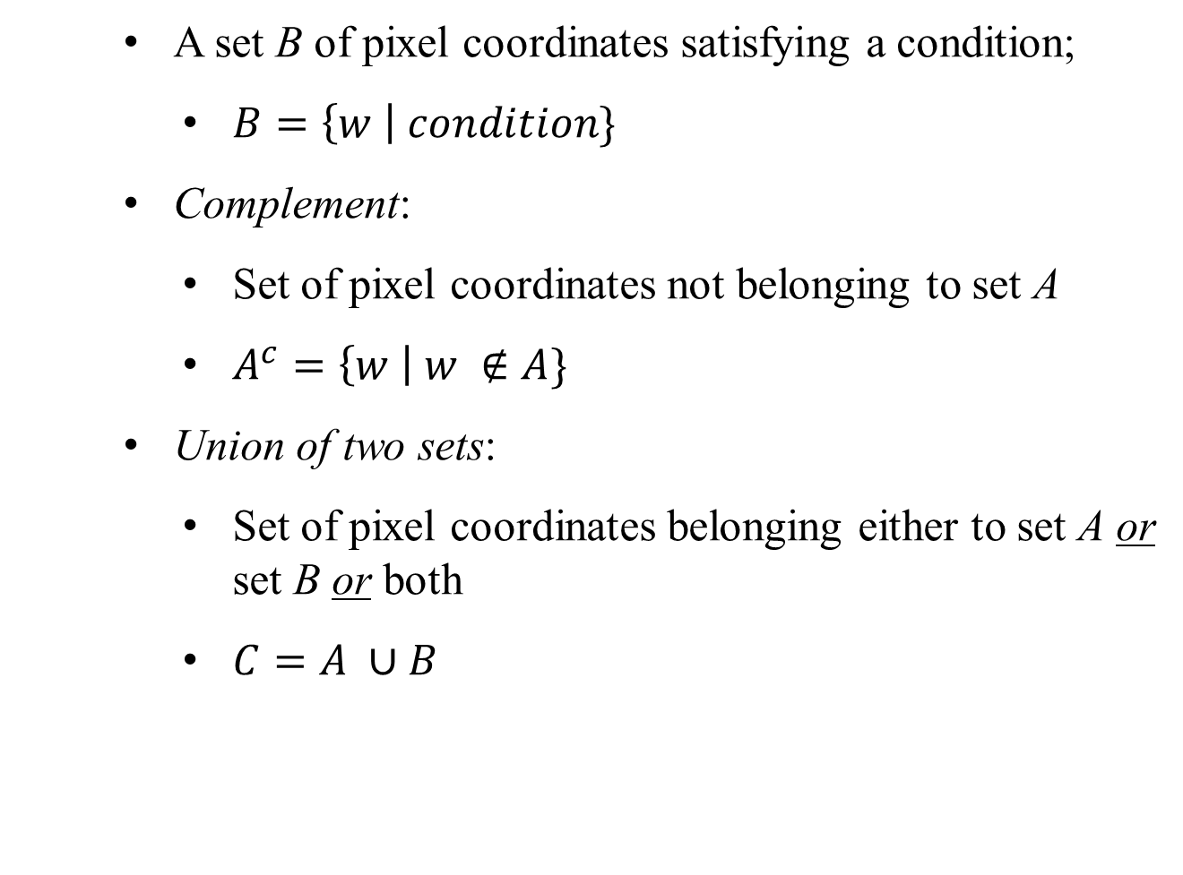
A little bit Set Theory (cont.)

Slide 11
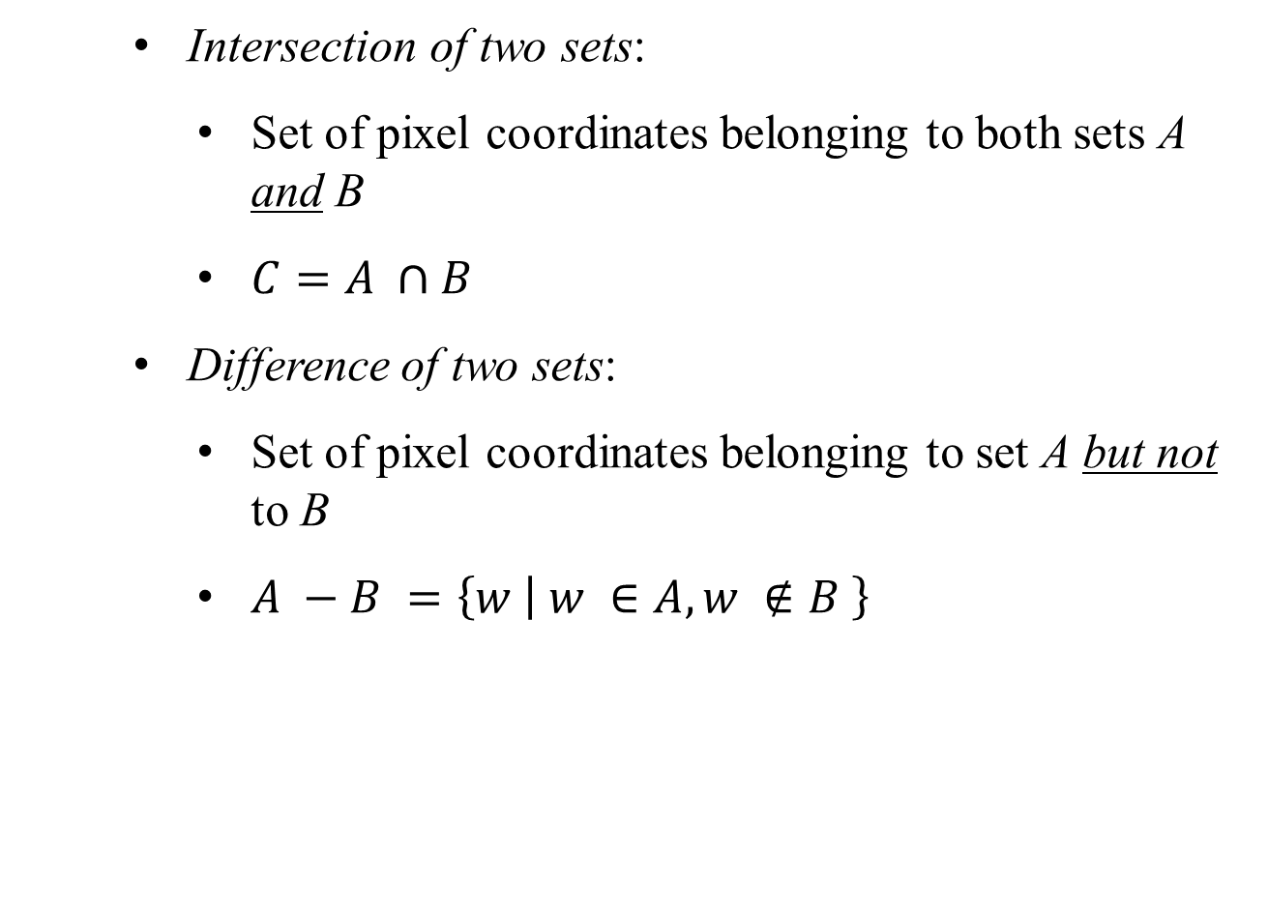
A little bit Set Theory (cont.)

Slide 12
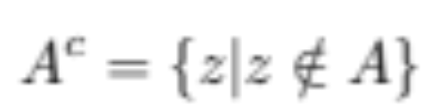
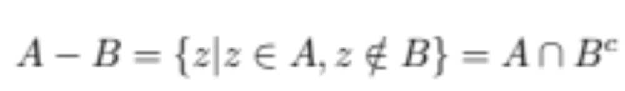
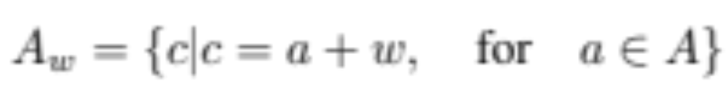
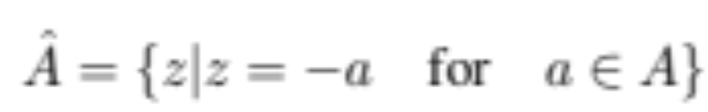
Fundamental concepts and operations
Basic set operations:
  Complement
  Difference
  Translation
  Reflection

Slide 13
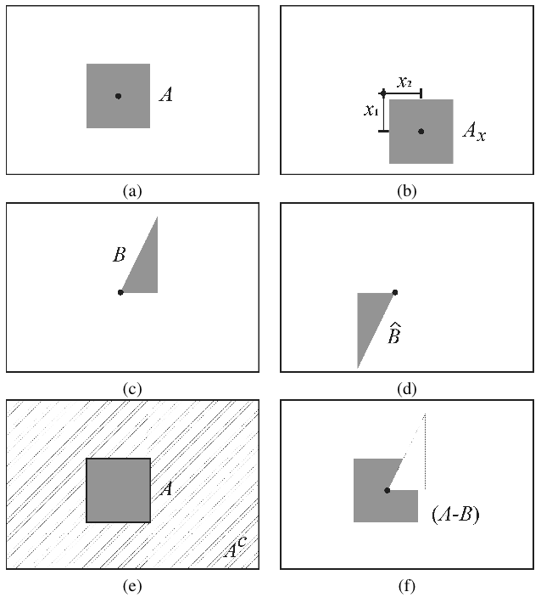
Fundamental concepts and operations (cont.)
Basic set operations
Set A
Translation of A
Set B
Reflection of B
Set A and its complement
Set Difference (A-B)

Slide 14
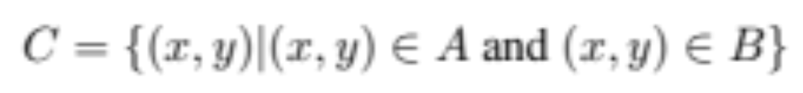
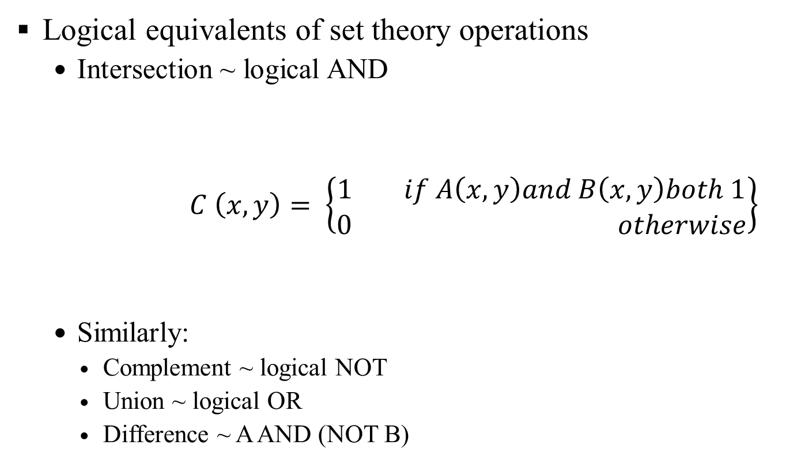
Fundamental concepts and operations (cont.)
Logical equivalents of set theory operations
  Intersection ~ logical AND
  $C \left(x, y\right)= \left\{\begin{aligned}1 if A\left(x, y\right)and B\left(x, y\right)both 1 \\ 0 otherwise\end{aligned}\right\}$
  Similarly:
    Complement ~ logical NOT
    Union ~ logical OR
    Difference ~ A AND (NOT B)

Slide 15
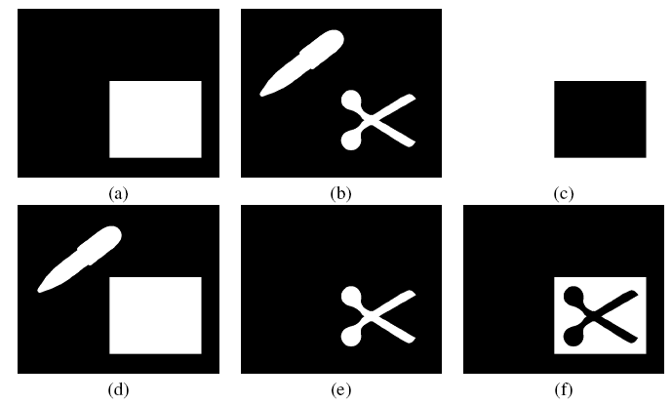
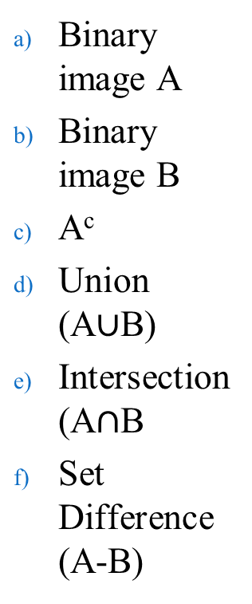
Fundamental concepts and operations (cont.)
Logical equivalents of set theory operations
Binary image A
Binary image B
A^{c}
Union (A$∪$B)
Intersection (A$∩$B
Set Difference (A-B)

Slide 16
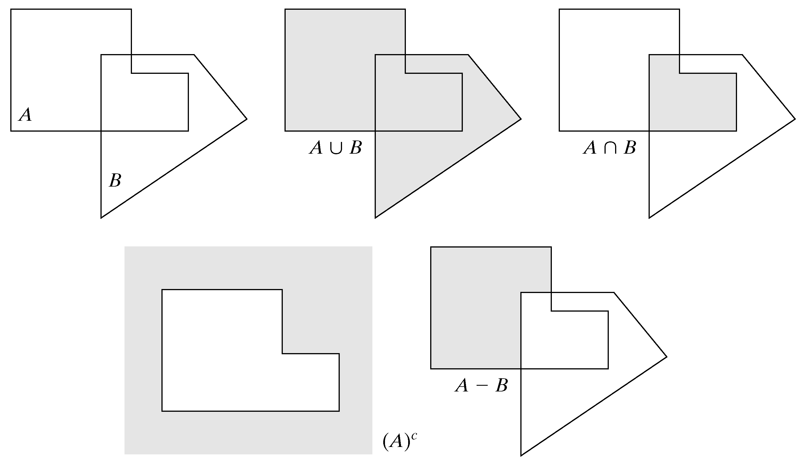
Fundamental concepts and operations (cont.)

Slide 17
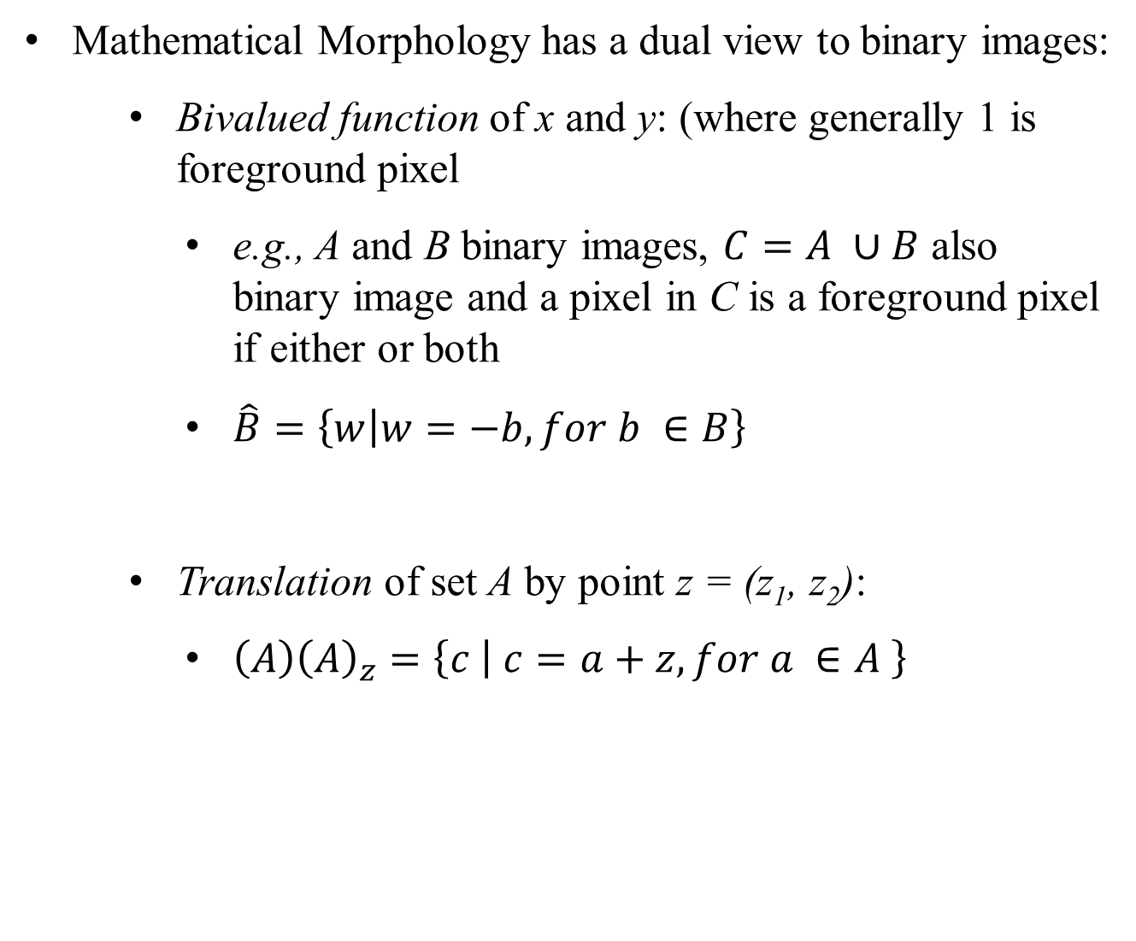
Binary Images (in MM)

Slide 18
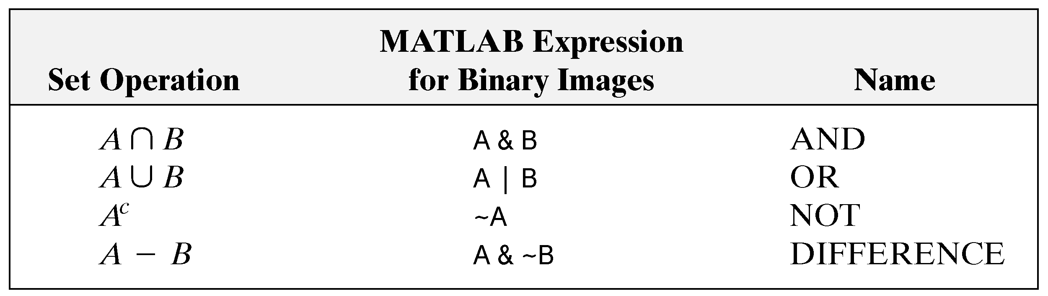
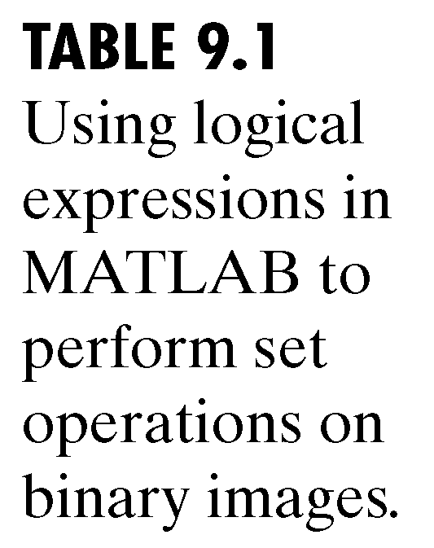
A little bit Set Theory (cont.)
Using logical expressions in MATLAB to perform set operations on binary images

Slide 19
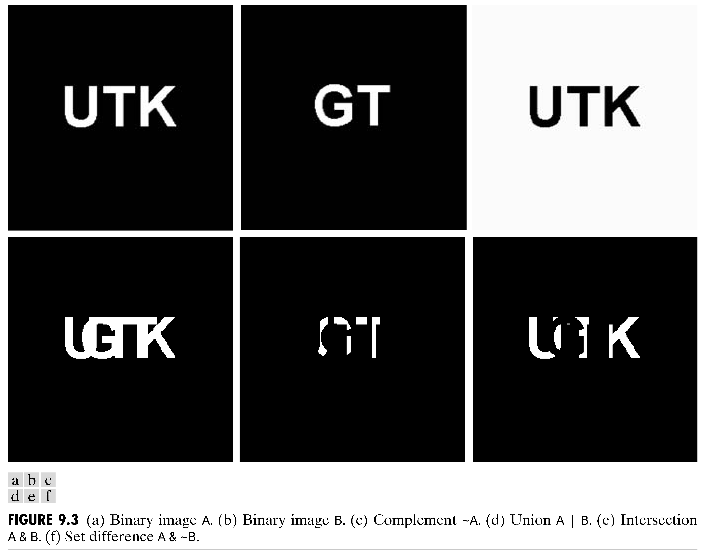
A little bit Set Theory (in practice)

Slide 20
The structuring element
The structuring element (SE) is the basic neighborhood structure associated with morphological image operations.
It is usually represented as a small matrix, whose shape and size impact the results of applying a certain morphological operator to an image.
Although a structuring element can have any shape, its implementation requires that it be converted to a rectangular array.
  For each array, the shaded squares correspond to the members of the SE whereas the empty squares are used for padding, only.

Slide 21
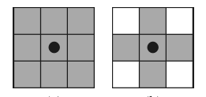
The structuring element (cont.)
Examples:
        square cross
MATLAB functions (see Examples 13.1 and 13.2 in PIVPUM):
  strel
  getsequence

Slide 22
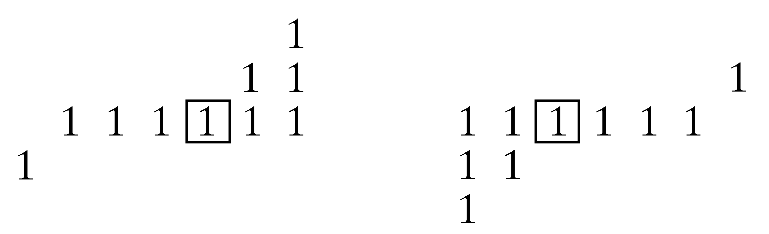
The structuring element (cont.)
SE reflection:
  Nonsymmetric SE SE reflected about its origin

Slide 23
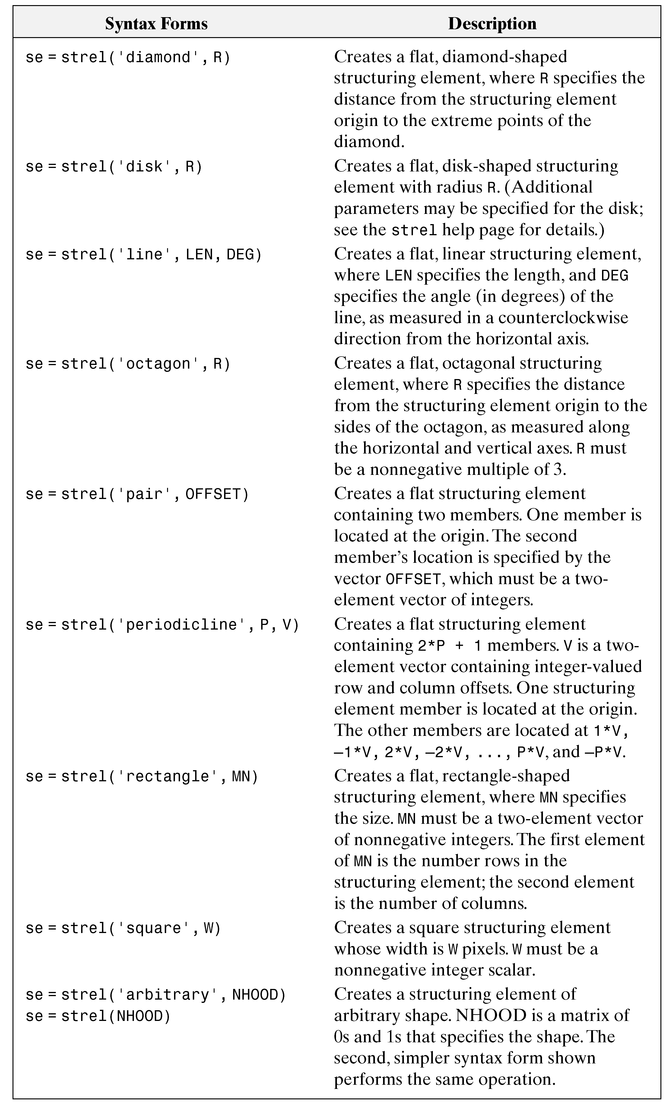
SE (in MATLAB)

Slide 24

Dilation and erosion
The two fundamental morphological image operations.
  Dilation: a morphological operation whose effect is to “grow” or “thicken” objects in a binary image.
    The extent and direction of this thickening is controlled by the size and shape of the structuring element.
    Mathematically:

Slide 25
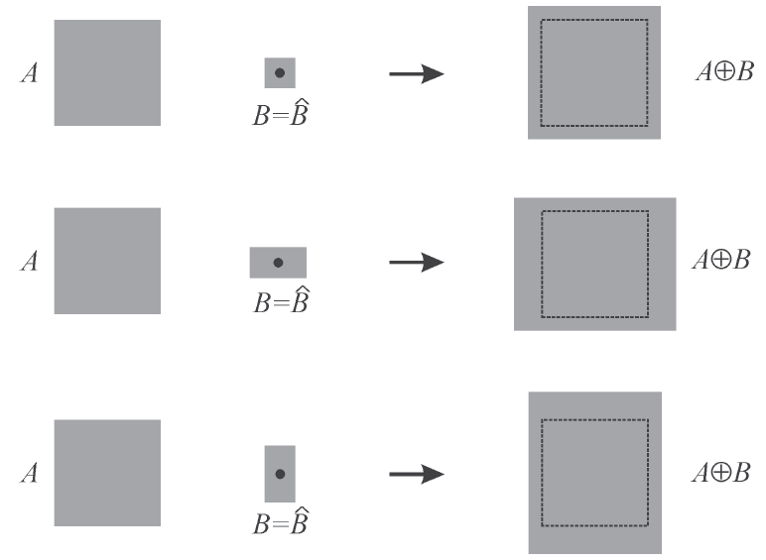
Dilation and erosion (cont.)
Dilation – geometrical interpretation

Slide 26
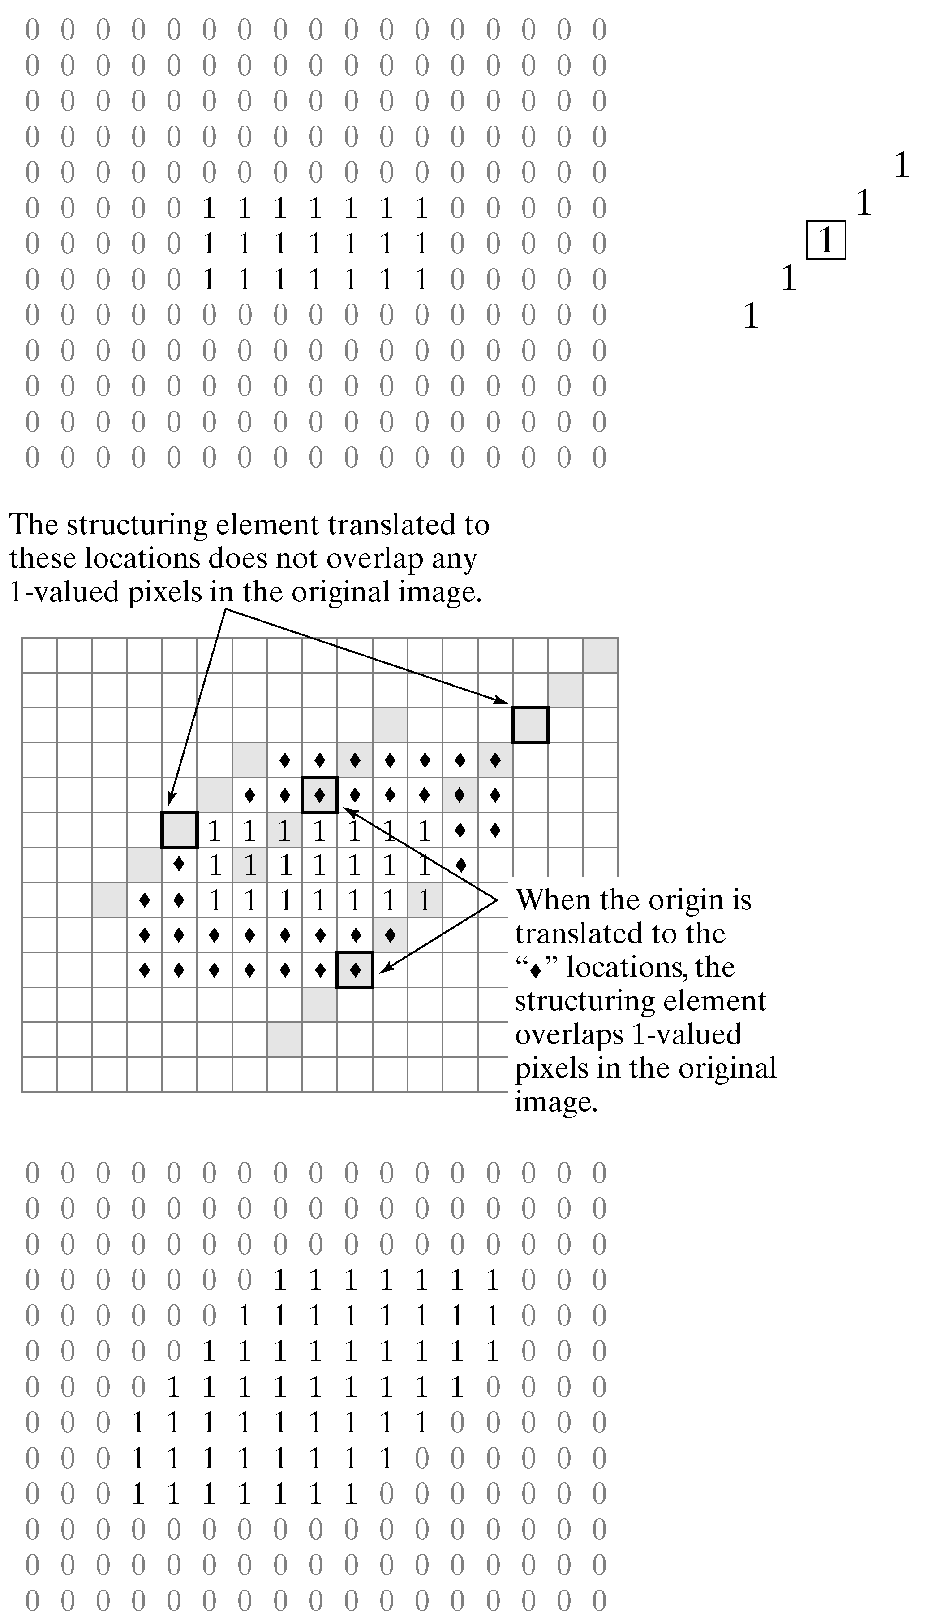
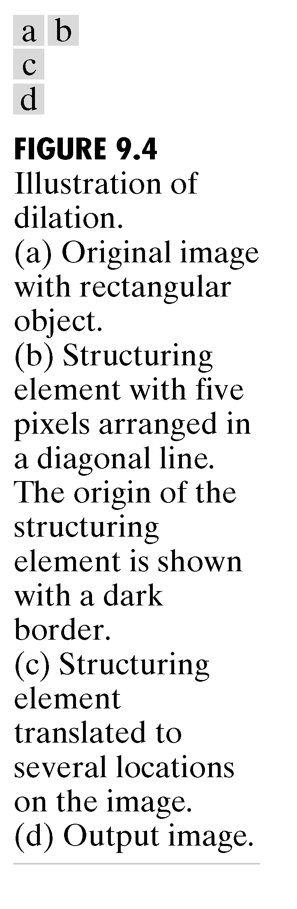
Dilation

Slide 27
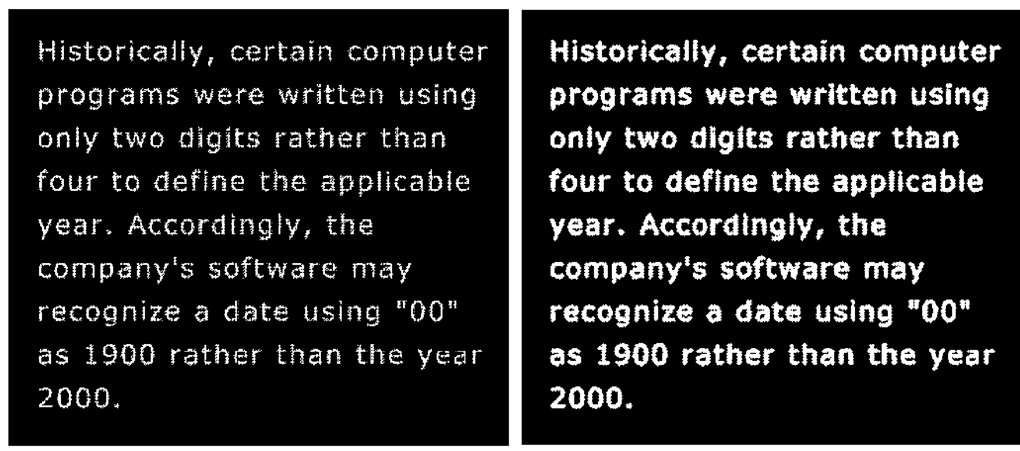
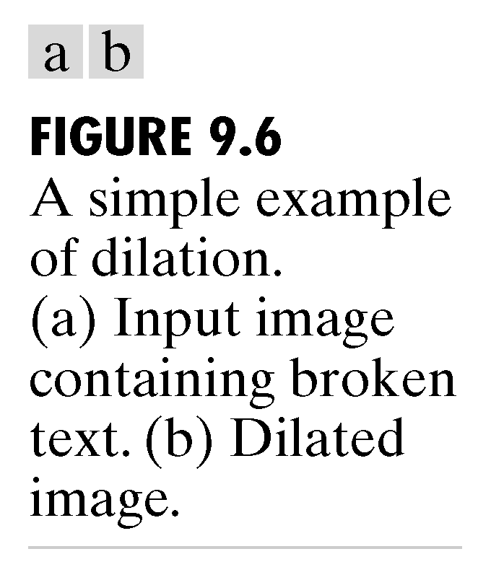
Dilation (cont.)

Slide 28
Dilation and erosion (cont.)
Dilation – MATLAB example
a = [0 0 0 0 0;
0 1 1 0 0;
0 1 1 0 0;
0 0 1 0 0;
0 0 0 0 0]
se1 = strel('square',2)
b = imdilate (a,se1)
se2 = strel('rectangle', [1 2])
c = imdilate (a,se2)

Slide 29

Dilation and erosion (cont.)
Erosion: a morphological operation whose effect is to “shrink” or “thin” objects in a binary image.
  The direction and extent of this thinning is controlled by the shape and size of the structuring element.
  Mathematically:

Slide 30
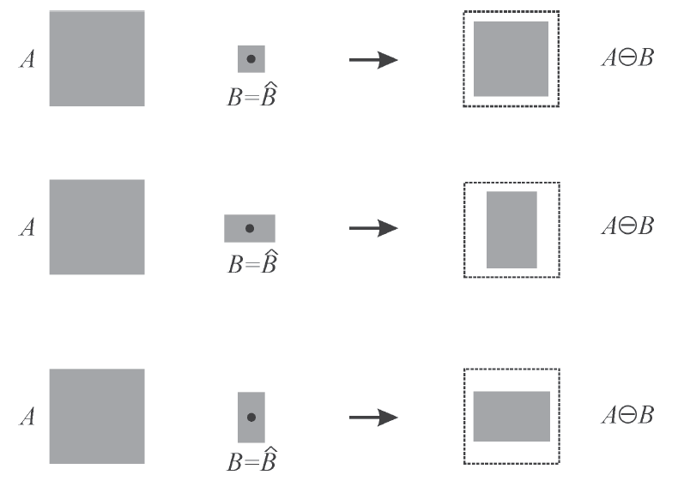
Dilation and erosion (cont.)
Erosion – geometrical interpretation

Slide 31
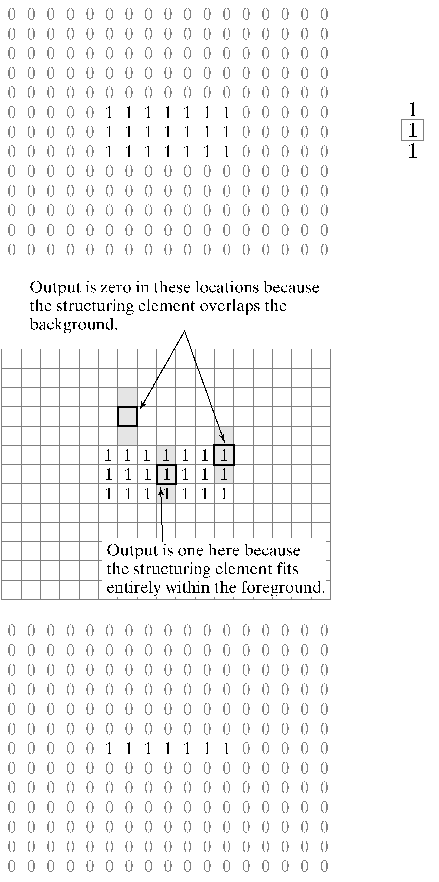
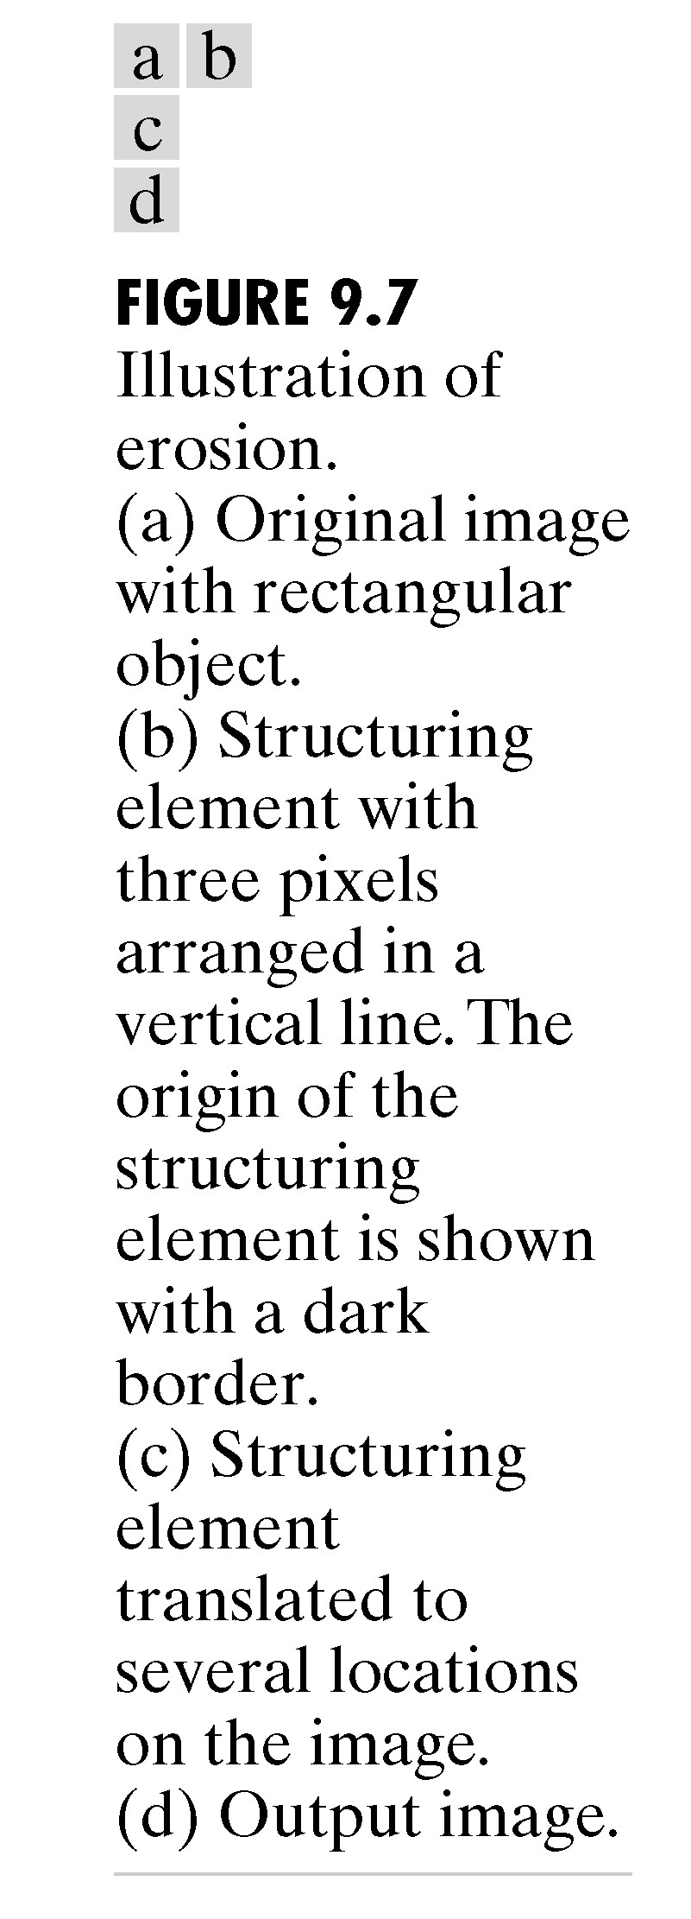
Erosion

Slide 32
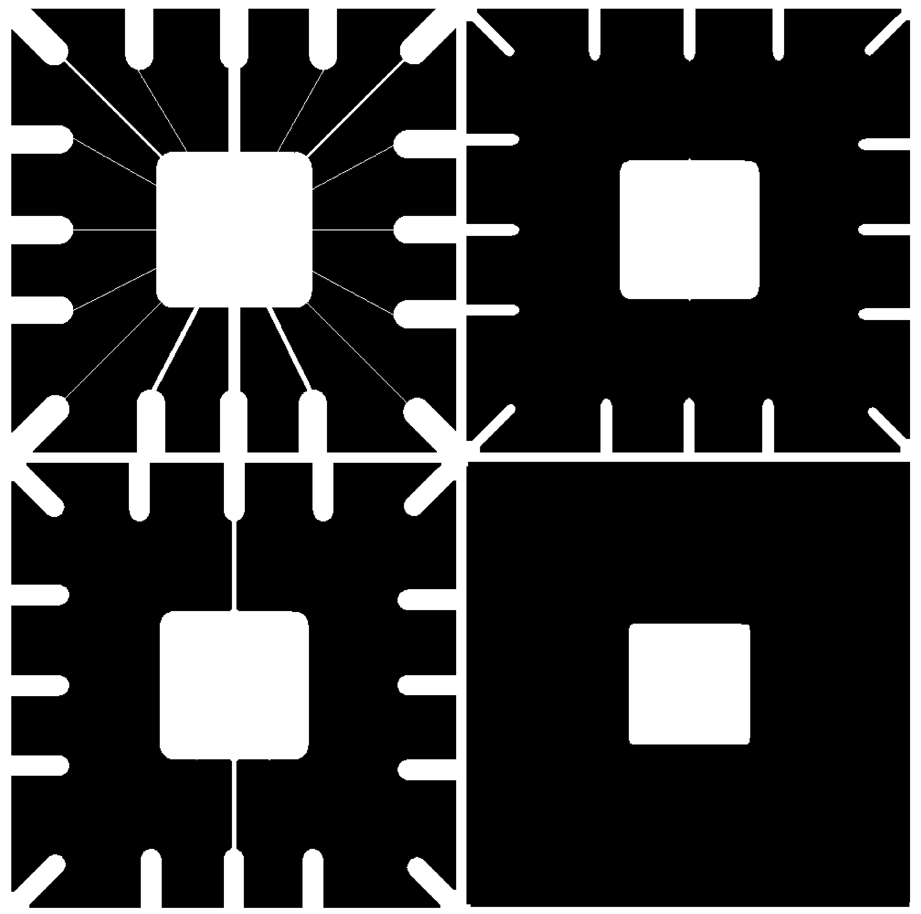
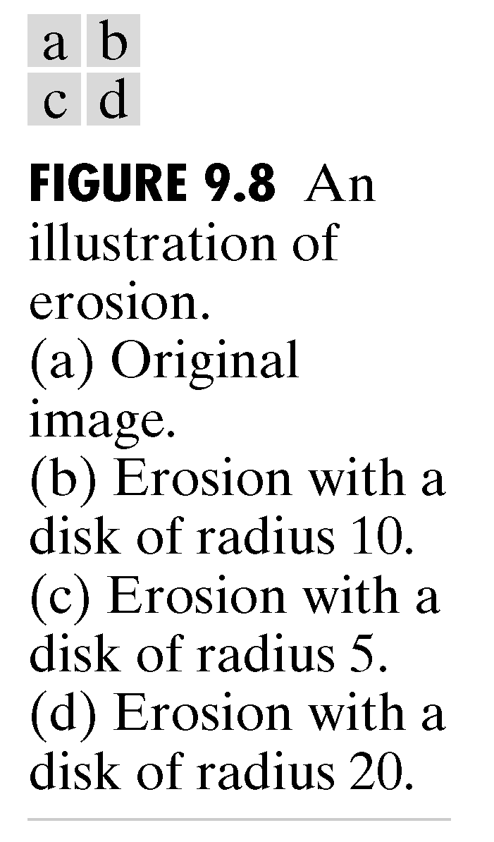
Erosion (cont.)

Slide 33
Dilation and erosion (cont.)
Erosion– MATLAB example
a = [ 0 0 0 0 0 ; 0 1 1 1 0; 1 1 1 0 0; 0 1 1 1 1; 0 0 0 0 0]
se1 = strel('square',2)
b = imerode (a,se1)
se2 = strel('rectangle', [1 2])
c = imerode (a,se2)

Slide 34
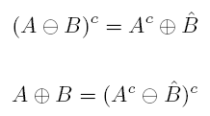
Dilation and erosion
Erosion and dilation are dual operations

Slide 35


Dilation and erosion
Erosion and dilation can be interpreted in terms of whether a SE fits or hits an image (region)
  Erosion:
  Dilation:

Slide 36


Compound operations
Opening: erosion followed by dilation
Mathematically:
or:
In MATLAB: imopen

Slide 37
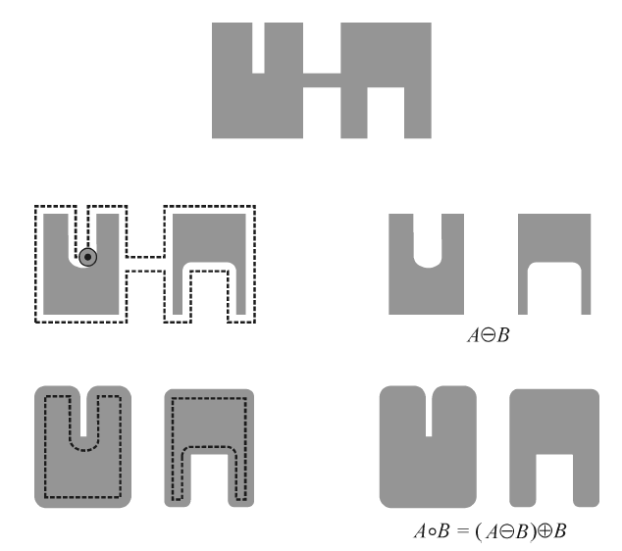
Compound operations (cont.)
Opening: example

Slide 38
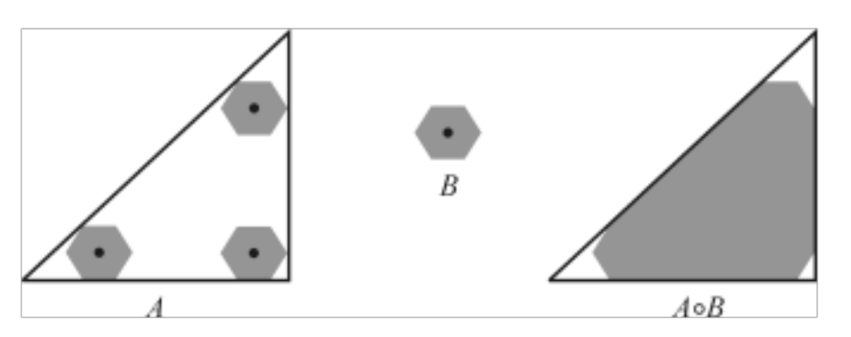
Compound operations (cont.)
Opening: geometrical interpretation

Slide 39

Compound operations (cont.)
Closing: dilation followed by erosion
Mathematically:
In MATLAB: imclose

Slide 40
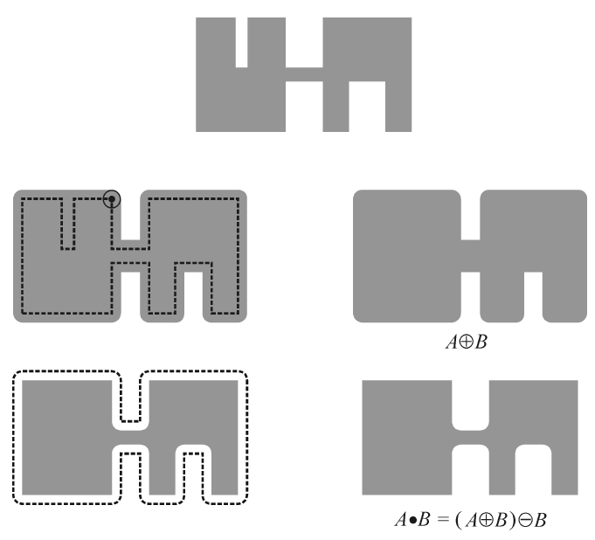
Compound operations (cont.)
Closing: example

Slide 41
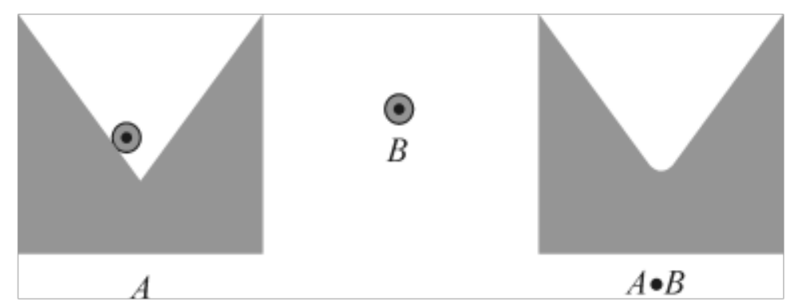
Compound operations (cont.)
Closing: geometrical interpretation

Slide 42
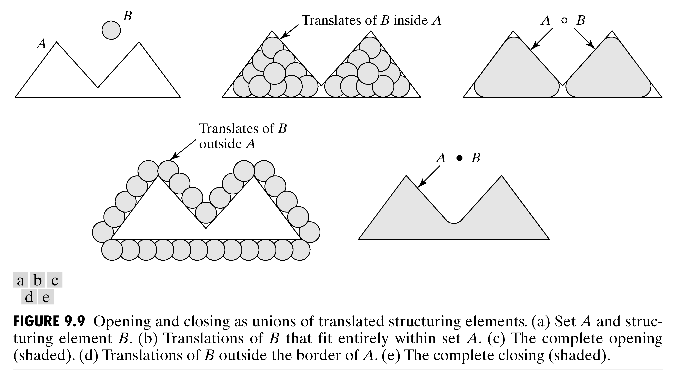
Opening and closing

Slide 43

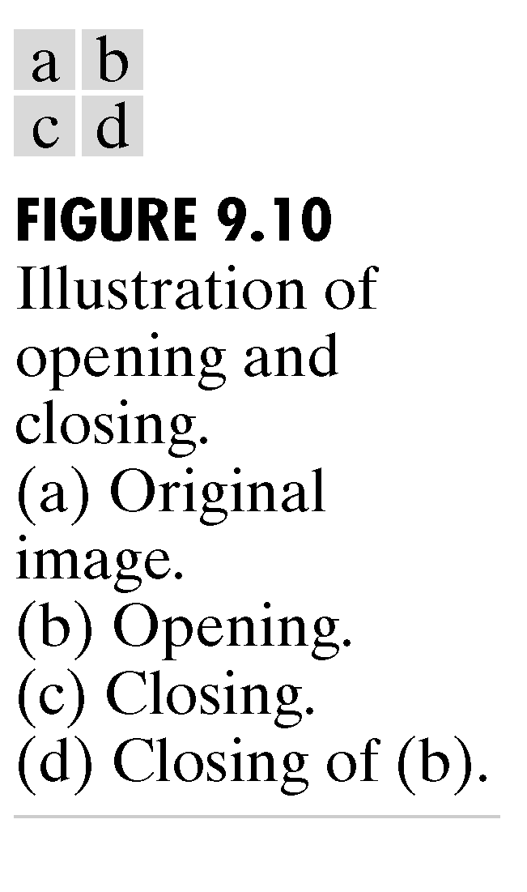
Opening and closing (cont.)
Illustration of opening and closing:
a) Original image b) Opening
c) Closing d) Closing of b

Slide 44
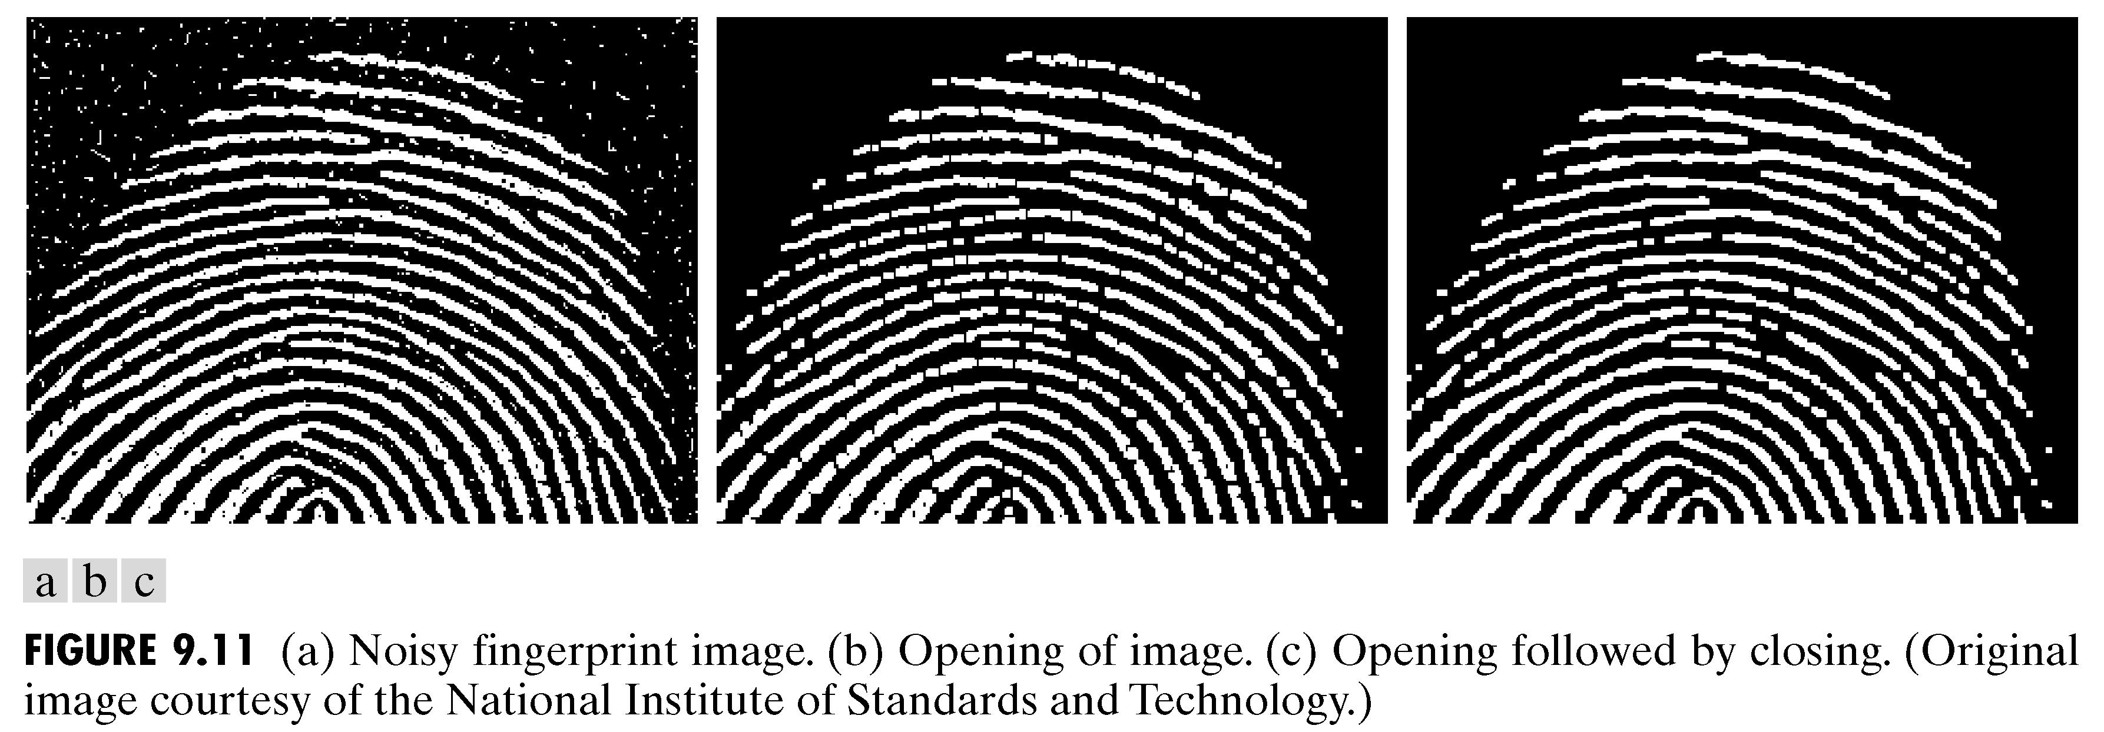
Opening and closing (in practice)

Slide 45


Compound operations (cont.)
Hit-or-miss (HoM) transform: a combination of morphological operations that uses two structuring elements (B₁ and B₂) designed in such a way that the output image will consist of all locations that match the pixels in B₁ (a hit) and that have none of the pixels in B₂ (a miss).
  Mathematically:
  or:
  In MATLAB: bwhitmiss

Slide 46
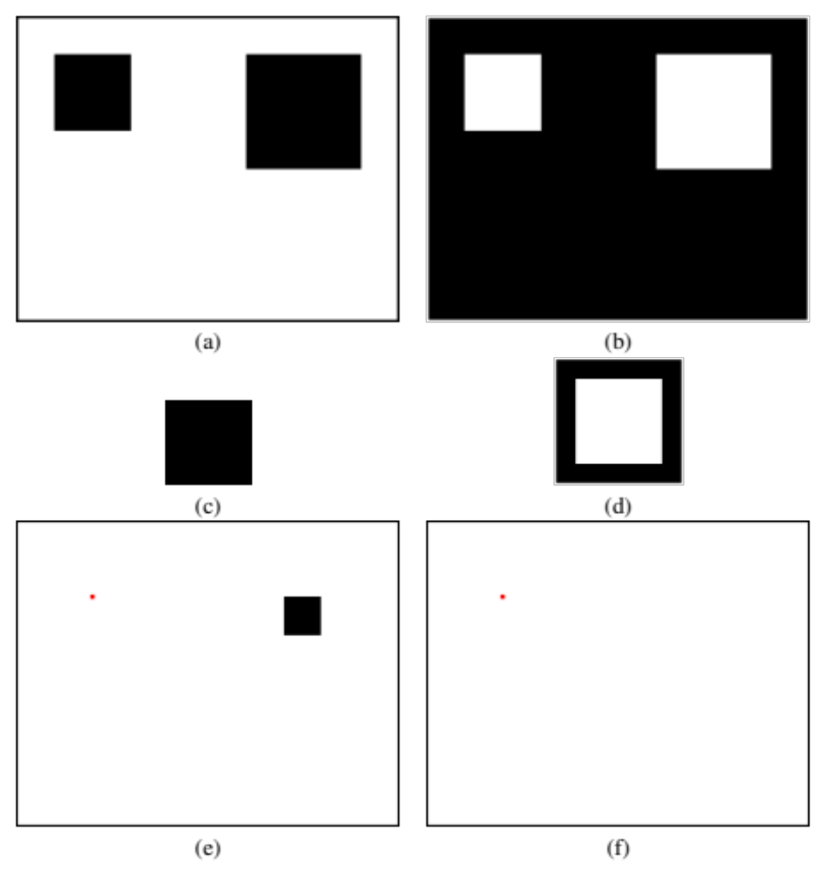
Compound operations (cont.)
HoM: example (Fig. 13.10 PIVPUM)

Slide 47
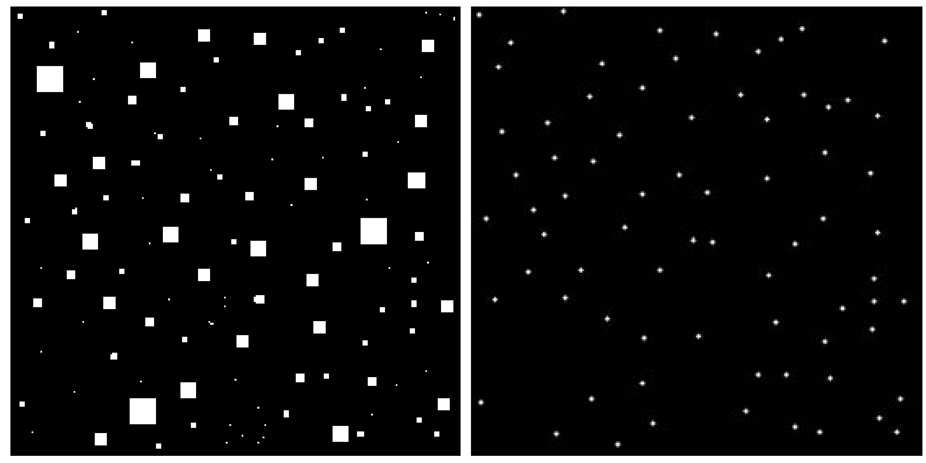
Compound operations (cont.)
HoM:
Original image Results of HoM

Slide 48

Morphological filtering
Morphological filters are Boolean filters that apply a many-to-one binary (or Boolean) function h within a window W in the binary input image f(x,y), producing at the output an image g(x,y) given by:

Slide 49
Morphological filtering (cont.)
Examples of Boolean operations (h):
  OR: equivalent to a morphological dilation with a square SE of the same size as W.
  AND: equivalent to a morphological erosion with a square SE of the same size as W.
  MAJ (majority): the morphological equivalent to a median filter applicable to binary images.

Slide 50

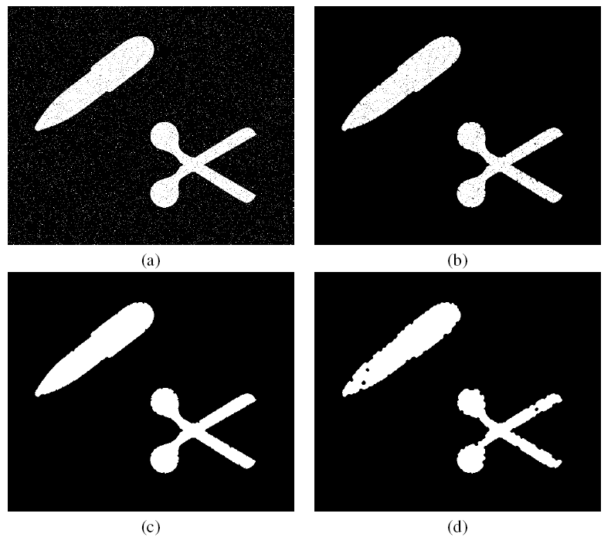
Morphological filtering (cont.)
Application: noise removal

Slide 51
Morphological algorithms
A “cookbook” approach
  In MATLAB: bwmorph (see also Tutorial 13.2 PIVPUM)
Example 13.6:
A = imread('circles.png');
B = bwmorph(A,'skel', Inf);
C = bwmorph(B,'spur',Inf);
D = bwmorph(A,'remove');
E = bwmorph(D,'thicken',3);
F = bwmorph(E,'thin',3);

Slide 52

Morphological algorithms (cont.)
Example 13.6 (PIVPUM):

Slide 53


Morphological algorithms (cont.)
  Operations supported by bwmorph

Slide 54



Boundary extraction
Internal: pixels in A that sit at the edge of A.
External: pixels outside A that sit immediately next to A.
Morphological gradient: combination of internal and external boundaries.
In MATLAB: bwperim

Slide 55

Boundary extraction (cont.)
Example 13.7 (PIVPUM):
a = ones(5,12)
a (1:2,1)=0
a (1:2,9)=0
a (4:5,5)=0
b = bwperim(a,8)

Slide 56

Region filling
In MATLAB: imfill

Slide 57

Region filling (cont.)

Slide 58

Extraction and labeling of connected components
Iterative procedure, similar to region filling
In MATLAB: bwlabel, bwselect, label2rgb

Slide 59

Extraction and labeling of connected components (cont.)

Slide 60

Labeling
Image containing ten objects
A subset of pixels from the image

Slide 61


Neighborhood relations

Slide 62


Labeling (finding connected components)
Connected components
a) Four 4-connected components b) Two 8-connected components
Label matrices obtained
c) using 4-connectivity d) using 8-connectivity

Slide 63
Grayscale morphology
Many morphological operations originally developed for binary images can be extended to grayscale images.
The mathematical formulation of grayscale morphology uses an input image f(x,y) and a structuring element (SE) b(x,y).
  Structuring elements in grayscale morphology come in two categories: nonflat and flat.
In MATLAB: strel
  Nonflat SEs can be created with the same function used to create flat SEs, but we must also pass a second matrix (containing the height values) as a parameter.

Slide 64

Grayscale morphology (cont.)
Dilation
  The dilation of an image f(x,y) by a flat SE b(x,y) is defined as:
  where D_{b} is called the domain of b.
  For a nonflat SE, b_{N}(x,y):

Slide 65

Grayscale morphology (cont.)
Erosion
  The erosion of an image f(x,y) by a flat SE b(x,y) is defined as:
  where D_{b} is called the domain of b.
  For a nonflat SE, b_{N}(x,y):

Slide 66

Grayscale erosion and dilation
Example 13.8 (PIVPUM)

Slide 67


Grayscale morphology (cont.)
Opening
  The opening of an image f(x,y) by SE b(x,y) is given by:
Closing
  The closing of an image f(x,y) by SE b(x,y) is given by:

Slide 68

Grayscale opening and closing
Example 13.9

Slide 69


Grayscale morphology (cont.)
Top-hat transformation
Bottom-hat transformation
In MATLAB: imtophat and imbothat

Slide 70

Top-hat and bottom-hat
Example 13.10 (PIVPUM)

Slide 71
Summary
You should now know
  What mathematical morphology is and how it can be used in image processing
  What the main morphological operations are and how their applications effect binary and grayscale images
  What a structuring element is and how it influences the result of a morphological operation
  Some most used morphological image processing algorithms

Slide 72
Next Lecture
Edge Detection

Slide 73
References
Rafael C. Gonzalez, Richard E. Woods, “Digital Image Processing, 4th Ed.”; Pearson, 2018, (DIP)
Rafael C. Gonzalez, Richard E. Woods, Steven L. Eddins, “Digital Image Processing Using MATLAB”; Pearson, 2004, (DIPUM)
Oge Marques, “Practical Image and Video Processing Using MATLAB”; Wiley, 2011, (PIVPUM)

