Slide 1


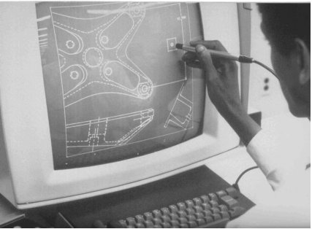
CSE 411
Computer Graphics
Lecture #6 2D Geometric Transformations
Prepared & Presented by Asst. Prof. Dr. Samsun M. BAŞARICI
Notes:
1

Slide 2
Objectives
HB Ch. 7, GVS Ch. 3
Basic 2D Transformations (rigid-body transformations):
  Translation
  Rotation
  Scaling
Homogenenous Representations and Coordinates
2D Composite Transformations

Slide 3
Objectives (cont.)
Other Transformations:
  Reflection
  Shearing
Raster Methods for Transformations and OpenGL
Transformations between 2D Coordinate Systems and OpenGL

Slide 4
Geometric Transformations
Sometimes also called modeling transformations
  Geometric transformations: Changing an object’s position (translation), orientation (rotation) or size (scaling)
  Modeling transformations: Constructing a scene or hierarchical description of a complex object
Others transformations: reflection and shearing operations

Slide 5
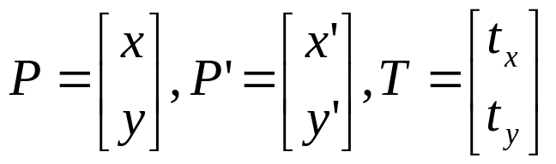
Basic 2D Geometric Transformations
2D Translation
  x’ = x + t_{x} , y’ = y + t_{y}
  P’=P+T
  Translation moves the object without deformation (rigid-body transformation)
P’
T
P

Slide 6
Basic 2D Geometric Transformations (cont.)
2D Translation
  To move a line segment, apply the transformation equation to each of the two line endpoints and redraw the line between new endpoints
  To move a polygon, apply the transformation equation to coordinates of each vertex and regenerate the polygon using the new set of vertex coordinates

Slide 7
2D Translation Routine
class wcPt2D {
public:
GLfloat x, y;
};
void translatePolygon (wcPt2D * verts, GLint nVerts, GLfloat tx, GLfloat ty)
{
GLint k;
for (k = 0; k < nVerts; k++) {
verts [k].x = verts [k].x + tx;
verts [k].y = verts [k].y + ty;
}
glBegin (GL_POLYGON);
for (k = 0; k < nVerts; k++)
glVertex2f (verts [k].x, verts [k].y);
glEnd ( );
}

Slide 8
Basic 2D Geometric Transformations (cont.)
2D Rotation
  Rotation axis
  Rotation angle
  rotation point or pivot point (x_{r},y_{r})
y_{r}
θ
x_{r}

Slide 9
Basic 2D Geometric Transformations (cont.)
2D Rotation
  If θ is positive → counterclockwise rotation
  If θ is negative → clockwise rotation
  Remember:
    cos(a + b) = cos a cos b - sin a sin b
    cos(a - b) = cos a sin b + sin a cos b

Slide 10
Basic 2D Geometric Transformations (cont.)
2D Rotation
  At first, suppose the pivot point is at the origin
  x’=r cos(θ+Φ) = r cos θ cos Φ - r sin θ sin Φ
  y’=r sin(θ+Φ) = r cos θ sin Φ + r sin θ cos Φ
  x = r cos Φ, y = r sin Φ
  x’=x cos θ - y sin θ
  y’=x sin θ + y cos θ
(x’,y’)
r
θ
r
(x,y)
Φ

Slide 11
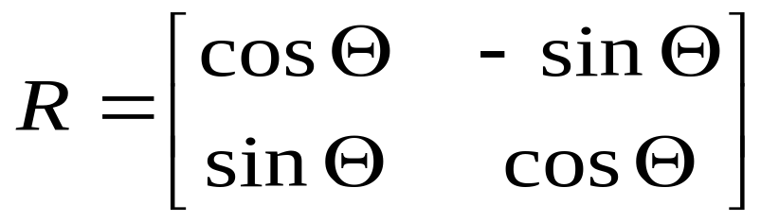
Basic 2D Geometric Transformations
2D Rotation
  P’=R·P
(x’,y’)
r
θ
r
(x,y)
Φ

Slide 12
Basic 2D Geometric Transformations (cont.)
2D Rotation
  Rotation of a point about any specified position (x_{r},y_{r})
  x’=x_{r}+(x - x_{r}) cos θ – (y - y_{r}) sin θ
  y’=y_{r}+(x - x_{r}) sin θ + (y - y_{r}) cos θ
  Rotations also move objects without deformation
  A line is rotated by applying the rotation formula to each of the endpoints and redrawing the line between the new end points
  A polygon is rotated by applying the rotation formula to each of the vertices and redrawing the polygon using new vertex coordinates

Slide 13
2D Rotation Routine
class wcPt2D {
public:
GLfloat x, y;
};
void rotatePolygon (wcPt2D * verts, GLint nVerts, wcPt2D pivPt, GLdouble theta)
{
wcPt2D * vertsRot;
GLint k;
for (k = 0; k < nVerts; k++) {
vertsRot [k].x = pivPt.x + (verts [k].x - pivPt.x) * cos (theta) - (verts [k].y - pivPt.y) * sin (theta);
vertsRot [k].y = pivPt.y + (verts [k].x - pivPt.x) * sin (theta) + (verts [k].y - pivPt.y) * cos (theta);
}
glBegin (GL_POLYGON);
for (k = 0; k < nVerts; k++)
glVertex2f (vertsRot [k].x, vertsRot [k].y);
glEnd ( );
}

Slide 14
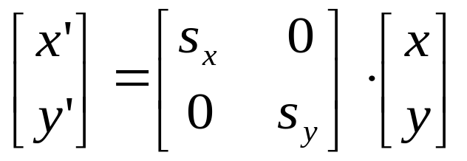
Basic 2D Geometric Transformations (cont.)
2D Scaling
  Scaling is used to alter the size of an object
  Simple 2D scaling is performed by multiplying object positions (x, y) by scaling factors s_{x} and s_{y}
  x’ = x · s_{x}
  y’ = y · s_{x}
  or P’ = S·P

Slide 15
Basic 2D Geometric Transformations (cont.)
2D Scaling
  Any positive value can be used as scaling factor
    Values less than 1 reduce the size of the object
    Values greater than 1 enlarge the object
    If scaling factor is 1 then the object stays unchanged
    If s_{x} = s_{y} , we call it uniform scaling
    If scaling factor <1, then the object moves closer to the origin and If scaling factor >1, then the object moves farther from the origin
x’
x

Slide 16
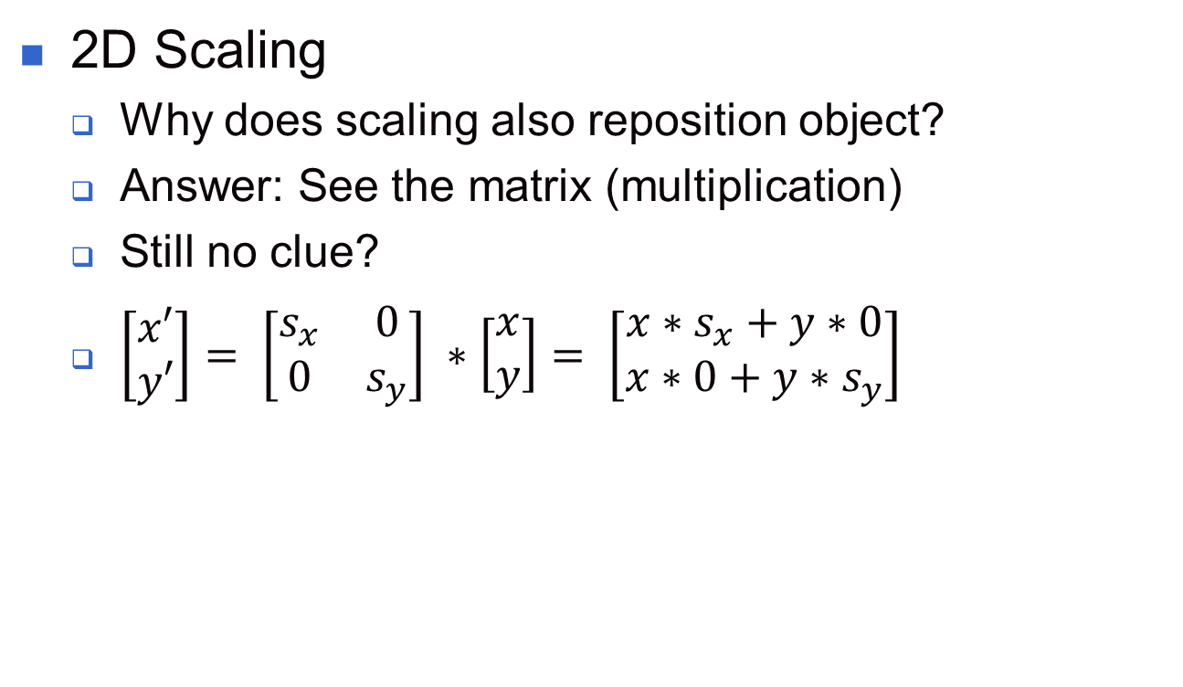
Basic 2D Geometric Transformations (cont.)
2D Scaling
  Why does scaling also reposition object?
  Answer: See the matrix (multiplication)
  Still no clue?
  $\left[\begin{matrix}x′ \\ y′\end{matrix}\right]= \left[\begin{matrix}s_{x} & 0 \\ 0 & s_{y}\end{matrix}\right] ∗\left[\begin{matrix}x \\ y\end{matrix}\right]= \left[\begin{matrix}x∗s_{x}+y∗0 \\ x∗0+y∗s_{y}\end{matrix}\right]$

Slide 17
Basic 2D Geometric Transformations (cont.)
2D Scaling
  We can control the location of the scaled object by choosing a position called the fixed point (x_{f},y_{f})
  x’ – x_{f} = (x – x_{f}) s_{x} y’ – y_{f} = (y – y_{f}) s_{y}
  x’=x · s_{x} + x_{f} (1 – s_{x})
  y’=y · s_{y} + y_{f} (1 – s_{y})
  Polygons are scaled by applying the above formula to each vertex, then regenerating the polygon using the transformed vertices

Slide 18
2D Scaling Routine
class wcPt2D {
public:
GLfloat x, y;
};
void scalePolygon (wcPt2D * verts, GLint nVerts, wcPt2D fixedPt, GLfloat sx,
GLfloat sy)
{
wcPt2D vertsNew;
GLint k;
for (k = 0; k < n; k++) {
vertsNew [k].x = verts [k].x * sx + fixedPt.x * (1 - sx);
vertsNew [k].y = verts [k].y * sy + fixedPt.y * (1 - sy);
}
glBegin (GL_POLYGON);
for (k = 0; k < n; k++)
glVertex2v (vertsNew [k].x, vertsNew [k].y);
glEnd ( );
}

Slide 19
Matrix Representations and Homogeneous Coordinates
Many graphics applications involve sequences of geometric transformations
  Animations
  Design and picture construction applications
We will now consider matrix representations of these operations
  Sequences of transformations can be efficiently processed using matrices

Slide 20
Matrix Representations and Homogeneous Coordinates (cont.)
P’ = M₁ · P + M₂
  P and P’ are column vectors
  M₁ is a 2 by 2 array containing multiplicative factors
  M₂ is a 2 element column matrix containing translational terms
  For translation M₁ is the identity matrix
  For rotation or scaling, M₂ contains the translational terms associated with the pivot point or scaling fixed point

Slide 21
Matrix Representations and Homogeneous Coordinates (cont.)
To produce a sequence of operations, such as scaling followed by rotation then translation, we could calculate the transformed coordinates one step at a time
A more efficient approach is to combine transformations, without calculating intermediate coordinate values

Slide 22
Matrix Representations and Homogeneous Coordinates (cont.)
Multiplicative and translational terms for a 2D geometric transformation can be combined into a single matrix if we expand the representations to 3 by 3 matrices
  We can use the third column for translation terms, and all transformation equations can be expressed as matrix multiplications

Slide 23
Matrix Representations and Homogeneous Coordinates (cont.)
Expand each 2D coordinate (x,y) to three element representation (x_{h},y_{h},h) called homogeneous coordinates
h is the homogeneous parameter such that x = x_{h}/h, y = y_{h}/h,
→ infinite homogeneous representations for a point
A convenient choice is to choose h = 1

Slide 24
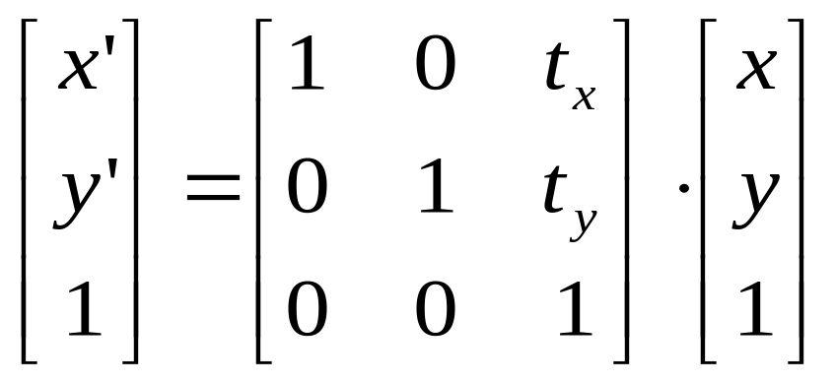
Matrix Representations and Homogeneous Coordinates (cont.)
2D Translation Matrix
or, P’ = T(t_{x},t_{y})·P

Slide 25
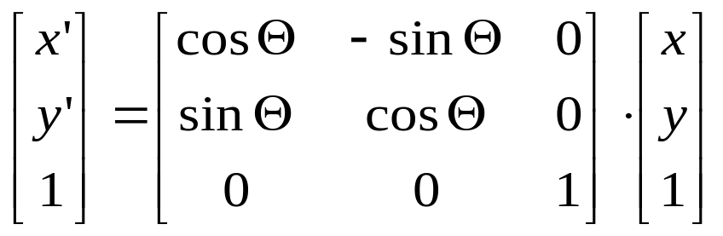
Matrix Representations and Homogeneous Coordinates (cont.)
2D Rotation Matrix
or, P’ = R(θ)·P

Slide 26
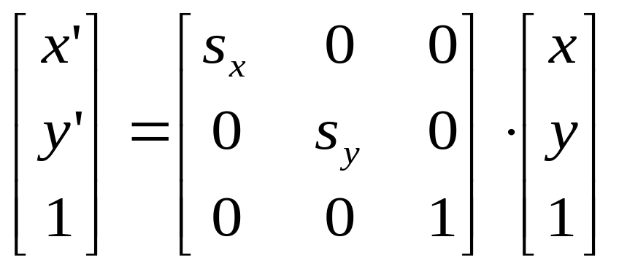
Matrix Representations and Homogeneous Coordinates (cont.)
2D Scaling Matrix
or, P’ = S(s_{x},s_{y})·P

Slide 27
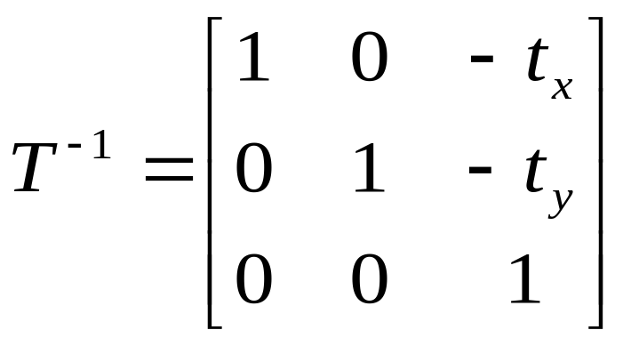
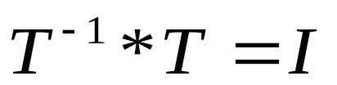
Inverse Transformations
2D Inverse Translation Matrix
By the way:

Slide 28
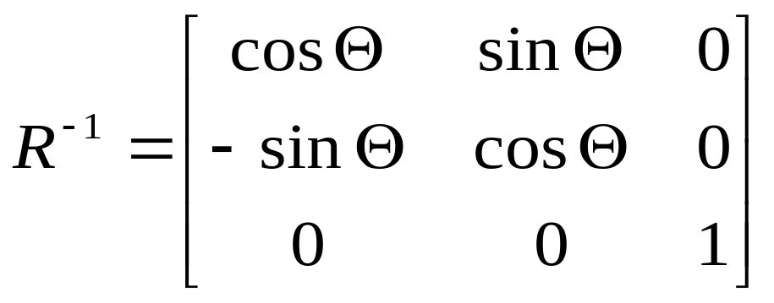
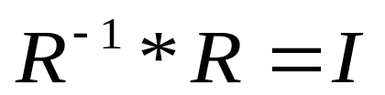
Inverse Transformations (cont.)
2D Inverse Rotation Matrix
And also:

Slide 29

Inverse Transformations (cont.)
2D Inverse Rotation Matrix:
  If θ is negative → clockwise
  In
  Only sine function is affected
  Therefore we can say
  Is that true?
  Proof: It’s up to you ☺

Slide 30
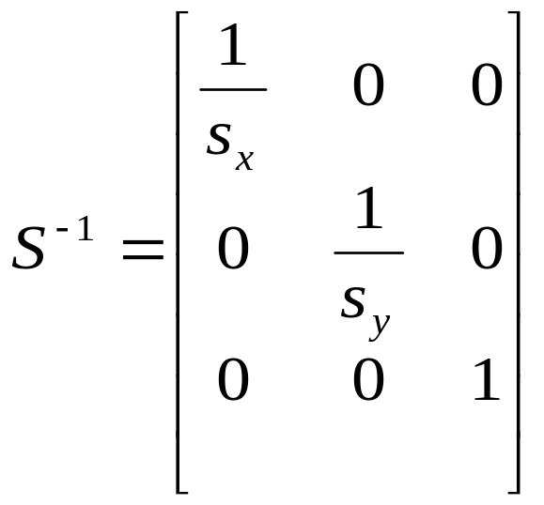
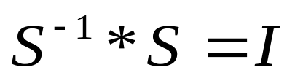
Inverse Transformations (cont.)
2D Inverse Scaling Matrix
Of course:

Slide 31
2D Composite Transformations
We can setup a sequence of transformations as a composite transformation matrix by calculating the product of the individual transformations
P’=M₂·M₁·P
=M·P

Slide 32
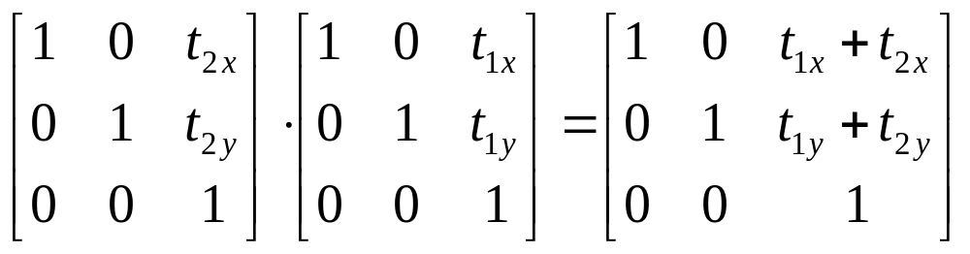
2D Composite Transformations (cont.)
Composite 2D Translations
  If two successive translation are applied to a point P, then the final transformed location P' is calculated as

Slide 33

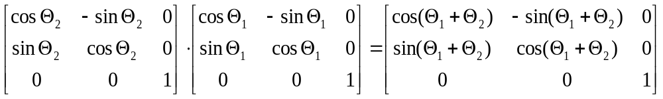
2D Composite Transformations (cont.)
Composite 2D Rotations

Slide 34
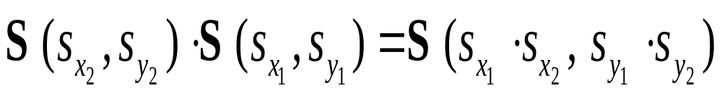
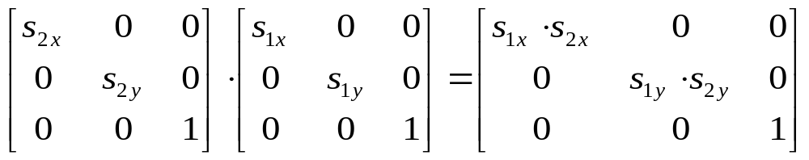
2D Composite Transformations (cont.)
Composite 2D Scaling

Slide 35
2D Composite Transformations (cont.)
Don’t forget:
Successive translations are additive
Successive scalings are multiplicative
  For example: If we triple the size of an object twice, the final size is nine (9) times the original
  9 times?
  Why?
  Proof: Again up to you ☺

Slide 36
General Pivot Point Rotation
Steps:
  Translate the object so that the pivot point is moved to the coordinate origin.
  Rotate the object about the origin.
  Translate the object so that the pivot point is returned to its original position.

Slide 37
General Pivot Point Rotation

Slide 38
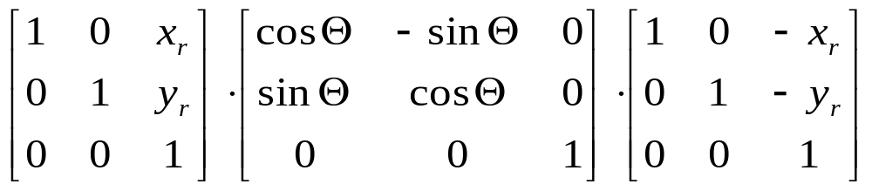
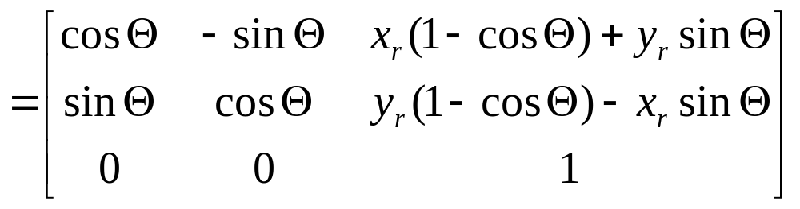
2D Composite Transformations (cont.)
General 2D Pivot-Point Rotation

Slide 39
General Fixed Point Scaling
Steps:
  Translate the object so that the fixed point coincides with the coordinate origin.
  Scale the object about the origin.
  Translate the object so that the pivot point is returned to its original position.

Slide 40
General Fixed Point Scaling (cont.)
(x_{r,} y_{r})
(x_{r,} y_{r})

Slide 41
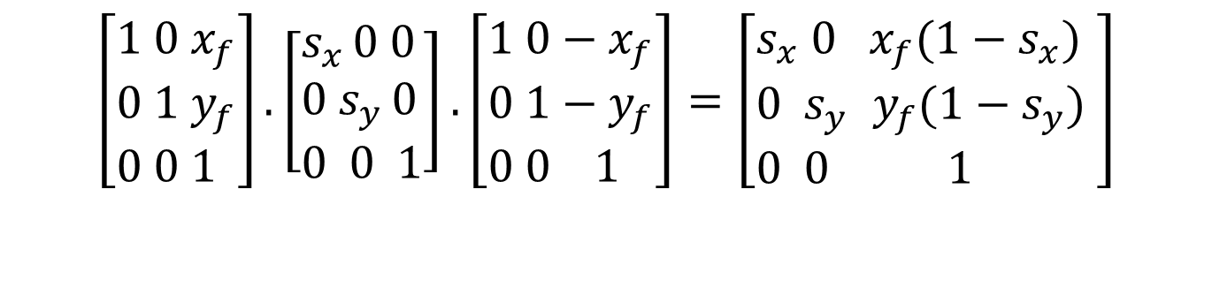
General Fixed Point Scaling (cont.)
General 2D Fixed-Point Scaling:
$$\left[\begin{aligned}&1 0{ x}_{f} \\ &0 1 y_{f} \\ &0 0 1\end{aligned}\right].\left[\begin{aligned}&s_{x }0 0 \\ &0{ s}_{y }0 \\ &0 0 1\end{aligned}\right].\left[\begin{aligned}&1 0−x_{f} \\ &0 1−y_{f} \\ &0 0 1\end{aligned}\right]=\left[\begin{aligned}&s_{x} 0{ x}_{f}(1−s_{x}) \\ &0{ s}_{y }y_{f}(1−s_{y}) \\ &0 0 1\end{aligned}\right]$$
$$T(x_{f},y_{f})⋅S(s_{x},s_{y})⋅T(−x_{f},−y_{f})=S(x_{f},y_{f},s_{x},s_{y})$$

Slide 42
2D Composite Transformations (cont.)
General 2D scaling directions:
  Above: scaling parameters were along x and y directions
  What about arbitrary directions?
  Answer: See next slides

Slide 43
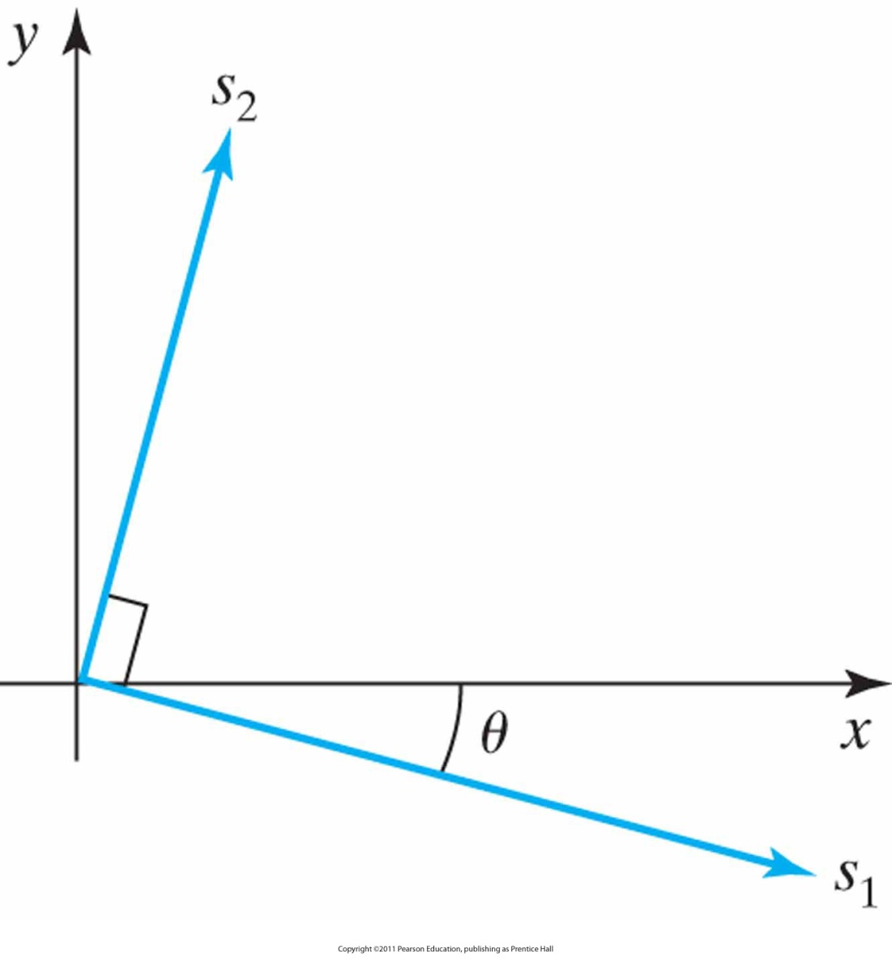
General 2D Scaling Directions
Scaling parameters s₁ and s₂ along orthogonal directions defined by the angular displacement θ.

Slide 44
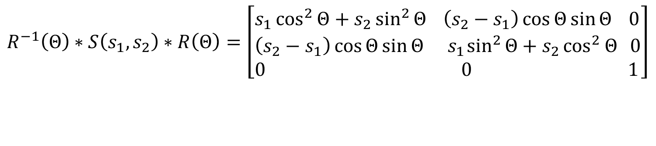
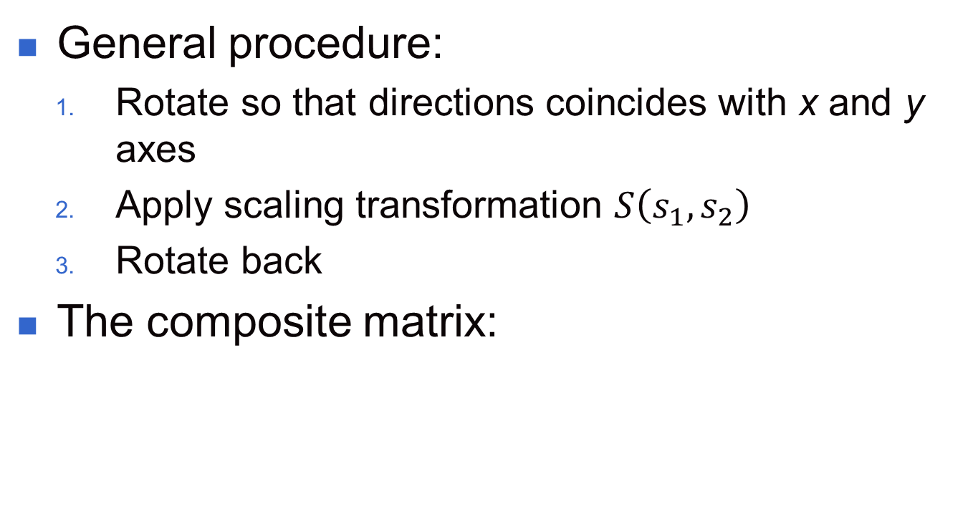
General 2D Scaling Directions (cont.)
General procedure:
  Rotate so that directions coincides with x and y axes
  Apply scaling transformation $S\left(s_{1},s_{2}\right)$
  Rotate back
The composite matrix:
$$R^{−1}\left(Θ\right)∗S\left(s_{1},s_{2}\right)∗R\left(Θ\right)=\left[\begin{aligned}&s_{1}\cos^{2}{Θ}+s_{2}\sin^{2}{Θ} \left(s_{2}−s_{1}\right)\cos{Θ}\sin{Θ }0 \\ &\left(s_{2}−s_{1}\right)\cos{Θ}\sin{Θ}{ s}_{1}\sin^{2}{Θ}+s_{2}\cos^{2}{Θ} 0 \\ &0 0 1\end{aligned}\right]$$

Slide 45
2D Composite Transformations (cont.)
Matrix Concatenation Properties:
  Matrix multiplication is associative !
    M₃· M₂· M₁= (M₃· M₂ ) · M₁ = M₃· ( M₂ · M₁ )
    A composite matrix can be created by multiplicating left-to-right (premultiplication) or right-to-left (postmultiplication)
  Matrix multiplication is not commutative !
    M₂ · M₁ ≠ M₁ · M₂

Slide 46
2D Composite Transformations (cont.)
Matrix Concatenation Properties:
    But:
      Two successive rotations
      Two successive translations
      Two successive scalings
    are commutative!
  Why?
  Proof: You got it: Up to you ☺ ☺

Slide 47
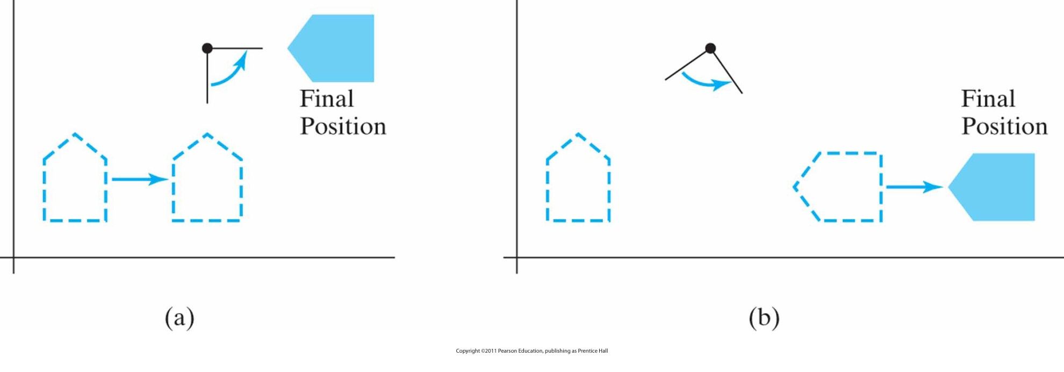
Reversing the order
in which a sequence of transformations is performed may affect the transformed position of an object.
In (a), an object is first translated in the x direction, then rotated counterclockwise through an angle of 45°.
In (b), the object is first rotated 45° counterclockwise, then translated in the x direction

Slide 48
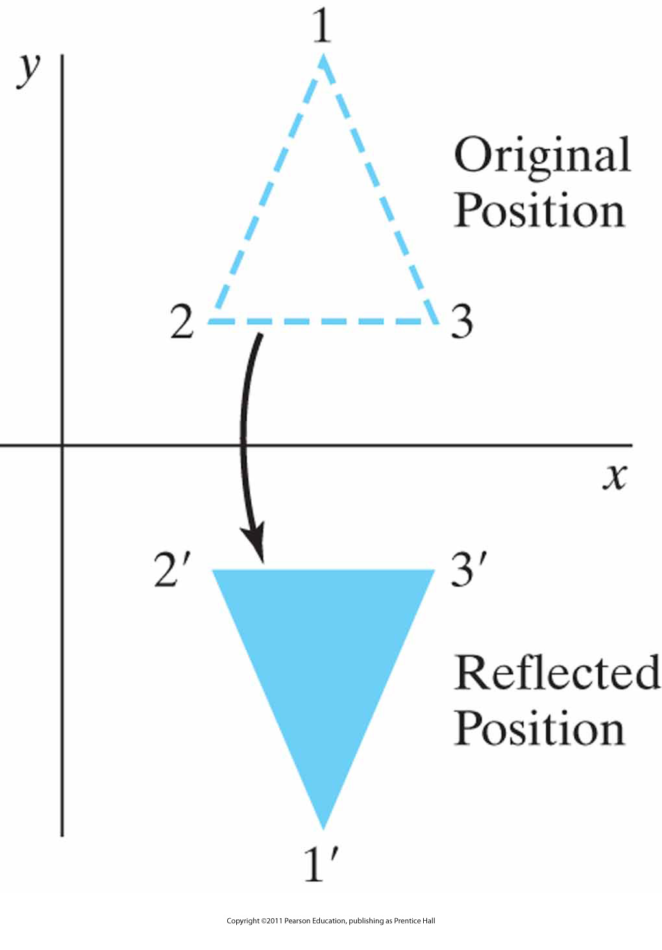
Other 2D Transformations
Reflection
  Transformation that produces a mirror image of an object

Slide 49
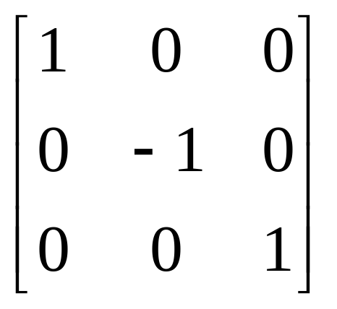
Other 2D Transformations (cont.)
Reflection
  Image is generated relative to an axis of reflection by rotating the object 180° about the reflection axis
  Reflection about the line y=0 (the x axis) (previous slide)

Slide 50
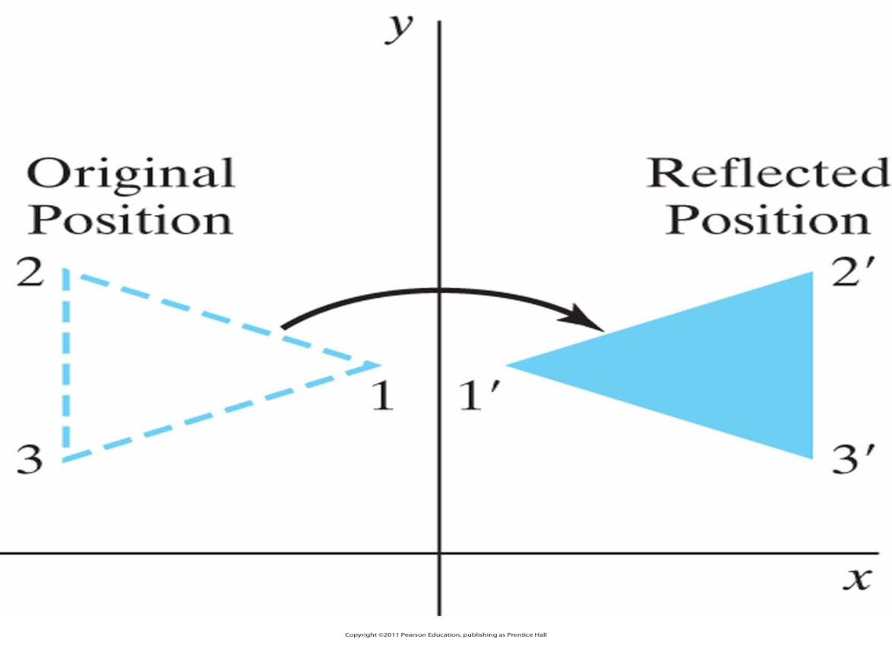
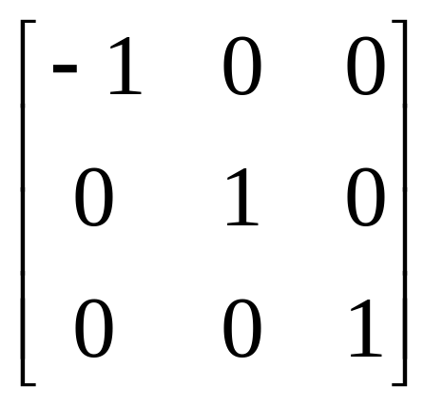
Other 2D Transformations (cont.)
Reflection
  Reflection about the line x=0 (the y axis)

Slide 51
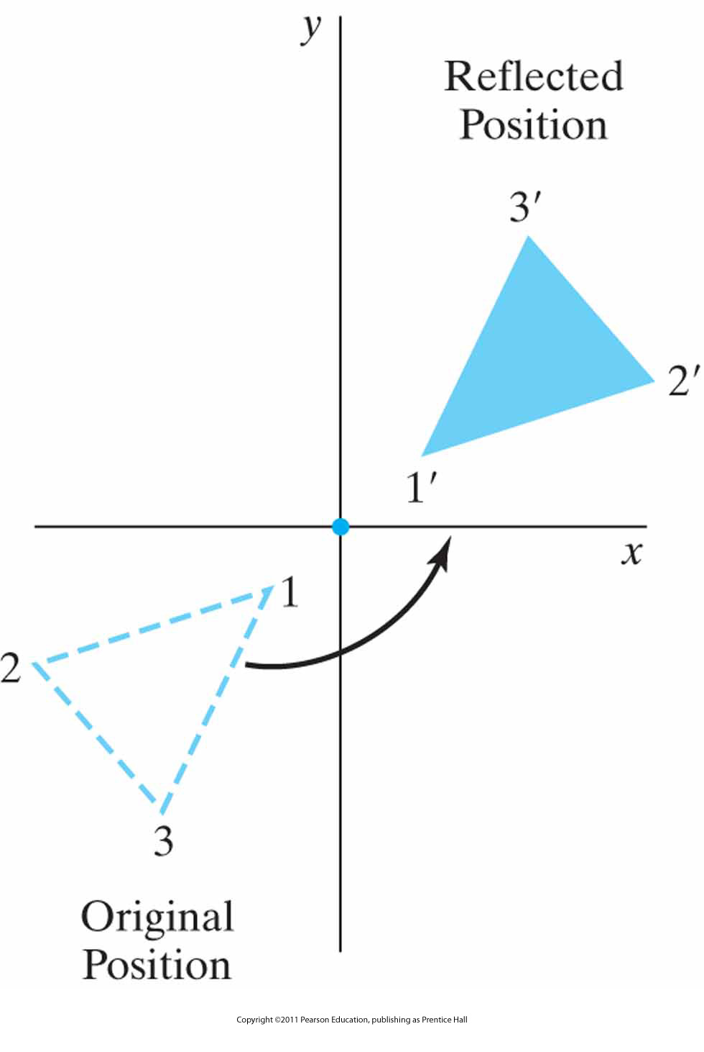
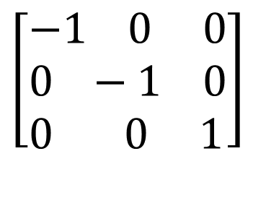
Other 2D Transformations (cont.)
Reflection about the origin
$$\left[\begin{aligned}&−1 0 0 \\ &0 −1 0 \\ &0 0 1\end{aligned}\right]$$

Slide 52
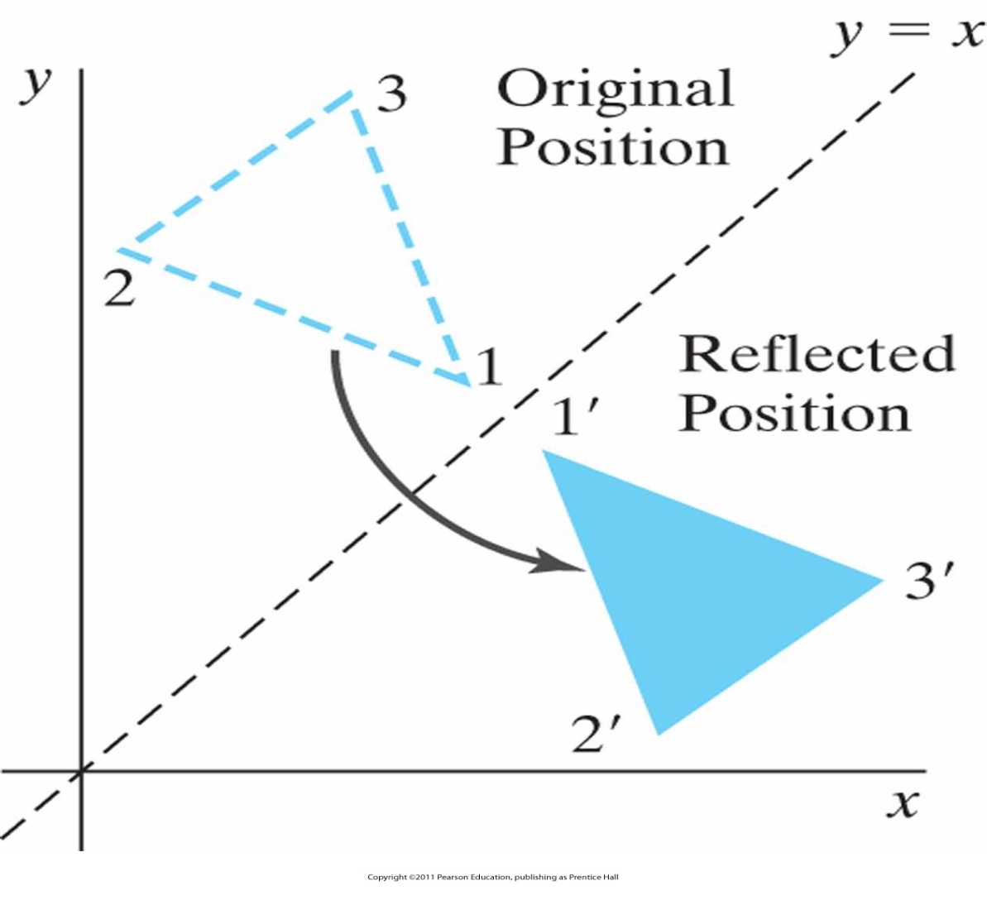
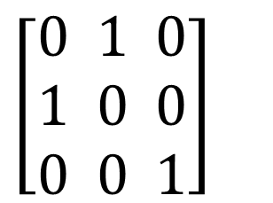
Other 2D Transformations (cont.)
Reflection about the line y=x
$$\left[\begin{aligned}&0 1 0 \\ &1 0 0 \\ &0 0 1\end{aligned}\right]$$

Slide 53
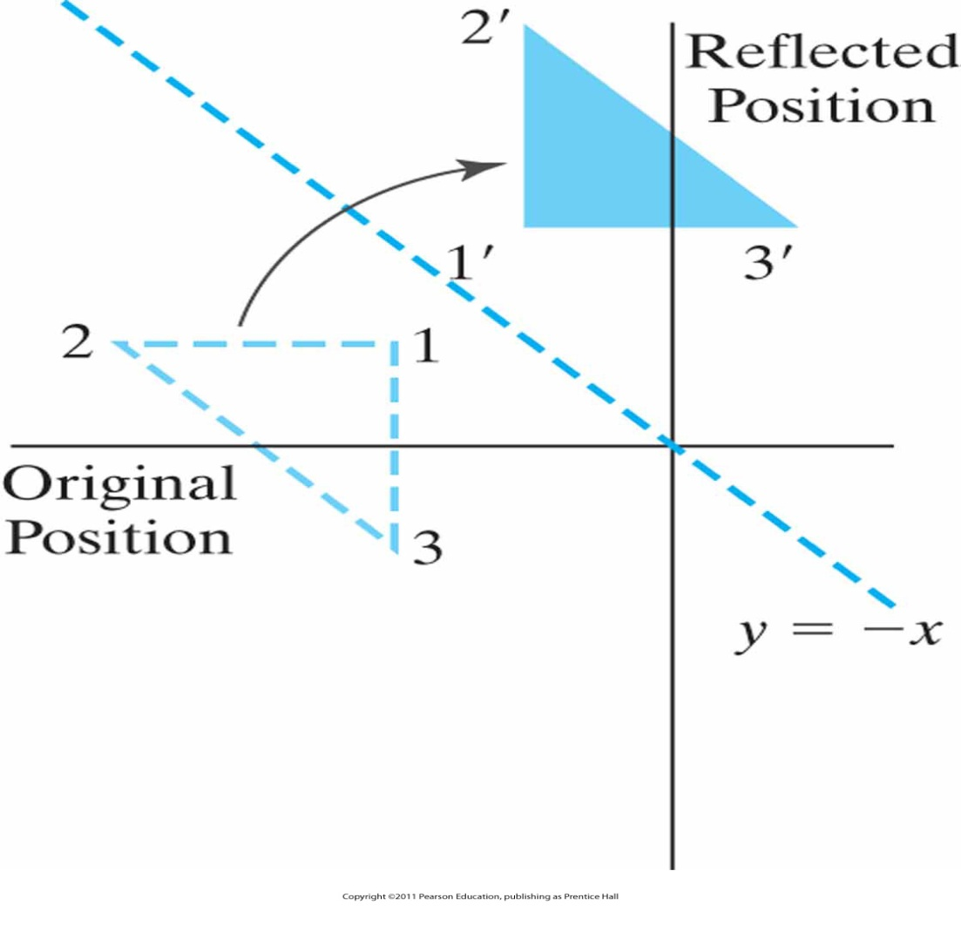
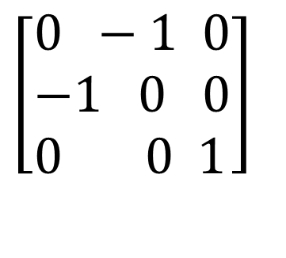
Other 2D Transformations (cont.)
Reflection about the line y=-x
$$\left[\begin{aligned}&0 −1 0 \\ &−1 0 0 \\ &0 0 1\end{aligned}\right]$$

Slide 54
Other 2D Transformations (cont.)
Shear
  Transformation that distorts the shape of an object such that the transformed shape appears as the object was composed of internal layers that had been caused to slide over each other
y
y
(2,1)
(3,1)
(0,1)
(1,1)
(0,0)
(1,0)
(1,0)
x
(0,0)
x
sh_{x}=2

Slide 55
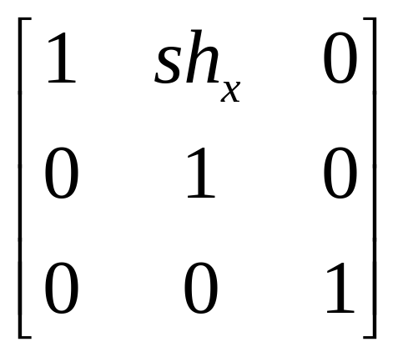
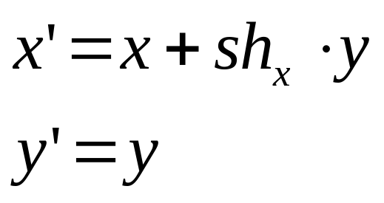
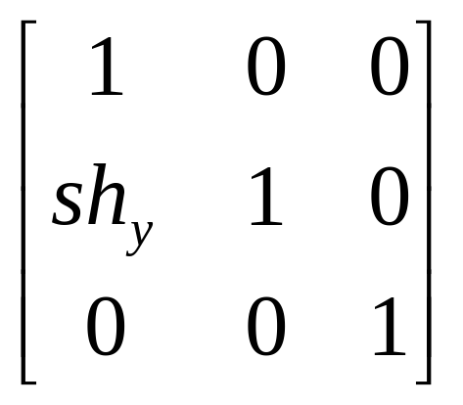
Other 2D Transformations (cont.)
Shear
  An x-direction shear relative to the x axis
  An y-direction shear relative to the y axis

Slide 56
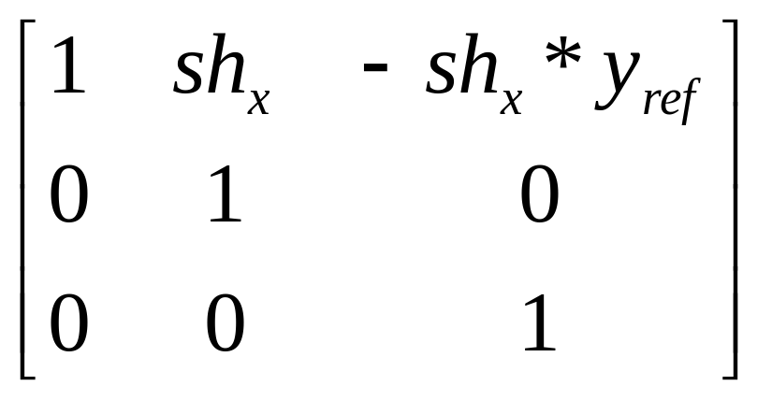
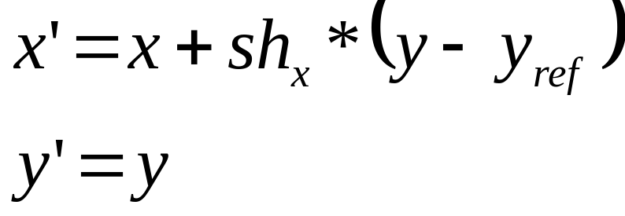
Other 2D Transformations (cont.)
Shear
  x-direction shear relative to other reference lines

Slide 57
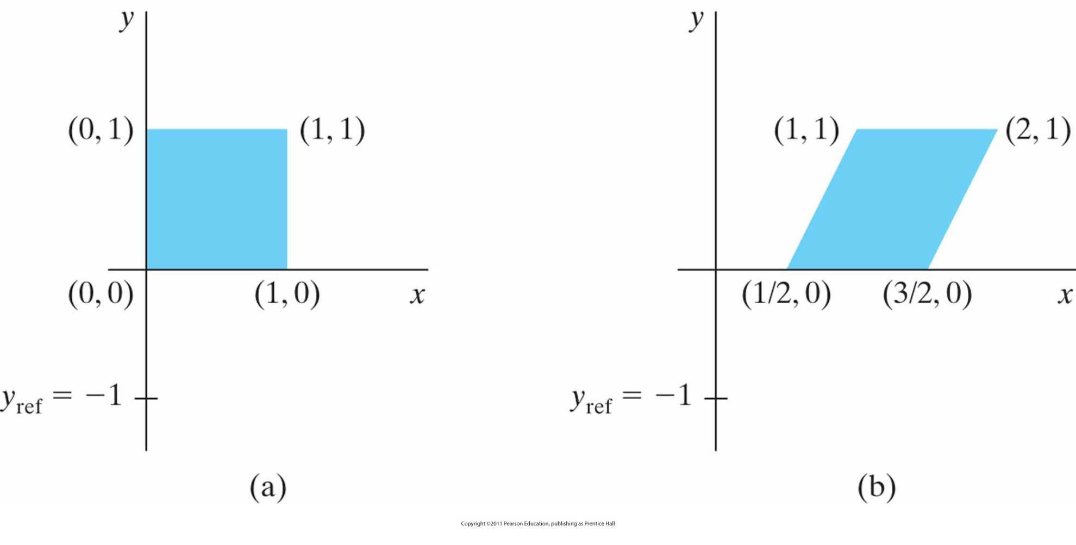
Example
A unit square (a) is transformed to a shifted parallelogram
(b) with sh_{x} = 0.5 and y_{ref} = −1 in the shear matrix from Slide 56

Slide 58
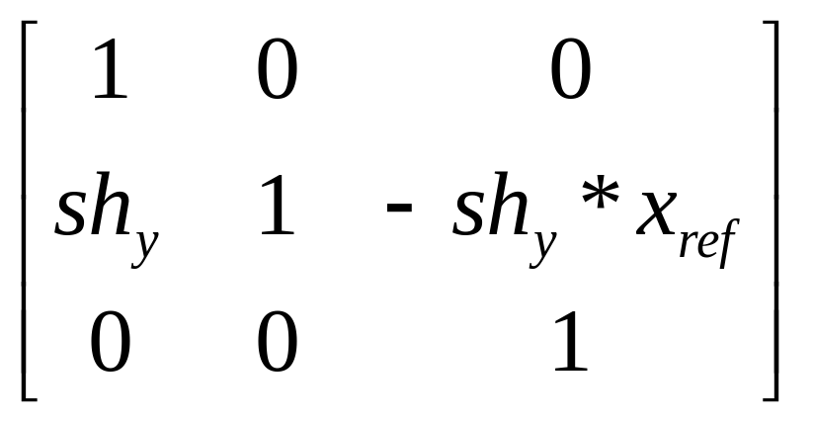
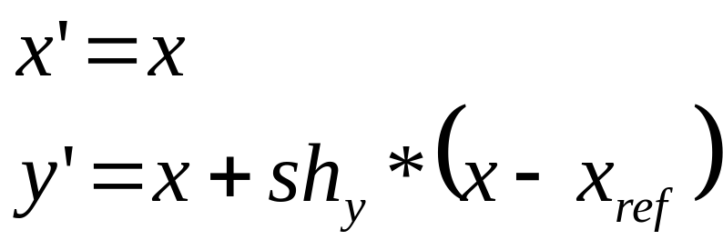
Other 2D Transformations (cont.)
Shear
  y-direction shear relative to the line x = x_{ref}

Slide 59
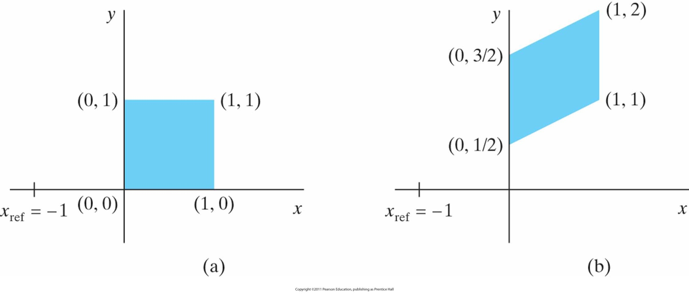
Example
A unit square (a) is turned into a shifted parallelogram
(b) with parameter values sh_{y} = 0.5 and x_{ref} = −1 in the y -direction shearing transformation from Slide 58

Slide 60
Raster Methods for Transformations and OpenGL
This slide is intentionally left blank
Your responsibility to fill it ☺

Slide 61
Transformation Between Coordinate Systems
Individual objects may be defined in their local cartesian reference system.
The local coordinates must be transformed to position the objects within the scene coordinate system.

Slide 62
Transformation Between Coordinate Systems
Steps for coordinate transformation
Translate so that the origin (x₀, y₀ ) of the x′-y′ system is moved to the origin of the x-y system.
Rotate the x′ axis on to the axis x.

Slide 63
Transformation Between Coordinate Systems (cont.)
y
x′
y'
y₀
θ
0
x₀
x

Slide 64
Transformation Between Coordinate Systems (cont.)
y
y₀
x′
y′
θ
0
x₀
x

Slide 65
Transformation Between Coordinate Systems (cont.)
y
y₀
y′
0
x′
x₀
x

Slide 66
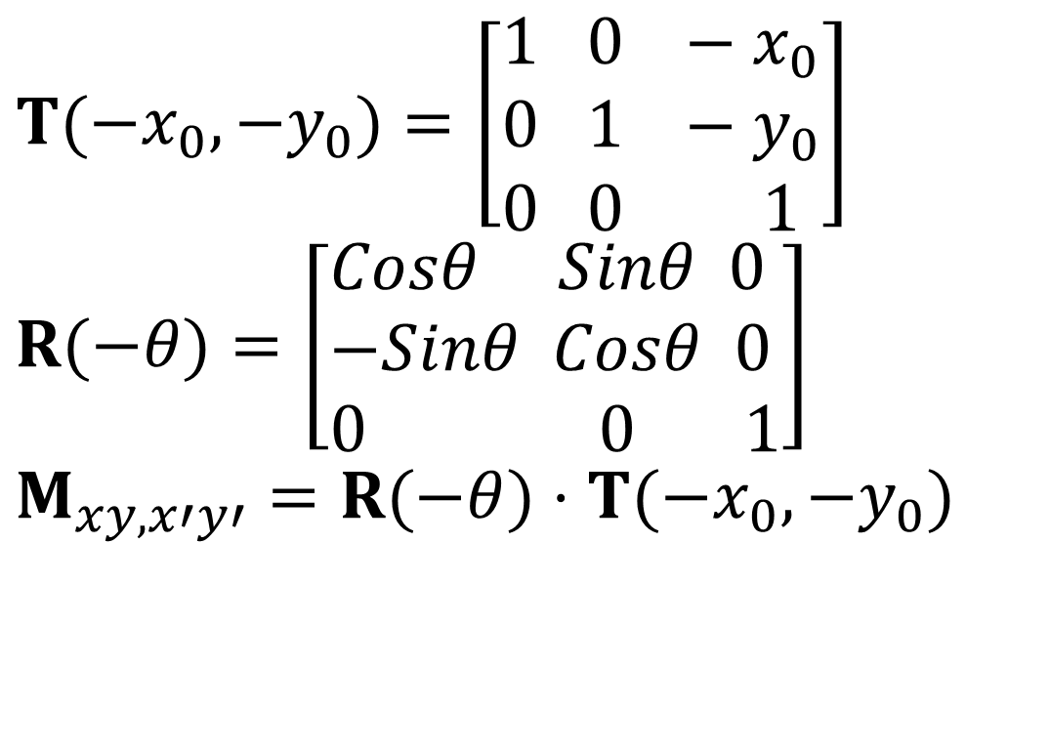
Transformation Between Coordinate Systems (cont.)
$$T(−x_{0},−y_{0})=\left[\begin{aligned}&1 0 −x_{0} \\ &0 1 −y_{0} \\ &0 0 1\end{aligned}\right] \\ R(−θ)=\left[\begin{aligned}&Cosθ Sinθ 0 \\ &−Sinθ Cosθ 0 \\ &0 0 1\end{aligned}\right] \\ M_{xy,x′y′}=R(−θ)⋅T(−x_{0},−y_{0})$$

Slide 67
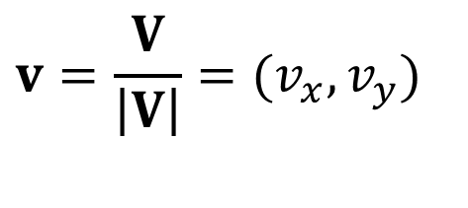
Transformation Between Coordinate Systems (cont.)
An alternative method:
-Specify a vector V that indicates the direction
for the positive y′ axis. Let
-Obtain the unit vector u=(u_{x} ,u _{y}) along the x′ axis by rotating v 90⁰ clockwise.
$$v=\frac{V}{\left|V\right|}=(v_{x},v_{y})$$

Slide 68
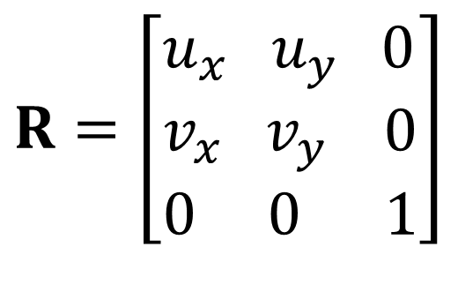
Transformation Between Coordinate Systems (cont.)
Elements of any rotation matrix can be expressed as elements of orthogonal unit vectors. That is, the rotation matrix can be written as
$$R=\left[\begin{aligned}&u_{x}{ u}_{y} 0 \\ &v_{x}{ v}_{y} 0 \\ &0 0 1\end{aligned}\right]$$

Slide 69
Transformation Between Coordinate Systems (cont.)
y
x′
y′
y₀
V
0
x₀
x

Slide 70
OpenGL Geometric Transformation Functions
A separate function is available for each of the basic geometric transformations
AND
All transformations are specified in three dimensions
Why?
Answer: Remember; OpenGL was developed as 3D library
But how to perform 2D transformations?
Answer: Set z = 0

Slide 71
Basic OpenGL Geometric Transformations
Translation
  glTranslate* (tx, ty, tz);
    * is either f or d
    tx, ty and tz are any real number
    For 2D, set tz=0.0
Rotation
  glRotate* (theta, vx, vy, vz);
    * is either f or d
    theta is rotation angle in degrees (internally converted to radian)
    Vector v=(vx, vy, vz) defines the orientation for a rotation axis that passes through the coordinate origin
    For 2D, set vz=1.0 and vx=vy=0.0

Slide 72
Basic OpenGL Geometric Transformations (cont.)
Scaling
  glScale* (sx, sy, sz);
    * is either f or d
    sx, sy and sz are any real number
    Negative values generate reflection
    Zero values can cause error because inverse matrix cannot be calculated
All routines construct a 4x4 transformation matrix
OpenGL uses composite matrices
  Be careful with the order

Slide 73
OpenGL Matrix Operations
glMatrixMode(.);
  Projection Mode: Determines how the scene is projected onto the screen
  Modelview Mode: Used for storing and combining geometric transformations
  Texture Mode: Used for mapping texture patterns to surfaces
  Color Mode: Used to convert from one color mode to another

Slide 74
OpenGL Matrix Operations
Modelview matrix, used to store and combine geometric transformations
  glMatrixMode(GL_MODELVIEW);
A call to a transformation routine generates a matrix that is multiplied by the current matrix
To assign the identity matrix to the current matrix
  glLoadIdentity();

Slide 75
OpenGL Matrix Operations (cont.)
Alternatively:
  glLoadMatrix* (elements16);
  To assign other values to the elements of the current matrix
  In column-major order:
    First four elements in first column
    Second four elements in second column
    Third four elements in third column
    Fourth four elements in fourth column

Slide 76
OpenGL Matrix Operations (cont.)
Concatenating a specified matrix with current matrix:
  glMultMatrix* (otherElements16);
  Current matrix is postmultiplied (right-to-left) by the specified matrix
Warning:
Matrix notation m_{jk} means:
  In OpenGL: j → column, k → row
  In mathematics: j → row, k → column

Slide 77
OpenGL Matrix Stacks
OpenGL maintains a matrix stack for transformations
Initially the modelview stack contains only the identity matrix
More about it:
  Coming soon

Slide 78
OpenGL Transformation Routines
For example, assume we want to do in the following order:
  translate by +2, -3, +4,
  rotate by 45⁰ around axis formed between origin and 1, 1, 1
  scale with respect to the origin by 2 in each direction.
Our code would be
glMatrixMode(GL_MODELVIEW);
glLoadIdentity(); //start with identity
glScalef(2.0,2.0,2.0); //Note: Start with the LAST operation
glRotatef(45.0,1.0,1.0,1.0);
glTranslatef(2.0,-3.0, 4.0); //End with the FIRST operation

Slide 79
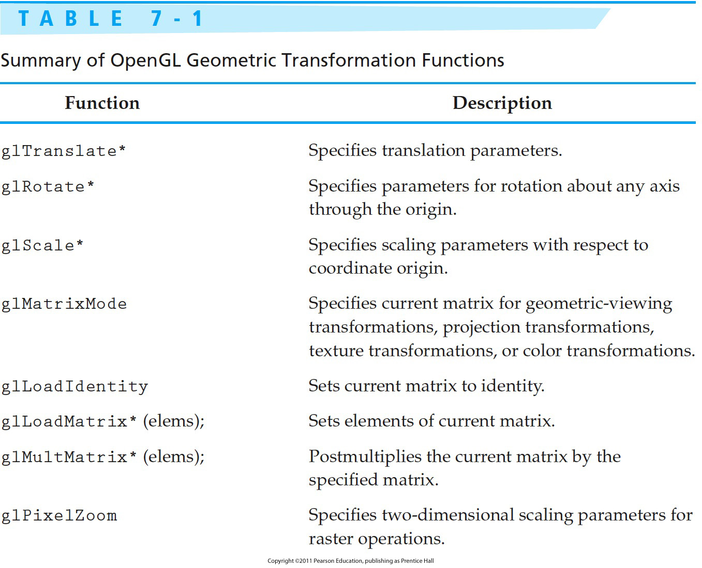
OpenGL Transformation Functions

Slide 80

Next Lecture
3D Geometric Transformations
80
Notes:
80

Slide 81
References
Donald Hearn, M. Pauline Baker, Warren R. Carithers, “Computer Graphics with OpenGL, 4th Edition”; Pearson, 2011
Sumanta Guha, “Computer Graphics Through OpenGL: From Theory to Experiments”, CRC Press, 2010
Edward Angel, “Interactive Computer Graphics. A Top-Down Approach Using OpenGL”, Addison-Wesley, 2005
81

