Slide 1


CSE306 Operating Systems
Lecture #6
Input / Output
Prepared & Presented by Asst. Prof. Dr. Samsun M. BAŞARICI

Slide 2
Topics covered
I/O devices
  Principles
  Classes
Memory mapped I/O
Interrupts
  Interrupt handlers
  Interrupt vectors
DMA
Disk hardware, CDs, DVDs
Clocks
Keyboards, mice
Monitors, GUIs
X Window System

Slide 3
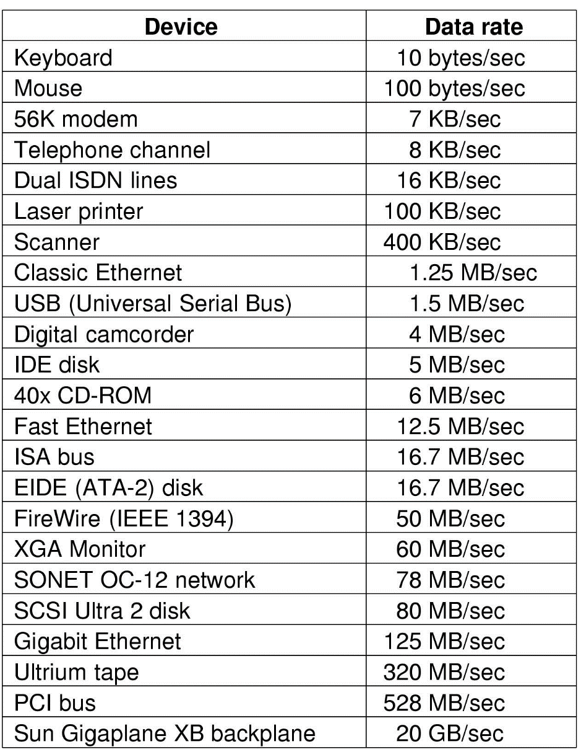
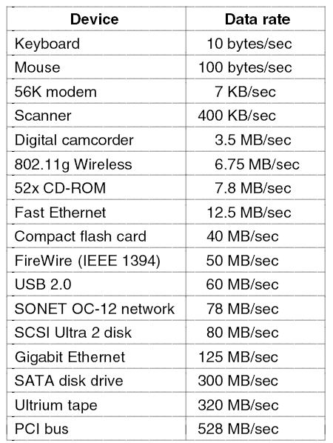
Principles of I/O Hardware
Some typical device, network, and data base rates

Slide 4
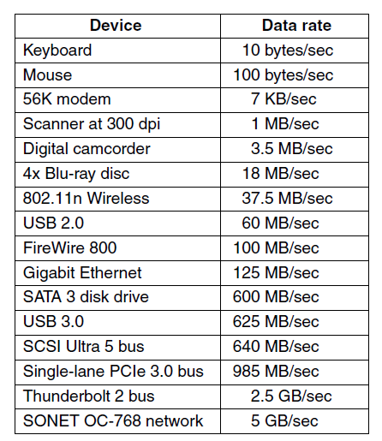
I/O Devices
Some typical device, network, and bus data rates.

Slide 5
I/O Devices (cont.)
Block devices
  Stores information in fixed-size blocks
  Transfers are in units of entire blocks
Character devices
  Delivers or accepts stream of characters, without regard to block structure
  Not addressable, does not have any seek operation

Slide 6
Device Controllers
I/O devices have components:
  mechanical component
  electronic component
The electronic component is the device controller
  may be able to handle multiple devices
Controller's tasks
  convert serial bit stream to block of bytes
  perform error correction as necessary
  make available to main memory

Slide 7
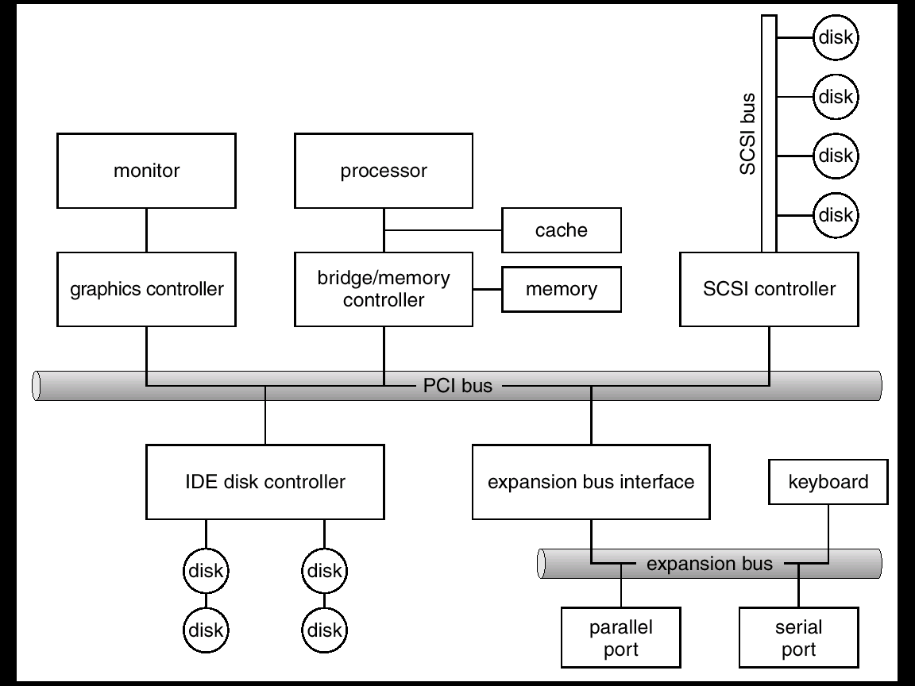
Bus structure of a PC

Slide 8
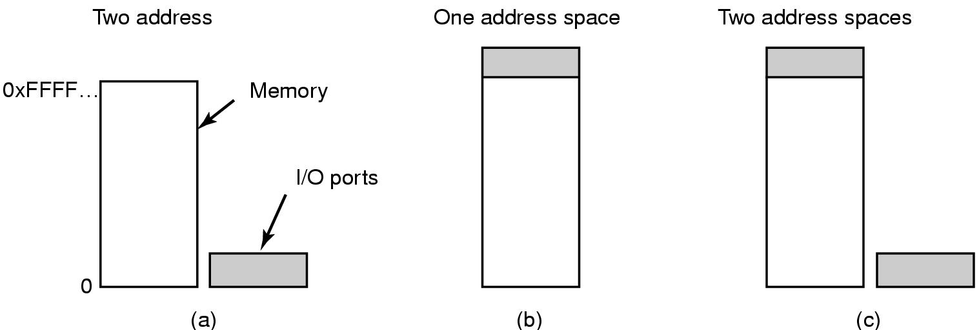
Memory-Mapped I/O
(a) Separate I/O and memory space
(b) Memory-mapped I/O
(c) Hybrid

Slide 9
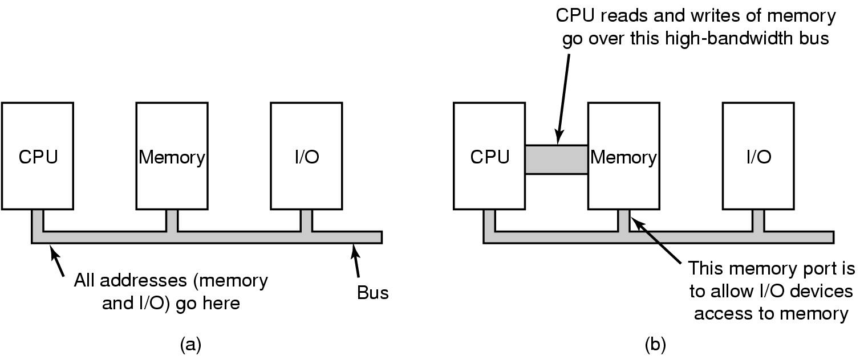
Memory-Mapped I/O (cont.)
(a) A single-bus architecture
(b) A dual-bus memory architecture

Slide 10
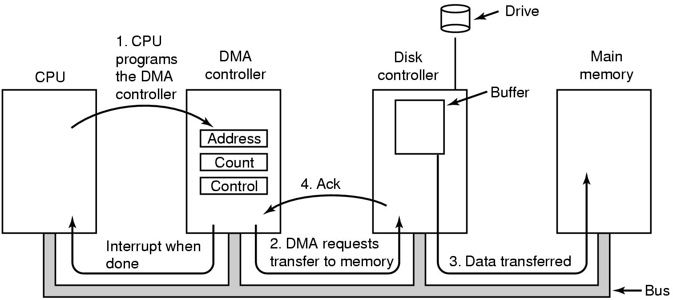
Direct Memory Access (DMA)
Operation of a DMA transfer

Slide 11
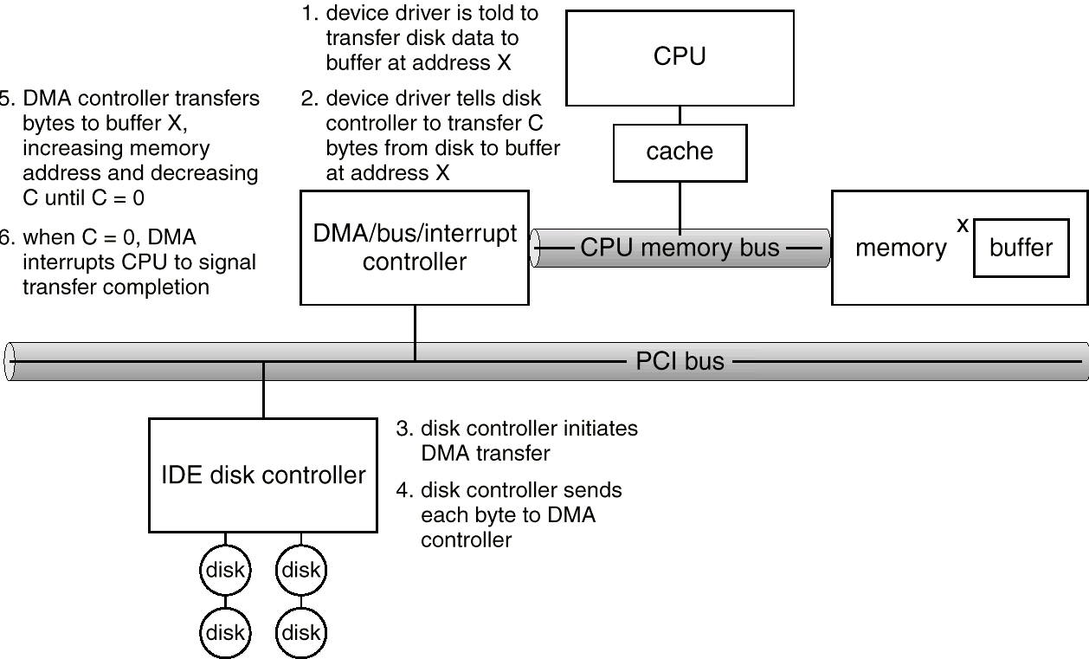
DMA transfer

Slide 12
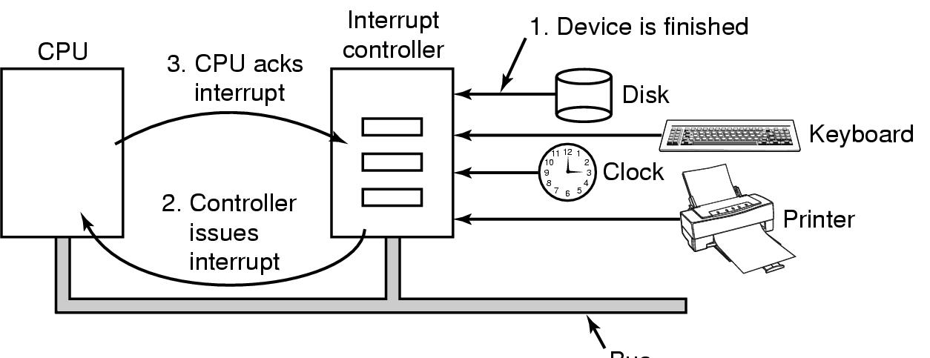
Interrupts Revisited
How interrupts happen. Connections between devices and interrupt controller actually use interrupt lines on the bus rather than dedicated wires

Slide 13
Precise and Imprecise Interrupts
Properties of a precise interrupt
PC (Program Counter) is saved in a known place.
All instructions before the one pointed to by the PC have fully executed.
No instruction beyond the one pointed to by the PC has been executed.
Execution state of the instruction pointed to by the PC is known.

Slide 14
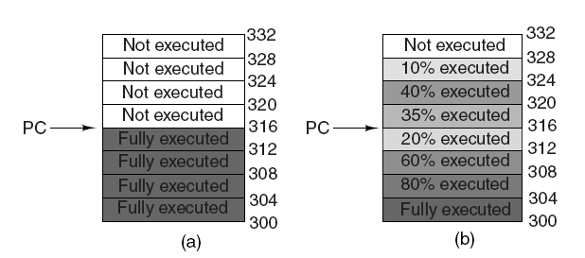
Precise and Imprecise Interrupts (cont.)
Figure 5-6. (a) A precise interrupt. (b) An imprecise interrupt.

Slide 15
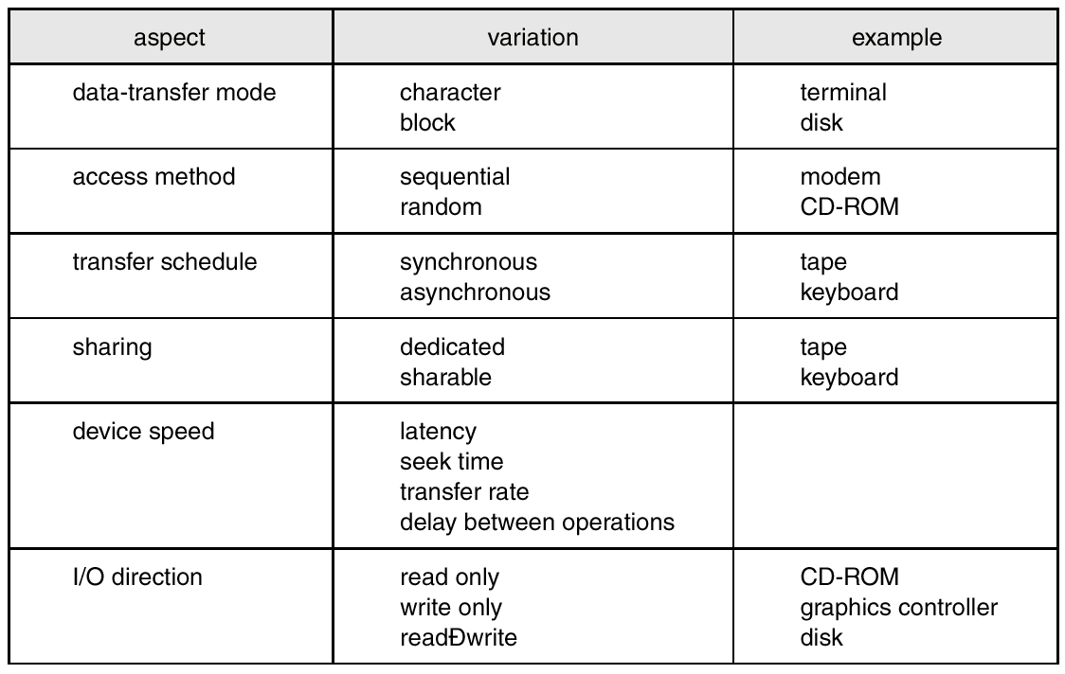
I/O modes

Slide 16
Principles of I/O Software
Goals of I/O Software
Device independence
  programs can access any I/O device
  without specifying device in advance
    (floppy, hard drive, or CD-ROM)
Uniform naming
  name of a file or device a string or an integer
  not depending on which machine
Error handling
  handle as close to the hardware as possible

Slide 17
Goals of I/O Software (cont.)
Synchronous vs. asynchronous transfers
  blocked transfers vs. interrupt-driven
Buffering
  data coming off a device cannot be stored in final destination
Sharable vs. dedicated devices
  disks are sharable
  tape drives would not be

Slide 18
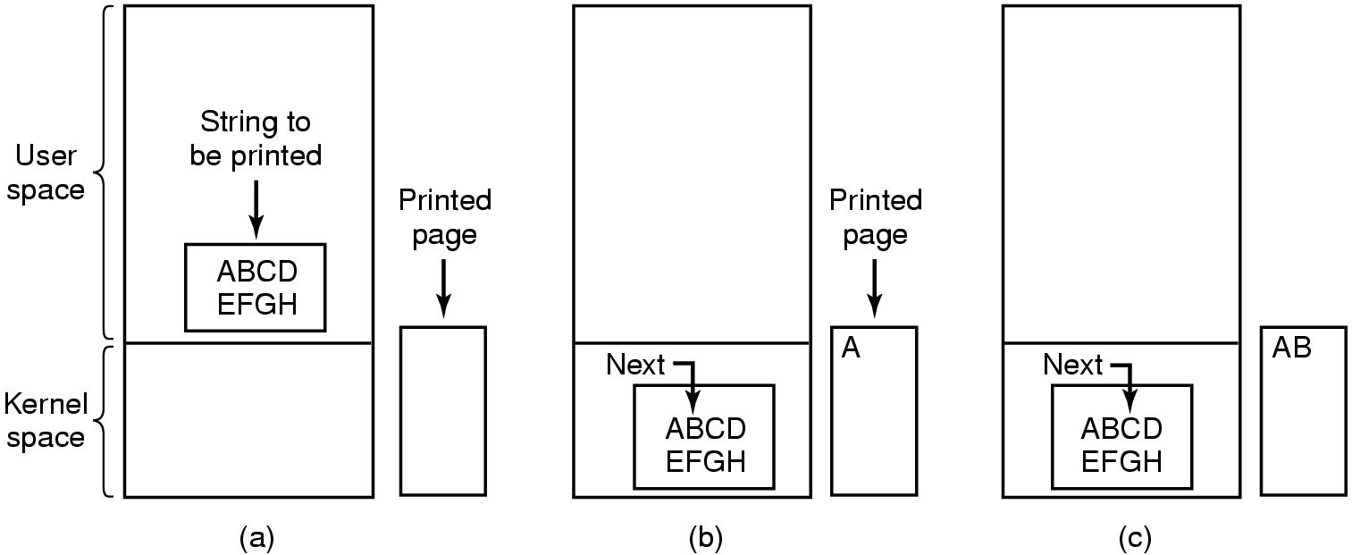
Programmed I/O
Steps in printing a string

Slide 19
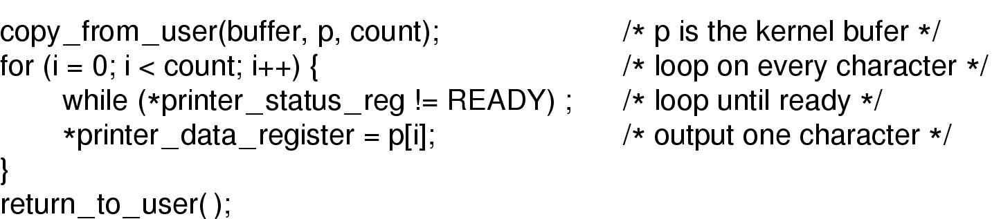
Programmed I/O (cont.)
Writing a string to the printer using programmed I/O

Slide 20
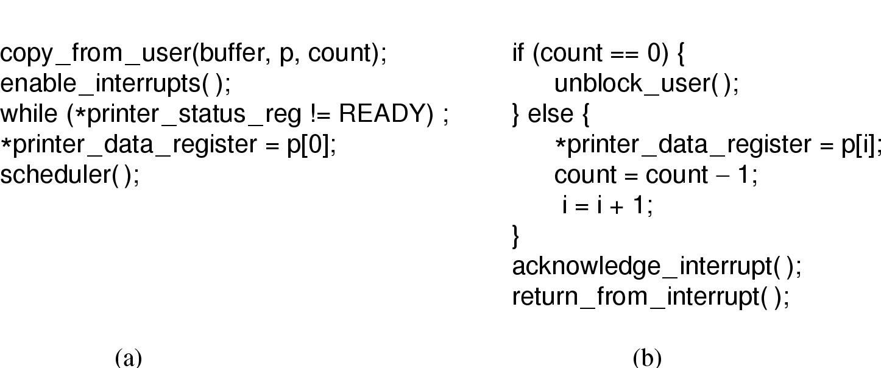
Interrupt-Driven I/O
Writing a string to the printer using interrupt-driven I/O
  (a) Code executed when print system call is made
  (b) Interrupt service procedure

Slide 21
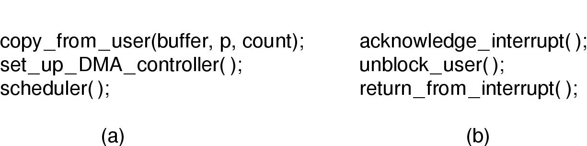
I/O Using DMA
Printing a string using DMA
  (a) code executed when the print system call is made
  (b) interrupt service procedure

Slide 22
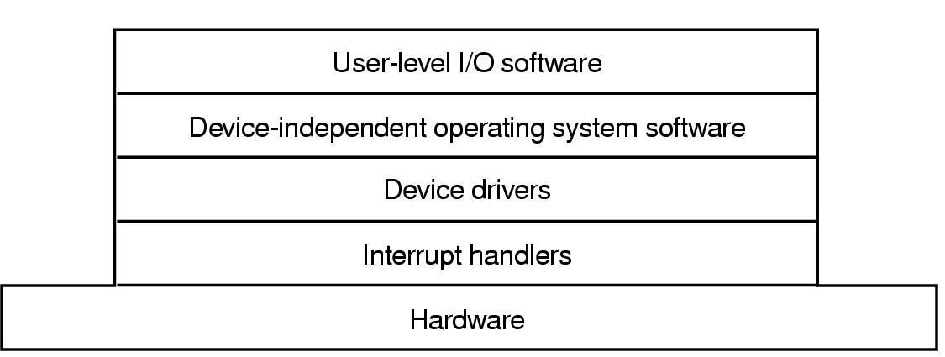
I/O Software Layers
Layers of the I/O Software System

Slide 23
Interrupt Handlers
Interrupt handlers are best hidden
  have driver starting an I/O operation block until interrupt notifies of completion
Interrupt procedure does its task
  then unblocks driver that started it
Steps must be performed in software after interrupt completed
  Save regs not already saved by interrupt hardware
  Set up context for interrupt service procedure

Slide 24
Interrupt Handlers (cont.)
  Set up stack for interrupt service procedure
  Ack interrupt controller, reenable interrupts
  Copy registers from where saved
  Run service procedure
  Choose which process to run next.
  Set up MMU context for process to run next
  Load new process' registers
  Start running the new process

Slide 25
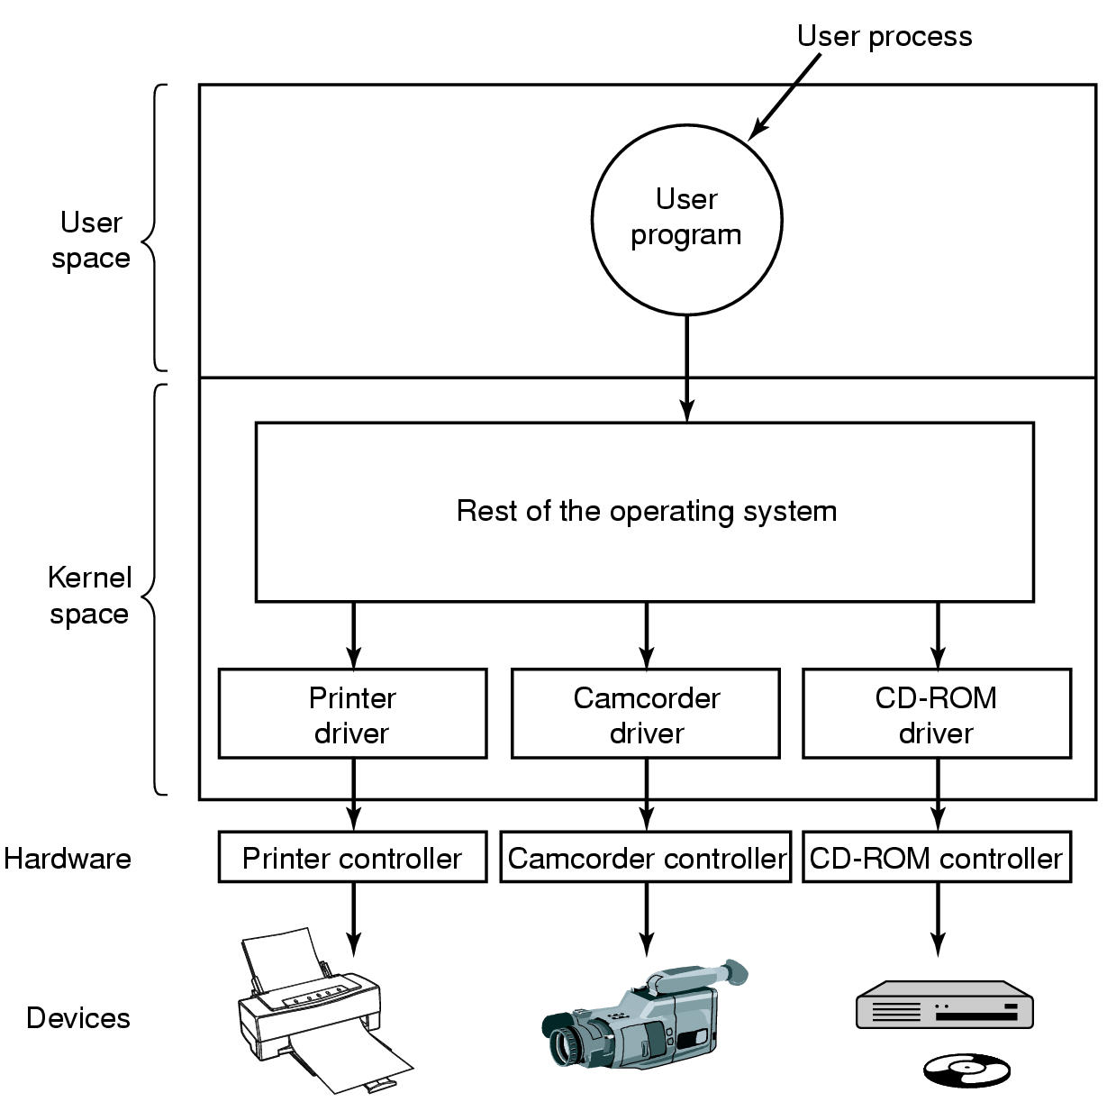
Device Drivers
Logical position of device drivers is shown here
Communications between drivers and device controllers goes over the bus

Slide 26
Device-Independent I/O Software
Uniform interfacing for device drivers
Buffering
Error reporting
Allocating and releasing dedicated devices
Providing a device-independent block size
Functions of the device-independent I/O software

Slide 27
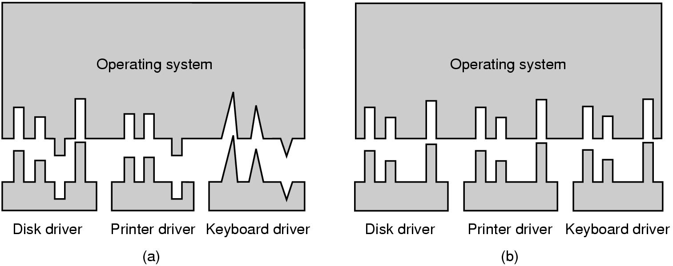
Uniform Interfacing for Device Drivers
(a) Without a standard driver interface
(b) With a standard driver interface

Slide 28
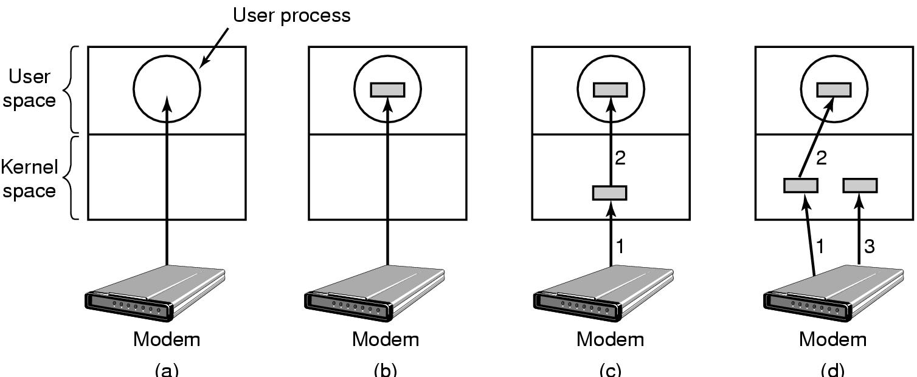
Buffering
(a) Unbuffered input
(b) Buffering in user space
(c) Buffering in the kernel followed by copying to user space
(d) Double buffering in the kernel

Slide 29
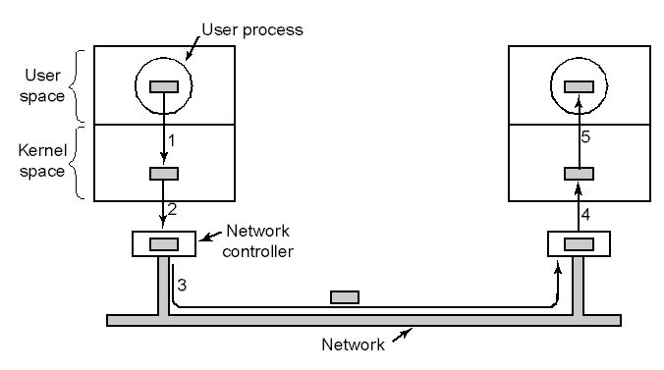
Buffering (cont.)
Networking may involve many copies

Slide 30
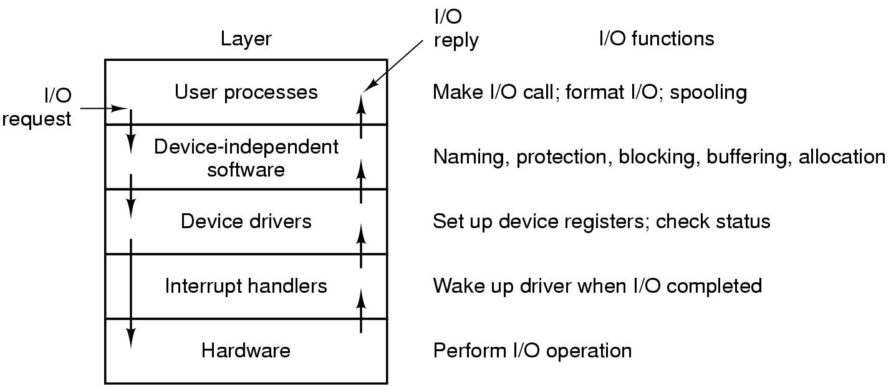
User Space I/O Software
Layers of the I/O system and the main functions of each layer

Slide 31
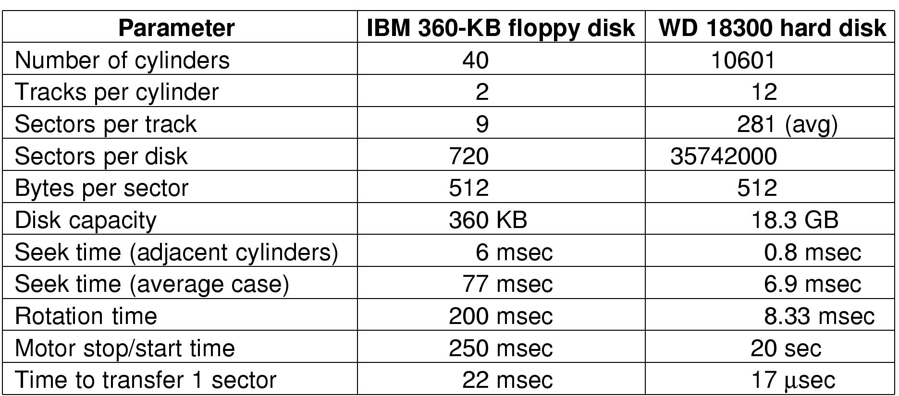
Disks
Disk Hardware
Disk parameters for the original IBM PC floppy disk and a Western Digital WD 18300 hard disk

Slide 32
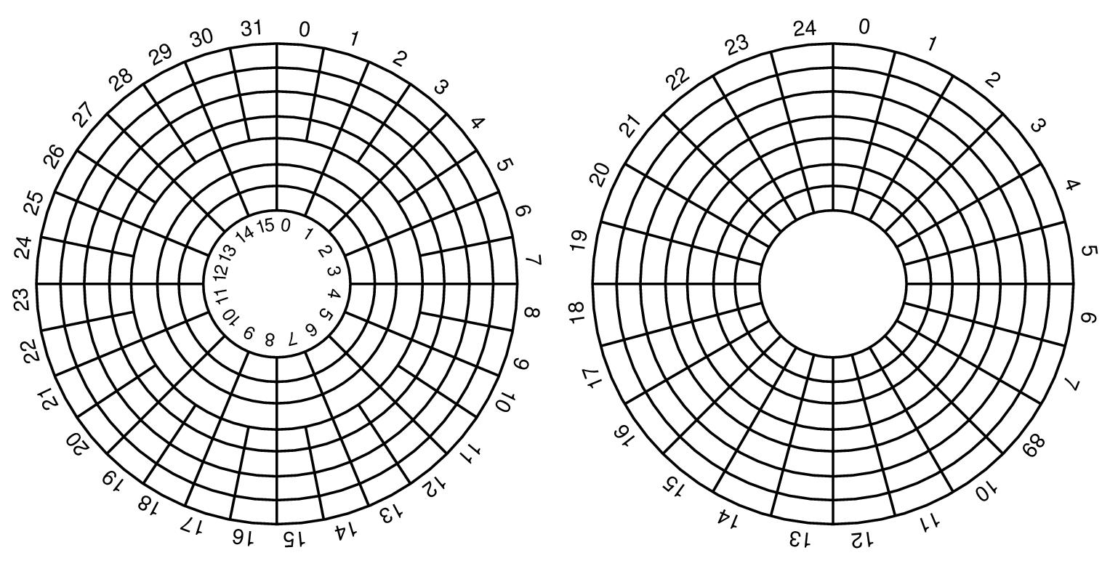
Disk Hardware (cont.)
(a) Physical geometry of a disk with two zones
(b) A possible virtual geometry for this disk

Slide 33
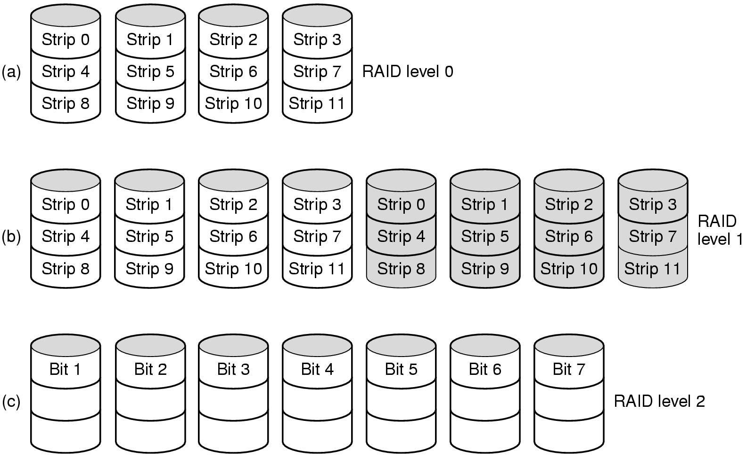
Disk Hardware (cont.): RAID (1)
Raid levels 0 through 2
Backup and parity drives are shaded

Slide 34
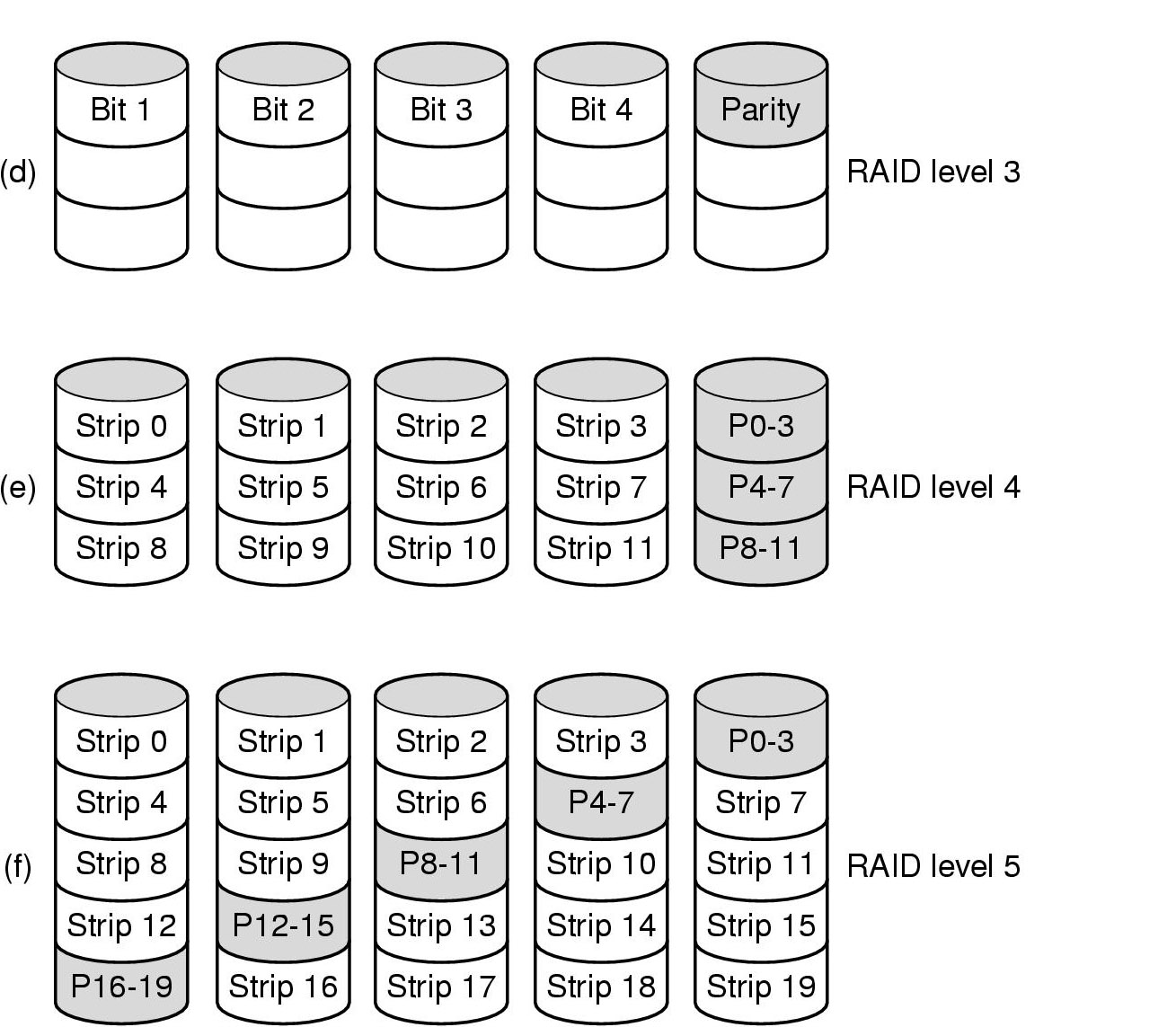
Disk Hardware (cont.): RAID (2)
Raid levels 3 through 5
Backup and parity drives are shaded

Slide 35
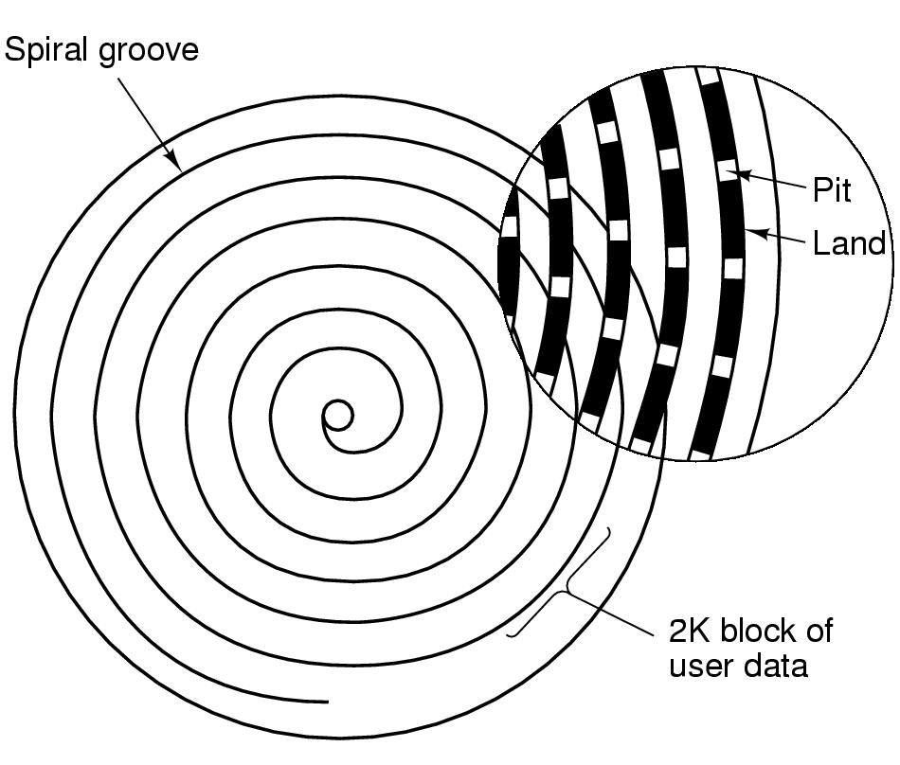
Disk Hardware (cont.): CD-ROMs (1)
Recording structure of a CD or CD-ROM

Slide 36
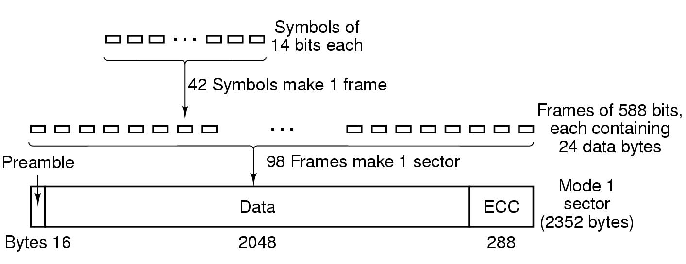
Disk Hardware (cont.): CD-ROMs (2)
Logical data layout on a CD-ROM

Slide 37
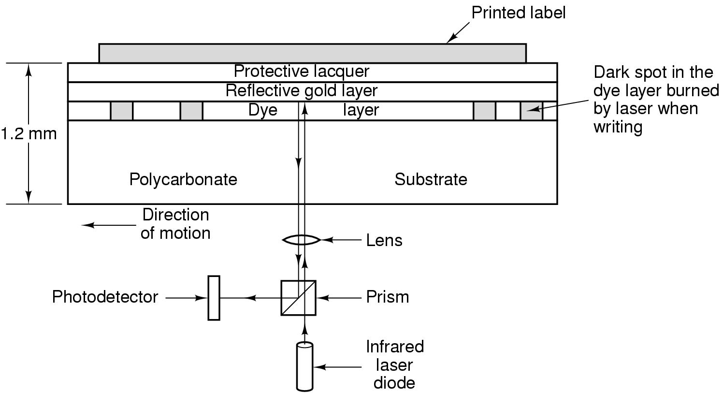
Disk Hardware (cont.): CD-Recordable
Cross section of a CD-R disk and laser
  not to scale
Silver CD-ROM has similar structure
  without dye layer
  with pitted aluminum layer instead of gold

Slide 38
Disk Hardware (cont.): DVD (1)
DVD Improvements on CDs
Smaller pits
(0.4 microns versus 0.8 microns for CDs).
A tighter spiral
(0.74 microns between tracks versus 1.6 microns for CDs).
A red laser
(at 0.65 microns versus 0.78 microns for CDs).

Slide 39
Disk Hardware (cont.): DVD (2)
DVD Formats
Single-sided, single-layer (4.7 GB).
Single-sided, dual-layer (8.5 GB).
Double-sided, single-layer (9.4 GB).
Double-sided, dual-layer (17 GB).

Slide 40
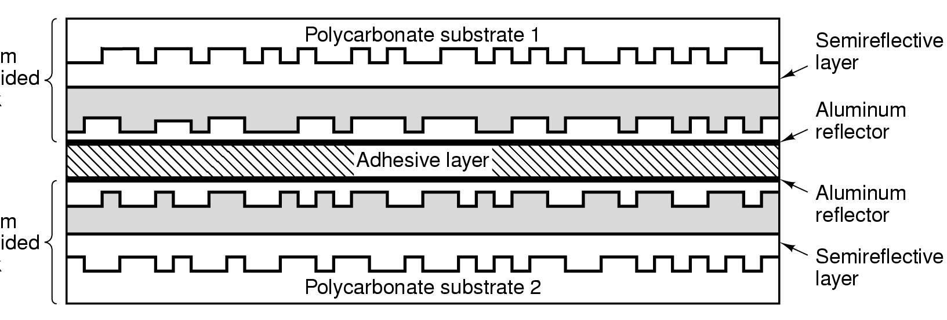
Disk Hardware (cont:): DVD (3)
A double sided, dual layer DVD disk

Slide 41
Disk Formatting
A disk sector

Slide 42
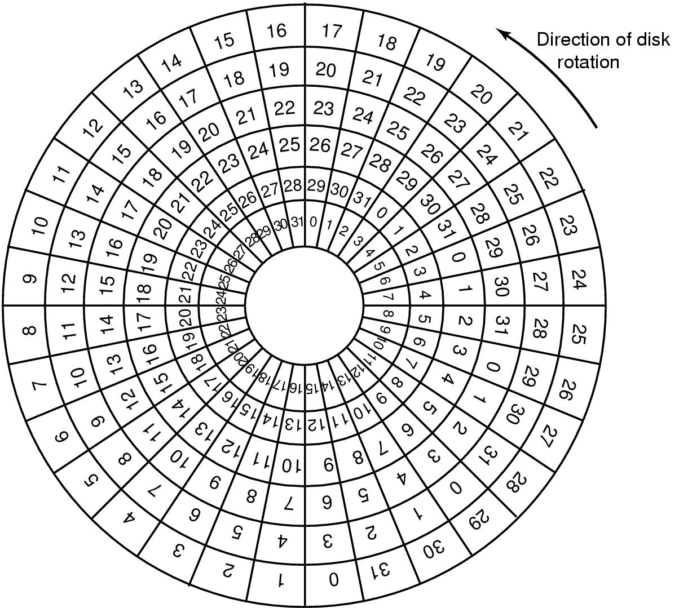
Disk Formatting (cont.)
An illustration of cylinder skew

Slide 43
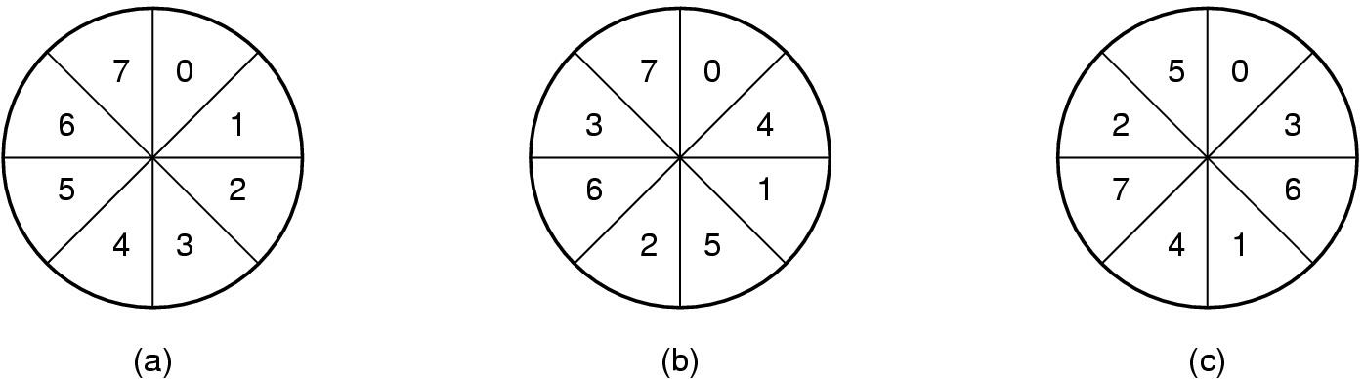
Disk Formatting (cont.)
(a) No interleaving
(b) Single interleaving
(c) Double interleaving

Slide 44
Disk Arm Scheduling Algorithms
Time required to read or write a disk block determined by 3 factors
  Seek time
  Rotational delay
  Actual transfer time
Seek time dominates
Error checking is done by controllers

Slide 45
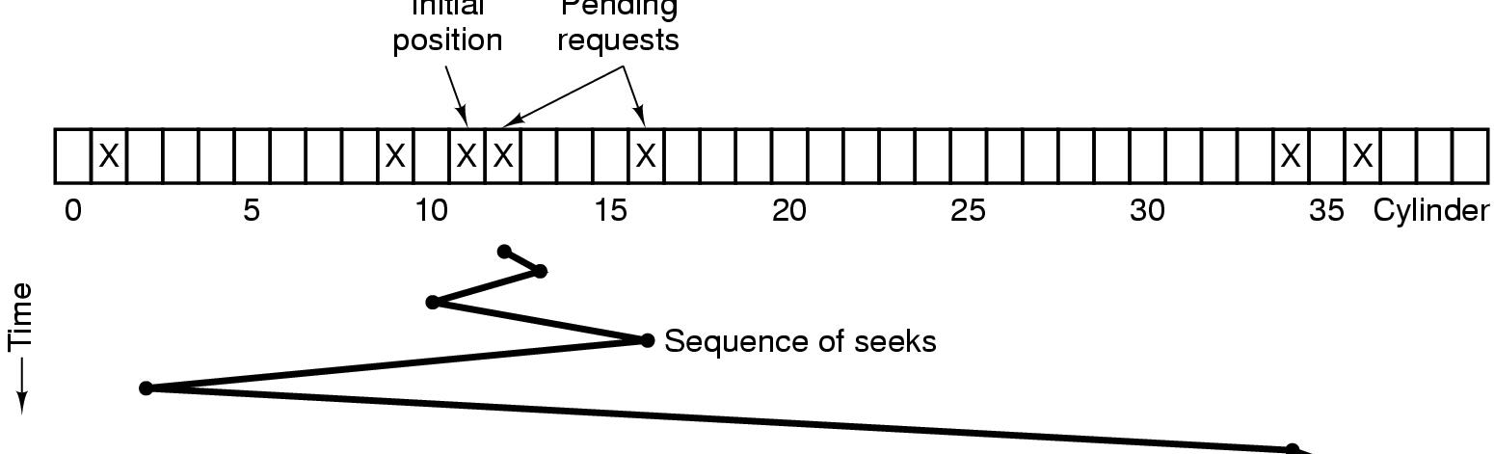
Disk Arm Scheduling Algorithms (cont.)
Initial
position
Pending
requests
Shortest Seek First (SSF) disk scheduling algorithm

Slide 46
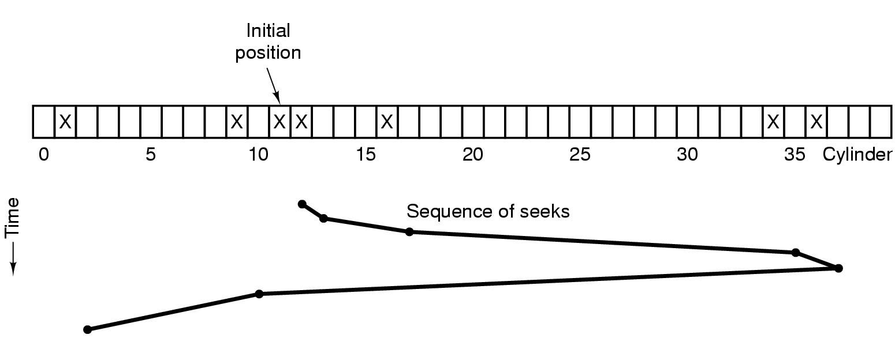
Disk Arm Scheduling Algorithms (cont.)
The elevator algorithm for scheduling disk requests

Slide 47
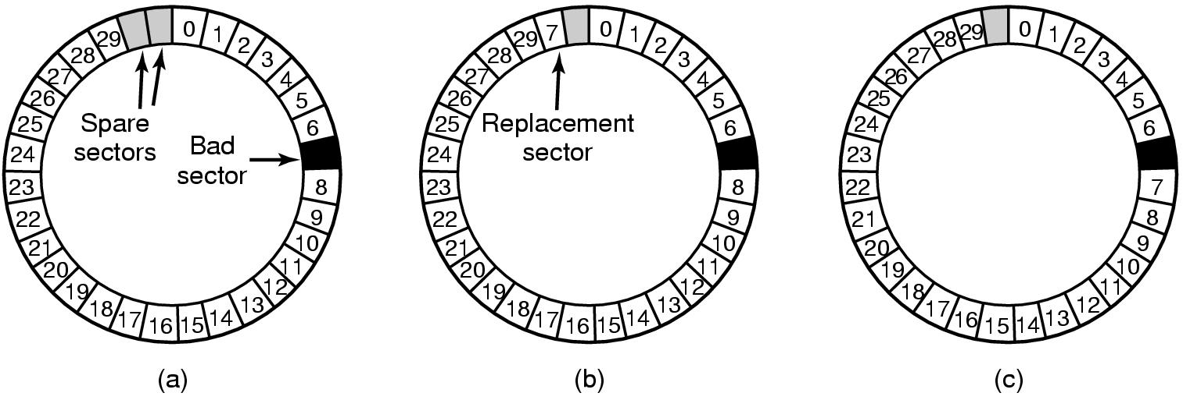
Error Handling
(a) A disk track with a bad sector
(b) Substituting a spare for the bad sector
(c) Shifting all the sectors to bypass the bad one

Slide 48
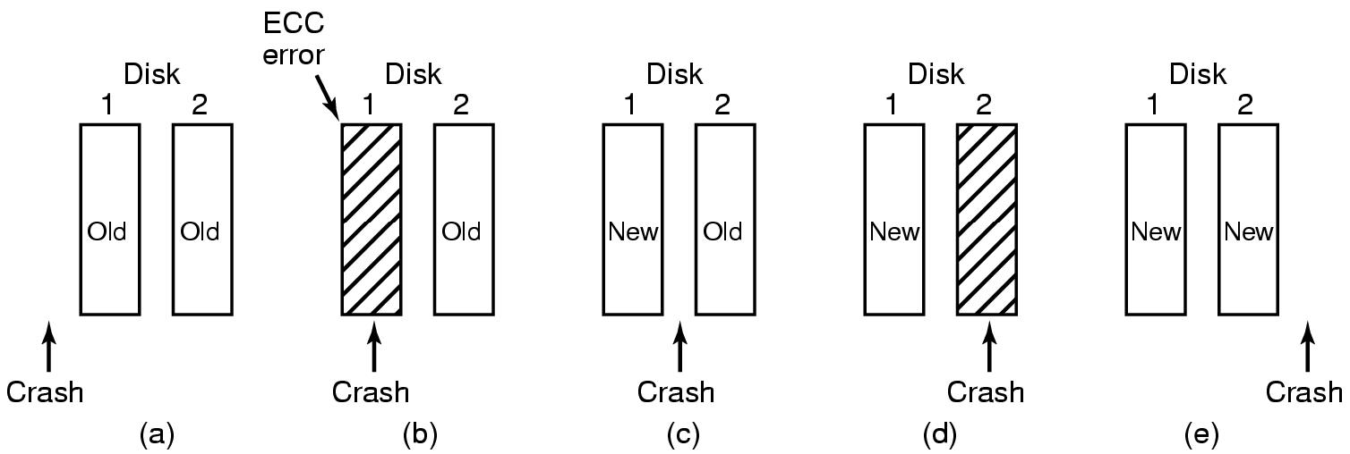
Stable Storage
Analysis of the influence of crashes on stable writes

Slide 49
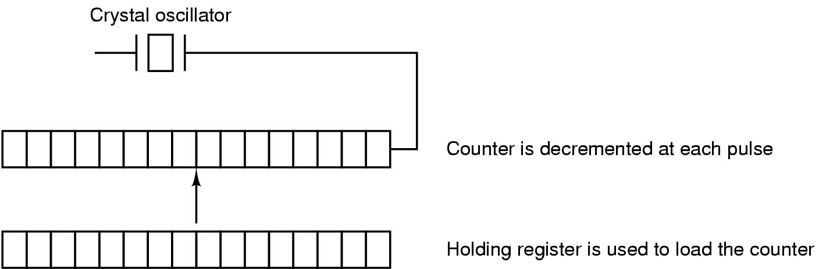
Clocks
Clock Hardware
A programmable clock

Slide 50
Clock Software
Typical duties of a clock driver
Maintaining the time of day.
Preventing processes from running longer than they are allowed to.
Accounting for CPU usage.
Handling alarm system call made by user processes.
Providing watchdog timers for parts of the system itself.
Doing profiling, monitoring, statistics gathering.
50

Slide 51
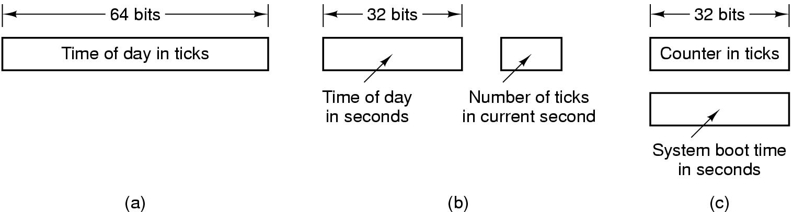
Clock Software (cont.)
Three ways to maintain the time of day

Slide 52
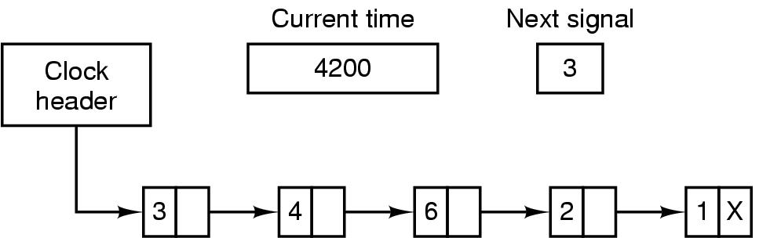
Clock Software (cont.)
Simulating multiple timers with a single clock

Slide 53
Soft Timers
A second clock available for timer interrupts
  specified by applications
  no problems if interrupt frequency is low
Soft timers avoid interrupts
  kernel checks for soft timer expiration before it exits to user mode
  how well this works depends on rate of kernel entries

Slide 54
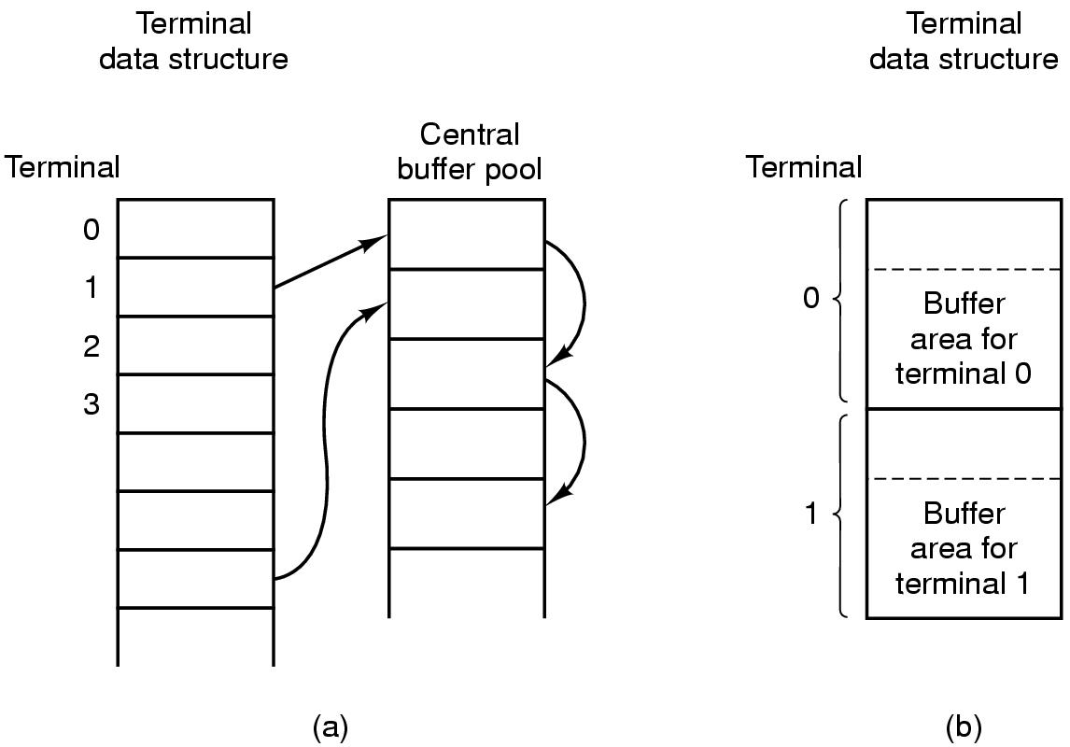
Input Software
(a) Central buffer pool
(b) Dedicated buffer for each terminal

Slide 55
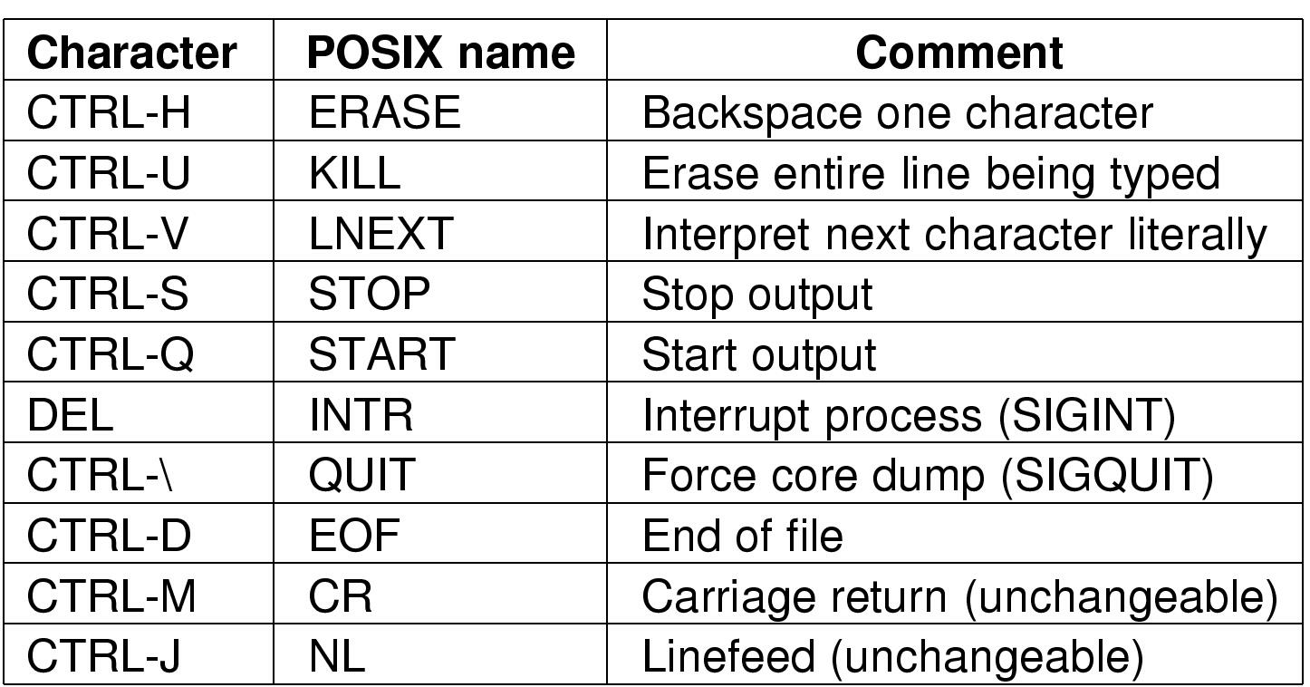
Input Software (cont.): Keyboard Software
Characters that are handled specially in canonical mode.

Slide 56
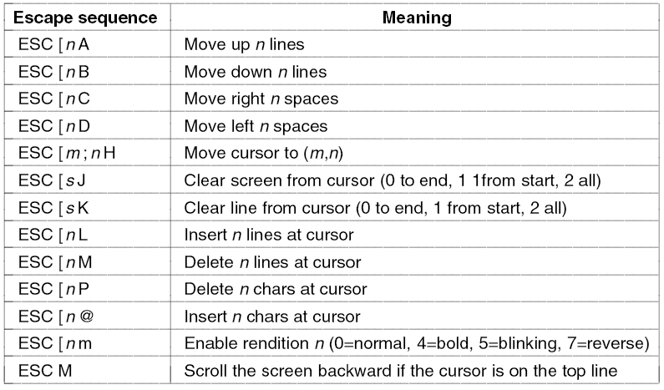
The X Window System
The ANSI escape sequences accepted by the terminal driver on output. ESC denotes the ASCII escape character (0x1B), and n, m, and s are optional numeric parameters.

Slide 57
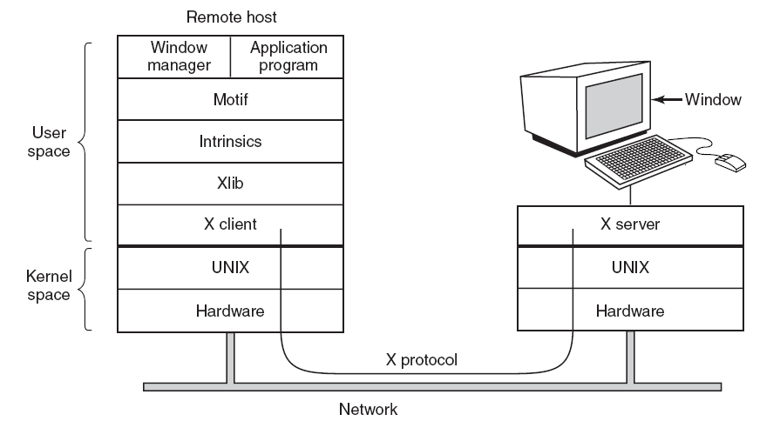
The X Window System (cont.)
Clients and servers in the M.I.T. X Window System.

Slide 58
The X Window System (cont.)
Types of messages between client and server:
Drawing commands from the program to the workstation.
Replies by the workstation to program queries.
Keyboard, mouse, and other event announcements.
Error messages.
58

Slide 59
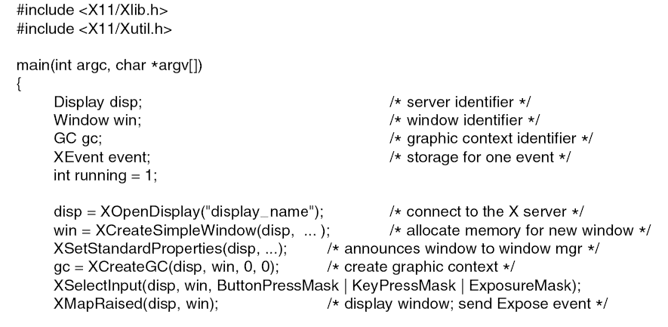
Graphical User Interfaces
Figure 5-38. A skeleton of an X Window application program.
. . .

Slide 60
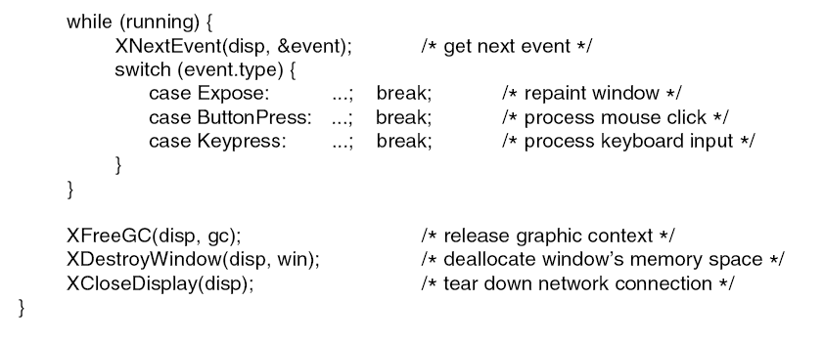
Graphical User Interfaces (cont.)
. . .
Figure 5-38. A skeleton of an X Window application program.

Slide 61
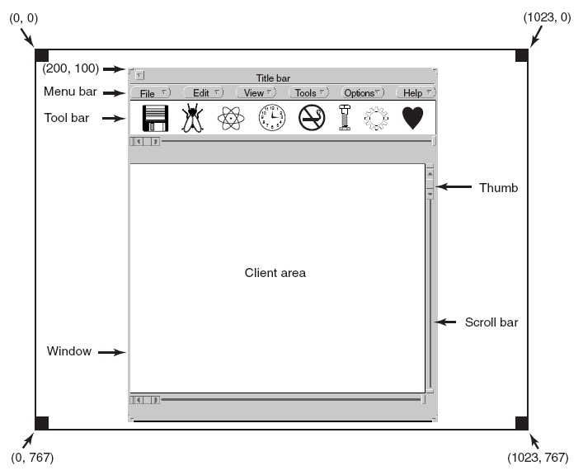
Graphical User Interfaces (cont.)
A sample window located at (200, 100) on an XGA display.

Slide 62
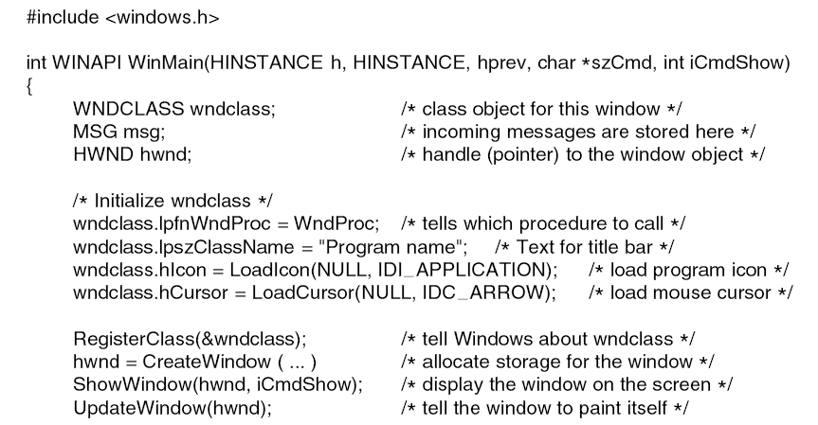
Graphical User Interfaces (cont.)
. . .
A skeleton of a Windows main program.

Slide 63
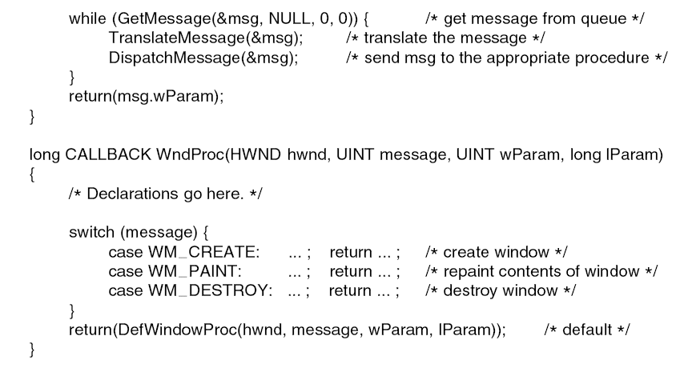
Graphical User Interfaces (cont.)
. . .
A skeleton of a Windows main program.

Slide 64
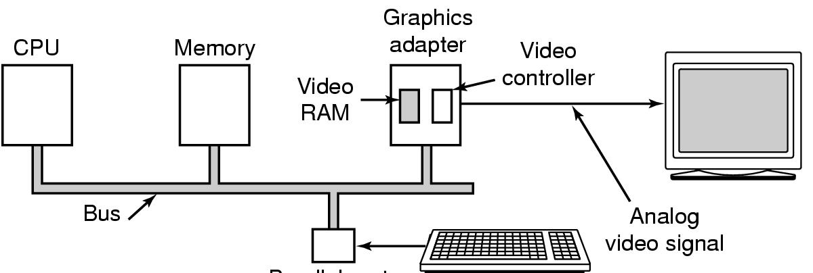
Display Hardware
Parallel port
Memory-mapped displays
driver writes directly into display's video RAM

Slide 65
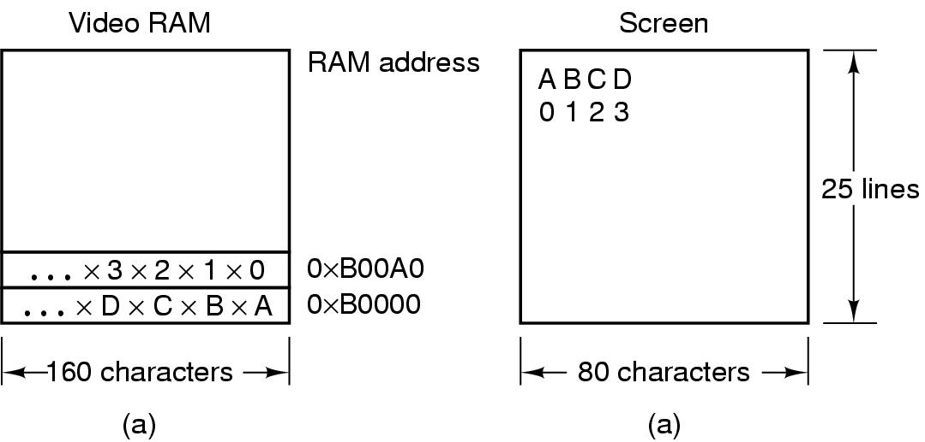
Display Hardware (cont.)
(a) A video RAM image
  simple monochrome display
  character mode
(b) Corresponding screen
  the xs are attribute bytes

Slide 66
Input Software
Keyboard driver delivers a number
  driver converts to characters
  uses a ASCII table
Exceptions, adaptations needed for other languages
  many OS provide for loadable keymaps or code pages

Slide 67
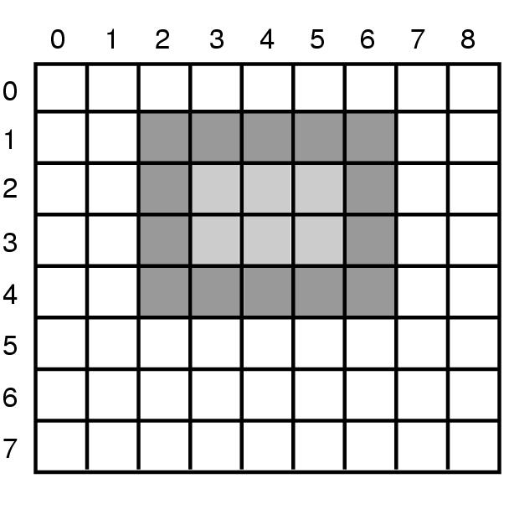
Bitmaps
An example rectangle drawn using Rectangle

Slide 68

Bitmaps (cont.)
Copying bitmaps using BitBlt.
  (a) before
  (b) after

Slide 69

Fonts
Examples of character outlines at different point sizes

Slide 70

Thin Clients
The THINC protocol display commands.

Slide 71

Power Management
Power consumption of various parts of a laptop computer

Slide 72

Power management (cont.)
The use of zones for backlighting the display

Slide 73

Power Management (cont.)
(a) Running at full clock speed
(b) Cutting voltage by two
  cuts clock speed by two,
  cuts power by four

Slide 74
Power Management (cont.)
Telling the programs to use less energy
  may mean poorer user experience
Examples
  change from color output to black and white
  speech recognition reduces vocabulary
  less resolution or detail in an image

Slide 75
Extra Slides
C commands for File Ops.

Slide 76
C commands for File Ops.
Open
#include <sys/types.h>
#include <sys/stat.h>
#include <fcntl.h>
int open(const char *pathname,
int oflag,
mode_t mode);

Slide 77
C commands for File Ops.
open – errno
#include <errno.h>
extern int errno;
EEXIST, EISDIR, EACCES, ENAMETOOLONG, ENOENT,
ENOTDIR, ENXIO, ENODEV, EROFS, ETXTBSY,
EFAULT, ELOOP, ENOSPC, ENOMEM, EMFILE, ENFILE

Slide 78
C commands for File Ops.
Oflag
O_RDONLY
O_WRONLY
O_RDWR
O_APPEND
O_TRUNC
O_NONBLOCK
O_SYNC

Slide 79
C commands for File Ops.
Creat
#include <sys/types.h>
#include <sys/stat.h>
#include <fcntl.h>
int creat(const char *pathname, mode_t mode)
==
open(pathname, O_WRONLY | O_CREAT | O_TRUNC, mode)

Slide 80
C commands for File Ops.
Close
#include <unistd.h>
int close(int filedes)

Slide 81
C commands for File Ops.
Lseek
#include <sys/types.h>
#include <unistd.h>
off_t lseek(int filedes,
off_t offset,
int whence)

Slide 82
C commands for File Ops.
lseek – whence
SEEK_SET
SEEK_CUR
SEEK_END
-----
Currpos = lseek(fd, 0, SEEK_CUR)
Currpos = -1, errno = EPIPE, cannot seek fd

Slide 83
C commands for File Ops.
Read
#include <unistd.h>
ssize_t read(int filedes,
void *buff,
size_t nbytes)
Ssize_t = signed integer, size_t = unsigned int
Ssize = 0 && errno = EAGAIN = non-block

Slide 84
C commands for File Ops.
Write
#include <unistd.h>
ssize_t write(int filedes,
const void *buff,
size_t nbytes)

Slide 85

Summary (including extra slides)
  I/O devices
  Organization of the I/O function
  The evolution of the I/O function
  Direct memory access
  Operating system design issues
  Design objectives
  Logical structure of the I/O function
  I/O Buffering
  Single/double/circular buffer
  The utility of buffering
  Disk scheduling
  Disk performance parameters
  Disk scheduling policies
  Raid
  Raid levels 0 – 6
  Disk cache
  Design and performance considerations
  UNIX SVR4 I/O
  Buffer cache
  Character queue
  Unbuffered I/O
  UNIX devices
  Linux I/O
  Disk scheduling
  Linux page cache
  Windows I/O
  Basic I/O facilities
  Asynchronous and Synchronous I/O
  Software RAID
  Volume shadow copies/encryption
Notes:
Chapter 11 Summary

Slide 86
References
Andrew S. Tanenbaum, Herbert Bos, Modern Operating Systems 4th Global Edition, Pearson, 2015
William Stallings, Operating Systems: Internals and Design Principles, 9th Global Edition, Pearson, 2017

