Slide 1


CSE310 Human-Computer Interaction
Lecture #6
HCI in the Software Process
Prepared & Presented by Asst. Prof. Dr. Samsun M. BAŞARICI

Slide 2
Learning Objectives
Learn how HCI is used in software engineering and the design process for interactive systems
Understand usability engineering
Appreciate the advantages of iterative design and prototyping
Understand design rationale

Slide 3
HCI in the software process
Software engineering and the design process for interactive systems
Usability engineering
Iterative design and prototyping
Design rationale

Slide 4
HCI Methodology
System Development Methodology: a standardized development process that defines a set of activities, methods and techniques, best practices, deliverables, and automated tools that systems developers and project managers are to use to develop and continuously improve information systems.

Slide 5
the software lifecycle
Software engineering is the discipline for understanding the software design process, or life cycle
Designing for usability occurs at all stages of the life cycle, not as a single isolated activity

Slide 6
The waterfall model
Requirements
specification
Architectural
design
Detailed
design
Coding and
unit testing
Integration
and testing
Operation and
maintenance

Slide 7
The Role of HCI Development in SDLC (Systems Development Life Cycle)
System Development Philosophy: follow formal scientific and engineering practice, yet make room for a strong creative element.
The general principles of user-centered systems development include
  (1) involving users as much as possible
  (2) integrating knowledge and expertise from different disciplines
  (3) encouraging high interactivity

Slide 8
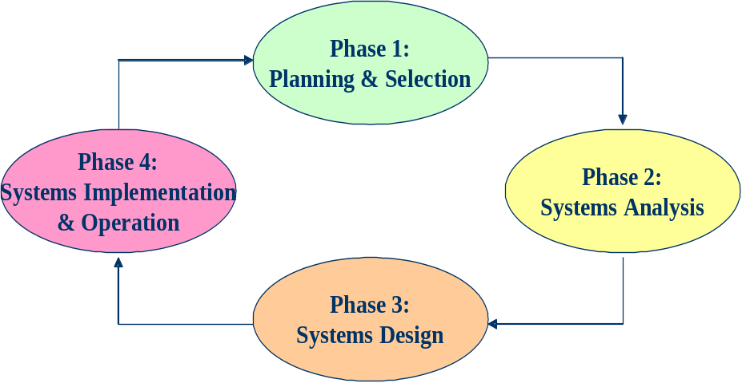
The Role of HCI Development in SDLC (cont.)
SDLC: a commonly used methodology for information systems development that breaks the whole systems development process into manageable phases.
Figure 11. 1 Modern SDLC (from Valacich et al, 2004)

Slide 9
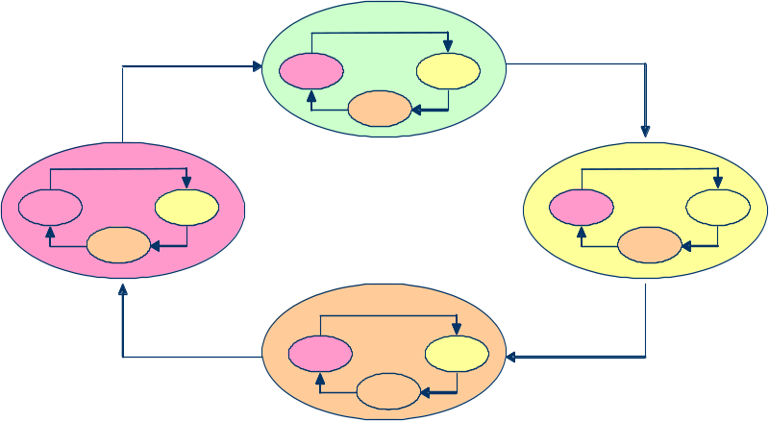
The Role of HCI Development in SDLC (cont.)
Iteration through each of the phases and back to the previous phases is key to creating successful systems. Figure illustrates the importance of iteration.
Modern SDLC: Iteration, Fast Feedback,
Accuracy, User-centered

Slide 10
The Human-Centred SDLC Model: HCSDLC
HCSDLC: a human centered systems development methodology where organizational needs and human needs are considered together throughout the systems development life cycle.
The next slide depicts the HCSDLC. The left side (a) is a typical SDLC model while the right side (b) is the HCSDLC model that covers both SA&D and HCI concerns and activities

Slide 11
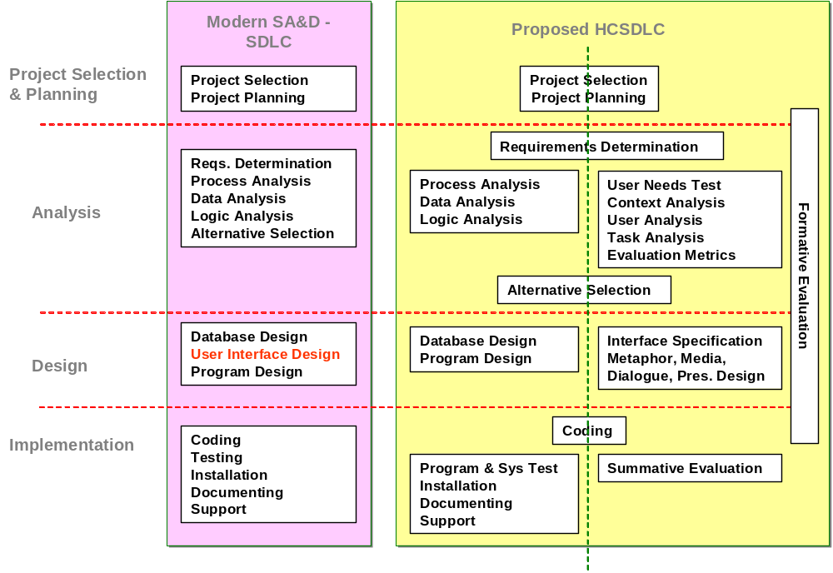
The Human-Centred SDLC Model: HCSDLC (cont.)

Slide 12
Activities in the life cycle
Requirements specification
  designer and customer try capture what the system is expected to provide can be expressed in natural language or more precise languages, such as a task analysis would provide
Architectural design
  high-level description of how the system will provide the services required factor system into major components of the system and how they are interrelated needs to satisfy both functional and nonfunctional requirements
Detailed design
  refinement of architectural components and interrelations to identify modules to be implemented separately the refinement is governed by the nonfunctional requirements

Slide 13
Verification and validation
Verification
  designing the product right
Validation
  designing the right product
The formality gap
  validation will always rely to some extent on subjective means of proof
Management and contractual issues
  design in commercial and legal contexts
Real-world
requirements
and constraints
The formality gap

Slide 14
The life cycle for interactive systems
cannot assume a linear
sequence of activities
as in the waterfall model
lots of feedback!
Requirements
specification
Architectural
design
Detailed
design
Coding and
unit testing
Integration
and testing
Operation and
maintenance

Slide 15
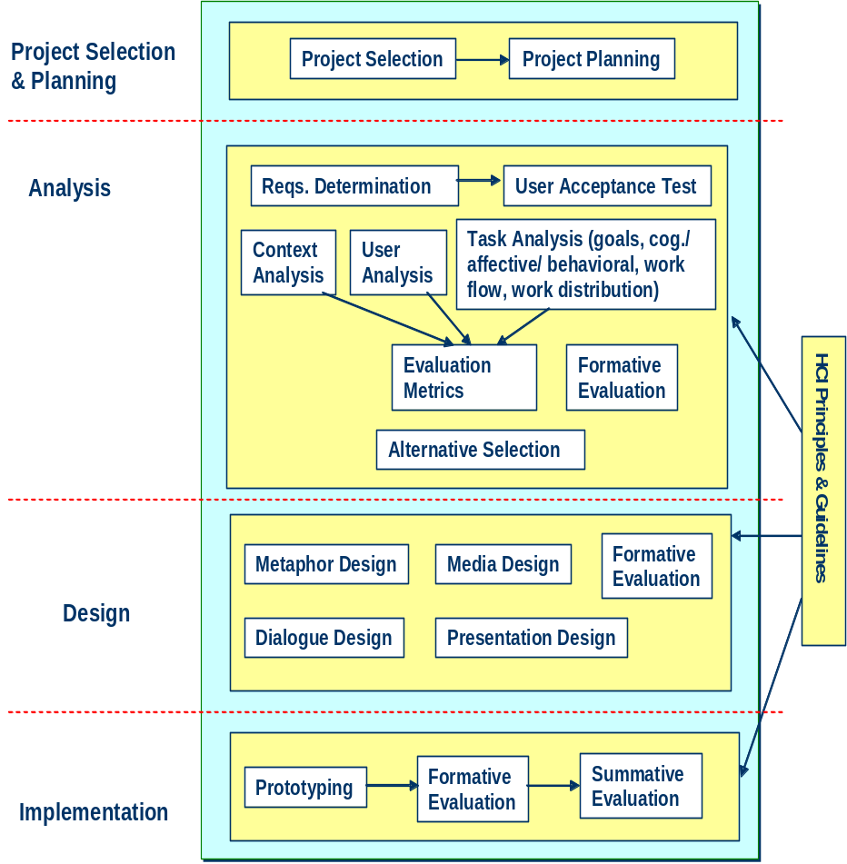
The HCI Development Methodology

Slide 16
Usability engineering
The ultimate test of usability based on measurement of user experience
Usability engineering demands that specific usability measures be made explicit as requirements
Usability specification
  usability attribute/principle
  measuring concept
  measuring method
  now level/ worst case/ planned level/ best case
Problems
  usability specification requires level of detail that may not be
  possible early in design satisfying a usability specification
  does not necessarily satisfy usability

Slide 17
part of a usability specification for a VCR
Attribute: Backward recoverability
Measuring concept: Undo an erroneous programming
sequence
Measuring method: Number of explicit user actions
to undo current program
Now level: No current product allows such an undo
Worst case: As many actions as it takes to
program-in mistake
Planned level: A maximum of two explicit user actions
Best case: One explicit cancel action

Slide 18
Philosophy, Strategies, Principles and Guidelines
HCSDLC philosophy: information systems development should meet both organizational and individual needs, thus all relevant human factors should be incorporated into the SDLC as early as possible.

Slide 19
Philosophy, Strategies, Principles and Guidelines (cont.)
HCI Development Strategies
Focus early on users and their tasks (at the beginning of SDLC). Evaluate throughout the entire system development process. Iterate when necessary. Consider all four levels of HCI concerns: utility, usability, organizational/social/ cultural impact, and holistic human experience.
HCI Development Strategies

Slide 20
Philosophy, Strategies, Principles and Guidelines (cont.)
HCI Development Principles
Improve users’ task performance and reduce their effort. Prevent disastrous user errors. Strive for fit between the tasks, information needed, and information presented. Enable enjoyable, engaging and satisfying interaction experiences. Promote trust. Keep design simple.
HCI Development Principles

Slide 21
Philosophy, Strategies, Principles and Guidelines (cont.)
HCI Development Guidelines
Maintain consistent interaction Provide the user with control over the interaction, supported by feedback Use metaphors Use direct manipulation Design aesthetic interfaces
HCI Guidelines

Slide 22
The Project Selection and Planning Phase
Project selection and planning: the first phase in SDLC where an organization’s total information systems needs are analyzed and arranged, a potential information systems project is identified, and an argument for continuing or not continuing with the project is presented.

Slide 23
The Project Selection and Planning Phase (cont.)
One important activity during project planning is to assess project feasibility. This is also called a feasibility study. Most feasibility factors fall into the following six categories:
  Economic or cost-benefit analysis
  Operational
  Technical
  Schedule
  Legal and contractual
  Political

Slide 24
The Interaction Analysis Phase
Analysis: studies the current system and proposes alternative systems.
  From the HCI perspective, requirement determination is still one of the most important activities, and alternative generation and selection are also necessary before subsequent design is conducted.
  In addition, HCI analysis includes user-acceptance tests on the system requirements

Slide 25
Requirement Determination and User-Acceptance Test
User acceptance test: a test during the analysis stage using simple mockups to test the likelihood of the system’s functionalities being accepted by its potential users.

Slide 26
Requirement Determination and User-Acceptance Test (cont.)
Intention to Use Assuming I had access to the system, I intend to use it. Given that I had access to the system, I predict that I would use it.
Perceived Usefulness Using the system will improve my performance on my job. Using the system in my job will increase my productivity. Using the system will enhance my effectiveness in my job. I find the system would be useful in my job.
Perceived Ease of Use My interaction with the system will be clear and understandable. Interacting with the system will not require a lot of my mental effort. I find the system will be easy to use. I will find it easy to get the system to do what I want it to do.
Note: all items can have 7-point Likert scale; the verb tenses can be modified appropriately to reflect future/current interactions, depending on the point of measurement.
User Acceptance Test Instrument

Slide 27
Context Analysis
Context analysis includes understanding the technical, environmental and social settings where the information systems will be used.
There are four aspects in Context Analysis:
    physical context,
    technical context,
    organizational context, and
    social and cultural context.

Slide 28
Context Analysis (cont.)
Physical context:
    Where are the tasks carried out?
    What entities and resources are implicated in task operation?
    What physical structures and entities are necessary to understand observed task action?

Slide 29
Context Analysis (cont.)
Technical context:
    What are the technology infrastructure, platforms, hardware and system software, network/wireless connections?
    For example, an E-commerce website may be designed to only allow people with certain browser versions to access. The website may also be designed to allow small screen devices such as PDAs or mobile phones access.

Slide 30
Context Analysis (cont.)
Organizational context:
  What is the larger system into which this information system is embedded?
  What are the interactions with other entities in the organization?
  What are the organizational policies or practices that may affect the individual’s attitude and behavior towards using the system?

Slide 31
Context Analysis (cont.)
Social and cultural context:
    What are the social or cultural factors that may affect user attitudes and eventual use of the information system?
    Any information system is always part of a larger social system.

Slide 32
User Analysis
User Analysis: identifies the target users of the system and their characteristics.
    Demographic data
    Traits and intelligence
    Job or task related factors

Slide 33
Task analysis
Task Analysis: studies what and how users think and feel when they do things to achieve their goals.
Possible points of analysis in task analysis
    User goals and use cases
    Cognitive, affective, and behavioral analysis of user tasks
    Workflow analysis
    General work distribution between users and the website/machine

Slide 34
Evaluation Metrics
Evaluation Metrics: specifies the expected human-computer interaction goals of the system being designed. There are four types of HCI goals.

Slide 35
Category/Type | Example Measures
Usefulness | Support individual’s tasks Can do some tasks that would not so without the system Extend one’s capability
Usability | Fewer errors and easy recovery Easy to use Easy to remember how to use Easy to learn Safe to use
Organizational, Social, Cultural Impact | Increased organizational productivity Reduced cost for training Reduced cost for user/ customer support Improved customer service Improved customer retention Reduced job turnover Reduced loss of business opportunities Increase in sales Improved organizational image
Holistic Human Experience | Aesthetically pleasing Enjoyable, entertaining, fun Motivating, engaging Trustworthy Supportive of creativity Rewarding Satisfying
Evaluation Metrics

Slide 36
ISO usability standard 9241
adopts traditional usability categories:
effectiveness
  can you achieve what you want to?
efficiency
  can you do it without wasting effort?
satisfaction
  do you enjoy the process?

Slide 37
some metrics from ISO 9241
Usability Effectiveness Efficiency Satisfaction
objective measures measures measures
Suitability Percentage of Time to Rating scale
for the task goals achieved complete a task for satisfaction
Appropriate for Number of power Relative efficiency Rating scale for
trained users features used compared with satisfaction with
an expert user power features
Learnability Percentage of Time to learn Rating scale for
functions learned criterion ease of learning
Error tolerance Percentage of Time spent on Rating scale for
errors corrected correcting errors error handling
successfully

Slide 38
Iterative design and prototyping
Iterative design overcomes inherent problems of incomplete requirements
Prototypes
  simulate or animate some features of intended system
  different types of prototypes
    throw-away
    incremental
    evolutionary
Management issues
  time
  planning
  non-functional features
  contracts

Slide 39
Techniques for prototyping
Storyboards
  need not be computer-based
  can be animated
Limited functionality simulations
  some part of system functionality provided by designers
  tools like HyperCard are common for these
  Wizard of Oz technique
Warning about iterative design
  design inertia – early bad decisions stay bad
  diagnosing real usability problems in prototypes….
  …. and not just the symptoms

Slide 40
The Interaction Design Phase
Design: to create or construct the system according to the analysis results.
Interface specification includes semantic understanding of the information needs to support HCI analysis results, and syntactical and lexical decisions including metaphor, media, dialogue, and presentation designs.

Slide 41
The Interaction Design Phase (cont.)
Metaphor and visualization design helps the user develop a mental model of the system.
    It is concerned with finding or inventing metaphors or analogies that are appropriate for users to understand the entire system or part of it.
    There are well accepted metaphors for certain tasks, such as a shopping cart for holding items before checking out in the E-Commerce context, and light bulbs for online help or daily tips in productivity software packages.

Slide 42
The Interaction Design Phase (cont.)
Media design is concerned with selecting appropriate media types for meeting the specific information presentation needs and human experience needs.
    Popular media types include text, static images (e.g., painting, drawing or photos), dynamic images (e.g., video clips and animations), and sound.

Slide 43
The Interaction Design Phase (cont.)
Dialogue design focuses on how information is provided to and captured from users during a specific task.
    Dialogues are analogous to a conversation between two people.
    Many existing interaction styles, such as menus, form-fill-ins, natural languages, dialog boxes, and direct manipulation, can be used.

Slide 44
The Interaction Design Phase (cont.)
Presentation design
  maximize visibility;
  minimize search time;
  provide structure and sequence of display;
  focus user attention on key data
  comprehended;
  provide only relevant information; and
  don’t overload user’s working memory.

Slide 45
Design rationale
Design rationale is information that explains why a computer system is the way it is.
Benefits of design rationale
  communication throughout life cycle
  reuse of design knowledge across products
  enforces design discipline
  presents arguments for design trade-offs
  organizes potentially large design space
  capturing contextual information

Slide 46
Design rationale (cont.)
Types of DR:
Process-oriented
  preserves order of deliberation and decision-making
Structure-oriented
  emphasizes post hoc structuring of considered design alternatives
Two examples:
  Issue-based information system (IBIS)
  Design space analysis

Slide 47
Issue-based information system (IBIS)
basis for much of design rationale research
process-oriented
main elements:
  issues
    – hierarchical structure with one ‘root’ issue
  positions
    – potential resolutions of an issue
  arguments
    – modify the relationship between positions and issues
gIBIS is a graphical version

Slide 48
structure of gIBIS
supports
Position
Argument
responds to
Issue
responds to
Position
objects to
Argument
specializes
Sub-issue
generalizes
questions
Sub-issue
Sub-issue

Slide 49
Design space analysis
structure-oriented
QOC – hierarchical structure:
  questions (and sub-questions)
    – represent major issues of a design
  options
– provide alternative solutions to the question
  criteria
– the means to assess the options in order to make a choice
DRL – similar to QOC with a larger language and more formal semantics

Slide 50
the QOC notation
Criterion
Option
Question
Option
Criterion
Option
Criterion
…
Consequent
Question
…
Question

Slide 51
Psychological design rationale
to support task-artefact cycle in which user tasks are affected by the systems they use
aims to make explicit consequences of design for users
designers identify tasks system will support
scenarios are suggested to test task
users are observed on system
psychological claims of system made explicit
negative aspects of design can be used to improve next iteration of design

Slide 52
Formative Evaluations
Formative evaluations identify defects in designs, thus informing design iterations and refinements.
  A number of different formative evaluations can occur several times during the design stage to form final decisions.
  In fact, it is strongly recommended that formative evaluations occur during the entire HCI development life cycle

Slide 53
The Implementation Phase
HCI development in this phase includes
    (1) prototyping,
    (2) formative evaluations to fine-tune the system,
    (3) summative evaluation before system release and
    (4) use evaluation after the system is installed and being used by targeted users for a period of time.

Slide 54
Documenting HCI Development Activities and Deliverables
ID | HCI Development Activity | Deliverables
1.1 | Project Selection and Planning | Schedule of IS projects development: Cost-benefit analysis: Other feasibility analyses:
2.1 | Requirements Determination | The specific system functionalities:
2.2 | User-Acceptance Test | Sample profile: Data collection time and setting: Sketches or mockups used: Test results: Suggestions for revising system functionalities:
2.3 | Context Analysis | Physical context: Technical context: Organizational context: Social/cultural context:
2.4 | User Analysis | Demographic: Traits/skill sets: Job or task related factors:
2.5 | Task Analysis | User goals and use cases: Cognitive, affective, behavioural analysis of user tasks: Workflow analysis: General work distribution between users and the system:
2.6 | Evaluation Metrics | Usefulness: Usability: Organizational/social/cultural impact: Holistic human experience:

Slide 55
Documenting HCI Development Activities and Deliverables
2.7 | Alternative Selection | Three alternatives: The main constraints: The chosen alternative:
2.8 | Formative Evaluation | Evaluation target, method, timing and results:
3.1 | Interface Specification | Metaphor and visualization design: Media design: Dialogue design: Presentation design:
3.2 | Formative Evaluation | Evaluation target, method, timing and results:
4.1 | Prototyping | Tools used:
4.2 | Formative Evaluation | Evaluation target, method, timing and results:
4.3 | Summative Evaluation | Sample profile: Data collection time and setting: Test results: Conclusions in light of evaluation metrics:
HCI Development Report Template

Slide 56
Summary
The software engineering life cycle
  distinct activities and the consequences for interactive system design
Usability engineering
  making usability measurements explicit as requirements
Iterative design and prototyping
  limited functionality simulations and animations
Design rationale
  recording design knowledge
  process vs. structure

Slide 57
Summary
HCI development in the overall system development life cycle by presenting the human-centered SDLC (HCSDLC) model first, and then emphasizing the HCI development aspect.
HCSDLC is an integrated methodology that emphasizes human-centeredness and considers HCI issues together with SA&D issues throughout the entire system development life cycle.
The HCI part of the HCSDLC methodology can be used alone to concentrate on the HCI development of an information system.
Very detailed materials on HCI development methodology
A HCI Development Report template is used to summarize the activities and deliverables of the methodology.

Slide 58
Next Lecture
Design Rules

Slide 59
References
Alan Dix, Janet Finlay, Gregory D. Abowd, Russell Beale, “Human-Computer Interaction, 3rd Edition”, Prentice Hall, 2004, ISBN: 0-13-046109-1

