Slide 1


CSE305 Software Engineering
Lecture #6
Prepared & Presented by Asst. Prof. Dr. Samsun M. BAŞARICI

Slide 2
Part 1
Software Testing

Slide 3
Topics covered
Development testing
Test-driven development
Release testing
User testing

Slide 4
Program testing
Testing is intended to show that a program does what it is intended to do and to discover program defects before it is put into use.
When you test software, you execute a program using artificial data.
You check the results of the test run for errors, anomalies or information about the program’s non-functional attributes.
Can reveal the presence of errors NOT their
absence.
Testing is part of a more general verification and validation process, which also includes static validation techniques.

Slide 5
Program testing goals
To demonstrate to the developer and the customer that the software meets its requirements.
  For custom software, this means that there should be at least one test for every requirement in the requirements document. For generic software products, it means that there should be tests for all of the system features, plus combinations of these features, that will be incorporated in the product release.
To discover situations in which the behavior of the software is incorrect, undesirable or does not conform to its specification.
  Defect testing is concerned with rooting out undesirable system behavior such as system crashes, unwanted interactions with other systems, incorrect computations and data corruption.

Slide 6
Validation and defect testing
The first goal leads to validation testing
  You expect the system to perform correctly using a given set of test cases that reflect the system’s expected use.
The second goal leads to defect testing
  The test cases are designed to expose defects. The test cases in defect testing can be deliberately obscure and need not reflect how the system is normally used.

Slide 7
Testing process goals
Validation testing
  To demonstrate to the developer and the system customer that the software meets its requirements
  A successful test shows that the system operates as intended.
Defect testing
  To discover faults or defects in the software where its behaviour is incorrect or not in conformance with its specification
  A successful test is a test that makes the system perform incorrectly and so exposes a defect in the system.

Slide 8
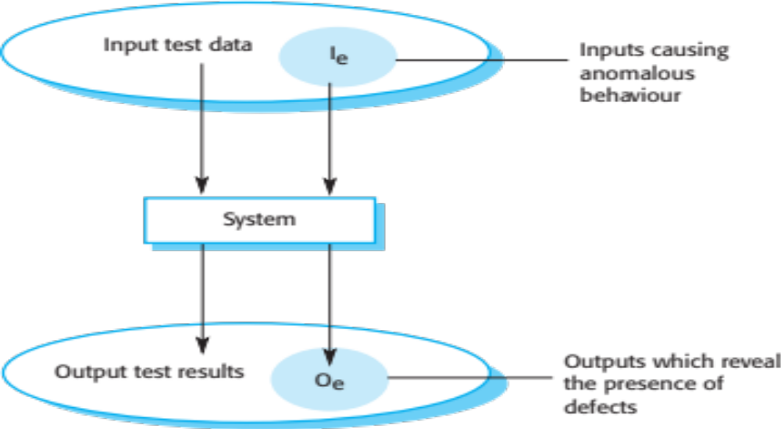
An input-output model of program testing

Slide 9
Verification vs validation
Verification:
"Are we building the product right”.
The software should conform to its specification.
Validation:
"Are we building the right product”.
The software should do what the user really requires.

Slide 10
V & V confidence
Aim of V & V is to establish confidence that the system is ‘fit for purpose’.
Depends on system’s purpose, user expectations and marketing environment
  Software purpose
    The level of confidence depends on how critical the software is to an organisation.
  User expectations
    Users may have low expectations of certain kinds of software.
  Marketing environment
    Getting a product to market early may be more important than finding defects in the program.

Slide 11
Inspections and testing
Software inspections Concerned with analysis of
the static system representation to discover problems (static verification)
  May be supplement by tool-based document and code analysis.
Software testing Concerned with exercising and
observing product behaviour (dynamic verification)
  The system is executed with test data and its operational behaviour is observed.

Slide 12
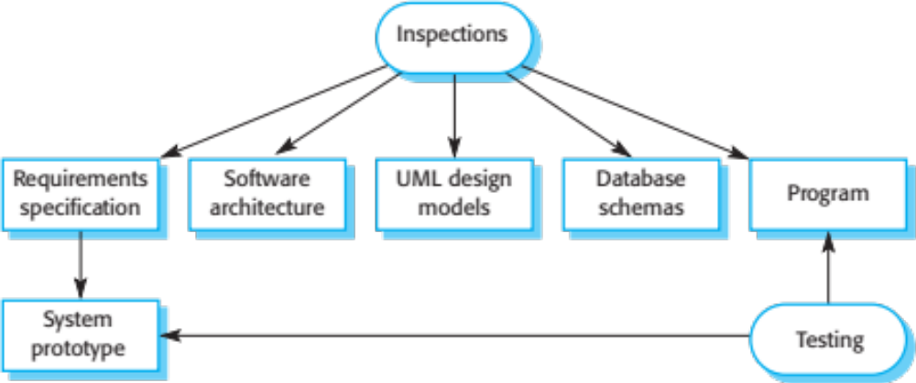
Inspections and testing (Cont.)

Slide 13
Software inspections
These involve people examining the source representation with the aim of discovering anomalies and defects.
Inspections not require execution of a system so may be used before implementation.
They may be applied to any representation of the system (requirements, design,configuration data, test data, etc.).
They have been shown to be an effective technique for discovering program errors.

Slide 14
Advantages of inspections
During testing, errors can mask (hide) other errors. Because inspection is a static process, you don’t have to be concerned with interactions between errors.
Incomplete versions of a system can be inspected without additional costs. If a program is incomplete, then you need to develop specialized test harnesses to test the parts that are available.
As well as searching for program defects, an inspection can also consider broader quality attributes of a program, such as compliance with standards, portability and maintainability.

Slide 15
Inspections and testing
Inspections and testing are complementary and not opposing verification techniques.
Both should be used during the V & V process.
Inspections can check conformance with a specification but not conformance with the customer’s real requirements.
Inspections cannot check non-functional characteristics such as performance, usability, etc.

Slide 16
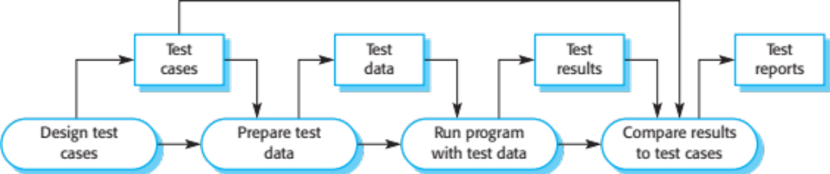
A model of the software testing process

Slide 17
Stages of testing
Development testing, where the system is tested during development to discover bugs and defects.
Release testing, where a separate testing team test a complete version of the system before it is released to users.
User testing, where users or potential users of a system test the system in their own environment.

Slide 18
Development testing

Slide 19
Development testing
Development testing includes all testing activities that are carried out by the team developing the system.
  Unit testing, where individual program units or object classes are tested. Unit testing should focus on testing the functionality of objects or methods.
  Component testing, where several individual units are integrated to create composite components. Component testing should focus on testing component interfaces.
  System testing, where some or all of the components in a system are integrated and the system is tested as a whole. System testing should focus on testing component interactions.

Slide 20
Unit testing
Unit testing is the process of testing individual components in isolation.
It is a defect testing process.
Units may be:
  Individual functions or methods within an object
  Object classes with several attributes and methods
  Composite components with defined interfaces used to access their functionality.

Slide 21
Object class testing
Complete test coverage of a class involves
  Testing all operations associated with an object
  Setting and interrogating all object attributes
  Exercising the object in all possible states.
Inheritance makes it more difficult to design object class tests as the information to be tested is not localised.

Slide 22
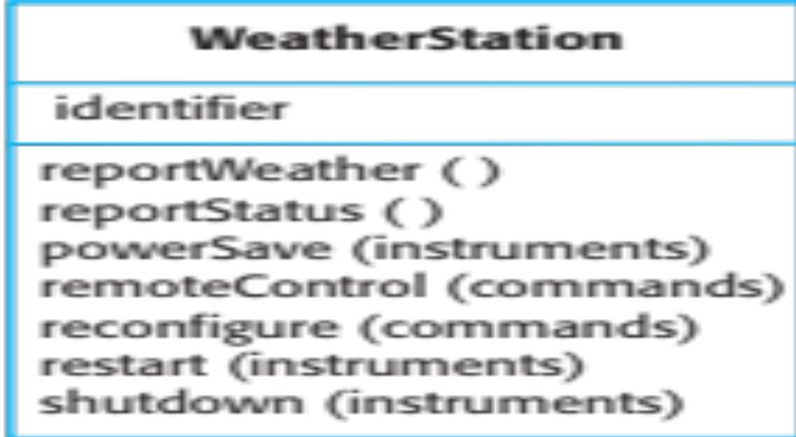
The weather station object interface

Slide 23
Weather station testing
Need to define test cases for reportWeather, calibrate, test, startup and shutdown.
Using a state model, identify sequences of state transitions to be tested and the event sequences to cause these transitions
For example:
  Shutdown -> Running-> Shutdown
  Configuring-> Running-> Testing -> Transmitting -> Running
  Running-> Collecting-> Running-> Summarizing -> Transmitting -> Running

Slide 24
Automated testing
Whenever possible, unit testing should be automated so that tests are run and checked without manual intervention.
In automated unit testing, you make use of a test automation framework (such as JUnit) to write and run your program tests.
Unit testing frameworks provide generic test classes that you extend to create specific test cases. They can then run all of the tests that you have implemented and report, often through some GUI, on the success of otherwise of the tests.

Slide 25
Automated test components
A setup part, where you initialize the system with the test case, namely the inputs and expected outputs.
A call part, where you call the object or method to be tested.
An assertion part where you compare the result of the call with the expected result. If the assertion evaluates to true, the test has been successful if false, then it has failed.

Slide 26
Choosing unit test cases
The test cases should show that, when used as expected, the component that you are testing does what it is supposed to do.
If there are defects in the component, these should be revealed by test cases.
This leads to 2 types of unit test case:
  The first of these should reflect normal operation of a program and should show that the component works as expected.
  The other kind of test case should be based on testing experience of where common problems arise. It should use abnormal inputs to check that these are properly processed and do not crash the component.

Slide 27
Testing strategies
Partition testing, where you identify groups of inputs that have common characteristics and should be processed in the same way.
  You should choose tests from within each of these groups.
Guideline-based testing, where you use testing guidelines to choose test cases.
  These guidelines reflect previous experience of the kinds of errors that programmers often make when developing components.

Slide 28
Partition testing
Input data and output results often fall into different classes where all members of a class are related.
Each of these classes is an equivalence partition or domain where the program behaves in an equivalent way for each class member.
Test cases should be chosen from each partition.

Slide 29
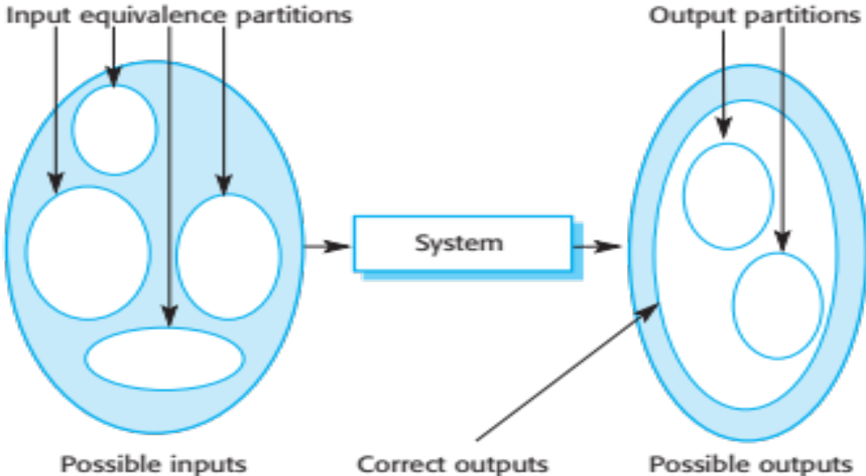
Equivalence partitioning

Slide 30
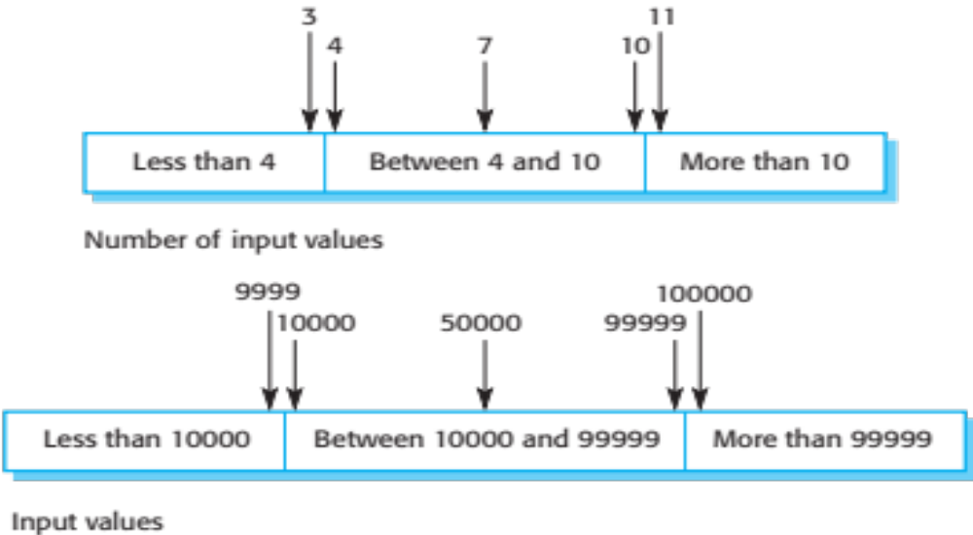
Equivalence partitions

Slide 31
Testing guidelines (sequences)
Test software with sequences which have only a single value.
Use sequences of different sizes in different tests.
Derive tests so that the first, middle and last elements of the sequence are accessed.
Test with sequences of zero length.

Slide 32
General testing guidelines
Choose inputs that force the system to generate all error messages
Design inputs that cause input buffers to overflow
Repeat the same input or series of inputs numerous times
Force invalid outputs to be generated
Force computation results to be too large or too small.

Slide 33
Component testing
Software components are often composite components that are made up of several interacting objects.
  For example, in the weather station system, the reconfiguration component includes objects that deal with each aspect of the reconfiguration.
You access the functionality of these objects through the defined component interface.
Testing composite components should therefore focus on showing that the component interface behaves according to its specification.
  You can assume that unit tests on the individual objects within the component have been completed.

Slide 34
Interface testing
Objectives are to detect faults due to interface errors or invalid assumptions about interfaces.
Interface types
  Parameter interfaces Data passed from one method or procedure to another.
  Shared memory interfaces Block of memory is shared between procedures or functions.
  Procedural interfaces Sub-system encapsulates a set of procedures to be called by other sub-systems.
  Message passing interfaces Sub-systems request services from other sub-systems

Slide 35
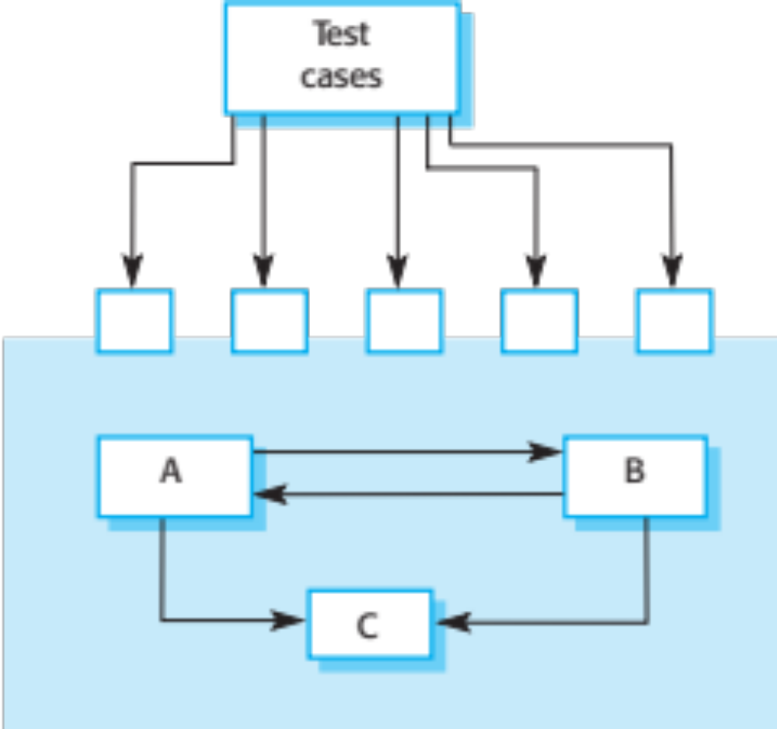
Interface testing

Slide 36
Interface errors
Interface misuse
  A calling component calls another component and makes an error in its use of its interface e.g. parameters in the wrong order.
Interface misunderstanding
  A calling component embeds assumptions about the behaviour of the called component which are incorrect.
Timing errors
  The called and the calling component operate at different speeds and out-of-date information is accessed.

Slide 37
Interface testing guidelines
Design tests so that parameters to a called procedure are at the extreme ends of their ranges.
Always test pointer parameters with null pointers.
Design tests which cause the component to fail.
Use stress testing in message passing systems.
In shared memory systems, vary the order in which components are activated.

Slide 38
System testing
System testing during development involves integrating components to create a version of the system and then testing the integrated system.
The focus in system testing is testing the interactions between components.
System testing checks that components are compatible, interact correctly and transfer the right data at the right time across their interfaces.
System testing tests the emergent behaviour of a system.

Slide 39
System and component testing
During system testing, reusable components that have been separately developed and off-the-shelf systems may be integrated with newly developed components. The complete system is then tested.
Components developed by different team members or sub-teams may be integrated at this stage. System testing is a collective rather than an individual process.
  In some companies, system testing may involve a separate testing team with no involvement from designers and programmers.

Slide 40
Use-case testing
The use-cases developed to identify system interactions can be used as a basis for system testing.
Each use case usually involves several system components so testing the use case forces these interactions to occur.
The sequence diagrams associated with the use case documents the components and interactions that are being tested.

Slide 41
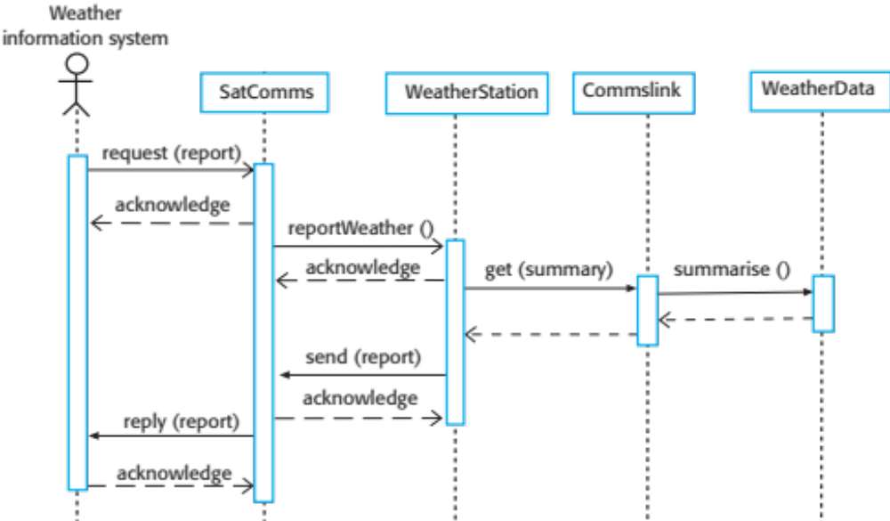
Collect weather data sequence chart

Slide 42
Test cases derived from sequence diagram
An input of a request for a report should have an associated acknowledgement. A report should ultimately be returned from the request.
  You should create summarized data that can be used to check that the report is correctly organized.
An input request for a report to WeatherStation results in a summarized report being generated.
  Can be tested by creating raw data corresponding to the summary that you have prepared for the test of SatComms and checking that the WeatherStation object correctly produces this summary. This raw data is also used to test the WeatherData object.

Slide 43
Testing policies
Exhaustive system testing is impossible so testing policies which define the required system test coverage may be developed.
Examples of testing policies:
  All system functions that are accessed through menus should be tested.
  Combinations of functions (e.g. text formatting) that are accessed through the same menu must be tested.
  Where user input is provided, all functions must be tested with both correct and incorrect input.

Slide 44
Test-driven development

Slide 45
Test-driven development
Test-driven development (TDD) is an approach to program development in which you inter-leave testing and code development.
Tests are written before code and ‘passing’ the tests is the critical driver of development.
You develop code incrementally, along with a test for that increment. You don’t move on to the next increment until the code that you have developed passes its test.
TDD was introduced as part of agile methods such as Extreme Programming. However, it can also be used in plan-driven development processes.

Slide 46
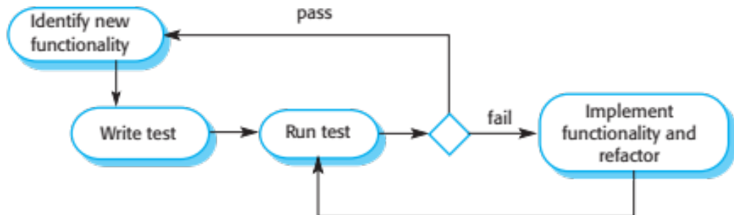
Test-driven development

Slide 47
TDD process activities
Start by identifying the increment of functionality that is required. This should normally be small and implementable in a few lines of code.
Write a test for this functionality and implement this as an automated test.
Run the test, along with all other tests that have been implemented. Initially, you have not implemented the functionality so the new test will fail.
Implement the functionality and re-run the test.
Once all tests run successfully, you move on to implementing the next chunk of functionality.

Slide 48
Benefits of test-driven development
Code coverage
  Every code segment that you write has at least one associated test so all code written has at least one test.
Regression testing
  A regression test suite is developed incrementally as a program is developed.
Simplified debugging
  When a test fails, it should be obvious where the problem lies. The newly written code needs to be checked and modified.
System documentation
  The tests themselves are a form of documentation that describe what the code should be doing.

Slide 49
Regression testing
Regression testing is testing the system to check that changes have not ‘broken’ previously working code.
In a manual testing process, regression testing is expensive but, with automated testing, it is simple and straightforward. All tests are rerun every time a change is made to the program.
Tests must run ‘successfully’ before the change is committed.

Slide 50
Release testing

Slide 51
Release testing
Release testing is the process of testing a particular release of a system that is intended for use outside of the development team.
The primary goal of the release testing process is to convince the supplier of the system that it is good enough for use.
  Release testing, therefore, has to show that the system delivers its specified functionality, performance and dependability, and that it does not fail during normal use.
Release testing is usually a black-box testing process where tests are only derived from the system specification.

Slide 52
Release testing and system testing
Release testing is a form of system testing.
Important differences:
  A separate team that has not been involved in the system development, should be responsible for release testing.
  System testing by the development team should focus on discovering bugs in the system (defect testing). The objective of release testing is to check that the system meets its requirements and is good enough for external use (validation testing).

Slide 53
Requirements based testing
Requirements-based testing involves examining each requirement and developing a test or tests for it.
Mentcare system requirements:
  If a patient is known to be allergic to any particular medication, then prescription of that medication shall result in a warning message being issued to the system user.
  If a prescriber chooses to ignore an allergy warning, they shall provide a reason why this has been ignored.

Slide 54
Requirements tests
Set up a patient record with no known allergies. Prescribe medication for allergies that are known to exist. Check that a warning message is not issued by the system.
Set up a patient record with a known allergy. Prescribe the medication to that the patient is allergic to, and check that the warning is issued by the system.
Set up a patient record in which allergies to two or more drugs are recorded. Prescribe both of these drugs separately and check that the correct warning for each drug is issued.
Prescribe two drugs that the patient is allergic to. Check that two warnings are correctly issued.
Prescribe a drug that issues a warning and overrule that warning. Check that the system requires the user to provide information explaining why the warning was overruled.

Slide 55
A usage scenario for the Mentcare system
George is a nurse who specializes in mental healthcare. One of his responsibilities is to visit patients at home to check that their treatment is effective and that they are not suffering from medication side effects.
On a day for home visits, George logs into the Mentcare system and uses it to print his schedule of home visits for that day, along with summary information about the patients to be visited. He requests that the records for these patients be downloaded to his laptop. He is prompted for his key phrase to encrypt the records on the laptop.
One of the patients that he visits is Jim, who is being treated with medication for depression. Jim feels that the medication is helping him but believes that it has the side effect of keeping him awake at night. George looks up Jim’s record and is prompted for his key phrase to decrypt the record. He checks the drug prescribed and queries its side effects. Sleeplessness is a known side effect so he notes the problem in Jim’s record and suggests that he visits the clinic to have his medication changed. Jim agrees so George enters a prompt to call him when he gets back to the clinic to make an appointment with a physician. George ends the consultation and the system re-encrypts Jim’s record.
After, finishing his consultations, George returns to the clinic and uploads the records of patients visited to the database. The system generates a call list for George of those patients who He has to contact for follow-up information and make clinic appointments.

Slide 56
Features tested by scenario
Authentication by logging on to the system.
Downloading and uploading of specified patient records to a laptop.
Home visit scheduling.
Encryption and decryption of patient records on a mobile device.
Record retrieval and modification.
Links with the drugs database that maintains side-effect information.
The system for call prompting.

Slide 57
Performance testing
Part of release testing may involve testing the emergent properties of a system, such as performance and reliability.
Tests should reflect the profile of use of the system.
Performance tests usually involve planning a series of tests where the load is steadily increased until the system performance becomes unacceptable.
Stress testing is a form of performance testing where the system is deliberately overloaded to test its failure behaviour.

Slide 58
User testing

Slide 59
User testing
User or customer testing is a stage in the testing process in which users or customers provide input and advice on system testing.
User testing is essential, even when comprehensive system and release testing have been carried out.
  The reason for this is that influences from the user’s working environment have a major effect on the reliability, performance, usability and robustness of a system. These cannot be replicated in a testing environment.

Slide 60
Types of user testing
Alpha testing
  Users of the software work with the development team to test the software at the developer’s site.
Beta testing
  A release of the software is made available to users to allow them to experiment and to raise problems that they discover with the system developers.
Acceptance testing
  Customers test a system to decide whether or not it is ready to be accepted from the system developers and deployed in the customer environment. Primarily for custom systems.

Slide 61
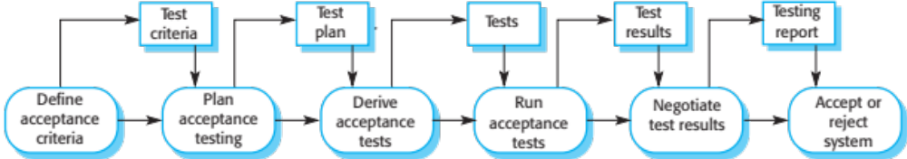
The acceptance testing process

Slide 62
Stages in the acceptance testing process
Define acceptance criteria
Plan acceptance testing
Derive acceptance tests
Run acceptance tests
Negotiate test results
Reject/accept system

Slide 63
Agile methods and acceptance testing
In agile methods, the user/customer is part of the development team and is responsible for making decisions on the acceptability of the system.
Tests are defined by the user/customer and are integrated with other tests in that they are run automatically when changes are made.
There is no separate acceptance testing process.
Main problem here is whether or not the embedded user is ‘typical’ and can represent the interests of all system stakeholders.

Slide 64
Key points
Testing can only show the presence of errors in a program. It cannot demonstrate that there are no remaining faults.
Development testing is the responsibility of the software development team. A separate team should be responsible for testing a system before it is released to customers.
Development testing includes unit testing, in which you test individual objects and methods component testing in which you test related groups of objects and system testing, in which you test partial or complete systems.

Slide 65
Key points
When testing software, you should try to ‘break’ the software by using experience and guidelines to choose types of test case that have been effective in discovering defects in other systems.
Wherever possible, you should write automated tests. The tests are embedded in a program that can be run every time a change is made to a system.
Test-first development is an approach to development where tests are written before the code to be tested.
Scenario testing involves inventing a typical usage scenario and using this to derive test cases.
Acceptance testing is a user testing process where the aim is to decide if the software is good enough to be deployed and used in its operational environment.

Slide 66
Part 2
Software Evolution

Slide 67
Topics covered
Evolution processes
Legacy systems
Software maintenance

Slide 68
Software change
Software change is inevitable
  New requirements emerge when the software is used;
  The business environment changes;
  Errors must be repaired;
  New computers and equipment is added to the system;
  The performance or reliability of the system may have to be improved.
A key problem for all organizations is implementing and managing change to their existing software systems.

Slide 69
Importance of evolution
Organisations have huge investments in their software systems - they are critical business assets.
To maintain the value of these assets to the business, they must be changed and updated.
The majority of the software budget in large companies is devoted to changing and evolving existing software rather than developing new software.

Slide 70
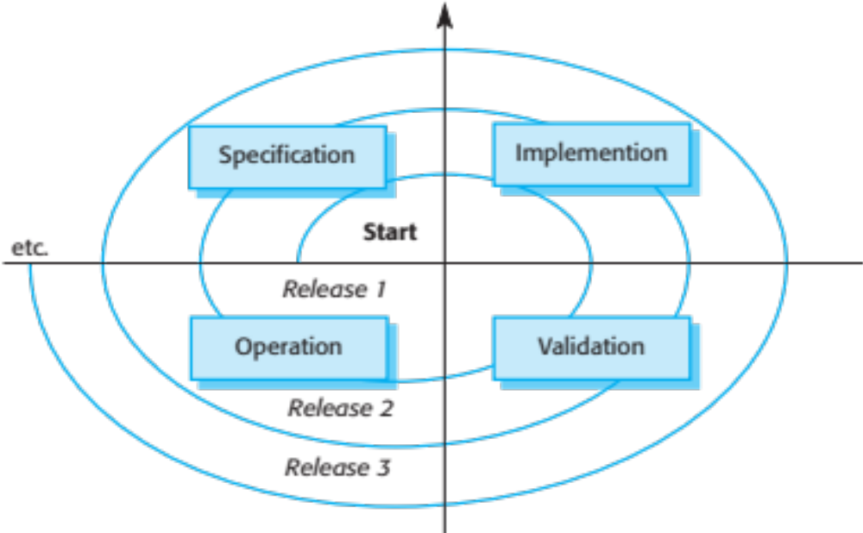
A spiral model of development and evolution

Slide 71
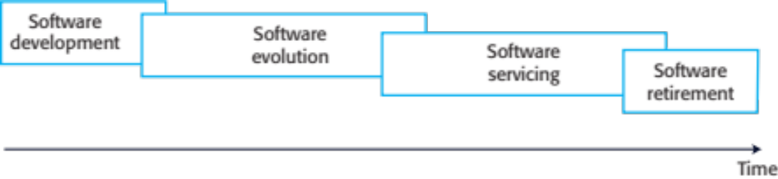
Evolution and servicing

Slide 72
Evolution and servicing
Evolution
  The stage in a software system’s life cycle where it is in operational use and is evolving as new requirements are proposed and implemented in the system.
Servicing
  At this stage, the software remains useful but the only changes made are those required to keep it operational i.e. bug fixes and changes to reflect changes in the software’s environment. No new functionality is added.
Phase-out
  The software may still be used but no further changes are made to it.

Slide 73
Evolution processes

Slide 74
Evolution processes
Software evolution processes depend on
  The type of software being maintained;
  The development processes used;
  The skills and experience of the people involved.
Proposals for change are the driver for system evolution.
  Should be linked with components that are affected by the change, thus allowing the cost and impact of the change to be estimated.
Change identification and evolution continues throughout the system lifetime.

Slide 75
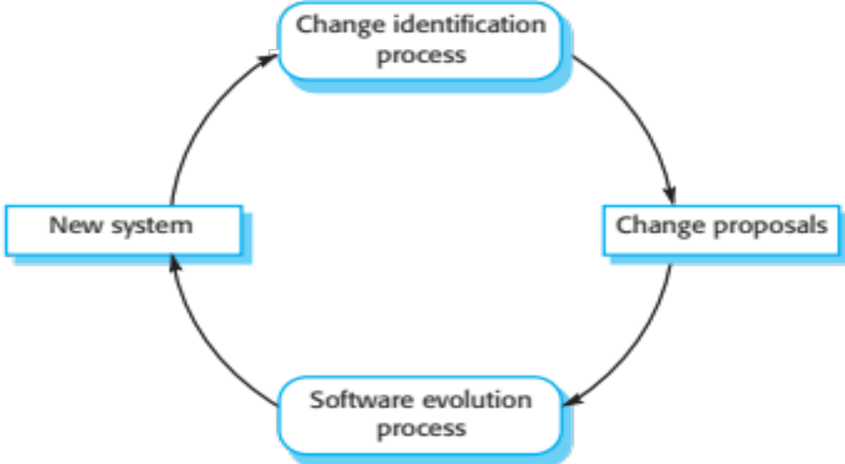
Change identification and evolution processes

Slide 76
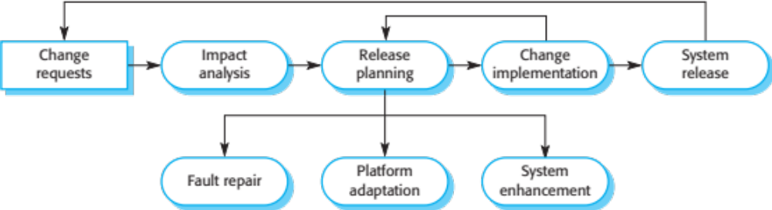
The software evolution process

Slide 77
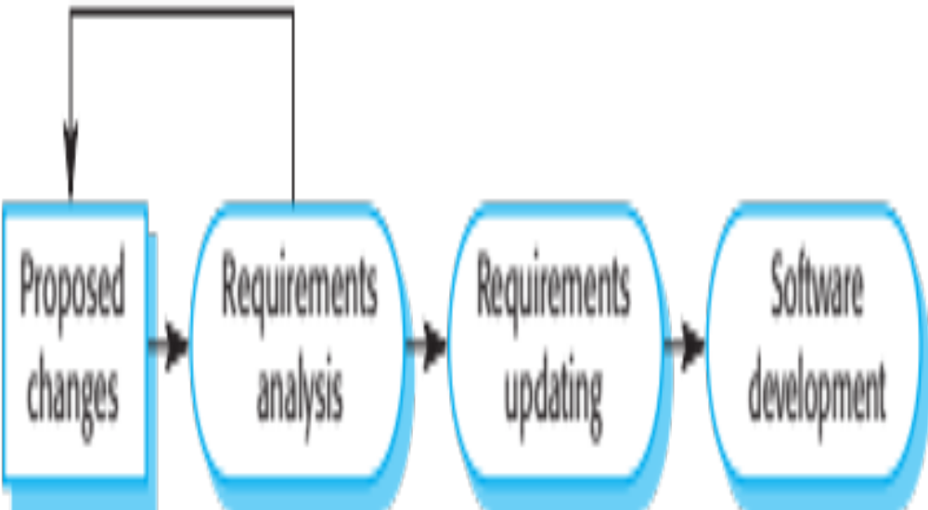
Change implementation

Slide 78
Change implementation (Cont.)
Iteration of the development process where the revisions to the system are designed, implemented and tested.
A critical difference is that the first stage of change implementation may involve program understanding, especially if the original system developers are not responsible for the change implementation.
During the program understanding phase, you have to understand how the program is structured, how it delivers functionality and how the proposed change might affect the program.

Slide 79
Urgent change requests
Urgent changes may have to be implemented without going through all stages of the software engineering process
  If a serious system fault has to be repaired to allow normal operation to continue;
  If changes to the system’s environment (e.g. an OS upgrade) have unexpected effects;
  If there are business changes that require a very rapid response (e.g. the release of a competing product).

Slide 80
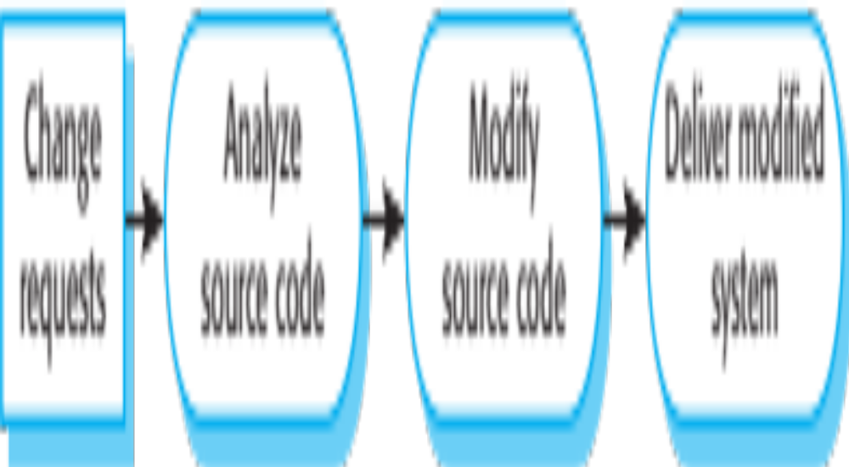
The emergency repair process

Slide 81
Agile methods and evolution
Agile methods are based on incremental development so the transition from development to evolution is a seamless one.
  Evolution is simply a continuation of the development process based on frequent system releases.
Automated regression testing is particularly valuable when changes are made to a system.
Changes may be expressed as additional user stories.

Slide 82
Handover problems
Where the development team have used an agile approach but the evolution team is unfamiliar with agile methods and prefer a plan-based approach.
  The evolution team may expect detailed documentation to support evolution and this is not produced in agile processes.
Where a plan-based approach has been used for development but the evolution team prefer to use agile methods.
  The evolution team may have to start from scratch developing automated tests and the code in the system may not have been refactored and simplified as is expected in agile development.

Slide 83
Legacy systems

Slide 84
Legacy systems
Legacy systems are older systems that rely on languages and technology that are no longer used for new systems development.
Legacy software may be dependent on older hardware, such as mainframe computers and may have associated legacy processes and procedures.
Legacy systems are not just software systems but are broader socio-technical systems that include hardware, software, libraries and other supporting software and business processes.

Slide 85
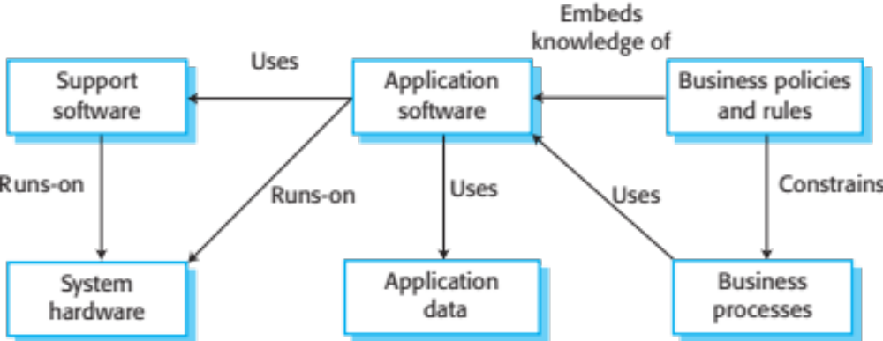
The elements of a legacy system

Slide 86
Legacy system components
System hardware Legacy systems may have been written for hardware that is no longer available.
Support software The legacy system may rely on a range of support software, which may be obsolete or unsupported.
Application software The application system that provides the business services is usually made up of a number of application programs.
Application data These are data that are processed by the application system. They may be inconsistent, duplicated or held in different databases.

Slide 87
Legacy system components
Business processes These are processes that are used in the business to achieve some business objective.
Business processes may be designed around a legacy system and constrained by the functionality that it provides.
Business policies and rules These are definitions of how the business should be carried out and constraints on the business. Use of the legacy application system may be embedded in these policies and rules.

Slide 88
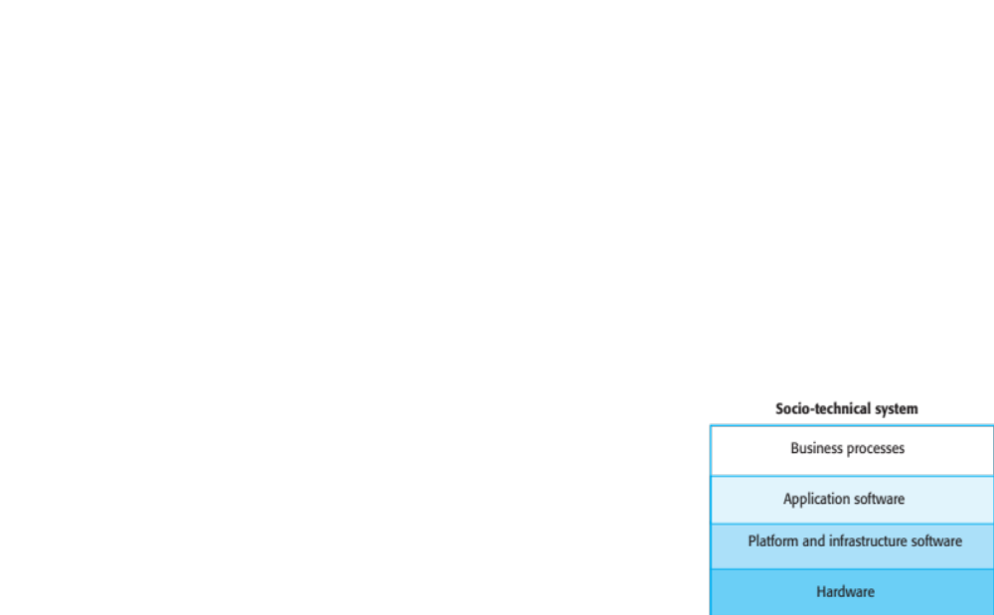
Legacy system layers

Slide 89
Legacy system replacement
Legacy system replacement is risky and expensive so businesses continue to use these systems
System replacement is risky for a number of reasons
  Lack of complete system specification
  Tight integration of system and business processes
  Undocumented business rules embedded in the legacy system
  New software development may be late and/or over budget

Slide 90
Legacy system change
Legacy systems are expensive to change for a number of reasons:
  No consistent programming style
  Use of obsolete programming languages with few people available with these language skills
  Inadequate system documentation
  System structure degradation
  Program optimizations may make them hard to understand
  Data errors, duplication and inconsistency

Slide 91
Legacy system management
Organisations that rely on legacy systems must choose a strategy for evolving these systems
  Scrap the system completely and modify business processes so that it is no longer required;
  Continue maintaining the system;
  Transform the system by re-engineering to improve its maintainability;
  Replace the system with a new system.
The strategy chosen should depend on the system quality and its business value.

Slide 92
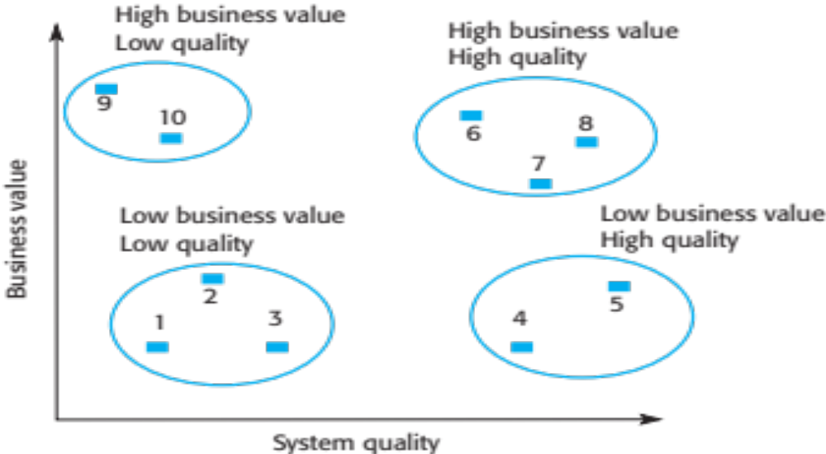
Figure 9.13 An example of a legacy system assessment

Slide 93
Legacy system categories
Low quality, low business value
  These systems should be scrapped.
Low-quality, high-business value
  These make an important business contribution but are expensive to maintain. Should be re-engineered or replaced if a suitable system is available.
High-quality, low-business value
  Replace with COTS, scrap completely or maintain.
High-quality, high business value
  Continue in operation using normal system maintenance.

Slide 94
Business value assessment
Assessment should take different viewpoints into account
  System end-users;
  Business customers;
  Line managers;
  IT managers;
  Senior managers.
Interview different stakeholders and collate results.

Slide 95
Issues in business value assessment
The use of the system
  If systems are only used occasionally or by a small number of people, they may have a low business value.
The business processes that are supported
  A system may have a low business value if it forces the use of inefficient business processes.
System dependability
  If a system is not dependable and the problems directly affect business customers, the system has a low business value.
The system outputs
  If the business depends on system outputs, then the system has a high business value.

Slide 96
System quality assessment
Business process assessment
  How well does the business process support the current goals of the business?
Environment assessment
  How effective is the system’s environment and how expensive is it to maintain?
Application assessment
  What is the quality of the application software system?

Slide 97
Business process assessment
Use a viewpoint-oriented approach and seek answers from system stakeholders
  Is there a defined process model and is it followed?
  Do different parts of the organisation use different processes for the same function?
  How has the process been adapted?
  What are the relationships with other business processes and are these necessary?
  Is the process effectively supported by the legacy application software?
Example - a travel ordering system may have a low business value because of the widespread use of web-based ordering.

Slide 98
Factors used in environment assessment
Factor | Questions
Supplier stability | Is the supplier still in existence? Is the supplier financially stable and likely to continue in existence? If the supplier is no longer in business, does someone else maintain the systems?
Failure rate | Does the hardware have a high rate of reported failures? Does the support software crash and force system restarts?
Age | How old is the hardware and software? The older the hardware and support software, the more obsolete it will be. It may still function correctly but there could be significant economic and business benefits to moving to a more modern system.
Performance | Is the performance of the system adequate? Do performance problems have a significant effect on system users?

Slide 99
Factors used in environment assessment
Factor | Questions
Support requirements | What local support is required by the hardware and software? If there are high costs associated with this support, it may be worth considering system replacement.
Maintenance costs | What are the costs of hardware maintenance and support software licences? Older hardware may have higher maintenance costs than modern systems. Support software may have high annual licensing costs.
Interoperability | Are there problems interfacing the system to other systems? Can compilers, for example, be used with current versions of the operating system? Is hardware emulation required?

Slide 100
Factors used in application assessment
Factor | Questions
Understandability | How difficult is it to understand the source code of the current system? How complex are the control structures that are used? Do variables have meaningful names that reflect their function?
Documentation | What system documentation is available? Is the documentation complete, consistent, and current?
Data | Is there an explicit data model for the system? To what extent is data duplicated across files? Is the data used by the system up to date and consistent?
Performance | Is the performance of the application adequate? Do performance problems have a significant effect on system users?

Slide 101
Factors used in application assessment
Factor | Questions
Programming language | Are modern compilers available for the programming language used to develop the system? Is the programming language still used for new system development?
Configuration management | Are all versions of all parts of the system managed by a configuration management system? Is there an explicit description of the versions of components that are used in the current system?
Test data | Does test data for the system exist? Is there a record of regression tests carried out when new features have been added to the system?
Personnel skills | Are there people available who have the skills to maintain the application? Are there people available who have experience with the system?

Slide 102
System measurement
You may collect quantitative data to make an assessment of the quality of the application system
  The number of system change requests; The higher this accumulated value, the lower the quality of the system.
  The number of different user interfaces used by the system; The more interfaces, the more likely it is that there will be inconsistencies and redundancies in these interfaces.
  The volume of data used by the system. As the volume of data (number of files, size of database, etc.) processed by the system increases, so too do the inconsistencies and errors in that data.
  Cleaning up old data is a very expensive and time-consuming process

Slide 103
Software maintenance

Slide 104
Software maintenance
Modifying a program after it has been put into use.
The term is mostly used for changing custom software. Generic software products are said to evolve to create new versions.
Maintenance does not normally involve major changes to the system’s architecture.
Changes are implemented by modifying existing components and adding new components to the system.

Slide 105
Types of maintenance
Fault repairs
  Changing a system to fix bugs/vulnerabilities and correct deficiencies in the way meets its requirements.
Environmental adaptation
  Maintenance to adapt software to a different operating environment
  Changing a system so that it operates in a different environment (computer, OS, etc.) from its initial implementation.
Functionality addition and modification
  Modifying the system to satisfy new requirements.

Slide 106
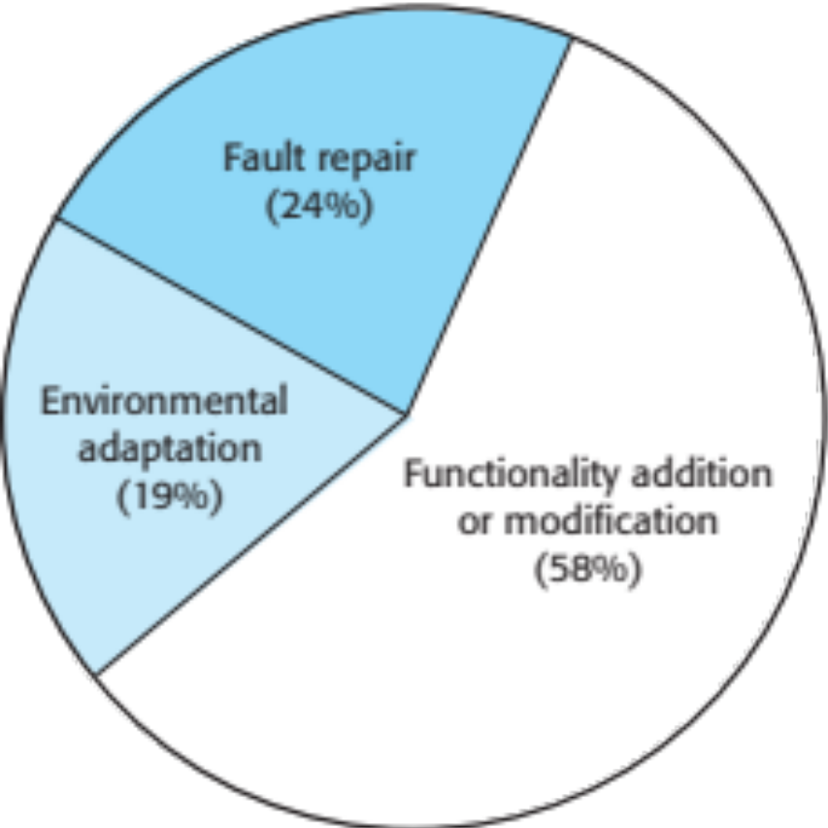
Maintenance effort distribution

Slide 107
Maintenance costs
Usually greater than development costs (2* to
100* depending on the application).
Affected by both technical and non-technical
factors.
Increases as software is maintained.
Maintenance corrupts the software structure so
makes further maintenance more difficult.
Ageing software can have high support costs
(e.g. old languages, compilers etc.).

Slide 108
Maintenance costs
It is usually more expensive to add new features to a system during maintenance than it is to add the same features during development
  A new team has to understand the programs being maintained
  Separating maintenance and development means there is no incentive for the development team to write maintainable software
  Program maintenance work is unpopular
    Maintenance staff are often inexperienced and have limited domain knowledge.
  As programs age, their structure degrades and they become harder to change

Slide 109
Maintenance prediction
Maintenance prediction is concerned with assessing which parts of the system may cause problems and have high maintenance costs
  Change acceptance depends on the maintainability of the components affected by the change;
  Implementing changes degrades the system and reduces its maintainability;
  Maintenance costs depend on the number of changes and costs of change depend on maintainability.

Slide 110
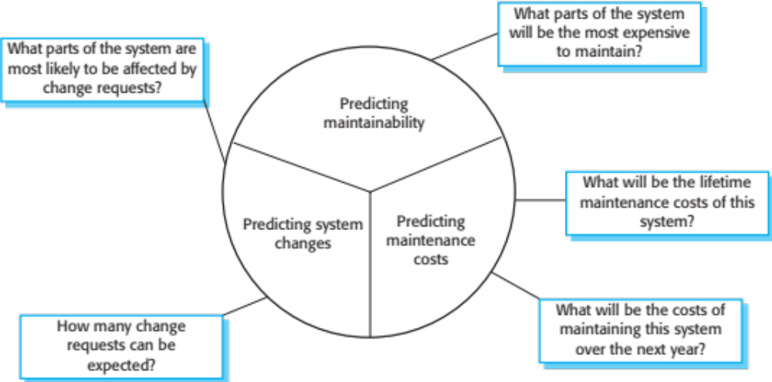
Maintenance prediction

Slide 111
Change prediction
Predicting the number of changes requires and understanding of the relationships between a system and its environment.
Tightly coupled systems require changes whenever the environment is changed.
Factors influencing this relationship are
  Number and complexity of system interfaces;
  Number of inherently volatile system requirements;
  The business processes where the system is used.

Slide 112
Complexity metrics
Predictions of maintainability can be made by assessing the complexity of system components.
Studies have shown that most maintenance effort is spent on a relatively small number of system components.
Complexity depends on
  Complexity of control structures;
  Complexity of data structures;
  Object, method (procedure) and module size.

Slide 113
Process metrics
Process metrics may be used to assess maintainability
  Number of requests for corrective maintenance;
  Average time required for impact analysis;
  Average time taken to implement a change request;
  Number of outstanding change requests.
If any or all of these is increasing, this may indicate a decline in maintainability.

Slide 114
Software reengineering
Restructuring or rewriting part or all of a
legacy system without changing its
functionality.
Applicable where some but not all sub-systems
of a larger system require frequent
maintenance.
Reengineering involves adding effort to make
them easier to maintain. The system may be re-structured and re-documented.

Slide 115
Advantages of reengineering
Reduced risk
  There is a high risk in new software development. There may be development problems, staffing problems and specification problems.
Reduced cost
  The cost of re-engineering is often significantly less than the costs of developing new software.

Slide 116
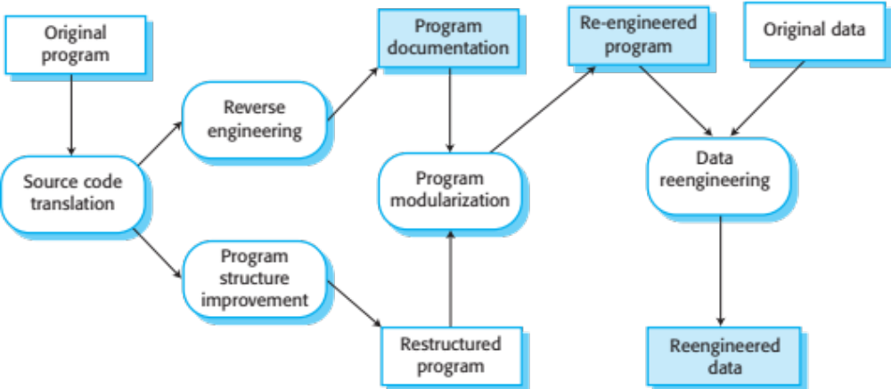
The reengineering process

Slide 117
Reengineering process activities
Source code translation
  Convert code to a new language.
Reverse engineering
  Analyse the program to understand it;
Program structure improvement
  Restructure automatically for understandability;
Program modularisation
  Reorganise the program structure;
Data reengineering
  Clean-up and restructure system data.

Slide 118
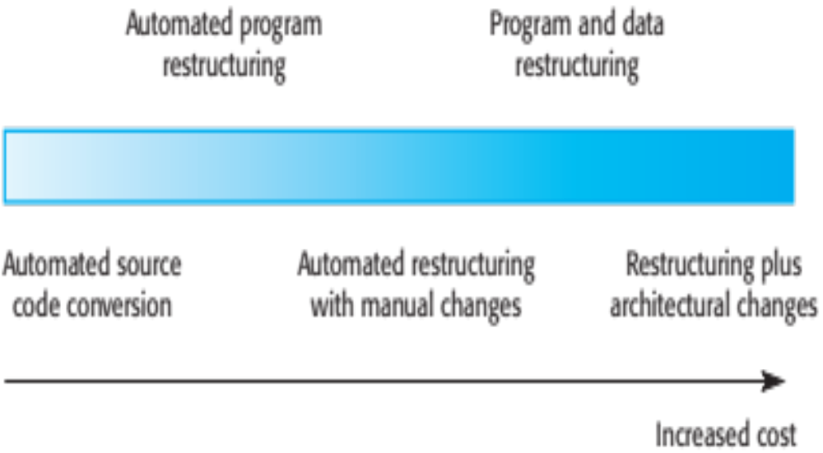
Reengineering approaches

Slide 119
Reengineering cost factors
The quality of the software to be reengineered.
The tool support available for reengineering.
The extent of the data conversion which is required.
The availability of expert staff for reengineering.
  This can be a problem with old systems based on technology that is no longer widely used.

Slide 120
Refactoring
Refactoring is the process of making improvements to a program to slow down degradation through change.
You can think of refactoring as ‘preventative maintenance’ that reduces the problems of future change.
Refactoring involves modifying a program to improve its structure, reduce its complexity or make it easier to understand.
When you refactor a program, you should not add functionality but rather concentrate on program improvement.

Slide 121
Refactoring and reengineering
Re-engineering takes place after a system has been maintained for some time and maintenance costs are increasing. You use automated tools to process and re-engineer a legacy system to create a new system that is more maintainable.
Refactoring is a continuous process of improvement throughout the development and evolution process. It is intended to avoid the structure and code degradation that increases the costs and difficulties of maintaining a system.

Slide 122
‘Bad smells’ in program code
Duplicate code
  The same or very similar code may be included at different places in a program. This can be removed and implemented as a single method or function that is called as required.
Long methods
  If a method is too long, it should be redesigned as a number of shorter methods.
Switch (case) statements
  These often involve duplication, where the switch depends on the type of a value. The switch statements may be scattered around a program. In object-oriented languages, you can often use polymorphism to achieve the same thing.

Slide 123
‘Bad smells’ in program code
Data clumping
  Data clumps occur when the same group of data items (fields in classes, parameters in methods) re-occur in several places in a program. These can often be replaced with an object that encapsulates all of the data.
Speculative generality
  This occurs when developers include generality in a program in case it is required in the future. This can often simply be removed.

Slide 124
Key points
Software development and evolution can be thought of as an integrated, iterative process that can be represented using a spiral model.
For custom systems, the costs of software maintenance usually exceed the software development costs.
The process of software evolution is driven by requests for changes and includes change impact analysis, release planning and change implementation.
Legacy systems are older software systems, developed using obsolete software and hardware technologies, that remain useful for a business.

Slide 125
Key points
It is often cheaper and less risky to maintain a legacy system than to develop a replacement system using modern technology.
The business value of a legacy system and the quality of the application should be assessed to help decide if a system should be replaced, transformed or maintained.
There are 3 types of software maintenance, namely bug fixing, modifying software to work in a new environment, and implementing new or changed requirements.

Slide 126
Key points
Software re-engineering is concerned with re-structuring and re-documenting software to make it easier to understand and change.
Refactoring, making program changes that preserve functionality, is a form of preventative maintenance.

Slide 127
Next Lecture
Project Management

Slide 128
References
Ian Sommerville; “Software Engineering”, 10th Global Ed., Pearson, 2016.

