Slide 1
CSE202 Database Management Systems
Lecture #6
Prepared & Presented by Asst. Prof. Dr. Samsun M. BAŞARICI

Slide 2
Learning Objectives
List several limitations in the relational database model.
Describe the object-oriented database concept.
Model data using such complex relationships as generalization and aggregation, and such concepts as inheritance and polymorphism.
Describe the benefits of encapsulation.
Describe the value of developing abstract data types.
Explain what an object/relational database is.

Slide 3
Outline
Overview of Object Database Concepts
Object-Relational Features:
Object Database Extensions to SQL
The ODMG Object Model and the Object Definition Language ODL
Object Database Conceptual Design
The Object Query Language OQL
Overview of the C++ Language Binding in the ODMG Standard

Slide 4
Historically Speaking
For much of IS history the emphasis was on the programs, with the data structures and ultimately the data stored in them being a secondary consideration.
The IS environment is changing from this program-centric mentality into a more data-centric one.

Slide 5
Object Orientation
An alternative approach to information systems and IS development.
Began during the 1980s.
More data-centric.

Slide 6
What’s Missing in the Relational Database Concept?
Many people would say that nothing is missing from the relational model.
Others would point out that for certain kinds of complex applications, the relational model is lacking in support for the more complex data model features they need.

Slide 7
What’s Missing in the Relational Database Concept?
Does not directly provide support for generalization/specialization.
Does not directly provide support for aggregation.

Slide 8
What’s Missing in the Relational Database Concept?
Does not have a system in which only a limited, controlled set of program segments is allowed to update particular data.
Does not directly support more complex data types such as:
  graphic images
  photo images
  video clips
  audio clips
  long text documents
  mathematical constructs such as matrices

Slide 9
Terminology: Object-Oriented Data Modeling
Object - describes an advanced data structure that includes an entity’s attributes plus methods or operations or procedures (program code!) that can operate on and modify the object’s attribute values.
(object) class - the objects that describe similar entities.

Slide 10
More advantages of Object Oriented Database Concept
Each object has an object identifier that is permanent and unique among all objects of all types in the system.
Some OODBMSs are implemented as pointer-based systems.
  related objects are “connected” by their storage addresses.
OODBMSs are the most natural data storage vehicles when object-oriented programming languages, such as C++, Smalltalk, and Java, are in use.

Slide 11
Unified Modeling Language
Introduced in 1997 by the Object Management Group (OMG)
Has nine standard diagrams that describe:
  the system’s data
  the business processes
  the intended results
  the components of the program code
  the hardware and software architectures.

Slide 12
UML Class Diagram
Describes the system’s data, including attributes of and relationships between the “objects.”

Slide 13
Object and Object-Relational
Databases
Object databases (ODB)
  Object data management systems (ODMS)
  Meet some of the needs of more complex applications
  Specify:
    Structure of complex objects
    Operations that can be applied to these objects

Slide 14
Overview of Object Database Concepts
Introduction to object-oriented concepts and features
  Origins in OO programming languages
  Object has two components:
    State (value) and behavior (operations)
  Instance variables
    Hold values that define internal state of object
  Operation is defined in two parts:
    Signature or interface and implementation

Slide 15
Overview of Object Database Concepts (cont’d.)
  Inheritance
    Permits specification of new types or classes that inherit much of their structure and/or operations from previously defined types or classes
  Operator overloading
    Operation’s ability to be applied to different types of objects
    Operation name may refer to several distinct implementations

Slide 16
Object Identity, and Objects versus Literals
Unique identity
  Implemented via a unique, system-generated object identifier (OID)
  Immutable
Most OO database systems allow for the representation of both objects and literals (or values)

Slide 17
Complex Type Structures for Objects and Literals
Structure of arbitrary complexity
  Contain all necessary information that describes object or literal
Nesting type constructors
  Construct complex type from other types
Most basic constructors:
  Atom
  Struct (or tuple)
  Collection

Slide 18
Complex Type Structures for Objects and Literals (cont.)
Collection types:
  Set
  Bag
  List
  Array
  Dictionary
Object definition language (ODL)
  Used to define object types for a particular database application

Slide 19
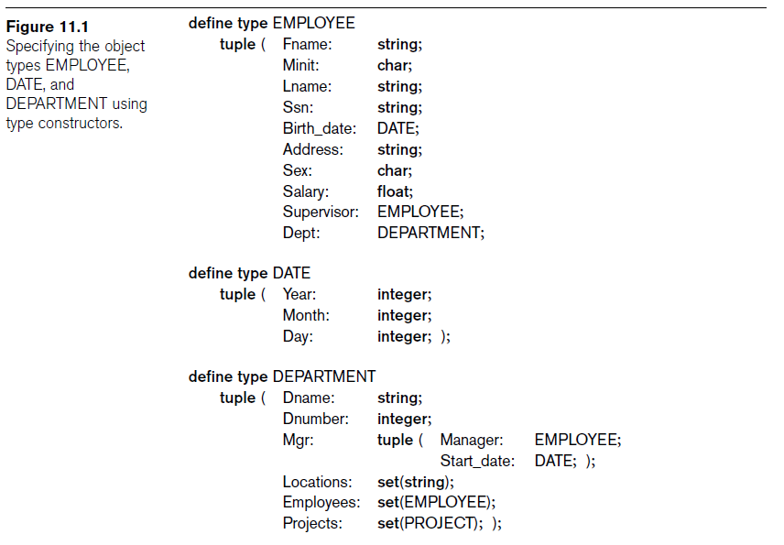

Slide 20
Generalization
Also known as generalization/specialization
Is a relationship that recognizes that some kinds of entities can be subdivided into smaller, more specialized groups.

Slide 21
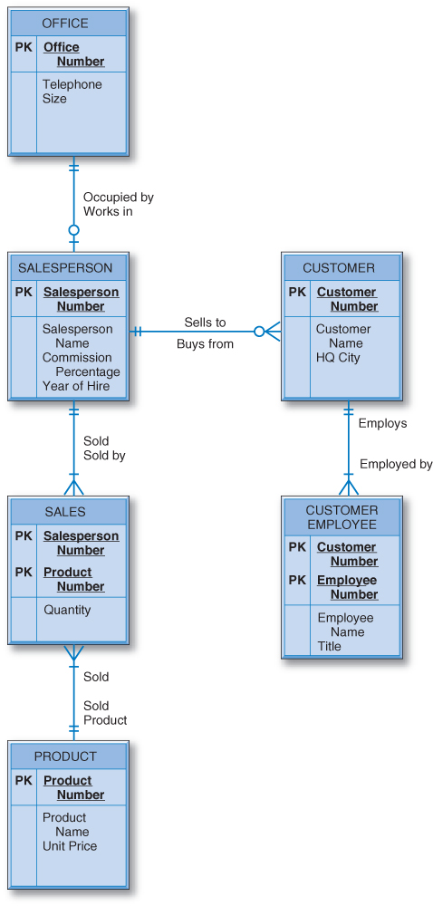
General Hardware Company ERD
General Hardware company E-R diagram.
General Hardware is a wholesaler.

Slide 22
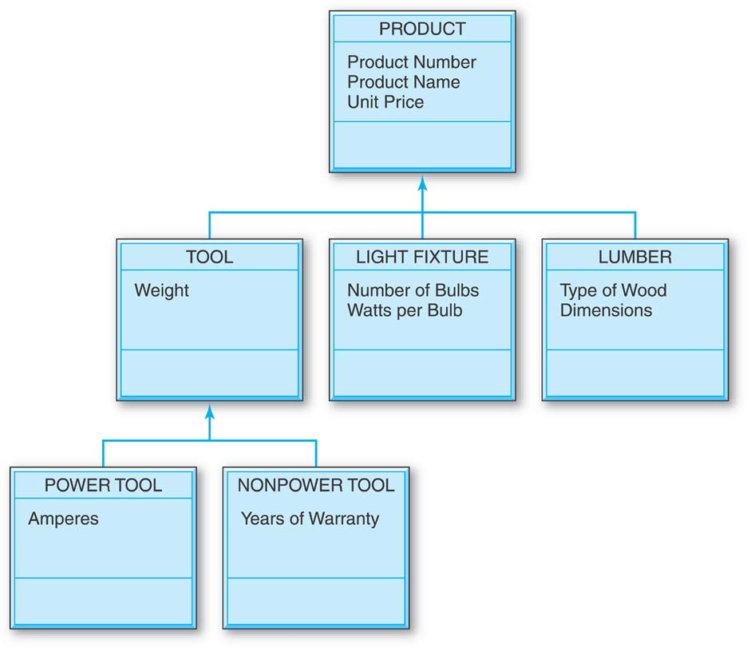
General Hardware Company Generalization Diagram
Each box represents a class and has three sections separated by horizontal lines.
  At the top, in capital letters, is the class name
  In the middle are the class attributes
  At the bottom are the class operations (not shown)

Slide 23
General Hardware Company Generalization Diagram (cont.)
The upward pointing arrows indicate generalizations.
There are three kinds of products
  TOOLs
  LIGHT FIXTUREs
  LUMBER
There are two kinds of tools
  POWER TOOLs
  NONPOWER TOOLs

Slide 24
Encapsulation of Operations and Persistence of Objects
Encapsulation
  Related to abstract data types and information hiding in programming languages
  Define behavior of a type of object based on operations that can be externally applied
  External users only aware of interface of the operations
  Divide structure of object into visible and hidden attributes

Slide 25
Encapsulation of Operations
Object constructor
  Used to create a new object
Destructor operation
  Used to destroy (delete) an object
Modifier operations
  Modify the states (values) of various attributes of an object
Retrieve information about the object
Dot notation used to apply operations to object

Slide 26
Persistence of Objects
Transient objects
  Exist in executing program
  Disappear once program terminates
Persistent objects
  Stored in database and persist after program termination
  Naming mechanism
  Reachability

Slide 27
Type Hierarchies and Inheritance
Inheritance
  Definition of new types based on other predefined types
  Leads to type (or class) hierarchy
Type: type name and list of visible (public) functions
  Format:
    TYPE_NAME: function, function, ..., function

Slide 28
Type Hierarchies and Inheritance (cont.)
Subtype
  Useful when creating a new type that is similar but not identical to an already defined type
  Example:
    EMPLOYEE subtype-of PERSON: Salary, Hire_date, Seniority
    STUDENT subtype-of PERSON: Major, Gpa

Slide 29
Type Hierarchies and Inheritance (cont.)
Extent
  Store collection of persistent objects for each type or subtype
  Extents are subsets of the extent of class OBJECT
Persistent collection
  Stored permanently in the database
Transient collection
  Exists temporarily during the execution of a program

Slide 30
Other Object-Oriented Concepts
Polymorphism of operations
  Also known as operator overloading
  Allows same operator name or symbol to be bound to two or more different implementations
  Depending on type of objects to which operator is applied
Multiple inheritance
  Subtype inherits functions (attributes and methods) of more than one supertype
Selective inheritance
  Subtype inherits only some of the functions of a supertype

Slide 31
Summary of Object Database Concepts
Object identity
Type constructor
Encapsulation of operations
Programming language compatibility
Type hierarchies and inheritance
Extents
Polymorphism and operator overloading

Slide 32
Object-Relational Features:
Object Database Extensions to SQL
Type constructors
  Specify complex objects
Mechanism for specifying object identity
Encapsulation of operations
  Provided through user-defined types (UDTs)
Inheritance mechanisms
  Provided using keyword UNDER

Slide 33
Object/Relational Database
OODBMSs were lacking in several areas, including the superior query capabilities of SQL that everyone had become accustomed to.
Relational database and object-oriented database have come together in the form of hybrid relational database management systems with object-oriented features added to them.

Slide 34
User-Defined Types and Complex Structures for Objects
UDT syntax:
  CREATE TYPE TYPE_NAME AS (<component declarations>);
ROW TYPE
  Directly create a structured attribute using the keyword ROW

Slide 35
User-Defined Types and Complex Structures for Objects (cont’d.)
Array type
  Reference elements using []
CARDINALITY function
  Return the current number of elements in an array

Slide 36
Object Identifiers Using Reference Types
Reference type
  Create unique system-generated object identifiers
  Examples:
    REF IS SYSTEM GENERATED
    REF IS <OID_ATTRIBUTE> <VALUE_GENERATION_METHOD> ;

Slide 37
Creating Tables Based on the UDTs
INSTANTIABLE
  Specify that UDT is instantiable
  Causes one or more tables to be created

Slide 38
Inheritance of Attributes
The PRODUCT class indicates that all products have three common attributes: Product Number, Product Name, and Unit Price.
All of the classes below PRODUCT inherit the attributes shown in PRODUCT.

Slide 39
Inheritance of Attributes (cont.)
The attributes for POWER TOOLs are:
  (from Product)
    Product Number
    Product Name
    Unit Price
  (from TOOL)
    Weight
  (from POWER TOOL)
    Amperes

Slide 40
Inheritance of Attributes (cont.)
The attributes for NONPOWER TOOLs are
  (from Product)
    Product Number
    Product Name
    Unit Price
  (from TOOL)
    Weight
  (from NON-POWER TOOL)
    Years of Warranty

Slide 41
Inheritance of Attributes (cont.)
The attributes for LIGHT FIXTUREs are
  (from Product)
    Product Number
    Product Name
    Unit Price
  (from LIGHT FIXTURE)
    Number of Bulbs
    Watts per Bulb

Slide 42
Inheritance of Attributes (cont.)
The attributes for LUMBER are
  (from Product)
    Product Number
    Product Name
    Unit Price
  (from LUMBER)
    Type of Wood
    Dimensions

Slide 43
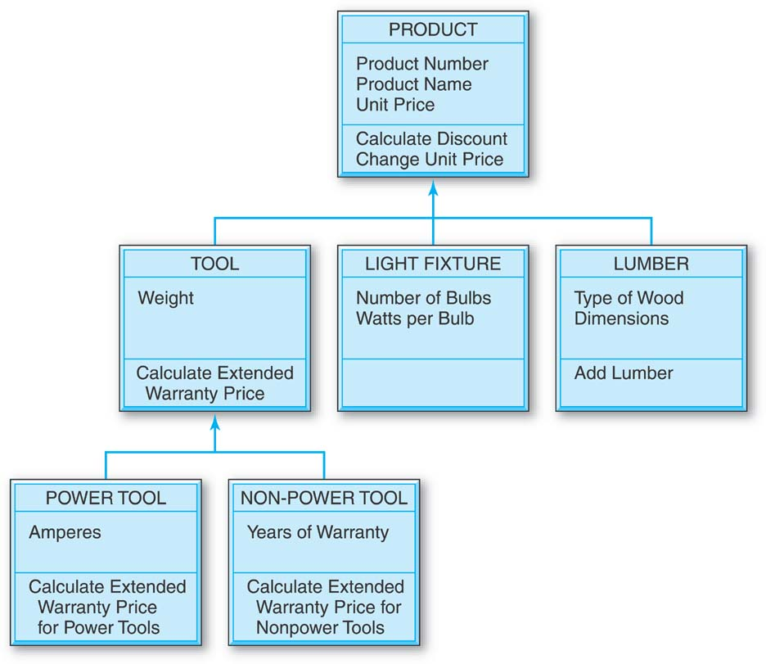
Operations
Operations have now been added to the UML Diagram.
There are three kinds of operations:
  Constructor
  Query
  Update

Slide 44
Operations: Constructor
Creates a new instance of a class, that is, a new object.
Example: Add Lumber
  an operation that will add a new instance of LUMBER, that is, a new object, to the database.

Slide 45
Operations: Query
Returns data about the values of an object’s attributes but does not update them.
Example: Calculate Discount
  calculates a discount for a particular customer buying a particular product and returns the result to the user who issued the query, but does not store the result in the database.

Slide 46
Operations: Update
Updates an object’s attribute values.
Example: Change Unit Price
  a product’s unit price may have to be changed, and the result is stored in the database as the new unit price.

Slide 47
Polymorphism
Modification or refinement of operations as they are inherited downward.
The operations that are performed differently in the lower level objects can have modified names and will perform differently for the different kinds of objects.

Slide 48
Polymorphism (cont.)
Looking at “Calculate Discount”:
  Since there is nothing more said about the discount further down the hierarchy, the discount is calculated in the same way for all kinds of products.
Looking at “Calculate Extended Warranty Price”:
  polymorphism occurs in the Calculate Extended Warranty Price operation because it is performed differently for power tools and nonpower tools.

Slide 49
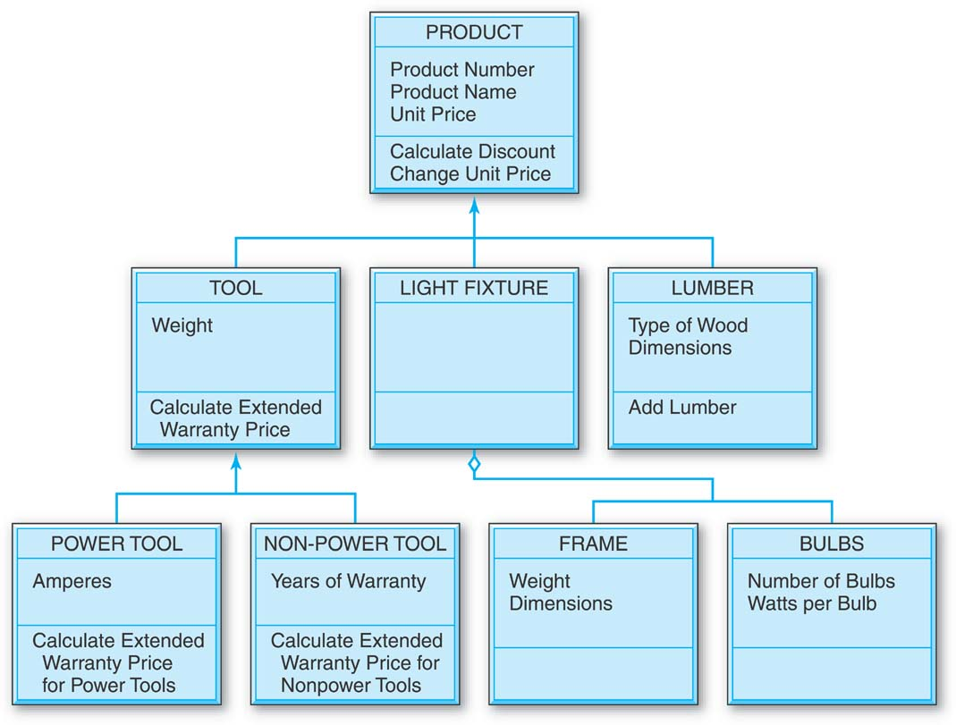
Aggregation

Slide 50
Aggregation (cont.)
A class is shown to be composed of other classes.
FRAMEs and BULBS are not kinds of LIGHT FIXTUREs; rather, each is a part of a LIGHT FIXTURE.

Slide 51
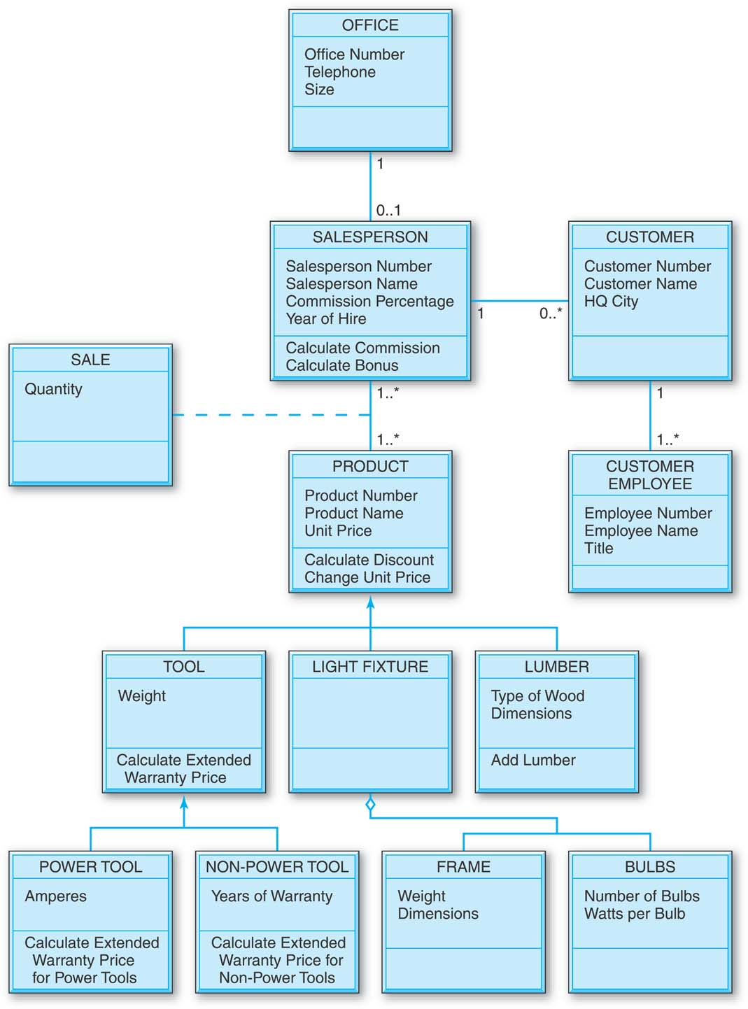
General Hardware Company Class Diagram

Slide 52
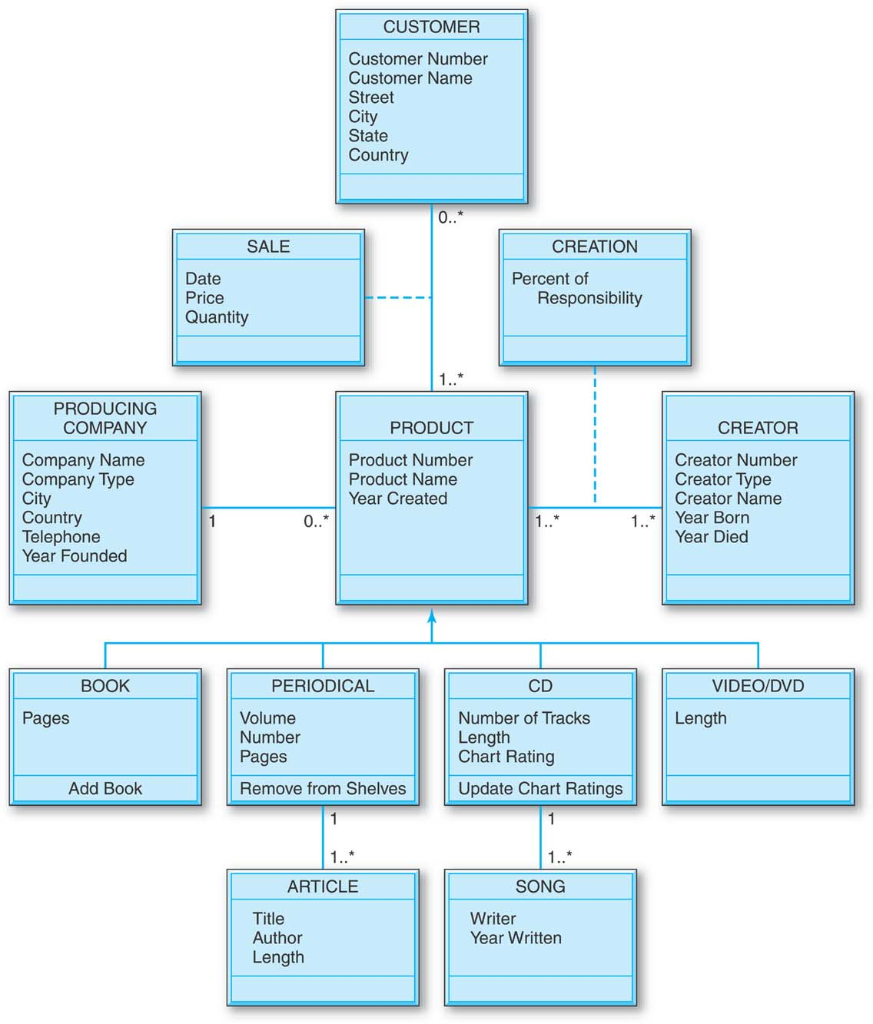
Good Reading Bookstores Class Diagram
A generalization hierarchy has been created under PRODUCT, which indicates that there are four kinds of products: BOOK, PERIODICAL, CD, and VIDEO/DVD.
The PERIODICAL class, and only this class, is associated with the ARTICLE class.

Slide 53
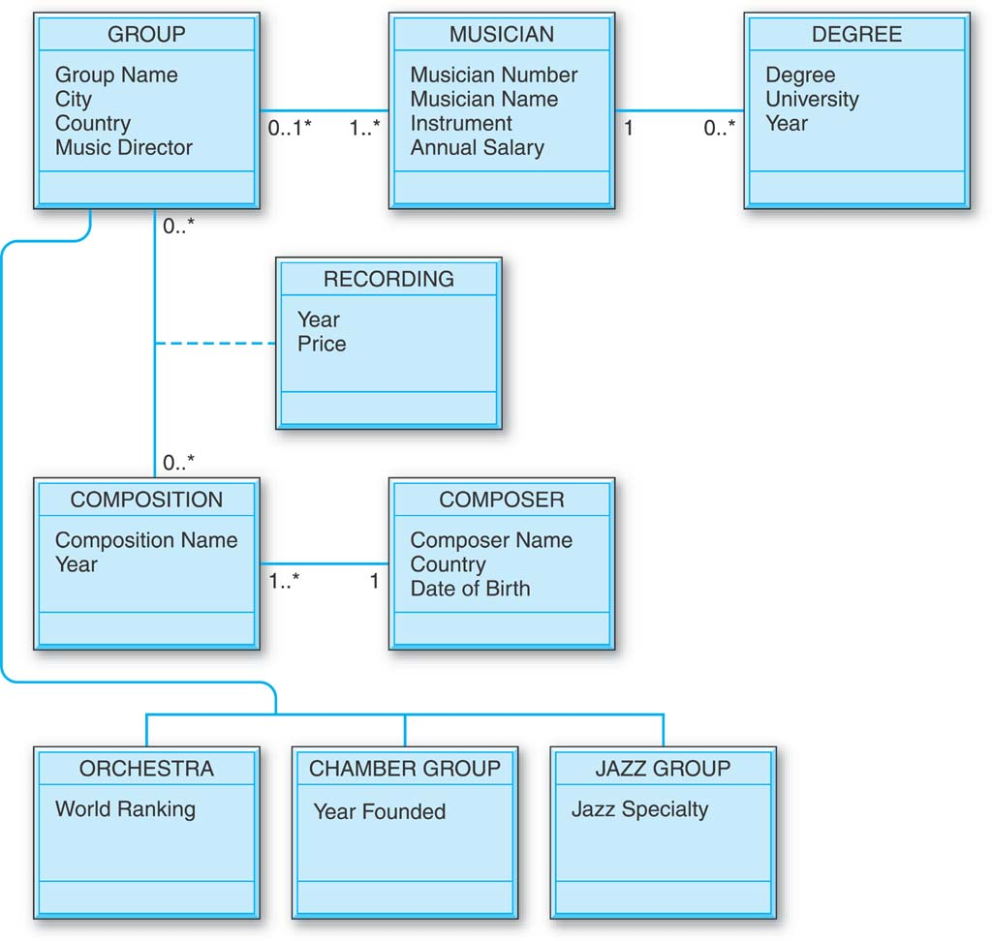
World Music Association Class Diagram
A generalization hierarchy has been constructed with subordinate classes ORCHESTRA, CHAMBER GROUP, and JAZZ GROUP.

Slide 54
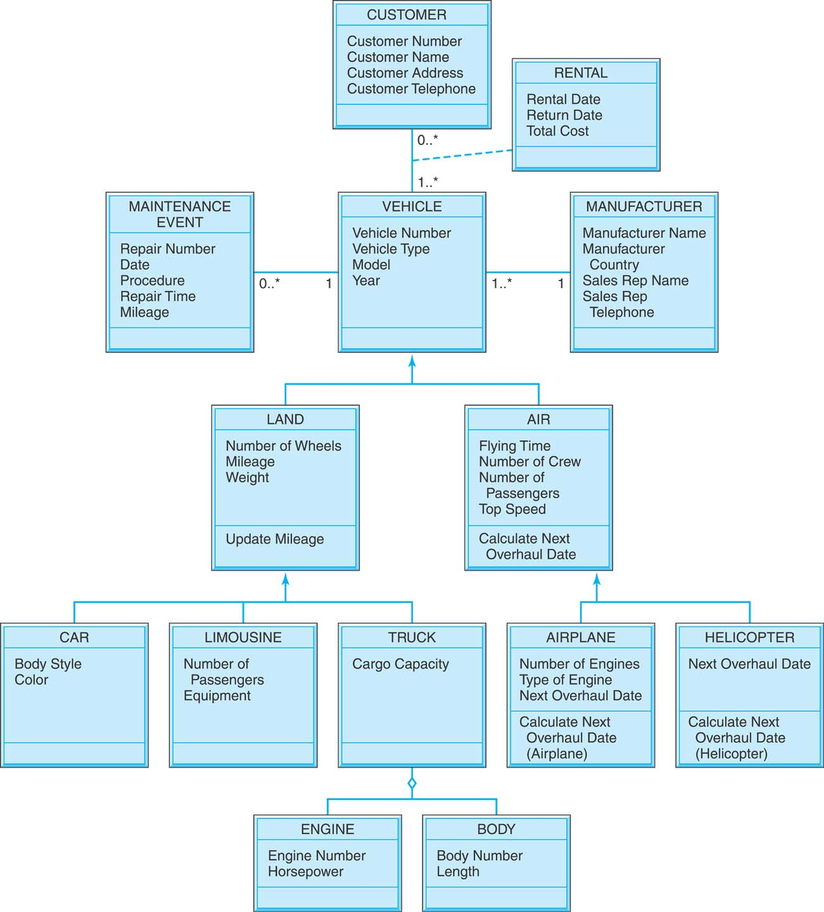
Lucky Rent-A-Vehicle Class Diagram
Lucky Rent-A-Car has expanded to become Lucky Rent-A-Vehicle!
A two-level generalization hierarchy under VEHICLE.
The diamond-shaped symbol on the branch under the TRUCK class indicates that there is an aggregation diagram under it.

Slide 55
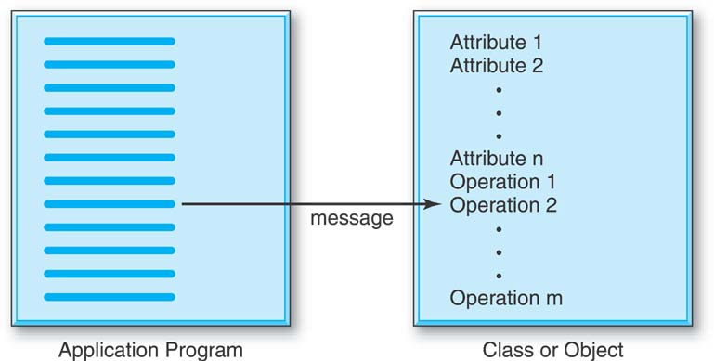
Encapsulation
The attributes of a class or even an individual object are “encapsulated,” stored together on the disk, with the operations that will act upon them.
OODBMS will only permit the attributes of the encapsulated objects to be updated by the encapsulated update-type operations, thereby improving data integrity.

Slide 56
Encapsulation (cont.)
When an application program requires encapsulated data, it sends a message to one of the object’s encapsulated operations to trigger it into action.
The application program sends along any input data needed for the operation.

Slide 57
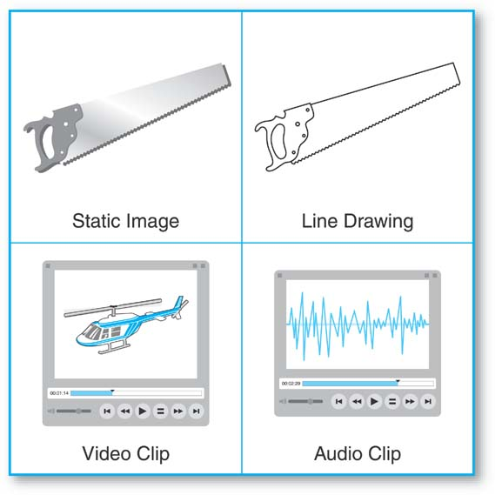
Abstract Data Types
Object-oriented database allows the creation of new, abstract data types and operations that are associated with them.

Slide 58
Encapsulation of Operations
User-defined type
  Specify methods (or operations) in addition to the attributes
  Format:
  CREATE TYPE <TYPE-NAME> (
  <LIST OF COMPONENT ATTRIBUTES AND THEIR TYPES>
  <DECLARATION OF FUNCTIONS (METHODS)>
  );

Slide 59
Encapsulation of Operations (cont.)
Constructor function TYPE_T( )
  Returns a new object of that type
  Format
    DECLARE EXTERNAL <FUNCTION_NAME> <SIGNATURE>
    LANGUAGE <LANGUAGE_NAME>;

Slide 60
Specifying Inheritance and Overloading of Functions
Inheritance rules:
  All attributes inherited
  Order of supertypes in UNDER clause determines inheritance hierarchy
  Instance of a subtype can be used in every context in which a supertype instance used
  Subtype can redefine any function defined in supertype

Slide 61
Specifying Inheritance and Overloading of Functions (cont.)
  When a function is called, best match selected based on types of all arguments
  For dynamic linking, runtime types of parameters is considered

Slide 62
Specifying Relationships via Reference
Component attribute of one tuple may be a reference to a tuple of another table
  Specified using keyword REF
Keyword SCOPE
  Specify name of table whose tuples referenced
Dot notation
  Build path expressions
–>
  Used for dereferencing

Slide 63
The ODMG Object Model and the Object Definition Language ODL
ODMG object model
  Data model for object definition language (ODL) and object query language (OQL)
Objects and Literals
  Basic building blocks of the object model
Object has five aspects:
  Identifier, name, lifetime, structure, and creation
Literal
  Value that does not have an object identifier

Slide 64
The ODMG Object Model and the ODL (cont.)
Behavior refers to operations
State refers to properties
Interface
  Specifies only behavior of an object type
  Typically noninstantiable
Class
  Specifies both state (attributes) and behavior (operations) of an object type
  Instantiable

Slide 65
Inheritance in the Object Model of ODMG
Behavior inheritance
  Also known as IS-A or interface inheritance
  Specified by the colon (:) notation
EXTENDS inheritance
  Specified by keyword extends
  Inherit both state and behavior strictly among classes
  Multiple inheritance via extends not permitted

Slide 66
Built-in Interfaces and Classes in the Object Model
Collection objects
  Inherit the basic Collection interface
I = O.create_iterator()
  Creates an iterator object for the collection
Collection objects further specialized into:
  set, list, bag, array, and dictionary

Slide 67
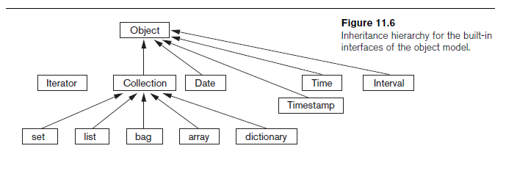
Built-in Interfaces and Classes in the Object Model (cont.)

Slide 68
Atomic (User-Defined) Objects
Specified using keyword class in ODL
Attribute
  Property; describes some aspect of an object
Relationship
  Two objects in the database are related
  Keyword inverse
    Single conceptual relationship in inverse directions
Operation signature:
  Operation name, argument types, return value

Slide 69
Extents, Keys, and Factory Objects
Extent
  Contains all persistent objects of class
Key
  One or more properties whose values are unique for each object in extent
Factory object
  Used to generate or create individual objects via its operations

Slide 70
The Object Definition Language ODL
Support semantic constructs of ODMG object model
Independent of any particular programming language

Slide 71
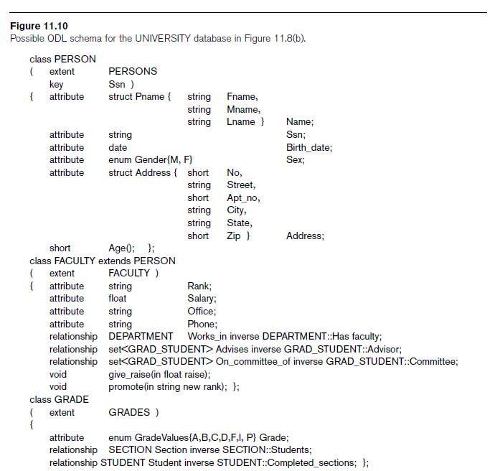

Slide 72
Object Database Conceptual Design
Differences between conceptual design of ODB and RDB, handling of:
  Relationships
  Inheritance
Philosophical difference between relational model and object model of data
  In terms of behavioral specification

Slide 73
Mapping an EER Schema to an ODB Schema
Create ODL class for each EER entity type
Add relationship properties for each binary relationship
Include appropriate operations for each class
ODL class that corresponds to a subclass in the EER schema
  Inherits type and methods of its superclass in ODL schema

Slide 74
Mapping an EER Schema to an ODB Schema (cont.)
Weak entity types
  Mapped same as regular entity types
Categories (union types)
  Difficult to map to ODL
An n-ary relationship with degree n > 2
  Map into a separate class, with appropriate references to each participating class

Slide 75
The Object Query Language OQL
Query language proposed for ODMG object model
Simple OQL queries, database entry points, and iterator variables
  Syntax: select ... from ... where ... structure
  Entry point: named persistent object
  Iterator variable: define whenever a collection is referenced in an OQL query

Slide 76
Query Results and Path Expressions
Result of a query
  Any type that can be expressed in ODMG object model
OQL orthogonal with respect to specifying path expressions
  Attributes, relationships, and operation names (methods) can be used interchangeably within the path expressions

Slide 77
Other Features of OQL
Named query
  Specify identifier of named query
OQL query will return collection as its result
  If user requires that a query only return a single element use element operator
Aggregate operators
Membership and quantification over a collection

Slide 78
Other Features of OQL (cont.)
Special operations for ordered collections
Group by clause in OQL
  Similar to the corresponding clause in SQL
  Provides explicit reference to the collection of objects within each group or partition
Having clause
  Used to filter partitioned sets

Slide 79
Overview of the C++ Language Binding in the ODMG Standard
Specifies how ODL constructs are mapped to C++ constructs
Uses prefix d_ for class declarations that deal with database concepts
Template classes
  Specified in library binding
  Overloads operation new so that it can be used to create either persistent or transient objects

Slide 80
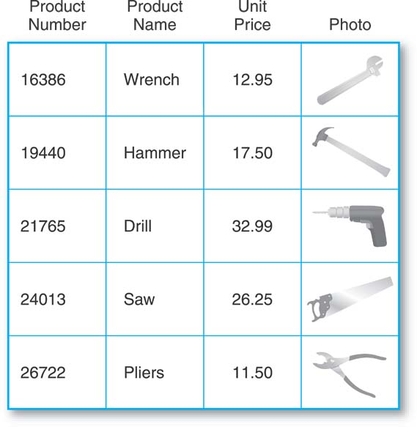
General Hardware Company as an Object/Relational Database

Slide 81
Next Lecture
XML & SQL Programming

Slide 82
References
Ramez Elmasri, Shamkant Navathe; “Fundamentals of Database Systems”, 6th Ed., Pearson, 2014
Mark L. Gillenson; “Fundamentals of Database Management Systems”, 2nd Ed., John Wiley, 2012
Universität Hamburg, Fachbereich Informatik, Einführung in Datenbanksysteme, Lecture Notes, 1999

