Slide 1


CSE 414 Systems Analysis and Design
Lecture #5
Determining Systems Requirements
Prepared & Presented by Asst. Prof. Dr. Samsun M. BAŞARICI

Slide 2
Learning Objectives
Describe options for designing and conducting interviews and develop a plan for conducting an interview to determine system requirements.
Explain the advantages and pitfalls of observing workers and analyzing business documents to determine system requirements.
Explain how computing can provide support for requirements determination.
Participate in and help plan a Joint Application Design session.

Slide 3
Learning Objectives (Cont.)
Use prototyping during requirements determination.
Describe contemporary approaches to requirements determination.
Understand how requirements determination techniques apply to the development of electronic commerce applications.

Slide 4
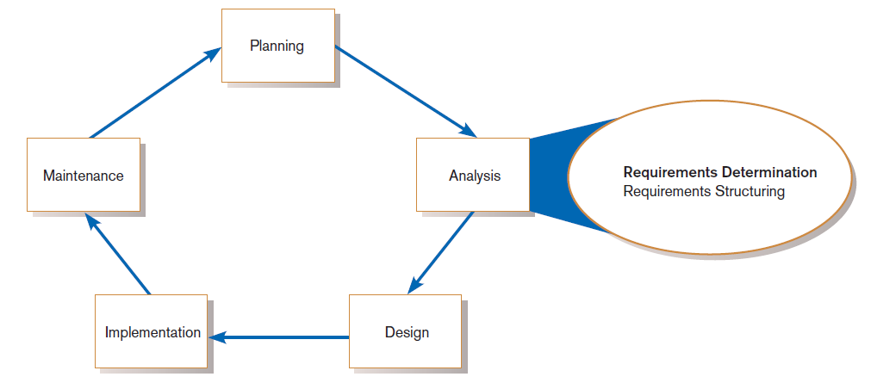
Performing Requirements Determination
FIGURE 6-1
Systems development life cycle with analysis phase highlighted
Notes:
At this point the planning phase has ended. If we think of this as a waterfall model, the results of planning are fairly stable, and we move forward to the next distinct stage.
In the analysis phase, we need to first get a good idea of what the requirements of the system are, and secondly characterize them in a structure that leads amenably into a system design. In this chapter we focus on requirements determination, and in the next we focus on requirements structuring.

Slide 5
The Process of Determining Requirements
Good Systems Analyst Characteristics:
  Impertinence—question everything
  Impartiality—consider all issues to find the best organizational solution
  Relax constraints—assume anything is possible
  Attention to details—every fact must fit
  Reframing—challenge yourself to new ways
Notes:
There is a certain attitude that fits well with the systems analyst role. This person doesn’t take things at face value but instead tries to dig deep. This person also balances the perspectives of all the people he or she interacts with, and isn’t weighed down by perceived obstacles. The ability to “think outside the box” is important.

Slide 6
Organizational Components to Understand
Business objectives that drive what and how work is done
Information people need to do their jobs
The data (definition, volume, size, etc.)
Existing data movement, transformation and storage processes
Dependencies and sequences
Data handling/processing rules
Business policies and guidelines
Key events
Notes:
All of these will be relevant throughout the systems analysis and design process.

Slide 7
Deliverables and Outcomes
Deliverables for Requirements Determination:
  From interviews and observations
    interview transcripts, observation notes, meeting minutes
  From existing written documents
    mission and strategy statements, business forms, procedure manuals, job descriptions, training manuals, system documentation, flowcharts
  From computerized sources
    Joint Application Design session results, CASE repositories, reports from existing systems, displays and reports from system prototype

Slide 8
Traditional Methods for Determining Requirements
Interviewing individuals
Interviewing groups
Observing workers
Studying business documents
Notes:
These have always been used in systems development projects. Computerized tools and techniques are a more recent phenomenon.

Slide 9
Interviewing and Listening
One of the primary ways analysts gather information about an information systems project
An interview guide is a document for developing, planning and conducting an interview.

Slide 10
Guidelines for Effective Interviewing
Plan the interview.
  Prepare interviewee: appointment, priming questions.
  Prepare agenda, checklist, questions.
Listen carefully and take notes (tape record if permitted).
Review notes within 48 hours.
Be neutral.
Seek diverse views.

Slide 11
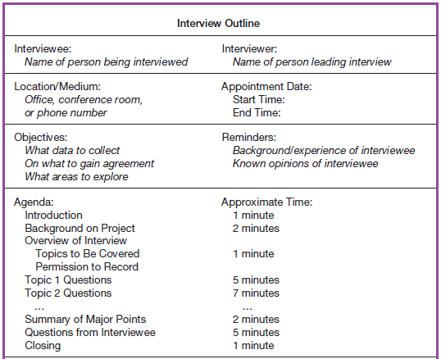
Interviewing and Listening (Cont.)
FIGURE 6-2 Typical interview guide
Notes:
Here is a typical interview guide. This gives the interviewer explicit instructions and time estimates for the interview. It helps to prepare the interviewer for conducting the interview.

Slide 12
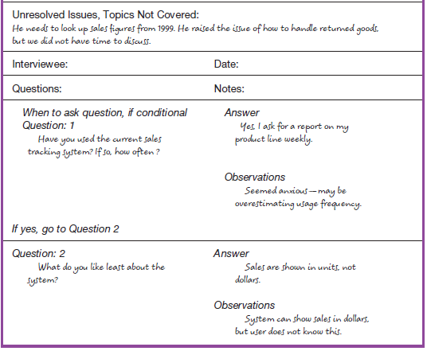
Interviewing and Listening (Cont.)
FIGURE 6-2 Typical interview guide (cont.)
Notes:
As you can see, there are spaces in the document for taking notes in a structured manner.

Slide 13
Choosing Interview Questions
Each question in an interview guide can include both verbal and non-verbal information.
  Open-ended questions: questions that have no pre-specified answers
  Closed-ended questions: questions that ask those responding to choose from among a set of specified responses
Notes:
Often we start with more open-ended questions, and probe with more closed-ended questions as follow-up.

Slide 14
Interviewing Guidelines
Don’t phrase a question in a way that implies a right or wrong answer.
Listen very carefully.
Type interview notes within 48 hours after the interview.
Don’t set expectations about the new system unless you know these will be deliverables.
Seek a variety of perspectives from the interviews.
Notes:
This reiterates some things we talked about earlier. Note the importance of phrasing your questions and comments in a neutral manner so as not to manipulate the interviewee’s response. During an interview, you should be recording the interviewee’s thoughts, not your own. Later you can analyze what the interviewee said, and you want to make sure you got it right.

Slide 15
Interviewing Groups
Drawbacks to individual interviews:
  Contradictions and inconsistencies between interviewees
  Follow-up discussions are time consuming
  New interviews may reveal new questions that require additional interviews with those interviewed earlier
Notes:
Individual interviews have their limits.
Group interviews come with their own sets of advantages and disadvantages, as we’ll see next.

Slide 16
Interviewing Groups (Cont.)
Interviewing several key people together
  Advantages
    More effective use of time
    Can hear agreements and disagreements at once
    Opportunity for synergies
  Disadvantages
    More difficult to schedule than individual interviews

Slide 17
Nominal Group Technique (NGT)
A facilitated process that supports idea generation by groups
Process
  Members come together as a group, but initially work separately.
  Each person writes ideas.
  Facilitator reads ideas out loud, and they are written on a blackboard or flipchart.
  Group openly discusses the ideas for clarification.
  Ideas are prioritized, combined, selected, reduced.
Used to complement group meetings or as part of JAD effort
Notes:
Nominal Group Technique is a good brainstorming approach.
In a requirements determination context, the ideas being sought in an NGT exercise would typically apply to problems with the existing system or ideas for new features in the system being developed. The end result would be a list of either problems or features that group members themselves had generated and prioritized.
We’ll talk more about JAD (joint application design) later.

Slide 18
Directly Observing Users
Direct Observation
  Watching users do their jobs
  Used to obtain more firsthand and objective measures of employee interaction with information systems
  Can cause people to change their normal operating behavior
  Time-consuming and limited time to observe
Notes:
It’s important to get a good idea of the “day in the life” of the users of your potential system. Observing them in their “natural environment” is one way to do this, and can give useful information. But, people often won’t behave in exactly the same way when you are watching them, so it’s not perfect information. And, as is also true with interviews, this takes time and effort to do.

Slide 19
Analyzing Procedures and Other Documents
Document Analysis
  Review of existing business documents
  Can give a historical and “formal” view of system requirements
Notes:
Documents can include organizational mission statements, business plans, organization charts, business policy manuals, job descriptions, internal and external correspondence, reports from prior organizational studies, written work procedures, and others.

Slide 20
Analyzing Procedures and Other Documents (Cont.)
Types of information to be discovered:
  Problems with existing system
  Opportunity to meet new need
  Organizational direction
  Names of key individuals
  Values of organization
  Special information processing circumstances
  Reasons for current system design
  Rules for processing data
Notes:
These documents can reveal a lot of useful information for the systems analyst. Here are a few.

Slide 21
Analyzing Procedures and Other Documents (Cont.)
Useful document: Written work procedure
  For an individual or work group
  Describes how a particular job or task is performed
  Includes data and information used and created in the process
Notes:
If you know the work procedure, this gives you insight into how the system should be designed. The system design, especially if done for a customized system, should flow naturally with the way people do their jobs.
The written work procedure gives a good idea of how people do their jobs. But, it is a formal document, and as we’ll see later, there are lots of “informal” factors that need to be accounted for when doing requirements gathering.

Slide 22
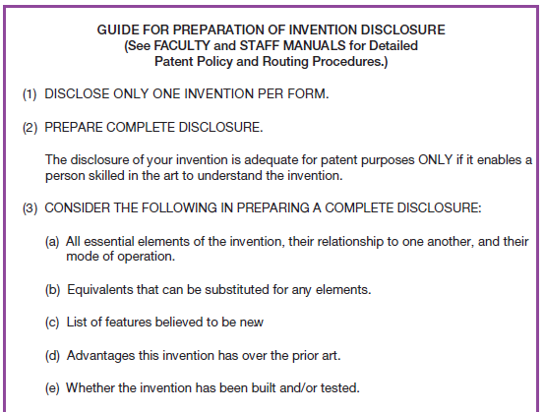
Analyzing Procedures and Other Documents (Cont.)
FIGURE 6-3 Example of a procedure
Notes:
Here is a written work procedure. As you can see, it’s a formal document, and lays out the rules and guidelines for completing a piece of work (in this case the requirements for disclosing an intellectual property claim of some invention.

Slide 23
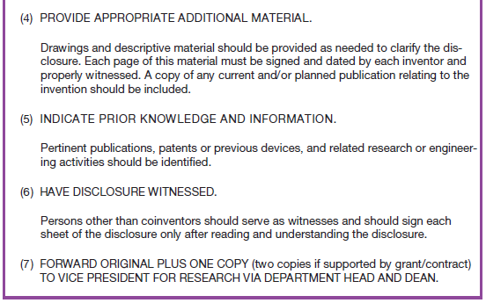
Analyzing Procedures and Other Documents (Cont.)
FIGURE 6-3 Example of a procedure (cont.)
Notes:
There are many other types of formal work procedure documents. One example especially relevant in the IT world is a Request for Proposal (RFP) which a company will use to get proposals from potential vendors and consultants for IT systems development projects.

Slide 24
Analyzing Procedures and Other Documents (Cont.)
Potential Problems with Procedure Documents:
  May involve duplication of effort
  May have missing procedures
  May be out of date
  May contradict information obtained through interviews
Notes:
Procedures as well as other documents aren’t perfect sources of information. As we saw earlier, the same is true for both individual and group interviews. That’s why you need to use a variety of different sources of information and techniques of information gathering.

Slide 25
Analyzing Procedures and Other Documents (Cont.)
Formal Systems: the official way a system works as described in organizational documentation (i.e. work procedure)
Informal Systems: the way a system actually works (i.e. interviews, observations)
Notes:
Here’s the formal/informal dichotomy we were talking about earlier. As you can see, the documentation gives the formal view, whereas the interviews and observations often uncover the informal processes.

Slide 26
Analyzing Procedures and Other Documents (Cont.)
Useful document: Business form
  Used for all types of business functions
  Explicitly indicates what data flow in and out of a system and data necessary for the system to function
  Gives crucial information about the nature of the organization

Slide 27
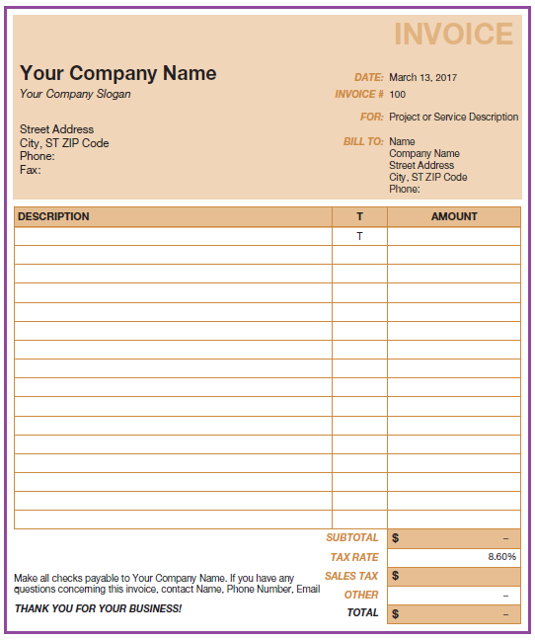
Analyzing Procedures and Other Documents (Cont.)
FIGURE 6-4
An invoice form from Microsoft Excel
(Source: Microsoft Corporation.)
Notes:
This is a very typical business document. You can see from this the type of data that would be needed in a database from looking at forms like this. Also, the layout of this sort of form gives a systems analyst some guidance in determining how screenshots should look in the system do be designed.

Slide 28
Analyzing Procedures and Other Documents (Cont.)
Useful document: Report
  Primary output of current system
  Enables you to work backwards from the report to the data needed to generate it
Useful document: Description of current information system
Notes:
Whereas business forms serve as guidelines for user input screens, reports give guidelines for outputs that should be produced by the proposed system.
Current information systems will typically have some documentation. These could be diagrams like DFDs or ER diagrams, user’s manuals, project workbooks from previous project, etc. These are very useful for understanding how a system currently operates.

Slide 29
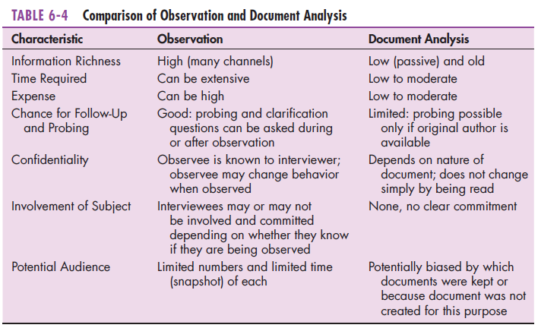
Observation vs. Document Analysis
Notes:
This table compares direct observation vs. document analysis. Each has its advantages and disadvantages.
You’ll want to use a combination of these, along with interviews and also along with the more contemporary and computer assisted methods, which we discuss next.

Slide 30
Contemporary Methods for Determining System Requirements
Joint Application Design (JAD)
  Brings together key users, managers, and systems analysts
  Purpose: collect system requirements simultaneously from key people
  Conducted off-site
CASE tools
  Used to analyze existing systems
  Help discover requirements to meet changing business conditions
System prototypes
  Iterative development process
  Rudimentary working version of system is built
  Refine understanding of system requirements in concrete terms
Notes:
Up to now, we discussed the traditional requirements gathering methods of interviewing, observation, and document analysis. More modern approaches have been developed, thanks largely to advances in information technology that provide computerized tools for assisting with various elements of systems analysis. We’ll talk about a few of these approaches now.
Here we three the three main “contemporary methods”. All of these involve use of computer technology.
JAD is a team-oriented methodology that combines group decision making practices with technologies to support them.
CASE tools have been discussed before. These are useful for many SDLC tasks, including requirements determination.
The system prototypes approach ties in nicely with discussion we had earlier (in chapter 1) about rapid application development and agile methodologies.

Slide 31
Joint Application Design (JAD)
Intensive group-oriented requirements determination technique
Team members meet in isolation for an extended period of time
Highly focused
Resource intensive
Started by IBM in 1970s
Notes:
Although we call JAD a “contemporary method”, you can see that it’s been around for a long time.

Slide 32
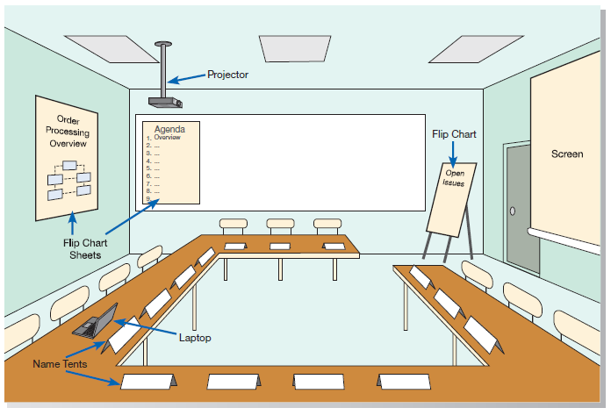
JAD (Cont.)
FIGURE 6-6 Illustration of the typical room layout for a JAD
(Source: Based on Wood and Silver, 1995.)
Notes:
This is a typical JAD room. Note that each station on the table includes laptops. The project should be able to display content from a laptop. The JAD room is a meeting room, but with additional computing facilities to assist with group decision making.

Slide 33
JAD (Cont.)
JAD Participants:
  Session Leader: organizes and runs JAD session
  Users: active, speaking participants
  Managers: active, speaking participants
  Sponsor: high-level champion, limited participation
  Systems Analysts: should mostly listen
  Scribe: record session activities
  IS Staff: should mostly listen
Notes:
There are specific JAD roles in the meeting, as listed here.

Slide 34
JAD (Cont.)
End Result
  Documentation detailing existing system
  Features of proposed system
Notes:
It shouldn’t be surprising that these are the end results of a JAD session. In general, what comes out of requirements determination, whether you are doing interviews, observation, document analysis, JAD, or other techniques is what we see on this slide.
JAD sessions can be lively and even heated. Interpersonal and communication skills are very important.

Slide 35
CASE Tools During JAD
Diagramming and form-building CASE tools are used
Enables analysts to enter system models directly into CASE during the JAD session
Screen designs and prototyping can be done during JAD and shown to users

Slide 36
Using Prototyping During Requirements Determination
Prototyping – an iterative process of systems development in which requirements are converted to a working system that is continually revised through close collaboration between an analyst and users.
Quickly converts requirements to working version of system
Once the user sees requirements converted to system, will ask for modifications or will generate additional requests

Slide 37
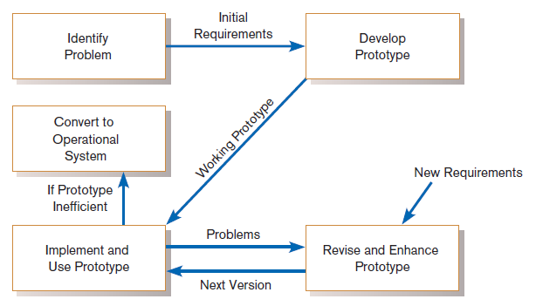
Using Prototyping During Requirements Determination (Cont.)
Figure 6-7
The prototyping methodology
(Source: Based on “Prototyping: The New
Paradigm for Systems Development,” by
J. D. Naumann and A. M. Jenkins, MIS
Quarterly 6(3): 29–44.)
Notes:
There is a lot of overlap between the prototyping approach and agile development methodologies.

Slide 38
Using Prototyping During Requirements Determination (Cont.)
Evolutionary prototyping – prototype becomes the basis of the operational system
  Prototype needs to be built in order to address the functional needs of the production system (e.g. database processing and coding logic).
Throwaway prototyping – prototype is just a model, discarded after use
  Prototype is just a mockup of screens shots an simple functionality, and production system will be built from scratch.

Slide 39
Using Prototyping During Requirements Determination (Cont.)
Most useful when:
  User requests are not clear.
  Few users are involved in the system.
  Designs are complex and require concrete form.
  There is a history of communication problems between analysts and users.
  Tools are readily available to build prototype.

Slide 40
Using Prototyping During Requirements Determination (Cont.)
Drawbacks
  Tendency to avoid formal documentation
  Difficult to adapt to more general user audience
  Sharing data with other systems is often not considered
  Systems Development Life Cycle (SDLC) checks are often bypassed

Slide 41
Radical Methods for Determining System Requirements
Business Process Reengineering (BPR): search for and implementation of radical change in business processes to achieve breakthrough improvements in products and services

Slide 42
Radical Methods for Determining System Requirements (Cont.)
BPR Goals
  Reorganize complete flow of data in major sections of an organization.
  Eliminate unnecessary steps.
  Achieve synergy between steps.
  Become more responsive to future change.

Slide 43
Identifying Processes to Reengineer
Key business processes
  Structured, measured set of activities designed to produce specific output for a particular customer or market
  Focused on customers and outcome
  Same techniques as requirements determination are used
Which activities need radical change?
  Importance of activity
  Feasibility of change
  Level of dysfunction of current activity

Slide 44
Disruptive Technologies
Information technologies must be applied to radically improve business processes.
Disruptive technologies are technologies that enable the breaking of long-held business rules that inhibit organizations from making radical business changes.

Slide 45
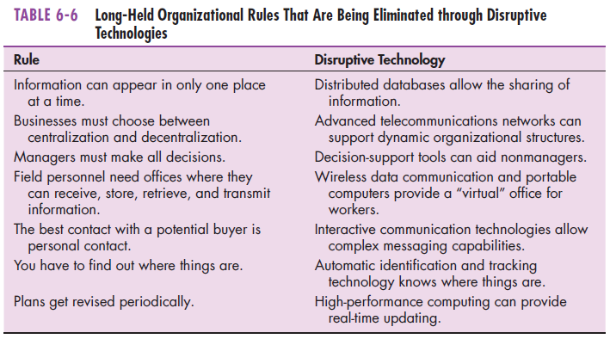
Disruptive Technologies (Cont.)
Notes:
Disruptive technologies radically change the way businesses do things. Here is a list of many “inhibitory” factors that used to exist in organizations, and the technologies that freed the businesses from these rules.

Slide 46
Requirements Determination using Agile Methodologies
Continual user involvement
  Replace traditional SDLC waterfall with iterative analyze–design–code–test cycle
Agile usage-centered design
  Focuses on user goals, roles, and tasks
The Planning Game
  Based on eXtreme programming
  Exploration, steering, commitment
Notes:
We learned about agile methodologies and eXtreme programming in chapter 1. Here we explore how these are used for requirements determination. Note the importance of having the user involved throughout the process.

Slide 47
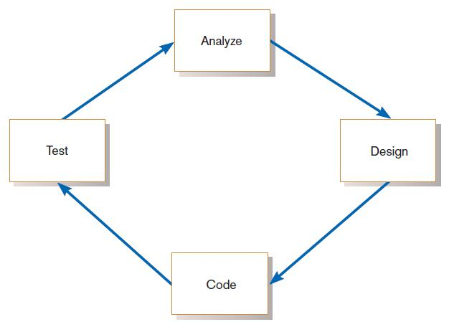
Continual User Involvement
FIGURE 6-9
The iterative analysis–design–code–test cycle
Notes:
In the traditional SDLC, users are not deeply involved in design and implementation. Here, the user is always in the loop. Of course, users don’t code, but the iterative cycle means they are involved throughout, watching and evaluating the evolution of the system as it is developed.

Slide 48
Agile Usage-Centered Design Steps
Gather group of programmers, analysts, users, testers, facilitator.
Document complaints of current system.
Determine important user roles.
Determine, prioritize, and describe tasks for each user role.
Group similar tasks into interaction contexts.
Associate each interaction context with a user interface for the system, and prototype the interaction context.
Step through and modify the prototype.
Notes:
Here is the overall approach to agile user-centered design. Again, we see a large priority on user involvement.

Slide 49
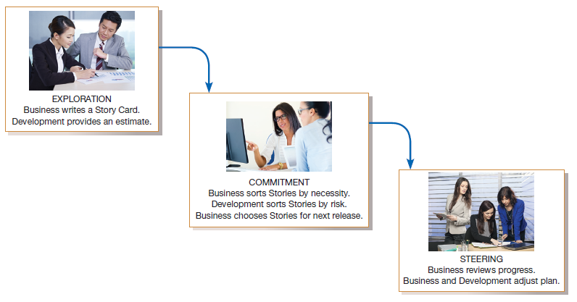
The Planning Game from eXtreme Programming
FIGURE 6-10
eXtreme Programming’s Planning Game
Notes:
The Planning Game involves the user (“Business”) and the IT person (“Development”). It has three main phases: exploration, commitment, and steering.
In exploration, Business creates a Story Card for something it wants the new system to do. Development responds with an estimation of how long it would take to implement the procedure. At this point, it may make sense to split a Story Card into multiple Story Cards, as the scope of features and procedures becomes more clear during discussion.
In the commitment phase, Business sorts Story Cards into three stacks: one for essential features, one for features that are not essential but would still add value, and one for features that would be nice to have. Development then sorts Story Cards according to risk, based on how well they can estimate the time needed to develop each feature. Business then selects the cards that will be included in the next release of the product.
In the final phase, steering, Business has a chance to see how the development process is progressing and to work with Development to adjust the plan accordingly. Steering can take place as often as once every three weeks.

Slide 50
Electronic Commerce Applications: Determining System Requirements
Determining system requirements for Pine Valley furniture’s WebStore
  System layout and navigation characteristics
  WebStore and site management system capabilities
  Customer and inventory information
  System prototype evolution
Notes:
Here we see system requirements determination for Pine Valley Furniture’s WebStore. The textbook goes into detail relating the concepts we just learned to the PVF case.
PVF conducted a JAD session, and from this came up with desired layout and navigation features, as well as WebStore’s structure/capabilities/functionality and site management. A prototype was built.

Slide 51
Summary
Now you learned how to:
  Describe interviewing options and develop interview plan.
  Explain advantages and pitfalls of worker observation and document analysis.
  Explain how computing can support requirements determination.
  Participate in and help plan Joint Application Design sessions.

Slide 52
Summary (Cont.)
  Use prototyping during requirements determination.
  Describe contemporary approaches to requirements determination.
  Understand how requirements determination techniques apply to the development of electronic commerce applications.

Slide 53
Next Lecture
Structuring Systems Process Requirements

Slide 54
References
Joseph S. Valacich, Joey F. George, Modern Systems Analysis and Design, 8th Global Edition, Pearson, 2016

