Slide 1


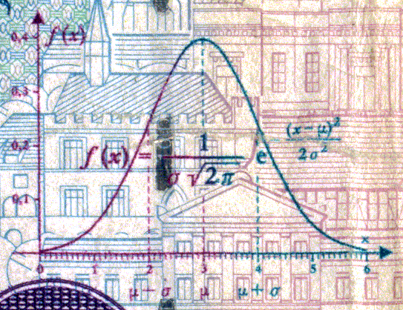
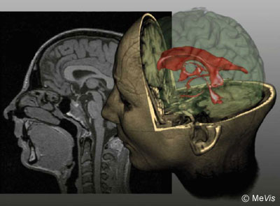
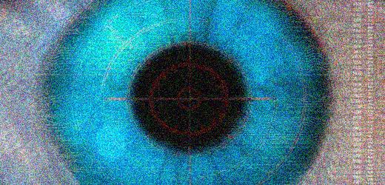
CSE 307
Fundamentals of Image Processing
Lecture #5 Image Restoration
Prepared & Presented by Asst. Prof. Dr. Samsun M. BAŞARICI

Slide 2


Objectives
What is noise (in the context of image processing) and how can it be modeled?
What are the main types of noise that may affect an image?
What is blurring (in the context of image processing) and how can it be modeled?
Which noise removal techniques are typically used in image processing?
Which deblurring techniques are typically used in image processing?
How can we estimate the degradation of an image?

Slide 3
Introduction
In image restoration we aim to improve an image which is assumed to have been degraded by a certain phenomenon.
The restoration techniques are mainly based on modeling this degradation phenomenon and recovering the original image by an inverse process.
Sounds like enhancement?
Enhancement vs. restoration?
  Enhancement: Largely subjective
  Restoration: More objective

Slide 4
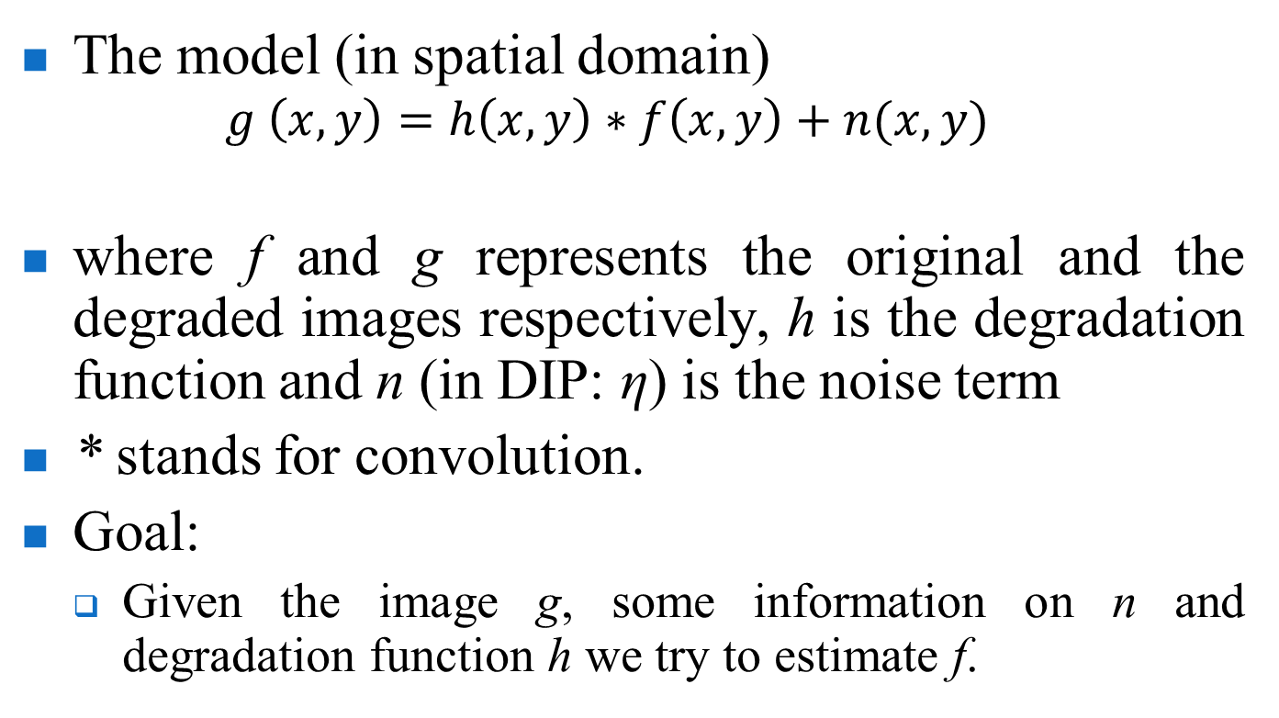
Image degradation/Restoration model
The model (in spatial domain)
  $$g \left(x, y\right)=h\left(x, y\right)∗f\left(x, y\right)+n(x, y)$$
where f and g represents the original and the degraded images respectively, h is the degradation function and n (in DIP: η) is the noise term
* stands for convolution.
Goal:
  Given the image g, some information on n and degradation function h we try to estimate f.

Slide 5
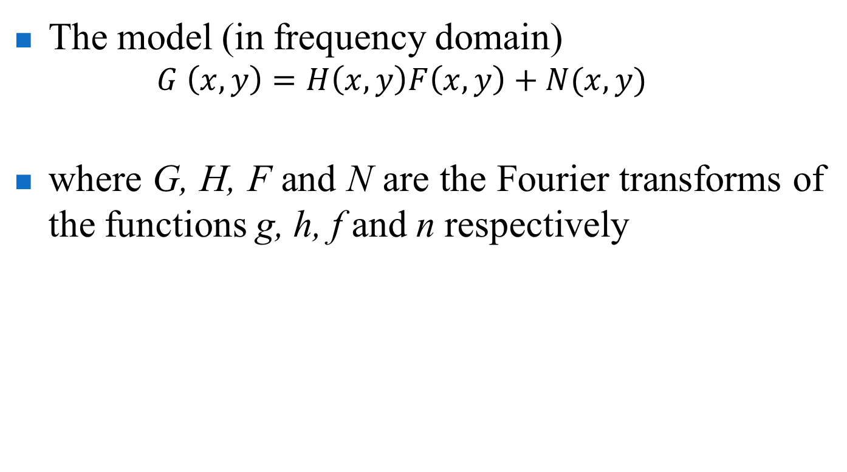
Image degradation/Restoration model (cont.)
The model (in frequency domain)
  $$G \left(x, y\right)=H\left(x, y\right)F\left(x, y\right)+N(x, y)$$
where G, H, F and N are the Fourier transforms of the functions g, h, f and n respectively

Slide 6
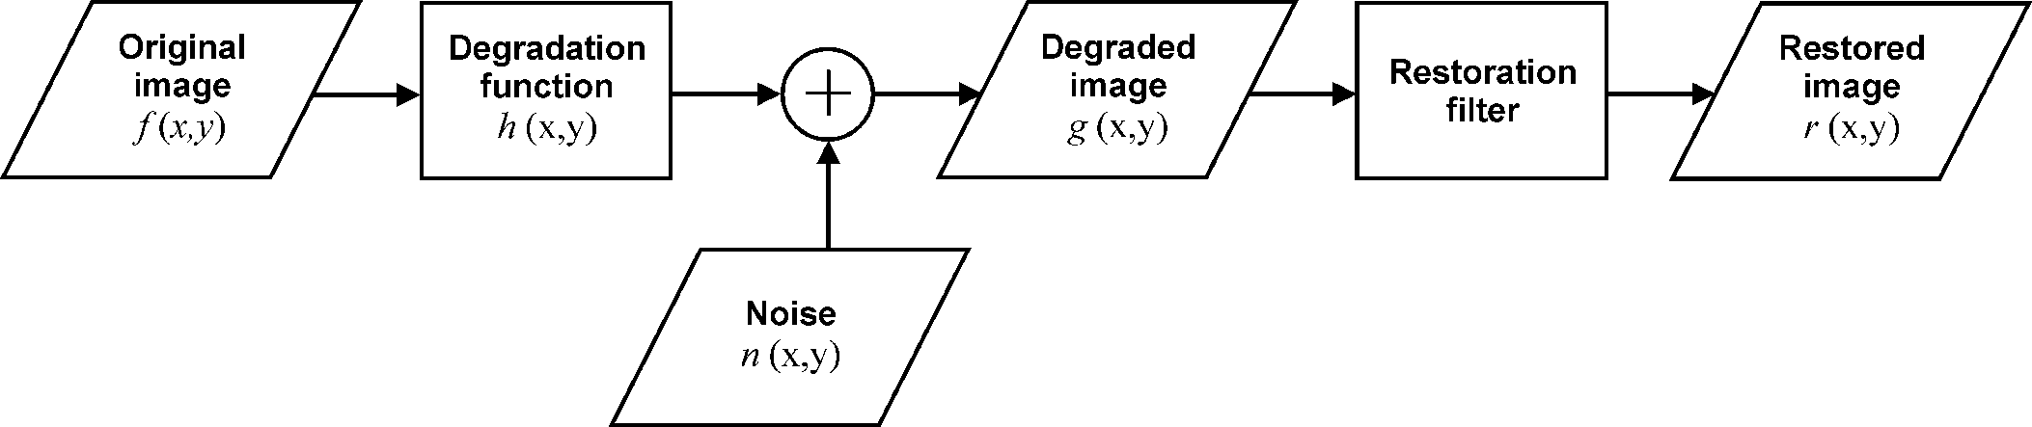


Image degradation/Restoration model (cont.)

Slide 7
Noise models
Noise can be defined as any undesired artifact that contanimates an image.
The main sources of noise arise during image acquization and transmission.
  Environmental conditions may effect the imaging sensors.
  Images may be corrupted when they are transmitted by a wireless network etc.
Here we will assume that the noise is independent of spatial coordinates.

Slide 8
Noise models (cont.)
Noise is treated as a random variable whose probability density function (PDF) or histogram, describes its shape and distribution across the range of gray levels.
In addition to that spatial-domain representation, noise patterns can sometimes also be represented in the frequency domain (through their frequency spectrum).

Slide 9
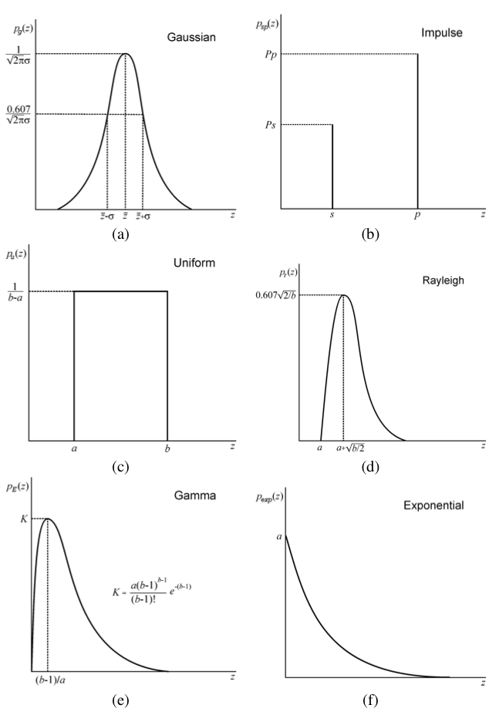
Noise models (cont.)
Gaussian
Impulse
(salt-and-pepper)
Uniform
Rayleigh
Gamma (Erlang)
Exponential

Slide 10
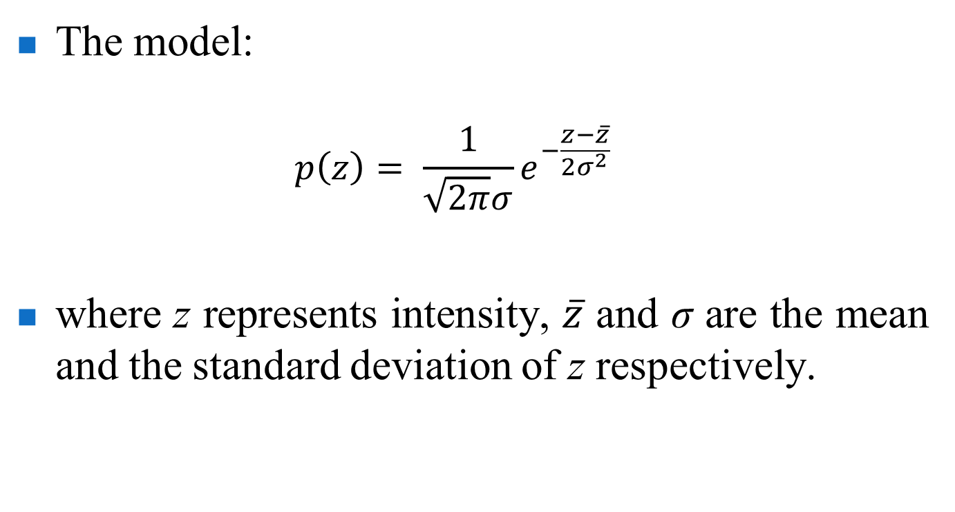
Gaussian noise
The model:
  $$p\left(z\right)= \frac{1}{\sqrt{2π}σ}e^{−\frac{z−\overline{z}}{2σ^{2}}}$$
where z represents intensity, $\overline{z}$ and σ are the mean and the standard deviation of z respectively.

Slide 11
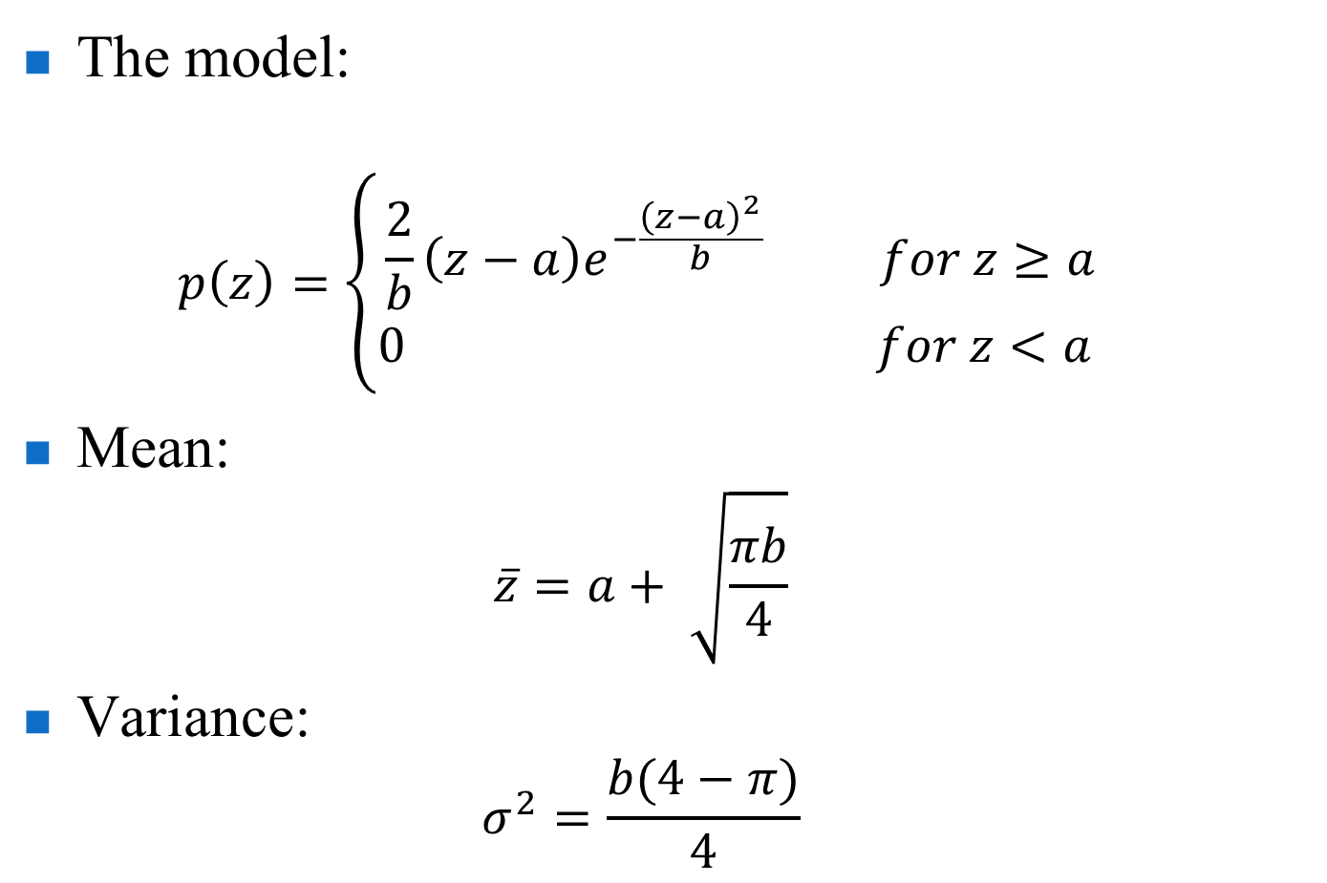
Rayleigh noise
The model:
  $$p\left(z\right)=\left\{\begin{matrix}\frac{2}{b}\left(z−a\right)e^{−\frac{{\left(z−a\right)}^{2}}{b}} for z≥a \\ 0 for z<a \end{matrix}\right.$$
Mean:
  $$\overline{z}=a+ \sqrt{\frac{πb}{4}}$$
Variance:
  $$σ^{2}=\frac{b(4−π)}{4}$$

Slide 12
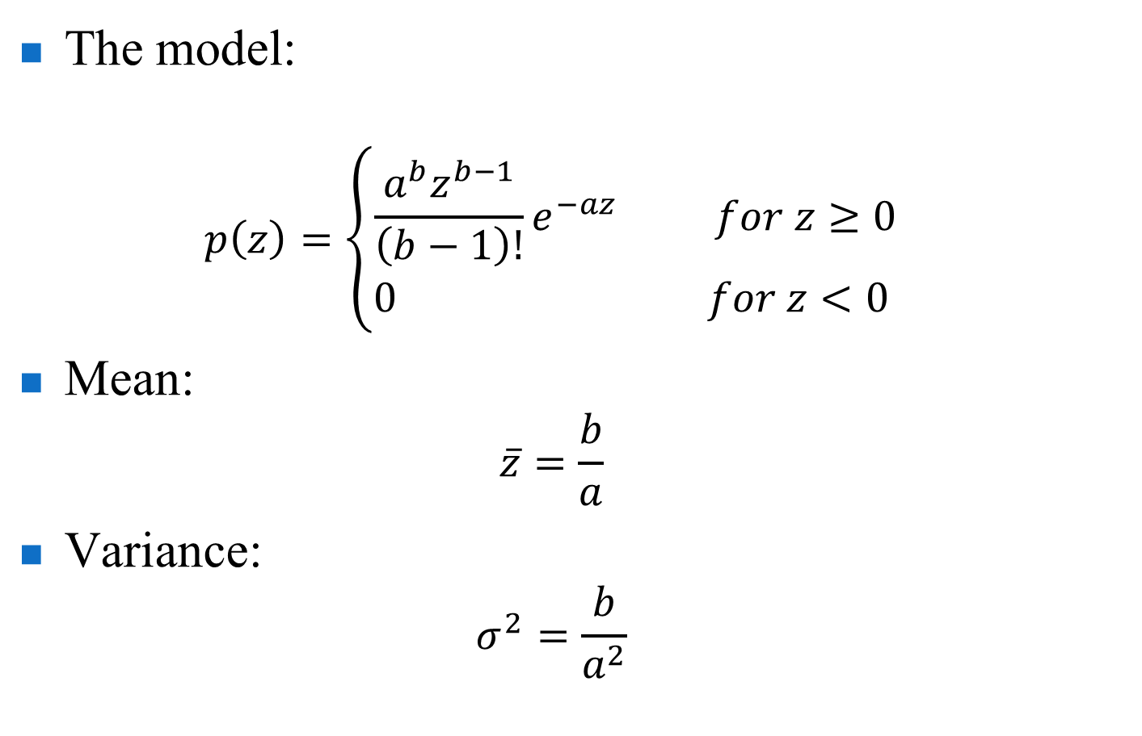
Gamma (Erlang) noise
The model:
  $$p\left(z\right)=\left\{\begin{matrix}\frac{a^{b}z^{b−1}}{\left(b−1\right)!}e^{−az} for z≥0 \\ 0 for z<0 \end{matrix}\right.$$
Mean:
  $$\overline{z}=\frac{b}{a}$$
Variance:
  $$σ^{2}=\frac{b}{a^{2}}$$

Slide 13
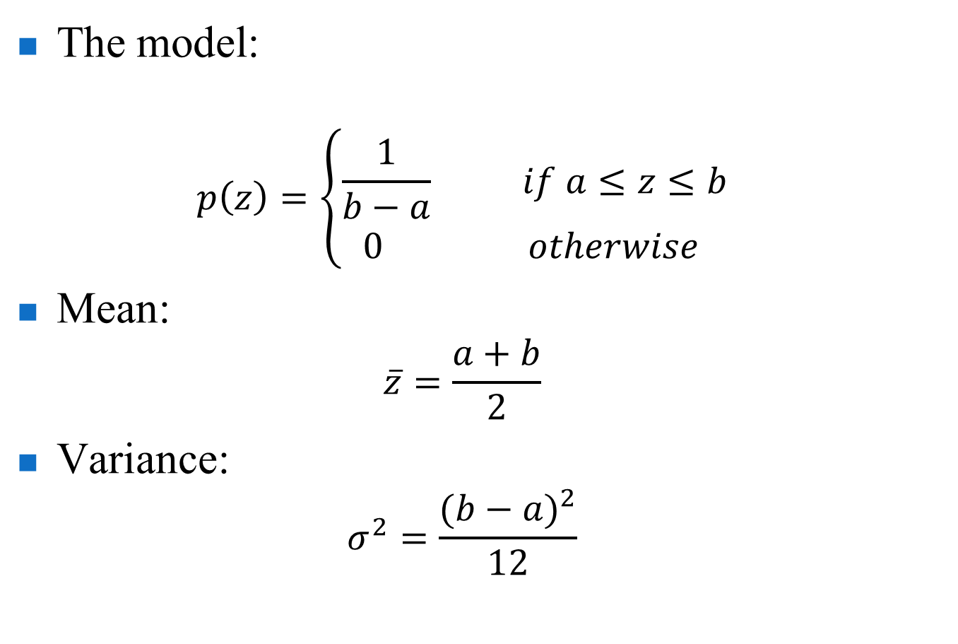
Uniform noise
The model:
  $$p\left(z\right)=\left\{\begin{matrix}\frac{1}{b−a} if a≤z≤b \\ 0 otherwise \end{matrix}\right.$$
Mean:
  $$\overline{z}=\frac{a+b}{2}$$
Variance:
  $$σ^{2}=\frac{{(b−a)}^{2}}{12}$$

Slide 14
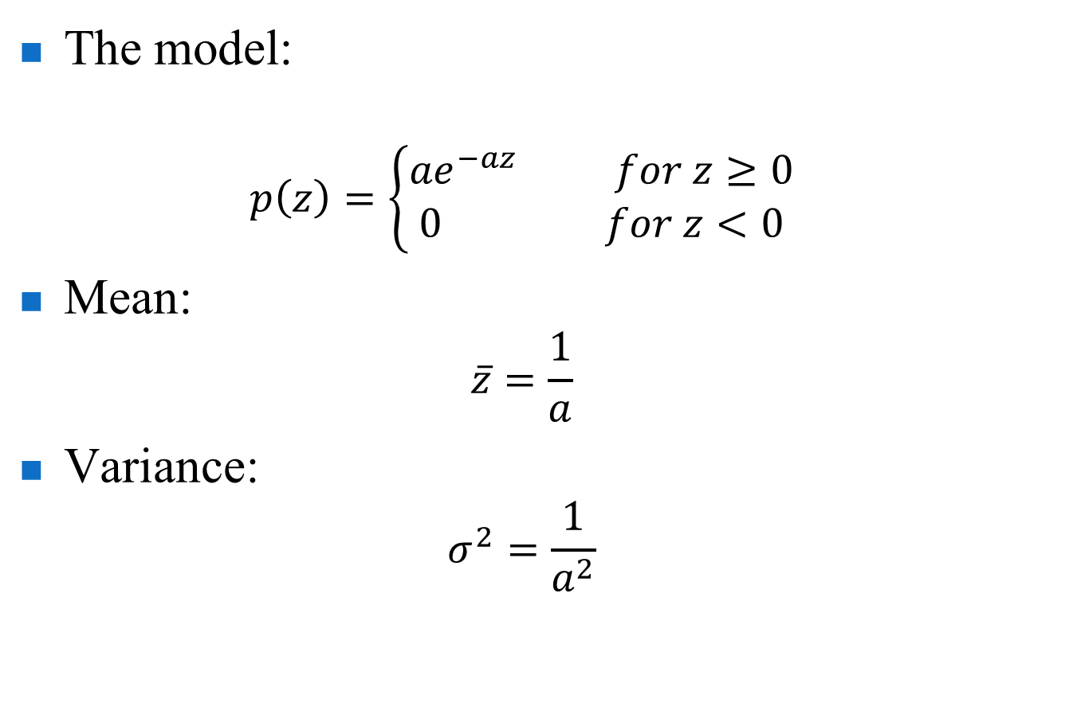
Exponential noise
The model:
  $$p\left(z\right)=\left\{\begin{matrix}{ae}^{−az} for z≥0 \\ 0 for z<0\end{matrix}\right.$$
Mean:
  $$\overline{z}=\frac{1}{a}$$
Variance:
  $$σ^{2}=\frac{1}{a^{2}}$$

Slide 15
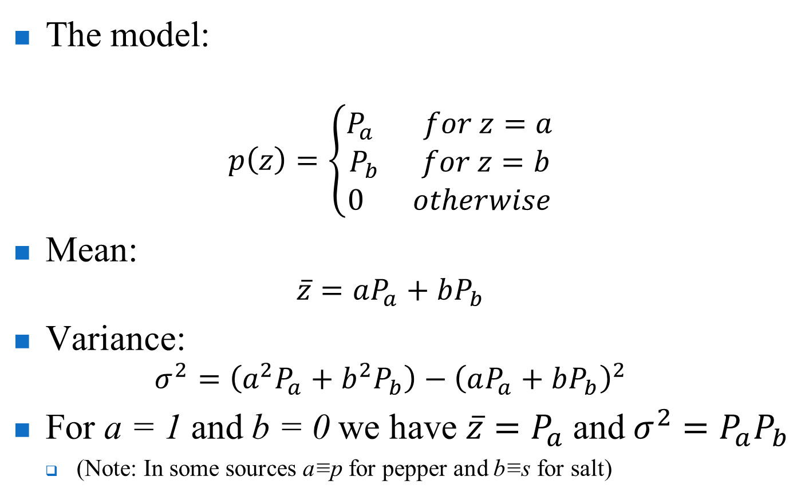
Impulse (salt-and-pepper) noise
The model:
  $$p\left(z\right)=\left\{\begin{matrix}P_{a} for z=a \\ P_{b} for z=b \\ 0 otherwise\end{matrix}\right.$$
Mean:
  $$\overline{z}=aP_{a}+bP_{b}$$
Variance:
  $$σ^{2}=\left(a^{2}P_{a}+b^{2}P_{b}\right)−{\left(aP_{a}+bP_{b}\right)}^{2}$$
For a = 1 and b = 0 we have $\overline{z}=P_{a}$ and $σ^{2}=P_{a}P_{b}$
  (Note: In some sources a≡p for pepper and b≡s for salt)

Slide 16
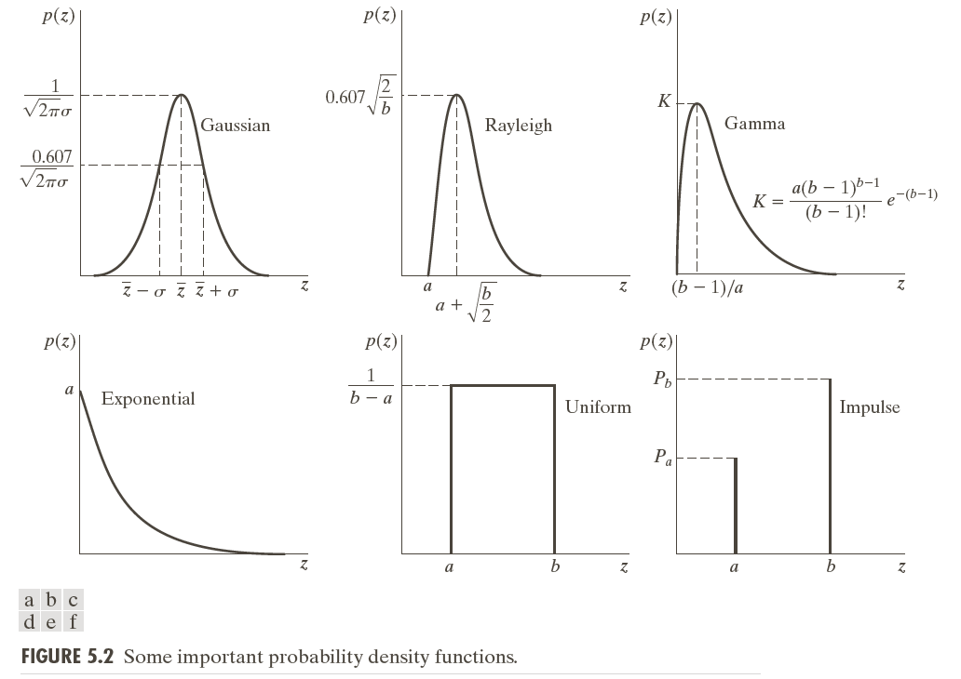
Noise models (again ☺)

Slide 17

Images with noise (examples)
Test pattern (Fig. 5.3 DIP) used to illustrate the characteristics of the noise PDFs shown in the previous slides

Slide 18
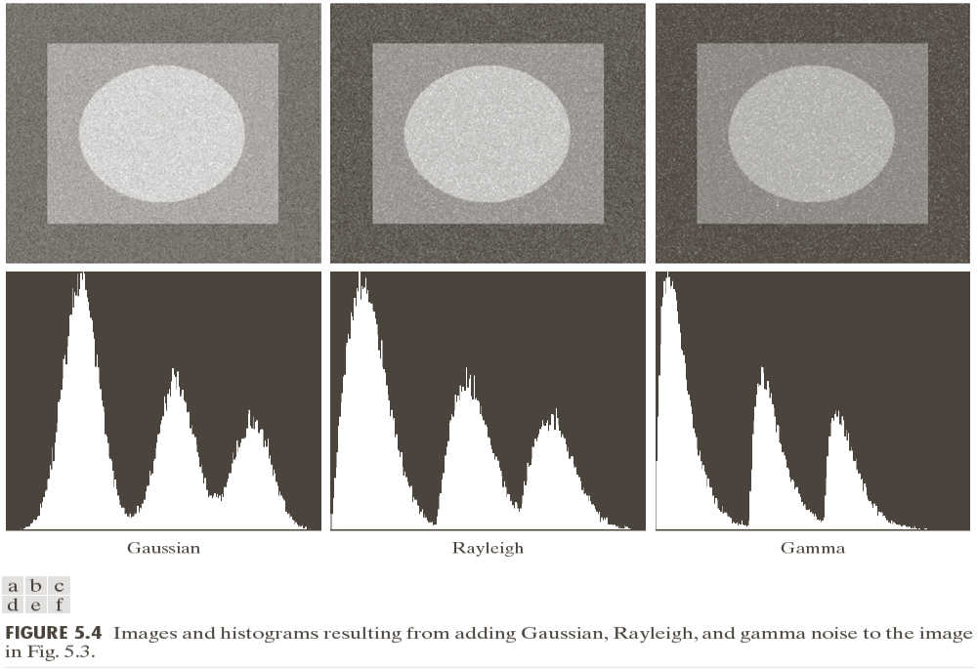
Images with noise (examples) (cont.)

Slide 19
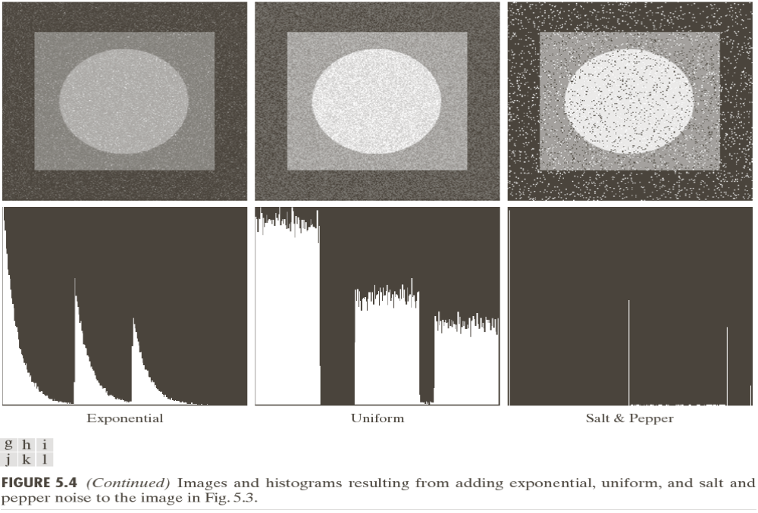
Images with noise (examples) (cont.)

Slide 20
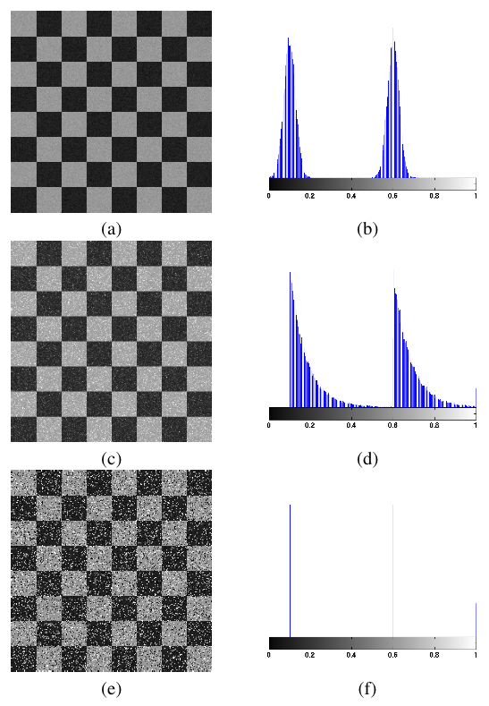
Images with noise (examples) (cont.)
Gaussian
Exponential
Impulse
(salt-and-pepper)

Slide 21
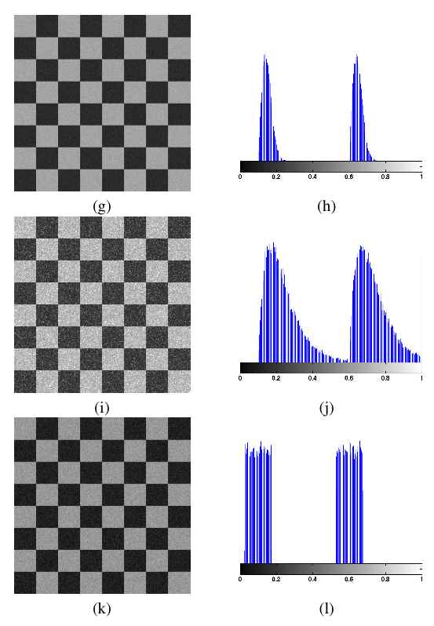
Images with noise (examples) (cont.)
Rayleigh
Gamma (Erlang)
Uniform

Slide 22
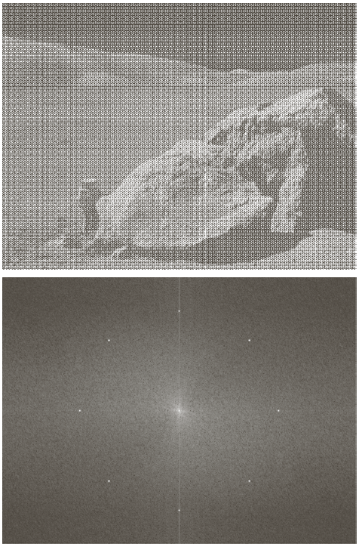
Images with noise (examples) (cont.)
Image corrupted by sinusoidal noise
Spectrum (each pair of conjugate impulses corresponds to one sine wave)

Slide 23
Estimation of noise distributions
How can we know the noise distribution?
  Partially from sensor specifications.
  From the noise characteristics captured from a set of images of “flat “ environment.
For example a noise distribution can be identified from small patches of homogeneous background intensity.

Slide 24
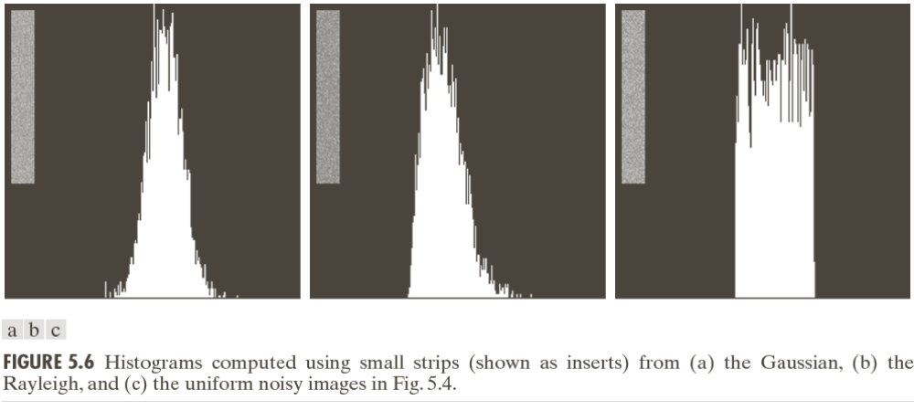
Estimation of noise distributions (cont.)

Slide 25
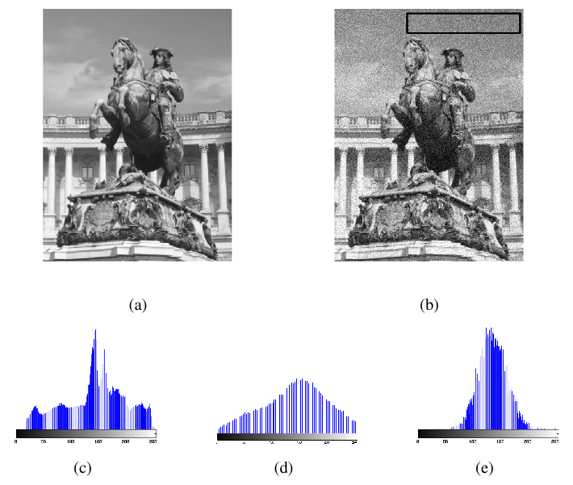
Estimation of noise distributions (cont.)

Slide 26
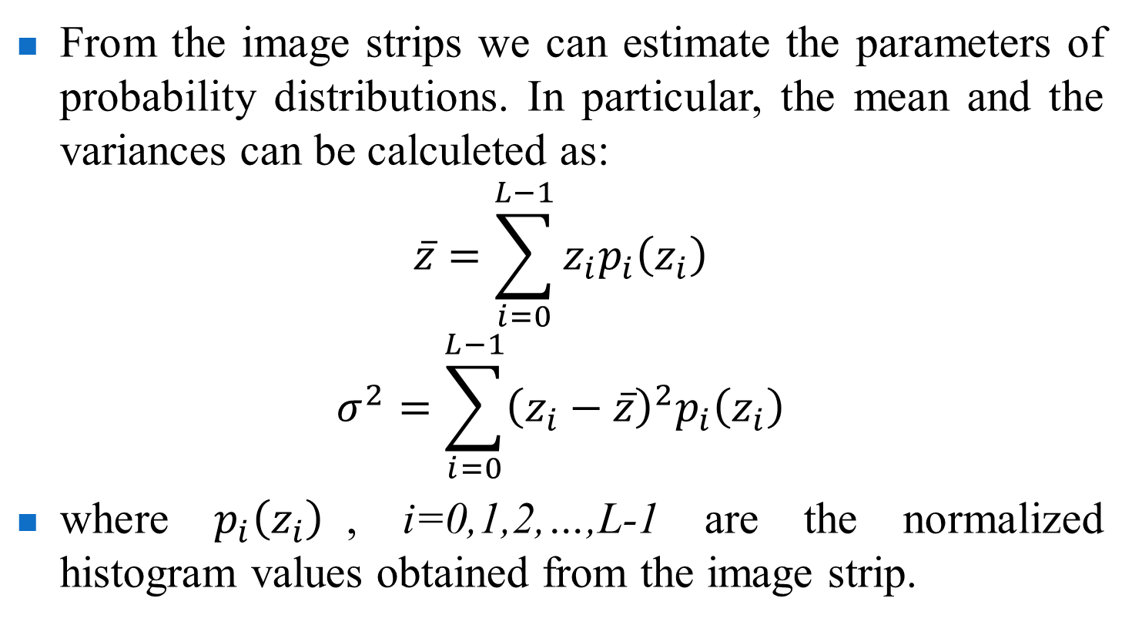
Estimation of noise distributions (cont.)
From the image strips we can estimate the parameters of probability distributions. In particular, the mean and the variances can be calculeted as:
$$\overline{z}=\sum_{i=0}^{L−1}{z_{i}p_{i}\left(z_{i}\right)}$$
$$σ^{2}=\sum_{i=0}^{L−1}{{\left(z_{i}−\overline{z}\right)}^{2}p_{i}\left(z_{i}\right)}$$
where $p_{i}\left(z_{i}\right)$, i=0,1,2,…,L-1 are the normalized histogram values obtained from the image strip.

Slide 27
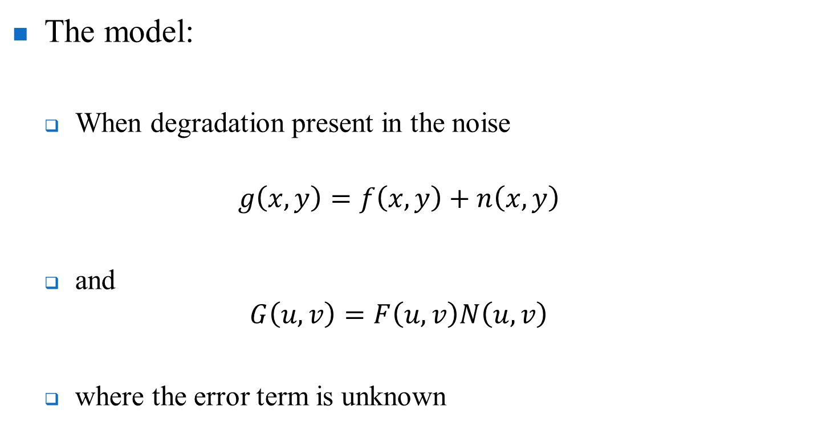
Restoration in the presence of noise-only spatial filtering
The model:
  When degradation present in the noise
  $$g\left(x,y\right)=f\left(x,y\right)+n\left(x,y\right)$$
  and
  $$G\left(u,v\right)=F\left(u,v\right)N\left(u,v\right)$$
  where the error term is unknown

Slide 28
Noise reduction – spatial domain
Mean filters
  Arithmetic
  Geometric
  Harmonic
  Contra-harmonic
Order-statistic (rank) filters
  Median
  Min
  Max
  Mid-point
  Alpha-trimmed mean
Adaptive filters

Slide 29
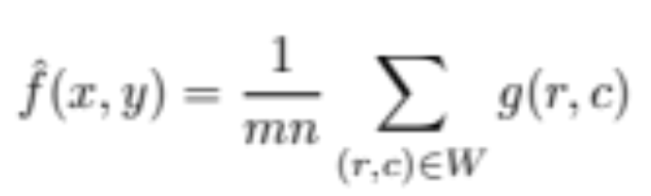
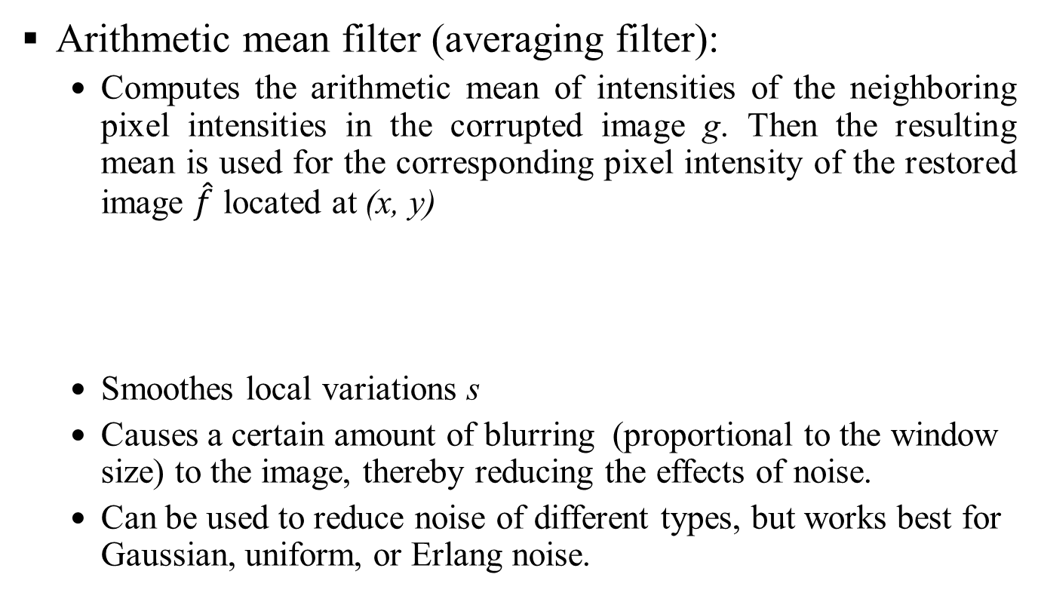
Mean filters
Arithmetic mean filter (averaging filter):
  Computes the arithmetic mean of intensities of the neighboring pixel intensities in the corrupted image g. Then the resulting mean is used for the corresponding pixel intensity of the restored image $\hat{f}$ located at (x, y)
  Smoothes local variations s
  Causes a certain amount of blurring (proportional to the window size) to the image, thereby reducing the effects of noise.
  Can be used to reduce noise of different types, but works best for Gaussian, uniform, or Erlang noise.

Slide 30
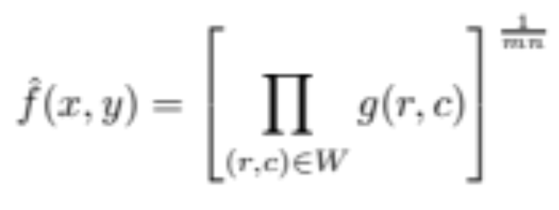
Mean filters (cont.)
Geometric mean filter
  a variation of the arithmetic mean filter
  primarily used on images with Gaussian noise
  retains image detail better than the arithmetic mean

Slide 31
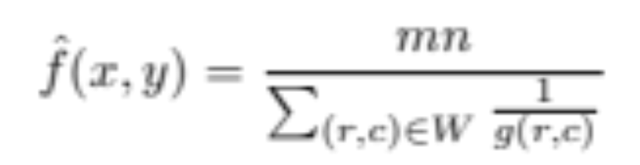
Mean filters (cont.)
Harmonic mean filter
  another variation of the arithmetic mean filter
  useful for images with Gaussian or salt noise
  black pixels (pepper noise) are not filtered

Slide 32
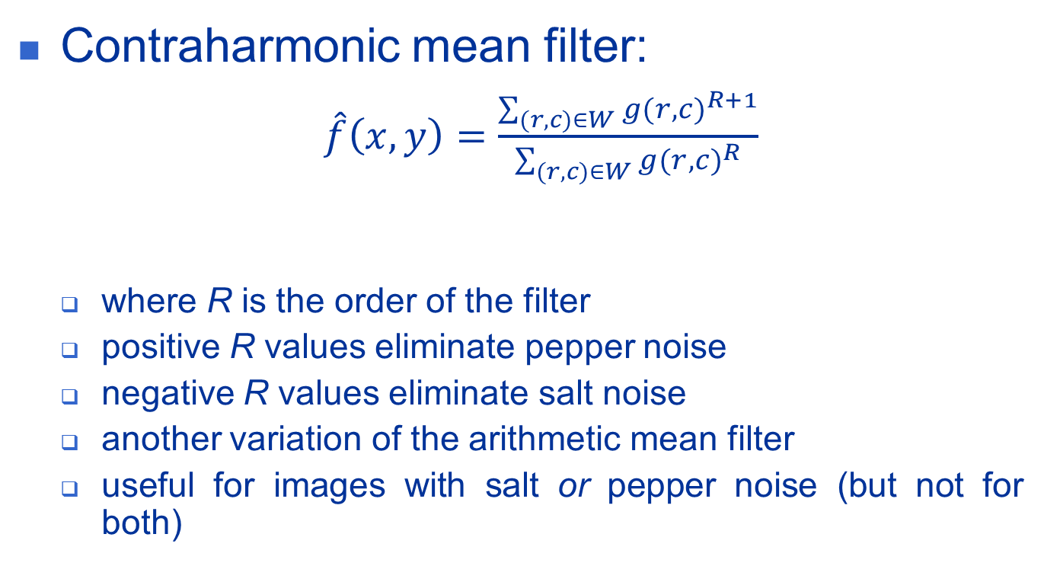
Mean filters (cont.)
Contraharmonic mean filter:
  $\hat{f}\left(x,y\right)=\frac{\sum_{(r,c)∈W}{g{(r,c)}^{R+1}}}{\sum_{(r,c)∈W}{g{(r,c)}^{R}}}$
  where R is the order of the filter
  positive R values eliminate pepper noise
  negative R values eliminate salt noise
  another variation of the arithmetic mean filter
  useful for images with salt or pepper noise (but not for both)

Slide 33
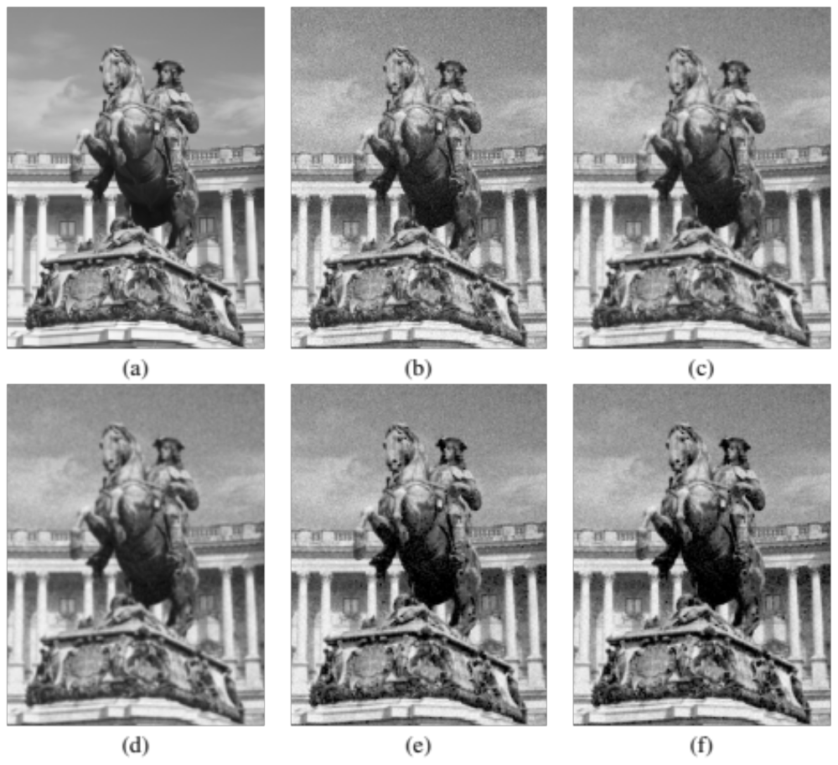
Mean filters (cont.)
Example 12.3 (PIVPUM)

Slide 34
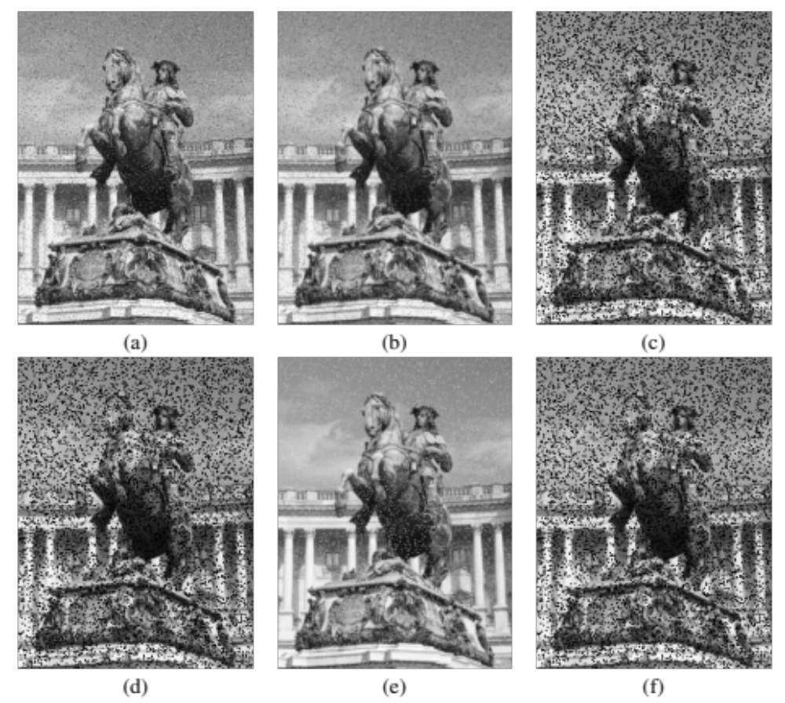
Mean filters (cont.)
Example 12.4 (PIVPUM)

Slide 35
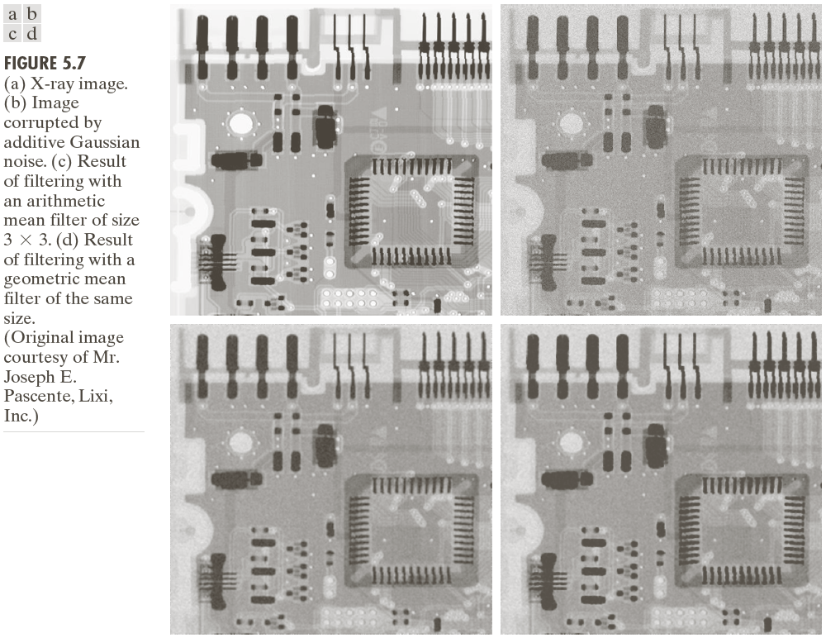
Mean filters (cont.)

Slide 36
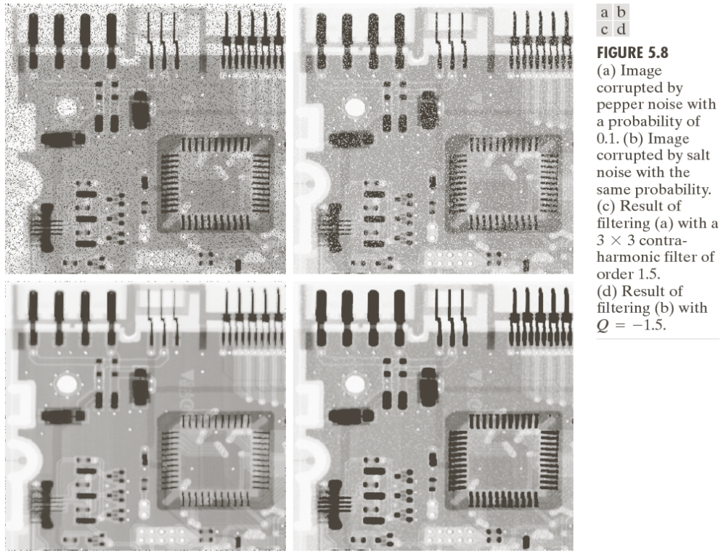
Mean filters (cont.)

Slide 37
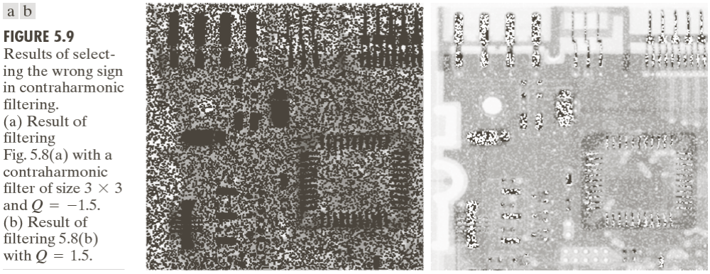
Mean filters (cont.)

Slide 38
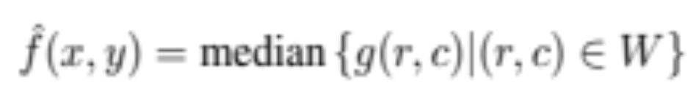
Order-statistic (rank) filters
Median filter
  Most popular and useful of the rank filters.
  Excellent filter for certain types of random noise.
  It works by selecting the middle pixel value from the ordered set of values within the m × n neighborhood (W) around the reference pixel.
    If mn is an even number (not common), the arithmetic average of the two values closest to the middle of the ordered set is used instead.
  Many variants, extensions, and optimized implementations in the literature.

Slide 39
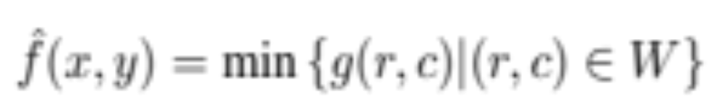
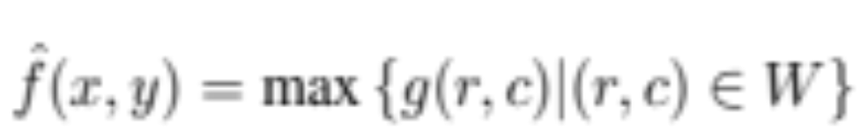
Order-statistic filters (cont.)
Min and Max filters
  Min: replaces the reference pixel with the lowest value of the ordered set
  Max: replaces the reference pixel with the highest value of the ordered set

Slide 40
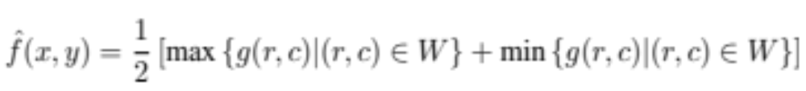
Order-statistic filters (cont.)
Midpoint filter
  Calculates the average of the highest and lowest pixel values within a window, thereby combining order statistics and averaging into one filter.
  Used to reduce Gaussian and uniform noise.

Slide 41
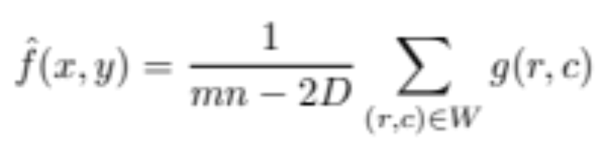
Order-statistic filters (cont.)
Alpha-trimmed mean filter
  Uses another combination of order statistics and averaging, in this case an average of the pixel values closest to the median, after the D lowest and the D highest values in an ordered set have been excluded.
  Rationale: to allow its user to control its behavior by specifying the parameter D:
    for D = 0: the filter behaves like a regular arithmetic mean filter;
    for D =(mn-1)/2: it is equivalent to the median filter.
  Used in cases where the image has been corrupted by more than one type of noise, e.g., salt-and-pepper and Gaussian.

Slide 42
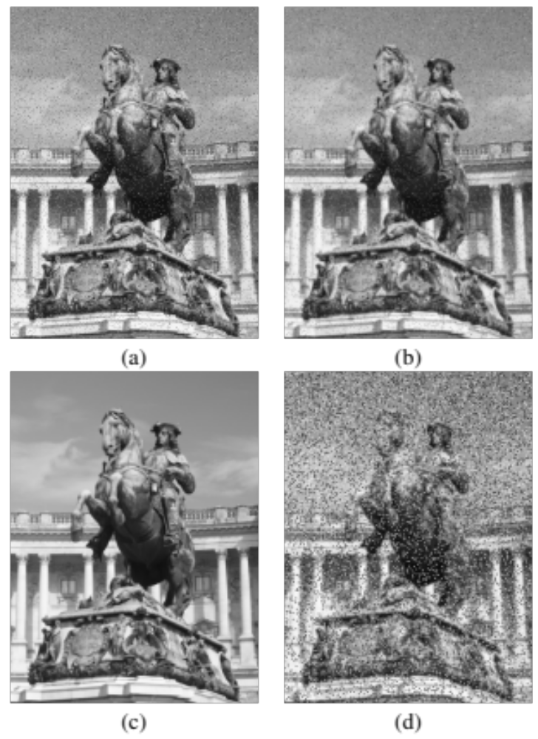
Rank filters (cont.)
Example 12.5 (PIVPUM)

Slide 43
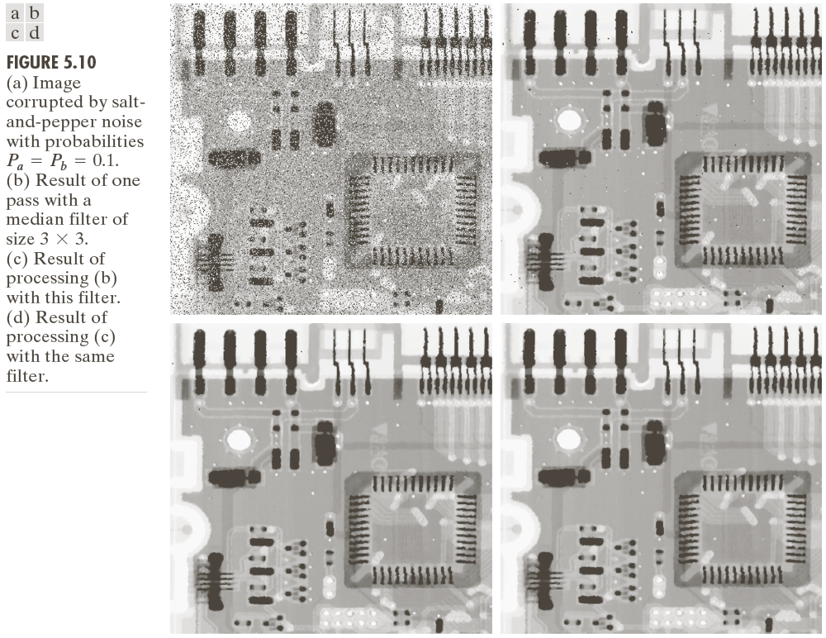
Rank filters (cont.)

Slide 44
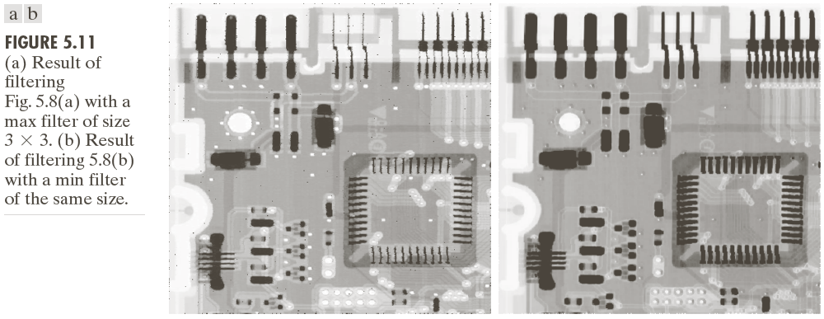
Rank filters (cont.)

Slide 45
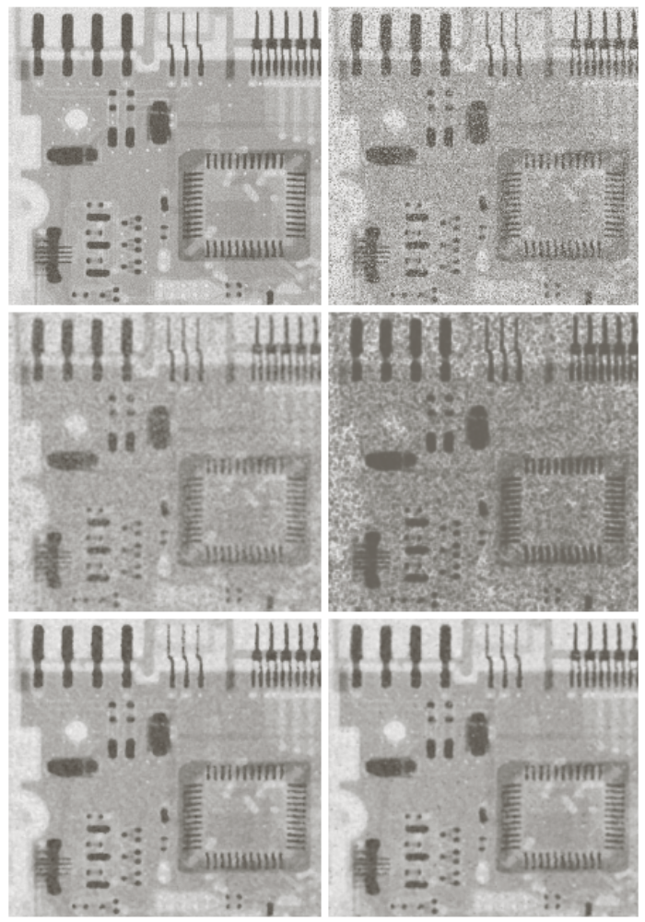
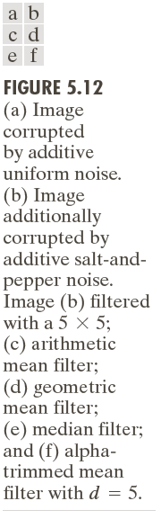
Rank filters (cont.)

Slide 46
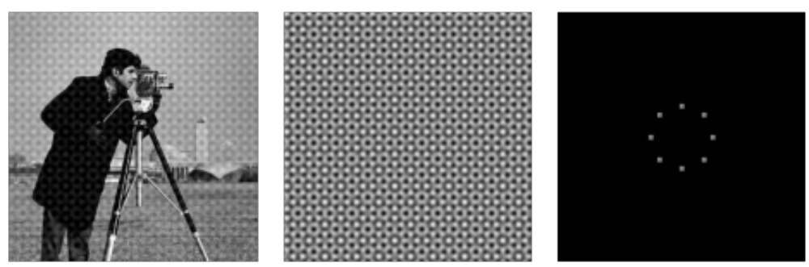
Noise reduction – frequency domain
Main application: reduction or removal of periodic noise.
Periodic noise
  a type of noise that usually arises as a result of electrical or electromechanical interference during the image acquisition process.

Slide 47
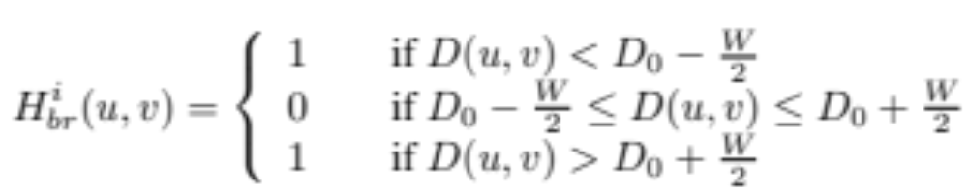
Noise reduction – frequency domain (cont.)
Bandreject filter
  attenuates frequency components within a certain range (the stopband of the filter) while leaving all other frequency components untouched (or amplifying them by a certain gain).
  Ideal bandreject filter

Slide 48
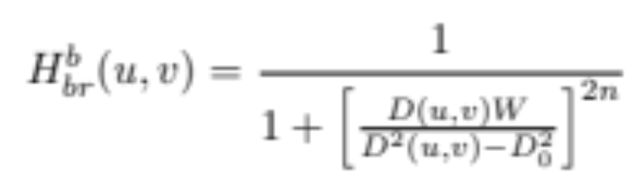
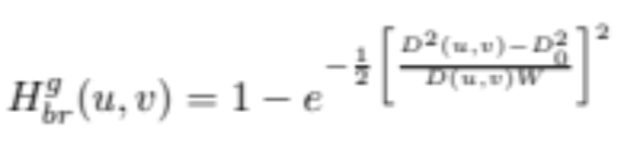
Noise reduction – frequency domain (cont.)
Bandreject filter
  Butterworth bandreject filter
  Gaussian bandreject filter

Slide 49
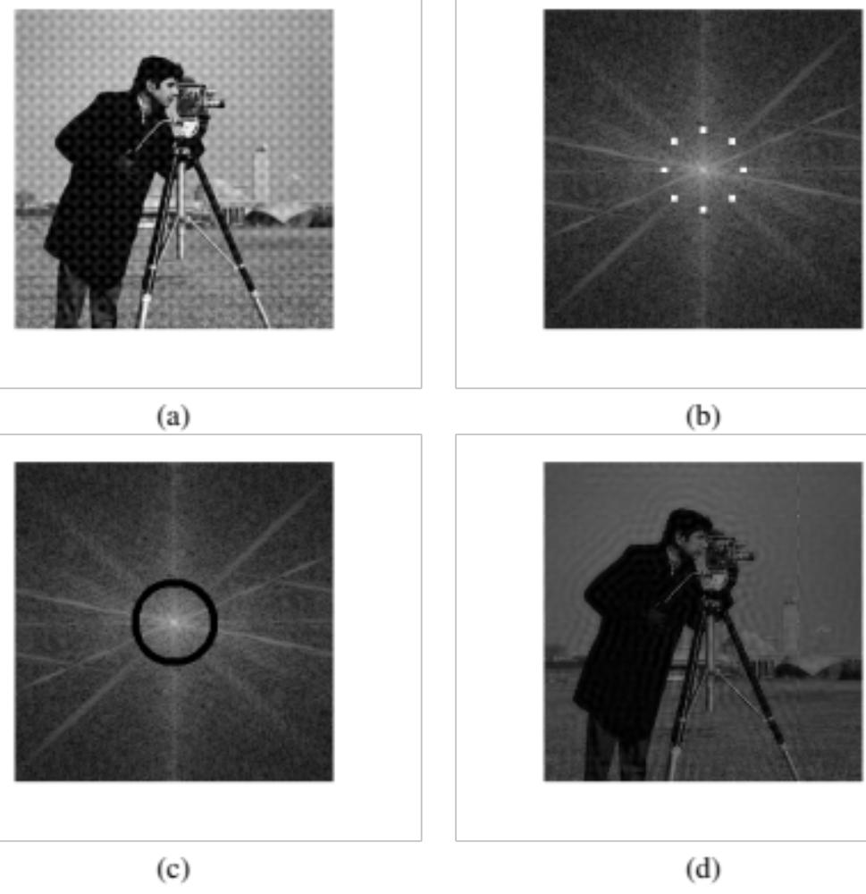
Noise reduction – Ideal bandreject filter (cont.)
Example 12.7 (PIVPUM)

Slide 50
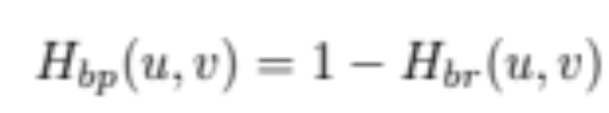
Noise reduction – frequency domain (cont.)
Bandpass filter
  Allows certain frequencies (within its passband) to be preserved while attenuating all others.
  It is, in effect, the opposite of a bandreject filter:

Slide 51
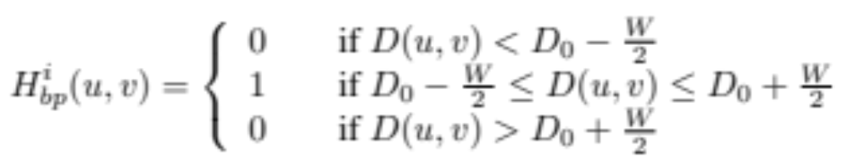


Noise reduction – frequency domain (cont.)
Bandpass filter (BPF)
  Ideal
  Butterworth
  Gaussian

Slide 52
Noise reduction – frequency domain (cont.)
Notch filter
  Special kind of frequency domain filter that attenuates (or allows) frequencies within a neighborhood around a center frequency.
    Due to the symmetry property of the Fourier transform, the spectrum of notch filters shows symmetric pairs around the origin (except for a notch filter located at the origin, of course).

Slide 53

Noise reduction – frequency domain (cont.)
Ideal notch filter

Slide 54


Noise reduction – frequency domain (cont.)
Butterworth notch filter

Slide 55

Noise reduction – frequency domain (cont.)
Gaussian notch filter

Slide 56

Noise reduction – frequency domain (cont.)
To convert a notch filter that rejects certain frequencies into one that allows those same frequencies to pass one has to simply compute:
where H_{np}(u, v) is the transfer function of the notch pass filter that corresponds to the notch reject filter whose transfer function is H_{nr} (u, v).

Slide 57

Image deblurring techniques
Goal: to process an image that has been subject to blurring caused, e.g., by camera motion during image capture or poor focusing of the lenses.
Simplest technique: inverse filtering
where: 1/H(u, v) is the FT of the restoration filter
Problems:
  Division by zero
  0/0 indetermination
  If there is also noise, it will heavily influence the calculations

Slide 58


Image deblurring techniques (cont.)
Inverse filtering
  Division by zero problem has 2 possible solutions:
    Apply a (Butterworth) lowpass filter with transfer function L(u,v) to the division, thus limiting the restoration to a range of frequencies below the restoration cutoff frequency:
    Use constrained division, where a threshold value T is chosen such that, if |H(u,v)| < T, the division does not take place and the original value is kept untouched, i.e.:

Slide 59

Image deblurring techniques (cont.)
Inverse filtering – Example 12.8 (PIVPUM)

Slide 60

Motion deblurring
Motion deblurring can be considered a special case of inverse filtering.
Example of motion deblurring using inverse filtering with constrained division and threshold
T = 0.05.
  The motion blurred has been removed at the expense of the appearance of vertical artifacts.

Slide 61

Image deblurring techniques (cont.)
Wiener filtering (1942)
  Image restoration solution that can be applied to images that have been subject to a degradation function and also contain noise (worst-case scenario).
  Attempt to model the error in the restored image through statistical methods, particularly the minimum mean-square estimator: once the error is modeled, the average error is mathematically minimized.
  The transfer function of a Wiener filter is given by:
  where H(u, v) is the degradation function and K is a constant used to approximate the amount of noise.

Slide 62

Image deblurring techniques (cont.)
Wiener filter in the presence of blur and noise
(Example 12.9 PIVPUM))

Slide 63

Image deblurring techniques (cont.)
Wiener filter in the presence of blur only

Slide 64
Image deblurring techniques (cont.)
Image deblurring in MATLAB:
  Wiener filter: deconvwnr
  Deblur image using regularized filter: deconvreg
  Deblur image using Lucy-Richardson method: deconvlucy
  Deblur image using blind deconvolution: deconvblind

Slide 65
Estimating the degradation function
Generally there are three ways to estimate H:
  Observation
  Experimentation
  Mathematical modeling

Slide 66

Estimating the degradation function (cont.)
If it is assumed that the effect of noise is negligible then the degradation function can be expressed as:
  $H_{S}= \frac{G_{S}\left(u,v\right)}{{\hat{F}}_{S}(u,v)}$
where $\hat{F}$ is estimated from rectangular section of image background.

Slide 67

Estimating the degradation by Experimentation
If images which are similar to a given degraded image can be obtained with appropriate system settings then the following simplified equation is used to estimate H:
  $$H\left(u,v\right)=\frac{G_{S}(u,v)}{A}$$
where A is a constant determined from the system settings.

Slide 68

Estimating the degradation by Experimentation (cont.)

Slide 69

Estimating the degradation by modeling
Various models have been proposed:
  Example: Hufnagel and Stanley (based on the physical characteristics of atmospheric turbulence):
  $$H\left(u,v\right)=e^{−k{\left(u^{2}+v^{2}\right)}^{5/6}}$$
  where k is a constant
  (Note that this model has the same form as the Gaussian LPF with the exception of the 5/6 power.)

Slide 70

Estimating the degradation by modeling (cont.)

Slide 71
Summary
You should now know
  What noise is and how it can be modeled
  What teh main types of noise that may affect an image are
  What blurring is and how it can be modeled
  Which noise removal techniques are typically used in image processing
  Which deblurring techniques are typically used in image processing
  How to estimate the degradation of an image

Slide 72
Next Lecture
Morphological Image Processing

Slide 73
References
Rafael C. Gonzalez, Richard E. Woods, “Digital Image Processing, 4th Ed.”; Pearson, 2018, (DIP)
Rafael C. Gonzalez, Richard E. Woods, Steven L. Eddins, “Digital Image Processing Using MATLAB”; Pearson, 2004, (DIPUM)
Oge Marques, “Practical Image and Video Processing Using MATLAB”; Wiley, 2011, (PIVPUM)

