Slide 1


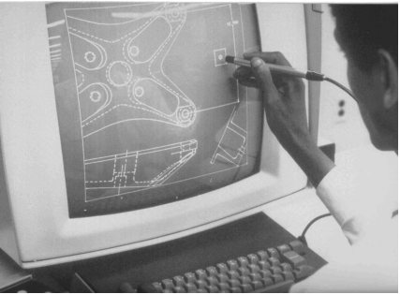
CSE 411
Computer Graphics
Lecture #5 Interactive Input Methods
Prepared & Presented by Asst. Prof. Dr. Samsun M. BAŞARICI
Notes:
1

Slide 2
Objectives
HB Ch. 20
Classification of Input Devices
Input Functions
Interactive Picture-Construction Techniques
GLUT Mouse Functions
GLUT Keyboard Functions
GLUT Menu Functions

Slide 3
Logical Classification of Input Devices
Locator Devices
  Interactive selection of a coordinate point
    Mice
    Joysticks
    Trackballs
    Spaceballs
    Etc.

Slide 4
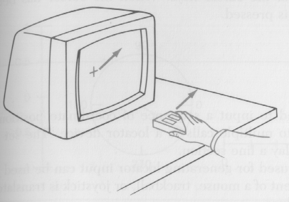
Logical Classification of Input Devices (cont.)
Stroke Devices
  Input a sequence of coordinate positions
    Mice (continuous movement)
    Graphic tablets
    Etc.

Slide 5
Logical Classification of Input Devices (cont.)
String Devices
  (Character) String input
    Keyboards

Slide 6
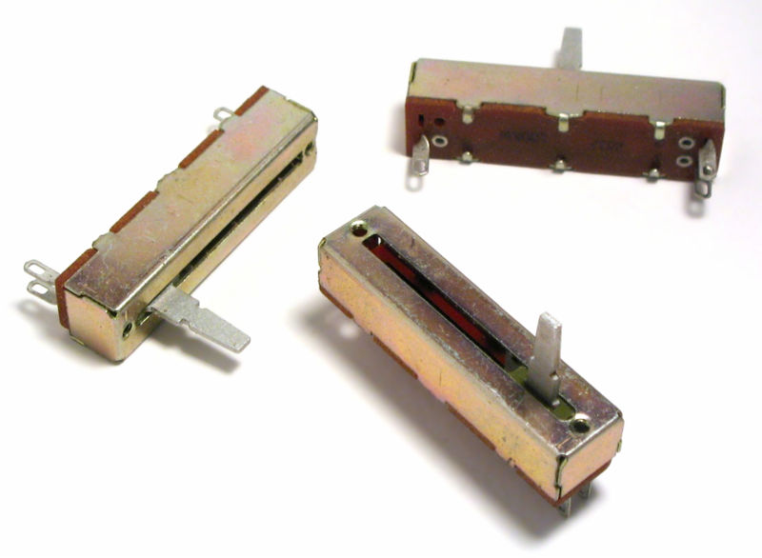
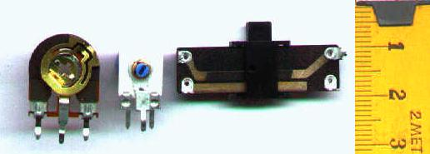
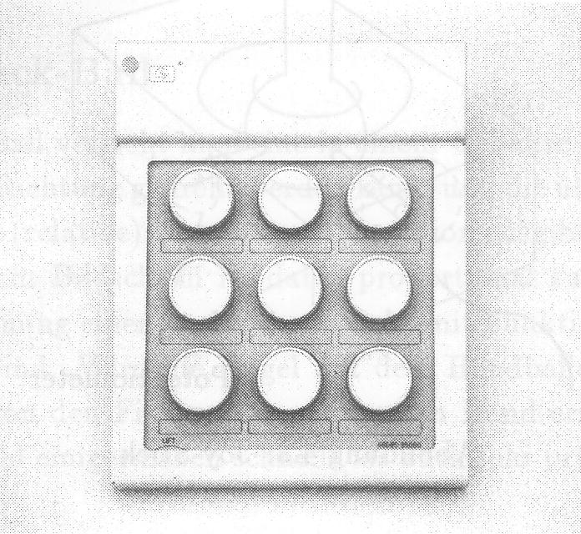
Logical Classification of Input Devices (cont.)
Valuator Devices
  Input a scalar value
    Faders
    Trimmers
    Potentiometers
    Etc.

Slide 7
Logical Classification of Input Devices (cont.)
Choice Devices
  Selecting menu options
    Mice
    Keyboards
    Etc.

Slide 8
Logical Classification of Input Devices (cont.)
Pick Devices
  Selecting objects
    Mice
    Keyboards
    Joysticks
    Etc.

Slide 9
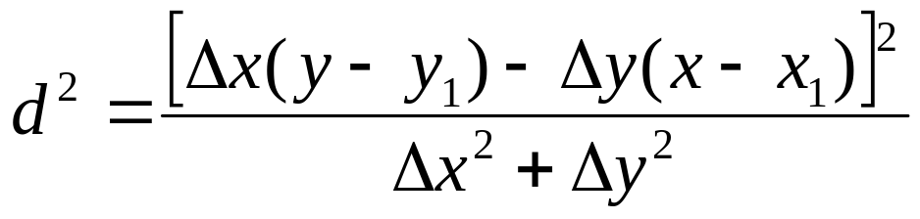
Logical Classification of Input Devices (cont.)
Pick Devices
  Example: Selecting one object
d₁
d₂
(x,y)

Slide 10
Logical Classification of Input Devices (cont.)
Pick Devices
  Example: Selecting multiple objects (pick window)
Bounding
Rectangle
ymax
ymin
xmin
xmax

Slide 11
Input Devices
Locator Devices:
  Specify one coordinate position
Stroke Devices:
  Specify set of coordinate positions
String Devices:
  Specify text input
Valuator Devices:
  Specify scalar value
Choice Devices:
  Select menu options
Pick Devices:
  Select component(s) of a picture

Slide 12
Input Functions for Graphical Data
Input Modes:
  Request mode:
    Data entry initiated by application program
    Suspend process, wait for input data
    Input device and program operate alternately
  Sample mode:
    Input device and program operate independent
  Event mode:
    Data entry initiated by input device (event initiated)
    Data stored in queue
    Input device and program operate alternately

Slide 13
Interactive Techniques
Positioning
Position Cursor
and Press Button
Object Displayed
at Cursor Position

Slide 14
Interactive Techniques
Dragging

Slide 15
Interactive Techniques
Constraints:
  Procedure for altering input coordinate values
Press Button
to Select First
Endpoint
Press Button
to Select
Second Endpoint
Press button
to Select First
Endpoint
Press Button
to Select
Second Endpoint

Slide 16
Interactive Techniques
Grids
  A kind of constraint
Press Button to
Select First Endpoint
Press Button to
Select Second Endpoint

Slide 17
Interactive Techniques
Rubber-Bands

Slide 18
Interactive Techniques
Rubber-Bands
Press button to start
Arc stretches out from start
position as cursor moves
Pressing stop button &
ends process
Press button to start
Rectangle stretches out
as cursor moves
Press button to stop

Slide 19
Interactive Techniques
Gravity Field

Slide 20
GLUT Input Device Functions
Device input is handled by GLUT and not by OpenGL core library
Why?

Slide 21
GLUT Mouse Functions
glutMouseFunc (mouseFcn);
void mouseFcn(GLint button, GLint action, GLint xmouse, GLint ymouse)
  button
    GLUT_LEFT_BUTTON, GLUT_MIDDLE_BUTTON, GLUT_RIGHT_BUTTON
  action
    GLUT_DOWN , GLUT_UP
  xmouse, ymouse
    mouse position relative to window when the button is pressed or released

Slide 22
Example Programs
ch20MousePlotPoint.c
ch20MousePlotPolyline.c

Slide 23
GLUT Mouse Functions (cont.)
glutMotionFunc(fncDoSomething);
  void fcnDoSomething(GLint xMouse, GLint yMouse)
  Invokes when mouse moves with a button pressed
glutPassiveMotionFunc(fncDoSomethingElse);
  void fcnDoSomethingElse(GLint xMouse, GLint yMouse)
  Invokes when mouse moves without pressing a button

Slide 24
GLUT Keyboard Functions
glutKeyboardFunc (keyFcn);
  void keyFcn(GLubyte key, GLint xMouse, GLint yMouse)
    key is assigned a character value or the corresponding ASCII code
Example
  ch20KeyboardCurveDrawing.c

Slide 25
GLUT Keyboard Functions (cont.)
glutSpecialFunc (specialKeyFcn);
  void specialKeyFcn(GLint specialKey, GLint xMouse, GLint yMouse)
    specialKey can be GLUT_KEY_F1…GLUT_KEY_F12, GLUT_KEY_UP, GLUT_KEY_RIGHT, GLUT_KEY_PAGE_DOWN, GLUT_KEY_HOME
Example
  ch20MouseKeyboardSquares.c

Slide 26
GLUT Menu Functions (cont.)
Creating a GLUT Menu
  glutCreateMenu (menuFcn);
  void menuFcn(GLint menuItemNumber)
  glutAddMenuEntry(charString, menuItemNumber);
    glutCreateMenu (menuFcn);
    glutAddMenuEntry(“First Menu Item”, 1);
    glutAddMenuEntry(“Second Menu Item”, 2);
  glutAttachMenu (button);
Example
  ch20GLUTMenu.c

Slide 27
GLUT Menu Functions (cont.)
Creating and Managing Multiple GLUT Menus
  menuID = glutCreateMenu (menuFcn);
  glutSetMenu (menuID);
  glutDestroyMenu (menuID);
  currentMenuID = glutGetMenu ();

Slide 28
GLUT Menu Functions (cont.)
Creating GLUT Submenus
  submenuID = glutCreateMenu (subMenuFcn);
  glutAddMenuEntry(“First Submenu Item”,1);
  .
  .
  glutCreateMenu (menuFcn);
  glutAddMenuEntry(“First Menu Item”,1);
  .
  .
  glutAddSubMenu (“Submenu Option”,submenuID);
Example
  ch20GLUTSubmenu.c

Slide 29
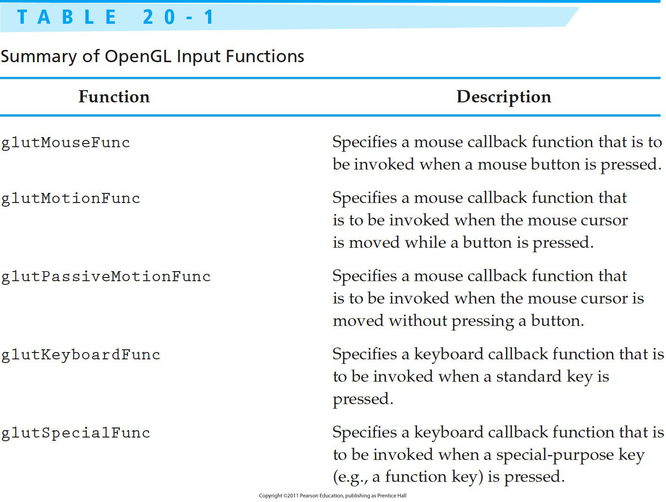
OpenGL Input Functions

Slide 30
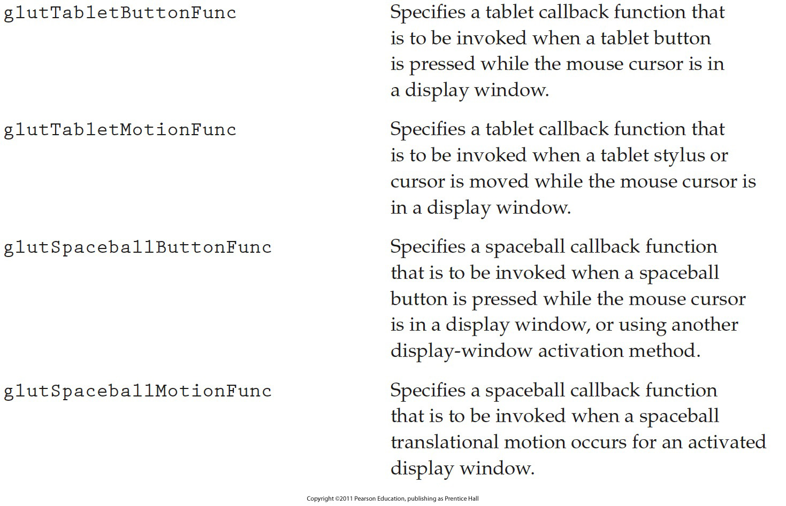
OpenGL Input Functions (cont.)

Slide 31
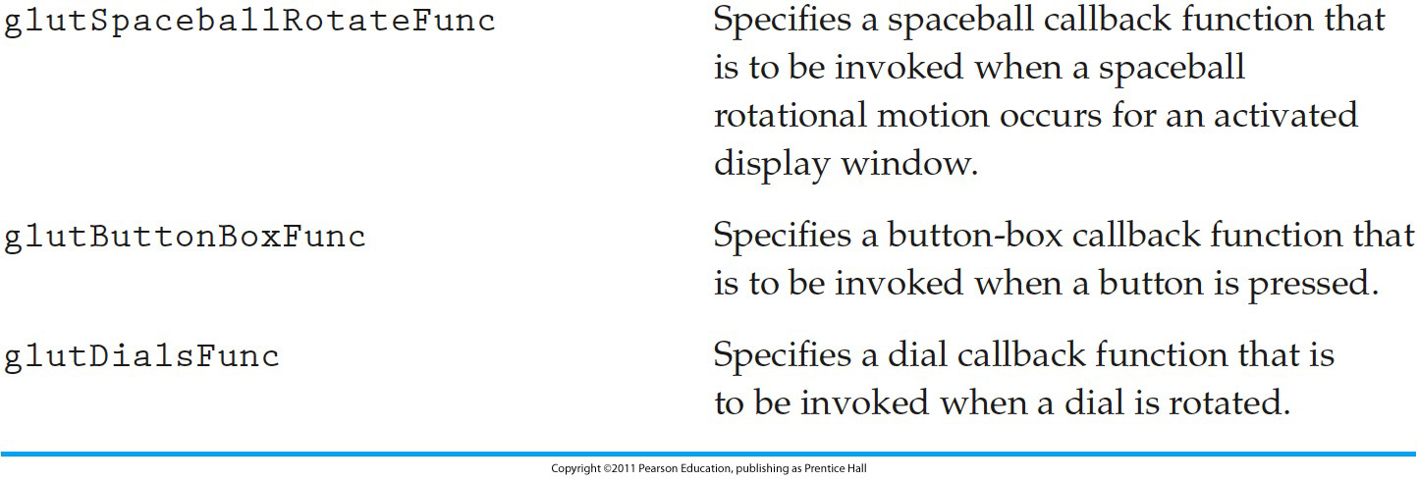
OpenGL Input Functions (cont.)

Slide 32
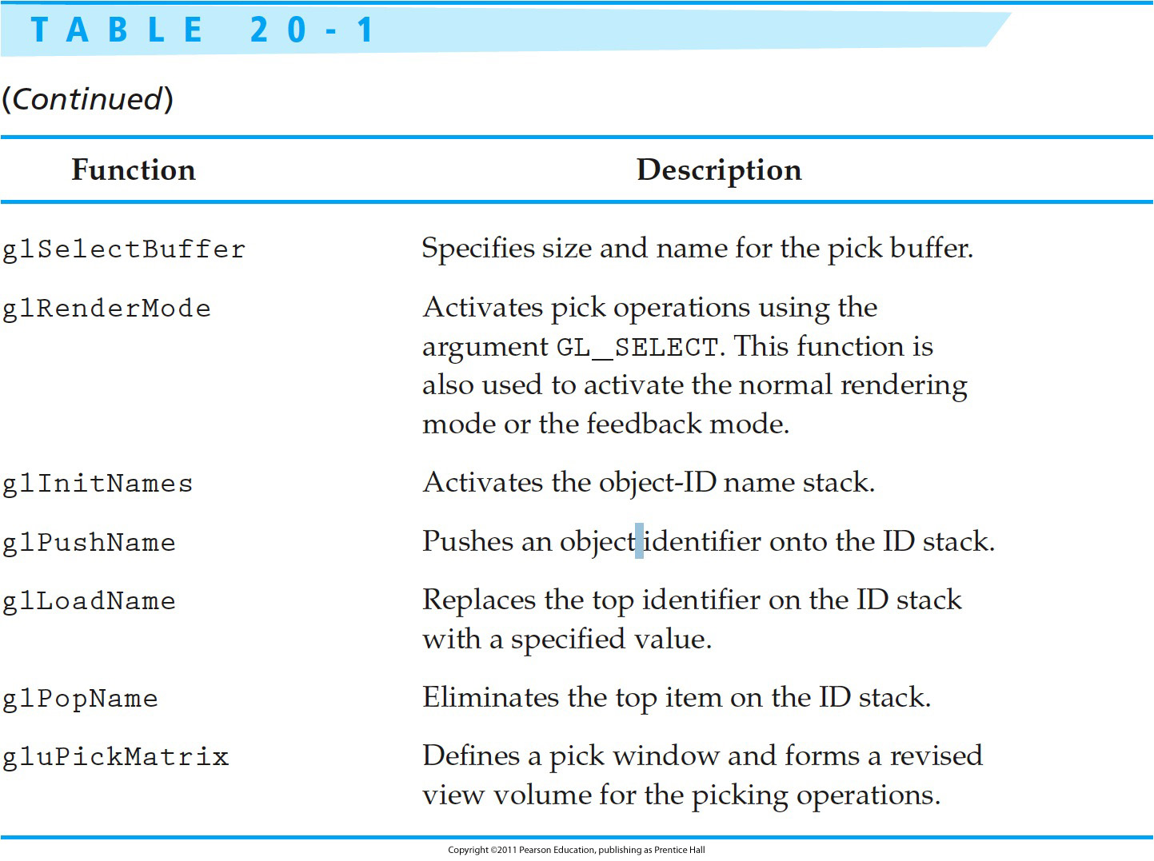
OpenGL Input Functions (cont.)

Slide 33
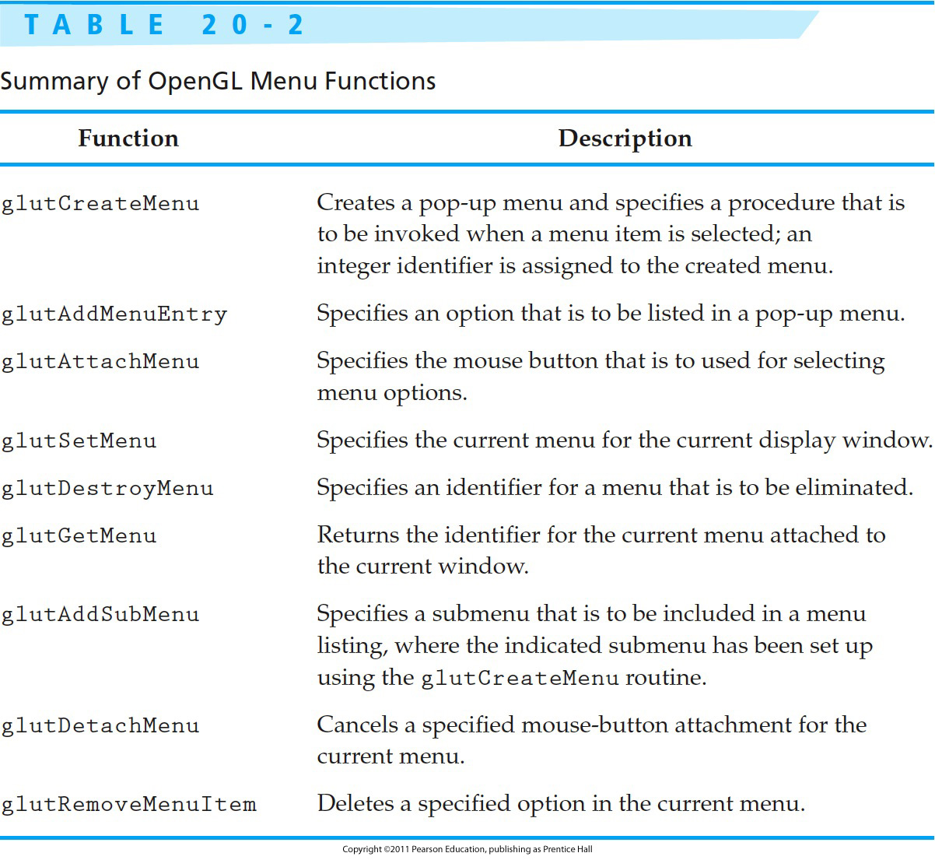
OpenGL Input Functions (cont.)

Slide 34

Next Lecture
2D Geometric Transformations
Interactive Input Methods
34
Notes:
34

Slide 35
References
Donald Hearn, M. Pauline Baker, Warren R. Carithers, “Computer Graphics with OpenGL, 4th Edition”; Pearson, 2011
Sumanta Guha, “Computer Graphics Through OpenGL: From Theory to Experiments”, CRC Press, 2010
Edward Angel, “Interactive Computer Graphics. A Top-Down Approach Using OpenGL”, Addison-Wesley, 2005
Interactive Input Methods
35

