Slide 1


CSE306 Operating Systems
Lecture #5
File Management
Prepared & Presented by Asst. Prof. Dr. Samsun M. BAŞARICI

Slide 2
Topics covered
Long term storage
Files and file system structure
File operations
Directories and directory operations
Allocation
File system implementation
Various file system examples

Slide 3
File Systems (1)
Essential requirements for long-term information storage:
It must be possible to store a very large amount of information.
The information must survive the termination of the process using it.
Multiple processes must be able to access the information concurrently.

Slide 4
File Systems (2)
Think of a disk as a linear sequence of fixed-size blocks and supporting reading and writing of blocks. Questions that quickly arise:
How do you find information?
How do you keep one user from reading another’s data?
How do you know which blocks are free?

Slide 5
What is it all about?
File system is a service which supports an abstract representation of the secondary storage
  Supported by OS
Why is a file system needed?
  What is so special about the secondary storage (as opposed to the main memory)?

Slide 6
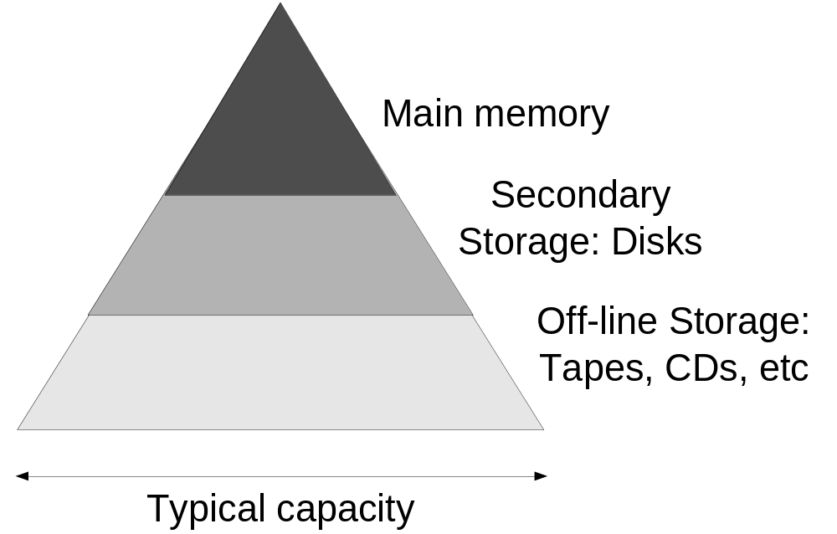
Memory Hierarchy

Slide 7
Main memory vs. Secondary storage
Small (MB/GB)
Expensive
Fast (10⁻⁶/10⁻⁷ sec)
Volatile
Directly accessible by CPU
  Interface: (virtual) memory address
Large (GB/TB)
Cheap
Slow (10⁻²/10⁻³ sec)
Persistent
Cannot be directly accessed by CPU
  Data should be first brought into the main memory

Slide 8
Some numbers…
1GB=2³⁰ ~10⁹ Bytes
1TB=2⁴⁰ ~10¹² (terabyte)
1PB=2⁵⁰ ~10¹⁵ (petabyte)
1EB=2⁶⁰ ~10¹⁸ (exabyte)
2³² ~ 4 x 10⁹: Genome base pairs
2⁶⁴ ~ 16 x 10¹⁸: Brain electrons
2²⁵⁶ ~ 65,536 x 10⁷²: Particles in Universe

Slide 9
Secondary storage structure
A number of disks directly attached to the computer
Network attached disks accessible through a fast network
  Storage Area Network (SAN)
Simple disks
Smart disks

Slide 10
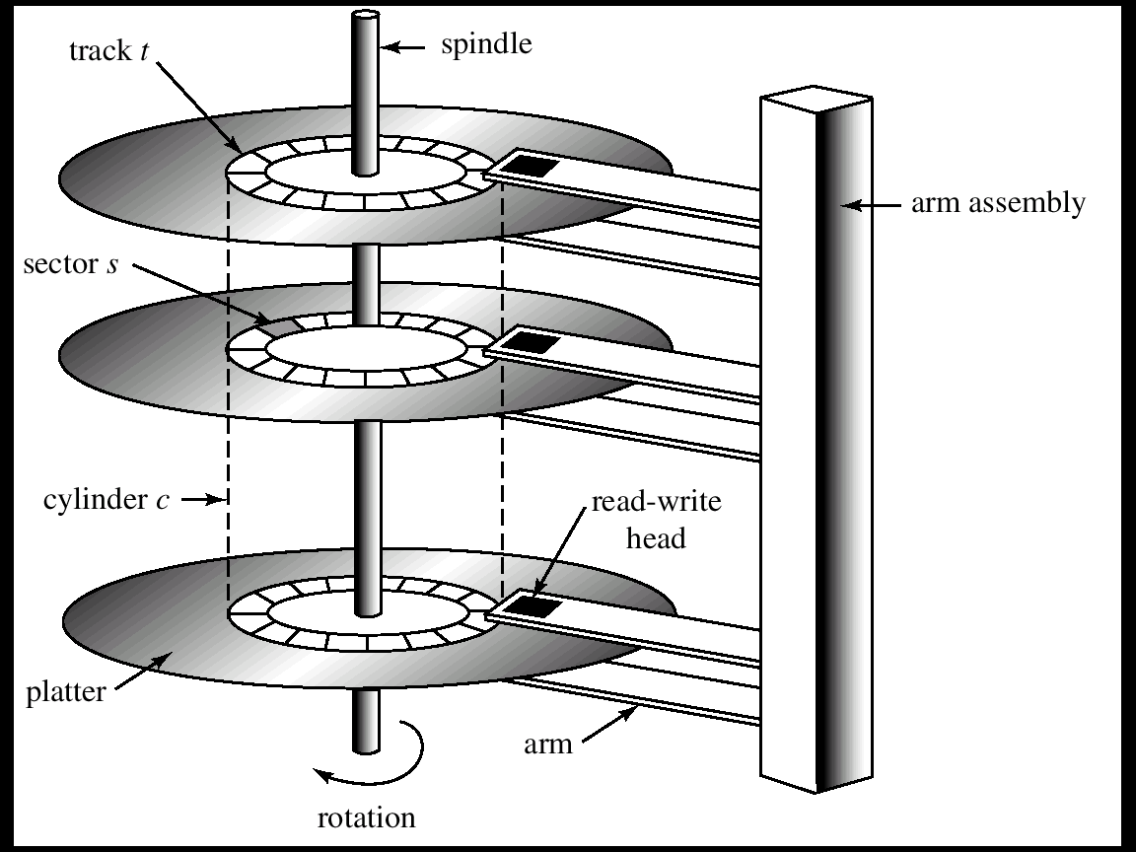
Internal disk structure

Slide 11
Data Access
Sector size is the minimum read/write unit of data (usually 1KB)
  Access: (#surface, #track, #sector)
Smart disk drives hide out the internal disk layout
  Access: (#sector)
Moving arm assembly (Seek) is expensive
  Sequential access is x100 times faster than the random access

Slide 12
File System services
File system is a layer between the secondary storage and the application
Presents the secondary storage as a collection of persistent objects with unique names, called files
Provides mechanisms for mapping the data between the secondary storage and the main memory

Slide 13
What is a file
File is a named persistent collection of data
Unstructured, sequential (UNIX)
  Data is accessed by specifying the offset
Collection of records (database systems)
  Supports associative access
    give me all records with “Name=Ahmet”
Attributes: owner, permissions, modification time, size, etc…

Slide 14
File system interface
File data access
  READ: Bring a specified chunk of data from file into the process virtual address space
  WRITE: Write a specified chunk of data from the process virtual address space to the file
CREATE, DELETE, SEEK, TRUNCATE
open, close, set_attributes
Many semantics al issues:
  Automatic size-extension
  Holes
  Persistence of open files
  More …

Slide 15
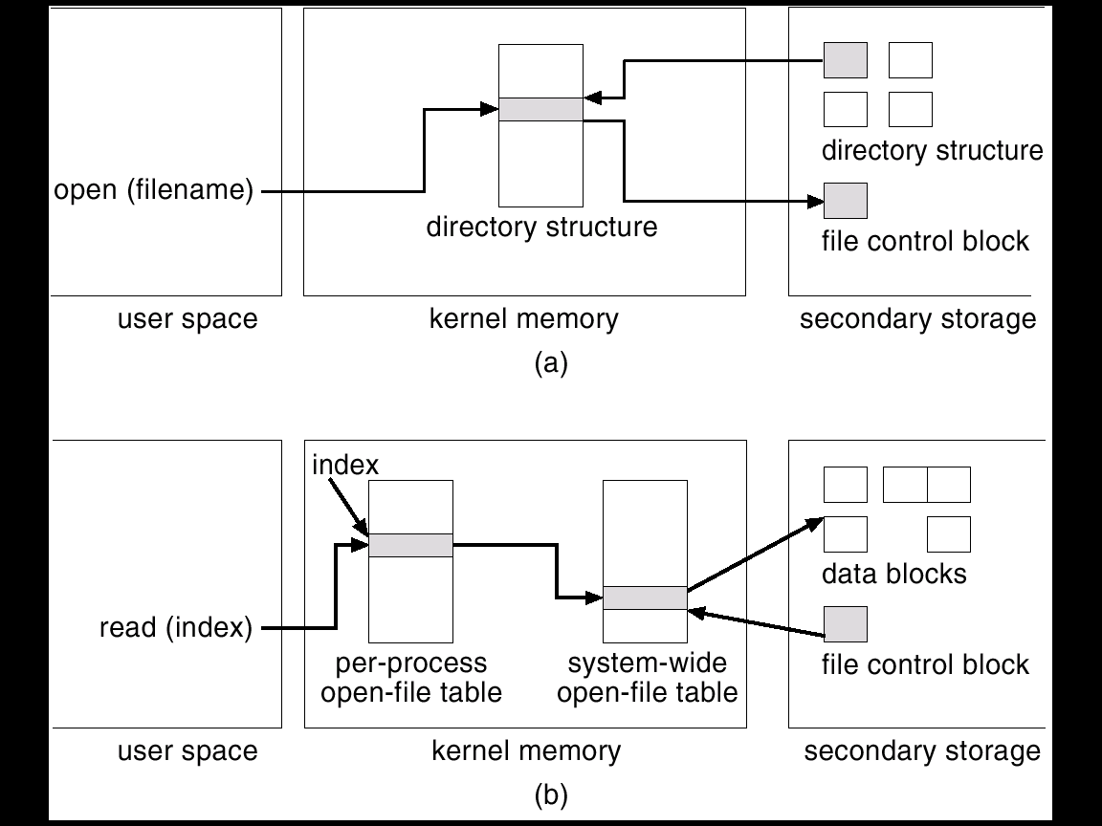
File system structure

Slide 16
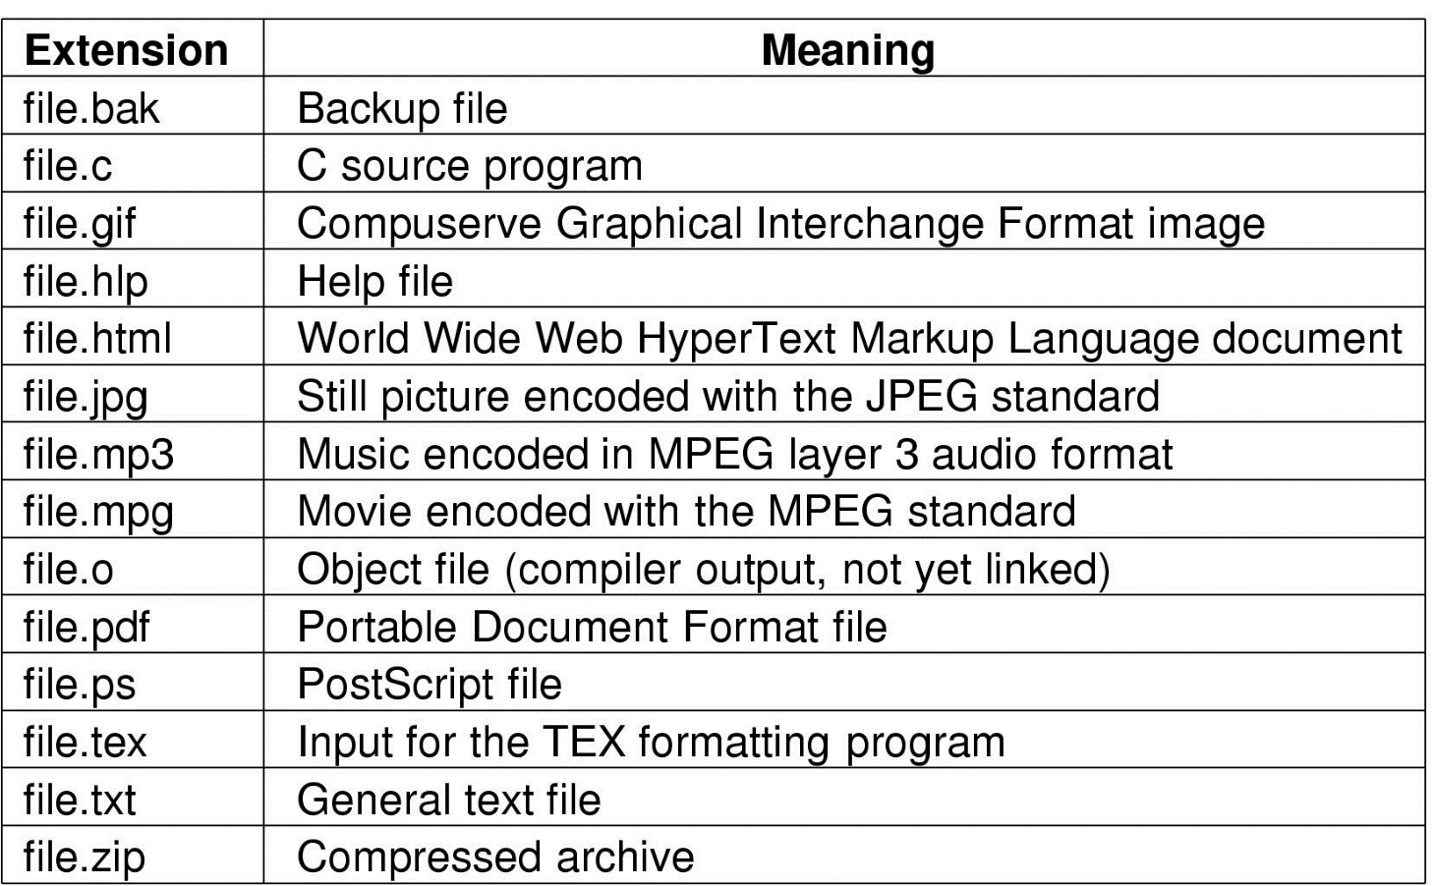
File Naming
Typical file extensions.

Slide 17
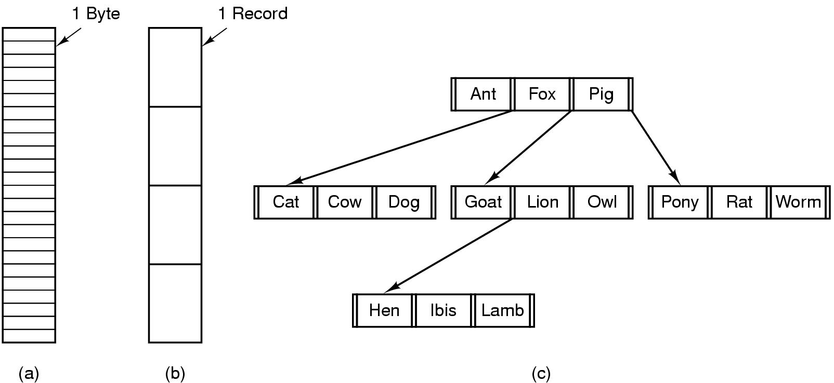
File Structure
Three kinds of files
  byte sequence
  record sequence
  tree

Slide 18
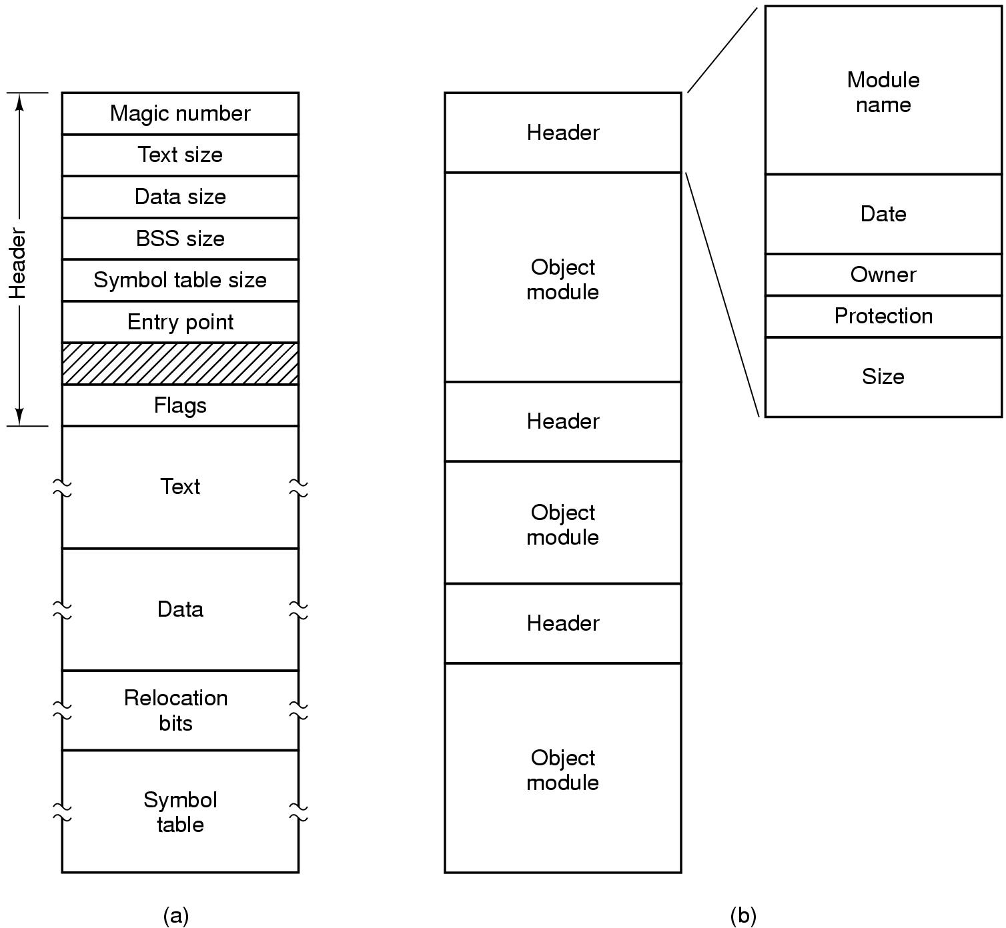
File Types
(a) An executable file (b) An archive

Slide 19
File Access
Sequential access
  read all bytes/records from the beginning
  cannot jump around, could rewind or back up
  convenient when medium was mag tape
Random access
  bytes/records read in any order
  essential for data base systems
  read can be …
    move file marker (seek), then read or …
    read and then move file marker

Slide 20
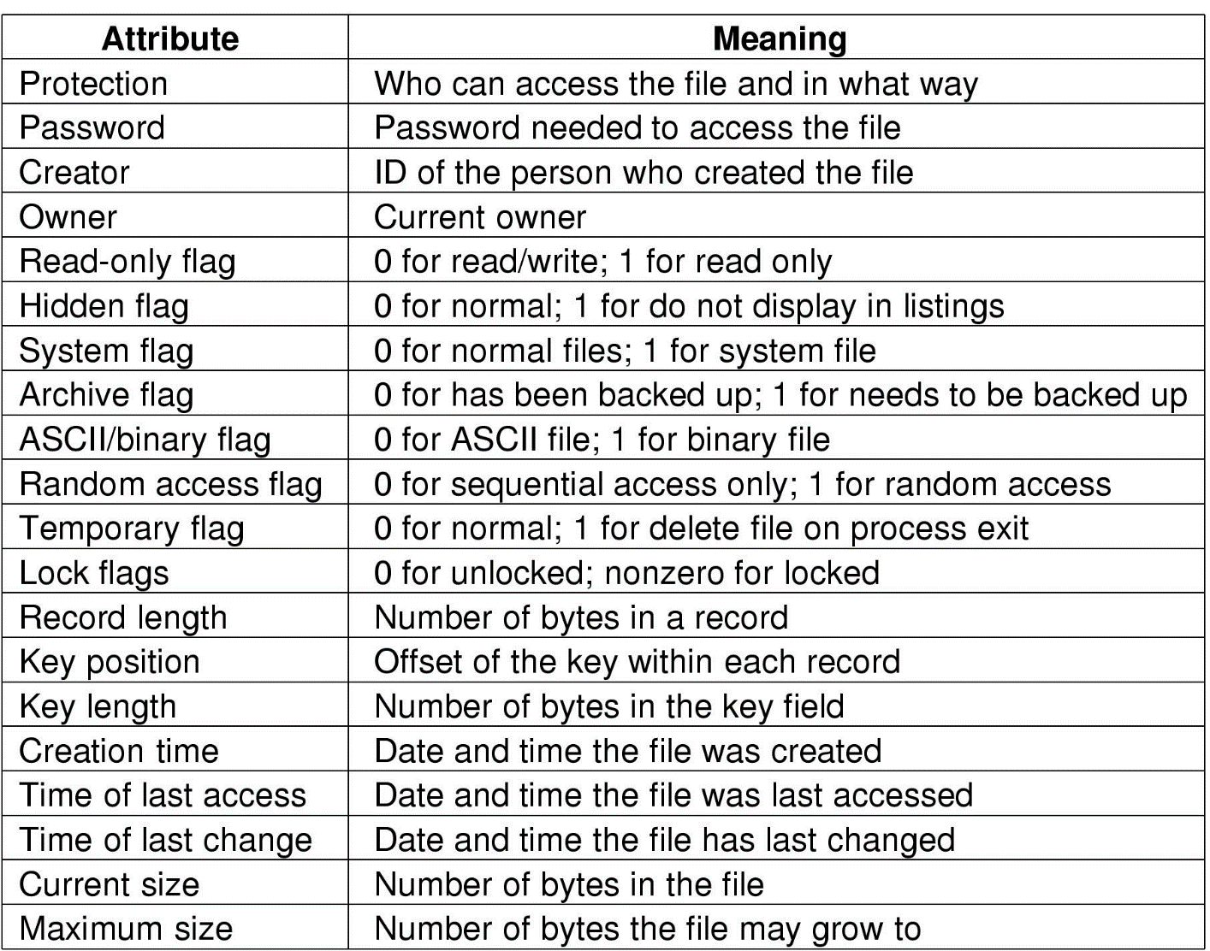
File Attributes
Possible file attributes

Slide 21
File Operations
  Create
  Delete
  Open
  Close
  Read
  Write
  Append
  Seek
  Get attributes
  Set Attributes
  Rename

Slide 22
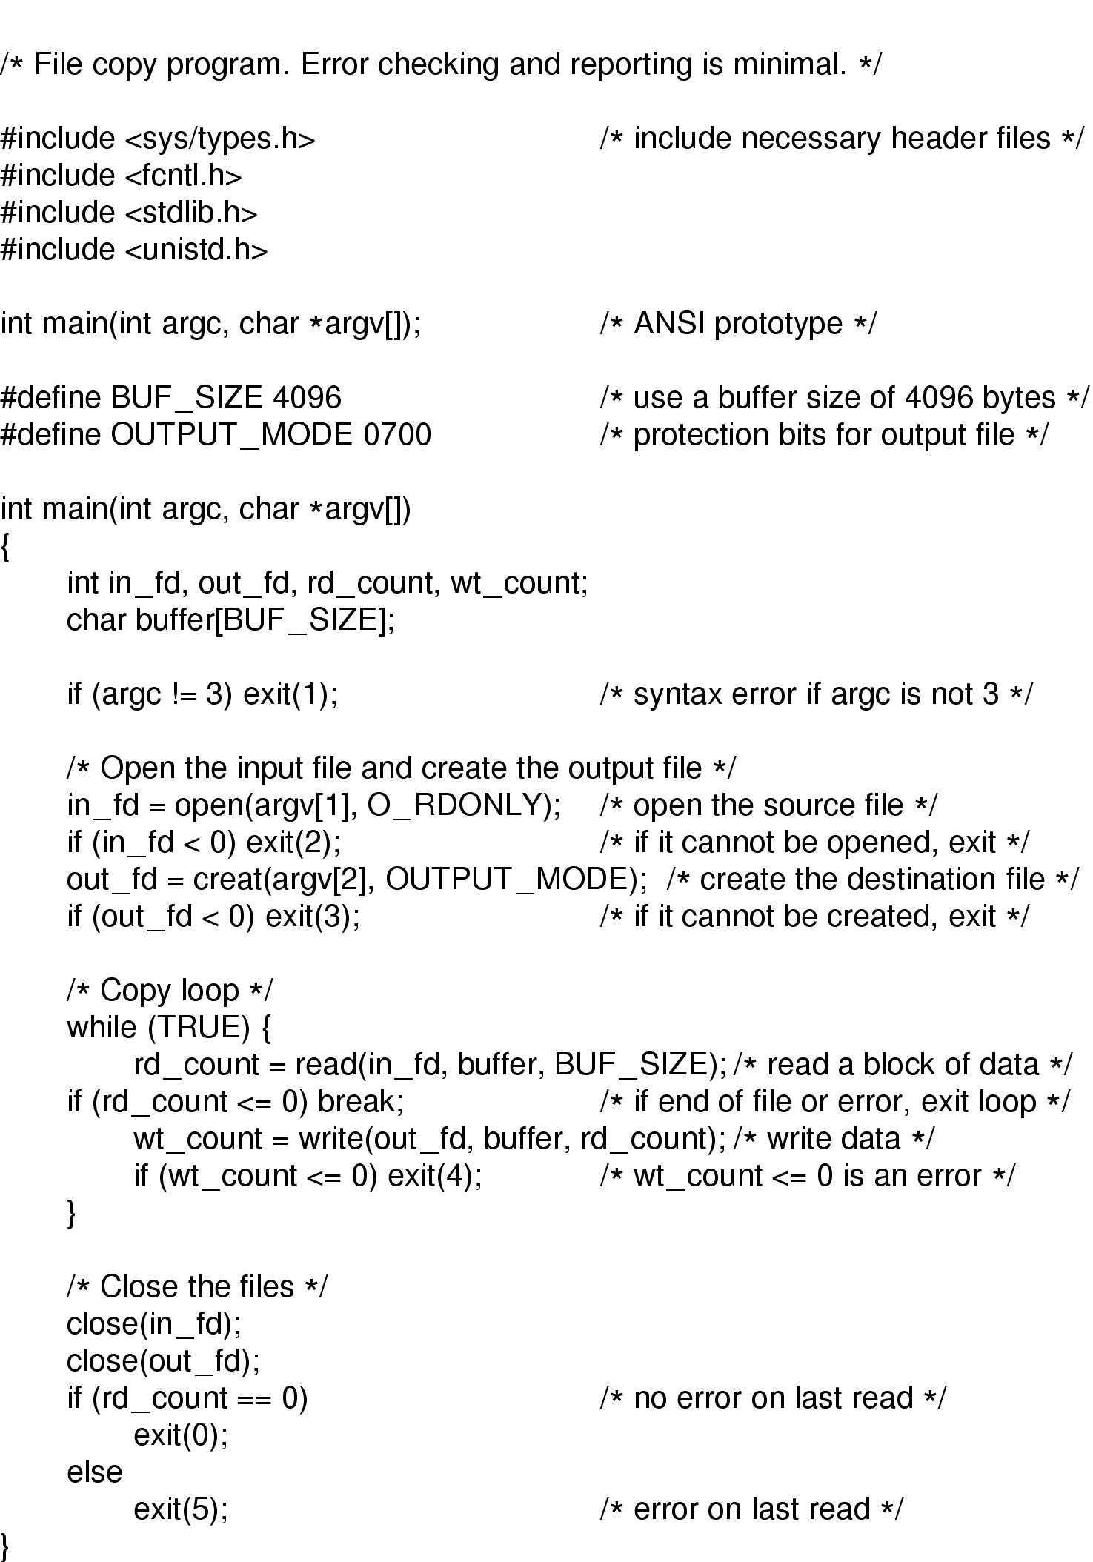
An Example Program Using File System Calls (1/2)

Slide 23
An Example Program Using File System Calls (2/2)

Slide 24
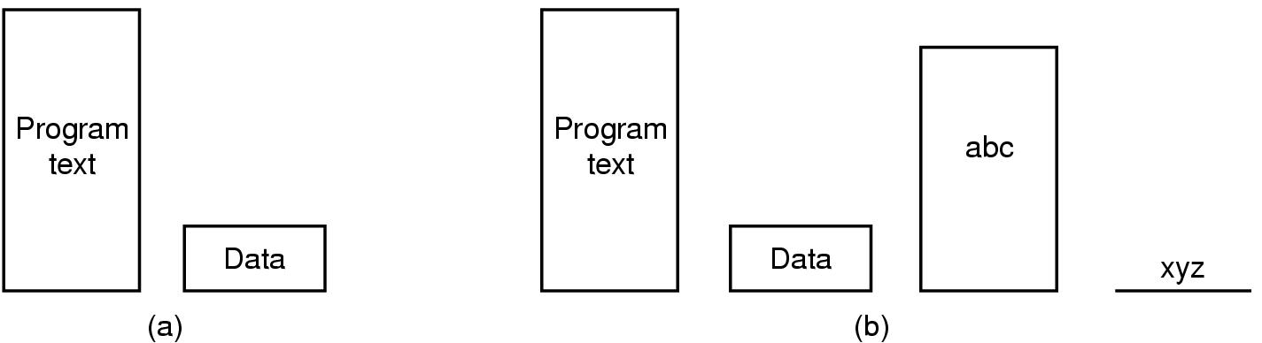
Memory-Mapped Files
(a) Segmented process before mapping files into its address space
(b) Process after mapping
  existing file abc into one segment
  creating new segment for xyz

Slide 25
Memory mapped files
A file (or a portion thereof) is mapped into a contiguous region of the process virtual memory
  UNIX: mmap system call
Mapping operation is very efficient:
  just marking
The access to file is governed by the virtual memory subsystem

Slide 26
Mmapped files: Pros and Cons
Advantages:
  reduce copying
  no need for a pre-allocated buffer cache in the main memory
Disadvantages:
  less or no control over the actual disk writing: the file data becomes volatile
  A mapped area must fit the virtual address space

Slide 27
Directories
Provide name to file mapping
May provide additional attributes per file
Different from regular files
  Support operations like create, delete, list
  Prevent duplicate names
  May be organized as a hash table for efficient searching
Mostly common structure: hierarchy
  Supports hierarchical pathnames

Slide 28
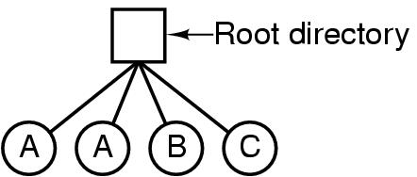
Directories
Single-Level Directory Systems
A single level directory system
  contains 4 files
  owned by 3 different people, A, B, and C

Slide 29
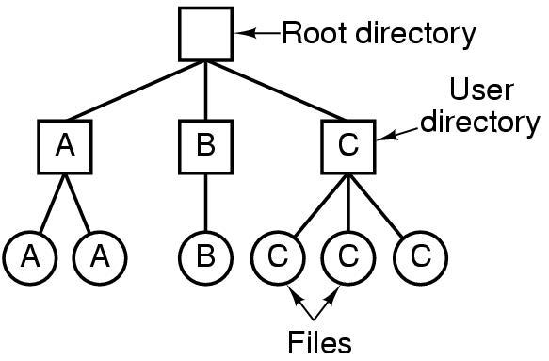
Two-level Directory Systems
Letters indicate owners of the directories and files

Slide 30
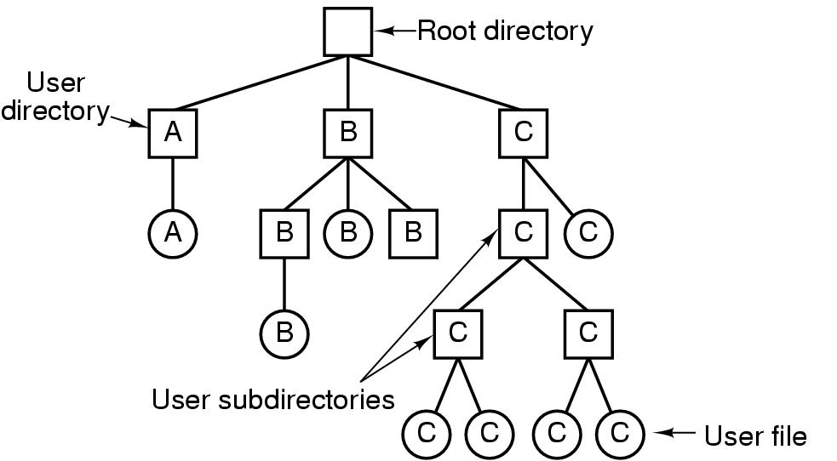
Hierarchical Directory Systems
A hierarchical directory system

Slide 31
Extending the directory hierarchy
Multiple volumes
  Unix: Mount/un-mount volume on directory
  Transparent pathname traversal: in-core mount table, in-core i-node of mount point and or mounted root.
Remote volumes
  Distributed file systems: Sun NFS, AFS/Coda, etc.

Slide 32
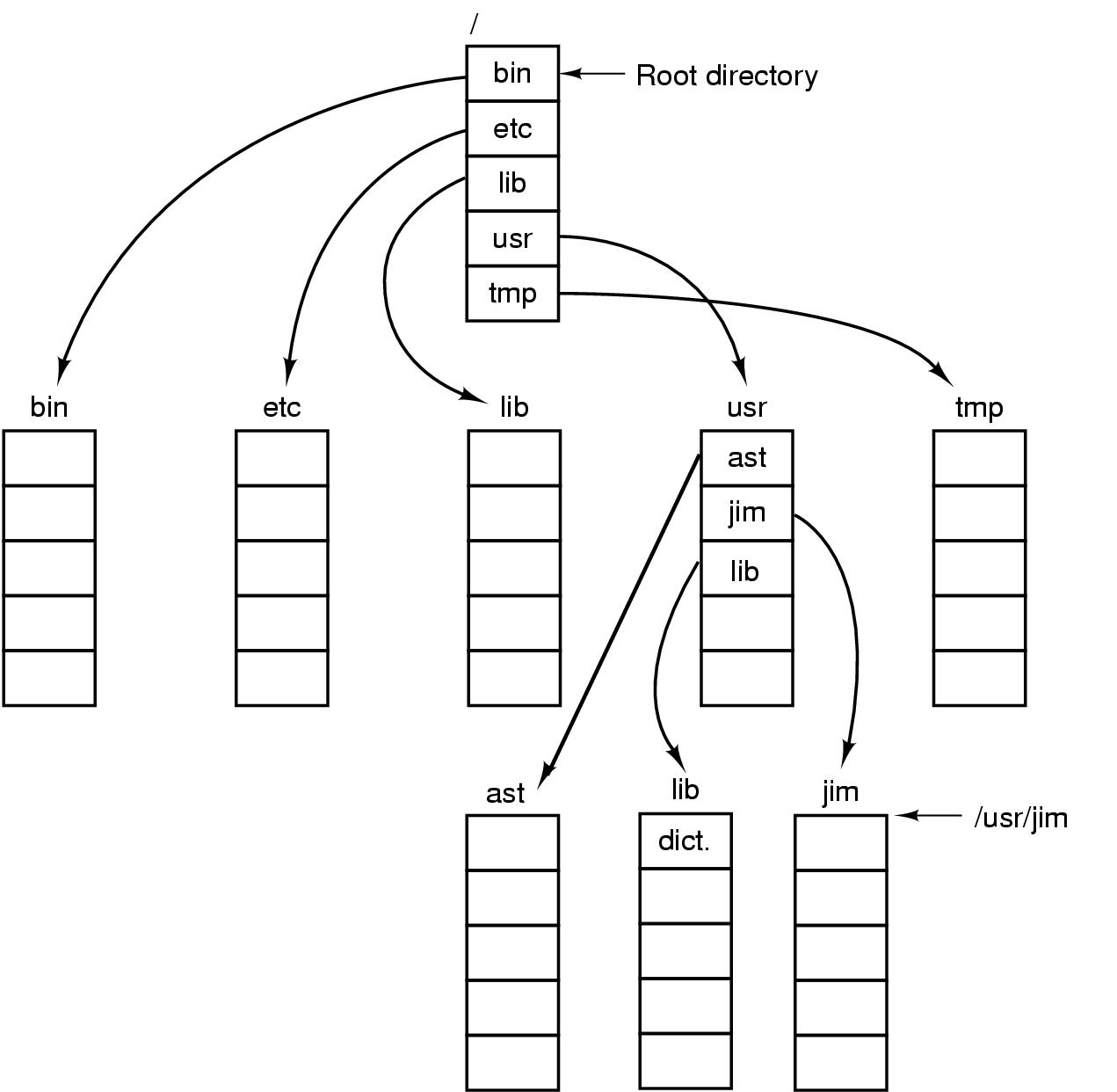
Path Names
A UNIX directory tree

Slide 33
Directory Operations
Create
Delete
Opendir
Closedir
Readdir
Rename
Link
Unlink

Slide 34
File system implementation
Virtual File Systems - easily change underlying storage mechanisms to local or remote
Directory Implementation: Linear list, Hash table
Allocation: Contiguous (fragmentation), linked allocation (FAT), Indexed Allocation (single level, multilevel)
Free space management: Bit vector, Linked list, Grouping, Counting
Recovery and consistency checking

Slide 35
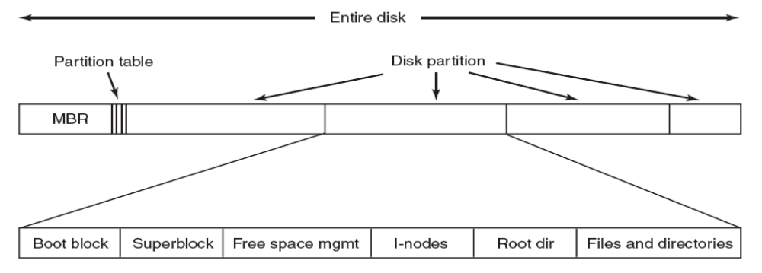
File System Layout
A possible file system layout.

Slide 36
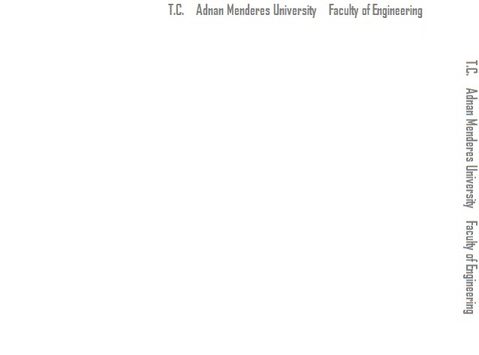
Allocating disk blocks to file data
Assume unstructured files
  Array of bytes
Efficient offset -> disk block mapping
Efficient disk access for both sequential and random patterns
  Minimizing number of long seeks
Efficient space utilization
  Minimizing external/internal fragmentation

Slide 37
Static Contiguous Allocation
Allocate each file a fixed number of blocks at the creation time
  #blocks is pre-defined or supplied as an argument
Efficient offset lookup
  Only the block # of the offset 0 is needed
Efficient disk access
Inefficient space utilization
  Internal, external fragmentation
No support for dynamic extension

Slide 38
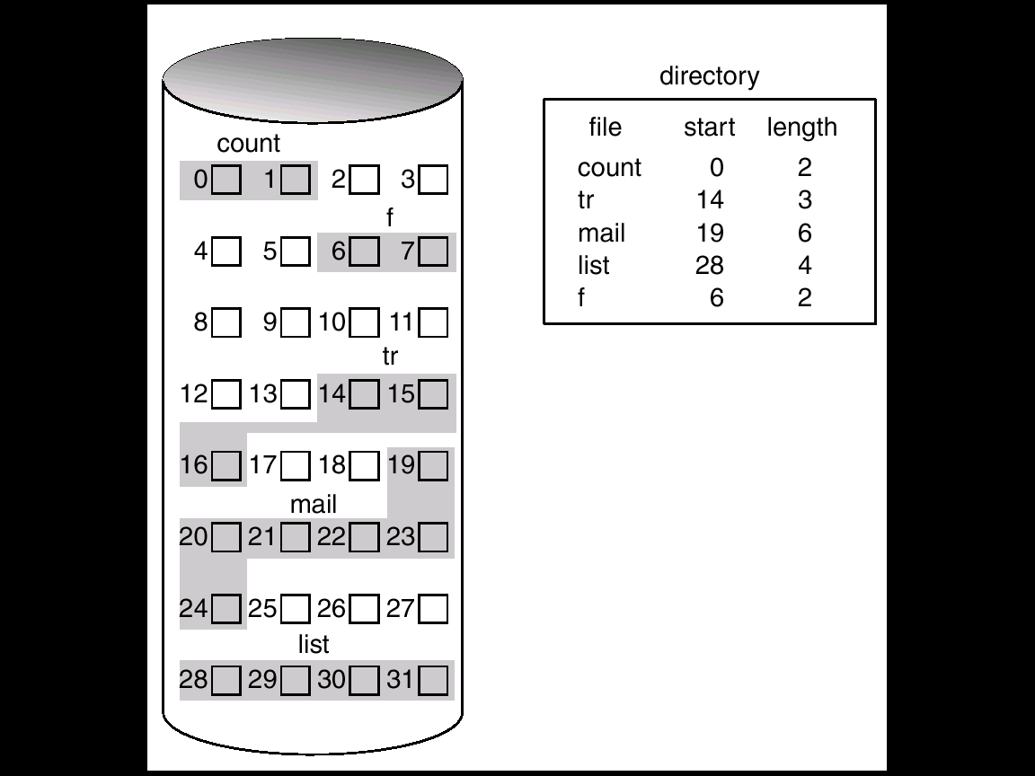
(Static) Contiguous allocation

Slide 39
Extent-based allocation
File gets blocks in contiguous chunks called extents
  Multiple contiguous allocations
For large files, B-tree is used for efficient offset lookup

Slide 40
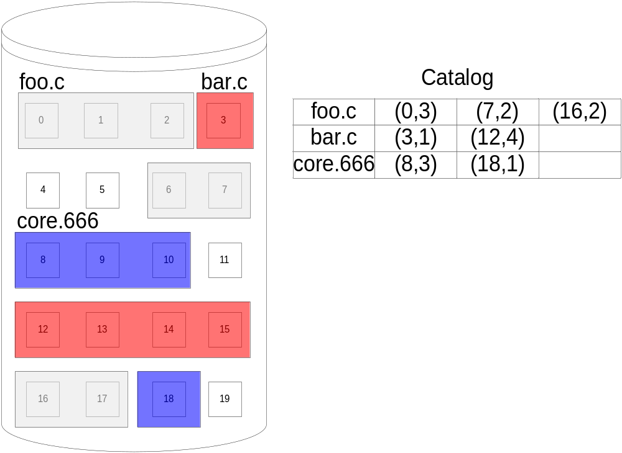
Extent-based allocation

Slide 41
Extent-based allocation
Efficient offset lookup and disk access
Support for dynamic growth/shrink
Dynamic memory allocation techniques are used (e.g., first-fit)
External/internal fragmentation may be a problem
  Depending on the implementation, requirements, etc…

Slide 42
Single-block allocation
Extent-based allocation with a fixed extent size of one disk block
  File blocks are scattered anywhere on the disk
    Inefficient sequential access
UNIX block allocation
Linked allocation
  MS-DOS File Allocation Table (FAT)

Slide 43
Block Allocation in UNIX
10 direct pointers
1 single indirect pointer: points to a block of N pointers to data blocks
1 double indirect pointer: points to a block of N pointers each of which points to a block of N pointers to data blocks
1 triple indirect pointer…
Overall addresses 10+N+N²+N³ disk blocks

Slide 44
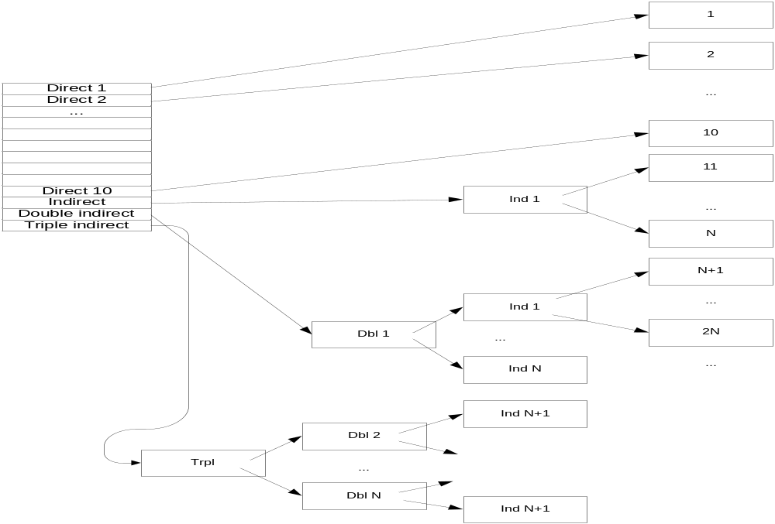
Block Allocation in UNIX

Slide 45
Block Allocation in UNIX
Optimized for small files
  Outdated empirical studies indicate that 98% of all files are under 80 KB
Poor performance for random access of large files (redirections)
No external fragmentation
Wasted space in pointer blocks for large sparse files
Modern UNIX implementations use the extent-based allocation

Slide 46
Linked Allocation
Each file is a linked list of disk blocks
Offset lookup:
  Efficient for sequential access
  Inefficient for random access
Access to large files may be inefficient as the blocks are scattered
  Solution: block clustering
No fragmentation, wasted space for pointers in each block

Slide 47
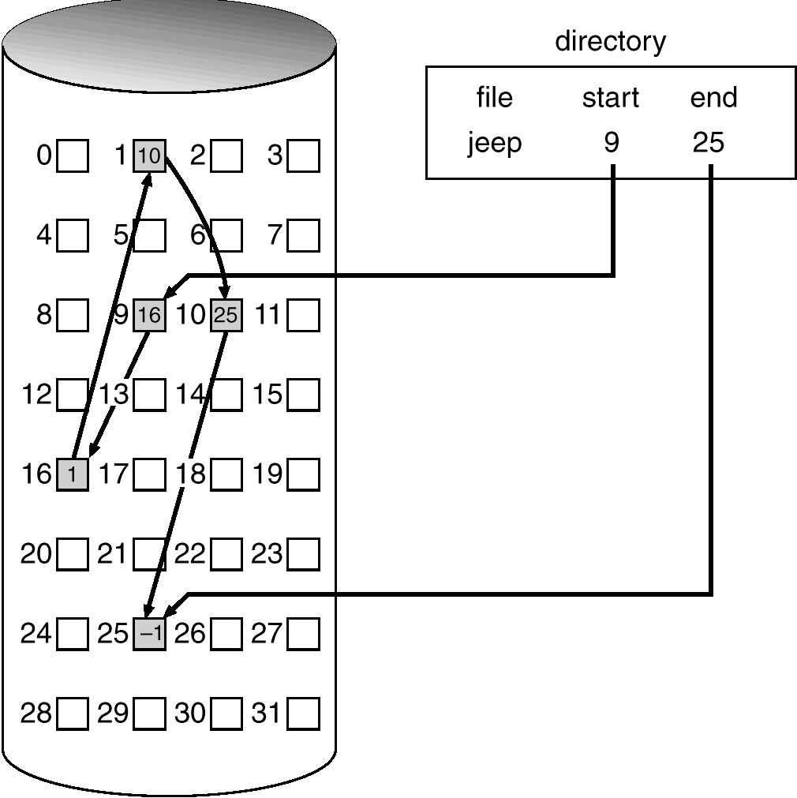
Linked Allocation
Catalog

Slide 48
File Allocation Table (FAT)
A section at the beginning of the disk is set aside to contain the table
  Indexed by the block numbers on disk
  An entry for each disk block (or for a cluster thereof)
FAT Entries corresponding to blocks belonging to the same file are chained
  The last file block, unused blocks and bad blocks have special markings

Slide 49
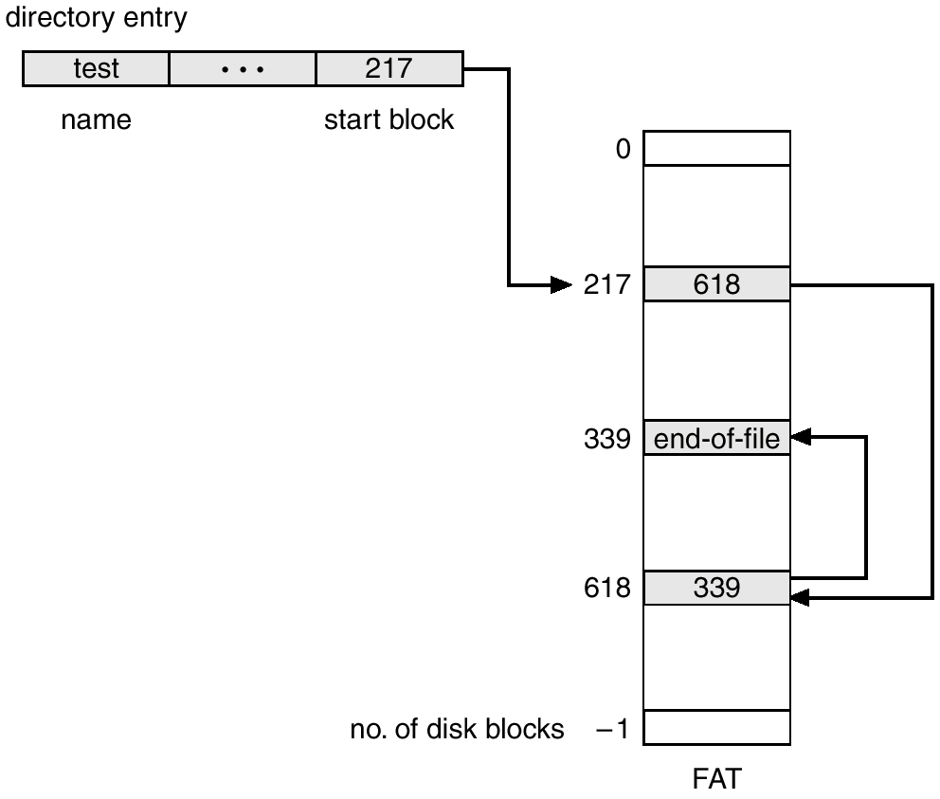
File allocation table (FAT)

Slide 50
FAT Pros and Cons
Improved random access
  just search a small table instead of the whole disk
Inefficient sequential access
  Seek back to the table and forth to the block for each file block!
Block allocation is easy
  just find the first 0 marked block

Slide 51
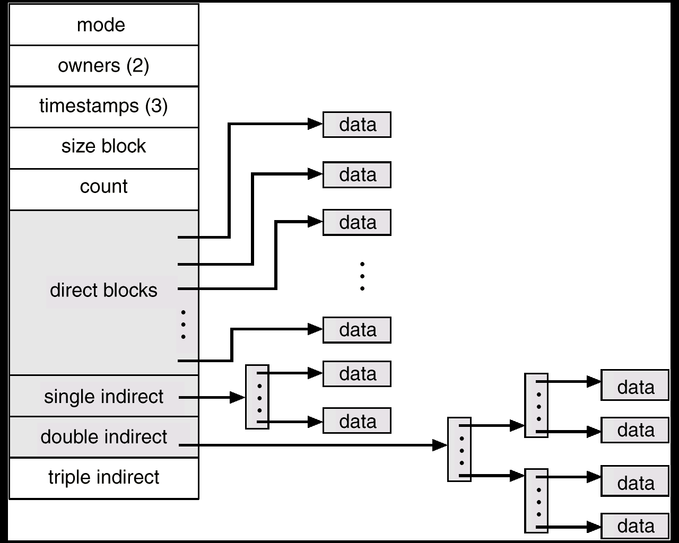
Unix - Indexed allocation

Slide 52
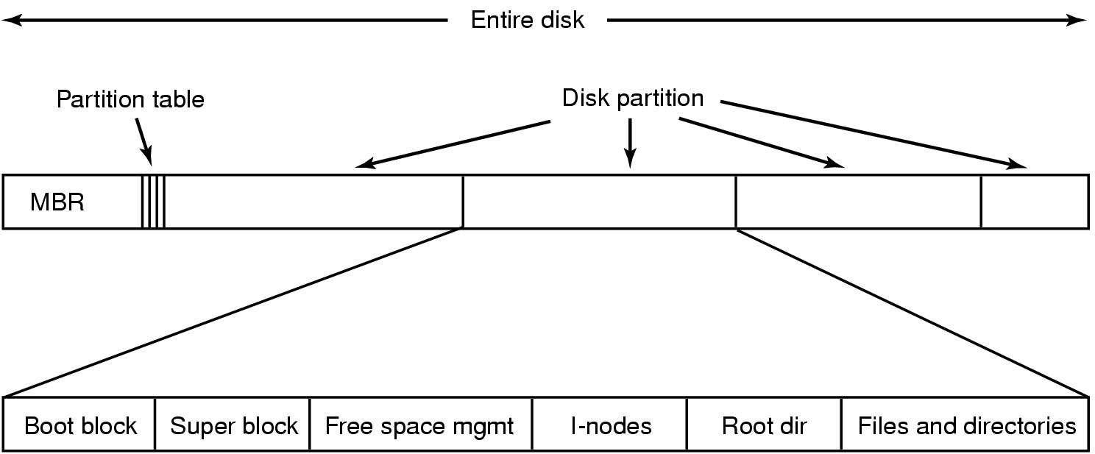
File System Implementation
A possible file system layout

Slide 53
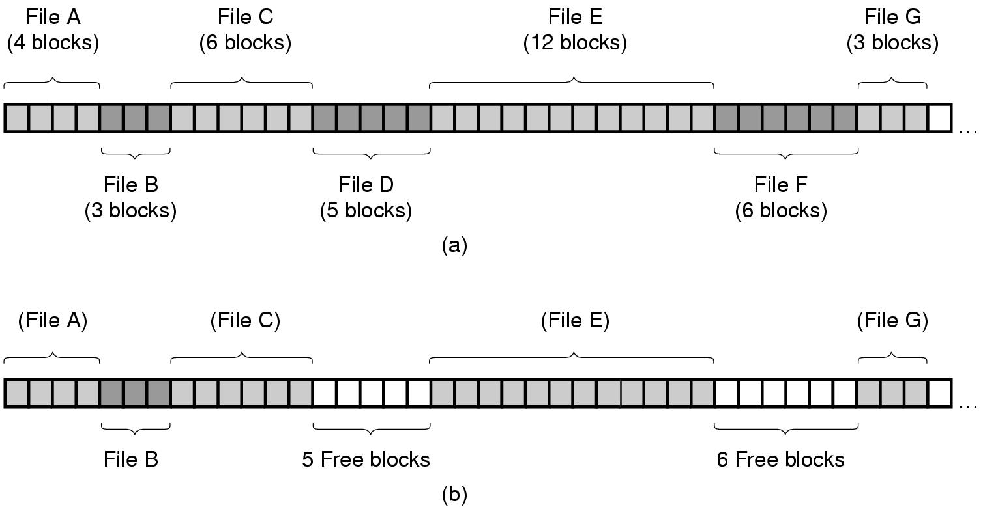
Implementing Files (1)
(a) Contiguous allocation of disk space for 7 files
(b) State of the disk after files D and E have been removed

Slide 54
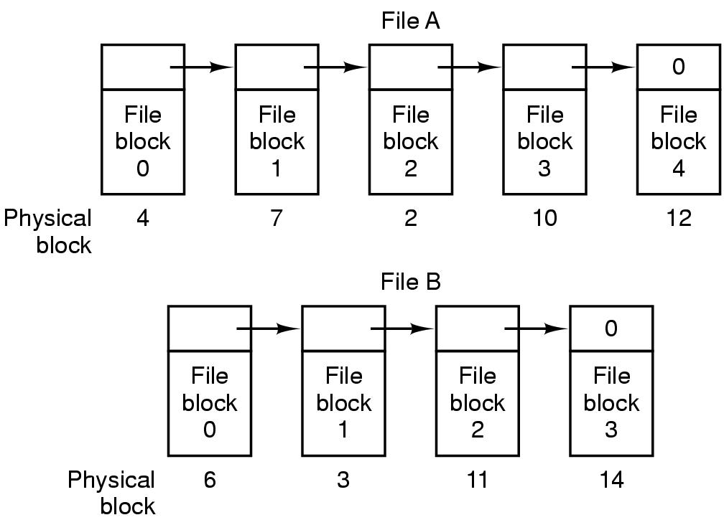
Implementing Files (2)
Storing a file as a linked list of disk blocks

Slide 55
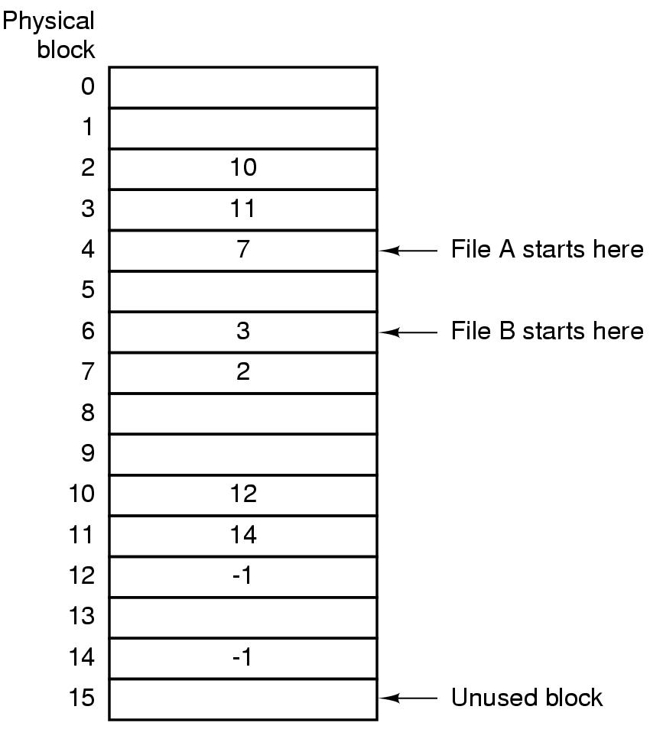
Implementing Files (3)
Linked list allocation using a file allocation table in RAM

Slide 56
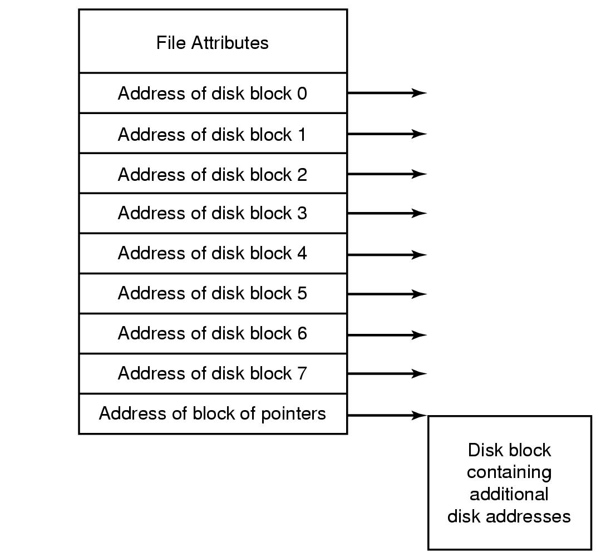
Implementing Files (4)
An example i-node

Slide 57
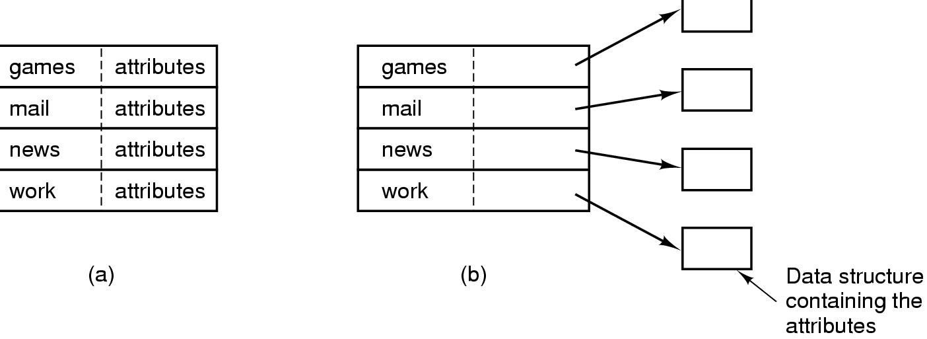
Implementing Directories (1)
(a) A simple directory
  fixed size entries
  disk addresses and attributes in directory entry
(b) Directory in which each entry just refers to an i-node

Slide 58
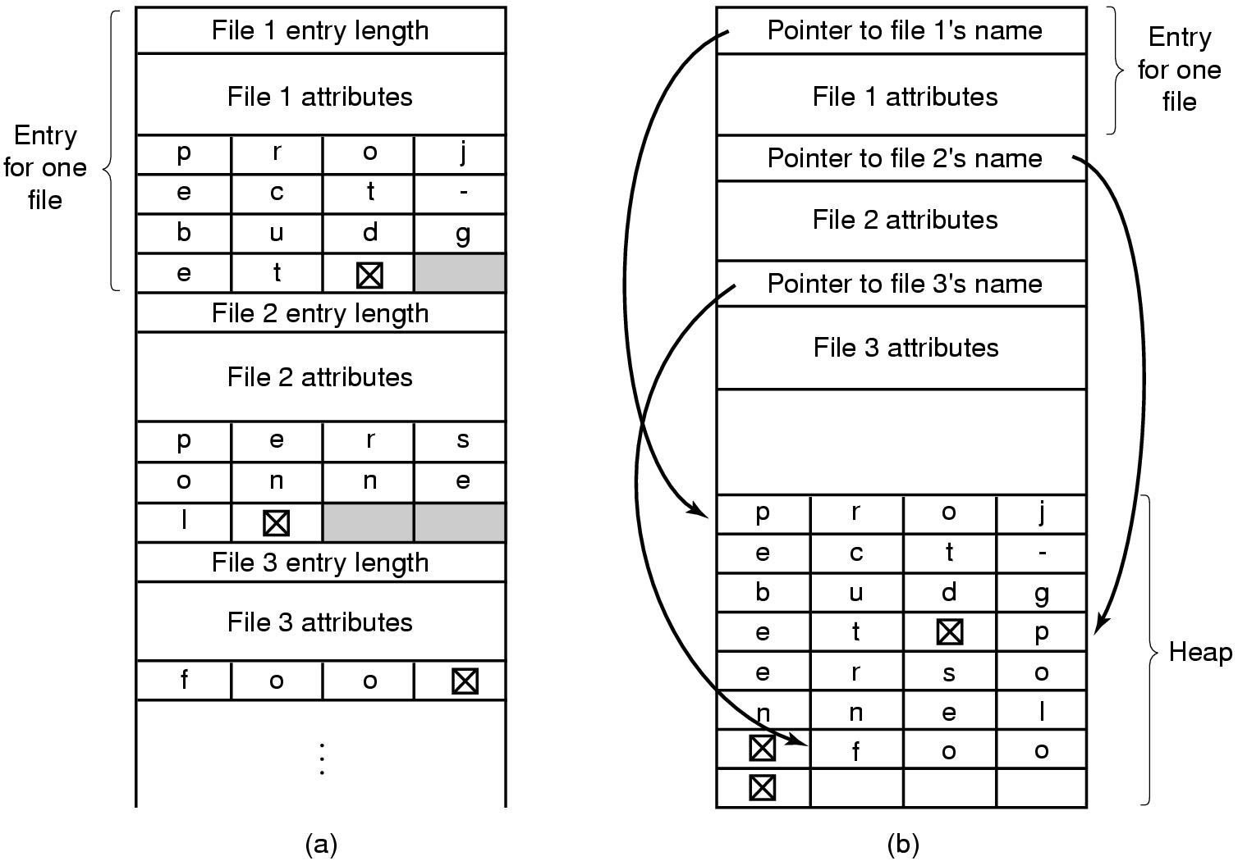
Implementing Directories (2)
Two ways of handling long file names in directory
  (a) In-line
  (b) In a heap

Slide 59
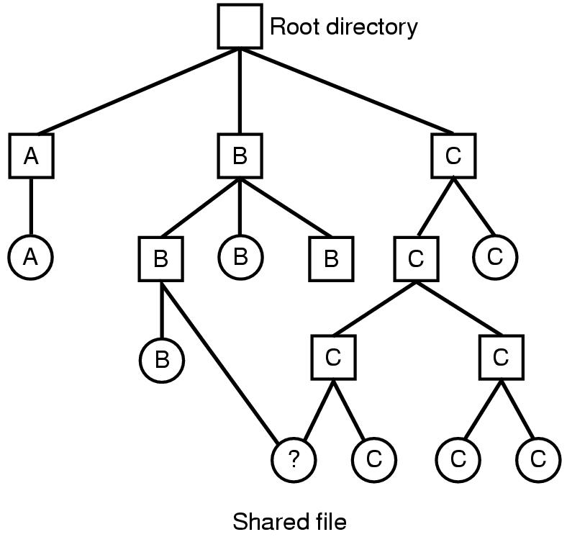
Shared Files (1)
File system containing a shared file

Slide 60
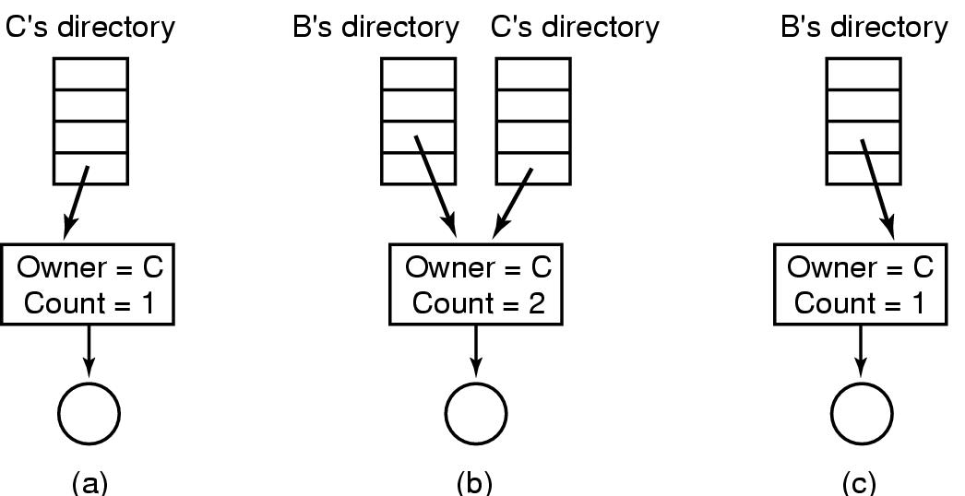
Shared Files (2)
(a) Situation prior to linking
(b) After the link is created
(c)After the original owner removes the file

Slide 61
Log-Structured File Systems
With CPUs faster, memory larger
  disk caches can also be larger
  increasing number of read requests can come from cache
  thus, most disk accesses will be writes
LFS Strategy structures entire disk as a log
  have all writes initially buffered in memory
  periodically write these to the end of the disk log
  when file opened, locate i-node, then find blocks

Slide 62
Journaling File Systems
Operations required to remove a file in UNIX:
Remove the file from its directory.
Release the i-node to the pool of free i-nodes.
Return all the disk blocks to the pool of free disk blocks.

Slide 63
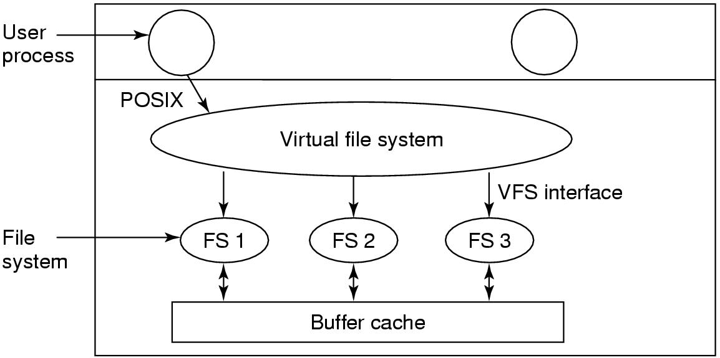
Virtual File Systems (1)
Position of the virtual file system.

Slide 64
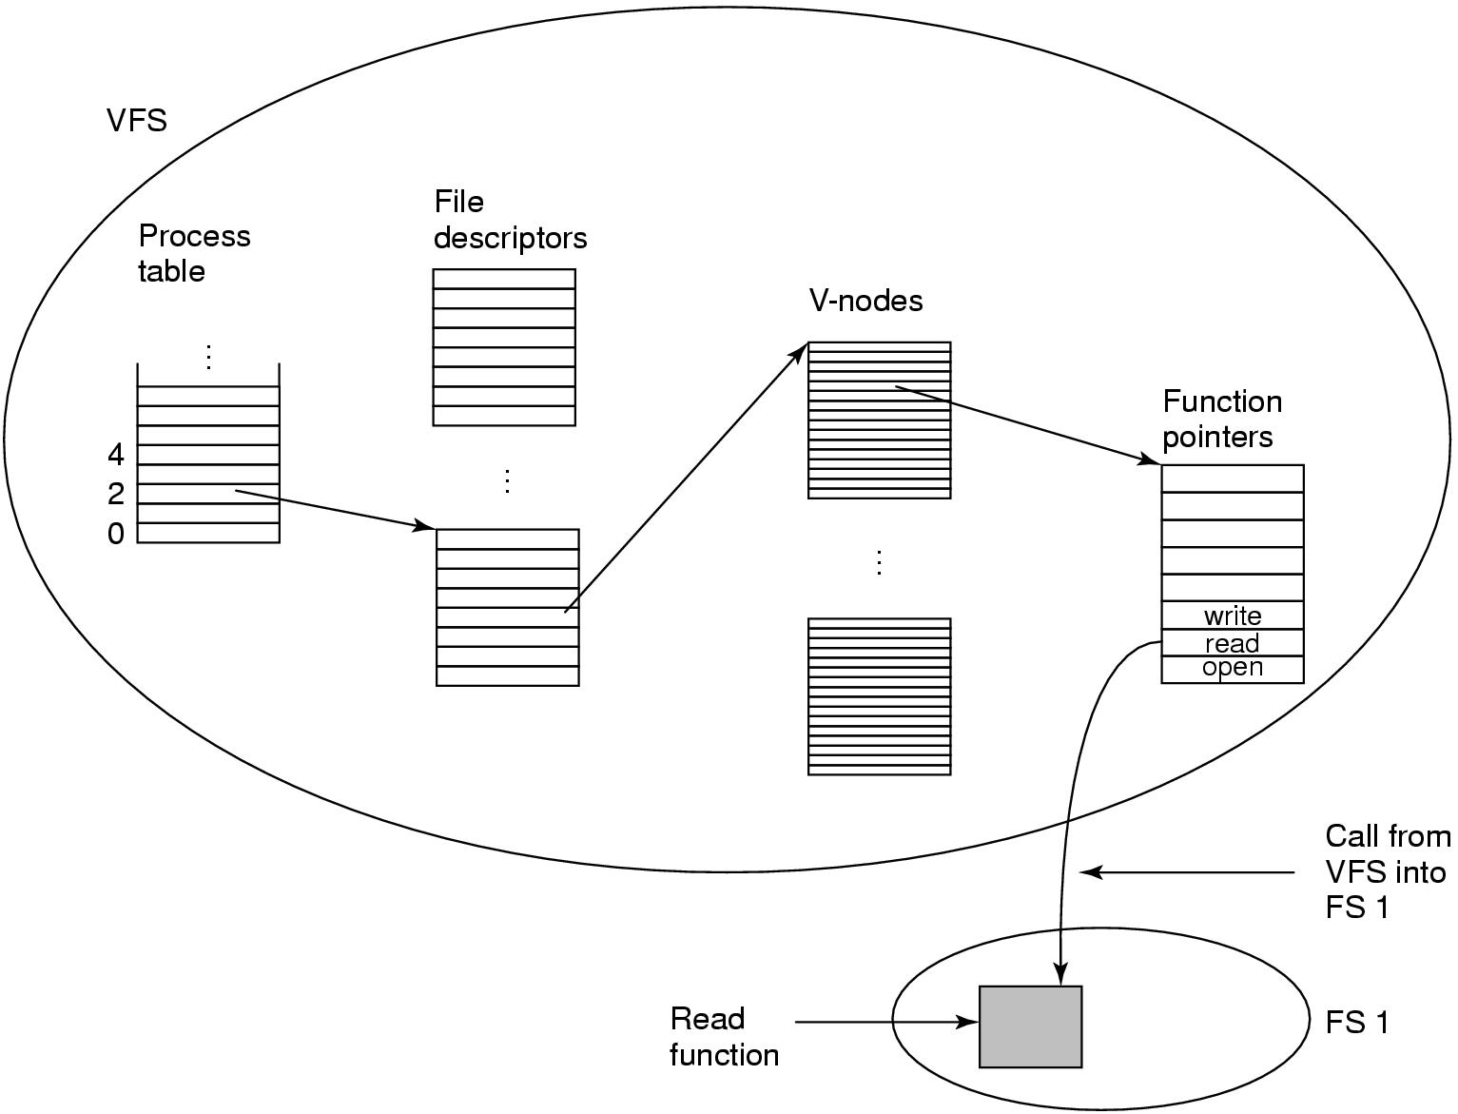
Virtual File Systems (2)
A simplified view of the data structures and code used by the VFS and concrete file system to do a read.

Slide 65
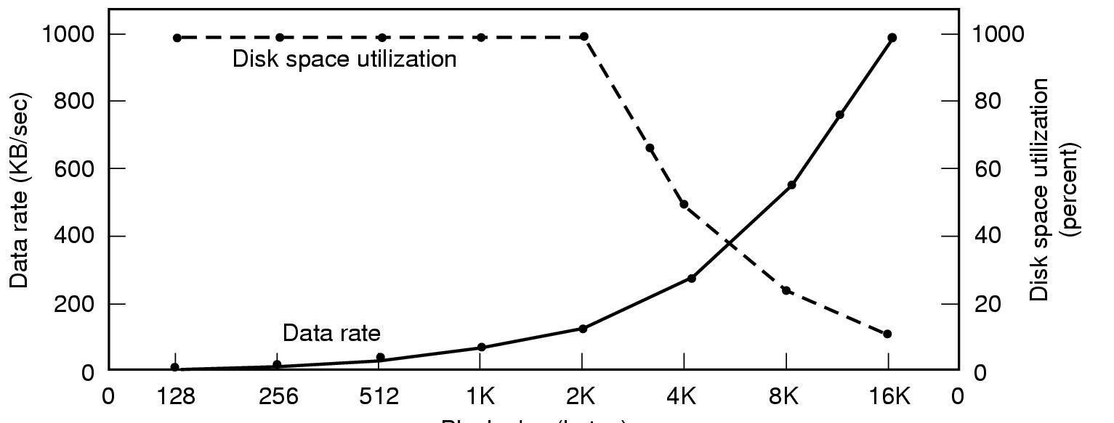
Disk Space Management (1)
Block size
Dark line (left hand scale) gives data rate of a disk
Dotted line (right hand scale) gives disk space efficiency
All files 2KB

Slide 66
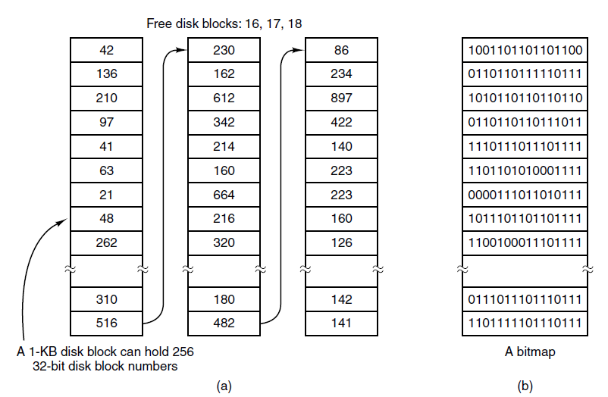
Disk Space Management (2)
(a) Storing the free list on a linked list
(b) A bit map

Slide 67
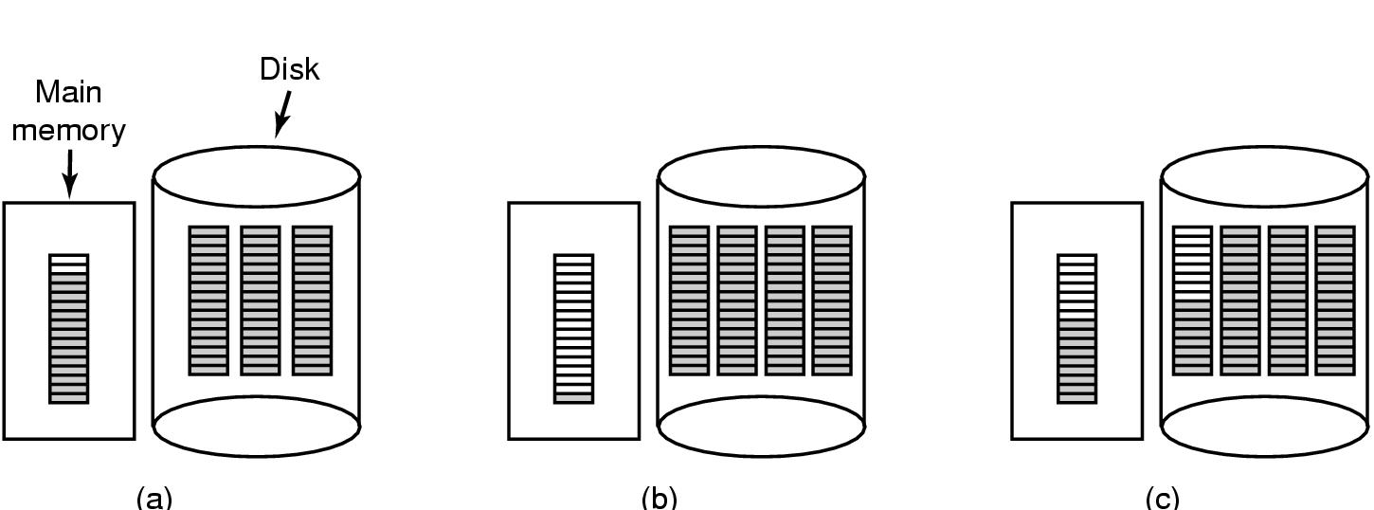
Disk Space Management (3)
(a) Almost-full block of pointers to free disk blocks in RAM
  - three blocks of pointers on disk
(b) Result of freeing a 3-block file
(c) Alternative strategy for handling 3 free blocks
  - shaded entries are pointers to free disk blocks

Slide 68
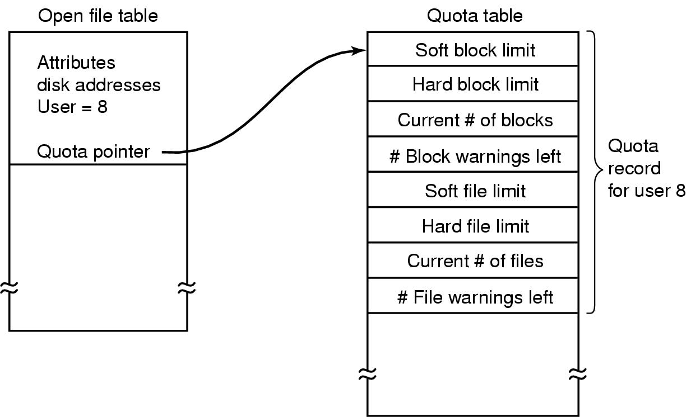
Disk Space Management (4)
Quotas for keeping track of each user’s disk use

Slide 69
Free space management
Disk bitmap: represent the disk block allocation as an array of bits
  Bit for each disk block: 1 - non-allocated block, 0 - allocated block
  Simple and efficient in finding free blocks
  Wastes space on disk
Linked list of free blocks (UNIX)
  Efficient for finding a single free block

Slide 70
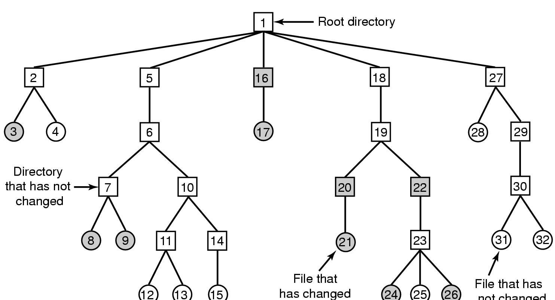
File System Reliability (1)
File that has
not changed
A file system to be dumped
  squares are directories, circles are files
  shaded items, modified since last dump
  each directory & file labeled by i-node number

Slide 71
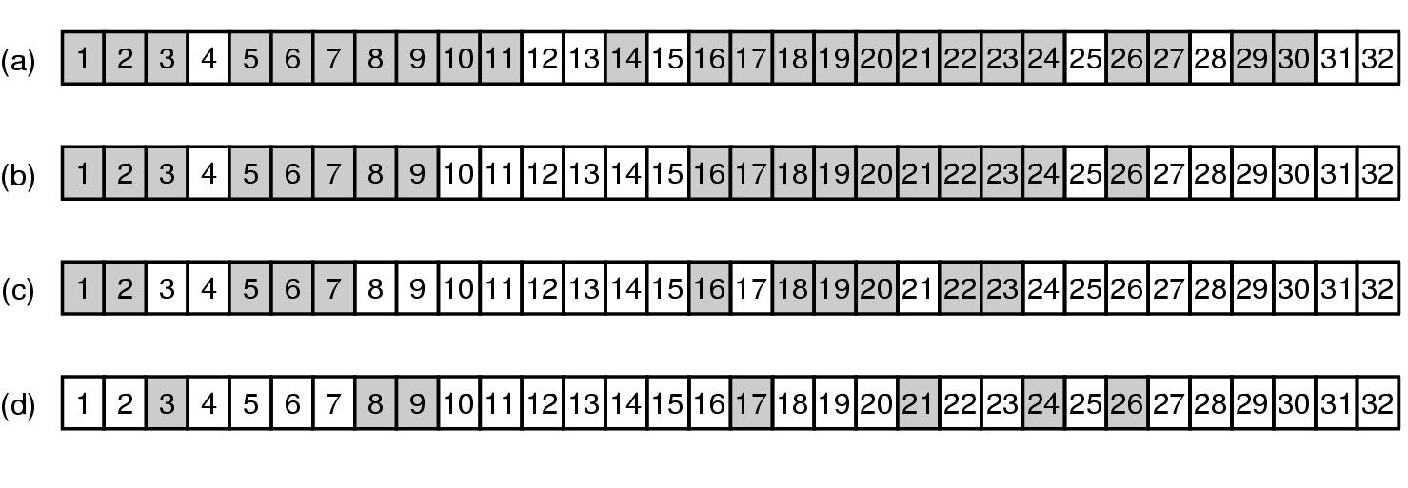
File System Reliability (2)
Bit maps used by the logical dumping algorithm

Slide 72
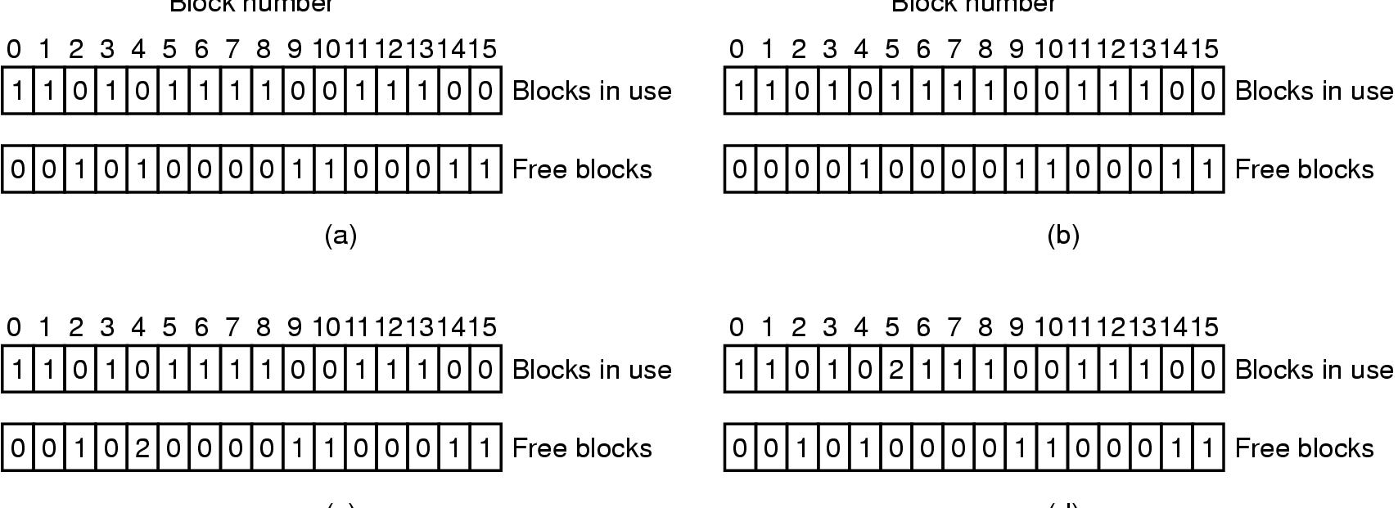
File System Reliability (3)
File system states
  (a) consistent
  (b) missing block
  (c) duplicate block in free list
  (d) duplicate data block

Slide 73
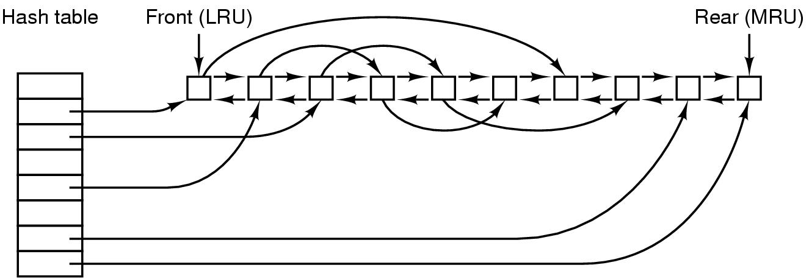
File System Performance (1)
The block cache data structures

Slide 74
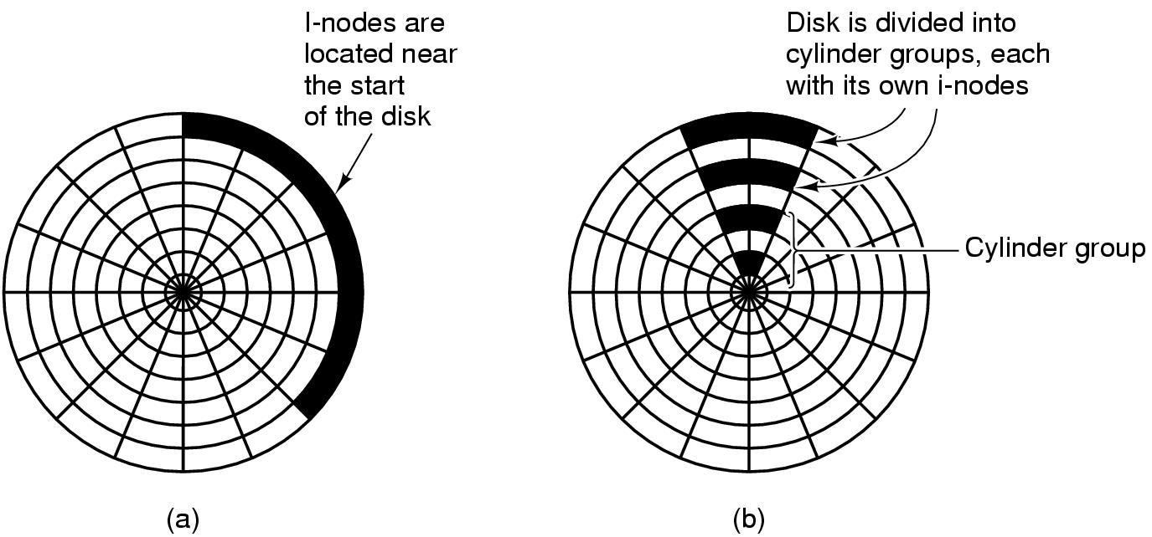
File System Performance (2)
I-nodes placed at the start of the disk
Disk divided into cylinder groups
  each with its own blocks and i-nodes

Slide 75
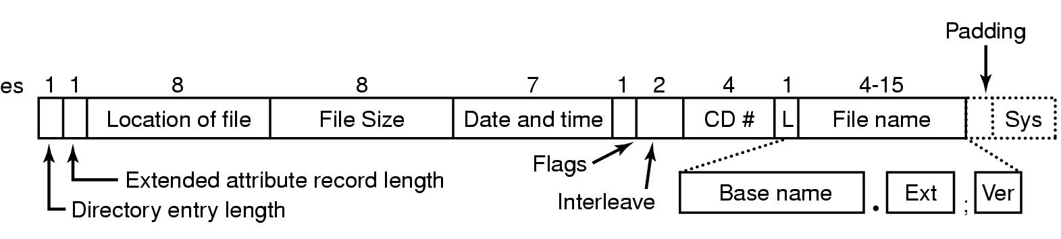
Example File Systems
CD-ROM File Systems
The ISO 9660 directory entry

Slide 76
Rock Ridge Extensions
Rock Ridge extension fields:
PX - POSIX attributes.
PN - Major and minor device numbers.
SL - Symbolic link.
NM - Alternative name.
CL - Child location.
PL - Parent location.
RE - Relocation.
TF - Time stamps.

Slide 77
Joliet Extensions
Joliet extension fields:
Long file names.
Unicode character set.
Directory nesting deeper than eight levels.
Directory names with extensions

Slide 78
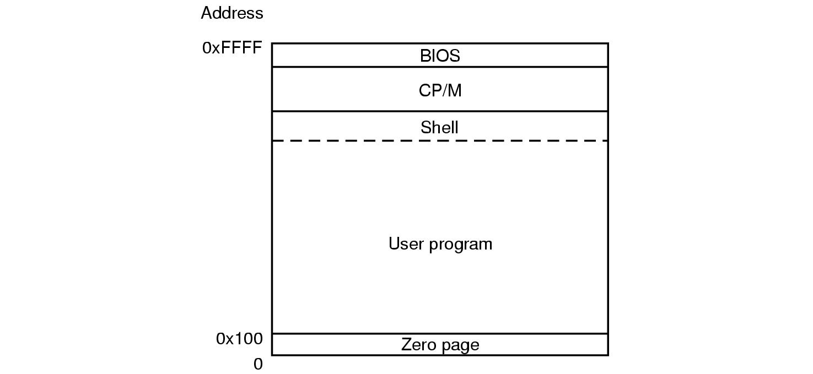
The CP/M File System (1)
Memory layout of CP/M

Slide 79
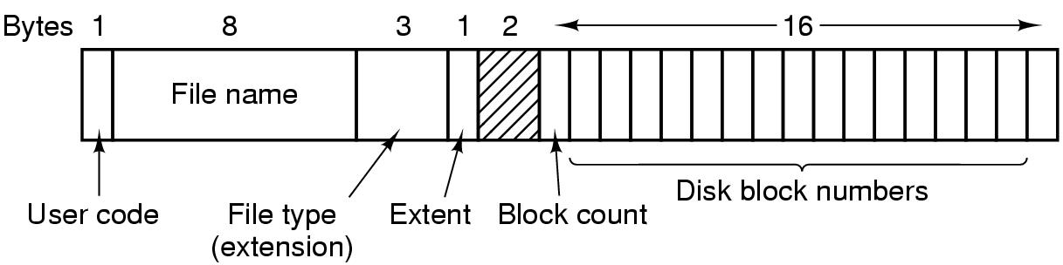
The CP/M File System (2)
The CP/M directory entry format

Slide 80
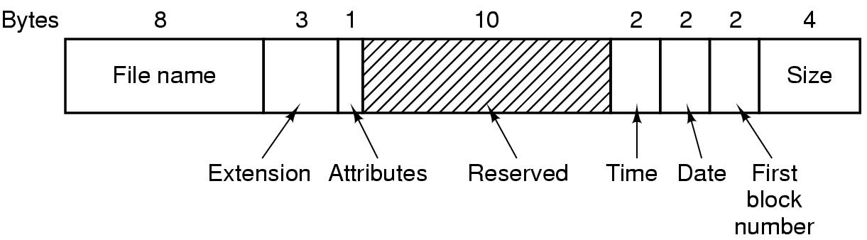
The MS-DOS File System (1)
The MS-DOS directory entry

Slide 81
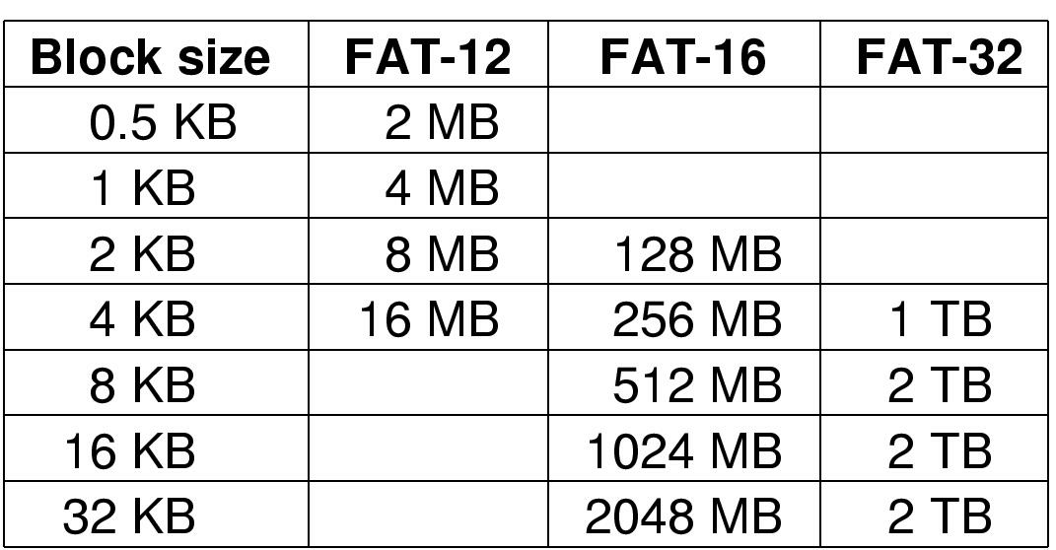
The MS-DOS File System (2)
Maximum partition for different block sizes
The empty boxes represent forbidden combinations

Slide 82
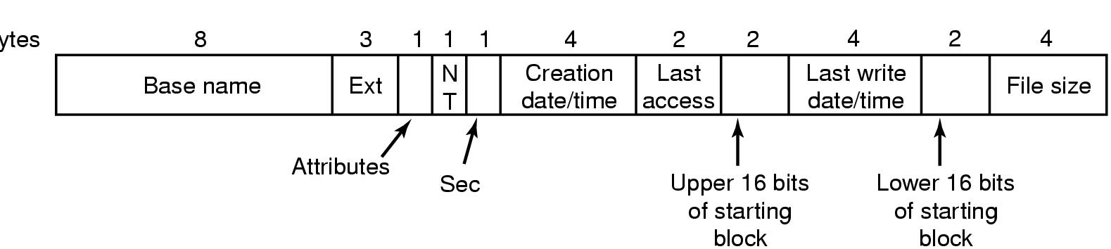
The Windows 98 File System (1)
Bytes
The extended MOS-DOS directory entry used in Windows 98

Slide 83
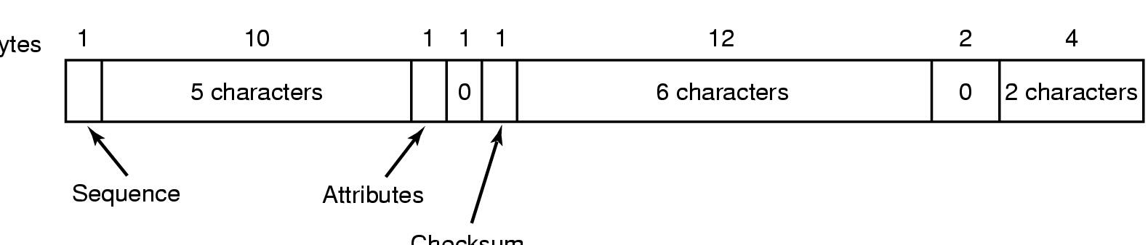
The Windows 98 File System (2)
Bytes
Checksum
An entry for (part of) a long file name in Windows 98

Slide 84
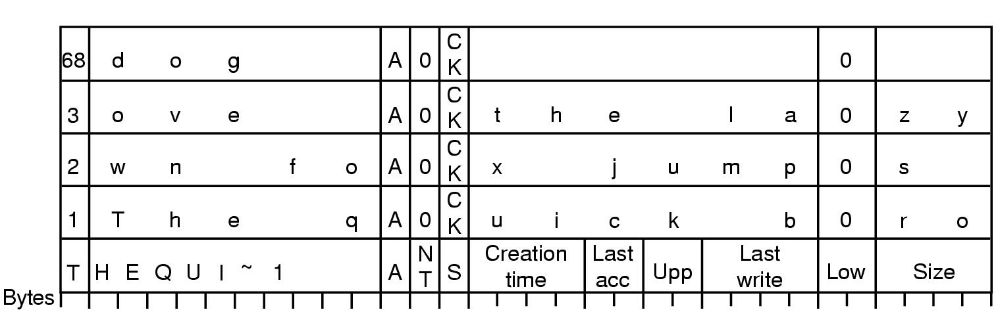
The Windows 98 File System (3)
An example of how a long name is stored in Windows 98

Slide 85
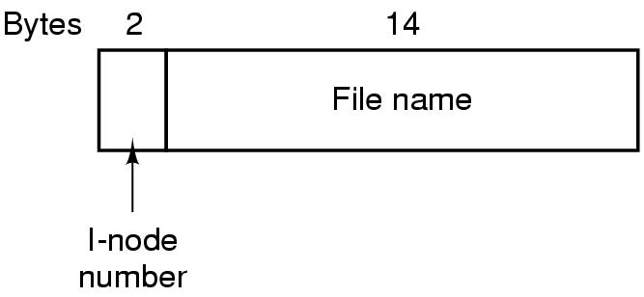
The UNIX V7 File System (1)
A UNIX V7 directory entry

Slide 86

The UNIX V7 File System (2)
A UNIX i-node

Slide 87

The UNIX V7 File System (3)
The steps in looking up /usr/ast/mbox

Slide 88
Log Structured File System
Ousterhout & Douglis (1992)
Caching is enough for good read performance
Writes is the real performance bottleneck
  writing-back cached user blocks may require many random disk accesses
  write-through for reliability denies optimizations
    logging solves the problem for metadata

Slide 89
Log Structured File System
The idea: everything is log
Each write - both data and control - is appended to the sequential log
The problem: how to locate files and data efficiently for random access by Reads
The solution: use a floating file map

Slide 90
Log structured file system
supermap
Before
supermap
After block change
supermap
After block addition

Slide 91
Summary
File structure
File management systems
File organization and access
  The pile
  The sequential file
  The indexed sequential file
  The indexed file
  The direct or hashed file
B-Trees
File directories
  Contents
  Structure
  Naming
File sharing
  Access rights
  Simultaneous access
Record blocking
Android file management
  File system
  SQLite
    Secondary storage management
      File allocation
      Free space management
      Volumes
      Reliability
    UNIX file management
      Inodes
      File allocation
      Directories
      Volume structure
    Linux virtual file system
      Superblock object
      Inode object
      Dentry object
      File object
      Caches
    Windows file system
      Key features of NTFS
      NTFS volume and file structure
      Recoverability
Notes:
Summary of Chapter 12.

Slide 92
Next Lecture
Input / Output

Slide 93
References
Andrew S. Tanenbaum, Herbert Bos, Modern Operating Systems 4th Global Edition, Pearson, 2015
William Stallings, Operating Systems: Internals and Design Principles, 9th Global Edition, Pearson, 2017

