Slide 1


CSE309 Computer Architecture and Organization
Lecture #5
Computers Systems: Input/Output
&
Operating System Support
Prepared & Presented by Asst. Prof. Dr. Samsun M. BAŞARICI

Slide 2
Part 1
Input/Output

Slide 3
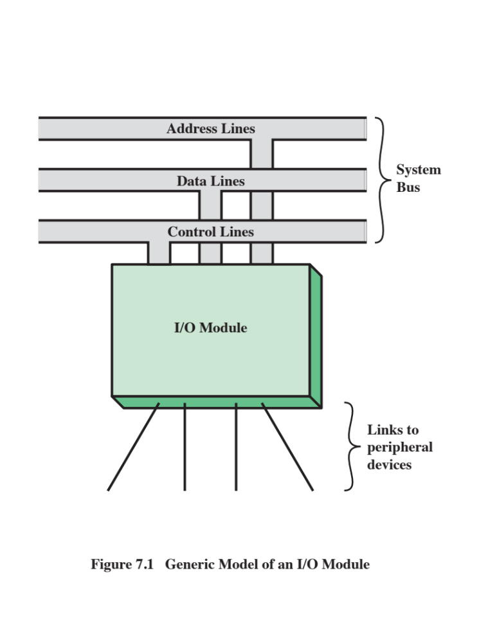
Notes:
Thus, an I/O module is required. This module has two major functions
(Figure 7.1):
• Interface to the processor and memory via the system bus or central switch
• Interface to one or more peripheral devices by tailored data links
We begin this chapter with a brief discussion of external devices, followed by
an overview of the structure and function of an I/O module. Then we look at the
various ways in which the I/O function can be performed in cooperation with the
processor and memory: the internal I/O interface. Finally, we examine the external
I/O interface, between the I/O module and the outside world.

Slide 4

External Devices
Three categories:
Human readable
  Suitable for communicating with the computer user
  Video display terminals (VDTs), printers
Machine readable
  Suitable for communicating with equipment
  Magnetic disk and tape systems, sensors and actuators
Communication
  Suitable for communicating with remote devices such as a terminal, a machine readable device, or another computer
Provide a means of exchanging data between the external environment and the computer
Attach to the computer by a link to an I/O module
  The link is used to exchange control, status, and data between the I/O module and the external device
Peripheral device
  An external device connected to an I/O module
Notes:
I/O operations are accomplished through a wide assortment of external devices
that provide a means of exchanging data between the external environment
and the computer. An external device attaches to the computer by a link to
an I/O module (Figure 7.1). The link is used to exchange control, status, and
data between the I/O module and the external device. An external device connected
to an I/O module is often referred to as a peripheral device or, simply, a
peripheral.
We can broadly classify external devices into three categories:
• Human readable: Suitable for communicating with the computer user
• Machine readable: Suitable for communicating with equipment
• Communication: Suitable for communicating with remote devices
Examples of human-readable devices are video display terminals (VDTs) and
printers. Examples of machine-readable devices are magnetic disk and tape systems,
and sensors and actuators, such as are used in a robotics application. Note
that we are viewing disk and tape systems as I/O devices in this chapter, whereas
in Chapter 6 we viewed them as memory devices. From a functional point of view,
these devices are part of the memory hierarchy, and their use is appropriately discussed
in Chapter 6. From a structural point of view, these devices are controlled by
I/O modules and are hence to be considered in this chapter.
Communication devices allow a computer to exchange data with a remote
device, which may be a human-readable device, such as a terminal, a machine readable
device, or even another computer.

Slide 5
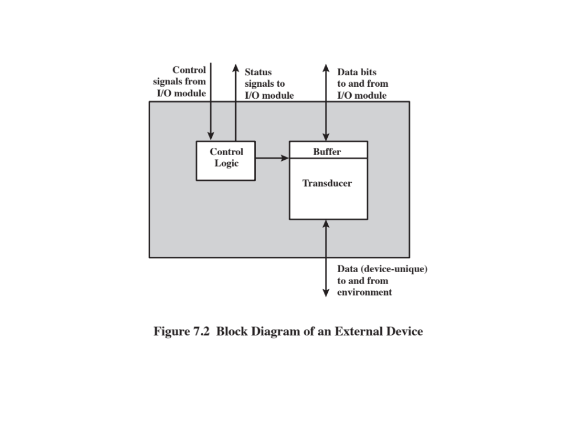
Notes:
In very general terms, the nature of an external device is indicated in
Figure 7.2. The interface to the I/O module is in the form of control, data, and status
signals. Control signals determine the function that the device will perform, such as
send data to the I/O module (INPUT or READ), accept data from the I/O module
(OUTPUT or WRITE), report status, or perform some control function particular
to the device (e.g., position a disk head). Data are in the form of a set of bits to
be sent to or received from the I/O module. Status signals indicate the state of the
device. Examples are READY/NOT-READY to show whether the device is ready
for data transfer.
Control logic associated with the device controls the device’s operation in
response to direction from the I/O module. The transducer converts data from electrical
to other forms of energy during output and from other forms to electrical
during input. Typically, a buffer is associated with the transducer to temporarily
hold data being transferred between the I/O module and the external environment.
A buffer size of 8 to 16 bits is common for serial devices, whereas block-
oriented devices such as disk drive controllers may have much larger buffers.
The interface between the I/O module and the external device will be examined
in Section 7.7. The interface between the external device and the environment
is beyond the scope of this book, but several brief examples are given here.
A disk drive contains electronics for exchanging data, control, and status signals with
an I/O module plus the electronics for controlling the disk read/write mechanism.
In a fixed-head disk, the transducer is capable of converting between the magnetic
patterns on the moving disk surface and bits in the device’s buffer (Figure 7.2). A
Moving-head disk must also be able to cause the disk arm to move radially in and
out across the disk’s surface.

Slide 6
Keyboard/Monitor
Most common means of computer/user interaction
User provides input through the keyboard
The monitor displays data provided by the computer
International Reference Alphabet (IRA)
Basic unit of exchange is the character
  Associated with each character is a code
  Each character in this code is represented by a unique 7-bit binary code
    128 different characters can be represented
Characters are of two types:
  Printable
    Alphabetic, numeric, and special characters that can be printed on paper or displayed on a screen
  Control
    Have to do with controlling the printing or displaying of characters
    Example is carriage return
    Other control characters are concerned with communications procedures
Keyboard Codes
When the user depresses a key it generates an electronic signal that is interpreted by the transducer in the keyboard and translated into the bit pattern of the corresponding IRA code
This bit pattern is transmitted to the I/O module in the computer
On output, IRA code characters are transmitted to an external device from the I/O module
The transducer interprets the code and sends the required electronic signals to the output device either to display the indicated character or perform the requested control function
Notes:
The most common means of computer/user interaction is a keyboard/monitor
arrangement. The user provides input through the keyboard. This input is then
transmitted to the computer and may also be displayed on the monitor. In addition,
the monitor displays data provided by the computer.
The basic unit of exchange is the character. Associated with each character
is a code, typically 7 or 8 bits in length. The most commonly used text code is the
International Reference Alphabet (IRA). Each character in this code is represented
by a unique 7-bit binary code; thus, 128 different characters can be represented.
Characters are of two types: printable and control. Printable characters are
the alphabetic, numeric, and special characters that can be printed on paper or displayed
on a screen. Some of the control characters have to do with controlling the
printing or displaying of characters; an example is carriage return. Other control
characters are concerned with communications procedures. See Appendix H for
details.
For keyboard input, when the user depresses a key, this generates an
electronic signal that is interpreted by the transducer in the keyboard and
translated into the bit pattern of the corresponding IRA code. This bit pattern
is then transmitted to the I/O module in the computer. At the computer, the
text can be stored in the same IRA code. On output, IRA code characters are
transmitted to an external device from the I/O module. The transducer at the
device interprets this code and sends the required electronic signals to the output
device either to display the indicated character or perform the requested
control function.

Slide 7
The major functions for an I/O module fall into the following categories:
Control and timing
Coordinates the flow of traffic between internal resources and external devices
Processor communication
Involves command decoding, data, status reporting, address recognition
Device communication
Involves commands, status information, and data
Data buffering
Performs the needed buffering operation to balance device and memory speeds
Error detection
Detects and reports transmission errors
Notes:
The major functions or requirements for an I/O module fall into the following
categories:
• Control and timing
• Processor communication
• Device communication
• Data buffering
• Error detection
During any period of time, the processor may communicate with one or more
external devices in unpredictable patterns, depending on the program’s need for I/O.
The internal resources, such as main memory and the system bus, must be shared
among a number of activities, including data I/O. Thus, the I/O function includes a
control and timing requirement, to coordinate the flow of traffic between internal
resources and external devices. For example, the control of the transfer of data from
an external device to the processor might involve the following sequence of steps:
1. The processor interrogates the I/O module to check the status of the attached
device.
2. The I/O module returns the device status.
3. If the device is operational and ready to transmit, the processor requests the
transfer of data, by means of a command to the I/O module.
4. The I/O module obtains a unit of data (e.g., 8 or 16 bits) from the external device.
5. The data are transferred from the I/O module to the processor.
If the system employs a bus, then each of the interactions between the processor
and the I/O module involves one or more bus arbitrations.
The preceding simplified scenario also illustrates that the I/O module must
communicate with the processor and with the external device. Processor communication
involves the following:
• Command decoding: The I/O module accepts commands from the processor,
typically sent as signals on the control bus. For example, an I/O module for a
disk drive might accept the following commands: READ SECTOR, WRITE
SECTOR, SEEK track number, and SCAN record ID. The latter two commands
each include a parameter that is sent on the data bus.
• Data: Data are exchanged between the processor and the I/O module over the
data bus.
• Status reporting: Because peripherals are so slow, it is important to know the
status of the I/O module. For example, if an I/O module is asked to send data
to the processor (read), it may not be ready to do so because it is still working
on the previous I/O command. This fact can be reported with a status signal.
Common status signals are BUSY and READY. There may also be signals to
report various error conditions.
• Address recognition: Just as each word of memory has an address, so does
each I/O device. Thus, an I/O module must recognize one unique address for
each peripheral it controls.
On the other side, the I/O module must be able to perform device communication.
This communication involves commands, status information, and data
(Figure 7.2).
An essential task of an I/O module is data buffering. The need for this function
is apparent from Figure 2.1. Whereas the transfer rate into and out of main
memory or the processor is quite high, the rate is orders of magnitude lower for
many peripheral devices and covers a wide range. Data coming from main memory
are sent to an I/O module in a rapid burst. The data are buffered in the I/O module
and then sent to the peripheral device at its data rate. In the opposite direction, data
are buffered so as not to tie up the memory in a slow transfer operation. Thus, the
I/O module must be able to operate at both device and memory speeds. Similarly, if
the I/O device operates at a rate higher than the memory access rate, then the I/O
module performs the needed buffering operation.
Finally, an I/O module is often responsible for error detection and for subsequently
reporting errors to the processor. One class of errors includes mechanical
and electrical malfunctions reported by the device (e.g., paper jam, bad disk track).
Another class consists of unintentional changes to the bit pattern as it is transmitted
from device to I/O module. Some form of error-detecting code is often used
to detect transmission errors. A simple example is the use of a parity bit on each
character of data. For example, the IRA character code occupies 7 bits of a byte.
The eighth bit is set so that the total number of 1s in the byte is even (even parity)
or odd (odd parity). When a byte is received, the I/O module checks the parity to
determine whether an error has occurred.

Slide 8
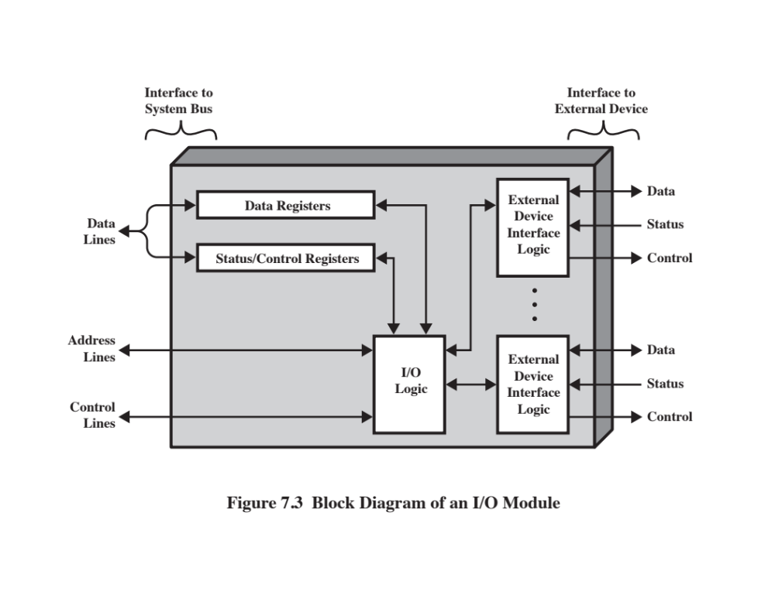
Notes:
I/O modules vary considerably in complexity and the number of external devices
that they control. We will attempt only a very general description here. (One specific
device, the Intel 82C55A, is described in Section 7.4.) Figure 7.3 provides a general
block diagram of an I/O module. The module connects to the rest of the computer
through a set of signal lines (e.g., system bus lines). Data transferred to and from the
module are buffered in one or more data registers. There may also be one or more
status registers that provide current status information. A status register may also
function as a control register, to accept detailed control information from the processor.
The logic within the module interacts with the processor via a set of control
lines. The processor uses the control lines to issue commands to the I/O module.
Some of the control lines may be used by the I/O module (e.g., for arbitration and
status signals). The module must also be able to recognize and generate addresses
associated with the devices it controls. Each I/O module has a unique address or, if
it controls more than one external device, a unique set of addresses. Finally, the I/O
module contains logic specific to the interface with each device that it controls.
An I/O module functions to allow the processor to view a wide range of devices
in a simple-minded way. There is a spectrum of capabilities that may be provided.
The I/O module may hide the details of timing, formats, and the electromechanics
of an external device so that the processor can function in terms of simple read and
write commands, and possibly open and close file commands. In its simplest form,
the I/O module may still leave much of the work of controlling a device (e.g., rewind
a tape) visible to the processor.
An I/O module that takes on most of the detailed processing burden, presenting
a high-level interface to the processor, is usually referred to as an I/O channel or
I/O processor. An I/O module that is quite primitive and requires detailed control
is usually referred to as an I/O controller or device controller. I/O controllers are
commonly seen on microcomputers, whereas I/O channels are used on mainframes.
In what follows, we will use the generic term I/O module when no confusion
results and will use more specific terms where necessary.

Slide 9
Programmed I/O
Three techniques are possible for I/O operations:
Programmed I/O
  Data are exchanged between the processor and the I/O module
  Processor executes a program that gives it direct control of the I/O operation
  When the processor issues a command it must wait until the I/O operation is complete
  If the processor is faster than the I/O module this is wasteful of processor time
  Interrupt-driven I/O
  Processor issues an I/O command, continues to execute other instructions, and is interrupted by the I/O module when the latter has completed its work
  Direct memory access (DMA)
  The I/O module and main memory exchange data directly without processor involvement
Notes:
Three techniques are possible for I/O operations. With programmed I/O, data are
exchanged between the processor and the I/O module. The processor executes a program
that gives it direct control of the I/O operation, including sensing device status,
sending a read or write command, and transferring the data. When the processor
issues a command to the I/O module, it must wait until the I/O operation is complete.
If the processor is faster than the I/O module, this is wasteful of processor time.
With interrupt-driven I/O, the processor issues an I/O command, continues to execute
other instructions, and is interrupted by the I/O module when the latter has completed
its work. With both programmed and interrupt I/O, the processor is responsible for
extracting data from main memory for output and storing data in main memory for
input. The alternative is known as direct memory access (DMA). In this mode, the I/O
module and main memory exchange data directly, without processor involvement.

Slide 10
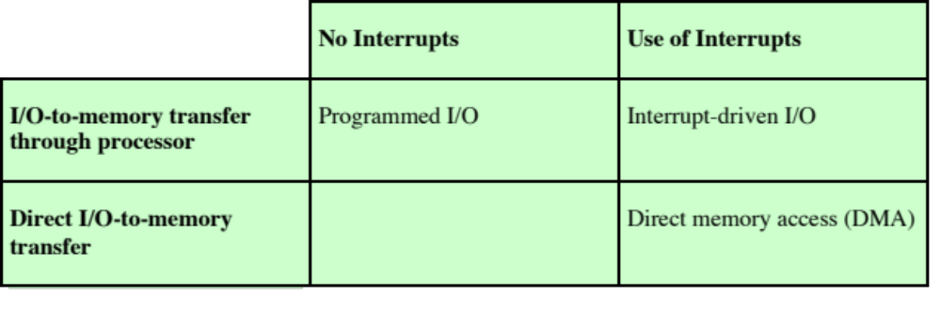
I/O Techniques
Notes:
Table 7.1 indicates the relationship among these three techniques. In this section,
we explore programmed I/O. Interrupt I/O and DMA are explored in the following
two sections, respectively.

Slide 11
I/O Commands
There are four types of I/O commands that an I/O module may receive when it is addressed by a processor:
Control
  - used to activate a peripheral and tell it what to do
Test
  - used to test various status conditions associated with an I/O module and its peripherals
Read
  - causes the I/O module to obtain an item of data from the peripheral and place it in an internal buffer
Write
  - causes the I/O module to take an item of data from the data bus and subsequently transmit that data item to the peripheral
Notes:
To execute an I/O-related instruction, the processor issues an address, specifying the
particular I/O module and external device, and an I/O command. There are four types
of I/O commands that an I/O module may receive when it is addressed by a processor:
• Control: Used to activate a peripheral and tell it what to do. For example, a
magnetic-tape unit may be instructed to rewind or to move forward one record.
These commands are tailored to the particular type of peripheral device.
• Test: Used to test various status conditions associated with an I/O module and
its peripherals. The processor will want to know that the peripheral of interest
is powered on and available for use. It will also want to know if the most
recent I/O operation is completed and if any errors occurred.
• Read: Causes the I/O module to obtain an item of data from the peripheral
and place it in an internal buffer (depicted as a data register in Figure 7.3). The
processor can then obtain the data item by requesting that the I/O module
place it on the data bus.
• Write: Causes the I/O module to take an item of data (byte or word) from the
data bus and subsequently transmit that data item to the peripheral.

Slide 12
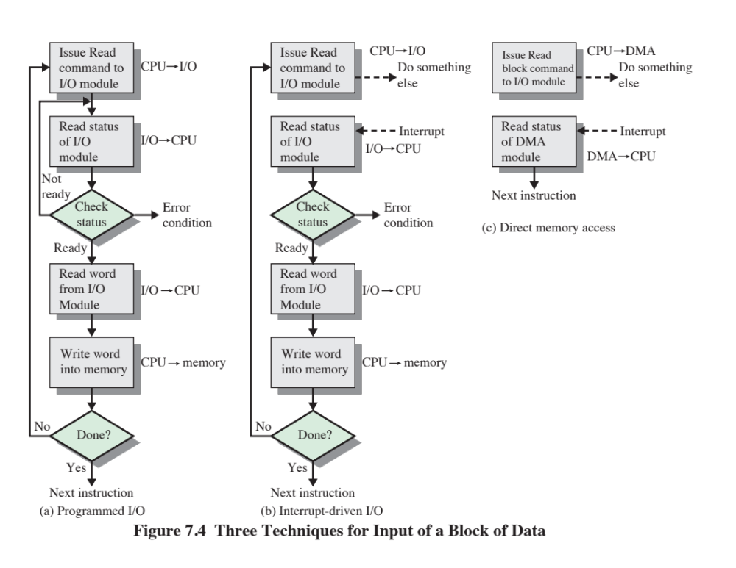
Notes:
Figure 7.4a gives an example of the use of programmed I/O to read in a block of
data from a peripheral device (e.g., a record from tape) into memory. Data are read
in one word (e.g., 16 bits) at a time. For each word that is read in, the processor must
remain in a status-checking cycle until it determines that the word is available in the
I/O module’s data register. This flowchart highlights the main disadvantage of this
technique: it is a time-consuming process that keeps the processor busy needlessly.

Slide 13
I/O Instructions
With programmed I/O there is a close correspondence between the I/O-related instructions that the processor fetches from memory and the I/O commands that the processor issues to an I/O module to execute the instructions
The form of the instruction depends on the way in which external devices are addressed
Each I/O device connected through I/O modules is given a unique identifier or address
When the processor issues an I/O command, the command contains the address of the desired device
Thus each I/O module must interpret the address lines to determine if the command is for itself
Memory-mapped I/O
There is a single address space for memory locations and I/O devices
A single read line and a single write line are needed on the bus
Notes:
With programmed I/O, there is a close correspondence between the I/O-related
instructions that the processor fetches from memory and the I/O commands that the
processor issues to an I/O module to execute the instructions. That is, the instructions
are easily mapped into I/O commands, and there is often a simple one-
to-one relationship. The form of the instruction depends on the way in which external
devices are addressed.
Typically, there will be many I/O devices connected through I/O modules to
the system. Each device is given a unique identifier or address. When the processor
issues an I/O command, the command contains the address of the desired device.
Thus, each I/O module must interpret the address lines to determine if the command
is for itself.
When the processor, main memory, and I/O share a common bus, two modes
of addressing are possible: memory mapped and isolated. With memory-mapped
I/O, there is a single address space for memory locations and I/O devices. The processor
treats the status and data registers of I/O modules as memory locations and
uses the same machine instructions to access both memory and I/O devices. So, for
example, with 10 address lines, a combined total of 2¹⁰ = 1024 memory locations
and I/O addresses can be supported, in any combination.
With memory-mapped I/O, a single read line and a single write line are needed
on the bus. Alternatively, the bus may be equipped with memory read and write
plus input and output command lines. Now, the command line specifies whether the
address refers to a memory location or an I/O device. The full range of addresses
may be available for both. Again, with 10 address lines, the system may now support
both 1024 memory locations and 1024 I/O addresses. Because the address space for
I/O is isolated from that for memory, this is referred to as isolated I/O.

Slide 14

I/O Mapping Summary
Memory mapped I/O
  Devices and memory share an address space
  I/O looks just like memory read/write
  No special commands for I/O
    Large selection of memory access commands available
Isolated I/O
  Separate address spaces
  Need I/O or memory select lines
  Special commands for I/O
    Limited set
Notes:
I/O mapping summary.

Slide 15
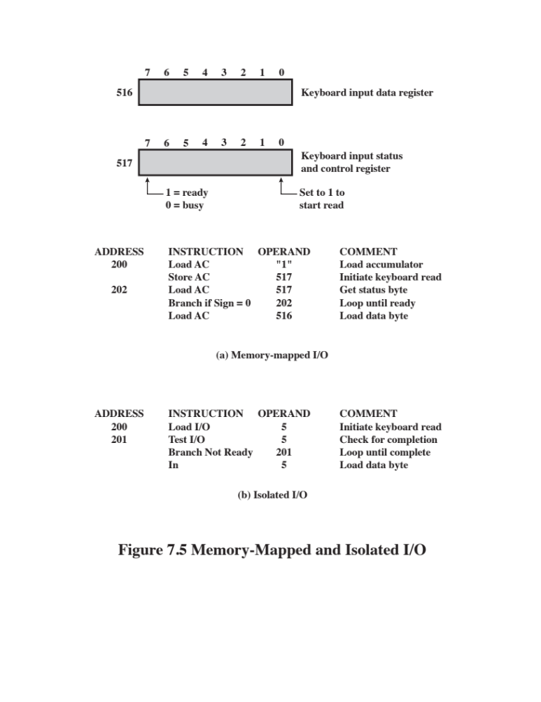
Notes:
Figure 7.5 contrasts these two programmed I/O techniques. Figure 7.5a shows
how the interface for a simple input device such as a terminal keyboard might appear
to a programmer using memory-mapped I/O. Assume a 10-bit address, with a 512-
bit memory (locations 0–511) and up to 512 I/O addresses (locations 512–1023).
Two addresses are dedicated to keyboard input from a particular terminal. Address
516 refers to the data register and address 517 refers to the status register, which
also functions as a control register for receiving processor commands. The program
shown will read 1 byte of data from the keyboard into an accumulator register in the
processor. Note that the processor loops until the data byte is available.
With isolated I/O (Figure 7.5b), the I/O ports are accessible only by special
I/O commands, which activate the I/O command lines on the bus.
For most types of processors, there is a relatively large set of different instructions
for referencing memory. If isolated I/O is used, there are only a few I/O
instructions. Thus, an advantage of memory-mapped I/O is that this large repertoire
of instructions can be used, allowing more efficient programming. A disadvantage is
that valuable memory address space is used up. Both memory-mapped and isolated
I/O are in common use.

Slide 16
Interrupt-Driven I/O
The problem with programmed I/O is that the processor has to wait a long time for the I/O module to be ready for either reception or transmission of data
An alternative is for the processor to issue an I/O command to a module and then go on to do some other useful work
The I/O module will then interrupt the processor to request service when it is ready to exchange data with the processor
The processor executes the data transfer and resumes its former processing
Notes:
The problem with programmed I/O is that the processor has to wait a long time
for the I/O module of concern to be ready for either reception or transmission of
data. The processor, while waiting, must repeatedly interrogate the status of the I/O
module. As a result, the level of the performance of the entire system is severely
degraded.
An alternative is for the processor to issue an I/O command to a module and
then go on to do some other useful work. The I/O module will then interrupt the
processor to request service when it is ready to exchange data with the processor.
The processor then executes the data transfer, as before, and then resumes its
former processing.
Let us consider how this works, first from the point of view of the I/O module.
For input, the I/O module receives a READ command from the processor. The I/O
module then proceeds to read data in from an associated peripheral. Once the data
are in the module’s data register, the module signals an interrupt to the processor
over a control line. The module then waits until its data are requested by the processor.
When the request is made, the module places its data on the data bus and is
then ready for another I/O operation.
From the processor’s point of view, the action for input is as follows. The processor
issues a READ command. It then goes off and does something else (e.g., the
processor may be working on several different programs at the same time). At the
end of each instruction cycle, the processor checks for interrupts (Figure 3.9). When
the interrupt from the I/O module occurs, the processor saves the context (e.g., program
counter and processor registers) of the current program and processes the
interrupt. In this case, the processor reads the word of data from the I/O module
and stores it in memory. It then restores the context of the program it was working
on (or some other program) and resumes execution.
Figure 7.4b shows the use of interrupt I/O for reading in a block of data.
Compare this with Figure 7.4a. Interrupt I/O is more efficient than programmed I/O
because it eliminates needless waiting. However, interrupt I/O still consumes a lot of
processor time, because every word of data that goes from memory to I/O module
or from I/O module to memory must pass through the processor.

Slide 17
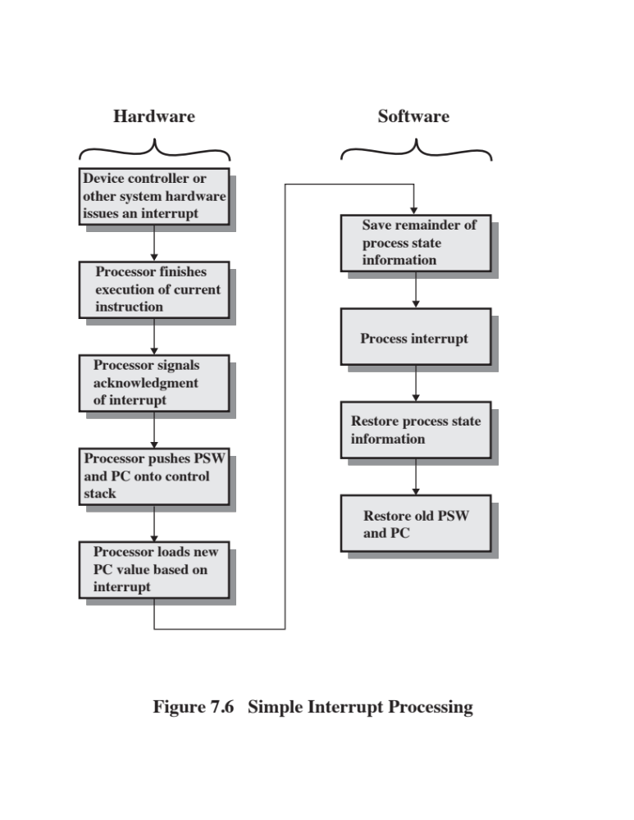
Notes:
Let us consider the role of the processor in interrupt-driven I/O in more detail.
The occurrence of an interrupt triggers a number of events, both in the processor
hardware and in software. Figure 7.6 shows a typical sequence. When an I/O device
completes an I/O operation, the following sequence of hardware events occurs:
1. The device issues an interrupt signal to the processor.
2. The processor finishes execution of the current instruction before responding
to the interrupt, as indicated in Figure 3.9.
3. The processor tests for an interrupt, determines that there is one, and sends an
acknowledgment signal to the device that issued the interrupt. The acknowledgment
allows the device to remove its interrupt signal.
4. The processor now needs to prepare to transfer control to the interrupt routine.
To begin, it needs to save information needed to resume the current program at
the point of interrupt. The minimum information required is (a) the status of the
processor, which is contained in a register called the program status word (PSW),
and (b) the location of the next instruction to be executed, which is contained in
the program counter. These can be pushed onto the system control stack.
5. The processor now loads the program counter with the entry location of the
interrupt-handling program that will respond to this interrupt. Depending on
the computer architecture and operating system design, there may be a single
program; one program for each type of interrupt; or one program for each
device and each type of interrupt. If there is more than one interrupt-handling
routine, the processor must determine which one to invoke. This information
may have been included in the original interrupt signal, or the processor may
have to issue a request to the device that issued the interrupt to get a response
that contains the needed information.

Slide 18
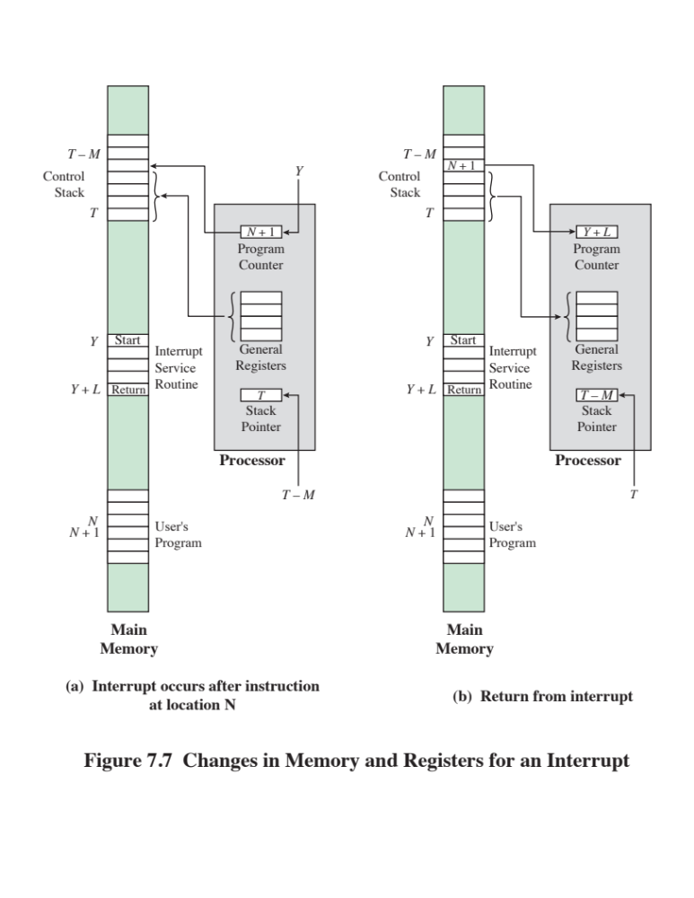
Notes:
Once the program counter has been loaded, the processor proceeds to the
next instruction cycle, which begins with an instruction fetch. Because the instruction
fetch is determined by the contents of the program counter, the result is that
control is transferred to the interrupt-handler program. The execution of this program
results in the following operations:
6. At this point, the program counter and PSW relating to the interrupted
program have been saved on the system stack. However, there is other information
that is considered part of the “state” of the executing program. In particular,
the contents of the processor registers need to be saved, because these
registers may be used by the interrupt handler. So, all of these values, plus any
other state information, need to be saved. Typically, the interrupt handler will
begin by saving the contents of all registers on the stack. Figure 7.7a shows a
simple example. In this case, a user program is interrupted after the instruction
at location N. The contents of all of the registers plus the address of the next
instruction (N + 1) are pushed onto the stack. The stack pointer is updated to
point to the new top of stack, and the program counter is updated to point to
the beginning of the interrupt service routine.
7. The interrupt handler next processes the interrupt. This includes an examination
of status information relating to the I/O operation or other event that
caused an interrupt. It may also involve sending additional commands or
acknowledgments to the I/O device.
8. When interrupt processing is complete, the saved register values are retrieved
from the stack and restored to the registers (e.g., see Figure 7.7b).
9. The final act is to restore the PSW and program counter values from the stack.
As a result, the next instruction to be executed will be from the previously
interrupted program.
Note that it is important to save all the state information about the interrupted
program for later resumption. This is because the interrupt is not a routine called
from the program. Rather, the interrupt can occur at any time and therefore at any
point in the execution of a user program. Its occurrence is unpredictable. Indeed, as
we will see in the next chapter, the two programs may not have anything in common
and may belong to two different users.

Slide 19
Design Issues
Two design issues arise in implementing interrupt I/O:
Because there will be multiple I/O modules how does the processor determine which device issued the interrupt?
If multiple interrupts have occurred how does the processor decide which one to process?
Notes:
Two design issues arise in implementing interrupt I/O. First, because there will
almost invariably be multiple I/O modules, how does the processor determine which
device issued the interrupt? And second, if multiple interrupts have occurred, how
does the processor decide which one to process?

Slide 20
Device Identification
Four general categories of techniques are in common use:
  Multiple interrupt lines
  Between the processor and the I/O modules
  Most straightforward approach to the problem
  Consequently even if multiple lines are used, it is likely that each line will have multiple I/O modules attached to it
  Software poll
  When processor detects an interrupt it branches to an interrupt-service routine whose job is to poll each I/O module to determine which module caused the interrupt
  Time consuming
  Daisy chain (hardware poll, vectored)
  The interrupt acknowledge line is daisy chained through the modules
  Vector – address of the I/O module or some other unique identifier
  Vectored interrupt – processor uses the vector as a pointer to the appropriate device-service routine, avoiding the need to execute a general interrupt-service routine first
  Bus arbitration (vectored)
  An I/O module must first gain control of the bus before it can raise the interrupt request line
  When the processor detects the interrupt it responds on the interrupt acknowledge line
  Then the requesting module places its vector on the data lines
Notes:
Let us consider device identification first. Four general categories of techniques
are in common use:
• Multiple interrupt lines
• Software poll
• Daisy chain (hardware poll, vectored)
• Bus arbitration (vectored)
The most straightforward approach to the problem is to provide multiple interrupt
lines between the processor and the I/O modules. However, it is impractical to
dedicate more than a few bus lines or processor pins to interrupt lines. Consequently,
even if multiple lines are used, it is likely that each line will have multiple I/O modules
attached to it. Thus, one of the other three techniques must be used on each line.
One alternative is the software poll. When the processor detects an interrupt,
it branches to an interrupt-service routine whose job it is to poll each I/O module
to determine which module caused the interrupt. The poll could be in the form of a
separate command line (e.g., TESTI/O). In this case, the processor raises TESTI/O
and places the address of a particular I/O module on the address lines. The I/O module
responds positively if it sets the interrupt. Alternatively, each I/O module could
contain an addressable status register. The processor then reads the status register
of each I/O module to identify the interrupting module. Once the correct module is
identified, the processor branches to a device-service routine specific to that device.
The disadvantage of the software poll is that it is time consuming. A more efficient
technique is to use a daisy chain, which provides, in effect, a hardware poll. An example
of a daisy-chain configuration is shown in Figure 3.26. For interrupts, all I/O modules
share a common interrupt request line. The interrupt acknowledge line is daisy chained
through the modules. When the processor senses an interrupt, it sends out an interrupt
acknowledge. This signal propagates through a series of I/O modules until it gets to a
requesting module. The requesting module typically responds by placing a word on
the data lines. This word is referred to as a vector and is either the address of the I/O
module or some other unique identifier. In either case, the processor uses the vector as
a pointer to the appropriate device-service routine. This avoids the need to execute a
general interrupt-service routine first. This technique is called a vectored interrupt.
There is another technique that makes use of vectored interrupts, and that is
bus arbitration. With bus arbitration, an I/O module must first gain control of the
bus before it can raise the interrupt request line. Thus, only one module can raise the
line at a time. When the processor detects the interrupt, it responds on the interrupt
acknowledge line. The requesting module then places its vector on the data lines.

Slide 21
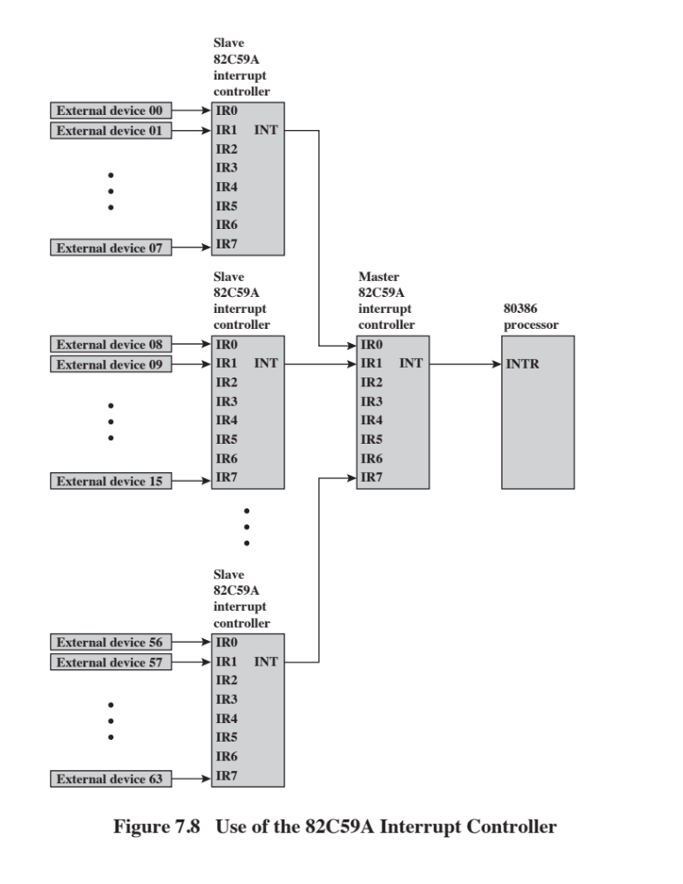
Notes:
The Intel 80386 provides a single Interrupt Request (INTR) and a single Interrupt
Acknowledge (INTA) line. To allow the 80386 to handle a variety of devices and priority
structures, it is usually configured with an external interrupt arbiter, the 82C59A.
External devices are connected to the 82C59A, which in turn connects to the 80386.
Figure 7.8 shows the use of the 82C59A to connect multiple I/O modules for the
80386. A single 82C59A can handle up to eight modules. If control for more than eight
modules is required, a cascade arrangement can be used to handle up to 64 modules.
The 82C59A’s sole responsibility is the management of interrupts. It accepts
interrupt requests from attached modules, determines which interrupt has the highest
priority, and then signals the processor by raising the INTR line. The processor
acknowledges via the INTA line. This prompts the 82C59A to place the appropriate
vector information on the data bus. The processor can then proceed to process the
interrupt and to communicate directly with the I/O module to read or write data.
The 82C59A is programmable. The 80386 determines the priority scheme to
be used by setting a control word in the 82C59A. The following interrupt modes are
possible:
• Fully nested: The interrupt requests are ordered in priority from 0 (IR0)
through 7 (IR7).
Rotating: In some applications a number of interrupting devices are of equal
priority. In this mode a device, after being serviced, receives the lowest priority
in the group.
• Special mask: This allows the processor to inhibit interrupts from certain devices.

Slide 22
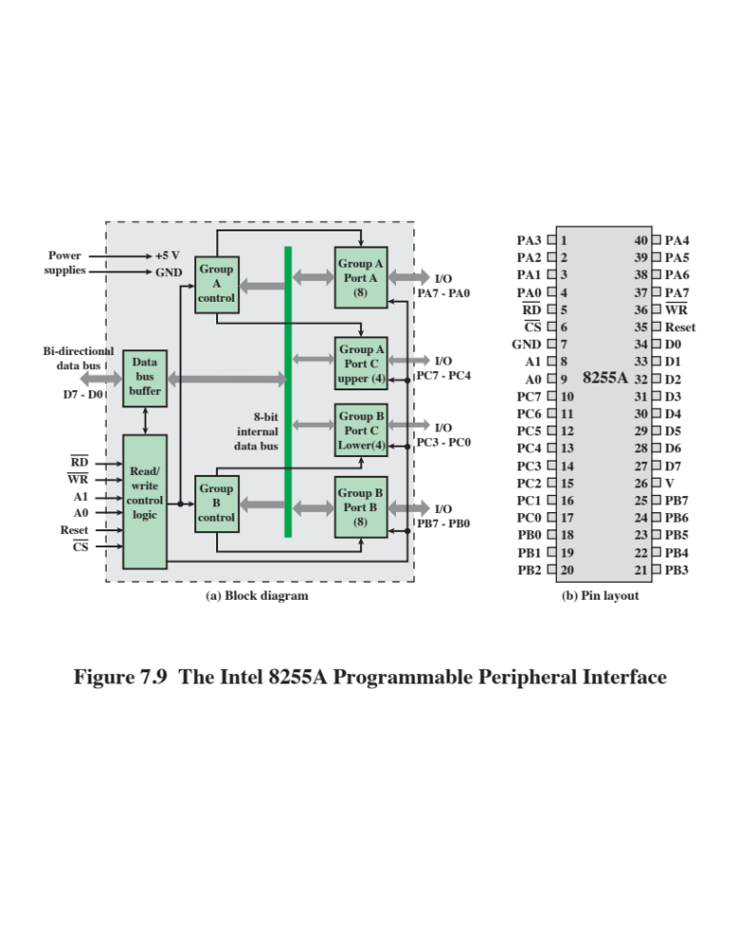
Notes:
As an example of an I/O module used for programmed I/O and interrupt-
driven I/O, we consider the Intel 8255A Programmable Peripheral Interface. The 8255A is
a single-chip, general-purpose I/O module originally designed for use with the Intel
80386 processor. It has since been cloned by other manufacturers and is a widely
used peripheral controller chip. Its uses include as a controller for simple I/O devices
for microprocessors and in embedded systems, including microcontroller systems.
Figure 7.9 shows a general block diagram plus the pin assignment for the
40-pin package in which it is housed.
The right side of the block diagram of Figure 7.9a is the external interface
of the 8255A. The 24 I/O lines are divided into three 8-bit groups (A, B, C). Each
group can function as an 8-bit I/O port, thus providing connection for three peripheral
devices. In addition, group C is subdivided into 4-bit groups (C_{A} and C_{B} ), which
may be used in conjunction with the A and B I/O ports. Configured in this manner,
group C lines carry control and status signals.
The left side of the block diagram is the internal interface to the microprocessor
system bus. It includes an 8-bit bidirectional data bus (D0 through D7), used to
transfer data between the microprocessor and the I/O ports and to transfer control
information.
The processor controls the 8255A by means of an 8-bit control register in the
processor. The processor can set the value of the control register to specify a variety
of operating modes and configurations. From the processor point of view, there is
a control port, and the control register bits are set in the processor and then sent to
the control port over lines D0—D7.

Slide 23
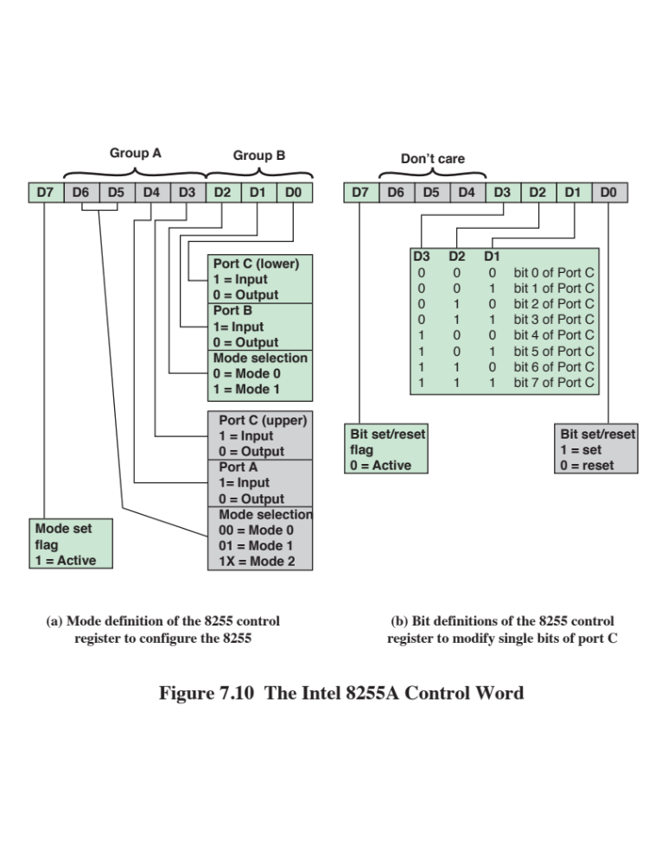
Notes:
Thus, when the processor sets both A1 and A2 to 1, the 8255A interprets the
8-bit value on the data bus as a control word. When the processor transfers an 8-bit
control word with line D7 set to 1 (Figure 7.10a), the control word is used to configure
the operating mode of the 24 I/O lines. The three modes are:
■ Mode 0: This is the basic I/O mode. The three groups of eight external lines
function as three 8-bit I/O ports. Each port can be designated as input or output.
Data may only be sent to a port if the port is defined as output, and data
may only be read from a port if the port is set to input.
■ Mode 1: In this mode, ports A and B can be configured as either input or
output, and lines from port C serve as control lines for A and B. The control
signals serve two principal purposes: “handshaking” and interrupt request.
Handshaking is a simple timing mechanism. One control line is used by the
sender as a DATA READY line, to indicate when the data are present on the
I/O data lines. Another line is used by the receiver as an ACKNOWLEDGE,
indicating that the data have been read and the data lines may be cleared.
Another line may be designated as an INTERRUPT REQUEST line and tied
back to the system bus.
■ Mode 2: This is a bidirectional mode. In this mode, port A can be configured
as either the input or output lines for bidirectional traffic on port B, with the
port B lines providing the opposite direction. Again, port C lines are used for
control signaling.
When the processor sets D7 to 0 (Figure 7.10b), the control word is used to
program the bit values of port C individually. This feature is rarely used.

Slide 24
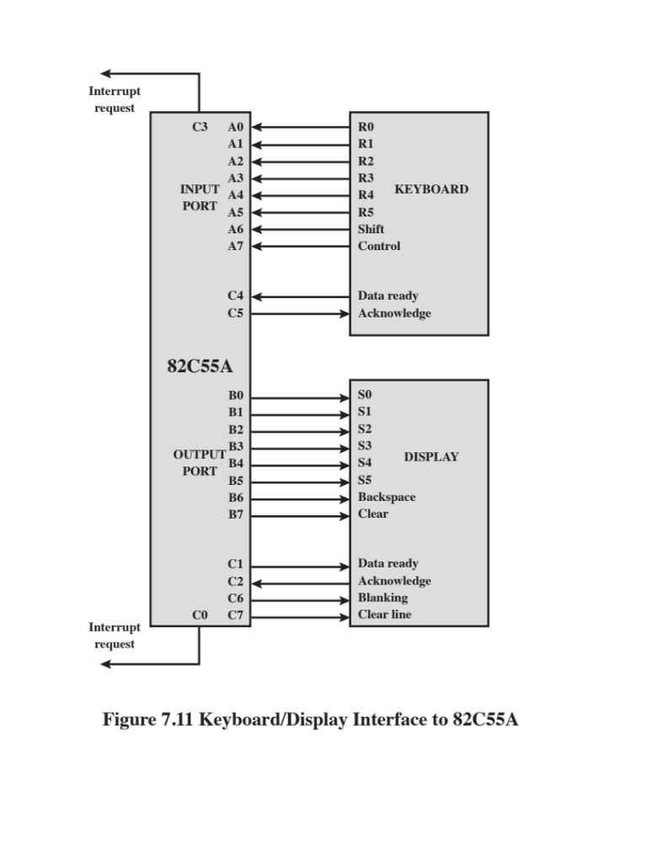
Notes:
Because the 8255A is programmable via the
control register, it can be used to control a variety of simple peripheral devices.
Figure 7.11 illustrates its use to control a keyboard/display terminal. The keyboard
provides 8 bits of input. Two of these bits, SHIFT and CONTROL, have special
meaning to the keyboard-handling
program executing in the processor. However,
this interpretation is transparent to the 8255A, which simply accepts the 8 bits of
data and presents them on the system data bus. Two handshaking control lines are
provided for use with the keyboard.
The display is also linked by an 8-bit data port. Again, two of the bits have
special meanings that are transparent to the 8255A. In addition to two handshaking
lines, two lines provide additional control functions.

Slide 25
Drawbacks of Programmed and Interrupt-Driven I/O
Both forms of I/O suffer from two inherent drawbacks:
  The I/O transfer rate is limited by the speed with which the processor can test and service a device
  The processor is tied up in managing an I/O transfer; a number of instructions must be executed for each I/O transfer
When large volumes of data are to be moved a more efficient technique is direct memory access (DMA)
Notes:
Interrupt-driven I/O, though more efficient than simple programmed I/O, still
requires the active intervention of the processor to transfer data between memory
and an I/O module, and any data transfer must traverse a path through the processor.
Thus, both these forms of I/O suffer from two inherent drawbacks:
1. The I/O transfer rate is limited by the speed with which the processor can test
and service a device.
2. The processor is tied up in managing an I/O transfer; a number of instructions
must be executed for each I/O transfer (e.g., Figure 7.5).
There is somewhat of a trade-off between these two drawbacks. Consider the
transfer of a block of data. Using simple programmed I/O, the processor is dedicated
to the task of I/O and can move data at a rather high rate, at the cost of doing
nothing else. Interrupt I/O frees up the processor to some extent at the expense of
the I/O transfer rate. Nevertheless, both methods have an adverse impact on both
processor activity and I/O transfer rate.
When large volumes of data are to be moved, a more efficient technique is
required: direct memory access (DMA).

Slide 26
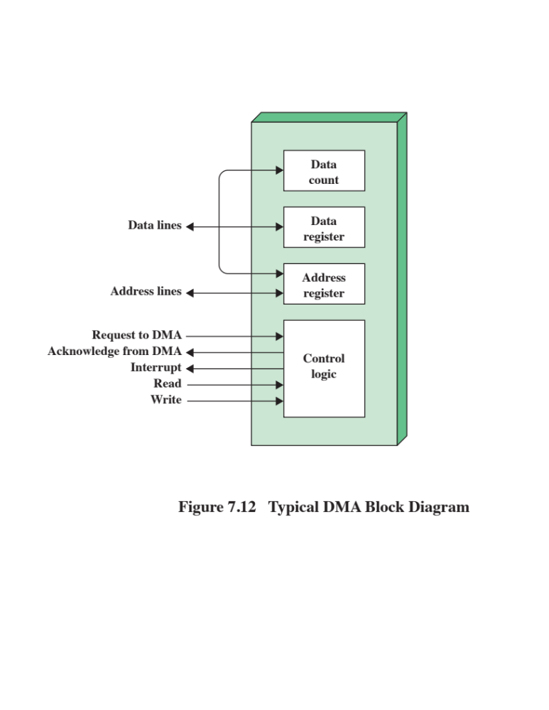
Notes:
DMA involves an additional module on the system bus. The DMA module
(Figure 7.12) is capable of mimicking the processor and, indeed, of taking over
control of the system from the processor. It needs to do this to transfer data to
and from memory over the system bus. For this purpose, the DMA module must
use the bus only when the processor does not need it, or it must force the processor
to suspend operation temporarily. The latter technique is more common and is
referred to as cycle stealing, because the DMA module in effect steals a bus cycle.
When the processor wishes to read or write a block of data, it issues a
command to the DMA module, by sending to the DMA module the following
information:
• Whether a read or write is requested, using the read or write control line
between the processor and the DMA module
• The address of the I/O device involved, communicated on the data lines
The starting location in memory to read from or write to, communicated on
the data lines and stored by the DMA module in its address register
• The number of words to be read or written, again communicated via the data
lines and stored in the data count register
The processor then continues with other work. It has delegated this I/O operation
to the DMA module. The DMA module transfers the entire block of data, one
word at a time, directly to or from memory, without going through the processor.
When the transfer is complete, the DMA module sends an interrupt signal to the
processor. Thus, the processor is involved only at the beginning and end of the
transfer (Figure 7.4c).

Slide 27
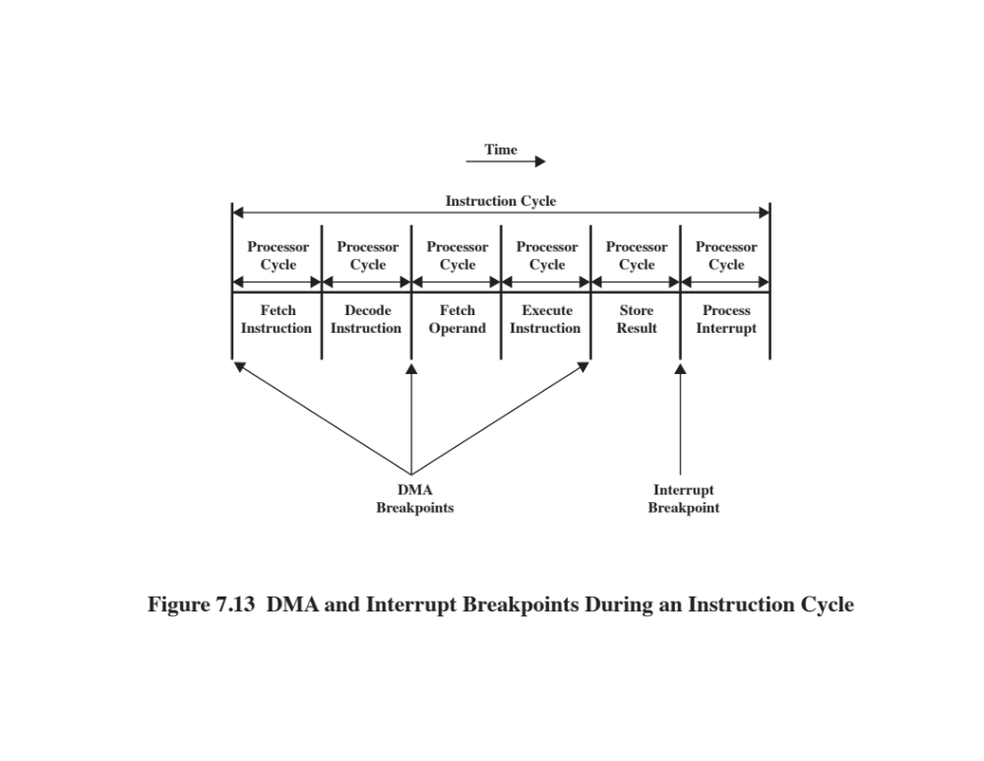
Notes:
Figure 7.13 shows where in the instruction cycle the processor may be suspended.
In each case, the processor is suspended just before it needs to use the bus.
The DMA module then transfers one word and returns control to the processor.
Note that this is not an interrupt; the processor does not save a context and do
something else. Rather, the processor pauses for one bus cycle. The overall effect
is to cause the processor to execute more slowly. Nevertheless, for a multiple-word
I/O transfer, DMA is far more efficient than interrupt-driven or programmed I/O.

Slide 28
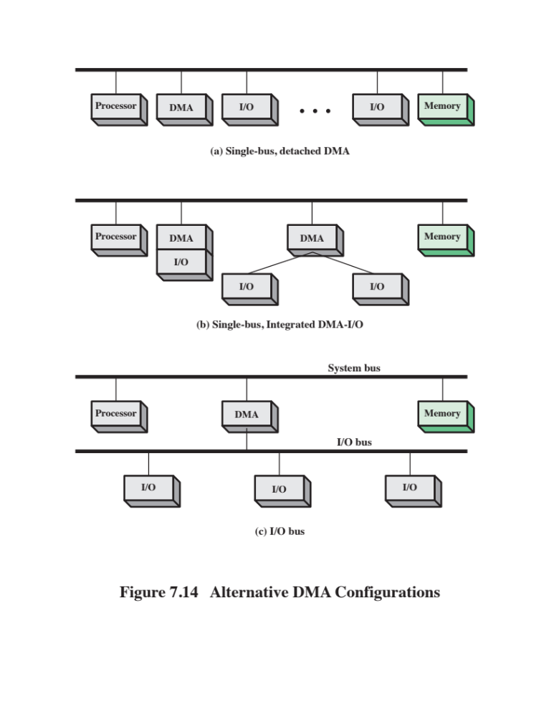
Notes:
The DMA mechanism can be configured in a variety of ways. Some possibilities
are shown in Figure 7.14. In the first example, all modules share the same system
bus. The DMA module, acting as a surrogate processor, uses programmed I/O to
exchange data between memory and an I/O module through the DMA module. This
configuration, while it may be inexpensive, is clearly inefficient. As with processor controlled
programmed I/O, each transfer of a word consumes two bus cycles.
The number of required bus cycles can be cut substantially by integrating the
DMA and I/O functions. As Figure 7.14b indicates, this means that there is a path
between the DMA module and one or more I/O modules that does not include the
system bus. The DMA logic may actually be a part of an I/O module, or it may be a
separate module that controls one or more I/O modules. This concept can be taken
one step further by connecting I/O modules to the DMA module using an I/O bus
(Figure 7.14c). This reduces the number of I/O interfaces in the DMA module to one
and provides for an easily expandable configuration. In both of these cases (Figures
7.14b and c), the system bus that the DMA module shares with the processor and
memory is used by the DMA module only to exchange data with memory. The
exchange of data between the DMA and I/O modules takes place off the system
bus.

Slide 29
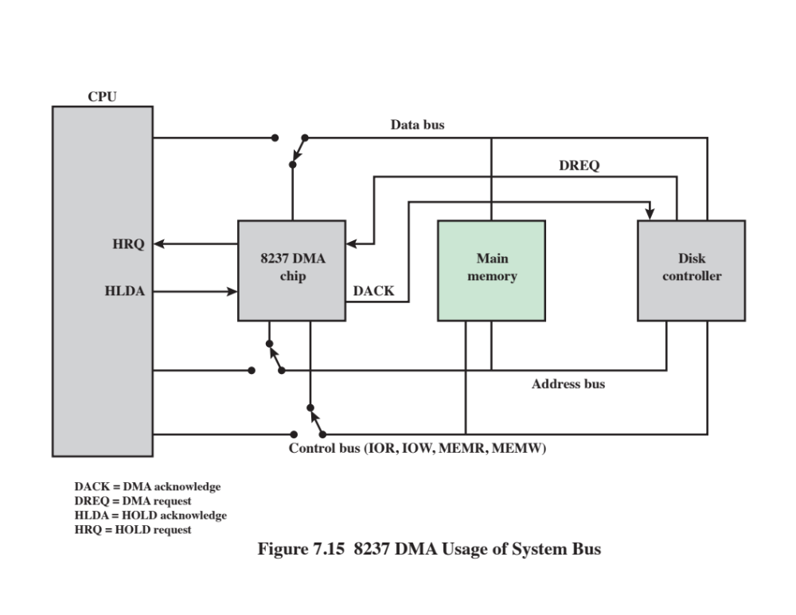
Notes:
The Intel 8237A DMA controller interfaces to the 80 x 86 family of processors and
to DRAM memory to provide a DMA capability. Figure 7.15 indicates the location
of the DMA module. When the DMA module needs to use the system buses (data,
address, and control) to transfer data, it sends a signal called HOLD to the processor.
The processor responds with the HLDA (hold acknowledge) signal, indicating
that the DMA module can use the buses. For example, if the DMA module is to
transfer a block of data from memory to disk, it will do the following:
1. The peripheral device (such as the disk controller) will request the service of
DMA by pulling DREQ (DMA request) high.
2. The DMA will put a high on its HRQ (hold request), signaling the CPU
through its HOLD pin that it needs to use the buses.
3.The CPU will finish the present bus cycle (not necessarily the present instruction)
and respond to the DMA request by putting high on its HDLA (hold
acknowledge), thus telling the 8237 DMA that it can go ahead and use the
buses to perform its task. HOLD must remain active high as long as DMA is
performing its task.
4. DMA will activate DACK (DMA acknowledge), which tells the peripheral
device that it will start to transfer the data.
5. DMA starts to transfer the data from memory to peripheral by putting the
address of the first byte of the block on the address bus and activating MEMR,
thereby reading the byte from memory into the data bus; it then activates IOW
to write it to the peripheral. Then DMA decrements the counter and increments
the address pointer and repeats this process until the count reaches zero
and the task is finished.
6. After the DMA has finished its job it will deactivate HRQ, signaling the CPU
that it can regain control over its buses.

Slide 30
Fly-By DMA Controller
Data does not pass through and is not stored in DMA chip
DMA only between I/O port and memory
Not between two I/O ports or two memory locations
Can do memory to memory via register
8237 contains four DMA channels
Programmed independently
Any one active
Numbered 0, 1, 2, and 3
Notes:
While the DMA is using the buses to transfer data, the processor is idle.
Similarly, when the processor is using the bus, the DMA is idle. The 8237 DMA
is known as a fly-by DMA controller. This means that the data being moved from
one location to another does not pass through the DMA chip and is not stored in
the DMA chip. Therefore, the DMA can only transfer data between an I/O port
and a memory address, but not between two I/O ports or two memory locations.
However, as explained subsequently, the DMA chip can perform a memory-to-memory
transfer via a register.
The 8237 contains four DMA channels that can be programmed independently,
and any one of the channels may be active at any moment. These channels are
numbered 0, 1, 2, and 3.

Slide 31
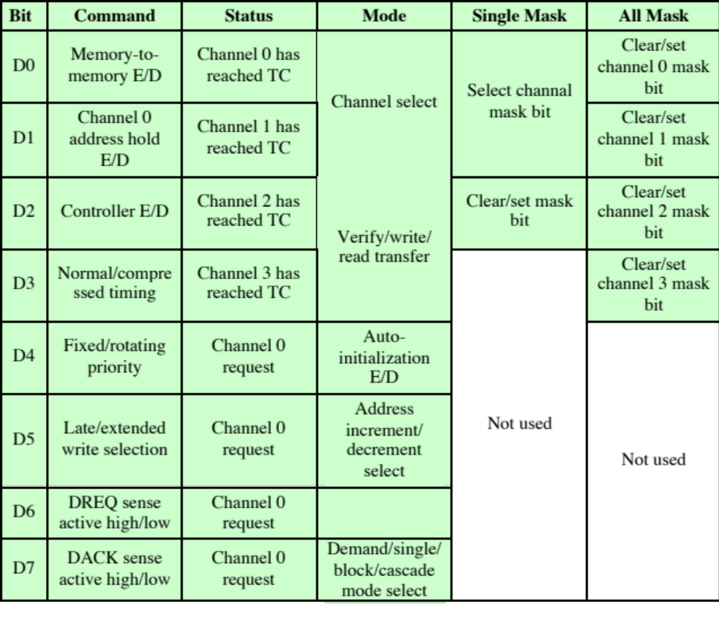
Table 7.2
Intel
8237A Registers
E/D = enable/disable
TC = terminal count
Notes:
The 8237 has a set of five control/command registers to program and control
DMA operation over one of its channels (Table 7.2):
• Command: The processor loads this register to control the operation of the
DMA. D0 enables a memory-to-memory transfer, in which channel 0 is used
to transfer a byte into an 8237 temporary register and channel 1 is used to
transfer the byte from the register to memory. When memory-to-memory is
enabled, D1 can be used to disable increment/decrement on channel 0 so that
a fixed value can be written into a block of memory. D2 enables or disables
DMA.
• Status: The processor reads this register to determine DMA status. Bits
D0–D3 are used to indicate if channels 0–3 have reached their TC (terminal
count). Bits D4–D7 are used by the processor to determine if any channel has
a DMA request pending.
• Mode: The processor sets this register to determine the mode of operation
of the DMA. Bits D0 and D1 are used to select a channel. The other bits
select various operation modes for the selected channel. Bits D2 and D3
determine if the transfer is from an I/O device to memory (write) or from
memory to I/O (read), or a verify operation. If D4 is set, then the memory
address register and the count register are reloaded with their original
values at the end of a DMA data transfer. Bits D6 and D7 determine the
way in which the 8237 is used. In single mode, a single byte of data is transferred.
Block and demand modes are used for a block transfer, with the
demand mode allowing for premature ending of the transfer. Cascade
mode allows multiple 8237s to be cascaded to expand the number of channels
to more than 4.
• Single Mask: The processor sets this register. Bits D0 and D1 select the channel.
Bit D2 clears or sets the mask bit for that channel. It is through this register
that the DREQ input of a specific channel can be masked (disabled) or
unmasked (enabled). While the command register can be used to disable the
whole DMA chip, the single mask register allows the programmer to disable
or enable a specific channel.
• All Mask: This register is similar to the single mask register except that all four
channels can be masked or unmasked with one write operation.
In addition, the 8237A has eight data registers: one memory address register
and one count register for each channel. The processor sets these registers to indicate
the location of size of main memory to be affected by the transfers.

Slide 32
Direct Cache Access (DCA)
DMA is not able to scale to meet the increased demand due to dramatic increases in data rates for network I/O
Demand is coming primarily from the widespread deployment of 10-Gbps and 100-Gbps Ethernet switches to handle massive amounts of data transfer to and from database servers and other high-performance systems
Another source of traffic comes from Wi-Fi in the gigabit range
Network Wi-Fi devices that handle 3.2 Gbps and 6.76 Gbps are becoming widely available and producing demand on enterprise systems
Notes:
DMA has proved an effective means of enhancing performance of I/O with peripheral
devices and network I/O traffic. However, for the dramatic increases in data
rates for network I/O, DMA is not able to scale to meet the increased demand.
This demand is coming primarily from the widespread deployment of 10-Gbps and
100-Gbps Ethernet switches to handle massive amounts of data transfer to and from
database servers and other high-performance
systems [STAL14a]. A secondary but increasingly important source of traffic comes
from Wi-Fi in the gigabit range. Network Wi-Fi
devices that handle 3.2 Gbps and 6.76 Gbps are becoming widely
available and producing demand on enterprise systems [STAL14b].
In this section, we will show how enabling the I/O function to have direct
access to the cache can enhance performance, a technique known as direct cache
access (DCA . Throughout this section, we are concerned only with the cache that
is closest to main memory, referred to as the last-level
cache . In some systems, this will be an L2 cache, in others an L3 cache.
To begin, we describe the way in which contemporary multicore systems use
on-chip shared cache to enhance DMA performance. This approach involves enabling
the DMA function to have direct access to the last-level
cache. Next we examine cache-related
performance issues that manifest when high-speed network traffic
is processed. From there, we look at several different strategies for DCA that are
designed to enhance network protocol processing performance. Finally, this section
describes a DCA approach implemented by Intel, referred to as Direct Data I/O.

Slide 33
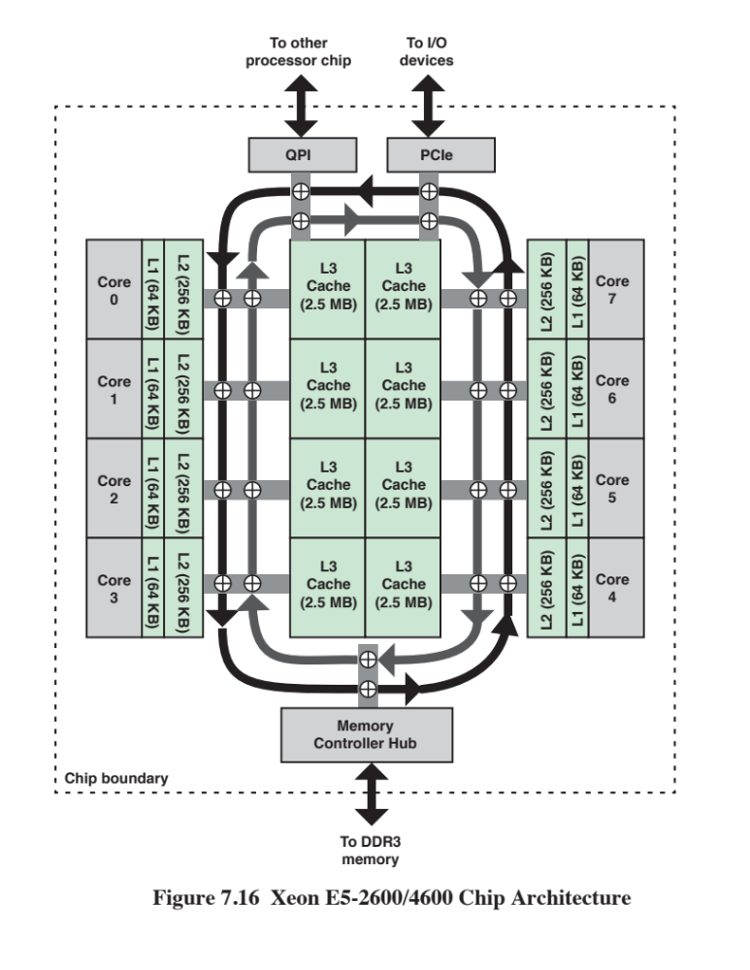
Notes:
Intel Xeon is Intel’s high-end, high-performance
processor family, used in servers, high-performance workstations, and
supercomputers. Many of the members of the Xeon family use a ring interconnect
system, as illustrated for the Xeon E5-2600/4600 in Figure 7.16.
The E5-2600/4600 can be configured with up to eight cores on a single chip.
Each core has dedicated L1 and L2 caches. There is a shared L3 cache of up to
20 MB. The L3 cache is divided into slices, one associated with each core although
each core can address the entire cache. Further, each slice has its own cache pipeline,
so that requests can be sent in parallel to the slices.
The bidirectional high-speed ring interconnect links cores, last-level
cache, PCIe, and integrated memory controller (IMC).
In essence, the ring operates as follows:
1. Each component that attaches to the bidirectional ring (QPI, PCIe, L3 cache,
L2 cache) is considered a ring agent, and implements ring agent logic.
2. The ring agents cooperate via a distributed protocol to request and allocate
access to the ring, in the form of time slots.
3. When an agent has data to send, it chooses the ring direction that results in the
shortest path to the destination and transmits when a scheduling slot is available.
The ring architecture provides good performance and scales well for multiple
cores, up to a point. For systems with a greater number of cores, multiple rings are
used, with each ring supporting some of the cores.
In traditional DMA operation, data is exchanged
between main memory and an I/O device by means of the system interconnection
structure, such as a bus, ring, or QPI point-to-point matrix. So, for example, if the
Xeon E5-2600/4600 used a traditional DMA technique, output would proceed as
follows. An I/O driver running on a core would send an I/O command to the I/O
controller (labeled PCIe in Figure 7.16) with the location and size of the buffer in
main memory containing the data to be transferred. The I/O controller issues a read
request that is routed to the memory controller hub (MCH), which accesses the data
on DDR3 memory and puts it on the system ring for delivery to the I/O controller.
The L3 cache is not involved in this transaction and one or more off-chip memory
reads are required. Similarly, for input, data arrives from the I/O controller and is
delivered over the system ring to the MCH and written out to main memory. The
MCH must also invalidate any L3 cache lines corresponding to the updated memory
locations. In this case, one or more off-chip memory writes are required. Further, if
an application wants to access the new data, a main memory read is required.
With the availability of large amounts of last-level cache, a more efficient
technique is possible, and is used by the Xeon E5-2600/4600. For output, when the
I/O controller issues a read request, the MCH first checks to see if the data is in the
L3 cache. This is likely to be the case, if an application has recently written data
into the memory block to be output. In that case, the MCH directs data from the L3
cache to the I/O controller; no main memory accesses are needed. However, it also
causes the data to be evicted from cache, that is, the act of reading by an I/O device
causes data to be evicted. Thus, the I/O operation proceeds efficiently because it
does not require main memory access. But, if an application does need that data
in the future, it must be read back into the L3 cache from main memory. The input
operation on the Xeon E5-2600/4600 operates as described in the previous paragraph;
the L3 cache is not involved.
Thus, the performance improvement involves only output operations.
A final point. Although the output transfer is directly from cache to the I/O
controller, the term direct cache access is not used for this feature. Rather the term
is reserved for the I/O protocol application, as described in the remainder of this
section.

Slide 34
Cache-Related Performance Issues
Network traffic is transmitted in the form of a sequence of protocol blocks called packets or protocol data units
The lowest, or link, level protocol is typically Ethernet, so that each arriving and departing block of data consists of an Ethernet packet containing as payload the higher-level protocol packet
The higher-level protocols are usually the Internet Protocol (IP), operating on top of Ethernet and the Transmission Control Protocol (TCP), operating on top of IP
The Ethernet payload consists of a block of data with a TCP header and an IP header
For outgoing data, Ethernet packets are formed in a peripheral component, such as in I/O controller or network interface controller (NIC)
For incoming traffic, the I/O controller strips off the Ethernet information and delivers the TCP/IP packet to the host CPU
Notes:
Network traffic is transmitted in the form of a sequence of protocol blocks, called
packets or protocol data units. The lowest, or link, level protocol is typically
Ethernet, so that each arriving and departing block of data consists of an Ethernet
packet containing as payload the higher-level protocol packet. The higher-level protocols
are usually the Internet Protocol (IP), operating on top of Ethernet, and
the Transmission Control Protocol (TCP), operating on top of IP. Accordingly, the
Ethernet payload consists of a block of data with a TCP header and an IP header.
For outgoing data, Ethernet packets are formed in a peripheral component, such
as an I/O controller or network interface controller (NIC). Similarly, for incoming
traffic, the I/O controller strips off the Ethernet information and delivers the TCP/
IP packet to the host CPU.

Slide 35
Cache-Related Performance Issues (Cont.)
For both outgoing and incoming traffic the core, main memory, and cache are all involved
In a DMA scheme, when an application wishes to transmit data, it places that data in an application-assigned buffer in main memory
The core transfers this to a system buffer in main memory and creates the necessary TCP and IP headers, which are also buffered in system memory
The packet is then picked up via DMA for transfer via the NIC
This activity engages not only main memory but also the cache
Similar transfers between system and application buffers are required for incoming traffic
Notes:
For both outgoing and incoming traffic, the core, main memory, and cache
are all involved. In a DMA scheme, when an application wishes to transmit data, it
places that data in an application-assigned buffer in main memory. The core transfers
this to a system buffer in main memory and creates the necessary TCP and IP
headers, which are also buffered in system memory. The packet is then picked up
via DMA for transfer via the NIC. This activity engages not only main memory but
also the cache. For incoming traffic, similar transfers between system and application
buffers are required.
When large volumes of protocol traffic are processed, two factors in this scenario
degrade performance. First, the core consumes valuable clock cycles in copying
data between system and application buffers. Second, because memory speeds have
not kept up with CPU speeds, the core loses time waiting on memory reads and
writes. In this traditional way of processing protocol traffic, the cache does not help
because the data and protocol headers are constantly changing and thus the cache
must constantly be updated.

Slide 36
Packet Traffic Steps:
Incoming
Outgoing
Packet arrives
DMA
NIC interrupts host
Retrieve descriptors and headers
Cache miss occurs
Header is processed
Payload transferred
Packet transfer requested
Packet created
Output operation invoked
DMA transfer
NIC signals completion
Driver frees buffer
Notes:
To clarify the performance issue and to explain the benefit of DCA as a way
of improving performance, let us look at the processing of protocol traffic in more
detail for incoming traffic. In general terms, the following steps occur:
1. Packet arrives. The NIC receives an incoming Ethernet packet. The NIC processes
and strips off the Ethernet control information. This includes doing an
error detection calculation. The remaining TCP/IP packet is then transferred
to the system’s DMA module, which generally is part of the NIC. The NIC
also creates a packet descriptor with information about the packet, such as its
buffer location in memory.
2. DMA. The DMA module transfers data, including the packet descriptor, to
main memory. It must also invalidate the corresponding cache lines, if any.
3. NIC interrupts host. After a number of packets have been transferred, the
NIC issues an interrupt to the host processor.
4. Retrieve descriptors and headers. The core processes the interrupt, invoking
an interrupt handling procedure, which reads the descriptor and header of the
received packets.
5. Cache miss occurs. Because this is new data coming in, the cache lines corresponding
to the system buffer containing the new data are invalidated. Thus,
the core must stall to read the data from main memory into cache, and then to
core registers.
6. Header is processed. The protocol software executes on the core to analyze
the contents of the TCP and IP headers. This will likely include accessing a
transport control block (TCB), which contains context information related
to TCP. The TCB access may or may not trigger a cache miss, necessitating a
main memory access.
7. Payload transferred. The data portion of the packet is transferred from the
system buffer to the appropriate application buffer.
A similar sequence of steps occurs for outgoing packet traffic, but there are
some differences that affect how the cache is managed. For outgoing traffic, the
following steps occur:
1. Packet transfer requested. When an application has a block of data to transfer
to a remote system, it places the data in an application buffer and alerts the
OS with some type of system call.
2. Packet created. The OS invokes a TCP/IP process to create the TCP/IP packet
for transmission. The TCP/IP process accesses the TCB (which may involve a
cache miss) and creates the appropriate headers. It also reads the data from
the application buffer, and then places the completed packet (headers plus
data) in a system buffer. Note that the data that is written into the system buffer
also exists in the cache. The TCP/IP process also creates a packet descriptor
that is placed in memory shared with the DMA module.
3. Output operation invoked. This uses a device driver program to signal the
DMA module that output is ready for the NIC.
4. DMA transfer. The DMA module reads the packet descriptor. Then, a
DMA transfer is performed from main memory or the last level cache to the NIC.
Note that DMA transfers invalidate the cache line in cache even in
the case of a read (by the DMA module). If the line is modified, this causes a
write back. The core does not do the invalidates. The invalidates happen when
the DMA module reads the data.
5. NIC signals completion. After the transfer is complete, the NIC signals the
driver on the core that originated the send signal.
6. Driver frees buffer. Once the driver receives the completion notice, if frees
up the buffer space for reuse. The core must also invalidate the cache lines
containing the buffer data.
As can be seen, network I/O involves a number of accesses to cache and main
memory and the movement of data between an application buffer and a system
buffer. The heavy involvement of main memory becomes a bottleneck, as both core
and network performance outstrip gains in memory access times.

Slide 37
Direct Cache Access Strategies
Simplest strategy was implemented as a prototype on a number of Intel Xeon processors between 2006 and 2010
This form of DCA applies only to incoming network traffic
The DCA function in the memory controller sends a prefetch hint to the core as soon as the data is available in system memory
This enables the core to prefetch the data packet from the system buffer
Much more substantial gains can be realized by avoiding the system buffer in main memory altogether
The packet and packet descriptor information are accessed only once in the system buffer by the core
For incoming packets, the core reads the data from the buffer and transfers the packet payload to an application buffer
It has no need to access that data in the system buffer again
Cache injection
Implemented in Intel’s Xeon processor line, referred to as Direct Data I/O
Notes:
Several strategies have been proposed for making more efficient use of caches for
network I/O, with the general term direct cache access applied to all of these strategies.
The simplest strategy is one that was implemented as a prototype on a number
of Intel Xeon processors between 2006 and 2010 [KUMA07, INTE08]. This form of
DCA applies only to incoming network traffic. The DCA function in the memory
controller sends a prefetch hint to the core as soon as the data is available in system
memory. This enables the core to prefetch the data packet from the system buffer,
thus avoiding cache misses and the associated waste of core cycles.
While this simple form of DCA does provide some improvement, much more
substantial gains can be realized by avoiding the system buffer in main memory
altogether. For the specific function of protocol processing, note that the packet
and packet descriptor information are accessed only once in the system buffer by
the core. For incoming packets, the core reads the data from the buffer and transfers
the packet payload to an application buffer. It has no need to access that data
in the system buffer again. Similarly, for outgoing packets, once the core has placed
the data in the system buffer, it has no need to access that data again. Suppose,
therefore, that the I/O system were equipped not only with the capability of directly
accessing main memory, but also of accessing the cache, both for input and output
operations. Then it would be possible to use the last-level cache instead of the main
memory to buffer packets and descriptors of incoming and outgoing packets.
This last approach, which is a true DCA, was proposed in [HUGG05]. It has
also been described as cache injection [LEON06]. A version of this more complete
form of DCA is implemented in Intel’s Xeon processor line, referred to as Direct
Data I/O [INTE12].

Slide 38
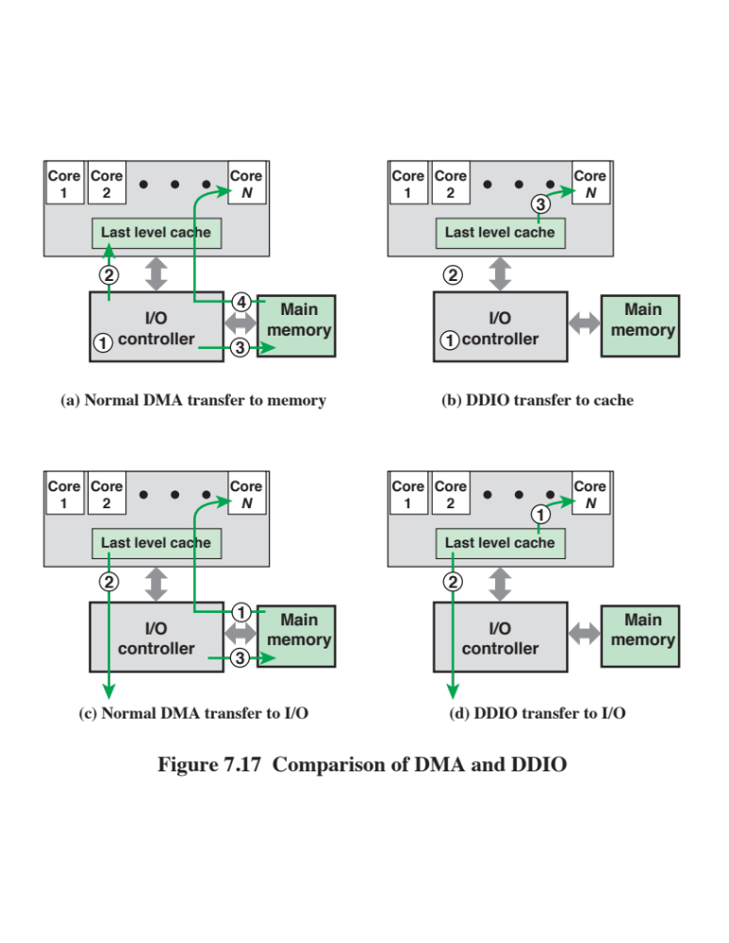
Notes:
Intel Direct Data I/O (DDIO) is implemented on all of the Xeon E5 family of processors.
Its operation is best explained with a side-by-side
comparison of transfers with and without DDIO.
First, we look at the case of a packet arriving at the NIC from the
network. Figure 7.17a shows the steps involved for a DMA operation. The NIC
initiates a memory write (1). Then the NIC invalidates the cache lines corresponding
to the system buffer (2). Next, the DMA operation is performed, depositing the
packet directly into main memory (3). Finally, after the appropriate core receives a
DMA interrupt signal, the core can read the packet data from memory through the
cache (4).
Before discussing the processing of an incoming packet using DDIO, we need
to summarize the discussion of cache write policy from Chapter 4, and introduce a
new technique. For the following discussion, there are issues relating to cache coherency
that arise in a multiprocessor or multicore environment. These are discussed
in Chapter 17 but the details need not concern us here. Recall that there are two
techniques for dealing with an update to a cache line:
■ Write through: All write operations are made to main memory as well as to
the cache, ensuring that main memory is always valid. Any other core–cache
module can monitor traffic to main memory to maintain consistency within its
own local cache.
■ Write back: Updates are made only in the cache. When an update occurs, a
dirty bit associated with the line is set. Then, when a block is replaced, it is
written back to main memory if and only if the dirty bit is set.
DDIO uses the write-back strategy in the L3 cache.
A cache write operation may encounter a cache miss, which is dealt with by
one of two strategies:
■ Write allocate: The required line is loaded into the cache from main memory.
Then, the line in the cache is updated by the write operation. This scheme is
typically used with the write-back method.
■ Non-write allocate: The block is modified directly in main memory. No change is
made to the cache. This scheme is typically used with the write-through method.
With the above in mind, we can describe the DDIO strategy for inbound
transfers initiated by the NIC.
1. If there is a cache hit, the cache line is updated, but not main memory; this is
simply the write-back strategy for a cache hit. The Intel literature refers to this
as write update .
2. If there is a cache miss, the write operation occurs to a line in the cache that will not
be written back to main memory. Subsequent writes update the cache line, again
with no reference to main memory or no future action that writes this data to main
memory. The Intel documentation [INTE12] refers to this as write allocate, which
unfortunately is not the same meaning for the term in the general cache literature.
The DDIO strategy is effective for a network protocol application because the
incoming data need not be retained for future use. The protocol application is going
to write the data to an application buffer, and there is no need to temporarily store
it in a system buffer.
Figure 7.17b shows the operation for DDIO input. The NIC initiates a memory
write (1). Then the NIC invalidates the cache lines corresponding to the system buffer
and deposits the incoming data in the cache (2). Finally, after the appropriate core
receives a DCA interrupt signal, the core can read the packet data from the cache (3).
packet output Figure 7.17c shows the steps involved for a DMA operation for
outbound packet transmission. The TCP/IP protocol handler executing on the core reads
data in from an application buffer and writes it out to a system buffer. These data access
operations result in cache misses and cause data to be read from memory and into the L3
cache (1). When the NIC receives notification for starting a transmit operation, it reads
the data from the L3 cache and transmits it (2). The cache access by the NIC causes the
data to be evicted from the cache and written back to main memory (3).
Figure 7.17d shows the steps involved for a DDIO operation for packet transmission.
The TCP/IP protocol handler creates the packet to be transmitted and
stores it in allocated space in the L3 cache, but not in main memory (2). The read
operation initiated by the NIC is satisfied by data from the cache, without causing
evictions to main memory.
It should be clear from these side-by-side comparisons that DDIO is more
efficient than DMA for both incoming and outgoing packets and is therefore better
able to keep up with the high packet traffic rate.

Slide 39
Evolution of the I/O Function
The CPU directly controls a peripheral device.
A controller or I/O module is added. The CPU uses programmed I/O without interrupts.
Same configuration as in step 2 is used, but now interrupts are employed. The CPU need not spend time waiting for an I/O operation to be performed, thus increasing efficiency.
The I/O module is given direct access to memory via DMA. It can now move a block of data to or from memory without involving the CPU, except at the beginning and end of the transfer.
The I/O module is enhanced to become a processor in its own right, with a specialized instruction set tailored for I/O
The I/O module has a local memory of its own and is, in fact, a computer in its own right. With this architecture a large set of I/O devices can be controlled with minimal CPU involvement.
Notes:
As computer systems have evolved, there has been a pattern of increasing complexity
and sophistication of individual components. Nowhere is this more evident than
in the I/O function. We have already seen part of that evolution. The evolutionary
steps can be summarized as follows:
1. The CPU directly controls a peripheral device. This is seen in simple microprocessor-
controlled devices.
2. A controller or I/O module is added. The CPU uses programmed I/O without
interrupts. With this step, the CPU becomes somewhat divorced from the specific
details of external device interfaces.
3. The same configuration as in step 2 is used, but now interrupts are employed.
The CPU need not spend time waiting for an I/O operation to be performed,
thus increasing efficiency.
4. The I/O module is given direct access to memory via DMA. It can now move
a block of data to or from memory without involving the CPU, except at the
beginning and end of the transfer.
5. The I/O module is enhanced to become a processor in its own right, with a
specialized instruction set tailored for I/O. The CPU directs the I/O processor
to execute an I/O program in memory. The I/O processor fetches and executes
these instructions without CPU intervention. This allows the CPU to specify a
sequence of I/O activities and to be interrupted only when the entire sequence
has been performed.
6. The I/O module has a local memory of its own and is, in fact, a computer
in its own right. With this architecture, a large set of I/O devices can be
controlled, with minimal CPU involvement. A common use for such an
architecture has been to control communication with interactive terminals.
The I/O processor takes care of most of the tasks involved in controlling the
terminals.
As one proceeds along this evolutionary path, more and more of the I/O
function is performed without CPU involvement. The CPU is increasingly
relieved of I/O-related tasks, improving performance. With the last two steps
(5–6), a major change occurs with the introduction of the concept of an I/O module
capable of executing a program. For step 5, the I/O module is often referred
to as an I/O channel. For step 6, the term I/O processor is often used. However,
both terms are on occasion applied to both situations. In what follows, we will use
the term I/O channel.

Slide 40
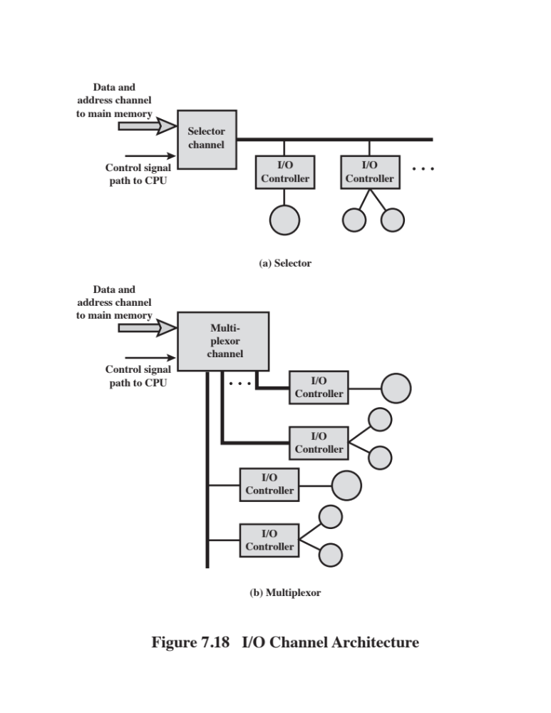
Notes:
The I/O channel represents an extension of the DMA concept. An I/O
channel has the ability to execute I/O instructions, which gives it complete control
over I/O operations. In a computer system with such devices, the CPU does
not execute I/O instructions. Such instructions are stored in main memory to
be executed by a special-purpose processor in the I/O channel itself. Thus, the
CPU initiates an I/O transfer by instructing the I/O channel to execute a program
in memory. The program will specify the device or devices, the area or
areas of memory for storage, priority, and actions to be taken for certain error
conditions. The I/O channel follows these instructions and controls the data
transfer.
Two types of I/O channels are common, as illustrated in Figure 7.18. A
selector channel controls multiple high-speed devices and, at any one time, is
dedicated to the transfer of data with one of those devices. Thus, the I/O channel
selects one device and effects the data transfer. Each device, or a small set of
devices, is handled by a controller, or I/O module, that is much like the I/O modules
we have been discussing. Thus, the I/O channel serves in place of the CPU in
controlling these I/O controllers. A multiplexor channel can handle I/O with multiple
devices at the same time. For low-speed devices, a byte multiplexor accepts or
transmits characters as fast as possible to multiple devices. For example, the resultant
character stream from three devices with different rates and individual streams
A₁A₂A₃A₄ …, B₁B₂B₃B₄ …, and C₁C₂C₃C₄ … might be A₁B₁C₁A₂C₂A₃B₂C₃A₄,
and so on. For high-speed devices, a block multiplexor interleaves blocks of data
from several devices.

Slide 41
Universal Serial Bus (USB)
Widely used for peripheral connections
Is the default interface for slower speed devices
Commonly used high-speed I/O
Has gone through multiple generations
  USB 1.0
    Defined a Low Speed data rate of 1.5 Mbps and a Full Speed rate of 12 Mbps
  USB 2.0
    Provides a data rate of 480 Mbps
  USB 3.0
    Higher speed bus called SuperSpeed in parallel with the USB 2.0 bus
    Signaling speed of SuperSpeed is 5 Gbps, but due to signaling overhead the usable data rate is up to 4 Gbps
  USB 3.1
    Includes a faster transfer mode called SuperSpeed+
    This transfer mode achieves a signaling rate of 10 Gbps and a theoretical usable data rate of 9.7 Gbps
Is controlled by a root host controller which attaches to devices to create a local network with a hierarchical tree topology
Notes:
USB is widely used for peripheral connections. It is the default interface for slower
speed devices, such as keyboard and pointing devices, but is also commonly used for
high-speed I/O, including printers, disk drives, and network adapters.
USB has gone through multiple generations. The first version, USB 1.0,
defined a Low Speed data rate of 1.5 Mbps and a Full Speed rate of 12 Mbps. USB
2.0 provides a data rate of 480 Mbps. USB 3.0 includes a new, higher speed bus
called SuperSpeed in parallel with the USB 2.0 bus. The signaling speed of Super-
Speed is 5 Gbps, but due to signaling overhead, the usable data rate is up to 4 Gbps.
The most recent specification is USB 3.1, which includes a faster transfer mode
called SuperSpeed+ . This transfer mode achieves a signaling rate of 10 Gbps and a
theoretical usable data rate of 9.7 Gbps.
A USB system is controlled by a root host controller, which attaches to devices
to create a local network with a hierarchical tree topology.

Slide 42
FireWire Serial Bus
Was developed as an alternative to small computer system interface (SCSI) to be used on smaller systems, such as personal computers, workstations, and servers
Objective was to meet the increasing demands for high I/O rates while avoiding the bulky and expensive I/O channel technologies developed for mainframe and supercomputer systems
IEEE standard 1394, for a High Performance Serial Bus
Uses a daisy chain configuration, with up to 63 devices connected off a single port
1022 FireWire buses can be interconnected using bridges
Provides for hot plugging which makes it possible to connect and disconnect peripherals without having to power the computer system down or reconfigure the system
Provides for automatic configuration
No terminations and the system automatically performs a configuration function to assign addresses
Notes:
FireWire was developed as an alternative to small computer system interface (SCSI)
to be used on smaller systems, such as personal computers, workstations, and servers.
The objective was to meet the increasing demands for high I/O rates on these systems,
while avoiding the bulky and expensive I/O channel technologies developed
for mainframe and supercomputer systems. The result is the IEEE standard 1394, for
a High Performance Serial Bus, commonly known as FireWire.
FireWire uses a daisy-chain configuration, with up to 63 devices connected
off a single port. Moreover, up to 1022 FireWire buses can be interconnected using
bridges, enabling a system to support as many peripherals as required.
FireWire provides for what is known as hot plugging, which makes it possible
to connect and disconnect peripherals without having to power the computer system
down or reconfigure the system. Also, FireWire provides for automatic configuration;
it is not necessary manually to set device IDs or to be concerned with the relative
position of devices. With FireWire, there are no terminations, and the system
automatically performs a configuration function to assign addresses. A FireWire bus
need not be a strict daisy chain. Rather, a tree-structured configuration is possible.
An important feature of the FireWire standard is that it specifies a set of three
layers of protocols to standardize the way in which the host system interacts with the
peripheral devices over the serial bus. The physical layer defines the transmission media
that are permissible under FireWire and the electrical and signaling characteristics of
each. Data rates from 25 Mbps to 3.2 Gbps are defined. The link layer describes the
transmission of data in the packets. The transaction layer defines a request–
response protocol that hides the lower-layer details of FireWire from applications.

Slide 43
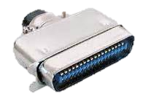
SCSI
Small Computer System Interface
A once common standard for connecting peripheral devices to small and medium-sized computers
Has lost popularity to USB and FireWire in smaller systems
High-speed versions remain popular for mass memory support on enterprise systems
Physical organization is a shared bus, which can support up to 16 or 32 devices, depending on the generation of the standard
  The bus provides for parallel transmission rather than serial, with a bus width of 16 bits on earlier generations and 32 bits on later generations
  Speeds range from 5 Mbps on the original SCSI-1 specification to 160 Mbps on SCSI-3 U3
Notes:
SCSI is a once common standard for connecting peripheral devices (disks, modems,
printers, etc.) to small and medium-sized computers. Although SCSI has evolved to
higher data rates, it has lost popularity to such competitors as USB and FireWire
in smaller systems. However, high-speed versions of SCSI remain popular for mass
memory support on enterprise systems. For example, the IBM zEnterprise EC12
and other IBM mainframes offer support for SCSI, and a number of Seagate hard
drive systems use SCSI.
The physical organization of SCSI is a shared bus, which can support up to 16
or 32 devices, depending on the generation of the standard. The bus provides for
parallel transmission rather than serial, with a bus width of 16 bits on earlier generations
and 32 bits on later generations. Speeds range from 5 Mbps on the original
SCSI-1 specification to 160 Mbps on SCSI-3 U3.

Slide 44


Thunderbolt
Most recent and fastest peripheral connection technology to become available for general-purpose use
Developed by Intel with collaboration from Apple
The technology combines data, video, audio, and power into a single high-speed connection for peripherals such as hard drives, RAID arrays, video-capture boxes, and network interfaces
Provides up to 10 Gbps throughput in each direction and up to 10 Watts of power to connected peripherals
Notes:
The most recent, and fastest, peripheral connection technology to become available for
general-purpose use is Thunderbolt, developed by Intel with collaboration from Apple.
One Thunderbolt cable can manage the work previously required of multiple cables.
The technology combines data, video, audio, and power into a single high-speed connection
for peripherals such as hard drives, RAID (Redundant Array of Independent
Disks) arrays, video-capture boxes, and network interfaces. It provides up to 10 Gbps
throughput in each direction and up to 10 Watts of power to connected peripherals.
Thunderbolt is described in detail in Appendix J.

Slide 45
InfiniBand
I/O specification aimed at the high-end server market
First version was released in early 2001
Heavily relied on by IBM zEnterprise series of mainframes
Standard describes an architecture and specifications for data flow among processors and intelligent I/O devices
Has become a popular interface for storage area networking and other large storage configurations
Enables servers, remote storage, and other network devices to be attached in a central fabric of switches and links
The switch-based architecture can connect up to 64,000 servers, storage systems, and networking devices
Notes:
InfiniBand is an I/O specification aimed at the high-end server market. The first
version of the specification was released in early 2001 and has attracted numerous
vendors. For example, IBM zEnterprise series of mainframes has relied heavily on
InfiniBand for a number of years. The standard describes an architecture and specifications
for data flow among processors and intelligent I/O devices. InfiniBand has
become a popular interface for storage area networking and other large storage configurations.
In essence, InfiniBand enables servers, remote storage, and other network
devices to be attached in a central fabric of switches and links. The switch-based
architecture can connect up to 64,000 servers, storage systems, and networking devices.
Infiniband is described in detail in Appendix J.

Slide 46

SATA
PCI Express
Serial Advanced Technology Attachment
An interface for disk storage systems
Provides data rates of up to 6 Gbps, with a maximum per device of 300 Mbps
Widely used in desktop computers and in industrial and embedded applications
High-speed bus system for connecting peripherals of a wide variety of types and speeds
Notes:
PCI Express is a high-speed
bus system for connecting peripherals of a wide variety
of types and speeds. Chapter 3 discusses PCI Express in detail.
Serial ATA (Serial Advanced Technology Attachment) is an interface for disk storage
systems. It provides data rates of up to 6 Gbps, with a maximum per device of
300 Mbps. SATA is widely used in desktop computers, and in industrial and embedded
applications.

Slide 47
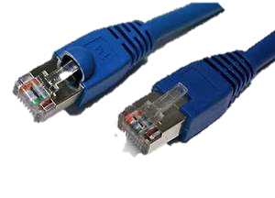
Ethernet
Predominant wired networking technology
Has evolved to support data rates up to 100 Gbps and distances from a few meters to tens of km
Has become essential for supporting personal computers, workstations, servers, and massive data storage devices in organizations large and small
Began as an experimental bus-based 3-Mbps system
Has moved from bus-based to switch-based
  Data rate has periodically increased by an order of magnitude
  There is a central switch with all of the devices connected directly to the switch
  Ethernet systems are currently available at speeds up to 100 Gbps
Notes:
Ethernet is the predominant wired networking technology, used in homes, offices,
data centers, enterprises, and wide-area networks. As Ethernet has evolved to support
data rates up to 100 Gbps and distances from a few meters to tens of km, it
has become essential for supporting personal computers, workstations, servers, and
massive data storage devices in organizations large and small.
Ethernet began as an experimental bus-based 3-Mbps system. With a bus system,
all of the attached devices, such as PCs, connect to a common coaxial cable,
much like residential cable TV systems. The first commercially-available Ethernet,
and the first version of IEEE 802.3, were bus-based systems operating at 10
Mbps. As technology has advanced, Ethernet has moved from bus-based
to switch-based, and the data rate has periodically increased by an order of magnitude. With
switch-based systems, there is a central switch, with all of the devices connected
directly to the switch. Currently, Ethernet systems are available at speeds up to 100
Gbps. Here’s a brief chronology.
■ 1983: 10 Mbps (megabit per second, million bits per second)
■ 1995: 100 Mbps
■ 1998: 1 Gbps (gigabit per second, billion bits per second)
■ 2003: 10 Gbps
■ 2010: 40 Gbps and 100 Gbps

Slide 48

Wi-Fi
Is the predominant wireless Internet access technology
Now connects computers, tablets, smart phones, and other electronic devices such as video cameras TVs and thermostats
In the enterprise has become an essential means of enhancing worker productivity and network effectiveness
Public hotspots have expanded dramatically to provide free Internet access in most public places
As the technology of antennas, wireless transmission techniques, and wireless protocol design has evolved, the IEEE 802.11 committee has been able to introduce standards for new versions of Wi-Fi at higher speeds
  Current version is 802.11ac (2014) with a maximum data rate of 3.2 Gbps
Notes:
Wi-Fi is the predominant wireless Internet access technology, used in homes, offices,
and public spaces. Wi-Fi in the home now connects computers, tablets, smart phones,
and a host of electronic devices, such as video cameras, TVs, and thermostats. Wi-Fi
in the enterprise has become an essential means of enhancing worker productivity
and network effectiveness. And public Wi-Fi hotspots have expanded dramatically
to provide free Internet access in most public places.
As the technology of antennas, wireless transmission techniques, and wireless
protocol design has evolved, the IEEE 802.11 committee has been able to introduce
standards for new versions of Wi-Fi at ever-higher speeds. Once the standard is
issued, industry quickly develops the products. Here’s a brief chronology, starting
with the original standard, which was simply called IEEE 802.11, and showing the
maximum data rate for each version:
■ 802.11 (1997): 2 Mbps (megabit per second, million bits per second)
■ 802.11a (1999): 54 Mbps
■ 802.11b (1999): 11 Mbps
■ 802.11n (1999): 600 Mbps
■ 802.11g (2003): 54 Mbps
■ 802.11ad (2012): 6.76 Gbps (billion bits per second)
■ 802.11ac (2014): 3.2 Gbps

Slide 49
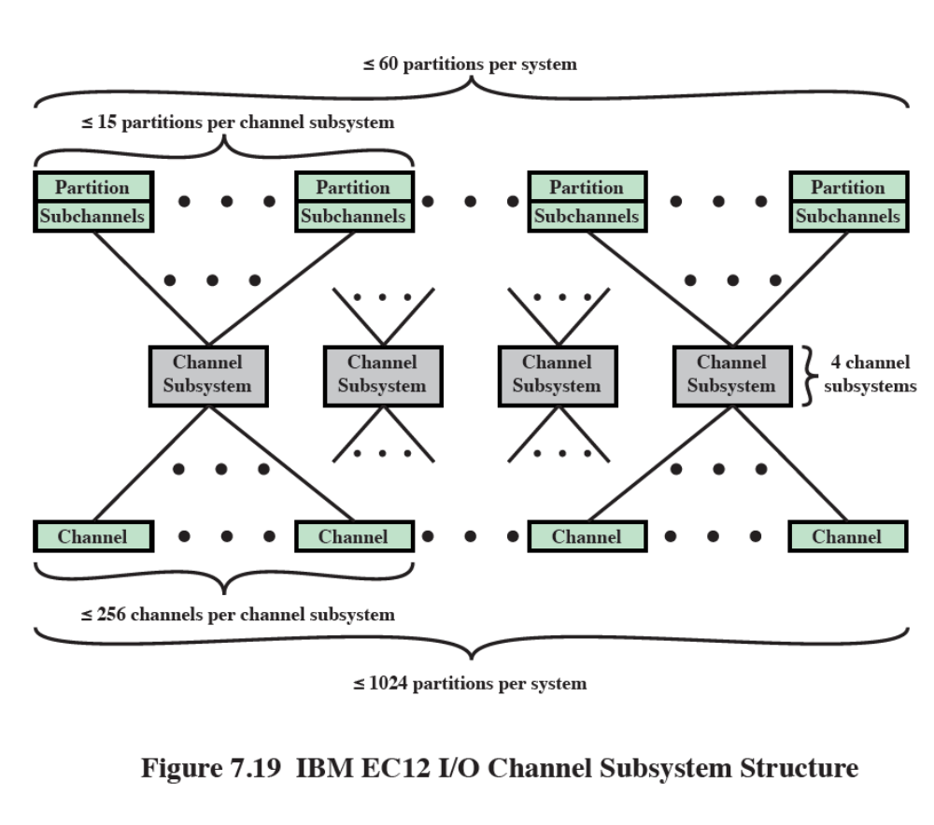
Notes:
The zEnterprise EC12 is IBM’s latest mainframe computer offering (at the time of
this writing). The system is based on the use of the zEC12 processor chip, which is a
5.5-GHz multicore chip with six cores. The zEC12 architecture can have a maximum
of 101 processor chips for a total of 606 cores. In this section, we look at the I/O
structure of the zEnterprise EC12.
The zEnterprise EC12 has a dedicated I/O subsystem that manages all I/O operations,
completely off-loading this processing and memory burden from the main
processors. Figure 7.21 shows the logical structure of the I/O subsystem. Of the 96
core processors, up to 4 of these can be dedicated for I/O use, creating 4 channel
subsystems (CSS) . Each CSS is made up of the following elements:
■ System assist processor (SAP): The SAP is a core processor configured for I/O
operation. Its role is to offload I/O operations and manage channels and the
I/O operations queues. It relieves the other processors of all I/O tasks, allowing
them to be dedicated to application logic.
■ Hardware system area (HSA): The HSA is a reserved part of the system memory
containing the I/O configuration. It is used by SAPs. A fixed amount of
32 GB is reserved, which is not part of the customer purchased memory. This provides for
greater configuration flexibility and higher availability by eliminating planned and preplanned outages.
■ Logical partitions: A logical partition is a form of virtual machine, which is in
essence, a logical processor defined at the operating system level. Each CSS
supports up to 16 logical partitions.
■ Subchannels: A subchannel appear to a program as a logical device and contain
the information required to perform an I/O operation. One subchannel
exists for each I/O device addressable by the CSS. A subchannel is used by the
channel subsystem code running on a partition to pass an I/O request to the
channel subsystem. A subchannel is assigned for each device defined to the
logical partition. Up to 196k subchannels are supported per CSS.
■ Channel path: A channel path is a single interface between a channel subsystem
and one or more control units, via a channel. Commands and data are sent
across a channel path to perform I/O requests. Each CSS can have up to 256
channel paths.
■ Channel: Channels are small processors that communicate with the I/O control
units (CUs). They manage the data transfer between memory and the
external devices.
This elaborate structure enables the mainframe to manage a massive number
of I/O devices and communication links. All I/O processing is offloaded from
the application and server processors, enhancing performance. The channel subsystem
processors are somewhat general in configuration, enabling them to manage
a wide variety of I/O duties and to keep up with evolving requirements. The channel
processors are specifically programmed for the I/O control units to which they
interface.

Slide 50
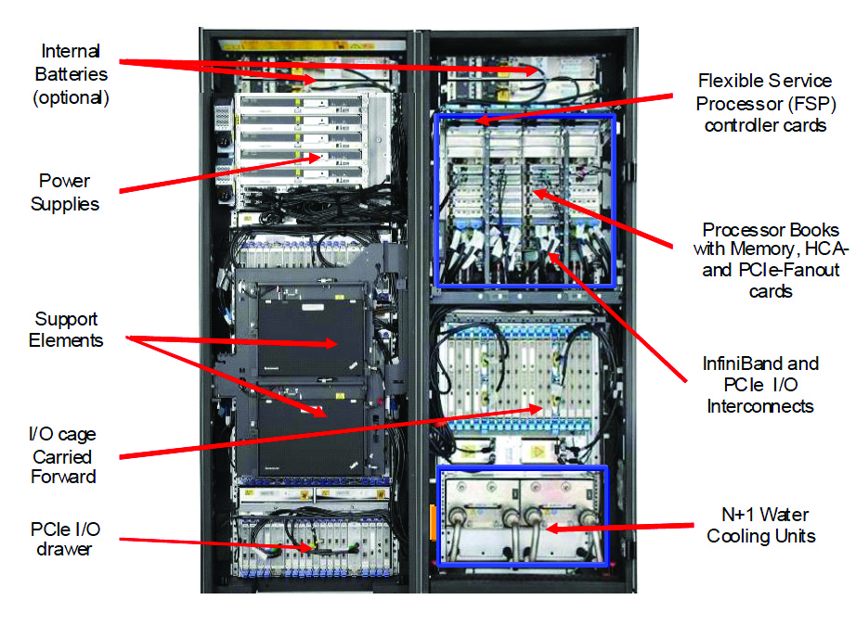
IBM zEC12 I/O Frames-Front View
Notes:
To explain the I/O system organization, we need to first briefly explain the physical
layout of the zEnterprise EC12. Figure 7.20 is a front view of the water-cooled version
of the machine (there is an air-cooled version). The system has the following
characteristics:
• Weight: 2430 kg (5358 lbs)
• Width: 1.568 m (5.14 ft)
• Depth: 1.69 m (6.13 ft)
• Height: 2.015 m (6.6 ft)
Not exactly a laptop.
The system consists of two large bays, called frames, that house the various
components of the zEnterprise EC12. The right hand A frame includes two large
cages, plus room for cabling and other components. The upper cage is a processor
cage, with four slots to house up to four processor books that are fully interconnected.
Each book contains a multichip module (MCM), memory cards, and I/O
cage connections. Each MCM is a board that houses six multicore chips and two
storage control chips.
The lower cage in the A frame is an I/O cage, which contains I/O hardware,
including multiplexors and channels. The I/O cage is a fixed unit installed by IBM to
the customer specifications at the factory.
The left hand Z frame contains internal batteries and power supplies and
room for one or more support elements, which are used by a system manager for
platform management. The Z frame also contains slots for two or more I/O drawers.
An I/O drawer contains similar components to an I/O cage. The differences are
that the drawer is smaller and easily swapped in and out at the customer site to meet
changing requirements.

Slide 51
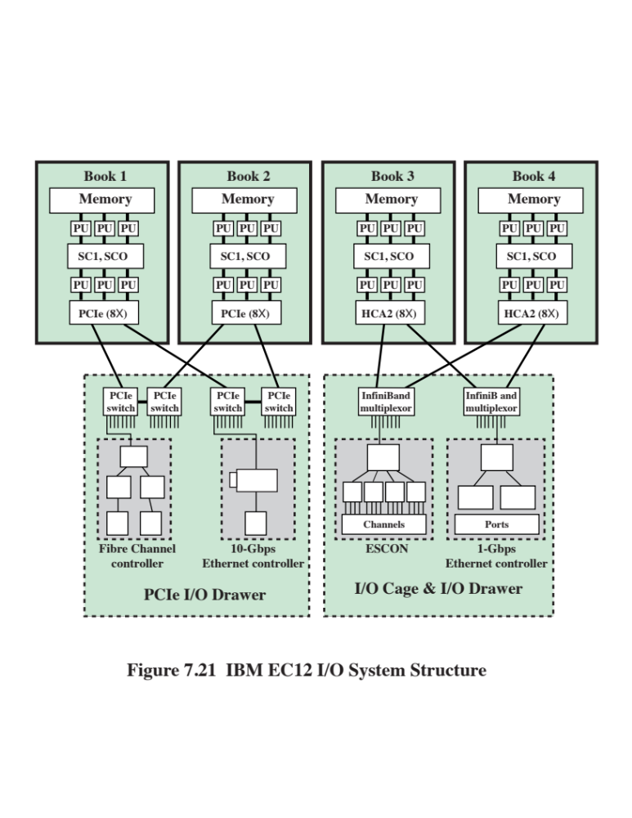
Notes:
With this background, we now show a typical configuration of the zEnterprise
EC12 I/O system structure (Figure 7.21). Each zEC12 processor book supports two
internal (i.e., internal to the A and Z frames) I/O infrastructures: InfiniBand for
I/O cages and I/O drawers, and PCI Express (PCIe) for I/O drawers. These channel
controllers are referred to as fanouts .
The InfiniBand connections from the processor book to the I/O cages and
I/O drawers are via a Host Channel Adapter (HCA) fanout, which has InfiniBand
links to InfiniBand multiplexors in the I/O cage or drawer. The InfiniBand multiplexors
are used to interconnect servers, communications infrastructure equipment,
storage, and embedded systems. In addition to using InfiniBand to interconnect
systems, all of which use InfiniBand, the InfiniBand multiplexor supports other I/O
technologies. ESCON (Enterprise Systems Connection) supports connectivity to
disks, tapes, and printer devices using a proprietary fiber-based technology. Ethernet
connections provide 1-Gbps and 10-Gbps connections to a variety of devices
that support this popular local area network technology. One noteworthy use of
Ethernet is to construct large server farms, particularly to interconnect blade servers
with each other and with other mainframes.
The PCIe connections from the processor book to the I/O drawers are via a
PCIe fanout to PCIe switches. The PCIe switches can connect to a number of I/O
device controllers. Typical examples for zEnterprise EC12 are 1-Gbps and 10-Gbps
Ethernet and Fiber Channel.
Each book contains a combination of up to 8 InfiniBand HCA and PCIe
fanouts. Each fanout supports up to 32 connections, for a total maximum of 256
connections per processor book, each connection controlled by a channel processor.

Slide 52
Summary
Input/Output
Interrupt-driven I/O
  Interrupt processing
  Design issues
  Intel 82C59A interrupt controller
  Intel 82C55A programmable peripheral interface
  Direct Cache Access
  DMA using shared last-level cache
  Cache-related performance issues
  Direct cache access strategies
  Direct data I/O
  I/O channels and processors
  The evolution of the I/O function
  Characteristics of I/O channels
External devices
  Keyboard/monitor
  Disk drive
I/O modules
  Module function
  I/O module structure
Programmed I/O
  Overview of programmed I/O
  I/O commands/instructions
  Direct memory access
  Drawbacks of programmed and interrupt-driven I/O
  DMA function
  Intel 8237A DMA controller
Notes:
Chapter 7 summary.

Slide 53
Part 2
Operating System Support

Slide 54
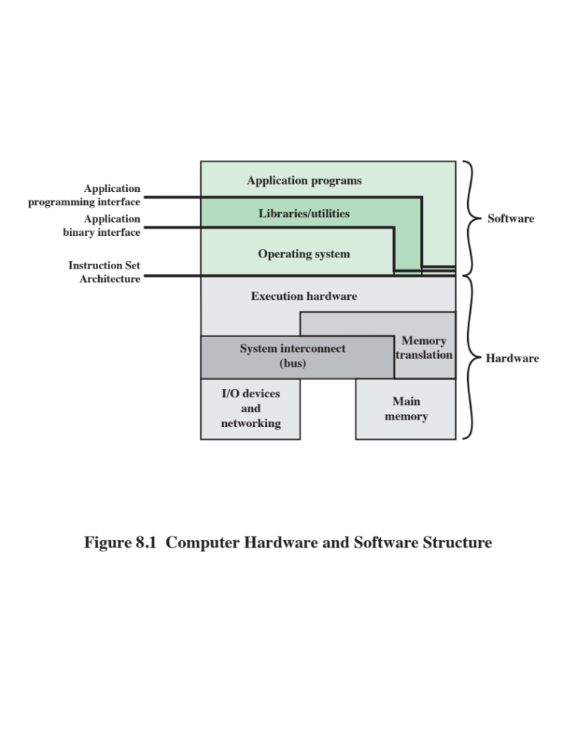
Notes:
An OS is a program that controls the execution of application programs and acts as
an interface between applications and the computer hardware. It can be thought of
as having two objectives:
• Convenience: An OS makes a computer more convenient to use.
• Efficiency: An OS allows the computer system resources to be used in an
efficient manner.
The hardware and software used in providing applications to a user can be viewed in a layered
or hierarchical fashion, as depicted in Figure 8.1. The user of those applications,
the end user, generally is not concerned with the computer’s architecture. Thus
the end user views a computer system in terms of an application. That application
can be expressed in a programming language and is developed by an application
programmer. To develop an application program as a set of processor instructions
that is completely responsible for controlling the computer hardware would be
an overwhelmingly complex task. To ease this task, a set of systems programs is
provided. Some of these programs are referred to as utilities. These implement
frequently used functions that assist in program creation, the management of
files, and the control of I/O devices. A programmer makes use of these facilities
in developing an application, and the application, while it is running, invokes the
utilities to perform certain functions.

Slide 55

Operating System (OS) Services
The most important system program
Masks the details of the hardware from the programmer and provides the programmer with a convenient interface for using the system
The OS typically provides services in the following areas:
  Program creation
  Program execution
  Access to I/O devices
  Controlled access to files
  System access
  Error detection and response
  Accounting
Notes:
The most important system program is the OS.
The OS masks the details of the hardware from the programmer and provides the
programmer with a convenient interface for using the system. It acts as mediator,
making it easier for the programmer and for application programs to access and use
those facilities and services.
Briefly, the OS typically provides services in the following areas:
• Program creation: The OS provides a variety of facilities and services, such
as editors and debuggers, to assist the programmer in creating programs.
Typically, these services are in the form of utility programs that are not actually
part of the OS but are accessible through the OS.
• Program execution: A number of steps need to be performed to execute a
program. Instructions and data must be loaded into main memory, I/O devices
and files must be initialized, and other resources must be prepared. The OS
handles all of this for the user.
• Access to I/O devices: Each I/O device requires its own specific set of instructions
or control signals for operation. The OS takes care of the details so that
the programmer can think in terms of simple reads and writes.
• Controlled access to files: In the case of files, control must include an understanding
of not only the nature of the I/O device (disk drive, tape drive) but
also the file format on the storage medium. Again, the OS worries about the
details. Further, in the case of a system with multiple simultaneous users, the
OS can provide protection mechanisms to control access to the files.
• System access: In the case of a shared or public system, the OS controls access
to the system as a whole and to specific system resources. The access function
must provide protection of resources and data from unauthorized users and
must resolve conflicts for resource contention.
• Error detection and response: A variety of errors can occur while a computer
system is running. These include internal and external hardware errors, such as
a memory error, or a device failure or malfunction; and various software errors,
such as arithmetic overflow, attempt to access forbidden memory location, and
inability of the OS to grant the request of an application. In each case, the OS must
make the response that clears the error condition with the least impact on running
applications. The response may range from ending the program that caused the
error, to retrying the operation, to simply reporting the error to the application.
• Accounting: A good OS collects usage statistics for various resources and
monitor performance parameters such as response time. On any system, this
information is useful in anticipating the need for future enhancements and in
tuning the system to improve performance. On a multiuser system, the information
can be used for billing purposes.

Slide 56
Interfaces
Key interfaces in a typical computer system:
Instruction set architecture (ISA)
Defines the machine language instructions that a computer can follow
Boundary between hardware and software
Application binary interface (ABI)
Defines a standard for binary portability across programs
Defines the system call interface to the operating system and the hardware resources and services available in a system through the user ISA
Application programming interface (API)
Gives a program access to the hardware resources and services available in a system through the user ISA supplemented with high-level language (HLL) library calls
Using an API enables application software to be ported easily to other systems that support the same API
Notes:
Figure 8.1 also indicates three key interfaces in a typical computer system:
• Instruction set architecture (ISA): The ISA defines the repertoire of machine
language instructions that a computer can follow. This interface is the boundary
between hardware and software. Note that both application programs
and utilities may access the ISA directly. For these programs, a subset of the
instruction repertoire is available (user ISA). The OS has access to additional
machine language instructions that deal with managing system resources
(system ISA).
• Application binary interface (ABI): The ABI defines a standard for binary
portability across programs. The ABI defines the system call interface to the
operating system and the hardware resources and services available in a system
through the user ISA.
• Application programming interface (API): The API gives a program access
to the hardware resources and services available in a system through the user
ISA supplemented with high-level language (HLL) library calls. Any system
calls are usually performed through libraries. Using an API enables application
software to be ported easily, through recompilation, to other systems that
support the same API.

Slide 57

Operating System as
Resource Manager
A computer is a set of resources for the movement, storage, and processing of data and for the control of these functions
  The OS is responsible for managing these resources
The OS as a control mechanism is unusual in two respects:
  The OS functions in the same way as ordinary computer software – it is a program executed by the processor
  The OS frequently relinquishes control and must depend on the processor to allow it to regain control
Notes:
A computer is a set of resources for the movement, storage, and processing of data and for the control of
these functions. The OS is responsible for managing these resources.
Can we say that the OS controls the movement, storage, and processing of
data? From one point of view, the answer is yes: By managing the computer’s
resources, the OS is in control of the computer’s basic functions. But this control is
exercised in a curious way. Normally, we think of a control mechanism as something
external to that which is controlled, or at least as something that is a distinct and
separate part of that which is controlled. (For example, a residential heating system
is controlled by a thermostat, which is completely distinct from the heat-generation
and heat-distribution apparatus.) This is not the case with the OS, which as a control
mechanism is unusual in two respects:
• The OS functions in the same way as ordinary computer software; that is, it is
a program executed by the processor.
• The OS frequently relinquishes control and must depend on the processor to
allow it to regain control.
Like other computer programs, the OS provides instructions for the processor.
The key difference is in the intent of the program. The OS directs the processor
in the use of the other system resources and in the timing of its execution of other
programs. But in order for the processor to do any of these things, it must cease
executing the OS program and execute other programs. Thus, the OS relinquishes
control for the processor to do some “useful” work and then resumes control long
enough to prepare the processor to do the next piece of work. The mechanisms
involved in all this should become clear as the chapter proceeds.

Slide 58
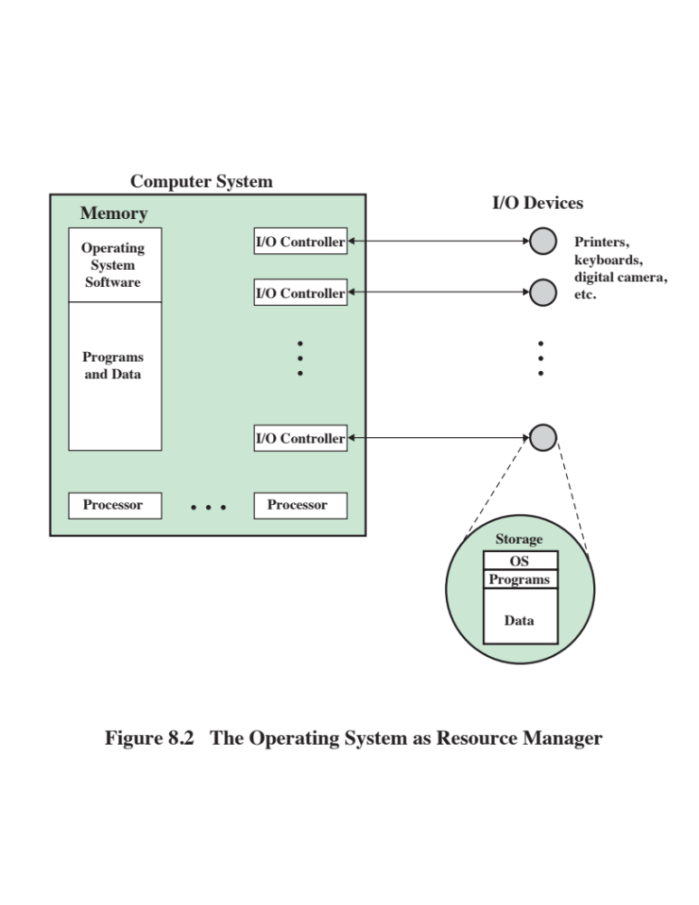
Notes:
Figure 8.2 suggests the main resources that are managed by the OS. A portion
of the OS is in main memory. This includes the kernel, or nucleus, which contains
the most frequently used functions in the OS and, at a given time, other portions of
the OS currently in use. The remainder of main memory contains user programs and
data. The allocation of this resource (main memory) is controlled jointly by the OS
and memory-management hardware in the processor, as we shall see. The OS decides
when an I/O device can be used by a program in execution, and controls access to and
use of files. The processor itself is a resource, and the OS must determine how much
processor time is to be devoted to the execution of a particular user program. In the
case of a multiple-processor system, this decision must span all of the processors.

Slide 59
Types of Operating Systems
Interactive system
  The user/programmer interacts directly with the computer to request the execution of a job or to perform a transaction
  User may, depending on the nature of the application, communicate with the computer during the execution of the job
Batch system
  Opposite of interactive
  The user’s program is batched together with programs from other users and submitted by a computer operator
  After the program is completed results are printed out for the user
Notes:
Certain key characteristics serve to differentiate various types of operating systems.
The characteristics fall along two independent dimensions. The first dimension
specifies whether the system is batch or interactive. In an interactive system, the
user/programmer interacts directly with the computer, usually through a keyboard/
display terminal, to request the execution of a job or to perform a transaction.
Furthermore, the user may, depending on the nature of the application, communicate
with the computer during the execution of the job. A batch system is the
opposite of interactive. The user’s program is batched together with programs from
other users and submitted by a computer operator. After the program is completed,
results are printed out for the user. Pure batch systems are rare today. However,
it will be useful to the description of contemporary operating systems to examine
batch systems briefly.
An independent dimension specifies whether the system employs multiprogramming
or not. With multiprogramming, the attempt is made to keep the processor
as busy as possible, by having it work on more than one program at a time. Several
programs are loaded into memory, and the processor switches rapidly among them.
The alternative is a uniprogramming system that works only one program at a time.

Slide 60

Early Systems
From the late 1940s to the mid-1950s the programmer interacted directly with the computer hardware – there was no OS
  Processors were run from a console consisting of display lights, toggle switches, some form of input device and a printer
Problems:
  Scheduling
    Sign-up sheets were used to reserve processor time
      This could result in wasted computer idle time if the user finished early
      If problems occurred the user could be forced to stop before resolving the problem
  Setup time
    A single program could involve
      Loading the compiler plus the source program into memory
      Saving the compiled program
      Loading and linking together the object program and common functions
Notes:
With the earliest computers, from the late 1940s to the mid-1950s,
the programmer interacted directly with the computer hardware; there was no
OS. These processors were run from a console, consisting of display lights, toggle
switches, some form of input device, and a printer. Programs in processor code were
loaded via the input device (e.g., a card reader). If an error halted the program,
the error condition was indicated by the lights. The programmer could proceed
to examine registers and main memory to determine the cause of the error. If the
program proceeded to a normal completion, the output appeared on the printer.
These early systems presented two main problems:
• Scheduling: Most installations used a sign-up sheet to reserve processor time.
Typically, a user could sign up for a block of time in multiples of a half hour or
so. A user might sign up for an hour and finish in 45 minutes; this would result
in wasted computer idle time. On the other hand, the user might run into problems,
not finish in the allotted time, and be forced to stop before resolving
the problem.
• Setup time: A single program, called a job, could involve loading the compiler
plus the high-level language program (source program) into memory,
saving the compiled program (object program), and then loading and linking
together the object program and common functions. Each of these steps could
involve mounting or dismounting tapes, or setting up card decks. If an error
occurred, the hapless user typically had to go back to the beginning of the
setup sequence. Thus a considerable amount of time was spent just in setting
up the program to run.
This mode of operation could be termed serial processing, reflecting the fact
that users have access to the computer in series. Over time, various system software
tools were developed to attempt to make serial processing more efficient. These
include libraries of common functions, linkers, loaders, debuggers, and I/O driver
routines that were available as common software for all users.

Slide 61
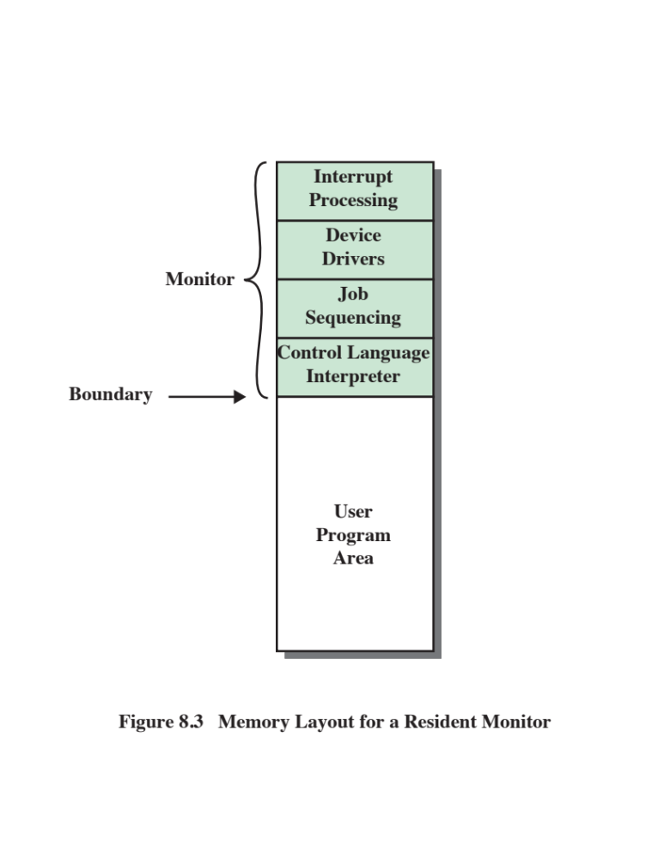
Notes:
Early processors were very expensive, and therefore it
was important to maximize processor utilization. The wasted time due to scheduling
and setup time was unacceptable.
To improve utilization, simple batch operating systems were developed. With
such a system, also called a monitor, the user no longer has direct access to the
processor. Rather, the user submits the job on cards or tape to a computer operator,
who batches the jobs together sequentially and places the entire batch on an input
device, for use by the monitor.
To understand how this scheme works, let us look at it from two points of
view: that of the monitor and that of the processor. From the point of view of the
monitor, the monitor controls the sequence of events. For this to be so, much of the
monitor must always be in main memory and available for execution (Figure 8.3).
That portion is referred to as the resident monitor. The rest of the monitor consists
of utilities and common functions that are loaded as subroutines to the user program
at the beginning of any job that requires them. The monitor reads in jobs one
at a time from the input device (typically a card reader or magnetic tape drive). As it
is read in, the current job is placed in the user program area, and control is passed to
this job. When the job is completed, it returns control to the monitor, which immediately
reads in the next job. The results of each job are printed out for delivery to
the user.

Slide 62
From the View of the Processor . . .
Processor executes instructions from the portion of main memory containing the monitor
  These instructions cause the next job to be read in another portion of main memory
  The processor executes the instruction in the user’s program until it encounters an ending or error condition
  Either event causes the processor to fetch its next instruction from the monitor program
The monitor handles setup and scheduling
  A batch of jobs is queued up and executed as rapidly as possible with no idle time
Job control language (JCL)
  Special type of programming language used to provide instructions to the monitor
Example:
  $JOB
  $FTN
  ... Some Fortran instructions
  $LOAD
  $RUN
  ... Some data
  $END
  Monitor, or batch OS, is simply a computer program
  It relies on the ability of the processor to fetch instructions from various portions of main memory in order to seize and relinquish control alternately
**Each FORTRAN instruction and each item of
data is on a separate punched card or a separate record on tape. In addition to FORTRAN and data lines, the job includes job control instructions, which are
denoted by the beginning “$”.
Notes:
Now consider this sequence from the point of view of the processor. At a certain
point in time, the processor is executing instructions from the portion of main
memory containing the monitor. These instructions cause the next job to be read
in to another portion of main memory. Once a job has been read in, the processor
will encounter in the monitor a branch instruction that instructs the processor to
continue execution at the start of the user program. The processor will then execute
the instruction in the user’s program until it encounters an ending or error condition.
Either event causes the processor to fetch its next instruction from the monitor
program. Thus the phrase “control is passed to a job” simply means that the processor
is now fetching and executing instructions in a user program, and “control is
returned to the monitor” means that the processor is now fetching and executing
instructions from the monitor program.
It should be clear that the monitor handles the scheduling problem. A batch of
jobs is queued up, and jobs are executed as rapidly as possible, with no intervening
idle time.
How about the job setup time? The monitor handles this as well. With each
job, instructions are included in a job control language (JCL). This is a special type
of programming language used to provide instructions to the monitor. A simple
example is that of a user submitting a program written in FORTRAN plus some
data to be used by the program. Each FORTRAN instruction and each item of
data is on a separate punched card or a separate record on tape. In addition to
FORTRAN and data lines, the job includes job control instructions, which are
denoted by the beginning “$”.
To execute this job, the monitor reads the $FTN line and loads the appropriate
compiler from its mass storage (usually tape). The compiler translates the user’s
program into object code, which is stored in memory or mass storage. If it is stored
in memory, the operation is referred to as “compile, load, and go.” If it is stored
on tape, then the $LOAD instruction is required. This instruction is read by the
monitor, which regains control after the compile operation. The monitor invokes
the loader, which loads the object program into memory in place of the compiler
and transfers control to it. In this manner, a large segment of main memory can
be shared among different subsystems, although only one such subsystem could be
resident and executing at a time.
We see that the monitor, or batch OS, is simply a computer program. It relies
on the ability of the processor to fetch instructions from various portions of main
memory in order to seize and relinquish control alternately.

Slide 63
Desirable Hardware Features
Memory protection
  User program must not alter the memory area containing the monitor
  The processor hardware should detect an error and transfer control to the monitor
  The monitor aborts the job, prints an error message, and loads the next job
Privileged instructions
  Can only be executed by the monitor
  If the processor encounters such an instruction while executing a user program an error interrupt occurs
  I/O instructions are privileged so the monitor retains control of all I/O devices
Timer
  Used to prevent a job from monopolizing the system
  If the timer expires an interrupt occurs and control returns to monitor
Interrupts
  Gives the OS more flexibility in relinquishing control to and regaining control from user programs
Notes:
Certain other hardware features are also desirable:
• Memory protection: While the user program is executing, it must not alter the
memory area containing the monitor. If such an attempt is made, the processor
hardware should detect an error and transfer control to the monitor. The
monitor would then abort the job, print out an error message, and load the
next job.
• Timer: A timer is used to prevent a single job from monopolizing the system.
The timer is set at the beginning of each job. If the timer expires, an interrupt
occurs, and control returns to the monitor.
• Privileged instructions: Certain instructions are designated privileged and can
be executed only by the monitor. If the processor encounters such an instruction
while executing a user program, an error interrupt occurs. Among the
privileged instructions are I/O instructions, so that the monitor retains control
of all I/O devices. This prevents, for example, a user program from accidentally
reading job control instructions from the next job. If a user program
wishes to perform I/O, it must request that the monitor perform the operation
for it. If a privileged instruction is encountered by the processor while it is
executing a user program, the processor hardware considers this an error and
transfers control to the monitor.
• Interrupts: Early computer models did not have this capability. This feature
gives the OS more flexibility in relinquishing control to and regaining control
from user programs.
Processor time alternates between execution of user programs and execution
of the monitor. There have been two sacrifices: Some main memory is now given
over to the monitor and some processor time is consumed by the monitor. Both
of these are forms of overhead. Even with this overhead, the simple batch system
improves utilization of the computer.

Slide 64
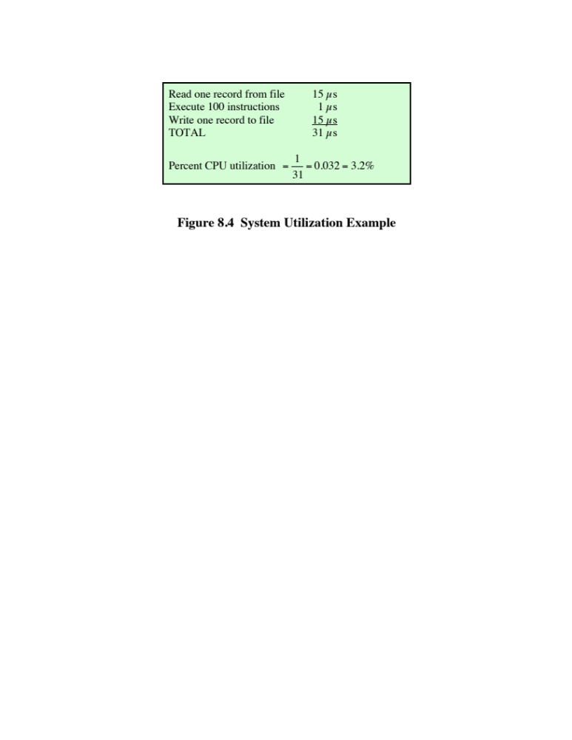
Notes:
Even with the automatic job sequencing
provided by a simple batch OS, the processor is often idle. The problem is that
I/O devices are slow compared to the processor. Figure 8.4 details a representative
calculation. The calculation concerns a program that processes a file of records and
performs, on average, 100 processor instructions per record. In this example the
computer spends over 96% of its time waiting for I/O devices to finish transferring
data! Figure 8.5a illustrates this situation.

Slide 65
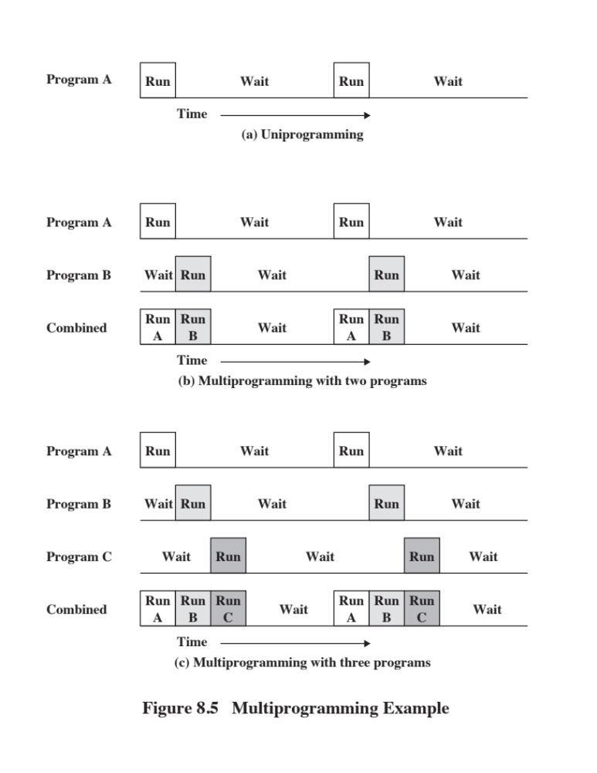
Notes:
The processor spends a certain amount of time executing, until it reaches an I/O instruction. It must then wait until that I/O
instruction concludes before proceeding.
This inefficiency is not necessary. We know that there must be enough memory
to hold the OS (resident monitor) and one user program. Suppose that there
is room for the OS and two user programs. Now, when one job needs to wait for
I/O, the processor can switch to the other job, which likely is not waiting for I/O
(Figure 8.5b). Furthermore, we might expand memory to hold three, four, or more
programs and switch among all of them (Figure 8.5c). This technique is known as multiprogramming,
or multitasking. It is the central theme of modern operating systems.
As with a simple batch system, a multiprogramming batch system must rely
on certain computer hardware features. The most notable additional feature that
is useful for multiprogramming is the hardware that supports I/O interrupts and
DMA. With interrupt-driven I/O or DMA, the processor can issue an I/O command
for one job and proceed with the execution of another job while the I/O is carried
out by the device controller. When the I/O operation is complete, the processor is
interrupted and control is passed to an interrupt-handling program in the OS. The
OS will then pass control to another job.

Slide 66
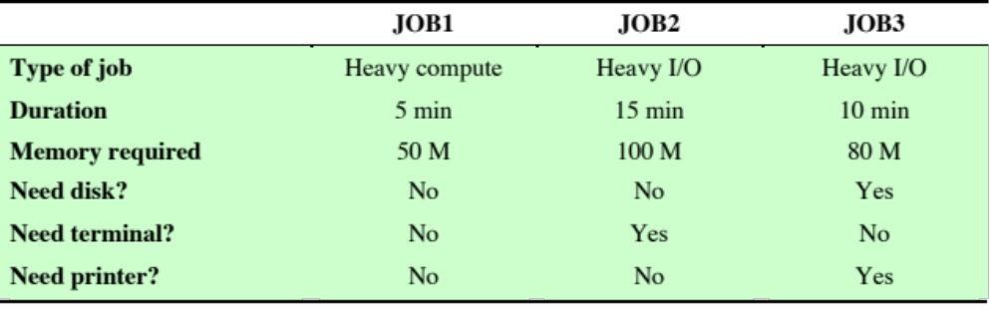
Table 8.1
Sample Program Execution Attributes
Notes:
This example illustrates the benefit of multiprogramming. Consider a
computer with 250 Mbytes of available memory (not used by the OS), a disk, a terminal,
and a printer. Three programs, JOB1, JOB2, and JOB3, are submitted for execution at the
same time, with the attributes listed in Table 8.1. We assume minimal processor requirements
for JOB2 and JOB3 and continuous disk and printer use by JOB3. For a simple
batch environment, these jobs will be executed in sequence. Thus, JOB1 completes in
5 minutes. JOB2 must wait until the 5 minutes is over and then completes 15 minutes
after that. JOB3 Begins after 20 minutes and completes at 30 minutes from the time it was
initially submitted.

Slide 67
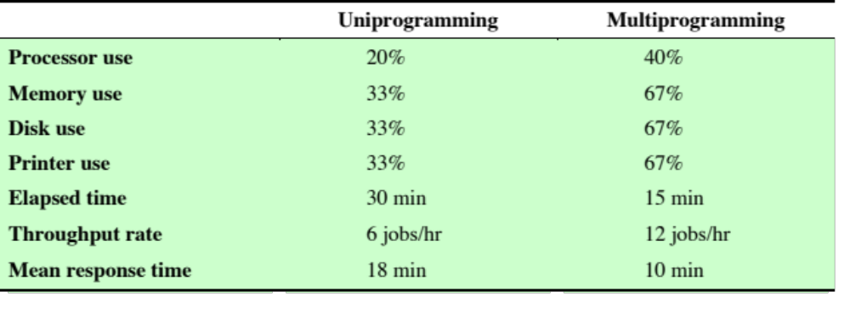
Effects of Multiprogramming on Resource Utilization
Notes:
The average resource utilization, throughput, and response times are
shown in the uniprogramming column of Table 8.2. Device-by-device
utilization is illustrated in Figure 8.6a. It is evident that there is gross underutilization for all resources when
averaged over the required 30-minute time period.
Now suppose that the jobs are run concurrently under a multiprogramming OS. Because
there is little resource contention between the jobs, all three can run in nearly minimum
time while coexisting with the others in the computer (assuming that JOB2 and
JOB3 are allotted enough processor time to keep their input and output operations active).
JOB1 will still require 5 minutes to complete but at the end of that time, JOB2 will be
one-third finished, and JOB3 will be half finished. All three jobs will have finished within
15 minutes. The improvement is evident when examining the multiprogramming column
of Table 8.2, obtained from the histogram shown in Figure 8.6b.

Slide 68
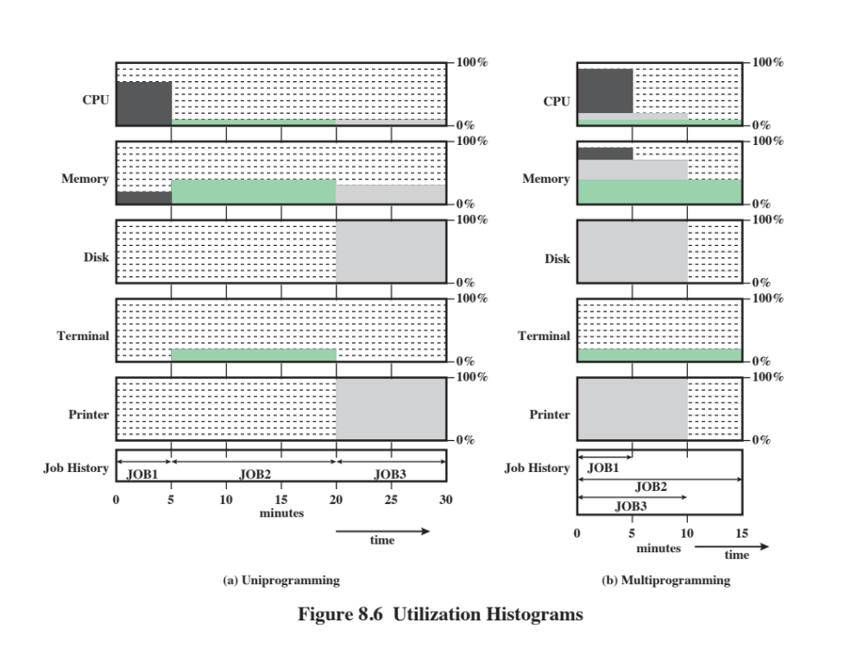
Notes:
Multiprogramming operating systems are fairly sophisticated compared to
single-program, or uniprogramming, systems. To have several jobs ready to run, the
jobs must be kept in main memory, requiring some form of memory management.
In addition, if several jobs are ready to run, the processor must decide which one
to run, which requires some algorithm for scheduling. These concepts are discussed
later in this chapter.

Slide 69

Time Sharing Systems
Used when the user interacts directly with the computer
Processor’s time is shared among multiple users
Multiple users simultaneously access the system through terminals, with the OS interleaving the execution of each user program in a short burst or quantum of computation
Example:
  If there are n users actively requesting service at one time, each user will only see on the average 1/n of the effective computer speed
Notes:
With the use of multiprogramming, batch processing
can be quite efficient. However, for many jobs, it is desirable to provide a mode in
which the user interacts directly with the computer. Indeed, for some jobs, such as
transaction processing, an interactive mode is essential.
Today, the requirement for an interactive computing facility can be, and often
is, met by the use of a dedicated microcomputer. That option was not available in the
1960s, when most computers were big and costly. Instead, time sharing was developed.
Just as multiprogramming allows the processor to handle multiple batch jobs
at a time, multiprogramming can be used to handle multiple interactive jobs. In
this latter case, the technique is referred to as time sharing, because the processor’s
time is shared among multiple users. In a time-sharing system, multiple users
simultaneously access the system through terminals, with the OS interleaving the
execution of each user program in a short burst or quantum of computation. Thus,
if there are n users actively requesting service at one time, each user will only see
on the average 1/n of the effective computer speed, not counting OS overhead.
However, given the relatively slow human reaction time, the response time on a
properly designed system should be comparable to that on a dedicated computer.

Slide 70
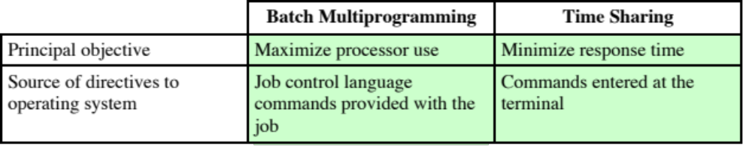
Batch Multiprogramming versus Time Sharing
Notes:
Both batch multiprogramming and time sharing use multiprogramming. The
key differences are listed in Table 8.3.

Slide 71
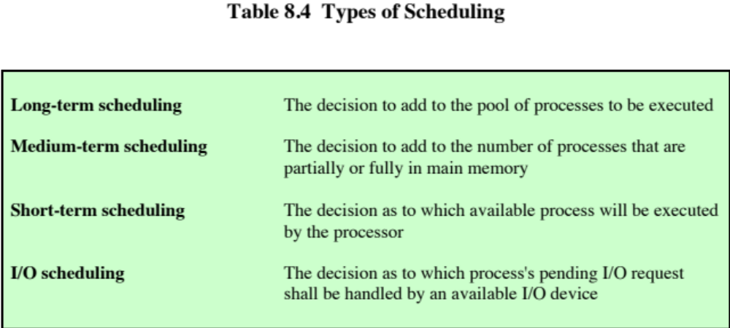
Notes:
The key to multiprogramming is scheduling. In fact, four types of scheduling are
typically involved (Table 8.4). We will explore these presently. But first, we introduce
the concept of process. This term was first used by the designers of the Multics
OS in the 1960s. It is a somewhat more general term than job. Many definitions
have been given for the term process, including
• A program in execution
• The “animated spirit” of a program
• That entity to which a processor is assigned

Slide 72
Long Term Scheduling
Determines which programs are submitted for processing
Once submitted, a job becomes a process for the short term scheduler
In some systems a newly created process begins in a swapped-out condition, in which case it is added to a queue for the medium-term scheduler
Batch system
Newly submitted jobs are routed to disk and held in a batch queue
The long-term scheduler creates processes from the queue when it can
Time-sharing system
A process request is generated when a user attempts to connect to the system
OS will accept all authorized comers until the system is saturated
At that point a connection request is met with a message indicating that the system is full and to try again later
Notes:
The long-term scheduler determines which programs are admitted to the system for
processing. Thus, it controls the degree of multiprogramming (number of processes
in memory). Once admitted, a job or user program becomes a process and is
added to the queue for the short-term scheduler. In some systems, a newly created
process begins in a swapped-out condition, in which case it is added to a queue for
the medium-term scheduler.
In a batch system, or for the batch portion of a general-purpose OS, newly
submitted jobs are routed to disk and held in a batch queue. The long-term scheduler
creates processes from the queue when it can. There are two decisions involved
here. First, the scheduler must decide that the OS can take on one or more additional
processes. Second, the scheduler must decide which job or jobs to accept and
turn into processes. The criteria used may include priority, expected execution time,
and I/O requirements.
For interactive programs in a time-sharing system, a process request is generated
when a user attempts to connect to the system. Time-sharing users are not
simply queued up and kept waiting until the system can accept them. Rather, the
OS will accept all authorized comers until the system is saturated, using some predefined
measure of saturation. At that point, a connection request is met with a
message indicating that the system is full and the user should try again later.

Slide 73
Medium-Term Scheduling and Short-Term Scheduling
  Medium-Term
Short-Term
  Part of the swapping function
  Swapping-in decision is based on the need to manage the degree of multiprogramming
  Swapping-in decision will consider the memory requirements of the swapped-out processes
Also known as the dispatcher
Executes frequently and makes the fine-grained decision of which job to execute next
Notes:
Medium-term scheduling is part of the swapping function, described in Section 8.3.
Typically, the swapping-in decision is based on the need to manage the degree of
multiprogramming. On a system that does not use virtual memory, memory management
is also an issue. Thus, the swapping-in decision will consider the memory
requirements of the swapped-out processes.
The long-term scheduler executes relatively infrequently and makes the coarse grained
decision of whether or not to take on a new process, and which one to take.
The short-term scheduler, also known as the dispatcher, executes frequently and
makes the fine-grained decision of which job to execute next.

Slide 74
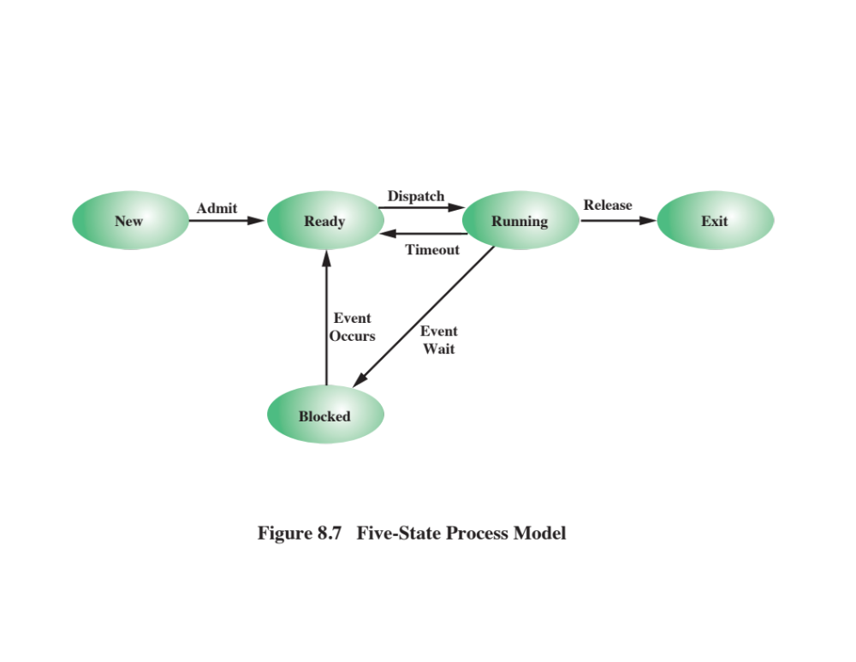
Notes:
To understand the operation of the short-term scheduler, we
need to consider the concept of a process state. During the lifetime of a process,
its status will change a number of times. Its status at any point in time is referred to
as a state. The term state is used because it connotes that certain information exists
that defines the status at that point. At minimum, there are five defined states for a
process (Figure 8.7):
• New: A program is admitted by the high-level scheduler but is not yet ready
to execute. The OS will initialize the process, moving it to the ready state.
• Ready: The process is ready to execute and is awaiting access to the processor.
• Running: The process is being executed by the processor.
• Waiting: The process is suspended from execution waiting for some system
resource, such as I/O.
• Halted: The process has terminated and will be destroyed by the OS.

Slide 75
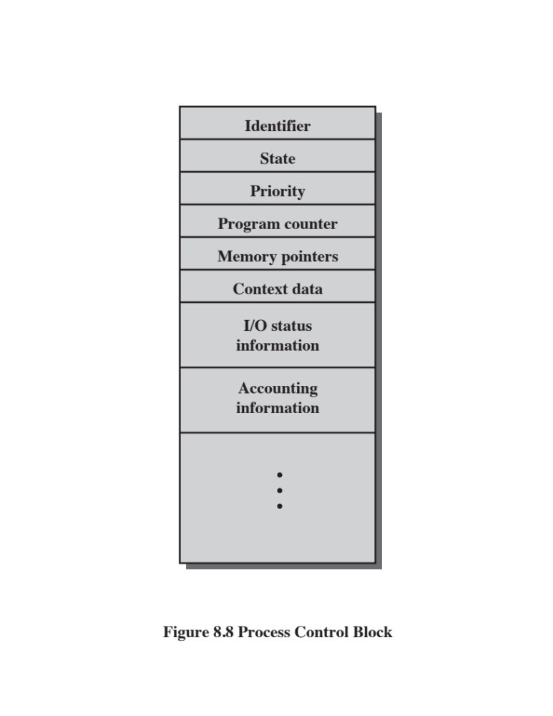
Notes:
For each process in the system, the OS must maintain information indicating
the state of the process and other information necessary for process execution.
For this purpose, each process is represented in the OS by a process control block
(Figure 8.8), which typically contains
• Identifier: Each current process has a unique identifier.
• State: The current state of the process (new, ready, and so on).
• Priority: Relative priority level.
• Program counter: The address of the next instruction in the program to be
executed.
• Memory pointers: The starting and ending locations of the process in memory.
• Context data: These are data that are present in registers in the processor
while the process is executing, and they will be discussed in Part Three. For
now, it is enough to say that these data represent the “context” of the process.
The context data plus the program counter are saved when the process leaves
the running state. They are retrieved by the processor when it resumes execution
of the process.
• I/O status information: Includes outstanding I/O requests, I/O devices (e.g., tape
drives) assigned to this process, a list of files assigned to the process, and so on.
• Accounting information: May include the amount of processor time and clock
time used, time limits, account numbers, and so on.
When the scheduler accepts a new job or user request for execution, it creates
a blank process control block and places the associated process in the new state.
After the system has properly filled in the process control block, the process is
transferred to the ready state.

Slide 76
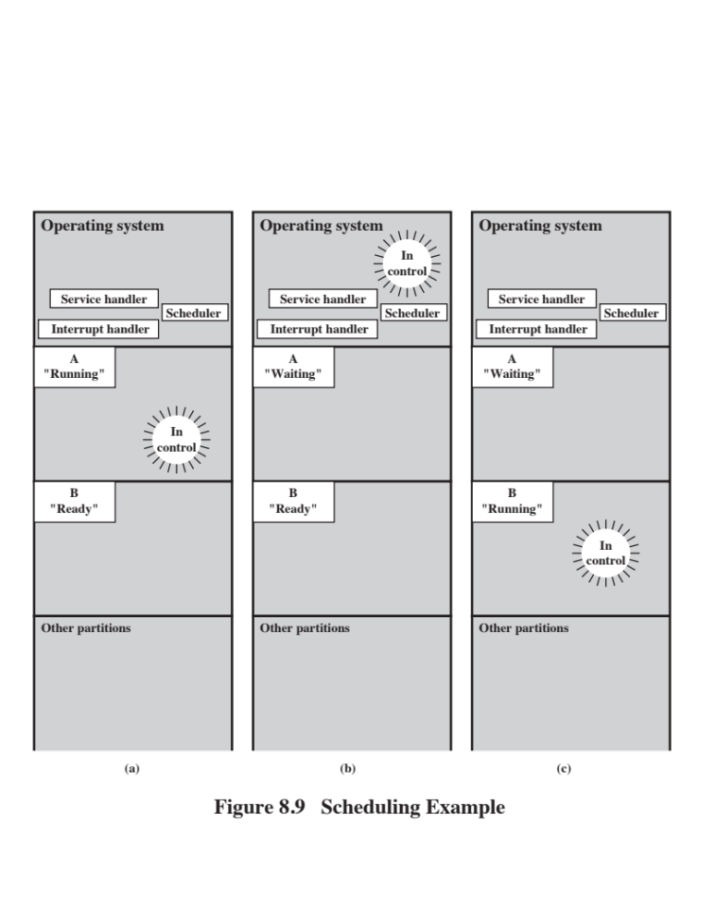
Notes:
To understand how the OS manages the scheduling of the
various jobs in memory, let us begin by considering the simple example in Figure 8.9.
The figure shows how main memory is partitioned at a given point in time. The
kernel of the OS is, of course, always resident. In addition, there are a number of
active processes, including A and B, each of which is allocated a portion of memory.
We begin at a point in time when process A is running. The processor is executing
instructions from the program contained in A’s memory partition. At some
later point in time, the processor ceases to execute instructions in A and begins
executing instructions in the OS area. This will happen for one of three reasons:
1. Process A issues a service call (e.g., an I/O request) to the OS. Execution of A
is suspended until this call is satisfied by the OS.
2. Process A causes an interrupt. An interrupt is a hardware-generated signal to
the processor. When this signal is detected, the processor ceases to execute A
and transfers to the interrupt handler in the OS. A variety of events related
to A will cause an interrupt. One example is an error, such as attempting to
execute a privileged instruction. Another example is a timeout; to prevent any
one process from monopolizing the processor, each process is only granted the
processor for a short period at a time.
3. Some event unrelated to process A that requires attention causes an interrupt.
An example is the completion of an I/O operation.
In any case, the result is the following. The processor saves the current context
data and the program counter for A in A’s process control block and then begins
executing in the OS. The OS may perform some work, such as initiating an I/O
operation. Then the short-term-scheduler portion of the OS decides which process
should be executed next. In this example, B is chosen. The OS instructs the processor
to restore B’s context data and proceed with the execution of B where it left off.

Slide 77
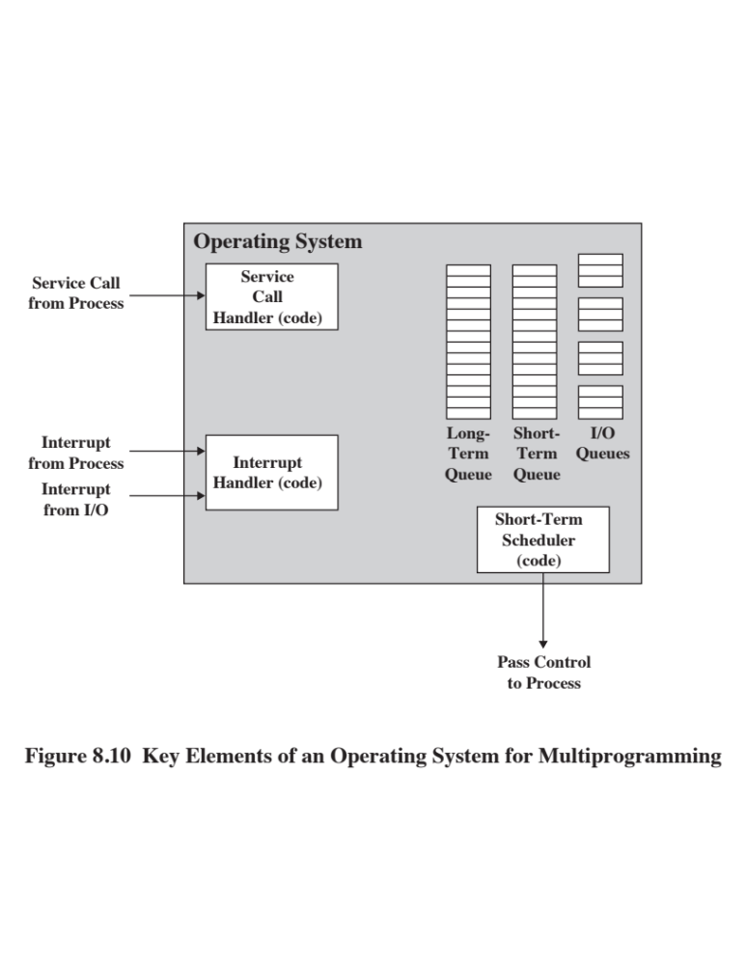
Notes:
This simple example highlights the basic functioning of the short-term scheduler.
Figure 8.10 shows the major elements of the OS involved in the multiprogramming
and scheduling of processes. The OS receives control of the processor at the
interrupt handler if an interrupt occurs and at the service-call handler if a service
call occurs. Once the interrupt or service call is handled, the short-term scheduler is
invoked to select a process for execution.
To do its job, the OS maintains a number of queues. Each queue is simply a
waiting list of processes waiting for some resource. The long-term queue is a list of
jobs waiting to use the system. As conditions permit, the high-level scheduler will
allocate memory and create a process for one of the waiting items. The short-term
queue consists of all processes in the ready state. Any one of these processes could
use the processor next. It is up to the short-term scheduler to pick one. Generally,
this is done with a round-robin algorithm, giving each process some time in turn.
Priority levels may also be used. Finally, there is an I/O queue for each I/O device.
More than one process may request the use of the same I/O device. All processes
waiting to use each device are lined up in that device’s queue.

Slide 78
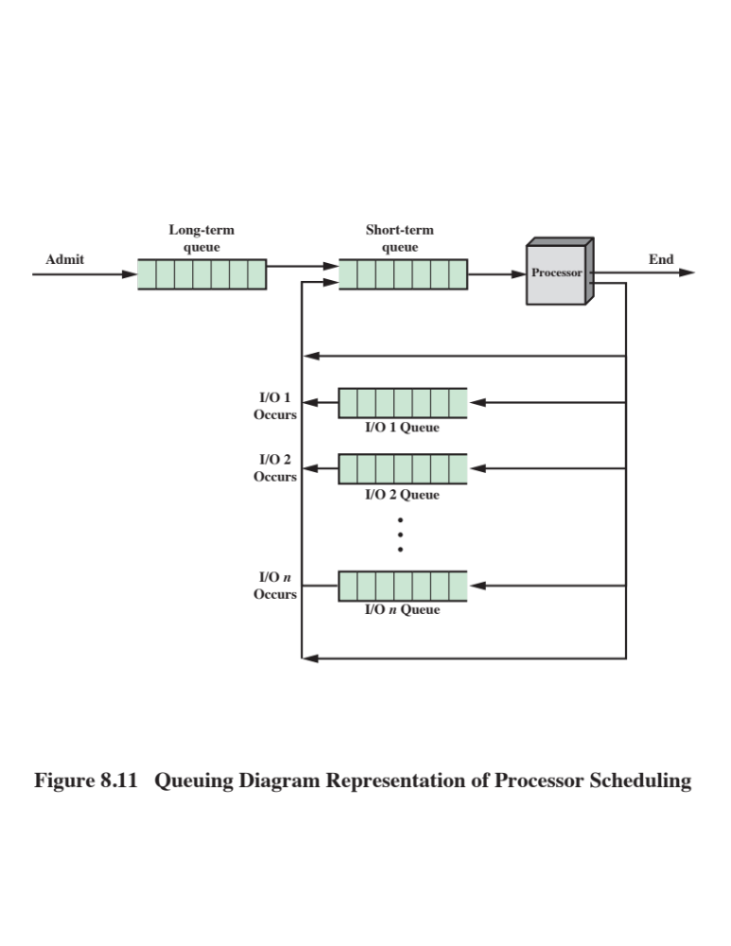
Notes:
Figure 8.11 suggests how processes progress through the computer under the
control of the OS. Each process request (batch job, user-defined interactive job) is
placed in the long-term queue. As resources become available, a process request
becomes a process and is then placed in the ready state and put in the short-term
queue. The processor alternates between executing OS instructions and executing
user processes. While the OS is in control, it decides which process in the short-term
queue should be executed next. When the OS has finished its immediate tasks, it
turns the processor over to the chosen process.
As was mentioned earlier, a process being executed may be suspended for
a variety of reasons. If it is suspended because the process requests I/O, then it
is placed in the appropriate I/O queue. If it is suspended because of a timeout or
because the OS must attend to pressing business, then it is placed in the ready state
and put into the short-term queue.
Finally, we mention that the OS also manages the I/O queues. When an I/O
operation is completed, the OS removes the satisfied process from that I/O queue
and places it in the short-term queue. It then selects another waiting process (if any)
and signals for the I/O device to satisfy that process’s request.

Slide 79
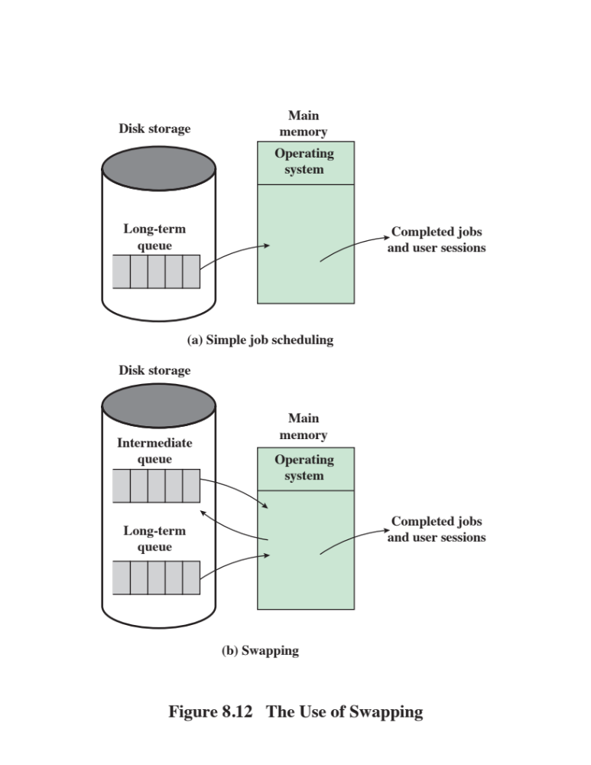
Notes:
Main memory could be expanded, and so be able to accommodate
more processes. But there are two flaws in this approach. First, main memory
is expensive, even today. Second, the appetite of programs for memory has grown
as fast as the cost of memory has dropped. So larger memory results in larger processes,
not more processes.
Another solution is swapping, depicted in Figure 8.12. We have a long-term
queue of process requests, typically stored on disk. These are brought in, one at a
time, as space becomes available. As processes are completed, they are moved out
of main memory. Now the situation will arise that none of the processes in memory
are in the ready state (e.g., all are waiting on an I/O operation). Rather than remain
idle, the processor swaps one of these processes back out to disk into an intermediate
queue. This is a queue of existing processes that have been temporarily kicked out
of memory. The OS then brings in another process from the intermediate queue, or
it honors a new process request from the long-term queue. Execution then continues
with the newly arrived process.
Swapping, however, is an I/O operation, and therefore there is the potential
for making the problem worse, not better. But because disk I/O is generally the
fastest I/O on a system (e.g., compared with tape or printer I/O), swapping will usually
enhance performance. A more sophisticated scheme, involving virtual memory,
improves performance over simple swapping. This will be discussed shortly. But
first, we must prepare the ground by explaining partitioning and paging.

Slide 80
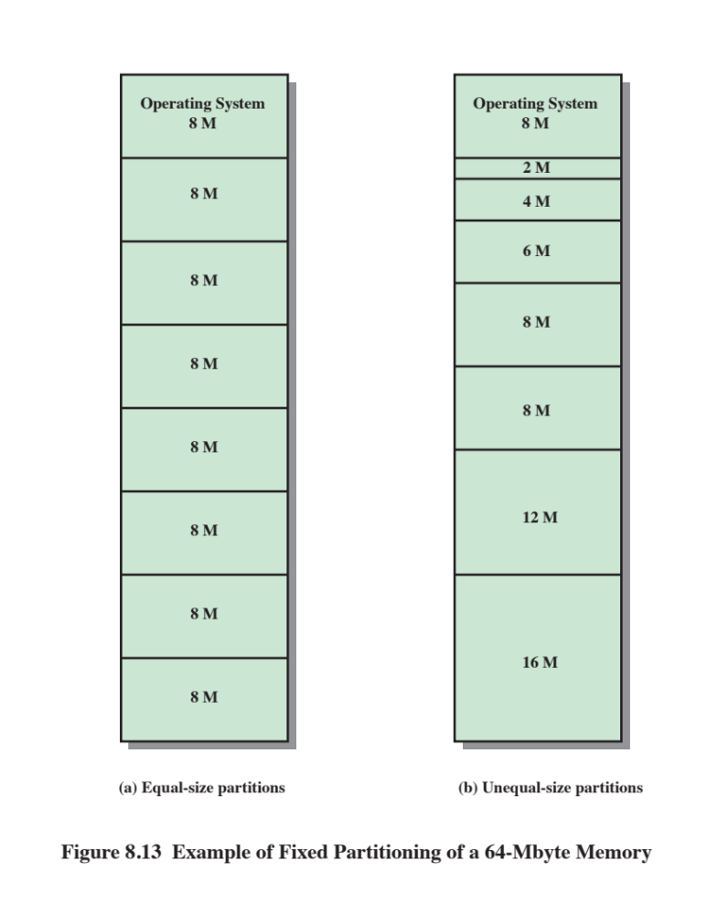
Notes:
The simplest scheme for partitioning available memory is to use fixed-size partitions,
as shown in Figure 8.13. Note that, although the partitions are of fixed size,
they need not be of equal size. When a process is brought into memory, it is placed
in the smallest available partition that will hold it.
Even with the use of unequal fixed-size partitions, there will be wasted memory.
In most cases, a process will not require exactly as much memory as provided by the
partition. For example, a process that requires 3M bytes of memory would be placed
in the 4M partition of Figure 8.13b, wasting 1M that could be used by another process.
A more efficient approach is to use variable-size partitions. When a process is
brought into memory, it is allocated exactly as much memory as it requires and no more.

Slide 81
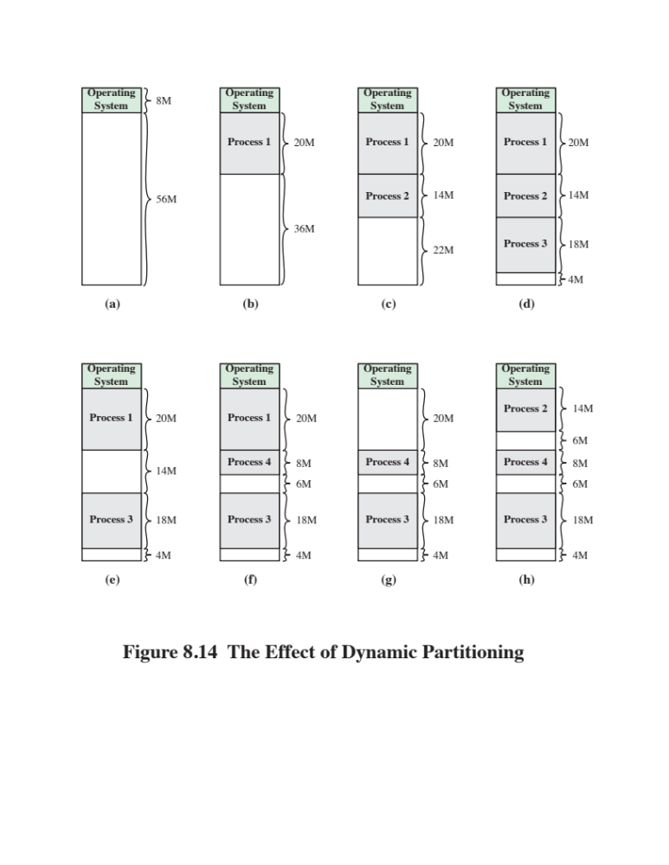
Logical address
- expressed as a location relative to the beginning of the program
Physical address
- an actual location in main memory
Base address
- current starting location of the process
Notes:
An example, using 64 Mbytes of main memory, is shown in Figure 8.14.
Initially, main memory is empty, except for the OS (a). The first three processes are loaded
in, starting where the OS ends and occupying just enough space for each process (b, c, d).
This leaves a “hole” at the end of memory that is too small for a fourth process. At some
point, none of the processes in memory is ready. The OS swaps out process 2 (e), which
leaves sufficient room to load a new process, process 4 (f). Because process 4 is smaller
than process 2, another small hole is created. Later, a point is reached at which none of the
processes in main memory is ready, but process 2, in the Ready-
Suspend state, is available. Because there is insufficient room in memory for process 2,
the OS swaps process 1 out (g) and swaps process 2 back in (h).
Before we consider ways of dealing with the shortcomings of partitioning, we
must clear up one loose end. Consider Figure 8.14; it should be obvious that a process
is not likely to be loaded into the same place in main memory each time it is
swapped in. Furthermore, if compaction is used, a process may be shifted while in
main memory. A process in memory consists of instructions plus data. The instructions
will contain addresses for memory locations of two types:
• Addresses of data items
• Addresses of instructions, used for branching instructions
But these addresses are not fixed. They will change each time a process is
swapped in. To solve this problem, a distinction is made between logical addresses
and physical addresses. A logical address is expressed as a location relative to the
beginning of the program. Instructions in the program contain only logical addresses.
A physical address is an actual location in main memory. When the processor executes
a process, it automatically converts from logical to physical address by adding
the current starting location of the process, called its base address, to each logical
address. This is another example of a processor hardware feature designed to meet
an OS requirement. The exact nature of this hardware feature depends on the memory
management strategy in use. We will see several examples later in this chapter.

Slide 82
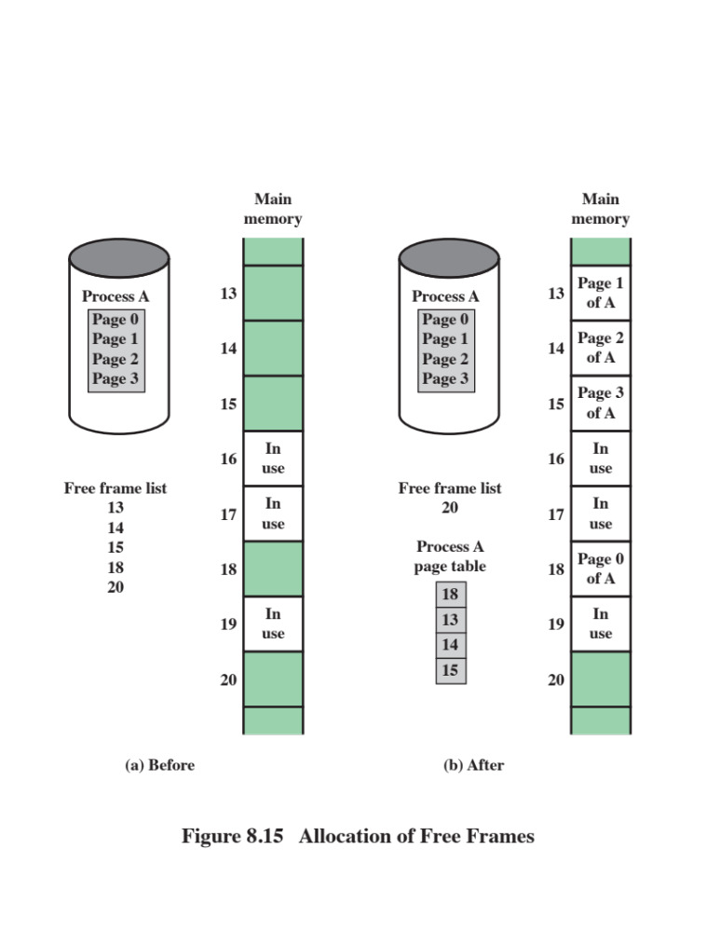
Notes:
Both unequal fixed-size and variable-size partitions are inefficient in the use of
memory. Suppose, however, that memory is partitioned into equal fixed-size chunks
that are relatively small, and that each process is also divided into small fixed-size
chunks of some size. Then the chunks of a program, known as pages, could be
assigned to available chunks of memory, known as frames, or page frames. At most,
then, the wasted space in memory for that process is a fraction of the last page.
Figure 8.15 shows an example of the use of pages and frames. At a given point
in time, some of the frames in memory are in use and some are free. The list of free
frames is maintained by the OS. Process A, stored on disk, consists of four pages.
When it comes time to load this process, the OS finds four free frames and loads the
four pages of the process A into the four frames.

Slide 83
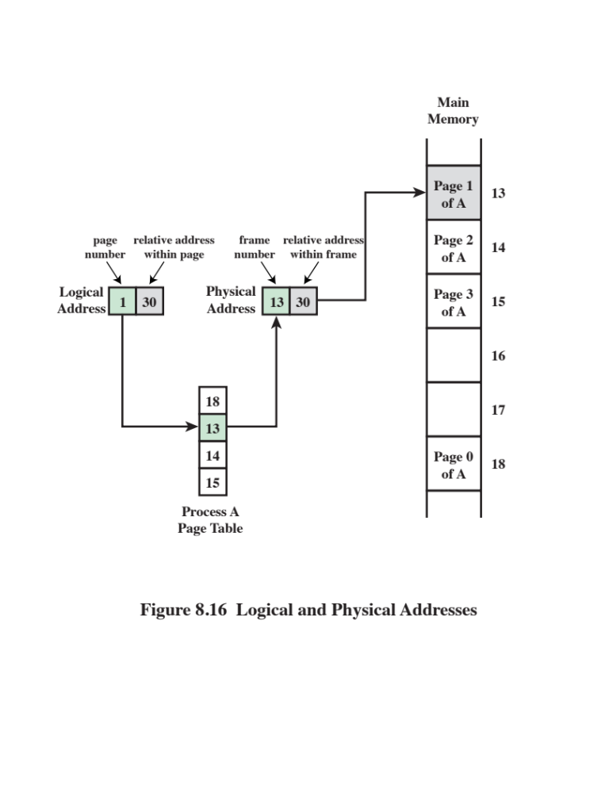
Notes:
Now suppose, as in this example, that there are not sufficient unused contiguous
frames to hold the process. Does this prevent the OS from loading A?
The answer is no, because we can once again use the concept of logical address. A
simple base address will no longer suffice. Rather, the OS maintains a page table
for each process. The page table shows the frame location for each page of the
process. Within the program, each logical address consists of a page number and
a relative address within the page. Recall that in the case of simple partitioning, a
logical address is the location of a word relative to the beginning of the program;
the processor translates that into a physical address. With paging, the logical-to-
physical address translation is still done by processor hardware. The processor
must know how to access the page table of the current process. Presented with a
logical address (page number, relative address), the processor uses the page table
to produce a physical address (frame number, relative address). An example is
shown in Figure 8.16.
This approach solves the problems raised earlier. Main memory is divided
into many small equal-size frames. Each process is divided into frame-size pages:
smaller processes require fewer pages, larger processes require more. When a
process is brought in, its pages are loaded into available frames, and a page table
is set up.

Slide 84
Virtual Memory
Demand Paging
Each page of a process is brought in only when it is needed
Principle of locality
  When working with a large process execution may be confined to a small section of a program (subroutine)
  It is better use of memory to load in just a few pages
  If the program references data or branches to an instruction on a page not in main memory, a page fault is triggered which tells the OS to bring in the desired page
Advantages:
  More processes can be maintained in memory
  Time is saved because unused pages are not swapped in and out of memory
Disadvantages:
  When one page is brought in, another page must be thrown out (page replacement)
  If a page is thrown out just before it is about to be used the OS will have to go get the page again
  Thrashing
    When the processor spends most of its time swapping pages rather than executing instructions
Notes:
With the use of paging, truly effective multiprogramming
systems came into being. Furthermore, the simple tactic of breaking a process up
into pages led to the development of another important concept: virtual memory.
To understand virtual memory, we must add a refinement to the paging
scheme just discussed. That refinement is demand paging, which simply means that
each page of a process is brought in only when it is needed, that is, on demand.
Consider a large process, consisting of a long program plus a number of arrays
of data. Over any short period of time, execution may be confined to a small section
of the program (e.g., a subroutine), and perhaps only one or two arrays of data
are being used. This is the principle of locality, which we introduced in Appendix
4A. It would clearly be wasteful to load in dozens of pages for that process when
only a few pages will be used before the program is suspended. We can make better
use of memory by loading in just a few pages. Then, if the program branches
to an instruction on a page not in main memory, or if the program references data
on a page not in memory, a page fault is triggered. This tells the OS to bring in the
desired page.
Thus, at any one time, only a few pages of any given process are in memory,
and therefore more processes can be maintained in memory. Furthermore, time is
saved because unused pages are not swapped in and out of memory. However, the
OS must be clever about how it manages this scheme. When it brings one page in, it
must throw another page out; this is known as page replacement. If it throws out a
page just before it is about to be used, then it will just have to go get that page again
almost immediately. Too much of this leads to a condition known as thrashing: the
processor spends most of its time swapping pages rather than executing instructions.
The avoidance of thrashing was a major research area in the 1970s and led to a variety
of complex but effective algorithms. In essence, the OS tries to guess, based on
recent history, which pages are least likely to be used in the near future.
A discussion of page replacement algorithms is beyond the scope of this chapter.
A potentially effective technique is least recently used (LRU), the same algorithm
discussed in Chapter 4 for cache replacement. In practice, LRU is difficult
to implement for a virtual memory paging scheme. Several alternative approaches
that seek to approximate the performance of LRU are in use; see Appendix K for
details.
With demand paging, it is not necessary to load an entire process into main
memory. This fact has a remarkable consequence: It is possible for a process to be
larger than all of main memory. One of the most fundamental restrictions in programming
has been lifted. Without demand paging, a programmer must be acutely
aware of how much memory is available. If the program being written is too large,
the programmer must devise ways to structure the program into pieces that can
be loaded one at a time. With demand paging, that job is left to the OS and the
hardware. As far as the programmer is concerned, he or she is dealing with a huge
memory, the size associated with disk storage.
Because a process executes only in main memory, that memory is referred to
as real memory. But a programmer or user perceives a much larger memory—that
which is allocated on the disk. This latter is therefore referred to as virtual memory.
Virtual memory allows for very effective multiprogramming and relieves the user of
the unnecessarily tight constraints of main memory.

Slide 85
Notes:
The basic mechanism for reading a word from memory
involves the translation of a virtual, or logical, address, consisting of page number
and offset, into a physical address, consisting of frame number and offset, using a
page table. Because the page table is of variable length, depending on the size of the
process, we cannot expect to hold it in registers. Instead, it must be in main memory
to be accessed. Figure 8.16 suggests a hardware implementation of this scheme.
When a particular process is running, a register holds the starting address of the
page table for that process. The page number of a virtual address is used to index
that table and look up the corresponding frame number. This is combined with the
offset portion of the virtual address to produce the desired real address.
In most systems, there is one page table per process. But each process can
occupy huge amounts of virtual memory. For example, in the VAX architecture,
each process can have up to 2³¹ = 2 Gbytes of virtual memory. Using 2⁹ = 512-byte
pages, that means that as many as 2²² page table entries are required per process.
Clearly, the amount of memory devoted to page tables alone could be unacceptably
high. To overcome this problem, most virtual memory schemes store page tables in
virtual memory rather than real memory. This means that page tables are subject to
paging just as other pages are. When a process is running, at least a part of its page
table must be in main memory, including the page table entry of the currently executing
page. Some processors make use of a two-level scheme to organize large page
tables. In this scheme, there is a page directory, in which each entry points to a page
table. Thus, if the length of the page directory is X, and if the maximum length of a
page table is Y, then a process can consist of up to X * Y pages. Typically, the maximum
length of a page table is restricted to be equal to one page. We will see an example
of this two-level approach when we consider the Intel x86 later in this chapter.

Slide 86
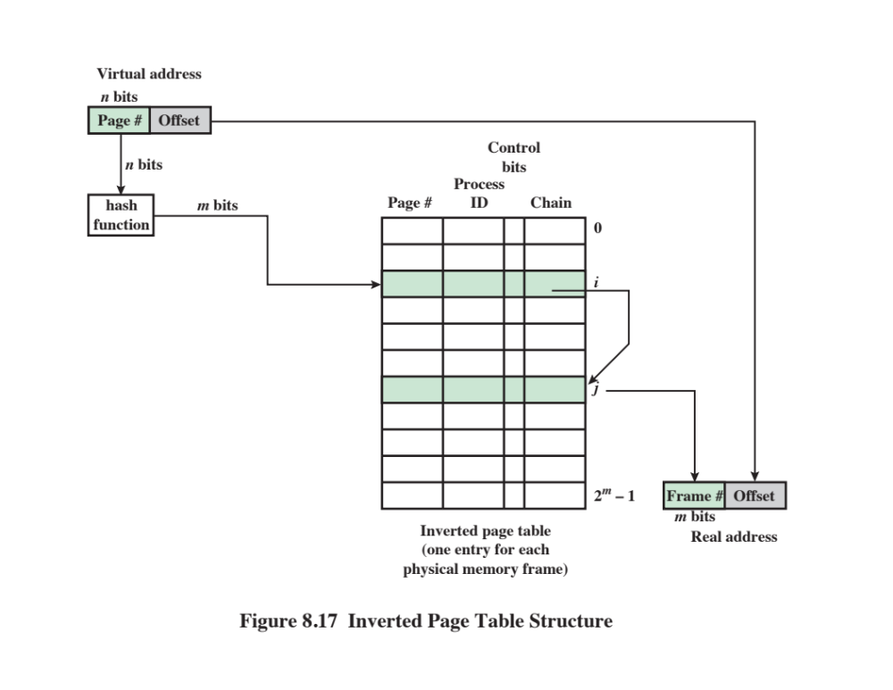
Notes:
An alternative approach to the use of one- or two-level page tables is the use
of an inverted page table structure (Figure 8.17). Variations on this approach are
used on the PowerPC, UltraSPARC, and the IA-64 architecture. An implementation
of the Mach OS on the RT-PC also uses this technique.
In this approach, the page number portion of a virtual address is mapped into
a hash value using a simple hashing function. The hash value is a pointer to the
inverted page table, which contains the page table entries. There is one entry in the
inverted page table for each real memory page frame rather than one per virtual
page. Thus a fixed proportion of real memory is required for the tables regardless of
the number of processes or virtual pages supported. Because more than one virtual
address may map into the same hash table entry, a chaining technique is used for
managing the overflow. The hashing technique results in chains that are typically
short—between one and two entries. The page table’s structure is called inverted
because it indexes page table entries by frame number rather than by virtual page
number.

Slide 87
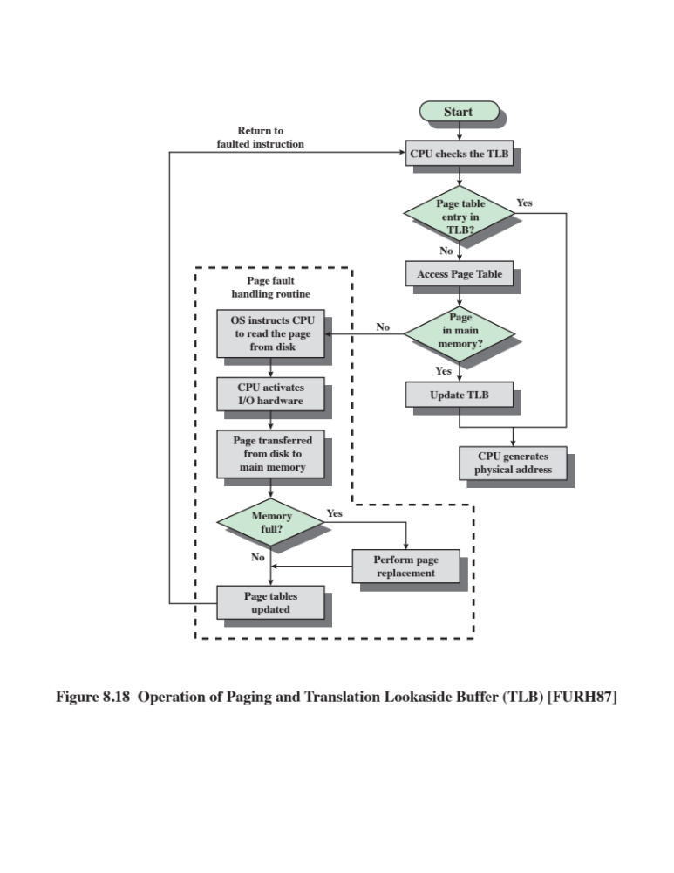
Notes:
In principle, then, every virtual memory reference can cause two physical memory
accesses: one to fetch the appropriate page table entry, and one to fetch the
desired data. Thus, a straightforward virtual memory scheme would have the effect
of doubling the memory access time. To overcome this problem, most virtual
memory schemes make use of a special cache for page table entries, usually called
a translation lookaside buffer (TLB). This cache functions in the same way as a
memory cache and contains those page table entries that have been most recently
used. Figure 8.18 is a flowchart that shows the use of the TLB. By the principle of
locality, most virtual memory references will be to locations in recently used pages.
Therefore, most references will involve page table entries in the cache. Studies of
the VAX TLB have shown that this scheme can significantly improve performance
[CLAR85, SATY81].

Slide 88
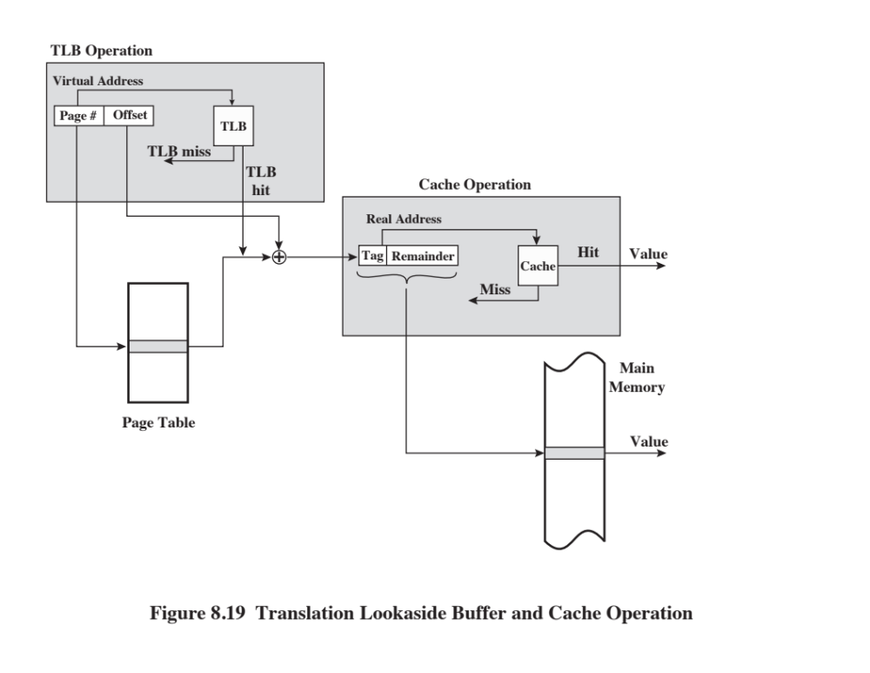
Notes:
Note that the virtual memory mechanism must interact with the cache system
(not the TLB cache, but the main memory cache). This is illustrated in Figure 8.19.
A virtual address will generally be in the form of a page number, offset. First, the
memory system consults the TLB to see if the matching page table entry is present.
If it is, the real (physical) address is generated by combining the frame number with
the offset. If not, the entry is accessed from a page table. Once the real address is
generated, which is in the form of a tag and a remainder, the cache is consulted to
see if the block containing that word is present (see Figure 4.5). If so, it is returned
to the processor. If not, the word is retrieved from main memory.
The reader should be able to appreciate the complexity of the processor hardware
involved in a single memory reference. The virtual address is translated into
a real address. This involves reference to a page table, which may be in the TLB, in
main memory, or on disk. The referenced word may be in cache, in main memory,
or on disk. In the latter case, the page containing the word must be loaded into main
memory and its block loaded into the cache. In addition, the page table entry for
that page must be updated.

Slide 89


Segmentation
Usually visible to the programmer
Provided as a convenience for organizing programs and data and as a means for associating privilege and protection attributes with instructions and data
Allows the programmer to view memory as consisting of multiple address spaces or segments
Advantages:
  Simplifies the handling of growing data structures
  Allows programs to be altered and recompiled independently without requiring that an entire set of programs be re-linked and re-loaded
  Lends itself to sharing among processes
  Lends itself to protection
Notes:
There is another way in which addressable memory can be subdivided, known as
segmentation. Whereas paging is invisible to the programmer and serves the purpose
of providing the programmer with a larger address space, segmentation is usually
visible to the programmer and is provided as a convenience for organizing programs
and data and as a means for associating privilege and protection attributes with
instructions and data.
Segmentation allows the programmer to view memory as consisting of multiple
address spaces or segments. Segments are of variable, indeed dynamic, size.
Typically, the programmer or the OS will assign programs and data to different segments.
There may be a number of program segments for various types of programs as
well as a number of data segments. Each segment may be assigned access and usage
rights. Memory references consist of a (segment number, offset) form of address.
This organization has a number of advantages to the programmer over a non-segmented
address space:
1. It simplifies the handling of growing data structures. If the programmer does
not know ahead of time how large a particular data structure will become, it
is not necessary to guess. The data structure can be assigned its own segment,
and the OS will expand or shrink the segment as needed.
2. It allows programs to be altered and recompiled independently without
requiring that an entire set of programs be re-linked and reloaded. Again, this
is accomplished using multiple segments.
3. It lends itself to sharing among processes. A programmer can place a utility
program or a useful table of data in a segment that can be addressed by other
processes.
4. It lends itself to protection. Because a segment can be constructed to contain a
well-defined set of programs or data, the programmer or a system administrator
can assign access privileges in a convenient fashion.
These advantages are not available with paging, which is invisible to the programmer.
On the other hand, we have seen that paging provides for an efficient
form of memory management. To combine the advantages of both, some systems
are equipped with the hardware and OS software to provide both.

Slide 90

Intel
x86
Includes hardware for both segmentation and paging
Unsegmented unpaged memory
  Virtual address is the same as the physical address
  Useful in low-complexity, high performance controller applications
Unsegmented paged memory
  Memory is viewed as a paged linear address space
  Protection and management of memory is done via paging
  Favored by some operating systems
Segmented unpaged memory
  Memory is viewed as a collection of logical address spaces
  Affords protection down to the level of a single byte
  Guarantees that the translation table needed is on-chip when the segment is in memory
  Results in predictable access times
Segmented paged memory
  Segmentation is used to define logical memory partitions subject to access control, and paging is used to manage the allocation of memory within the partitions
  Operating systems such as UNIX System V favor this view
Memory
Management
Notes:
The x86 includes hardware for both segmentation and paging. Both mechanisms
can be disabled, allowing the user to choose from four distinct views of
memory:
• Unsegmented unpaged memory: In this case, the virtual address is the same
as the physical address. This is useful, for example, in low-complexity, high performance
controller applications.
• Unsegmented paged memory: Here memory is viewed as a paged linear
address space. Protection and management of memory is done via paging.
This is favored by some operating systems (e.g., Berkeley UNIX).
• Segmented unpaged memory: Here memory is viewed as a collection of logical
address spaces. The advantage of this view over a paged approach is that it
affords protection down to the level of a single byte, if necessary. Furthermore,
unlike paging, it guarantees that the translation table needed (the segment
table) is on-chip when the segment is in memory. Hence, segmented unpaged
memory results in predictable access times.
• Segmented paged memory: Segmentation is used to define logical memory
partitions subject to access control, and paging is used to manage the allocation
of memory within the partitions. Operating systems such as UNIX System V
favor this view.

Slide 91
Segmentation (Cont.)
Each virtual address consists of a 16-bit segment reference and a 32-bit offset
  Two bits of segment reference deal with the protection mechanism
  14 bits specify segment
Unsegmented virtual memory is 2³² = 4Gbytes
Segmented virtual memory is 2⁴⁶=64 terabytes (Tbytes)
Physical address space employs a 32-bit address for a maximum of 4 Gbytes
Virtual address space is divided into two parts
  One-half is global, shared by all processors
  The remainder is local and is distinct for each process
Notes:
When segmentation is used, each virtual address (called a logical address in the
Pentium II documentation) consists of a 16-bit segment reference and a 32-bit
offset. Two bits of the segment reference deal with the protection mechanism, leaving
14 bits for specifying a particular segment. Thus, with unsegmented memory, the
user’s virtual memory is 2³² = 4 Gbytes. With segmented memory, the total virtual
memory space as seen by a user is 2⁴⁶ = 64 terabytes (Tbytes). The physical address
space employs a 32-bit address for a maximum of 4 Gbytes.
The amount of virtual memory can actually be larger than the 64 Tbytes. This
is because the processor’s interpretation of a virtual address depends on which
process is currently active. Virtual address space is divided into two parts. One-half
of the virtual address space (8K segments * 4 Gbytes) is global, shared by all processes;
the remainder is local and is distinct for each process.

Slide 92
Segment Protection
Associated with each segment are two forms of protection:
  Privilege level
  Access attribute
There are four privilege levels
  Most protected (level 0)
  Least protected (level 3)
Privilege level associated with a data segment is its “classification”
Privilege level associated with a program segment is its “clearance”
An executing program may only access data segments for which its clearance level is lower than or equal to the privilege level of the data segment
The privilege mechanism also limits the use of certain instructions
Notes:
Associated with each segment are two forms of protection: privilege level and
access attribute. There are four privilege levels, from most protected (level 0) to
least protected (level 3). The privilege level associated with a data segment is its
“classification”; the privilege level associated with a program segment is its “clearance.”
An executing program may only access data segments for which its clearance
level is lower than (more privileged) or equal to (same privilege) the privilege level
of the data segment.
The hardware does not dictate how these privilege levels are to be used; this
depends on the OS design and implementation. It was intended that privilege level 1
would be used for most of the OS, and level 0 would be used for that small portion
of the OS devoted to memory management, protection, and access control.
This leaves two levels for applications. In many systems, applications will reside at
level 3, with level 2 being unused. Specialized application subsystems that must be
protected because they implement their own security mechanisms are good candidates
for level 2. Some examples are database management systems, office automation
systems, and software engineering environments.
In addition to regulating access to data segments, the privilege mechanism
limits the use of certain instructions. Some instructions, such as those dealing with
memory-management registers, can only be executed in level 0. I/O instructions can
only be executed up to a certain level that is designated by the OS; typically, this will
be level 1.
The access attribute of a data segment specifies whether read/write or read only
accesses are permitted. For program segments, the access attribute specifies
read/execute or read-only access.

Slide 93
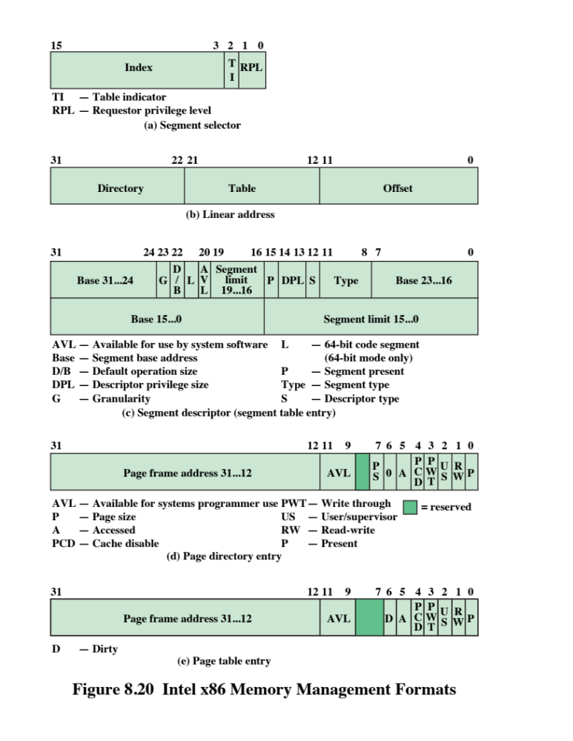
Notes:
The address translation mechanism for segmentation involves mapping a virtual
address into what is referred to as a linear address (Figure 8.20b). A virtual
address consists of the 32-bit offset and a 16-bit segment selector (Figure 8.20a).
The segment selector consists of the following fields:
• Table Indicator (TI): Indicates whether the global segment table or a local
segment table should be used for translation.
• Segment Number: The number of the segment. This serves as an index into
the segment table.
• Requested Privilege Level (RPL): The privilege level requested for this access.

Slide 94
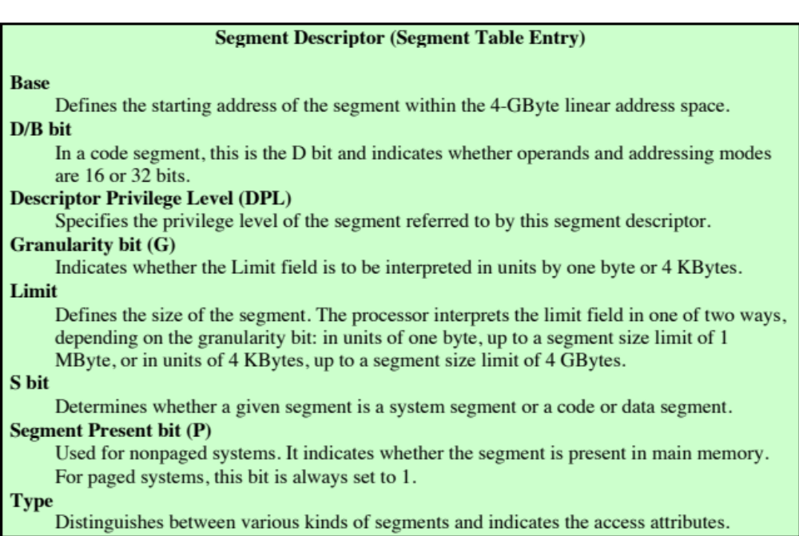
Table 8.5
x86 Memory Management Parameters (page 1 of 2)
Notes:
Each entry in a segment table consists of 64 bits, as shown in Figure 8.20c. The
fields are defined in Table 8.5.

Slide 95

Table 8.5
x86 Memory Management Parameters (page 2 of 2)
Notes:
x86 memory management parameters – page 2 of 2

Slide 96

Paging
Segmentation may be disabled
  In which case linear address space is used
Two level page table lookup
  First, page directory
    1024 entries max
    Splits 4 Gbyte linear memory into 1024 page groups of 4 Mbyte
    Each page table has 1024 entries corresponding to 4 Kbyte pages
    Can use one page directory for all processes, one per process or mixture
    Page directory for current process always in memory
  Use TLB holding 32 page table entries
  Two page sizes available, 4k or 4M
Notes:
Segmentation is an optional feature and may be disabled. When segmentation is in
use, addresses used in programs are virtual addresses and are converted into linear
addresses, as just described. When segmentation is not in use, linear addresses are
used in programs. In either case, the following step is to convert that linear address
into a real 32-bit address.
To understand the structure of the linear address, you need to know that
the Pentium II paging mechanism is actually a two-level table lookup operation.
The first level is a page directory, which contains up to 1024 entries. This splits the
4-Gbyte linear memory space into 1024 page groups, each with its own page table,
and each 4 Mbytes in length. Each page table contains up to 1024 entries; each entry
corresponds to a single 4-Kbyte page. Memory management has the option of using
one page directory for all processes, one page directory for each process, or some
combination of the two. The page directory for the current task is always in main
memory. Page tables may be in virtual memory.
Figure 8.20 shows the formats of entries in page directories and page tables,
and the fields are defined in Table 8.5. Note that access control mechanisms can be
provided on a page or page group basis.
The x86 also makes use of a translation lookaside buffer. The buffer
can hold 32 page table entries. Each time that the page directory is changed, the
buffer is cleared.

Slide 97

Notes:
Figure 8.21 illustrates the combination of segmentation and paging mechanisms.
For clarity, the translation lookaside buffer and memory cache mechanisms
are not shown.
Finally, the x86 includes a new extension not found on the 80386 or
80486, the provision for two page sizes. If the PSE (page size extension) bit in control
register 4 is set to 1, then the paging unit permits the OS programmer to define
a page as either 4 Kbyte or 4 Mbyte in size.
When 4-Mbyte pages are used, there is only one level of table lookup for
pages. When the hardware accesses the page directory, the page directory entry
(Figure 8.20d) has the PS bit set to 1. In this case, bits 9 through 21 are ignored and
bits 22 through 31 define the base address for a 4-Mbyte page in memory. Thus,
there is a single page table.
The use of 4-Mbyte pages reduces the memory-management storage
requirements for large main memories. With 4-Kbyte pages, a full 4-Gbyte
main memory requires about 4 Mbytes of memory just for the page tables. With
4-Mbyte pages, a single table, 4 Kbytes in length, is sufficient for page memory
management.

Slide 98

Notes:
ARM provides a versatile virtual memory system architecture that can be tailored to
the needs of the embedded system designer.
Figure 8.22 provides an overview of the memory management hardware in the
ARM for virtual memory. The virtual memory translation hardware uses one or
two levels of tables for translation from virtual to physical addresses, as explained
subsequently. The translation lookaside buffer (TLB) is a cache of recent page table
entries. If an entry is available in the TLB, then the TLB directly sends a physical
address to main memory for a read or write operation. As explained in Chapter 4,
data is exchanged between the processor and main memory via the cache. If a logical
cache organization is used (Figure 4.7a), then the ARM supplies that address
directly to the cache as well as supplying it to the TLB when a cache miss occurs. If
a physical cache organization is used (Figure 4.7b), then the TLB must supply the
physical address to the cache.
Entries in the translation tables also include access control bits, which determine
whether a given process may access a given portion of memory. If access is
denied, access control hardware supplies an abort signal to the ARM processor.

Slide 99
Virtual Memory Address Translation
The ARM supports memory access based on either sections or pages
Supersections (optional)
  Consist of 16-MB blocks of main memory
Sections
  Consist of 1-MB blocks of main memory
Large pages
  Consist of 64-kB blocks of main memory
Small pages
  Consist of 4-kB blocks of main memory
Sections and supersections are supported to allow mapping of a large region of memory while using only a single entry in the TLB
The translation table held in main memory has two levels:
  First-level table
    Holds section and supersection translations, and pointers to second-level table
  Second-level tables
    Hold both large and small page translations
Notes:
The ARM supports memory access based on either sections or pages:
• Supersections (optional): Consist of 16-MB blocks of main memory
• Sections: Consist of 1-MB blocks of main memory
• Large pages: Consist of 64-kB blocks of main memory
• Small pages: Consist of 4-kB blocks of main memory
Sections and supersections are supported to allow mapping of a large region
of memory while using only a single entry in the TLB. Additional access control
mechanisms are extended within small pages to 1kB subpages, and within large
pages to 16kB subpages. The translation table held in main memory has two levels:
• First-level table: Holds section and supersection translations, and pointers to
second-level tables
• Second-level tables: Hold both large and small page translations
The memory-management unit (MMU) translates virtual addresses generated
by the processor into physical addresses to access main memory, and also derives
and checks the access permission. Translations occur as the result of a TLB miss,
and start with a first-level fetch. A section-mapped access only requires a first-level
fetch, whereas a page-mapped access also requires a second-level fetch.

Slide 100

Notes:
Figure 8.23 shows the two-level address translation process for small pages.
There is a single level 1 (L1) page table with 4K 32-bit entries. Each L1 entry points
to a level 2 (L2) page table with 255 32-bit entries. Each of the L2 entry points to a
4-kB page in main memory. The 32-bit virtual address is interpreted as follows: The
most significant 12 bits are an index into the L1 page table. The next 8 bits are an
index into the relevant L2 page table. The least significant 12 bits index a byte in the
relevant page in main memory.
A similar two-page lookup procedure is used for large pages. For sections and
supersection, only the L1 page table lookup is required.

Slide 101

Notes:
To get a better understanding of the ARM memory management scheme, we consider
the key formats, as shown in Figure 8.24. The control bits shown in this figure
are defined in Table 8.6.

Slide 102

Notes:
Table 8.6 ARM Memory Management Parameters

Slide 103
Access Control
The AP access control bits in each table entry control access to a region of memory by a given process
A region of memory can be designated as:
  No access
  Read only
  Read-write
  The region can be privileged access only, reserved for use by the OS and not by applications
  ARM employs the concept of a domain:
  Collection of sections and/or pages that have particular access permissions
  The ARM architecture supports 16 domains
  Allows multiple processes to use the same translation tables while maintaining some protection from each other
  Two kinds of domain access are supported:
  Clients
    Users of domains that must observe the access permissions of the individual sections and/or pages that make up that domain
  Managers
    Control the behavior of the domain and bypass the access permissions for table entries in that domain
Notes:
The AP access control bits in each table entry control access to a region of memory
by a given process. A region of memory can be designated as no access, read
only, or read-write. Further, the region can be designated as privileged access only,
reserved for use by the OS and not by applications.
ARM also employs the concept of a domain, which is a collection of sections
and/or pages that have particular access permissions. The ARM architecture supports
16 domains. The domain feature allows multiple processes to use the same
translation tables while maintaining some protection from each other.
Each page table entry and TLB entry contains a field that specifies which
domain the entry is in. A 2-bit field in the Domain Access Control Register controls
access to each domain. Each field allows the access to an entire domain to be enabled
and disabled very quickly, so that whole memory areas can be swapped in and
out of virtual memory very efficiently. Two kinds of domain access are supported:
• Clients: Users of domains (execute programs and access data) that must
observe the access permissions of the individual sections and/or pages that
make up that domain
• Managers: Control the behavior of the domain (the current sections and pages
in the domain, and the domain access), and bypass the access permissions for
table entries in that domain
One program can be a client of some domains, and a manager of some other
domains, and have no access to the remaining domains. This allows very flexible
memory protection for programs that access different memory resources.

Slide 104
Summary
Operating System
Support
Memory management
  Swapping
  Partitioning
  Paging
  Virtual memory
  Translation lookaside buffer
  Segmentation
  ARM memory management
  Memory system organization
  Virtual memory address translation
  Memory-management formats
  Access control
Operating system overview
  Operating system objectives and functions
  Types of operating systems
Scheduling
  Long-term scheduling
  Medium-term scheduling
  Short-term scheduling
Intel x86 memory management
  Address space
  Segmentation
  paging
Notes:
Chapter 8 summary.

Slide 105
Next Lecture
CPU: Structure & Function

Slide 106
References
William Stallings; “Computer Organization and Architecture, Designing for Performance”, 10th Global Ed., Pearson, 2016.
Douglas E. Comer; “Essentials of Computer Architecture”, 2nd Ed., Taylor & Francis, 2017.
Computer Organization and Design, The Hardware/Software Interface, by David Patterson and John Hennessy, 4th Edition, Morgan Kaufmann Publishers, 2011.

