Slide 1
CSE202 Database Management Systems
Lecture #5
Prepared & Presented by Asst. Prof. Dr. Samsun M. BAŞARICI

Slide 2
Learning Objectives
Understand the role of information systems in organizations
Recognize the DB design and implementation process
Using UML diagrams as an aid to DB design specification
Example for a UML-based design tool
  Rational Rose: A UML-based design tool
Differentiate and apply automated DB design tools

Slide 3
Outline
The role of information systems in organizations
The DB design and implementation process
Use of UML diagrams as an aid to DB design specification
Rational Rose: A UML-based design tool
Automated DB design tools

Slide 4
Practical Database Design
Methodology and Use of UML Diagrams
Design methodology
  Target database managed by some type of database management system
Various design methodologies
Large database
  Several dozen gigabytes of data and a schema with more than 30 or 40 distinct entity types

Slide 5
The Role of Information Systems in Organizations
Organizational context for using database systems
  Organizations have created the position of database administrator (DBA) and database administration departments
  Information technology (IT) and information resource management (IRM) departments
    Key to successful business management

Slide 6
The Role of Information Systems in Organizations (cont.)
  Database systems are integral components in computer-based information systems
  Personal computers and database system-like software products
    Utilized by users who previously belonged to the category of casual and occasional database users
  Personal databases gaining popularity
  Databases are distributed over multiple computer systems
    Better local control and faster local processing

Slide 7
The Role of Information Systems in Organizations (cont.)
  Data dictionary systems or information repositories
    Mini DBMSs
    Manage meta-data
  High-performance transaction processing systems require around-the-clock nonstop operation
    Performance is critical

Slide 8
The Information System Life Cycle
Information system (IS)
  Resources involved in collection, management, use, and dissemination of information resources of organization

Slide 9
The Information System Life Cycle
Macro life cycle
  Feasibility analysis
  Requirements collection and analysis
  Design
  Implementation
  Validation and acceptance testing
  Requirements collection and analysis

Slide 10
The Information System Life Cycle (cont.)
The database application system life cycle: micro life cycle
  System definition
  Database design
  Database implementation
  Loading or data conversion

Slide 11
The Information System Life Cycle (cont.)
  Application conversion
  Testing and validation
  Operation
  Monitoring and maintenance

Slide 12
The Database Design and Implementation Process
Design logical and physical structure of one or more databases
  Accommodate the information needs of the users in an organization for a defined set of applications
Goals of database design
  Very hard to accomplish and measure
Often begins with informal and incomplete requirements

Slide 13
The Database Design and Implementation Process (cont.)
Main phases of the overall database design and implementation process:
  1. Requirements collection and analysis
  2. Conceptual database design
  3. Choice of a DBMS
  4. Data model mapping (also called logical database design)
  5. Physical database design
  6. Database system implementation and tuning

Slide 14
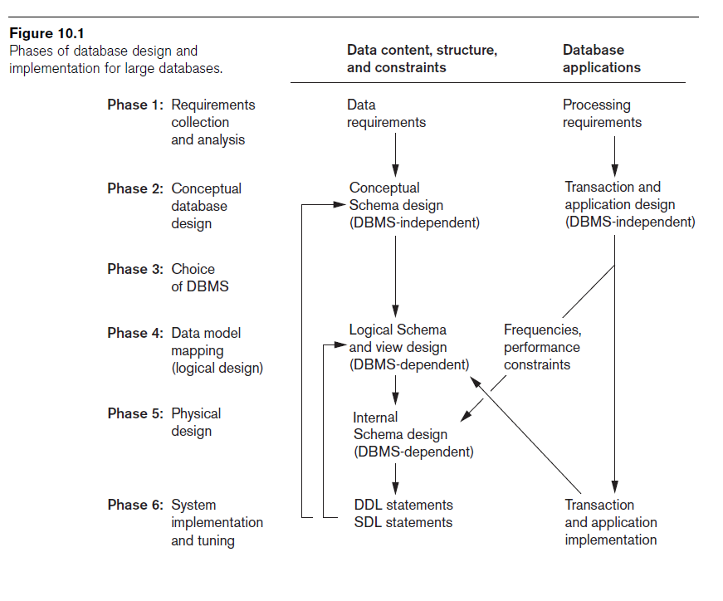

Slide 15
The Database Design and Implementation Process (cont.)
Parallel activities
  Data content, structure, and constraints of the database
  Design of database applications
Data-driven versus process-driven design
Feedback loops among phases and within phases are common

Slide 16
The Database Design and Implementation Process (cont.)
Heart of the database design process
  Conceptual database design (Phase 2)
  Data model mapping (Phase 4)
  Physical database design (Phase 5)
  Database system implementation and tuning (Phase 6)

Slide 17
Phase 1: Requirements Collection and Analysis
Activities
  Identify application areas and user groups
  Study and analyze documentation
  Study current operating environment
  Collect written responses from users

Slide 18
Phase 1 (cont.)
Requirements specification techniques
  Oriented analysis (OOA)
  Data flow diagrams (DFDs
  Refinement of application goals
  Computer-aided

Slide 19
Phase 2: Conceptual Database Design
Phase 2a: Conceptual Schema Design
  Important to use a conceptual high-level data model
  Approaches to conceptual schema design
    Centralized (or one shot) schema design approach
    View integration approach

Slide 20
Phase 2: (cont.)
  Strategies for schema design
    Top-down strategy
    Bottom-up strategy
    Inside-out strategy
    Mixed strategy
  Schema (view) integration
    Identify correspondences/conflicts among schemas:
      Naming conflicts, type conflicts, domain (value set) conflicts, conflicts among constraints
    Modify views to conform to one another
    Merge of views and restructure

Slide 21
Phase 2: (cont.)
  Strategies for the view integration process
    Binary ladder integration
    N-ary integration
    Binary balanced strategy
    Mixed strategy
Phase 2b: Transaction Design
  In parallel with Phase 2a
  Specify transactions at a conceptual level
  Identify input/output and functional behavior
  Notation for specifying processes

Slide 22
Phase 3: Choice of a DBMS
Costs to consider
  Software acquisition cost
  Maintenance cost
  Hardware acquisition cost
  Database creation and conversion cost
  Personnel cost
  Training cost
  Operating cost
Consider DBMS portability among different types of hardware

Slide 23
Phase 4: Data Model Mapping
(Logical Database Design)
Create a conceptual schema and external schemas
  In data model of selected DBMS
Stages
  System-independent mapping
  Tailoring schemas to a specific DBMS

Slide 24
Phase 5: Physical Database Design
Choose specific file storage structures and access paths for the database files
  Achieve good performance
Criteria used to guide choice of physical database design options:
  Response time
  Space utilization
  Transaction throughput

Slide 25
Phase 6: Database System Implementation and Tuning
Typically responsibility of the DBA
  Compose DDL
  Load database
  Convert data from earlier systems
Database programs implemented by application programmers
Most systems include monitoring utility to collect performance statistics

Slide 26
Use of UML Diagrams as an Aid to Database Design Specification
Use UML as a design specification standard
Unified Modeling Language (UML) approach
  Combines commonly accepted concepts from many object-oriented (O-O) methods and methodologies
  Includes use case diagrams, sequence diagrams, and statechart diagrams

Slide 27
UML for Database Application Design
Advantages of UML
  Resulting models can be used to design relational, object-oriented, or object-relational databases
  Brings traditional database modelers, analysts, and designers together with software application developers

Slide 28
Different Types of Diagrams in UML
Structural diagrams
  Class diagrams and package diagrams
  Object diagrams
  Component diagrams
  Deployment diagrams

Slide 29
Different Types of Diagrams in UML (cont.)
Behavioral diagrams
  Use case diagrams
  Sequence diagrams
  Collaboration diagrams
  Statechart diagrams
  Activity diagrams

Slide 30
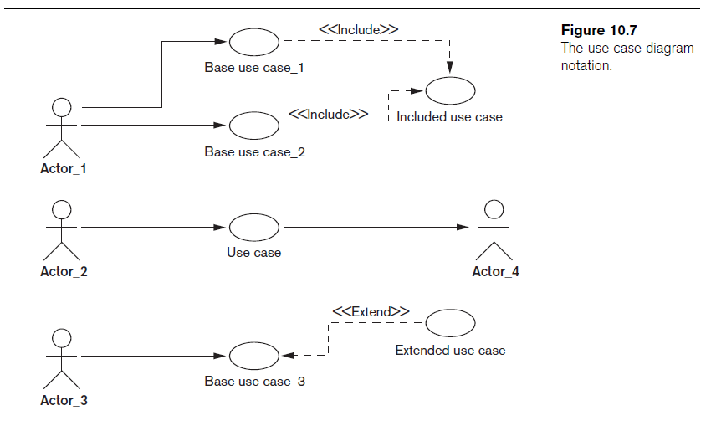

Slide 31
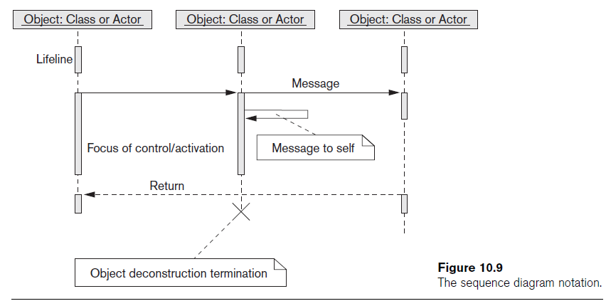
Different Types of Diagrams in UML (cont.)

Slide 32
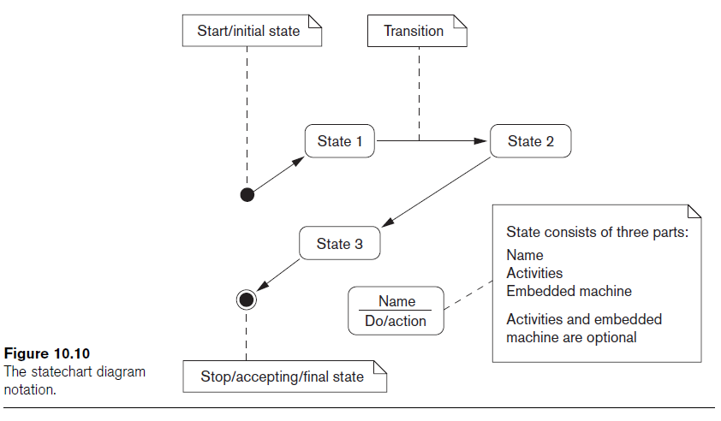
Different Types of Diagrams in UML (cont’d.)

Slide 33
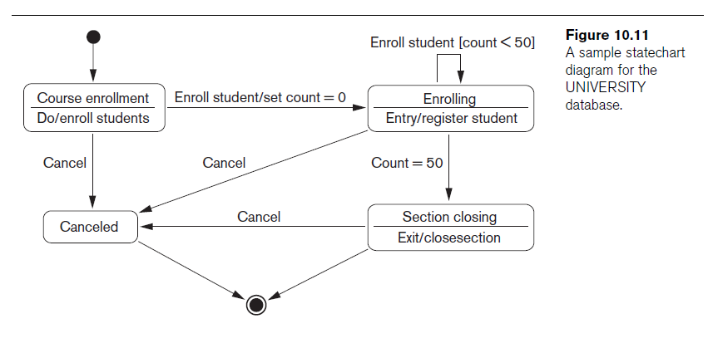
Modeling and Design Example:
UNIVERSITY Database

Slide 34
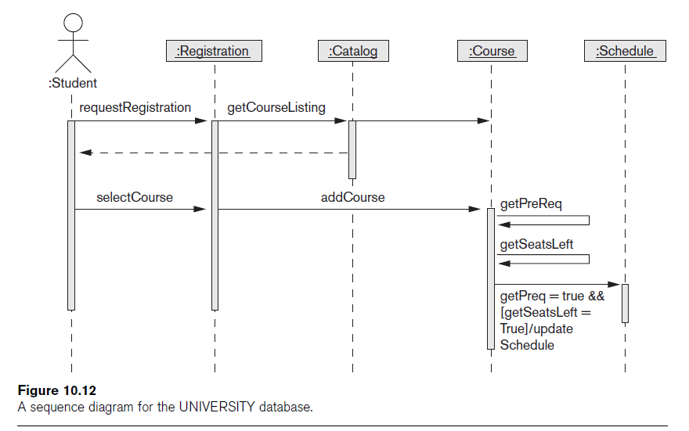

Slide 35
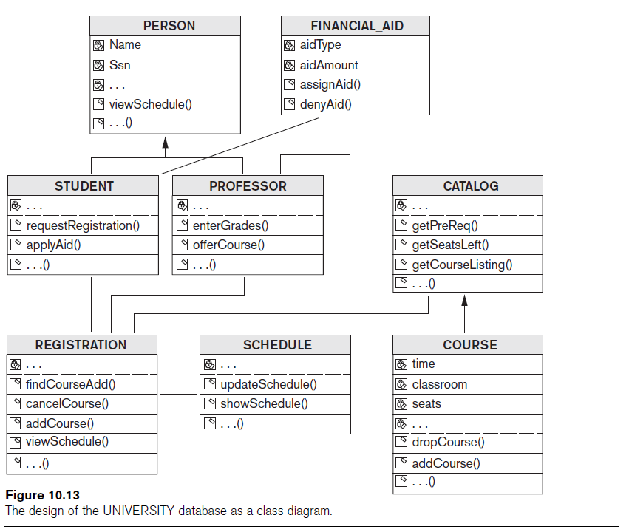

Slide 36
Rational Rose: A UML-Based Design Tool
Rational Rose for database design
  Modeling tool used in the industry to develop information systems
Rational Rose data modeler
  Visual modeling tool for designing databases
  Provides capability to:
    Forward engineer a database
    Reverse engineer an existing implemented database into conceptual design

Slide 37
Data Modeling Using Rational Rose Data Modeler
Reverse engineering
  Allows the user to create a conceptual data model based on an existing database schema specified in a DDL file
Forward engineering and DDL generation
  Create a data model directly from scratch in Rose
  Generate DDL for a specific DBMS

Slide 38
Data Modeling Using Rational Rose Data Modeler (cont.)
Conceptual design in UML notation
  Build ER diagrams using class diagrams in Rational Rose
  Identifying relationships
    Object in a child class cannot exist without a corresponding parent object
  Non-identifying relationships
    Specify a regular association (relationship) between two independent classes

Slide 39
Data Modeling Using Rational Rose Data Modeler (cont.)
Converting logical data model to object model and vice versa
  Logical data model can be converted to an object model
  Allows a deep understanding of relationships between conceptual and implementation models

Slide 40
Data Modeling Using Rational Rose Data Modeler (cont.)
Synchronization between the conceptual design and the actual database
Extensive domain support
  Create a standard set of user-defined data types
Easy communication among design teams
  Application developer can access both the object and data models

Slide 41
Automated Database Design Tools
Many CASE (computer-aided software engineering) tools for database design
Combination of the following facilities
  Diagramming
  Model mapping
  Design normalization

Slide 42
Automated Database Design Tools (cont.)
Characteristics that a good design tool should possess:
  Easy-to-use interface
  Analytical components
  Heuristic components
  Trade-off analysis
  Display of design results
  Design verification

Slide 43
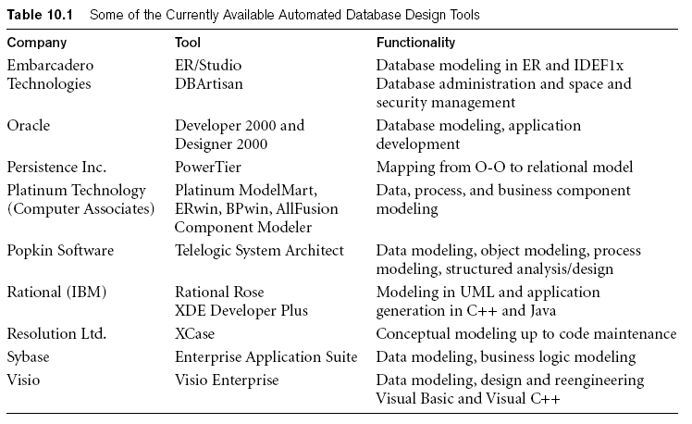
Automated Database Design Tools (cont.)
Variety of products available
  Some use expert system technology

Slide 44
Additional Material: Part 1
Logical DB Design

Slide 45
Chapter 7
Logical Database Design
Fundamentals of Database Management Systems, 2nd ed.
by
Mark L. Gillenson, Ph.D.
University of Memphis
John Wiley & Sons, Inc.

Slide 46
Chapter Objectives
Describe the concept of logical database design.
Design relational databases by converting entity-relationship diagrams into relational tables.
Describe the data normalization process.

Slide 47
Chapter Objectives
Perform the data normalization process.
Test tables for irregularities using the data normalization process.

Slide 48
Logical Database Design
The process of deciding how to arrange the attributes of the entities in the business environment into database structures, such as the tables of a relational database.
The goal is to create well structured tables that properly reflect the company’s business environment.

Slide 49
Logical Design of Relational Database Systems
(1) The conversion of E-R diagrams into relational tables.
(2) The data normalization technique.
(3) The use of the data normalization technique to test the tables resulting from the E-R diagram conversions.

Slide 50
Converting E-R Diagrams into Relational Tables
Each entity will convert to a table.
Each many-to-many relationship or associative entity will convert to a table.
During the conversion, certain rules must be followed to ensure that foreign keys appear in their proper places in the tables.

Slide 51
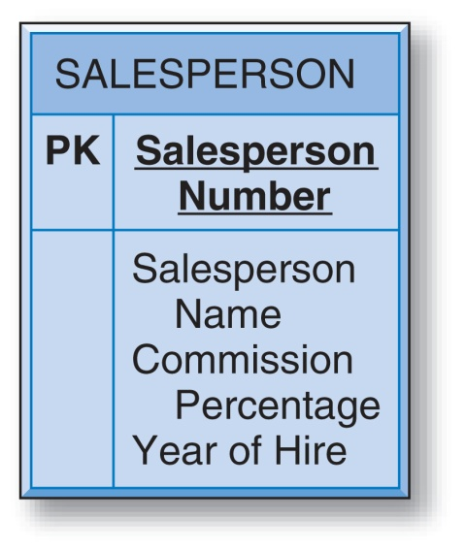

Converting a Simple Entity
The table simply contains the attributes that were specified in the entity box.
Salesperson Number is underlined to indicate that it is the unique identifier of the entity and the primary key of the table.

Slide 52
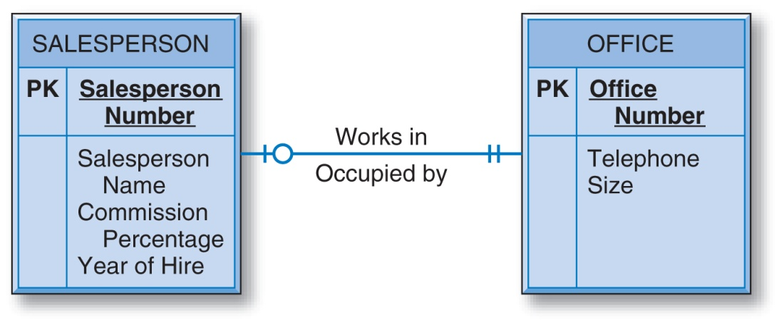
Converting Entities in Binary Relationships: One-to-One
There are three options for designing tables to represent this data.

Slide 53
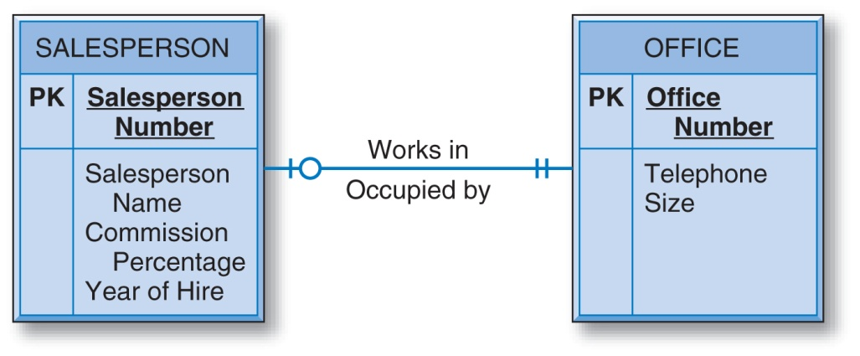
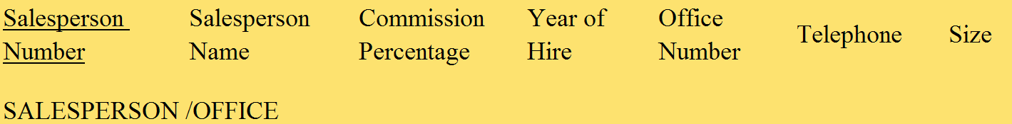
One-to-One: Option #1
The two entities are combined into one relational table.

Slide 54


One-to-One: Option #2
Separate tables for the SALESPERSON and OFFICE entities, with Office Number as a foreign key in the SALESPERSON table.

Slide 55


One-to-One: Option #3
Separate tables for the SALESPERSON and OFFICE entities, with Salesperson Number as a foreign key in the OFFICE table.

Slide 56
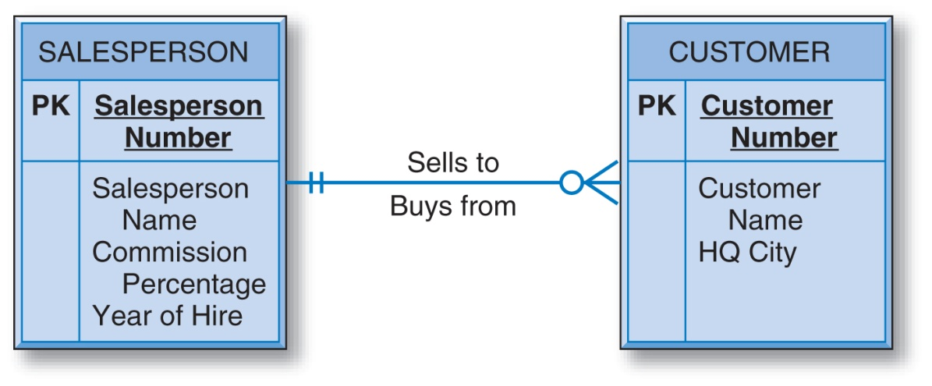
Converting Entities in Binary Relationships: One-to-Many
The unique identifier of the entity on the “one side” of the one-to-many relationship is placed as a foreign key in the table representing the entity on the “many side.”
So, the Salesperson Number attribute is placed in the CUSTOMER table as a foreign key.

Slide 57
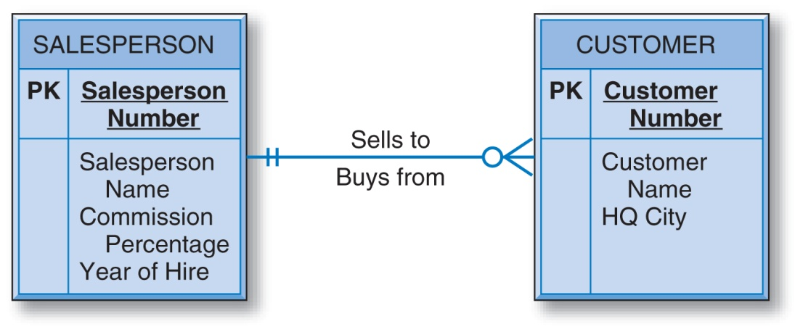

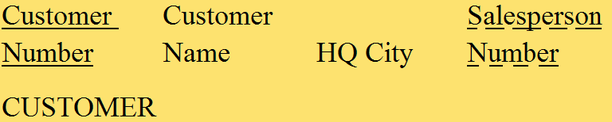
Converting Entities in Binary Relationships: One-to-Many

Slide 58
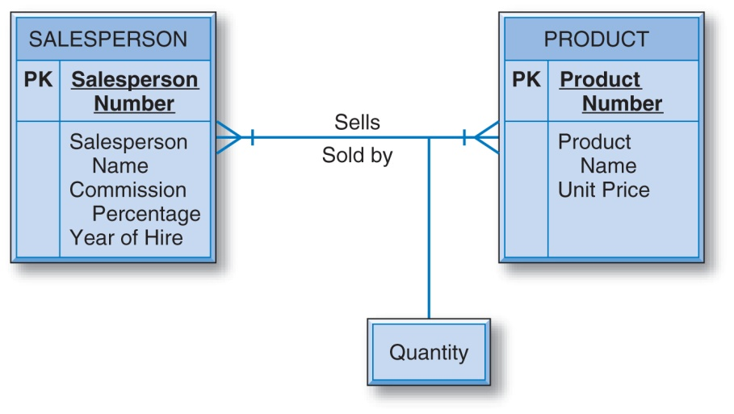
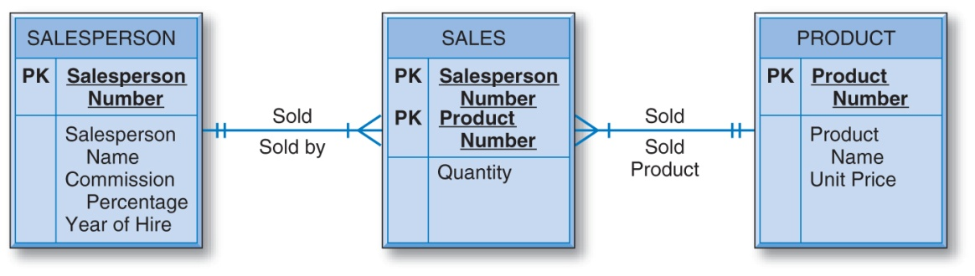
Converting Entities in Binary Relationships: Many-to-Many
E-R diagram with the many-to-many binary relationship and the equivalent diagram using an associative entity.

Slide 59
Converting Entities in Binary Relationships: Many-to-Many
An E-R diagram with two entities in a many-to-many relationship converts to three relational tables.
Each of the two entities converts to a table with its own attributes but with no foreign keys (regarding this relationship).
In addition, there must be a third “many-to-many” table for the many-to-many relationship.

Slide 60



Converting Entities in Binary Relationships: Many-to-Many
The primary key of SALE is the combination of the unique identifiers of the two entities in the many-to-many relationship. Additional attributes are the intersection data.

Slide 61
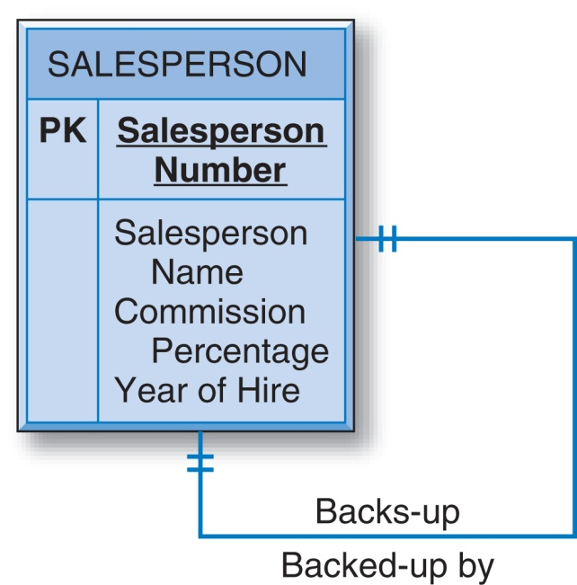
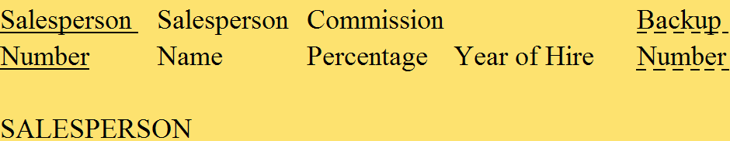
Converting Entities in Unary Relationships: One-to-One
With only one entity type involved and with a one-to-one relationship, the conversion requires only one table.

Slide 62
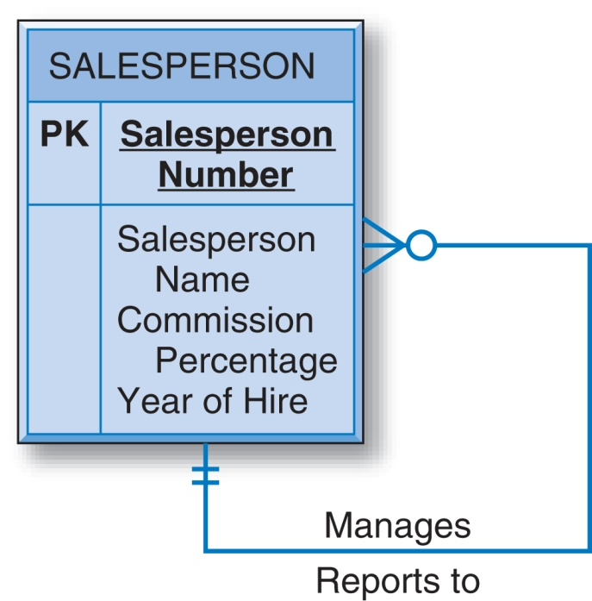

Converting Entities in Unary Relationships: One-to-Many
Very similar to the one-to-one unary case.

Slide 63
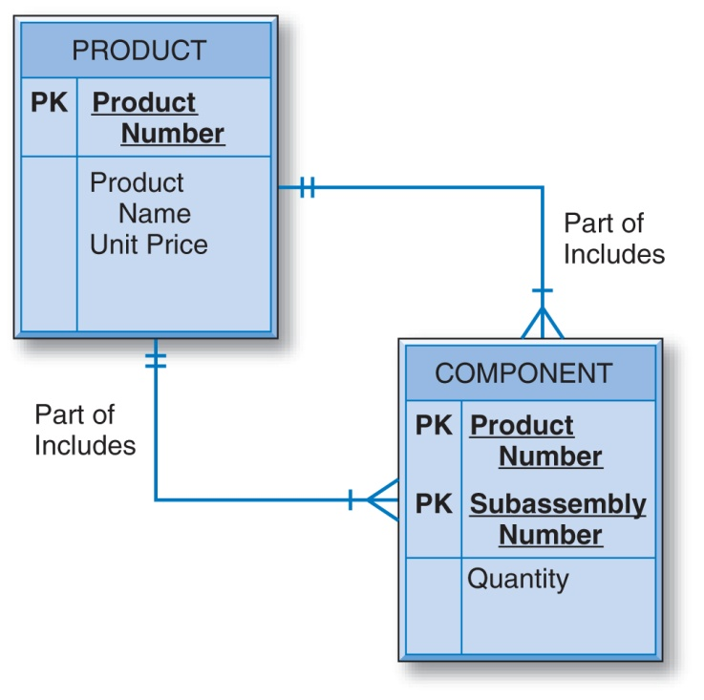


Converting Entities in Unary Relationships: Many-to-Many
This relationship requires two tables in the conversion.
The PRODUCT table has no foreign keys.

Slide 64
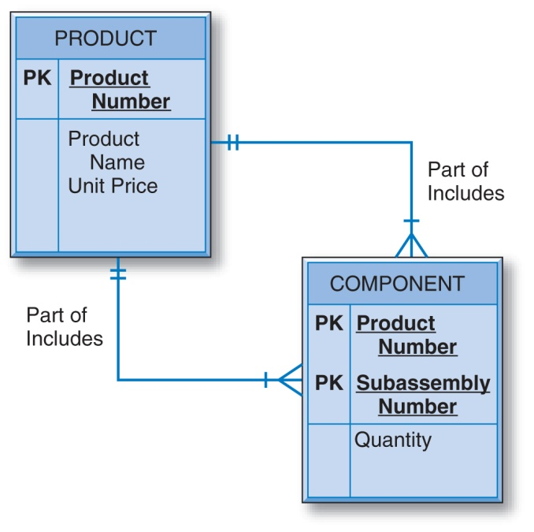
Converting Entities in Unary Relationships: Many-to-Many
A second table is created since in the conversion of a many-to-many relationship of any degree — unary, binary, or ternary — the number of tables will be equal to the number of entity types (one, two, or three, respectively) plus one more table for the many-to-many relationship.

Slide 65
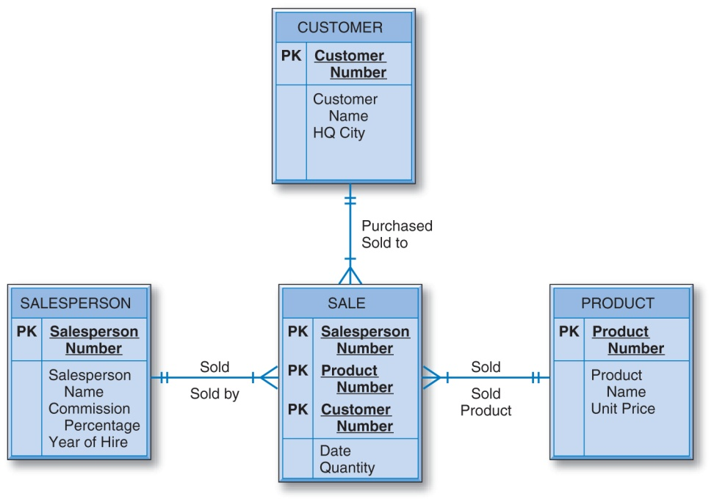




Converting Entities in
Ternary Relationships
The primary key of the SALE table is the combination of the unique identifiers of the three entities involved, plus the Date attribute.

Slide 66
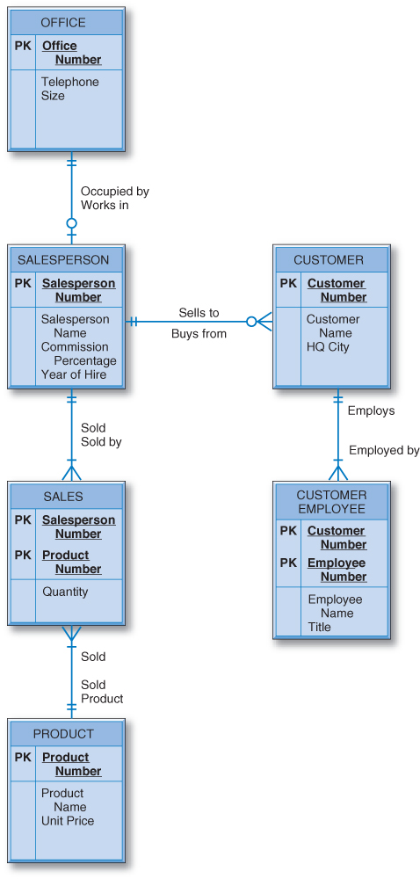
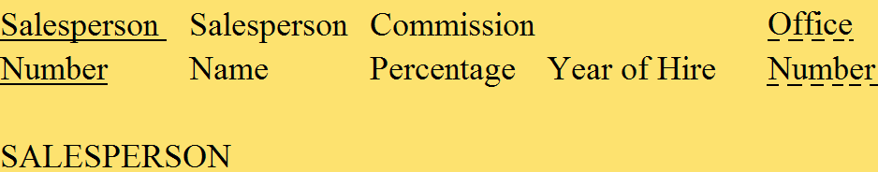



Designing the General Hardware Company Database

Slide 67
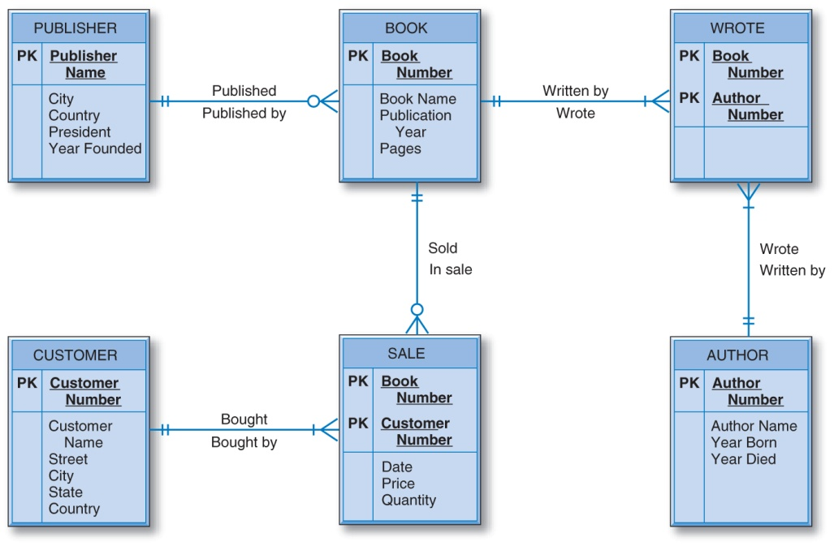






Designing the Good Reading Bookstores Database

Slide 68
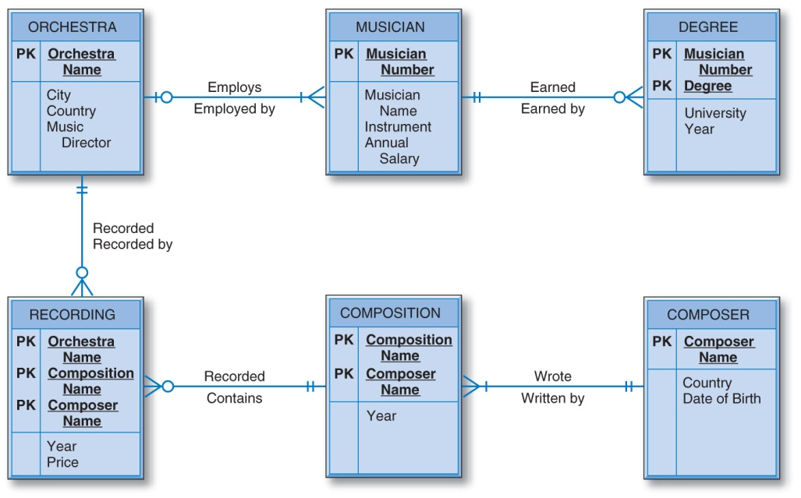




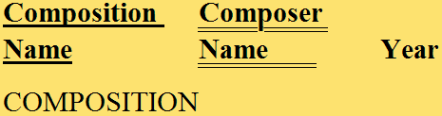

Designing the World Music Association Database

Slide 69
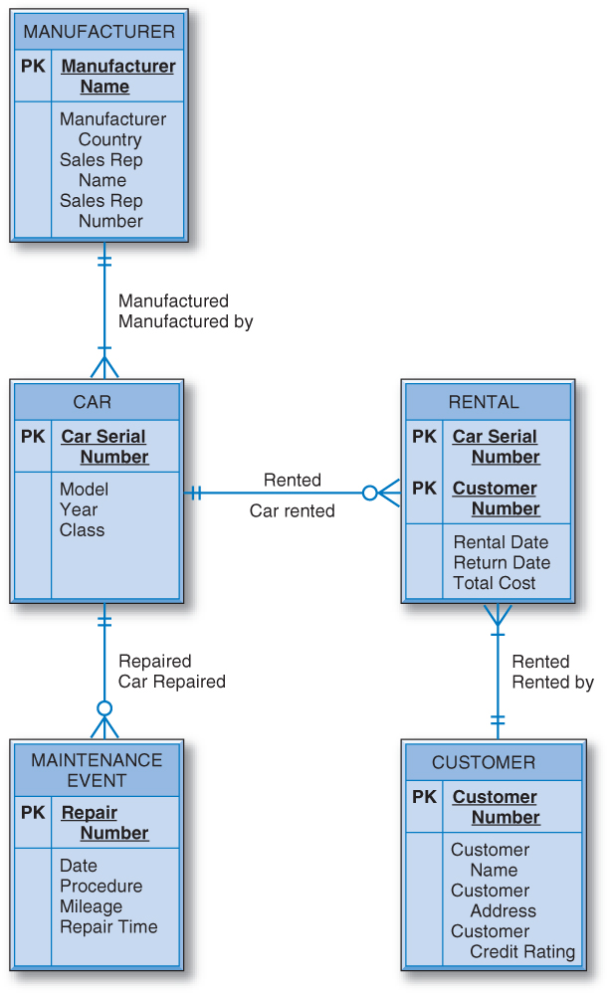

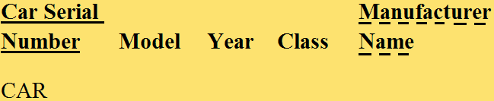


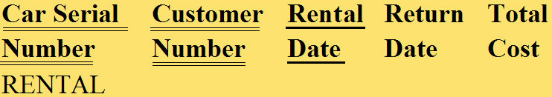
Designing the Lucky
Rent-A-Car Database

Slide 70
The Data Normalization Process
A methodology for organizing attributes into tables so that redundancy among the nonkey attributes is eliminated.
The output of the data normalization process is a properly structured relational database.

Slide 71
The Data Normalization Technique
Input:
  all the attributes that must be incorporated into the database
  a list of all the defining associations between the attributes (i.e., the functional dependencies).
    a means of expressing that the value of one particular attribute is associated with a single, specific value of another attribute.
    If we know that one of these attributes has a particular value, then the other attribute must have some other value.

Slide 72
Functional Dependence
Salesperson Number
Salesperson Name
Salesperson Number is the determinant.
The value of Salesperson Number determines the value of Salesperson Name.
Salesperson Name is functionally dependent on Salesperson Number.

Slide 73
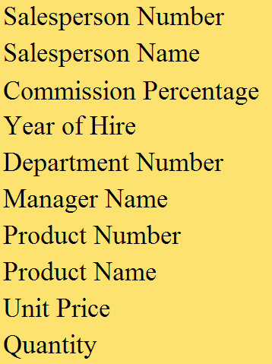
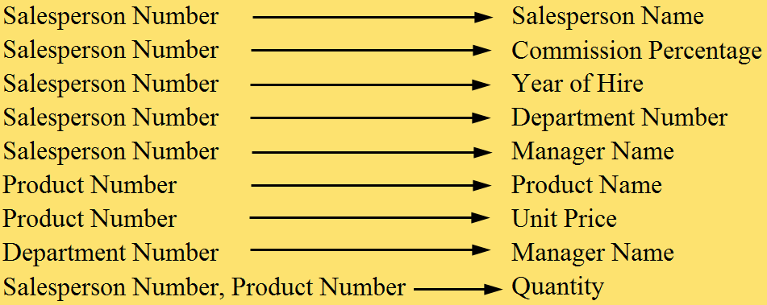
General Hardware Environment: SALESPERSON and PRODUCT

Slide 74
Steps in the Data Normalization Process
First Normal Form
Second Normal Form
Third Normal Form

Slide 75
The Data Normalization Process
Once the attributes are arranged in third normal form, the group of tables that they comprise is a well-structured relational database with no data redundancy.
A group of tables is said to be in a particular normal form if every table in the group is in that normal form.
The data normalization process is progressive.
  For example, if a group of tables is in second normal form, it is also in first normal form.

Slide 76
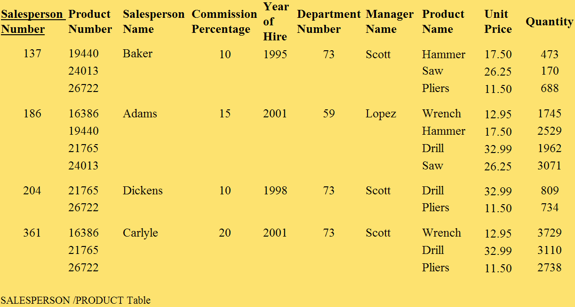
General Hardware Company: Unnormalized Data
Records contain multivalued attributes.

Slide 77

General Hardware Company: First Normal Form
The attributes under consideration have been listed in one table, and a primary key has been established.
The number of records has been increased so that every attribute of every record has just one value.
The multivalued attributes have been eliminated.

Slide 78
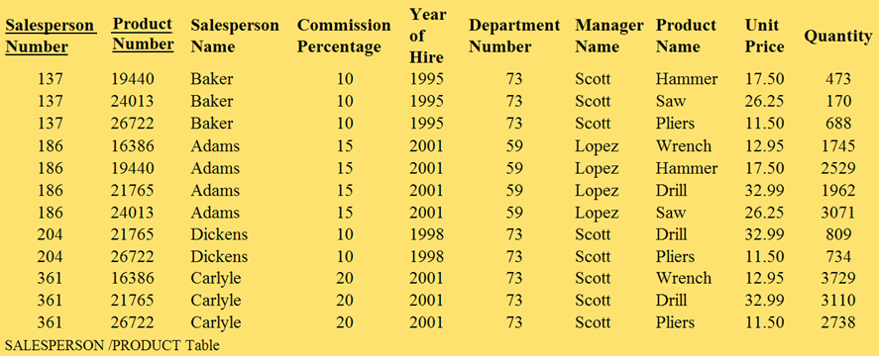
General Hardware Company: First Normal Form

Slide 79
General Hardware Company: First Normal Form
First normal form is merely a starting point in the normalization process.
First normal form contains a great deal of data redundancy.
  Three records involve salesperson 137, so there are three places in which his name is listed as Baker, his commission percentage is listed as 10, and so on.
  Two records involve product 19440 and this product’s name is listed twice as Hammer and its unit price is listed twice as 17.50.

Slide 80
General Hardware Company: Second Normal Form
No Partial Functional Dependencies
  Every nonkey attribute must be fully functionally dependent on the entire key of that table.
  A nonkey attribute cannot depend on only part of the key.

Slide 81



General Hardware Company: Second Normal Form
In SALESPERSON, Salesperson Number is the sole primary key attribute. Every nonkey attribute of the table is fully defined just by Salesperson Number.
Similar logic for PRODUCT and QUANTITY tables.

Slide 82
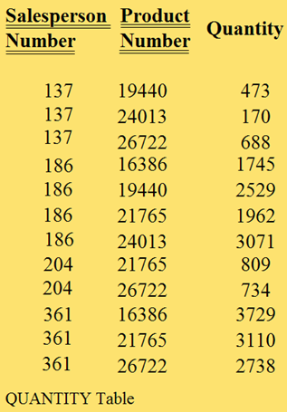
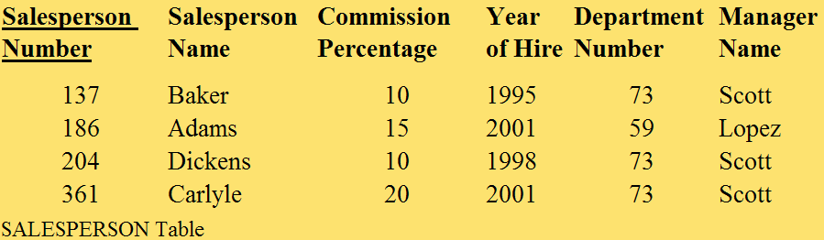
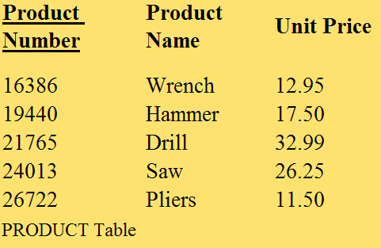
General Hardware Company: Second Normal Form

Slide 83
General Hardware Company: Third Normal Form
Does not allow transitive dependencies in which one nonkey attribute is functionally dependent on another.
Nonkey attributes are not allowed to define other nonkey attributes.

Slide 84
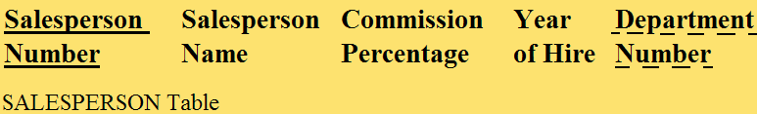



General Hardware Company: Third Normal Form

Slide 85
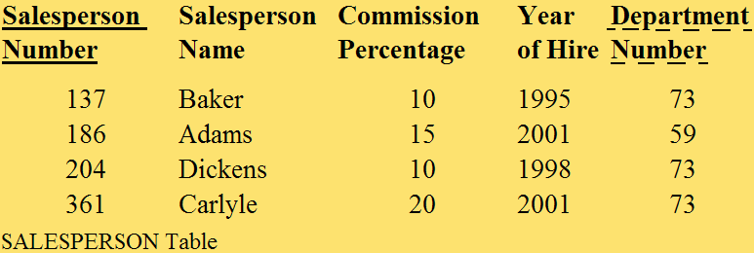
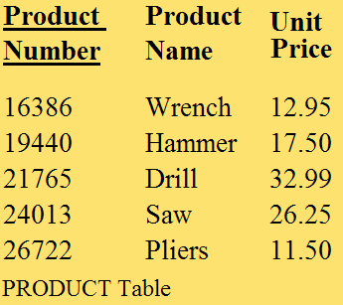
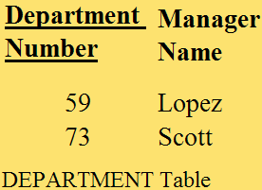
General Hardware Company: Third Normal Form

Slide 86
General Hardware Company: Third Normal Form
Important points about the third normal form structure are:
  It is completely free of data redundancy.
  All foreign keys appear where needed to logically tie together related tables.
  It is the same structure that would have been derived from a properly drawn entity-relationship diagram of the same business environment.

Slide 87
Candidate Keys as Determinants
There is one exception to the rule that in third normal form, nonkey attributes are not allowed to define other nonkey attributes.
The rule does not hold if the defining nonkey attribute is a candidate key of the table.
Candidate keys in a relation may define other nonkey attributes without violating third normal form.

Slide 88
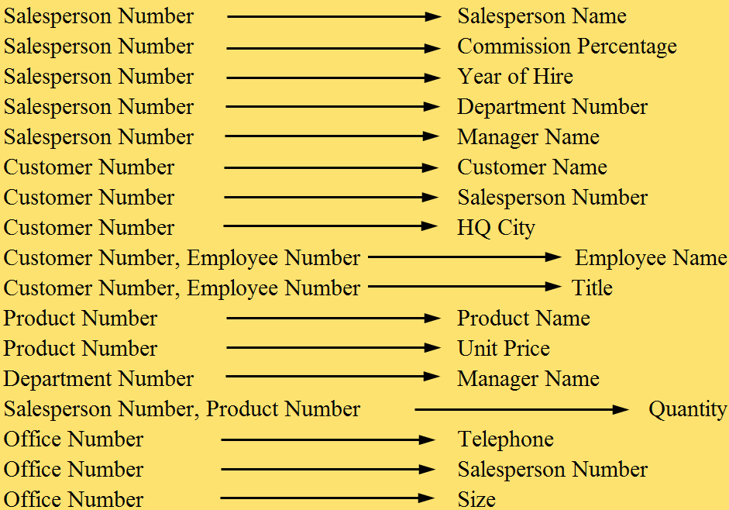
General Hardware Company: Functional Dependencies

Slide 89


General Hardware Company: First Normal Form

Slide 90
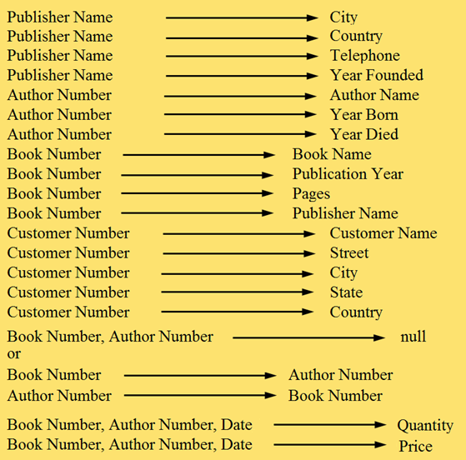
Good Reading Bookstores: Functional Dependencies

Slide 91
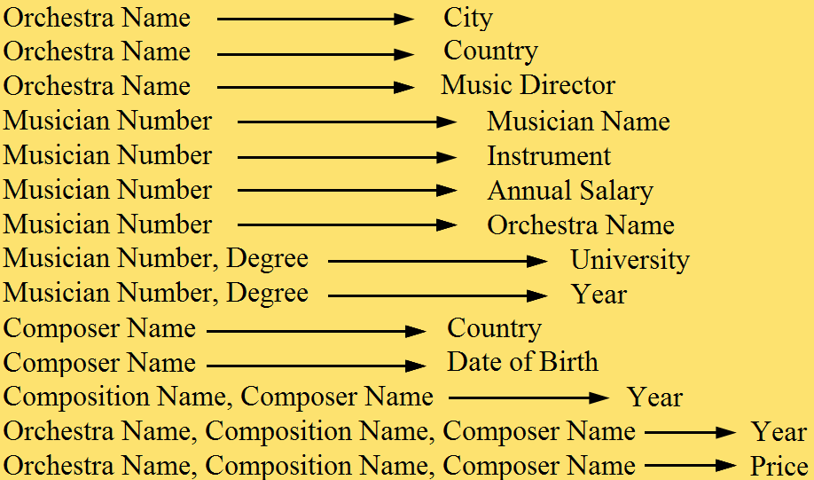
World Music Association: Functional Dependencies

Slide 92
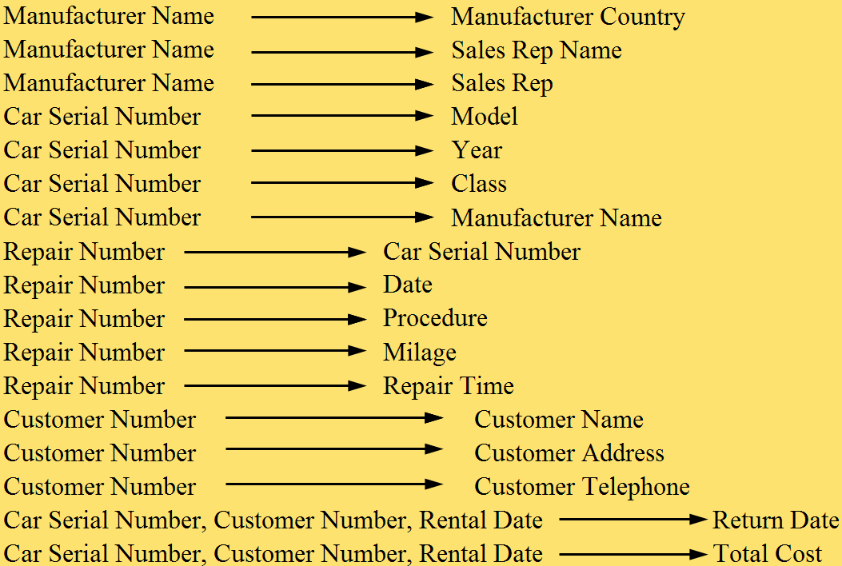
Lucky Rent-A-Car:
Functional Dependencies

Slide 93
Data Normalization Check
The basic idea in checking the structural worthiness of relational tables, created through E-R diagram conversion, with the data normalization rules is to:
  Check to see if there are any partial functional dependencies.
  Check to see if there are any transitive dependencies.

Slide 94
Creating a Table with SQL
CREATE TABLE SALESPERSON
(SPNUM CHAR(3) PRIMARY KEY,
SPNAME CHAR(12)
COMMPERCT DECIMAL(3,0)
YEARHIRE CHAR(4)
OFFNUM CHAR(3) );
Dropping a Table with SQL
DROP TABLE SALESPERSON;

Slide 95
Creating a View with SQL
CREATE VIEW EMPLOYEE AS
SELECT SPNUM, SPNAME, YEARHIRE
FROM SLAESPERSON;
Dropping a View with SQL
DROP VIEW EMPLOYEE ;

Slide 96
The SQL Update, Insert, and Delete Commands
UPDATE SALESPERSON
SET COMMPERCT = 12
WHERE SPNUM = ‘204’;
INSERT INTO SALESPERSON
VALUES
(‘489’, ‘Quinlan’, 15, ‘2011’, ‘59’);
DELETE FROM SALESPERSON
WHERE SPNUM = ‘186’;

Slide 97
Additional Material: Part 2
Physical DB Design

Slide 98
Chapter 8
Physical Database Design
Fundamentals of Database Management Systems, 2nd ed.
by
Mark L. Gillenson, Ph.D.
University of Memphis
John Wiley & Sons, Inc.

Slide 99
Chapter Objectives
Describe the concept of physical database design.
Describe how a disk device works.
Describe the principles of file organizations and access methods.

Slide 100
Chapter Objectives
Describe how simple linear indexes and B+-tree indexes work.
Describe how hashed files work.
List and describe the inputs to the physical database design process.

Slide 101
Chapter Objectives
Perform physical database design and improve database performance using a variety of techniques ranging from adding indexes to denormalization.

Slide 102
Database Performance
Factors Affecting Application and Database Performance
Application Factors
  Need for Joins
  Need to Calculate Totals
Data Factors
  Large Data Volumes
Database Structure Factors
  Lack of Direct Access
  Clumsy Primary Keys
Data Storage Factors
  Related Data Dispersed on Disk
Business Environment Factors
  Too Many Data Access Operations
  Overly Liberal Data Access

Slide 103
Physical Database Design
The process of modifying a database structure to improve the performance of the run-time environment.
We are going to modify the third normal form tables produced by the logical database design techniques to make the applications that will use them run faster.

Slide 104
Disk Storage
Primary (Main) Memory - where computers execute programs and process data
  Very fast
  Permits direct access
  Has several drawbacks
    relatively expensive
    not transportable
    is volatile

Slide 105
Disk Storage
Secondary Memory - stores the vast volume of data and the programs that process them
Data is loaded from secondary memory into primary memory when required for processing.

Slide 106

Primary and Secondary Memory
When a person needs some particular information that’s not in her brain at the moment, she finds a book in the library that has the information and, by reading it, transfers the information from the book into her brain.

Slide 107
How Disk Storage Works
Disks come in a variety of types and capacities
  Multi-platter, aluminum or ceramic disk units
  Removable, external hard drives.
Provide a direct access capability to the data.

Slide 108
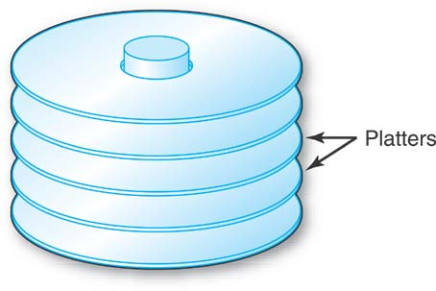
How Disk Storage Works
Several disk platters are stacked together, and mounted on a central spindle, with some space in between them.
Referred to as “the disk.”

Slide 109
How Disk Storage Works
The platters have a metallic coating that can be magnetized, and this is how the data is stored, bit-by-bit.

Slide 110
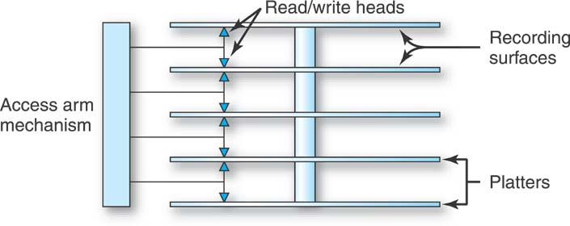
Access Arm Mechanism
The basic disk drive has one access arm mechanism with arms that can reach in between the disks.
At the end of each arm are two read/write heads.
The platters spin, all together as a single unit, on the central spindle, at a high velocity.

Slide 111
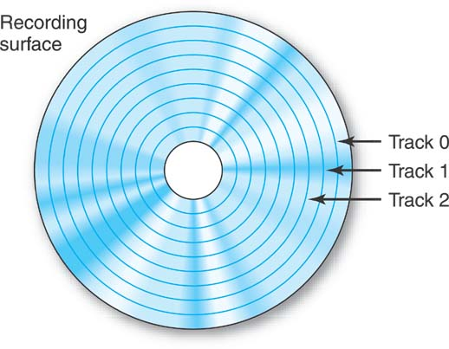
Tracks
Concentric circles on which data is stored, serially by bit.
Numbered track 0, track 1, track 2, and so on.

Slide 112
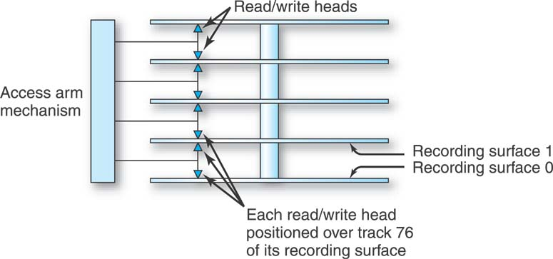
Cylinders
A collection of tracks, one from each recording surface, one directly above the other.
Number of cylinders in a disk = number of tracks on any one of its recording surfaces.

Slide 113

Cylinders
The collection of each surface’s track 76, one above the other, seem to take the shape of a cylinder.
This collection of tracks is called cylinder 76.

Slide 114

Cylinders
Once we have established a cylinder, it is also necessary to number the tracks within the cylinder.
Cylinder 76’s tracks.

Slide 115
Steps in Finding and Transferring Data
Seek Time - The time it takes to move the access arm mechanism to the correct cylinder from whatever cylinder it’s currently positioned.
Head Switching - Selecting the read/write head to access the required track of the cylinder.
Rotational Delay - Waiting for the desired data on the track to arrive under the read/write head as the disk is spinning.

Slide 116
Steps in Finding and Transferring Data
Transfer Time - The time to actually move the data from the disk to primary memory once the previous 3 steps have been completed.

Slide 117
File Organizations and Access Methods
File Organization - the way that we store the data for subsequent retrieval.
Access Method - The way that we retrieve the data, based on it being stored in a particular file organization.

Slide 118
Achieving Direct Access
An index tool.
Hashing Method - a way of storing and retrieving records.
If we know the value of a field of a record that we want to retrieve, the index or hashing method will pinpoint its location in the file and instruct the hardware mechanisms of the disk device where to find it.

Slide 119

The Index
Principal is the same as that governing the index in the back of a book.

Slide 120
The Index
The items of interest are copied over into the index, but the original text is not disturbed in any way.
The items in the index are sorted.
Each item in the index is associated with a “pointer.”

Slide 121

Simple Linear Index
Index is ordered by Salesperson Name field.
The first index record shows Adams 3 because the record of the Salesperson file with salesperson name Adams is at relative record location 3 in the Salesperson file.

Slide 122

Simple Linear Index
An index built over the City field.
An index can be built over a field with nonunique values.

Slide 123

Simple Linear Index
An index built over the Salesperson Number field.
Indexed sequential file - the file is stored on the disk in order based on a set of field values (salesperson numbers), and an index is built over that same field.

Slide 124

Simple Linear Index

Slide 125
Simple Linear Index
French 8, would have to be inserted between the index records for Dickens and Green to maintain the crucial alphabetic sequence.
Would have to move all of the index records from Green to Taylor down one record position.
Not a good solution for indexing the records of a file.

Slide 126
B+-tree Index
The most common data indexing system in use today.
Unlike simple linear indexes, B+-trees are designed to comfortably handle the insertion of new records into the file and to handle record deletion.

Slide 127

B+-tree Index
An arrangement of special index records in a “tree.”
A single index record, the “root,” at the top, with “branches” leading down from it to other “nodes.”

Slide 128
B+-tree Index
The lowest level nodes are called “leaves.”
Think of it as a family tree.

Slide 129
B+-tree Index
Each key value in the tree is associated with a pointer that is the address of either a lower level index record or a cylinder containing the salesperson records.
The index records contain salesperson number key values copied from certain of the salesperson records.

Slide 130

B+-tree Index

Slide 131
B+-tree Index
Each index record, at every level of the tree, contains space for the same number of key value/pointer pairs.
Each index record is at least half full.
The tree index is small and can be kept in main memory indefinitely for a frequently accessed file.

Slide 132
B+-tree Index
This is an indexed-sequential file, because the file is stored in sequence by the salesperson numbers and the index is built over the Salesperson Number field.
B+-tree indexes can also be used to index nonkey, nonunique fields.
In general, the storage unit for groups of records can be the cylinder or any other physical device subunit.

Slide 133
B+-tree Index
Say that a new record with salesperson number 365 must be inserted.
Suppose that cylinder 5 is completely full.

Slide 134

B+-tree Index
The collection of records on the entire cylinder has to be split between cylinder 5 and an empty reserve cylinder, say cylinder 11.
There is no key value/pointer pair representing cylinder 11 in the tree index.

Slide 135

B+-tree Index
The index record, into which the key for the new cylinder should go, which happens to be full, is split into two index records.
The now five key values and their associated pointers are divided between them.

Slide 136
Indexes
Can be built over any field (unique or nonunique) of a file.
Can also be built on a combination of fields.
In addition to its direct access capability, an index can be used to retrieve the records of a file in logical sequence based on the indexed field.

Slide 137
Indexes
Many separate indexes into a file can exist simultaneously. The indexes are quite independent of each other.
When a new record is inserted into a file, an existing record is deleted, or an indexed field is updated, all of the affected indexes must be updated.

Slide 138
Hashed Files
The number of records in a file is estimated, and enough space is reserved on a disk to hold them.
Additional space is reserved for additional overflow records.

Slide 139
Hashed Files
To determine where to insert a particular record of the file, the record’s key value is converted by a hashing routine into one of the reserved record locations on the disk.
To find and retrieve the record, the same hashing routine is applied to the key value during the search.

Slide 140
Division-Remainder Method
Divide the key value of the record that we want to insert or retrieve by the number of record locations that we have reserved.
Perform the division, discard the quotient, and use the remainder to tell us where to locate the record.

Slide 141

A Hashed File
Storage area for 50 records plus overflow records.
Collision - more than one key value hashes to the same location.
  The two key values are called “synonyms.”

Slide 142
Hashed Files
Hashing disallows any sequential storage based on a set of field values.
A file can only be hashed once, based on the values of a single field or a single combination of fields.
If a file is hashed on one field, direct access based on another field can be achieved by building an index on the other field.

Slide 143
Hashed Files
Many hashing routines have been developed.
The goal is to minimize the number of collisions, which can slow down retrieval performance.
In practice, several hashing routines are tested on a file to determine the best “fit.”
Even a relatively simple procedure like the division-remainder method can be fine-tuned.

Slide 144
Hashed Files
A hashed file must occasionally be reorganized after so many collisions have occurred that performance is degraded to an unacceptable level.
A new storage area with a new number of storage locations is chosen, and the process starts all over again.

Slide 145
Inputs to Physical
Database Design
Physical database design starts where logical database design ends.
The well structured relational tables produced by the conversion from ERDs or by the data normalization process form the starting point for physical database design.

Slide 146
More Inputs to Physical Database Design
Inputs Into the Physical Database Design Process
The Tables Produced by the Logical Database Design Process
Business Environment Requirements
  Response Time Requirements
  Throughput Requirements
Data Characteristics
  Data Volume Assessment
  Data Volatility
Application Characteristics
  Application Data Requirements
  Application Priorities
Operational Requirements
  Data Security Concerns
  Backup and Recovery Concerns
Hardware and Software Characteristics
  DBMS Characteristics
  Hardware Characteristics

Slide 147
The Tables Produced by the Logical Database Design Process
Form the starting point of the physical database design process.
Reflect all of the data in the business environment.
Are likely to be unacceptable from a performance point of view and must be modified in physical database design.

Slide 148
Business Environment Requirements
Response Time Requirements
Throughput Requirements

Slide 149
Business Environment Requirements: Response Time Requirements
Response time is the delay from the time that the Enter Key is pressed to execute a query until the result appears on the screen.
What are the response time requirements?

Slide 150
Business Environment Requirements: Throughput Requirements
Throughput is the measure of how many queries from simultaneous users must be satisfied in a given period of time by the application set and the database that supports it.

Slide 151
Data Characteristics
Data Volume Assessment
  How much data will be in the database?
  Roughly how many records is each table expected to have?
Data Volatility
  Refers to how often stored data is updated.

Slide 152
Application Characteristics
What is the nature of the applications that will use the data?
Which applications are the most important to the company?
Which data will be accessed by each application?

Slide 153
Application Characteristics
Application Data Requirements
Application Priorities

Slide 154
Application Characteristics: Data Requirements
Which database tables does each application require for its processing?
Do the applications require that tables be joined?
How many applications and which specific applications will share particular database tables?
Are the applications that use a particular table run frequently or infrequently?

Slide 155
Application Characteristics: Priorities
When a modification to a table proposed during physical design that’s designed to help the performance of one application hinders the performance of another application, which of the two applications is the more critical to the company?

Slide 156
Operational Requirements: Data Security, Backup and Recovery
Data Security
  Protecting data from theft or malicious destruction and making sure that sensitive data is accessible only to those employees of the company who have a “need to know.”
Backup and Recovery
  Being able to recover a table or a database that has been corrupted or lost due to hardware or software failure to the recovery of an entire information system after a natural disaster.

Slide 157
Hardware and Software Characteristics
DBMS Characteristics
  For example, exact nature of indexes, attribute data type options, and SQL query features, which must be known and taken into account during physical database design.
Hardware Characteristics
  Processor speeds and disk data transfer rates.

Slide 158
Physical Database Design Techniques
Physical Design Categories and Techniques That DO NOT Change the Logical Design
Adding External Features
  Adding Indexes
  Adding Views
Reorganizing Stored Data
  Clustering Files
Splitting a Table into Multiple Tables
  Horizontal Partitioning
  Vertical Partitioning
  Splitting-Off Large Text Attributes

Slide 159
Physical Database Design Techniques
Physical Design Categories and Techniques That DO Change the Logical Design
Changing Attributes in a Table
  Substituting Foreign Keys
Adding Attributes to a Table
  Creating New Primary Keys
  Storing Derived Data
Combining Tables
  Combine Tables in One-to-One relationships
  Alternative for Repeating Groups
  Denormalization
Adding New Tables
  Duplicating Tables
  Adding Subset Tables

Slide 160
Adding External Features
Doesn’t change the logical design at all.
There is no introduction of data redundancy.

Slide 161
Adding External Features
Adding Indexes
Adding Views

Slide 162
Adding External Features: Adding Indexes
Which attributes or combinations of attributes should you consider indexing in order to have the greatest positive impact on the application environment?
  Attributes that are likely to be prominent in direct searches
    Primary keys
    Search attributes
  Attributes that are likely to be major players in operations, such as joins, SQL SELECT ORDER BY clauses and SQL SELECT GROUP BY clauses.

Slide 163
Adding External Features: Adding Indexes
What potential problems can be caused by building too many indexes?
Indexes are wonderful for direct searches. But when the data in a table is updated, the system must take the time to update the table’s indexes, too.

Slide 164

General Hardware Company With Some Indexes

Slide 165
Adding External Features: Adding Views
Doesn’t change the logical design.
No data is physically duplicated.
An important device in protecting the security and privacy of data.

Slide 166
Reorganizing Stored Data
Doesn’t change the logical design.
No data is physically duplicated.
Clustering Files
  Houses related records together on a disk.

Slide 167

Reorganizing Stored Data: Clustering Files
The salesperson record for salesperson 137, Baker, is followed on the disk by the customer records for customers 0121, 0933, 1047, and 1826.

Slide 168
Splitting a Table Into
Multiple Tables
Horizontal Partitioning
Vertical Partitioning
Splitting-Off Large Text Attributes

Slide 169
Splitting a Table Into
Multiple Tables: Horizontal Partitioning
The rows of a table are divided into groups, and the groups are stored separately on different areas of a disk or on different disks.
Useful in managing the different groups of records separately for security or backup and recovery purposes.
Improve data retrieval performance.
Disadvantage: retrieval of records from more than one partition can be more complex and slower.

Slide 170


Splitting a Table Into
Multiple Tables: Horizontal Partitioning

Slide 171
Splitting a Table Into
Multiple Tables: Vertical Partitioning
The separate groups, each made up of different columns of a table, are created because different users or applications require different columns.
Each partition must have a copy of the primary key.

Slide 172


Splitting a Table Into
Multiple Tables: Vertical Partitioning
The Salesperson table

Slide 173
Splitting a Table Into
Multiple Tables: Splitting Off Large Text Attributes
A variation on vertical partitioning involves splitting off large text attributes into separate partitions.
Each partition must have a copy of the primary key.

Slide 174

Changing Attributes in a Table
Changes the logical design.
Substituting a Foreign Key
  Substitute an alternate key (Salesperson Name, assuming it is a unique attribute) as a foreign key.
  Saves on the number of performance-slowing joins.

Slide 175
Adding Attributes to a Table
Creating New Primary Keys
Storing Derived Data

Slide 176
Adding Attributes to a Table: Creating New Primary Keys
Changes the logical design.
In a table with no single attribute primary key, indexing a multi-attribute key would likely be clumsy and slow.
Create a new serial number attribute primary key for the table.

Slide 177

Adding Attributes to a Table: Creating New Primary Keys
The current two-attribute primary key of the CUSTOMER EMPLOYEE table can be replaced by one, new attribute.

Slide 178



Adding Attributes to a Table: Storing Derived Data
Calculate answers to certain queries once and store them in the database.

Slide 179
Combining Tables
If two tables are combined into one, then there must surely be situations in which the presence of the new single table allows us to avoid joins that would have been necessary when there were two tables.
  Combination of Tables in One-to-One Relationships
  Alternatives for Repeating Groups
  Denormalization

Slide 180

Combining Tables: Combination of Tables in One-to-One Relationships
Advantage: if we ever have to retrieve detailed data about a salesperson and his office in one query, it can now be done without a join.

Slide 181
Combining Tables: Combination of Tables in One-to-One Relationships
Disadvantages:
  the tables are no longer logically as well as physically independent.
  retrievals of salesperson data alone or of office data alone could be slower than before.
  storage of data about unoccupied offices is problematic and may require a reevaluation of which field should be the primary key.

Slide 182

Combining Tables: Alternatives for Repeating Groups
If repeating groups are well controlled, they can be folded into one table.

Slide 183
Combining Tables: Denormalization
It may be necessary to take pairs of related, third normal form tables and to combine them, introducing possibly massive data redundancy.
Unsatisfactory response times and throughput may mandate eliminating run-time joins.

Slide 184

Combining Tables: Denormalization
Since a salesperson can have several customers, a particular salesperson’s data will be repeated for each customer he has.

Slide 185

Combining Tables: Denormalization

Slide 186
Adding New Tables
Duplicating Tables
  Duplicate tables and have different applications access the duplicates.
Adding Subset Tables
  Duplicate only those portions of a table that are most heavily accessed.
  Assign subsets to different applications to ease the performance crunch.

Slide 187
Good Reading Bookstores: Problem
Assume that Good Reading’s headquarters frequently needs to quickly find the details of a book, based on either its book number or its title, together with details about its publisher.
If a join takes too long, resulting in unacceptable response times, throughput, or both, what are the possibilities in terms of physical design that can improve the situation?

Slide 188
Good Reading Bookstores: Solutions
The Book Number attribute and the Book Title attributes in the PUBLISHER table can each have an index built on them to provide direct access, since the problem says that books are going to be searched for based on one of these two attributes.
The two join attributes—the Publisher Name attribute of the PUBLISHER table and the Publisher Name attribute of the BOOK table—can each have an index built on them to help speed up the join operation.

Slide 189
Good Reading Bookstores: Solutions
If the DBMS permits it, the two tables can be clustered, with the book records associated with a particular publisher stored near that publisher’s record on the disk.
The two tables can be denormalized, with the appropriate publisher data being appended to each book record (and the PUBLISHER table being eliminated).

Slide 190
Next Lecture
Object & Object-Relational DB

Slide 191
References
Ramez Elmasri, Shamkant Navathe; “Fundamentals of Database Systems”, 6th Ed., Pearson, 2014
Mark L. Gillenson; “Fundamentals of Database Management Systems”, 2nd Ed., John Wiley, 2012
Universität Hamburg, Fachbereich Informatik, Einführung in Datenbanksysteme, Lecture Notes, 1999

