Slide 1


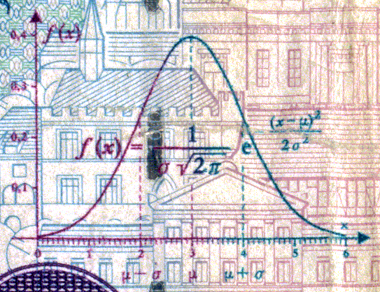
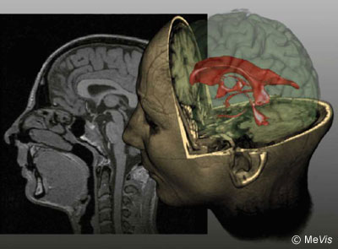
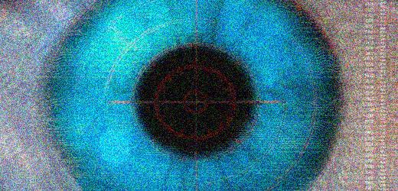
CSE 307
Fundamentals of Image Processing
Lecture #4 Frequency Domain Filtering
(Part 1)
Prepared & Presented by Asst. Prof. Dr. Samsun M. BAŞARICI

Slide 2


Objectives
Which mathematical tools are used to represent an image’s contents in the 2D frequency domain? (Part 1)
What is the Fourier transform, what are its main properties, and how is it used in the context of frequency-domain filtering? (Part 1)
What are the differences between low-pass and high-pass filters? (Part 2)
What are the differences among ideal, Butterworth, and Gaussian filters? (Part 2)

Slide 3

Filtering in the frequency domain
The convolution theorem:
The symbol * stands for the convolution of two functions.
The symbol stands for the Fourier transform pair.
The above expression indicates that convolution of two spatial functions can be obtained by computing the inverse Fourier transforms of the of the two functions.

Slide 4
Filtering in the frequency domain (cont.)
H(u,v) is called as the transfer function. Linear spatial convolution is by convolving f(x,y) and h(x,y). The same result is obtained in the frequency domain by multiplying F(u,v) and H(u,v).
The basic idea in frequency domain is to select a filter transfer function that modifies F(u,v) in a specified manner. A transfer function is multiplied by a centered F(u,v).

Slide 5
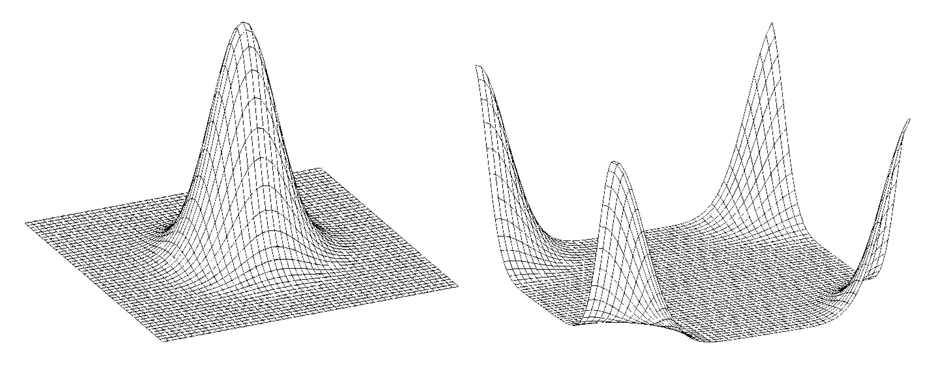
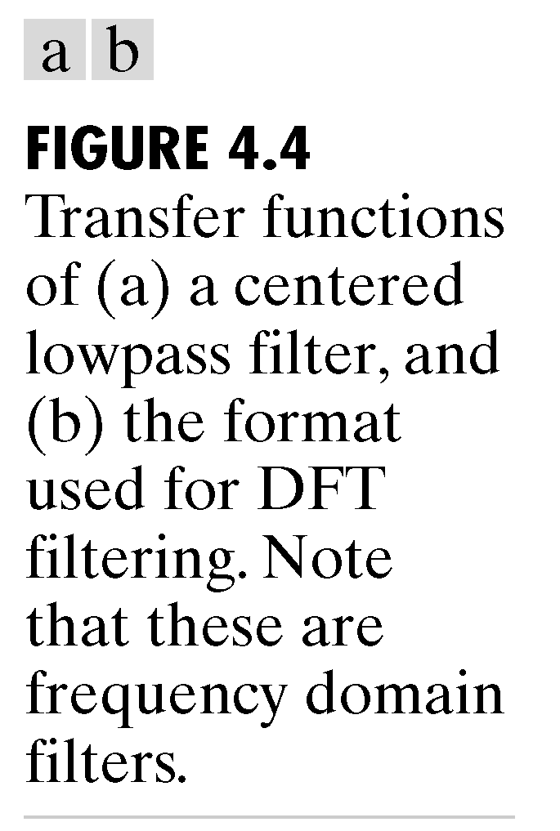
Filtering in the frequency domain (cont.)

Slide 6
Filtering in the frequency domain (cont.)
Example: Linear spatial filtering.
f =
0 0 0 0 0
0 0 0 0 0
0 0 1 0 0
0 0 0 0 0
0 0 0 0 0
w =
1 2 3
4 5 6
7 8 9
g=imfilter(f, w, filtering_mode, boundary_options, size_options)

Slide 7
Filtering in the frequency domain (cont.)
g=imfilter(f, w, filtering_mode, boundary_options, size_options)
>> g=imfilter(f,w,'corr',0,'full')
g =
0 0 0 0 0 0 0
0 0 0 0 0 0 0
0 0 9 8 7 0 0
0 0 6 5 4 0 0
0 0 3 2 1 0 0
0 0 0 0 0 0 0
0 0 0 0 0 0 0

Slide 8
Filtering in the frequency domain (cont.)
With specified values of P and Q we use the following syntax to compute the FFT using zero padding.
>> F=fft2(f, 7,7)
F =
Columns 1 through 2
1.00000000000000 -0.22252093395631 - 0.97492791218182i
-0.22252093395631 - 0.97492791218182i -0.90096886790242 + 0.43388373911756i
-0.90096886790242 + 0.43388373911756i 0.62348980185873 + 0.78183148246803i
0.62348980185873 + 0.78183148246803i 0.62348980185873 - 0.78183148246803i
0.62348980185873 - 0.78183148246803i -0.90096886790242 - 0.43388373911756i
-0.90096886790242 - 0.43388373911756i -0.22252093395631 + 0.97492791218182i
-0.22252093395631 + 0.97492791218182i 1.00000000000000
.
.
.

Slide 9
Filtering in the frequency domain (cont.)
1. Obtain the Fourier transform:
F=fft2(f);
2. Generate a filter function, H of size P×Q. If the filter is centered then use the following before using it:
H=fftshift(H)
3. Multiply the transform by the filter:
  G=H.*F;
4. Obtain the real part of G:

Slide 10
Low-pass filtering (LPF)
Low-pass filters attenuate the high frequency components of the Fourier Transform of an image, while leaving the low frequency components unchanged.
The typical overall effect of applying a low-pass filter (LPF) to an image is a controlled degree of blurring.

Slide 11
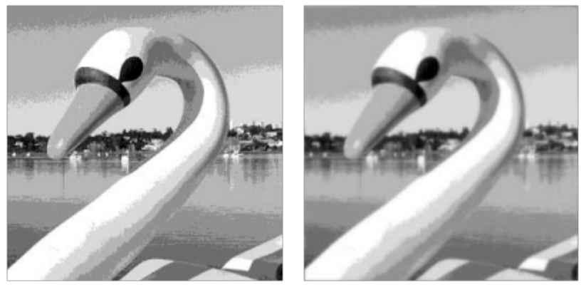
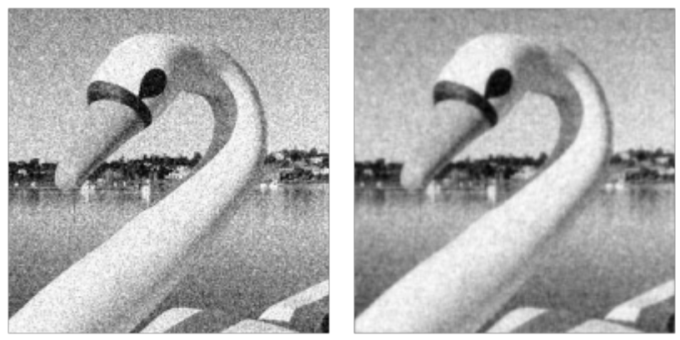
Low-pass filtering (LPF) (cont.)
Example of LPF for smoothing of false contours
Example of LPF for noise reduction

Slide 12
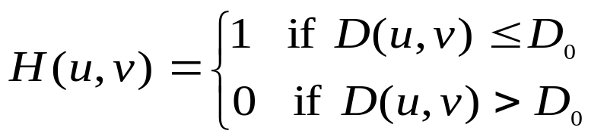
Low-pass filtering (LPF) (cont.)
Ideal lowpass filter (ILPF):
where D(u,v) is the distance from point (u,v) to the center of the
filter.

Slide 13
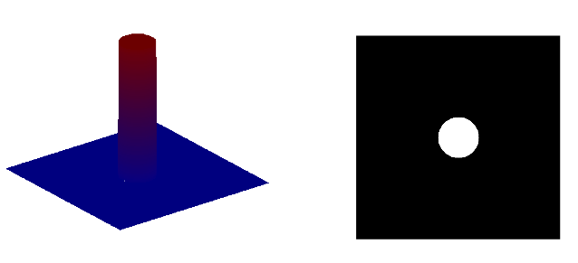

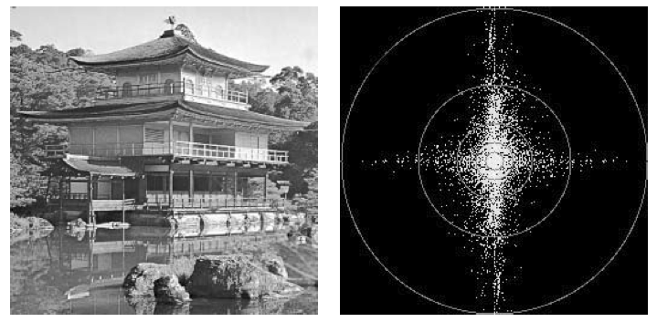
Low-pass filtering (LPF) (cont.)
Ideal LPF

Slide 14
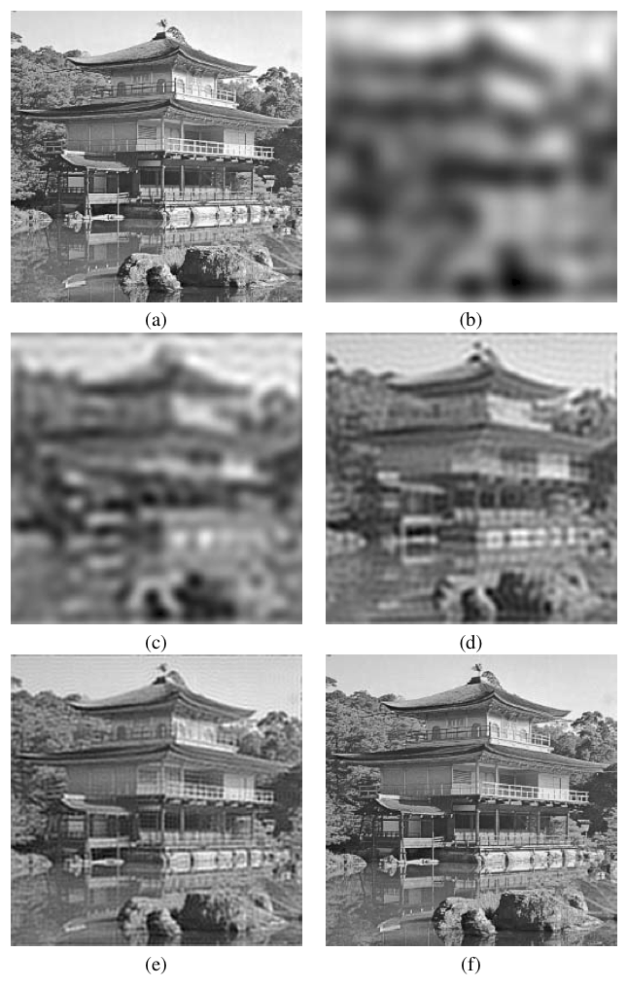
LPF (cont.)
Ideal LPF – example

Slide 15
Low-pass filtering (LPF) (cont.)
Gaussian lowpass filter (GLPF):
where D(u,v) is the distance from point (u,v) to the center of the filter.

Slide 16
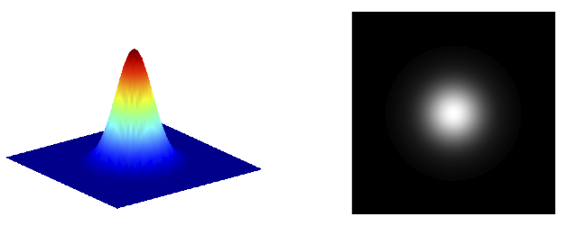

Low-pass filtering (LPF) (cont.)
Gaussian LPF

Slide 17
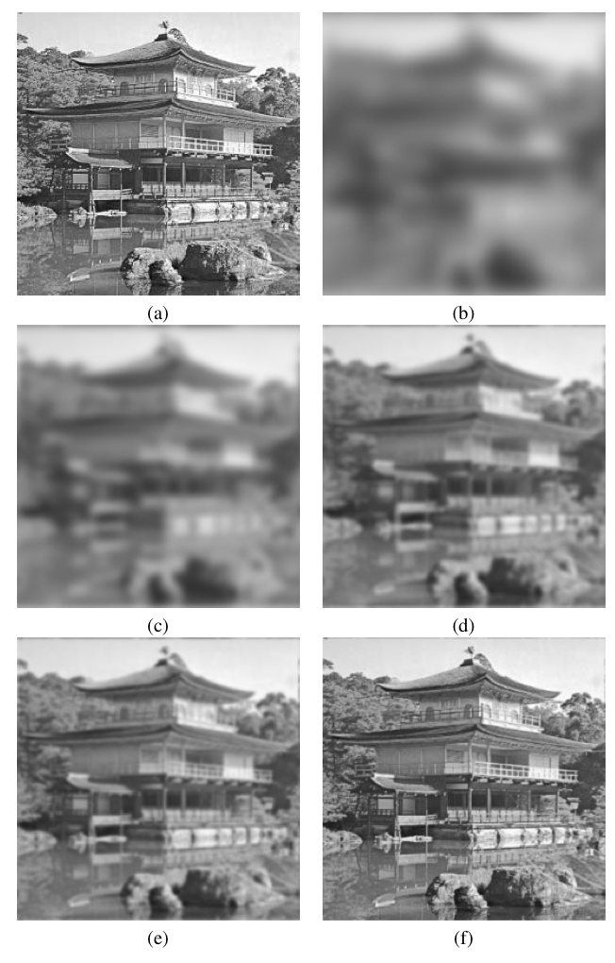
LPF (cont.)
Gaussian LPF – example

Slide 18
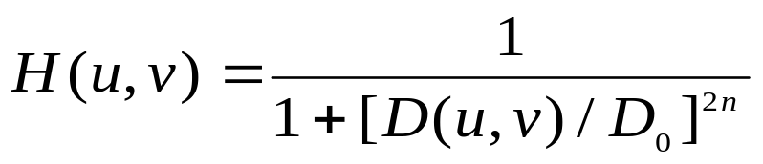
Low-pass filtering (LPF) (cont.)
Butterworth lowpass filter (BLPF):
where D(u,v) is the distance from point (u,v) to the center of the
filter.

Slide 19
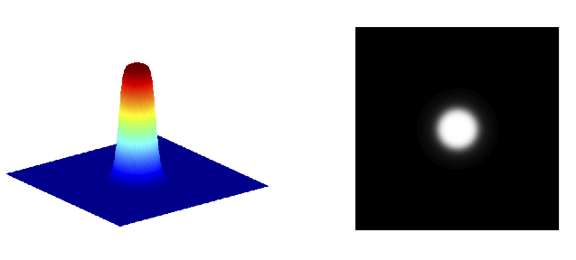

Low-pass filtering (LPF) (cont.)
Butterworth LPF

Slide 20
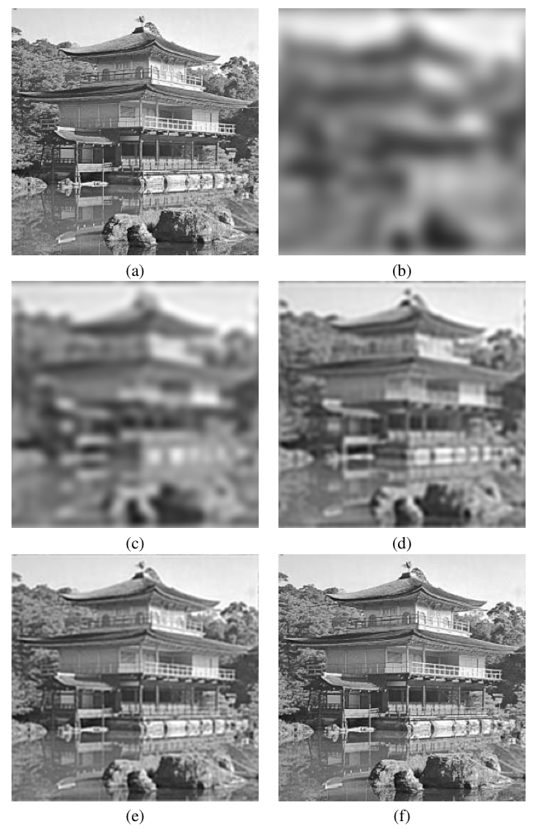
LPF (cont.)
Butterworth LPF – example

Slide 21
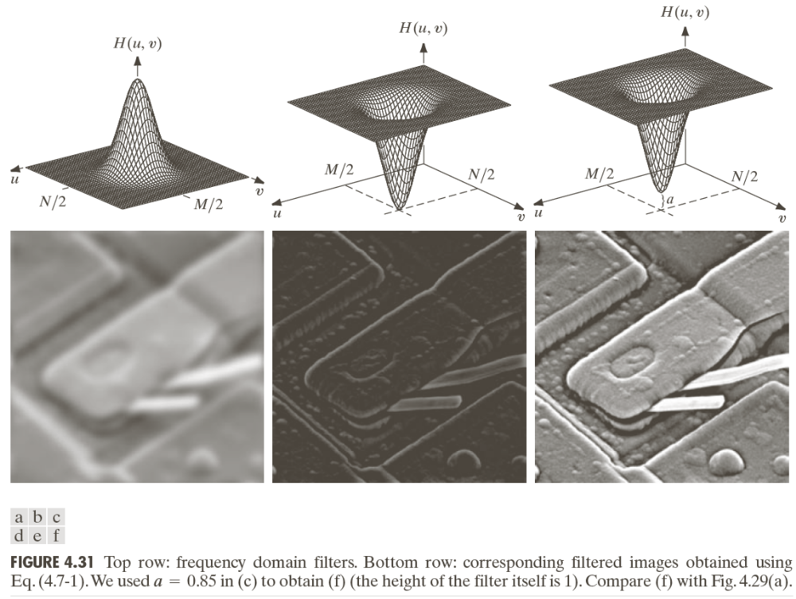
Low-pass filtering (LPF) (cont.)

Slide 22
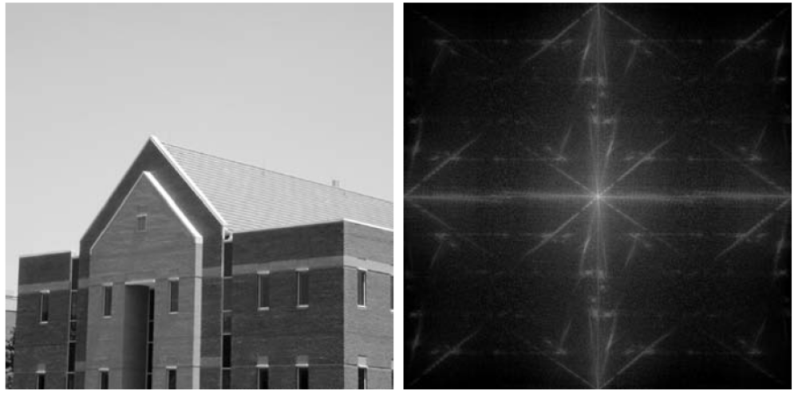
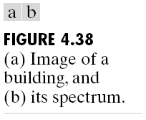
Low-pass filtering (LPF) (cont.)

Slide 23
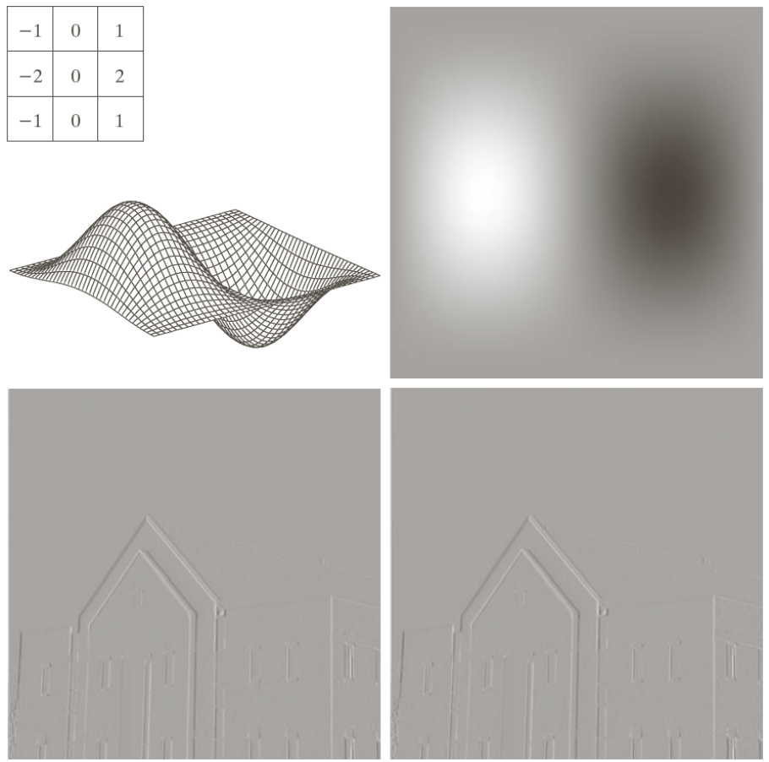
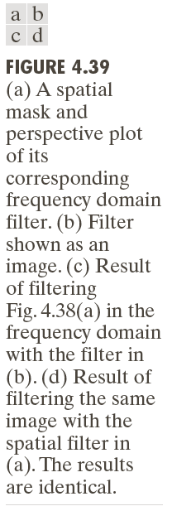
Low-pass filtering (LPF) (cont.)

Slide 24
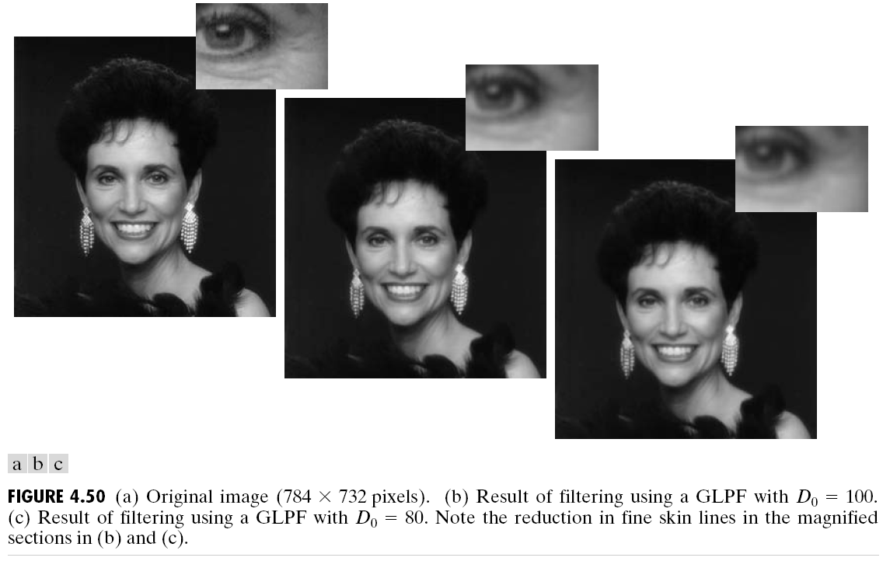
Low-pass filtering (LPF) (cont.)

Slide 25
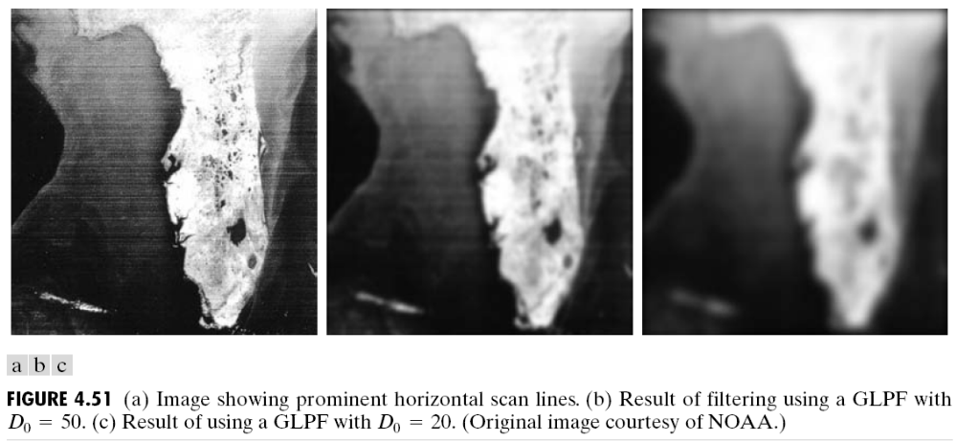
Low-pass filtering (LPF) (cont.)

Slide 26

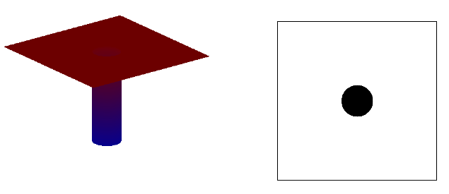
High-pass filtering
Ideal HPF

Slide 27

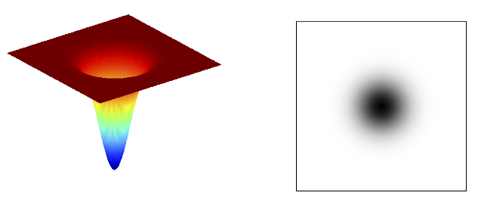
High-pass filtering (cont.)
Gaussian HPF

Slide 28

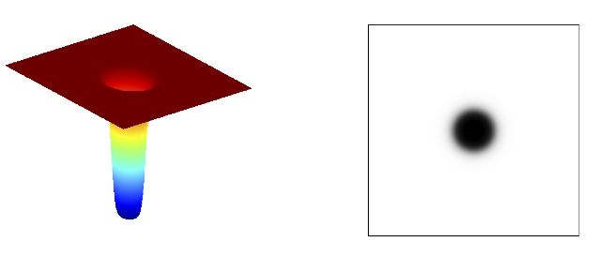
High-pass filtering (cont.)
Butterworth HPF

Slide 29

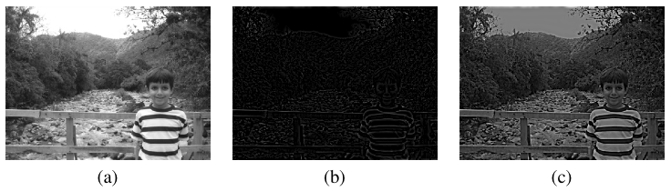
High-frequency emphasis

Slide 30
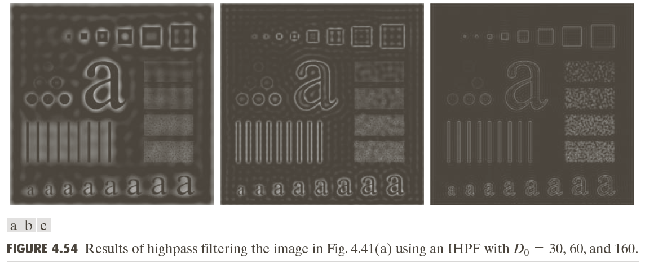
High-pass filtering (cont.)

Slide 31
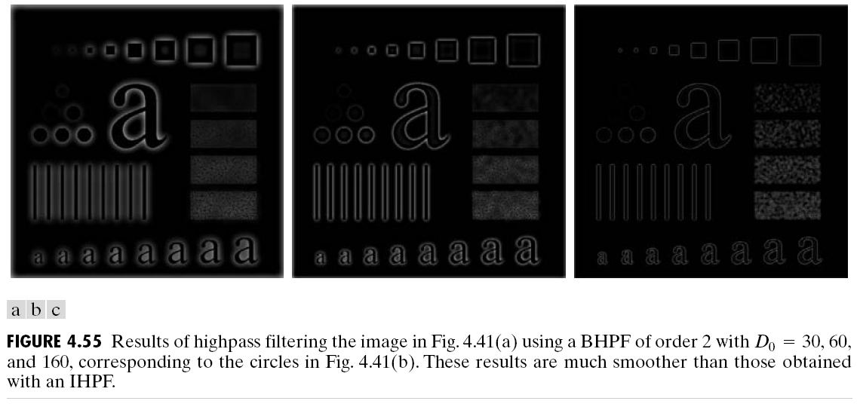
High-pass filtering (cont.)

Slide 32
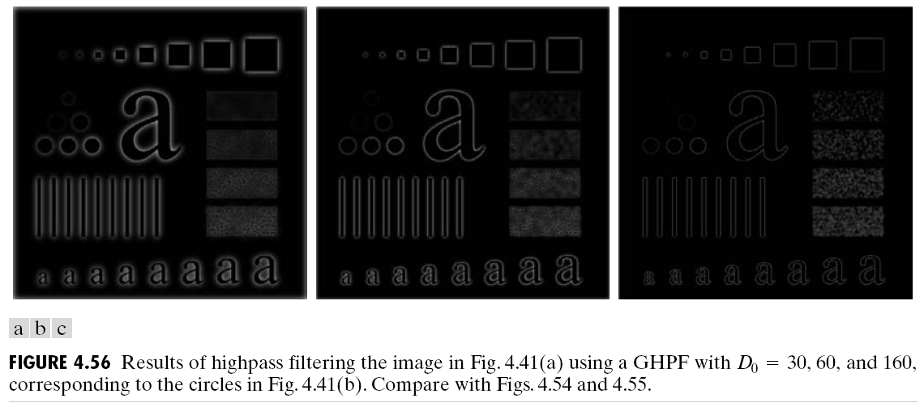
High-pass filtering (cont.)

Slide 33
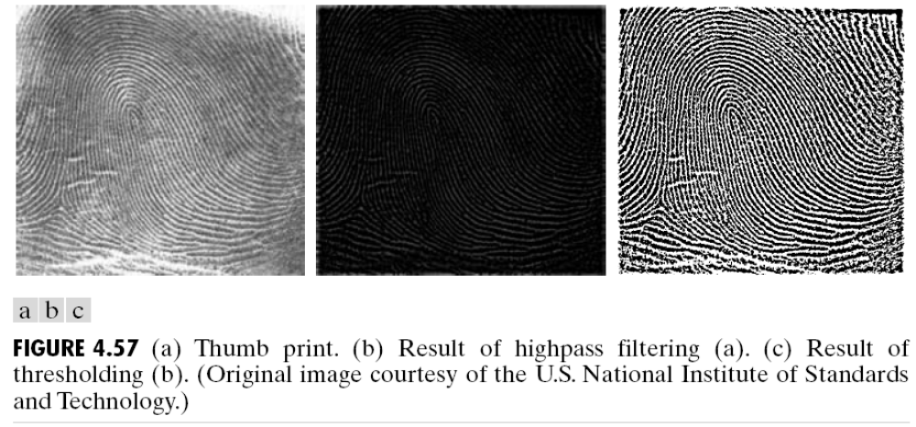
High-pass filtering (cont.)

Slide 34
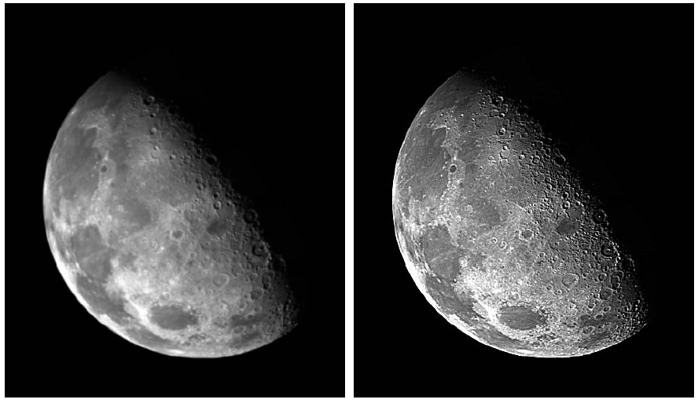
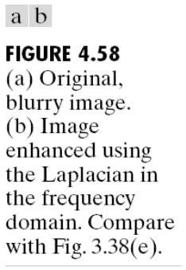
High-pass filtering (cont.)

Slide 35
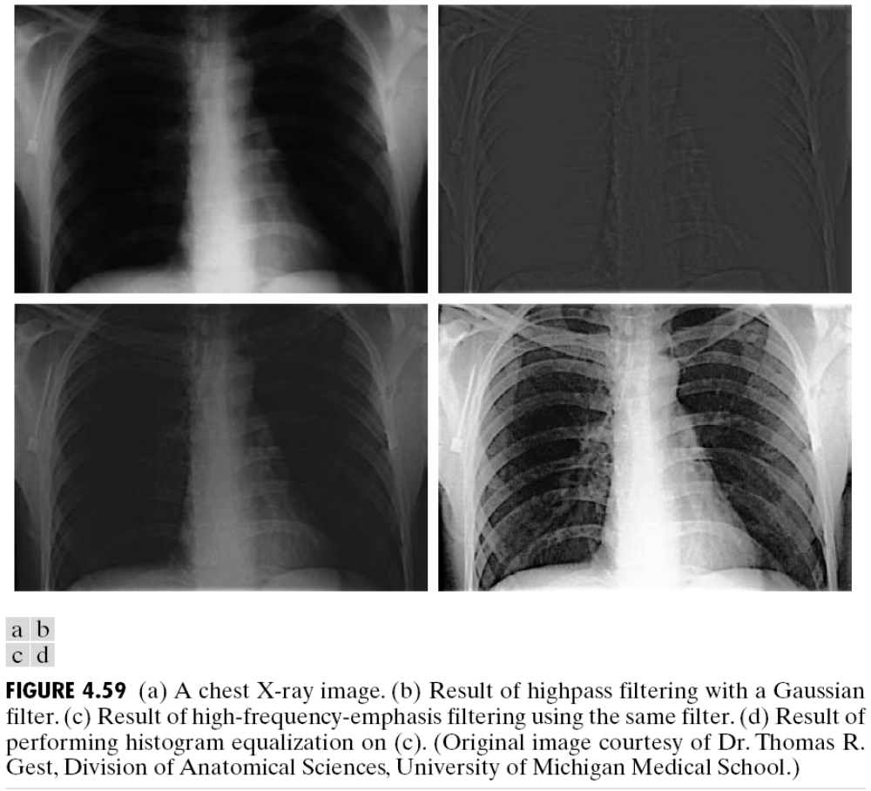
High-pass filtering (cont.)

Slide 36
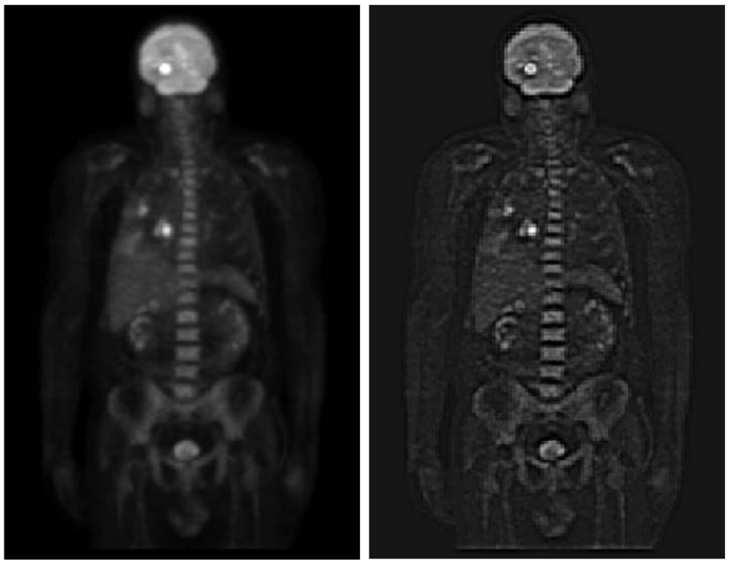
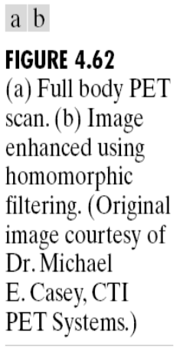
High-pass filtering (cont.)

Slide 37
Summary
You should now know
  How to design, implement and use frequency domain filters
  The differences between ideal, butterworth and Gaussian low-pass and high-pass filters

Slide 38
Next Lecture
Image Restoration

Slide 39
References
Rafael C. Gonzalez, Richard E. Woods, “Digital Image Processing, 4th Ed.”; Pearson, 2018, (DIP)
Rafael C. Gonzalez, Richard E. Woods, Steven L. Eddins, “Digital Image Processing Using MATLAB”; Pearson, 2004, (DIPUM)
Oge Marques, “Practical Image and Video Processing Using MATLAB”; Wiley, 2011, (PIVPUM)
Ronald N. Bracewell, “The Fourier Transform and Its Applications, 3rd Ed.”; McGraw Hill, 2000
Hüseyin Yalaz, Samsun M. Başarıcı, Erkan Özefe, “Systemtheoretische Untersuchung der Gauß-, LoG-, DoG- und Gabor-Funktionen”; M.Sc. Thesis, Universität Hamburg, 2000

