Slide 1


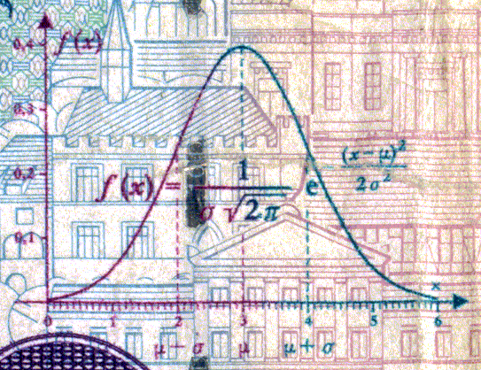
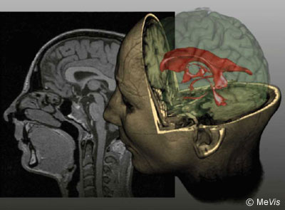
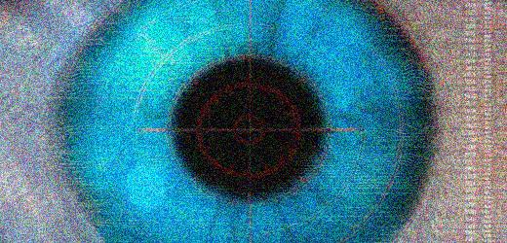
CSE 307
Fundamentals of Image Processing
Lecture #4 Frequency Domain Filtering
(Part 1)
Prepared & Presented by Asst. Prof. Dr. Samsun M. BAŞARICI

Slide 2


Objectives
Which mathematical tools are used to represent an image’s contents in the 2D frequency domain? (Part 1)
What is the Fourier transform, what are its main properties, and how is it used in the context of frequency-domain filtering? (Part 1)
What are the differences between low-pass and high-pass filters? (Part 2)
What are the differences among ideal, Butterworth, and Gaussian filters? (Part 2)

Slide 3
Frequency Domain
Analysis of mathematical functions or signals with respect to frequency, rather than time
A time-domain graph shows how a signal changes over time, whereas a frequency-domain graph shows how much of the signal lies within each given frequency band over a range of frequencies.
A frequency-domain representation can also include information on the phase shift that must be applied to each sinusoid in order to be able to recombine the frequency components to recover the original time signal.
In DIP: Analysis of the image in another domain rather than in spatial domain.

Slide 4
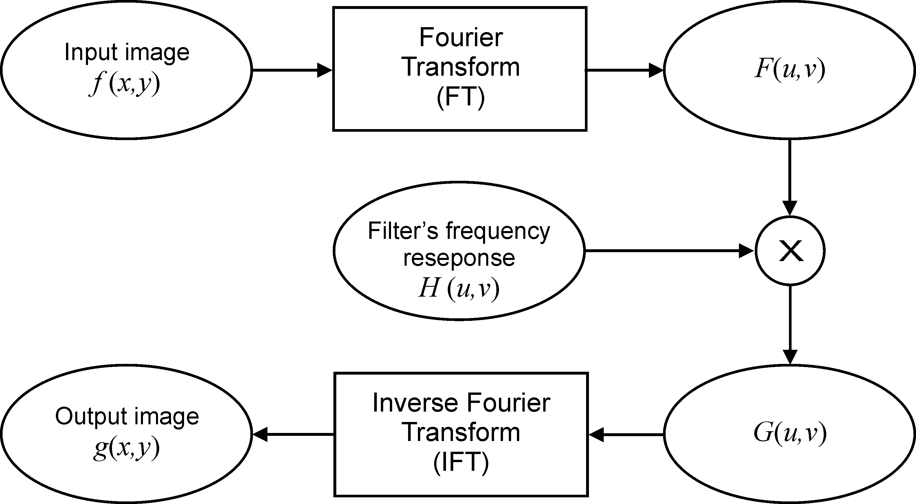
Frequency-domain operations

Slide 5
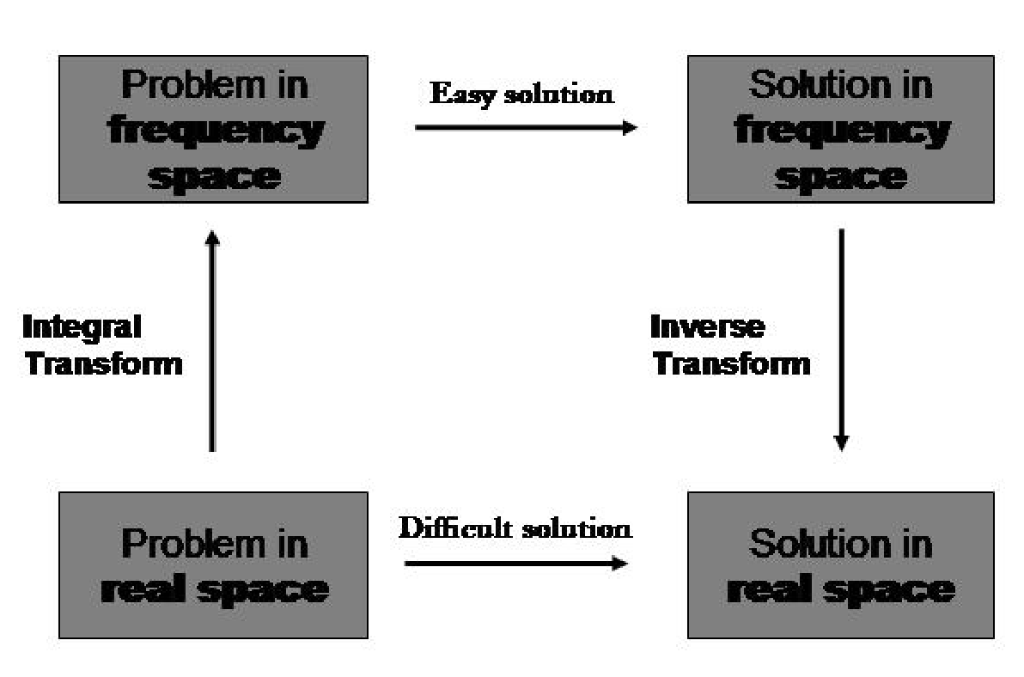
Easier

Slide 6
Background
Jean Baptiste Joseph Fourier (21 March 1768 – 16 May 1830): French mathematician and physician
1822: Théorie analytique de la chaleur (The Analytic Theory of Heat)
Main idea: Every periodic function can be expressed as a sum of sines/cosines (Fourier Series) →Harmonic analysis

Slide 7
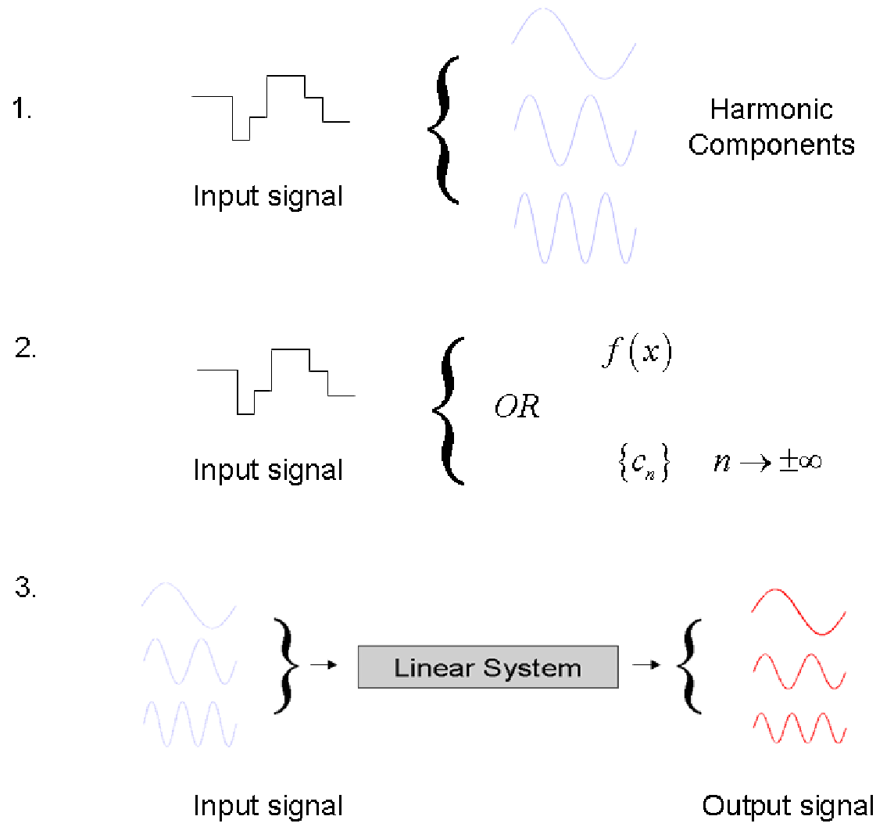
The main idea

Slide 8


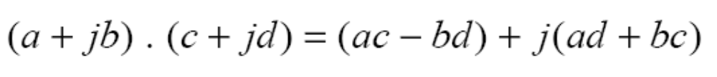
Mathematical Background:
Complex Numbers
A complex number x is of the form:
α: real part, b: imaginary part
Addition:
Multiplication:

Slide 9
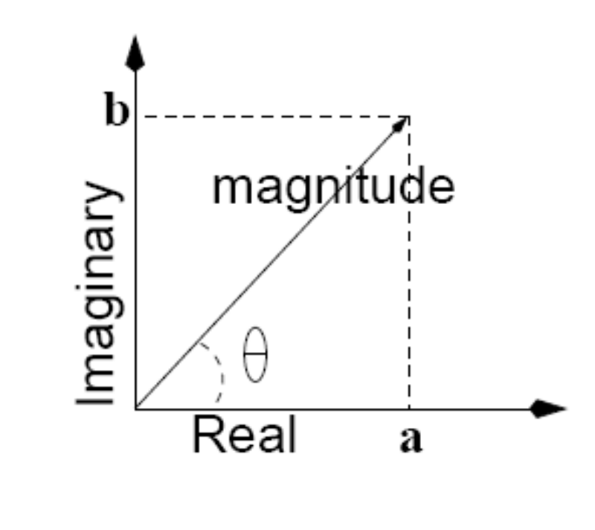
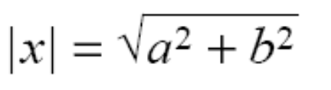


Mathematical Background:
Complex Numbers (cont.)
Magnitude-Phase (i.e.,vector) representation
Magnitude:
Phase:
φ
Magnitude-Phase notation:

Slide 10
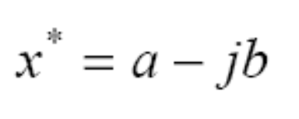
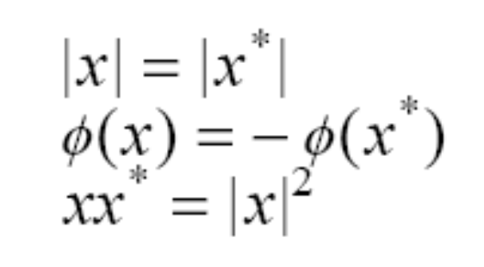
Mathematical Background:
Complex Numbers (cont.)
Multiplication using magnitude-phase representation
Complex conjugate
Properties

Slide 11

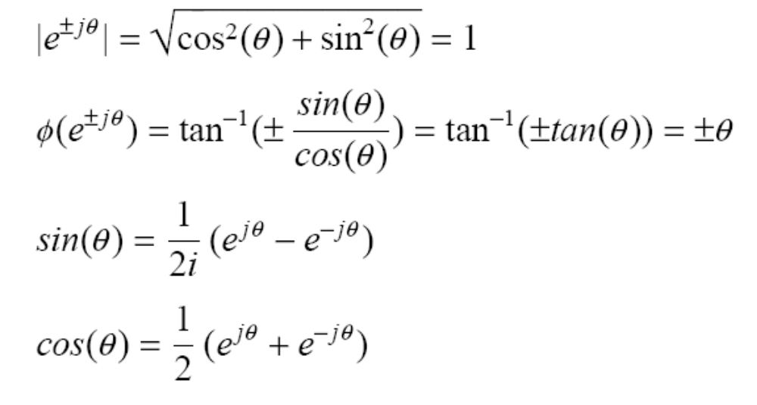
Mathematical Background:
Complex Numbers (cont.)
Euler’s formula
Properties
j

Slide 12

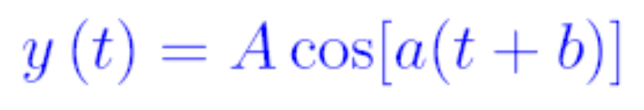
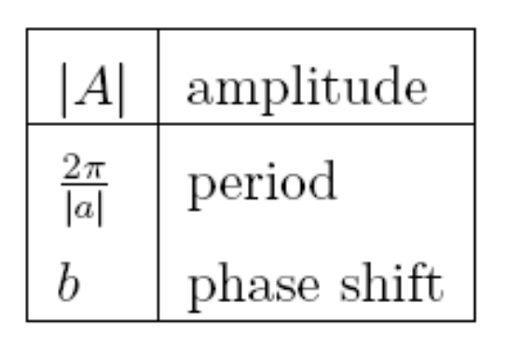
Mathematical Background:
Sine and Cosine Functions
Periodic functions
General form of sine and cosine functions:

Slide 13
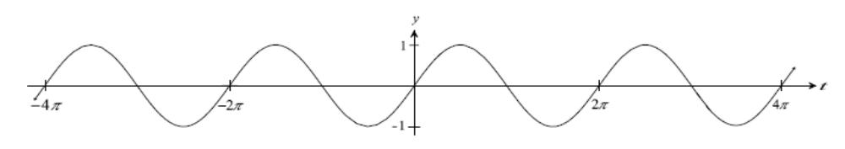

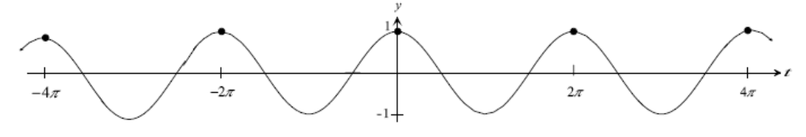

Mathematical Background:
Sine and Cosine Functions (cont.)
Special case: A=1, b=0, α=1
π
3π/2
π/2
π
π/2
3π/2

Slide 14
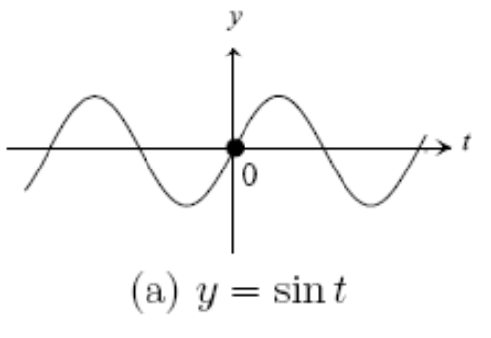
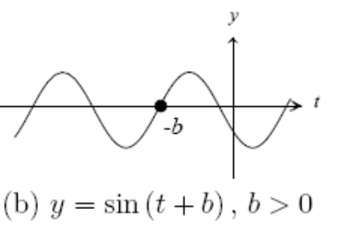
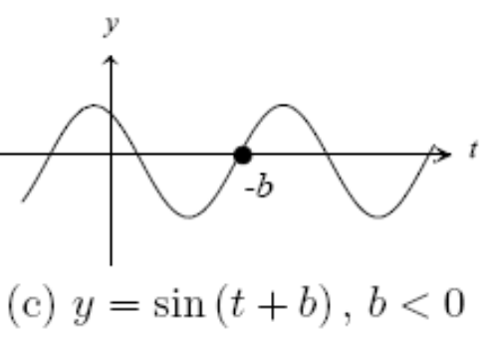
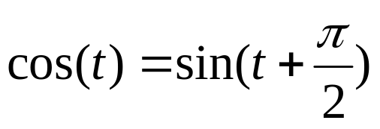
Mathematical Background:
Sine and Cosine Functions (cont.)
Shifting or translating the sine function by a const b
Remember: cosine is a shifted sine function:

Slide 15
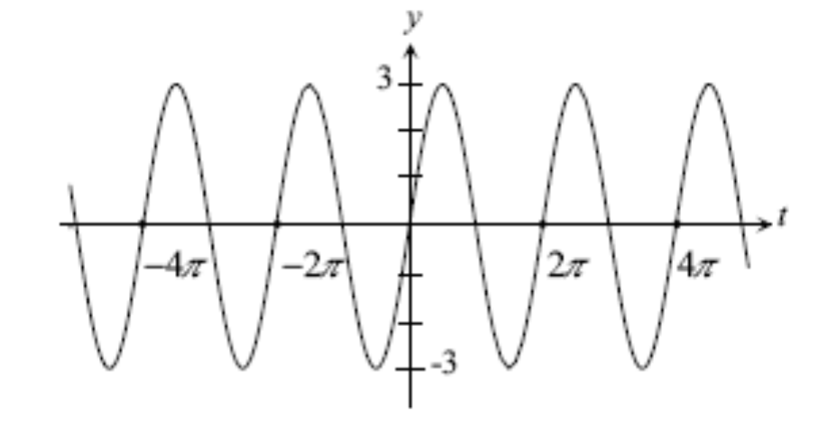

Mathematical Background:
Sine and Cosine Functions (cont.)
Changing the amplitude A

Slide 16
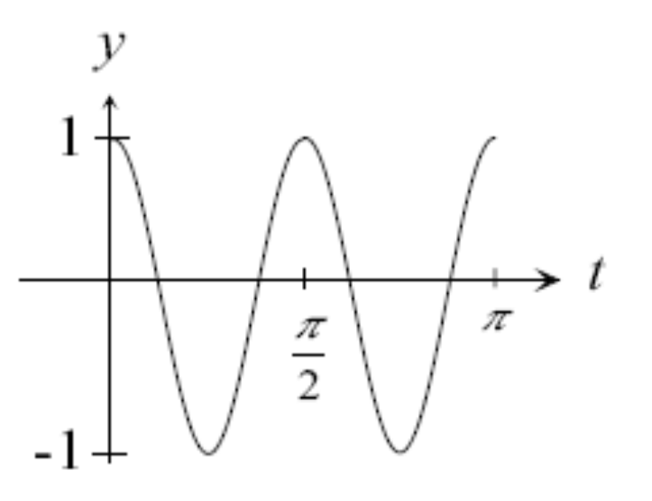

Mathematical Background:
Sine and Cosine Functions (cont.)
Changing the period T=2π/|α|
  consider A=1, b=0: y=cos(αt)
α =4
period 2π/4=π/2
shorter period
higher frequency
(i.e., oscillates faster)
Frequency is defined as f=1/T
Alternative notation: sin(αt)=sin(2πt/T)=sin(2πft)

Slide 17
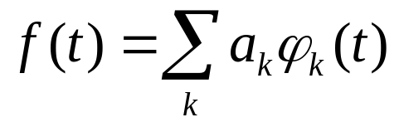
Basis Functions
Given a vector space of functions, S, then if any f(t) ϵ S can be expressed as
the set of functions φ_{k}(t) are called the expansion set of S.
If the expansion is unique, the set φ_{k}(t) is a basis.

Slide 18
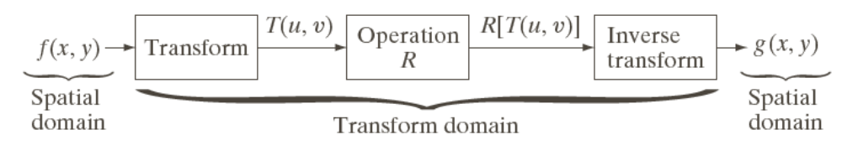
Image Transforms
Many times, image processing tasks are best performed in a domain other than the spatial domain.
Key steps:
  (1) Transform the image
  (2) Carry the task(s) in the transformed domain.
  (3) Apply inverse transform to return to the spatial domain.

Slide 19
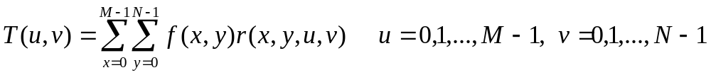
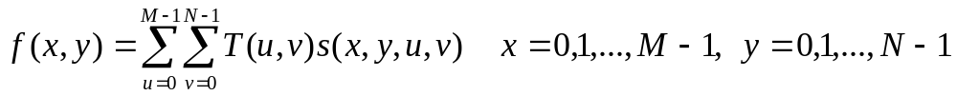
Transformation Kernels
Forward Transformation
Inverse Transformation
forward transformation kernel
inverse transformation kernel

Slide 20
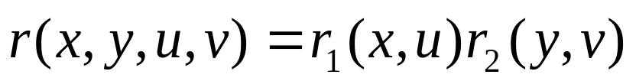
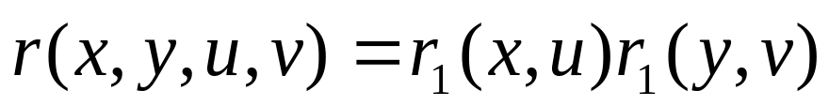
Kernel Properties
A kernel is said to be separable if:
A kernel is said to be symmetric if:

Slide 21
Notation
Continuous Fourier Transform (FT)
Discrete Fourier Transform (DFT)
Fast Fourier Transform (FFT)

Slide 22
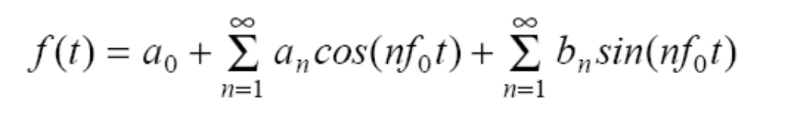
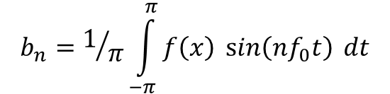
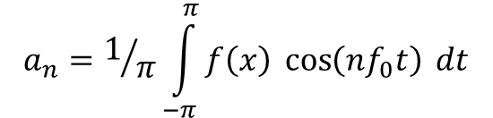
Fourier Series Theorem
Any periodic function f(t) can be expressed as a weighted sum (infinite) of sine and cosine functions of varying frequency:
is called the “fundamental frequency”
$$a_{n}=1/π\int_{−π}^{π}{f\left(x\right)\cos\left(nf_{0}t\right) dt}$$
$$b_{n}=1/π\int_{−π}^{π}{f\left(x\right)\sin\left(nf_{0}t\right) dt}$$

Slide 23
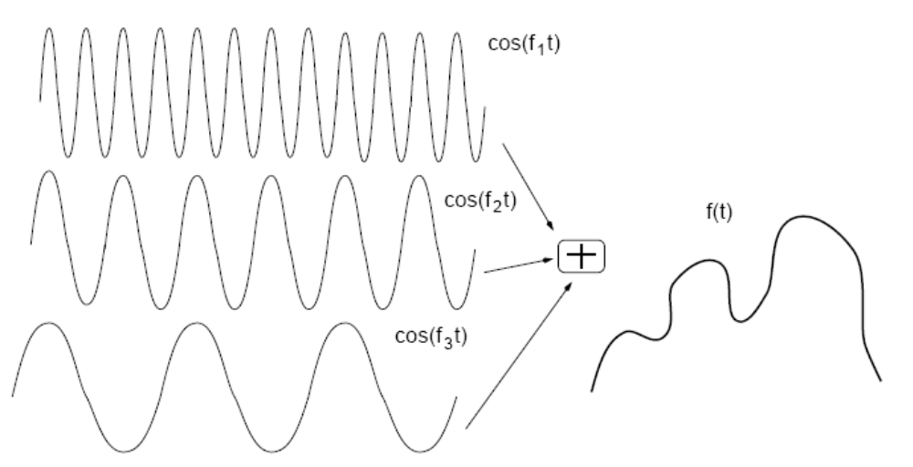
Fourier Series (cont.)
α₁
α₂
α₃

Slide 24
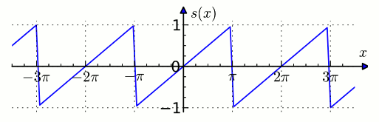
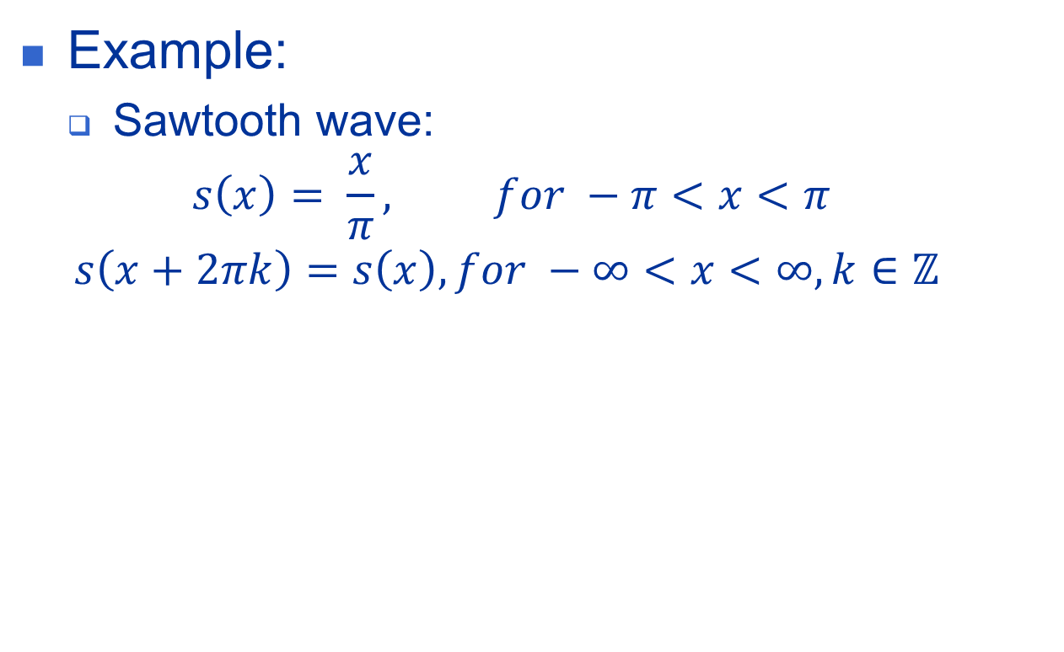
Fourier Series (cont.)
Example:
  Sawtooth wave:
  $$s\left(x\right)= \frac{x}{π}, for −π<x<π$$
  $$s\left(x+2πk\right)=s\left(x\right), for −∞<x<∞, k∈ℤ$$

Slide 25
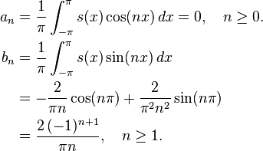
Fourier Series (cont.)
Example:
  The Fourier coefficients:

Slide 26
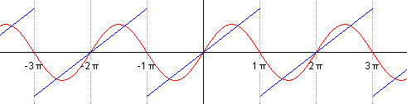
Fourier Series (cont.)
Example:
  Animated plot of the first five successive partial Fourier series:

Slide 27
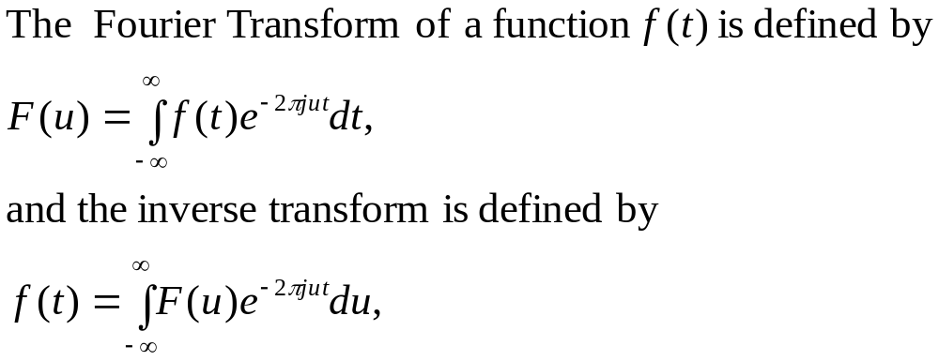
The Fourier transform of functions of one variable

Slide 28
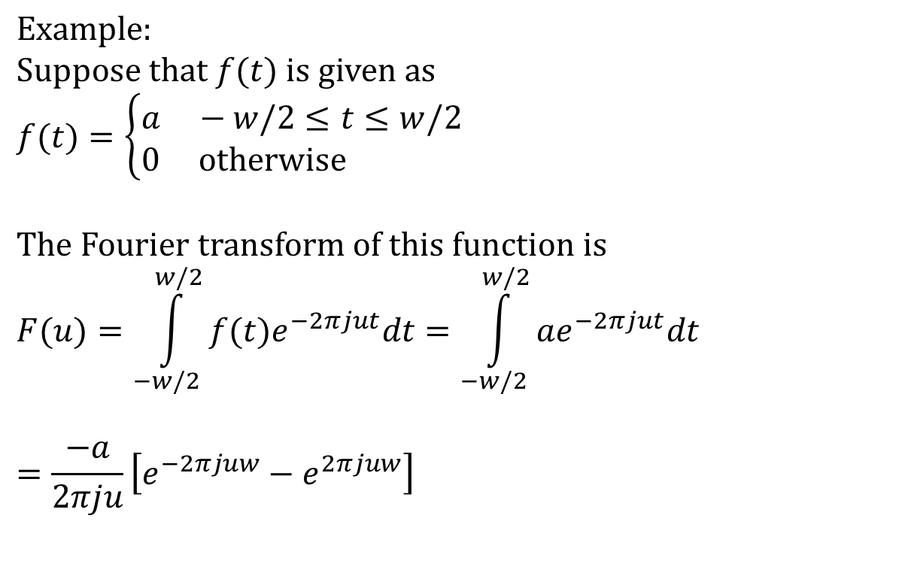
The Fourier transform of functions of one variable (cont.)
$$\text{Example}\text{:} \\ \text{Suppose} \text{that} f(t) \text{is} \text{given} \text{as} \\ f(t)=\left\{\begin{aligned}&a −w/2≤t≤w/2 \\ &0 \text{otherwise}\end{aligned}\right.$$
$$\text{The} \text{Fourier} \text{transform} \text{of} \text{this} \text{function} \text{is} \\ F(u)=\int_{−w/2}^{w/2}{f(t)e^{−2πjut}dt}=\int_{−w/2}^{w/2}{ae^{−2πjut}dt}$$
$$=\frac{−a}{2πju}\left[e^{−2πjuw}−e^{2πjuw}\right]$$

Slide 29
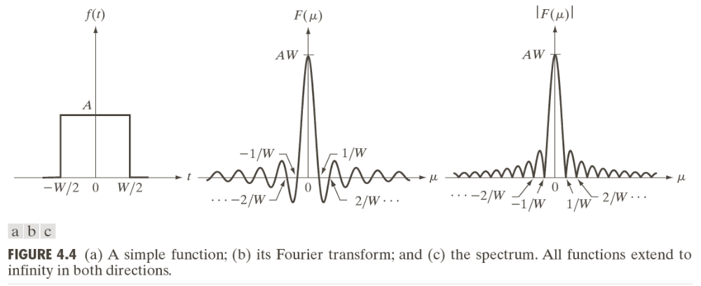
The Fourier transform of functions of one variable (cont.)

Slide 30
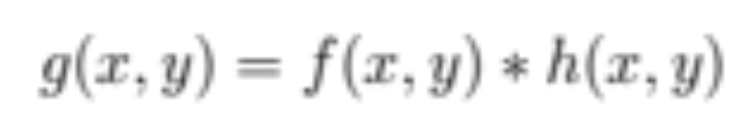
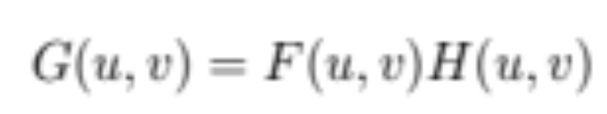
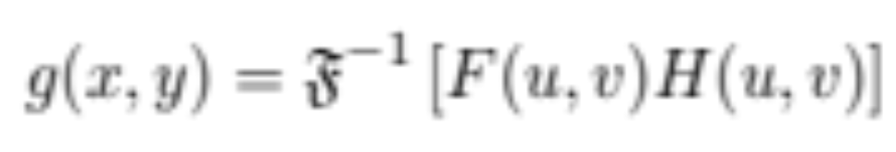
Mathematical foundation
Convolution theorem
FT
Inverse 2D Fourier Transform (FT)

Slide 31
Designing frequency-domain filters with MATLAB and the IPT
2 options:
  Obtain the frequency domain filter response function from spatial filter convolution mask. The IPT has a function that does exactly that: freqz2.
  Generate filters directly in the frequency domain. In this case a meshgrid array (of the same size as the image) is created using the MATLAB function meshgrid.

Slide 32
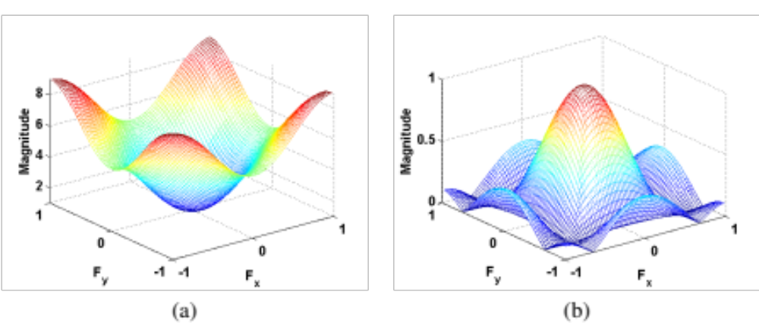
Examples of response functions for frequency-domain filters
Example (PIVPUM):
h2 = ones(3,3) / 9
freqz2(h2) %(a)
h3 = [0 -1 0; -1 5 -1; 0 -1 0]
freqz2(h3) %(b)

Slide 33
Mathematical foundation (again ☺)
Transform: a mathematical tool that allows the conversion of a set of values to another set of values, creating, therefore, a new way of representing the same information.
In image processing:
  original domain = spatial domain
  results of frequency-domain operations lie in the transform domain.
Motivation for using mathematical transforms in image processing: some tasks (e.g., frequency-domain filtering, image compression) are best performed by applying selected algorithms in the transform domain. transformation to the result

Slide 34


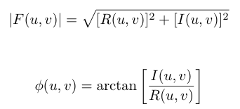
Mathematical foundation (cont.)
2D Fourier transform (in MATLAB: fft2 and ifft2)

Slide 35
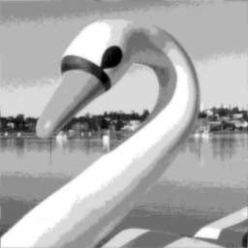
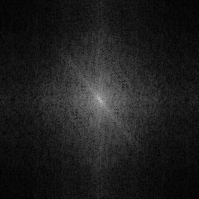
Example of an image and its FT
I = imread('Figure11_04_a.png');
Id = im2double(I);
ft = fft2(Id);
ft_shift = fftshift(ft);
imshow(log(1 + abs(ft_shift)), [])

Slide 36
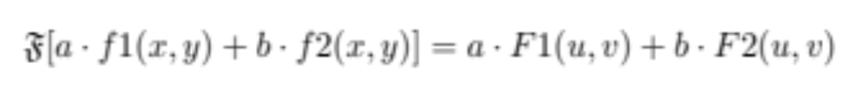
Fourier Transform: properties
Linearity
and

Slide 37
Fourier Transform: properties (cont.)
Translation
and

Slide 38
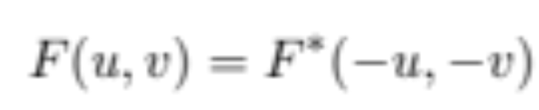
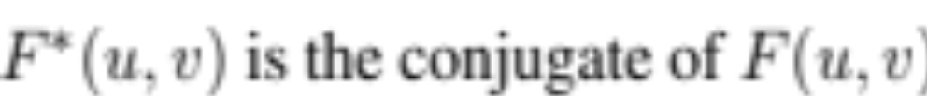


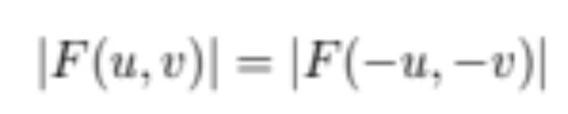
Fourier Transform: properties (cont.)
Conjugate symmetry
where:
i.e., if:
then:

Slide 39


Fourier Transform: properties (cont.)
Periodicity
and

Slide 40
Fourier Transform: properties (cont.)
Separability
  The Fourier Transform is separable, i.e., the FT of a 2D image can be computed by two passes of the 1D FT algorithm, once along the rows (columns), followed by another pass along the columns (rows) of the result.

Slide 41

Fourier Transform: properties (cont.)
Rotation
  If an image is rotated by a certain angle θ, its 2D FT will be rotated by the same angle.

Slide 42

Continuous Fourier Transform (FT)
Transforms a signal (i.e., function) from the spatial (x) domain to the frequency (u) domain.
(IFT)
where

Slide 43


Sampling

Slide 44

The Discrete Fourier Transform(DFT) of one variable

Slide 45

The Fourier transform of functions of two variables

Slide 46

The Fourier transform of functions of two variables (cont.)

Slide 47


The Fourier transform of functions of two variables (cont.)

Slide 48


The Fourier transform of functions of two variables (cont.)

Slide 49

The 2D discrete Fourier transform

Slide 50

2D DFT (cont.)

Slide 51

Application of DFT

Slide 52

Application of DFT (cont.)

Slide 53
Application of DFT (cont.)
It can be shown that
The DFT is infinitely periodic in both u and v directions, with the periodicity determined by M and N.

Slide 54
Application of DFT (cont.)
Periodicity is also a property of the inverse DFT.
An image obtained by taking the inverse DFT is also infinitely periodic in both u and v directions, with the periodicity determined by M and N.

Slide 55


Application of DFT (cont.)

Slide 56

Application of DFT (cont.)

Slide 57



Slide 58
Computing and visualizing the 2D DFT
The FFT of an M × N image array is obtained by the syntax
F=fft2(f)
The Fourier spectrum is obtained as
S=abs(F)

Slide 59
Computing and visualizing the 2D DFT (cont.)
The funcion fftshift moves the origin of transform to the center of the frequency rectangle.
Fc=fftshift (F)
Log transformation:
S2=log(1+abs(Fc))
Function ifftshift reverses the centering:
F=ifftshift(Fc)

Slide 60
Computing and visualizing the 2D DFT (cont.)
To compute inverse FFT
f=ifft2 (F)
If the imput used to compute F is real then the inverse should also be real. However fft2 often has small imaginary components resulting from round-off errors. It is good practice to extract the real part of the result:
f=real(ifft2(F))

Slide 61


Computing and visualizing the 2D DFT (cont.)

Slide 62

Computing and visualizing the 2D DFT (cont.)

Slide 63
Why is FT Useful?
Easier to remove undesirable frequencies.
Faster perform certain operations in the frequency domain than in the spatial domain.

Slide 64


Example: Removing undesirable frequencies
noisy signal
frequencies
To remove certain
frequencies, set their
corresponding F(u)
coefficients to zero!
remove high
frequencies
reconstructed
signal

Slide 65


How do frequencies show up in an image?
Low frequencies correspond to slowly varying information (e.g., continuous surface).
High frequencies correspond to quickly varying information (e.g., edges)
Original Image
Low-passed

Slide 66

Example of noise reduction using FT

Slide 67


Symmetry properties of 2D DFT

Slide 68


Summary of 2D DFT properties

Slide 69

Summary of 2D DFT properties (cont.)

Slide 70


Summary of 2D DFT pairs

Slide 71

Summary of 2D DFT pairs (cont.)

Slide 72
Summary
You should now know
  The Fundamentals of frequency domain filtering

Slide 73
Next Lecture
Frequency Domain Filtering (cont.)

Slide 74
References
Rafael C. Gonzalez, Richard E. Woods, “Digital Image Processing, 4th Ed.”; Pearson, 2018, (DIP)
Rafael C. Gonzalez, Richard E. Woods, Steven L. Eddins, “Digital Image Processing Using MATLAB”; Pearson, 2004, (DIPUM)
Oge Marques, “Practical Image and Video Processing Using MATLAB”; Wiley, 2011, (PIVPUM)
Ronald N. Bracewell, “The Fourier Transform and Its Applications, 3rd Ed.”; McGraw Hill, 2000
Hüseyin Yalaz, Samsun M. Başarıcı, Erkan Özefe, “Systemtheoretische Untersuchung der Gauß-, LoG-, DoG- und Gabor-Funktionen”; M.Sc. Thesis, Universität Hamburg, 2000

