Slide 1


CSE 414 Systems Analysis and Design
Lecture #4
Initiating and Planning Systems Development Projects
Prepared & Presented by Asst. Prof. Dr. Samsun M. BAŞARICI

Slide 2
Learning Objectives
Describe the steps involved in the project initiation and planning process.
List and describe various methods for assessing project feasibility.
Describe the activities needed to build and review the baseline project plan.
Describe the activities and participant roles within a structured walkthrough.

Slide 3
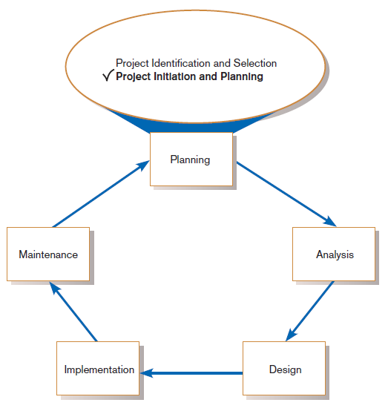
The Process of Initiating and Planning IS Development Projects
FIGURE 5-1
Systems development life cycle
with project initiation and
planning highlighted
Project initiation focuses on activities designed to assist in organizing a team to conduct project planning.
Notes:
At this point in the IS planning process, a project has been selected, and it is time to plan out how it’s going to be done.
However, some of the items discussed in this chapter are highly relevant for project selection, especially those related to feasibility analysis, as we’ll see later.

Slide 4
Initiating and Planning Systems Development Projects
What must be considered when making the decision on the division between project initiation and planning (PIP) and analysis?
How much effort should be expended on the PIP process?
Who is responsible for performing the PIP process?
Why is PIP such a challenging activity?

Slide 5
The Process of Initiating and Planning IS Development Projects (Cont.)
Establishing the Project Initiation Team
Establishing a Relationship with the Customer
Establishing the Project Initiation Plan
Establishing Management Procedures
Establishing the Project Management Environment and Project Workbook
Developing the Project Charter
Notes:
As you can see, we’re revisiting some things we’ve already discussed in previous chapters.

Slide 6
The Process of Initiating and Planning IS Development Projects (Cont.)
The key activity of project planning is the process of defining clear, discrete activities and the work needed to complete each activity within a single project.
The objective of the project planning process is the development of a Baseline Project Plan (BPP) and the Project Scope Statement (PSS).

Slide 7
The Process of Initiating and Planning IS Development Projects (Cont.)
Business Case
  Justification for an information system
  Presented in terms of the tangible and intangible economic benefits and costs
  The technical and organizational feasibility of the proposed system
Notes:
The size, scope, and complexity of a project will dictate the comprehensiveness of the project planning process and resulting documents.
You’re going to need to state some assumptions about resource availability and potential problems. The business case involves an analysis of these assumptions and the system costs and benefits.

Slide 8
Elements of Project Planning
Describe project scope, alternatives, feasibility.
Divide project into tasks.
Estimate resource requirements and create resource plan.
Develop preliminary schedule.
Develop communication plan.
Notes:
Several of these elements were discussed in previous chapters.

Slide 9
Elements of Project Planning (Cont.)
Determine standards and procedures.
Identify and assess risk.
Create preliminary budget.
Develop a statement of work.
Set baseline project plan.
Notes:
We’ll go into more detail about these elements in the next several slides.

Slide 10
Deliverables and Outcomes
Baseline Project Plan (BPP)
  A major outcome and deliverable from the PIP phase
  Contains the best estimate of a project’s scope, benefits, costs, risks, and resource requirements
Notes:
We talked about the BPP in chapter 3. We’ll look at how to build and review a BPP in more detail later.

Slide 11
Deliverables and Outcomes (Cont.)
Project Scope Statement (PSS)
  A document prepared for the customer
  Describes what the project will deliver
  Outlines at a high level all work required to complete the project
Notes:
We also talked about project scope in chapter 3, and will revisit it later.

Slide 12
Assessing Project Feasibility
Economic
Technical
Operational
Scheduling
Legal and contractual
Political
Notes:
These are the most common ways to categorize feasibility considerations. Economic feasibility relates to cos-benefit analysis. Technical feasibility is especially relevant in IS projects; does the technology exist to do what we want to do? Operational has to do with the degree to which the result serves a useful purpose for the organization, and scheduling feasibility refers to time concerns. There may also be legal and regulatory issues to deal with. And political feasibility is very important; for a successful IS project, especially in a big company, you need to get user buy-in.

Slide 13
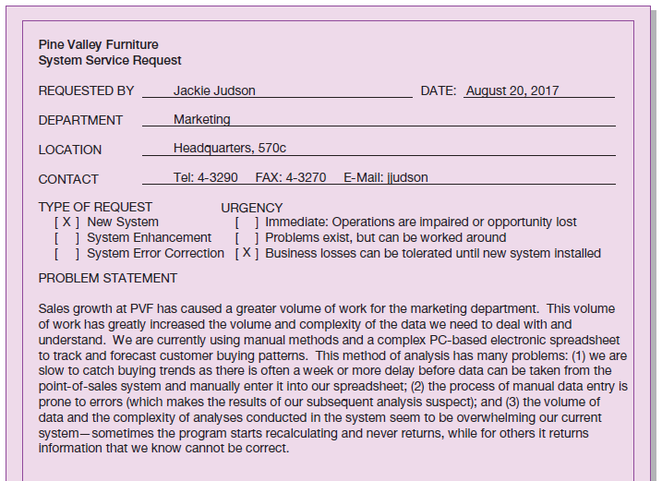
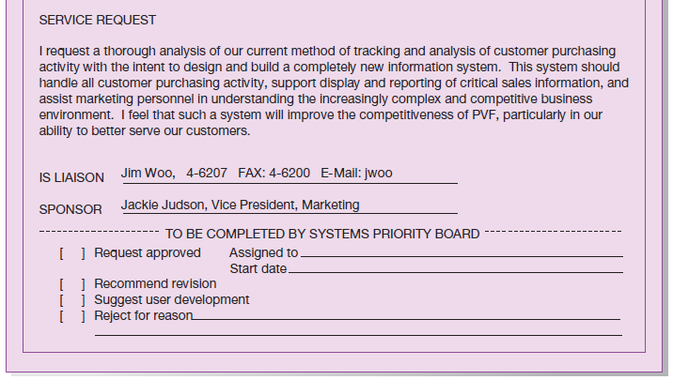
Assessing Project Feasibility (Cont.)
FIGURE 5-2
System Service Request for Customer Tracking System (Pine Valley Furniture)
Notes:
Here’s a system service request for the customer tracking system at PVF. We saw a similar one for Purchase Fulfillment in chapter 3. This request will be evaluated, like all others, prior to being selected, as we saw in chapter 4.

Slide 14
Assessing Project Feasibility (Cont.)
Economic feasibility: a process of identifying the financial benefits and costs associated with a development project
  Often referred to as a cost-benefit analysis
  Project is reviewed after each SDLC phase in order to decide whether to continue, redirect, or kill a project
Notes:
Note that economic feasibility isn’t just done in the planning phase. At each point along the way, the project is re-evaluated to determine if and how to proceed.

Slide 15
Determining Project Benefits
Tangible benefits refer to items that can be measured in dollars and with certainty.
Examples include:
  reduced personnel expenses
  lower transaction costs, or
  higher profit margins.
Notes:
Since economic feasibility is a measure of costs and benefits, it makes sense that part of this involves identifying just what the benefits and costs are. Some of these benefits and costs are “tangible”, meaning you can measure them in dollars and cents. Here are some examples of “tangible benefits”.

Slide 16
Determining Project Benefits (Cont.)
Most tangible benefits will fit within the following categories:
  Cost reduction and avoidance
  Error reduction
  Increased flexibility
  Increased speed of activity
  Improvement of management planning and control
  Opening new markets and increasing sales opportunities
Notes:
Anything that can be easily translated into dollars and cents is considered to be a tangible benefit (or cost).

Slide 17
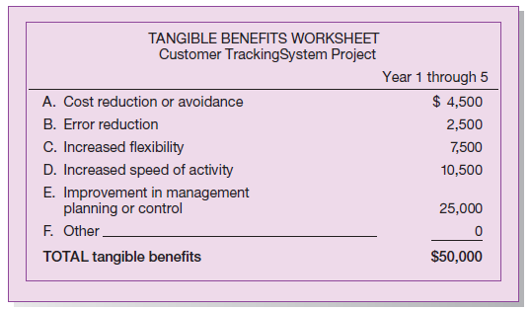
Determining Project Benefits (Cont.)
Figure 5-3
Tangible benefits for Customer Tracking
System (Pine Valley Furniture)
Notes:
Here’s a PVF tangible benefit worksheet for the customer tracking system.

Slide 18
Determining Project Benefits (Cont.)
Intangible benefits are benefits derived from the creation of an information system that cannot be easily measured in dollars or with certainty.
  May have direct organizational benefits, such as the improvement of employee morale
  May have broader societal implications, such as the reduction of waste creation or resource consumption
Notes:
The intangible benefits may be a bit more “touchy-feely”, but they can be just as important.

Slide 19
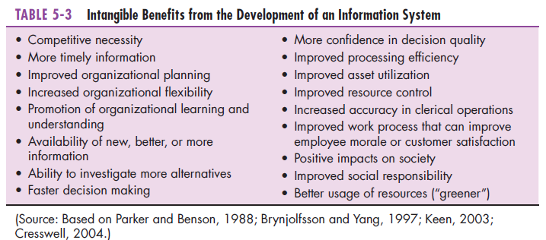
Determining Project Benefits (Cont.)
Notes:
Actually, for many of these items, it may be possible to come up with some monetary calculations, so the line between “tangible” and “intangible” is sometimes a bit blurry.

Slide 20
Determining Project Costs
Tangible cost: a cost associated with an information system that can be measured in dollars and with certainty
IS development tangible costs include:
  Hardware costs
  Labor costs, or
  Operational costs, including employee training and building renovations.
Notes:
So now that we looked at the benefits, let’s next look at the costs. Here we see some obvious tangible costs.

Slide 21
Determining Project Costs (Cont.)
Intangible cost: a cost associated with an information system that cannot be easily measured in terms of dollars or with certainty
Intangible costs can include:
  Loss of customer goodwill,
  Employee morale, or
  Operational inefficiency.
Notes:
And some potential intangible costs. It’s very important to get this IS project right, because the result has a psychological and social consequence, as well as a financial one.

Slide 22
Determining Project Costs (Cont.)
One-time cost: a cost associated with project start-up and development or system start-up
These costs encompass activities such as:
  Systems development,
  New hardware and software purchases,
  User training,
  Site preparation, and
  Data or system conversion.
Notes:
Some costs are one-time costs. These are the costs for initial design, acquisition, and implementation.

Slide 23
Determining Project Costs (Cont.)
Recurring cost: a cost resulting from the ongoing evolution and use of a system
Examples of these costs include:
  Application software maintenance
  Incremental data storage expenses
  Incremental communications
  New software and hardware leases, and
  Supplies and other expenses (i.e., paper, forms, data center personnel).
Notes:
Other costs are recurring costs, which will continue to accrue as long as the system is in use.

Slide 24
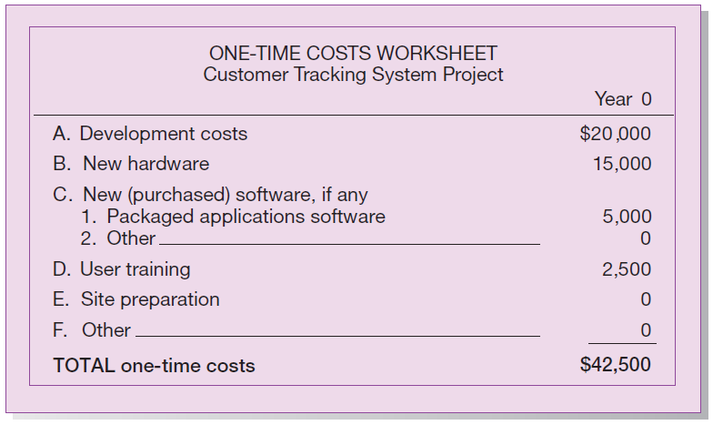
Determining Project Costs (Cont.)
Figure 5-4
One-time costs for Customer Tracking System (Pine Valley Furniture)
Notes:
Here we see a one-time cost worksheet for PVF.

Slide 25
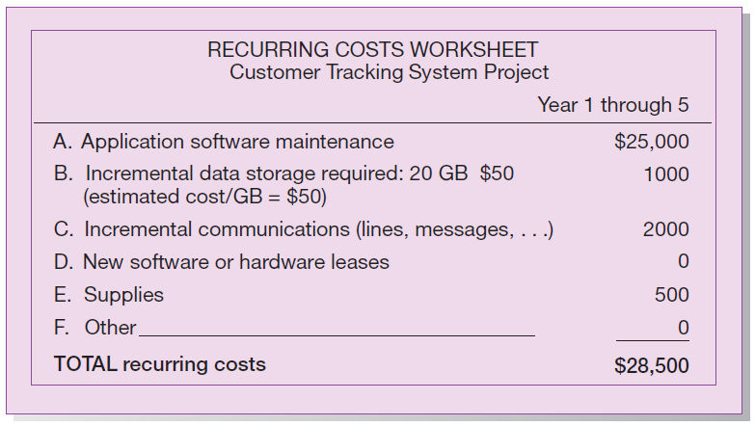
Determining Project Costs (Cont.)
Figure 5-5
Recurring costs for Customer Tracking System (Pine Valley Furniture)
Notes:
Here we see a recurring cost worksheet for PVF.

Slide 26
Determining Project Costs (Cont.)
Both one-time and recurring costs can consist of items that are fixed or variable in nature.
Fixed costs are billed or incurred at a regular interval and usually at a fixed rate.
  Example: facility lease payment
Variable costs are items that vary in relation to usage.
  Example: long-distance charges

Slide 27
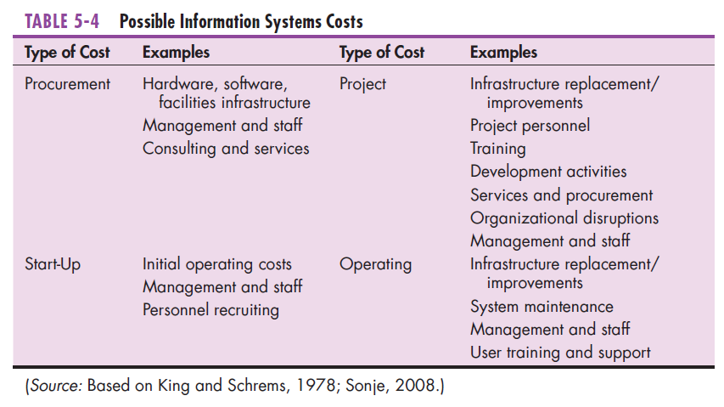
Determining Project Costs (Cont.)
Notes:
Here are several common types of IS system costs, both in terms of the IS project and in terms of continuing operations and maintenance.

Slide 28
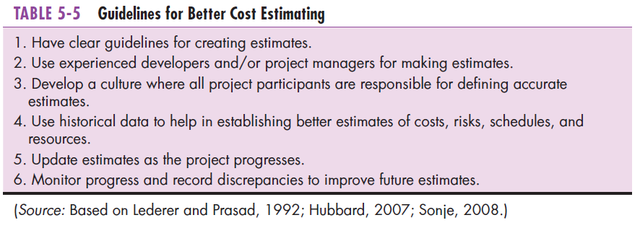
Determining Project Costs (Cont.)
Notes:
Predicting the costs associated with the development of an information system is an inexact science. But experience has provided some guidelines that help estimate project costs.

Slide 29
The Time Value of Money
Time value of money (TVM): the concept that money available today is worth more than the same amount tomorrow
Discount rate: the rate of return used to compute the present value of future cash flows (the cost of capital)
Present value: the current value of a future cash flow
Notes:
Financial formulas and calculations will come into play when determining costs and benefits. The terms on this and the next slide are often used to perform economic feasibility, not just for information systems projects, but for other types of projects as well.
All of these terms are related to the “time value of money”. The amount of currency you have now is not worth the same now as it will be worth five years from now. The idea behind TVM is that money available today is worth more than the same amount tomorrow.

Slide 30
The Time Value of Money (Cont.)
Net Present Value (NPV)
  Use discount rate to determine present value of cash outlays and receipts
Return on Investment (ROI)
  Ratio of cash receipts to cash outlays
Break-Even Analysis (BEA)
  Amount of time required for cumulative cash flow to equal initial and ongoing investment

Slide 31
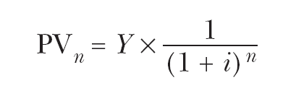
The Time Value of Money (Cont.)
Net Present Value
  PVn = present value of Y dollars n years from now based on a discount rate of i.
  NPV = sum of PVs across years.
  Calculates time value of money
Notes:
The net present value is a prediction of how much your money will be worth in the future, based on an expected discount (depreciation) rate over time.

Slide 32

The Time Value of Money (Cont.)
Break-even analysis: a type of cost-benefit analysis to identify at what point (if ever) benefits equal costs
Notes:
A yearly cash flow = yearly benefit present value minus one-time cost minus recurring cost present value.
The overall NPV (at a particular year) of the cash flow reflects the total cash flows for all preceding years. The yearly cash flow refers to only that year’s flow.
The break-even ratio tells you the percentage of time into the project that the benefits start to exceed the costs. Typically, costs exceed benefits early in the project, and over time benefits begin to catch up with costs.

Slide 33
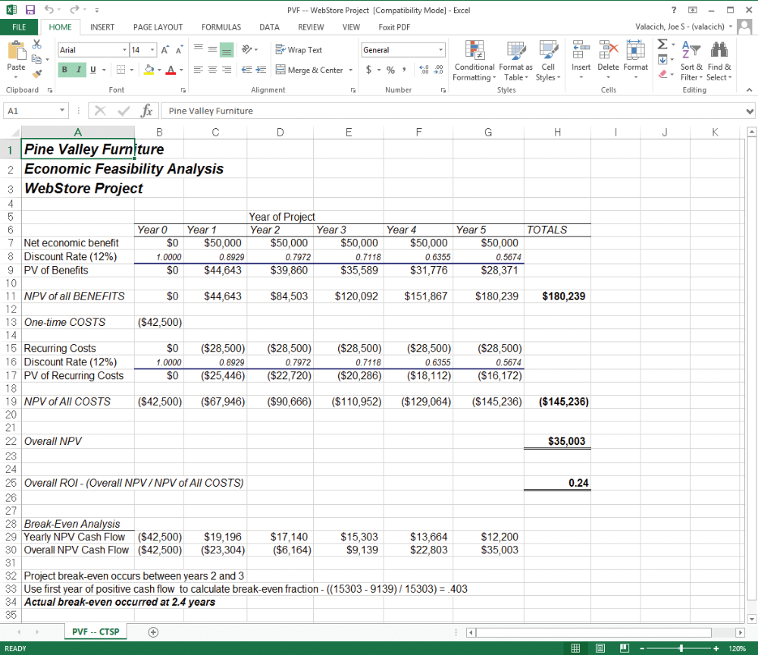
The Time Value of Money (Cont.)
Figure 5-6
Summary spreadsheet reflecting the present value calculations of all benefits and costs for the Customer Tracking System (Pine Valley Furniture)
(Source: Microsoft Corporation.)
Notes:
Here we see an Excel spreadsheet with PVF’s cost-benefit analysis for the customer tracking system. Excel has financial functions for calculating things like net present value. The ROI of this project can be compared with ROIs of other projects to help decide which projects to pursue.
To calculate the precise break-even point, we use the first year of positive cash flow. This is year 2. At this point we apply the breakeven calculation, to arrive at 0.403, or about 2.4 years into the five year project.

Slide 34
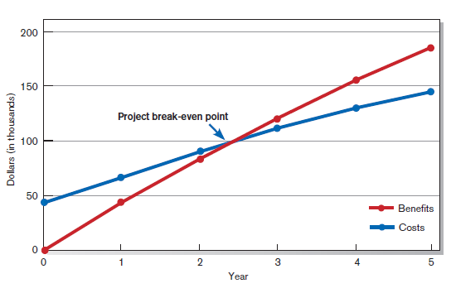
The Time Value of Money (Cont.)
Figure 5-7
Break-even analysis for Customer Tracking System (Pine Valley Furniture)
Notes:
This graph illustrates the break-even point. Obviously, economic feasibility requires that we do in fact get to a break-even point in a reasonable amount of time.

Slide 35
Assessing Technical Feasibility
Technical feasibility: a process of assessing the development organization’s ability to construct a proposed system
Assessment of the possible target hardware, software, and operating environments
Consider system size, complexity, and the group’s experience with similar systems
Notes:
Now that we’ve talked about economic feasibility, we’ll turn to technical feasibility.

Slide 36
Assessing Technical Feasibility (Cont.)
The potential consequences of not assessing and managing risks can include:
  Failure to attain expected benefits from the project
  Inaccurate project cost estimates.
  Inaccurate project duration estimates.
  Failure to achieve adequate system performance levels.
  Failure to adequately integrate the new system with existing hardware, software, or organizational procedures.
Notes:
All projects have risk, and you can’t completely avoid it. But you need to consider them when assessing technical feasibility.

Slide 37
Project Risk Factors
Project size
  Team size, organizational departments, project duration, programming effort
Project structure
  New vs. renovated system, resulting organizational changes, management commitment, user perceptions
Development group
  Familiarity with platform, software, development method, application area, development of similar systems
User group
  Familiarity with IS development process, application area, use of similar systems

Slide 38
Assessing Technical Feasibility (Cont.)
Four general rules of risk assessment:
  Larger projects are riskier than smaller projects.
  A system in which the requirements are easily obtained and highly structured will be less risky than one in which requirements are messy, ill structured, ill defined, or subject to the judgment of an individual.

Slide 39
Assessing Technical Feasibility (Cont.)
  The development of a system employing commonly used or standard technology will be less risky than one employing novel or nonstandard technology.
  A project is less risky when the user group is familiar with the systems development process and application area than if unfamiliar.

Slide 40
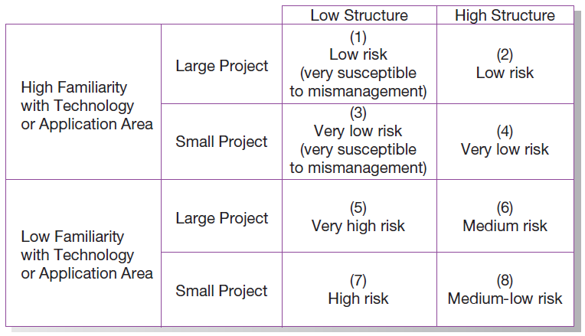
Assessing Technical Feasibility (Cont.)
FIGURE 5-8
Effects of degree of project structure, project size, and familiarity with
application area on project implementation risk (Source: Based on 7th Applegate, Austin, and McFarlan. 2007; Tech Republic, 2005.)
Notes:
This is a good pictorial view of risk. All other things being equal, small projects are less risky than large projects. All other things being equal, highly structured projects are less risky than low structured projects. All other things being equal, projects are less risky if the members have high familiarity with the technology than if they don’t.

Slide 41
Assessing Other Feasibility Concerns
Operational
  Does the proposed system solve problems or take advantage of opportunities?
Scheduling
  Can the project time frame and completion dates meet organizational deadlines?
Legal and Contractual
  What are the legal and contractual ramifications of the proposed system development project?
Political
  How do key stakeholders view the proposed system?
Notes:
Economic and technical feasibility are probably the most detailed analyses to do. But these are others.
Operational feasibility includes justifying the project on the basis of being consistent with or necessary for accomplishing the information systems plan, and on whether it accomplishes what’s requested in the SSR.
Schedule feasibility requires you to analyze the likelihood that all potential time frames and completion date schedules can be met and that meeting these dates will be sufficient for dealing with the needs of the organization.
Legal and contractual issues include ownership, copyright, non-disclosure agreements, labor laws, antitrust legislation, financial reporting standards, and foreign trade regulations.
Political issues can also come up, especially if there is controversy about the proposed project.

Slide 42
Building the Baseline Project Plan
A Baseline Project Plan (BPP) is a document intended primarily to guide the development team.
Sections:
  Introduction
  System description
  Feasibility assessment
  Management issues
Notes:
We talked about baseline project plans in chapter 3.
Here’ we’ll go into more detail about its construction.

Slide 43
Building the Baseline Project Plan (Cont.)
Project Scope statement is part of the BPP introduction.
Sections:
  Problem statement
  Project objectives
  Project description
  Business benefits
  Deliverables
  Expected duration
Notes:
Project scope statement was also discussed in chapter 3.

Slide 44
Factors in Determining Scope
Organizational units affected by new system
Current systems that will interact with or change because of new system
People who are affected by new system
Range of potential system capabilities
Notes:
These are all things to consider when trying to figure out how big a project this is going to be. It’s important to go into the project with open eyes, and not to downplay its costs and efforts.

Slide 45
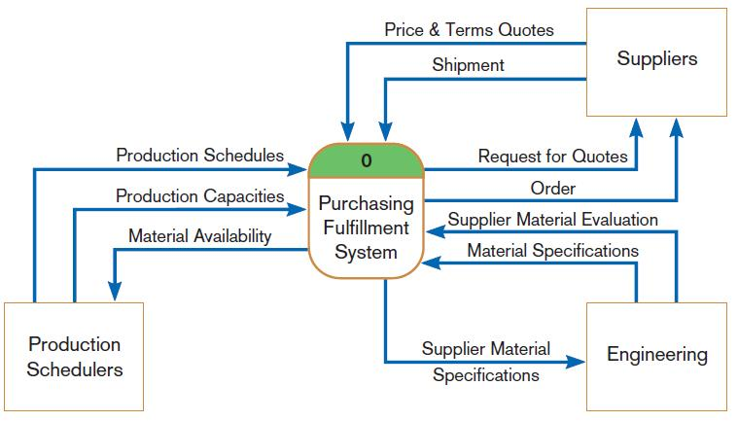
Diagram Depiction of Project Scope
FIGURE 5-11
Context-level data flow diagram showing project scope for Purchasing Fulfillment System (Pine Valley Furniture)
Notes:
This is a data flow diagram. We’ll be talking a lot more about these when we get to chapter 7. The rounded rectangle in the middle represents a process. The rectangles represent a source (origin) or sink (destination) of the data flows, which are the arrows going between the process and a source or sink.
We’ll be using data flow diagrams a lot when it comes to doing systems analysis, especially with regard to structuring system requirements.

Slide 46
Building the Baseline Project Plan (Cont.)
System description section outlines possible alternative solutions.
Feasibility assessment section outlines issues related to project costs and benefits, technical difficulties, and other such concerns.
Management issues section outlines a number of managerial concerns related to the project.

Slide 47
Reviewing the Baseline Project Plan
Structured Walkthroughs: a peer-group review of any product created during the system development process
Roles: coordinator, presenter, user, secretary, standard-bearer, maintenance oracle
Can be applied to BPP, system specifications, logical and physical designs, program code, test procedures, manuals and documentation
Notes:
Here we are looking at how the plan is reviewed and evaluated. The structured walkthrough is a team process during which members analyze and evaluate the details of the BPP, designs, code, etc.

Slide 48
Making an Effective Presentation
Presentation planning
  Audience, message, presentation environment
Presentation design
  Organized, simple, consistent, variety, proof-read, limit bells-and-whistles, appropriate supplemental materials, clear beginning and end

Slide 49
Making an Effective Presentation (Cont.)
Presentation delivery
  Practice, arrive early, use special software keys for shortcuts, have a backup plan, deliver information effectively, good personal appearance

Slide 50
E-Commerce Initialization and Planning (PVF)
Web-based system costs:
  Platform – web hosting service, web server, server software, plug-ins, firewall, router, internet connection
  Content and service – creative design/devt., ongoing design fees, project mgt., site mgt., content staff, graphics staff, support staff, enhancement funds, licensing fees, programming, consulting, research, training, travel
  Marketing – direct mail, public relations, print advertising, paid website links, promotions, marketing staff, advertising sales staff
Notes:
The next few slides apply the concepts we discussed to PVF’s WebStore project. Her, we see the expected costs of the system, divided into platform, content and service, and marketing. Obviously, one thing that distinguishes Internet-based systems from others is the predominance of Internet related technologies as you see in the platform costs. Also, because this is an e-commerce application, much effort goes into making a high-quality, easy to use, and pleasurable web experience, which influences the content and service costs.

Slide 51
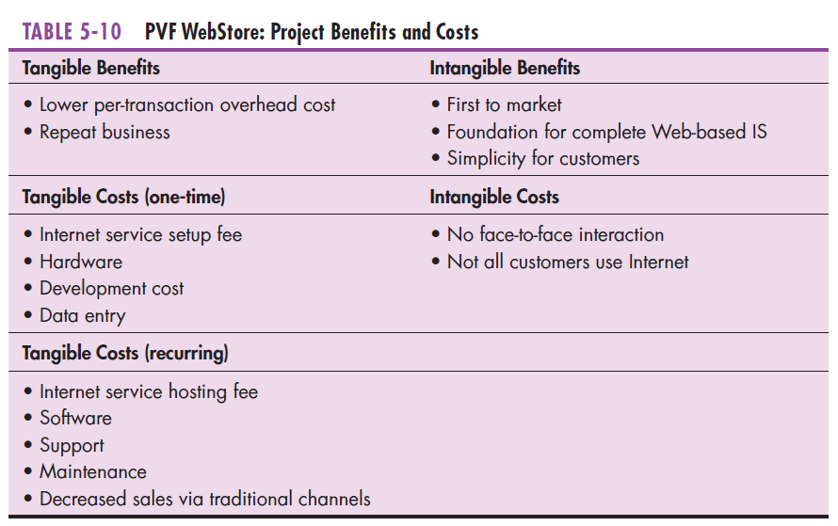
E-Commerce Initialization and Planning (PVF) (Cont.)
Notes:
Here is a cost-benefit breakdown. Remember that some costs are one-time initial costs, and others are recurring. Also, remember that not all benefits and costs are directly related to money; these are called “intangible”.

Slide 52
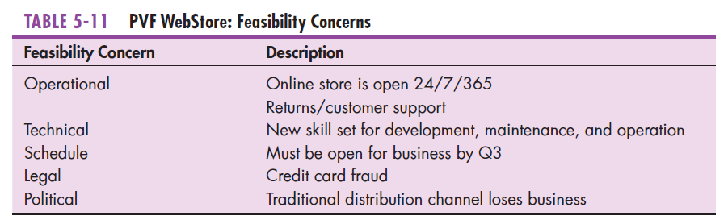
E-Commerce Initialization and Planning (PVF) (Cont.)
Notes:
Here are some of the concerns that were raised during feasibility analysis.

Slide 53
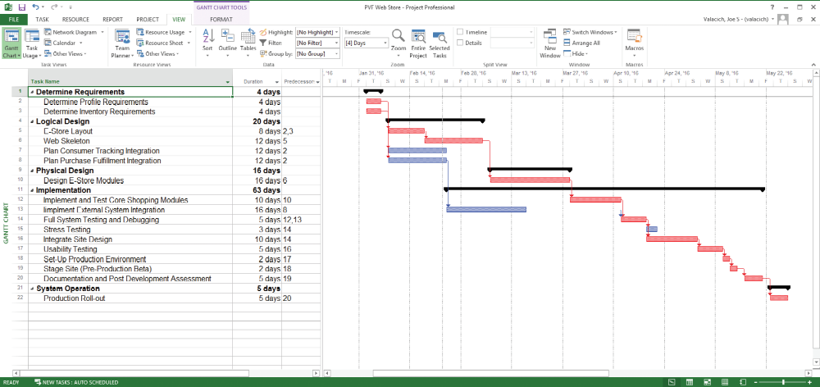
E-Commerce Initialization and Planning (PVF) (Cont.)
Figure 5-16
Schedule for WebStore project at Pine Valley Furniture
(Source: Microsoft Corporation.)
Notes:
Here we see a work breakdown structure and Gantt chart for the project. You can see from the WBS that this is following a more-or-less waterfall approach. Note, however, that there is considerable overlap between logical and physical design, and also between design and implementation. You can also see the critical path as red bars in the Gantt chart.

Slide 54
Summary
Now you should know be able to:
  Describe the steps involved in the project initiation and planning process.
  List and describe various methods for assessing project feasibility.
  Describe the activities needed to build and review the baseline project plan.
  Describe the activities and participant roles within a structured walkthrough.

Slide 55
Next Lecture
Determining Systems Requirements

Slide 56
References
Joseph S. Valacich, Joey F. George, Modern Systems Analysis and Design, 8th Global Edition, Pearson, 2016

