Slide 1


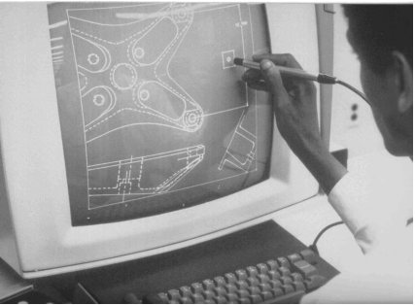
CSE 411
Computer Graphics
Lecture #4 Attributes of Output Primitives and Algorithms
Prepared & Presented by Asst. Prof. Dr. Samsun M. BAŞARICI
Notes:
1

Slide 2
Objectives
HB Ch. 5 & 6
OpenGL state variables
Color and gray scale & OpenGL functions
Point attributes & OpenGL functions
Line attributes & OpenGL functions
Curve attributes & OpenGL functions
Fill-area attributes & OpenGL functions
Character attributes & OpenGL functions
OpenGL antialiasing functions
OpenGL attribute groups

Slide 3
Objectives (cont.)
Line drawing algorithms
Circle generating algorithms
Ellipse generating algorithms
Scan-line polygon fill algorithms
  For convex polygons
  For regions with curved boundaries
Implementation methods for antialiasing

Slide 4
Attributes
Attribute parameter: A parameter that effects the way the primitive is to be displayed.
Color (common for all attributes)
Style
  Dotted, dashed, thick, thin
One approach is to extend the function calls for primitives
Another alternative is to have the system to have a list of current attribute values
  State variables or state parameters

Slide 5
OpenGL State Variables
Remember state machines?
State parameters are attributes of the output primitives
In OpenGL, state parameters include
  Color
  Current matrix mode
  Elements of the Modelview matrix
  Current position of frame buffer
  Lighting effects parameters
Changes affect next operations
State parameters can be queried

Slide 6
Color and Gray Scale
RGB color buffer
  Store RGB color codes in frame buffer or in a separate table
  Color code placed at pixel location
  Minimum number of colors for 3-bits
  Left bit → Red, Middle bit → Green, Left bit → Blue
  0 → black, 1 → blue, …, 7 → white
  More color bits increase the size of the frame buffer: 24-bits * 1024 * 1024 = 3MB

Slide 7
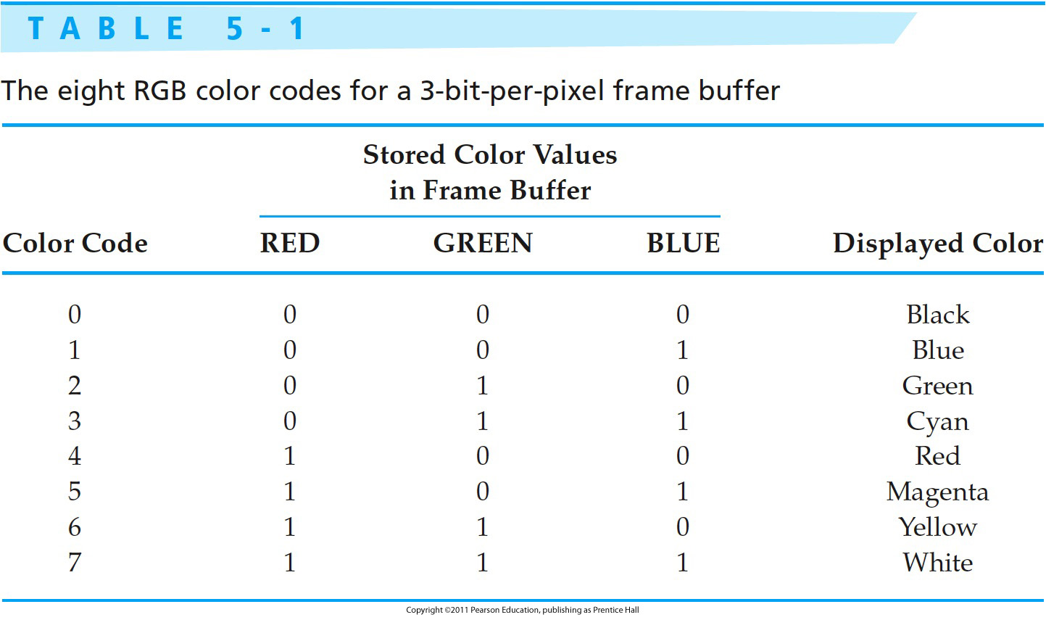
Example: Color table

Slide 8
Color and Gray Scale
Color tables
  Color map (color look-up table)
  Each pixel in the frame buffer contains a value (Ex. 196) corresponding to an entry in the color table (Ex. 2081), which has 256 entries.
  Color table contains a 3-byte color code that represents an RGB color – 1-byte for the Red, 1-byte for the Green, 1-byte for the Blue.
  Pick 256 colors from a total of 17 million, and save storage: 8 bits * 1024 * 1024 = 1MB

Slide 9
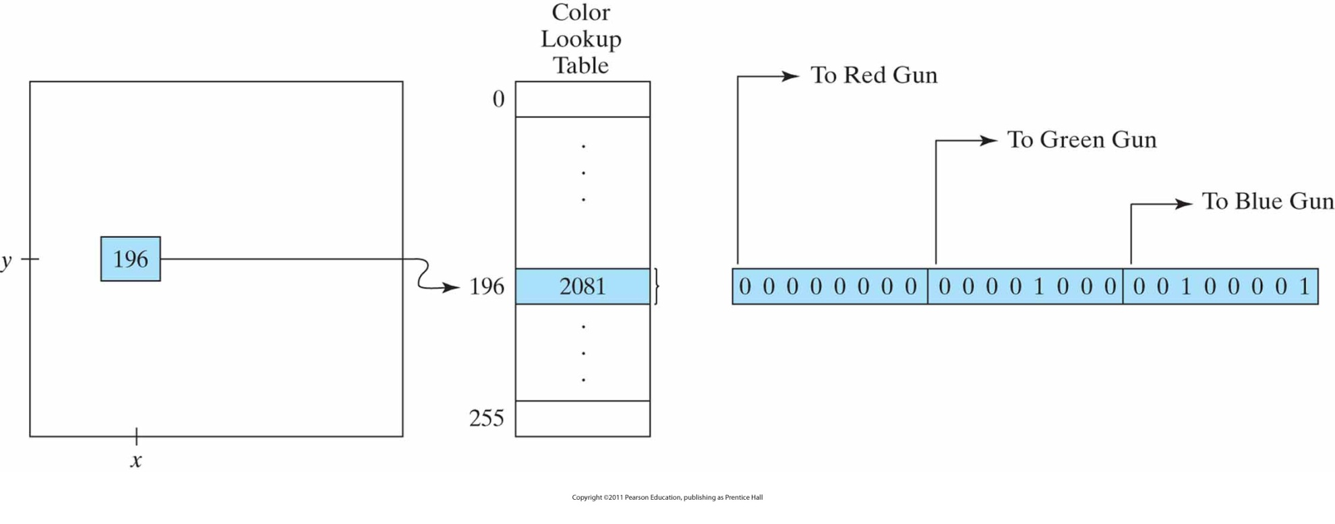
Color and Gray Scale (cont.)
A color lookup table with 24 bits per entry that is accessed from a frame buffer with 8 bits per pixel. A value of 196 stored at pixel position (x, y) references the location in this table containing the hexadecimal value 0x0821 (a decimal value of 2081). Each 8-bit segment of this entry controls the intensity level of one of the three electron guns in an RGB monitor.

Slide 10
Color and Gray Scale
Gray scale
  Shades of gray
  0 → dark gray, 1 → light gray
Other color parameters
  Intensity (amount of light energy)
  Luminance (perceived brightness)

Slide 11
Color Functions
Set color display mode to RGB
glutInitDisplayMode(GLUT_SINGLE | GLUT_RGB);
  GLUT_SINGLE or GLUT_DOUBLE
  GLUT_RGB, GLUT_RGBA, GLUT_INDEX
Alpha value (RGBA) for color blending of overlapping primitives (transparent or not)
glColor3/4*(colorComponents)
  * means b (byte), i (int), s (short), d (double), f (float)
  default (1.0f, 1.0f, 1.0f, 1.0f) for white

Slide 12
Important
OpenGL converts color information to floating-point format.
There are no OpenGL core library functions for loading values into a color-lookup table.
Why?
  Answer: Table-processing routines are part of a window system. Therefore, GLUT routines.

Slide 13
Color Blending
Color mixing functions
In OpenGL (blending two objects):
  Load one object into frame-buffer
  Combine the color of second object with frame-buffer color
Destination color: Color of frame-buffer
Source color: Color of second object

Slide 14
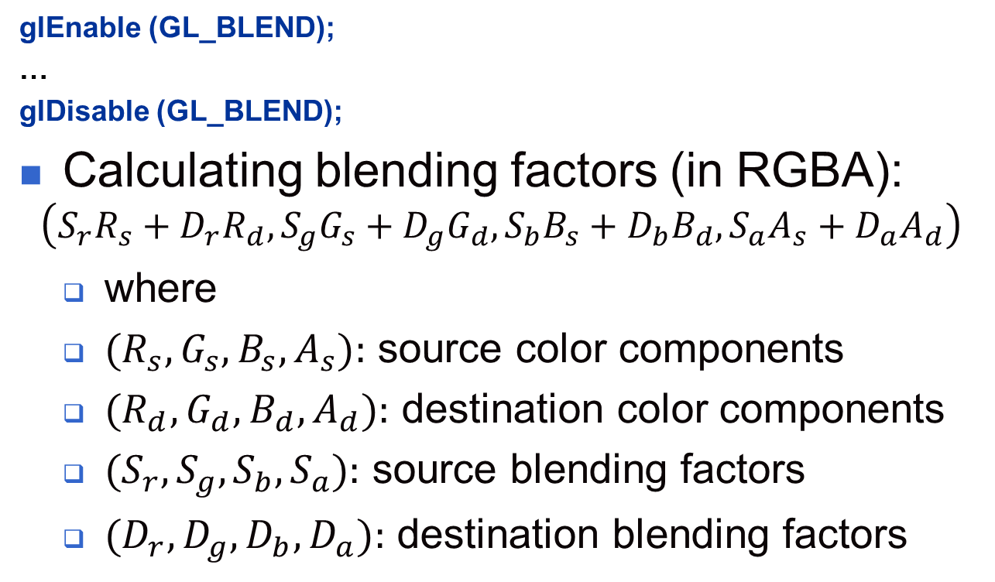
Color Blending (cont.)

Slide 15
OpenGL Color Arrays
We have seen that we can specify coordinate values with vertex arrays.
Can this be done with color values too?
Can we specify color in the same manner like coordinate values for our cube from previous lessons?
  Answer: Yes, we can?
How?
  Answer: Using color arrays
What do you mean?
  Answer. Find it out by yourself (Hint: HB p. 136-138)

Slide 16
Example: Color Functions
void triangleColor (void)
// displays a three-colored triangle
{
glClear (GL_COLOR_BUFFER_BIT); // apply clear color to color buffer
glBegin(GL_TRIANGLES); // Drawing Using Triangles
glColor3f(1.0f, 0.0f, 0.0f); // set color to red
glVertex2i( 100, 150); // top
glColor3f(0.0f, 1.0f, 0.0f); // set color to green
glVertex2i(10,10); // bottom Left
glColor3f(0.0f, 0.0f, 1.0f); // set color to blue
glVertex2i(180,15); // bottom right
glEnd(); // finished drawing the triangle
glFlush();
}

Slide 17
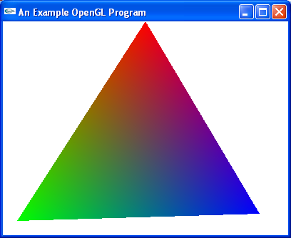
Example: Color Functions (cont.)

Slide 18
Point Attributes and Functions
Attributes are any parameters that affect the way graphic primitives are displayed.
Point
  Color
  Size is a multiple of the pixel size (a square).
glPointSize (size); // size is the number of pixels

Slide 19
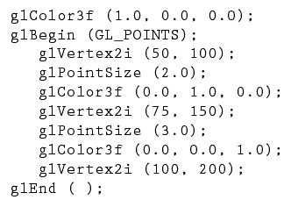
Point Attributes (cont.)
Point color & size :
_{Pixel size = 1}

Slide 20
Line Attributes and Functions
Line attributes
  Basic attributes: color, width, style
  Color
  Width
    glLineWidth (width); // width is the width of the line
    Default width is 1.0

Slide 21
Line Attributes and Functions (cont.)
Line attributes
  Style
    Solid lines, dashed lines, dotted lines can be generated by modifying the line drawing algorithm – spacing between drawn pixels
    Can be also generated from the raster by using a pixel mask, for example 11111000 will display a dashed line with dash length of 5 and inter-dash length of 3.

Slide 22
Line Attributes and Functions (cont.)
Line attributes
  Style
    glLineStipple (repeatFactor, pattern);
    pattern references a 16-bit integer that describes how the line should be displayed (default 0xFFFF, all bits set to 1, solid line) (starts at left-order bit)
    repeatFactor specifies how many times each bit in the pattern is to be repeated before the next bit in the pattern in applied (default 1).
    Example: 0x00FF
    displays -------- -------- -------- …
    8 solid line pixels, followed by 8 spaces
    Requires first glEnable (GL_LINE_STIPPLE);
    line-pattern feature can be disabled by
    glDisable (GL_LINE_STIPPLE);

Slide 23
Example: Line Attributes and Functions
void drawLines(void)
{
glClear (GL_COLOR_BUFFER_BIT);
glEnable(GL_LINE_STIPPLE);
glColor3f(1.0,0.0,0.0);
glLineStipple(1, 0x1C47);
linePlot(10,10,100,120);
glColor3f(0.0,1.0,0.0);
glLineStipple(1, 0x00FF);
glLineWidth(2.0);
linePlot(20,10,110,120);
glColor3f(0.0,0.0,1.0);
glLineStipple(1, 0x0101);
glLineWidth(3.0);
linePlot(30,10,120,120);
glFlush();
}
void linePlot (int x0,int y0,int xend,int yend)
{
glBegin(GL_LINES);
glVertex2i( x0, y0);
glVertex2i(xend,yend);
glEnd();
}

Slide 24
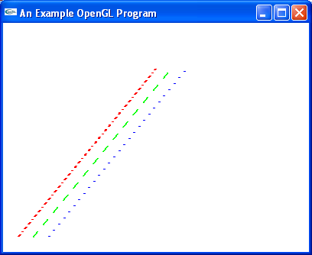
Example: Line Attributes and Functions (cont.)

Slide 25
Curved Attributes
This slide doesn’t contain any information
Why?

Slide 26
Fill-Area Attributes
Standard output primitives – solid, pattern, hollow
Fill primitive – solid circle, rectangle, triangle, …

Slide 27
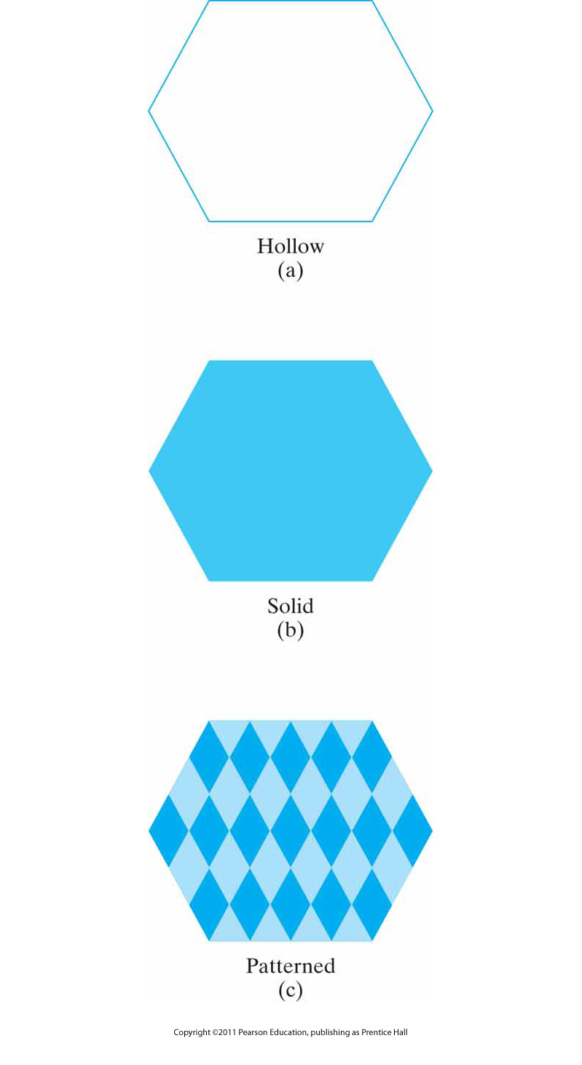
Basic Polygon Fill Styles

Slide 28

Areas Filled With Hatch Patterns

Slide 29
Fill-Area Attributes
OpenGL fill-area routines for convex polygons only.
Four steps:
  Define a fill pattern
  Invoke the polygon-fill routine
  Activate the polygon-fill feature
  Describe the polygons to be filled.

Slide 30
Fill-Area Attributes (cont.)
Define a fill pattern (1)
  Store pattern in a 32 x 32 byte array (fillPattern)
  Bytes are numbered from right to left
  GLubyte fillpattern[ ] = {0xff, 0x00,…};
Invoke the polygon-fill routine (2)
glPolygonStipple (fillPattern)
Activate the polygon-fill feature (3)
glEnable (GL_POLYGON_STIPPLE)
Describe the polygons to be filled (4)
glBegin (GL_POLYGON)
At the end
glDisable (GL_POLYGON_STIPPLE)

Slide 31
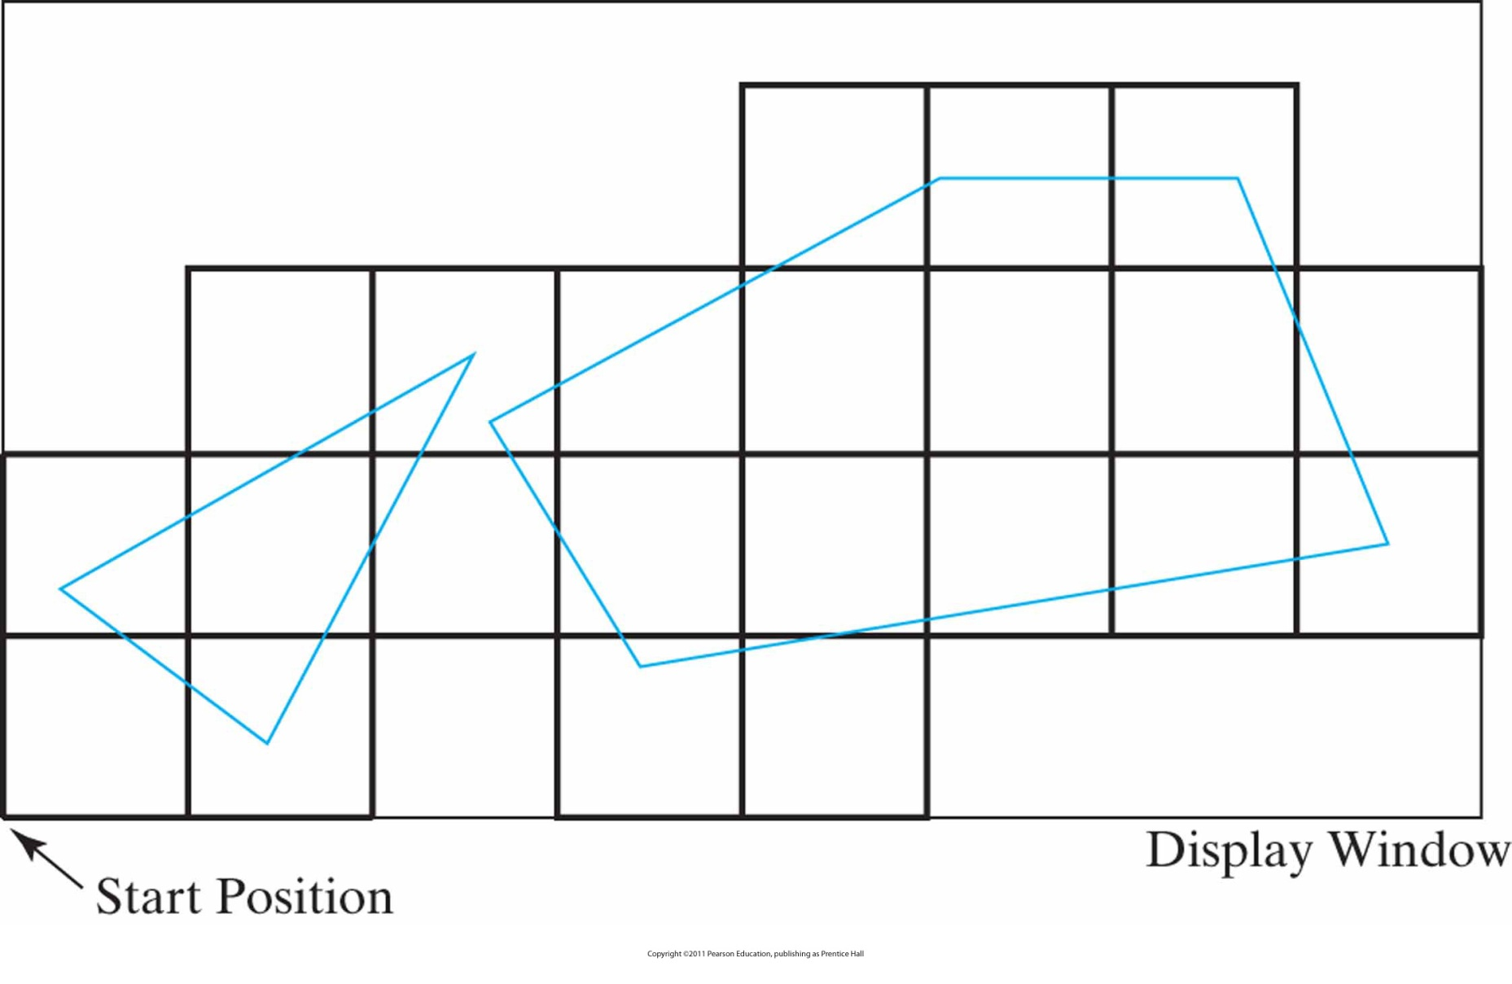
Example: Filling Two Polygons
Tiling a rectangular fill pattern across a display window to fill two convex polygons.

Slide 32
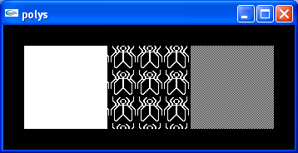
Example: Filling With Fly

Slide 33
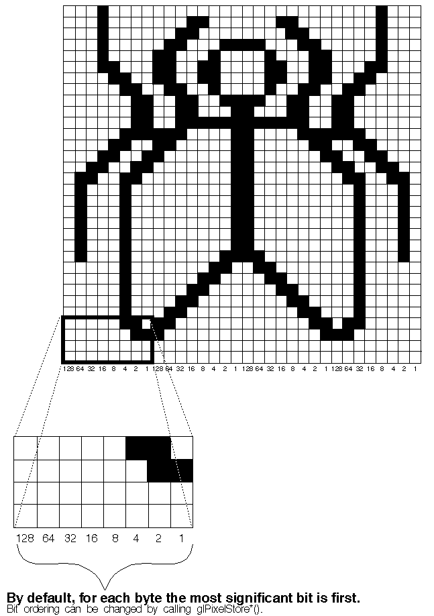
Example: The Fly
(from the redbook)

Slide 34
Example: The Fly (cont.)
byte fly[] = {
(byte) 0x00, (byte) 0x00, (byte) 0x00, (byte) 0x00, (byte) 0x00, (byte) 0x00, (byte) 0x00, (byte) 0x00,
(byte) 0x03, (byte) 0x80, (byte) 0x01, (byte) 0xC0, (byte) 0x06, (byte) 0xC0, (byte) 0x03, (byte) 0x60,
(byte) 0x04, (byte) 0x60, (byte) 0x06, (byte) 0x20, (byte) 0x04, (byte) 0x30, (byte) 0x0C, (byte) 0x20,
(byte) 0x04, (byte) 0x18, (byte) 0x18, (byte) 0x20, (byte) 0x04, (byte) 0x0C, (byte) 0x30, (byte) 0x20,
(byte) 0x04, (byte) 0x06, (byte) 0x60, (byte) 0x20, (byte) 0x44, (byte) 0x03, (byte) 0xC0, (byte) 0x22,
(byte) 0x44, (byte) 0x01, (byte) 0x80, (byte) 0x22, (byte) 0x44, (byte) 0x01, (byte) 0x80, (byte) 0x22,
(byte) 0x44, (byte) 0x01, (byte) 0x80, (byte) 0x22, (byte) 0x44, (byte) 0x01, (byte) 0x80, (byte) 0x22,
(byte) 0x44, (byte) 0x01, (byte) 0x80, (byte) 0x22, (byte) 0x44, (byte) 0x01, (byte) 0x80, (byte) 0x22,
(byte) 0x66, (byte) 0x01, (byte) 0x80, (byte) 0x66, (byte) 0x33, (byte) 0x01, (byte) 0x80, (byte) 0xCC,
(byte) 0x19, (byte) 0x81, (byte) 0x81, (byte) 0x98, (byte) 0x0C, (byte) 0xC1, (byte) 0x83, (byte) 0x30,
(byte) 0x07, (byte) 0xe1, (byte) 0x87, (byte) 0xe0, (byte) 0x03, (byte) 0x3f, (byte) 0xfc, (byte) 0xc0,
(byte) 0x03, (byte) 0x31, (byte) 0x8c, (byte) 0xc0, (byte) 0x03, (byte) 0x33, (byte) 0xcc, (byte) 0xc0,
(byte) 0x06, (byte) 0x64, (byte) 0x26, (byte) 0x60, (byte) 0x0c, (byte) 0xcc, (byte) 0x33, (byte) 0x30,
(byte) 0x18, (byte) 0xcc, (byte) 0x33, (byte) 0x18, (byte) 0x10, (byte) 0xc4, (byte) 0x23, (byte) 0x08,
(byte) 0x10, (byte) 0x63, (byte) 0xC6, (byte) 0x08, (byte) 0x10, (byte) 0x30, (byte) 0x0c, (byte) 0x08,
(byte) 0x10, (byte) 0x18, (byte) 0x18, (byte) 0x08, (byte) 0x10, (byte) 0x00, (byte) 0x00, (byte) 0x08
};

Slide 35
Character Attributes
Character attributes
  Font (typeface)
  Helvetica, Courier, Times Roman, …
  Underlining style
  solid, dotted, double
  Style
  boldface, italics, outline, shadow
  Size
  10-point, 12-point, …
  Color

Slide 36
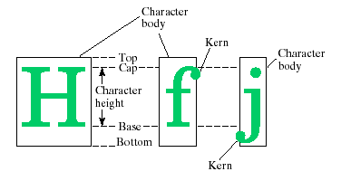
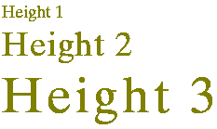
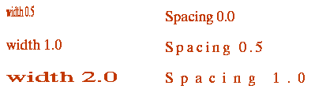
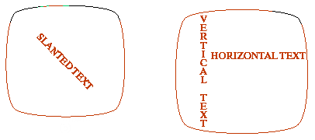
Character Attributes (cont.)

Slide 37
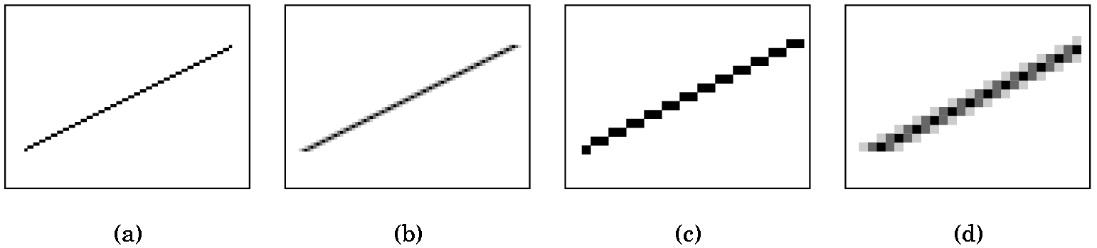
Antialiasing
Aliasing
Information loss due to low-frequency sampling
Jagged or stair-step appearance
Antialiasing
Modified Bresenham’s line algorithm (coming soon):
We put a pixel to y_{k}, and lightened pixel y_{k}-1 and y_{k}+1.

Slide 38
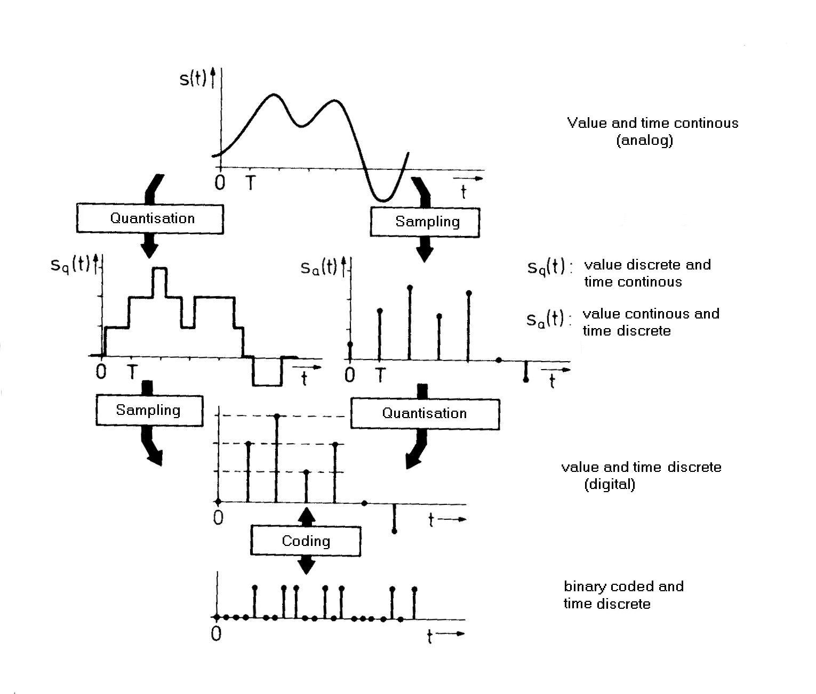
Signal Processing and Sampling

Slide 39
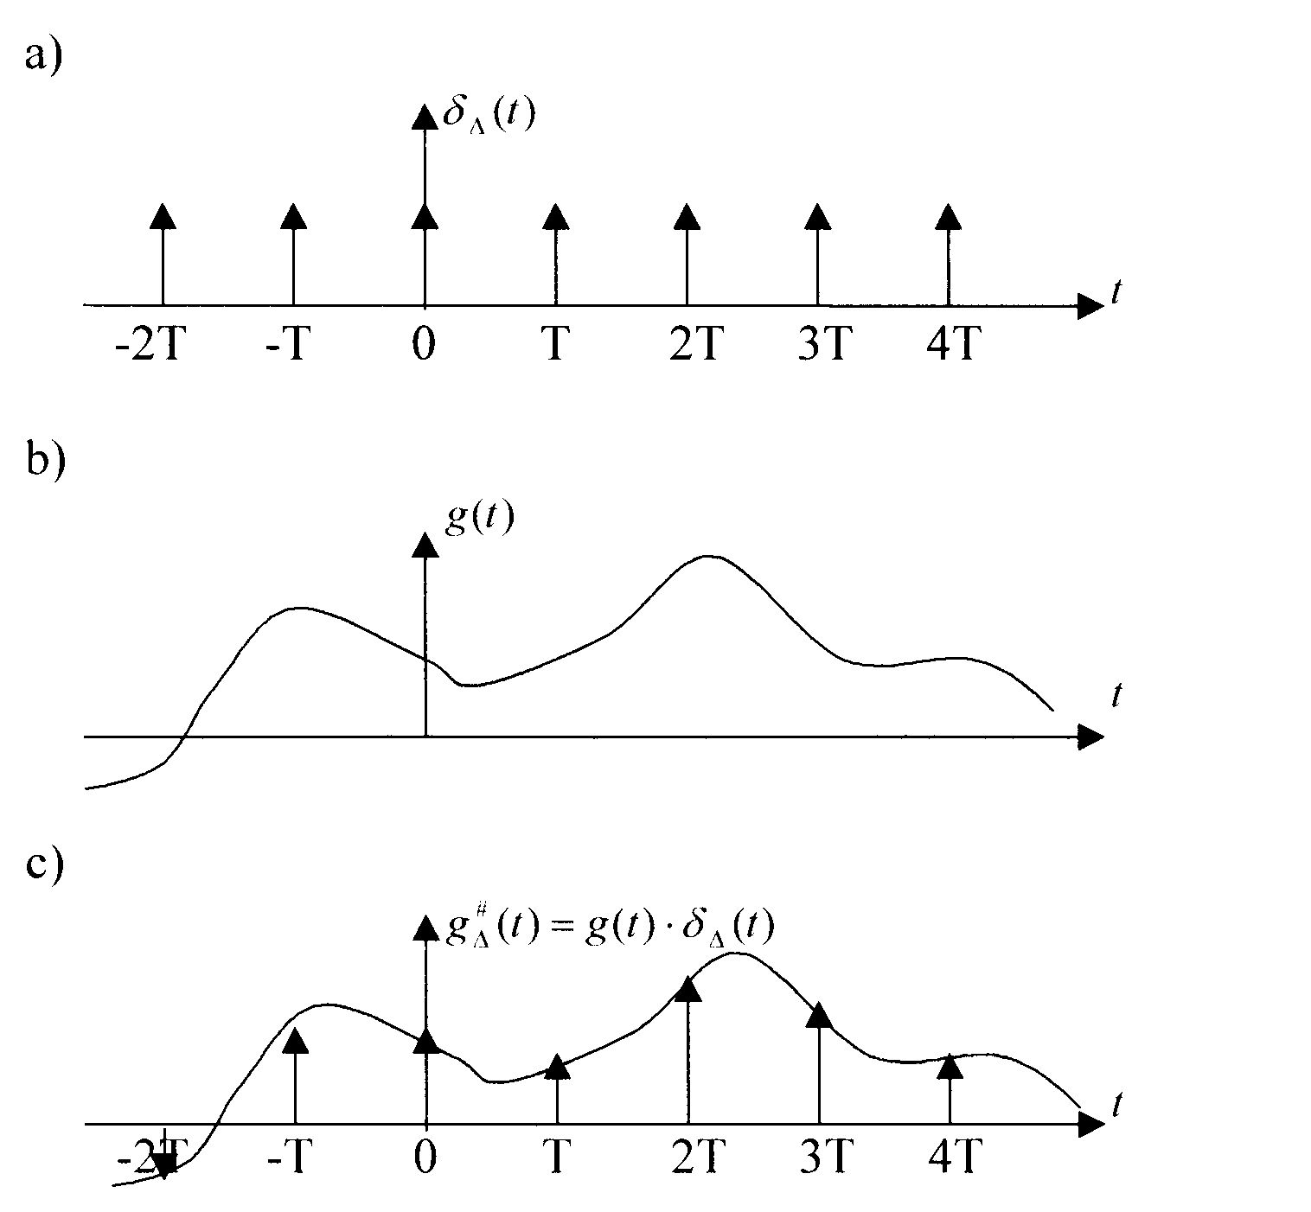
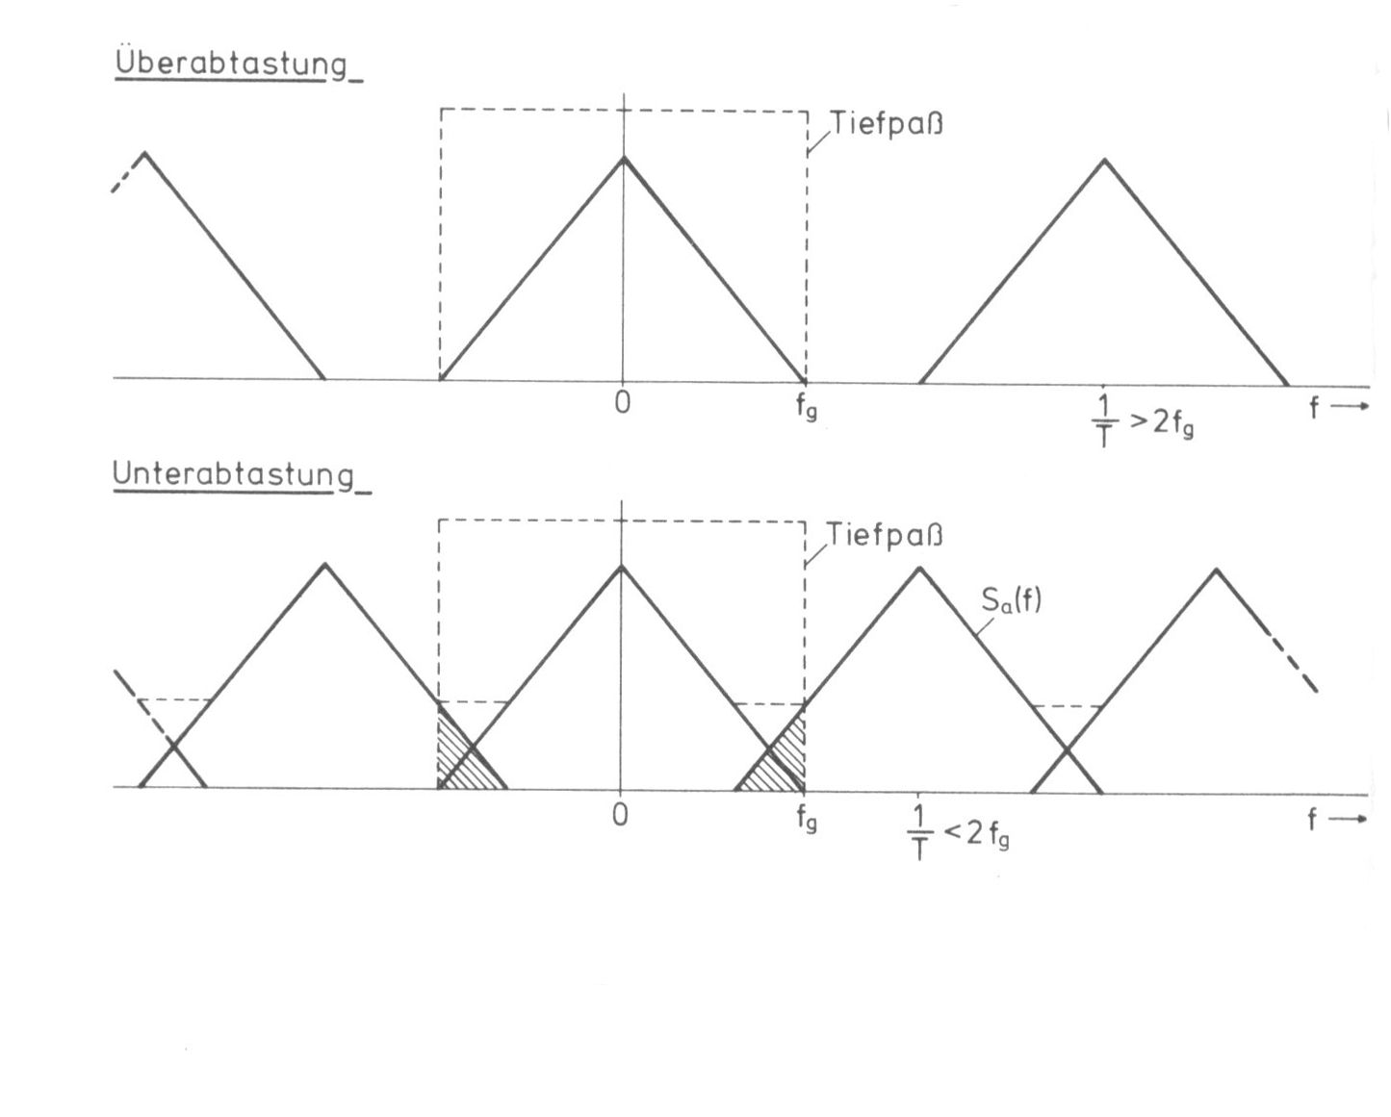
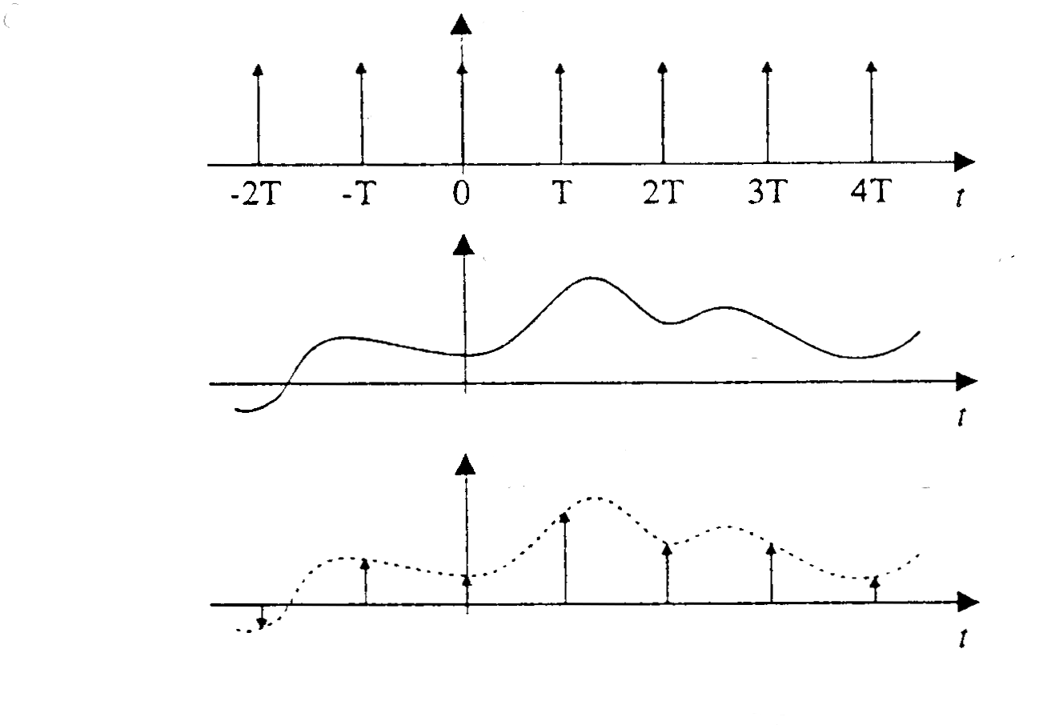
Signal Processing and Sampling

Slide 40
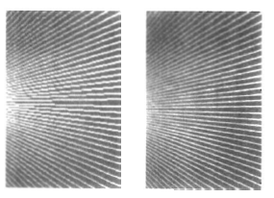
Antialiasing
Used to improve the appearance of lines.

Slide 41
Antialiasing in OpenGL
glEnable ( primitive_type )
primitive_type:
GL_POINT_SMOOTH
GL_LINE_SMOOTH
GL_POLYGON_SMOOTH
Color-blending
glEnable (GL_BLEND)
glBlendFunc (GL_SRC_ALPHA, GL_ONE_MINUS_SRC_ALPHA)

Slide 42
OpenGL Query Functions
Current values of any state parameter, including attribute settings, can be retrieved with OpenGL query functions.
General structure:
  glGet… (parameter1, parameter2)
    Booleanv, Floatv, Integerv, Doublev
    Parameter1: Attribute/state parameter
    Parameter2: Pointer to an array of the data type indicated by function name

Slide 43
OpenGL Attribute Groups
Around 20 groups in OpenGL, e.g. Point-attribute groups, line-attribute groups, polygon-attribute groups, color-attribute groups, etc.
  glPushAttrib (attrGroup);
  Places all parameters within the specified group onto an attribute stack.
  glPopAttrib ();
  Reinstating all values on the attribute stack.
  Takes no argument
  Why?

Slide 44
OpenGL Attribute Groups (cont.)
Above: Server attribute stack
For client attribute stack:
  glPushClientAttrib (attrGroup);
  glPopClientAttrib ();
  Warning: Only two client attribute groups are available:
    For pixel-storage modes: Includes information such as byte alignment and the type of arrays used to store subimages of the display
    For vertex arrays: Information about current vertex-array state, like enable/disable state of various arrays

Slide 45
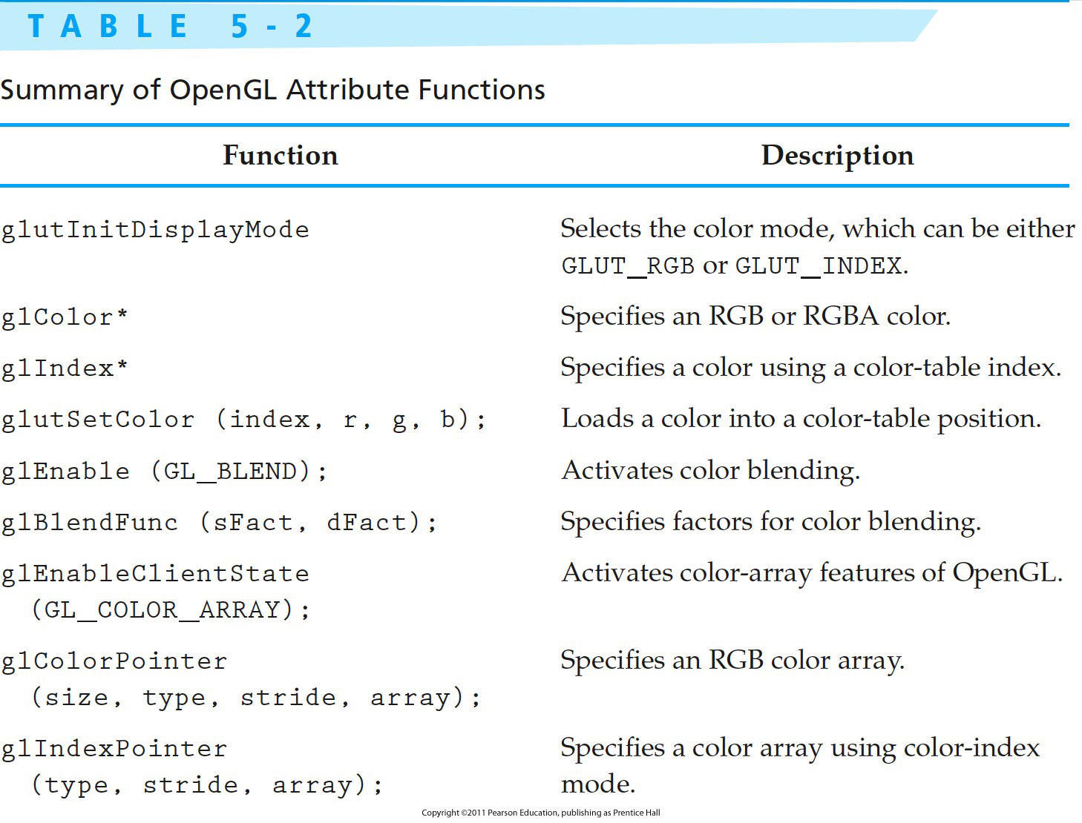
OpenGL Attribute Functions

Slide 46
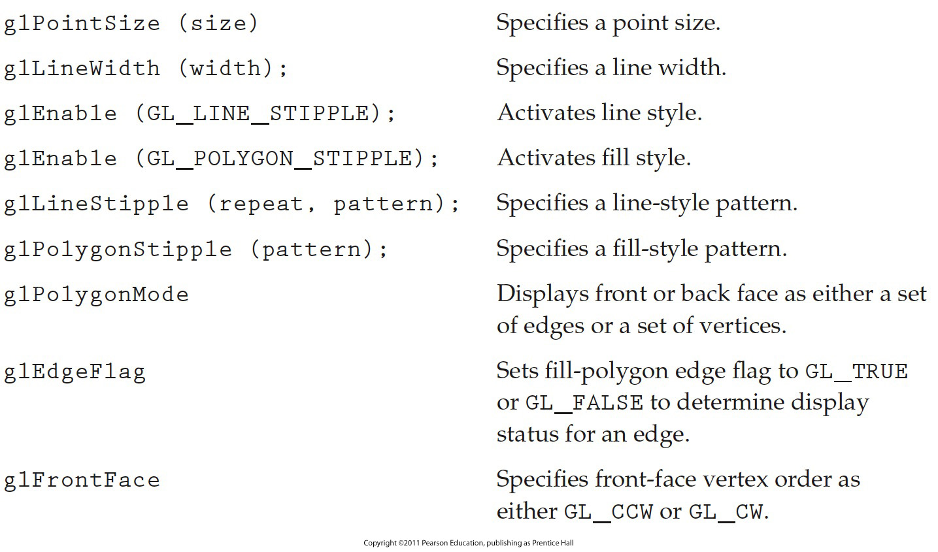
OpenGL Attribute Functions (cont.)
Notes:
46

Slide 47
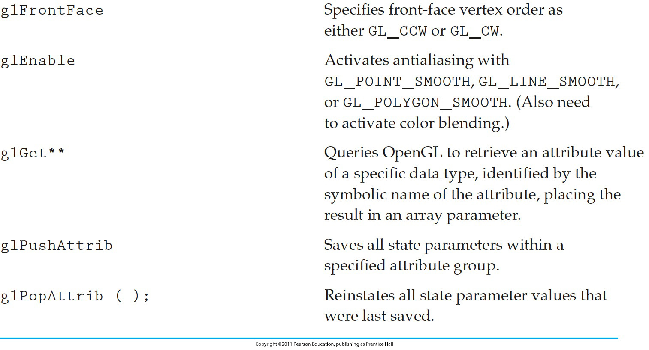
OpenGL Attribute Functions (cont.)
Notes:
47

Slide 48
Line Drawing Algorithms
Lines drawn as pixels
Graphics system
  Projects the endpoints to their pixel locations in the frame buffer (screen coordinates as integers)
  Finds a path of pixels between the two
  Loads the color
  Plots the line on the monitor from frame buffer (video controller)
  Rounding causes all lines except horizontal or vertical to be displayed as jigsaw appearance (low resolution)
  Improvement: high resolution, or adjust pixel intensities on the line path.

Slide 49
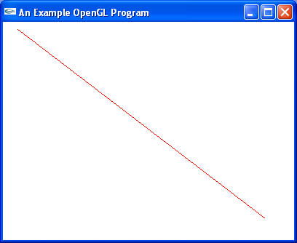
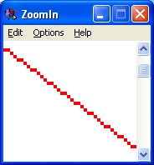
Line Drawing Algorithms (cont.)

Slide 50
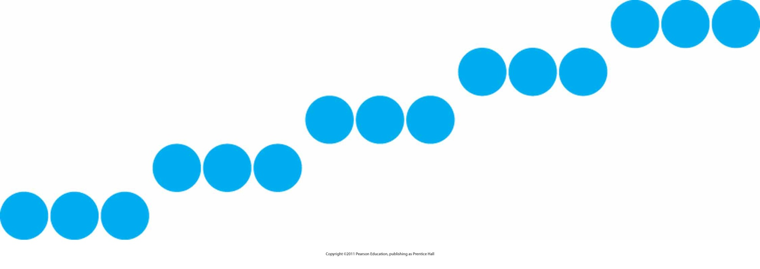
Closer Look

Slide 51
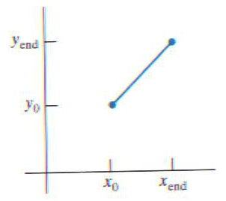

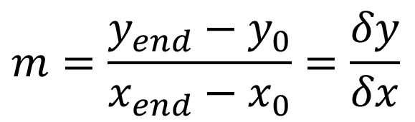
Line Drawing Algorithms (cont.)
Line equation
  Slope-intercept form
  y = m x + b
  slope m
  y-intercept b
  Slope
  y-intercept
$$m=\frac{y_{end}−y_{0}}{x_{end}−x_{0}}=\frac{δy}{δx}$$
$$b=y_{0}−mx_{0}$$

Slide 52
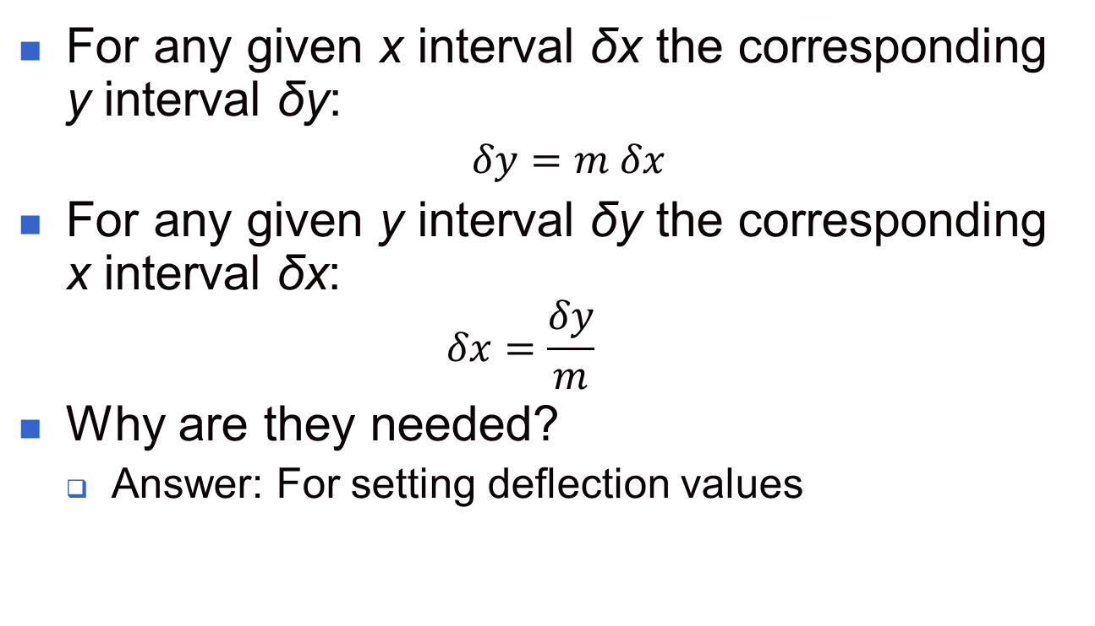
Calculating the values

Slide 53
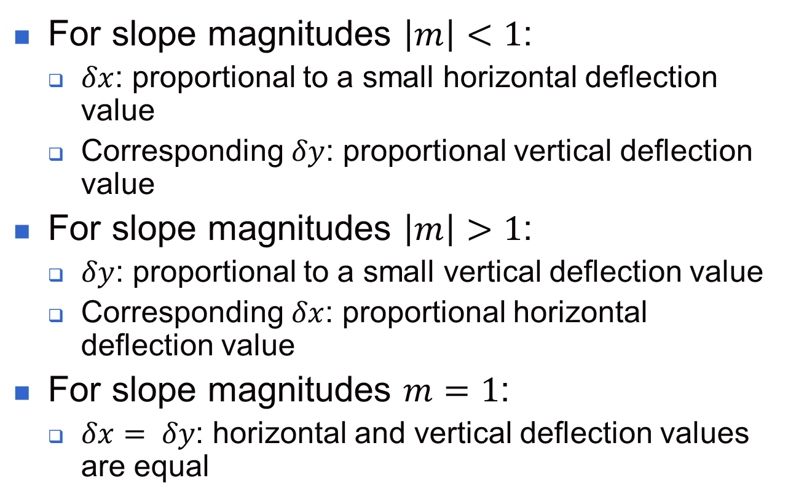
Setting Deflection Values

Slide 54
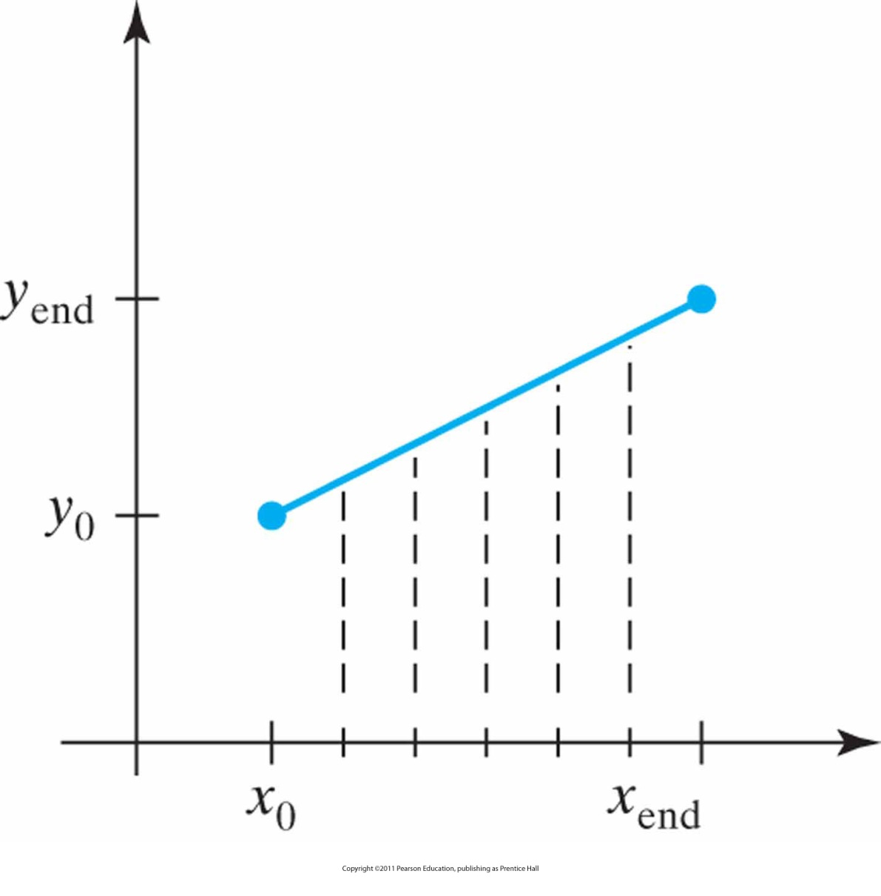
Line Sampling
Straight-line segment with five sampling positions along the x axis between x₀ and x_{end}.

Slide 55
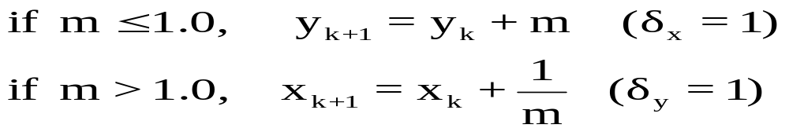
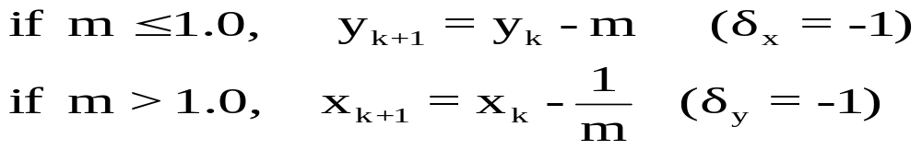
Line Drawing Algorithms (cont.)
DDA (Digital Differential Analyzer)
  Scan conversion line algorithm based on calculating either δx or δy
  Line sampled at regular intervals of x, then corresponding y is calculated and rounded
  From left to right

Slide 56
DDA Algorithm
void lineDDA (int x0, int y0, int xEnd, int yEnd)
{
int dx = xEnd - x0, dy = yEnd - y0, steps, k;
float xIncrement, yIncrement, x = x0, y = y0;
if (fabs (dx) > fabs (dy))
steps = fabs (dx);
else
steps = fabs (dy);
xIncrement = float (dx) / float (steps);
yIncrement = float (dy) / float (steps);
setPixel (round (x), round (y));
for (k = 0; k < steps; k++) {
x += xIncrement;
y += yIncrement;
setPixel (round (x), round (y));
}
}

Slide 57
DDA Algorithm (cont.)
Advantage
  Does not calculate coordinates based on the complete equation (uses offset method)
Disadvantage
  Round-off errors are accumulated, thus line diverges more and more from straight line
  Round-off operations take time
    Perform integer arithmetic by storing float as integers in numerator and denominator and performing integer arithmetic.

Slide 58
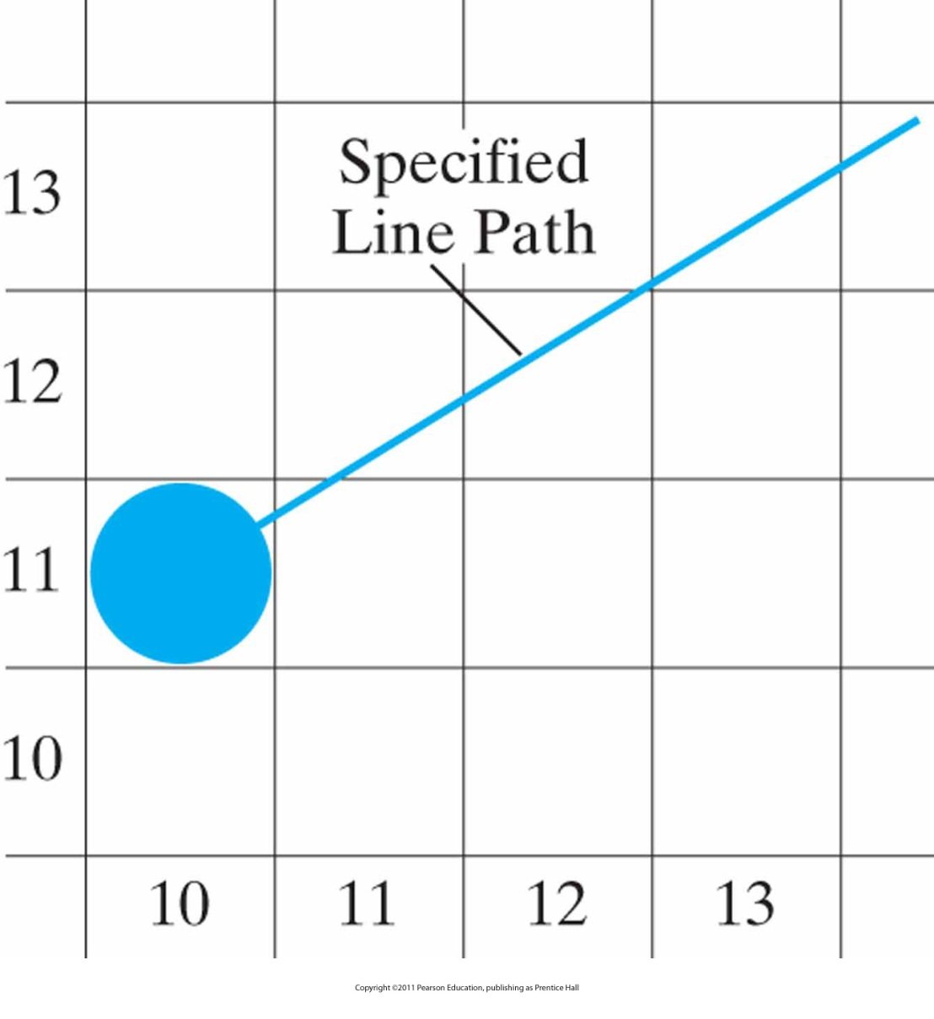
Line Drawing Algorithms (cont.)
A section of a display screen where a straight-line segment is to be plotted, starting from the pixel at column 10 on scan line 11.

Slide 59
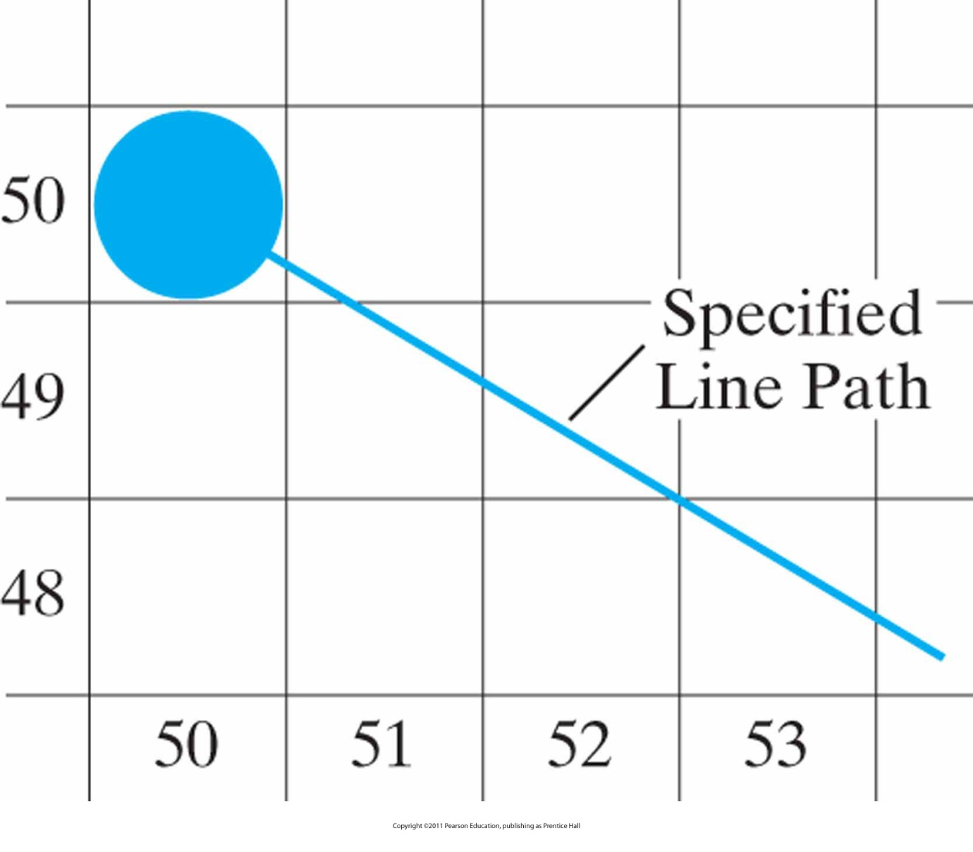
Line Drawing Algorithms (cont.)
A section of a display screen where a negative slope line segment is to be plotted, starting from the pixel at column 50 on scan line 50.

Slide 60
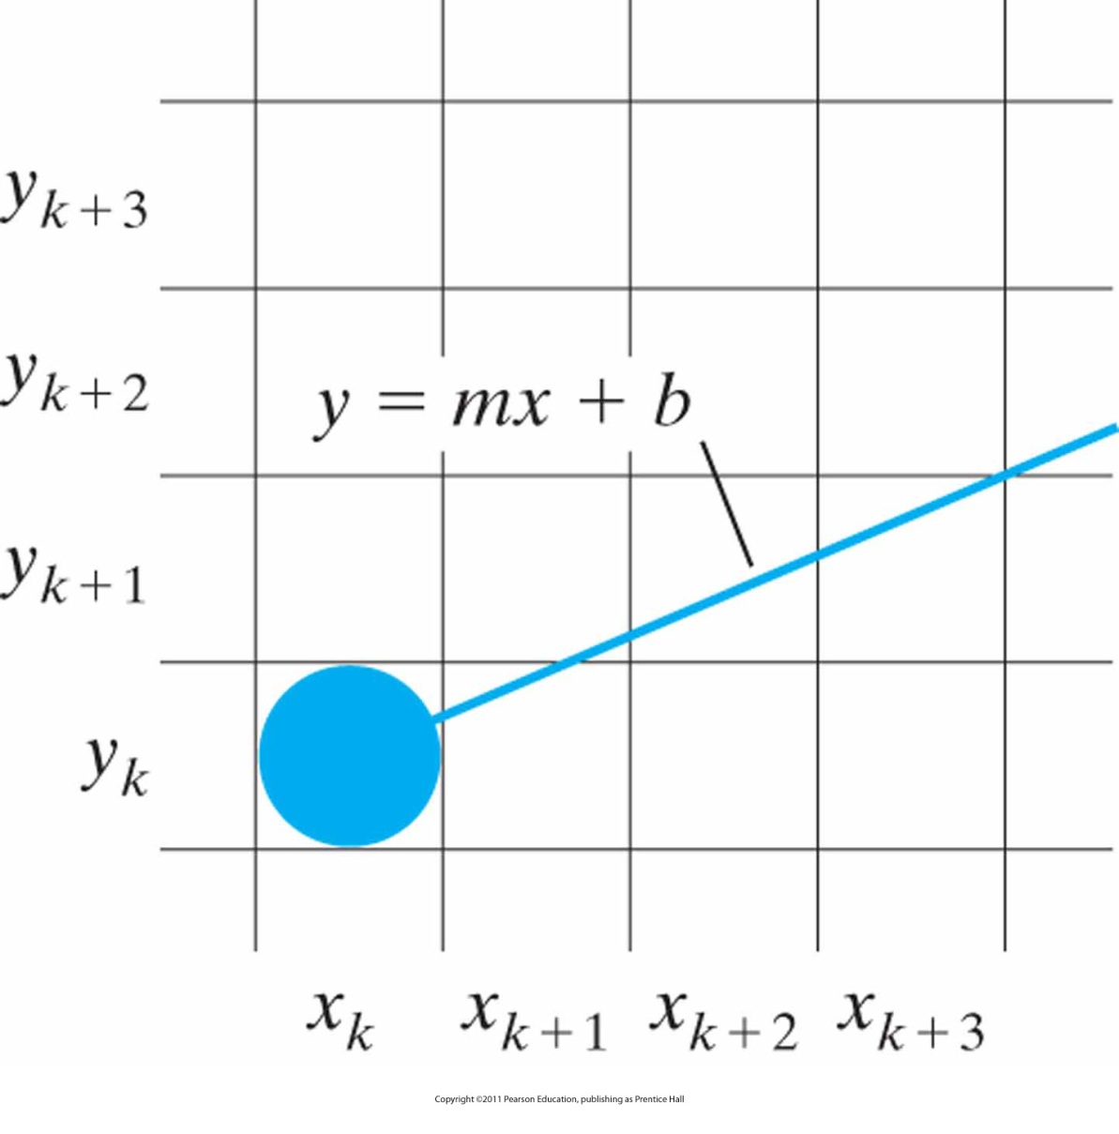
Line Drawing Algorithms (cont.)
A section of the screen showing a pixel in column x_{k} on scan line y_{k} that is to be plotted along the path of a line segment with slope 0 < m < 1.

Slide 61
Line Drawing Algorithms (cont.)
Considering all examples in previous slides:
  Which pixel should be choosen to be displayed?
    Answer: The closest one
  Which one is closer?
    Answer: Calculate the distance to the line and perform an efficiency test
  Fine, but how?
    Answer: Given by Jack Bresenham 1962 (programmer at IBM at that time)

Slide 62
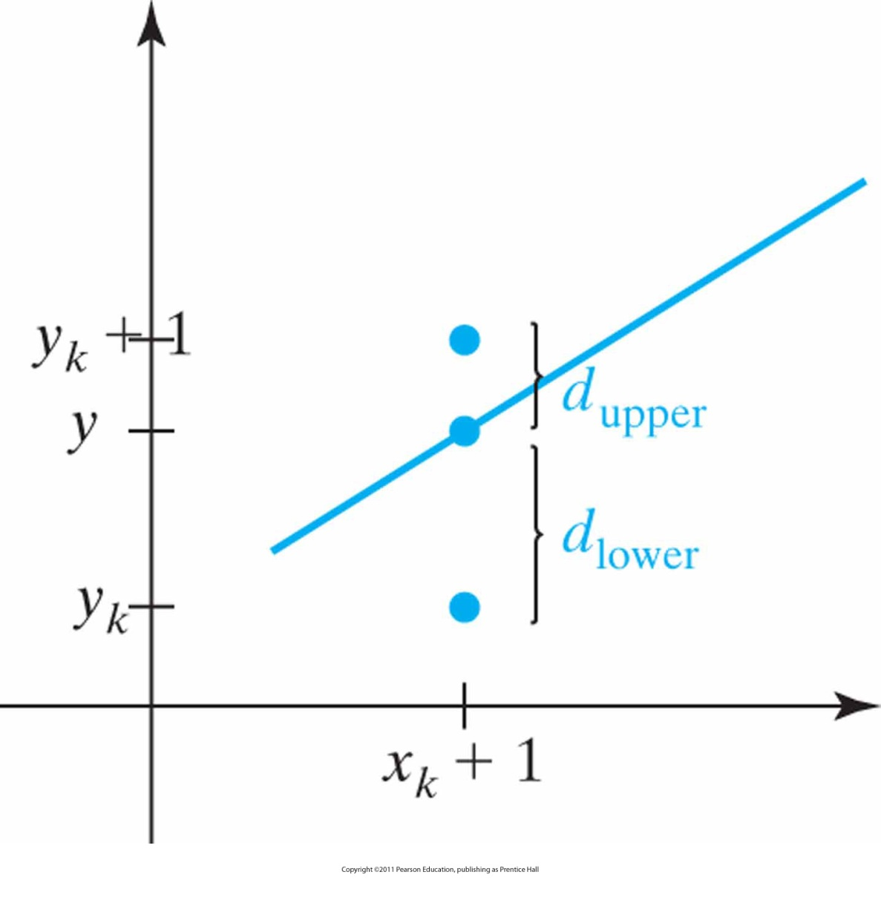
Vertical Distances
Vertical distances between pixel positions and the line y coordinate at sampling position x_{k} + 1.

Slide 63
Bresenham’s Line Drawing Algorithm
Bresenham’s line drawing algorithm (positive slope less than 1)
y = m (x_{k} + 1)+b
d_{lower} = y – y_{k} = m (x_{k} + 1)+b – y_{k}
d_{upper} = (y_{k} + 1) – y = y_{k} + 1 - m (x_{k} + 1)-b
d_{lower} – d_{upper} = 2m(x_{k}+1) – 2y_{k} + 2b –1
decision parameter:
p_{k}= Δx (d_{lower} – d_{upper} )
p_{k} = 2Δy x_{k}- 2Δx y_{k} + c
  sign of p_{k} is the same as sign of d_{lower} – d_{upper}

Slide 64
Bresenham’s Line Drawing Algorithm (cont.)
  Input the two line endpoints and store the left endpoint in (x₀, y₀).
  Set the color for the frame-buffer position (x₀, y₀) – i.e. plot the first point.
  Calculate the constant 2Δy –Δx, and set the starting value for the decision parameter as p₀ = 2Δy –Δx.
  At each x_{k} along the line, from k=0, perform the following test:
  if p_{k}<0, next point to plot is (x_{k} + 1, y_{k}) and p_{k+1} = p_{k} + 2Δy
  otherwise, next point to plot is (x_{k} + 1, y_{k} + 1 )
  and p_{k+1} = p_{k} + 2Δy- 2Δx
  Repeat step 4 Δx - 1 times.

Slide 65
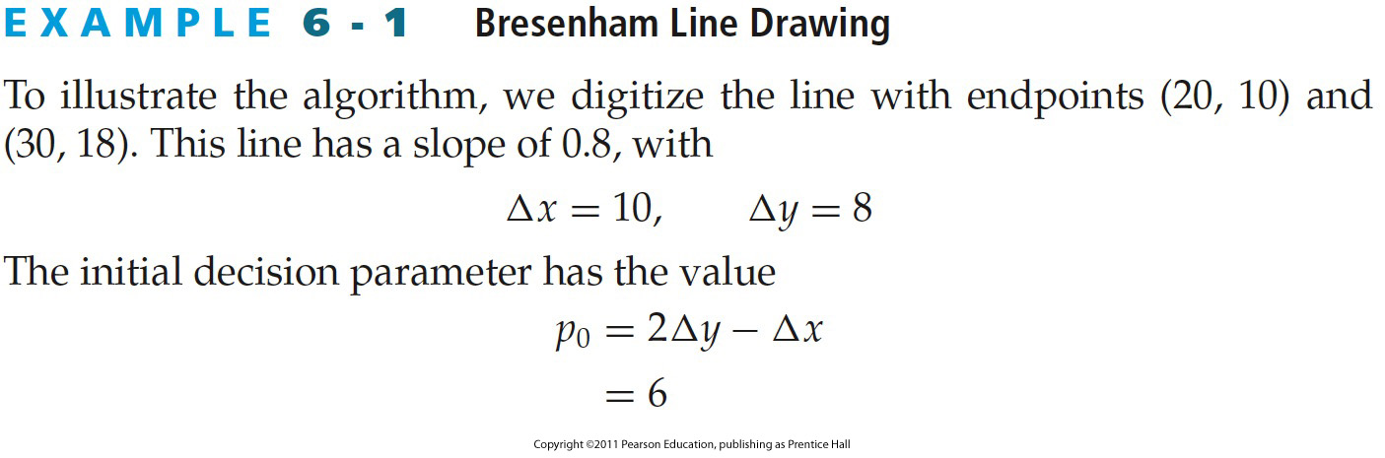
Example 6-1 Bresenham Line Drawing
Example: Bresenham Line Drawing
From HB p. 166-168
Notes:
65

Slide 66
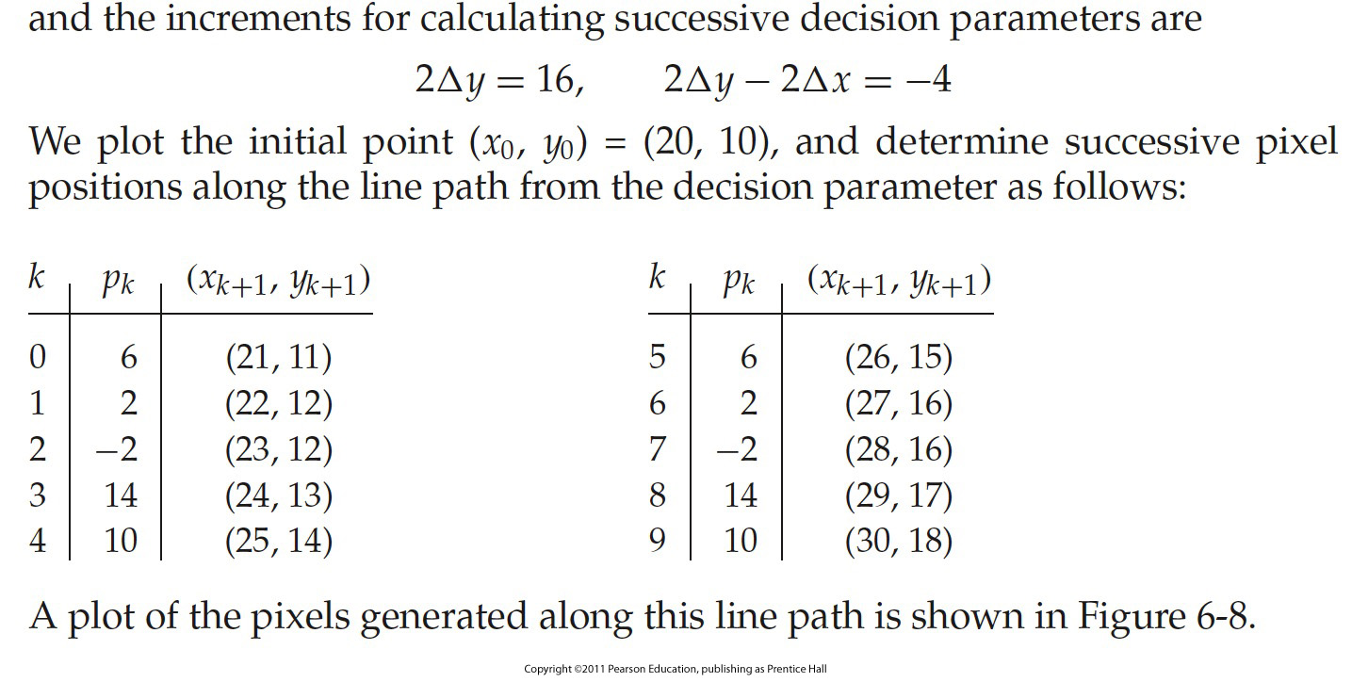
Example: Bresenham Line Drawing (cont.)
From HB p. 166-168
Notes:
66

Slide 67
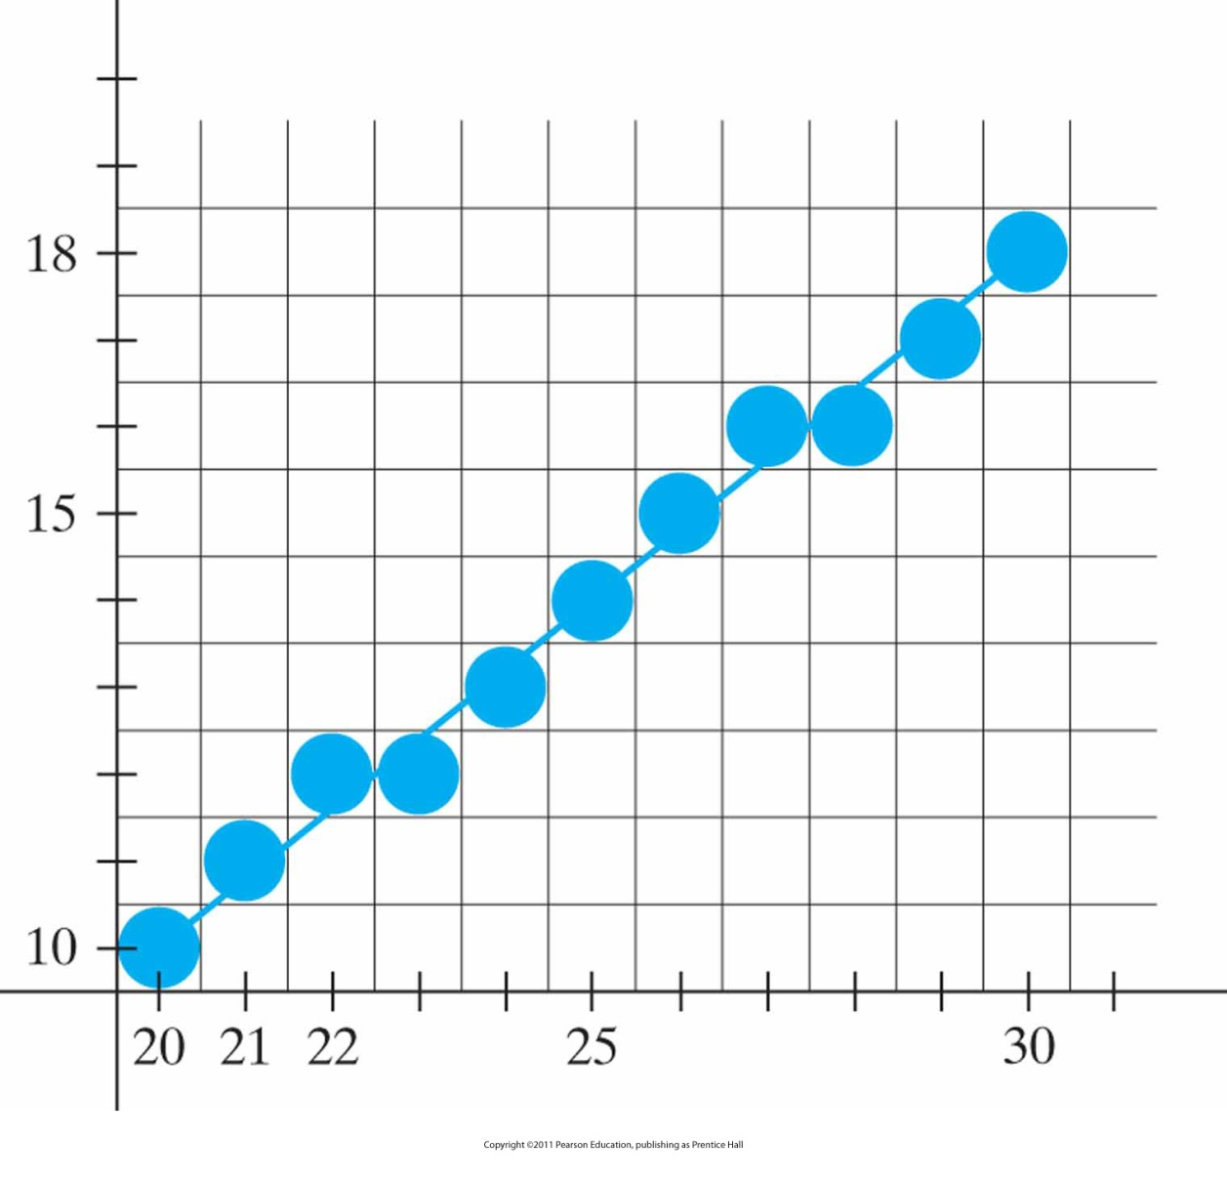
Example: Bresenham Line Drawing (cont.)
Pixel positions along the line path between endpoints (20, 10) and (30, 18), plotted with Bresenham’s line algorithm.

Slide 68
Line Drawing Algorithms (cont.)
All algorithms above are given for a given slope
What about arbitrary slopes?
  Answer: Think about it (Hint: see next slide)

Slide 69
Line Drawing Algorithms (cont.)
To draw a line:
  For 1: step through x, increment y
  For 2: step through y, increment x
  For 3: step through y, decrement x
  For 8: step through x, decrement y
  For 4,5,6,7: swap end coordinates & use the algorithm for the symmetric quadrants
3
2
4
1
5
8
6
7

Slide 70
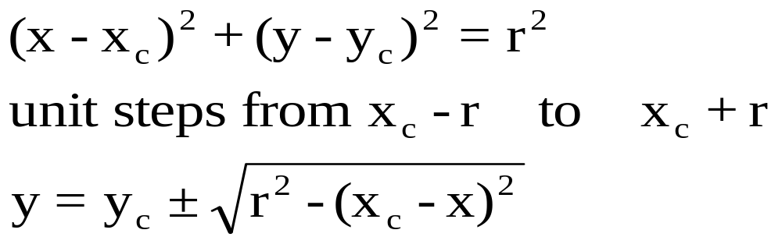
Circle Drawing Algorithms
Properties of circle:

Slide 71
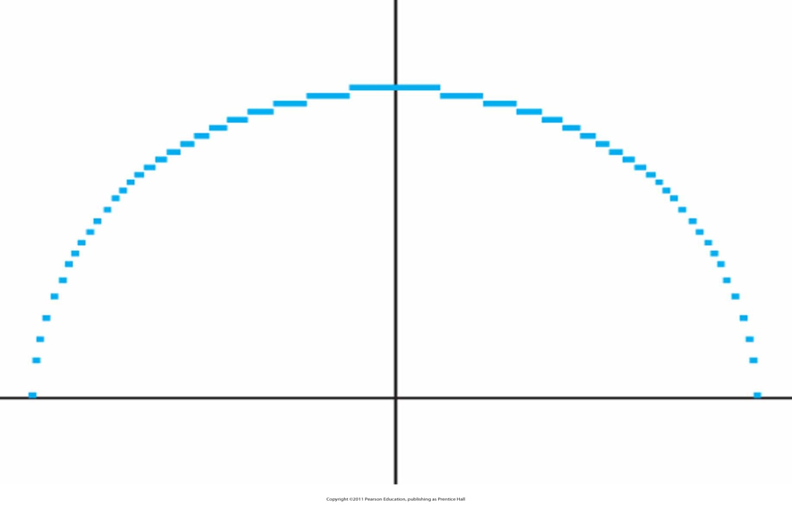
Circle Drawing Algorithms (cont.)
Problems:
  Complexity
  Non-uniform spacing

Slide 72
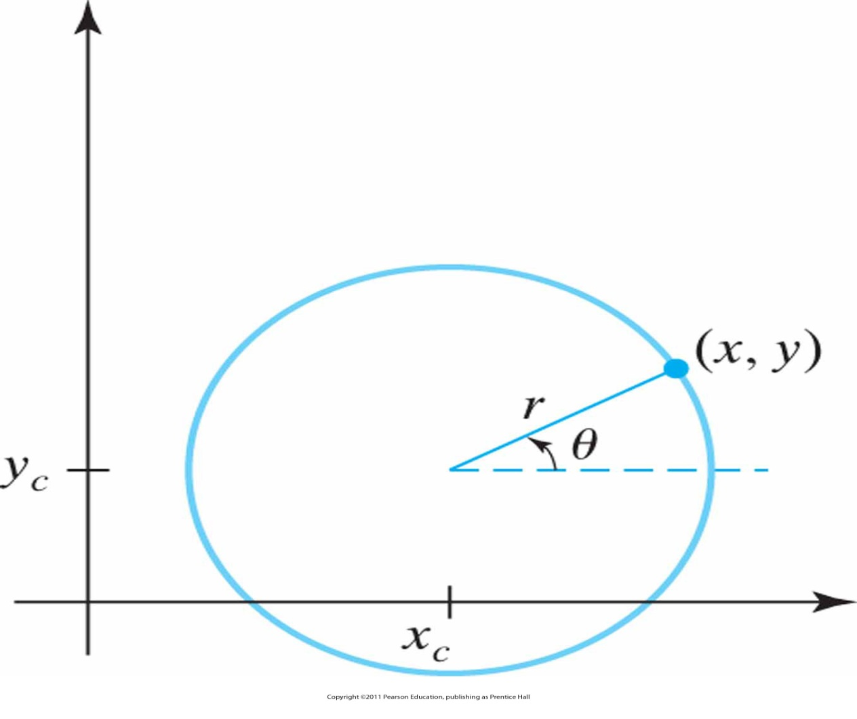
Circle Drawing Algorithms (cont.)
Solutions?:
  Complexity: Adjust spacing by interchanging x and y whenever absolute value of slope of circle is greater than 1 → increasing complexity
  Non-uniform spacing: Using polar coordinates

Slide 73
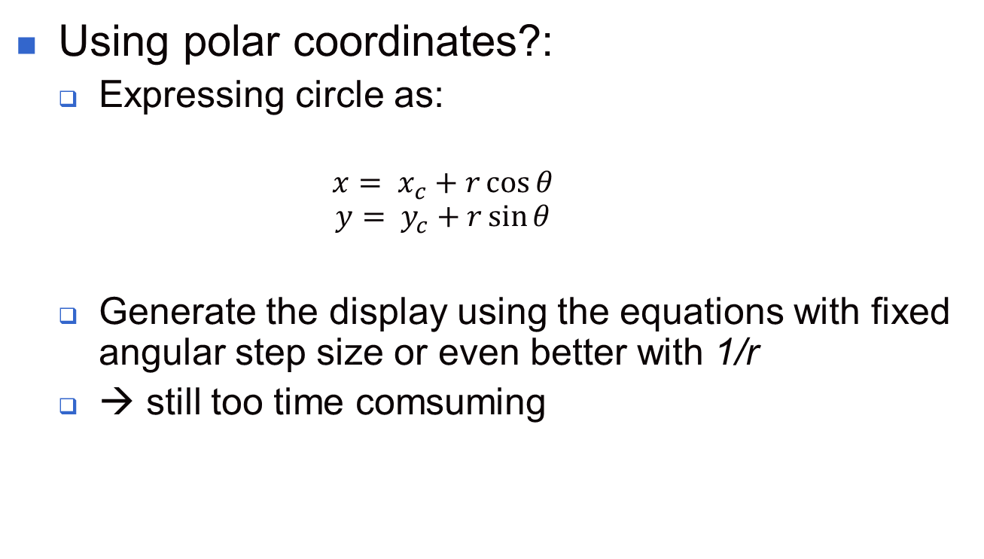
Circle Drawing Algorithms (cont.)

Slide 74
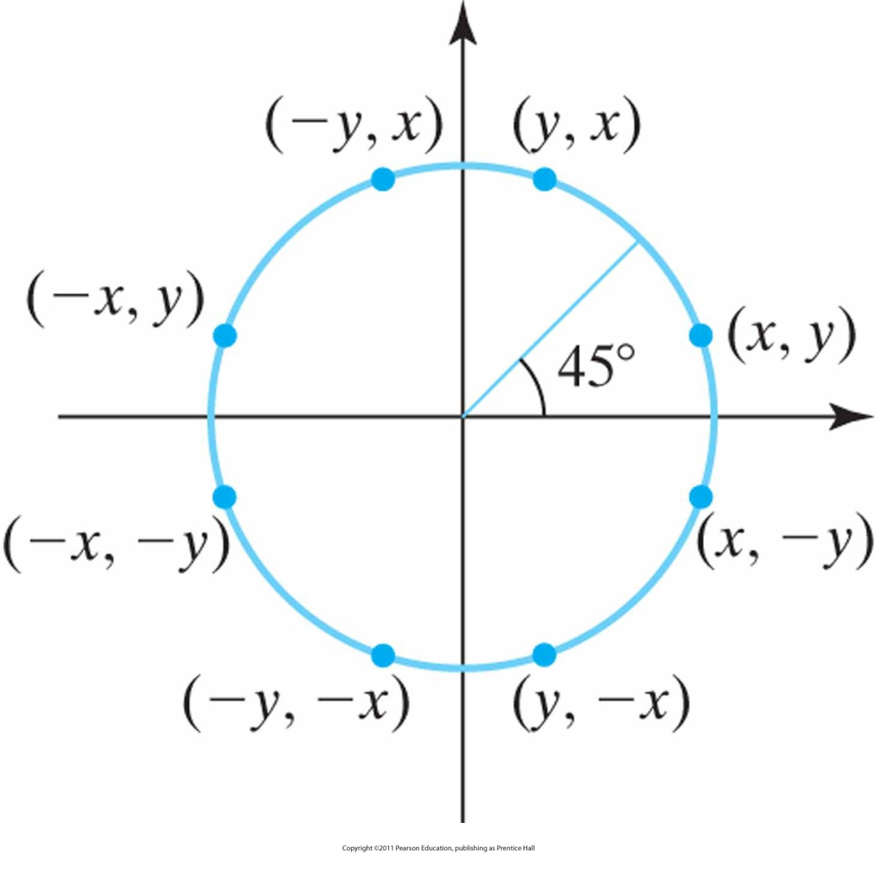
Symmetry of a circle
.Calculation of a circle point (x, y) in one octant yields the circle points shown for the other seven octants.

Slide 75
Using Symmetry
Calculate points in section x = 0 to x = y
In this section |slope| ≤ 1
  at x = 0 → slope = 0
  at x = y → slope = -1
Reduces computational complexity

Slide 76
Midpoint Circle Algorithm
General procedure:
  Calculate pixel positions for a circle with center at (0, 0) (origin)
  Move to proper position, i.e. add x_{c} and y_{c}
  Use decision parameter to determine closest pixel
  For other 7 octants use symmetry

Slide 77
Midpoint Circle Algorithm (cont.)
In other terms:
Principle of the midpoint algorithm
  Reason from octants of a circle centered in (0,0), then find the remaining octants by symmetry, then translate to (x_{c}, y_{c}).
  The circle function is the decision parameter.
  Calculate the circle function for the midpoint between two pixels.

Slide 78

Midpoint Circle Algorithm (cont.)
Circle function:
$$f_{circ}(x,y)=x^{2}+y^{2}−r^{2}$$
If any point (x,y) is inside the circle, f_{circ}(x,y)<0
If any point (x,y) is on the circle, f_{circ}(x,y)=0
If any point (x,y) is outside the circle, f_{circ}(x,y)>0

Slide 79
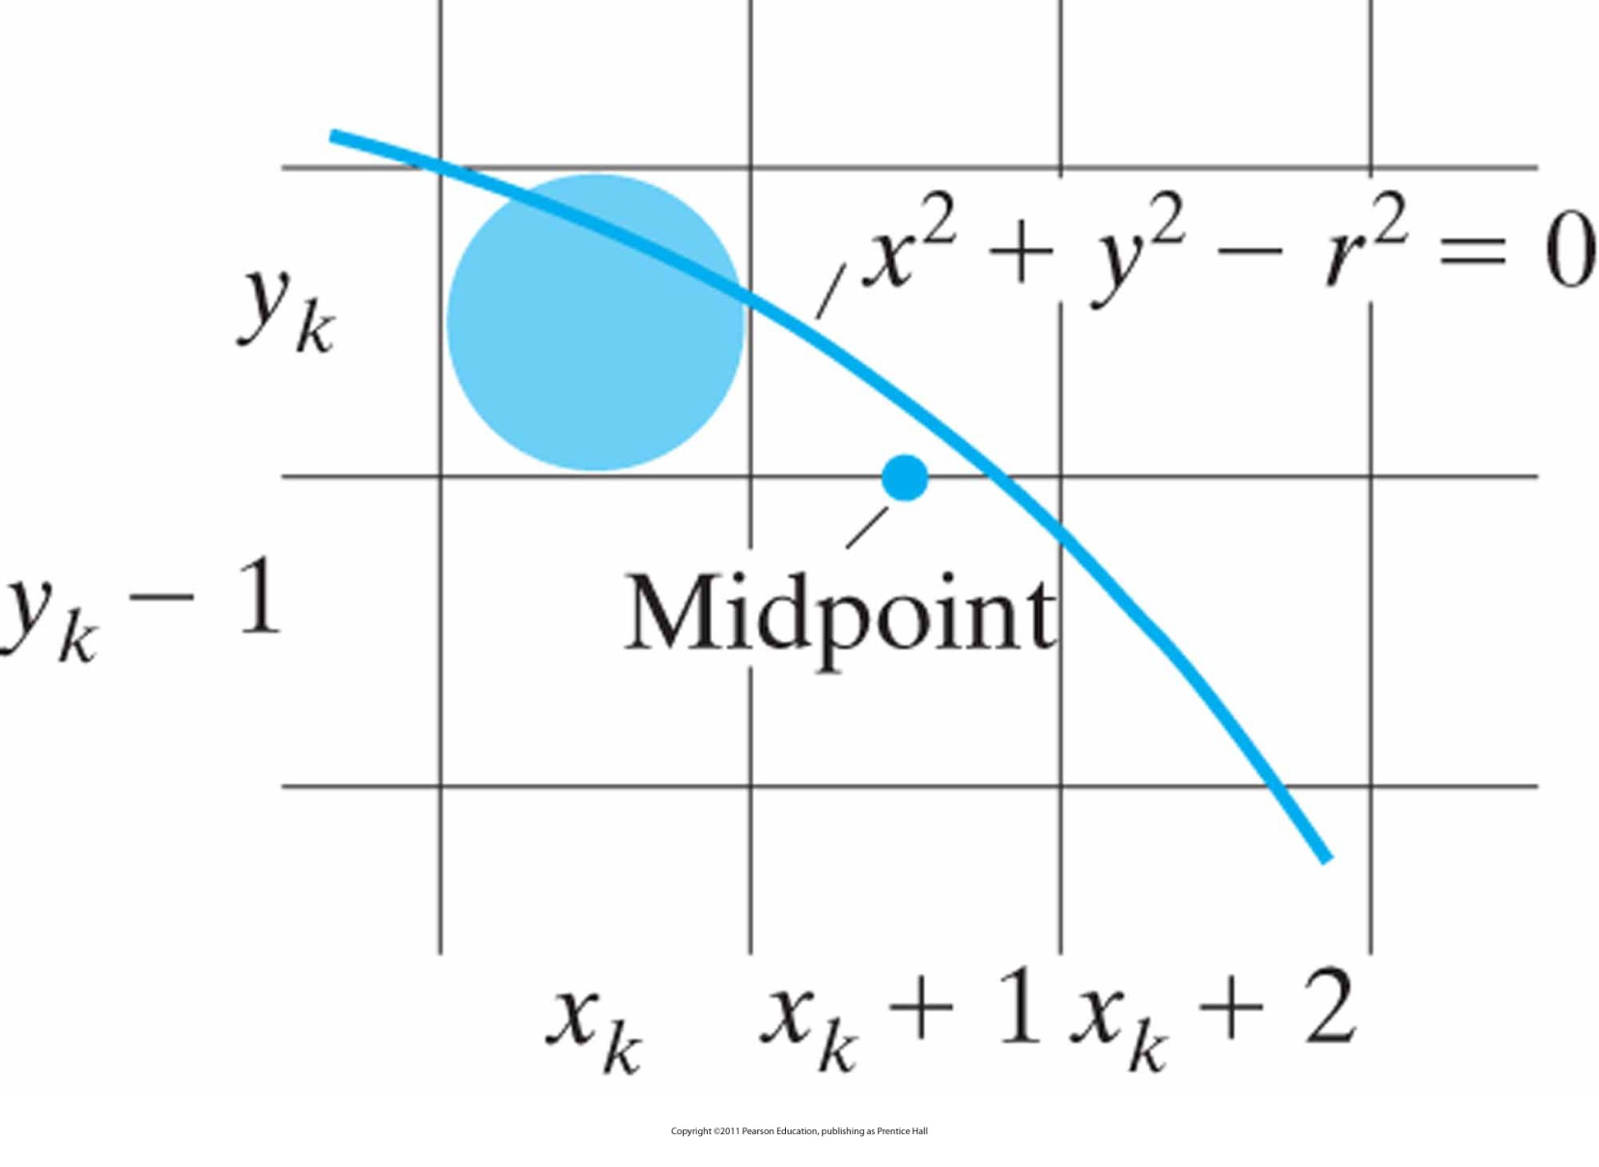
Midpoint
Candidate pixels at sampling position x_{k} + 1 along a circular path

Slide 80
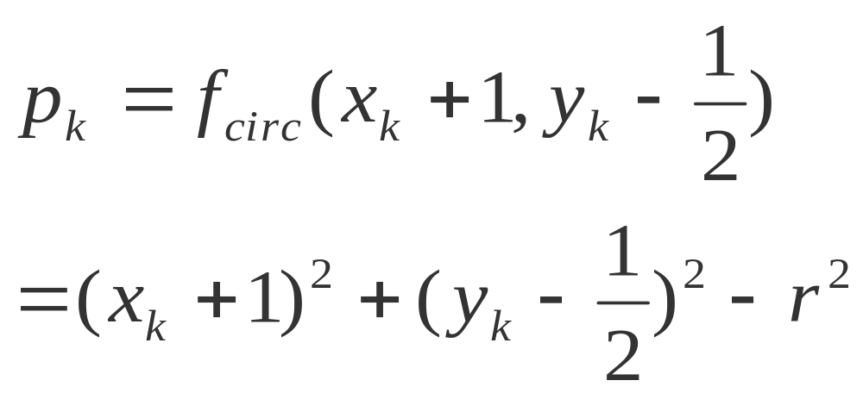
Midpoint Circle Algorithm (cont.):
Decision parameter
If p_{k}<0, midpoint is inside the circle and y_{k} is closer -> we select y_{k}
If p_{k}>=0, midpoint is outside or on the circle and y_{k}-1 is closer -> we select y_{k}-1

Slide 81
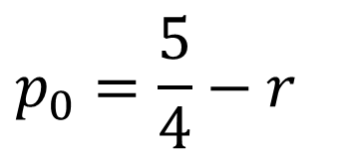
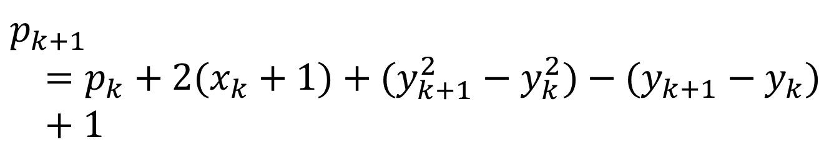
Midpoint Circle Algorithm (cont.):
Decision parameter
We can find a recursive expression for the next decision parameter as:
$$p_{k+1}=p_{k}+2(x_{k}+1)+(y_{k+1}^{2}−y_{k}^{2})−(y_{k+1}−y_{k})+1$$
We can obtain the initial decision parameter as:
$$p_{0}=\frac{5}{4}−r$$

Slide 82
Midpoint Circle Algorithm (cont.)
Input radius r and circle center (x_{c}, y_{c}), then set the coordinates for the first point on the circumference of a circle centered on the origin as (x₀, y₀) = (0, r).
Calculate the initial value of the decision parameter as p₀ = 5/4 – r (1 – r if an integer)
At each x_{k}, from k=0, perform the following test:
  if p_{k}<0, next point to plot along the circle centered on (0,0) is (x_{k+1}, y_{k}) and p_{k+1} = p_{k} + 2 x_{k+1} + 1
  otherwise, next point to plot is (x_{k}+ 1, y_{k} - 1)
  and p_{k+1} = p_{k} + 2 x_{k+1} + 1 - 2 y_{k+1}
  where 2 x_{k+1} = 2 x_{k} + 2, and 2 y_{k+1} = 2 y_{k} - 2

Slide 83
Midpoint Circle Algorithm (cont.)
Determine symmetry points in the other seven octants.
Move each calculated pixel position (x, y) onto the circular path centered at (x_{c}, y_{c}) and plot the coordinate values:
x = x + x_{c}, y = y + y_{c}
Repeat steps 3 through 5 until x >= y.

Slide 84

Example: Midpoint Circle Drawing
From HB p. 175-177
Notes:
84

Slide 85

Example: Midpoint Circle Drawing (cont.)
From HB p. 175-177
Notes:
85

Slide 86

Example: Midpoint Circle Drawing (cont.)
Pixel positions (solid circles) along a circle path centered on the origin and with radius r = 10, as calculated by the midpoint circle algorithm. Open (“hollow”) circles show the symmetry positions in the first quadrant.

Slide 87
General Curve Functions
Ellipses can be drawn similarly using a modified midpoint algorithm.
Similar algorithms can be used to display polynomials, exponential functions, trigonometric functions, conics, probability distributions, etc.

Slide 88
Ellipse Generating Algorithms
What is an ellipse?
An elongated circle
Describe as a modified circle whose radius varies from a maximum value in one direction to a minimum value in the perpendicular direction
Major and minor axis
Two foci

Slide 89

An Ellipse
Generated about foci F₁ and F₂

Slide 90

An Ellipse (cont.)

Slide 91

An Ellipse (cont.)
Centered at (x_{c}, y_{c}) with semimajor axis r_{x} and semiminor axis r_{y}.

Slide 92

The Bounding Circle
and eccentric angle θ for an ellipse with r_{x} > r_{y} .

Slide 93
Midpoint Ellipse Algorithm
General procedure (same like circle):
  Determine curve positions for an ellipse with center at (0, 0) (origin)
  Move to proper position, i.e. add x_{c} and y_{c}
  If required perform rotation
  Use decision parameter to determine closest pixel
  For other 3 quadrants use symmetry
3 Quadrants? In circle 7 octants!
So what is wrong?
Warning: Symmetry for ellipse only in quadrants

Slide 94

Symmetry of an Ellipse
Calculation of a point (x, y) in one quadrant yields the ellipse points shown for the other three quadrants.

Slide 95

Ellipse Processing Regions
Over region 1, the magnitude of the ellipse slope is less than 1.0; over region 2, the magnitude of the slope is greater than 1.0.

Slide 96

Midpoint Ellipse Algorithm (cont.)
Ellipse function:
If any point (x,y) is inside the ellipse, f_{ellipse}(x,y)<0
If any point (x,y) is on the ellipse, f_{ellipse}(x,y)=0
If any point (x,y) is outside the ellipse, f_{ellipse}(x,y)>0

Slide 97

Midpoint
Between candidate pixels at sampling position x_{k} + 1 along an elliptical path.

Slide 98

Midpoint (cont.)
Between candidate pixels at sampling position y_{k} − 1 along an elliptical path.

Slide 99

Midpoint Ellipse Algorithm (cont.): Decision Parameter
We can find a recursive expression for the next decision parameter as:
$$p1_{k+1}=p1_{k}+2r_{y}^{2}(x_{k}+1)+r_{y}^{2}+r_{x}^{2}\left[(y_{k+1}−\frac{1}{2})^{2}−(y_{k}−\frac{1}{2})^{2}\right]$$
We can obtain the initial decision parameter as:
$$p1_{0}=r_{y}^{2}−r_{x}^{2}r_{y}+\frac{1}{4}r_{x}^{2}$$

Slide 100

Midpoint Ellipse Algorithm (cont.): Decision Parameter
We can find a recursive expression for the next decision parameter as:
$$p2_{k+1}=p2_{k}+2r_{x}^{2}(y_{k}−1)+r_{x}^{2}+r_{y}^{2}\left[(x_{k+1}+\frac{1}{2})^{2}−(x_{k}+\frac{1}{2})^{2}\right]$$
We can obtain the initial decision parameter as:
$$p2_{0}=r_{y}^{2}(x_{0}+\frac{1}{2})^{2}+r_{x}^{2}(y_{0}−1)^{2}−r_{x}^{2}r_{y}^{2}$$

Slide 101

Midpoint Ellipse Algorithm (cont.): Decision Parameter
Incrementing the decision parameter:
$$increment=\left\{\begin{matrix}2r_{y}^{2}x_{k+1}+r_{y}^{2}, \text{if} p1_{k}<0 \\ 2r_{y}^{2}x_{k+1}+r_{y}^{2}−2r_{x}^{2}y_{k+1}, \text{if} p1_{k}≥0\end{matrix}\right.$$

Slide 102


Midpoint Ellipse Algorithm (cont.): Region 1-Region 2?
When to move from region 1 to region 2?
Answer: Decide on slope
But how to calculate slope?
Answer:
At the boundary dy / dx = -1.0
If move from region1 to region 2

Slide 103





Midpoint Ellipse Algorithm (cont.)
Input radii r_{x}, r_{y} and ellipse center (x_{c}, y_{c}), and obtain the first point on the origin as (x₀, y₀) = (0, r_{y}).
Calculate the initial value of the decision parameter in region 1 as
At each x_{k} in region 1, from k=0, perform the following test:
  if p1_{k}<0, next point to plot along the ellipse centered on (0,0) is (x_{k+1}, y_{k}) and
  otherwise, next point to plot is (x_{k}+ 1, y_{k} - 1)
  and
  with
  and continue until
$$p1_{0}=r_{y}^{2}−r_{x}^{2}r_{y}+\frac{1}{4}r_{x}^{2}$$

Slide 104



Midpoint Ellipse Algorithm (cont.)
Calculate the initial value of the decision parameter in region 1 as
    (x₀, y₀) is last calculated point from region 1
At each y_{k} position in region 2, starting at k=0, perform the following test:
      if p2_{k}>0, next point to plot along the ellipse centered on (0,0) is (x_{k}, y_{k}-1) and
      otherwise, next point to plot is (x_{k}+ 1, y_{k} - 1)
      and
      and continue until y = 0
$$p2_{0}=r_{y}^{2}{\left(x_{0}+\frac{1}{2}\right)}^{2}+r_{x}^{2}{\left(y_{0}−1\right)}^{2}+r_{x}^{2}r_{y}^{2}$$

Slide 105
Midpoint Ellipse Algorithm (cont.)
Determine symmetry points in the other three quadrants.
Move each calculated pixel position (x, y) onto the elliptical path centered at (x_{c}, y_{c}) and plot the coordinate values: x = x + x_{c}, y = y + y_{c}

Slide 106

Example: Midpoint Ellipse Drawing
From HB p. 182-184
Notes:
106

Slide 107

Example: Midpoint Ellipse Drawing (cont.)
From HB p. 182-184
Notes:
107

Slide 108

Example: Midpoint Ellipse Drawing (cont.)
From HB p. 182-184
Notes:
108

Slide 109

Example: Midpoint Ellipse Drawing (cont.)
Pixel positions along an elliptical path centered on the origin with r_{x} = 8 and r_{y} = 6, using the midpoint algorithm to calculate locations within the first quadrant

Slide 110
Fill-Area Algorithms
Standard output primitives – solid, pattern, hollow
Fill primitive – solid circle, rectangle, triangle, …
Two ways of filling:
  Find where each scanline overlaps area (scan-line fill)
  Start from interior position and paint outward until boundary is reached
Used in general purpose packages and paint programs.

Slide 111
Area Filling
General idea:
  Determine boundary intersection
  Fill interior

Slide 112
Scan-line Polygon-fill Algorithm
For convex polygons.
  Determine the intersection positions of the boundaries of the fill region with the screen scan lines.
A
B
y
F
C
E
D

Slide 113
Scan-line Polygon-fill Algorithm (cont.)
For convex polygons.
  Pixel positions between pairs of intersections between scan line and edges are filled with color, including the intersection pixels.
A
B
y
F
C
E
D

Slide 114
Scan-line Polygon-fill Algorithm (cont.)
For concave polygons.
  Scan line may intersect more than once:
    Intersects an even number of edges
    Even number of intersection vertices yields to pairs of intersections, which can be filled as previously
A
C
B
y
D
G
F
E

Slide 115
Scan-line Polygon-fill Algorithm (cont.)
For concave polygons.
  Scan line may intersect more than once:
    Intersects an even number of edges
    Even number of intersection vertices yields to pairs of intersections, which can be filled as previously
A
C
B
D
y
G
F
E

Slide 116
Scan-line Polygon-fill Algorithm (cont.)
For concave polygons.
  Scan line may intersect more than once:
    Intersects an odd number of edges
    Not all pairs are interior: (3,4) is not interior
A
C
B
y
1
2
3
4
5
G
D
F
E

Slide 117

Scan-line Polygon-fill Algorithm (cont.)
Interior pixels along a scan line passing through a polygon fill area.

Slide 118

Scan-line Polygon-fill Algorithm (cont.)
Intersection points along scan lines that intersect polygon vertices. Scan line y generates an odd number of intersections, but scan line y’ generates an even number of intersections that can be paired to identify correctly the interior pixel spans.

Slide 119
Scan-line Polygon-fill Algorithm (cont.)
For concave polygons.
  Generate 2 intersections when at a local minimum, else generate only one intersection.
  Algorithm to determine whether to generate one intersection or 2 intersections.
    If the y-coordinate is monotonically increasing or decreasing, decrease the number of vertices by shortening the edge.
    If it is not monotonically increasing or decreasing, leave the number of vertices as it is.

Slide 120
Scan-line Polygon-fill Algorithm (cont.)
scan line
y+1
y
y-1
y decreasing:
decrease by 1
y increasing:
decrease by 1
The y-coordinate of the upper
endpoint of the current edge
is decreased by 1.
The y-coordinate of the upper
endpoint of the next edge
is decreased by 1.

Slide 121
Scan-line Polygon-fill Algorithm (cont.)
In previous slide edges are shortened and vertices are counted only once because edges are adjusted
But how to do it?
Answer: Using coherence properties

Slide 122

Scan-line Polygon-fill Algorithm (cont.)
Coherence properties: Certain properties of one part of the scene related to properties of other parts, e.g. slope
Sequential fill algorithm with incremental coordinate calculations

Slide 123

Using Coherence Properties
Two successive scan lines intersecting a polygon boundary. At both positions same slopes

Slide 124
Fill-Area Algorithms
Polygon fill-in algorithm:
  store the edges in a sorted edge table where each entry corresponds to a scan line (sorted on the smallest y value on each edge)
    For sorting, e.g. Bucket sort
  shorten the edges that have vertex-intersection issues by processing scan lines from bottom of polygon to top (active edge list)
  for each scan line, fill-in the pixel spans for each pair of x intercepts.

Slide 125

Example: Fill-Area Algorithms
__
A polygon and its sorted edge table, with edge DC shortened by one unit in the y direction.

Slide 126
Other Fill-Area Algorithms
For areas with irregular boundaries
  Boundary-fill algorithm
  start at an inside position and paint color point by point until reaching the boundary (of different color):
void boundaryFill4 (int x, int y, int fillColor, int borderColor)
{
int interiorColor;
/* Set current color to fillColor, then perform following oprations. */
getPixel (x, y, interiorColor);
if ((interiorColor != borderColor) && (interiorColor != fillColor)) {
setPixel (x, y); // Set color of pixel to fillColor.
boundaryFill4 (x + 1, y , fillColor, borderColor);
boundaryFill4 (x - 1, y , fillColor, borderColor);
boundaryFill4 (x , y + 1, fillColor, borderColor);
boundaryFill4 (x , y - 1, fillColor, borderColor)
}
}

Slide 127
Boundary-Fill Algorithm
General idea:
  Start at position (x, y)
  Test color of neighboring pixels
  If neighbor pixel’s color is not boundary color, change color
  Proceed until all pixels processed

Slide 128

Neighbors?
4-connected area
8-connected area
Hollow circles represent pixels to be tested from the current test position, shown as a solid color.

Slide 129
Boundary Fill: 4-connected vs. 8-connected
_{Start point}
4-connected
8-connected

Slide 130

Implementing Boundary-Fill
Boundary fill across pixel spans for a 4-connected area:
Initial scan line with a filled pixel span, showing the position of the initial point (hollow) and the stacked positions for pixel spans on adjacent scan lines.
Filled pixel span on the first scan line above the initial scan line and the current contents of the stack.
Filled pixel spans on the first two scan lines above the initial scan line and the current contents of the stack.
Completed pixel spans for the upper-right portion of the defined region and the remaining stacked positions to be processed.

Slide 131
Other Fill-Area Algorithms (cont.)
For areas with irregular boundaries
  Flood-fill algorithm
  start at an inside position and reassign all pixel values currently set to a given interior color with the desired fill color.
void floodFill4 (int x, int y, int fillColor, int interiorColor)
{
int color;
/* Set current color to fillColor, then perform following operations. */
getPixel (x, y, color);
if (color = interiorColor) {
setPixel (x, y); // Set color of pixel to fillColor.
floodFill4 (x + 1, y, fillColor, interiorColor);
floodFill4 (x - 1, y, fillColor, interiorColor);
floodFill4 (x, y + 1, fillColor, interiorColor);
floodFill4 (x, y - 1, fillColor, interiorColor)
}
}

Slide 132
Flood-Fill Algorithm
Set pixel to fill color value until bounds.
  An interior point (x, y)
  A boundary color
  A fill color
_{Boundary color}
_{Fill color}
_{Interior point (x, y)}

Slide 133
Implementation of Antialiasing
(Remember) Aliasing: Information loss due to low-frequency sampling (undersampling)
How to avoid it?
Answer: Using Nyquist sampling frequency/rate
or
Answer: Using Nyquist sampling interval

Slide 134
Nyquist?
Harry Nyquist: 7. February 1889 in Nilsby, Sweden; † 4. April 1976 in Harlingen, Texas
Claude Elwood Shannon: 30. April 1916 in Petoskey, Michigan; † 24. Februar 2001 in Medford, Massachusetts
Nyquist-Shannon-Sample Theorem: Set the sampling frequency to at least twice that of the highest frequency occurring in the object
Nyquist sampling frequency: f_{s} = 2f_{max}
Nyquist sampling interval: ∆x = ∆x_{cycle} / 2

Slide 135

Sampling
Sampling the periodic shape in (a) at the indicated positions produces the aliased lower-frequency representation in (b).

Slide 136
Antialiasing Methods
Supersampling (postfiltering): Sample at hşgh resolution (at subpixel level) but show on lower resolution
Area sampling (prefiltering): Antialiasing by computing overlap areas
Pixel phasing (for raster objects): Shift display location of pixel areas

Slide 137
Supersampling
General idea (for straight line segments):
  Divide each pixel into a number subpixels
  Count number of subpixels overlapping the line path
  Set intensity of each pixel to a value proportional to subpixel count

Slide 138

Example: Supersampling
Supersampling subpixel positions along a straight-line segment whose left endpoint is at screen coordinates (10, 20).

Slide 139
Weighting Subpixels
Multiply each pixel with a weighted mask
₁
₂
₁
₂
₄
₂
₁
₂
₁
_{Subpixel}
_{weighting}
_{mask}

Slide 140
Areasampling
General idea (for straight line segments):
  Set pixel intensities proportional to the area of overlap of the pixel with the finite-width line

Slide 141

Example: Areas Sampling
Supersampling subpixel positions in relation to the interior of a line of finite width.

Slide 142
Filtering Techniques
Similar to weighting but here continuous weighting surface (filter function)
Multiply each pixel with the function
What kind of function?
Answer: Next slide

Slide 143

Common Filter Functions
Filters used to antialias line paths. The volume of each filter is normalized to 1.0, and the height gives the relative weight at any subpixel position.

Slide 144

Next Lecture
Interactive Input Methods
Attributes of Output Primitives and Algorithms
144
Notes:
144

Slide 145
References
Donald Hearn, M. Pauline Baker, Warren R. Carithers, “Computer Graphics with OpenGL, 4th Edition”; Pearson, 2011
Sumanta Guha, “Computer Graphics Through OpenGL: From Theory to Experiments”, CRC Press, 2010
Edward Angel, “Interactive Computer Graphics. A Top-Down Approach Using OpenGL”, Addison-Wesley, 2005
Attributes of Output Primitives and Algorithms
145

