Slide 1


CSE306 Operating Systems
Lecture #4
Memory Management
Prepared & Presented by Asst. Prof. Dr. Samsun M. BAŞARICI

Slide 2
Topics covered
Memory as a valuable resource
Memory management requirements
Interplay of HW and SW
Memory management issues
  Paging
  Segmentation
  Partioning
  Swapping
  …

Slide 3
Memory
Paraphrase of Parkinson’s Law, ‘‘Programs expand to fill the memory available to hold them.’’
Average home computer nowadays has 10,000 times more memory than the IBM 7094, the largest computer in the world in the early 1960s

Slide 4
Memory Management
Ideally programmers want memory that is
  large
  fast
  non volatile
Memory hierarchy
  small amount of fast, expensive memory – cache
  some medium-speed, medium price main memory
  gigabytes of slow, cheap disk storage
Memory manager handles the memory hierarchy

Slide 5
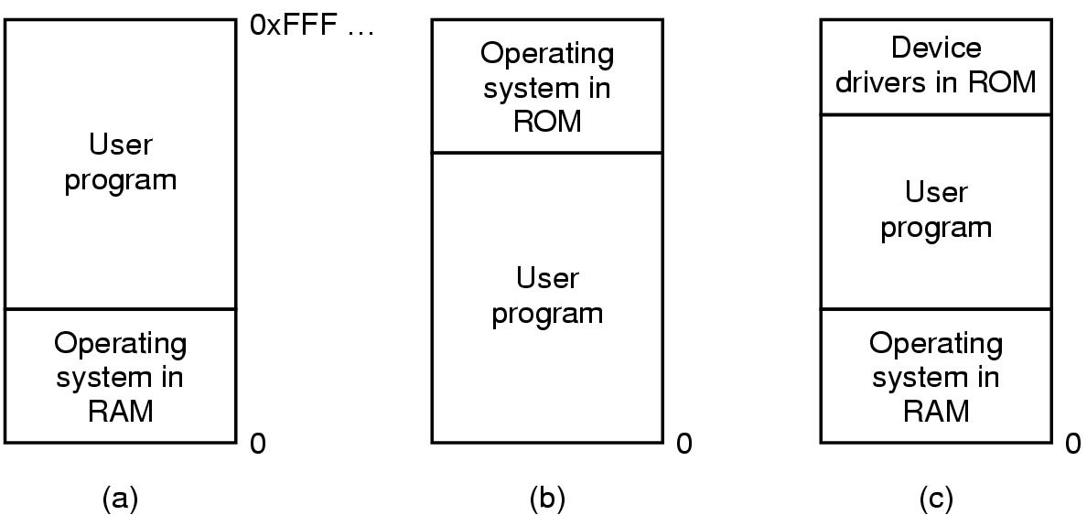
No Memory Abstraction
Three simple ways of organizing memory with an operating system and one user process.

Slide 6
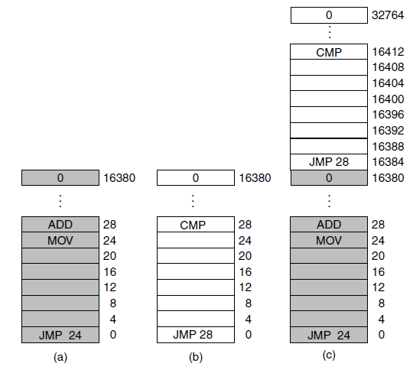
Running Multiple Programs Without a Memory Abstraction
Illustration of the relocation problem:
(a) A 16-KB program.
(b) Another 16-KB program.
(c) The two programs loaded consecutively into memory.

Slide 7
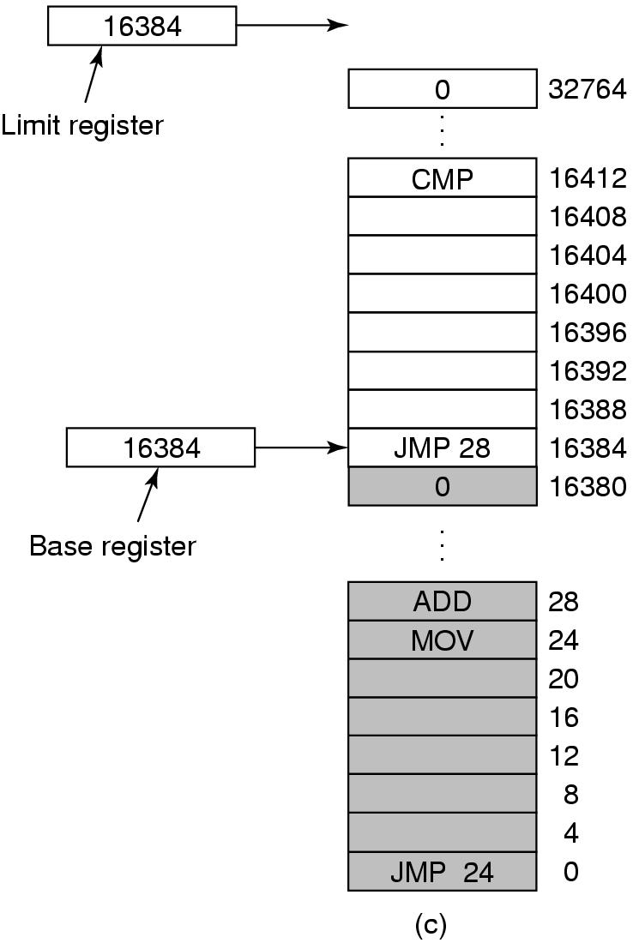
Base and Limit Registers
Base and limit registers can be used to give each process a separate address space.

Slide 8
Swapping
A process can be swapped temporarily out of memory to a backing store, and then brought back into memory for continued execution.
Backing store — fast disk large enough to accommodate copies of all memory images for all users; must provide direct access to these memory images.
Roll out, roll in — swapping variant used for priority­based scheduling algorithms; lower­priority process is swapped out so higher­priority process can be loaded and executed.
Major part of swap time is transfer time; total transfer time is directly proportional to the amount of memory swapped.
Modified versions of swapping are found on many systems, i.e., UNIX and Microsoft Windows.

Slide 9
Schematic View of Swapping
Operating
System
Swap
Out
Process
P₁
Swap
In
Process
P₂
User
Space

Slide 10
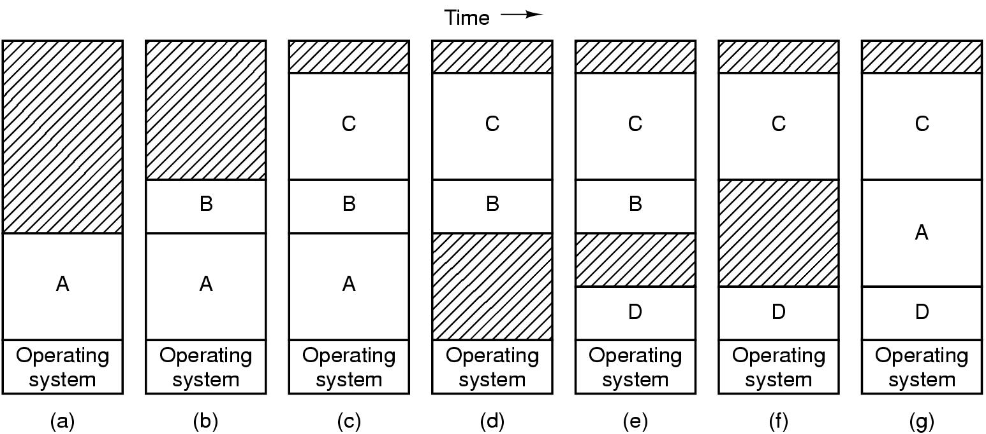
Swapping (1)
Memory allocation changes as processes come into memory and leave it. The shaded regions are unused memory.

Slide 11
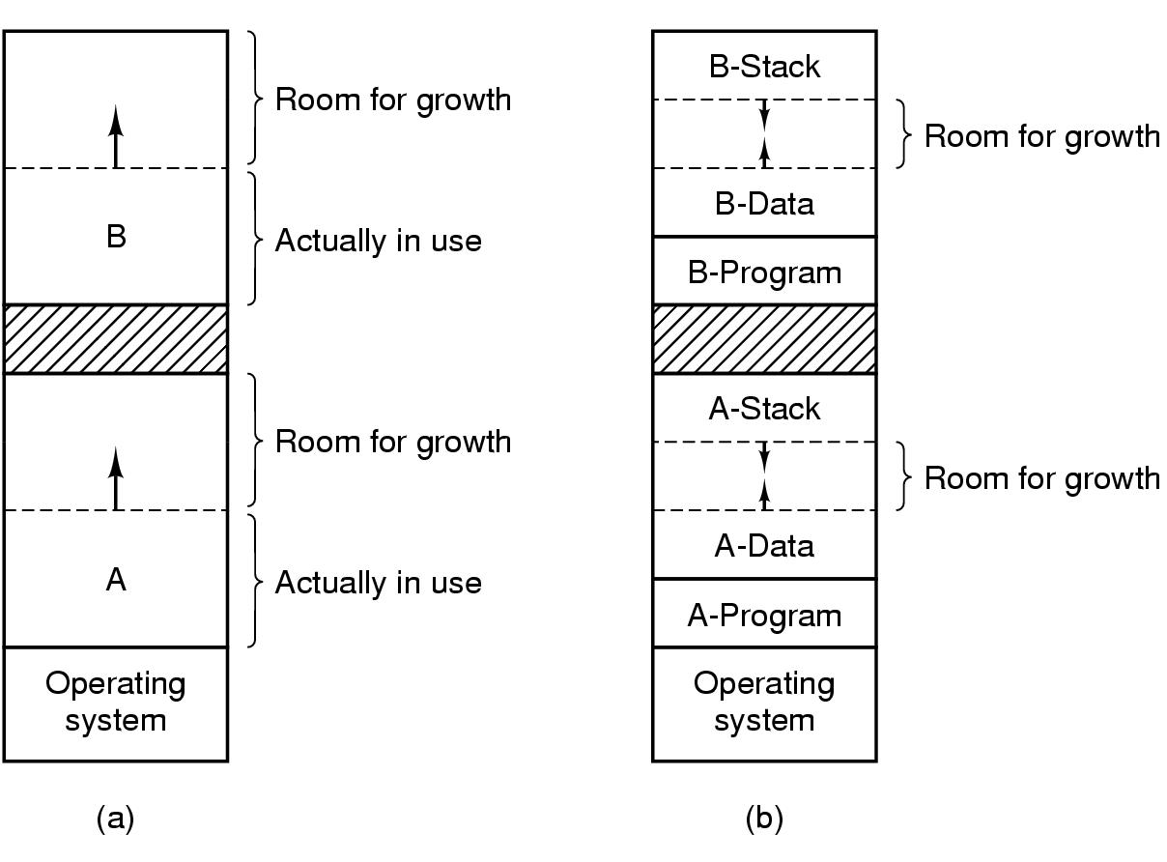
Swapping (2)
Allocating space for growing data segment.
(b) Allocating space for growing stack, growing data segment.

Slide 12
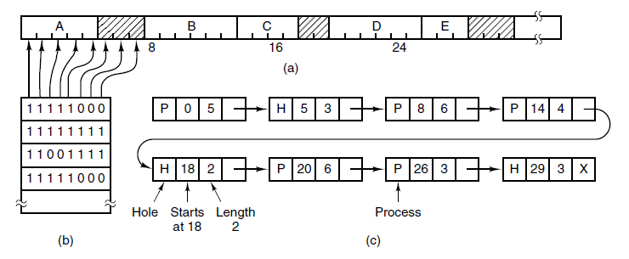
Memory Management with Bitmaps
A part of memory with five processes and three holes. The tick marks show the memory allocation units. The shaded regions (0 in the bitmap) are free.
(b) The corresponding bitmap.
(c) The same information as a list.

Slide 13
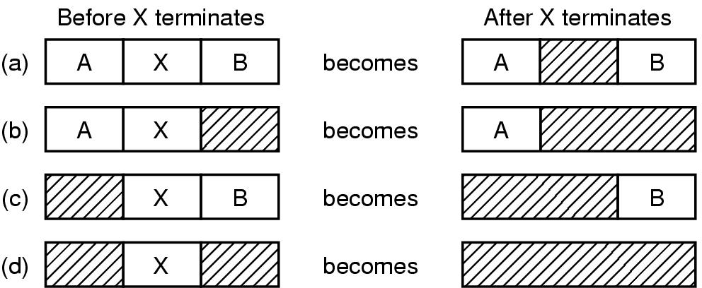
Memory Management with Linked Lists (1)
Four neighbor combinations for the terminating process X

Slide 14
Memory Management with Linked Lists (2)
Multiple­partition allocation
  Hole — block of available memory; holes of various size are scattered throughout memory.
  When a process arrives, it is allocated memory from a hole large enough to accommodate it.
  Operating system maintains information about:
  a) allocated partitions b) free partitions (hole)
OS
OS
OS
OS
Process 5
Process 5
Process 5
Process 5
Process 9
Process 9
Process 8
Process 10
Process 2
Process 2
Process 2
Process 2

Slide 15
Memory Management with Linked Lists (3)
How to satisfy a request of size n from a list of free holes.
  First­fit: Allocate the first hole that is big enough.
  Next-fit: Like first fit; remember last found hole
  Best­fit: Allocate the smallest hole that is big enough; must search entire list, unless ordered by size. Produces the smallest leftover hole.
  Worst­fit: Allocate the largest hole; must also search entire list. Produces the largest leftover hole.
  Quick-fit: Maintain separate lists for some of the more common sizes requested
First­fit and best­fit better than worst­fit in terms of speed and storage utilization.

Slide 16
Overlays
Keep in memory only those instructions and data that are needed at any given time.
Needed when process is larger than amount of memory allocated to it.
Implemented by user, no special support needed from operating system; programming design of overlay structure is complex.

Slide 17
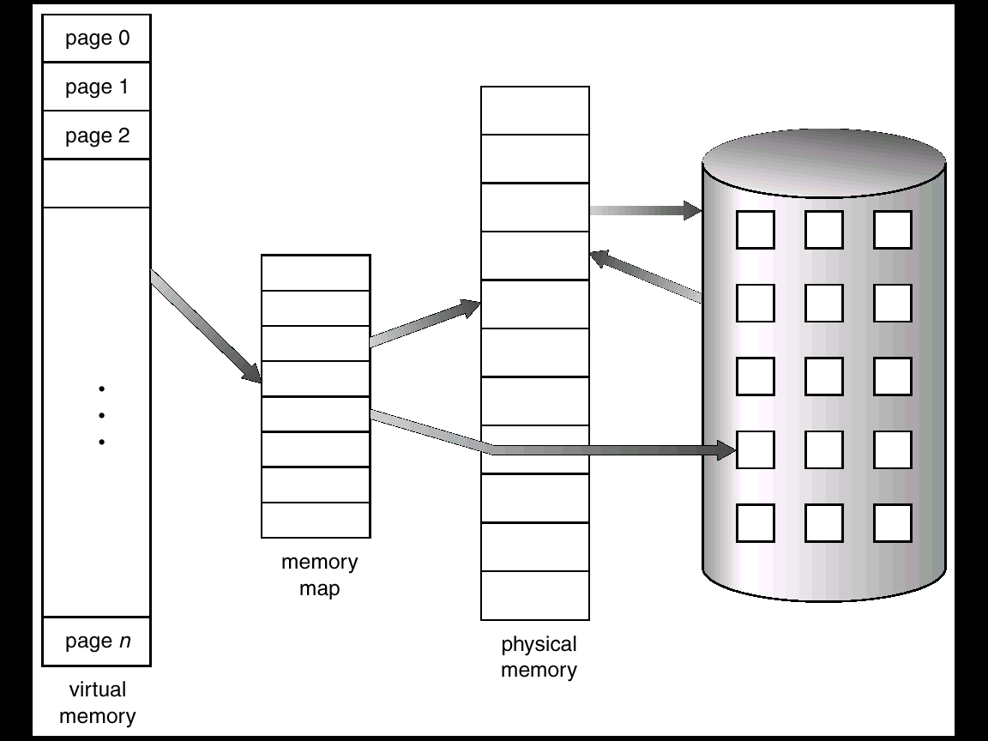
Virtual Memory

Slide 18
Memory Management Unit (MMU)
Hardware device that maps virtual to physical addresses.
In MMU scheme, the value in the relocation register is added to every address generated by a user process at the time it is sent to memory.
The user program deals with logical addresses; it never sees the real physical addresses.

Slide 19
Logical versus Physical Address Space
The concept of a logical address space that is bound to a separate physical address space is central to proper memory management.
  Logical address — generated by the CPU; also referred to as a virtual address.
  Physical address — address seen by the memory unit.
Logical and physical addresses are the same in compile-time and load-time address binding schemes; logical (virtual) and physical addresses differ in execution-time address-binding scheme.

Slide 20
Virtual Memory
Paging (1)
Logical address space of a process can be noncontiguous; process is allocated physical memory wherever the latter is available.
Divide physical memory into fixed­sized blocks called frames (size is power of 2, between 512 bytes and 8192 bytes).
Divide logical memory into blocks of same size called pages.
Keep track of all free frames.
To run a program of size n pages, need to find n free frames and load program.
Set up a page table to translate logical to physical addresses.
Internal fragmentation.

Slide 21
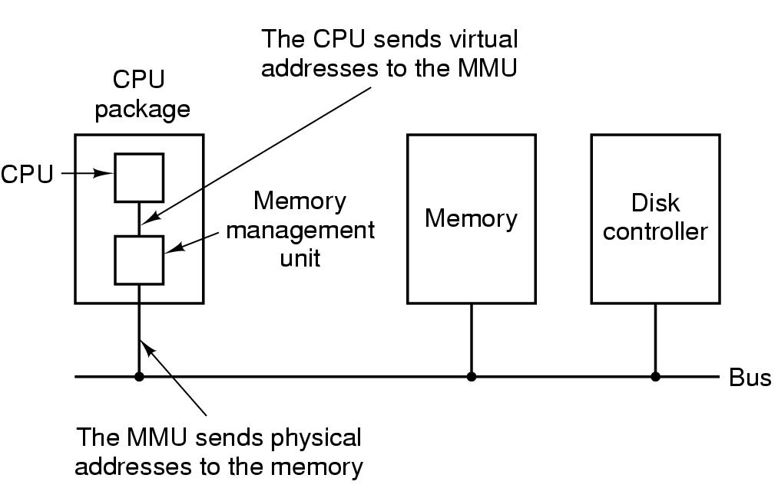
Virtual Memory – Paging (2)
The position and function of the MMU – shown as being a part of the CPU chip (it commonly is nowadays). Logically it could be a separate chip, was in years gone by.

Slide 22
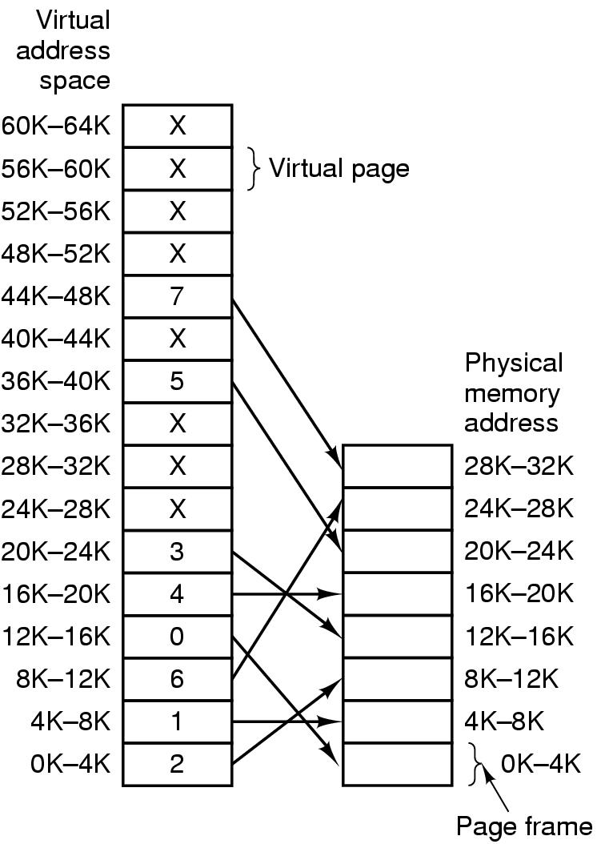
Paging (3)
Relation between virtual addresses and physical memory addresses given by page table.

Slide 23
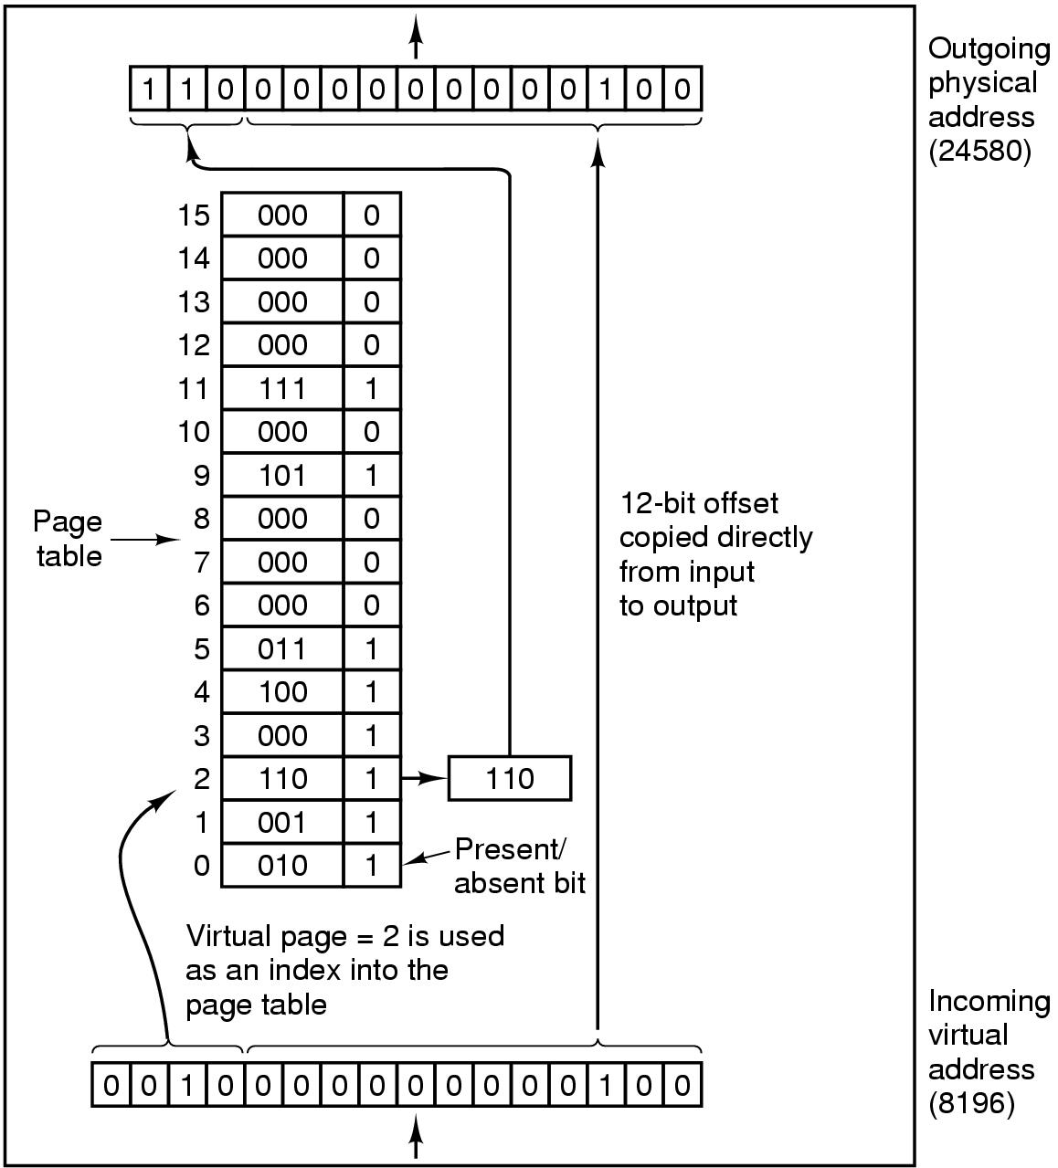
Paging (4)
The internal operation of the MMU with 16 4-KB pages.

Slide 24
Address Translation Scheme
Address generated by CPU is divided into:
Page number (p) — used as an index into a page table which contains base address of each page in physical memory.
Page offset (d) — combined with base address to define the physical memory address that is sent to the memory unit.

Slide 25
Address Translation Architecture
Logical
Address
Physical
Address
f
CPU
p
d
f
d
p
f
Physical Memory
Page Table

Slide 26
Paging Example
0
1
page 0
page 0
2
0
1
page 1
1
4
3
page 2
2
3
page 2
3
7
4
page 1
Page
Table
page 3
5
Logical
Memory
6
7
7
page 3
Physical
Memory

Slide 27
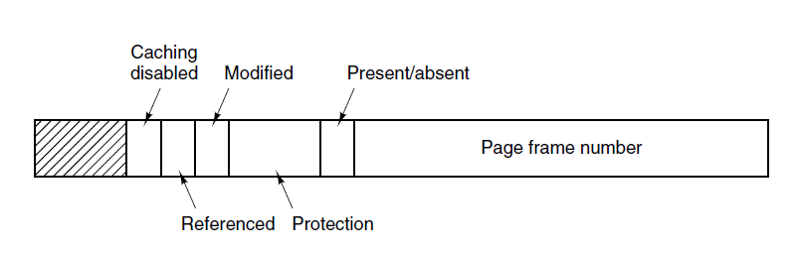
Structure of a Page Table Entry
A typical page table entry.

Slide 28
Speeding Up Paging
Paging implementation issues:
The mapping from virtual address to physical address must be fast.
If the virtual address space is large, the page table will be large.

Slide 29
Implementation of Page Table
Page table is kept in main memory.
Page­table base register (PTBR) points to the page table.
Page­table length register (PTLR) indicates size of the page table.
In this scheme every data/instruction access requires two memory accesses. One for the page table and one for the data/instruction.
The two memory access problem can be solved by the use of a special fast­lookup hardware cache called associative registers or translation look­aside buffers (TLBs).

Slide 30
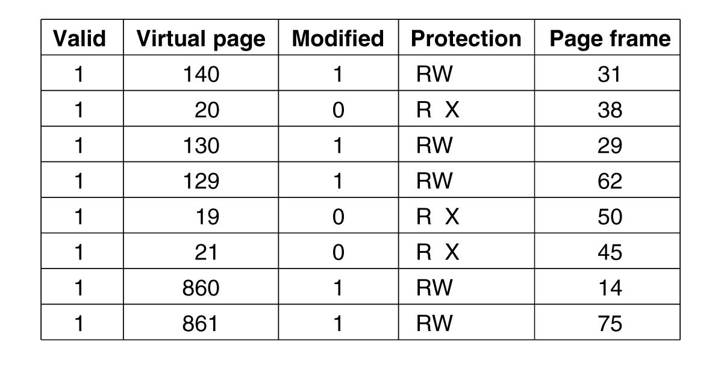
Translation Lookaside Buffers
A TLB to speed up paging.

Slide 31
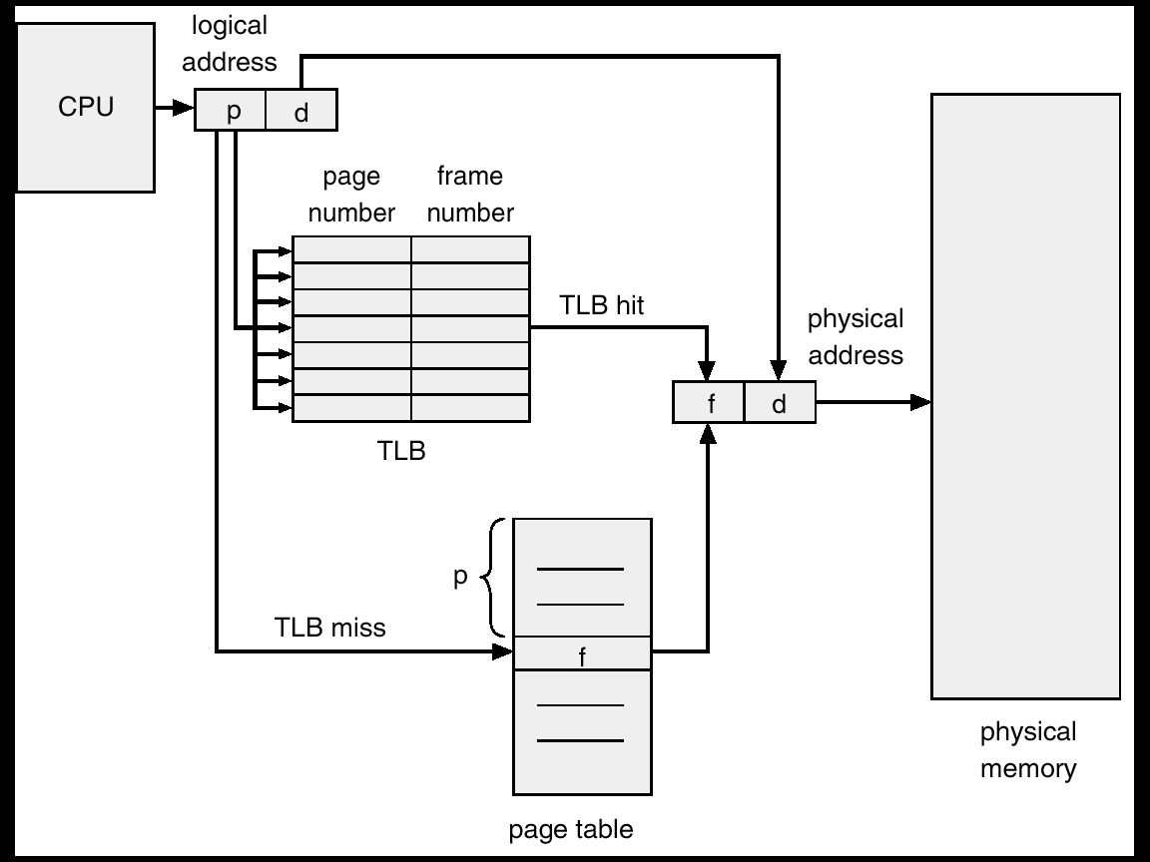
TLB

Slide 32
Associative Registers (TLBs)
Associative Registers — parallel search
Address Translation (p, d)
  If p is in an associative register, get frame number out
  Otherwise, translate through page table in memory
Page
Number
Frame
Number

Slide 33
Effective Access Time
Associative lookup = ε time unit
Assume memory cycle time is 1 microsecond
Hit ratio – percentage of times that a page number is found in the associative registers; ratio related to number of associative registers and locality of process
Hit ratio = α
Effective Access Time (EAT)
EAT = (1 + ε ) α + (2 + ε )(1 – α)
= 2 + ε – α

Slide 34
Memory Protection
Memory protection implemented by associating protection bits with each frame.
Valid–invalid bit attached to each entry in the page table:
  “valid” indicates that the associated page is in the process' logical address space, and is thus a legal page.
  “invalid” indicates that the page is not in the process' logical address space.
Extend mechanism for access type (read, write, execute)

Slide 35
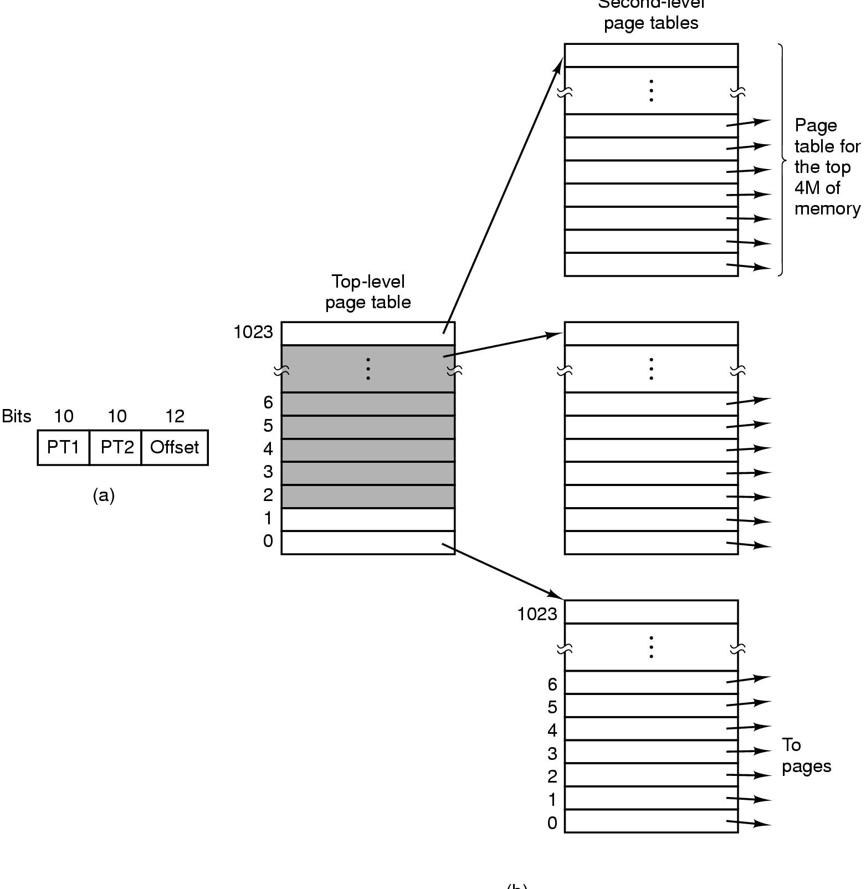
Page Tables
Second-level page tables
Top-level
page table
32 bit address with 2 page table fields
Two-level page tables

Slide 36
Two Level Paging Scheme
page 0
1
page 1
•
•
•
•
•
•
500
page 100
•
•
•
•
•
•
100
page 500
•
•
•
•
•
•
•
•
•
page 708
708
•
•
•
Outer Page
Table
•
•
•
page 900
929
•
•
•
•
•
•
page 929
900
Page Table
Physical Memory

Slide 37
Two Level Paging Example
A logical address (on 32 bit machine with 4K page size) is divided into:
  a logical page number consisting of 20 bits
  a page offset consisting of 12 bits
Since the page table is paged, the page number is further divided into:
  a 10 bit page number
  a 10 bit offset
Thus, a logical address is as follows:
  where p1 is an index into the outer page table, and p2 is the displacement within the page of the inner page table.
Page number
Page offset
p₁
p₂
d

Slide 38
Address–Translation Scheme
Address–translation scheme for a two–level 32–bit paging architecture
Page number
Page offset
p₁
p₂
d
p₁
p₂
d

Slide 39
Multilevel Paging and Performance
On a two-level paging scheme, two memory accesses are required to convert from logical to physical, plus the memory access for the original reference.
To make this or higher levels of paging performance feasible, caching of translation entries is required
Example:
  4-level paging scheme; 100 nsec access time; 20 nsec TLB lookup time; 98% TLB hit rate:
  EAT = 0.98 x 120 + 0.02 x 520
  = 128 nsec.
  Which is only a 28 percent slowdown in memory access time.

Slide 40
Inverted Page Table
One entry for each real page of memory.
Entry consists of the virtual address of the page stored in that real memory location, with information about the process that owns that page.
Decreases memory needed to store each page table, but increases time needed to search the table when a page reference occurs.
Use hash table to limit the search to one – or at most a few – page table entries.

Slide 41
Inverted Page Table Architecture
Physical
Memory
Logical
Address
Physical
Address
CPU
pid
p
d
i
d
Search
i
pid
p
Inverted Page Table

Slide 42
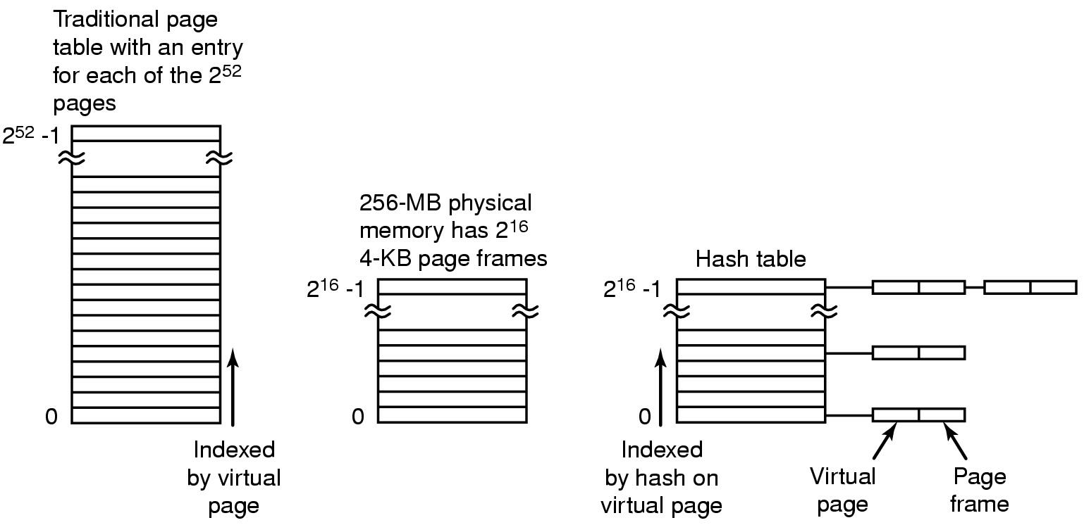
Inverted Page Tables
Comparison of a traditional page table with an inverted page table

Slide 43
Page Replacement Algorithms
Page fault forces choice
  which page must be removed
  make room for incoming page
Modified page must first be saved
  unmodified just overwritten
Better not to choose an often used page
  will probably need to be brought back in soon

Slide 44
Page Replacement Algorithms
Optimal page replacement algorithm
Not recently used page replacement
First-In, First-Out page replacement
Second chance page replacement
Clock page replacement
Least recently used page replacement
Working set page replacement
WSClock page replacement

Slide 45
Optimal Page Replacement Algorithm
Replace page needed at the farthest point in future
  Optimal but unrealizable
Estimate by …
  logging page use on previous runs of process
  although this is impractical

Slide 46
Not Recently Used Page Replacement Algorithm
Each page has Reference bit, Modified bit
  bits are set when page is referenced, modified
Pages are classified
  not referenced, not modified
  not referenced, modified
  referenced, not modified
  referenced, modified
NRU removes page at random
  from lowest numbered non empty class

Slide 47
FIFO Page Replacement Algorithm
Maintain a linked list of all pages
  in order they came into memory
Page at beginning of list replaced
Disadvantage
  page in memory the longest may be often used

Slide 48
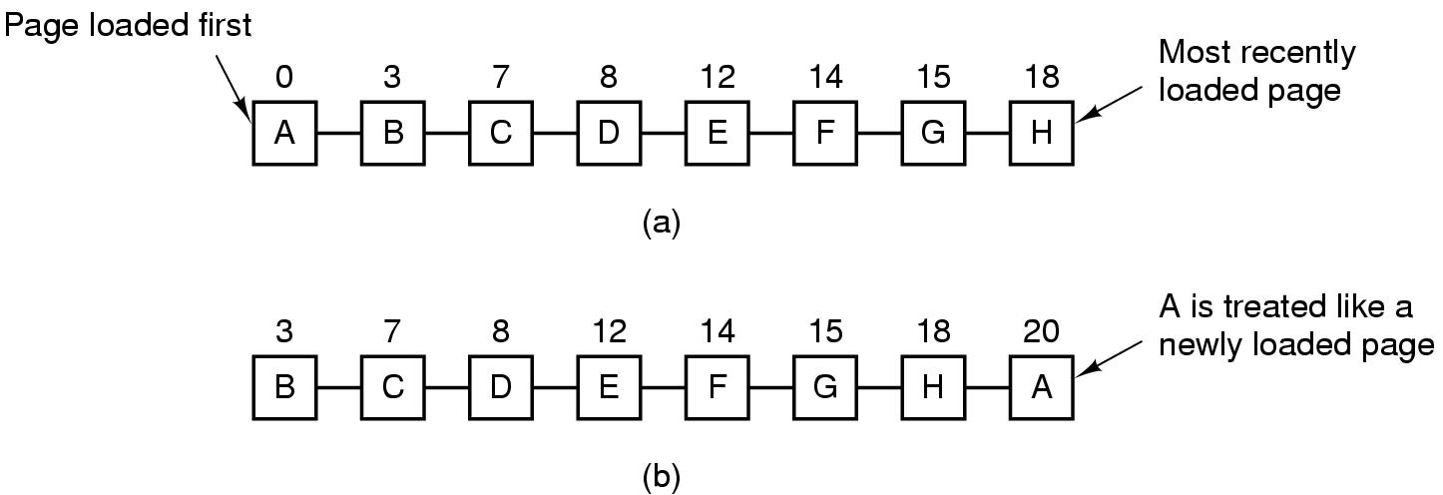
Second Chance Algorithm
Operation of second chance.
(a) Pages sorted in FIFO order.
(b) Page list if a page fault occurs at time 20 and A has its R bit set. The numbers above the pages are their load times.

Slide 49
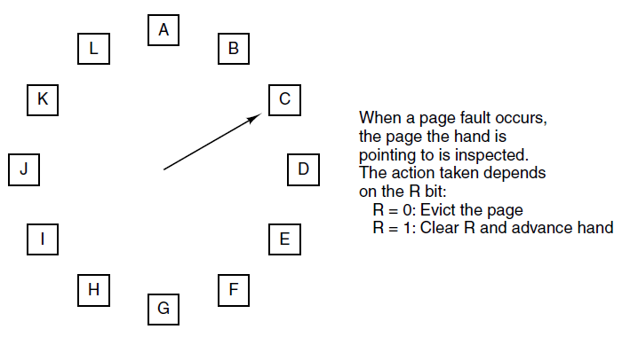
Clock Page Replacement Algorithm
The clock page replacement algorithm.

Slide 50
Least Recently Used (LRU)
Assume pages used recently will used again soon
  throw out page that has been unused for longest time
Must keep a linked list of pages
  most recently used at front, least at rear
  update this list every memory reference !!
Alternatively keep counter in each page table entry
  choose page with lowest value counter
  periodically zero the counter

Slide 51
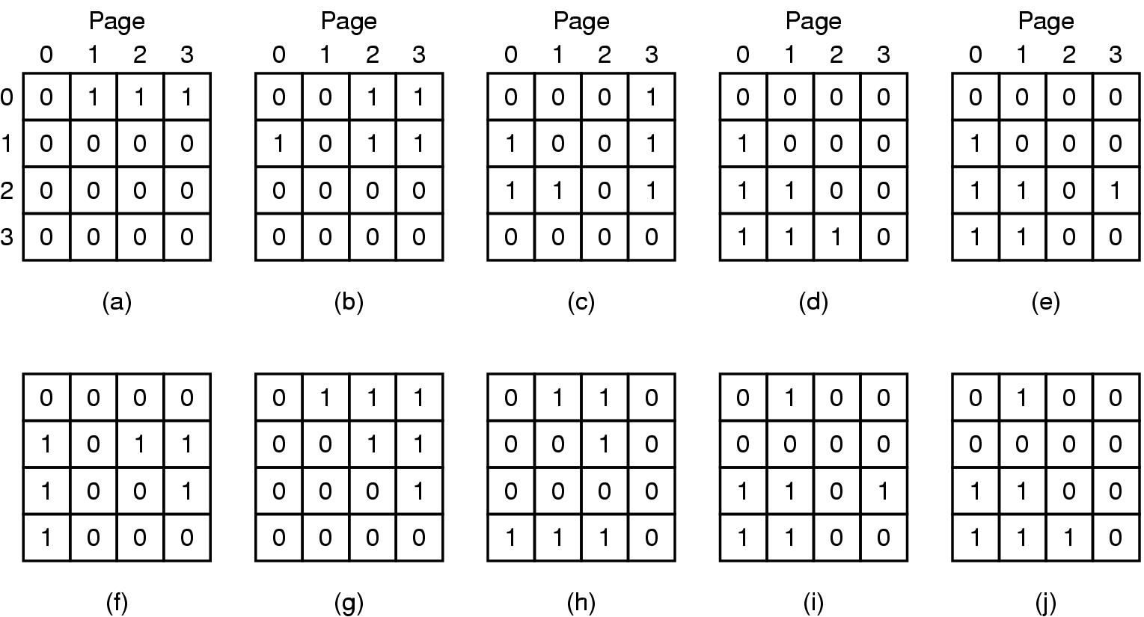
LRU Page Replacement Algorithm
LRU using a matrix when pages are referenced in the order 0, 1, 2, 3, 2, 1, 0, 3, 2, 3.

Slide 52
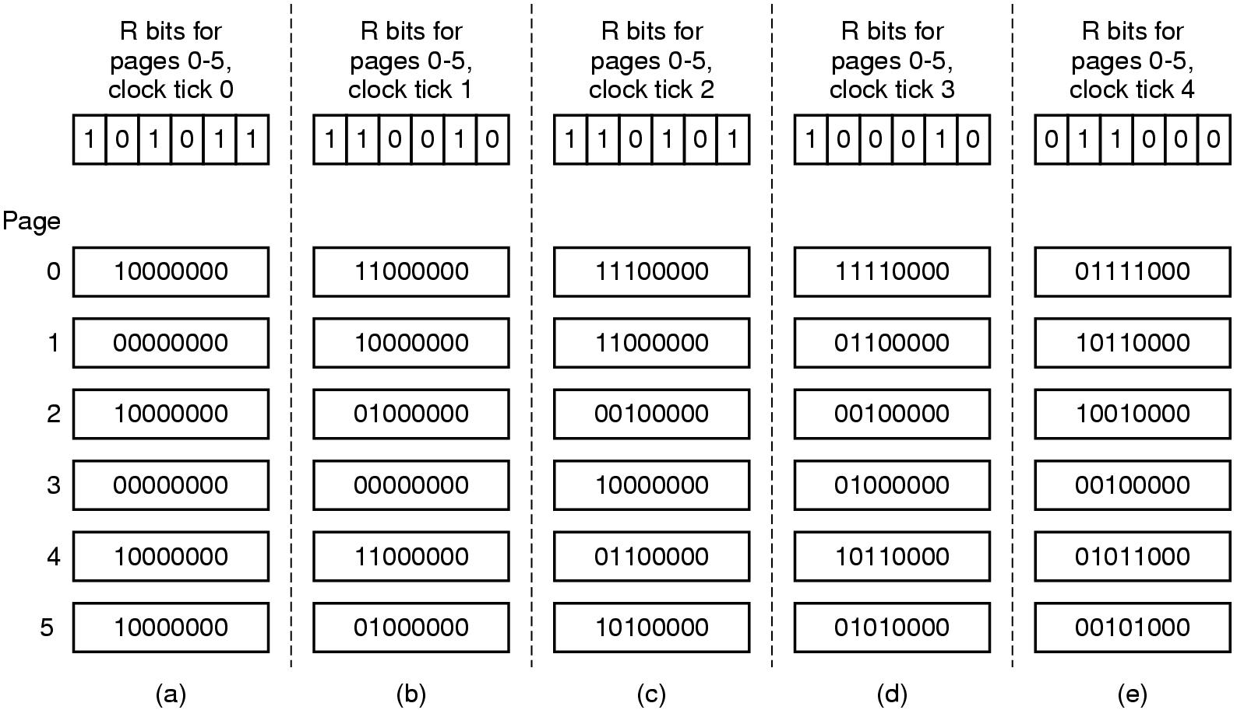
Simulating LRU in Software
The aging algorithm simulates LRU in software. Shown are six pages for five clock ticks. The five clock ticks are represented by (a) to (e).

Slide 53
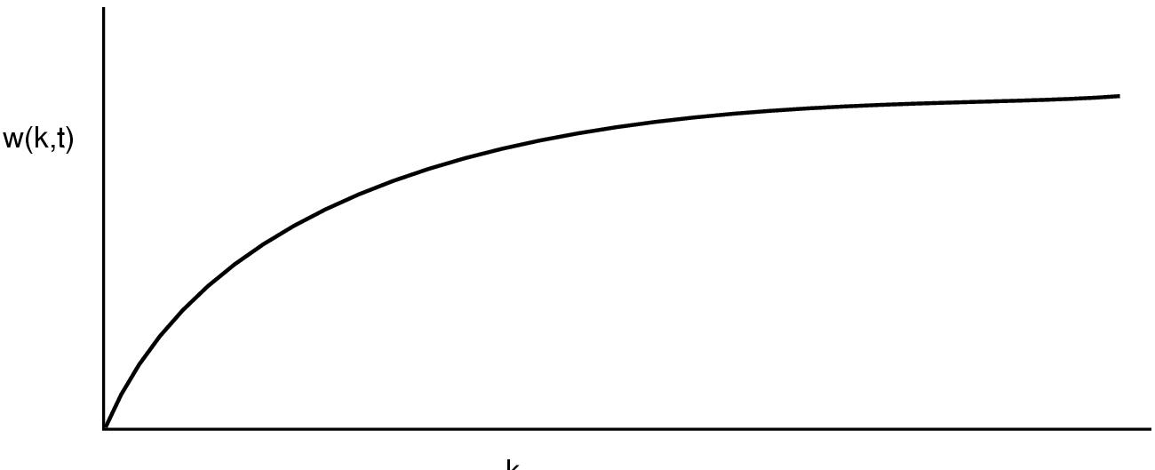
Working Set Page Replacement (1)
The working set is the set of pages used by the k most recent memory references. The function w(k, t) is the size of the working set at time t.

Slide 54
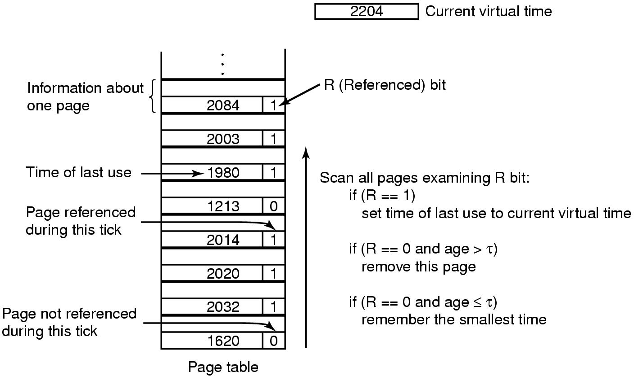
Working Set Page Replacement (2)
The working set algorithm.

Slide 55
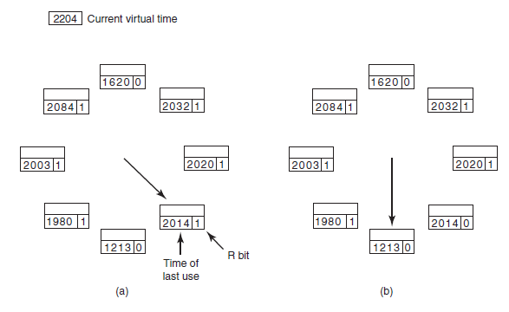
The WSClock Page Replacement Algorithm (1)
Operation of the WSClock algorithm. (a) and (b) give an example of what happens when R = 1.

Slide 56
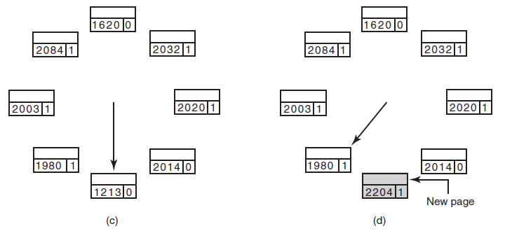
The WSClock Page Replacement Algorithm (2)
Operation of the WSClock algorithm.
(c) and (d) give an example of R = 0.

Slide 57
The WSClock Page Replacement Algorithm (3)
When the hand comes all the way around to its
starting point there are two cases to consider:
At least one write has been scheduled.
No writes have been scheduled.

Slide 58
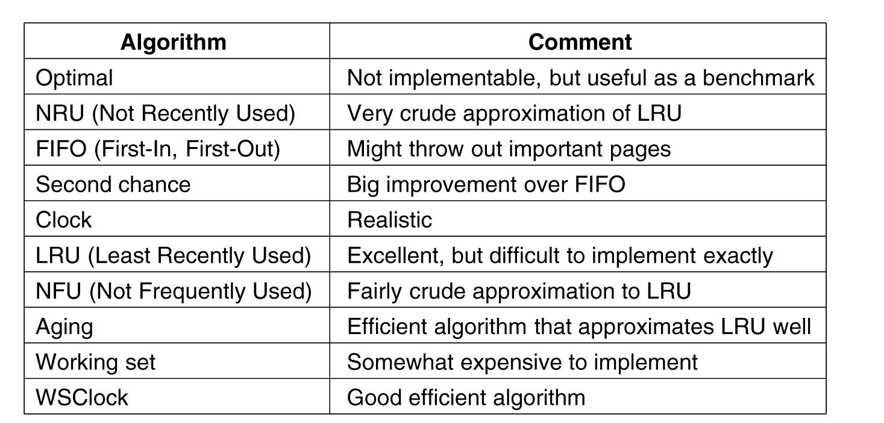
Summary of Page Replacement Algorithms
Page replacement algorithms discussed in here.

Slide 59
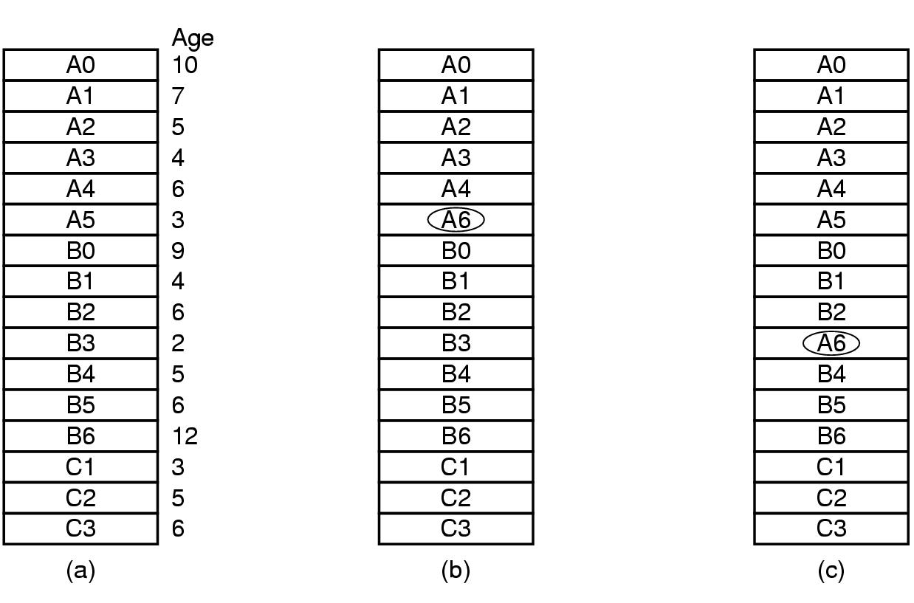
Local versus Global Allocation Policies (1)
Local versus global page replacement.
(a) Original configuration (b) Local page replacement (c) Global page replacement

Slide 60
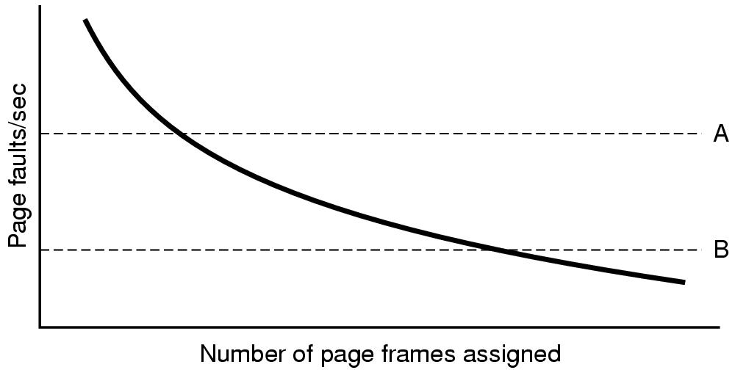
Local versus Global Allocation Policies (2)
Page fault rate as a function of the number of page frames assigned.

Slide 61
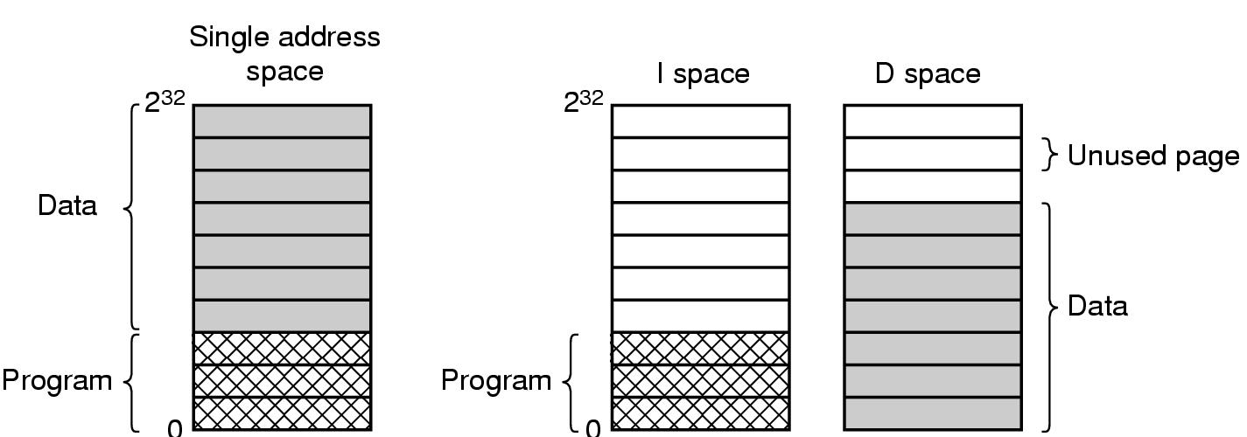
Separate Instruction and Data Spaces
(a) One address space. (b) Separate I and D spaces.

Slide 62
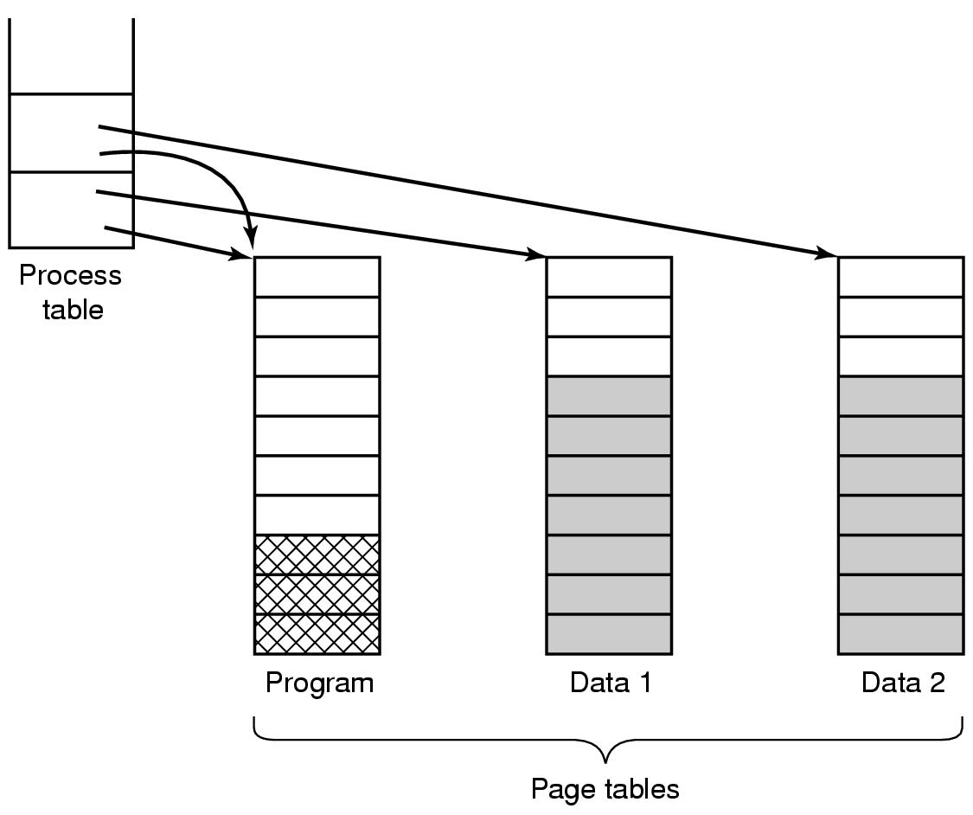
Shared Pages
Two processes sharing the same program sharing its page table.

Slide 63
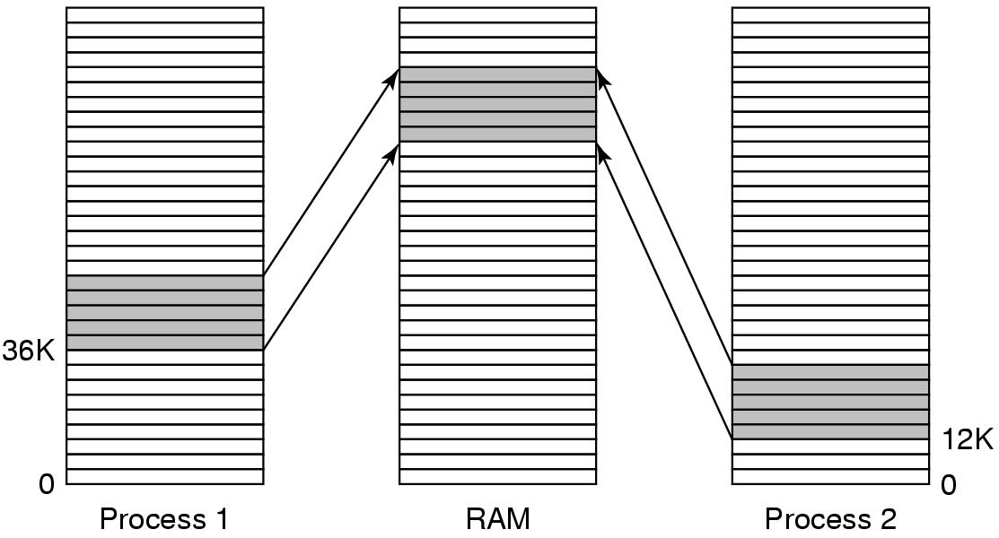
Shared Libraries
A shared library being used by two processes.

Slide 64
Page Fault Handling (1)
The hardware traps to the kernel, saving the program counter on the stack.
An assembly code routine is started to save the general registers and other volatile information.
The operating system discovers that a page fault has occurred, and tries to discover which virtual page is needed.
Once the virtual address that caused the fault is known, the system checks to see if this address is valid and the protection consistent with the access

Slide 65
Page Fault Handling (2)
If the page frame selected is dirty, the page is scheduled for transfer to the disk, and a context switch takes place.
When page frame is clean, operating system looks up the disk address where the needed page is, schedules a disk operation to bring it in.
When disk interrupt indicates page has arrived, page tables updated to reflect position, frame marked as being in normal state.

Slide 66
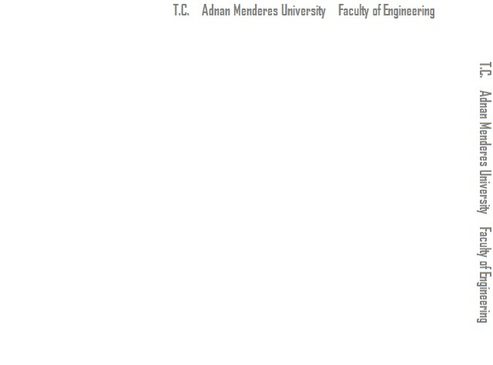
Page Fault Handling (3)
Faulting instruction backed up to state it had when it began and program counter reset to point to that instruction.
Faulting process scheduled, operating system returns to the (assembly language) routine that called it.
This routine reloads registers and other state information and returns to user space to continue execution, as if no fault had occurred.

Slide 67
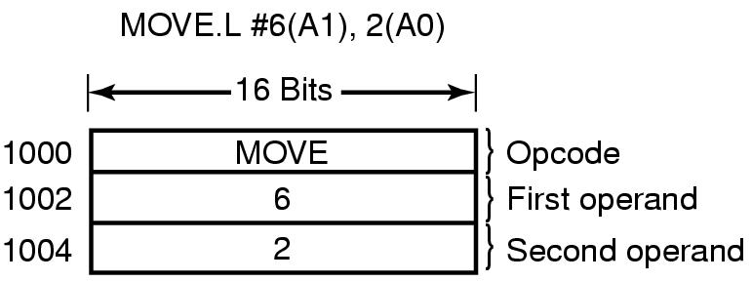
Instruction Backup
An instruction causing a page fault.

Slide 68
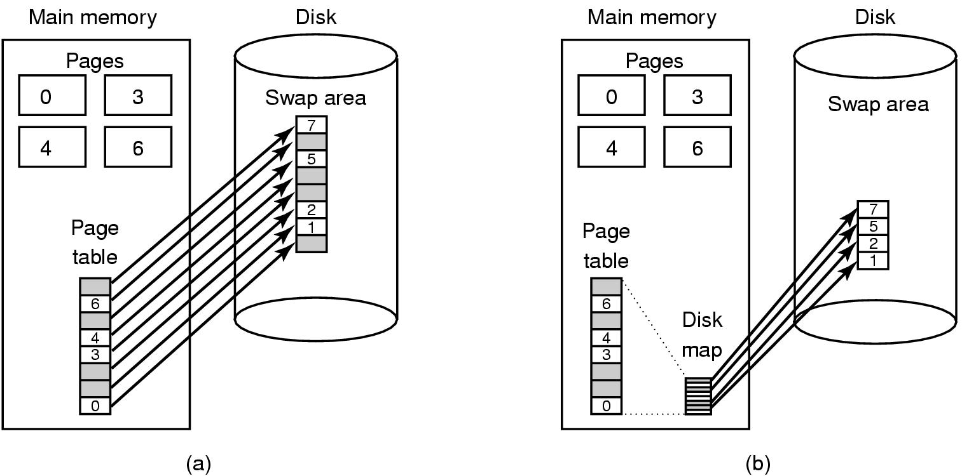
Backing Store (1)
Paging to a static swap area

Slide 69
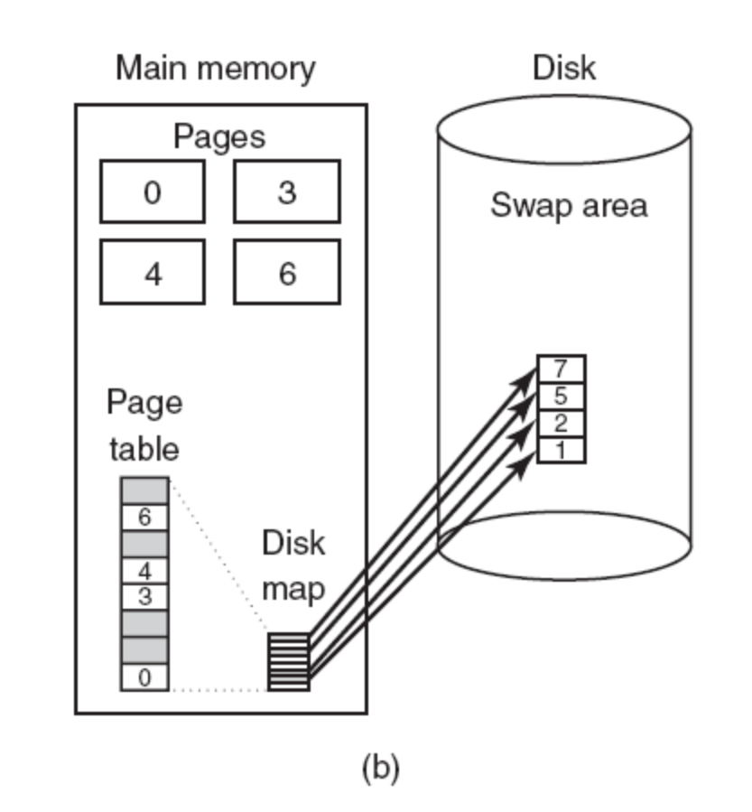
Backing Store (2)
(b) Backing up pages dynamically.

Slide 70
Separation of Policy and Mechanism (1)
Memory management system is divided into
three parts:
A low-level MMU handler.
A page fault handler that is part of the kernel.
An external pager running in user space.

Slide 71
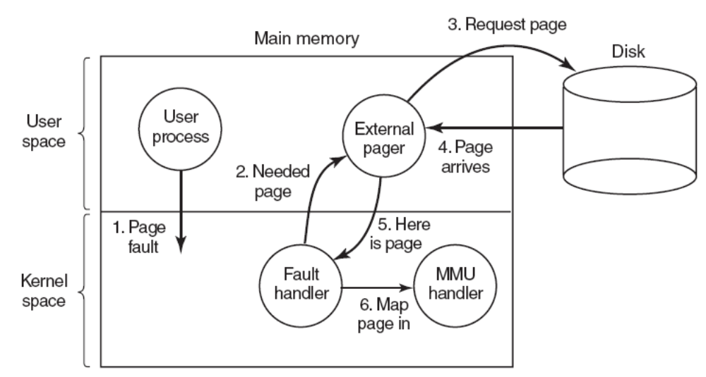
Separation of Policy and Mechanism (2)
Page fault handling with an external pager.

Slide 72
Segmentation (1)
A compiler has many tables that are built up as compilation proceeds, possibly including:
The source text being saved for the printed listing (on batch systems).
The symbol table – the names and attributes of variables.
The table containing integer, floating-point constants used.
The parse tree, the syntactic analysis of the program.
The stack used for procedure calls within the compiler.

Slide 73
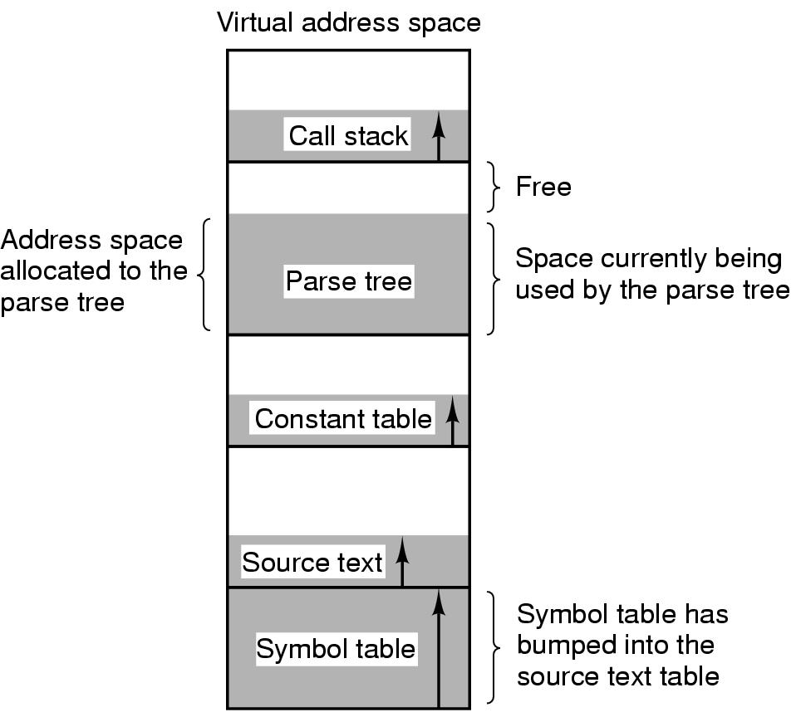
Segmentation (2)
In a one-dimensional address space with growing tables, one table may bump into another.

Slide 74
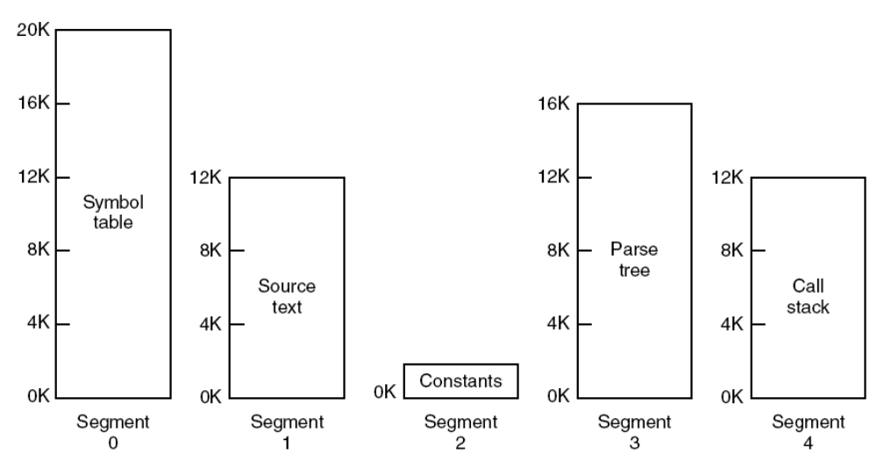
Segmentation (3)
A segmented memory allows each table to grow or shrink independently of the other tables.

Slide 75
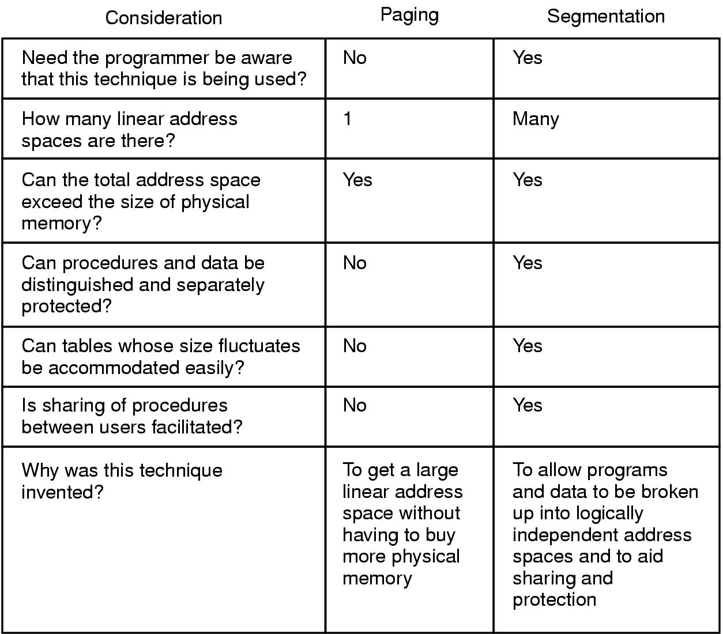
Implementation of Pure Segmentation
Comparison of paging and segmentation.

Slide 76
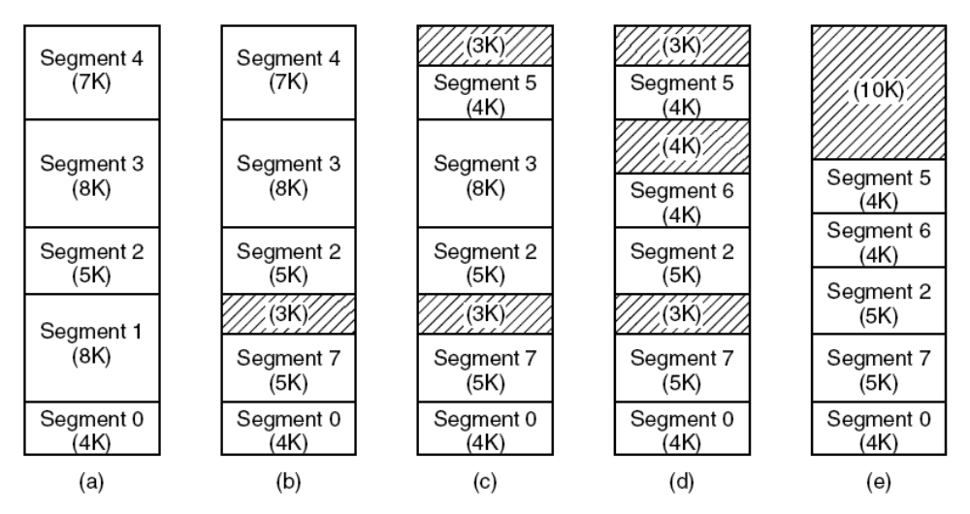
Segmentation with Paging: MULTICS (1)
(a)-(d) Development of checkerboarding
(e) Removal of the checkerboarding by compaction.

Slide 77
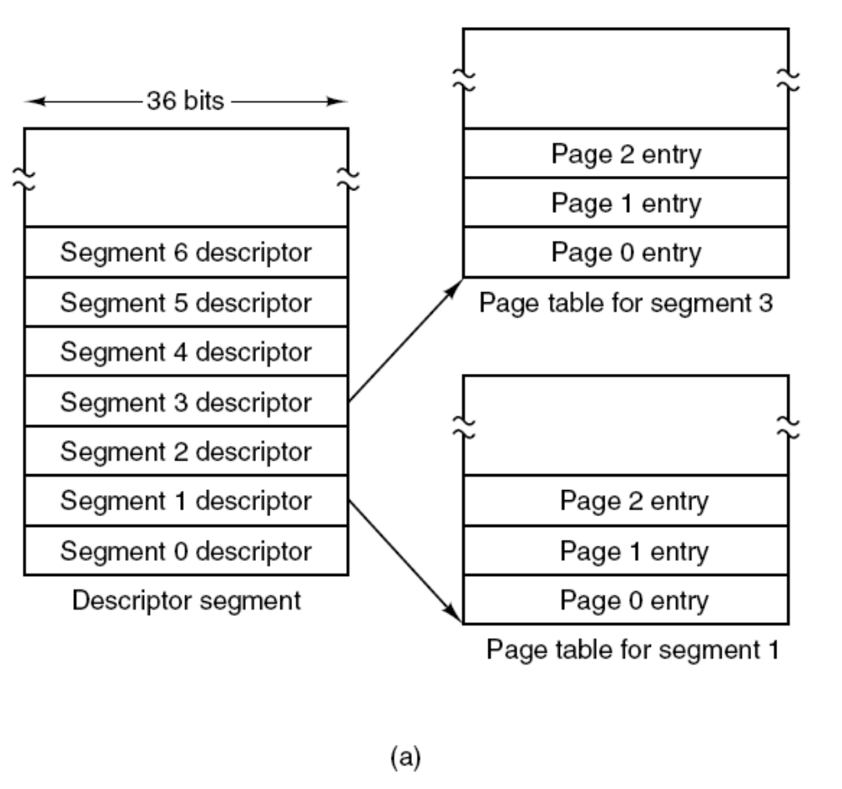
Segmentation with Paging: MULTICS (2)
The MULTICS virtual memory
(a) The descriptor segment points to the page tables.

Slide 78
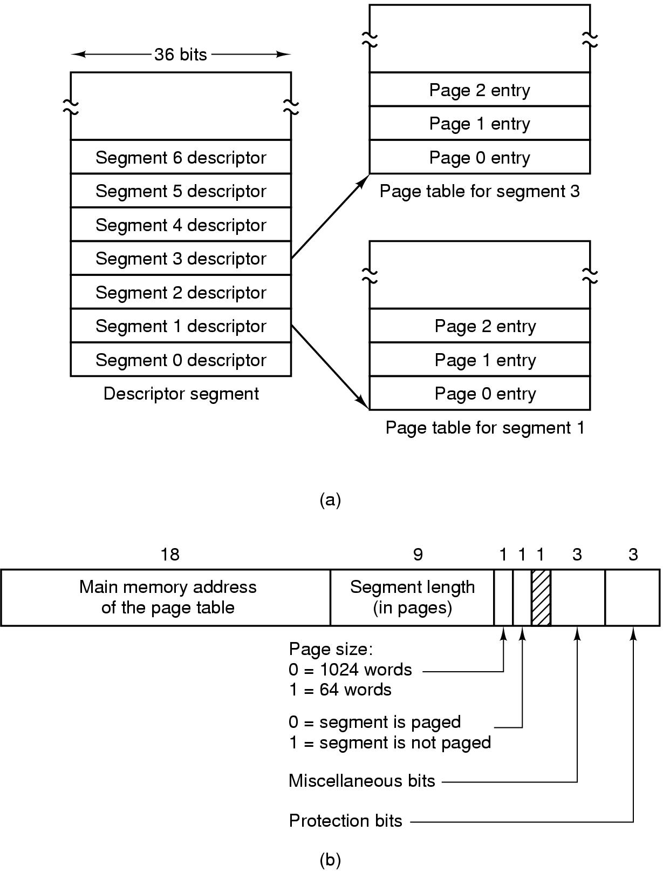
Segmentation with Paging: MULTICS (3)
The MULTICS virtual memory.
(b) A segment descriptor. The numbers are the field lengths.

Slide 79
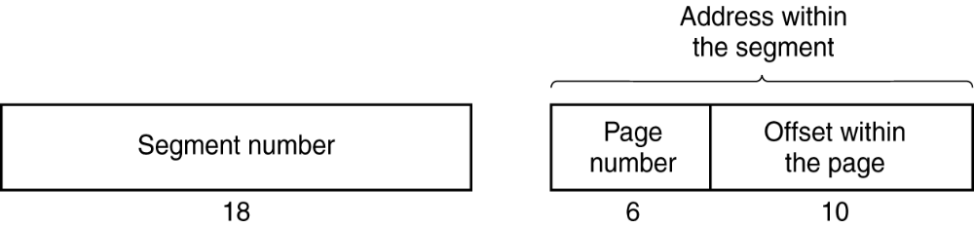
Segmentation with Paging: MULTICS (4)
A 34-bit MULTICS virtual address.

Slide 80
Segmentation with Paging: MULTICS (5)
When a memory reference occurs, the following algorithm is carried out:
The segment number used to find segment descriptor.
Check is made to see if the segment’s page table is in memory.
  If not, segment fault occurs.
  If there is a protection violation, a fault (trap) occurs.

Slide 81
Segmentation with Paging: MULTICS (6)
Page table entry for the requested virtual page examined.
  If the page itself is not in memory, a page fault is triggered.
  If it is in memory, the main memory address of the start of the page is extracted from the page table entry
The offset is added to the page origin to give the main memory address where the word is located.
The read or store finally takes place.

Slide 82
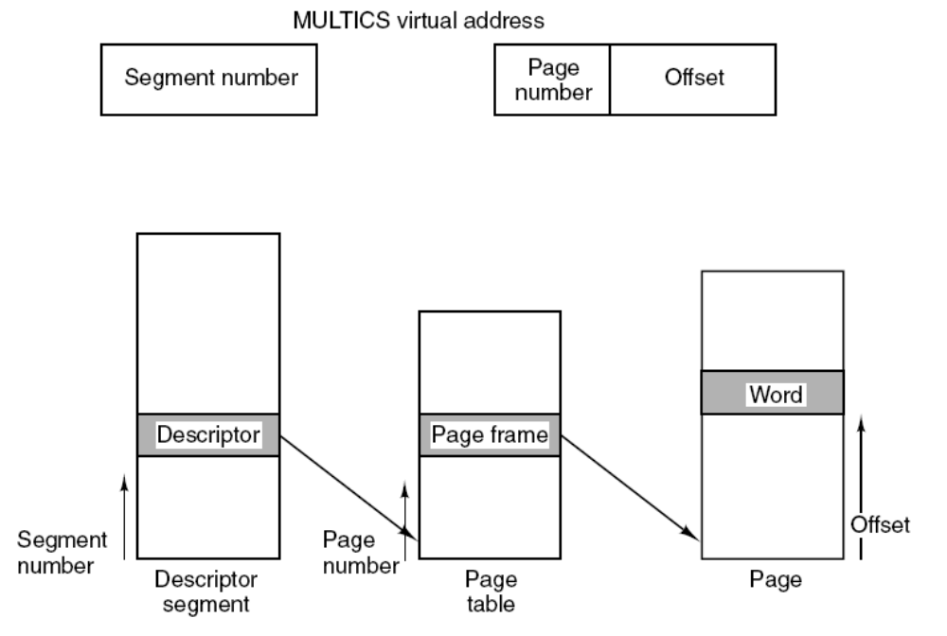
Segmentation with Paging: MULTICS (7)
Conversion of a two-part MULTICS address into a main memory address.

Slide 83
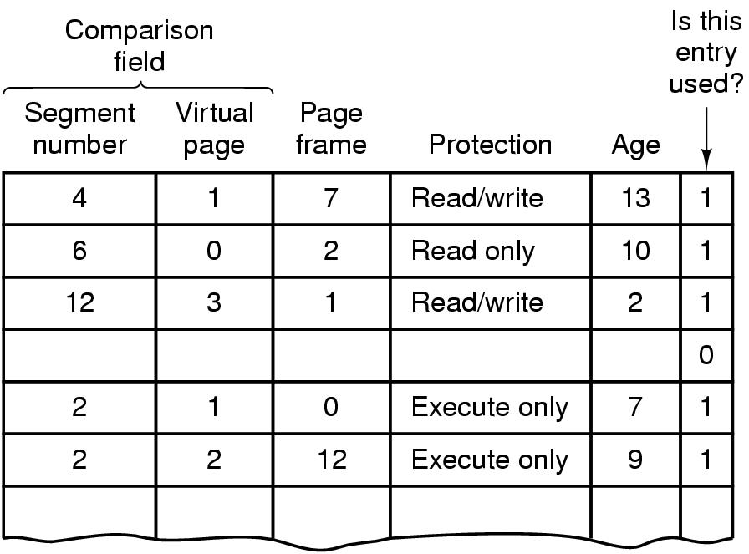
Segmentation with Paging: MULTICS (8)
A simplified version of the MULTICS TLB. The existence of two page sizes makes the actual TLB more complicated.

Slide 84
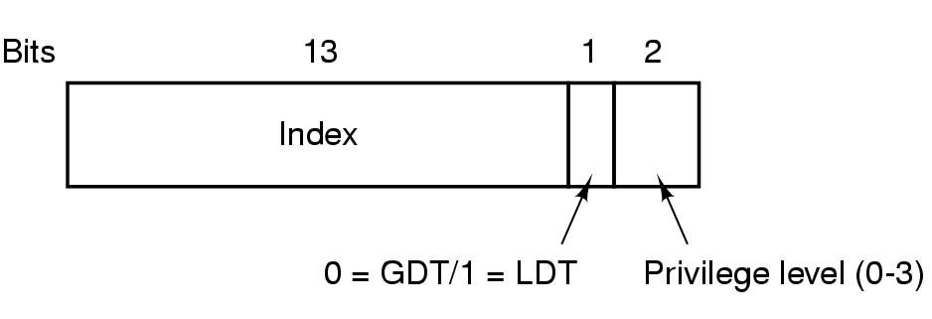
Segmentation with Paging: The Pentium (1)
A Pentium selector.

Slide 85
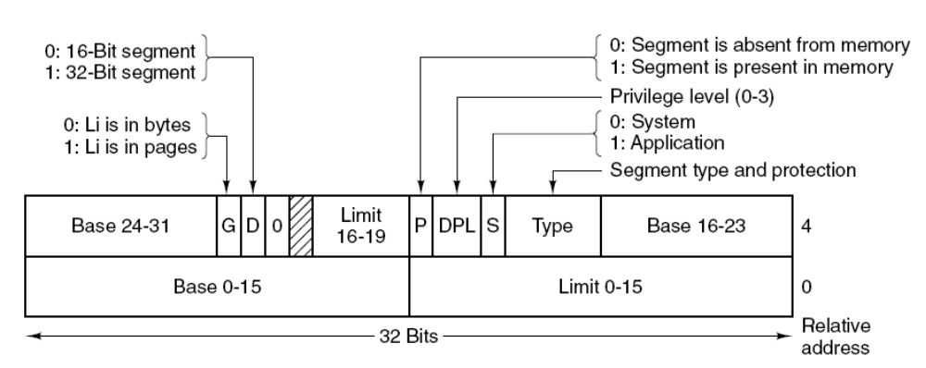
Segmentation with Paging: The Pentium (2)
Pentium code segment descriptor.
Data segments differ slightly.

Slide 86
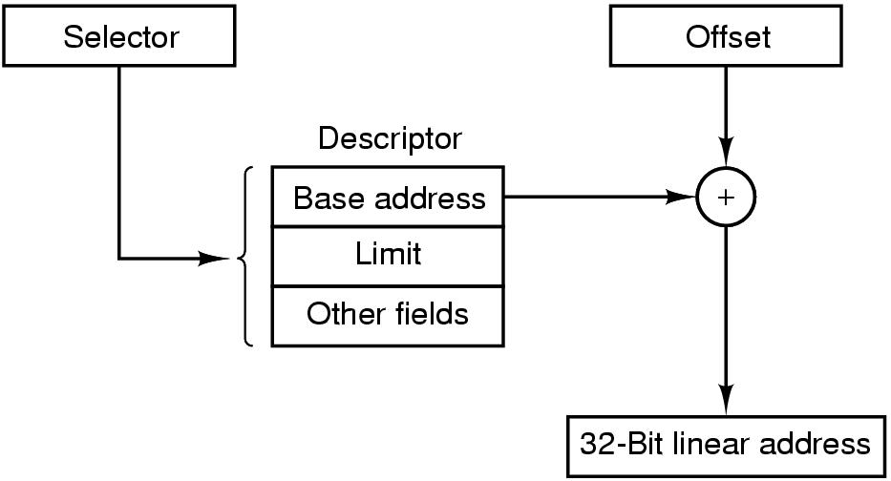
Segmentation with Paging: The Pentium (3)
Conversion of a (selector, offset) pair to a linear address.

Slide 87
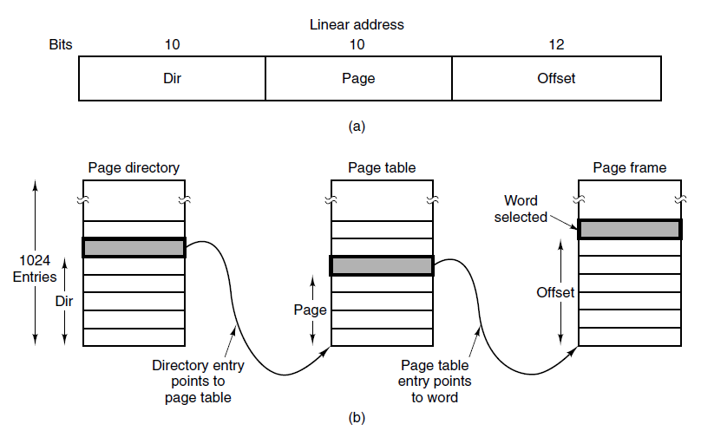
Segmentation with Paging: The Pentium (4)
Mapping of a linear address onto a physical address.

Slide 88
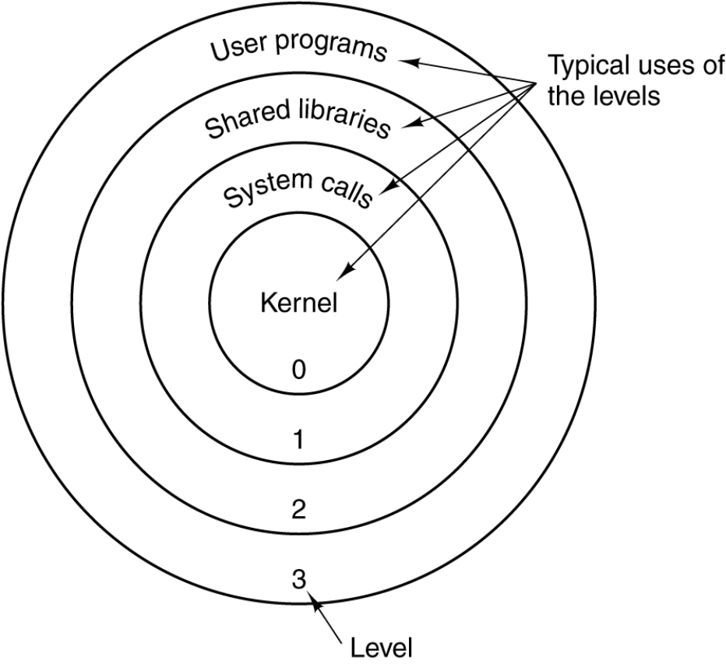
Segmentation with Paging: The Pentium (5)
Protection on the Pentium.

Slide 89
Summary
Memory management requirements
    Relocation
    Protection
    Sharing
    Logical organization
    Physical organization
Paging
Memory partitioning
    Fixed partitioning
    Dynamic partitioning
    Buddy system
    Relocation
Segmentation
Hardware and control structures
    Locality and virtual memory
    Paging
    Segmentation
    Combined paging and segmentation
    Protection and sharing
OS software
    Fetch policy
    Placement policy
    Replacement policy
    Resident set management
    Cleaning policy
    Load control
Notes:
Chapter 3 Summary

Slide 90
Next Lecture
File Management

Slide 91
References
Andrew S. Tanenbaum, Herbert Bos, Modern Operating Systems 4th Global Edition, Pearson, 2015
William Stallings, Operating Systems: Internals and Design Principles, 9th Global Edition, Pearson, 2017

