Slide 1


CSE310 Human-Computer Interaction
Lecture #4
The Paradigms
Prepared & Presented by Asst. Prof. Dr. Samsun M. BAŞARICI

Slide 2
Learning Objectives
Understand the paradigms of interaction in historical context
Appreciate the study of paradigms for interaction design
Know some key person and events in the context of interaction from the point-of-view of paradigms

Slide 3
why study paradigms
Concerns
  how can an interactive system be developed to ensure its usability?
  how can the usability of an interactive system be demonstrated or measured?
History of interactive system design provides paradigms for usable designs

Slide 4
What are Paradigms
Predominant theoretical frameworks or scientific world views
  e.g., Aristotelian, Newtonian, Einsteinian (relativistic) paradigms in physics
Understanding HCI history is largely about understanding a series of paradigm shifts
  Not all listed here are necessarily “paradigm” shifts, but are at least candidates
  History will judge which are true shifts

Slide 5
Paradigms of interaction
New computing technologies arrive, creating a new perception of the
human—computer relationship.
We can trace some of these shifts in the history of interactive technologies.

Slide 6

The initial paradigm
Batch processing
Impersonal computing

Slide 7
Example Paradigm Shifts
Batch processing
Time-sharing
Interactive computing

Slide 8
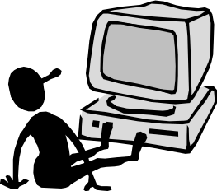
Example Paradigm Shifts (cont.)
Batch processing
Timesharing
Networking
@#$% !
???
Community computing

Slide 9
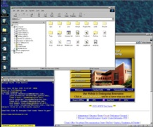
Example Paradigm Shifts (cont.)
Batch processing
Timesharing
Networking
Graphical displays
Move this file here,
and copy this to there.
C…P… filename
dot star… or was
it R…M?
% foo.bar
ABORT
dumby!!!
Direct manipulation

Slide 10
Example Paradigm Shifts (cont.)
Batch processing
Timesharing
Networking
Graphical display
Microprocessor
Personal computing

Slide 11
Example Paradigm Shifts (cont.)
Batch processing
Timesharing
Networking
Graphical display
Microprocessor
WWW
Global information

Slide 12

Example Paradigm Shifts (cont.)
Batch processing
Timesharing
Networking
Graphical display
Microprocessor
WWW
Ubiquitous Computing
A symbiosis of physical and electronic worlds in service of everyday activities.

Slide 13
Time-sharing
1940s and 1950s – explosive technological growth
1960s – need to channel the power
J.C.R. Licklider at ARPA
single computer supporting multiple users

Slide 14
Video Display Units
more suitable medium than paper
1962 – Sutherland's Sketchpad
computers for visualizing and manipulating data
one person's contribution could drastically change the history of computing

Slide 15
Programming toolkits
Engelbart at Stanford Research Institute
1963 – augmenting man's intellect
1968 NLS/Augment system demonstration
the right programming toolkit provides building blocks to producing complex interactive systems

Slide 16
Personal computing
1970s – Papert's LOGO language for simple graphics programming by children
A system is more powerful as it becomes easier to user
Future of computing in small, powerful machines dedicated to the individual
Kay at Xerox PARC – the Dynabook as the ultimate personal computer

Slide 17
Window systems and the WIMP interface
humans can pursue more than one task at a time
windows used for dialogue partitioning, to “change the topic”
1981 – Xerox Star first commercial windowing system
windows, icons, menus and pointers now familiar interaction mechanisms

Slide 18
Metaphor
relating computing to other real-world activity is effective teaching technique
  LOGO's turtle dragging its tail
  file management on an office desktop
  word processing as typing
  financial analysis on spreadsheets
  virtual reality – user inside the metaphor
Problems
  some tasks do not fit into a given metaphor
  cultural bias

Slide 19
Direct manipulation
1982 – Shneiderman describes appeal of graphically-based interaction
  visibility of objects
  incremental action and rapid feedback
  reversibility encourages exploration
  syntactic correctness of all actions
  replace language with action
1984 – Apple Macintosh
the model-world metaphor
What You See Is What You Get (WYSIWYG)

Slide 20
Language versus Action
actions do not always speak louder than words!
DM – interface replaces underlying system
language paradigm
interface as mediator
interface acts as intelligent agent
programming by example is both action and language

Slide 21
Hypertext
1945 – Vannevar Bush and the memex
key to success in managing explosion of information
mid 1960s – Nelson describes hypertext as non-linear browsing structure
hypermedia and multimedia
Nelson's Xanadu project still a dream today

Slide 22
Multimodality
a mode is a human communication channel
emphasis on simultaneous use of multiple channels for input and output

Slide 23
Computer Supported Cooperative Work (CSCW)
CSCW removes bias of single user / single computer system
Can no longer neglect the social aspects
Electronic mail is most prominent success

Slide 24
The World Wide Web
Hypertext, as originally realized, was a closed system
Simple, universal protocols (e.g. HTTP) and mark-up languages (e.g. HTML) made publishing and accessing easy
Critical mass of users lead to a complete transformation of our information economy.

Slide 25
Agent-based Interfaces
Original interfaces
  Commands given to computer
  Language-based
Direct Manipulation/WIMP
  Commands performed on “world” representation
  Action based
Agents - return to language by instilling proactivity and “intelligence” in command processor
  Avatars, natural language processing

Slide 26
Ubiquitous Computing
“The most profound technologies are those that disappear.”
Mark Weiser, 1991
Late 1980’s: computer was very apparent
How to make it disappear?
  Shrink and embed/distribute it in the physical world
  Design interactions that don’t demand our intention

Slide 27
Sensor-based and Context-aware Interaction
Humans are good at recognizing the “context” of a situation and reacting appropriately
Automatically sensing physical phenomena (e.g., light, temp, location, identity) becoming easier
How can we go from sensed physical measures to interactions that behave as if made “aware” of the surroundings?

Slide 28



chapter 4
Paradigms
(additional materials)

Slide 29
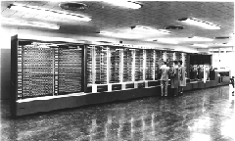
Beginnings – Computing in 1945
Harvard Mark I
  Picture from http://piano.dsi.uminho.pt/museuv/indexmark.htm
55 feet long, 8 feet high, 5 tons
Notes:
Picture from http://piano.dsi.uminho.pt/museuv/indexmark.htm

Slide 30
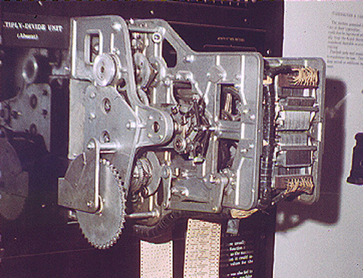
Context - Computing in 1945
Ballistics calculations
Physical switches (before microprocessor)
Paper tape
Simple arithmetic & fixed calculations (before programs)
3 seconds to multiply
Picture from http://www.gmcc.ab.ca/~supy/
Notes:
Picture from http://www.gmcc.ab.ca/~supy/

Slide 31
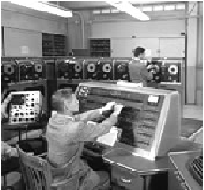
Batch Processing
Computer had one task, performed sequentially
No “interaction” between operator and computer after starting the run
Punch cards, tapes for input
Serial operations

Slide 32
People
Who are the people associated with various interactive paradigm shifts?

Slide 33

Other Resources
Howard Rheingold – Tools for Thought
  History of interactive breakthroughs
  On-line at http://www.rheingold.com/texts/tft/

Slide 34
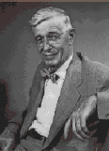
Innovator: Vannevar Bush
“As We May Think” - 1945 Atlantic Monthly
  “…publication has been extended far beyond our
  present ability to make real use of the record.”
Postulated Memex device
  Stores all records/articles/communications
  Items retrieved by indexing, keywords, cross
  references (now called hyperlinks)
  (Envisioned as microfilm, not computer)
Interactive and nonlinear components are key
http://www.theatlantic.com/unbound/flashbks/computer/bushf.htm

Slide 35
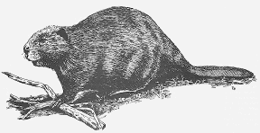
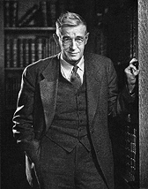
More About Vannevar Bush
Name rhymes with "Beaver"
Faculty member MIT
Coordinated WWII effort with 6000 US scientists
Social contract for science
  federal government funds universities
  universities do basic research
  research helps economy & national defense
Notes:
Picture of Bush from http://www-eecs.mit.edu/AY95-96/events/bush/

Slide 36
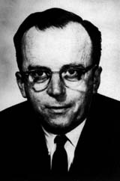
Innovator: J. R. Licklider
1960 - Postulated “man-computer symbiosis”
Couple human brains
and computing machines
tightly to revolutionize
information handling

Slide 37
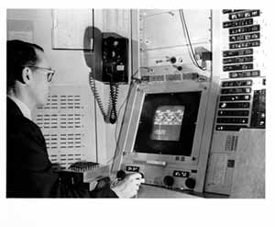
Innovator: Ivan Sutherland
SketchPad - 1963 PhD thesis at MIT
  Hierarchy - pictures & subpictures
  Master picture with instances (ie, OOP)
  Constraints
  Icons
  Copying
  Light pen input device
  Recursive operations

Slide 38
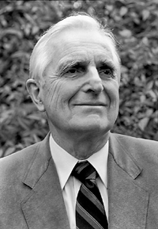
Innovator: Douglas Englebart
Landmark system/demo:
  hierarchical hypertext, multimedia, mouse, high-res display, windows, shared files, electronic messaging, CSCW, teleconferencing, ...
Inventor
of mouse

Slide 39

About Doug Engelbart
Graduate of Berkeley (EE '55)
  "bi-stable gaseous plasma digital devices"
Stanford Research Institute (SRI)
  Augmentation Research Center
1962 Paper "Conceptual Model for Augmenting Human Intellect"
  Complexity of problems increasing
  Need better ways of solving problems
Picture of Engelbart from bootstrap.org
Notes:
Picture of Engelbart from bootstrap.org

Slide 40
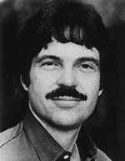
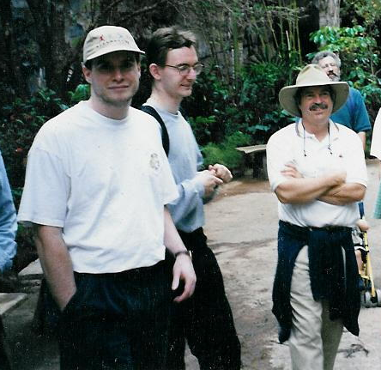
Innovator: Alan Kay
Dynabook - Notebook sized computer loaded with multimedia and can store everything
@PARC
Personal
computing
Desktop
interface
Overlapping
windows

Slide 41

Innovator: Ben Shneiderman
Coins and explores notion of direct manipulation of interface
Long-time Director of
HCI Lab at Maryland

Slide 42
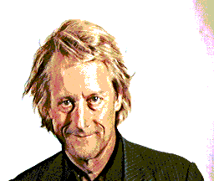
Innovator: Ted Nelson
Computers can help people, not just business
Coined term
“hypertext”

Slide 43
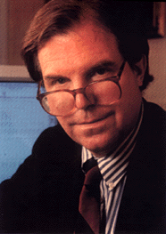
Innovator: Nicholas Negroponte
MIT Architecture Machine Group
  ’69-’80s - prior to Media Lab
Ideas
  wall-sized displays, video
  disks, AI in interfaces
  (agents), speech recognition,
  multimedia with hypertext
  Put That There (Video)

Slide 44
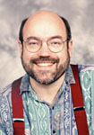
Innovator: Mark Weiser
Introduced notion of Ubiquitous Computing and Calm Technology
  It’s everywhere, but recedes quietly into background
CTO of Xerox PARC

Slide 45
Next Lecture
Interaction Design Basics

Slide 46
References
Alan Dix, Janet Finlay, Gregory D. Abowd, Russell Beale, “Human-Computer Interaction, 3rd Edition”, Prentice Hall, 2004, ISBN: 0-13-046109-1

