Slide 1


CSE309 Computer Architecture and Organization
Lecture #4
Computers Systems: Memory
Prepared & Presented by Asst. Prof. Dr. Samsun M. BAŞARICI

Slide 2
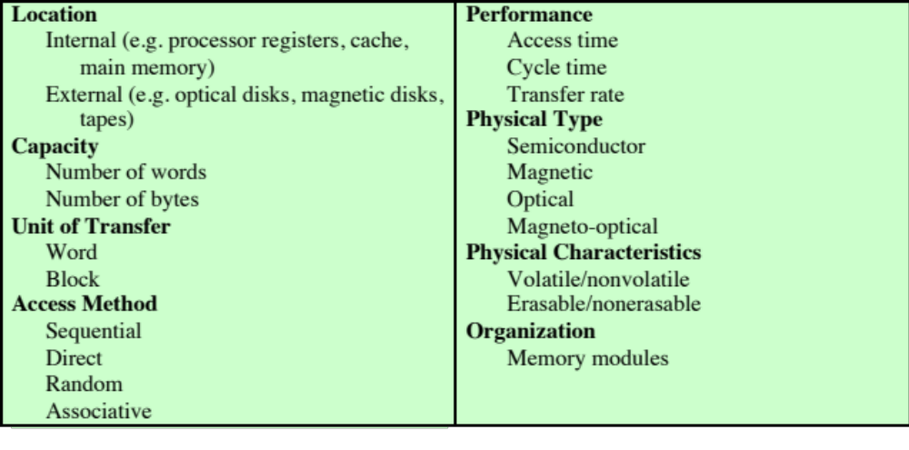
Key Characteristics of Computer Memory Systems
Notes:
The complex subject of computer memory is made more manageable if we classify
memory systems according to their key characteristics. The most important of these
are listed in Table 4.1.

Slide 3
Characteristics of Memory Systems
Location
  Refers to whether memory is internal and external to the computer
  Internal memory is often equated with main memory
  Processor requires its own local memory, in the form of registers
  Cache is another form of internal memory
  External memory consists of peripheral storage devices that are accessible to the processor via I/O controllers
Capacity
  Memory is typically expressed in terms of bytes
Unit of transfer
  For internal memory the unit of transfer is equal to the number of electrical lines into and out of the memory module
Notes:
The term location in Table 4.1 refers to whether memory is internal and external
to the computer. Internal memory is often equated with main memory. But there
are other forms of internal memory. The processor requires its own local memory, in
the form of registers (e.g., see Figure 2.3). Further, as we shall see, the control unit
portion of the processor may also require its own internal memory. We will defer
discussion of these latter two types of internal memory to later chapters. Cache is
another form of internal memory. External memory consists of peripheral storage
devices, such as disk and tape, that are accessible to the processor via I/O controllers.
An obvious characteristic of memory is its capacity. For internal memory, this is
typically expressed in terms of bytes (1 byte = 8 bits) or words. Common word lengths
are 8, 16, and 32 bits. External memory capacity is typically expressed in terms of bytes.
A related concept is the unit of transfer. For internal memory, the unit
of transfer is equal to the number of electrical lines into and out of the memory
module. This may be equal to the word length, but is often larger, such as 64, 128, or
256 bits. To clarify this point, consider three related concepts for internal memory:
• Word: The “natural” unit of organization of memory. The size of a word is typically
equal to the number of bits used to represent an integer and to the instruction
length. Unfortunately, there are many exceptions. For example, the CRAY
C90 (an older model CRAY supercomputer) has a 64-bit word length but uses
a 46-bit integer representation. The Intel x86 architecture has a wide variety of
instruction lengths, expressed as multiples of bytes, and a word size of 32 bits.
• Addressable units: In some systems, the addressable unit is the word. However,
many systems allow addressing at the byte level. In any case, the relationship
between the length in bits A of an address and the number N of addressable
units is 2^{A} = N.
• Unit of transfer: For main memory, this is the number of bits read out of or
written into memory at a time. The unit of transfer need not equal a word or
an addressable unit. For external memory, data are often transferred in much
larger units than a word, and these are referred to as blocks

Slide 4
Method of Accessing Units of Data
Sequential access
Memory is organized into units of data called records
Access must be made in a specific linear sequence
Access time is variable
Direct access
Involves a shared read-write mechanism
Individual blocks or records have a unique address based on physical location
Access time is variable
Random access
Each addressable location in memory has a unique, physically wired-in addressing mechanism
The time to access a given location is independent of the sequence of prior accesses and is constant
Any location can be selected at random and directly addressed and accessed
Main memory and some cache systems are random access
Associative
A word is retrieved based on a portion of its contents rather than its address
Each location has its own addressing mechanism and retrieval time is constant independent of location or prior access patterns
Cache memories may employ associative access
Notes:
Another distinction among memory types is the method of accessing units of
data. These include the following:
• Sequential access: Memory is organized into units of data, called records.
Access must be made in a specific linear sequence. Stored addressing information
is used to separate records and assist in the retrieval process. A shared
read–write mechanism is used, and this must be moved from its current location
to the desired location, passing and rejecting each intermediate record.
Thus, the time to access an arbitrary record is highly variable. Tape units, discussed
in Chapter 6, are sequential access.
Direct access: As with sequential access, direct access involves a shared
read–write mechanism. However, individual blocks or records have a unique
address based on physical location. Access is accomplished by direct access
to reach a general vicinity plus sequential searching, counting, or waiting to
reach the final location. Again, access time is variable. Disk units, discussed in
Chapter 6, are direct access.
• Random access: Each addressable location in memory has a unique, physically
wired-in addressing mechanism. The time to access a given location is independent
of the sequence of prior accesses and is constant. Thus, any location
can be selected at random and directly addressed and accessed. Main memory
and some cache systems are random access.
• Associative: This is a random access type of memory that enables one to make
a comparison of desired bit locations within a word for a specified match, and
to do this for all words simultaneously. Thus, a word is retrieved based on a
portion of its contents rather than its address. As with ordinary random-access
memory, each location has its own addressing mechanism, and retrieval time
is constant independent of location or prior access patterns. Cache memories
may employ associative access.

Slide 5
Capacity and Performance:
The two most important characteristics of memory
Three performance parameters are used:
Access time (latency)
For random-access memory it is the time it takes to perform a read or write operation
For non-random-access memory it is the time it takes to position the read-write mechanism at the desired location
Memory cycle time
Access time plus any additional time required before second access can commence
Additional time may be required for transients to die out on signal lines or to regenerate data if they are read destructively
Concerned with the system bus, not the processor
Transfer rate
The rate at which data can be transferred into or out of a memory unit
For random-access memory it is equal to 1/(cycle time)
Notes:
From a user’s point of view, the two most important characteristics of memory
are capacity and performance. Three performance parameters are used:
• Access time (latency): For random-access memory, this is the time it takes to
perform a read or write operation, that is, the time from the instant that an
address is presented to the memory to the instant that data have been stored
or made available for use. For non-random-access memory, access time is the
time it takes to position the read–write mechanism at the desired location.
• Memory cycle time: This concept is primarily applied to random-access memory
and consists of the access time plus any additional time required before a second
access can commence. This additional time may be required for transients to die
out on signal lines or to regenerate data if they are read destructively. Note that
memory cycle time is concerned with the system bus, not the processor.
• Transfer rate: This is the rate at which data can be transferred into or out of a
memory unit. For random-access memory, it is equal to 1/(cycle time).

Slide 6

Memory
  The most common forms are:
  Semiconductor memory
  Magnetic surface memory
  Optical
  Magneto-optical
  Several physical characteristics of data storage are important:
  Volatile memory
    Information decays naturally or is lost when electrical power is switched off
  Nonvolatile memory
    Once recorded, information remains without deterioration until deliberately changed
    No electrical power is needed to retain information
  Magnetic-surface memories
    Are nonvolatile
  Semiconductor memory
    May be either volatile or nonvolatile
  Nonerasable memory
    Cannot be altered, except by destroying the storage unit
    Semiconductor memory of this type is known as read-only memory (ROM)
  For random-access memory the organization is a key design issue
  Organization refers to the physical arrangement of bits to form words
Notes:
A variety of physical types of memory have been employed. The most common
today are semiconductor memory, magnetic surface memory, used for disk and
tape, and optical and magneto-optical.
Several physical characteristics of data storage are important. In a volatile
memory, information decays naturally or is lost when electrical power is switched
off. In a nonvolatile memory, information once recorded remains without deterioration
until deliberately changed; no electrical power is needed to retain information.
Magnetic-surface memories are nonvolatile. Semiconductor memory (memory
on integrated circuits) may be either volatile or nonvolatile. Nonerasable memory
cannot be altered, except by destroying the storage unit. Semiconductor memory of
this type is known as read-only memory (ROM). Of necessity, a practical nonerasable
memory must also be nonvolatile.
For random-access memory, the organization is a key design issue. In this context,
organization refers to the physical arrangement of bits to form words. The
obvious arrangement is not always used, as is explained in Chapter 5.

Slide 7
Part 1
Internal Memory

Slide 8
Memory Hierarchy
Design constraints on a computer’s memory can be summed up by three questions:
  How much, how fast, how expensive
There is a trade-off among capacity, access time, and cost
  Faster access time, greater cost per bit
  Greater capacity, smaller cost per bit
  Greater capacity, slower access time
The way out of the memory dilemma is not to rely on a single memory component or technology, but to employ a memory hierarchy
Notes:
The design constraints on a computer’s memory can be summed up by three questions:
How much? How fast? How expensive?
The question of how much is somewhat open ended. If the capacity is there,
applications will likely be developed to use it. The question of how fast is, in a sense,
easier to answer. To achieve greatest performance, the memory must be able to
keep up with the processor. That is, as the processor is executing instructions, we
would not want it to have to pause waiting for instructions or operands. The final
question must also be considered. For a practical system, the cost of memory must
be reasonable in relationship to other components.
As might be expected, there is a trade-off among the three key characteristics
of memory: capacity, access time, and cost. A variety of technologies are used to
implement memory systems, and across this spectrum of technologies, the following
relationships hold:
• Faster access time, greater cost per bit
• Greater capacity, smaller cost per bit
• Greater capacity, slower access time
The dilemma facing the designer is clear. The designer would like to use memory
technologies that provide for large-capacity memory, both because the capacity
is needed and because the cost per bit is low. However, to meet performance
requirements, the designer needs to use expensive, relatively lower-capacity memories
with short access times.
The way out of this dilemma is not to rely on a single memory component or
technology, but to employ a memory hierarchy.

Slide 9
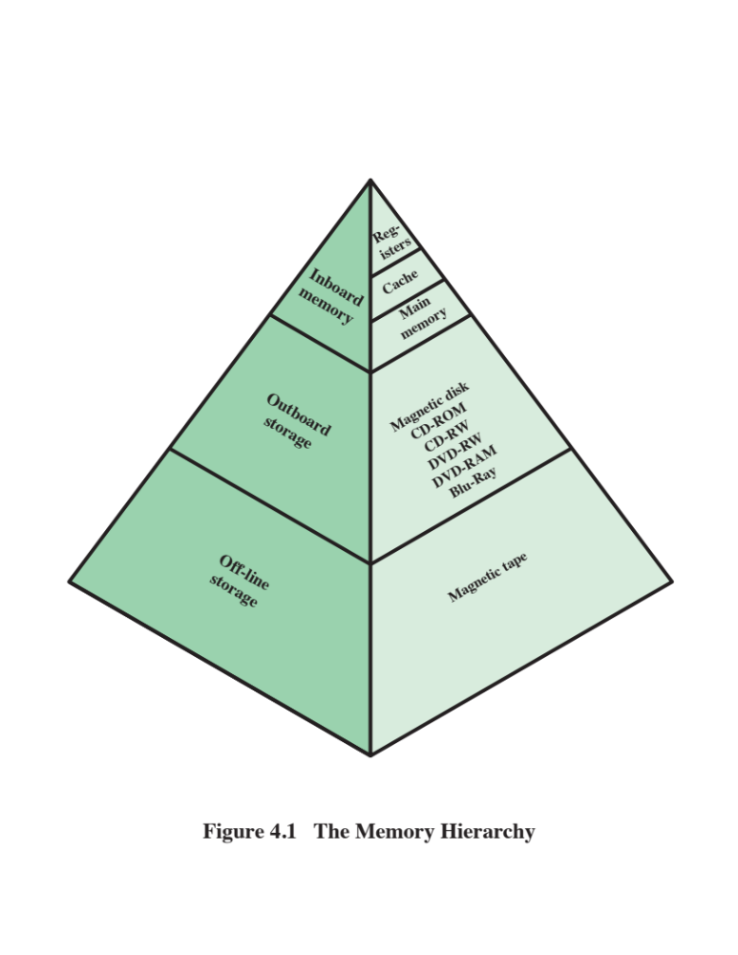
Notes:
A typical hierarchy is illustrated in
Figure 4.1. As one goes down the hierarchy, the following occur:
a. Decreasing cost per bit
b. Increasing capacity
c. Increasing access time
d. Decreasing frequency of access of the memory by the processor
Thus, smaller, more expensive, faster memories are supplemented by larger,
cheaper, slower memories. The key to the success of this organization is item (d)
:decreasing frequency of access. We examine this concept in greater detail when we
discuss the cache, later in this chapter, and virtual memory in Chapter 8. A brief
explanation is provided at this point.
The use of two levels of memory to reduce average access time works in principle,
but only if conditions (a) through (d) apply. By employing a variety of technologies,
a spectrum of memory systems exists that satisfies conditions (a) through
(c). Fortunately, condition (d) is also generally valid.
The basis for the validity of condition (d) is a principle known as locality of
reference [DENN68]. During the course of execution of a program, memory references
by the processor, for both instructions and data, tend to cluster. Programs
typically contain a number of iterative loops and subroutines. Once a loop or subroutine
is entered, there are repeated references to a small set of instructions.
Similarly, operations on tables and arrays involve access to a clustered set of data
words. Over a long period of time, the clusters in use change, but over a short period
of time, the processor is primarily working with fixed clusters of memory references.

Slide 10
Memory Hierarchy (Cont.)
As one goes down the hierarchy, the following occur:
  a. Decreasing cost per bit
  b. Increasing capacity
  c. Increasing access time
  d. Decreasing frequency of access of the memory by the processor
The key to the success of this organization is item (d) decreasing frequency of access.
The basis for the validity of condition (d) is a principle known as locality of reference

Slide 11
Locality
Main reason why caches work.
Coming soon

Slide 12
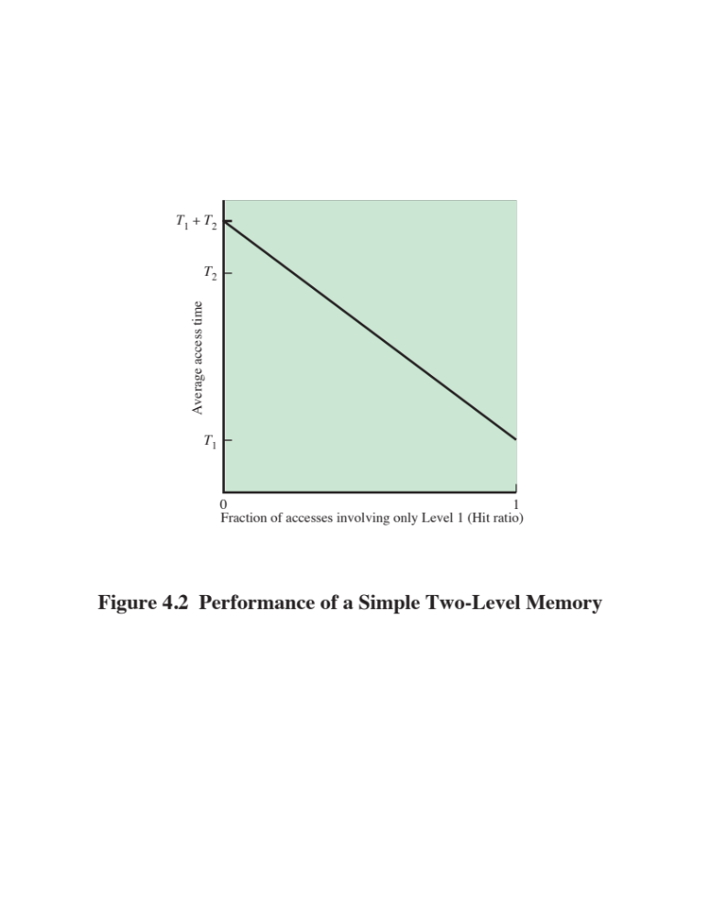
Notes:
Suppose that the processor has access to two levels of memory. Level
1 contains 1000 words and has an access time of 0.01 μs; level 2 contains 100,000 words
and has an access time of0.1 μs. Assume that if a word to be accessed is in level 1, then the
processor accesses it directly. If it is in level 2, then the word is first transferred to level 1
and then accessed by the processor. For simplicity, we ignore the time required for the processor
to determine whether the word is in level 1 or level 2. Figure 4.2 shows the general
shape of the curve that covers this situation. The figure shows the average access time to
a two-level memory as a function of the hit ratio H, where H is defined as the fraction of
all memory accesses that are found in the faster memory (e.g., the cache), T₁ is the access
time to level 1, and T₂ is the access time to level 2. As can be seen, for high percentages
of level 1 access, the average total access time is much closer to that of level 1 than that
of level 2.
In our example, suppose 95% of the memory accesses are found in level 1. Then the
average time to access a word can be expressed as
(0.95)(0.01 μs) + (0.05)(0.01 μs + 0.1 μs) = 0.0095 + 0.0055 = 0.015 μs
The average access time is much closer to 0.01 μs than to 0.1 μs, as desired.
Accordingly, it is possible to organize data across the hierarchy such that the
percentage of accesses to each successively lower level is substantially less than that
of the level above. Consider the two-level example already presented. Let level 2
memory contains all program instructions and data. The current clusters can be
temporarily placed in level 1. From time to time, one of the clusters in level 1 will
have to be swapped back to level 2 to make room for a new cluster coming in to
level 1. On average, however, most references will be to instructions and data contained
in level 1.
This principle can be applied across more than two levels of memory, as suggested
by the hierarchy shown in Figure 4.1. The fastest, smallest, and most expensive
type of memory consists of the registers internal to the processor. Typically, a
processor will contain a few dozen such registers, although some machines contain
hundreds of registers. Main memory is the principal internal memory system of
the computer. Each location in main memory has a unique address. Main memory
is usually extended with a higher-speed, smaller cache. The cache is not usually
visible to the programmer or, indeed, to the processor. It is a device for staging
the movement of data between main memory and processor registers to improve
performance.

Slide 13
Memory
The use of three levels exploits the fact that semiconductor memory comes in a variety of types which differ in speed and cost
Data are stored more permanently on external mass storage devices
External, nonvolatile memory is also referred to as secondary memory or auxiliary memory
Disk cache
  A portion of main memory can be used as a buffer to hold data temporarily that is to be read out to disk
  A few large transfers of data can be used instead of many small transfers of data
  Data can be retrieved rapidly from the software cache rather than slowly from the disk
Notes:
The three forms of memory just described are, typically, volatile and employ
semiconductor technology. The use of three levels exploits the fact that semiconductor
memory comes in a variety of types, which differ in speed and cost. Data are
stored more permanently on external mass storage devices, of which the most common
are hard disk and removable media, such as removable magnetic disk, tape,
and optical storage. External, nonvolatile memory is also referred to as secondary
memory or auxiliary memory . These are used to store program and data files and
are usually visible to the programmer only in terms of files and records, as opposed
to individual bytes or words. Disk is also used to provide an extension to main memory
known as virtual memory, which is discussed in Chapter 8.
Other forms of memory may be included in the hierarchy. For example, large
IBM mainframes include a form of internal memory known as expanded storage.
This uses a semiconductor technology that is slower and less expensive than that
of main memory. Strictly speaking, this memory does not fit into the hierarchy but
is a side branch: Data can be moved between main memory and expanded storage
but not between expanded storage and external memory. Other forms of secondary
memory include optical and magneto-optical disks. Finally, additional levels can be
effectively added to the hierarchy in software. A portion of main memory can be
used as a buffer to hold data temporarily that is to be read out to disk. Such a technique,
sometimes referred to as a disk cache, improves performance in two ways:
■ Disk writes are clustered. Instead of many small transfers of data, we have
a few large transfers of data. This improves disk performance and minimizes
processor involvement.
■ Some data destined for write-out
may be referenced by a program before the
next dump to disk. In that case, the data are retrieved rapidly from the software
cache rather than slowly from the disk.
Appendix 4A examines the performance implications of multilevel memory
structures.

Slide 14
Part 1.1
Cache Memory

Slide 15
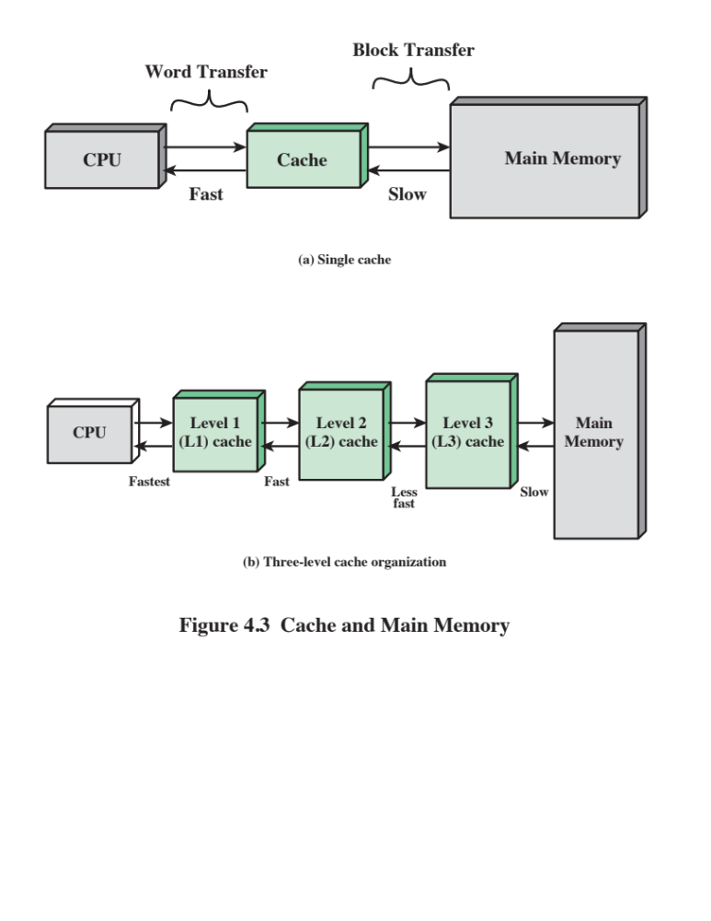
Notes:
Cache memory is designed to combine the memory access time of expensive, high-speed
memory combined with the large memory size of less expensive, lower-speed
memory.
The concept is illustrated in Figure 4.3a. There is a relatively large and slow
main memory together with a smaller, faster cache memory. The cache contains a
copy of portions of main memory. When the processor attempts to read a word of
memory, a check is made to determine if the word is in the cache. If so, the word is
delivered to the processor. If not, a block of main memory, consisting of some fixed
number of words, is read into the cache and then the word is delivered to the processor.
Because of the phenomenon of locality of reference, when a block of data is
fetched into the cache to satisfy a single memory reference, it is likely that there will
be future references to that same memory location or to other words in the block.
Figure 4.3b depicts the use of multiple levels of cache. The L2 cache is slower
and typically larger than the L1 cache, and the L3 cache is slower and typically
larger than the L2 cache.

Slide 16
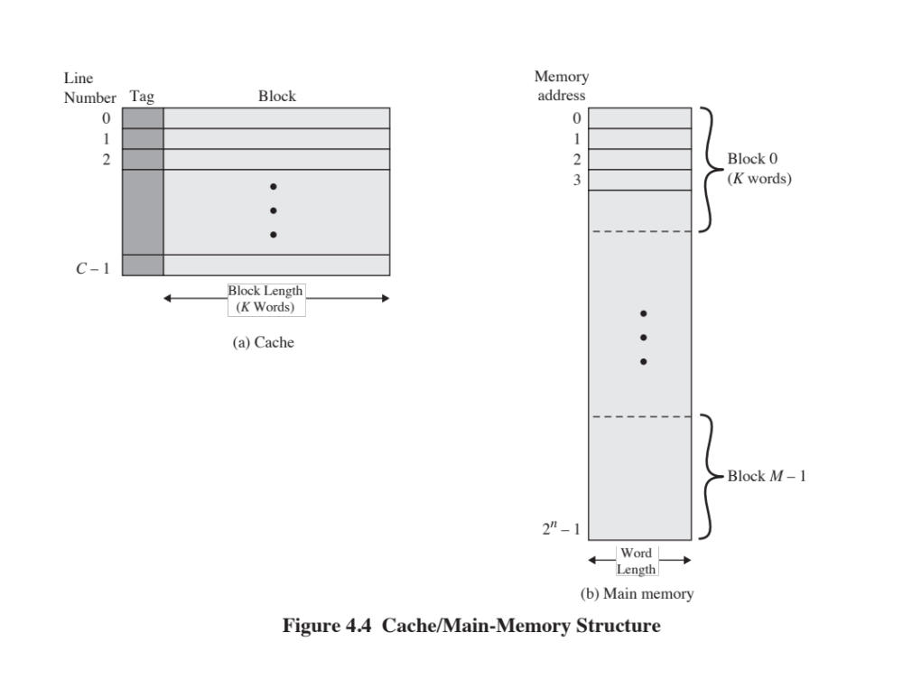
Notes:
Figure 4.4 depicts the structure of a cache/main-memory system.

Slide 17
The principle of locality
It’s usually difficult or impossible to figure out what data will be “most frequently accessed” before a program actually runs, which makes it hard to know what to store into the small, precious cache memory.
But in practice, most programs exhibit locality, which the cache can take advantage of.
  The principle of temporal locality says that if a program accesses one memory address, there is a good chance that it will access the same address again.
  The principle of spatial locality says that if a program accesses one memory address, there is a good chance that it will also access other nearby addresses.

Slide 18
Temporal locality in programs
The principle of temporal locality says that if a program accesses one memory address, there is a good chance that it will access the same address again.
Loops are excellent examples of temporal locality in programs.
  The loop body will be executed many times.
  The computer will need to access those same few locations of the instruction memory repeatedly.
For example:
  Each instruction will be fetched over and over again, once on every loop iteration.
Loop: lw $t0, 0($s1)
add $t0, $t0, $s2
sw $t0, 0($s1)
addi $s1, $s1, -4
bne $s1, $0, Loop

Slide 19
Temporal locality in data
Programs often access the same variables over and over, especially within loops. Below, sum and i are repeatedly read and written.
Commonly-accessed variables can sometimes be kept in registers, but this is not always possible.
  There are a limited number of registers.
  There are situations where the data must be kept in memory, as is the case with shared or dynamically-allocated memory.
sum = 0;
for (i = 0; i < MAX; i++)
sum = sum + f(i);

Slide 20
Spatial locality in programs
The principle of spatial locality says that if a program accesses one memory address, there is a good chance that it will also access other nearby addresses.
Nearly every program exhibits spatial locality, because instructions are usually executed in sequence—if we execute an instruction at memory location i, then we will probably also execute the next instruction, at memory location i+1.
Code fragments such as loops exhibit both temporal and spatial locality.
sub $sp, $sp, 16
sw $ra, 0($sp)
sw $s0, 4($sp)
sw $a0, 8($sp)
sw $a1, 12($sp)

Slide 21

Spatial locality in data
Programs often access data that is stored contiguously.
  Arrays, like a in the code on the top, are stored in memory contiguously.
  The individual fields of a record or object like employee are also kept contiguously in memory.
Can data have both spatial and temporal locality?
sum = 0;
for (i = 0; i < MAX; i++)
sum = sum + a[i];
employee.name = “Homer Simpson”;
employee.boss = “Mr. Burns”;
employee.age = 45;

Slide 22
How caches take advantage of temporal locality
The first time the processor reads from an address in main memory, a copy of that data is also stored in the cache.
  The next time that same address is read, we can use the copy of the data in the cache instead of accessing the slower dynamic memory.
  So the first read is a little slower than before since it goes through both main memory and the cache, but subsequent reads are much faster.
This takes advantage of temporal locality—commonly accessed data is stored in the faster cache memory.
CPU
A little static
RAM (cache)
Lots of
dynamic RAM

Slide 23
How caches take advantage of spatial locality (Cont.)
When the CPU reads location i from main memory, a copy of that data is placed in the cache.
But instead of just copying the contents of location i, we can copy several values into the cache at once, such as the four bytes from locations i through i + 3.
  If the CPU later does need to read from locations i + 1, i + 2 or i + 3, it can access that data from the cache and not the slower main memory.
  For example, instead of reading just one array element at a time, the cache might actually be loading four array elements at once.
Again, the initial load incurs a performance penalty, but we’re gambling on spatial locality and the chance that the CPU will need the extra data.
CPU
A little static
RAM (cache)
Lots of
dynamic RAM

Slide 24
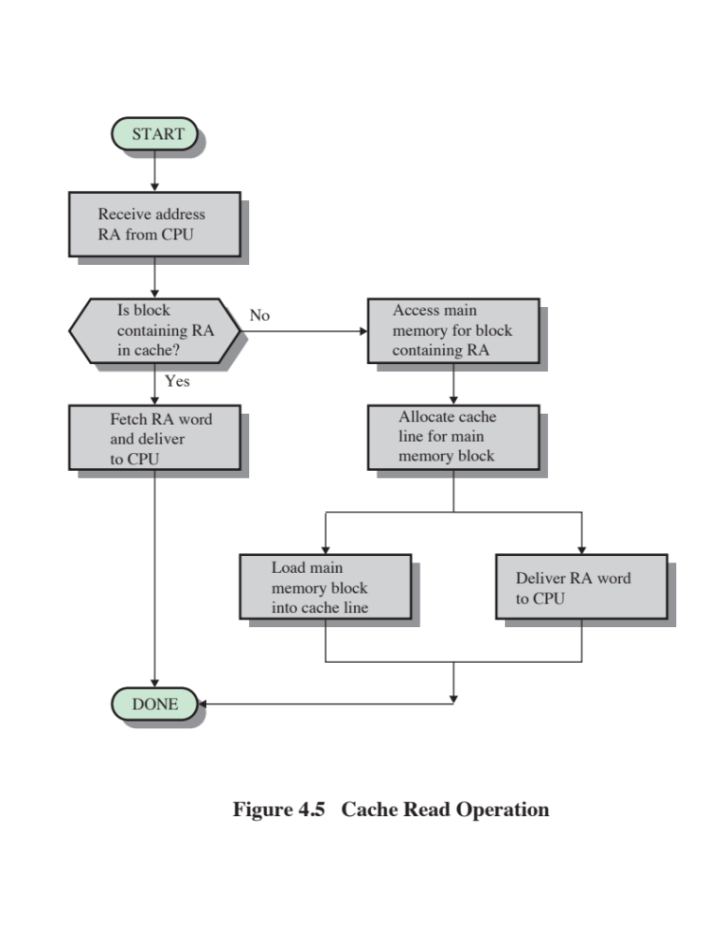
Notes:
Figure 4.5 illustrates the read operation. The processor generates the read
address (RA) of a word to be read. If the word is contained in the cache, it is delivered
to the processor. Otherwise, the block containing that word is loaded into the
cache, and the word is delivered to the processor.
Figure 4.5 shows these last two
operations occurring in parallel and reflects the organization shown in Figure 4.6,
which is typical of contemporary cache organizations.

Slide 25
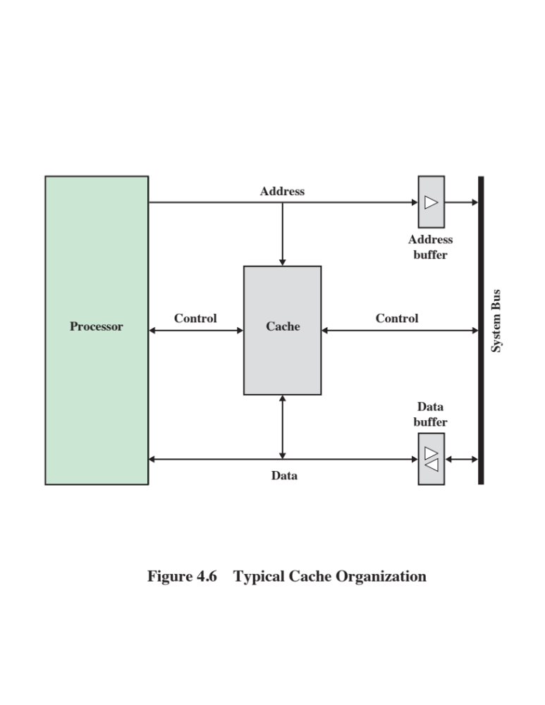
Notes:
In this organization, the cache
connects to the processor via data, control, and address lines. The data and address
lines also attach to data and address buffers, which attach to a system bus from
which main memory is reached. When a cache hit occurs, the data and address buffers
are disabled and communication is only between processor and cache, with no
system bus traffic. When a cache miss occurs, the desired address is loaded onto the
system bus and the data are returned through the data buffer to both the cache and
the processor. In other organizations, the cache is physically interposed between
the processor and the main memory for all data, address, and control lines. In this
latter case, for a cache miss, the desired word is first read into the cache and then
transferred from cache to processor.
A discussion of the performance parameters related to cache use is contained
in Appendix 4A.

Slide 26
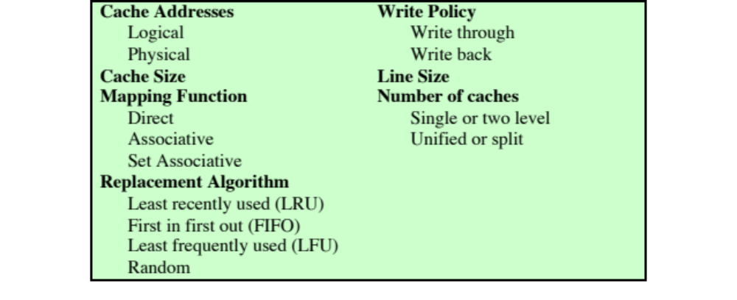
Elements of Cache Design
Notes:
This section provides an overview of cache design parameters and reports some
typical results. We occasionally refer to the use of caches in high-performance computing
(HPC). HPC deals with supercomputers and their software, especially for
scientific applications that involve large amounts of data, vector and matrix computation,
and the use of parallel algorithms. Cache design for HPC is quite different
than for other hardware platforms and applications. Indeed, many researchers
have found that HPC applications perform poorly on computer architectures that
employ caches [BAIL93]. Other researchers have since shown that a cache hierarchy
can be useful in improving performance if the application software is tuned to
exploit the cache [WANG99, PRES01].
Although there are a large number of cache implementations, there are a few
basic design elements that serve to classify and differentiate cache architectures.
Table 4.2 lists key elements.

Slide 27

Cache Addresses
Virtual Memory
Virtual memory
  Facility that allows programs to address memory from a logical point of view, without regard to the amount of main memory physically available
  When used, the address fields of machine instructions contain virtual addresses
  For reads to and writes from main memory, a hardware memory management unit (MMU) translates each virtual address into a physical address in main memory
Notes:
Almost all non-embedded processors, and many embedded processors, support virtual
memory, a concept discussed in Chapter 8. In essence, virtual memory is a facility
that allows programs to address memory from a logical point of view, without
regard to the amount of main memory physically available. When virtual memory is
used, the address fields of machine instructions contain virtual addresses. For reads
to and writes from main memory, a hardware memory management unit (MMU)
translates each virtual address into a physical address in main memory.

Slide 28
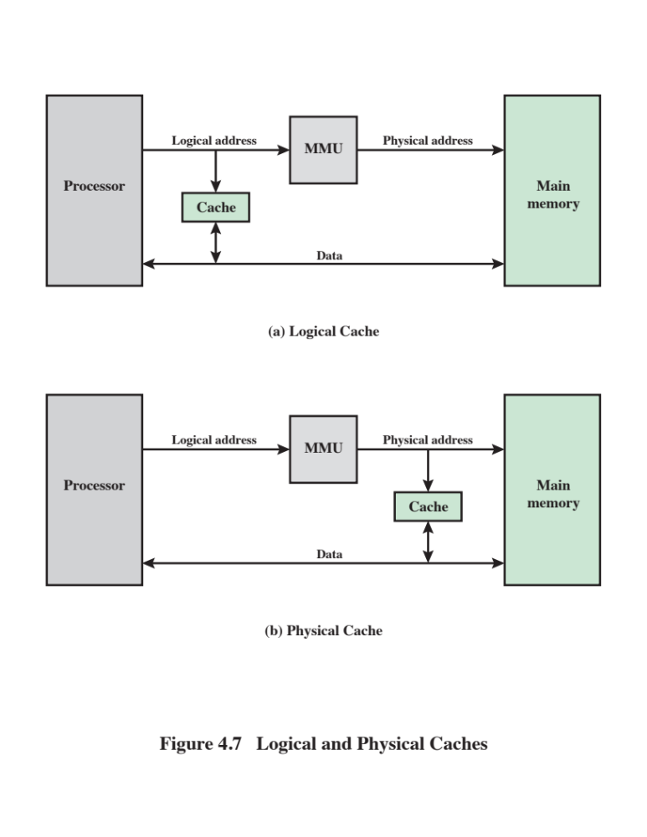
Notes:
When virtual addresses are used, the system designer may choose to place the
cache between the processor and the MMU or between the MMU and main memory
(Figure 4.7). A logical cache, also known as a virtual cache, stores data using
virtual addresses. The processor accesses the cache directly, without going through
the MMU. A physical cache stores data using main memory physical addresses.
One obvious advantage of the logical cache is that cache access speed is faster
than for a physical cache, because the cache can respond before the MMU performs
an address translation. The disadvantage has to do with the fact that most virtual
memory systems supply each application with the same virtual memory address
space. That is, each application sees a virtual memory that starts at address 0. Thus,
the same virtual address in two different applications refers to two different physical
addresses. The cache memory must therefore be completely flushed with each
application context switch, or extra bits must be added to each line of the cache to
identify which virtual address space this address refers to.

Slide 29
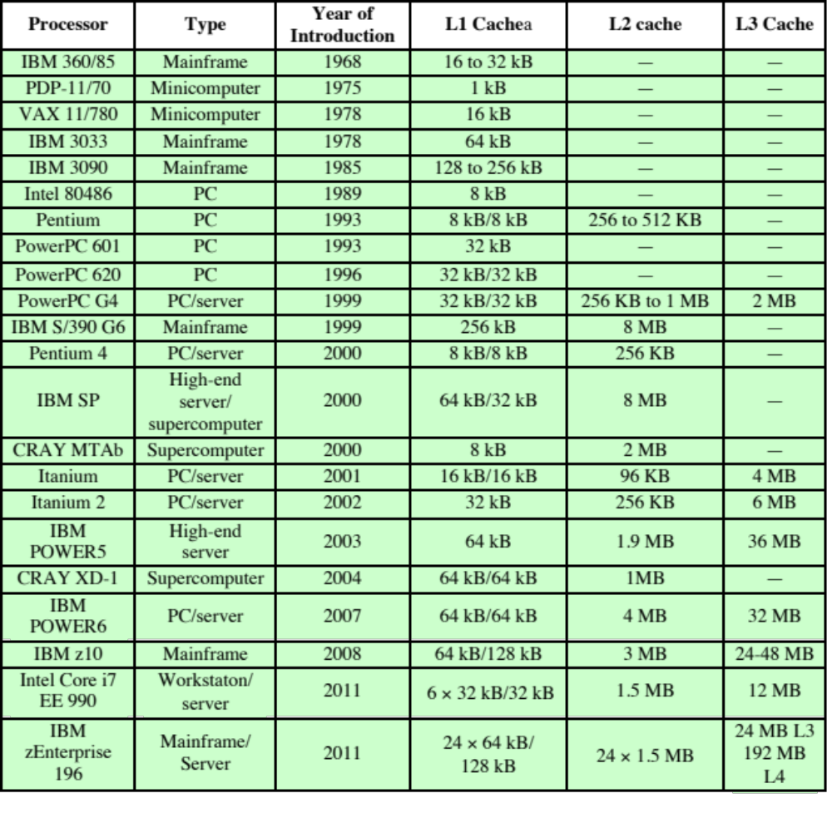
Table 4.3
Cache Sizes of Some Processors
ª Two values separated by a slash refer to instruction and data caches.
^{b} Both caches are instruction only; no data caches.
(Table can be found on page 134 in the textbook.)
Notes:
The first item in Table 4.2, cache size, has already been discussed. We would like the
size of the cache to be small enough so that the overall average cost per bit is close
to that of main memory alone and large enough so that the overall average access
time is close to that of the cache alone. There are several other motivations for
minimizing cache size. The larger the cache, the larger the number of gates involved
in addressing the cache. The result is that large caches tend to be slightly slower
than small ones—even when built with the same integrated circuit technology and
put in the same place on chip and circuit board. The available chip and board area
also limits cache size. Because the performance of the cache is very sensitive to the
nature of the workload, it is impossible to arrive at a single “optimum” cache size.
Table 4.3 lists the cache sizes of some current and past processors.

Slide 30
Mapping Function
Because there are fewer cache lines than main memory blocks, an algorithm is needed for mapping main memory blocks into cache lines
Three techniques can be used:
Direct
The simplest technique
Maps each block of main memory into only one possible cache line
Associative
Permits each main memory block to be loaded into any line of the cache
The cache control logic interprets a memory address simply as a Tag and a Word field
To determine whether a block is in the cache, the cache control logic must simultaneously examine every line’s Tag for a match
Set Associative
A compromise that exhibits the strengths of both the direct and associative approaches while reducing their disadvantages
Notes:
Because there are fewer cache lines than main memory blocks, an algorithm is
needed for mapping main memory blocks into cache lines. Further, a means is
needed for determining which main memory block currently occupies a cache line.
The choice of the mapping function dictates how the cache is organized. Three
techniques can be used: direct, associative, and set associative.
Direct mapping: The simplest technique, known as direct mapping, maps each
block of main memory into only one possible cache line.
Associative mapping: Associative mapping overcomes the disadvantage of direct
mapping by permitting each main memory block to be loaded into any line of the
cache.
Set-associative mapping: Set-associative mapping is a compromise that
exhibits the strengths of both the direct and associative approaches while reducing
their disadvantages.

Slide 31
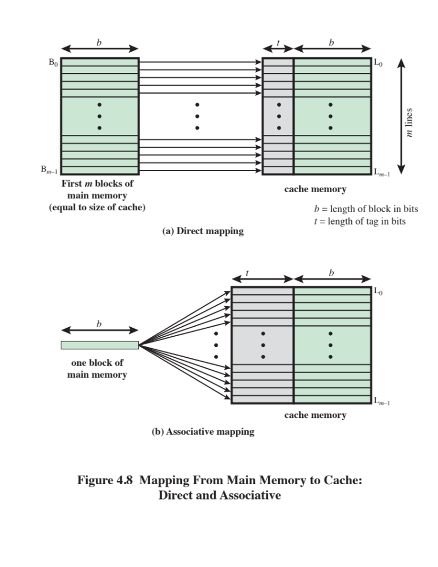
Notes:
The mapping is expressed as
i = j modulo m
where
i = cache line number
j = main memory block number
m = number of lines in the cache
Figure 4.8a shows the mapping for the first m blocks of main memory. Each
block of main memory maps into one unique line of the cache. The next m blocks
of main memory map into the cache in the same fashion; that is, block B_{m} of main
memory maps into line L₀ of cache, block _{Bm+1} maps into line L₁, and so on.

Slide 32
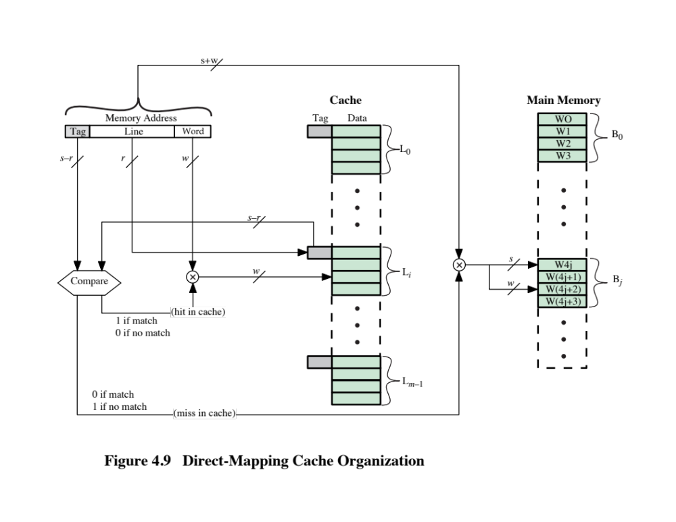
Notes:
The mapping function is easily implemented using the main memory address.
Figure 4.9 illustrates the general mechanism.
For purposes of cache access, each
main memory address can be viewed as consisting of three fields. The least significant
w bits identify a unique word or byte within a block of main memory; in most
contemporary machines, the address is at the byte level. The remaining s bits specify
one of the 2^{s} blocks of main memory. The cache logic interprets these s bits as
a tag of s - r bits (most significant portion) and a line field of r bits. This latter field
identifies one of the m = 2^{r} lines of the cache. To summarize,
■ Address length = (s + w ) bits
■ Number of addressable units = 2^{s+w} words or bytes
■ Block size = line size = 2^{w} words or bytes
■ Number of blocks in main memory = 2^{s+w}/2^{w} = 2^{s}
■ Number of lines in cache = m = 2^{r}
■ Size of cache = 2^{r+w} words or bytes
■ Size of tag = (s - r ) bits

Slide 33
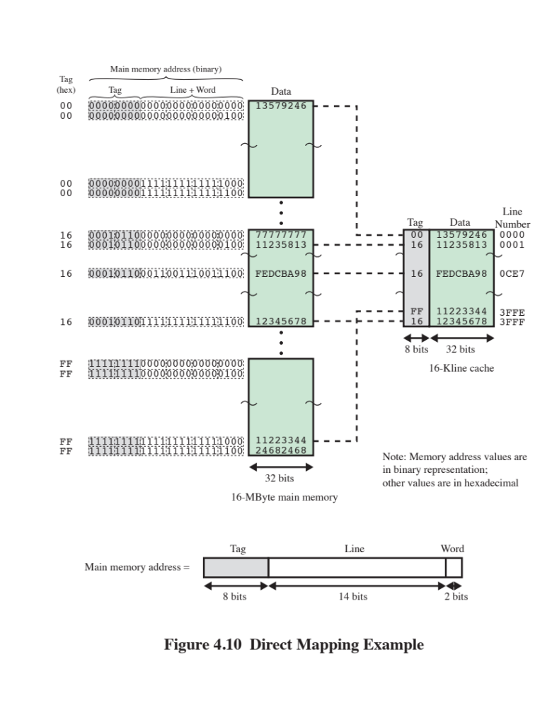
Notes:
Figure 4.10 shows our example system using direct mapping. In the example,
m = 16K = 2¹⁴ and i = j modulo 2¹⁴. The mapping becomes
Cache Line Starting Memory Address of Block
0 000000, 010000, …, FF0000
1 000004, 010004, …, FF0004
. .
. .
. .
2¹⁴ - 1 00FFFC, 01FFFC, …, FFFFFC
Note that no two blocks that map into the same line number have the same tag number. Thus,
blocks with starting addresses 000000, 010000, …, FF0000 have tag numbers 00, 01, …, FF, respectively.
Referring back to Figure 4.5, a read operation works as follows. The cache system is presented
with a 24-bit address. The 14-bit line number is used as an index into the cache to access a particular
line. If the 8-bit tag number matches the tag number currently stored in that line, then the 2-bit word
number is used to select one of the 4 bytes in that line. Otherwise, the 22-bit tag-plus-line
field is used to fetch a block from main memory. The actual address that is used for the fetch is the 22-bit
tag-plus-line concatenated with two 0 bits, so that 4 bytes are fetched starting on a block boundary.
The effect of this mapping is that blocks of main memory are assigned to lines
of the cache as follows:
Cache line Main memory blocks assigned
0 0, m, 2m, c, 2^{s} - m
1 1, m + 1, 2m + 1, c, 2^{s} - m + 1
. .
. .
. .
m - 1 m - 1, 2m - 1, 3m - 1, c, 2^{s} - 1
Thus, the use of a portion of the address as a line number provides a unique
mapping of each block of main memory into the cache. When a block is actually
read into its assigned line, it is necessary to tag the data to distinguish it from other
blocks that can fit into that line. The most significant s - r bits serve this purpose.

Slide 34

Direct Mapping Summary
Address length = (s + w) bits
Number of addressable units = 2^{s+w} words or bytes
Block size = line size = 2^{w} words or bytes
Number of blocks in main memory = 2^{s+ w}/2^{w} = 2^{s}
Number of lines in cache = m = 2^{r}
Size of tag = (s – r) bits
Notes:
The direct mapping technique is simple and inexpensive to implement. Its
main disadvantage is that there is a fixed cache location for any given block. Thus,
if a program happens to reference words repeatedly from two different blocks that
map into the same line, then the blocks will be continually swapped in the cache,
and the hit ratio will be low (a phenomenon known as thrashing).

Slide 35

Victim Cache
  Originally proposed as an approach to reduce the conflict misses of direct mapped caches without affecting its fast access time
Fully associative cache
Typical size is 4 to 16 cache lines
Residing between direct mapped L1 cache and the next level of memory
Notes:
One approach to lower the miss penalty is to remember what was discarded
in case it is needed again. Since the discarded data has already been fetched, it can
be used again at a small cost. Such recycling is possible using a victim cache. Victim
cache was originally proposed as an approach to reduce the conflict misses of direct
mapped caches without affecting its fast access time. Victim cache is a fully associative
cache, whose size is typically 4 to 16 cache lines, residing between a direct mapped L1
cache and the next level of memory. This concept is explored in Appendix F.

Slide 36
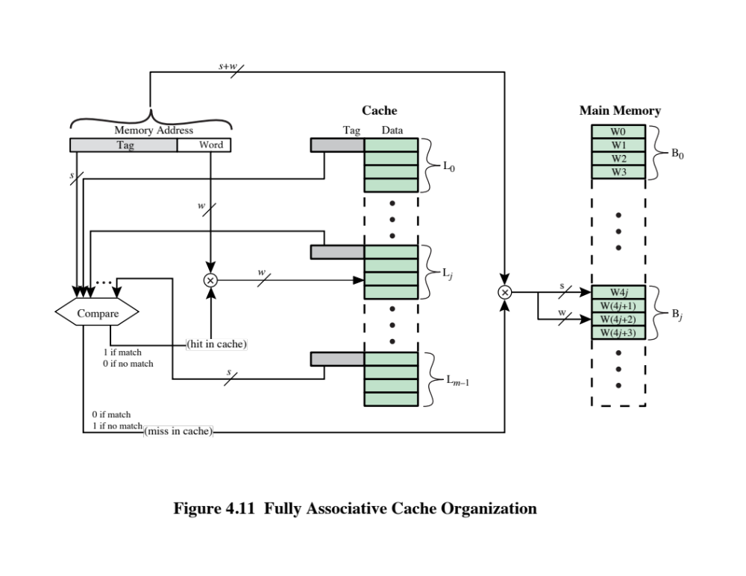
Notes:
Associative mapping overcomes the disadvantage of direct
mapping by permitting each main memory block to be loaded into any line of the
cache (Figure 4.8b). In this case, the cache control logic interprets a memory address
simply as a Tag and a Word field. The Tag field uniquely identifies a block of main
memory. To determine whether a block is in the cache, the cache control logic must
simultaneously examine every line’s tag for a match. Figure 4.11 illustrates the logic.

Slide 37
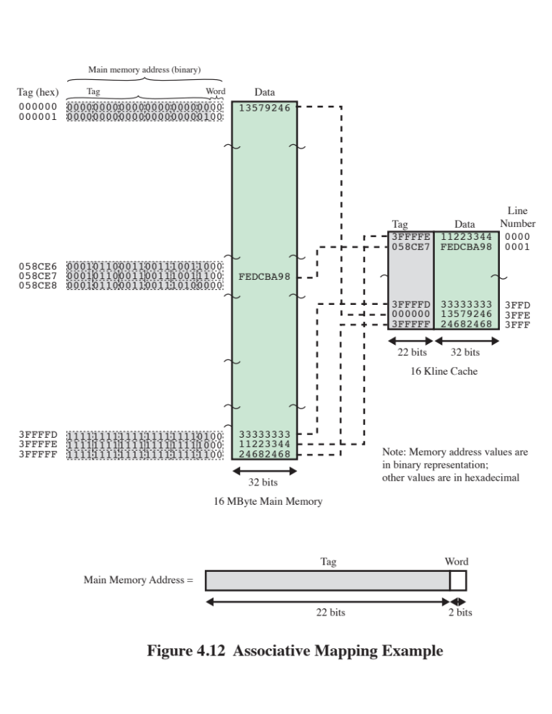
Notes:
Figure 4.12 shows our example using associative mapping. A main
memory address consists of a 22-bit tag and a 2-bit byte number. The 22-bit tag must be
stored with the 32-bit block of data for each line in the cache. Note that it is the leftmost
(most significant) 22 bits of the address that form the tag. Thus, the 24-bit hexadecimal
address 16339C has the 22-bit tag 058CE7. This is easily seen in binary notation:
memory address 0001 0110 0011 0011 1001 1100 (binary)
1 6 3 3 9 C (hex)
tag (leftmost 22 bits) 00 0101 1000 1100 1110 0111 (binary)
0 5 8 C E 7 (hex)

Slide 38
Associative Mapping Summary
Address length = (s + w) bits
Number of addressable units = 2^{s+w} words or bytes
Block size = line size = 2^{w} words or bytes
Number of blocks in main memory = 2^{s+ w}/2^{w} = 2^{s}
Number of lines in cache = undetermined
Size of tag = s bits
Notes:
With associative mapping, there is flexibility as to which block to replace when
a new block is read into the cache. Replacement algorithms, discussed later in this
section, are designed to maximize the hit ratio. The principal disadvantage of associative
mapping is the complex circuitry required to examine the tags of all cache
lines in parallel.

Slide 39
Set Associative Mapping
Compromise that exhibits the strengths of both the direct and associative approaches while reducing their disadvantages
Cache consists of a number of sets
Each set contains a number of lines
A given block maps to any line in a given set
e.g. 2 lines per set
  2 way associative mapping
  A given block can be in one of 2 lines in only one set
Notes:
Set-associative mapping is a compromise that
exhibits the strengths of both the direct and associative approaches while reducing
their disadvantages.
In this case, the cache consists of a number sets, each of which consists of a
number of lines. The relationships are
m = v* k
i = j modulo v
where
i = cache set number
j = main memory block number
m = number of lines in the cache
v = number of sets
k = number of lines in each set
This is referred to as k-way set-associative mapping. With set-associative
mapping,block B_{j} can be mapped into any of the lines of set j.

Slide 40
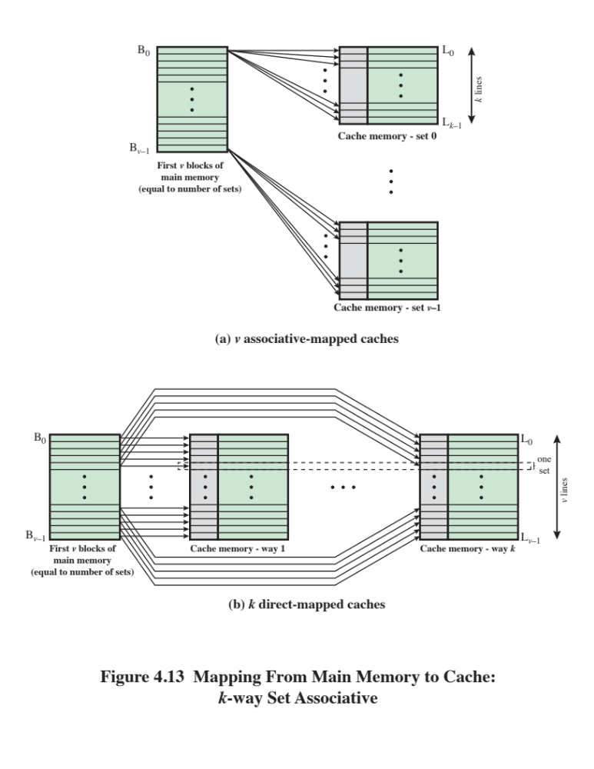
Notes:
Figure 4.13a illustrates
this mapping for the first v blocks of main memory. As with associative mapping,
each word maps into multiple cache lines. For set-associative mapping, each word
maps into all the cache lines in a specific set, so that main memory block B₀ maps
into set 0, and so on. Thus, the set-associative cache can be physically implemented
as n associative caches. It is also possible to implement the set-associative cache as
k direct mapping caches, as shown in Figure 4.13b. Each direct-mapped cache is
referred to as a way, consisting of v lines. The first v lines of main memory are direct
mapped into the v lines of each way; the next group of v lines of main memory are
similarly mapped, and so on. The direct-mapped implementation is typically used
for small degrees of associativity (small values of k) while the associative-mapped
implementation is typically used for higher degrees of associativity [JACO08].

Slide 41
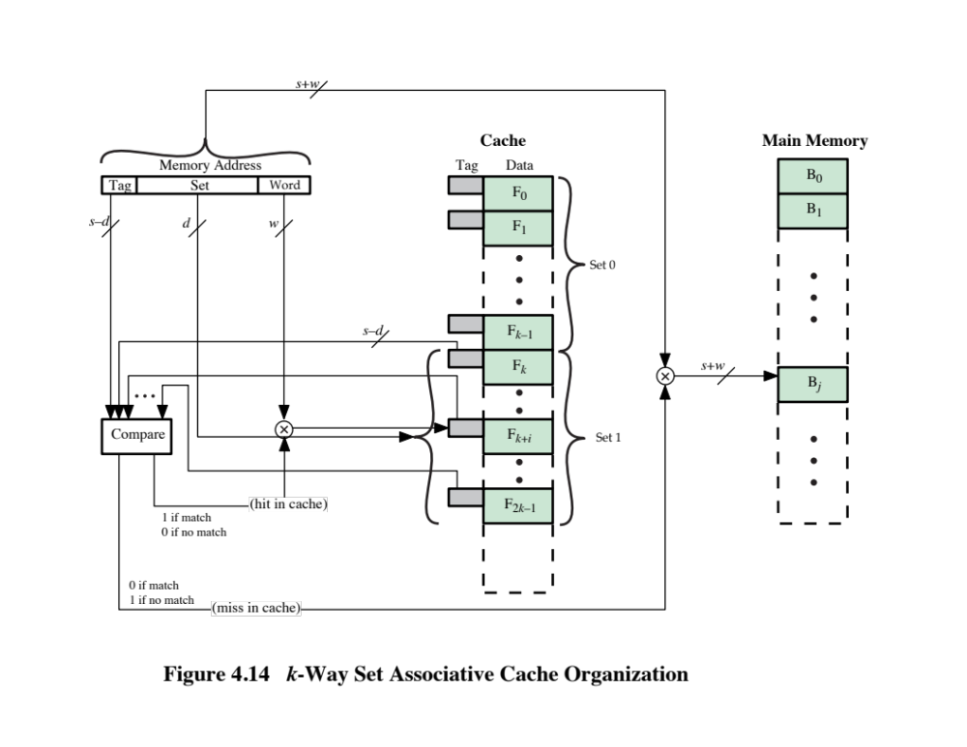
Notes:
For set-associative mapping, the cache control logic interprets a memory
address as three fields: Tag, Set, and Word. The d set bits specify one of v = 2^{d} sets.
The s bits of the Tag and Set fields specify one of the 2^{s} blocks of main memory.
Figure 4.14 illustrates the cache control logic. With fully associative mapping, the
tag in a memory address is quite large and must be compared to the tag of every line
in the cache. With k-way set-associative mapping, the tag in a memory address is
much smaller and is only compared to the k tags within a single set.

Slide 42
Set Associative Mapping Summary
Address length = (s + w) bits
Number of addressable units = 2^{s+w} words or bytes
Block size = line size = 2^{w} words or bytes
Number of blocks in main memory = 2^{s+w/}2^{w=}2^{s}
Number of lines in set = k
Number of sets = v = 2^{d}
Number of lines in cache = m=kv = k * 2^{d}
Size of cache = k * 2^{d+w} words or bytes
Size of tag = (s – d) bits
Notes:
Set Associative Mapping Summary.

Slide 43
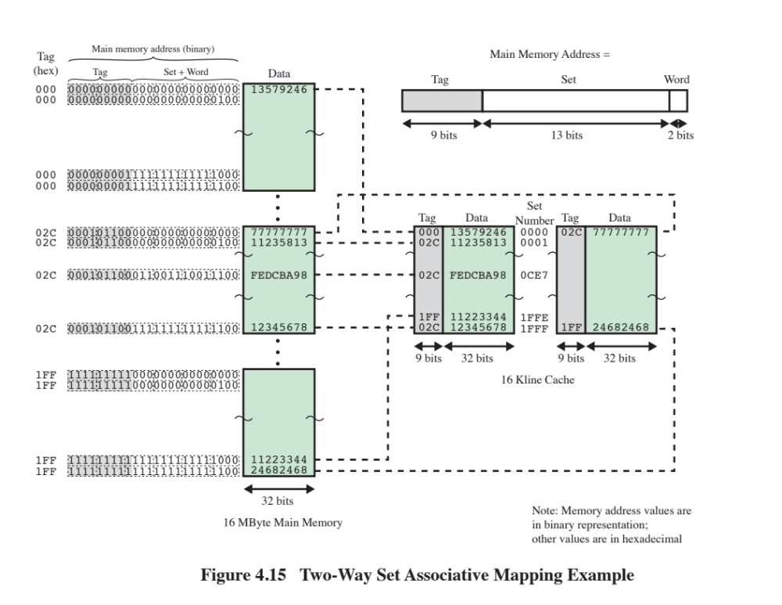
Notes:
Figure 4.15 shows our example using set-associative
mapping with two lines in each set, referred to as two-way
set-associative. The 13-bit set number identifies
a unique set of two lines within the cache. It also gives the number of the block in
main memory, modulo 2¹³. This determines the mapping of blocks into lines. Thus, blocks
000000, 008000, …, FF8000 of main memory map into cache set 0. Any of those blocks can
be loaded into either of the two lines in the set. Note that no two blocks that map into the
same cache set have the same tag number. For a read operation, the 13-bit set number is
used to determine which set of two lines is to be examined. Both lines in the set are examined
for a match with the tag number of the address to be accessed.
In the extreme case of v = m , k = 1, the set-associative
technique reduces to direct mapping, and for v = 1, k = m , it reduces to associative mapping. The use of
two lines per set (v = m /2, k = 2) is the most common set-associative
organization. It significantly improves the hit ratio over direct mapping. Four- way set associative
(v = m /4, k = 4) makes a modest additional improvement for a relatively small
additional cost [MAYB84, HILL89]. Further increases in the number of lines per
set have little effect.

Slide 44
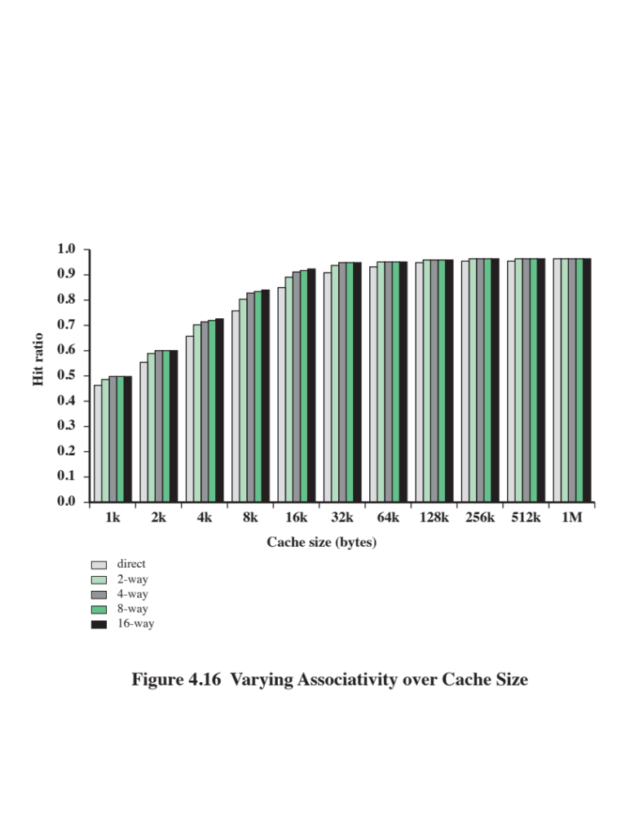
Notes:
Figure 4.16 shows the results of one simulation study of set-associative cache
performance as a function of cache size [GENU04]. The difference in performance
between direct and two-way set associative is significant up to at least a cache size of
64 kB. Note also that the difference between two-way and four-way at 4 kB is much
less than the difference in going from for 4 kB to 8 kB in cache size. The complexity
of the cache increases in proportion to the associativity, and in this case would not
be justifiable against increasing cache size to 8 or even 16 Kbytes. A final point to
note is that beyond about 32 kB, increase in cache size brings no significant increase
in performance.
The results of Figure 4.16 are based on simulating the execution of a GCC
compiler. Different applications may yield different results. For example, [CANT01]
reports on the results for cache performance using many of the CPU2000 SPEC
benchmarks. The results of [CANT01] in comparing hit ratio to cache size follow
the same pattern as Figure 4.16, but the specific values are somewhat different.

Slide 45

Replacement Algorithms
Once the cache has been filled, when a new block is brought into the cache, one of the existing blocks must be replaced
For direct mapping there is only one possible line for any particular block and no choice is possible
For the associative and set-associative techniques a replacement algorithm is needed
To achieve high speed, an algorithm must be implemented in hardware
Notes:
Once the cache has been filled, when a new block is brought into the cache, one
of the existing blocks must be replaced. For direct mapping, there is only one possible
line for any particular block, and no choice is possible. For the associative
and set-associative techniques, a replacement algorithm is needed. To achieve high
speed, such an algorithm must be implemented in hardware.

Slide 46
The most common replacement algorithms are:
Least recently used (LRU)
  Most effective
  Replace that block in the set that has been in the cache longest with no reference to it
  Because of its simplicity of implementation, LRU is the most popular replacement algorithm
First-in-first-out (FIFO)
  Replace that block in the set that has been in the cache longest
  Easily implemented as a round-robin or circular buffer technique
Least frequently used (LFU)
  Replace that block in the set that has experienced the fewest references
  Could be implemented by associating a counter with each line
Notes:
A number of algorithms
have been tried. We mention four of the most common. Probably the most
effective is least recently used (LRU): Replace that block in the set that has been in
the cache longest with no reference to it. For two-way set associative, this is easily
implemented. Each line includes a USE bit. When a line is referenced, its USE bit
is set to 1 and the USE bit of the other line in that set is set to 0. When a block is to
be read into the set, the line whose USE bit is 0 is used. Because we are assuming
that more recently used memory locations are more likely to be referenced, LRU
should give the best hit ratio. LRU is also relatively easy to implement for a fully
associative cache. The cache mechanism maintains a separate list of indexes to all
the lines in the cache. When a line is referenced, it moves to the front of the list.
For replacement, the line at the back of the list is used. Because of its simplicity of
implementation, LRU is the most popular replacement algorithm.
Another possibility is first-in-first-out (FIFO): Replace that block in the set
that has been in the cache longest. FIFO is easily implemented as a round-robin
or circular buffer technique. Still another possibility is least frequently used (LFU):
Replace that block in the set that has experienced the fewest references. LFU could
be implemented by associating a counter with each line. A technique not based on
usage (i.e., not LRU, LFU, FIFO, or some variant) is to pick a line at random from
among the candidate lines. Simulation studies have shown that random replacement
provides only slightly inferior performance to an algorithm based on usage [SMIT82].

Slide 47
Write Policy
When a block that is resident in the cache is to be replaced there are two cases to consider:
If the old block in the cache has not been altered then it may be overwritten with a new block without first writing out the old block
If at least one write operation has been performed on a word in that line of the cache then main memory must be updated by writing the line of cache out to the block of memory before bringing in the new block
There are two problems to contend with:
More than one device may have access to main memory
A more complex problem occurs when multiple processors are attached to the same bus and each processor has its own local cache - if a word is altered in one cache it could conceivably invalidate a word in other caches
Notes:
When a block that is resident in the cache is to be replaced, there are two cases to
consider. If the old block in the cache has not been altered, then it may be overwritten
with a new block without first writing out the old block. If at least one write
operation has been performed on a word in that line of the cache, then main memory
must be updated by writing the line of cache out to the block of memory before
bringing in the new block. A variety of write policies, with performance and economic
trade-offs, is possible. There are two problems to contend with. First, more
than one device may have access to main memory. For example, an I/O module
may be able to read-write directly to memory. If a word has been altered only in the
cache, then the corresponding memory word is invalid. Further, if the I/O device
has altered main memory, then the cache word is invalid. A more complex problem
occurs when multiple processors are attached to the same bus and each processor
has its own local cache. Then, if a word is altered in one cache, it could conceivably
invalidate a word in other caches.

Slide 48
Write Through and Write Back
Write through
  Simplest technique
  All write operations are made to main memory as well as to the cache
  The main disadvantage of this technique is that it generates substantial memory traffic and may create a bottleneck
Write back
  Minimizes memory writes
  Updates are made only in the cache
  Portions of main memory are invalid and hence accesses by I/O modules can be allowed only through the cache
  This makes for complex circuitry and a potential bottleneck
Notes:
The simplest technique is called write through. Using this technique, all write
operations are made to main memory as well as to the cache, ensuring that main
memory is always valid. Any other processor–cache module can monitor traffic to
main memory to maintain consistency within its own cache. The main disadvantage
of this technique is that it generates substantial memory traffic and may create a bottleneck.
An alternative technique, known as write back, minimizes memory writes.
With write back, updates are made only in the cache. When an update occurs, a
dirty bit, or use bit, associated with the line is set. Then, when a block is replaced, it
is written back to main memory if and only if the dirty bit is set. The problem with
write back is that portions of main memory are invalid, and hence accesses by I/O
modules can be allowed only through the cache. This makes for complex circuitry
and a potential bottleneck. Experience has shown that the percentage of memory
references that are writes is on the order of 15% [SMIT82]. However, for HPC
applications, this number may approach 33% (vector-vector multiplication) and can
go as high as 50% (matrix transposition).
In a bus organization in which more than one device (typically a processor)
has a cache and main memory is shared, a new problem is introduced. If data in one
cache are altered, this invalidates not only the corresponding word in main memory,
but also that same word in other caches (if any other cache happens to have that
same word). Even if a write-through policy is used, the other caches may contain
invalid data. A system that prevents this problem is said to maintain cache coherency.
Possible approaches to cache coherency include the following:
• Bus watching with write through: Each cache controller monitors the address
lines to detect write operations to memory by other bus masters. If another
master writes to a location in shared memory that also resides in the cache
memory, the cache controller invalidates that cache entry. This strategy depends
on the use of a write-through policy by all cache controllers.
• Hardware transparency: Additional hardware is used to ensure that all updates
to main memory via cache are reflected in all caches. Thus, if one processor
modifies a word in its cache, this update is written to main memory. In addition,
any matching words in other caches are similarly updated.
• Non-cacheable memory: Only a portion of main memory is shared by more
than one processor, and this is designated as non-cacheable. In such a system,
all accesses to shared memory are cache misses, because the shared memory
is never copied into the cache. The non-cacheable memory can be identified
using chip-select logic or high-address bits.

Slide 49
Line Size
When a block of data is retrieved and placed in the cache not only the desired word but also some number of adjacent words are retrieved
As the block size increases the hit ratio will at first increase because of the principle of locality
As the block size increases more useful data are brought into the cache
The hit ratio will begin to decrease as the block becomes bigger and the probability of using the newly fetched information becomes less than the probability of reusing the information that has to be replaced
Two specific effects come into play:
Larger blocks reduce the number of blocks that fit into a cache
As a block becomes larger each additional word is farther from the requested word
Notes:
Another design element is the line size. When a block of data is retrieved and placed
in the cache, not only the desired word but also some number of adjacent words are
retrieved. As the block size increases from very small to larger sizes, the hit ratio
will at first increase because of the principle of locality, which states that data in the
vicinity of a referenced word are likely to be referenced in the near future. As the
block size increases, more useful data are brought into the cache. The hit ratio will
begin to decrease, however, as the block becomes even bigger and the probability
of using the newly fetched information becomes less than the probability of reusing
the information that has to be replaced. Two specific effects come into play:
• Larger blocks reduce the number of blocks that fit into a cache. Because each
block fetch overwrites older cache contents, a small number of blocks results
in data being overwritten shortly after they are fetched.
• As a block becomes larger, each additional word is farther from the requested
word and therefore less likely to be needed in the near future.
The relationship between block size and hit ratio is complex, depending on
the locality characteristics of a particular program, and no definitive optimum value
has been found. A size of from 8 to 64 bytes seems reasonably close to optimum
[SMIT87, PRZY88, PRZY90, HAND98]. For HPC systems, 64- and 128-byte cache
line sizes are most frequently used.

Slide 50
Multilevel Caches
As logic density has increased it has become possible to have a cache on the same chip as the processor
The on-chip cache reduces the processor’s external bus activity and speeds up execution time and increases overall system performance
  When the requested instruction or data is found in the on-chip cache, the bus access is eliminated
  On-chip cache accesses will complete appreciably faster than would even zero-wait state bus cycles
  During this period the bus is free to support other transfers
Two-level cache:
  Internal cache designated as level 1 (L1)
  External cache designated as level 2 (L2)
Potential savings due to the use of an L2 cache depends on the hit rates in both the L1 and L2 caches
The use of multilevel caches complicates all of the design issues related to caches, including size, replacement algorithm, and write policy
Notes:
As logic density has increased, it has become possible to
have a cache on the same chip as the processor: the on-chip cache. Compared with
a cache reachable via an external bus, the on-chip cache reduces the processor’s
external bus activity and therefore speeds up execution times and increases overall
system performance. When the requested instruction or data is found in the on-chip
cache, the bus access is eliminated. Because of the short data paths internal to
the processor, compared with bus lengths, on-chip cache accesses will complete
appreciably faster than would even zero-wait state bus cycles. Furthermore, during
this period the bus is free to support other transfers.
The inclusion of an on-chip cache leaves open the question of whether an
off-chip, or external, cache is still desirable. Typically, the answer is yes, and most contemporary
designs include both on-chip and external caches. The simplest such organization
is known as a two-level cache, with the internal cache designated as level 1 (L1)
and the external cache designated as level 2 (L2). The reason for including an L2 cache
is the following: If there is no L2 cache and the processor makes an access request
for a memory location not in the L1 cache, then the processor must access DRAM or
ROM memory across the bus. Due to the typically slow bus speed and slow memory
access time, this results in poor performance. On the other hand, if an L2 SRAM (static
RAM) cache is used, then frequently the missing information can be quickly retrieved.
If the SRAM is fast enough to match the bus speed, then the data can be accessed
using a zero-wait state transaction, the fastest type of bus transfer.
Two features of contemporary cache design for multilevel caches are noteworthy.
First, for an off-chip L2 cache, many designs do not use the system bus as
the path for transfer between the L2 cache and the processor, but use a separate
data path, so as to reduce the burden on the system bus. Second, with the continued
shrinkage of processor components, a number of processors now incorporate the L2
cache on the processor chip, improving performance.
The potential savings due to the use of an L2 cache depends on the hit rates
in both the L1 and L2 caches. Several studies have shown that, in general, the use
of a second-level cache does improve performance (e.g., see [AZIM92], [NOVI93],
[HAND98]). However, the use of multilevel caches does complicate all of the design
issues related to caches, including size, replacement algorithm, and write policy; see
[HAND98] and [PEIR99] for discussions.

Slide 51
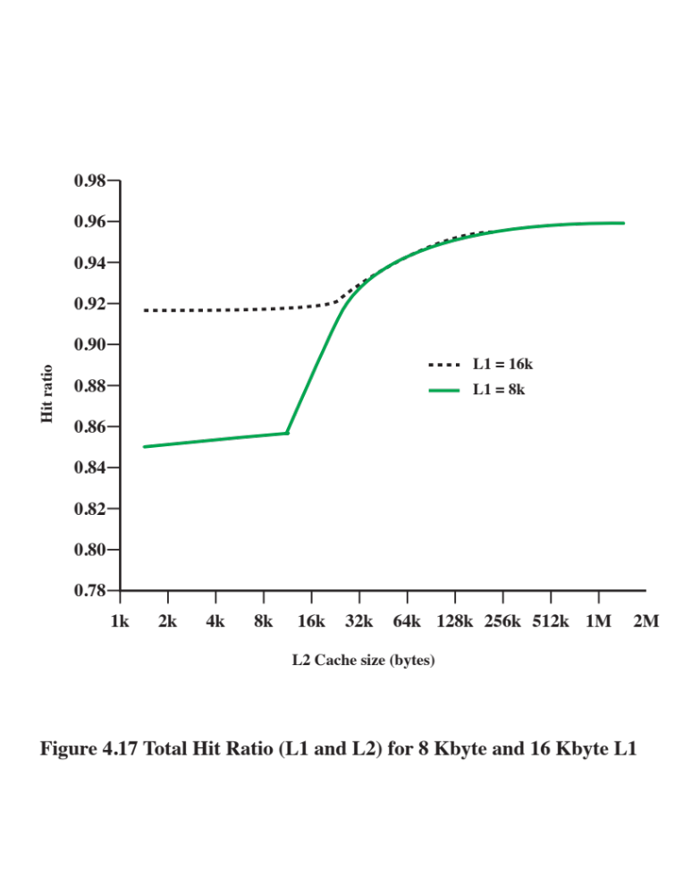
Notes:
Figure 4.17 shows the results of one simulation study of two-level cache performance
as a function of cache size [GENU04]. The figure assumes that both
caches have the same line size and shows the total hit ratio. That is, a hit is counted
if the desired data appears in either the L1 or the L2 cache. The figure shows the
impact of L2 on total hits with respect to L1 size. L2 has little effect on the total
number of cache hits until it is at least double the L1 cache size. Note that the steepest
part of the slope for an L1 cache of 8 Kbytes is for an L2 cache of 16 Kbytes.
Again for an L1 cache of 16 Kbytes, the steepest part of the curve is for an L2 cache
size of 32 Kbytes. Prior to that point, the L2 cache has little, if any, impact on total
cache performance. The need for the L2 cache to be larger than the L1 cache to
affect performance makes sense. If the L2 cache has the same line size and capacity
as the L1 cache, its contents will more or less mirror those of the L1 cache.
With the increasing availability of on-chip area available for cache, most contemporary
microprocessors have moved the L2 cache onto the processor chip and
added an L3 cache. Originally, the L3 cache was accessible over the external bus.
More recently, most microprocessors have incorporated an on-chip L3 cache. In
either case, there appears to be a performance advantage to adding the third level
(e.g., see [GHAI98]). Further, large systems, such as the IBM mainframe zEnterprise
systems, now incorporate 3 on-chip cache levels and a fourth level of cache
shared across multiple chips [CURR11].

Slide 52
Unified Versus Split Caches
Has become common to split cache:
  One dedicated to instructions
  One dedicated to data
  Both exist at the same level, typically as two L1 caches
Advantages of unified cache:
  Higher hit rate
    Balances load of instruction and data fetches automatically
    Only one cache needs to be designed and implemented
Trend is toward split caches at the L1 and unified caches for higher levels
Advantages of split cache:
  Eliminates cache contention between instruction fetch/decode unit and execution unit
    Important in pipelining
Notes:
When the on-chip cache first made an appearance,
many of the designs consisted of a single cache used to store references to both data
and instructions. More recently, it has become common to split the cache into two:
one dedicated to instructions and one dedicated to data. These two caches both exist
at the same level, typically as two L1 caches. When the processor attempts to fetch an
instruction from main memory, it first consults the instruction L1 cache, and when the
processor attempts to fetch data from main memory, it first consults the data L1 cache.
There are two potential advantages of a unified cache:
• For a given cache size, a unified cache has a higher hit rate than split caches
because it balances the load between instruction and data fetches automatically.
That is, if an execution pattern involves many more instruction fetches
than data fetches, then the cache will tend to fill up with instructions, and if an
execution pattern involves relatively more data fetches, the opposite will occur.
• Only one cache needs to be designed and implemented.
The trend is toward split caches at the L1 and unified caches for higher levels,
particularly for superscalar machines, which emphasize parallel instruction execution
and the prefetching of predicted future instructions. The key advantage of the
split cache design is that it eliminates contention for the cache between the instruction
fetch/decode unit and the execution unit. This is important in any design that
relies on the pipelining of instructions. Typically, the processor will fetch instructions
ahead of time and fill a buffer, or pipeline, with instructions to be executed. Suppose
now that we have a unified instruction/data cache. When the execution unit performs
a memory access to load and store data, the request is submitted to the unified cache.
If, at the same time, the instruction prefetcher issues a read request to the cache for
an instruction, that request will be temporarily blocked so that the cache can service
the execution unit first, enabling it to complete the currently executing instruction.
This cache contention can degrade performance by interfering with efficient use of
the instruction pipeline. The split cache structure overcomes this difficulty.

Slide 53
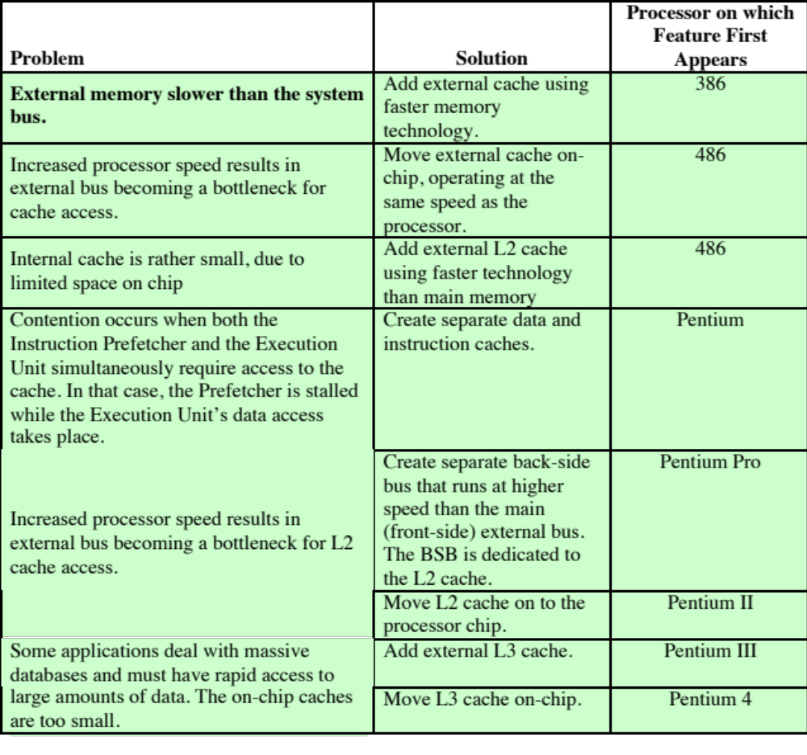
Table 4.4
Intel
Cache Evolution
(Table is on page 150 in the textbook.)
Notes:
The evolution of cache organization is seen clearly in the evolution of Intel microprocessors
(Table 4.4). The 80386 does not include an on-chip cache. The 80486
includes a single on-chip cache of 8 Kbytes, using a line size of 16 bytes and a
four-way set-associative organization. All of the Pentium processors include two
on-chip L1 caches, one for data and one for instructions. For the Pentium 4, the
L1 data cache is 16 Kbytes, using a line size of 64 bytes and a four-way set-associative
organization. The Pentium 4 instruction cache is described subsequently. The
Pentium II also includes an L2 cache that feeds both of the L1 caches. The L2 cache
is eight-way set associative with a size of 512 kB and a line size of 128 bytes. An L3
cache was added for the Pentium III and became on-chip with high-end versions of
the Pentium 4.

Slide 54
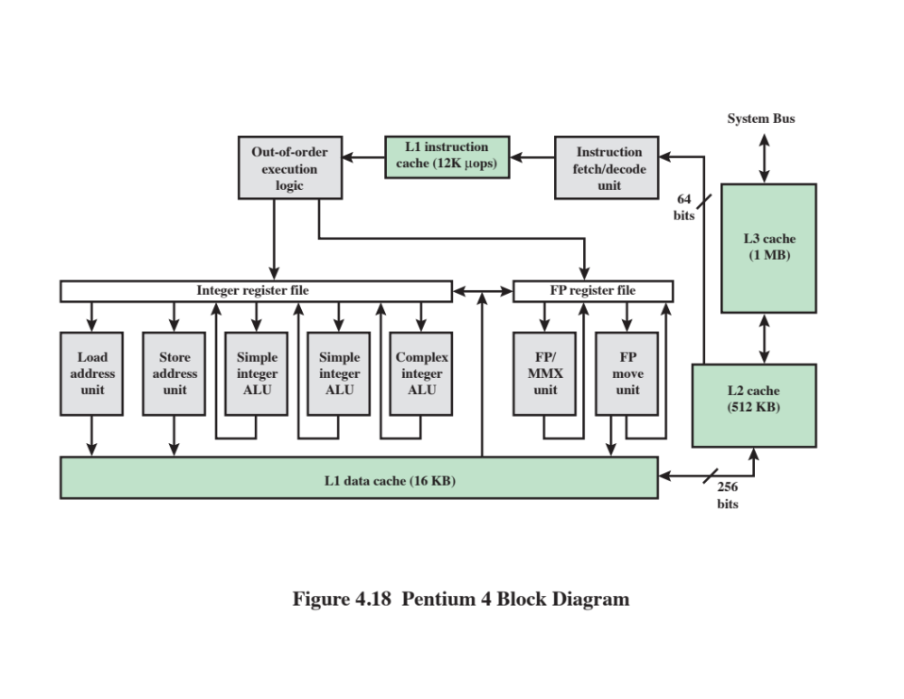
Notes:
Figure 4.18 provides a simplified view of the Pentium 4 organization, highlighting
the placement of the three caches. The processor core consists of four major
components:
• Fetch/decode unit: Fetches program instructions in order from the L2 cache,
decodes these into a series of micro-operations, and stores the results in the L1
instruction cache.
• Out-of-order execution logic: Schedules execution of the micro-operations
subject to data dependencies and resource availability; thus, micro-operations
may be scheduled for execution in a different order than they were fetched
from the instruction stream. As time permits, this unit schedules speculative
execution of micro-operations that may be required in the future.
Execution units: These units executes micro-operations, fetching the required
data from the L1 data cache and temporarily storing results in registers.
• Memory subsystem: This unit includes the L2 and L3 caches and the system
bus, which is used to access main memory when the L1 and L2 caches have a
cache miss and to access the system I/O resources.
Unlike the organization used in all previous Pentium models, and in most
other processors, the Pentium 4 instruction cache sits between the instruction
decode logic and the execution core. The reasoning behind this design decision is
as follows: As discussed more fully in Chapter 16, the Pentium process decodes, or
translates, Pentium machine instructions into simple RISC-like instructions called
micro-operations. The use of simple, fixed-length micro-operations enables the use
of superscalar pipelining and scheduling techniques that enhance performance.
However, the Pentium machine instructions are cumbersome to decode; they have a
variable number of bytes and many different options. It turns out that performance
is enhanced if this decoding is done independently of the scheduling and pipelining
logic. We return to this topic in Chapter 16.
The data cache employs a write-back policy: Data are written to main memory
only when they are removed from the cache and there has been an update. The
Pentium 4 processor can be dynamically configured to support write-through caching.

Slide 55
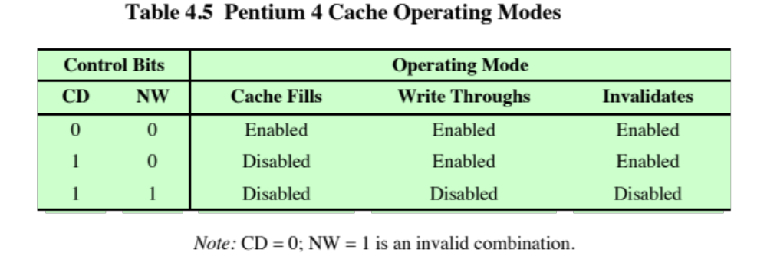
Notes:
The L1 data cache is controlled by two bits in one of the control registers,
labeled the CD (cache disable) and NW (not write-through) bits (Table 4.5). There
are also two Pentium 4 instructions that can be used to control the data cache: INVD
invalidates (flushes) the internal cache memory and signals the external cache (if
any) to invalidate. WBINVD writes back and invalidates internal cache and then
writes back and invalidates external cache.
Both the L2 and L3 caches are eight-way set-associative with a line size of
128 bytes.

Slide 56
Summary
Cache
Memory
  Elements of cache design
  Cache addresses
  Cache size
  Mapping function
  Replacement algorithms
  Write policy
  Line size
  Number of caches
Computer memory system overview
  Characteristics of Memory Systems
  Memory Hierarchy
Cache memory principles
  Pentium 4 cache organization
Notes:
Chapter 4 summary.

Slide 57
Part 1.2
Main Memory

Slide 58
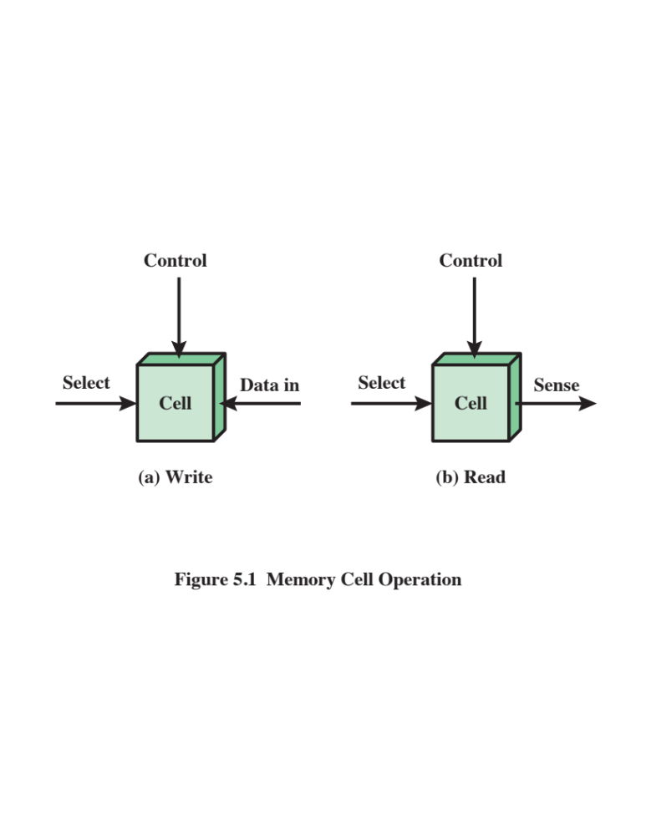
Notes:
In earlier computers, the most common form of random-access storage for computer
main memory employed an array of doughnut-shaped ferromagnetic loops
referred to as cores. Hence, main memory was often referred to as core, a term that
persists to this day. The advent of, and advantages of, microelectronics has long
since vanquished the magnetic core memory. Today, the use of semiconductor chips
for main memory is almost universal. Key aspects of this technology are explored
in this section.
The basic element of a semiconductor memory is the memory cell. Although a variety
of electronic technologies are used, all semiconductor memory cells share certain
properties:
• They exhibit two stable (or semistable) states, which can be used to represent
binary 1 and 0.
• They are capable of being written into (at least once), to set the state.
• They are capable of being read to sense the state.
Figure 5.1 depicts the operation of a memory cell. Most commonly, the cell
has three functional terminals capable of carrying an electrical signal. The select
terminal, as the name suggests, selects a memory cell for a read or write operation.
The control terminal indicates read or write. For writing, the other terminal
provides an electrical signal that sets the state of the cell to 1 or 0. For reading, that
terminal is used for output of the cell’s state. The details of the internal organization,
functioning, and timing of the memory cell depend on the specific integrated
circuit technology used and are beyond the scope of this book, except for a brief
summary. For our purposes, we will take it as given that individual cells can be
selected for reading and writing operations.

Slide 59
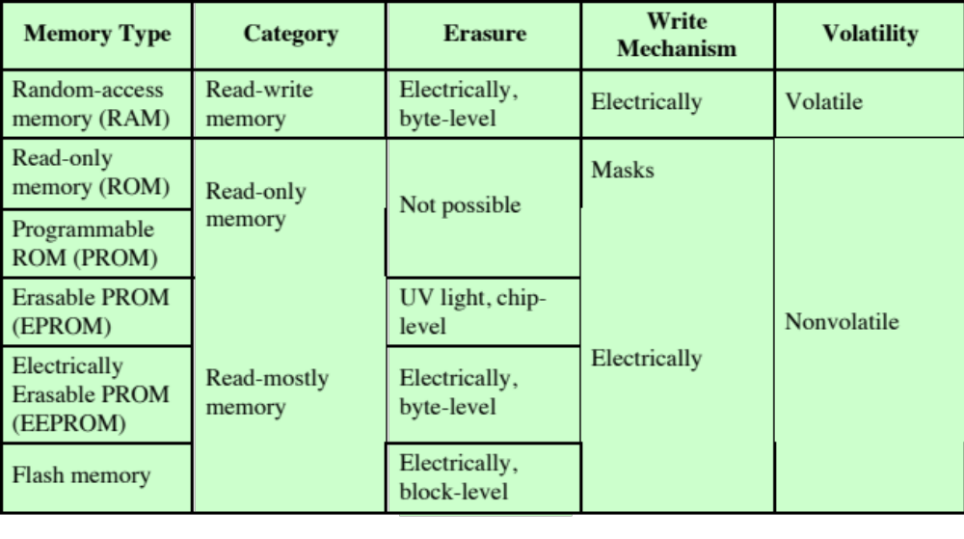
Semiconductor Memory Types
Notes:
All of the memory types that we will explore in this chapter are random access. That is,
individual words of memory are directly accessed through wired-in addressing logic.
Table 5.1 lists the major types of semiconductor memory. The most common
is referred to as random-access memory (RAM). This is, in fact, a misuse of the
term, because all of the types listed in the table are random access. One distinguishing
characteristic of memory that is designated as RAM is that it is possible
both to read data from the memory and to write new data into the memory easily
and rapidly. Both the reading and writing are accomplished through the use of
electrical signals.
The other distinguishing characteristic of RAM is that it is volatile. A RAM
must be provided with a constant power supply. If the power is interrupted, then
the data are lost. Thus, RAM can be used only as temporary storage. The two traditional
forms of RAM used in computers are DRAM and SRAM.

Slide 60
Dynamic RAM (DRAM)
RAM technology is divided into two technologies:
  Dynamic RAM (DRAM)
  Static RAM (SRAM)
  DRAM
    Made with cells that store data as charge on capacitors
    Presence or absence of charge in a capacitor is interpreted as a binary 1 or 0
    Requires periodic charge refreshing to maintain data storage
    The term dynamic refers to tendency of the stored charge to leak away, even with power continuously applied
Notes:
RAM technology is divided into two technologies: dynamic and
static. A dynamic RAM (DRAM) is made with cells that store data as charge on
capacitors. The presence or absence of charge in a capacitor is interpreted as a
binary 1 or 0. Because capacitors have a natural tendency to discharge, dynamic
RAMs require periodic charge refreshing to maintain data storage. The term
dynamic refers to this tendency of the stored charge to leak away, even with power
continuously applied.

Slide 61
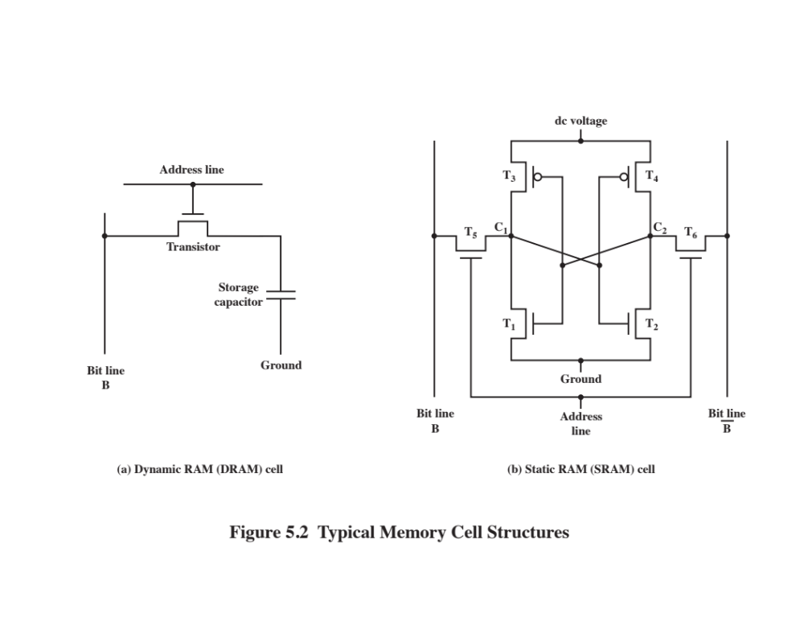
Notes:
Figure 5.2a is a typical DRAM structure for an individual cell that stores 1 bit.
The address line is activated when the bit value from this cell is to be read or written.
The transistor acts as a switch that is closed (allowing current to flow) if a voltage is
applied to the address line and open (no current flows) if no voltage is present on
the address line.
For the write operation, a voltage signal is applied to the bit line; a high voltage
represents 1, and a low voltage represents 0. A signal is then applied to the
address line, allowing a charge to be transferred to the capacitor.
For the read operation, when the address line is selected, the transistor turns
on and the charge stored on the capacitor is fed out onto a bit line and to a sense
amplifier. The sense amplifier compares the capacitor voltage to a reference value
and determines if the cell contains a logic 1 or a logic 0. The readout from the cell
discharges the capacitor, which must be restored to complete the operation.
Although the DRAM cell is used to store a single bit (0 or 1), it is essentially
an analog device. The capacitor can store any charge value within a range; a threshold
value determines whether the charge is interpreted as 1 or 0.
Figure 5.2b is a typical SRAM structure for an individual cell. Four transistors
(T₁, T₂, T₃, T₄) are cross connected in an arrangement that produces a stable logic
state. In logic state 1, point C₁ is high and point C₂ is low; in this state, T₁ and T₄ are off
and T₂ and T₃ are on. In logic state 0, point C₁ is low and point C₂ is high; in this state,
T₁ and T₄ are on and T₂ and T₃ are off. Both states are stable as long as the direct
current (dc) voltage is applied. Unlike the DRAM, no refresh is needed to retain data.
As in the DRAM, the SRAM address line is used to open or close a switch.
The address line controls two transistors (T₅ and T₆). When a signal is applied to
this line, the two transistors are switched on, allowing a read or write operation. For
a write operation, the desired bit value is applied to line B, while its complement
is applied to line B. This forces the four transistors (T₁, T₂, T₃, T₄) into the proper
state. For a read operation, the bit value is read from line B.

Slide 62
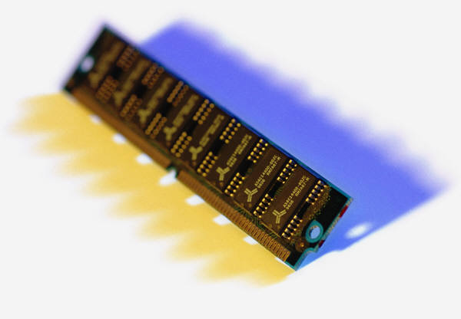
Static RAM (SRAM)
  Digital device that uses the same logic elements used in the processor
  Binary values are stored using traditional flip-flop logic gate configurations
  Will hold its data as long as power is supplied to it
Notes:
In contrast, a static RAM (SRAM) is a digital device that uses the
same logic elements used in the processor. In a SRAM, binary values are stored
using traditional flip-flop logic-gate configurations (see Chapter 11 for a description
of flip-flops). A static RAM will hold its data as long as power is supplied to it.
As in the DRAM, the SRAM address line is used to open or close a switch.
The address line controls two transistors (T₅ and T₆ ). When a signal is applied to
this line, the two transistors are switched on, allowing a read or write operation. For
a write operation, the desired bit value is applied to line B, while its complement
is applied to line B. This forces the four transistors (T₁ , T₂ , T₃ , T₄ ) into the proper
state. For a read operation, the bit value is read from line B.

Slide 63
SRAM versus DRAM
SRAM
Both volatile
  Power must be continuously supplied to the memory to preserve the bit values
Dynamic cell
  Simpler to build, smaller
  More dense (smaller cells = more cells per unit area)
  Less expensive
  Requires the supporting refresh circuitry
  Tend to be favored for large memory requirements
  Used for main memory
Static
  Faster
  Used for cache memory (both on and off chip)
DRAM
Notes:
Both static and dynamic RAMs are volatile; that is,
power must be continuously supplied to the memory to preserve the bit values.
A dynamic memory cell is simpler and smaller than a static memory cell. Thus, a
DRAM is more dense (smaller cells = more cells per unit area) and less expensive
than a corresponding SRAM. On the other hand, a DRAM requires the supporting
refresh circuitry. For larger memories, the fixed cost of the refresh circuitry is more
than compensated for by the smaller variable cost of DRAM cells. Thus, DRAMs
tend to be favored for large memory requirements. A final point is that SRAMs are
somewhat faster than DRAMs. Because of these relative characteristics, SRAM is
used for cache memory (both on and off chip), and DRAM is used for main memory.

Slide 64
Read Only Memory (ROM)
Contains a permanent pattern of data that cannot be changed or added to
No power source is required to maintain the bit values in memory
Data or program is permanently in main memory and never needs to be loaded from a secondary storage device
Data is actually wired into the chip as part of the fabrication process
  Disadvantages of this:
    No room for error, if one bit is wrong the whole batch of ROMs must be thrown out
    Data insertion step includes a relatively large fixed cost
Notes:
As the name suggests, a read-only memory (ROM) contains a permanent pattern
of data that cannot be changed. A ROM is nonvolatile; that is, no power source is
required to maintain the bit values in memory. While it is possible to read a ROM,
it is not possible to write new data into it. An important application of ROMs is
microprogramming, discussed in Part Four. Other potential applications include
• Library subroutines for frequently wanted functions
• System programs
• Function tables
For a modest-sized requirement, the advantage of ROM is that the data or program
is permanently in main memory and need never be loaded from a secondary storage
device.
A ROM is created like any other integrated circuit chip, with the data actually
wired into the chip as part of the fabrication process. This presents two problems:
• The data insertion step includes a relatively large fixed cost, whether one or
thousands of copies of a particular ROM are fabricated.
• There is no room for error. If one bit is wrong, the whole batch of ROMs must
be thrown out.

Slide 65
Programmable ROM (PROM)
Less expensive alternative
Nonvolatile and may be written into only once
Writing process is performed electrically and may be performed by supplier or customer at a time later than the original chip fabrication
Special equipment is required for the writing process
Provides flexibility and convenience
Attractive for high volume production runs
Notes:
When only a small number of ROMs with a particular memory content is
needed, a less expensive alternative is the programmable ROM (PROM). Like the
ROM, the PROM is nonvolatile and may be written into only once. For the PROM,
the writing process is performed electrically and may be performed by a supplier
or customer at a time later than the original chip fabrication. Special equipment is
required for the writing or “programming” process. PROMs provide flexibility and
convenience. The ROM remains attractive for high-volume production runs.

Slide 66
Read-Mostly Memory
EPROM
Erasable programmable read-only memory
Erasure process can be performed repeatedly
More expensive than PROM but it has the advantage of the multiple update capability
EEPROM
Electrically erasable programmable read-only memory
Can be written into at any time without erasing prior contents
Combines the advantage of non-volatility with the flexibility of being updatable in place
More expensive than EPROM
Flash Memory
Intermediate between EPROM and EEPROM in both cost and functionality
Uses an electrical erasing technology, does not provide byte-level erasure
Microchip is organized so that a section of memory cells are erased in a single action or “flash”
Notes:
Another variation on read-only memory is the read-mostly memory, which is
useful for applications in which read operations are far more frequent than write
operations but for which nonvolatile storage is required. There are three common
forms of read-mostly memory: EPROM, EEPROM, and flash memory.
The optically erasable programmable read-only memory (EPROM) is read
and written electrically, as with PROM. However, before a write operation, all the
storage cells must be erased to the same initial state by exposure of the packaged
chip to ultraviolet radiation. Erasure is performed by shining an intense ultraviolet
light through a window that is designed into the memory chip. This erasure process
can be performed repeatedly; each erasure can take as much as 20 minutes to
perform. Thus, the EPROM can be altered multiple times and, like the ROM and
PROM, holds its data virtually indefinitely. For comparable amounts of storage, the
EPROM is more expensive than PROM, but it has the advantage of the multiple
update capability.
A more attractive form of read-mostly memory is electrically erasable programmable
read-only memory (EEPROM). This is a read-mostly memory that can
be written into at any time without erasing prior contents; only the byte or bytes
addressed are updated. The write operation takes considerably longer than the read
operation, on the order of several hundred microseconds per byte. The EEPROM
combines the advantage of non-volatility with the flexibility of being updatable in
place, using ordinary bus control, address, and data lines. EEPROM is more expensive
than EPROM and also is less dense, supporting fewer bits per chip.
Another form of semiconductor memory is flash memory (so named because
of the speed with which it can be reprogrammed). First introduced in the mid-1980s,
flash memory is intermediate between EPROM and EEPROM in both cost and
functionality. Like EEPROM, flash memory uses an electrical erasing technology.
An entire flash memory can be erased in one or a few seconds, which is much faster
than EPROM. In addition, it is possible to erase just blocks of memory rather than
an entire chip. Flash memory gets its name because the microchip is organized so
that a section of memory cells are erased in a single action or “flash.” However,
flash memory does not provide byte-level erasure. Like EPROM, flash memory
uses only one transistor per bit, and so achieves the high density (compared with
EEPROM) of EPROM.

Slide 67
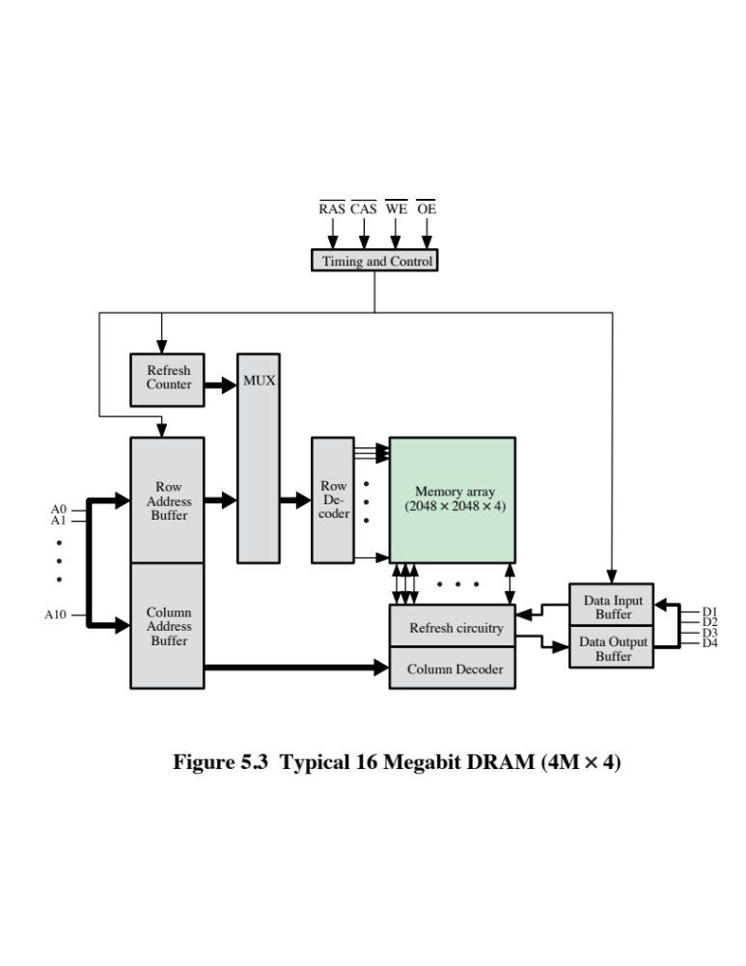
Notes:
Figure 5.3 shows a typical organization of a 16-Mbit DRAM. In this case, 4 bits
are read or written at a time. Logically, the memory array is organized as four square
arrays of 2048 by 2048 elements. Various physical arrangements are possible. In any
case, the elements of the array are connected by both horizontal (row) and vertical
(column) lines. Each horizontal line connects to the Select terminal of each cell in its
row; each vertical line connects to the Data-In/Sense terminal of each cell in its column.
Address lines supply the address of the word to be selected. A total of log₂ W
lines are needed. In our example, 11 address lines are needed to select one of 2048
rows. These 11 lines are fed into a row decoder, which has 11 lines of input and 2048
lines for output. The logic of the decoder activates a single one of the 2048 outputs
depending on the bit pattern on the 11 input lines (2¹¹ = 2048).
An additional 11 address lines select one of 2048 columns of 4 bits per column.
Four data lines are used for the input and output of 4 bits to and from a data buffer.
On input (write), the bit driver of each bit line is activated for a 1 or 0 according to
the value of the corresponding data line. On output (read), the value of each bit line
is passed through a sense amplifier and presented to the data lines. The row line
selects which row of cells is used for reading or writing.
Because only 4 bits are read/written to this DRAM, there must be multiple
DRAMs connected to the memory controller to read/write a word of data to the bus.
Note that there are only 11 address lines (A0–A10), half the number you
would expect for a 2048 * 2048 array. This is done to save on the number of pins.
The 22 required address lines are passed through select logic external to the chip
and multiplexed onto the 11 address lines. First, 11 address signals are passed to the
chip to define the row address of the array, and then the other 11 address signals are
presented for the column address.
As an aside, multiplexed addressing plus the use of square arrays result in a
quadrupling of memory size with each new generation of memory chips. One more
pin devoted to addressing doubles the number of rows and columns, and so the size
of the chip memory grows by a factor of 4.
Figure 5.3 also indicates the inclusion of refresh circuitry. All DRAMs require
a refresh operation. A simple technique for refreshing is, in effect, to disable the
DRAM chip while all data cells are refreshed. The refresh counter steps through all
of the row values. For each row, the output lines from the refresh counter are supplied
to the row decoder and the RAS line is activated. The data are read out and
written back into the same location. This causes each cell in the row to be refreshed.

Slide 68
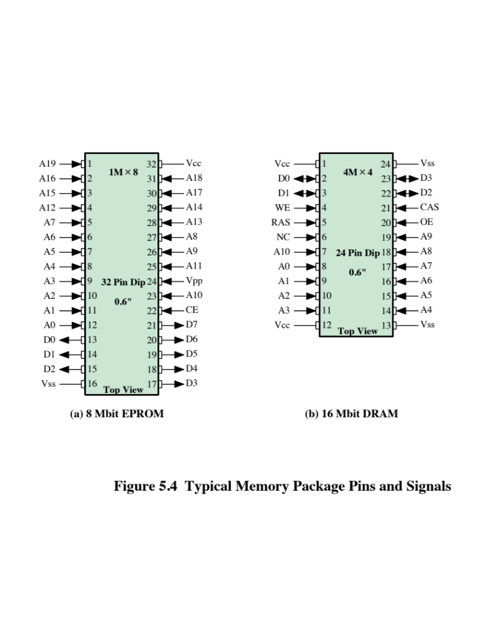
Notes:
As was mentioned in Chapter 2, an integrated circuit is mounted on a package that
contains pins for connection to the outside world.
Figure 5.4a shows an example EPROM package, which is an 8-Mbit chip
organized as 1M * 8. In this case, the organization is treated as a one-word-per-chip
package. The package includes 32 pins, which is one of the standard chip package
sizes. The pins support the following signal lines:
• The address of the word being accessed. For 1M words, a total of 20 (2²⁰ = 1M)
pins are needed (A0–A19).
• The data to be read out, consisting of 8 lines (D0–D7).
• The power supply to the chip (V_{cc}).
• A ground pin (V_{ss}).
• A chip enable (CE) pin. Because there may be more than one memory chip,
each of which is connected to the same address bus, the CE pin is used to indicate
whether or not the address is valid for this chip. The CE pin is activated
by logic connected to the higher-order bits of the address bus (i.e., address bits
above A19). The use of this signal is illustrated presently.
• A program voltage (V_{pp}) that is supplied during programming (write operations).
A typical DRAM pin configuration is shown in Figure 5.4b, for a 16-Mbit chip
organized as 4M * 4. There are several differences from a ROM chip. Because
a RAM can be updated, the data pins are input/output. The write enable (WE)
and output enable (OE) pins indicate whether this is a write or read operation.
Because the DRAM is accessed by row and column, and the address is multiplexed,
only 11 address pins are needed to specify the 4M row/column combinations
(2¹¹ * 2¹¹ = 2²² = 4M). The functions of the row address select (RAS) and column
address select (CAS) pins were discussed previously. Finally, the no connect (NC)
pin is provided so that there are an even number of pins.

Slide 69
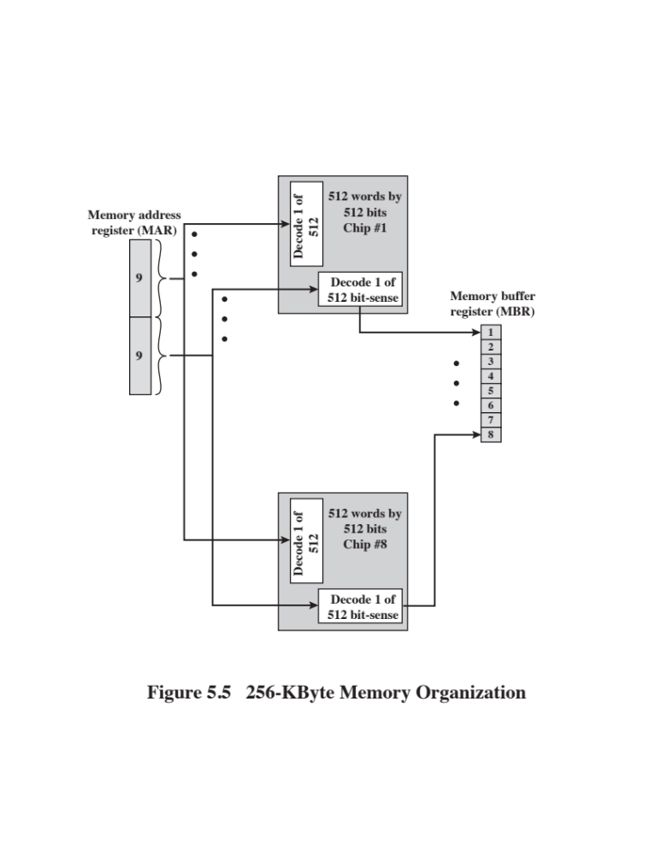
Notes:
If a RAM chip contains only 1 bit per word, then clearly we will need at least a
number of chips equal to the number of bits per word. As an example, Figure 5.5
shows how a memory module consisting of 256K 8-bit words could be organized. For
256K words, an 18-bit address is needed and is supplied to the module from some
external source (e.g., the address lines of a bus to which the module is attached).
The address is presented to 8 256K * 1-bit chips, each of which provides the input/
output of 1 bit.

Slide 70
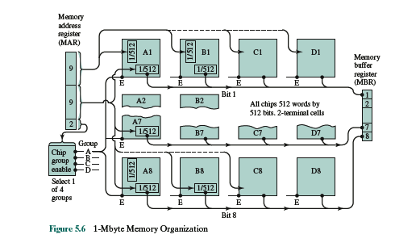
Notes:
This organization works as long as the size of memory equals the number of
bits per chip. In the case in which larger memory is required, an array of chips is
needed. Figure 5.6 shows the possible organization of a memory consisting of 1M
word by 8 bits per word. In this case, we have four columns of chips, each column
containing 256K words arranged as in Figure 5.5. For 1M word, 20 address lines are
needed. The 18 least significant bits are routed to all 32 modules. The high-order
2 bits are input to a group select logic module that sends a chip enable signal to one
of the four columns of modules.

Slide 71
Interleaved Memory
Composed of a collection of DRAM chips
Grouped together to form a memory bank
Each bank is independently able to service a memory read or write request
K banks can service K requests simultaneously, increasing memory read or write rates by a factor of K
If consecutive words of memory are stored in different banks, the transfer of a block of memory is speeded up
Notes:
Main memory is composed of a collection of DRAM memory chips. A number of
chips can be grouped together to form a memory bank. It is possible to organize
the memory banks in a way known as interleaved memory. Each bank is independently
able to service a memory read or write request, so that a system with
K banks can service K requests simultaneously, increasing memory read or write
rates by a factor of K. If consecutive words of memory are stored in different
banks, then the transfer of a block of memory is speeded up. Appendix G explores
the topic of interleaved memory.

Slide 72
Error Correction
Hard Failure
  Permanent physical defect
  Memory cell or cells affected cannot reliably store data but become stuck at 0 or 1 or switch erratically between 0 and 1
  Can be caused by:
    Harsh environmental abuse
    Manufacturing defects
    Wear
Soft Error
  Random, non-destructive event that alters the contents of one or more memory cells
  No permanent damage to memory
  Can be caused by:
    Power supply problems
    Alpha particles
Notes:
A semiconductor memory system is subject to errors. These can be categorized as
hard failures and soft errors. A hard failure is a permanent physical defect so that
the memory cell or cells affected cannot reliably store data but become stuck at
0 or 1 or switch erratically between 0 and 1. Hard errors can be caused by harsh
environmental abuse, manufacturing defects, and wear. A soft error is a random,
nondestructive event that alters the contents of one or more memory cells without
damaging the memory. Soft errors can be caused by power supply problems
or alpha particles. These particles result from radioactive decay and are distressingly
common because radioactive nuclei are found in small quantities in nearly all
materials. Both hard and soft errors are clearly undesirable, and most modern main
memory systems include logic for both detecting and correcting errors.

Slide 73
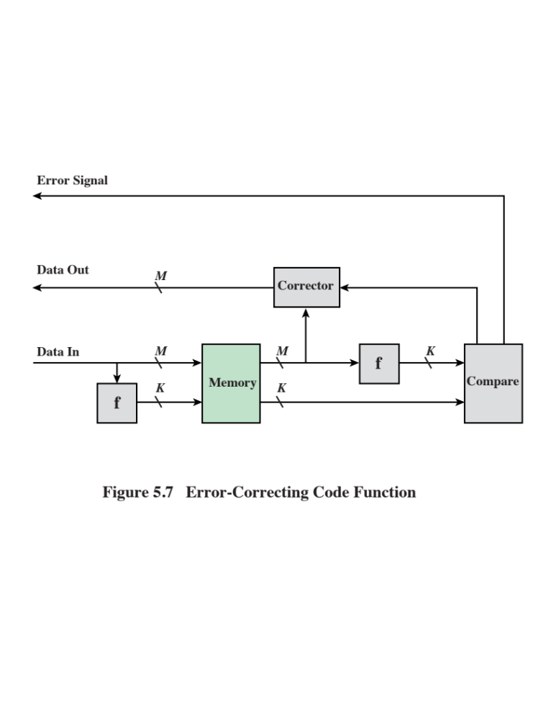
Notes:
Figure 5.7 illustrates in general terms how the process is carried out. When
data are to be written into memory, a calculation, depicted as a function f, is performed
on the data to produce a code. Both the code and the data are stored. Thus,
if an M-bit word of data is to be stored and the code is of length K bits, then the
actual size of the stored word is M + K bits.
When the previously stored word is read out, the code is used to detect and possibly
correct errors. A new set of K code bits is generated from the M data bits and
compared with the fetched code bits. The comparison yields one of three results:
• No errors are detected. The fetched data bits are sent out.
• An error is detected, and it is possible to correct the error. The data bits plus
error correction bits are fed into a corrector, which produces a corrected set of
M bits to be sent out.
• An error is detected, but it is not possible to correct it. This condition is reported.
Codes that operate in this fashion are referred to as error-correcting codes. A
code is characterized by the number of bit errors in a word that it can correct and detect.

Slide 74
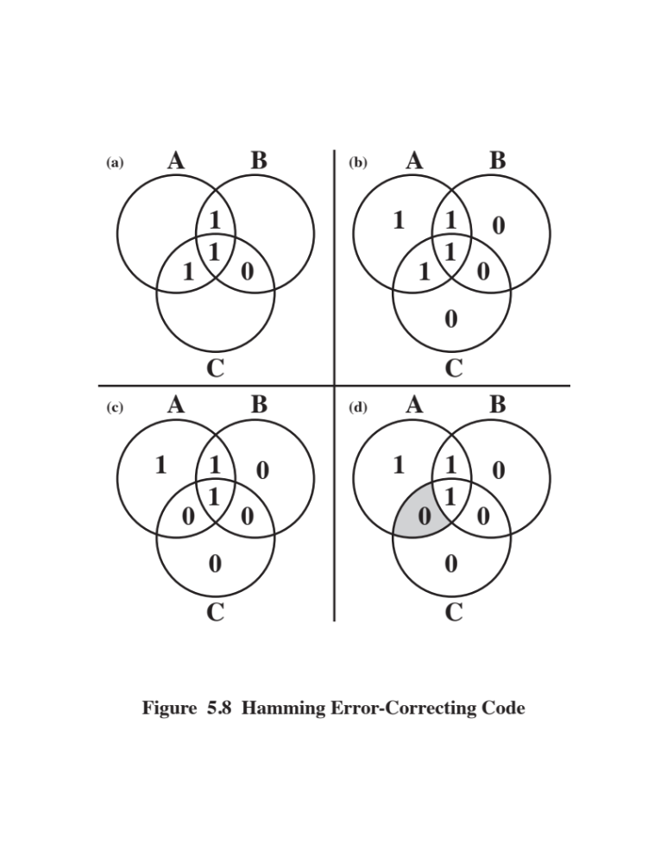
Notes:
The simplest of the error-correcting codes is the Hamming code devised by
Richard Hamming at Bell Laboratories. Figure 5.8 uses Venn diagrams to illustrate
the use of this code on 4-bit words (M = 4). With three intersecting circles,
there are seven compartments. We assign the 4 data bits to the inner compartments
(Figure5.8a). The remaining compartments are filled with what are called parity
bits. Each parity bit is chosen so that the total number of 1s in its circle is even
(Figure5.8b). Thus, because circle A includes three data 1s, the parity bit in that
circle is set to 1. Now, if an error changes one of the data bits (Figure 5.8c), it is easily
found. By checking the parity bits, discrepancies are found in circle A and circle
C but not in circle B. Only one of the seven compartments is in A and C but not B.
The error can therefore be corrected by changing that bit.

Slide 75
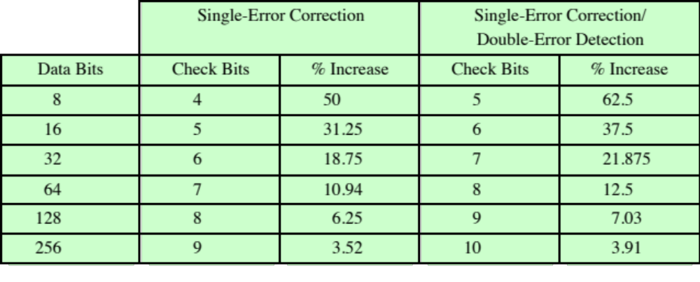
Increase in Word Length with Error Correction
Notes:
The first three columns of Table 5.2
lists the number of check bits required for various data word lengths.
For convenience, we would like to generate a 4-bit syndrome for an 8-bit data
word with the following characteristics:
• If the syndrome contains all 0s, no error has been detected.
• If the syndrome contains one and only one bit set to 1, then an error has
occurred in one of the 4 check bits. No correction is needed.
• If the syndrome contains more than one bit set to 1, then the numerical value
of the syndrome indicates the position of the data bit in error. This data bit is
inverted for correction.

Slide 76
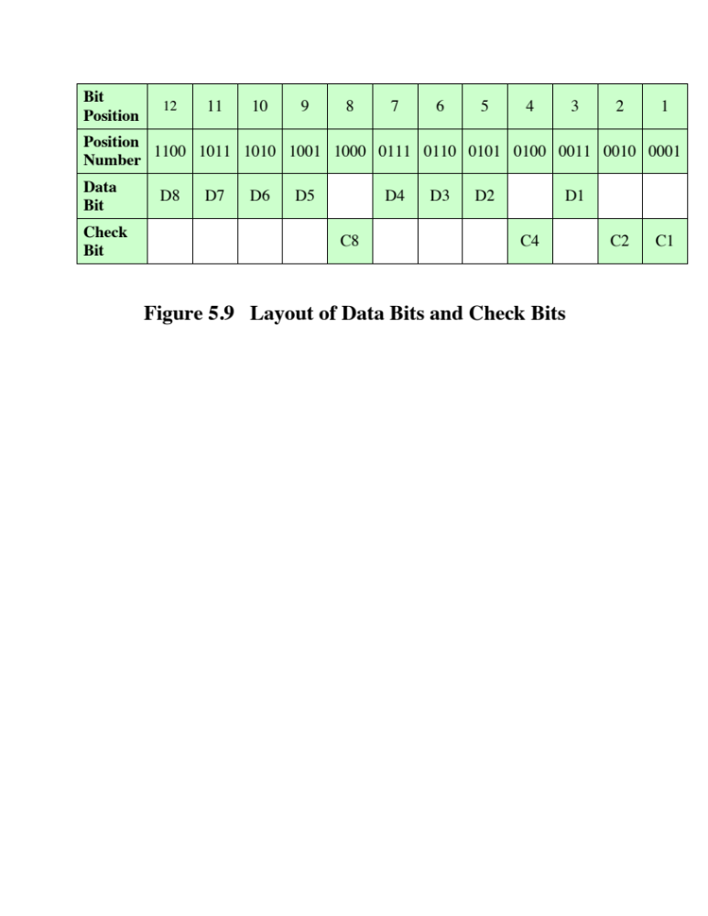
Notes:
To achieve these characteristics, the data and check bits are arranged into a
12-bit word as depicted in Figure 5.9. The bit positions are numbered from 1 to 12.
Those bit positions whose position numbers are powers of 2 are designated as check
bits.

Slide 77
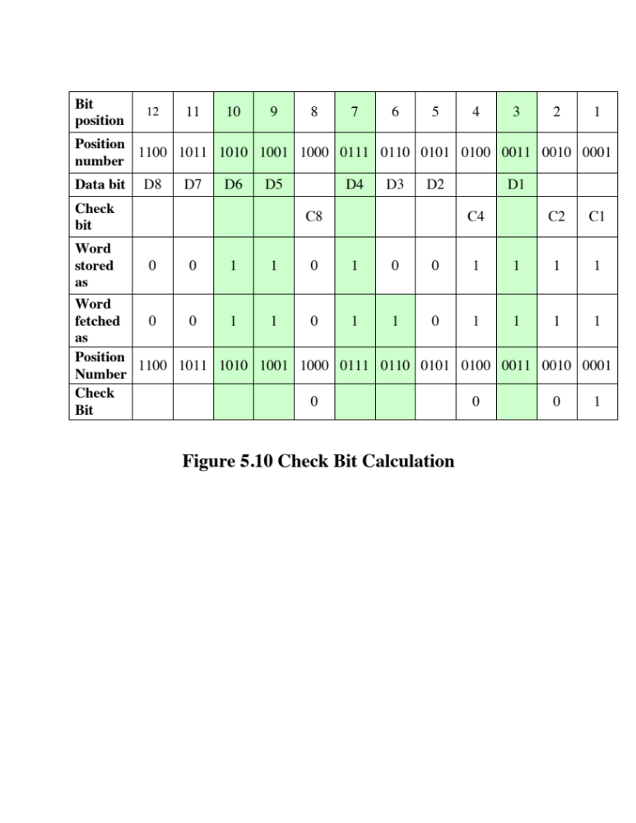
Notes:
Figure 5.10 illustrates the calculation. The data and check bits are
positioned properly in the 12-bit word. Four of the data bits have a value 1 (shaded
in the table), and their bit position values are XORed to produce the Hamming
code 0111, which forms the four check digits. The entire block that is stored is
001101001111. Suppose now that data bit 3, in bit position 6, sustains an error and is
changed from 0 to 1. The resulting block is 001101101111, with a Hamming code of
0111. An XOR of the Hamming code and all of the bit position values for nonzero
data bits results in 0110. The nonzero result detects an error and indicates that the
error is in bit position 6.

Slide 78
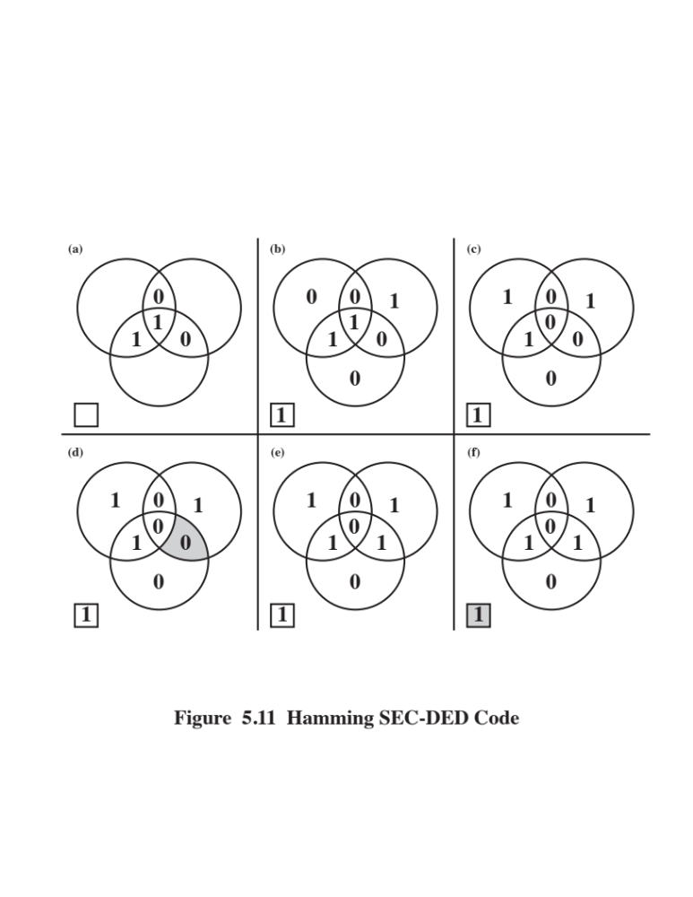
Notes:
The code just described is known as a single-error-correcting (SEC) code.
More commonly, semiconductor memory is equipped with a single-error-correcting,
double-error-detecting (SEC-DED) code. As Table 5.2 shows, such codes require
one additional bit compared with SEC codes.
Figure 5.11 illustrates how such a code works, again with a 4-bit data word.
The sequence shows that if two errors occur (Figure 5.11c), the checking procedure
goes astray (d) and worsens the problem by creating a third error (e). To overcome
the problem, an eighth bit is added that is set so that the total number of 1s in the
diagram is even. The extra parity bit catches the error (f).
An error-correcting code enhances the reliability of the memory at the cost of
added complexity. With a 1-bit-per-chip organization, an SEC-DED code is generally
considered adequate. For example, the IBM 30xx implementations used an 8-bit SECDED
code for each 64 bits of data in main memory. Thus, the size of main memory is
actually about 12% larger than is apparent to the user. The VAX computers used a 7-bit
SEC-DED for each 32 bits of memory, for a 22% overhead. A number of contemporary
DRAMs use 9 check bits for each 128 bits of data, for a 7% overhead [SHAR03].

Slide 79
Advanced DRAM Organization
SDRAM
DDR-DRAM
  One of the most critical system bottlenecks when using high-performance processors is the interface to main internal memory
  The traditional DRAM chip is constrained both by its internal architecture and by its interface to the processor’s memory bus
  A number of enhancements to the basic DRAM architecture have been explored
    The schemes that currently dominate the market are SDRAM and DDR-DRAM
RDRAM
Notes:
As discussed in Chapter 1, one of the most critical system bottlenecks when using
high-performance processors is the interface to main internal memory. This interface
is the most important pathway in the entire computer system. The basic building
block of main memory remains the DRAM chip, as it has for decades; until
recently, there had been no significant changes in DRAM architecture since the
early 1970s. The traditional DRAM chip is constrained both by its internal architecture
and by its interface to the processor’s memory bus.
We have seen that one attack on the performance problem of DRAM
main memory has been to insert one or more levels of high-speed SRAM cache
between the DRAM main memory and the processor. But SRAM is much costlier
than DRAM, and expanding cache size beyond a certain point yields diminishing
returns.
In recent years, a number of enhancements to the basic DRAM architecture
have been explored. The schemes that currently dominate the market are SDRAM
and DDR-DRAM. We examine each of these in turn.

Slide 80
Synchronous DRAM (SDRAM)
One of the most widely used forms of DRAM
Exchanges data with the processor synchronized to an external clock signal and running at the full speed of the processor/memory bus without imposing wait states
With synchronous access the DRAM moves data in and out under control of the system clock
The processor or other master issues the instruction and address information which is latched by the DRAM
The DRAM then responds after a set number of clock cycles
Meanwhile the master can safely do other tasks while the SDRAM is processing
Notes:
One of the most widely used forms of DRAM is the synchronous DRAM
(SDRAM) [VOGL94]. Unlike the traditional DRAM, which is asynchronous, the
SDRAM exchanges data with the processor synchronized to an external clock signal
and running at the full speed of the processor/memory bus without imposing
wait states.
In a typical DRAM, the processor presents addresses and control levels to
the memory, indicating that a set of data at a particular location in memory should
be either read from or written into the DRAM. After a delay, the access time, the
DRAM either writes or reads the data. During the access-time delay, the DRAM
performs various internal functions, such as activating the high capacitance of the
row and column lines, sensing the data, and routing the data out through the output
buffers. The processor must simply wait through this delay, slowing system
performance.
With synchronous access, the DRAM moves data in and out under control of
the system clock. The processor or other master issues the instruction and address
information, which is latched by the DRAM. The DRAM then responds after a set
number of clock cycles. Meanwhile, the master can safely do other tasks while the
SDRAM is processing the request.

Slide 81
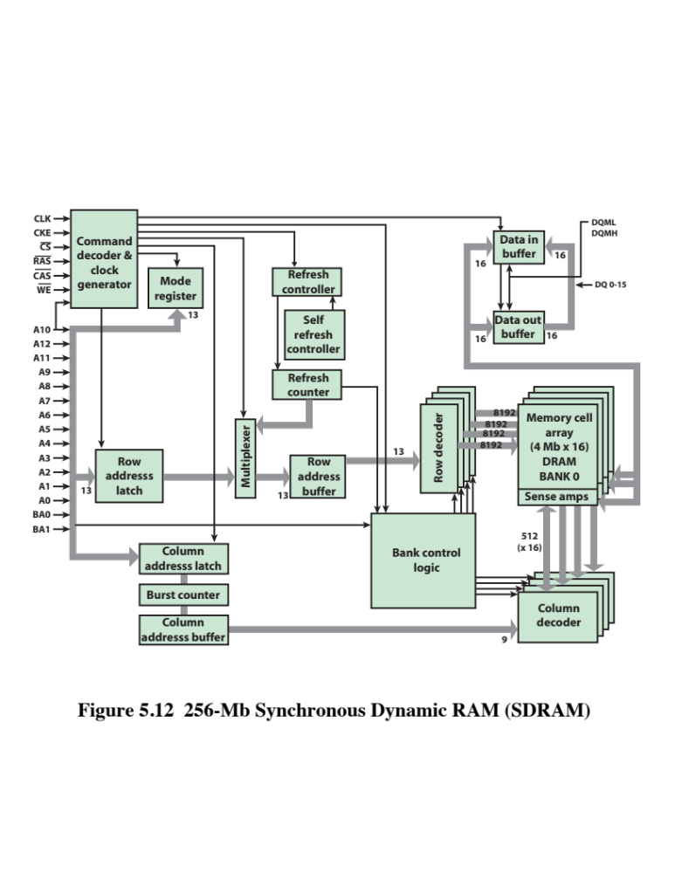
Notes:
Figure 5.12 shows the internal logic of a typical 256-Mb SDRAM typical
of SDRAM organization.

Slide 82
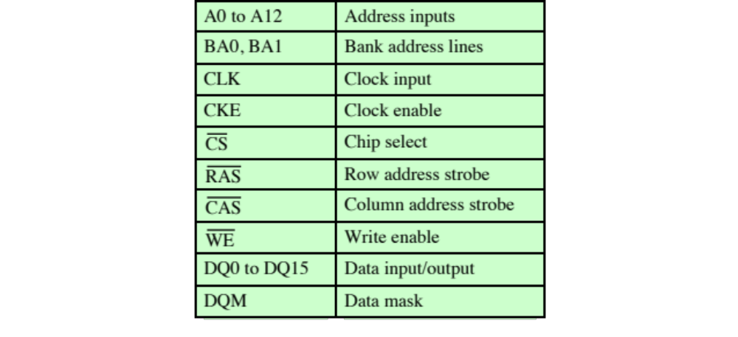
Table 5.3
SDRAM
Pin
Assignments
Notes:
Table 5.3 defines the various pin assignments.
The SDRAM employs a burst mode to eliminate the address setup time and
row and column line pre-charge time after the first access. In burst mode, a series of
data bits can be clocked out rapidly after the first bit has been accessed. This mode
is useful when all the bits to be accessed are in sequence and in the same row of the
array as the initial access. In addition, the SDRAM has a multiple-bank internal
architecture that improves opportunities for on-chip parallelism.
The mode register and associated control logic is another key feature differentiating
SDRAMs from conventional DRAMs. It provides a mechanism to
customize the SDRAM to suit specific system needs. The mode register specifies
the burst length, which is the number of separate units of data synchronously fed
onto the bus. The register also allows the programmer to adjust the latency between
receipt of a read request and the beginning of data transfer.
The SDRAM performs best when it is transferring large blocks of data serially,
such as for applications like word processing, spreadsheets, and multimedia.

Slide 83
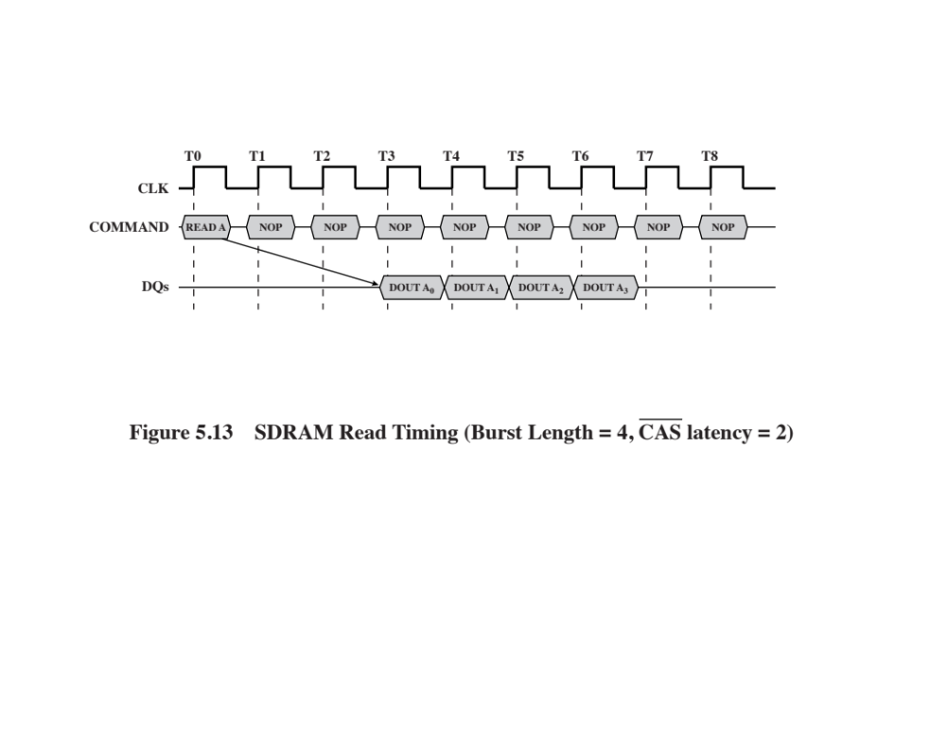
Notes:
Figure 5.13 shows an example of SDRAM operation.
In this case, the burst length is 4 and the latency is 2. The burst read command is
initiated by having CS and CAS low while holding RAS and WE high at the rising
edge of the clock. The address inputs determine the starting column address for the burst,
and the mode register sets the type of burst (sequential or interleave) and the burst length (1, 2,
4, 8, full page). The delay from the start of the command to when the data from the
first cell appears on the outputs is equal to the value of the CAS latency that is set
in the mode register.

Slide 84
Double Data Rate SDRAM
(DDR SDRAM)
Developed by the JEDEC Solid State Technology Association (Electronic Industries Alliance’s semiconductor-engineering-standardization body)
Numerous companies make DDR chips, which are widely used in desktop computers and servers
DDR achieves higher data rates in three ways:
  First, the data transfer is synchronized to both the rising and falling edge of the clock, rather than just the rising edge
  Second, DDR uses higher clock rate on the bus to increase the transfer rate
  Third, a buffering scheme is used
Notes:
Although SDRAM is a significant improvement on asynchronous RAM, it still
has shortcomings that unnecessarily limit that I/O data rate that can be achieve. To
address these shortcomings a newer version of SDRAM, referred to as double-data-
rate DRAM (DDR RAM) provides several features that dramatically increase
the data rate. DDR DRAM was developed by the JEDEC Solid State Technology
Association, the Electronic Industries Alliance’s semiconductor-engineering-standardization
body. Numerous companies make DDR chips, which are widely used in
desktop computers and servers.
DDR achieves higher data rates in three ways. First, the data transfer is synchronized
to both the rising and falling edge of the clock, rather than just the rising
edge. This doubles the data rate; hence the term double data rate . Second, DDR
uses higher clock rate on the bus to increase the transfer rate. Third, a buffering
scheme is used, as explained subsequently.

Slide 85
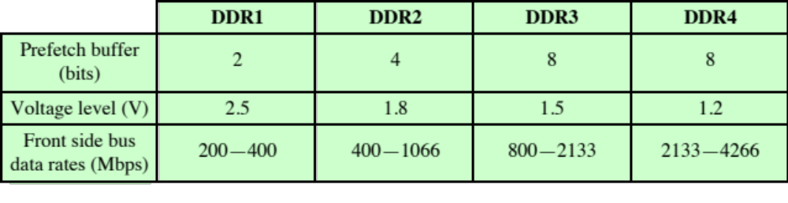
DDR Characteristics
Notes:
JDEC has thus far defined four generations of the DDR technology (Table 5.4).
The initial DDR version makes use of a 2-bit prefetch buffer. The prefetch buffer is
a memory cache located on the SDRAM chip. It enables the SDRAM chip to preposition
bits to be placed on the data bus as rapidly as possible. The DDR I/O bus
uses the same clock rate as the memory chip, but because it can handle two bits per
cycle, it achieves a data rate that is double the clock rate. The 2-bit prefetch buffer
enables the SDRAM chip to keep up with the I/O bus.

Slide 86
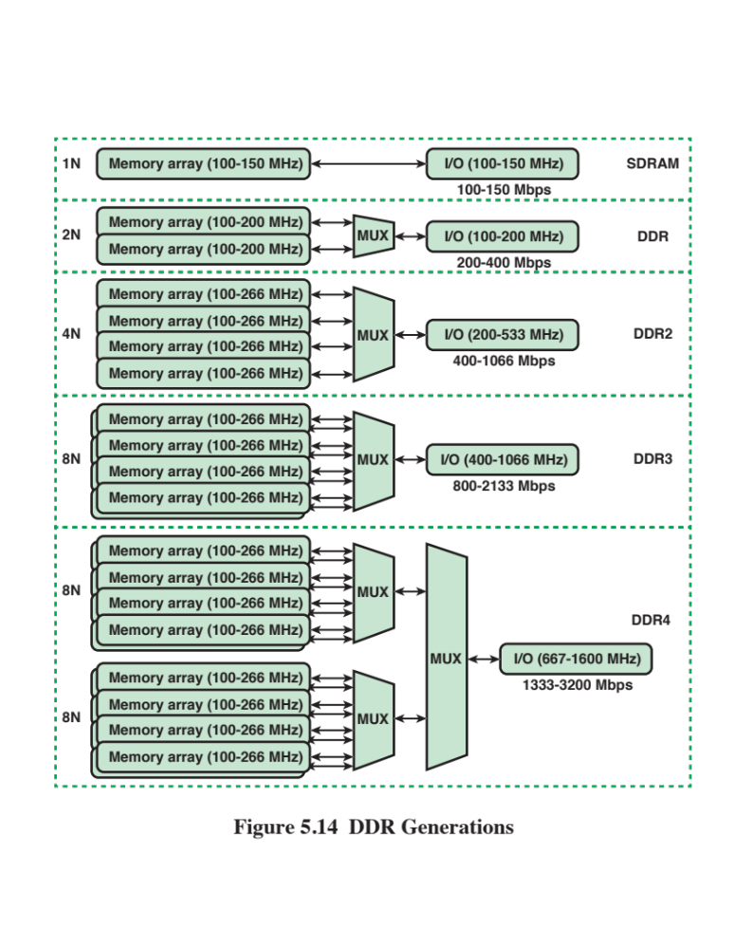
Notes:
To understand the operation of the prefetch buffer, we need to look at it from
the point of view of a word transfer. The prefetch buffer size determines how many
words of data are fetched (across multiple SDRAM chips) every time a column command
is performed with DDR memories. Because the core of the DRAM is much
slower than the interface, the difference is bridged by accessing information in parallel
and then serializing it out the interface through a multiplexor (MUX). Thus,
DDR prefetches two words, which means that every time a read or a write operation
is performed, it is performed on two words of data, and bursts out of, or into, the
SDRAM over one clock cycles on both clock edges for a total of two consecutive
operations. As a result, the DDR I/O interface is twice as fast as the SDRAM core.
Although each new generation of SDRAM results is much greater capacity,
the core speed of the SDRAM has not changed significantly from generation to
generation. To achieve greater data rates than those afforded by the rather modest
increases in SDRAM clock rate, JDEC increased the buffer size. For DDR2, a 4-bit
buffer is used, allowing for words to be transferred in parallel, increasing the effective
data rate by a factor of 4. For DDR3, an 8-bit buffer is used and a factor of 8
speedup is achieved (Figure 5.14).
The downside to the prefetch is that it effectively determines the minimum
burst length for the SDRAMs. For example, it is very difficult to have an efficient
burst length of four words with DDR3’s prefetch of eight. Accordingly, the JDEC
designers chose not to increase the buffer size to 16 bits for DDR4, but rather to
introduce the concept of a bank group [ALLA13]. Bank groups are separate entities
such that they allow a column cycle to complete within a bank group, but that
column cycle does not impact what is happening in another bank group. Thus,
two prefetches of eight can be operating in parallel in the two bank groups. This
arrangement keeps the prefetch buffer size the same as for DDR3, while increasing
performance as if the prefetch is larger.
Figure 5.14 shows a configuration with two bank groups. With DDR4, up to 4
bank groups can be used.

Slide 87
Flash Memory
Used both for internal memory and external memory applications
First introduced in the mid-1980’s
Is intermediate between EPROM and EEPROM in both cost and functionality
Uses an electrical erasing technology like EEPROM
It is possible to erase just blocks of memory rather than an entire chip
Gets its name because the microchip is organized so that a section of memory cells are erased in a single action
Does not provide byte-level erasure
Uses only one transistor per bit so it achieves the high density of EPROM
Notes:
Another form of semiconductor memory is flash memory. Flash memory is used
both for internal memory and external memory applications. Here, we provide a
technical overview and look at its use for internal memory.
First introduced in the mid-1980s, flash memory is intermediate between
EPROM and EEPROM in both cost and functionality. Like EEPROM, flash memory
uses an electrical erasing technology. An entire flash memory can be erased in
one or a few seconds, which is much faster than EPROM. In addition, it is possible
to erase just blocks of memory rather than an entire chip. Flash memory gets its
name because the microchip is organized so that a section of memory cells are
erased in a single action or "flash." However, flash memory does not provide bytelevel
erasure. Like EPROM, flash memory uses only one transistor per bit, and so
achieves the high density (compared with EEPROM) of EPROM.

Slide 88
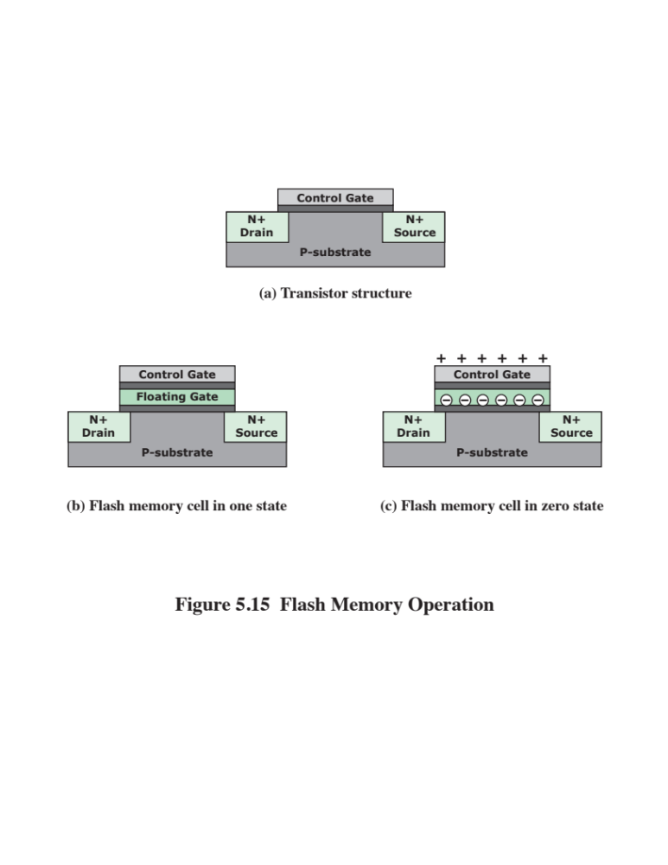
Notes:
Figure 5.15 illustrates the basic operation of a flash memory. For comparison, Figure
5.15a depicts the operation of a transistor. Transistors exploit the properties of
semiconductors so that a small voltage applied to the gate can be used to control the
flow of a large current between the source and the drain.
In a flash memory cell, a second gate—called a floating gate, because it is insulated
by a thin oxide layer—is added to the transistor. Initially, the floating gate
does not interfere with the operation of the transistor (Figure 5.15b). In this state,
the cell is deemed to represent binary 1. Applying a large voltage across the oxide
layer causes electrons to tunnel through it and become trapped on the floating gate,
where they remain even if the power is disconnected (Figure 5.15c). In this state, the
cell is deemed to represent binary 0. The state of the cell can be read by using external
circuitry to test whether the transistor is working or not. Applying a large voltage
in the opposite direction removes the electrons from the floating gate, returning
to a state of binary 1.
An important characteristic of flash memory is that it is persistent memory,
which means that it retains data when there is no power applied to the memory.
Thus, it is useful for secondary (external) storage, and as an alternative to random
access memory in computers.

Slide 89
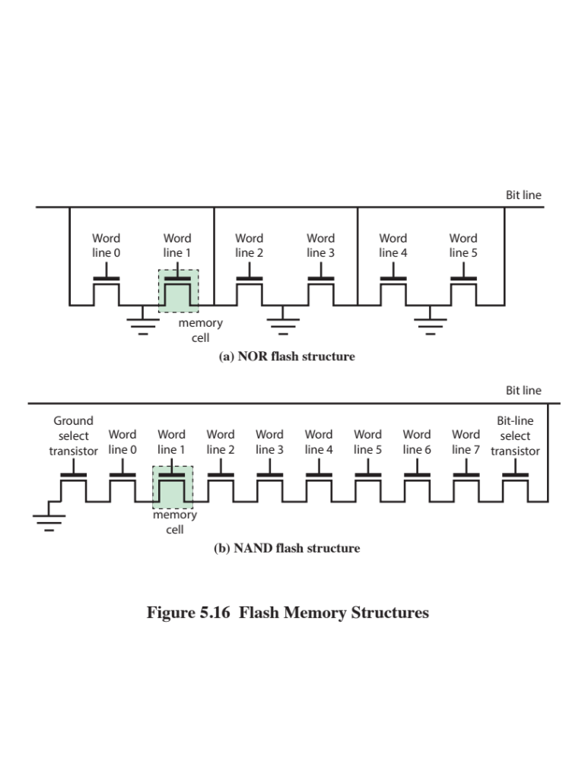
Notes:
There are two distinctive types of flash memory, designated as NOR and NAND
(Figure 5.16). In NOR flash memory , the basic unit of access is a bit, referred to as a
memory cell . Cells in NOR flash are connected in parallel to the bit lines so that each
cell can be read/write/erased individually. If any memory cell of the device is turned
on by the corresponding word line, the bit line goes low. This is similar in function to
a NOR logic gate.
NAND flash memory is organized in transistor arrays with 16 or 32 transistors
in series. The bit line goes low only if all the transistors in the corresponding word
lines are turned on. This is similar in function to a NAND logic gate.

Slide 90
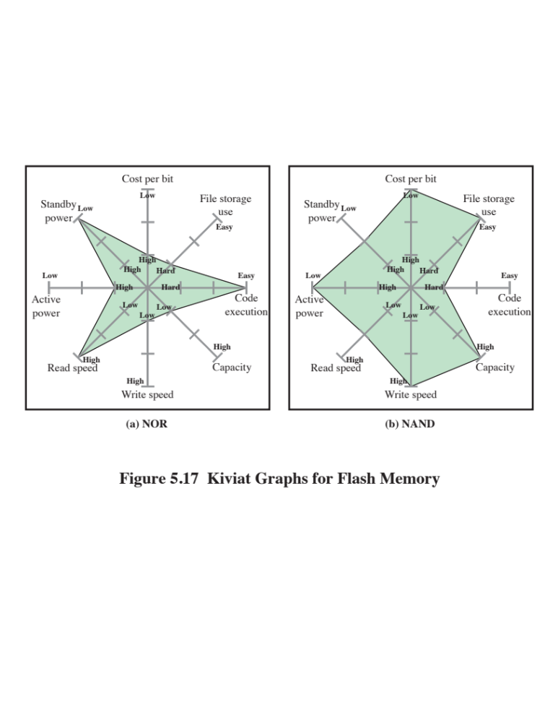
Notes:
Although the specific quantitative values of various characteristics of NOR
and NAND are changing year by year, the relative differences between the two
types has remained stable. These differences are usefully illustrated by the Kiviat
graphs shown in Figure 5.17.
NOR flash memory provides high-speed random access. It can read and write
data to specific locations, and can reference and retrieve a single byte. NAND reads
and writes in small blocks. NAND provides higher bit density than NOR and greater
write speed. NAND flash does not provide a random-access external address bus so
the data must be read on a blockwise basis (also known as page access), where each
block holds hundreds to thousands of bits.
For internal memory in embedded systems, NOR flash memory has traditionally
been preferred. NAND memory has made some inroads, but NOR remains the
dominant technology for internal memory. It is ideally suited for microcontrollers
where the amount of program code is relatively small and a certain amount of application
data does not vary. For example, the flash memory in Figure 1.16 is NOR
memory.
NAND memory is better suited for external memory, such as USB flash
drives, memory cards (in digital cameras, MP3 players, etc.), and in what are known
as solid-state disks (SSDs). We discuss SSDs in Chapter 6.

Slide 91
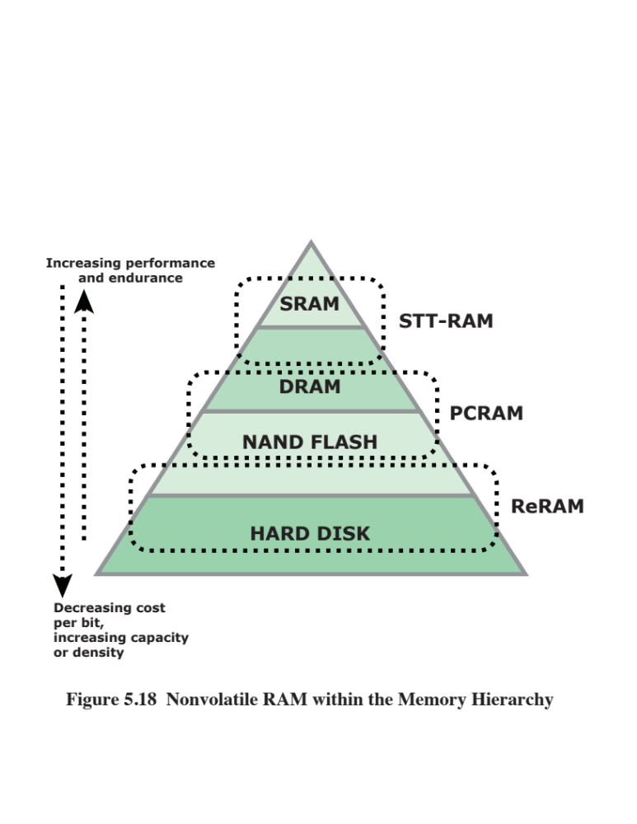
Notes:
The traditional memory hierarchy has consisted of three levels (Figure 5.18):
■ Static RAM (SRAM): SRAM provides rapid access time, but is the most expensive
and the least dense (bit density). SRAM is suitable for cache memory.
■ Dynamic RAM (DRAM): Cheaper, denser, and slower than SRAM, DRAM
has traditionally been the choice off-chip main memory.
■ Hard disk: A magnetic disk provides very high bit density and very low cost
per bit, with relatively slow access times. It is the traditional choice for external
storage as part of the memory hierarchy.
Into this mix, as we have seen, as been added flash memory. Flash memory has the
advantage over traditional memory that it is nonvolatile. NOR flash is best suited
to storing programs and static application data in embedded systems, while NAND
flash has characteristics intermediate between DRAM and hard disks.
Over time, each of these technologies has seen improvements in scaling: higher
bit density, higher speed, lower power consumption, and lower cost. However, for
semiconductor memory, it is becoming increasingly difficult to continue the pace of
improvement [ITRS14].
Recently, there have been breakthroughs in developing new forms of nonvolatile
semiconductor memory that continue scaling beyond flash memory. The
most promising technologies are spin-transfer torque RAM (STT-RAM), phasechange
RAM (PCRAM), and resistive RAM (ReRAM) ([ITRS14], [GOER12]).
All of these are in volume production. However, because NAND Flash and to some
extent NOR Flash are still dominating the applications, these emerging memories
have been used in specialty applications and have not yet fulfilled their original
promise to become dominating mainstream high-density nonvolatile memory. This
is likely to change in the next few years.
Figure 5.18 shows how these three technologies are likely to fit into the memory
hierarchy.

Slide 92
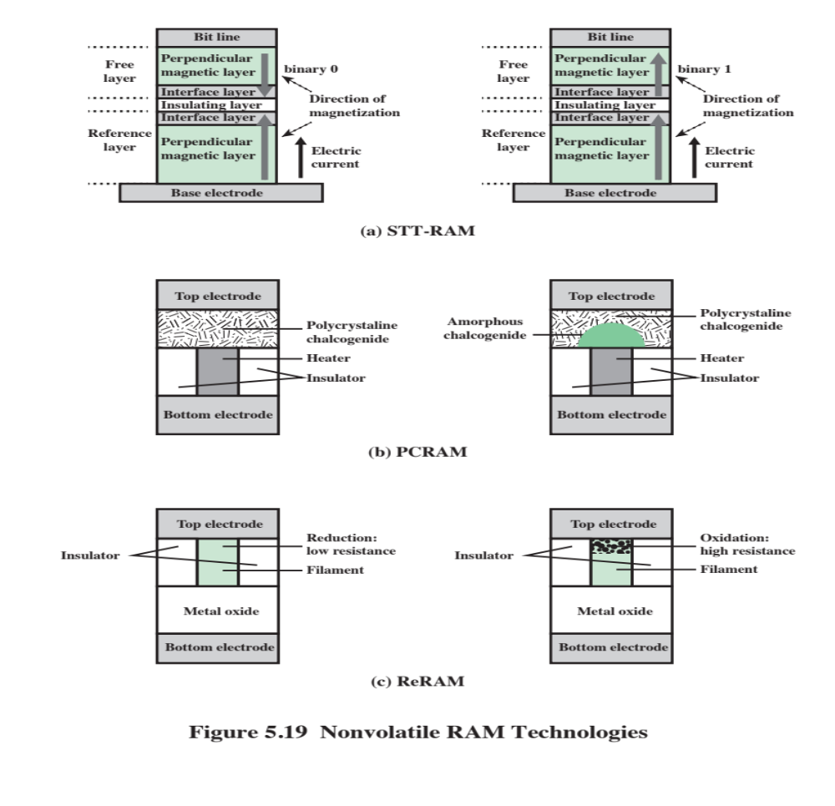
Notes:
STT-RAM is a new type of Magnetic RAM (MRAM), which features non-volatility,
fast writing/reading speed <10ns), and high programming endurance (>10¹⁵cycles)
and zero standby power [KULT13]. The storage capability or programmability of
MRAM arises from magnetic tunneling junction (MTJ), in which a thin tunneling
dielectric is sandwiched between two ferromagnetic layers. One ferromagnetic layer
(pinned or reference layer) is designed to have its magnetization pinned, while the
magnetization of the other layer (free layer) can be flipped by a write event. An MTJ
has a low (high) resistance if the magnetizations of the free layer and the pinned layer
are parallel (anti-parallel). In first-generation MRAM design, the magnetization of the
free layer is changed by the current-induced magnetic field. In STT-RAM, a new write
mechanism, called polarization-current-induced magnetization switching, is introduced.
For STT-RAM, the magnetization of the free layer is flipped by the electrical
current directly. Because the current required to switch an MTJ resistance state is proportional
to the MTJ cell area, STT-RAM is believed to have a better scaling property
than the first-generation MRAM. Figure 5.19a illustrates the general configuration.
STT-RAM is a good candidate for either cache or main memory.
PCRAM
Phase-change RAM is the most mature or the new technologies, with an extensive
technical literature ([RAOU09], [ZHOU09], [LEE10]).
PCRAM technology is based on a chalcogenide alloy material, which is similar
to those commonly used in optical storage media (compact discs and digital versatile
discs). The data storage capability is achieved from the resistance differences
between an amorphous (high-resistance) and a crystalline (low-resistance) phase
of the chalcogenide-based material. In SET operation, the phase change material is
crystallized by applying an electrical pulse that heats a significant portion of the cell
above its crystallization temperature. In RESET operation, a larger electrical current
is applied and then abruptly cut off in order to melt and then quench the material,
leaving it in the amorphous state. Figure 5.19b illustrates the general configuration.
PCRAM is a good candidate to replace or supplement DRAM for main
memory.
ReRAM (also known as RRAM) works by creating resistance rather than directly
storing charge. An electric current is applied to a material, changing the resistance
of that material. The resistance state can then be measured and a 1 or 0 is read as
the result. Much of the work done on ReRAM to date has focused on finding appropriate
materials and measuring the resistance state of the cells. ReRAM designs
are low voltage, endurance is far superior to flash memory, and the cells are much
smaller—at least in theory. Figure 5.19c shows one ReRam configuration.
ReRAM is a good candidate to replace or supplement both secondary storage
and main memory.

Slide 93
Summary
Internal
Memory
Semiconductor main memory
  Organization
  DRAM and SRAM
  Types of ROM
  Chip logic
  Chip packaging
  Module organization
  Interleaved memory
Error correction
  DDR DRAM
  Synchronous DRAM
  DDR SDRAM
  Flash memory
  Operation
  NOR and NAND flash memory
  Newer nonvolatile solid-state memory technologies
Notes:
Chapter 5 summary.

Slide 94
Part 2
External Memory

Slide 95

Magnetic Disk
A disk is a circular platter constructed of nonmagnetic material, called the substrate, coated with a magnetizable material
  Traditionally the substrate has been an aluminium or aluminium alloy material
  Recently glass substrates have been introduced
Benefits of the glass substrate:
  Improvement in the uniformity of the magnetic film surface to increase disk reliability
  A significant reduction in overall surface defects to help reduce read-write errors
  Ability to support lower fly heights
  Better stiffness to reduce disk dynamics
  Greater ability to withstand shock and damage
Notes:
A disk is a circular platter constructed of nonmagnetic material, called the substrate,
coated with a magnetizable material. Traditionally, the substrate has been an aluminum
or aluminum alloy material. More recently, glass substrates have been introduced.
The glass substrate has a number of benefits, including the following:
• Improvement in the uniformity of the magnetic film surface to increase disk
reliability
• A significant reduction in overall surface defects to help reduce read-write errors
• Ability to support lower fly heights (described subsequently)
• Better stiffness to reduce disk dynamics
• Greater ability to withstand shock and damage

Slide 96
Magnetic Read and Write
Mechanisms
Data are recorded on and later retrieved from the disk via a conducting coil named the head
In many systems there are two heads, a read head and a write head
During a read or write operation the head is stationary while the platter rotates beneath it
The write mechanism exploits the fact that electricity flowing through a coil produces a magnetic field
Electric pulses are sent to the write head and the resulting magnetic patterns are recorded on the surface below, with different patterns for positive and negative currents
The write head itself is made of easily magnetizable material and is in the shape of a rectangular doughnut with a gap along one side and a few turns of conducting wire along the opposite side
An electric current in the wire induces a magnetic field across the gap, which in turn magnetizes a small area of the recording medium
Reversing the direction of the current reverses the direction of the magnetization on the recording medium
Notes:
Data are recorded on and later retrieved from the disk via a conducting coil named
the head; in many systems, there are two heads, a read head and a write head. During
a read or write operation, the head is stationary while the platter rotates beneath it.
The write mechanism exploits the fact that electricity flowing through a coil
produces a magnetic field. Electric pulses are sent to the write head, and the resulting
magnetic patterns are recorded on the surface below, with different patterns for
positive and negative currents. The write head itself is made of easily magnetizable
material and is in the shape of a rectangular doughnut with a gap along one side and
a few turns of conducting wire along the opposite side (Figure 6.1). An electric current
in the wire induces a magnetic field across the gap, which in turn magnetizes a
small area of the recording medium. Reversing the direction of the current reverses
the direction of the magnetization on the recording medium.
The traditional read mechanism exploits the fact that a magnetic field moving
relative to a coil produces an electrical current in the coil. When the surface of the
disk passes under the head, it generates a current of the same polarity as the one
already recorded. The structure of the head for reading is in this case essentially
the same as for writing and therefore the same head can be used for both. Such
single heads are used in floppy disk systems and in older rigid disk systems.
Contemporary rigid disk systems use a different read mechanism, requiring
a separate read head, positioned for convenience close to the write head. The read
head consists of a partially shielded magnetoresistive (MR) sensor. The MR material
has an electrical resistance that depends on the direction of the magnetization of
the medium moving under it. By passing a current through the MR sensor, resistance
changes are detected as voltage signals. The MR design allows higher-frequency
operation, which equates to greater storage densities and operating speeds.

Slide 97
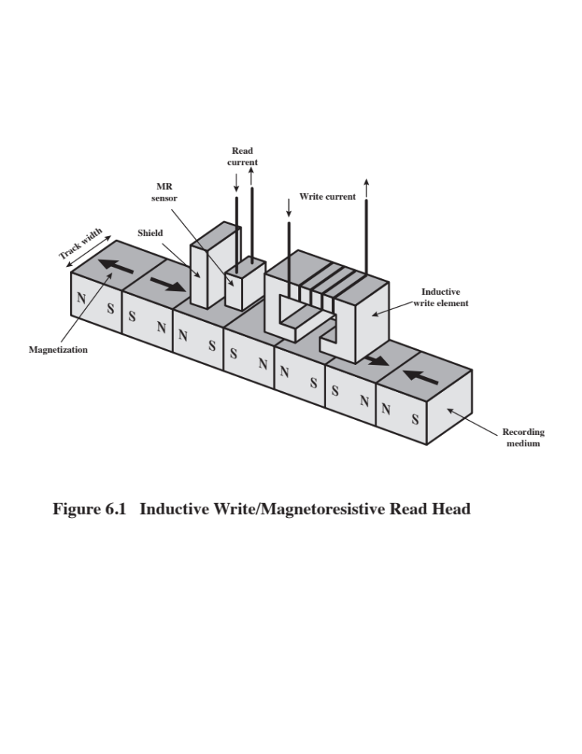
Notes:
Figure 6.1. Inductive Write/Magnetoresistive Read Head

Slide 98
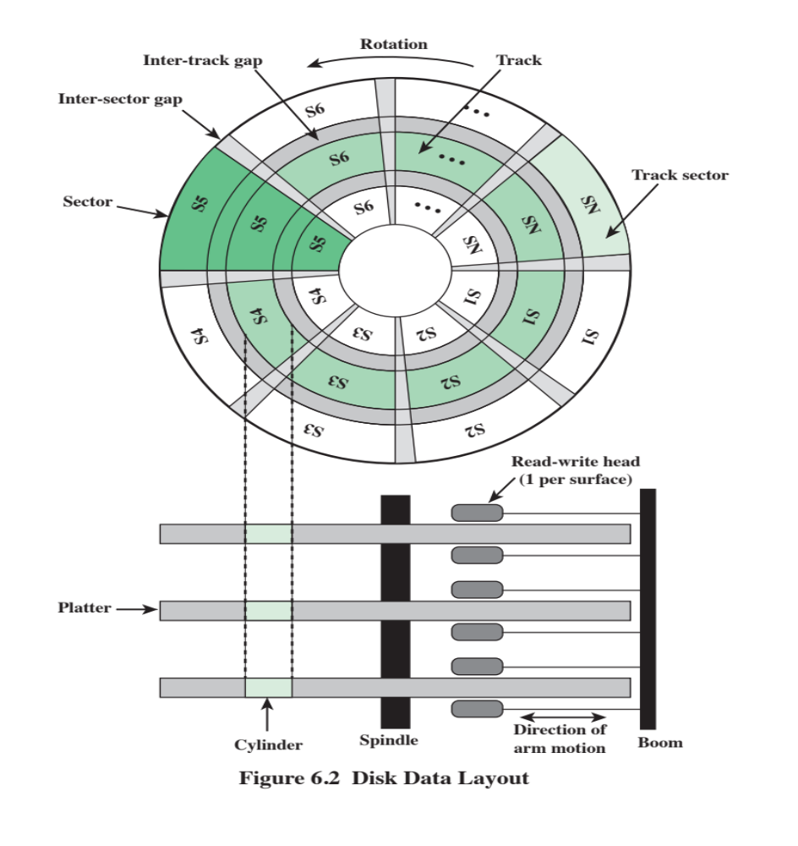
Notes:
The head is a relatively small device capable of reading from or writing to a portion
of the platter rotating beneath it. This gives rise to the organization of data on the
platter in a concentric set of rings, called tracks . Each track is the same width as the
head. There are thousands of tracks per surface.
Figure 6.2 depicts this data layout. Adjacent tracks are separated by intertrack
gaps . This prevents, or at least minimizes, errors due to misalignment of the head
or simply interference of magnetic fields. Data are transferred to and from the disk
in sectors . There are typically hundreds of sectors per track, and these may be of
either fixed or variable length. In most contemporary systems, fixed-
length sectors are used, with 512 bytes being the nearly universal sector size. To avoid imposing
unreasonable precision requirements on the system, adjacent sectors are separated
by intersector gaps.

Slide 99
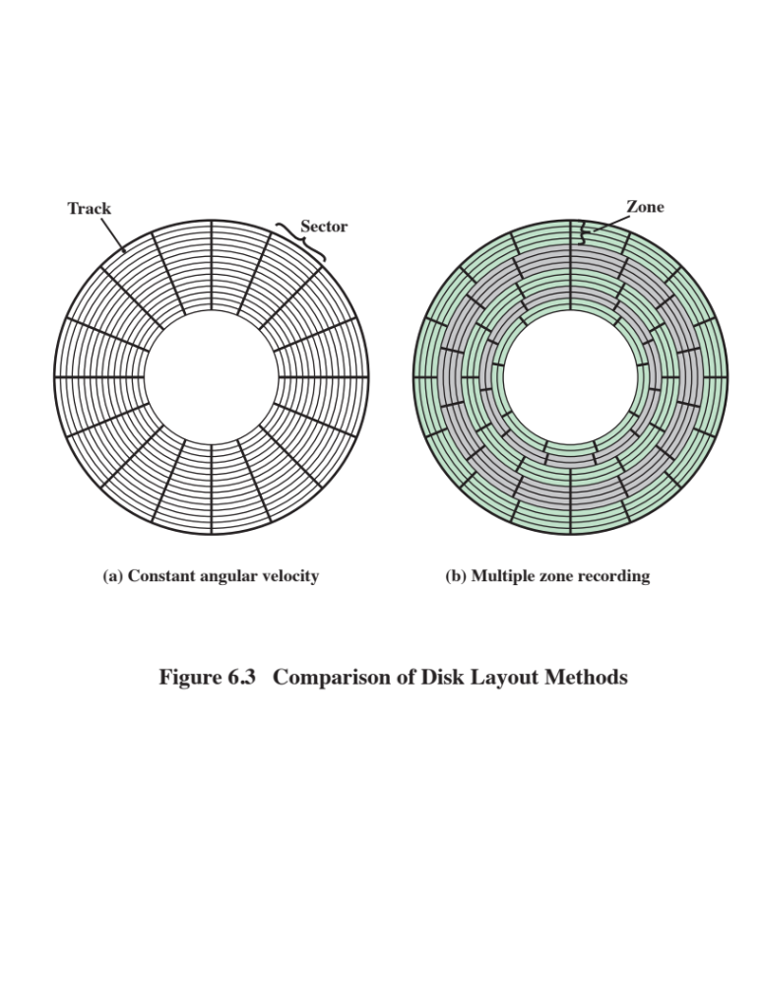
Notes:
A bit near the center of a rotating disk travels past a fixed point (such as a read–
write head) slower than a bit on the outside. Therefore, some way must be found
to compensate for the variation in speed so that the head can read all the bits at the
same rate. This can be done by increasing the spacing between bits of information
recorded in segments of the disk. The information can then be scanned at the same
rate by rotating the disk at a fixed speed, known as the constant angular velocity
(CAV). Figure 6.3a shows the layout of a disk using CAV. The disk is divided into
a number of pie-shaped sectors and into a series of concentric tracks. The advantage
of using CAV is that individual blocks of data can be directly addressed by
track and sector. To move the head from its current location to a specific address, it
only takes a short movement of the head to a specific track and a short wait for the
proper sector to spin under the head. The disadvantage of CAV is that the amount
of data that can be stored on the long outer tracks is the only same as what can be
stored on the short inner tracks.
Because the density, in bits per linear inch, increases in moving from the outermost
track to the innermost track, disk storage capacity in a straightforward CAV
system is limited by the maximum recording density that can be achieved on the
innermost track. To increase density, modern hard disk systems use a technique
known as multiple zone recording, in which the surface is divided into a number
of concentric zones (16 is typical). Within a zone, the number of bits per track is
constant. Zones farther from the center contain more bits (more sectors) than zones
closer to the center. This allows for greater overall storage capacity at the expense
of somewhat more complex circuitry. As the disk head moves from one zone to
another, the length (along the track) of individual bits changes, causing a change
in the timing for reads and writes.
Figure 6.3b is a simplified MZR layout, with 15 tracks organized into 5 zones.
The innermost two zones have two tracks each, with each track having nine sectors;
the next zone has 3 tracks, each with 12 sectors; and the outermost 2 zones have 4
tracks each, with each track having 16 sectors.

Slide 100

Notes:
Some means is needed to locate sector positions within a track. Clearly, there
must be some starting point on the track and a way of identifying the start and end
of each sector. These requirements are handled by means of control data recorded
on the disk. Thus, the disk is formatted with some extra data used only by the disk
drive and not accessible to the user.
An example of disk formatting is shown in Figure 6.4. In this case, each track
contains 30 fixed-length sectors of 600 bytes each. Each sector holds 512 bytes of
data plus control information useful to the disk controller. The ID field is a unique
identifier or address used to locate a particular sector. The SYNCH byte is a special
bit pattern that delimits the beginning of the field. The track number identifies a
track on a surface. The head number identifies a head, because this disk has multiple
surfaces (explained presently). The ID and data fields each contain an error detecting
code.

Slide 101

Physical Characteristics of Disk Systems
Notes:
Table 6.1 lists the major characteristics that differentiate among the various types
of magnetic disks.

Slide 102

Characteristics
  Fixed-head disk
  One read-write head per track
  Heads are mounted on a fixed ridged arm that extends across all tracks
  Movable-head disk
  One read-write head
  Head is mounted on an arm
  The arm can be extended or retracted
  Removable disk
  Can be removed and replaced with another disk
  Advantages:
    Unlimited amounts of data are available with a limited number of disk systems
    A disk may be moved from one computer system to another
  Floppy disks and ZIP cartridge disks are examples of removable disks
  Non-removable disk
  Permanently mounted in the disk drive
  The hard disk in a personal computer is a non-removable disk
Double sided disk
  Magnetizable coating is applied to both sides of the platter
Notes:
First, the head may either be fixed or movable with respect to
the radial direction of the platter. In a fixed-head disk, there is one read-write
head per track. All of the heads are mounted on a rigid arm that extends across
all tracks; such systems are rare today. In a movable-head disk, there is only one
read-write head. Again, the head is mounted on an arm. Because the head must
be able to be positioned above any track, the arm can be extended or retracted for
this purpose.
The disk itself is mounted in a disk drive, which consists of the arm, a spindle
that rotates the disk, and the electronics needed for input and output of binary data.
A non-removable disk is permanently mounted in the disk drive; the hard disk in
a personal computer is a non-removable disk. A removable disk can be removed
and replaced with another disk. The advantage of the latter type is that unlimited
amounts of data are available with a limited number of disk systems. Furthermore,
such a disk may be moved from one computer system to another. Floppy disks and
ZIP cartridge disks are examples of removable disks.
For most disks, the magnetizable coating is applied to both sides of the platter,
which is then referred to as double sided. Some less expensive disk systems use
single-sided disks.
Some disk drives accommodate multiple platters stacked vertically a fraction
of an inch apart. Multiple arms are provided (Figure 6.2). Multiple–
platter disks employ a movable head, with one read-write
head per platter surface. All of the
heads are mechanically fixed so that all are at the same distance from the center of
the disk and move together. Thus, at any time, all of the heads are positioned over
tracks that are of equal distance from the center of the disk. The set of all the tracks
in the same relative position on the platter is referred to as a cylinder . This is illustrated
in Figure 6.2.

Slide 103
Disk
Classification
The head mechanism provides a classification of disks into three types
The head must generate or sense an electromagnetic field of sufficient magnitude to write and read properly
The narrower the head, the closer it must be to the platter surface to function
  A narrower head means narrower tracks and therefore greater data density
The closer the head is to the disk the greater the risk of error from impurities or imperfections
Winchester Heads
Used in sealed drive assemblies that are almost free of contaminants
Designed to operate closer to the disk’s surface than conventional rigid disk heads, thus allowing greater data density
Is actually an aerodynamic foil that rests lightly on the platter’s surface when the disk is motionless
  The air pressure generated by a spinning disk is enough to make the foil rise above the surface
Notes:
Finally, the head mechanism provides a classification of disks into three types.
Traditionally, the read-write head has been positioned a fixed distance above the
platter, allowing an air gap. At the other extreme is a head mechanism that actually
comes into physical contact with the medium during a read or write operation. This
mechanism is used with the floppy disk, which is a small, flexible platter and the
least expensive type of disk.
To understand the third type of disk, we need to comment on the relationship
between data density and the size of the air gap. The head must generate or sense an
electromagnetic field of sufficient magnitude to write and read properly. The narrower
the head is, the closer it must be to the platter surface to function. A narrower
head means narrower tracks and therefore greater data density, which is desirable.
However, the closer the head is to the disk, the greater the risk of error from impurities
or imperfections. To push the technology further, the Winchester disk was
developed. Winchester heads are used in sealed drive assemblies that are almost
free of contaminants. They are designed to operate closer to the disk’s surface than
conventional rigid disk heads, thus allowing greater data density. The head is actually
an aerodynamic foil that rests lightly on the platter’s surface when the disk is
motionless. The air pressure generated by a spinning disk is enough to make the foil
rise above the surface. The resulting noncontact system can be engineered to use
narrower heads that operate closer to the platter’s surface than conventional rigid
disk heads.

Slide 104

Typical Hard Disk Drive Parameters
Notes:
Table 6.2 gives disk parameters for typical contemporary high-performance
disks.

Slide 105

Notes:
The actual details of disk I/O operation depend on the computer system, the operating
system, and the nature of the I/O channel and disk controller hardware. A
general timing diagram of disk I/O transfer is shown in Figure 6.5.

Slide 106

Disk Performance Parameters
When the disk drive is operating the disk is rotating at constant speed
To read or write the head must be positioned at the desired track and at the beginning of the desired sector on the track
  Track selection involves moving the head in a movable-head system or electronically selecting one head on a fixed-head system
  Once the track is selected, the disk controller waits until the appropriate sector rotates to line up with the head
Seek time
  On a movable–head system, the time it takes to position the head at the track
  Rotational delay (rotational latency)
  The time it takes for the beginning of the sector to reach the head
  Access time
  The sum of the seek time and the rotational delay
  The time it takes to get into position to read or write
  Transfer time
  Once the head is in position, the read or write operation is then performed as the sector moves under the head
  This is the data transfer portion of the operation
Notes:
When the disk drive is operating, the disk is rotating at constant speed. To
read or write, the head must be positioned at the desired track and at the beginning
of the desired sector on that track. Track selection involves moving the head in a
movable-head system or electronically selecting one head on a fixed-head system.
On a movable-head system, the time it takes to position the head at the track is
known as seek time. In either case, once the track is selected, the disk controller
waits until the appropriate sector rotates to line up with the head. The time it takes
for the beginning of the sector to reach the head is known as rotational delay, or
rotational latency. The sum of the seek time, if any, and the rotational delay equals
the access time, which is the time it takes to get into position to read or write. Once
the head is in position, the read or write operation is then performed as the sector
moves under the head; this is the data transfer portion of the operation; the time
required for the transfer is the transfer time.
In addition to the access time and transfer time, there are several queuing
delays normally associated with a disk I/O operation. When a process issues an I/O
request, it must first wait in a queue for the device to be available. At that time, the
device is assigned to the process. If the device shares a single I/O channel or a set
of I/O channels with other disk drives, then there may be an additional wait for the
channel to be available. At that point, the seek is performed to begin disk access.
In some high-end systems for servers, a technique known as rotational positional
sensing (RPS) is used. This works as follows: When the seek command has
been issued, the channel is released to handle other I/O operations. When the seek
is completed, the device determines when the data will rotate under the head. As
that sector approaches the head, the device tries to reestablish the communication
path back to the host. If either the control unit or the channel is busy with another
I/O, then the reconnection attempt fails and the device must rotate one whole
revolution before it can attempt to reconnect, which is called an RPS miss. This is
an extra delay element that must be added to the timeline of Figure 6.5.
It is clear that the order in which sectors are read from the disk has a tremendous
effect on I/O performance. In the case of file access in which multiple
sectors are read or written, we have some control over the way in which sectors
of data are deployed. However, even in the case of a file access, in a multiprogramming
environment, there will be I/O requests competing for the same disk.
Thus, it is worthwhile to examine ways in which the performance of disk I/O
can be improved over that achieved with purely random access to the disk. This
leads to a consideration of disk scheduling algorithms, which is the province of
the operating system and beyond the scope of this book (see [STAL15] for a
discussion).

Slide 107
RAID
Consists of 7 levels
Levels do not imply a hierarchical relationship but designate different design architectures that share three common characteristics:
  Set of physical disk drives viewed by the operating system as a single logical drive
  Data are distributed across the physical drives of an array in a scheme known as striping
  Redundant disk capacity is used to store parity information, which guarantees data recoverability in case of a disk failure
Redundant Array of Independent Disks
Notes:
With the use of multiple disks, there is a wide variety of ways in which the
data can be organized and in which redundancy can be added to improve reliability.
This could make it difficult to develop database schemes that are usable
on a number of platforms and operating systems. Fortunately, industry has
agreed on a standardized scheme for multiple-disk database design, known as
RAID (Redundant Array of Independent Disks). The RAID scheme consists
of seven levels, zero through six. These levels do not imply a hierarchical relationship
but designate different design architectures that share three common
characteristics:
1. RAID is a set of physical disk drives viewed by the operating system as a single
logical drive.
2. Data are distributed across the physical drives of an array in a scheme known
as striping, described subsequently.
3. Redundant disk capacity is used to store parity information, which guarantees
data recoverability in case of a disk failure.
The details of the second and third characteristics differ for the different RAID
levels. RAID 0 and RAID 1 do not support the third characteristic.
The term RAID was originally coined in a paper by a group of researchers
at the University of California at Berkeley [PATT88]. The paper outlined various
RAID configurations and applications and introduced the definitions of the
RAID levels that are still used. The RAID strategy employs multiple disk drives
and distributes data in such a way as to enable simultaneous access to data from
multiple drives, thereby improving I/O performance and allowing easier incremental
increases in capacity.

Slide 108

RAID Levels
N = number of data disks; m proportional to log N
Notes:
The unique contribution of the RAID proposal is to address effectively the
need for redundancy. Although allowing multiple heads and actuators to operate
simultaneously achieves higher I/O and transfer rates, the use of multiple devices
increases the probability of failure. To compensate for this decreased reliability,
RAID makes use of stored parity information that enables the recovery of data lost
due to a disk failure.
We now examine each of the RAID levels. Table 6.3 provides a rough guide
to the seven levels. In the table, I/O performance is shown both in terms of data
transfer capacity, or ability to move data, and I/O request rate, or ability to satisfy
I/O requests, since these RAID levels inherently perform differently relative to
these two metrics. Each RAID level’s strong point is highlighted by darker shading.

Slide 109

Notes:
Figure 6.6 illustrates the use of the seven RAID schemes to support a data
capacity requiring four disks with no redundancy. The figures highlight the layout
of user data and redundant data and indicates the relative storage requirements of
the various levels. We refer to these figures throughout the following discussion.
Of the seven RAID levels described, only four are commonly used: RAID levels
0, 1, 5, and 6.

Slide 110

Notes:
Figure 6.6 continued.

Slide 111

Notes:
RAID level 0 is not a true member of the RAID family because it does not include
redundancy to improve performance. However, there are a few applications, such as
some on supercomputers in which performance and capacity are primary concerns
and low cost is more important than improved reliability.
For RAID 0, the user and system data are distributed across all of the disks in
the array. This has a notable advantage over the use of a single large disk: If two-
different I/O requests are pending for two different blocks of data, then there is a
good chance that the requested blocks are on different disks. Thus, the two requests
can be issued in parallel, reducing the I/O queuing time.
But RAID 0, as with all of the RAID levels, goes further than simply distributing
the data across a disk array: The data are striped across the available disks. This
is best understood by considering Figure 6.7. All of the user and system data are
viewed as being stored on a logical disk. The logical disk is divided into strips; these
strips may be physical blocks, sectors, or some other unit. The strips are mapped
round robin to consecutive physical disks in the RAID array. A set of logically consecutive
strips that maps exactly one strip to each array member is referred to as a
stripe. In an n-disk array, the first n logical strips are physically stored as the first
strip on each of the n disks, forming the first stripe; the second n strips are distributed
as the second strips on each disk; and so on. The advantage of this layout is that if a
single I/O request consists of multiple logically contiguous strips, then up to n strips
for that request can be handled in parallel, greatly reducing the I/O transfer time.
Figure 6.7 indicates the use of array management software to map between
logical and physical disk space. This software may execute either in the disk subsystem
or in a host computer.

Slide 112
RAID
Level 0
Addresses the issues of request patterns of the host system and layout of the data
Impact of redundancy does not interfere with analysis
Raid 0
RAID 0 for High Data Transfer Capacity
RAID 0 for High I/O Request Rate
For applications to experience a high transfer rate two requirements must be met:
  A high transfer capacity must exist along the entire path between host memory and the individual disk drives
  The application must make I/O requests that drive the disk array efficiently
For an individual I/O request for a small amount of data the I/O time is dominated by the seek time and rotational latency
A disk array can provide high I/O execution rates by balancing the I/O load across multiple disks
If the strip size is relatively large multiple waiting I/O requests can be handled in parallel, reducing the queuing time for each request
Notes:
The performance of any of the
RAID levels depends critically on the request patterns of the host system and on
the layout of the data. These issues can be most clearly addressed in RAID 0, where
the impact of redundancy does not interfere with the analysis. First, let us consider
the use of RAID 0 to achieve a high data transfer rate. For applications to experience
a high transfer rate, two requirements must be met. First, a high transfer capacity
must exist along the entire path between host memory and the individual disk drives.
This includes internal controller buses, host system I/O buses, I/O adapters, and host
memory buses.
The second requirement is that the application must make I/O requests that
drive the disk array efficiently. This requirement is met if the typical request is for
large amounts of logically contiguous data, compared to the size of a strip. In this
case, a single I/O request involves the parallel transfer of data from multiple disks,
increasing the effective transfer rate compared to a single-disk transfer.
In a transaction-oriented environment, the user is typically more concerned with
response time than with transfer rate. For
an individual I/O request for a small amount of data, the I/O time is dominated by the
motion of the disk heads (seek time) and the movement of the disk (rotational latency).
In a transaction environment, there may be hundreds of I/O requests per second.
A disk array can provide high I/O execution rates by balancing the I/O load
across multiple disks. Effective load balancing is achieved only if there are typically
multiple I/O requests outstanding. This, in turn, implies that there are multiple independent
applications or a single transaction-oriented application that is capable of
multiple asynchronous I/O requests. The performance will also be influenced by the
strip size. If the strip size is relatively large, so that a single I/O request only involves
a single disk access, then multiple waiting I/O requests can be handled in parallel,
reducing the queuing time for each request.

Slide 113
RAID
Level 1
Raid 1
Characteristics
Positive Aspects
Differs from RAID levels 2 through 6 in the way in which redundancy is achieved
Redundancy is achieved by the simple expedient of duplicating all the data
Data striping is used but each logical strip is mapped to two separate physical disks so that every disk in the array has a mirror disk that contains the same data
RAID 1 can also be implemented without data striping, although this is less common
A read request can be serviced by either of the two disks that contains the requested data
There is no “write penalty”
Recovery from a failure is simple, when a drive fails the data can be accessed from the second drive
Provides real-time copy of all data
Can achieve high I/O request rates if the bulk of the requests are reads
Principal disadvantage is the cost
Notes:
RAID 1 differs from RAID levels 2 through 6 in the way in which redundancy is
achieved. In these other RAID schemes, some form of parity calculation is used to
introduce redundancy, whereas in RAID 1, redundancy is achieved by the simple
expedient of duplicating all the data. As Figure 6.6b shows, data striping is used, as
in RAID 0. But in this case, each logical strip is mapped to two separate physical
disks so that every disk in the array has a mirror disk that contains the same data.
RAID 1 can also be implemented without data striping, though this is less common.
There are a number of positive aspects to the RAID 1 organization:
1. A read request can be serviced by either of the two disks that contains the requested
data, whichever one involves the minimum seek time plus rotational
latency.
2. A write request requires that both corresponding strips be updated, but this
can be done in parallel. Thus, the write performance is dictated by the slower
of the two writes (i.e., the one that involves the larger seek time plus rotational
latency). However, there is no “write penalty” with RAID 1. RAID levels
2 through 6 involve the use of parity bits. Therefore, when a single strip is
updated, the array management software must first compute and update the
parity bits as well as updating the actual strip in question.
3. Recovery from a failure is simple. When a drive fails, the data may still be
accessed from the second drive.
The principal disadvantage of RAID 1 is the cost; it requires twice the disk
space of the logical disk that it supports. Because of that, a RAID 1 configuration
is likely to be limited to drives that store system software and data and other highly
critical files. In these cases, RAID 1 provides real-time copy of all data so that in the
event of a disk failure, all of the critical data are still immediately available.
In a transaction-oriented environment, RAID 1 can achieve high I/O request
rates if the bulk of the requests are reads. In this situation, the performance of RAID 1
can approach double of that of RAID 0. However, if a substantial fraction of the I/O
requests are write requests, then there may be no significant performance gain over
RAID 0. RAID 1 may also provide improved performance over RAID 0 for data
transfer intensive applications with a high percentage of reads. Improvement occurs
if the application can split each read request so that both disk members participate.

Slide 114
RAID
Level 2
Raid 2
Characteristics
Performance
An error-correcting code is calculated across corresponding bits on each data disk and the bits of the code are stored in the corresponding bit positions on multiple parity disks
Typically a Hamming code is used, which is able to correct single-bit errors and detect double-bit errors
The number of redundant disks is proportional to the log of the number of data disks
Would only be an effective choice in an environment in which many disk errors occur
Makes use of a parallel access technique
In a parallel access array all member disks participate in the execution of every I/O request
Spindles of the individual drives are synchronized so that each disk head is in the same position on each disk at any given time
Data striping is used
  Strips are very small, often as small as a single byte or word
Notes:
RAID levels 2 and 3 make use of a parallel access technique. In a parallel access
array, all member disks participate in the execution of every I/O request. Typically,
the spindles of the individual drives are synchronized so that each disk head is in the
same position on each disk at any given time.
As in the other RAID schemes, data striping is used. In the case of RAID 2
and 3, the strips are very small, often as small as a single byte or word. With RAID 2,
an error-correcting code is calculated across corresponding bits on each data disk,
and the bits of the code are stored in the corresponding bit positions on multiple
parity disks. Typically, a Hamming code is used, which is able to correct single-bit
errors and detect double-bit errors.
Although RAID 2 requires fewer disks than RAID 1, it is still rather costly.
The number of redundant disks is proportional to the log of the number of data
disks. On a single read, all disks are simultaneously accessed. The requested data
and the associated error-correcting code are delivered to the array controller. If
there is a single-bit error, the controller can recognize and correct the error instantly,
so that the read access time is not slowed. On a single write, all data disks and parity
disks must be accessed for the write operation.
RAID 2 would only be an effective choice in an environment in which many
disk errors occur. Given the high reliability of individual disks and disk drives,
RAID 2 is overkill and is not implemented.

Slide 115
RAID
Level 3
Raid 3
Redundancy
Performance
Requires only a single redundant disk, no matter how large the disk array
Employs parallel access, with data distributed in small strips
Instead of an error correcting code, a simple parity bit is computed for the set of individual bits in the same position on all of the data disks
Can achieve very high data transfer rates
In the event of a drive failure, the parity drive is accessed and data is reconstructed from the remaining devices
Once the failed drive is replaced, the missing data can be restored on the new drive and operation resumed
In the event of a disk failure, all of the data are still available in what is referred to as reduced mode
Return to full operation requires that the failed disk be replaced and the entire contents of the failed disk be regenerated on the new disk
In a transaction-oriented environment performance suffers
Notes:
RAID 3 is organized in a similar fashion to RAID 2. The difference is that RAID
3 requires only a single redundant disk, no matter how large the disk array. RAID
3 employs parallel access, with data distributed in small strips. Instead of an error correcting
code, a simple parity bit is computed for the set of individual bits in the
same position on all of the data disks.
In the event of a drive failure, the parity drive is accessed and data
is reconstructed from the remaining devices. Once the failed drive is replaced, the
missing data can be restored on the new drive and operation resumed.
In the event of a disk failure, all of the data are still available in what is referred
to as reduced mode. In this mode, for reads, the missing data are regenerated on the
fly using the exclusive-OR calculation. When data are written to a reduced RAID 3
array, consistency of the parity must be maintained for later regeneration. Return to
full operation requires that the failed disk be replaced and the entire contents of the
failed disk be regenerated on the new disk.
Because data are striped in very small strips, RAID 3 can achieve
very high data transfer rates. Any I/O request will involve the parallel transfer of
data from all of the data disks. For large transfers, the performance improvement is
especially noticeable. On the other hand, only one I/O request can be executed at a
time. Thus, in a transaction-oriented environment, performance suffers.

Slide 116
RAID
Level 4
Raid 4
Characteristics
Performance
Makes use of an independent access technique
  In an independent access array, each member disk operates independently so that separate I/O requests can be satisfied in parallel
Data striping is used
  Strips are relatively large
  To calculate the new parity the array management software must read the old user strip and the old parity strip
Involves a write penalty when an I/O write request of small size is performed
Each time a write occurs the array management software must update not only the user data but also the corresponding parity bits
Thus each strip write involves two reads and two writes
Notes:
RAID levels 4 through 6 make use of an independent access technique. In an independent
access array, each member disk operates independently, so that separate
I/O requests can be satisfied in parallel. Because of this, independent access arrays
are more suitable for applications that require high I/O request rates and are relatively
less suited for applications that require high data transfer rates.
As in the other RAID schemes, data striping is used. In the case of RAID
4 through 6, the strips are relatively large. With RAID 4, a bit-by-bit parity strip
is calculated across corresponding strips on each data disk, and the parity bits are
stored in the corresponding strip on the parity disk.
RAID 4 involves a write penalty when an I/O write request of small size is performed.
Each time that a write occurs, the array management software must update
not only the user data but also the corresponding parity bits.
To calculate the new parity, the array management software must read the old
user strip and the old parity strip. Then it can update these two strips with the new
data and the newly calculated parity. Thus, each strip write involves two reads and
two writes.
In the case of a larger size I/O write that involves strips on all disk drives, parity
is easily computed by calculation using only the new data bits. Thus, the parity drive
can be updated in parallel with the data drives and there are no extra reads or writes.
In any case, every write operation must involve the parity disk, which therefore
can become a bottleneck.

Slide 117
RAID Level 5
Raid 56
RAID Level 6
Characteristics
Characteristics
Organized in a similar fashion to RAID 4
Difference is distribution of the parity strips across all disks
A typical allocation is a round-robin scheme
The distribution of parity strips across all drives avoids the potential I/O bottleneck found in RAID 4
Two different parity calculations are carried out and stored in separate blocks on different disks
Advantage is that it provides extremely high data availability
Three disks would have to fail within the mean time to repair (MTTR) interval to cause data to be lost
Incurs a substantial write penalty because each write affects two parity blocks
Notes:
RAID 5 is organized in a similar fashion to RAID 4. The difference is that RAID
5 distributes the parity strips across all disks. A typical allocation is a round-robin
scheme, as illustrated in Figure 6.8f. For an n-disk array, the parity strip is on a
different disk for the first n stripes, and the pattern then repeats.
The distribution of parity strips across all drives avoids the potential I/O
bottle-neck found in RAID 4.
RAID 6 was introduced in a subsequent paper by the Berkeley researchers
[KATZ89]. In the RAID 6 scheme, two different parity calculations are carried out
and stored in separate blocks on different disks. Thus, a RAID 6 array whose user
data require N disks consists of N + 2 disks.
Figure 6.6g illustrates the scheme. P and Q are two different data check algorithms.
One of the two is the exclusive-OR calculation used in RAID 4 and 5. But
the other is an independent data check algorithm. This makes it possible to regenerate
data even if two disks containing user data fail.
The advantage of RAID 6 is that it provides extremely high data availability.
Three disks would have to fail within the MTTR (mean time to repair) interval to
cause data to be lost. On the other hand, RAID 6 incurs a substantial write penalty,
because each write affects two parity blocks. Performance benchmarks [EISC07]
show a RAID 6 controller can suffer more than a 30% drop in overall write performance
compared with a RAID 5 implementation. RAID 5 and RAID 6 read
performance is comparable.

Slide 118

RAID Comparison (page 1 of 2)
Notes:
Table 6.4 is a comparative summary of the seven levels.

Slide 119

RAID Comparison (page 2 of 2)
Notes:
Table 6.4 RAID comparison (page 2 of 2)

Slide 120
SSD Compared to HDD
SSDs have the following advantages over HDDs:
High-performance input/output operations per second (IOPS)
Durability
Longer lifespan
Lower power consumption
Quieter and cooler running capabilities
Lower access times and latency rates
Notes:
SSDs have the following advantages over HDDs:
• High-performance input/output operations per second (IOPS): Significantly
increases performance I/O subsystems.
• Durability: Less susceptible to physical shock and vibration.
• Longer lifespan: SSDs are not susceptible to mechanical wear.
• Lower power consumption: SSDs use considerably less than comparable-size HDDs.
• Quieter and cooler running capabilities: Less floor space required, lower
energy costs, and a greener enterprise.
• Lower access times and latency rates: Over 10 times faster than the spinning
disks in an HDD.
Currently, HDDs enjoy a cost per bit advantage and a capacity advantage, but
these differences are shrinking.

Slide 121

Comparison of Solid State Drives and Disk Drives
Notes:
As the cost of flash-based SSDs has dropped and the performance and bit density
increased, SSDs have become increasingly competitive with HDDs. Table 6.5 shows
typical measures of comparison at the time of this writing.

Slide 122

Notes:
Figure 6.8 illustrates a general view of the common architectural system component
associated with any SSD system. On the host system, to operating system invokes
file system software to access data on the disk. The file system, in turn, invokes I/O
driver software. The I/O driver software provides host access to the particular SSD
product. The interface component in Figure 6.8 refers to the physical and electrical
interface between the host processor and the SSD peripheral device. If the device is
an internal hard drive, a common interface is PCIe. For external devices, one common
interface is USB.
In addition to the interface to the host system, the SSD contains the following
components:
• Controller: Provides SSD device level interfacing and firmware execution.
• Addressing: Logic that performs the selection function across the flash
memory components.
• Data buffer/cache: High speed RAM memory components used for speed
matching and to increased data throughput.
• Error correction: Logic for error detection and correction.
• Flash memory components: Individual NAND flash chips.

Slide 123
Practical Issues
There are two practical issues peculiar to SSDs that are not faced by HDDs:
Flash memory becomes unusable after a certain number of writes
  Techniques for prolonging life:
    Front-ending the flash with a cache to delay and group write operations
    Using wear-leveling algorithms that evenly distribute writes across block of cells
    Bad-block management techniques
  Most flash devices estimate their own remaining lifetimes so systems can anticipate failure and take preemptive action
SDD performance has a tendency to slow down as the device is used
  The entire block must be read from the flash memory and placed in a RAM buffer
  Before the block can be written back to flash memory, the entire block of flash memory must be erased
  The entire block from the buffer is now written back to the flash memory
Notes:
There are two practical issues peculiar to SSDs that are not faced by HDDs. First,
SDD performance has a tendency to slow down as the device is used. To understand
the reason for this, you need to know that files are stored on disk as a set of pages,
typically 4 KB in length. These pages are not necessarily, and indeed not typically,
stored as a contiguous set of pages on the disk. The reason for this arrangement is
explained in our discussion of virtual memory in Chapter 8. However, flash memory
is accessed in blocks, with a typically block size of 512 KB, so that there are typically
128 pages per block. Now consider what must be done to write a page onto a flash
memory.
1. The entire block must be read from the flash memory and placed in a RAM
buffer. Then the appropriate page in the RAM buffer is updated.
2. Before the block can be written back to flash memory, the entire block of flash
memory must be erased—it is not possible to erase just one page of the flash
memory.
3. The entire block from the buffer is now written back to the flash memory.
Now, when a flash drive is relatively empty and a new file is created, the
pages of that file are written on to the drive contiguously, so that one or only a few
blocks are affected. However, over time, because of the way virtual memory works,
files become fragmented, with pages scattered over multiple blocks. As the drive
become more occupied, there is more fragmentation, so the writing of a new file can
affect multiple blocks. Thus, the writing of multiple pages from one block becomes
slower, the more fully occupied the disk is. Manufacturers have developed a variety
of techniques to compensate for this property of flash memory, such as setting aside
a substantial portion of the SSD as extra space for write operations (called over provisioning),
then to erase inactive pages during idle time used to defragment the
disk. Another technique is the TRIM command, which allows an operating system
to inform a solid state drive (SSD) which blocks of data are no longer considered in
use and can be wiped internally.
A second practical issue with flash memory drives is that a flash memory
becomes unusable after a certain number of writes. As flash cells are stressed,
they lose their ability to record and retain values. A typical limit is 100,000 writes
[GSOE08]. Techniques for prolonging the life of an SSD drive include front-ending
the flash with a cache to delay and group write operations, using wear-leveling algorithms
that evenly distribute writes across block of cells, and sophisticated bad-block
management techniques. In addition, vendors are deploying SSDs in RAID configurations
to further reduce the probability of data loss. Most flash devices are also
capable of estimating their own remaining lifetimes so systems can anticipate failure
and take preemptive action.

Slide 124

Optical
Disk
Products
Notes:
In 1983, one of the most successful consumer products of all time was introduced:
the compact disk (CD) digital audio system. The CD is a non-erasable disk that can
store more than 60 minutes of audio information on one side. The huge commercial
success of the CD enabled the development of low-cost optical-disk storage
technology that has revolutionized computer data storage. A variety of optical-disk
systems have been introduced (Table 6.6). We briefly review each of these.

Slide 125

Compact Disk Read-Only Memory
(CD-ROM)
Audio CD and the CD-ROM share a similar technology
  The main difference is that CD-ROM players are more rugged and have error correction devices to ensure that data are properly transferred
  Production:
  The disk is formed from a resin such as polycarbonate
  Digitally recorded information is imprinted as a series of microscopic pits on the surface of the polycarbonate
    This is done with a finely focused, high intensity laser to create a master disk
  The master is used, in turn, to make a die to stamp out copies onto polycarbonate
  The pitted surface is then coated with a highly reflective surface, usually aluminum or gold
  This shiny surface is protected against dust and scratches by a top coat of clear acrylic
  Finally a label can be silkscreened onto the acrylic
Notes:
Both the audio CD and the CD-ROM (compact disk read-only
memory) share a similar technology. The main difference is that CD-ROM players
are more rugged and have error correction devices to ensure that data are properly
transferred from disk to computer. Both types of disk are made the same way. The
disk is formed from a resin, such as polycarbonate. Digitally recorded information
(either music or computer data) is imprinted as a series of microscopic pits on the
surface of the polycarbonate. This is done, first of all, with a finely focused, high intensity
laser to create a master disk. The master is used, in turn, to make a die to
stamp out copies onto polycarbonate. The pitted surface is then coated with a highly
reflective surface, usually aluminum or gold. This shiny surface is protected against
dust and scratches by a top coat of clear acrylic. Finally, a label can be silkscreened
onto the acrylic.

Slide 126

Notes:
Information is retrieved from a CD or CD-ROM by a low-powered laser
housed in an optical-disk player, or drive unit. The laser shines through the clear
polycarbonate while a motor spins the disk past it (Figure 6.9). The intensity of
the reflected light of the laser changes as it encounters a pit. Specifically, if the laser
beam falls on a pit, which has a somewhat rough surface, the light scatters and a low
intensity is reflected back to the source. The areas between pits are called lands.
A land is a smooth surface, which reflects back at higher intensity. The change
between pits and lands is detected by a photo sensor and converted into a digital
signal. The sensor tests the surface at regular intervals. The beginning or end of
a pit represents a 1; when no change in elevation occurs between intervals, a 0 is
recorded.
Recall that on a magnetic disk, information is recorded in concentric tracks.
With the simplest constant angular velocity (CAV) system, the number of bits per
track is constant. An increase in density is achieved with multiple zoned recording,
in which the surface is divided into a number of zones, with zones farther from the
center containing more bits than zones closer to the center. Although this technique
increases capacity, it is still not optimal.
To achieve greater capacity, CDs and CD-ROMs do not organize information
on concentric tracks. Instead, the disk contains a single spiral track, beginning near
the center and spiraling out to the outer edge of the disk. Sectors near the outside
of the disk are the same length as those near the inside. Thus, information is packed
evenly across the disk in segments of the same size and these are scanned at the
same rate by rotating the disk at a variable speed. The pits are then read by the laser
at a constant linear velocity (CLV). The disk rotates more slowly for accesses near
the outer edge than for those near the center. Thus, the capacity of a track and the
rotational delay both increase for positions nearer the outer edge of the disk. The
data capacity for a CD-ROM is about 680 MB.

Slide 127

Notes:
Data on the CD-ROM are organized as a sequence of blocks. A typical block
format is shown in Figure 6.10. It consists of the following fields:
• Sync: The sync field identifies the beginning of a block. It consists of a byte of
all 0s, 10 bytes of all 1s, and a byte of all 0s.
• Header: The header contains the block address and the mode byte. Mode
0 specifies a blank data field; mode 1 specifies the use of an error-correcting
code and 2048 bytes of data; mode 2 specifies 2336 bytes of user data with no
error-correcting code.
• Data: User data.
• Auxiliary: Additional user data in mode 2. In mode 1, this is a 288-byte error correcting
code.
With the use of CLV, random access becomes more difficult. Locating a specific
address involves moving the head to the general area, adjusting the rotation
speed and reading the address, and then making minor adjustments to find and
access the specific sector.

Slide 128


CD-ROM
CD-ROM is appropriate for the distribution of large amounts of data to a large number of users
Because the expense of the initial writing process it is not appropriate for individualized applications
The CD-ROM has two advantages:
    The optical disk together with the information stored on it can be mass replicated inexpensively
    The optical disk is removable, allowing the disk itself to be used for archival storage
  The CD-ROM disadvantages:
    It is read-only and cannot be updated
    It has an access time much longer than that of a magnetic disk drive
Notes:
CD-ROM is appropriate for the distribution of large amounts of data to a
large number of users. Because of the expense of the initial writing process, it is not
appropriate for individualized applications. Compared with traditional magnetic
disks, the CD-ROM has two advantages:
• The optical disk together with the information stored on it can be mass replicated
inexpensively—unlike a magnetic disk. The database on a magnetic disk
has to be reproduced by copying one disk at a time using two disk drives.
• The optical disk is removable, allowing the disk itself to be used for archival
storage. Most magnetic disks are non-removable. The information on non-removable
magnetic disks must first be copied to another storage medium
before the disk drive/disk can be used to store new information.
The disadvantages of CD-ROM are as follows:
• It is read-only and cannot be updated.
• It has an access time much longer than that of a magnetic disk drive, as much
as half a second.

Slide 129
CD Recordable CD Rewritable
(CD-R) (CD-RW)
Can be repeatedly written and overwritten
Phase change disk uses a material that has two significantly different reflectivities in two different phase states
Amorphous state
  Molecules exhibit a random orientation that reflects light poorly
Crystalline state
  Has a smooth surface that reflects light well
A beam of laser light can change the material from one phase to the other
Disadvantage is that the material eventually and permanently loses its desirable properties
Advantage is that it can be rewritten
Write-once read-many
Accommodates applications in which only one or a small number of copies of a set of data is needed
Disk is prepared in such a way that it can be subsequently written once with a laser beam of modest-intensity
Medium includes a dye layer which is used to change reflectivity and is activated by a high-intensity laser
Provides a permanent record of large volumes of user data
Notes:
To accommodate applications in which only one or a small
number of copies of a set of data is needed, the write-once read-many CD, known
as the CD recordable (CD-R), has been developed. For CD-R, a disk is prepared
in such a way that it can be subsequently written once with a laser beam of
modest -intensity. Thus, with a some what more expensive disk controller than for
CD-ROM, the customer can write once as well as read the disk.
The CD-R medium is similar to but not identical to that of a CD or
CD-ROM. For CDs and CD-ROMs, information is recorded by the pitting of
the surface of the medium, which changes reflectivity. For a CD-R, the medium
includes a dye layer. The dye is used to change reflectivity and is activated
by a high-intensity laser. The resulting disk can be read on a CD-R drive or a
CD-ROM drive.
The CD-R optical disk is attractive for archival storage of documents and files.
It provides a permanent record of large volumes of user data.
The CD-RW optical disk can be repeatedly written and
overwritten, as with a magnetic disk. Although a number of approaches have been
tried, the only pure optical approach that has proved attractive is called phase
change. The phase change disk uses a material that has two significantly different
reflectivities in two different phase states. There is an amorphous state, in which the
molecules exhibit a random orientation that reflects light poorly; and a crystalline
state, which has a smooth surface that reflects light well. A beam of laser light can
change the material from one phase to the other. The primary disadvantage of
phase change optical disks is that the material eventually and permanently loses
its desirable properties. Current materials can be used for between 500,000 and
1,000,000 erase cycles.
The CD-RW has the obvious advantage over CD-ROM and CD-R that it can
be rewritten and thus used as a true secondary storage. As such, it competes with
magnetic disk. A key advantage of the optical disk is that the engineering tolerances
for optical disks are much less severe than for high-capacity magnetic disks. Thus,
they exhibit higher reliability and longer life.

Slide 130

Notes:
With the capacious digital versatile disk (DVD), the electronics industry has at last
found an acceptable replacement for the analog VHS video tape. The DVD has
replaced the videotape used in video cassette recorders (VCRs) and, more important
for this discussion, replace the CD-ROM in personal computers and servers.
The DVD takes video into the digital age. It delivers movies with impressive picture
quality, and it can be randomly accessed like audio CDs, which DVD machines
can also play. Vast volumes of data can be crammed onto the disk, currently seven
times as much as a CD-ROM. With DVD’s huge storage capacity and vivid quality,
PC games have become more realistic and educational software incorporates more
video. Following in the wake of these developments has been a new crest of traffic
over the Internet and corporate intranets, as this material is incorporated into
Web sites.
The DVD’s greater capacity is due to three differences from CDs (Figure 6.11):
1. Bits are packed more closely on a DVD. The spacing between loops of a spiral on a
CD is 1.6 μm and the minimum distance between pits along the spiral is 0.834 μm.
The DVD uses a laser with shorter wavelength and achieves a loop spacing of
0.74 μm and a minimum distance between pits of 0.4 μm. The result of these
two improvements is about a seven-fold increase in capacity, to about 4.7 GB.
2. The DVD employs a second layer of pits and lands on top of the first layer. A
dual-layer DVD has a semi-reflective layer on top of the reflective layer, and
by adjusting focus, the lasers in DVD drives can read each layer separately.
This technique almost doubles the capacity of the disk, to about 8.5 GB. The
lower reflectivity of the second layer limits its storage capacity so that a full
doubling is not achieved.
3. The DVD-ROM can be two sided, whereas data are recorded on only one side
of a CD. This brings total capacity up to 17 GB.

Slide 131

Notes:
High-definition optical disks are designed to store high-definition videos and to
provide significantly greater storage capacity compared to DVDs. The higher bit
density is achieved by using a laser with a shorter wavelength, in the blue-violet
range. The data pits, which constitute the digital 1s and 0s, are smaller on the high-definition
optical disks compared to DVD because of the shorter laser wavelength.
Two competing disk formats and technologies initially competed for market
acceptance: HD DVD and Blu-ray DVD. The Blu-ray scheme ultimately achieved
market dominance. The HD DVD scheme can store 15 GB on a single layer on a
single side. Blu-ray positions the data layer on the disk closer to the laser (shown on
the right-hand side of each diagram in Figure 6.12). This enables a tighter focus and
less distortion and thus smaller pits and tracks. Blu-ray can store 25 GB on a single
layer. Three versions are available: read only (BD-ROM), recordable once (BD-R),
and re-recordable (BD-RE).

Slide 132

Magnetic Tape
Tape systems use the same reading and recording techniques as disk systems
Medium is flexible polyester tape coated with magnetizable material
Coating may consist of particles of pure metal in special binders or vapor-plated metal films
Data on the tape are structured as a number of parallel tracks running lengthwise
Serial recording
  Data are laid out as a sequence of bits along each track
  Data are read and written in contiguous blocks called physical records
  Blocks on the tape are separated by gaps referred to as inter-record gaps
Notes:
Tape systems use the same reading and recording techniques as disk systems. The
medium is flexible polyester (similar to that used in some clothing) tape coated with
magnetizable material. The coating may consist of particles of pure metal in special
binders or vapor-plated metal films. The tape and the tape drive are analogous
to a home tape recorder system. Tape widths vary from 0.38 cm (0.15 inch) to
1.27 cm (0.5 inch). Tapes used to be packaged as open reels that have to be threaded
through a second spindle for use. Today, virtually all tapes are housed in cartridges.
Data on the tape are structured as a number of parallel tracks running lengthwise.
Earlier tape systems typically used nine tracks. This made it possible to store
data one byte at a time, with an additional parity bit as the ninth track. This was
followed by tape systems using 18 or 36 tracks, corresponding to a digital word or
double word. The recording of data in this form is referred to as parallel recording.
Most modern systems instead use serial recording, in which data are laid out as a
sequence of bits along each track, as is done with magnetic disks. As with the disk,
data are read and written in contiguous blocks, called physical records, on a tape.
Blocks on the tape are separated by gaps referred to as inter-record gaps. As with the
disk, the tape is formatted to assist in locating physical records.

Slide 133

Notes:
The typical recording technique used in serial tapes is referred to as serpentine
recording. In this technique, when data are being recorded, the first set of bits is
recorded along the whole length of the tape. When the end of the tape is reached,
the heads are repositioned to record a new track, and the tape is again recorded on
its whole length, this time in the opposite direction. That process continues, back
and forth, until the tape is full (Figure 6.13a). To increase speed, the read-write
head is capable of reading and writing a number of adjacent tracks simultaneously
(typically two to eight tracks). Data are still recorded serially along individual tracks,
but blocks in sequence are stored on adjacent tracks, as suggested by Figure 6.13b.
A tape drive is a sequential-access device. If the tape head is positioned at
record 1, then to read record N, it is necessary to read physical records 1 through
N - 1, one at a time. If the head is currently positioned beyond the desired record, it
is necessary to rewind the tape a certain distance and begin reading forward. Unlike
the disk, the tape is in motion only during a read or write operation.
In contrast to the tape, the disk drive is referred to as a direct-access device. A
disk drive need not read all the sectors on a disk sequentially to get to the desired
one. It must only wait for the intervening sectors within one track and can make successive
accesses to any track.
Magnetic tape was the first kind of secondary memory. It is still widely used as
the lowest-cost, slowest-speed member of the memory hierarchy.

Slide 134

LTO Tape Drives
Notes:
The dominant tape technology today is a cartridge system known as linear
tape-open (LTO). LTO was developed in the late 1990s as an open-source alternative
to the various proprietary systems on the market. Table 6.7 shows parameters
for the various LTO generations. See Appendix J for details.

Slide 135
Summary
External Memory
RAID
  RAID level 0
  RAID level 1
  RAID level 2
  RAID level 3
  RAID level 4
  RAID level 5
  RAID level 6
Optical memory
  Compact disk
  Digital versatile disk
  High-definition optical disks
Magnetic disk
  Magnetic read and write mechanisms
  Data organization and formatting
  Physical characteristics
  Disk performance parameters
Solid state drives
  SSD compared to HDD
  SSD organization
  Practical issues
  Magnetic tape
Notes:
Chapter 6 summary.

Slide 136
Next Lecture
Computer Systems: Input/Output

Slide 137
References
William Stallings; “Computer Organization and Architecture, Designing for Performance”, 10th Global Ed., Pearson, 2016.
Douglas E. Comer; “Essentials of Computer Architecture”, 2nd Ed., Taylor & Francis, 2017.
Computer Organization and Design, The Hardware/Software Interface, by David Patterson and John Hennessy, 4th Edition, Morgan Kaufmann Publishers, 2011.

