Slide 1


CSE305 Software Engineering
Lecture #4
Prepared & Presented by Asst. Prof. Dr. Samsun M. BAŞARICI

Slide 2
Part 1
Requirements Engineering

Slide 3
Topics covered
Functional and non-functional requirements
Requirements engineering processes
Requirements elicitation
Requirements specification
Requirements validation
Requirements change

Slide 4
Requirements engineering
The process of establishing the services that a customer requires from a system and the constraints under which it operates and is developed.
The system requirements are the descriptions of the system services and constraints that are generated during the requirements engineering process.

Slide 5
What is a requirement?
It may range from a high-level abstract statement of a service or of a system constraint to a detailed mathematical functional specification.
This is inevitable as requirements may serve a dual function
  May be the basis for a bid for a contract - therefore must be open to interpretation;
  May be the basis for the contract itself - therefore must be defined in detail;
  Both these statements may be called requirements.

Slide 6
Requirements abstraction (Davis, 1993)
“If a company wishes to let a contract for a large software development project, it must define its needs in a sufficiently abstract way that a solution is not pre-defined. The requirements must be written so that several contractors can bid for the contract, offering, perhaps, different ways of meeting the client organization’s needs. Once a contract has been awarded, the contractor must write a system definition for the client in more detail so that the client understands and can validate what the software will do. Both of these documents may be called the requirements document for the system.”

Slide 7
Types of requirement
User requirements
  Statements in natural language plus diagrams of the services the system provides and its operational constraints. Written for customers.
System requirements
  A structured document setting out detailed descriptions of the system’s functions, services and operational constraints. Defines what should be implemented so may be part of a contract between client and contractor.

Slide 8
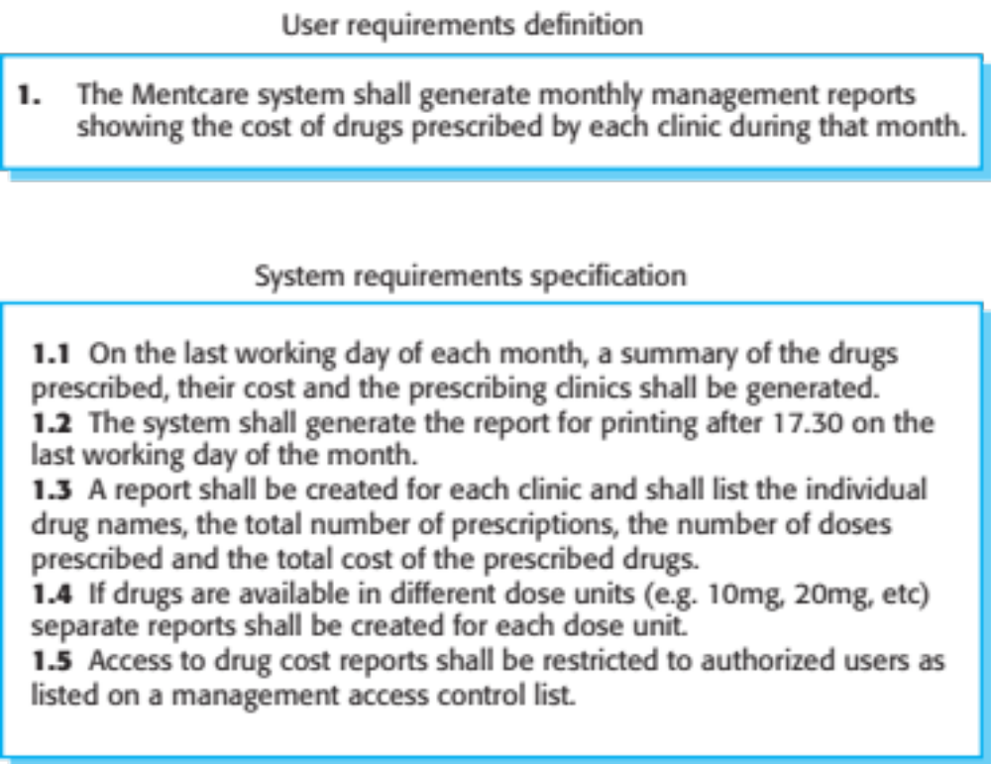
User and system requirements

Slide 9
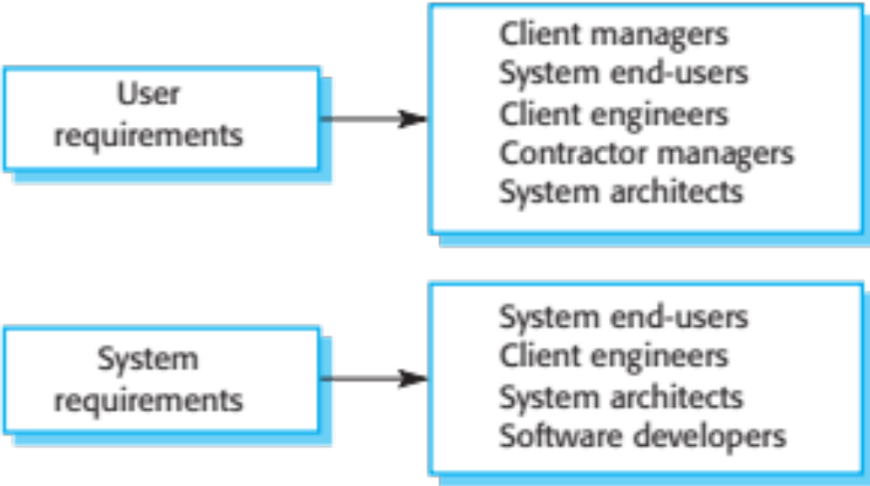
Readers of different types of requirements specification

Slide 10
System stakeholders
Any person or organization who is affected by the system in some way and so who has a legitimate interest
Stakeholder types
  End users
  System managers
  System owners
  External stakeholders

Slide 11
Stakeholders in the Mentcare system
Patients whose information is recorded in the system.
Doctors who are responsible for assessing and treating patients.
Nurses who coordinate the consultations with doctors and administer some treatments.
Medical receptionists who manage patients’ appointments.
IT staff who are responsible for installing and maintaining the system.

Slide 12
Stakeholders in the Mentcare system (Cont.)
A medical ethics manager who must ensure that the system meets current ethical guidelines for patient care.
Health care managers who obtain management information from the system.
Medical records staff who are responsible for ensuring that system information can be maintained and preserved, and that record keeping procedures have been properly implemented.

Slide 13
Agile methods and requirements
Many agile methods argue that producing detailed system requirements is a waste of time as requirements change so quickly.
The requirements document is therefore always out of date.
Agile methods usually use incremental requirements engineering and may express requirements as ‘user stories’ (discussed in Lecture #3).
This is practical for business systems but problematic for systems that require pre-delivery analysis (e.g. critical systems) or systems developed by several teams.

Slide 14
Functional and non-functional requirements

Slide 15
Functional and non-functional requirements
Functional requirements
  Statements of services the system should provide, how the system should react to particular inputs and how the system should behave in particular situations.
  May state what the system should not do.
Non-functional requirements
  Constraints on the services or functions offered by the system such as timing constraints, constraints on the development process, standards, etc.
  Often apply to the system as a whole rather than individual features or services.
Domain requirements
  Constraints on the system from the domain of operation

Slide 16
Functional requirements
Describe functionality or system services.
Depend on the type of software, expected users and the type of system where the software is used.
Functional user requirements may be high-level statements of what the system should do.
Functional system requirements should describe the system services in detail.

Slide 17
Mentcare system: functional requirements
A user shall be able to search the appointments lists for all clinics.
The system shall generate each day, for each clinic, a list of patients who are expected to attend appointments that day.
Each staff member using the system shall be uniquely identified by his or her 8-digit employee number.

Slide 18
Requirements imprecision
Problems arise when functional requirements are not precisely stated.
Ambiguous requirements may be interpreted in different ways by developers and users.
Consider the term ‘search’ in requirement 1
  User intention – search for a patient name across all appointments in all clinics;
  Developer interpretation – search for a patient name in an individual clinic. User chooses clinic then search.

Slide 19
Requirements completeness and consistency
In principle, requirements should be both complete and consistent.
Complete
  They should include descriptions of all facilities required.
Consistent
  There should be no conflicts or contradictions in the descriptions of the system facilities.
In practice, because of system and environmental complexity, it is impossible to produce a complete and consistent requirements document.

Slide 20
Non-functional requirements
These define system properties and constraints e.g. reliability, response time and storage requirements. Constraints are I/O device capability, system representations, etc.
Process requirements may also be specified mandating a particular IDE, programming language or development method.
Non-functional requirements may be more critical than functional requirements. If these are not met, the system may be useless.

Slide 21
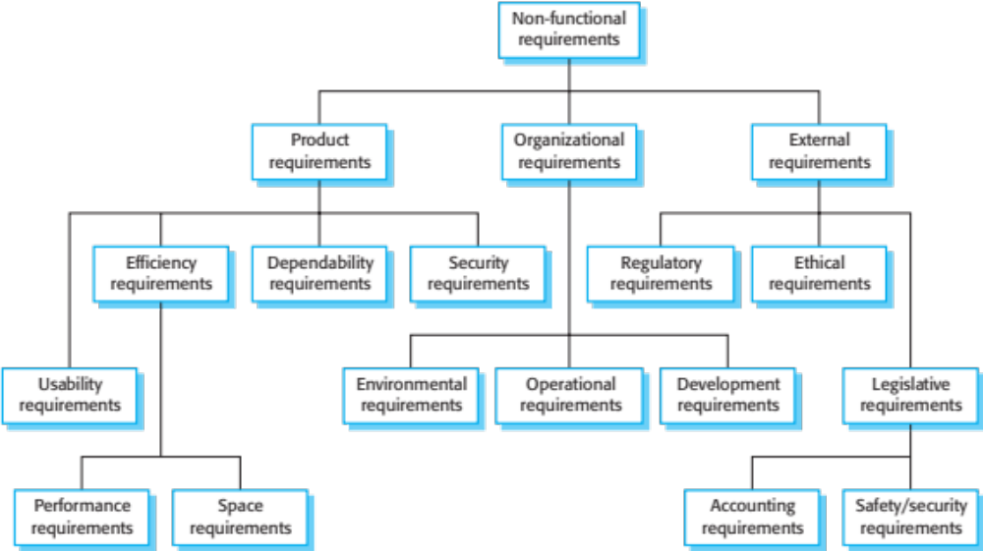
Types of non-functional requirement

Slide 22
Non-functional requirements implementation
Non-functional requirements may affect the overall architecture of a system rather than the individual components.
  For example, to ensure that performance requirements are met, you may have to organize the system to minimize communications between components.
A single non-functional requirement, such as a security requirement, may generate a number of related functional requirements that define system services that are required.
  It may also generate requirements that restrict existing requirements.

Slide 23
Non-functional classifications
Product requirements
  Requirements which specify that the delivered product must behave in a particular way e.g. execution speed, reliability, etc.
Organisational requirements
  Requirements which are a consequence of organisational policies and procedures e.g. process standards used, implementation requirements, etc.
External requirements
  Requirements which arise from factors which are external to the system and its development process e.g. interoperability requirements, legislative requirements, etc.

Slide 24
Examples of non-functional requirements in the Mentcare system
Product requirement The Mentcare system shall be available to all clinics during normal working hours (Mon–Fri, 0830–17.30). Downtime within normal working hours shall not exceed five seconds in any one day. Organizational requirement Users of the Mentcare system shall authenticate themselves using their health authority identity card. External requirement The system shall implement patient privacy provisions as set out in HStan-03-2006-priv.

Slide 25
Goals and requirements
Non-functional requirements may be very difficult to state precisely and imprecise requirements may be difficult to verify.
Goal
  A general intention of the user such as ease of use.
Verifiable non-functional requirement
  A statement using some measure that can be objectively tested.
Goals are helpful to developers as they convey the intentions of the system users.

Slide 26
Usability requirements
The system should be easy to use by medical staff and should be organized in such a way that user errors are minimized. (Goal)
Medical staff shall be able to use all the system functions after four hours of training. After this training, the average number of errors made by experienced users shall not exceed two per hour of system use. (Testable non-functional requirement)

Slide 27
Metrics for specifying nonfunctional requirements
Property | Measure
Speed | Processed transactions/second User/event response time Screen refresh time
Size | Mbytes Number of ROM chips
Ease of use | Training time Number of help frames
Reliability | Mean time to failure Probability of unavailability Rate of failure occurrence Availability
Robustness | Time to restart after failure Percentage of events causing failure Probability of data corruption on failure
Portability | Percentage of target dependent statements Number of target systems

Slide 28
Requirements engineering processes

Slide 29
Requirements engineering processes
The processes used for RE vary widely depending on the application domain, the people involved and the organisation developing the requirements.
However, there are a number of generic activities common to all processes
  Requirements elicitation;
  Requirements analysis;
  Requirements validation;
  Requirements management.
In practice, RE is an iterative activity in which these processes are interleaved.

Slide 30
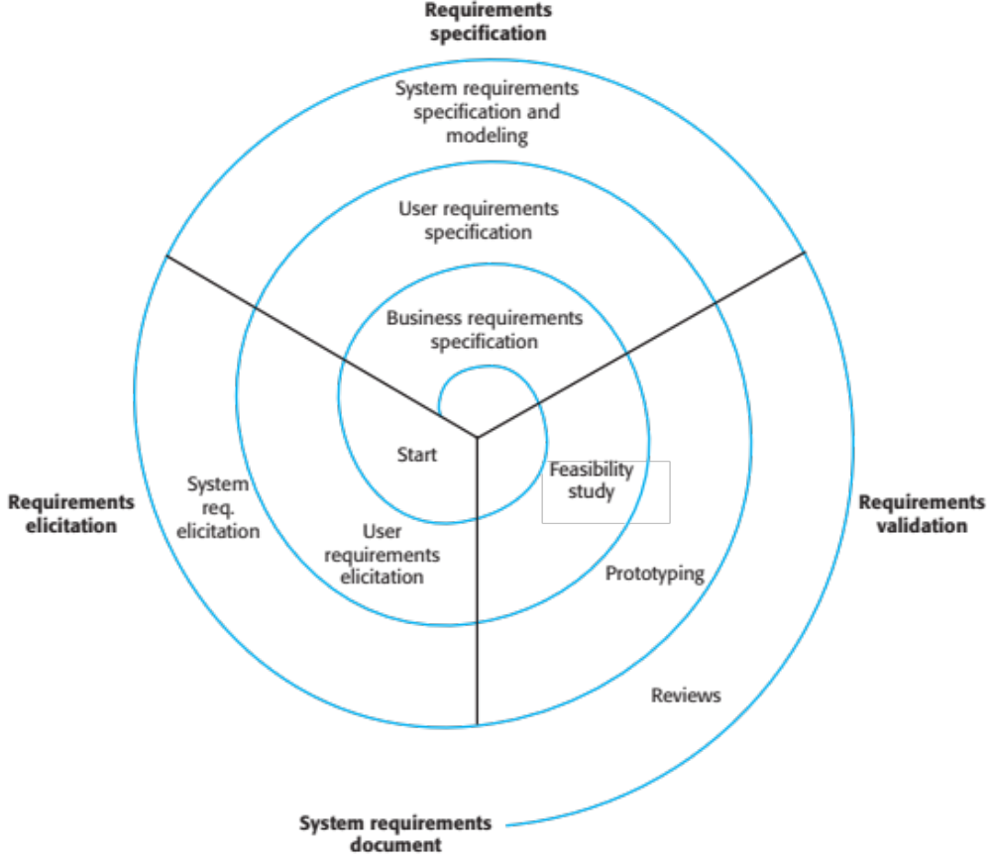
A spiral view of the requirements engineering process

Slide 31
Requirements elicitation

Slide 32
Requirements elicitation and analysis
Sometimes called requirements elicitation or requirements discovery.
Involves technical staff working with customers to find out about the application domain, the services that the system should provide and the system’s operational constraints.
May involve end-users, managers, engineers involved in maintenance, domain experts, trade unions, etc. These are called stakeholders.

Slide 33
Requirements elicitation

Slide 34
Requirements elicitation
Software engineers work with a range of system stakeholders to find out about the application domain, the services that the system should provide, the required system performance, hardware constraints, other systems, etc.
Stages include:
  Requirements discovery,
  Requirements classification and organization,
  Requirements prioritization and negotiation,
  Requirements specification.

Slide 35
Problems of requirements elicitation
Stakeholders don’t know what they really want.
Stakeholders express requirements in their own terms.
Different stakeholders may have conflicting requirements.
Organisational and political factors may influence the system requirements.
The requirements change during the analysis process. New stakeholders may emerge and the business environment may change.

Slide 36
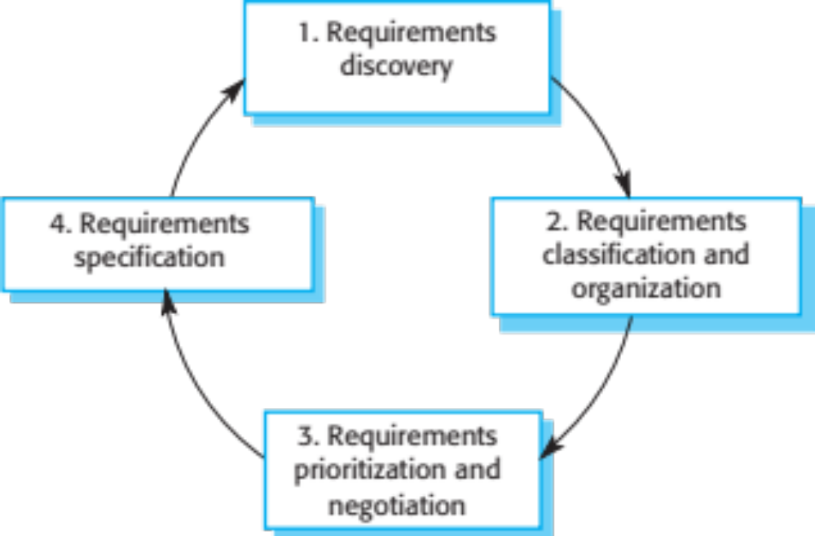
The requirements elicitation and analysis process

Slide 37
Process activities
Requirements discovery
  Interacting with stakeholders to discover their requirements. Domain requirements are also discovered at this stage.
Requirements classification and organisation
  Groups related requirements and organises them into coherent clusters.
Prioritisation and negotiation
  Prioritising requirements and resolving requirements conflicts.
Requirements specification
  Requirements are documented and input into the next round of the spiral.

Slide 38
Requirements discovery
The process of gathering information about the required and existing systems and distilling the user and system requirements from this information.
Interaction is with system stakeholders from managers to external regulators.
Systems normally have a range of stakeholders.

Slide 39
Interviewing
Formal or informal interviews with stakeholders are part of most RE processes.
Types of interview
  Closed interviews based on pre-determined list of questions
  Open interviews where various issues are explored with stakeholders.
Effective interviewing
  Be open-minded, avoid pre-conceived ideas about the requirements and are willing to listen to stakeholders.
  Prompt the interviewee to get discussions going using a springboard question, a requirements proposal, or by working together on a prototype system.

Slide 40
Interviews in practice
Normally a mix of closed and open-ended interviewing.
Interviews are good for getting an overall understanding of what stakeholders do and how they might interact with the system.
Interviewers need to be open-minded without pre-conceived ideas of what the system should do
You need to prompt the use to talk about the system by suggesting requirements rather than simply asking them what they want.

Slide 41
Problems with interviews
Application specialists may use language to describe their work that isn’t easy for the requirements engineer to understand.
Interviews are not good for understanding domain requirements
  Requirements engineers cannot understand specific domain terminology;
  Some domain knowledge is so familiar that people find it hard to articulate or think that it isn’t worth articulating.

Slide 42
Ethnography
A social scientist spends a considerable time observing and analysing how people actually work.
People do not have to explain or articulate their work.
Social and organisational factors of importance may be observed.
Ethnographic studies have shown that work is usually richer and more complex than suggested by simple system models.

Slide 43
Scope of ethnography
Requirements that are derived from the way that people actually work rather than the way I which process definitions suggest that they ought to work.
Requirements that are derived from cooperation and awareness of other people’s activities.
  Awareness of what other people are doing leads to changes in the ways in which we do things.
Ethnography is effective for understanding existing processes but cannot identify new features that should be added to a system.

Slide 44
Focused ethnography
Developed in a project studying the air traffic control process
Combines ethnography with prototyping
Prototype development results in unanswered questions which focus the ethnographic analysis.
The problem with ethnography is that it studies existing practices which may have some historical basis which is no longer relevant.

Slide 45
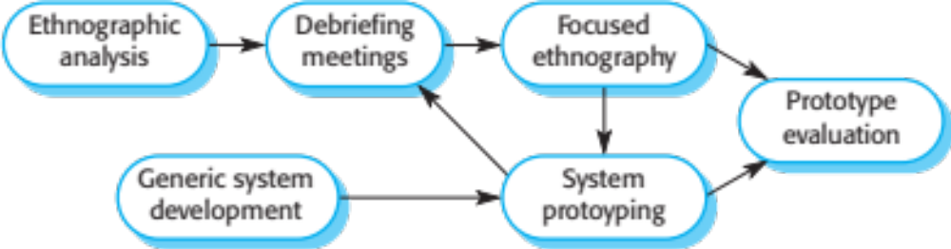
Ethnography and prototyping for requirements analysis

Slide 46
Stories and scenarios
Scenarios and user stories are real-life examples of how a system can be used.
Stories and scenarios are a description of how a system may be used for a particular task.
Because they are based on a practical situation, stakeholders can relate to them and can comment on their situation with respect to the story.

Slide 47
Photo sharing in the classroom (iLearn)
Jack is a primary school teacher in Ullapool (a village in northern Scotland). He has decided that a class project should be focused around the fishing industry in the area, looking at the history, development and economic impact of fishing. As part of this, pupils are asked to gather and share reminiscences from relatives, use newspaper archives and collect old photographs related to fishing and fishing communities in the area. Pupils use an iLearn wiki to gather together fishing stories and SCRAN (a history resources site) to access newspaper archives and photographs. However, Jack also needs a photo sharing site as he wants pupils to take and comment on each others’ photos and to upload scans of old photographs that they may have in their families.
Jack sends an email to a primary school teachers group, which he is a member of to see if anyone can recommend an appropriate system. Two teachers reply and both suggest that he uses KidsTakePics, a photo sharing site that allows teachers to check and moderate content. As KidsTakePics is not integrated with the iLearn authentication service, he sets up a teacher and a class account. He uses the iLearn setup service to add KidsTakePics to the services seen by the pupils in his class so that when they log in, they can immediately use the system to upload photos from their mobile devices and class computers.

Slide 48
Scenarios
A structured form of user story
Scenarios should include
  A description of the starting situation;
  A description of the normal flow of events;
  A description of what can go wrong;
  Information about other concurrent activities;
  A description of the state when the scenario finishes.

Slide 49
Uploading photos (iLearn)
Initial assumption: A user or a group of users have one or more digital photographs to be uploaded to the picture sharing site. These are saved on either a tablet or laptop computer. They have successfully logged on to KidsTakePics.
Normal: The user chooses upload photos and they are prompted to select the photos to be uploaded on their computer and to select the project name under which the photos will be stored. They should also be given the option of inputting keywords that should be associated with each uploaded photo. Uploaded photos are named by creating a conjunction of the user name with the filename of the photo on the local computer.
On completion of the upload, the system automatically sends an email to the project moderator asking them to check new content and generates an on-screen message to the user that this has been done.

Slide 50
Uploading photos (Cont.)
What can go wrong:
No moderator is associated with the selected project. An email is automatically generated to the school administrator asking them to nominate a project moderator. Users should be informed that there could be a delay in making their photos visible.
Photos with the same name have already been uploaded by the same user. The user should be asked if they wish to re-upload the photos with the same name, rename the photos or cancel the upload. If they chose to re-upload the photos, the originals are overwritten. If they chose to rename the photos, a new name is automatically generated by adding a number to the existing file name.
Other activities: The moderator may be logged on to the system and may approve photos as they are uploaded.
System state on completion: User is logged on. The selected photos have been uploaded and assigned a status ‘awaiting moderation’. Photos are visible to the moderator and to the user who uploaded them.

Slide 51
Requirements specification

Slide 52
Requirements specification
The process of writing down the user and system requirements in a requirements document.
User requirements have to be understandable by end-users and customers who do not have a technical background.
System requirements are more detailed requirements and may include more technical information.
The requirements may be part of a contract for the system development
  It is therefore important that these are as complete as possible.

Slide 53
Ways of writing a system requirements specification
Notation | Description
Natural language | The requirements are written using numbered sentences in natural language. Each sentence should express one requirement.
Structured natural language | The requirements are written in natural language on a standard form or template. Each field provides information about an aspect of the requirement.
Design description languages | This approach uses a language like a programming language, but with more abstract features to specify the requirements by defining an operational model of the system. This approach is now rarely used although it can be useful for interface specifications.
Graphical notations | Graphical models, supplemented by text annotations, are used to define the functional requirements for the system; UML use case and sequence diagrams are commonly used.
Mathematical specifications | These notations are based on mathematical concepts such as finite-state machines or sets. Although these unambiguous specifications can reduce the ambiguity in a requirements document, most customers don’t understand a formal specification. They cannot check that it represents what they want and are reluctant to accept it as a system contract

Slide 54
Requirements and design
In principle, requirements should state what the system should do and the design should describe how it does this.
In practice, requirements and design are inseparable
  A system architecture may be designed to structure the requirements;
  The system may inter-operate with other systems that generate design requirements;
  The use of a specific architecture to satisfy non-functional requirements may be a domain requirement.
  This may be the consequence of a regulatory requirement.

Slide 55
Natural language specification
Requirements are written as natural language sentences supplemented by diagrams and tables.
Used for writing requirements because it is expressive, intuitive and universal. This means that the requirements can be understood by users and customers.

Slide 56
Guidelines for writing requirements
Invent a standard format and use it for all requirements.
Use language in a consistent way. Use shall for mandatory requirements, should for desirable requirements.
Use text highlighting to identify key parts of the requirement.
Avoid the use of computer jargon.
Include an explanation (rationale) of why a requirement is necessary.

Slide 57
Problems with natural language
Lack of clarity
  Precision is difficult without making the document difficult to read.
Requirements confusion
  Functional and non-functional requirements tend to be mixed-up.
Requirements amalgamation
  Several different requirements may be expressed together.

Slide 58
Example requirements for the insulin pump software system
3.2 The system shall measure the blood sugar and deliver insulin, if required, every 10 minutes. (Changes in blood sugar are relatively slow so more frequent measurement is unnecessary; less frequent measurement could lead to unnecessarily high sugar levels.) 3.6 The system shall run a self-test routine every minute with the conditions to be tested and the associated actions defined in Table 1. (A self-test routine can discover hardware and software problems and alert the user to the fact the normal operation may be impossible.)

Slide 59
Structured specifications
An approach to writing requirements where the freedom of the requirements writer is limited and requirements are written in a standard way.
This works well for some types of requirements e.g. requirements for embedded control system but is sometimes too rigid for writing business system requirements.

Slide 60
Form-based specifications
Definition of the function or entity.
Description of inputs and where they come from.
Description of outputs and where they go to.
Information about the information needed for the computation and other entities used.
Description of the action to be taken.
Pre and post conditions (if appropriate).
The side effects (if any) of the function.

Slide 61
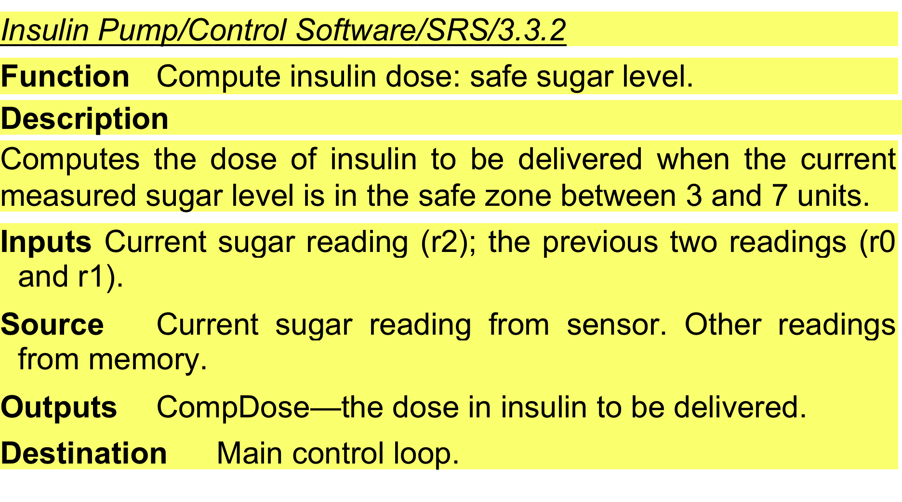
A structured specification of a requirement for an insulin pump

Slide 62
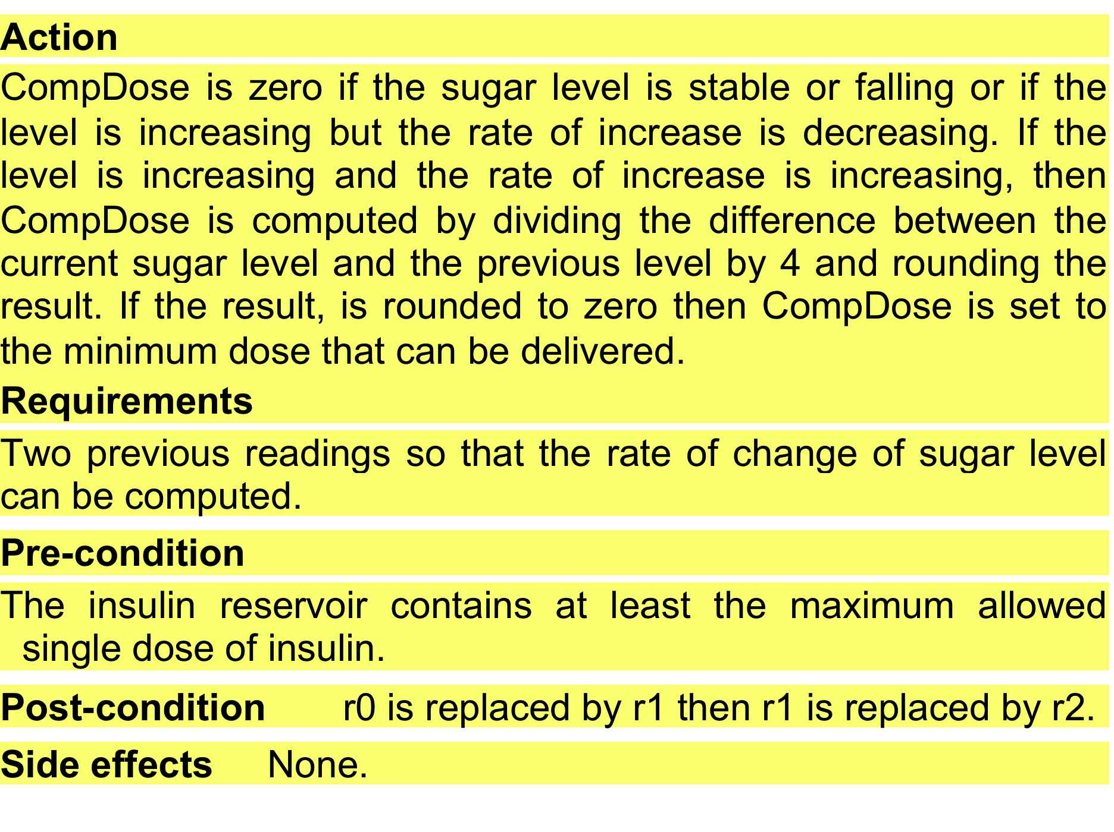
A structured specification of a requirement for an insulin pump (Cont.)

Slide 63
Tabular specification
Used to supplement natural language.
Particularly useful when you have to define a number of possible alternative courses of action.
For example, the insulin pump systems bases its computations on the rate of change of blood sugar level and the tabular specification explains how to calculate the insulin requirement for different scenarios.

Slide 64
Tabular specification of computation for an insulin pump
Condition | Action
Sugar level falling (r2 < r1) | CompDose = 0
Sugar level stable (r2 = r1) | CompDose = 0
Sugar level increasing and rate of increase decreasing ((r2 – r1) < (r1 – r0)) | CompDose = 0
Sugar level increasing and rate of increase stable or increasing ((r2 – r1) ≥ (r1 – r0)) | CompDose = round ((r2 – r1)/4) If rounded result = 0 then CompDose = MinimumDose

Slide 65
Use cases
Use-cases are a kind of scenario that are included in the UML.
Use cases identify the actors in an interaction and which describe the interaction itself.
A set of use cases should describe all possible interactions with the system.
High-level graphical model supplemented by more detailed tabular description (next lecture).
UML sequence diagrams may be used to add detail to use-cases by showing the sequence of event processing in the system.

Slide 66
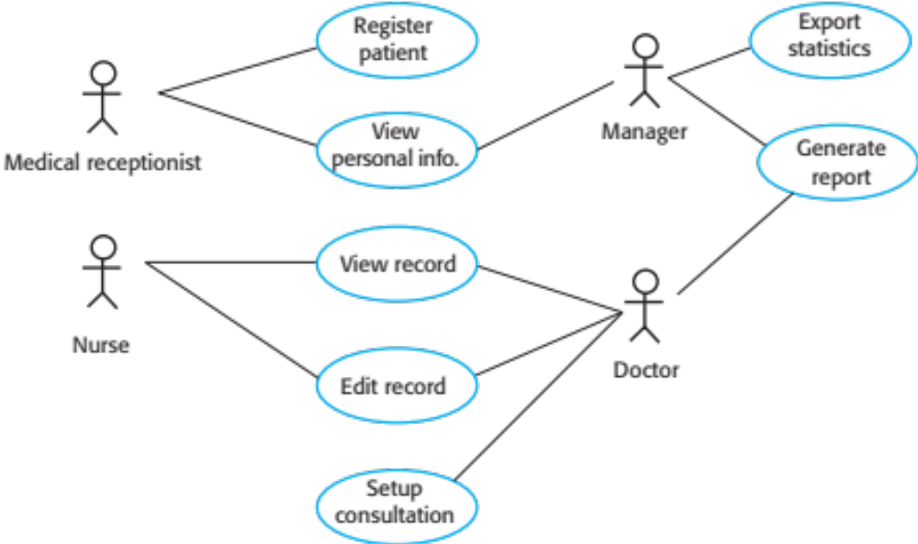
Use cases for the Mentcare system

Slide 67
The software requirements document
The software requirements document (sometimes software requirements specification SRS) is the official statement of what is required of the system developers.
Should include both a definition of user requirements and a specification of the system requirements.
It is NOT a design document. As far as possible, it should set of WHAT the system should do rather than HOW it should do it.

Slide 68
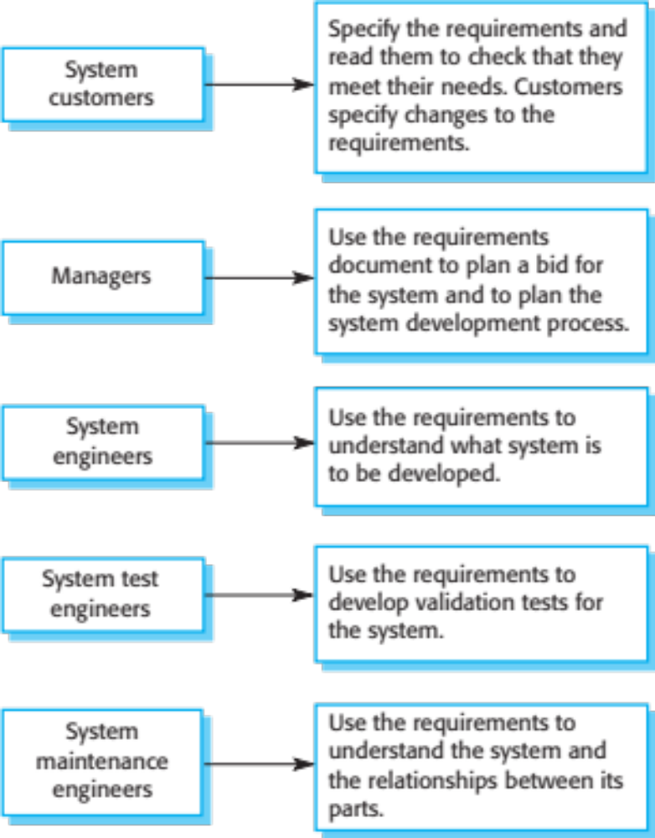
Users of a requirements document

Slide 69
Requirements document variability
Information in requirements document depends on type of system and the approach to development used.
Systems developed incrementally will, typically, have less detail in the requirements document.
Requirements documents standards have been designed e.g. IEEE standard. These are mostly applicable to the requirements for large systems engineering projects.

Slide 70
The structure of a requirements document
Chapter | Description
Preface | This should define the expected readership of the document and describe its version history, including a rationale for the creation of a new version and a summary of the changes made in each version.
Introduction | This should describe the need for the system. It should briefly describe the system’s functions and explain how it will work with other systems. It should also describe how the system fits into the overall business or strategic objectives of the organization commissioning the software.
Glossary | This should define the technical terms used in the document. You should not make assumptions about the experience or expertise of the reader.
User requirements definition | Here, you describe the services provided for the user. The nonfunctional system requirements should also be described in this section. This description may use natural language, diagrams, or other notations that are understandable to customers. Product and process standards that must be followed should be specified.
System architecture | This chapter should present a high-level overview of the anticipated system architecture, showing the distribution of functions across system modules. Architectural components that are reused should be highlighted.

Slide 71
The structure of a requirements document (Cont.)
Chapter | Description
System requirements specification | This should describe the functional and nonfunctional requirements in more detail. If necessary, further detail may also be added to the nonfunctional requirements. Interfaces to other systems may be defined.
System models | This might include graphical system models showing the relationships between the system components and the system and its environment. Examples of possible models are object models, data-flow models, or semantic data models.
System evolution | This should describe the fundamental assumptions on which the system is based, and any anticipated changes due to hardware evolution, changing user needs, and so on. This section is useful for system designers as it may help them avoid design decisions that would constrain likely future changes to the system.
Appendices | These should provide detailed, specific information that is related to the application being developed; for example, hardware and database descriptions. Hardware requirements define the minimal and optimal configurations for the system. Database requirements define the logical organization of the data used by the system and the relationships between data.
Index | Several indexes to the document may be included. As well as a normal alphabetic index, there may be an index of diagrams, an index of functions, and so on.

Slide 72
Requirements validation

Slide 73
Requirements validation
Concerned with demonstrating that the requirements define the system that the customer really wants.
Requirements error costs are high so validation is very important
  Fixing a requirements error after delivery may cost up to 100 times the cost of fixing an implementation error.

Slide 74
Requirements checking
Validity. Does the system provide the functions which best support the customer’s needs?
Consistency. Are there any requirements conflicts?
Completeness. Are all functions required by the customer included?
Realism. Can the requirements be implemented given available budget and technology
Verifiability. Can the requirements be checked?

Slide 75
Requirements validation techniques
Requirements reviews
  Systematic manual analysis of the requirements.
Prototyping
  Using an executable model of the system to check requirements. (Covered in lecture #2)
Test-case generation
  Developing tests for requirements to check testability.

Slide 76
Requirements reviews
Regular reviews should be held while the requirements definition is being formulated.
Both client and contractor staff should be involved in reviews.
Reviews may be formal (with completed documents) or informal. Good communications between developers, customers and users can resolve problems at an early stage.

Slide 77
Review checks
Verifiability
  Is the requirement realistically testable?
Comprehensibility
  Is the requirement properly understood?
Traceability
  Is the origin of the requirement clearly stated?
Adaptability
  Can the requirement be changed without a large impact on other requirements?

Slide 78
Requirements change

Slide 79
Changing requirements
The business and technical environment of the system always changes after installation.
  New hardware may be introduced, it may be necessary to interface the system with other systems, business priorities may change (with consequent changes in the system support required), and new legislation and regulations may be introduced that the system must necessarily abide by.
The people who pay for a system and the users of that system are rarely the same people.
  System customers impose requirements because of organizational and budgetary constraints. These may conflict with end-user requirements and, after delivery, new features may have to be added for user support if the system is to meet its goals.

Slide 80
Changing requirements (Cont.)
Large systems usually have a diverse user community, with many users having different requirements and priorities that may be conflicting or contradictory.
  The final system requirements are inevitably a compromise between them and, with experience, it is often discovered that the balance of support given to different users has to be changed.

Slide 81
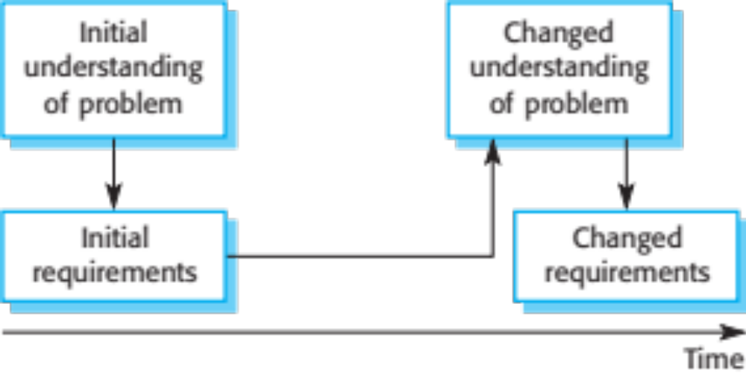
Requirements evolution

Slide 82
Requirements management
Requirements management is the process of managing changing requirements during the requirements engineering process and system development.
New requirements emerge as a system is being developed and after it has gone into use.
You need to keep track of individual requirements and maintain links between dependent requirements so that you can assess the impact of requirements changes. You need to establish a formal process for making change proposals and linking these to system requirements.

Slide 83
Requirements management planning
Establishes the level of requirements management detail that is required.
Requirements management decisions:
  Requirements identification Each requirement must be uniquely identified so that it can be cross-referenced with other requirements.
  A change management process This is the set of activities that assess the impact and cost of changes. I discuss this process in more detail in the following section.
  Traceability policies These policies define the relationships between each requirement and between the requirements and the system design that should be recorded.
  Tool support Tools that may be used range from specialist requirements management systems to spreadsheets and simple database systems.

Slide 84
Requirements change management
Deciding if a requirements change should be accepted
  Problem analysis and change specification
    During this stage, the problem or the change proposal is analyzed to check that it is valid. This analysis is fed back to the change requestor who may respond with a more specific requirements change proposal, or decide to withdraw the request.
  Change analysis and costing
    The effect of the proposed change is assessed using traceability information and general knowledge of the system requirements. Once this analysis is completed, a decision is made whether or not to proceed with the requirements change.
  Change implementation
    The requirements document and, where necessary, the system design and implementation, are modified. Ideally, the document should be organized so that changes can be easily implemented.

Slide 85
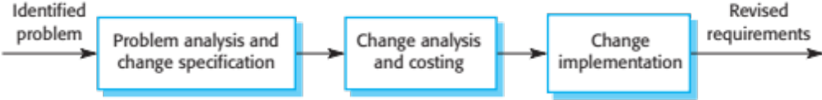
Requirements change management

Slide 86
Key points
Requirements for a software system set out what the system should do and define constraints on its operation and implementation.
Functional requirements are statements of the services that the system must provide or are descriptions of how some computations must be carried out.
Non-functional requirements often constrain the system being developed and the development process being used.
They often relate to the emergent properties of the system and therefore apply to the system as a whole.

Slide 87
Key points
The requirements engineering process is an iterative process that includes requirements elicitation, specification and validation.
Requirements elicitation is an iterative process that can be represented as a spiral of activities – requirements discovery, requirements classification and organization, requirements negotiation and requirements documentation.
You can use a range of techniques for requirements elicitation including interviews and ethnography. User stories and scenarios may be used to facilitate discussions.

Slide 88
Key points
Requirements specification is the process of formally documenting the user and system requirements and creating a software requirements document.
The software requirements document is an agreed statement of the system requirements. It should be organized so that both system customers and software developers can use it.

Slide 89
Key points
Requirements validation is the process of checking the requirements for validity, consistency, completeness, realism and verifiability.
Business, organizational and technical changes inevitably lead to changes to the requirements for a software system. Requirements management is the process of managing and controlling these changes.

Slide 90
Part 2
System Modeling

Slide 91
Topics covered
Context models
Interaction models
Structural models
Behavioral models
Model-driven engineering

Slide 92
System modeling
System modeling is the process of developing abstract models of a system, with each model presenting a different view or perspective of that system.
System modeling has now come to mean representing a system using some kind of graphical notation, which is now almost always based on notations in the Unified Modeling Language (UML).
System modelling helps the analyst to understand the functionality of the system and models are used to communicate with customers.

Slide 93
Existing and planned system models
Models of the existing system are used during requirements engineering. They help clarify what the existing system does and can be used as a basis for discussing its strengths and weaknesses. These then lead to requirements for the new system.
Models of the new system are used during requirements engineering to help explain the proposed requirements to other system stakeholders. Engineers use these models to discuss design proposals and to document the system for implementation.
In a model-driven engineering process, it is possible to generate a complete or partial system implementation from the system model.

Slide 94
System perspectives
An external perspective, where you model the context or environment of the system.
An interaction perspective, where you model the interactions between a system and its environment, or between the components of a system.
A structural perspective, where you model the organization of a system or the structure of the data that is processed by the system.
A behavioral perspective, where you model the dynamic behavior of the system and how it responds to events.

Slide 95
UML diagram types
Activity diagrams, which show the activities involved in a process or in data processing .
Use case diagrams, which show the interactions between a system and its environment.
Sequence diagrams, which show interactions between actors and the system and between system components.
Class diagrams, which show the object classes in the system and the associations between these classes.
State diagrams, which show how the system reacts to internal and external events.

Slide 96
Use of graphical models
As a means of facilitating discussion about an existing or proposed system
  Incomplete and incorrect models are OK as their role is to support discussion.
As a way of documenting an existing system
  Models should be an accurate representation of the system but need not be complete.
As a detailed system description that can be used to generate a system implementation
  Models have to be both correct and complete.

Slide 97
Context models

Slide 98
Context models
Context models are used to illustrate the operational context of a system - they show what lies outside the system boundaries.
Social and organisational concerns may affect the decision on where to position system boundaries.
Architectural models show the system and its relationship with other systems.

Slide 99
System boundaries
System boundaries are established to define what is inside and what is outside the system.
  They show other systems that are used or depend on the system being developed.
The position of the system boundary has a profound effect on the system requirements.
Defining a system boundary is a political judgment
  There may be pressures to develop system boundaries that increase / decrease the influence or workload of different parts of an organization.

Slide 100
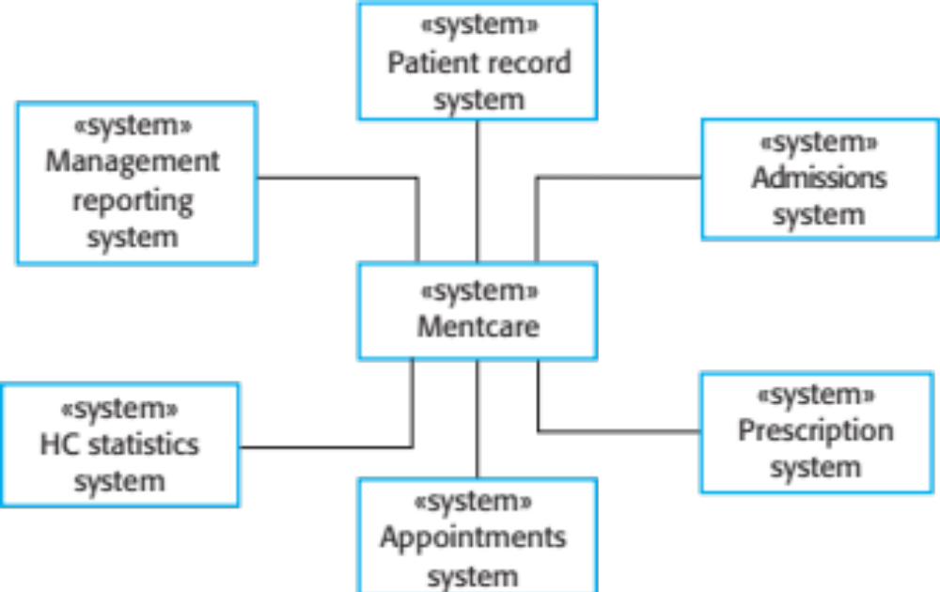
The context of the Mentcare system

Slide 101
Process perspective
Context models simply show the other systems in the environment, not how the system being developed is used in that environment.
Process models reveal how the system being developed is used in broader business processes.
UML activity diagrams may be used to define business process models.

Slide 102
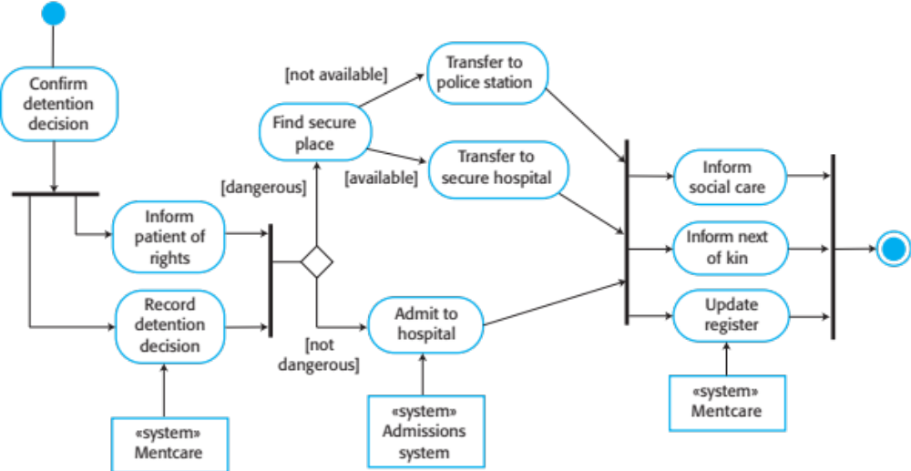
Process model of involuntary detention

Slide 103
Interaction models

Slide 104
Interaction models
Modeling user interaction is important as it helps to identify user requirements.
Modeling system-to-system interaction highlights the communication problems that may arise.
Modeling component interaction helps us understand if a proposed system structure is likely to deliver the required system performance and dependability.
Use case diagrams and sequence diagrams may be used for interaction modelling.

Slide 105
Use case modeling
Use cases were developed originally to support requirements elicitation and now incorporated into the UML.
Each use case represents a discrete task that involves external interaction with a system.
Actors in a use case may be people or other systems.
Represented diagrammatically to provide an overview of the use case and in a more detailed textual form.

Slide 106

Transfer-data use case
A use case in the Mentcare system

Slide 107
Tabular description of the ‘Transfer data’ use-case
MHC-PMS: Transfer data
Actors | Medical receptionist, patient records system (PRS)
Description | A receptionist may transfer data from the Mentcase system to a general patient record database that is maintained by a health authority. The information transferred may either be updated personal information (address, phone number, etc.) or a summary of the patient’s diagnosis and treatment.
Data | Patient’s personal information, treatment summary
Stimulus | User command issued by medical receptionist
Response | Confirmation that PRS has been updated
Comments | The receptionist must have appropriate security permissions to access the patient information and the PRS.

Slide 108
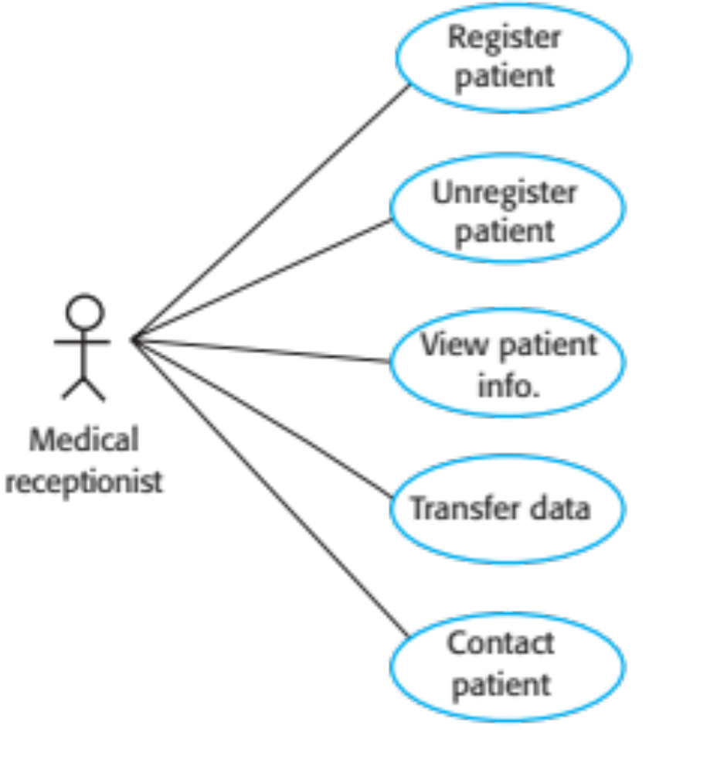
Use cases in the Mentcare system involving the role ‘Medical Receptionist’

Slide 109
Sequence diagrams
Sequence diagrams are part of the UML and are used to model the interactions between the actors and the objects within a system.
A sequence diagram shows the sequence of interactions that take place during a particular use case or use case instance.
The objects and actors involved are listed along the top of the diagram, with a dotted line drawn vertically from these.
Interactions between objects are indicated by annotated arrows.

Slide 110
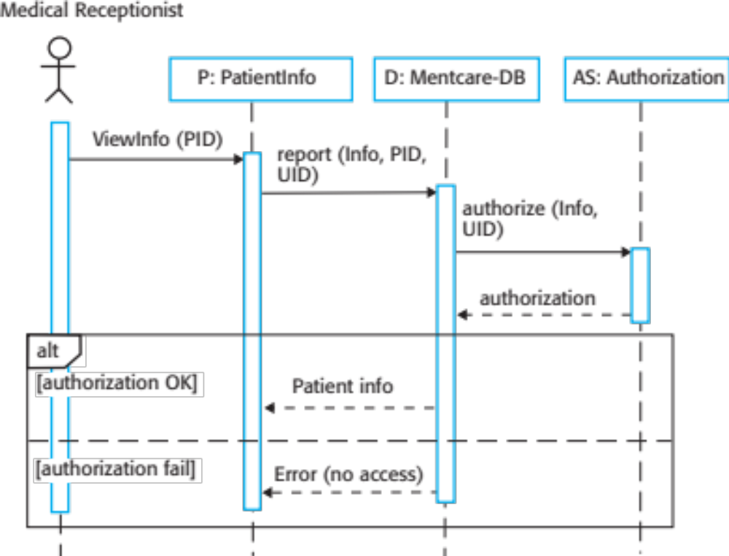
Sequence diagram for View patient information

Slide 111
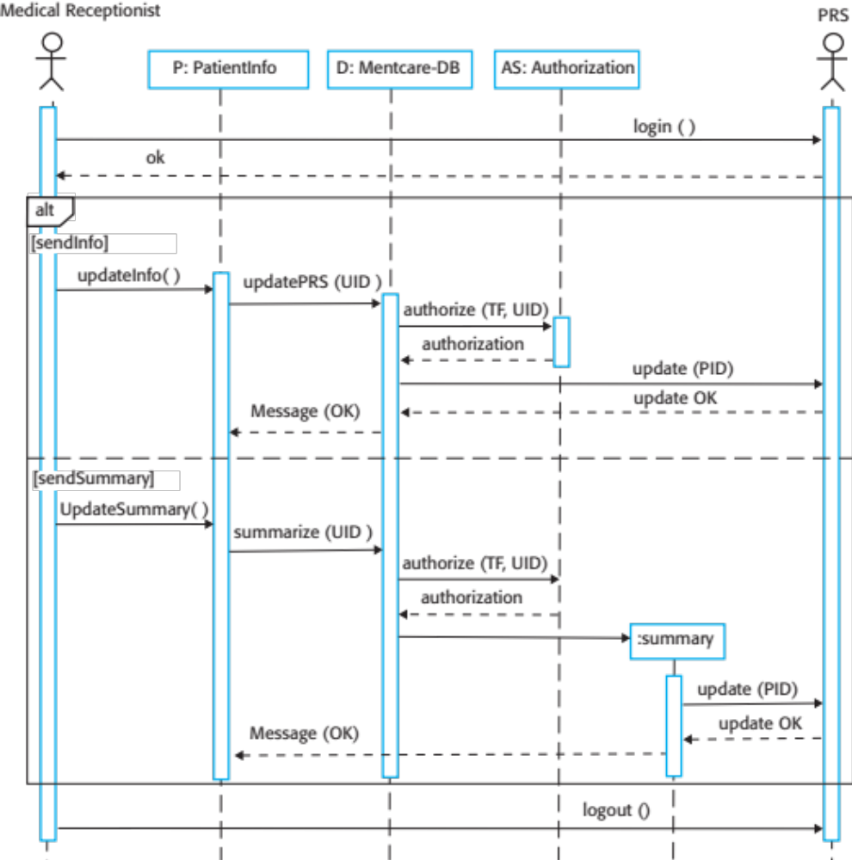
Sequence diagram for Transfer Data

Slide 112
Structural models

Slide 113
Structural models
Structural models of software display the organization of a system in terms of the components that make up that system and their relationships.
Structural models may be static models, which show the structure of the system design, or dynamic models, which show the organization of the system when it is executing.
You create structural models of a system when you are discussing and designing the system architecture.

Slide 114
Class diagrams
Class diagrams are used when developing an object-oriented system model to show the classes in a system and the associations between these classes.
An object class can be thought of as a general definition of one kind of system object.
An association is a link between classes that indicates that there is some relationship between these classes.
When you are developing models during the early stages of the software engineering process, objects represent something in the real world, such as a patient, a prescription, doctor, etc.

Slide 115

UML classes and association

Slide 116
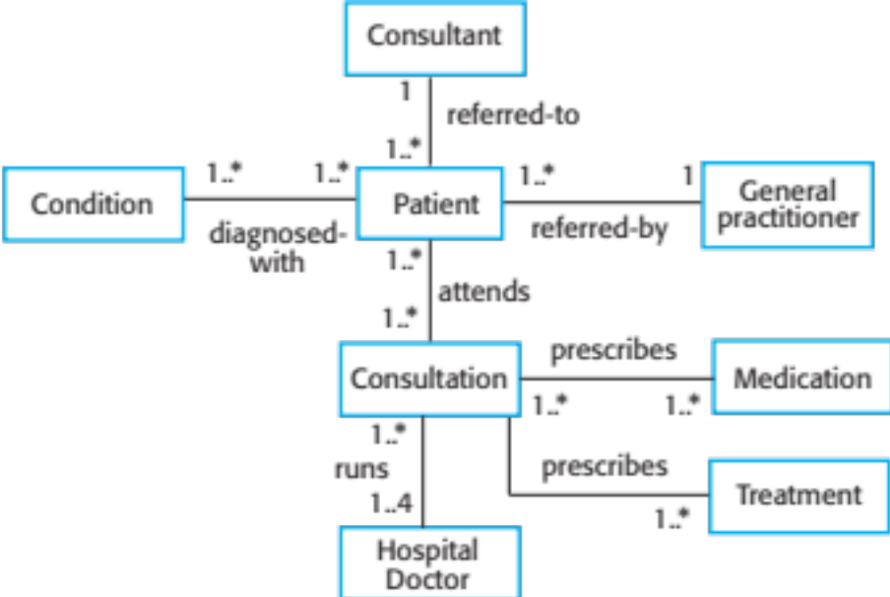
Classes and associations in the MHC-PMS

Slide 117
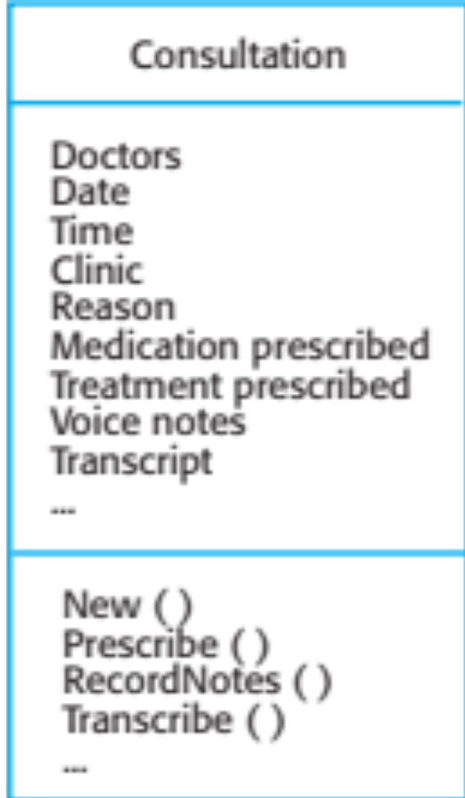
The Consultation class

Slide 118
Generalization
Generalization is an everyday technique that we use to manage complexity.
Rather than learn the detailed characteristics of every entity that we experience, we place these entities in more general classes (animals, cars, houses, etc.) and learn the characteristics of these classes.
This allows us to infer that different members of these classes have some common characteristics e.g. squirrels and rats are rodents.

Slide 119
Generalization (Cont.)
In modeling systems, it is often useful to examine the classes in a system to see if there is scope for generalization. If changes are proposed, then you do not have to look at all classes in the system to see if they are affected by the change.
In object-oriented languages, such as Java, generalization is implemented using the class inheritance mechanisms built into the language.
In a generalization, the attributes and operations associated with higher-level classes are also associated with the lower-level classes.
The lower-level classes are subclasses inherit the attributes and operations from their superclasses. These lower-level classes then add more specific attributes and operations.

Slide 120
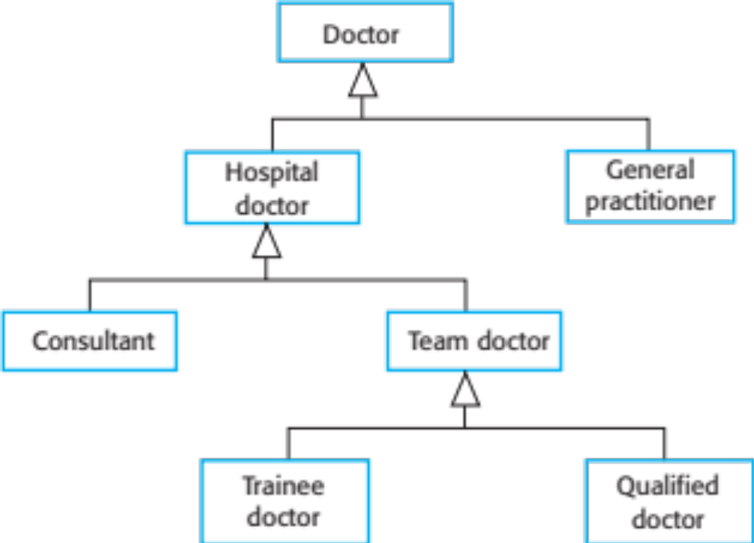
A generalization hierarchy

Slide 121
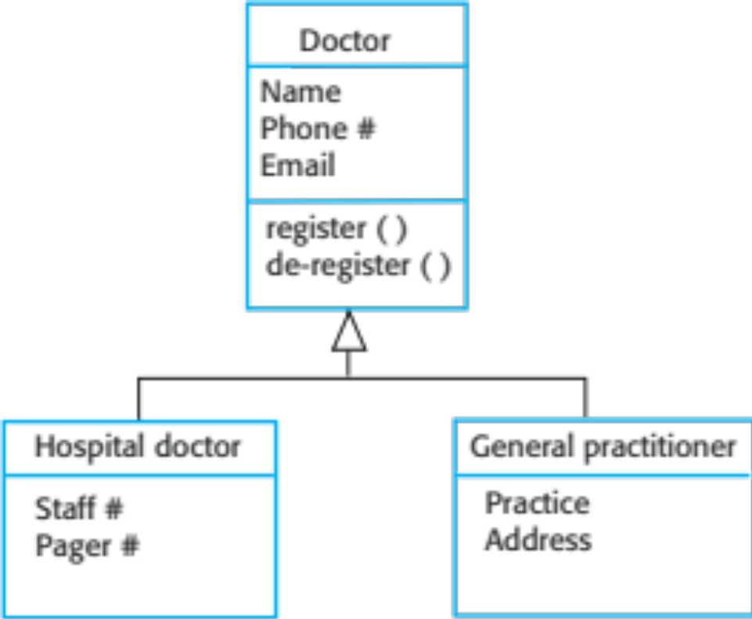
A generalization hierarchy with added detail

Slide 122
Object class aggregation models
An aggregation model shows how classes that are collections are composed of other classes.
Aggregation models are similar to the part-of relationship in semantic data models.

Slide 123
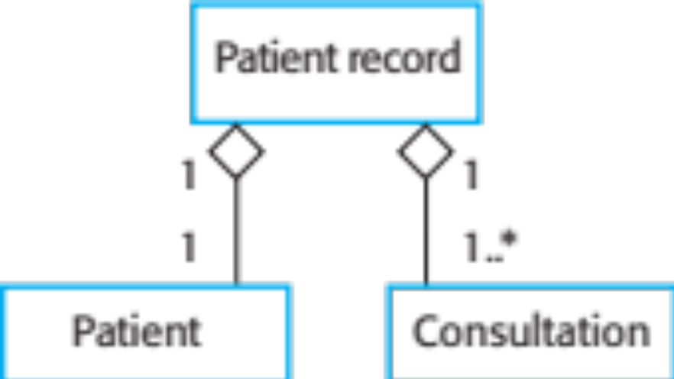
The aggregation association

Slide 124
Behavioral models

Slide 125
Behavioral models
Behavioral models are models of the dynamic behavior of a system as it is executing. They show what happens or what is supposed to happen when a system responds to a stimulus from its environment.
You can think of these stimuli as being of two types:
  Data Some data arrives that has to be processed by the system.
  Events Some event happens that triggers system processing. Events may have associated data, although this is not always the case.

Slide 126
Data-driven modeling
Many business systems are data-processing systems that are primarily driven by data. They are controlled by the data input to the system, with relatively little external event processing.
Data-driven models show the sequence of actions involved in processing input data and generating an associated output.
They are particularly useful during the analysis of requirements as they can be used to show end-to-end processing in a system.

Slide 127
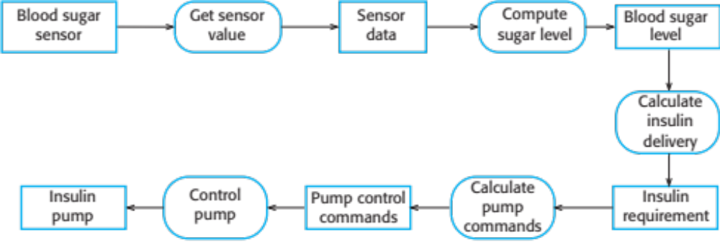
An activity model of the insulin pump’s operation

Slide 128
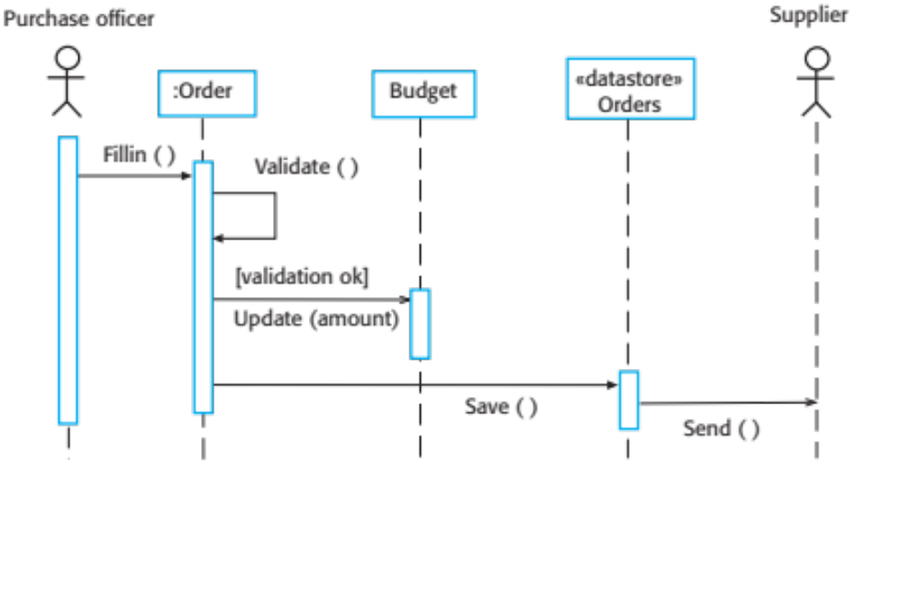
Order processing

Slide 129
Event-driven modeling
Real-time systems are often event-driven, with minimal data processing. For example, a landline phone switching system responds to events such as ‘receiver off hook’ by generating a dial tone.
Event-driven modeling shows how a system responds to external and internal events.
It is based on the assumption that a system has a finite number of states and that events (stimuli) may cause a transition from one state to another.

Slide 130
State machine models
These model the behaviour of the system in response to external and internal events.
They show the system’s responses to stimuli so are often used for modelling real-time systems.
State machine models show system states as nodes and events as arcs between these nodes. When an event occurs, the system moves from one state to another.
Statecharts are an integral part of the UML and are used to represent state machine models.

Slide 131
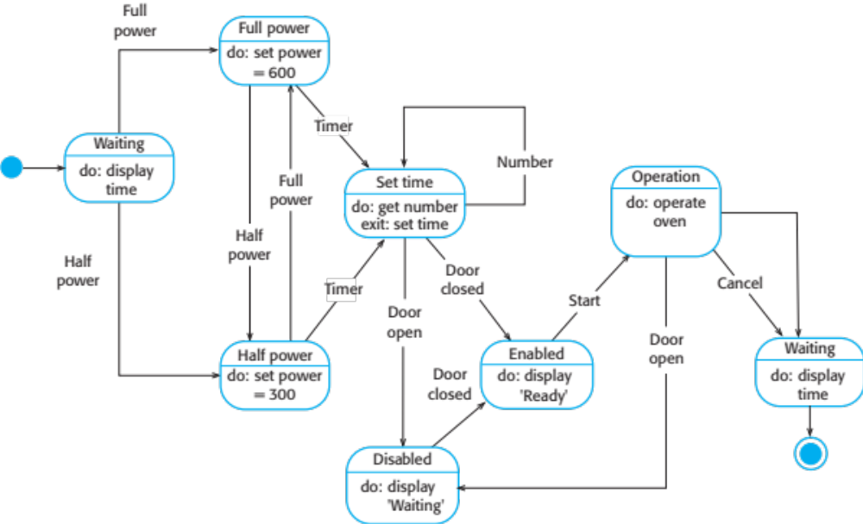
State diagram of a microwave oven

Slide 132
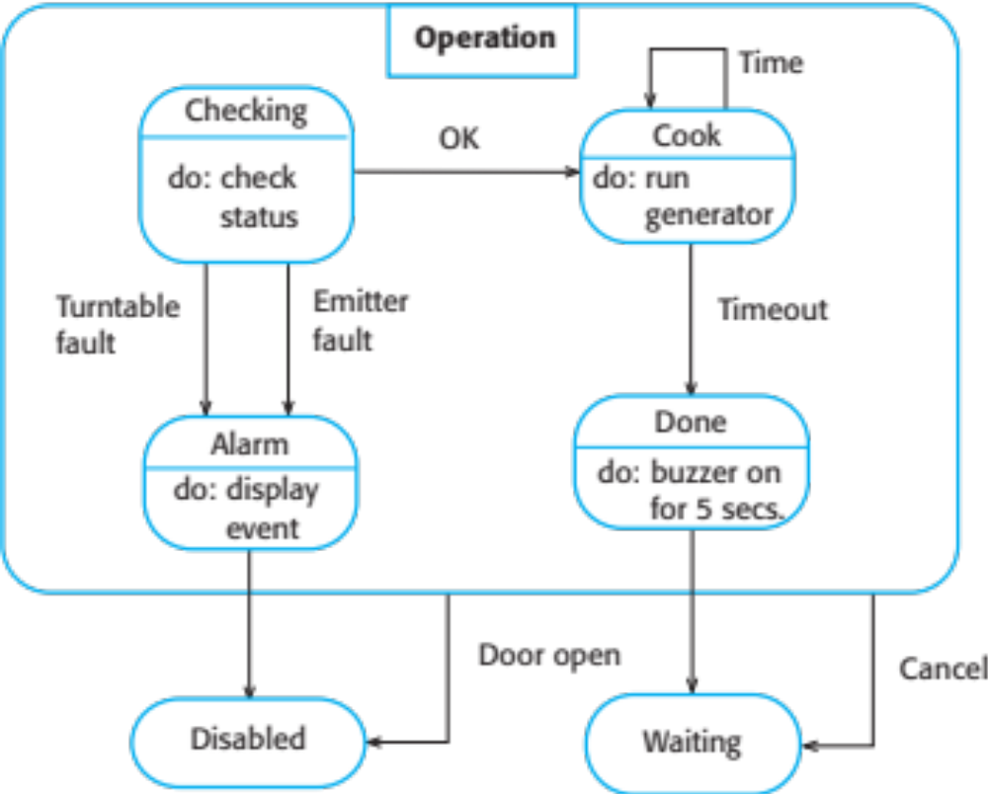
Microwave oven operation

Slide 133
States and stimuli for the microwave oven
State | Description
Waiting | The oven is waiting for input. The display shows the current time.
Half power | The oven power is set to 300 watts. The display shows ‘Half power’.
Full power | The oven power is set to 600 watts. The display shows ‘Full power’.
Set time | The cooking time is set to the user’s input value. The display shows the cooking time selected and is updated as the time is set.
Disabled | Oven operation is disabled for safety. Interior oven light is on. Display shows ‘Not ready’.
Enabled | Oven operation is enabled. Interior oven light is off. Display shows ‘Ready to cook’.
Operation | Oven in operation. Interior oven light is on. Display shows the timer countdown. On completion of cooking, the buzzer is sounded for five seconds. Oven light is on. Display shows ‘Cooking complete’ while buzzer is sounding.

Slide 134
States and stimuli for the microwave oven (Cont.)
Stimulus | Description
Half power | The user has pressed the half-power button.
Full power | The user has pressed the full-power button.
Timer | The user has pressed one of the timer buttons.
Number | The user has pressed a numeric key.
Door open | The oven door switch is not closed.
Door closed | The oven door switch is closed.
Start | The user has pressed the Start button.
Cancel | The user has pressed the Cancel button.

Slide 135
Model-driven engineering

Slide 136
Model-driven engineering
Model-driven engineering (MDE) is an approach to software development where models rather than programs are the principal outputs of the development process.
The programs that execute on a hardware/software platform are then generated automatically from the models.
Proponents of MDE argue that this raises the level of abstraction in software engineering so that engineers no longer have to be concerned with programming language details or the specifics of execution platforms.

Slide 137
Usage of model-driven engineering
Model-driven engineering is still at an early stage of development, and it is unclear whether or not it will have a significant effect on software engineering practice.
Pros
  Allows systems to be considered at higher levels of abstraction
  Generating code automatically means that it is cheaper to adapt systems to new platforms.
Cons
  Models for abstraction and not necessarily right for implementation.
  Savings from generating code may be outweighed by the costs of developing translators for new platforms.

Slide 138
Model driven architecture
Model-driven architecture (MDA) was the precursor of more general model-driven engineering
MDA is a model-focused approach to software design and implementation that uses a subset of UML models to describe a system.
Models at different levels of abstraction are created. From a high-level, platform independent model, it is possible, in principle, to generate a working program without manual intervention.

Slide 139
Types of model
A computation independent model (CIM)
  These model the important domain abstractions used in a system. CIMs are sometimes called domain models.
A platform independent model (PIM)
  These model the operation of the system without reference to its implementation. The PIM is usually described using UML models that show the static system structure and how it responds to external and internal events.
Platform specific models (PSM)
  These are transformations of the platform-independent model with a separate PSM for each application platform. In principle, there may be layers of PSM, with each layer adding some platform-specific detail.

Slide 140
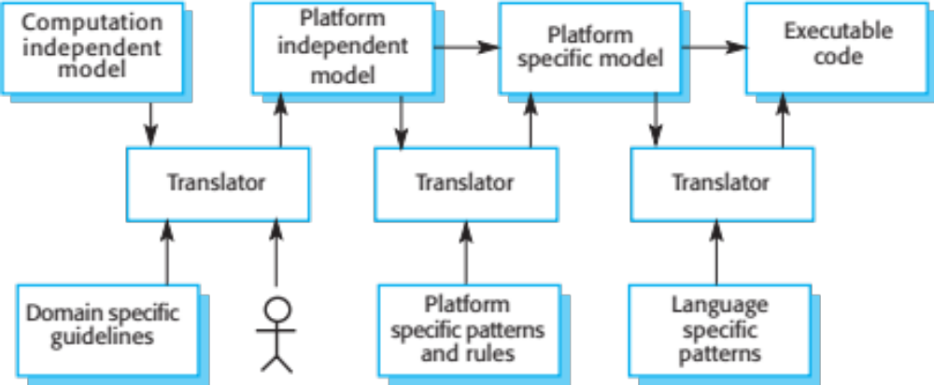
MDA transformations

Slide 141
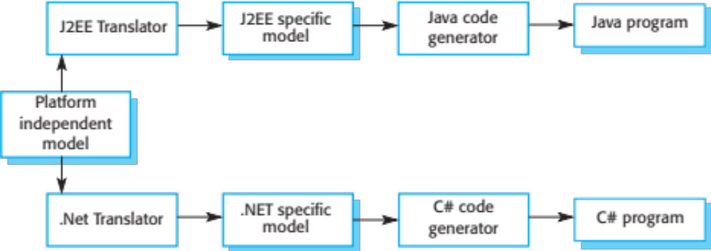
Multiple platform-specific models

Slide 142
Agile methods and MDA
The developers of MDA claim that it is intended to support an iterative approach to development and so can be used within agile methods.
The notion of extensive up-front modeling contradicts the fundamental ideas in the agile manifesto and some suspect that few agile developers feel comfortable with model-driven engineering.
If transformations can be completely automated and a complete program generated from a PIM, then, in principle, MDA could be used in an agile development process as no separate coding would be required.

Slide 143
Adoption of MDA
A range of factors has limited the adoption of MDE/MDA
Specialized tool support is required to convert models from one level to another
There is limited tool availability and organizations may require tool adaptation and customization to their environment
For the long-lifetime systems developed using MDA, companies are reluctant to develop their own tools or rely on small companies that may go out of business

Slide 144
Adoption of MDA
Models are a good way of facilitating discussions about a software design. However the abstractions that are useful for discussions may not be the right abstractions for implementation.
For most complex systems, implementation is not the major problem – requirements engineering, security and dependability, integration with legacy systems and testing are all more significant.

Slide 145
Adoption of MDA (Cont.)
The arguments for platform-independence are only valid for large, long-lifetime systems. For software products and information systems, the savings from the use of MDA are likely to be outweighed by the costs of its introduction and tooling.
The widespread adoption of agile methods over the same period that MDA was evolving has diverted attention away from model-driven approaches.

Slide 146
Key points
A model is an abstract view of a system that ignores system details. Complementary system models can be developed to show the system’s context, interactions, structure and behaviour.
Context models show how a system that is being modeled is positioned in an environment with other systems and processes.
Use case diagrams and sequence diagrams are used to describe the interactions between users and systems in the system being designed. Use cases describe interactions between a system and external actors; sequence diagrams add more information to these by showing interactions between system objects.
Structural models show the organization and architecture of a system. Class diagrams are used to define the static structure of classes in a system and their associations.

Slide 147
Key points
Behavioral models are used to describe the dynamic behavior of an executing system. This behavior can be modeled from the perspective of the data processed by the system, or by the events that stimulate responses from a system.
Activity diagrams may be used to model the processing of data, where each activity represents one process step.
State diagrams are used to model a system’s behavior in response to internal or external events.
Model-driven engineering is an approach to software development in which a system is represented as a set of models that can be automatically transformed to executable code.

Slide 148
Next Lecture
Architectural design and implementation

Slide 149
References
Ian Sommerville; “Software Engineering”, 10th Global Ed., Pearson, 2016.

