Slide 1
CSE202 Database Management Systems
Lecture #4
Prepared & Presented by Asst. Prof. Dr. Samsun M. BAŞARICI

Slide 2
Learning Objectives
Apply high-level conceptual data modeling
Creating a sample database
Understand and apply DB terms
Differentiate between ER and UML notations

Slide 3
Outline
Using high-level conceptual data models for database design
A sample database application
Entity types, entity sets, attributes, and keys
Relationship types, relationship sets, roles, and structural constraints
Weak entity types
Refining the ER design for the COMPANY database
ER diagrams, naming conventions, and design issues
Example of other Notation: UML class diagrams
Relationship types of degree higher than two

Slide 4
Data Modeling Using the Entity-Relationship (ER) Model
Entity-Relationship (ER) model
  Popular high-level conceptual data model
ER diagrams
  Diagrammatic notation associated with the ER model
Unified Modeling Language (UML)

Slide 5
Using High-Level Conceptual Data Models for Database Design
Requirements collection and analysis
  Database designers interview prospective database users to understand and document data requirements
  Result: data requirements
  Functional requirements of the application

Slide 6
Using High-Level Conceptual Data Models (cont’d.)
Conceptual schema
  Conceptual design
  Description of data requirements
  Includes detailed descriptions of the entity types, relationships, and constraints
  Transformed from high-level data model into implementation data model

Slide 7
Using High-Level Conceptual Data Models (cont.)
Logical design or data model mapping
  Result is a database schema in implementation data model of DBMS
Physical design phase
  Internal storage structures, file organizations, indexes, access paths, and physical design parameters for the database files specified

Slide 8
A Sample Database Application
COMPANY
  Employees, departments, and projects
  Company is organized into departments
  Department controls a number of projects
  Employee: store each employee’s name, Social Security number, address, salary, sex (gender), and birth date
  Keep track of the dependents of each employee

Slide 9
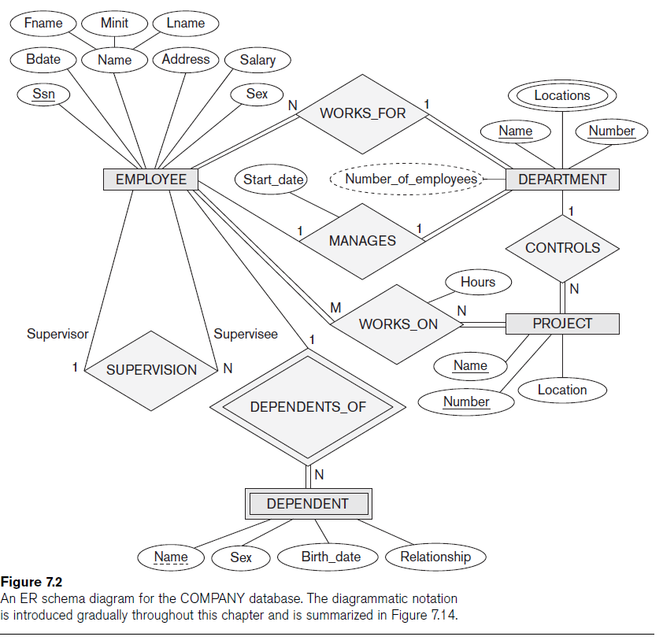

Slide 10
Entity Types, Entity Sets, Attributes, and Keys
ER model describes data as:
  Entities
  Relationships
  Attributes

Slide 11
Entities and Attributes
Entity
  Thing in real world with independent existence
Attributes
  Particular properties that describe entity
  Types of attributes:
    Composite versus simple (atomic) attributes
    Single-valued versus multivalued attributes
    Stored versus derived attributes
    NULL values
    Complex attributes

Slide 12
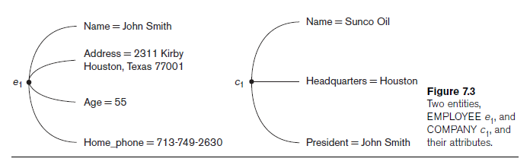
Entities and Attributes (cont.)

Slide 13
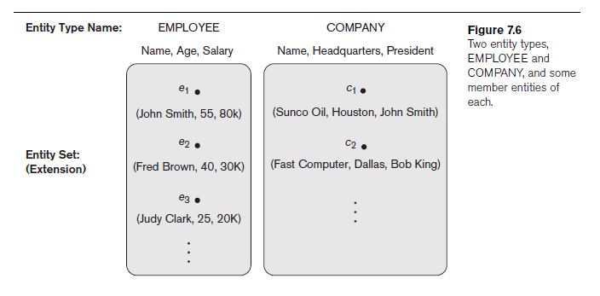
Entity Types, Entity Sets, Keys, and Value Sets
Entity type
  Collection (or set) of entities that have the same attributes

Slide 14
Entity Types, Entity Sets, Keys, and Value Sets (cont.)
Key or uniqueness constraint
  Attributes whose values are distinct for each individual entity in entity set
  Key attribute
    Uniqueness property must hold for every entity set of the entity type
Value sets (or domain of values)
  Specifies set of values that may be assigned to that attribute for each individual entity

Slide 15
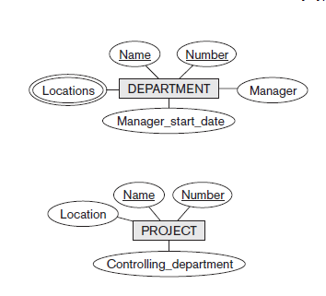
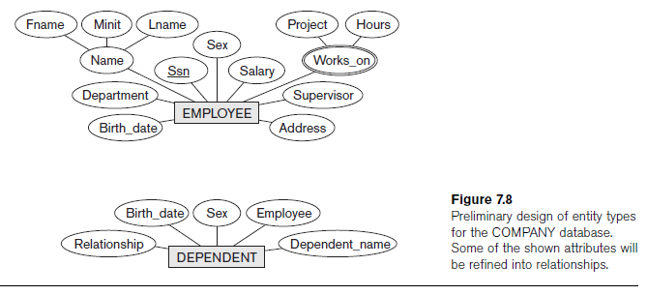
Initial Conceptual Design of the COMPANY Database

Slide 16
Relationship Types, Relationship Sets, Roles, and Structural Constraints
Relationship
  When an attribute of one entity type refers to another entity type
  Represent references as relationships not attributes

Slide 17
Relationship Types, Sets, and Instances
Relationship type R among n entity types E₁, E₂, ..., E_{n}
  Defines a set of associations among entities from these entity types
Relationship instances r_{i}
  Each r_{i} associates n individual entities (e₁, e₂, ..., e_{n})
  Each entity e_{j} in r_{i} is a member of entity set E_{j}

Slide 18
Relationship Degree
Degree of a relationship type
  Number of participating entity types
  Binary, ternary
Relationships as attributes
  Think of a binary relationship type in terms of attributes

Slide 19
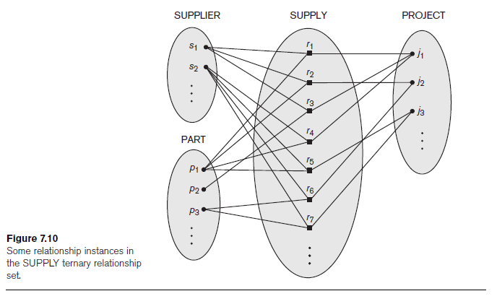

Slide 20
Role Names and Recursive Relationships
Role names and recursive relationships
  Role name signifies role that a participating entity plays in each relationship instance
Recursive relationships
  Same entity type participates more than once in a relationship type in different roles
  Must specify role name

Slide 21
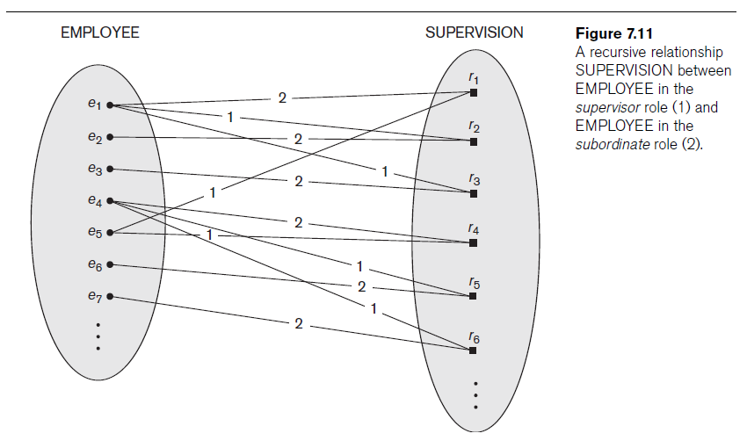

Slide 22
Constraints on Binary Relationship Types
Cardinality ratio for a binary relationship
  Specifies maximum number of relationship instances that entity can participate in
Participation constraint
  Specifies whether existence of entity depends on its being related to another entity
  Types: total and partial

Slide 23
Attributes of Relationship Types
Attributes of 1:1 or 1:N relationship types can be migrated to one entity type
For a 1:N relationship type
  Relationship attribute can be migrated only to entity type on N-side of relationship
For M:N relationship types
  Some attributes may be determined by combination of participating entities
  Must be specified as relationship attributes

Slide 24
Weak Entity Types
Do not have key attributes of their own
  Identified by being related to specific entities from another entity type
Identifying relationship
  Relates a weak entity type to its owner
Always has a total participation constraint

Slide 25
Refining the ER Design for the COMPANY Database
Change attributes that represent relationships into relationship types
Determine cardinality ratio and participation constraint of each relationship type

Slide 26
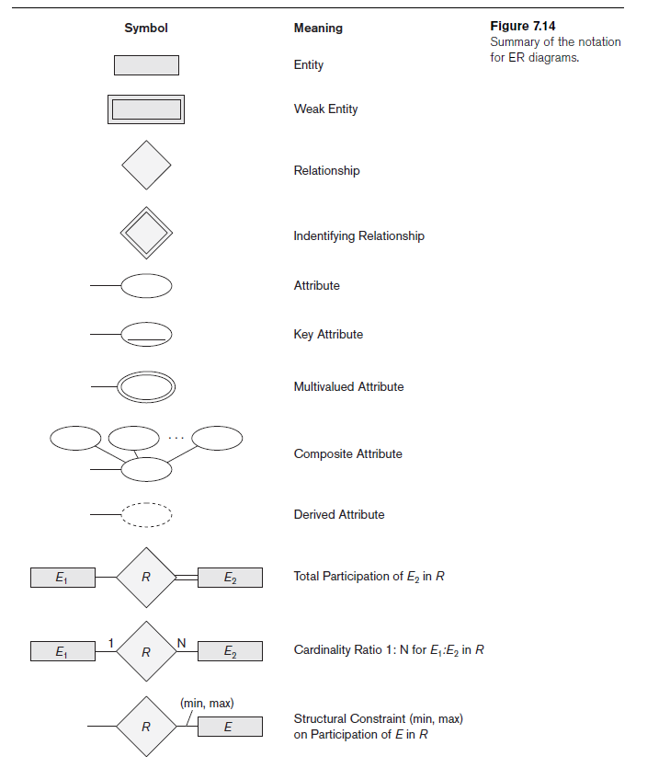
ER Diagrams, Naming Conventions, and Design Issues

Slide 27
Proper Naming of Schema Constructs
Choose names that convey meanings attached to different constructs in schema
Nouns give rise to entity type names
Verbs indicate names of relationship types
Choose binary relationship names to make ER diagram readable from left to right and from top to bottom

Slide 28
Design Choices for ER Conceptual Design
Model concept first as an attribute
  Refined into a relationship if attribute is a reference to another entity type
Attribute that exists in several entity types may be elevated to an independent entity type
  Can also be applied in the inverse

Slide 29
Alternative Notations for ER Diagrams
Specify structural constraints on relationships
  Replaces cardinality ratio (1:1, 1:N, M:N) and single/double line notation for participation constraints
  Associate a pair of integer numbers (min, max) with each participation of an entity type E in a relationship type R, where 0 ≤ min ≤ max and max ≥ 1

Slide 30
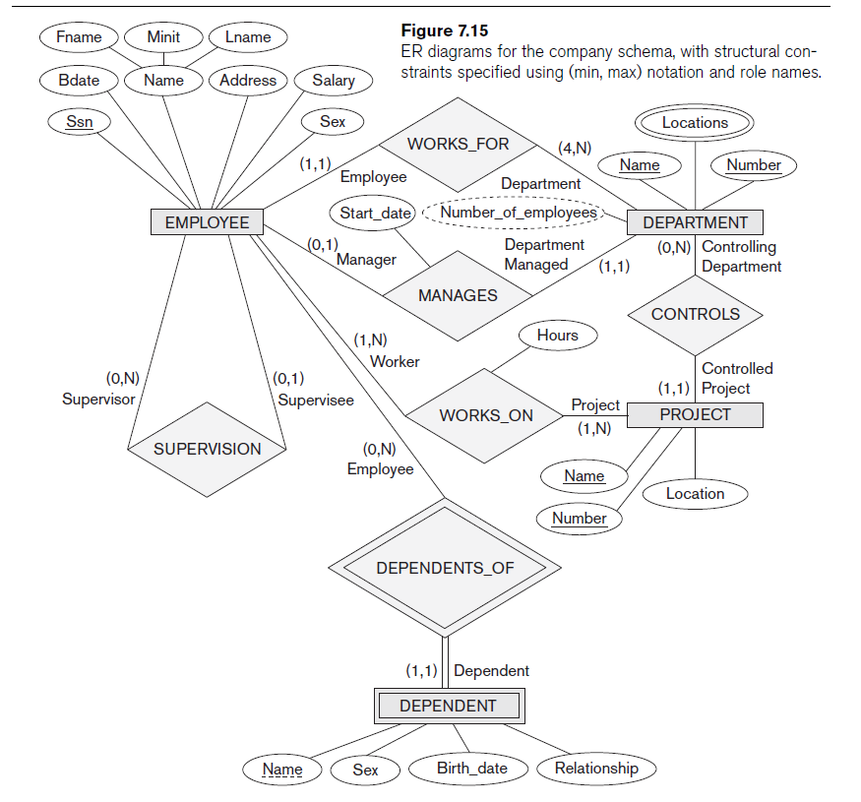

Slide 31
Example of Other Notation:
UML Class Diagrams
UML methodology
  Used extensively in software design
  Many types of diagrams for various software design purposes
UML class diagrams
  Entity in ER corresponds to an object in UML

Slide 32
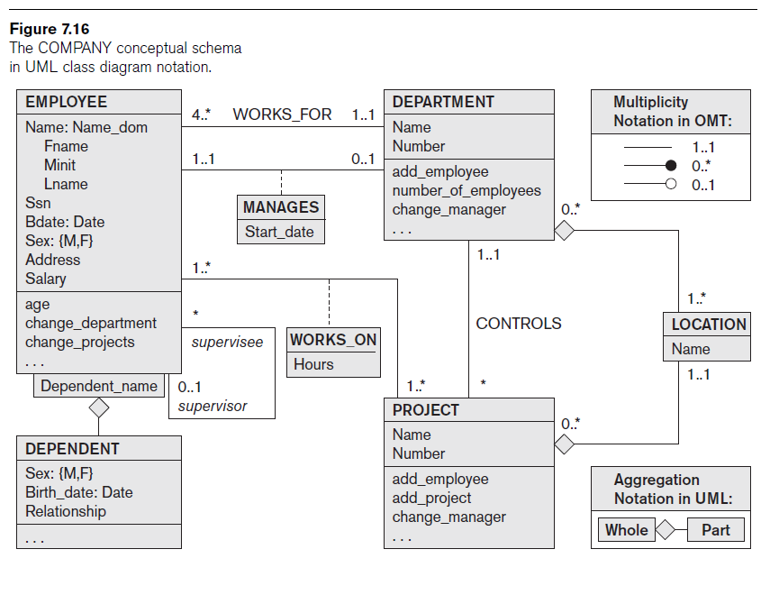

Slide 33
Example of Other Notation:
UML Class Diagrams (cont.)
Class includes three sections:
  Top section gives the class name
  Middle section includes the attributes;
  Last section includes operations that can be applied to individual objects

Slide 34
Example of Other Notation:
UML Class Diagrams (cont.)
Associations: relationship types
Relationship instances: links
Binary association
  Represented as a line connecting participating classes
  May optionally have a name
Link attribute
  Placed in a box connected to the association’s line by a dashed line

Slide 35
Example of Other Notation:
UML Class Diagrams (cont.)
Multiplicities: min..max, asterisk (*) indicates no maximum limit on participation
Types of relationships: association and aggregation
Distinguish between unidirectional and bidirectional associations
Model weak entities using qualified association

Slide 36
Relationship Types of Degree Higher than Two
Degree of a relationship type
  Number of participating entity types
Binary
  Relationship type of degree two
Ternary
  Relationship type of degree three

Slide 37
Choosing between Binary and Ternary (or Higher-Degree) Relationships
Some database design tools permit only binary relationships
  Ternary relationship must be represented as a weak entity type
  No partial key and three identifying relationships
Represent ternary relationship as a regular entity type
  By introducing an artificial or surrogate key

Slide 38
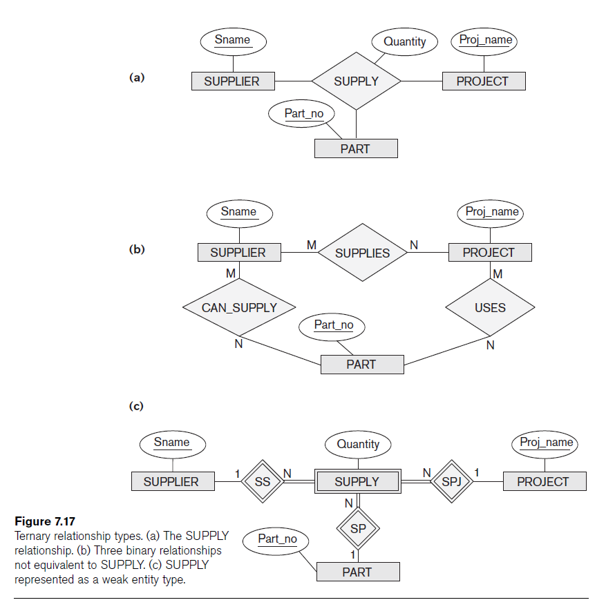

Slide 39
Constraints on Ternary (or Higher-Degree) Relationships
Notations for specifying structural constraints on n-ary relationships
  Should both be used if it is important to fully specify structural constraints

Slide 40
Additional Material
Enhanced Entity-Relationship (EER) Model

Slide 41
Chapter 8 (Elmasri) Outline
Subclasses, Superclasses, and Inheritance
Specialization and Generalization
Constraints and Characteristics of Specialization and Generalization Hierarchies
Modeling of UNION Types Using Categories
A Sample UNIVERSITY EER Schema, Design Choices, and Formal Definitions
Example of Other Notation: Representing Specialization and Generalization in UML
Class Diagrams
Data Abstraction, Knowledge Representation, and Ontology Concepts

Slide 42
The Enhanced Entity-Relationship (EER) Model
Enhanced ER (EER) model
  Created to design more accurate database schemas
    Reflect the data properties and constraints more precisely
  More complex requirements than traditional applications

Slide 43
Subclasses, Superclasses, and Inheritance
EER model includes all modeling concepts of the ER model
In addition, EER includes:
  Subclasses and superclasses
  Specialization and generalization
  Category or union type
  Attribute and relationship inheritance

Slide 44
Subclasses, Superclasses, and Inheritance (cont.)
Enhanced ER or EER diagrams
  Diagrammatic technique for displaying these concepts in an EER schema
Subtype or subclass of an entity type
  Subgroupings of entities that are meaningful
  Represented explicitly because of their significance to the database application

Slide 45
Subclasses, Superclasses, and Inheritance (cont.)
Terms for relationship between a superclass and any one of its subclasses
  Superclass/subclass
  Supertype/subtype
  Class/subclass relationship
Type inheritance
  Subclass entity inherits all attributes and relationships of superclass

Slide 46
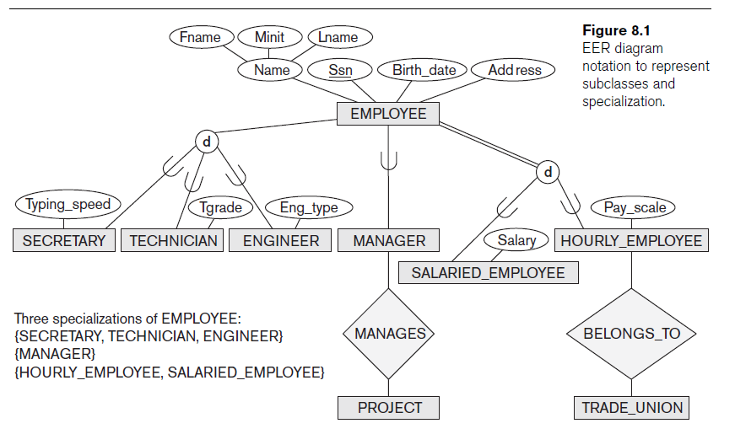

Slide 47
Specialization and Generalization
Specialization
  Process of defining a set of subclasses of an entity type
  Defined on the basis of some distinguishing characteristic of the entities in the superclass
Subclass can define:
  Specific attributes
  Specific relationship types

Slide 48
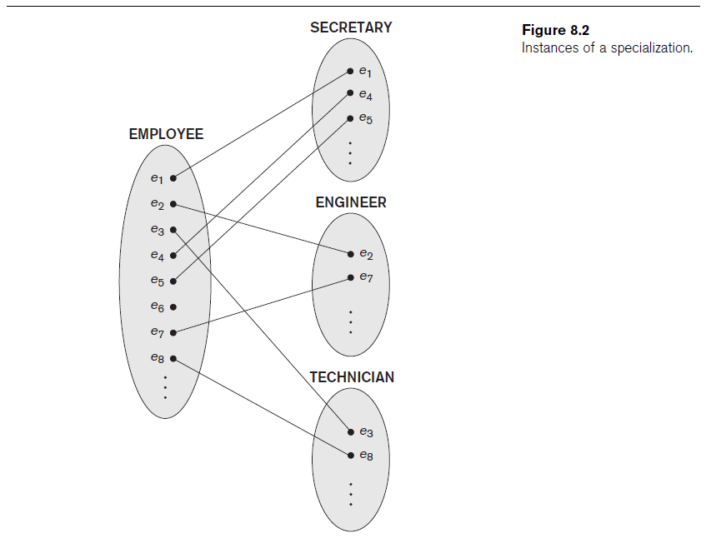

Slide 49
Specialization and Generalization (cont.)
Certain attributes may apply to some but not all entities of the superclass
Some relationship types may be participated in only by members of the subclass

Slide 50
Generalization
Reverse process of abstraction
Generalize into a single superclass
  Original entity types are special subclasses
Generalization
  Process of defining a generalized entity type from the given entity types

Slide 51
Constraints and Characteristics of Specialization and Generalization Hierarchies
Constraints that apply to a single specialization or a single generalization
Differences between specialization/
generalization lattices and hierarchies

Slide 52
Constraints on Specialization and Generalization
May be several or one subclass
Determine entity subtype:
  Predicate-defined (or condition-defined) subclasses
  Attribute-defined specialization
  User-defined

Slide 53
Constraints on Specialization and Generalization (cont.)
Disjointness constraint
  Specifies that the subclasses of the specialization must be disjoint
Completeness (or totalness) constraint
  May be total or partial
Disjointness and completeness constraints are independent

Slide 54
Specialization and Generalization Hierarchies and Lattices
Specialization hierarchy
  Every subclass participates as a subclass in only one class/subclass relationship
  Results in a tree structure or strict hierarchy
Specialization lattice
  Subclass can be a subclass in more than one class/subclass relationship

Slide 55
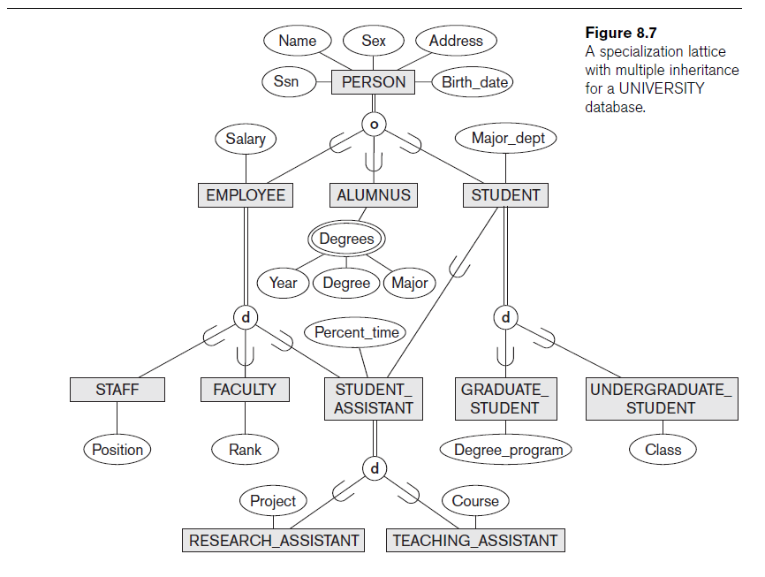

Slide 56
Specialization and Generalization Hierarchies and Lattices (cont.)
Multiple inheritance
  Subclass with more than one superclass
  If attribute (or relationship) originating in the same superclass inherited more than once via different paths in lattice
    Included only once in shared subclass
Single inheritance
  Some models and languages limited to single inheritance

Slide 57
Utilizing Specialization and Generalization in Refining Conceptual Schemas
Specialization process
  Start with entity type then define subclasses by successive specialization
  Top-down conceptual refinement process
Bottom-up conceptual synthesis
  Involves generalization rather than specialization

Slide 58
Modeling of UNION Types Using Categories
  Union type or a category
  Represents a single superclass/subclass relationship with more than one superclass
  Subclass represents a collection of objects that is a subset of the UNION of distinct entity types
  Attribute inheritance works more selectively
  Category can be total or partial
Some modeling methodologies do not have union types

Slide 59
A Sample UNIVERSITY EER Schema, Design Choices, and Formal Definitions
The UNIVERSITY Database Example
  UNIVERSITY database
    Students and their majors
    Transcripts, and registration
    University’s course offerings

Slide 60
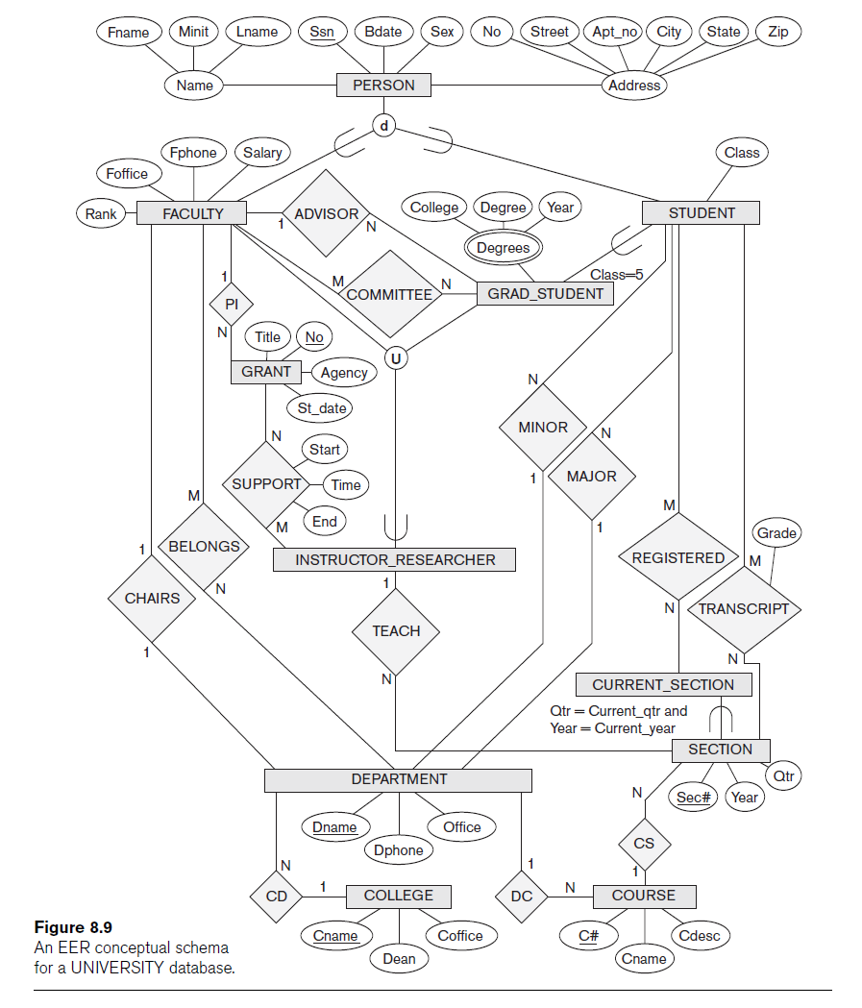

Slide 61
Design Choices for Specialization/Generalization
Many specializations and subclasses can be defined to make the conceptual model accurate
If subclass has few specific attributes and no specific relationships
  Can be merged into the superclass

Slide 62
Design Choices for Specialization/Generalization (cont.)
If all the subclasses of a specialization/generalization have few specific attributes and no specific relationships
  Can be merged into the superclass
  Replace with one or more type attributes that specify the subclass or subclasses that each entity belongs to

Slide 63
Design Choices for Specialization/Generalization (cont.)
Union types and categories should generally be avoided
Choice of disjoint/overlapping and total/partial constraints on specialization/generalization
  Driven by rules in miniworld being modeled

Slide 64
Formal Definitions for the EER Model Concepts
Class
  Set or collection of entities
  Includes any of the EER schema constructs of group entities
Subclass
  Class whose entities must always be a subset of the entities in another class
Specialization
  Set of subclasses that have same superclass

Slide 65
Formal Definitions for the EER Model Concepts (cont.)
Generalization
  Generalized entity type or superclass
Predicate-defined
  Predicate on the attributes of is used to specify which entities in C are members of S
User-defined
  Subclass that is not defined by a predicate

Slide 66
Formal Definitions for the EER Model Concepts (cont.)
Category
  Class that is a subset of the union of n defining superclasses
Relationship type
  Any class can participate in a relationship

Slide 67
Example of Other Notation
Representing specialization and generalization in UML class diagrams
  Basic notation
    See Figure 8.10
  Base class
    Root superclass
  Leaf classes
    Subclasses (leaf nodes)

Slide 68
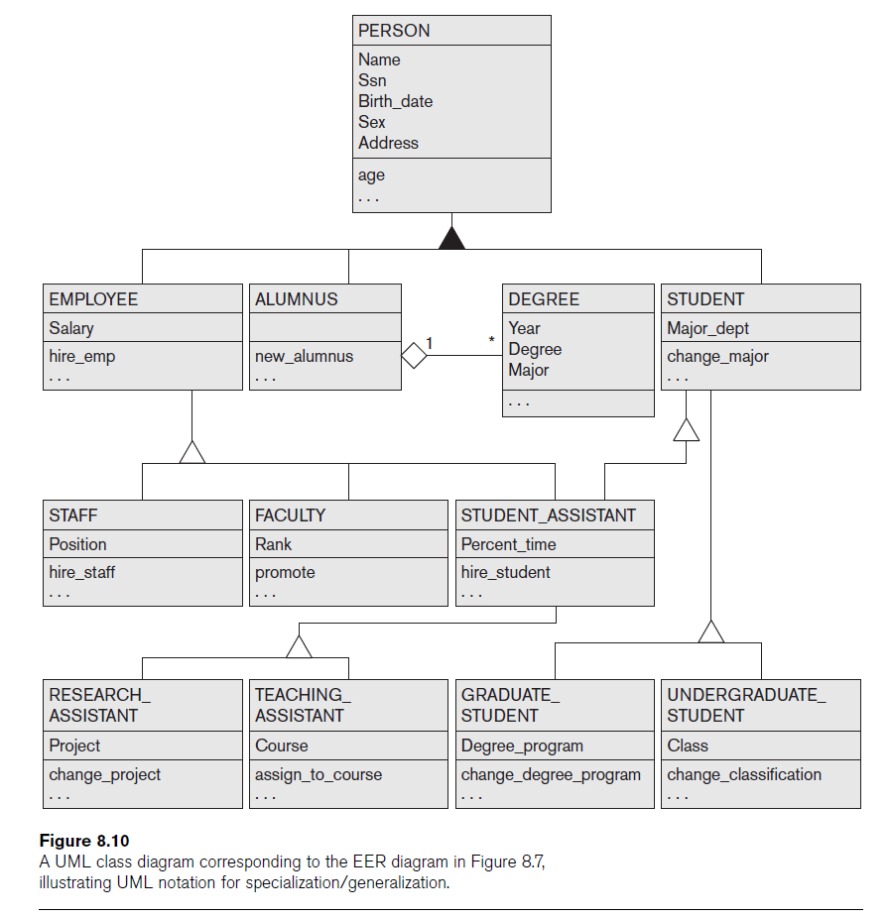

Slide 69
Data Abstraction, Knowledge
Representation, and Ontology Concepts
Goal of knowledge representation (KR) techniques
  Accurately model some domain of knowledge
  Create an ontology that describes the concepts of the domain and how these concepts are interrelated
Goals of KR are similar to those of semantic data models
  Important similarities and differences

Slide 70
Classification and Instantiation
Classification
  Systematically assigning similar objects/entities to object classes/entity types
Instantiation
  Inverse of classification
  Generation and specific examination of distinct objects of a class

Slide 71
Classification and Instantiation (cont.)
Exception objects
  Differ in some respects from other objects of class
    KR schemes allow such class properties
One class can be an instance of another class (called a meta-class)
  Cannot be represented directly in EER model

Slide 72
Identification
Abstraction process
Classes and objects are made uniquely identifiable by means of some identifier
Needed at two levels
  To distinguish among database objects and classes
  To identify database objects and to relate them to their real-world counterparts

Slide 73
Specialization and Generalization
Specialization
  Classify a class of objects into more specialized subclasses
Generalization
  Generalize several classes into a higher-level abstract class
  Includes the objects in all these classes

Slide 74
Aggregation and Association
Aggregation
  Abstraction concept for building composite objects from their component objects
Association
  Associate objects from several independent classes
Main structural distinction
  When an association instance is deleted
    Participating objects may continue to exist

Slide 75
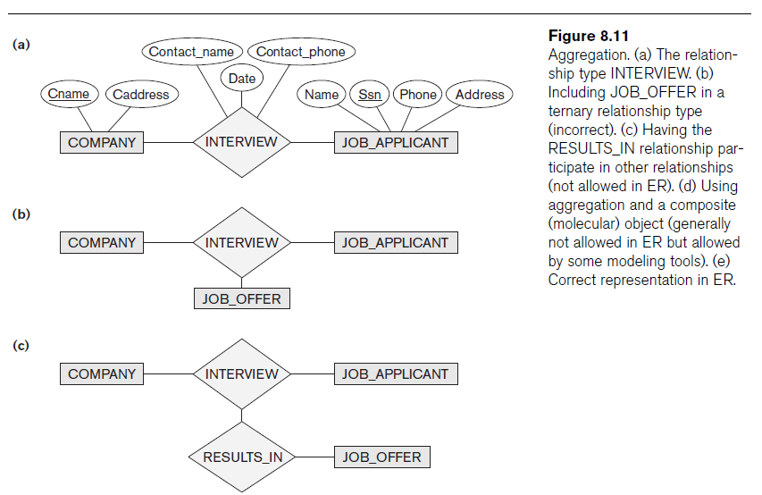

Slide 76
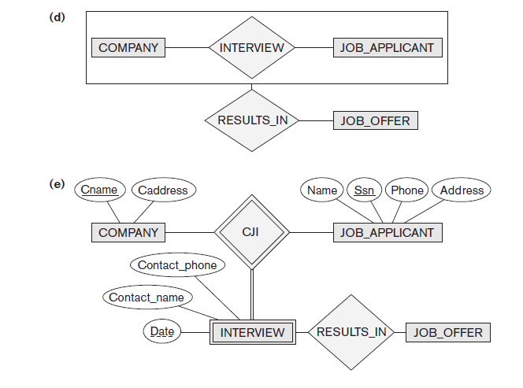
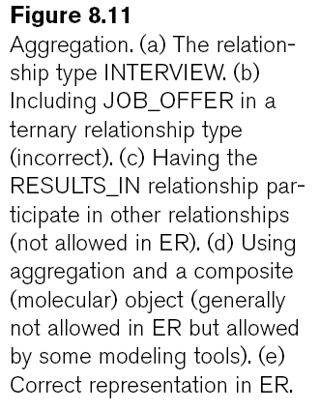

Slide 77
Ontologies and the Semantic Web
Documents contain less structure than database information does
Semantic Web
  Allow meaningful information exchange and search among machines
Ontology
  Specification of a conceptualization
Specification
  Language and vocabulary terms used to specify conceptualization

Slide 78
Next Lecture
Database design methodology & UML

Slide 79
References
Ramez Elmasri, Shamkant Navathe; “Fundamentals of Database Systems”, 6th Ed., Pearson, 2014.

