Slide 1


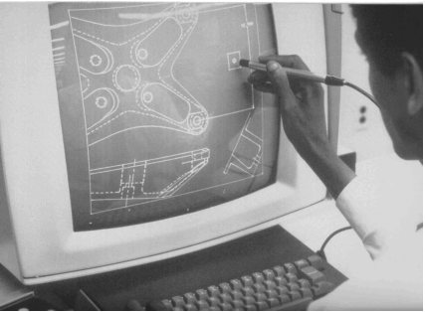
CSE 411
Computer Graphics
Lecture #3 Graphics Output Primitives
Prepared & Presented by Asst. Prof. Dr. Samsun M. BAŞARICI

Slide 2
Objectives
HB Ch. 4 & GVS Ch. 7 (partly)
Coordinate reference frames
Two-dimensional world reference
OpenGL Point Functions
OpenGL Line Functions
Polygon Fill Areas & OpenGL functions
OpenGL Vertex Arrays
Character Primitives & OpenGL functions

Slide 3
Graphics Output Primitives
Graphics output primitives
  Functions used to describe the various picture components
  Examples: car, house, flower, …
Geometric primitives
  Functions used to describe points, lines, triangles, circles, …

Slide 4
Coordinate Reference Frames
Cartesian coordinate system
  Can be 2D or 3D
  Objects are associated to a set of coordinates
  World coordinates are associated to a scene
Object description
  Coordinates of vertices
  Color
  Coordinate extents (min and max for each (x,y,z) in object – also called the bounding box
    In 2D – bounding rectangle

Slide 5
Coordinate Reference Frames (cont.)
Screen coordinates
  Location of object on a monitor
  Start from upper left corner (origin (0,0))
  Pixel coordinates
    Scan line number (y)
    Column number (x)
  Other origin → lower left corner (0,0)
  Pixel coordinate references the center of the pixel
    setPixel (x, y)
    getPixel (x, y, color)
    Depth value is 0 in 2D

Slide 6
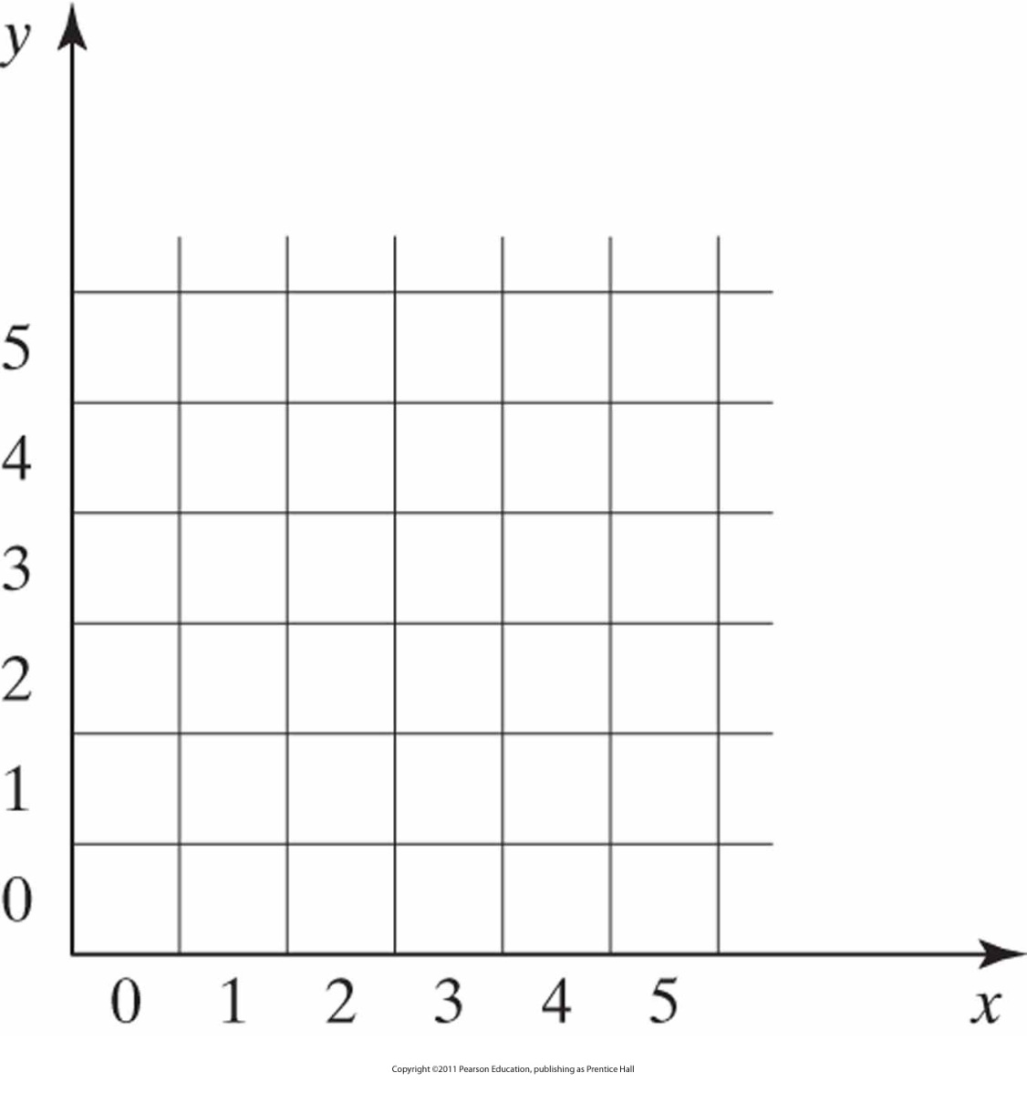
Pixel positions
Referenced with respect to the lower-left corner of a screen area.

Slide 7
Coordinate Specifications
Absolute coordinate values
Relative coordinate values:
  Current position + offset

Slide 8
2D World Reference
gluOrtho2D (xMin, xMax, yMin, yMax)
  References display window as a rectangle with the minimum and maximum values listed
  Absolute coordinates within these ranges will be displayed
glMatrixMode(GL_PROJECTION);
// set projection parameters to 2D
glLoadIdentity(); // sets projection matrix to identity
gluOrtho2D(0.0, 200.0, 0.0, 150.0);
// set coordinate values
// with vertices (0,0) for lower left corner
// and (200, 150) for upper right corner

Slide 9
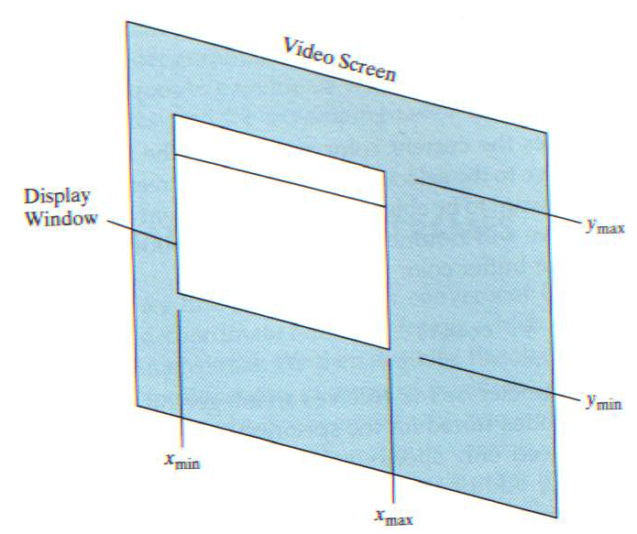
glOrtho2D Function

Slide 10
Point Functions
Point
  Coordinates
  Color – default color is white
  Size – one screen pixel by default (glPointSize)
  glBegin (GL_POINTS)
  glVertex2i (50, 100);
  glVertex2i (75, 150);
    glVertex2i (100, 200);
    glEnd();
  Coordinates can also be set in an int []:
  int point1 [] = {50, 100};
  …
  glVertex2iv (point1);

Slide 11
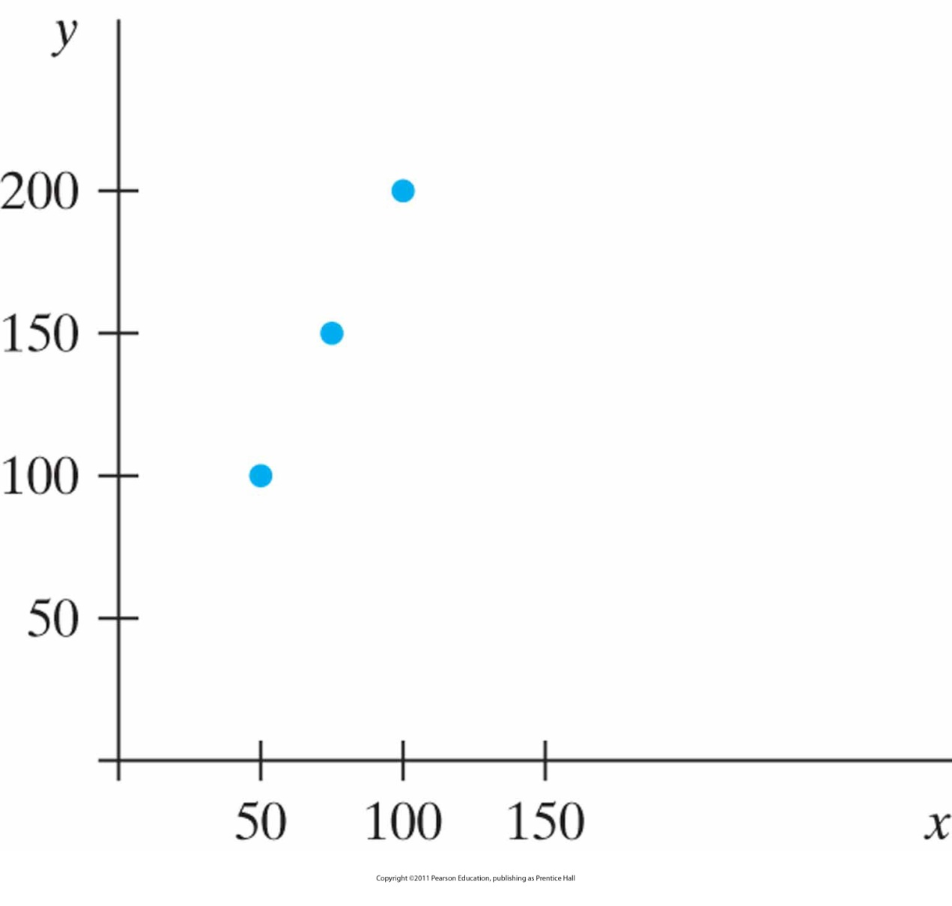
Example: Three Point Positions
Generated with glBegin (GL_POINTS).

Slide 12
OpenGL Line Functions
Line
  Defined by two endpoint coordinates
  (one line segment)
  glBegin(GL_LINES );
  glVertex2i( 180, 15 );
  glVertex2i( 10, 145 );
  glEnd();
  If several vertices, a line is drawn between the first and second, then a separate one between the third and the fourth, etc. (isolated vertices are not drawn).

Slide 13
OpenGL Line Functions (cont.)
Polyline
  Defined by line connecting all the points
  glBegin(GL_LINE_STRIP );
  glVertex2i( 180, 15 );
  glVertex2i( 10, 145 );
  glVertex2i( 100, 20 );
  glVertex2i( 30, 150 );
  glEnd();
  Draws a line between vertex 1 and vertex 2
  then between vertex 2 and vertex 3
  then between vertex 3 and vertex 4.

Slide 14
OpenGL Line Functions (cont.)
Polyline
  In addition to GL_LINE_STRIP, adds a line between the last vertex and the first one
  glBegin(GL_LINE_LOOP );
  glVertex2i( 180, 15 );
  glVertex2i( 10, 145 );
  glVertex2i( 100, 20 );
  glVertex2i( 30, 150 );
  glEnd();
  Draws a line between vertex 1 and vertex 2
  then between vertex 2 and vertex 3
  then between vertex 3 and vertex 4
  then between vertex 4 and vertex 1.

Slide 15
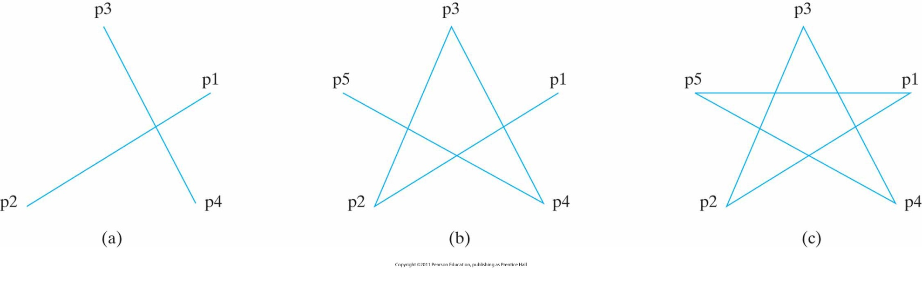
Example: Line segments
With five endpoint coordinates
An unconnected set of lines generated with the primitive line constant GL_LINES.
A polyline generated with GL_LINE_STRIP.
A closed polyline generated with GL_LINE_LOOP.

Slide 16
OpenGL Curve Functions
Not included in OpenGL core library (only Bézier splines: polynomials defined with a discrete point set)
GLU has routines for 3D quadrics like spheres, cylinders and also rational B-splines
GLUT has routines for 3D quadrics like spheres, cones and others

Slide 17
OpenGL Curve Functions (cont.)
How to draw curves?
Solution: Approximating using polyline

Slide 18
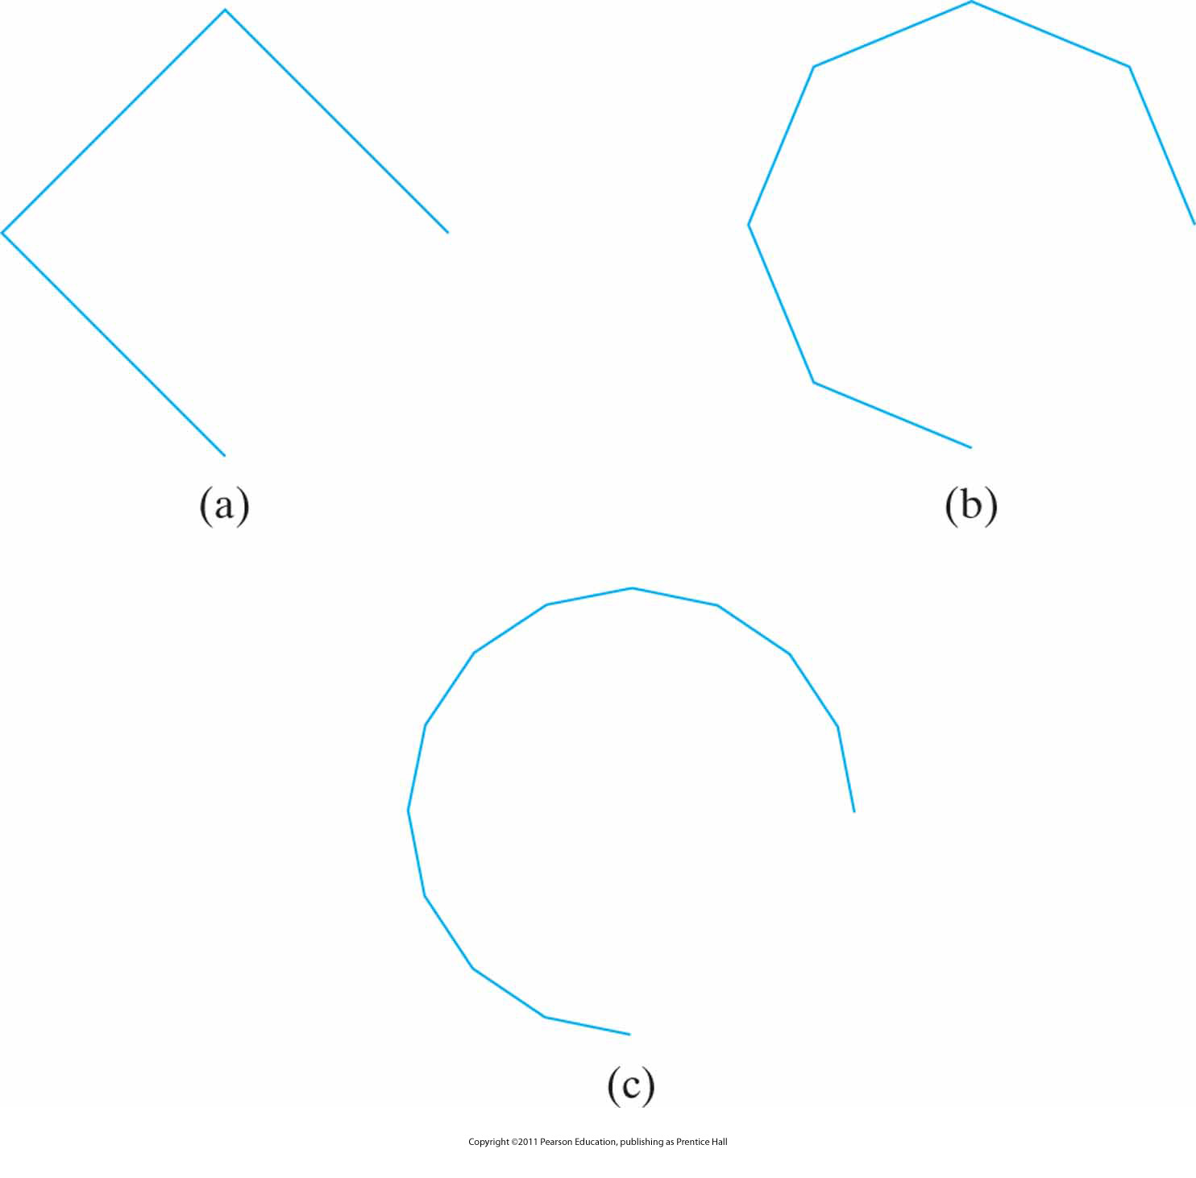
Curve Approximation
A circular arc approximated with (a) three straight-line segments, (b) six line segments, and (c) twelve line segments.

Slide 19
Fill-Area Primitives
Fill-areas
  Area filled with a certain color
  Most often the shape is that of a polygon
  Boundaries are linear
  Most curved surfaces can be approximated with polygon facets (surface fitting with polygon mesh)
  Standard graphics objects are objects made of a set of polygon surface patches.

Slide 20
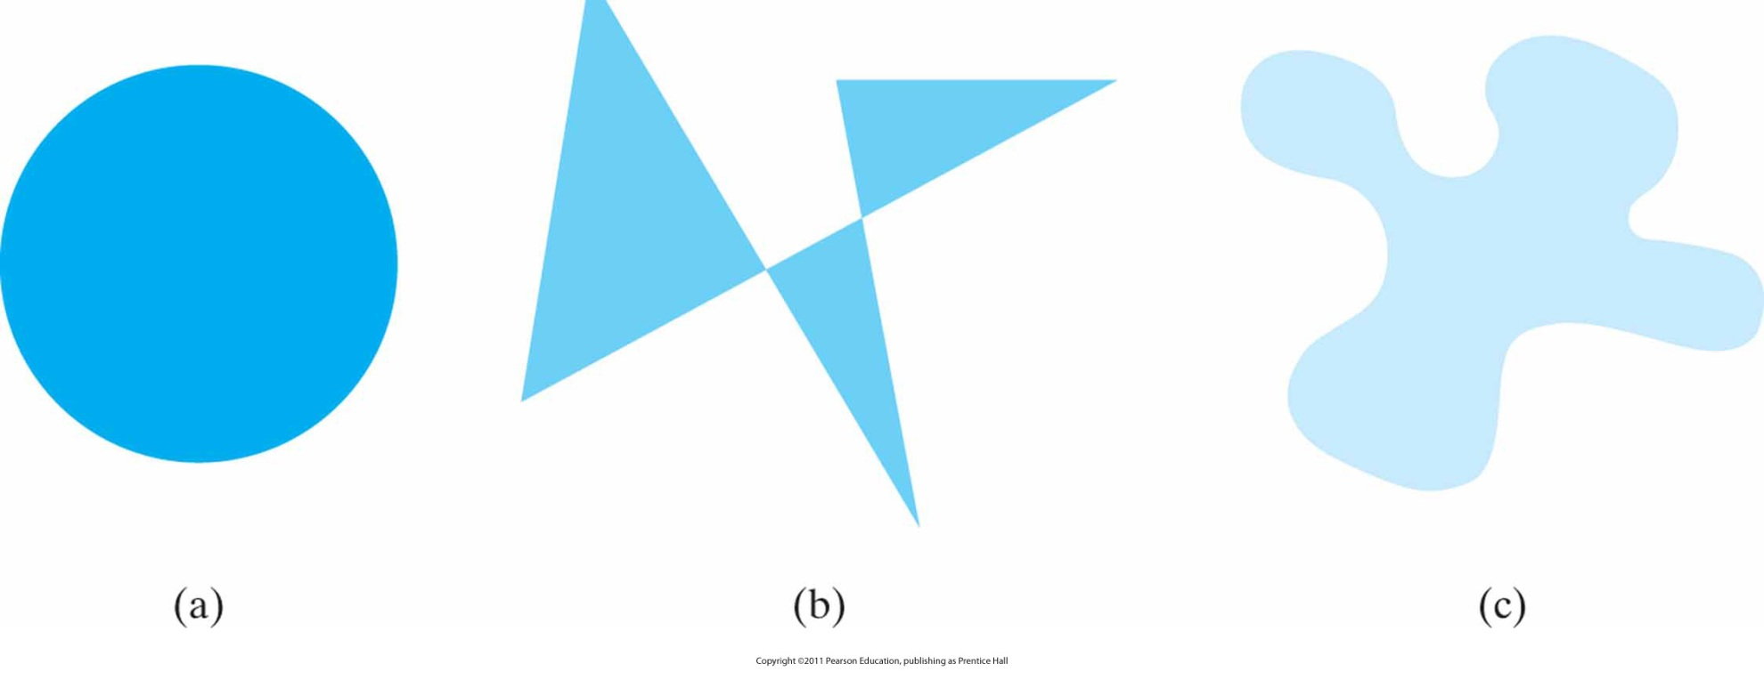
Solid-color fill areas curved boundary
Specified with various boundaries.
A circular fill region
A fill area bounded by a closed polyline
A filled area specified with an irregular curved boundary

Slide 21
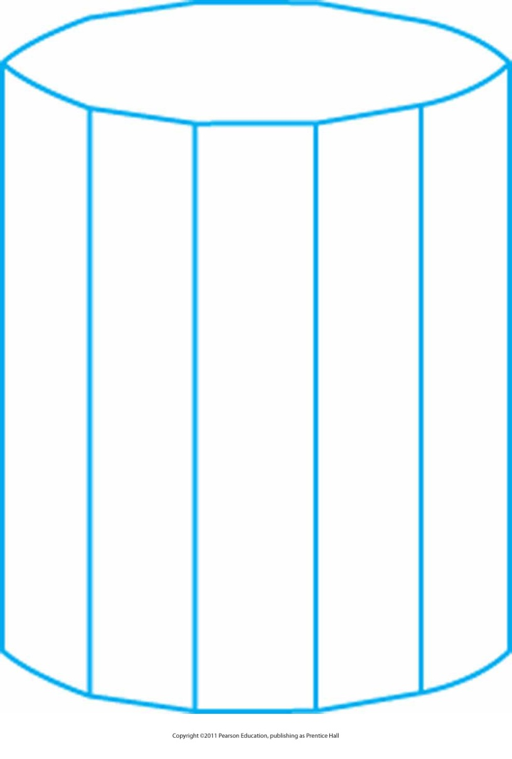
Approximating a curved surface
Wire-frame representation for a cylinder, showing only the front (visible) faces of the polygon mesh used to approximate the surfaces.

Slide 22
Polygon Fill-Areas
Polygon classification
  Polygon is a figure with three or more vertices and vertices are connected by a sequence of straight line called edges or sides
  A polygon should be closed and with no edges crossing
  Convex polygon has all interior angles less than or equal to 180º, line joining two interior points is also interior to the polygon
  Concave polygon otherwise

Slide 23
OpenGL Fill Area Functions
OpenGL requires all polygons to be convex
If need to draw concave polygons, then split them into convex polygons
GLU library contains routines to convert concave polygons into a set of triangles, triangle mashes, triangle fans and straight line segments

Slide 24
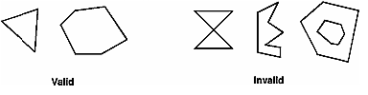
Valid and Invalid Polygons

Slide 25
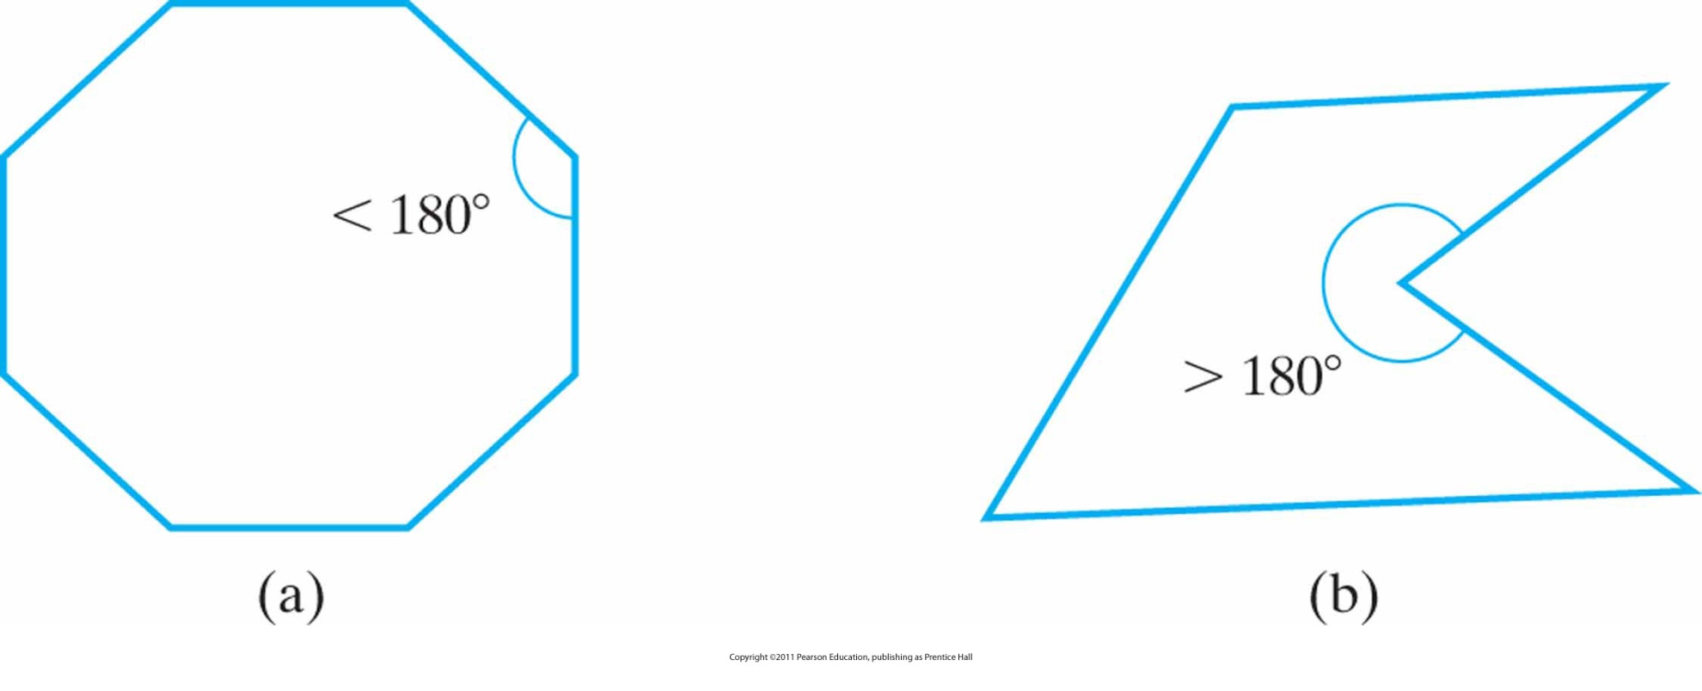
Convex and Concave Polygons
A convex polygon (a), and a concave polygon (b).

Slide 26
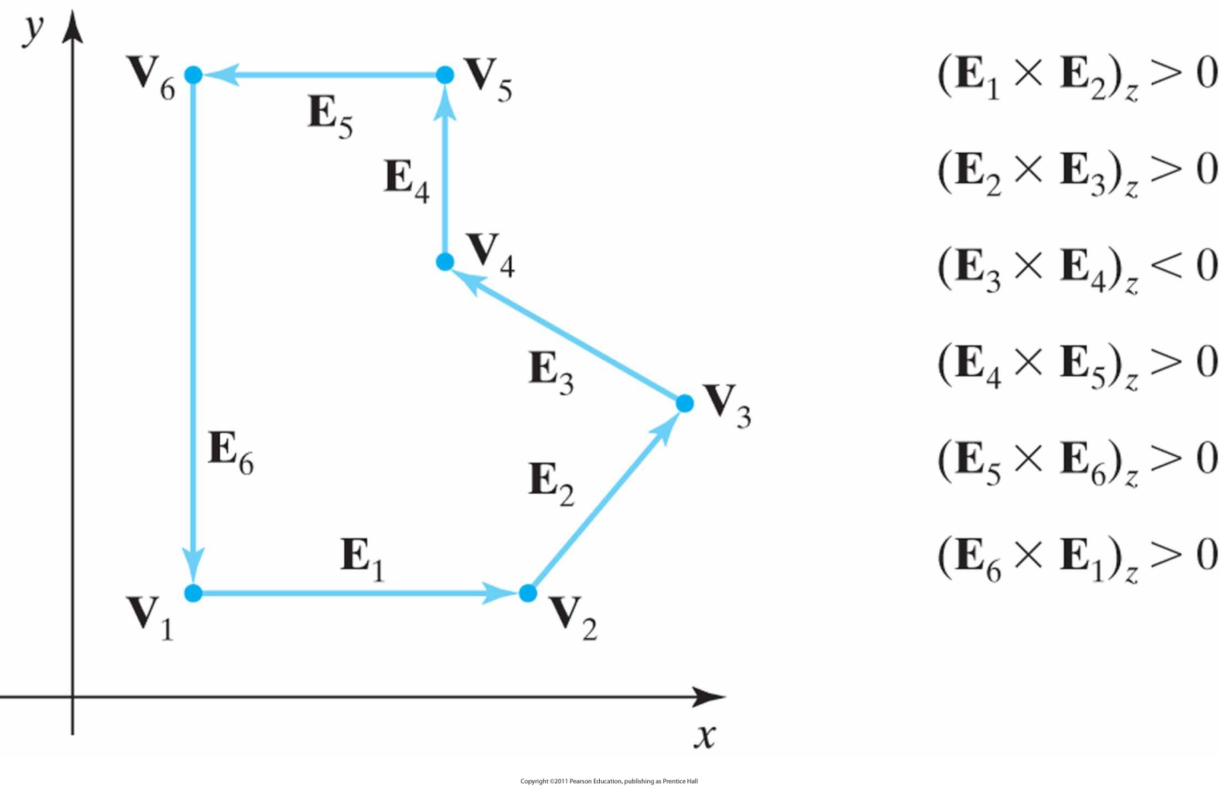
Identifying a concave polygon
By calculating cross-products of successive pairs of edge vectors

Slide 27
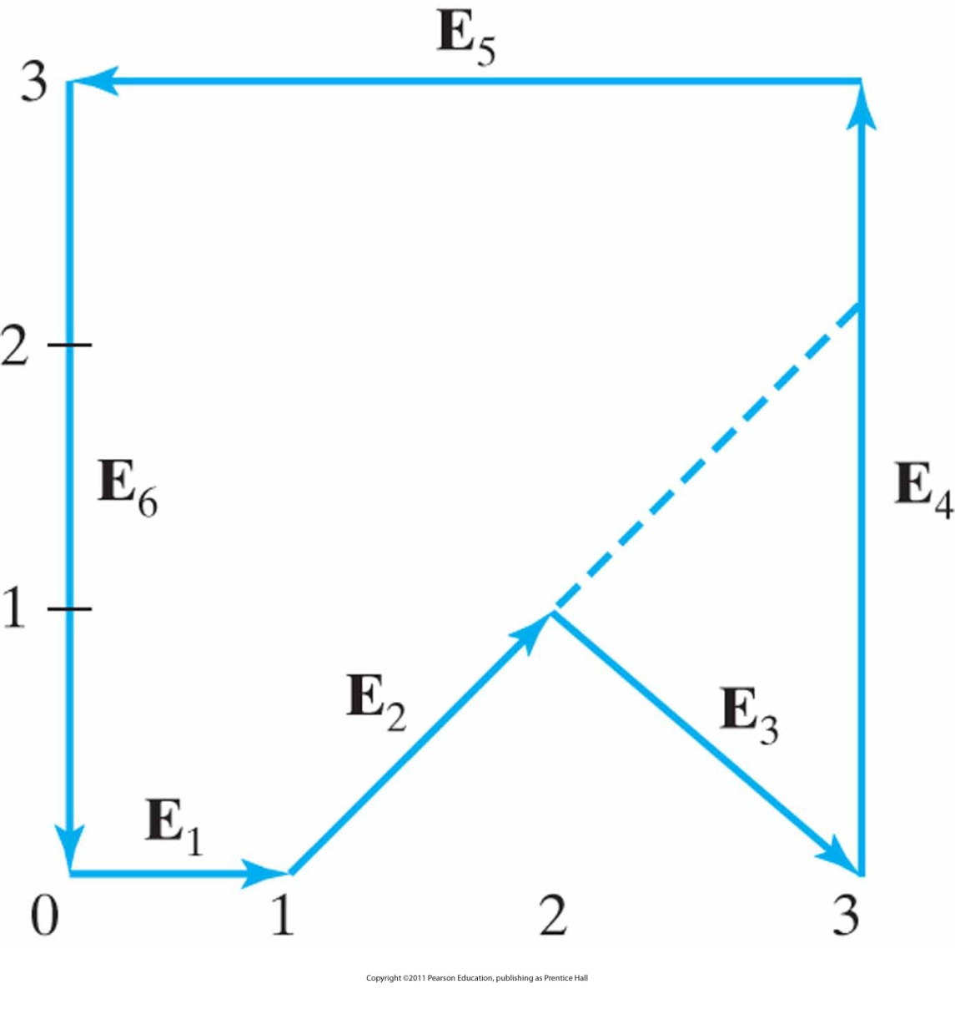
Splitting a concave polygon
Using the vector method.

Slide 28
Example: Splitting a concave polygon
Polygon from Slide 27:
  Edge vectors:
  z component is 0 because all edges are in xy plane
    E₁= (1, 0, 0) E₂= (1, 1, 0) E₃= (1, -1, 0)
    E₄= (0, 2, 0) E₅= (-3, 0, 0) E₆= (0, -2, 0)
(Remember) The cross-product E_{j} x E_{k} for two successive edge vectors is a vector perpendicular the xy plane with z component equal to E_{jx} E_{ky} - E_{kx} E_{jy}

Slide 29
Example: Splitting a concave polygon (cont.)
So:
  E₁ x E₂ = (0, 0, 1) E₂ x E₃ = (0, 0, -2)
  E₃ x E₄ = (0, 0, 2) E₄ x E₅ = (0, 0, 6)
  E₅ x E₆ = (0, 0, 6) E₆ x E₁ = (0, 0, 2)
E₂ x E₃ negative, split along the line of vector E₂

Slide 30
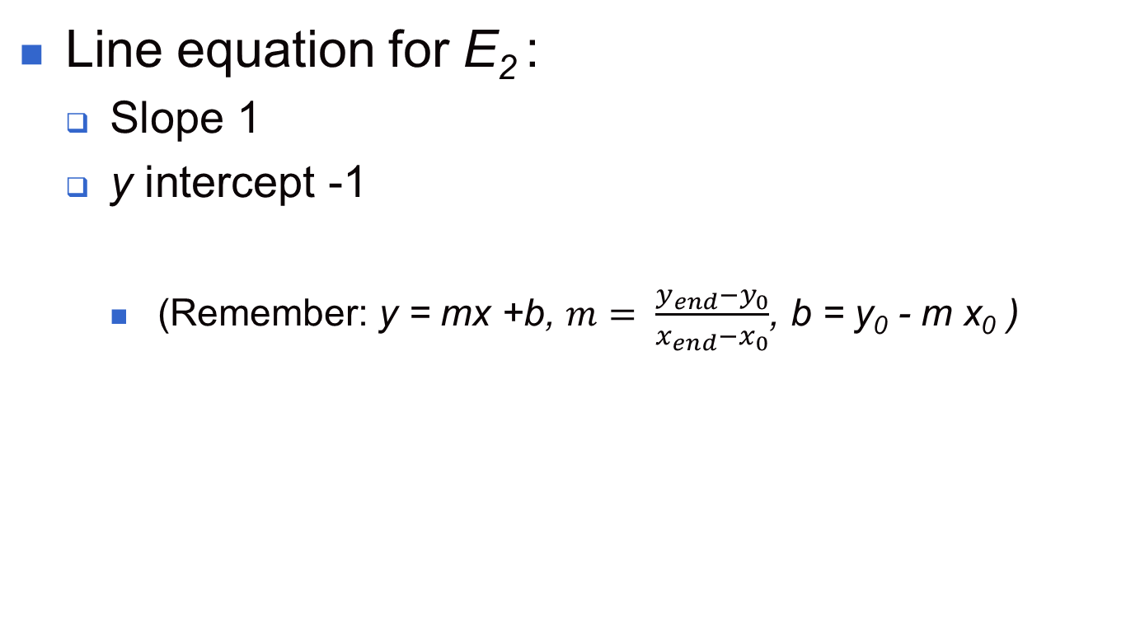
Example: Splitting a concave polygon (cont.)

Slide 31
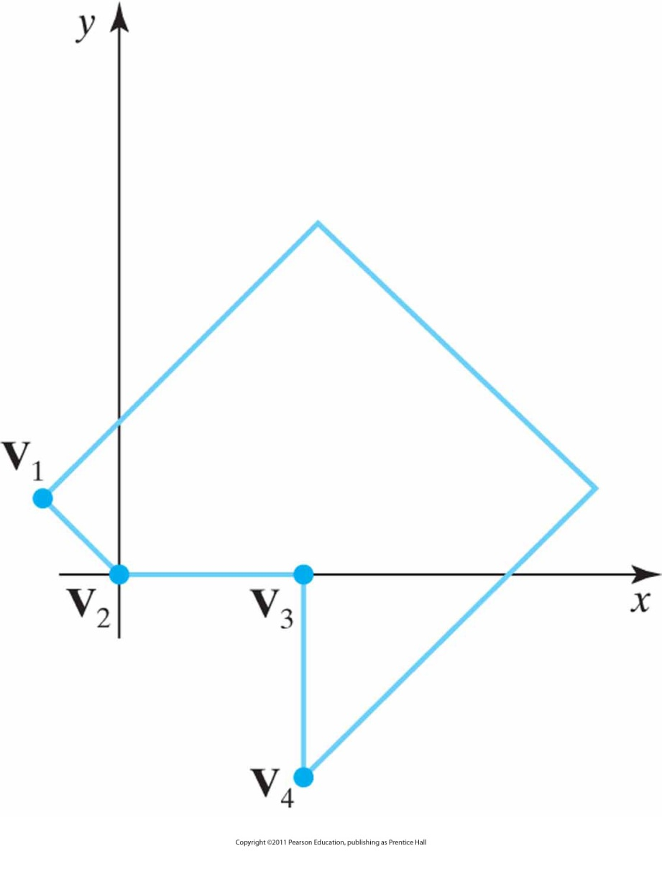
Splitting a concave polygon
Using the rotational method

Slide 32
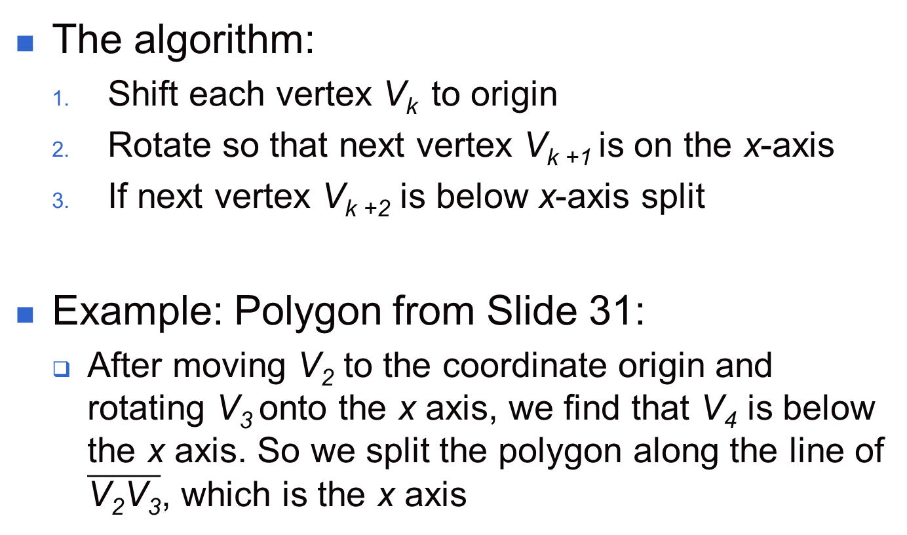
Example: Splitting a concave polygon

Slide 33
Inside-Outside Tests
In CG applications often interior regions of objects have to be identified.
Approaches:
  Odd-even rule:
    Draw a line from a point to outside of coordinate extents
    Count line segments of the object crossing this line
    If the number is odd then the point is interior, else exterior

Slide 34
Inside-Outside Tests (cont.)
Nonzero winding-number rule:
  Init winding-number to 0
  Draw a line from a point
  Move along the line
  Count line segments of object crossing this line
  If crossing line is from right-to-left; winding-number + 1, otherwise winding-number – 1
  If winding-number ≠ 0 then point interior, else exterior
But: How to determine directional boundary crossings?
  (Hint: Using vectors)

Slide 35
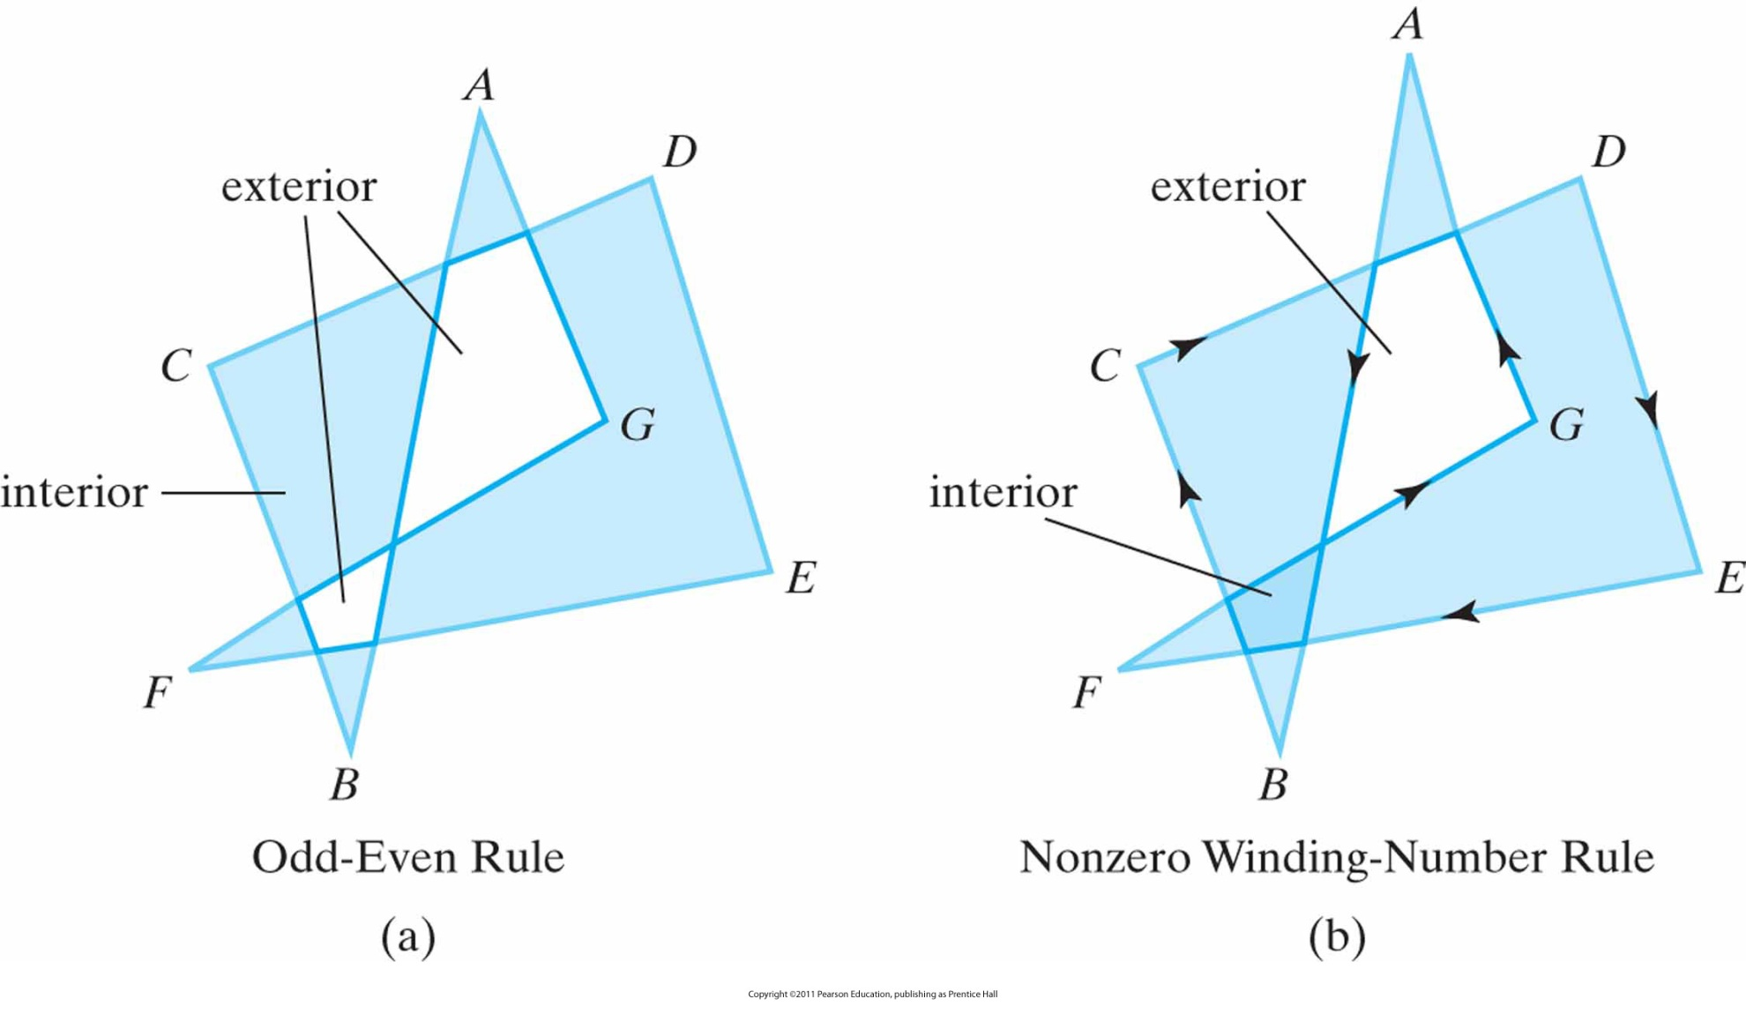
Example: Inside-Outside Tests

Slide 36
Polygon Tables
Objects in a scene are described as sets of polygon surface facets.
Data is organized in polygon data tables
  Geometric data tables
    Vertex table: Coordinate values for each vertex
    Edge table: Pointers to vertex table defining each edge in polygon
    Surface-facet table: Pointers to edge tabel defining each edge for given surface
  Attribute data tables: Degree of transparency, surface reflectivity, texture characteristics

Slide 37
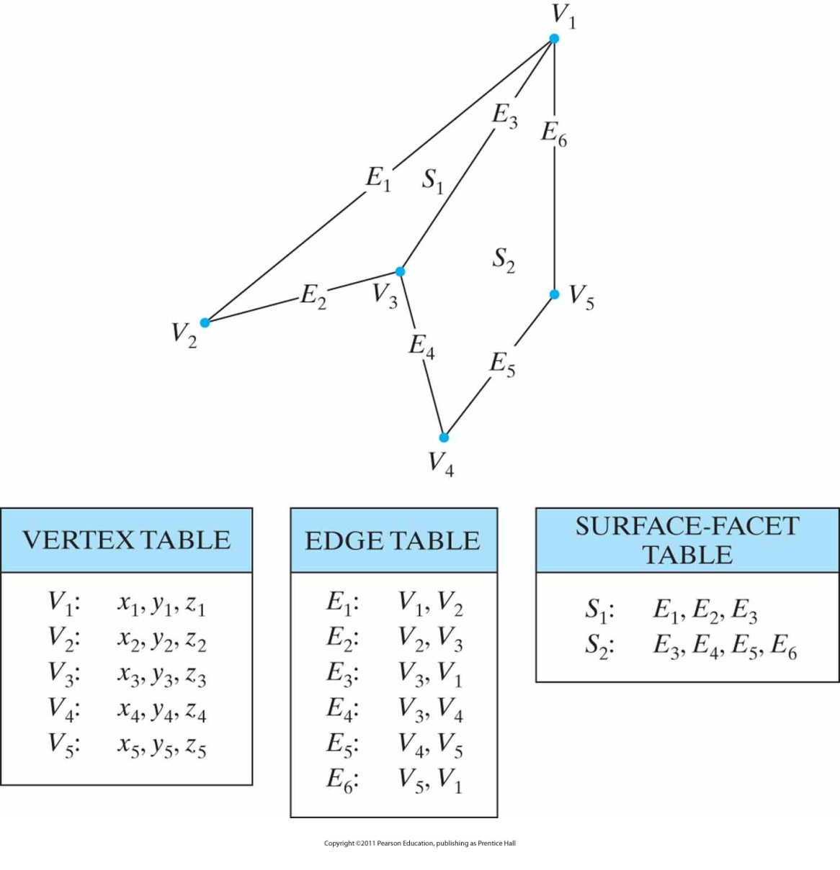
Geometric data-table
Representation for two adjacent polygon surface facets, formed with six edges and five vertices.

Slide 38
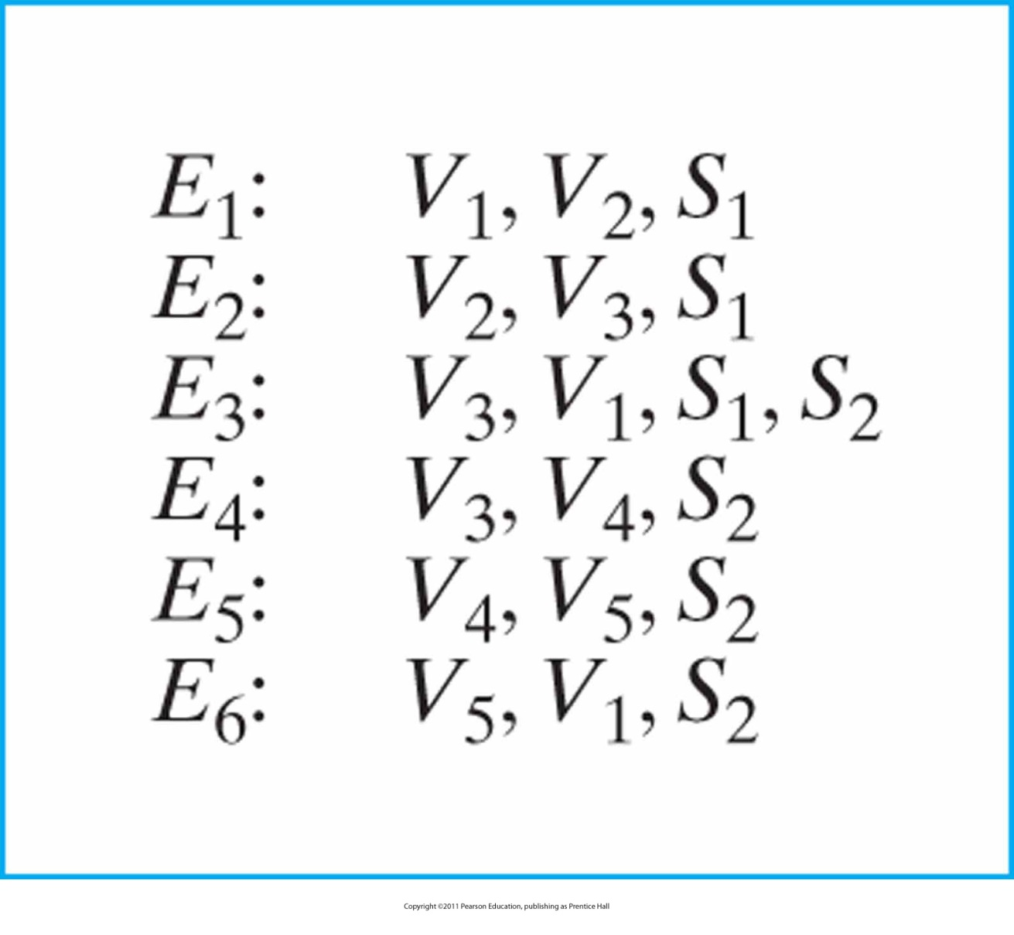
Expanded Edge Table
For the surfaces of figure in Slide 37 expanded to include pointers into the surface-facet table.

Slide 39
Polygon Tables
Error checking is easier when using three data tables.
Error checking includes:
  Is every vertex listed as an endpoint for at least two edges?
  Is every edge a part of at least one polygon?
  Is every polygon closed?
  Has each polygon at least one shared edge?
  If the edge table contains pointers to polygons, has every edge referenced by a polygon pointer a reciprocal pointer back to the polygon?

Slide 40
Plane Equations
For many CG applications the spatial orientation of the surface components of objects is needed.
This information is obtained from vertex coordinate values and the equations that describe the polygon surface.
General equation for a plane is:
  Ax + By + Cz + D = 0
    (x, y, z) any point on the plane
    A, B, C, D plane parameters

Slide 41
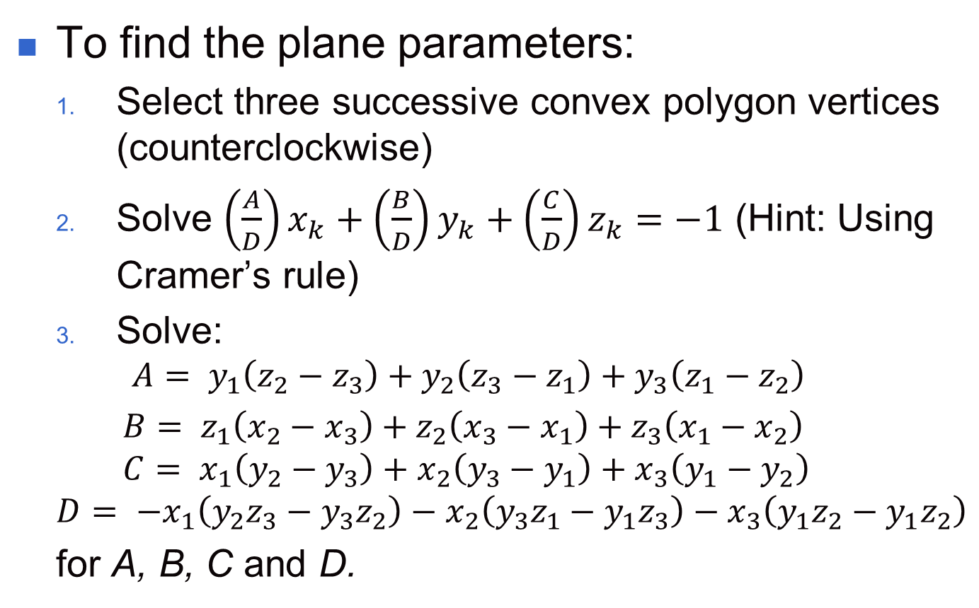
Plane Equations: The Parameters

Slide 42
Front and Back Polygon Faces
The sides of a polygon surface have to be distinguished.
The side of a polygon surface facing into the interior of an object is called back face.
The visible/outward side of a polygon surface is called front face.
Every polygon on a plane partitions the space into two regions.
Any point that is not on the plane and is visible to the front face of a polygon surface is called in front of/outside the plane (and also outside the object).
Otherwise behind/inside.

Slide 43
Where is the Point?
For any point (x, y, z) not on a plane:
  Ax + By + Cz + D ≠ 0
So if:
  Ax + By + Cz + D < 0, point is behind the plane
  Ax + By + Cz + D > 0, point is in front of the plane

Slide 44
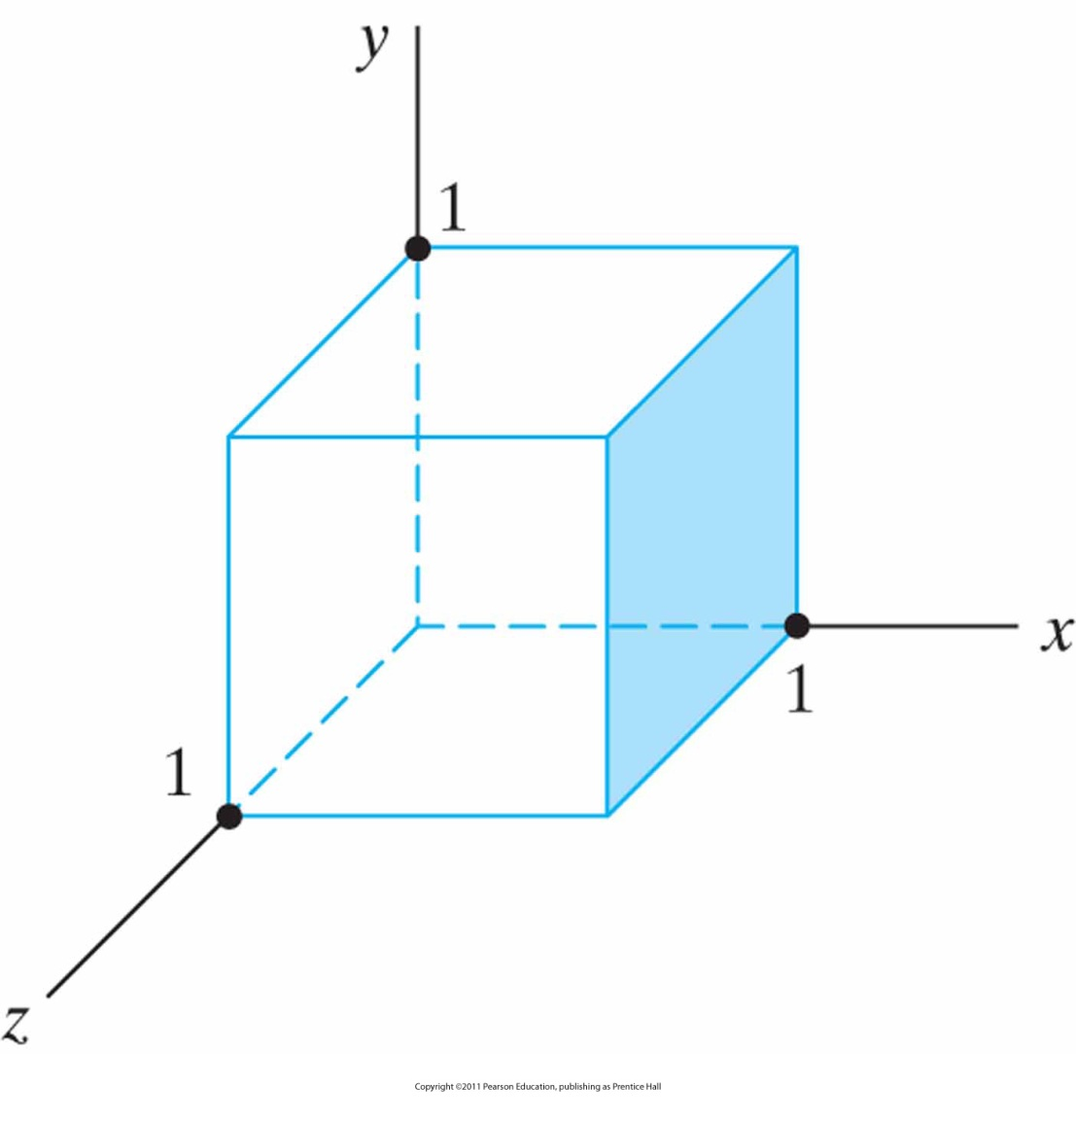
Example: Point in Relation to Unit Cube
The shaded polygon surface of the unit cube has the plane equation x − 1 = 0

Slide 45
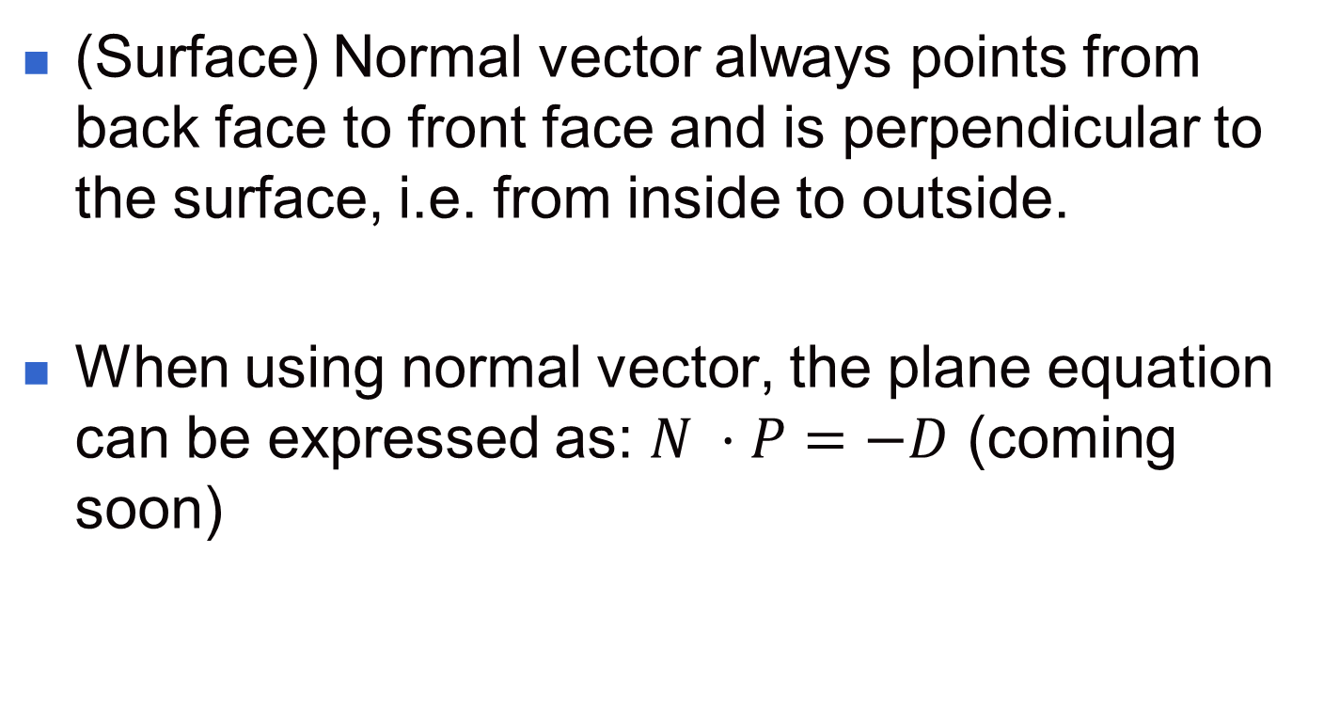
Orientation of a Polygon Surface

Slide 46
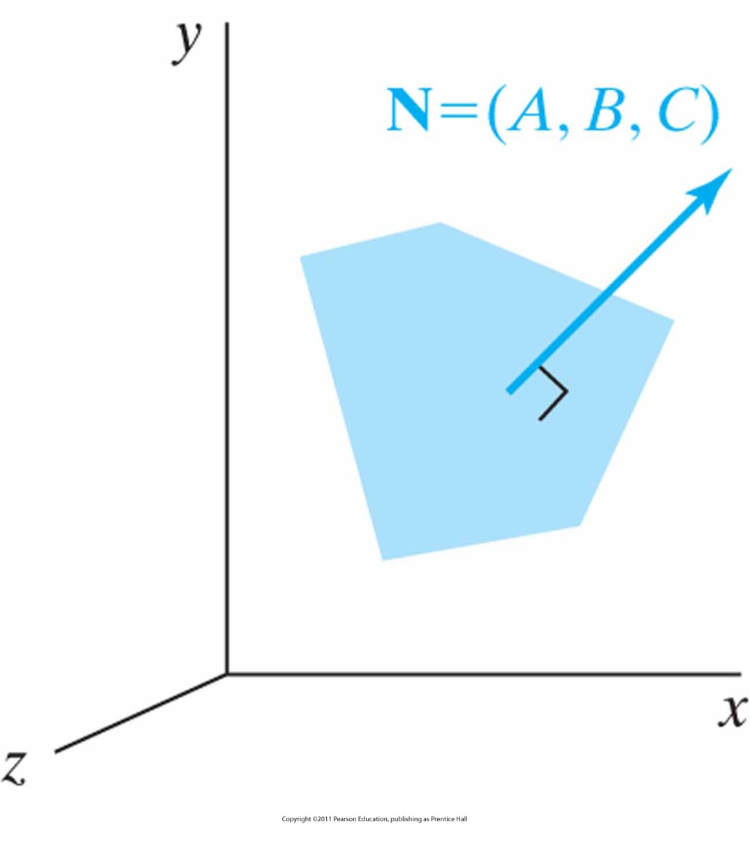
The normal vector N
For a plane described with the equation Ax + By +Cz + D = 0 is perpendicular to the plane and has Cartesian components (A, B, C)

Slide 47
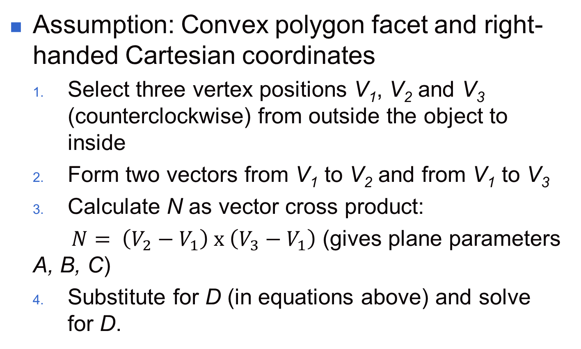
Calculating the Normal Vector

Slide 48
Calculating the Normal Vector

Slide 49
OpenGL Fill Area Functions
By default, a polygon interior is displayed in a solid color, determined by the current color settings
Alternatively, we can fill a polygon with a pattern and we can display polygon edges as line borders around the interior fill
Polygon vertices are specified counterclockwise.

Slide 50
OpenGL Fill Area Functions (cont.)
Rectangle
  glRect*(x1,y1,x2,y2) where * means d, f, i, s, v)
    glRecti(200,100,50,250)
    int vertex1[ ]= {200,100};
    int vertex1[ ]= {50,250};
    glRectiv(vertex1, vertex2);

Slide 51
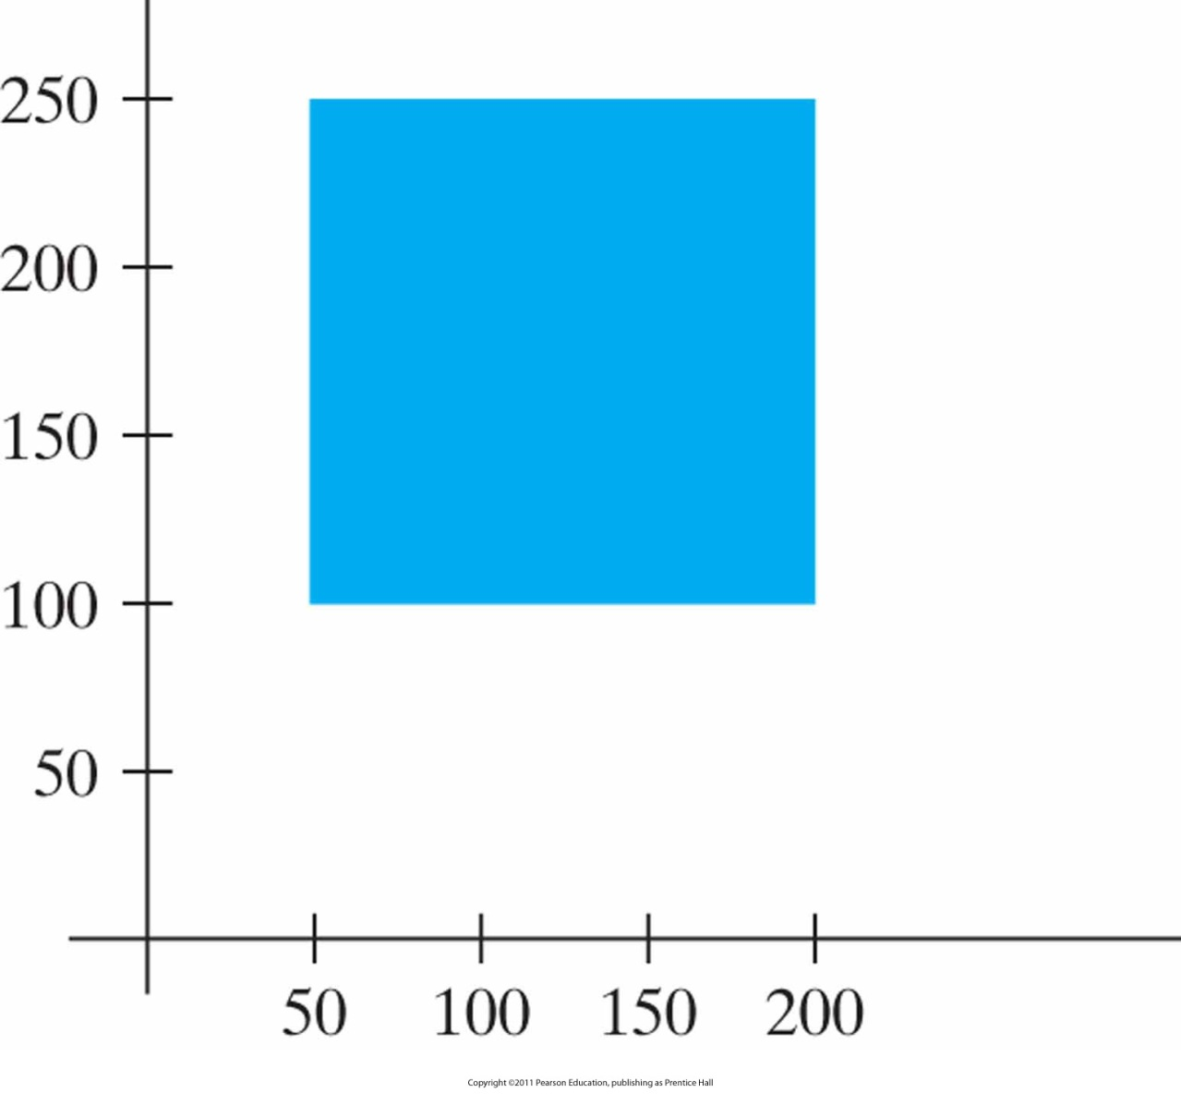
Example: Square Fill Area
using the glRect function.

Slide 52
Counterclockwise? Clockwise?
What happened in previous example?
Why clockwise?
Answer: In OpenGL normally always counterclockwise but in general counterclockwise is necessary if back face/front face distinction is important.

Slide 53
OpenGL Fill Area Functions
GL_POLYGON
  glBegin(GL_POLYGON);
    glVertex2iv(p1);
    glVertex2iv(p2);
    glVertex2iv(p3);
    glVertex2iv(p4);
    glVertex2iv(p5);
    glVertex2iv(p6);
    glEnd( );

Slide 54
OpenGL Fill Area Functions (cont.)
Triangle (GL_TRIANGLES or GL_TRIANGLE_STRIP or GL_TRIANGLE_FAN)
GL_TRIANGLE_STRIP
  glBegin(GL_TRIANGLES);
    glVertex2iv(p1);
    glVertex2iv(p2);
    glVertex2iv(p3);
    glVertex2iv(p4);
    glVertex2iv(p5);
    glVertex2iv(p6);
    glEnd( );

Slide 55
OpenGL Fill Area Functions (cont.)
GL_TRIANGLE_STRIP
  glBegin(GL_TRIANGLE_STRIP);
    glVertex2iv(p1);
    glVertex2iv(p2);
    glVertex2iv(p6);
    glVertex2iv(p3);
    glVertex2iv(p5);
    glVertex2iv(p4);
    glEnd( );

Slide 56
OpenGL Fill Area Functions (cont.)
GL_TRIANGLE_FAN
  glBegin(GL_TRIANGLE_FAN);
    glVertex2iv(p1);
    glVertex2iv(p2);
    glVertex2iv(p3);
    glVertex2iv(p4);
    glVertex2iv(p5);
    glVertex2iv(p6);
    glEnd( );

Slide 57
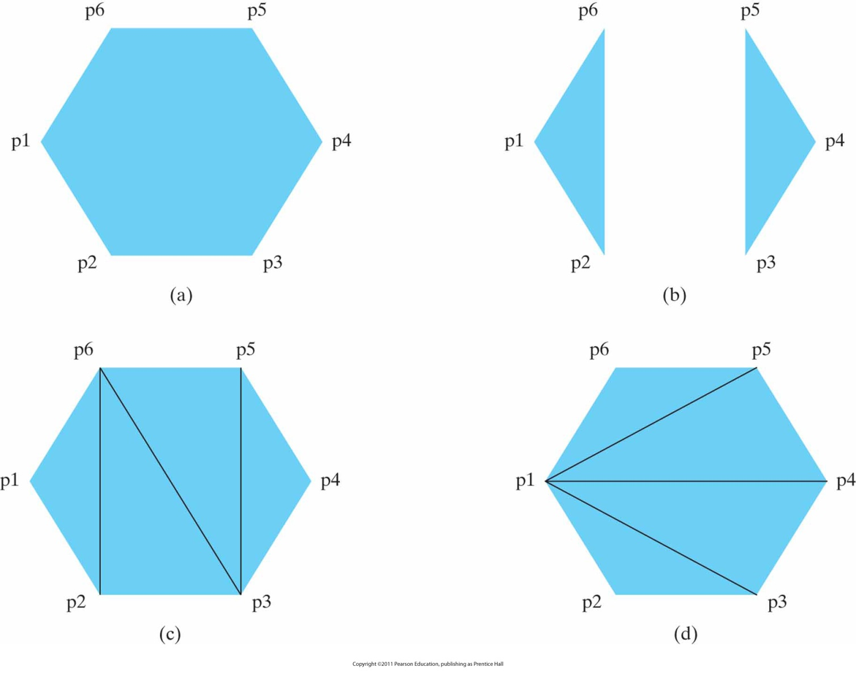
Polygon Fill Areas
Using a list of six vertex positions. (a) A single convex polygon fill area generated with the primitive constant GL_POLYGON. (b) Two unconnected triangles generated with GL_ TRIANGLES. (c) Four connected triangles generated with GL_TRIANGLE_STRIP. (d) Four connected triangles generated with GL_TRIANGLE_FAN.

Slide 58
OpenGL Fill Area Functions
Quads (GL_QUADS or GL_QUAD_STRIP)
GL_QUADS
  glBegin(GL_QUADS);
    glVertex2iv(p1);
    glVertex2iv(p2);
    glVertex2iv(p3);
    glVertex2iv(p4);
    glVertex2iv(p5);
    glVertex2iv(p6);
    glVertex2iv(p7);
    glVertex2iv(p8);
    glEnd( );

Slide 59
OpenGL Fill Area Functions (cont.)
GL_QUAD_STRIP
  glBegin(GL_QUADS);
    glVertex2iv(p1);
    glVertex2iv(p2);
    glVertex2iv(p4);
    glVertex2iv(p3);
    glVertex2iv(p5);
    glVertex2iv(p6);
    glVertex2iv(p8);
    glVertex2iv(p7);
    glEnd( );

Slide 60
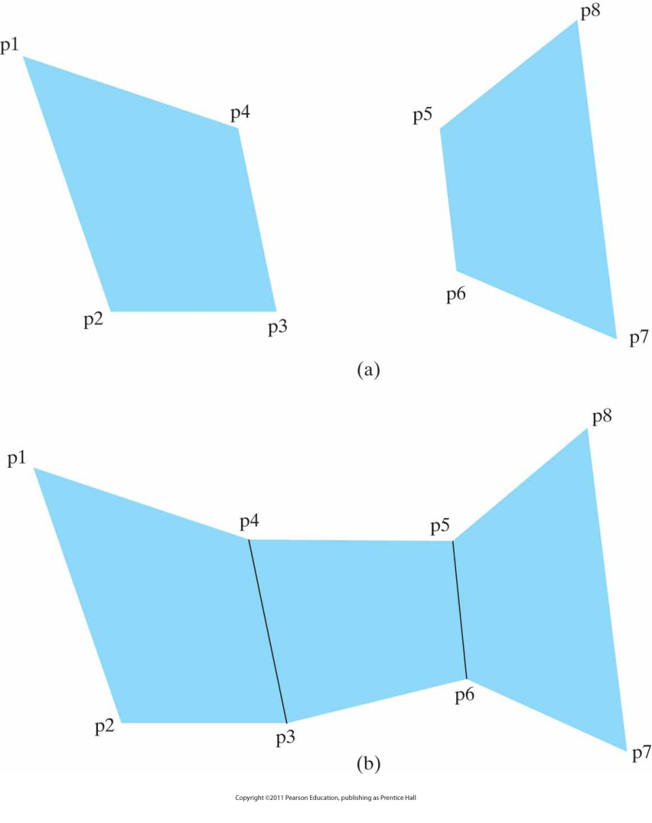
Quadrilateral Fill Areas
Using a list of eight vertex positions. (a) Two unconnected quadrilaterals generated with GL_QUADS. (b) Three connected quadrilaterals generated with GL_QUAD_STRIP.

Slide 61
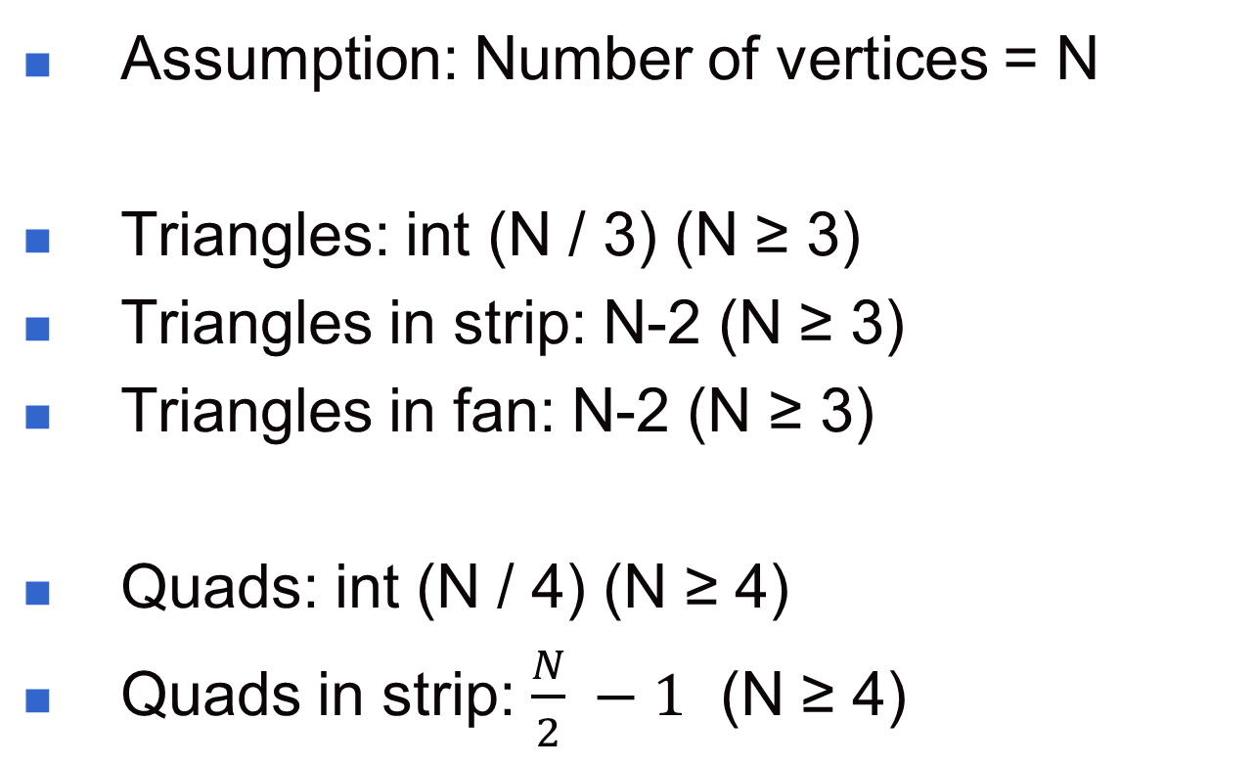
How many objects?

Slide 62
Processing Order
Assumption: Position in vertex list = n
  (n = 1, n = 2, …, n = N-2)
Triangles: Nothing special
Triangles in strip:
  If n odd: n, n + 1, n + 2
  If n even: n + 1, n, n + 2
Triangles in fan: 1, n + 1, n + 2
Quads in strip: 2n – 1, 2n, 2n + 2, 2n +1

Slide 63
Vertex Arrays
We can store a list of points:
  int pt[8][3] = {{0,0,0},{0,1,0},{1,0,0},{1,1,0},
  {0,0,1},{0,1,1},{1,0,1},{1,1,1}};
Above could be used for a cube.
To plot faces can make calls beginning with either glBegin(GL_POLYGON) or glBegin(GL_QUADS)

Slide 64
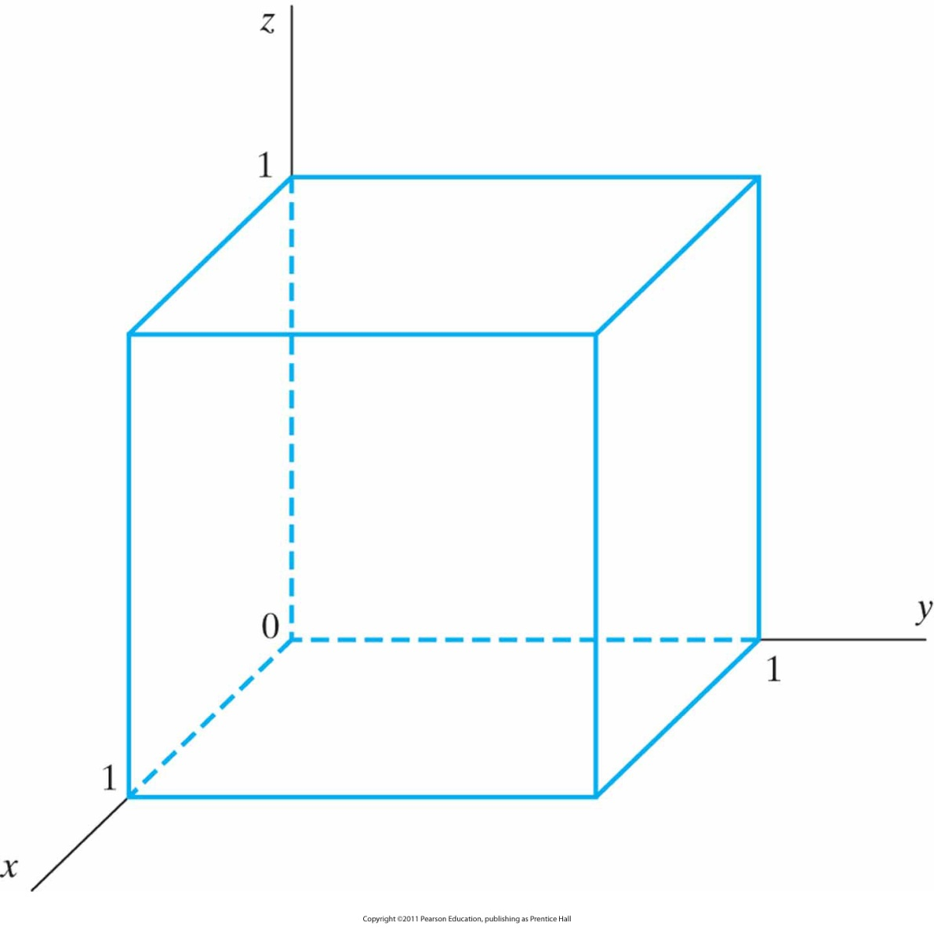
Example: Cube
with an edge length of 1

Slide 65
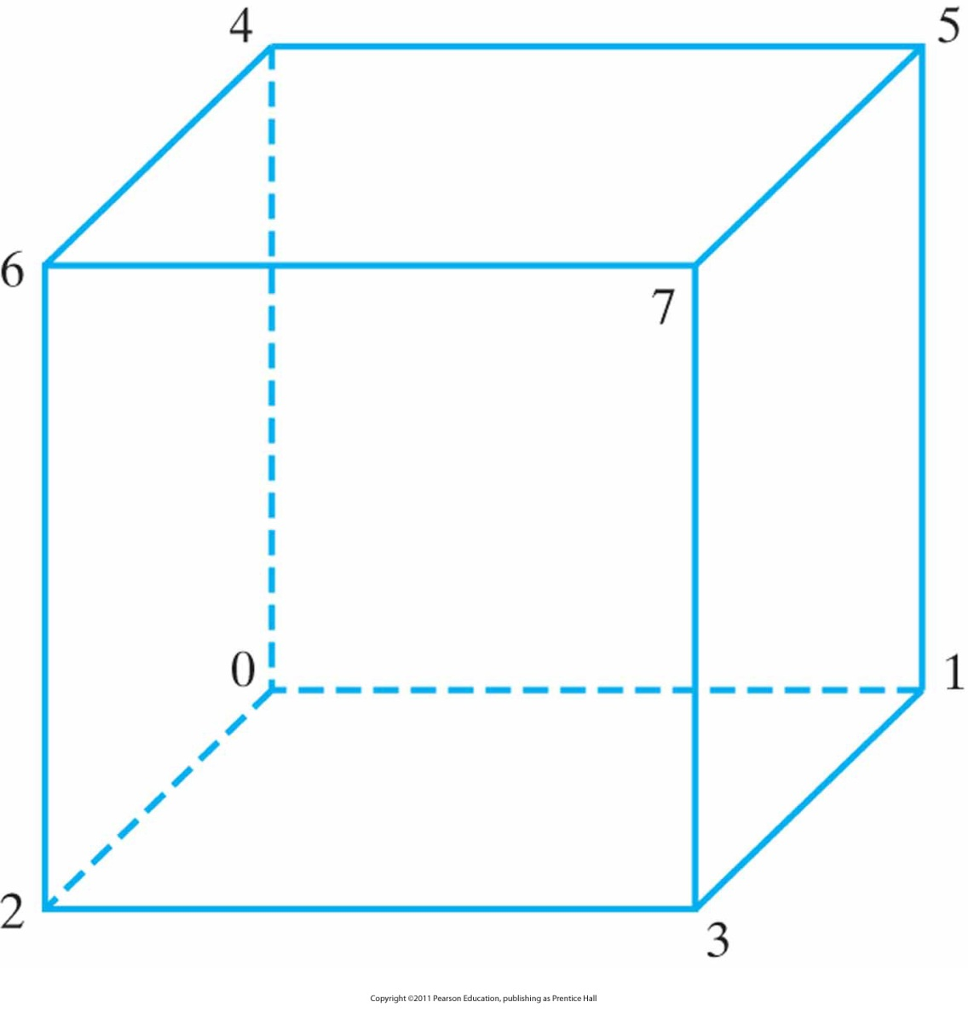
Example: Cube (cont.)
Subscript values for array pt corresponding to the vertex coordinates for the cube shown in Slide 64.

Slide 66
Vertex Arrays (cont.)
void quad(int p1, int p2, int p3, int p4) {
glBegin(GL_QUADS);
glVertex3i( pt[p1][0], pt[p1][1], pt[p1][2] );
glVertex3i( pt[p2][0], pt[p2][1], pt[p2][2] );
glVertex3i( pt[p3][0], pt[p3][1], pt[p3][2] );
glVertex3i( pt[p4][0], pt[p4][1], pt[p4][2] );
glEnd();
}
void cube() {
quad(6,2,3,7);
quad(5,1,0,4);
quad(7,3,1,5);
quad(4,0,2,6);
quad(2,0,1,3);
quad(7,5,4,6);
}
Too many function calls!

Slide 67
Vertex Arrays (cont.)
Use vertex arrays!
General procedure:
  Activate vertex array feature
  Specify location and data for vertex coordinates
  Process multiple primitives with few calls

Slide 68
Vertex Arrays (cont.)
  glEnableClientState(GL_VERTEX_ARRAY); (1)
  glVertexPointer(3,GL_INT,0,pt); (2)
  GLubyte vertIndex[] = {6,2,3,7, 5,1,0,4, 7,3,1,5, 4,0,2,6, 2,0,1,3, 7,5,4,6}; (vertices for cube)
  glDrawElements(GL_QUADS, 24, GL_UNSIGNED_BYTE,vertIndex);
Vertex arrays can be disabled with
  glDisableClientState(GL_VERTEX_ARRAY); (3)

Slide 69
OpenGL Output Primitives
Next slides give a summary of OpenGL output primitive functions and related routines (incl. Pixel-array primitives and Character primitives)
(See also HB p. 102-117)

Slide 70
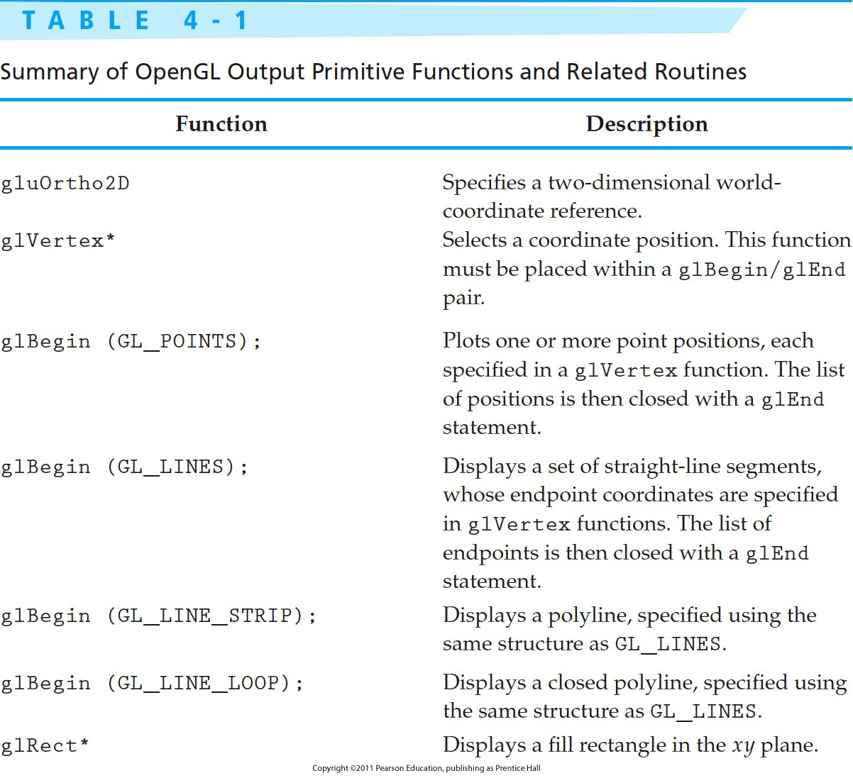
Table 4.1

Slide 71
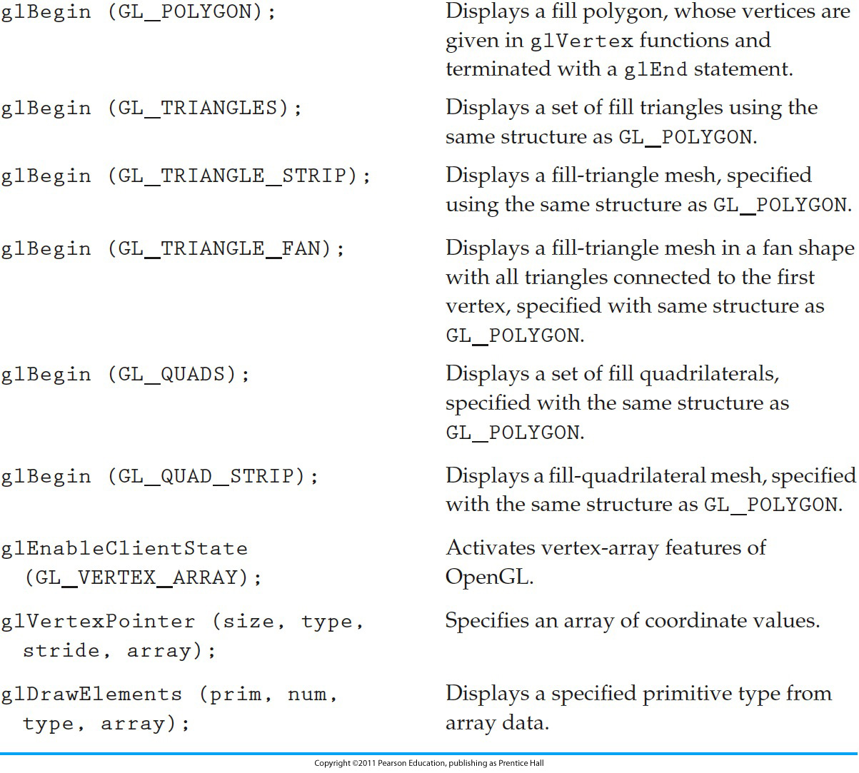
Table 4-1 (cont.)
Notes:
71

Slide 72
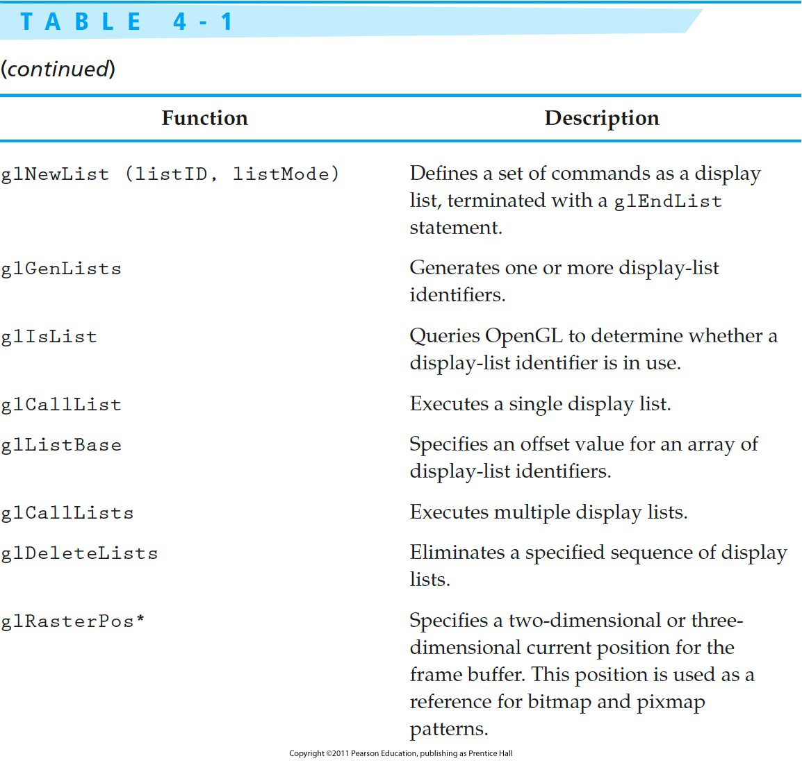
Table 4-1 (cont.)
Notes:
72

Slide 73
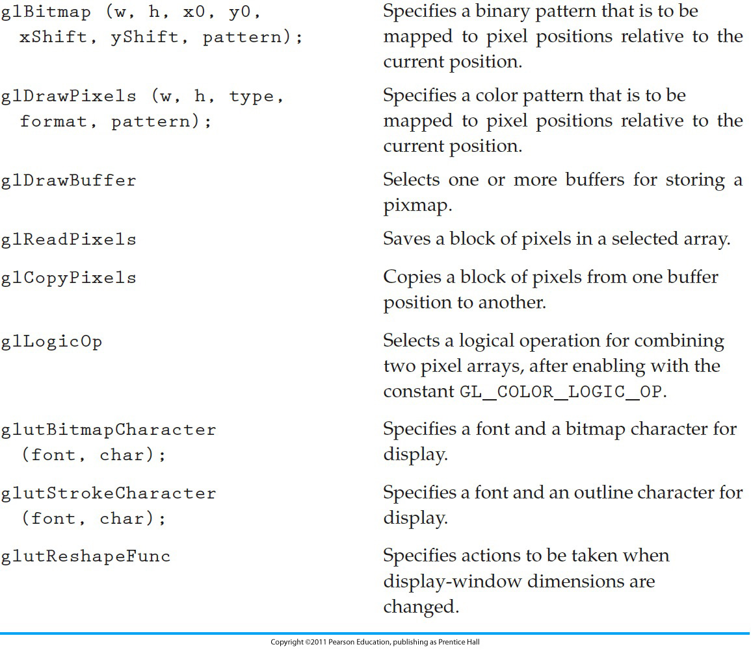
Table 4-1 (cont.)
Notes:
73

Slide 74

Next Lecture
Attributes of Graphics Primitives

Slide 75
References
Donald Hearn, M. Pauline Baker, Warren R. Carithers, “Computer Graphics with OpenGL, 4th Edition”; Pearson, 2011
Sumanta Guha, “Computer Graphics Through OpenGL: From Theory to Experiments”, CRC Press, 2010
Richard S. Wright, Nicholas Haemel, Graham Sellers, Benjamin Lipchak, “OpenGL SuperBible: Comprehensive Tutorial and Reference”, Addison-Wesley, 2010
Edward Angel, “Interactive Computer Graphics. A Top-Down Approach Using OpenGL”, Addison-Wesley, 2005

