Slide 1


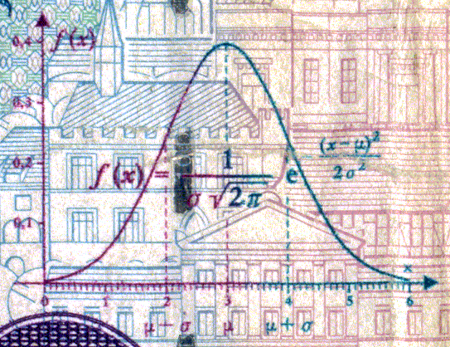
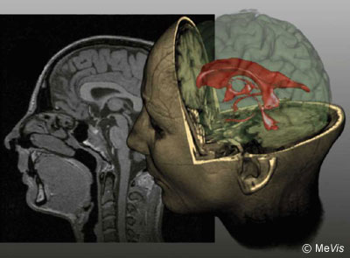
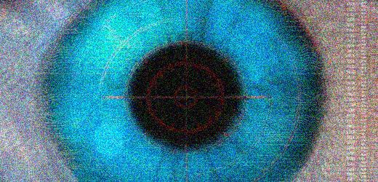
CSE 307
Basics of Image Processing
Lecture #3 Intensity Transformations and Spatial Filtering
Prepared & Presented by Asst. Prof. Dr. Samsun M. BAŞARICI

Slide 2


Objectives
What does it mean to “enhance” an image?
How can image enhancement be achieved using gray-level transformations?
What are the most commonly used gray-level transformations and how can they be implemented using MATLAB?
What is the histogram of an image?
How can the histogram of an image be computed?

Slide 3
Objectives (cont.)
How much information does the histogram provide about the image?
What is histogram equalization and what happens to an image whose histogram is equalized?
How can the histogram be modified through direct histogram specification and what happens to an image when we do it?

Slide 4
Objectives (cont.)
What other histogram modification techniques can be applied to digital images and what is the result of applying such techniques?
What is neighborhood processing and how does it differ from point processing?
What is convolution and how is it used to process digital images?
What is a low-pass linear filter, what is it used for, and how can it be implemented using 2D convolution?

Slide 5
Objectives (cont.)
What is a median filter and what is it used for?
What is a high-pass linear filter, what is it used for, and how can it be implemented using 2D convolution?

Slide 6
Spatial Domain
The term spatial domain refers to the image plane.
Methods based on spatial domain process are the direct manupulation of pixel positions in an image.
Intensity transformation and spatial filtering are two important spatial processing

Slide 7
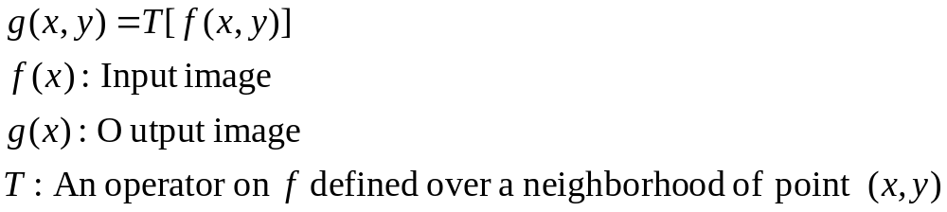
Background
Intensity transformations and spatial filtering:
  The spatial domain process:
This procedure is called spatial filtering

Slide 8
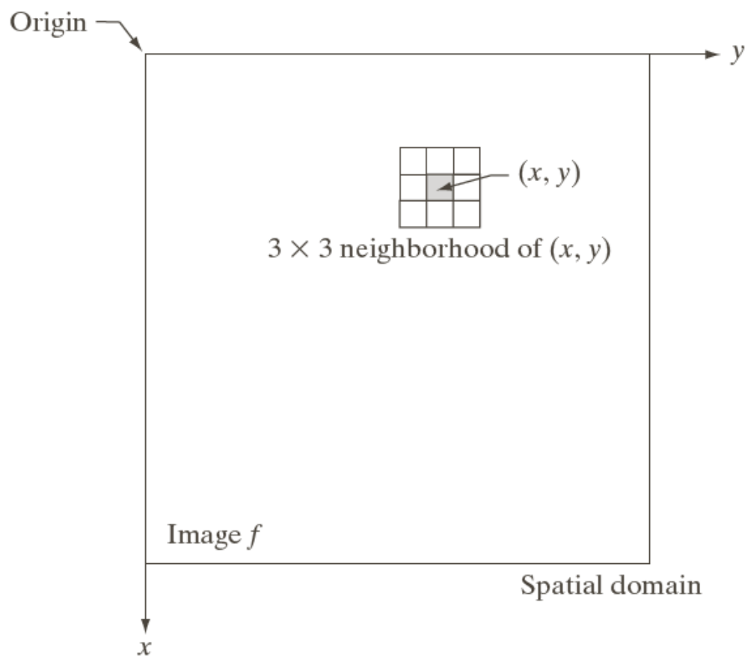
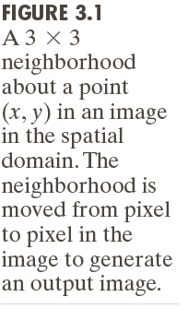
Background (cont.)
T is applied to neighboring pixels to yield the output at that location

Slide 9
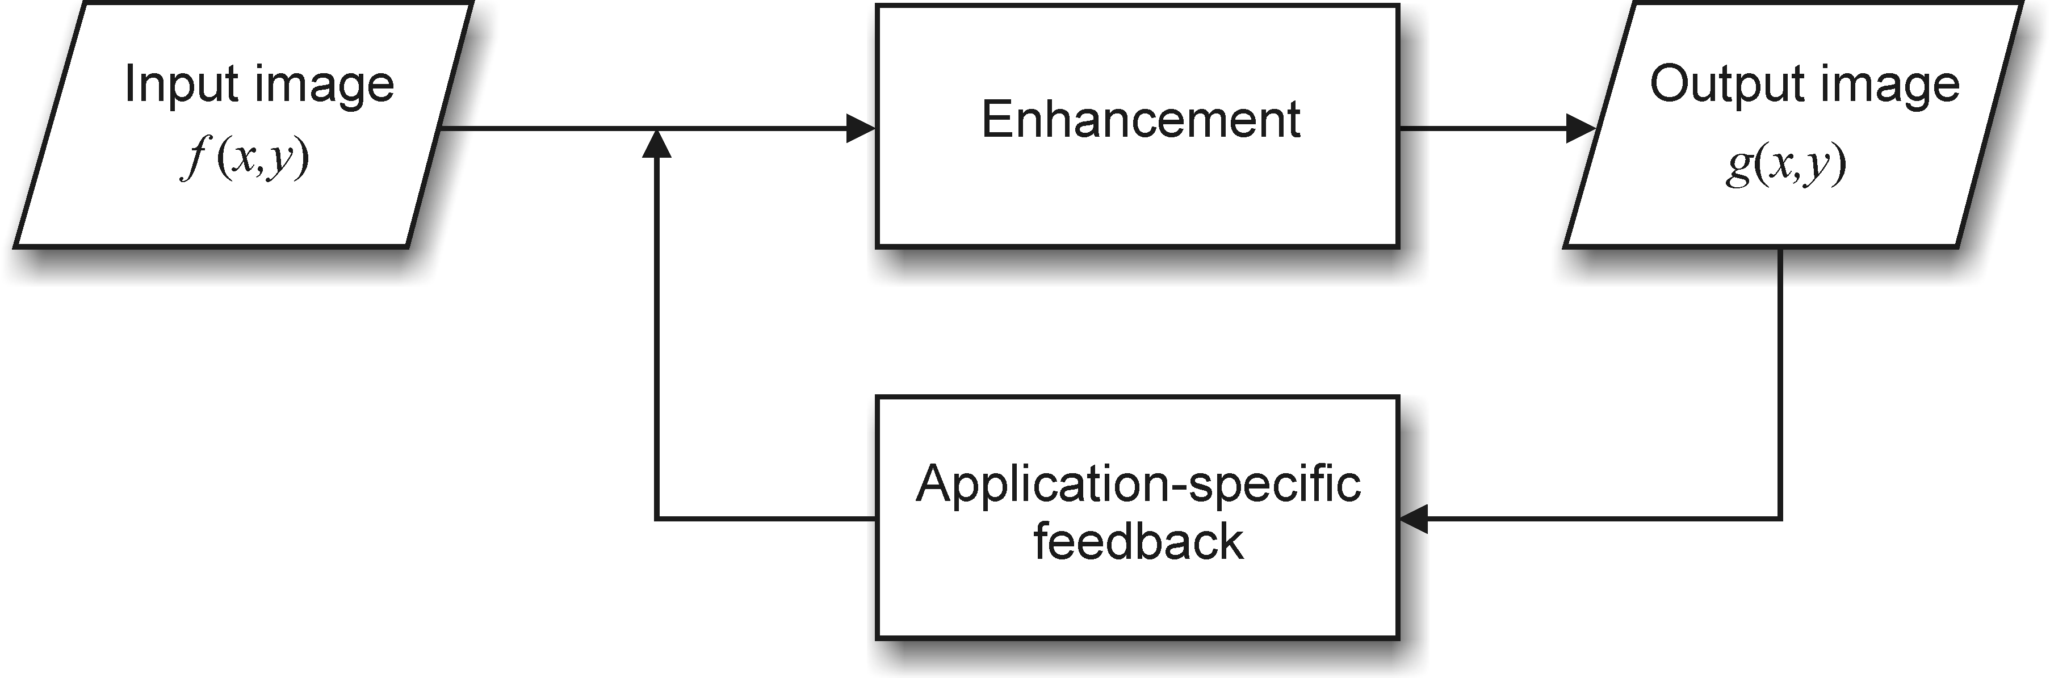
The image enhancement process

Slide 10
Image enhancement
Goals:
  to improve the subjective quality of an image for human viewing; (an image needs improvement)
  to modify the image in such a way as to make it more suitable to further analysis and automatic extraction of its contents. (low-level features must be detected)
Usually:
  Goal-specific
  Interactive
  Subjective

Slide 11


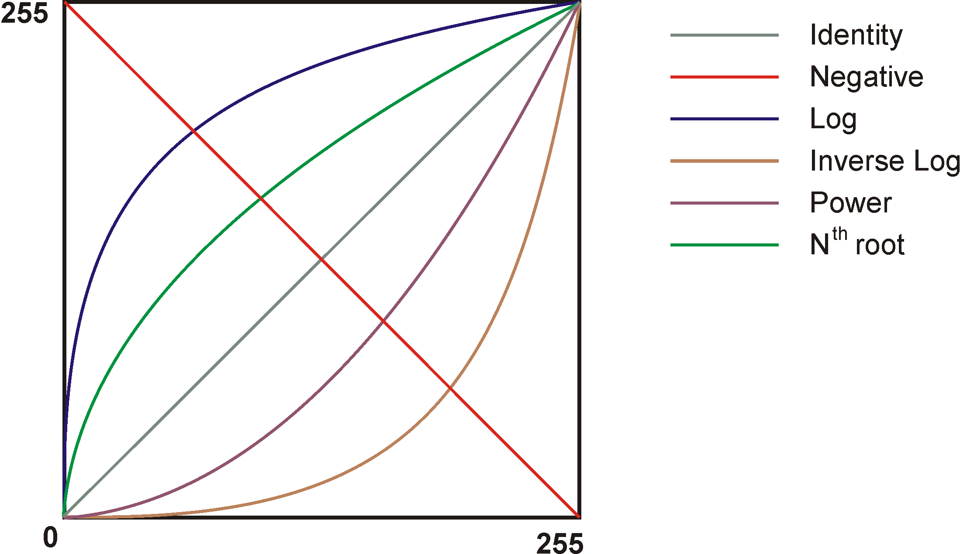
Some intensity transformation functions
Different types of the transformation function chosen yields different output.

Slide 12
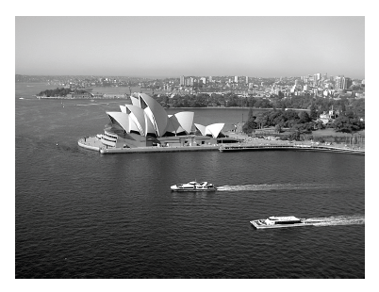

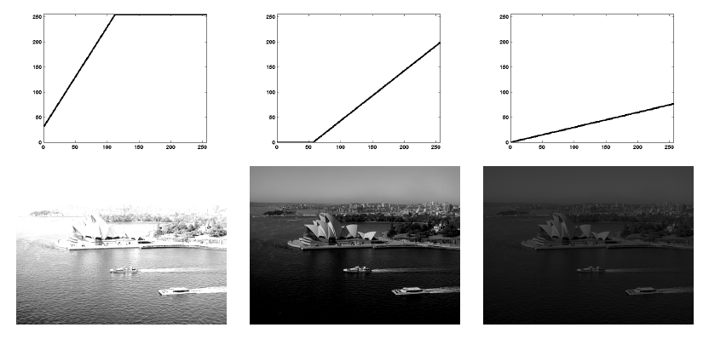
Linear Point Transformations
c = 1
b = -56
c = 0.3
b = 0
c = 2
b = 32

Slide 13
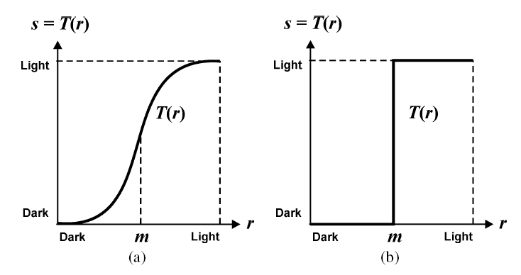
Examples of Point Transformations
Contrast manipulation

Slide 14

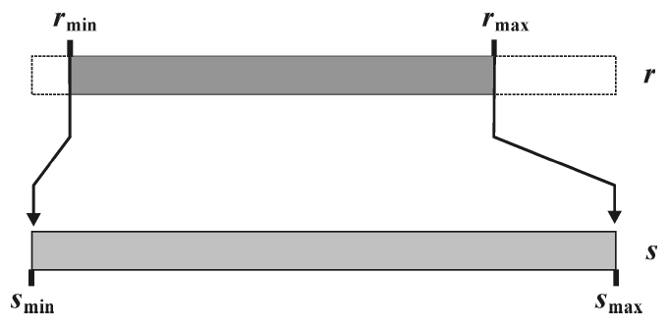
Examples of Point Transformations (cont.)
Auto-contrast

Slide 15
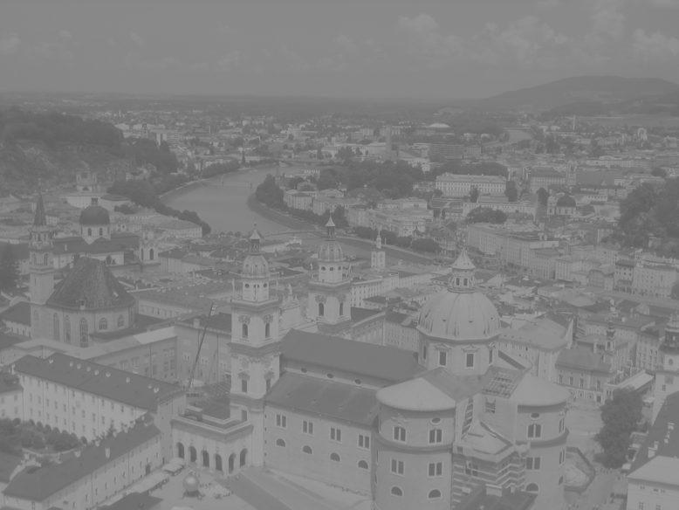

Examples of Point Transformations (cont.)
Auto-contrast example
I = imread('salzburg_before.png');
f = double(I);
fmin = min(min(f))
fmax = max(max(f))
g = uint8(255*(f-fmin)/(fmax-fmin));
imshow(g)

Slide 16
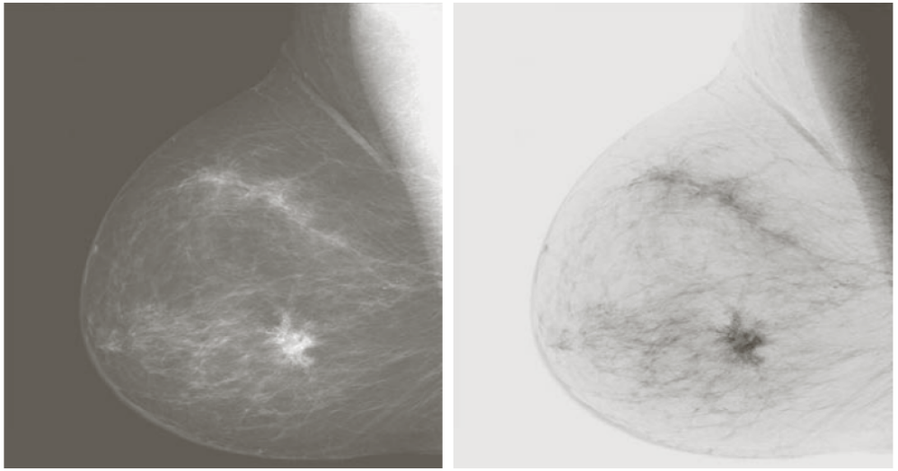
Image negatives
Suppose that the intensity level is given in the range [0,L-1].
The negative of an image is obtained by the expression s=L-1-r
Original digital mammogram
Negative image

Slide 17
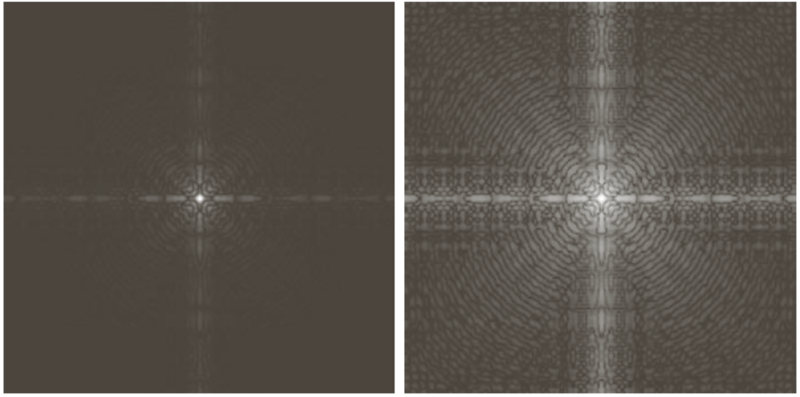
Log transformation
The general form of log transformation is s=clog(1+r) where c is a constant.
Fourier spectrum
log with c=1, i.e. s=log(1+r)

Slide 18

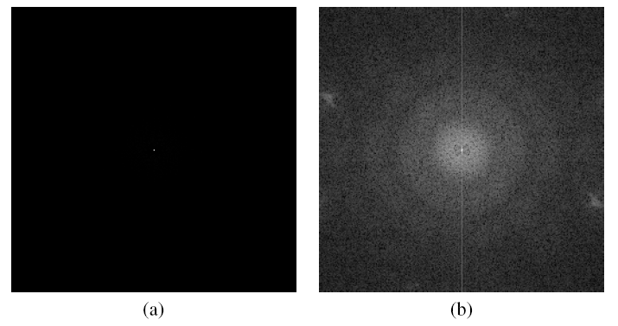
Log transformation (cont.)
Example:

Slide 19
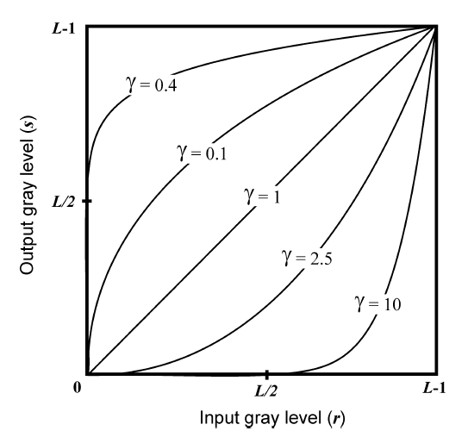

Power-law (gamma) transformations
The general form of gamma (or power-law) transformation is s=cr^{γ} where c is a constant.

Slide 20
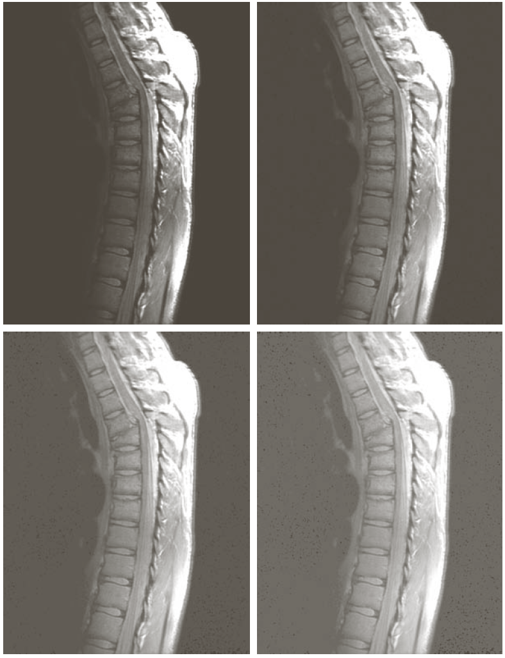
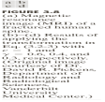
Gamma transformation (cont.)
MRI of a fractured human spine
Results of the transformation s=r^{γ} with
γ = 0.6
γ = 0.4
γ = 0.3

Slide 21
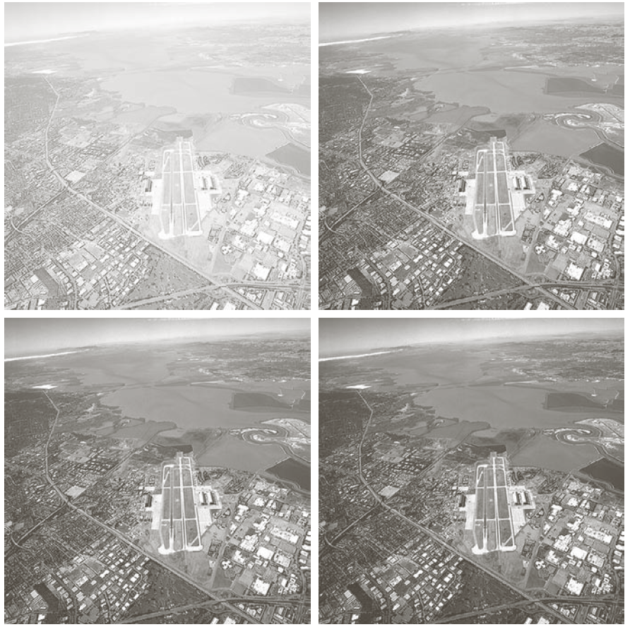
Gamma transformation (cont.)
Aerial image
Results of the transformation s=r^{γ} with
γ = 3.0
γ = 4.0
γ = 5.0

Slide 22
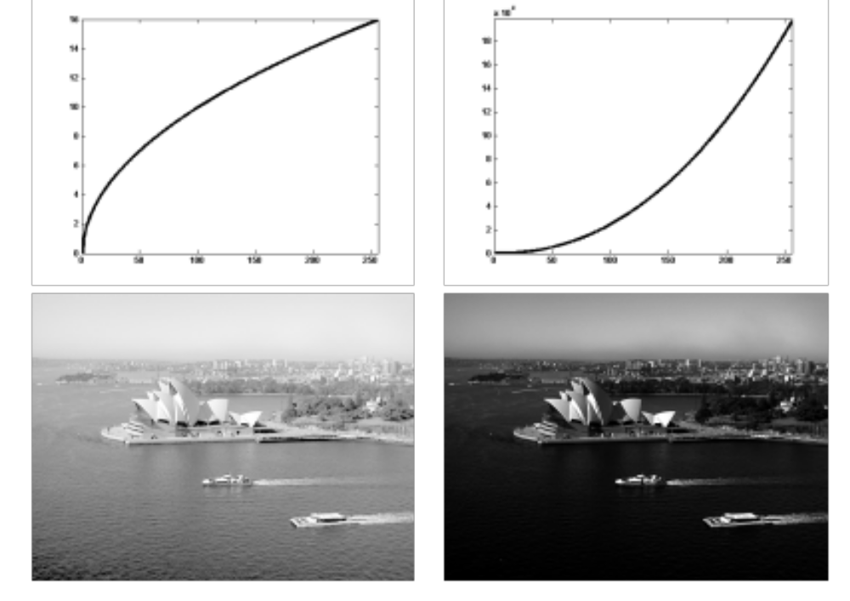
Gamma correction
Example:

Slide 23
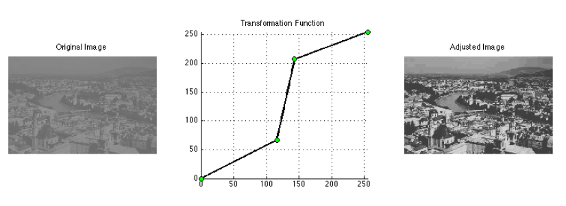
Piecewise-linear transformations
Contrast stretching
Intensity-level slicing
Bit-plane slicing
Example:

Slide 24
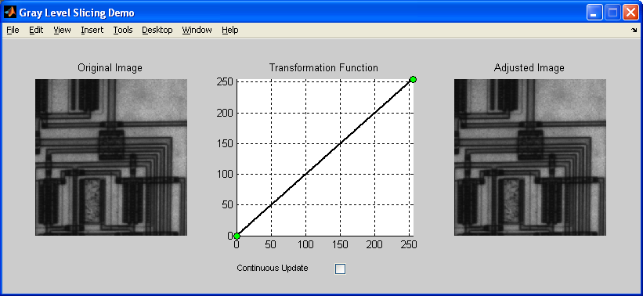
Practical Point Transformations
Specifying point transformations interactively
  glsdemo

Slide 25
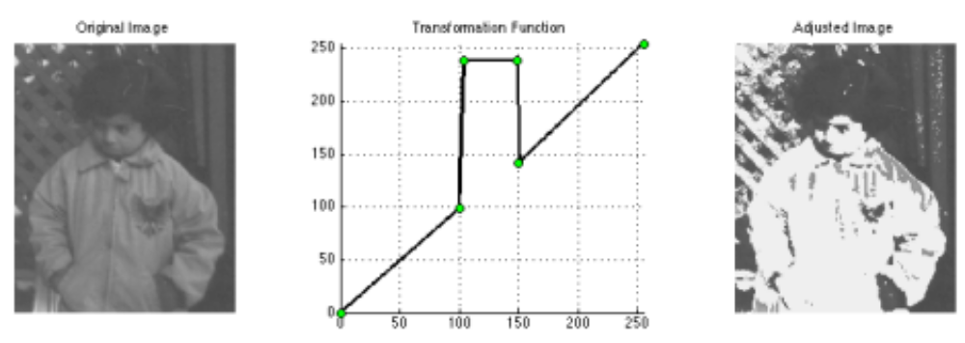
Practical Point Transformations (cont.)
Specifying point transformations interactively
  glsdemo example

Slide 26
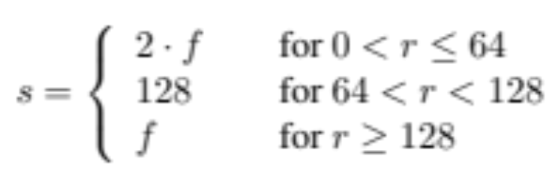
Using look-up tables (LUTs)
For images of type uint8 (i.e., monochrome images with 256 gray levels), the LUT will consist of a 1D array of length 256.
  LUTs can be easily implemented in MATLAB.
Example 8.5 (PIVPUM):
% Building the LUT
LUT = uint8(zeros([1 256]));
LUT(1:65) = 2*(0:64);
LUT(66:129) = 128;
LUT(130:256) = (130:256)-1;
% Applying the LUT to a 3-by-3 test image
A = uint8([20 40 0; 178 198 64; 77 128 1])
B = intlut(A, LUT)

Slide 27
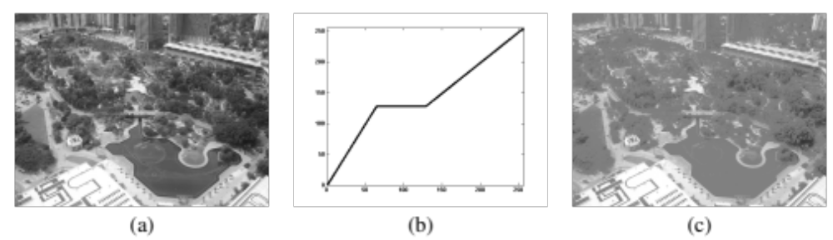
Using LUTs on a real image
Example 8.5 (cont.):

Slide 28
Nonlinear transformation using LUTs
Example 8.6 (PIVPUM):
% Without a LUT
I = imread('klcc_gray.png');
tic
I2 = double(I);
J = 5*sqrt(I2);
O = uint8(J);
toc
subplot(1,2,1), imshow(I), subplot(1,2,2), imshow(O)
% With a LUT
I = imread('klcc_gray.png');
tic
LUT = double(zeros([1 256]));
LUT(1:256) = 5 * sqrt(0:255);
LUT_int8 = uint8(LUT);
O = intlut(I, LUT_int8);
toc
figure, subplot(1,2,1), imshow(I), subplot(1,2,2), imshow(O)

Slide 29
What is a histogram?
The histogram of a monochrome image is a graphical representation of the frequency of occurrence of each gray level in the image.
The data structure that stores the frequency values is a 1D array of numerical values, h, whose individual elements store the number (or percentage) of image pixels that correspond to each possible gray level.

Slide 30




What is a histogram? (cont.)
Definition PIVPUM

Slide 31
Histogram processing
We can obtain histogram of an MxN image with intensity levels in the range [0, L-1] by defining a discrete function h(r_{k})=n_{k}
where r_{k} is the kth intensity value and n_{k} is the number of pixels having the intensity r_{k}.
Commonly, the normalized form of the above function is used. In this case we have the probability function as
p(r_{k})=n_{k} /(MN ), k=0,1,2, ..., n

Slide 32
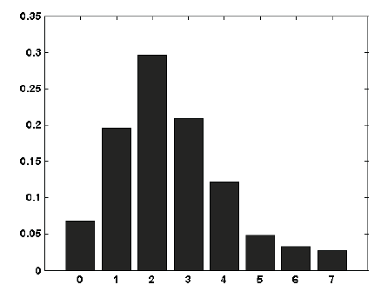
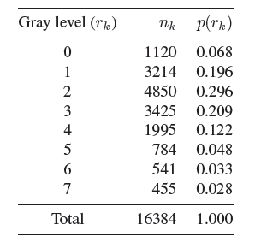
Histogram examples
Example:histogram for a hypothetical image containing 128×128 pixels and 8 gray levels.

Slide 33
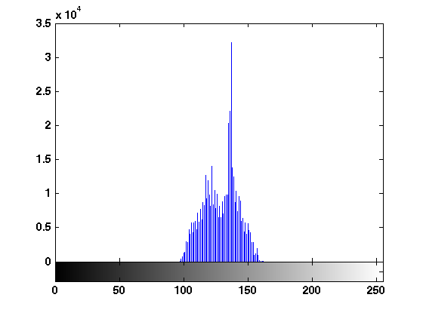
Histogram examples (cont.)
In MATLAB: imhist

Slide 34
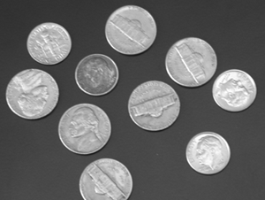
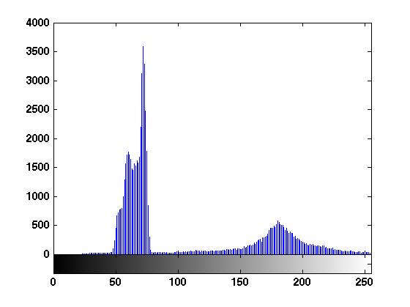
Histogram examples (cont.)

Slide 35
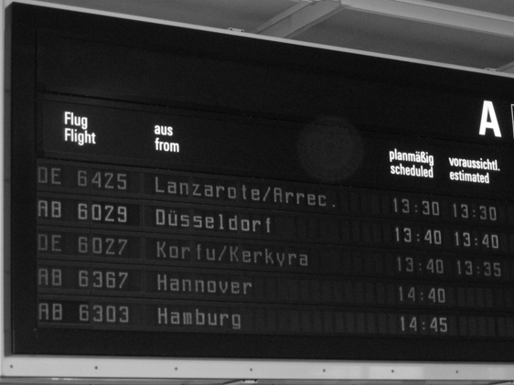
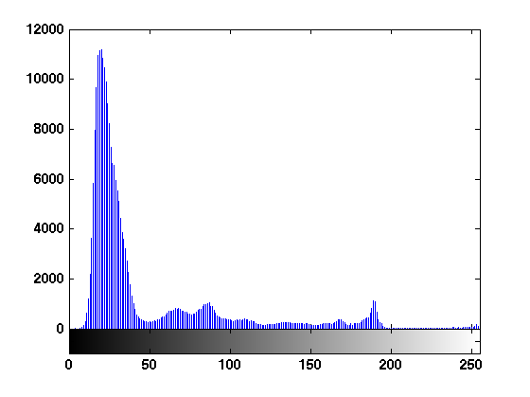
Histogram examples (cont.)

Slide 36
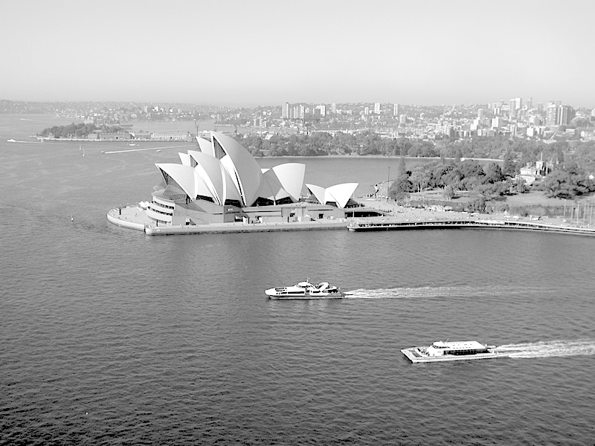
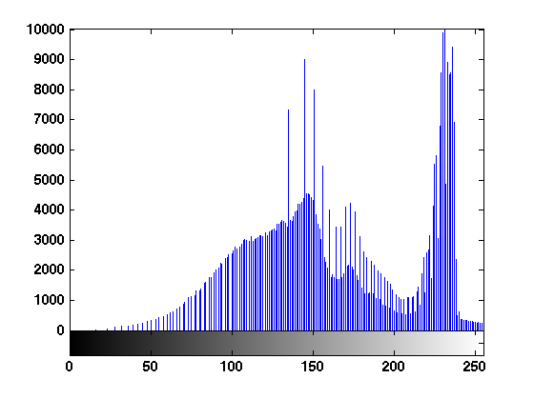
Histogram examples (cont.)

Slide 37
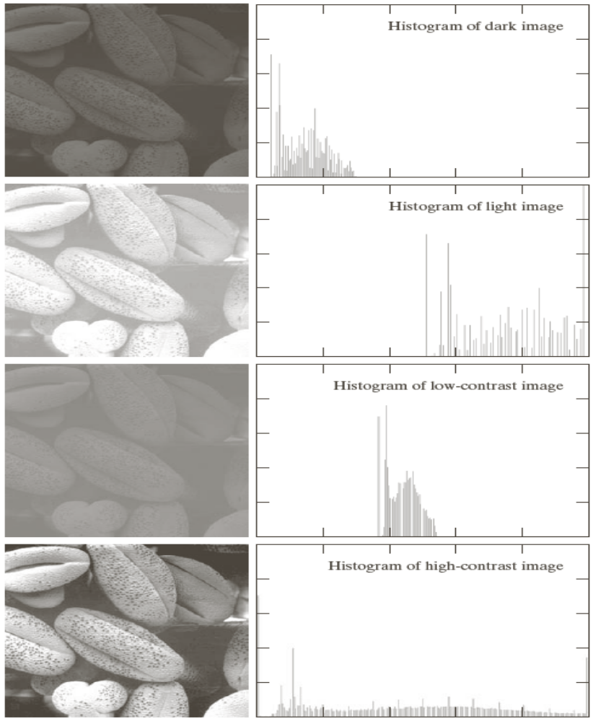
Histogram examples (cont.)

Slide 38
Interpreting image histograms
Histograms have become a popular tool for conveying image statistics and helping determine certain problems in an image.
A histogram carries significant qualitative and quantitative information about the corresponding image (e.g., minimum, average, and maximum gray level values, dominance of bright or dark pixels, etc.).
A histogram is not enough to draw qualitative conclusions about the overall quality of the image, presence or absence of noise, etc.

Slide 39
Interpreting image histograms (cont.)
Although a histogram provides the frequency distribution of gray levels in an image, it tells us nothing about the spatial distribution of the pixels whose gray levels are represented in the histogram.
Histograms can be used whenever a statistical representation of the gray level distribution in an image is desired.
Histograms can also be used to enhance or modify the characteristics of an image, particularly its contrast.

Slide 40
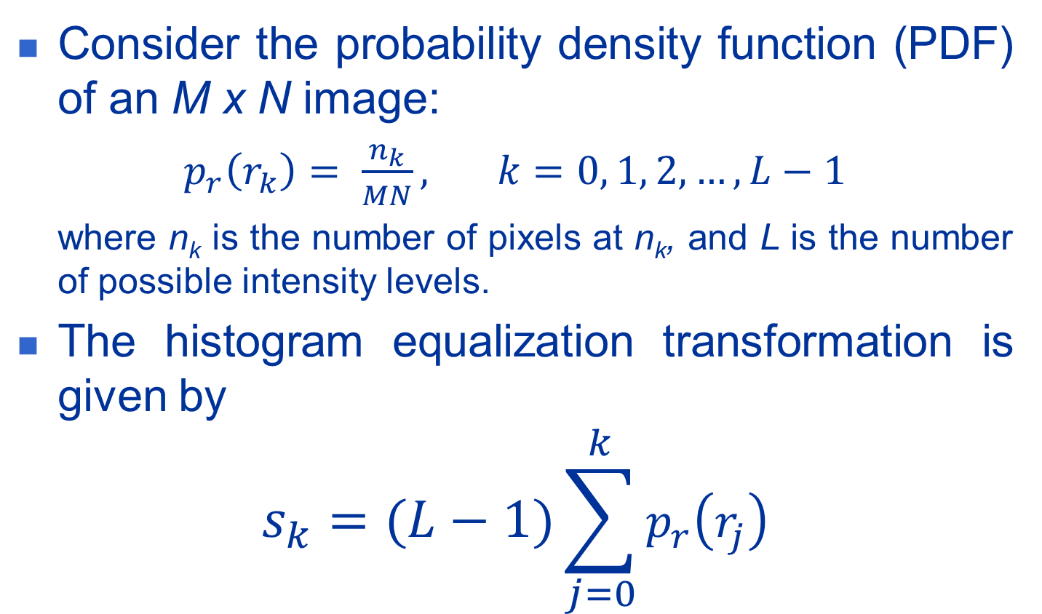
Histogram equalization
Consider the probability density function (PDF) of an M x N image:
$p_{r}\left(r_{k}\right)= \frac{n_{k}}{MN}, k=0, 1, 2, …, L−1$
  where n_{k} is the number of pixels at n_{k}, and L is the number of possible intensity levels.
The histogram equalization transformation is given by
$$s_{k}=(L−1)\sum_{j=0}^{k}{p_{r}\left(r_{j}\right)}$$

Slide 41
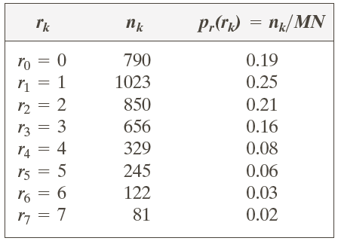
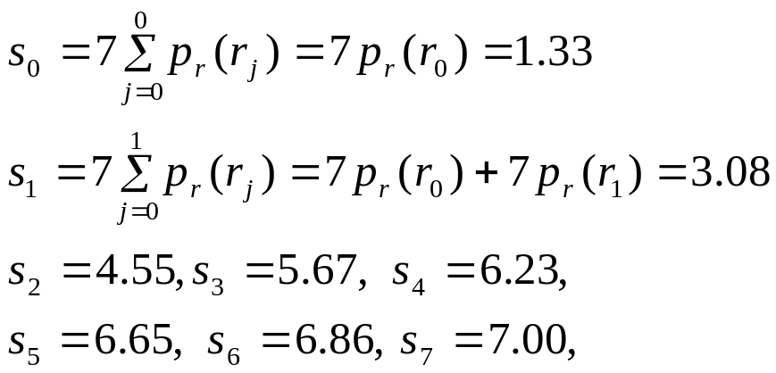
Histogram equalization (cont.)
Example:
  Suppose that for an image L = 8, M = N = 64 and the corresponding intensity distribution is as follows:
Intensity distribution and histogram values for 3-bit 64x64image

Slide 42
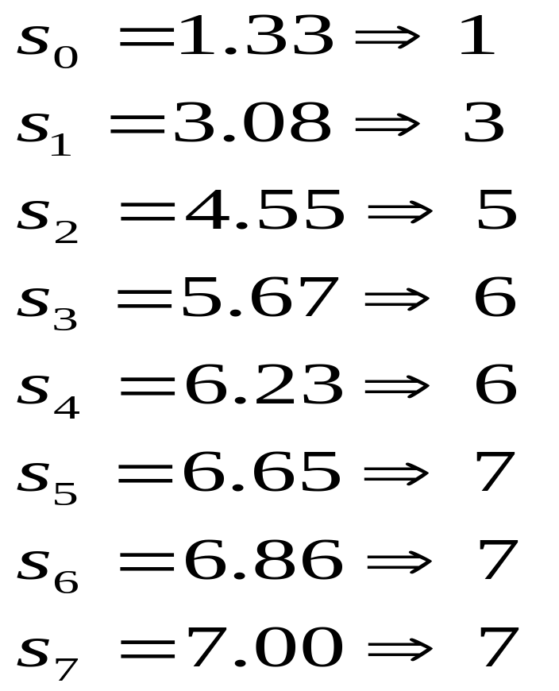
Histogram equalization (cont.)
The histogram equalized values are:

Slide 43
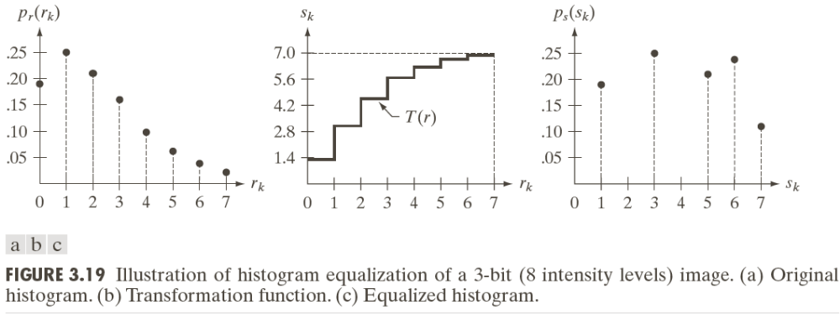
Histogram equalization (cont.)
From DIP:

Slide 44
Histogram equalization (cont.)
In MATLAB: histeq
Example 9.4 (PIVPUM):
I = imread('sydney_low_contrast.png');
I = im2double(I);
J = histeq(I);
figure, subplot(2,2,1), imshow(I), ...
subplot(2,2,2), imshow(J), ...
subplot(2,2,3), imhist(I), ylim('auto'),...
subplot(2,2,4), imhist(J), ylim('auto')

Slide 45
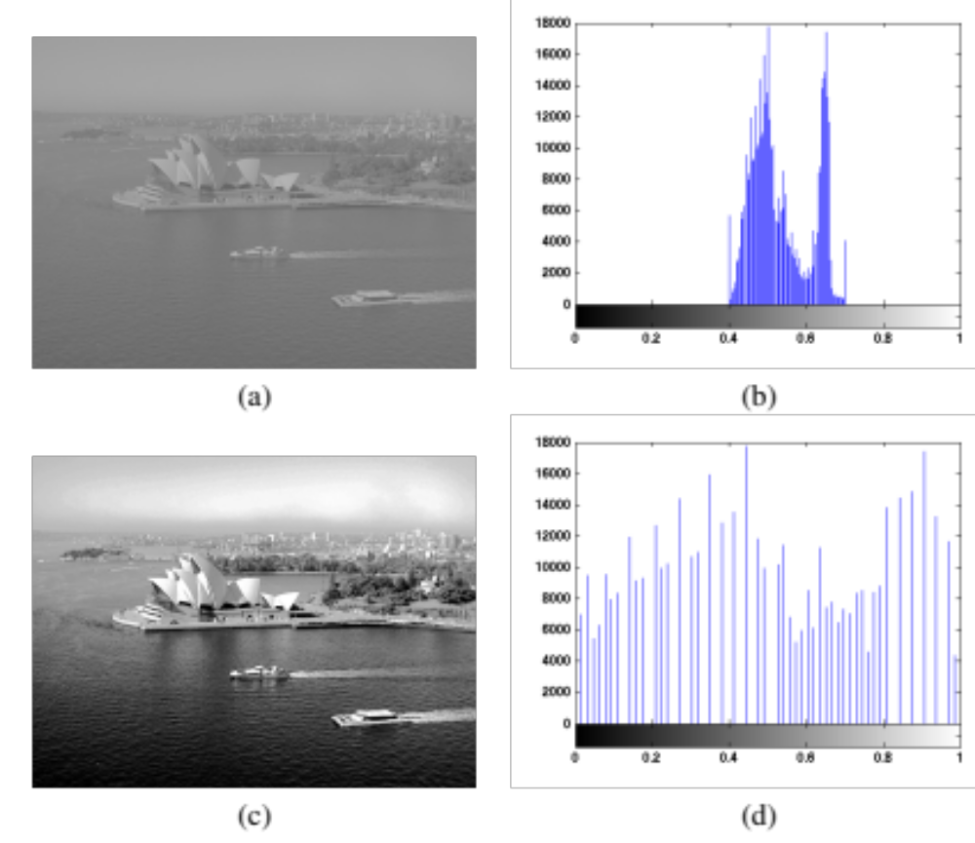
Histogram equalization (cont.)
Example 9.4 (cont.):

Slide 46
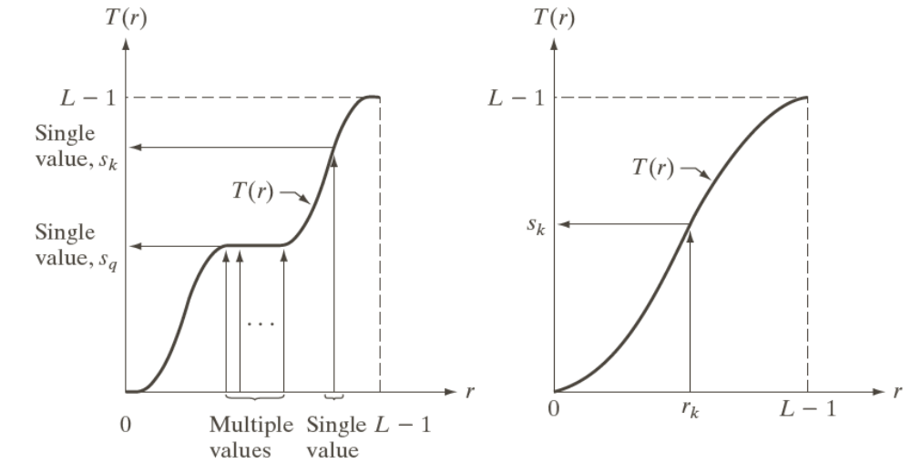
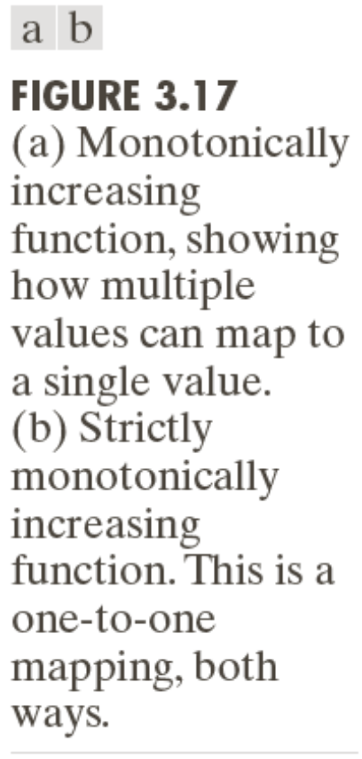
Increasing functions

Slide 47
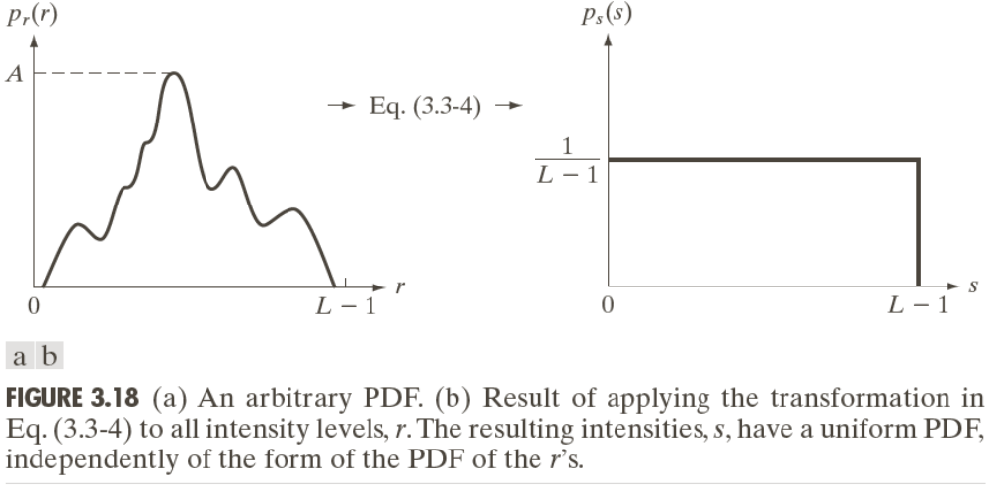

Histogram equalization (cont.)
Remember:
  Cumulative distribution function CDF
$$s=T\left(r\right)=(L−1)\int_{0}^{r}{p_{r}\left(w\right)dw}$$
CDF
CDF

Slide 48
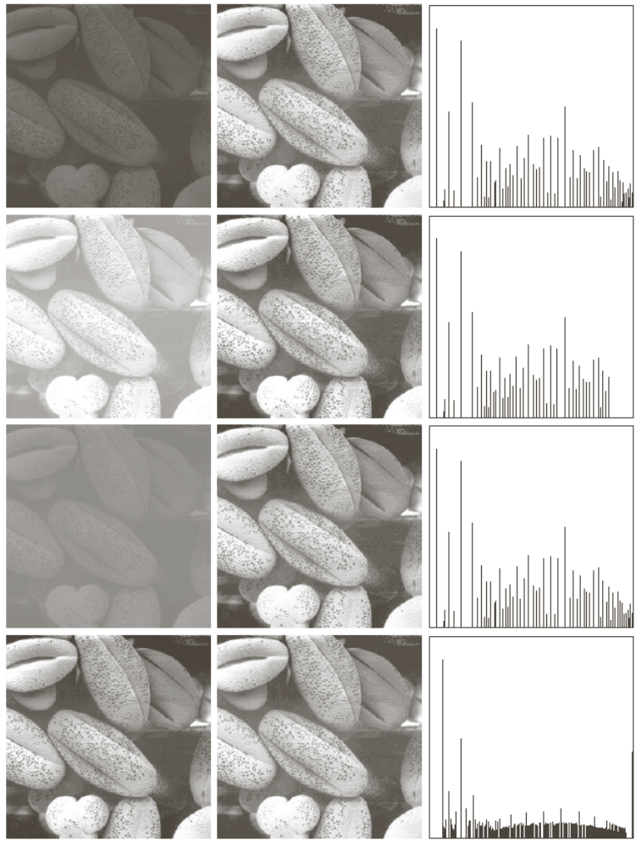
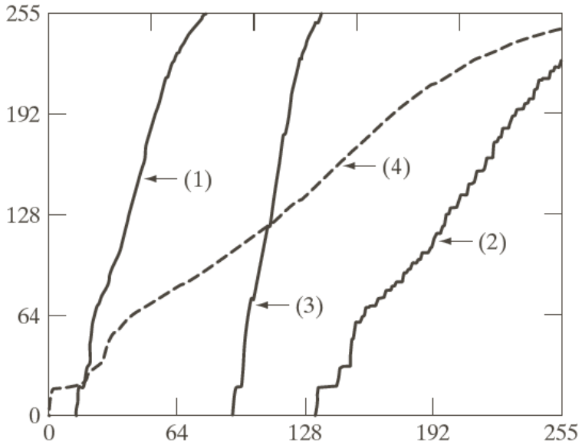
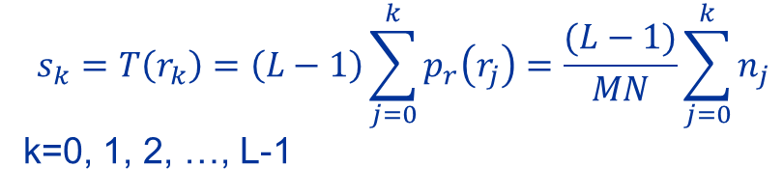
Transformation functions for histogram equalization. Transformations (1) through (4) were obtained from images using
$$s_{k}=T\left(r_{k}\right)=\left(L−1\right)\sum_{j=0}^{k}{p_{r}\left(r_{j}\right)}=\frac{(L−1)}{MN}\sum_{j=0}^{k}{n_{j}}$$
k=0, 1, 2, …, L-1
Left column: Original images
Center column: corresponding histogram equalized images
Right column: histograms of the images in the center column

Slide 49
Global vs. local histogram equalization
In MATLAB: histeq and adapthisteq
Example 9.5 (PIVPUM):
I = imread('coins.png');
figure, subplot(1,2,1), imshow(I), ...
subplot(1,2,2), imhist(I), ylim('auto')
J = histeq(I);
figure, subplot(1,2,1), imshow(J), ...
subplot(1,2,2), imhist(J), ylim('auto')
K = adapthisteq(I);
figure, subplot(1,2,1), imshow(K), ...
subplot(1,2,2), imhist(K), ylim('auto')

Slide 50
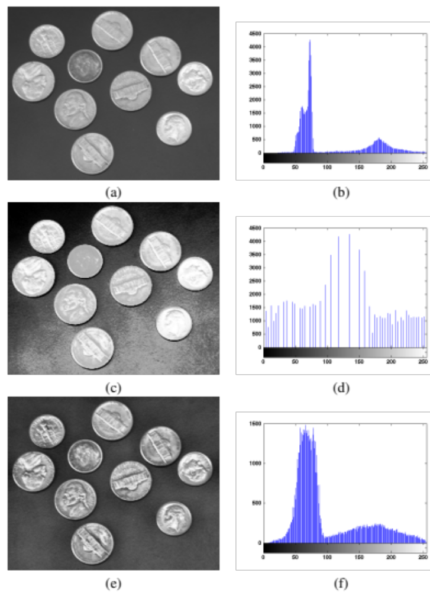
Global vs. local histogram equalization (cont.)
Example 9.5 (cont.):

Slide 51
Histogram matching
Histogram equalization is based on producing an image that has uniformly distributed intensities.
In some cases uniform distribution may not be the best choice. Alternatively we may want to transform an image to another one that has a specified distribution (i.e. Normal distribution).

Slide 52
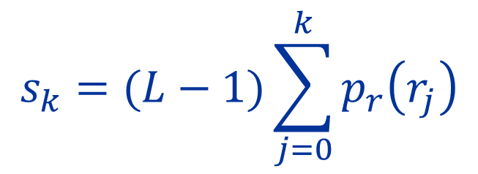

Histogram matching (cont.)
As in the histogram equalization first we obtain the cumulative probabilities as
$$p_{r}\left(r_{k}\right)=\frac{n_{k}}{MN}, k=0, 1, 2, …, L−1$$
    where n_{k} is the number of pixels at n_{k}, and L is the number of possible intensity levels.
$$s_{k}=(L−1)\sum_{j=0}^{k}{p_{r}\left(r_{j}\right)}$$

Slide 53

Histogram matching (cont.)
Next we define the specified CDF (multiplied by L-1) by
$$G\left(z_{q}\right)=(L−1)\sum_{i=0}^{q}{p_{z}(z_{i})}$$
The histogram matching transfromation is given by $G\left(z_{q}\right)=s_{k}$
    where G is the CDF of the specified distribution and $s_{k}$ is the uniformly distributed intensity level to be transformed.
Thus the solution for $z_{q}$ is given by
$$z_{q}= G^{−1}(s_{k})$$

Slide 54


Histogram matching: An example
From the previous examples the histogram equalized values were found to be
Suppose that the specified histogram is given as in the table and the actual histogram is shown in the last column of the table.

Slide 55

Histogram matching: An example (cont.)
In the next step we compute the transformation function values

Slide 56

Histogram matching: An example (cont.)
All possible values of the transfromation function G scaled, rounded, and ordered with respect to z.

Slide 57


Histogram matching: An example (cont.)
In the final step we find the mappings from s to z.
  For example $s_{0}=1$ and ${G(z}_{3})=1$ which implies that $z_{3}=G^{−1}\left(s_{0}\right)=G^{−1}\left(1\right)=3$. Other mappings are shown below.

Slide 58

Histogram matching: An example (cont.)
Histogram Equalization
Histogram Matching
r_{k} | n_{k} | p_{r}(r_{k}) | CumulDistr. | (L-1) xCD | s_{k}
r₀=0 | 790 | 0.00 | 0.19 | 1.33 | 1
r₀=1 | 1023 | 0.25 | 0.44 | 3.08 | 3
r₀=2 | 850 | 0.21 | 0.65 | 4.55 | 5
r₀=3 | 656 | 0.16 | 0.81 | 5.67 | 6
r₀=4 | 329 | 0.08 | 0.89 | 6.23 | 6
r₀=5 | 245 | 0.06 | 0.95 | 6.65 | 7
r₀=6 | 122 | 0.03 | 0.98 | 6.86 | 7
r₀=7 | 81 | 0.02 | 1.00 | 7.00 | 7
Total | 4096 | 1.00 | - | - | -
z_{q} | p_{z}(z_{q}) | CumulDistr. | (L-1) xCD | s’_{k}
z₀=0 | 0.00 | 0.00 | 0.00 | 0
z₀=1 | 0.00 | 0.00 | 0.00 | 0
z₀=2 | 0.00 | 0.00 | 0.00 | 0
z₀=3 | 0.15 | 0.15 | 1.05 | 1
z₀=4 | 0.20 | 0.35 | 2.45 | 2
z₀=5 | 0.30 | 0.65 | 4.55 | 5
z₀=6 | 0.20 | 0.85 | 5.95 | 6
z₀=7 | 0.15 | 1.00 | 7.00 | 7
Total | 1.00 | - | - | -

Slide 59


Histogram matching (cont.)

Slide 60


Histogram matching (cont.)

Slide 61


Histogram matching (cont.)

Slide 62


Direct histogram specification
Example 9.6 (PIVPUM):
Original Desired Result

Slide 63
Direct histogram specification
In MATLAB: histeq
Example 9.7:
I = imread('sydney_low_contrast.png');
Id = im2double(I);
figure, imhist(Id), ylim('auto'), ...
title ('Original histogram');
des_hist = uint8(zeros(1,256));
des_hist(1:128) = linspace(256,0,128);
des_hist(129:end) = linspace(0,256,128);
x_axis = 0:255;
figure, bar(x_axis, des_hist), axis tight, ...
title('Desired histogram');
hgram = im2double(des_hist);
Jd = histeq(Id,hgram);
figure, imhist(Jd), ylim('auto'), ...
title ('Resulting histogram');

Slide 64

Direct histogram specification (cont.)
Example 9.7 (PIVPUM):

Slide 65

Direct histogram specification (cont.)
Interactive histogram matching tool (ihmdemo)

Slide 66

Other histogram modification techniques
Histogram sliding (Example 9.8 PIVPUM):

Slide 67
Histogram sliding
In MATLAB: imadd and imsubtract
Example 9.8:
I = imread('schonbrunn_gray_low_contrast.png');
figure, imhist(I), ylim('auto'), title ('Original histogram');
I2 = imadd(I, 50);
figure, imhist(I2), ylim('auto'), ...
title ('Sliding to the right by 50');
I3 = imsubtract(I,50);
figure, imhist(I3), ylim('auto'), ...
title ('Sliding to the left by 50');

Slide 68


Other histogram modification techniques
Histogram stretching (Example 9.9 PIVPUM):

Slide 69


Other histogram modification techniques (cont.)
Histogram shrinking (Example 9.10 PIVPUM):

Slide 70
Histogram stretching and shrinking
In MATLAB: imadjust
%% Histogram stretching
I = imread('schonbrunn_gray_low_contrast.png');
figure, imhist(I), ylim('auto'), title ('Original histogram');
I2 = imadjust(I);
figure, imhist(I2), ylim('auto'), title ('After histogram stretching');
figure, subplot(1,2,1), imshow(I), subplot(1,2,2), imshow(I2)
%% Histogram shrinking
I = imread('schonbrunn_gray.png');
figure, imhist(I), ylim('auto'), title ('Original histogram');
Id = im2double(I);
Jd = imadjust(Id, [], [49/255 140/255]);
J = uint8(255.*Jd);
figure, imhist(J), ylim('auto'), title ('After histogram shrinking');
figure, subplot(1,2,1), imshow(I), subplot(1,2,2), imshow(J)

Slide 71
Spatial filtering
Spatial filtering is one of the tools that have been widely used in image processing.
The term filtering refers to accepting or rejecting certain frequency component in the image.
  Low pass filter: Filter that passes low frequencies only. It blurs (smoothes) an image.

Slide 72
Spatial filtering: The mechanics
A spatial filter consists of
  Neighbourhood (a small rectangle)
  A predefined operation
A filter is called a linear spatial filter if the corresponding operation performed on the image pixels is linear.
Otherwise it is called a non-linear spatial filter.

Slide 73

Spatial filtering: The mechanics (cont.)

Slide 74
Neighborhood processing
Main steps:
  Define a reference point in the input image, f(x₀, y₀).
  Perform an operation that involves only pixels within a neighborhood around the reference point in the input image.
  Apply the result of that operation to the pixel of same coordinates in the output image, g(x₀, y₀).
  Repeat the process for every pixel in the input image.

Slide 75

Neighborhood processing
(linear filtering)

Slide 76
Neighborhood processing (cont.)
Linear filters: where the resulting output pixel is computed as a sum of products of the pixel values and mask coefficients in the pixel's neighborhood in the original image.
  Example: mean filter
Nonlinear filters: where the resulting output pixel is selected from an ordered (ranked) sequence of pixel values in the pixel's neighborhood in the original image.
  Example: median filter

Slide 77
Convolution and correlation
Convolution and correlation are the two fundamental mathematical operations involved in linear neighborhood-oriented image processing algorithms.
  The two operations differ in a very subtle way.
Convolution is a widely used mathematical operator that processes an image by computing -- for each pixel -- a weighted sum of the values of that pixel and its neighbors.
  Depending on the choice of weights a wide variety of image processing operations can be implemented.

Slide 78

Convolution and correlation (cont.)
1D convolution

Slide 79


Convolution and correlation (cont.)
2D convolution

Slide 80

Convolution and correlation (cont.)
2D convolution
  Example 10.2 (PIVPUM)

Slide 81

Convolution and correlation (cont.)
Convolution with different masks
  Convolution is a very versatile image processing method.
  Depending on the choice of mask coefficients, entirely different results can be obtained.

Slide 82

Convolution and correlation (cont.)
Convolution with different masks
  Example:

Slide 83
Convolution and correlation (cont.)
Correlation
  Simply put, correlation is the same as convolution without the mirroring (flipping) of the mask before the sums-of-products are computed.
  The difference between using correlation and convolution in 2D neighborhood processing operations is often irrelevant because many popular masks used in image processing are symmetrical around the origin.

Slide 84

Convolution and correlation (cont.)

Slide 85

Dealing with image borders

Slide 86
Dealing with image borders: options
Ignore the borders. There are two variants of this approach:
  Keep the pixel values that cannot be reached by the overlapping mask untouched.
  Replace the pixel values that cannot be reached by the overlapping mask with a constant fixed value, usually zero (black).
Pad the input image with zeros.
Pad with extended values.
Pad with mirrored values.
Treat the input image as a 2D periodic function whose values repeat themselves in both horizontal and vertical directions.
In MATLAB: check the boundary_options parameter for function imfilter.

Slide 87


Convolution and correlation (cont.)

Slide 88
Convolution in MATLAB
conv2: computes the 2D convolution between two matrices. In addition to the two matrices it takes a third parameter that specifies the size of the output.
filter2: rotates the convolution mask (which is treated as a 2D FIR filter) 180° in each direction to create a convolution kernel and then calls conv2 to perform the convolution operation.

Slide 89

Generating spatial filter masks
To generate an mxn linear filter we need to determine the elements of a an mxn matrix as shown below:

Slide 90


Generating spatial filter masks (cont.)

Slide 91
Image smoothing (Low-Pass Filters)
Spatial filters whose effect on the output image is equivalent to attenuating high-frequency components (i.e., fine details in the image) and preserving low-frequency components (i.e., coarser details and homogeneous areas in the image).
Linear LPFs can be implemented using 2D convolution masks with non-negative coefficients.
Linear LPFs are typically used to either blur an image or reduce the amount of noise present in the image.
In MATLAB: imfilter and fspecial

Slide 92
Smoothing spatial filters
Smoothing filters are used for noise reduction.
Various smoothing filters have been developed.
In this section we consider a few of them

Slide 93
Smoothing linear filters
These filters produces the weighted average of pixel intensities in the neighbour of the filter mask.

Slide 94


Smoothing linear filters (cont.)

Slide 95

Mean (averaging) filter
The simplest and most widely known spatial smoothing filter.
It uses convolution with a mask whose coefficients have a value of 1, and divides the result by a scaling factor (the total number of elements in the mask).
Also known as box filter.

Slide 96

Mean (averaging) filter: impact of mask size

Slide 97

Mean (averaging) filter: variations
Modified mask coefficients, e.g.:
Directional averaging
Selective application of averaging calculation results
Removal of outliers before calculating the average

Slide 98


Gaussian blur filter
The best-known example of a LPF implemented with a non-uniform kernel.
The mask coefficients for the Gaussian blur filter are samples from a 2D Gaussian function:

Slide 99
Gaussian blur filter (cont.)
Properties:
  The kernel is symmetric with respect to rotation, therefore there is no directional bias in the result.
  The kernel is separable, which can lead to fast computational implementations.
  The kernel's coefficients fall off to (almost) zero at the kernel's edges.
  The Fourier Transform (FT) of a Gaussian filter is another Gaussian (coming soon).
  The convolution of two Gaussians is another Gaussian.

Slide 100

Gaussian blur filter (cont.)
Example 10.4 (PIVPUM):
I = imread('Figure10_07_a.png');
h1 = fspecial('gaussian', [5 5], 1)
h2 = fspecial('gaussian', [13 13], 1);
h3 = fspecial('average', [13 13]);
J1 = imfilter(I, h1);
J2 = imfilter(I, h2);
J3 = imfilter(I, h3);

Slide 101

Gaussian blur filter (cont.)
Gaussian filter:

Slide 102


Non-linear(order statistics) filters
These filters are based on finding the median of the intensities covered by the filter and replacing it with the center pixel.

Slide 103
Median and other nonlinear filters
Nonlinear filters also work at a neighborhood level, but do not process the pixel values using the convolution operator.
  Instead, they usually apply a ranking (sorting) function to the pixel values within the neighborhood and select a value from the sorted list.
  Sometimes called rank filters.
  Examples: median filter, max and min filters

Slide 104

Median filter
Works by sorting the pixel values within a neighborhood, finding the median value and replacing the original pixel value with the median of that neighborhood.

Slide 105

Median filter (cont.)
Example
(salt-and-pepper noise reduction)

Slide 106
Image sharpening (High-Pass Filters)
Spatial filters whose effect on the output image is equivalent to preserving or emphasizing its high-frequency components (e.g., fine details, points, lines, and edges), i.e. to highlight transitions in intensity within the image.
Linear HPFs can be implemented using 2D convolution masks with positive and negative coefficients, which correspond to a digital approximation of the Laplacian, a simple, isotropic (i.e., rotation invariant) second-order derivative that is capable of responding to intensity transitions in any direction.

Slide 107
Sharpening Spatial filters
The principal objective of sharpening is to highlight transition in intensity.
Smoothing filter techniques are analogous to integration.
Sharpening filter techniques are analogous to differentiation.
Laplacian filter is a well known sharpening filter.

Slide 108


Image sharpening (HPF)
The Laplacian

Slide 109


Image sharpening (HPF) (cont.)
Composite Laplacian mask
For c=1:

Slide 110

Image sharpening (HPF) (cont.)
Example 10.5 (PIVPUM):
I = imread('coat_of_arms_before.png');
h = fspecial('laplacian', 0);
I1 = im2double(I);
J = imfilter(I1,h);
K = I1-J;
h8 = [1 1 1; 1 -8 1; 1 1 1]
K8 = I1 - imfilter(I1,h8,'replicate');
Ja = J + 0.75;

Slide 111


Sharpening Spatial filters (cont.)

Slide 112


Sharpening Spatial filters (cont.)

Slide 113

Directional difference filters
Similar to the Laplacian high-frequency filter.
  Main difference: directional difference filters emphasize edges in a specific direction.
Usually called emboss filters.
Examples of masks that can be used to implement the emboss effect:

Slide 114
Unsharp masking
Consists of computing the subtraction between the input image and a blurred (low-pass filtered) version of the input image.
Rationale: to “increase the amount of high-frequency (fine) detail by reducing the importance of its low-frequency contents”.

Slide 115


Unsharp masking
Variants (see Tutorial 10.3 PIVPUM):
  (1)
  (2)

Slide 116


Unsharp masking (cont.)

Slide 117

Unsharp masking (cont.)
Variants

Slide 118

High-boost filtering
where: c (c > 8) is a coefficient (“amplification factor”) that controls how much weight is given to the original image and the high-pass filtered version of that image.
  For c=8, the results would be equivalent to those seen earlier for the conventional isotropic Laplacian mask.
  Greater values of c will cause significantly less sharpening.

Slide 119
ROI Processing
Filtering operations are sometimes performed only in a small part of an image, known as a region of interest (ROI), which can be specified by defining a (usually binary) mask.
  Image masking is the process of extracting such a subimage (or ROI) from a larger image for further processing.
In MATLAB
  A combination of two functions: roipoly (see Tutorial 6.2 PIVPUM) and roifilt2

Slide 120
ROI Processing (cont.)
Example 10.6 (PIVPUM):
I = imread('Figure10_11_a.png');
r = [90 254 254 90];
c = [84 84 447 447];
BW = roipoly(I,c,r);
h = fspecial('gaussian', [15 15], 5);
J = roifilt2(h,I,BW);
h8 = [1 1 1; 1 -8 1; 1 1 1]
K = roifilt2(h8,I,BW);
h4 = [0 -1 0; -1 5 -1; 0 -1 0]
L = roifilt2(h4,I,BW);

Slide 121

ROI Processing (cont.)
Example 10.6 (cont.):

Slide 122
Combining spatial enhancement methods
When faced with a practical image processing problem, a question arises:
Which techniques should I use and in which sequence?
There is no universal answer to this question.
  Most image processing solutions are problem-specific and involve the application of several algorithms -- in a meaningful sequence -- to achieve the desired goal.
  The choice of algorithms and fine-tuning of their parameters is a trial-and-error process.
  Using the knowledge acquired so far you should be able to implement, configure, fine-tune, and combine image processing algorithms for a wide variety of real-world problems.

Slide 123


Combining spatial enhancement methods: An example

Slide 124


Combining spatial enhancement methods: An example (cont.)

Slide 125
Summary
You should now know
  What image enhancement is and how it can be achieved (mathematically and using MATLAB)
  What a histogram is and how to perform operations like histogram equalization, histogram matching etc.
  What information can be extracted from a histogram
  How to compute a histogram
  What neighborhood operations are

Slide 126
Summary (cont.)
You should now know
  The difference between heighborhood and point operations
  Spatial filters and how to apply them for image smoothing, sharpening, ROI processing etc.
  How to design and implement 1D-2D spatial smoothing or sharpening filter masks
  How to combine different processing approaches to create solutions to a given IP problem

Slide 127
Next Lecture
Frequency Domain Filtering

Slide 128
References
Rafael C. Gonzalez, Richard E. Woods “Digital Image Processing, 4th Ed.”; Pearson, 2018, (DIP)
Rafael C. Gonzalez, Richard E. Woods, Steven L. Eddins “Digital Image Processing Using MATLAB”; Pearson, 2004, (DIPUM)
Oge Marques, “Practical Image and Video Processing Using MATLAB”; Wiley, 2011, (PIVPUM)

