Slide 1


CSE306 Operating Systems
Lecture #3
Deadlocks
Prepared & Presented by Asst. Prof. Dr. Samsun M. BAŞARICI

Slide 2
Topics covered
Resources and their allocation
What is a deadlock?
How do deadlocks occur?
Can deadlocks be avoided?
Can deadlocks be predicted?
Recovery from deadlock

Slide 3
Resources
Examples of computer resources
  printers
  tape drives
  tables
Processes need access to resources in reasonable order
Suppose a process holds resource A and requests resource B
  at same time another process holds B and requests A
  both are blocked and remain so

Slide 4
The Deadlock Problem
A set of blocked processes each holding a resource and waiting to acquire a resource held by another process in the set.
Example:
  System has 2 tape drives.
  P1 and P2 each hold one tape drive and each needs another one.
Example:
  Semaphores A and B, initialized to 1
P₀
wait (A);
wait (B);
P₁
wait (B);
wait (A);

Slide 5
Bridge Crossing Example
Traffic only in one direction.
Each section of a bridge can be viewed as a resource.
If a deadlock occurs, it can be resolved if one car backs up (preempt resources and roll back).
Several cars may have to be backed up if a deadlock occurs.
Starvation is possible.

Slide 6

Roundabout (Traffic Circle) Example
Traffic only in one direction. Cars only drive forward
Right-hand traffic
Cars: Processes; Lanes: Resources
Deadlock: Each car blocks a lane piece and wants to drive into the lane of front one

Slide 7
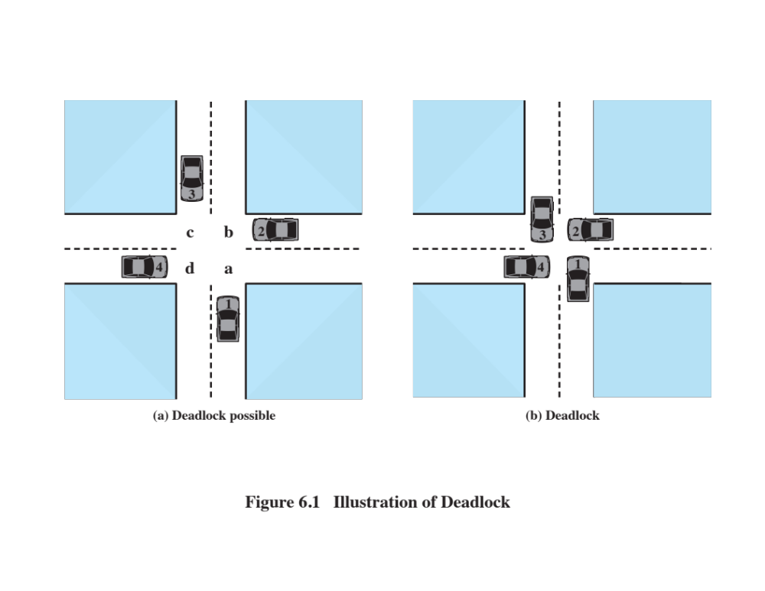
Crossing Example
Notes:
All deadlocks involve conflicting needs for resources by two or more processes. A common example is the traffic deadlock. Figure 6.1a shows a situation in which four cars have arrived at a four-way stop intersection at approximately the same time. The four quadrants of the intersection are the resources over which control is needed. In particular, if all four cars wish to go straight through the intersection, the resource requirements are as follows:
• Car 1, traveling north, needs quadrants a and b.
• Car 2 needs quadrants b and c.
• Car 3 needs quadrants c and d.
• Car 4 needs quadrants d and a.
The rule of the road in the United States is that a car at a four-way stop should defer to a car immediately to its right. This rule works if there are only two or three cars at the intersection. For example, if only the northbound and westbound cars arrive at the intersection, the northbound car will wait and the westbound car proceeds. However, if all four cars arrive at about the same time, each will refrain from entering the intersection, this causes a potential deadlock. The deadlock is only potential, not actual, because the necessary resources are available for any of the cars to proceed. If one car eventually does proceed, it can do so.
However, if all four cars ignore the rules and proceed (cautiously) into the
intersection at the same time, then each car seizes one resource (one quadrant) but
cannot proceed because the required second resource has already been seized by
another car. This is an actual deadlock.

Slide 8
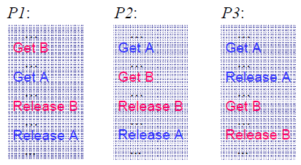
Process Example
Processes access two shared resources: Mutual Exclusion

Slide 9
Resources (1)
Deadlocks occur when …
  processes are granted exclusive access to devices
  we refer to these devices generally as resources
Preemptable resources
  can be taken away from a process with no ill effects
Nonpreemptable resources
  will cause the process to fail if taken away

Slide 10
Resources (2): System Model
Resource Types R₁, R₂, …, R_{m-1}
  CPU cycles, memory space, I/O devices
Each resource type R_{i} has W_{i} instances.
Each process utilizes a resource as follows:
  request
  use
  release

Slide 11
Resources (3)
Sequence of events required to use a resource
  request the resource
  use the resource
  release the resource
Must wait if request is denied
  requesting process may be blocked
  may fail with error code

Slide 12
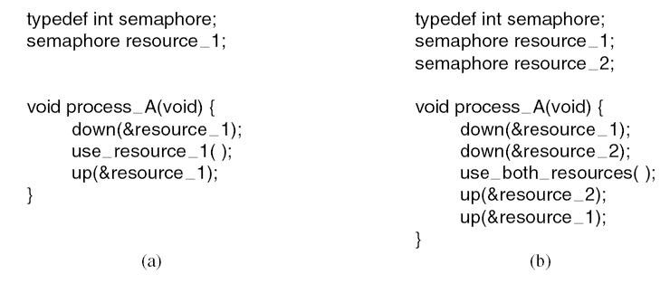
Resource Acquisition (1)
Using a semaphore to protect resources.
(a) One resource. (b) Two resources.

Slide 13
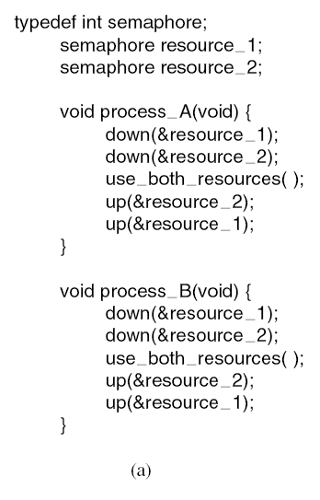
Resource Acquisition (2)
(a) Deadlock-free code.

Slide 14
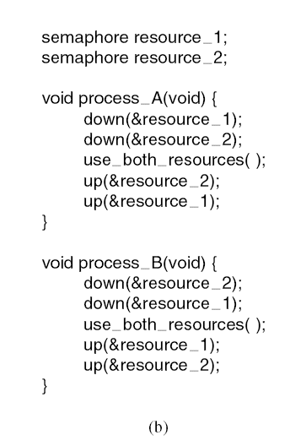
Resource Acquisition (3)
(b) Code with a potential deadlock.

Slide 15
Resource Categories
Reusable
Can be safely used by only one process at a time and is not depleted by that use
Processors, I/O channels, main and secondary memory, devices, and data structures such as files, databases, and semaphores
Consumable
One that can be created (produced) and destroyed (consumed)
Interrupts, signals, messages, and information
In I/O buffers
Notes:
Two general categories of resources can be distinguished: reusable and consumable. A reusable resource is one that can be safely used by only one process at a time and is not depleted by that use. Processes obtain resource units that they later release for reuse by other processes. Examples of reusable resources include processors; I/O channels; main and secondary memory; devices; and data structures such as files, databases, and semaphores.
A consumable resource is one that can be created (produced) and destroyed (consumed). Examples of consumable resources are interrupts, signals, messages, and information in I/O buffers.

Slide 16
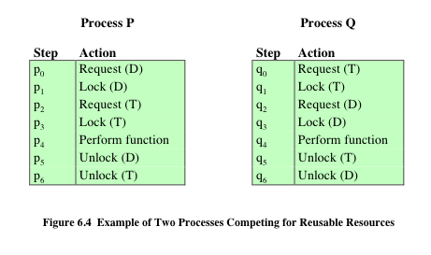
Notes:
As an example of deadlock involving reusable resources, consider two processes that compete for exclusive access to a disk file D and a tape drive T. The programs engage in the operations depicted in Figure 6.4 . Deadlock occurs if each process holds one resource and requests the other. For example, deadlock occurs if the multiprogramming system interleaves the execution of the two processes as follows:
p 0 p 1 q 0 q 1 p 2 q 2
It may appear that this is a programming error rather than a problem for the OS designer. However, we have seen that concurrent program design is challenging. Such deadlocks do occur, and the cause is often embedded in complex program logic, making detection difficult. One strategy for dealing with such a deadlock is to impose system design constraints concerning the order in which resources can be requested.

Slide 17
Example:
Memory Request
Space is available for allocation of 200Kbytes, and the following sequence of events occur:
Deadlock occurs if both processes progress to their second request
P1
P2
. . .
. . .
Request 80 Kbytes;
Request 70 Kbytes;
. . .
. . .
Request 60 Kbytes;
Request 80 Kbytes;
Notes:
Another example of deadlock with a reusable resource has to do with requests for main memory. Suppose the space available for allocation is 200 Kbytes, and the following sequence of requests occurs: (see diagram)
Deadlock occurs if both processes progress to their second request. If the amount of memory to be requested is not known ahead of time, it is difficult to deal with this type of deadlock by means of system design constraints. The best way to deal with this particular problem is, in effect, to eliminate the possibility by using virtual memory, which is discussed in Chapter 8 .

Slide 18
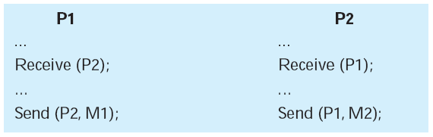
Consumable Resources Deadlock
Consider a pair of processes, in which each process attempts to receive a message from the other process and then send a message to the other process:
Deadlock occurs if the Receive is blocking
Notes:
As an example of deadlock involving consumable resources, consider the following pair of processes, in which each process attempts to receive a message
from the other process and then send a message to the other process: (see diagram)
Deadlock occurs if the Receive is blocking (i.e., the receiving process is blocked until the message is received). Once again, a design error is the cause of the deadlock. Such errors may be quite subtle and difficult to detect. Furthermore, it may take a rare combination of events to cause the deadlock; thus a program could be in use for a considerable period of time, even years, before the deadlock actually occurs.

Slide 19
Introduction to Deadlocks
Formal definition :
A set of processes is deadlocked if each process in the set is waiting for an event that only another process in the set can cause
Usually the event is release of a currently held resource
None of the processes can …
  run
  release resources
  be awakened

Slide 20
Deadlock
The permanent blocking of a set of processes that either compete for system resources or communicate with each other
A set of processes is deadlocked when each process in the set is blocked awaiting an event that can only be triggered by another blocked process in the set
Permanent because none of the events is ever triggered
No efficient solution in the general case
Notes:
Deadlock can be defined as the permanent blocking of a set of processes that either compete for system resources or communicate with each other. A set of processes is deadlocked when each process in the set is blocked awaiting an event (typically the freeing up of some requested resource) that can only be triggered by another blocked process in the set. Deadlock is permanent because none of the events is ever triggered. Unlike other problems in concurrent process management, there is no efficient solution in the general case.

Slide 21
Four Conditions for Deadlocks (1)
Assumptions of the system
Mutual exclusion condition
  each resource assigned to 1 process or is available
Hold and wait condition
  process holding resources can request additional
No preemption condition
  previously granted resources cannot forcibly taken away

Slide 22
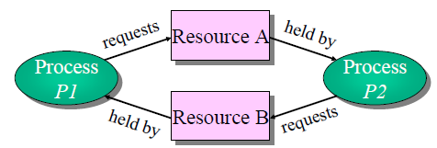
Four Conditions for Deadlock (2)
Appearance of a particular event
Circular wait condition
  must be a circular chain of 2 or more processes
  each is waiting for resource held by next member of the chain

Slide 23
Conditions for Deadlock
Mutual Exclusion
Only one process may use a resource at a time
Hold-and-Wait
A process may hold allocated resources while awaiting assignment of other resources
No Pre-emption
No resource can be forcibly removed from a process holding it
Circular Wait
A closed chain of processes exists, such that each process holds at least one resource needed by the next process in the chain
No process may access a resource until that has been allocated to another process
Notes:
Three conditions of policy must be present for a deadlock to be possible:
1. Mutual exclusion . Only one process may use a resource at a time. No process may access a resource unit that has been allocated to another process.
2. Hold and wait . A process may hold allocated resources while awaiting assignment of other resources.
3. No preemption . No resource can be forcibly removed from a process holding it.
In many ways these conditions are quite desirable. For example, mutual exclusion is needed to ensure consistency of results and the integrity of a database. Similarly, preemption should not be done arbitrarily. For example, when data resources are involved, preemption must be supported by a rollback recovery mechanism, which restores a process and its resources to a suitable previous state from which the process can eventually repeat its actions.
The first three conditions are necessary but not sufficient for a deadlock to exist. For deadlock to actually take place, a fourth condition is required:
4. Circular wait . A closed chain of processes exists, such that each process holds at least one resource needed by the next process in the chain (e.g., Figure 6.5c
and Figure 6.6 ).
The fourth condition is, actually, a potential consequence of the first three. That is, given that the first three conditions exist, a sequence of events may occur that lead to an unresolvable circular wait. The unresolvable circular wait is in fact the definition of deadlock. The circular wait listed as condition 4 is unresolvable because the first three conditions hold. Thus, the four conditions, taken together, constitute necessary and sufficient conditions for deadlock.

Slide 24
Resource Allocation Graph
V is partitioned into two types:
  P = {P₁, P₂ , …, P_{n}}, the set consisting of all the processes in the system.
  R = {R₁, R₂, …, R_{m}}, the set consisting of all resource types in the system.
request edge: directed edge P_{i} → R_{j}
P_{i} is requesting a resource of type R_{j}
assignment edge: directed edge R_{j} → P_{i}
P_{i} holds a resource of type R_{j}

Slide 25
Resource Allocation Graph (Cont.)
Process
Resource Type with 4 instances
P_{i} requests instance of R_{j}
P_{i} is holding an instance of R_{j}
P_{i}
R_{j}
P_{i}
R_{j}

Slide 26
Example of a Graph with No Cycles
R₁
R₃
P₁
P₂
P₃
R₂
R₄

Slide 27
Example of a Graph with a Cycle
R₁
R₃
P₁
P₂
P₃
R₂
R₄

Slide 28
Fundamental Facts
If a graph contains no cycles than no deadlock.
If a graph contains a cycle than
  if only one instance per resource type, then deadlock
  if several instances per resource type, possibility of deadlock.

Slide 29
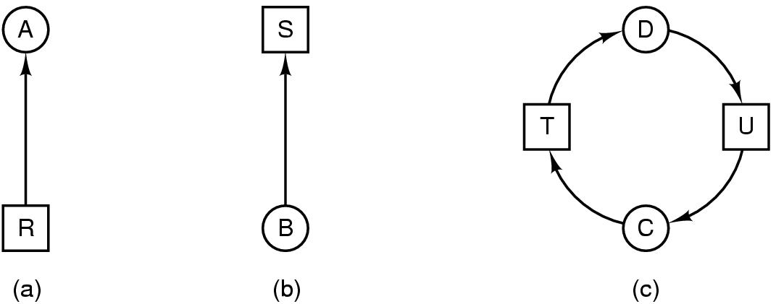
Deadlock Modeling (1)
Modeled with directed graphs
  resource R assigned to process A
  process B is requesting/waiting for resource S
  process C and D are in deadlock over resources T and U

Slide 30
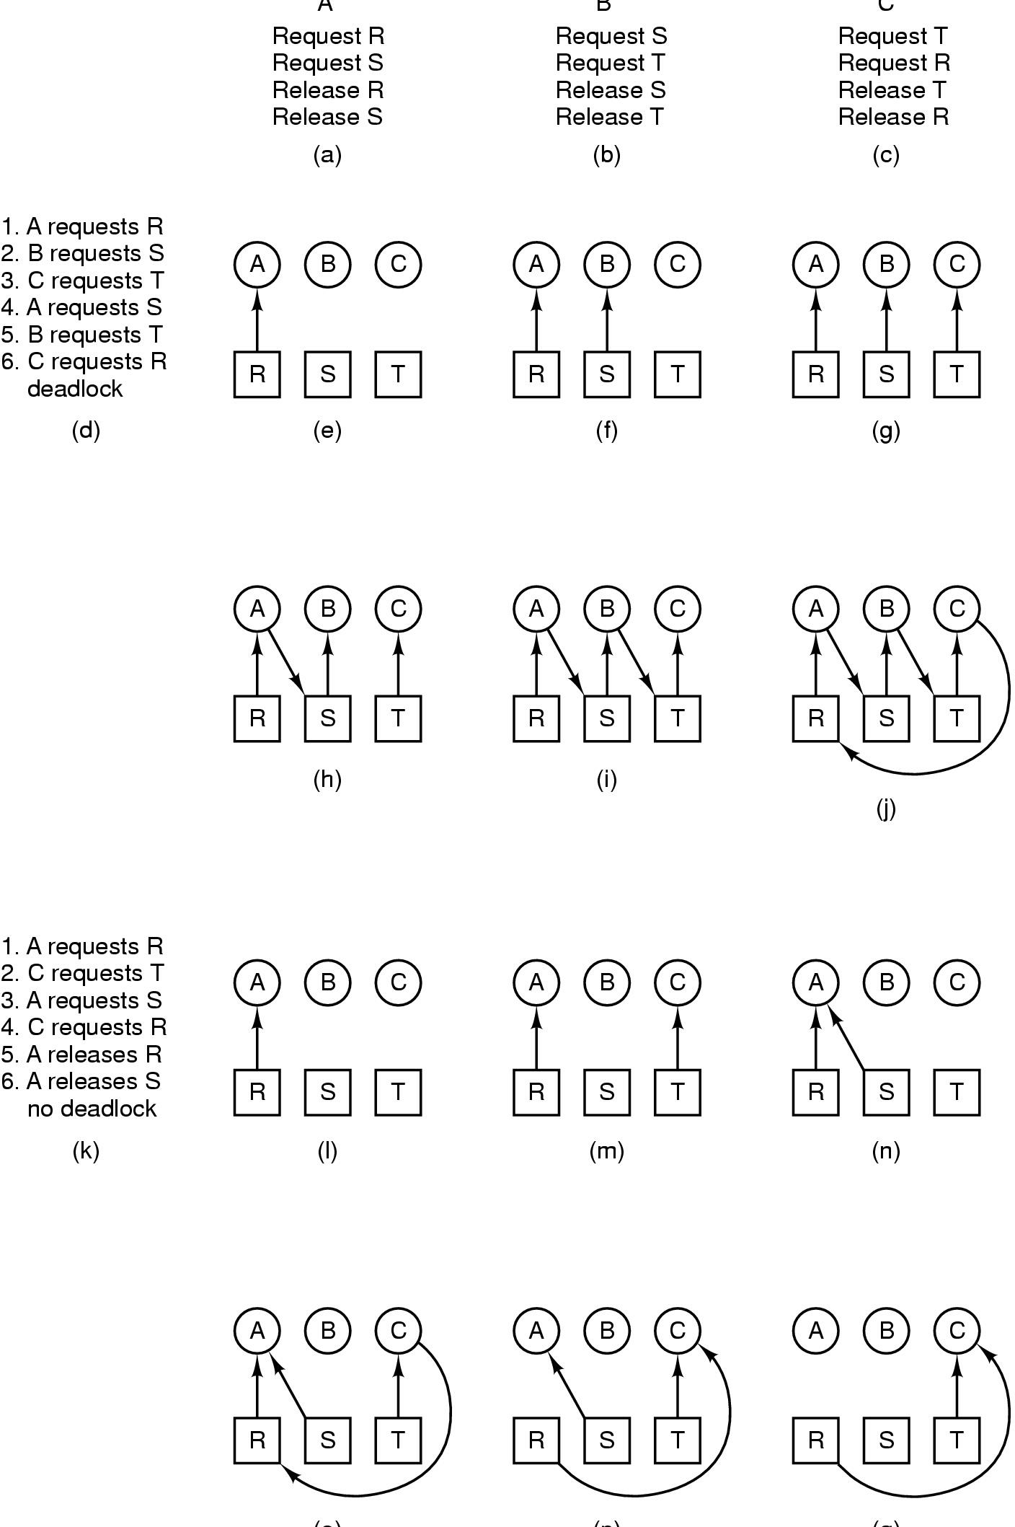
Deadlock Modeling (2)
A B C
How deadlock occurs

Slide 31
Deadlock Modeling (3)
(o) (p) (q)
How deadlock can be avoided

Slide 32
Methods for Handling Deadlock
1. Ignoring the problem: We can pretend that deadlocks will never occur and live happily in our ignorance.
2. Detection and Recovery : We can allow the system to enter a deadlock state and then recover.
3. Dynamic avoidance: Careful resource allocation
4. Prevention : We can try to design a protocol which ensures that deadlock never occurs.

Slide 33
The Ostrich Algorithm
Pretend there is no problem
Reasonable if
  deadlocks occur very rarely
  cost of prevention is high
UNIX and Windows takes this approach
It is a trade off between
  convenience
  correctness

Slide 34
The Ostrich Algorithm (2)
This method used by most operating systems. User programs are expected to behave properly. The system does not interface. This is understandable : it is very hard to make general rules for every situations which might arise.

Slide 35
Deadlock Detection
Allow system to enter deadlock state
Detection Algorithm
Recovery Scheme

Slide 36
Single Instance of Each Resource Type
Maintain wait-for graph
  Nodes are processes
  P_{i} → P_{j} if P_{i} is waiting for P_{j}
Periodically invoke an algorithm that searches for a cycle in the graph.
An algorithm to detect a cycle in a graph requires an order of n² operations, where n is the number of vertices in the graph.

Slide 37
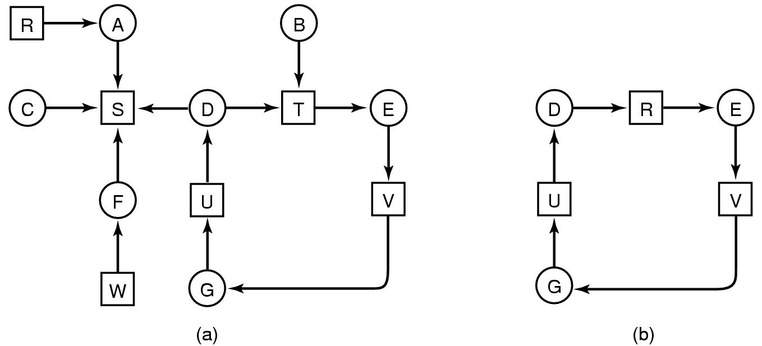
Detection with One Resource of Each Type
(a) Note the resource ownership and requests
(b) A cycle can be found within the graph, denoting deadlock

Slide 38
Deadlock Detection Algorithm
For each node N in graph perform following 5 steps with N as start node (Data structure used is a list L of nodes)
Initialize L (L=empty), designate all arcs as unmarked
Add current node to L. If node occurs twice in list → cycle, terminate algorithm
From given node; If any unmarked arcs go to step 4, else go to step 5
Pick unmarked edge (arc), follow it to new current node, go to step 2
Dead end; Remove node, go back to previous node, mark it as current and go to step 2. If this node is initial node → no cycle

Slide 39
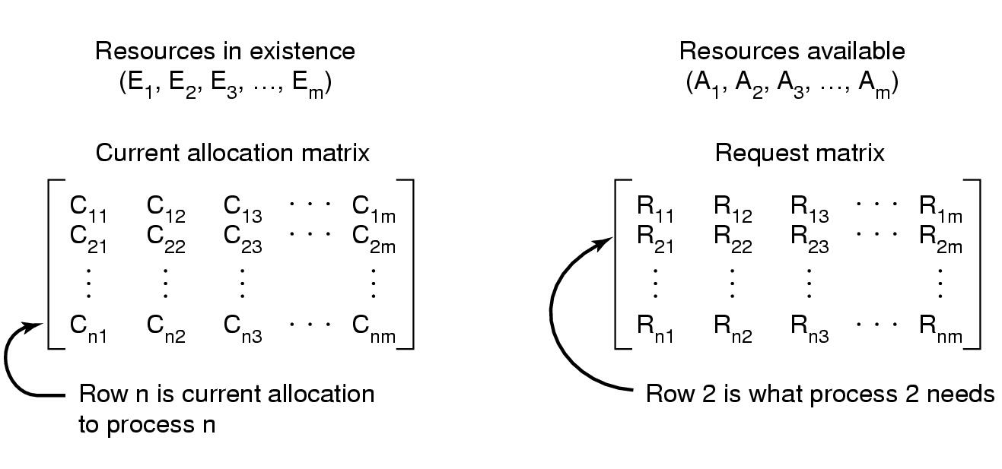
Detection with Multiple Resources of Each Type
Data structures needed by deadlock detection algorithm

Slide 40
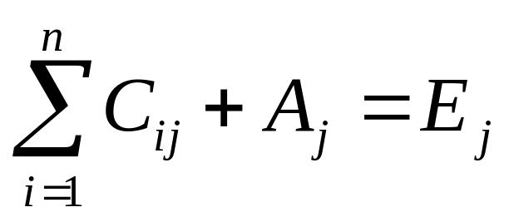
Multiple Instances of a Resource Type
Every resource is allocated or available

Slide 41
Multiple Instances of a Resource Type
Let n = number of processes and m = number of resource types.
Available: Vector of length m. If Available[j] = k, there are k instances of resource type R_{j} available.
Allocation: n x m matrix. If Allocation[i, j] = k, then P_{i} is currently allocated k instances of R_{j}.
Request: n x m matrix. If Request[i, j] = k, then P_{i} is requesting k instances of resource type R_{j}.

Slide 42
Detection Algorithm (Short Form)
Look for unmarked process P_{i} for which the i-th row of R is less than or equal to A
If such a process is found, add the i-th row of C to A, mark the process, go to step 1
If no such process exists, terminate

Slide 43
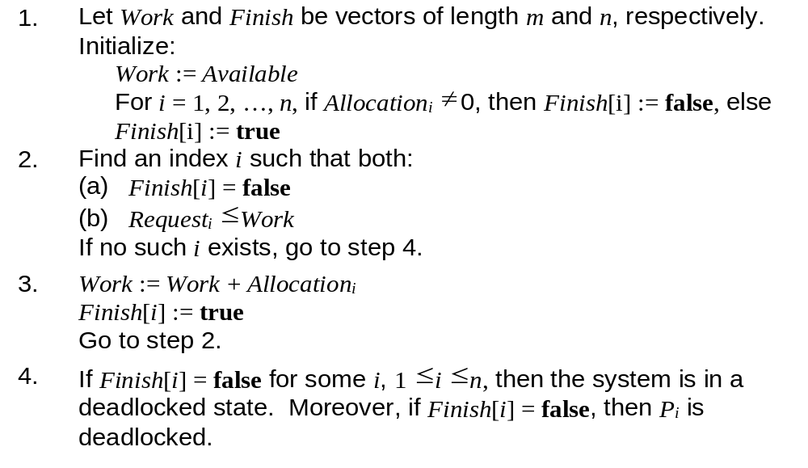
Detection Algorithm
Algorithm requires O(m ⋅ n²) operations to detect deadlock.

Slide 44
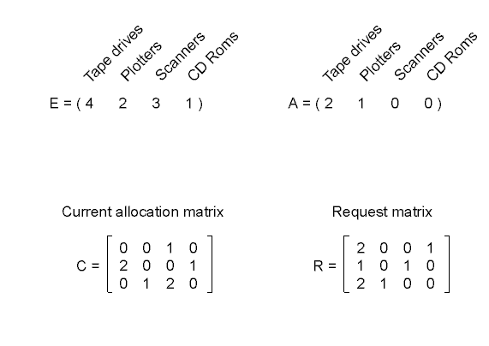
Detection with Multiple Resources of Each Type
An example for the deadlock detection algorithm

Slide 45
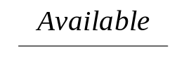
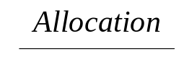
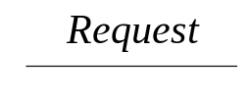
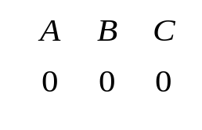

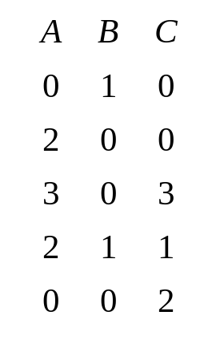
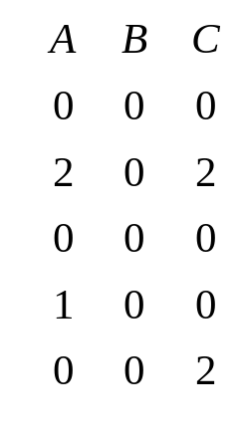
Example of Detection Algorithm
5 processes P₀ through P₄; 3 resource types A (7 instances), B (2 instances), and C (6 instances).
Snapshot at time T₀:

Slide 46
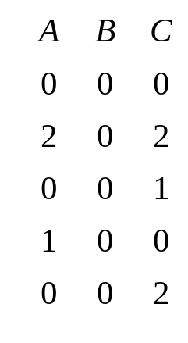
Example (Cont.)
P₂ requests an additional instance of type C:
State of the system?

Slide 47
Detection Algorithm Usage
When, and how often, to invoke depends on:
  How often is deadlock likely to occur?
  How many processes will need to be rolled back?
If deadlock algorithm is invoked arbitrarily, there may be many cycles in the resource graph and so we would not be able to tell which of the many deadlocked processes “caused” the deadlock.

Slide 48
Recovery from Deadlock (1)
Recovery through preemption
  take a resource from some other process
  depends on nature of the resource
Recovery through rollback
  checkpoint a process periodically
  use this saved state
  restart the process if it is found deadlocked

Slide 49
Recovery from Deadlock (2)
Recovery through killing processes
  crudest but simplest way to break a deadlock
  kill one of the processes in the deadlock cycle
  the other processes get its resources
  choose process that can be rerun from the beginning

Slide 50
Recovery from Deadlock: Resource Preemption
Selecting a victim — minimize cost.
Rollback — return to some safe state, restart process from that state.
Starvation — same process may always be picked as victim; include number of rollbacks in cost factor.

Slide 51
Recovery from Deadlock: Process Termination
Abort all deadlocked processes.
Abort one process at a time until the deadlock cycle is eliminated.
In which order should be choose to abort?
  Priority of the process.
  Computation metric — current length or length to completion
  Resources the process has used.
  Resources the process is requesting.
  Number of process requiring termination.
  Interactive versus batch.

Slide 52
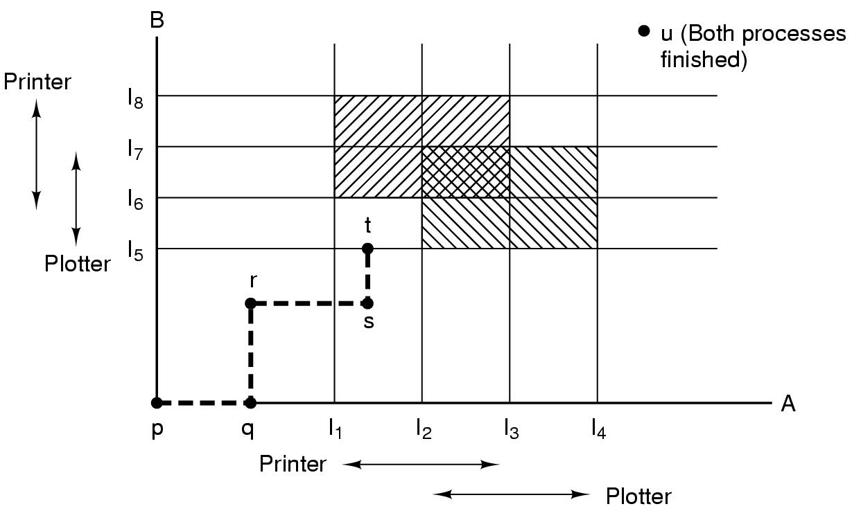
Deadlock Avoidance
Resource Trajectories
Two process resource trajectories

Slide 53
Remember: Process Example
Processes access two shared resources: Mutual Exclusion

Slide 54
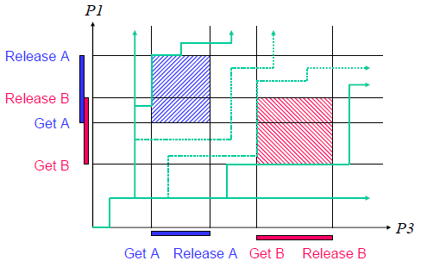
Resource Trajectories (1)
Resource trajectories for the example

Slide 55
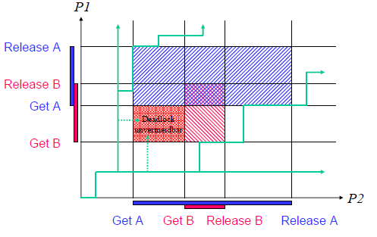
Resource Trajectories (2)
Resource trajectories for the example

Slide 56
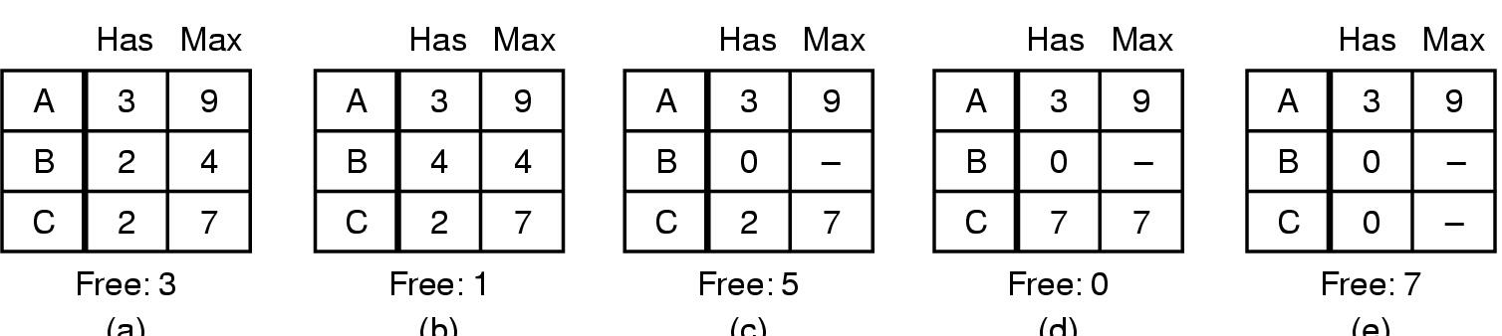
Safe and Unsafe States (1)
(a) (b) (c) (d) (e)
Demonstration that the state in (a) is safe

Slide 57
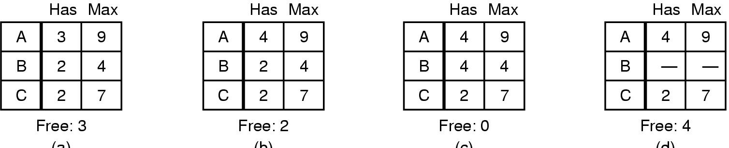
Safe and Unsafe States (2)
(a) (b) (c) (d)
Demonstration that the state in (b) is not safe

Slide 58
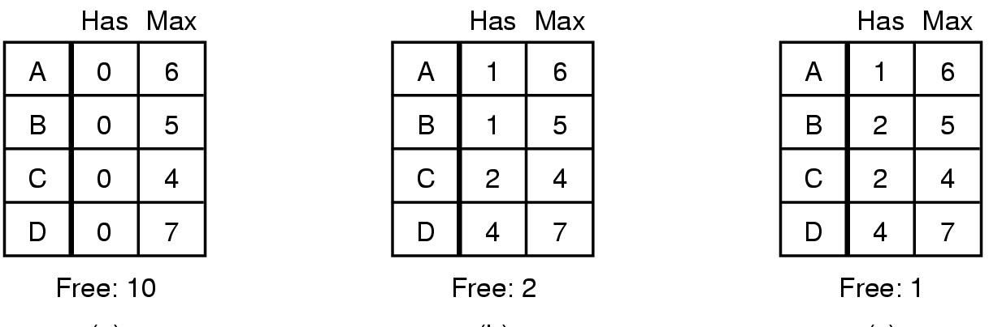
The Banker's Algorithm for a Single Resource
(a) (b) (c)
Three resource allocation states
  (a) safe
  (b) safe
  (c) unsafe

Slide 59
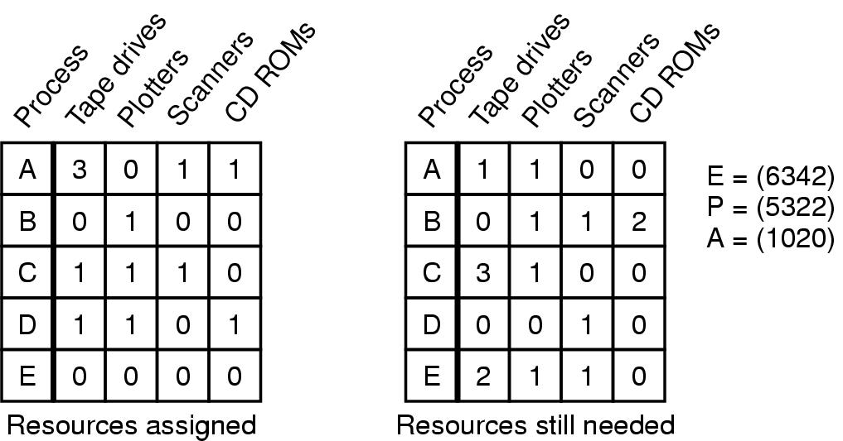
Banker's Algorithm for Multiple Resources
Example of banker's algorithm with multiple resources

Slide 60
Banker's Algorithm for Multiple Resources
Algorithm for checking if state is safe
  Look for a row R, whose unmet needs are all smaller than or equal to A. If no such row → system eventually will deadlock
  Assume the process of the row chosen rquests all resources it needs and finishes. Mark that process as terminated and add all its resources to A.
  Repeat steps 1 and 2 until either all processes marked as terminated (safe state) or deadlock occurs

Slide 61
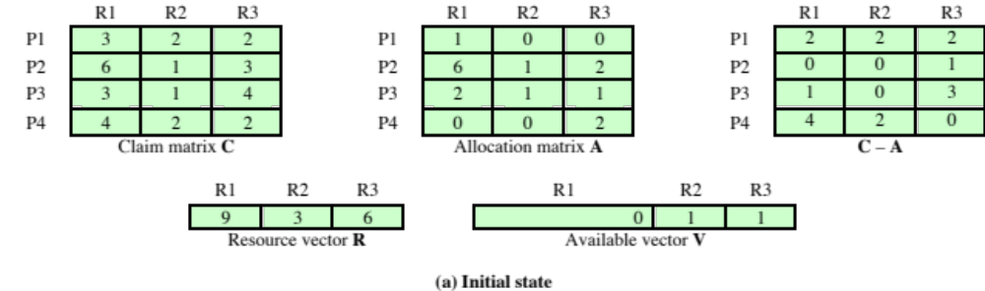
Example for Banker's Algorithm (1)
Figure 6.7 (S) Determination of a Safe State
Notes:
The following example illustrates these concepts. Figure 6.7a shows the state of a system consisting of four processes and three resources. The total amount of resources R1, R2, and R3 are 9, 3, and 6 units, respectively. In the current state allocations have been made to the four processes, leaving 1 unit of R2 and 1 unit of R3 available. Is this a safe state? To answer this question, we ask an intermediate question: Can any of the four processes be run to completion with the resources available? That is, can the difference between the maximum requirement and current allocation for any process be met with the available resources? In terms of the matrices and vectors introduced earlier, the condition to be met
for process i is:
C_{ij} - A_{ij} … V_{j}, for all j

Slide 62
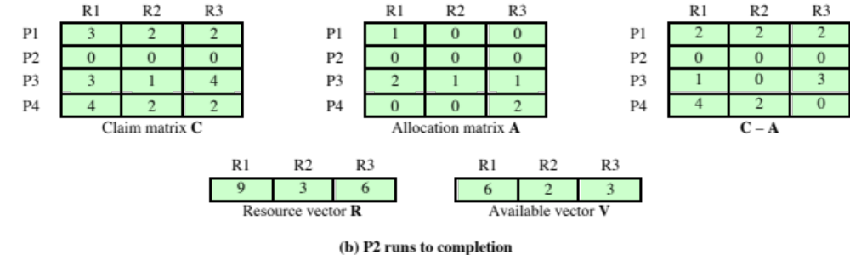
Example for Banker's Algorithm (2)
Figure 6.7 Determination of a Safe State
Notes:
Clearly, this is not possible for P1, which has only 1 unit of R1 and requires 2 more units of R1, 2 units of R2, and 2 units of R3. However, by assigning one unit of R3 to process P2, P2 has its maximum required resources allocated and can run to completion. Let us assume that this is accomplished. When P2 completes, its resources can be returned to the pool of available resources. The resulting state is shown in Figure 6.7b . Now we can ask again if any of the remaining processes can be completed. In this case, each of the remaining processes could be completed.

Slide 63
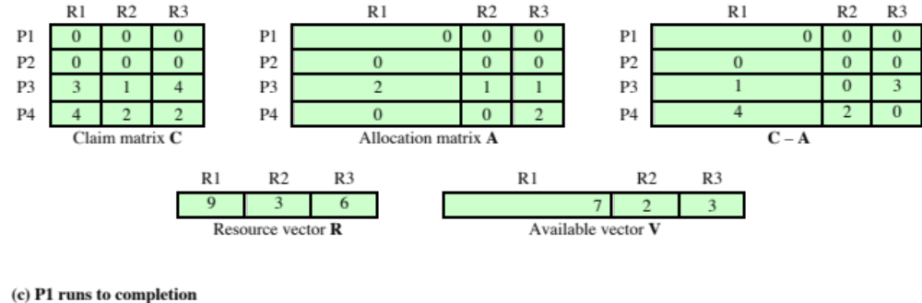
Example for Banker's Algorithm (3)
Figure 6.7 Determination of a Safe State
Notes:
Suppose we choose P1, allocate the required resources, complete P1, and return all of P1’s resources to the available pool. We are left in the state shown in Figure 6.7c .

Slide 64
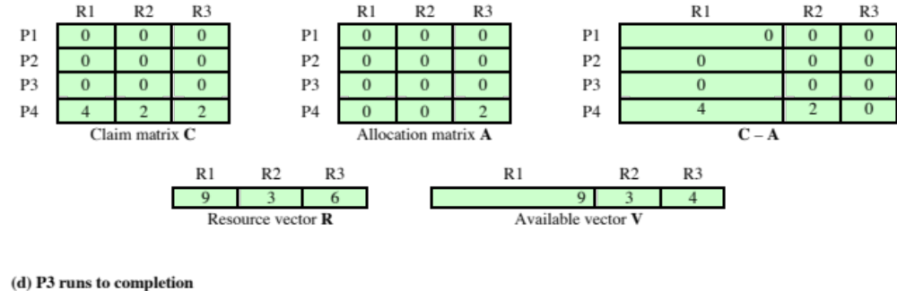
Example for Banker's Algorithm (4)
(d) P3 runs to completion
Figure 6.7 Determination of a Safe State
Notes:
Next, we can complete P3, resulting in the state of Figure 6.7d . Finally, we can complete P4. At this point, all of the processes have been run to completion. Thus, the state defined by Figure 6.7a is a safe state.
These concepts suggest the following deadlock avoidance strategy, which ensures that the system of processes and resources is always in a safe state. When a process makes a request for a set of resources, assume that the request is granted, update the system state accordingly, and then determine if the result is a safe state. If so, grant the request and, if not, block the process until it is safe to grant the request.

Slide 65
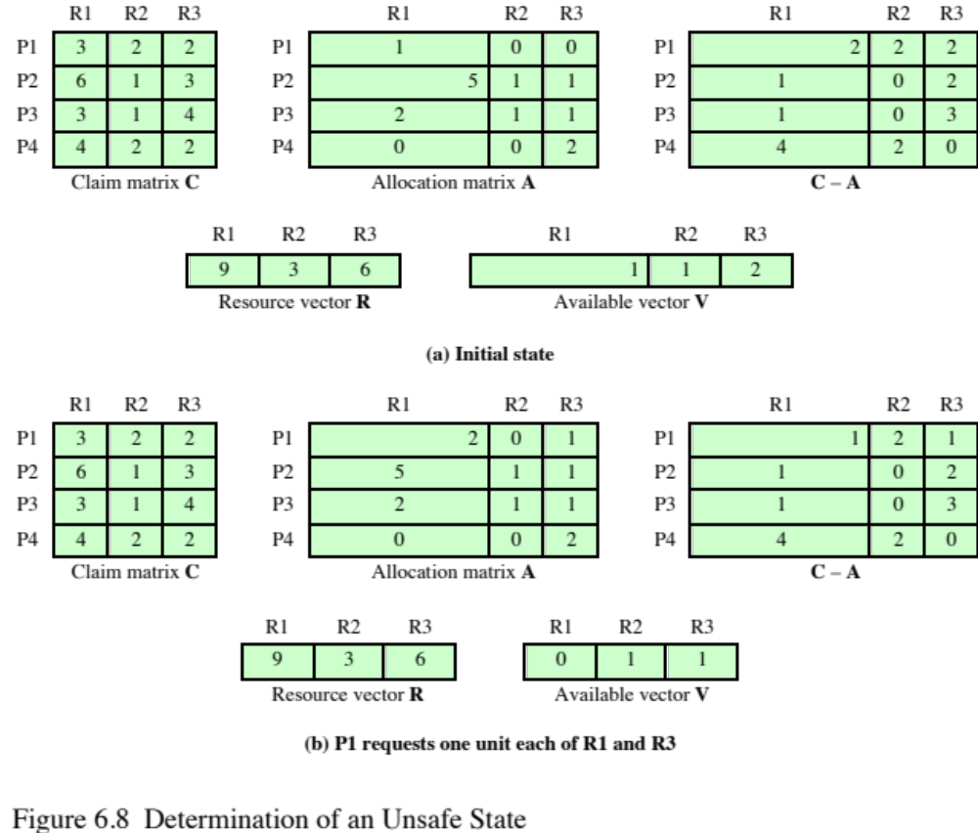
Example for Banker's Algorithm (5)
Figure 6.8 Determination of an Unsafe State
Notes:
Consider the state defined in Figure 6.8a . Suppose P2 makes a request for one additional unit of R1 and one additional unit of R3. If we assume the request is granted, then the resulting state is that of Figure 6.7a . We have already seen that this is a safe state; therefore, it is safe to grant the request. Now let us return to the state of Figure 6.8a and suppose that P1 makes the request for one additional unit each of R1 and R3; if we assume that the request is granted, we are left in the state of Figure 6.8b . Is this a safe state? The answer is no, because each process will need at least one additional unit of R1, and there are none available. Thus, on the basis of deadlock avoidance, the request by P1 should be denied and P1 should be blocked.
It is important to point out that Figure 6.8b is not a deadlocked state. It merely has the potential for deadlock. It is possible, for example, that if P1 were run from this state it would subsequently release one unit of R1 and one unit of R3 prior to needing these resources again. If that happened, the system would return to a safe state. Thus, the deadlock avoidance strategy does not predict deadlock with certainty; it merely anticipates the possibility of deadlock and assures that there is never such a possibility.

Slide 66
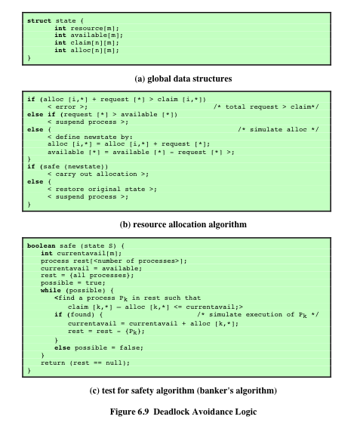
Example for Banker's Algorithm (6)
Notes:
Figure 6.9 gives an abstract version of the deadlock avoidance logic. The main algorithm is shown in part (b). With the state of the system defined by the data structure state , request[*] is a vector defining the resources requested by process i . First, a check is made to assure that the request does not exceed the original claim of the process. If the request is valid, the next step is to determine if it is possible to fulfill the request (i.e., there are sufficient resources available). If it is not possible, then the process is suspended. If it is possible, the final step is to
determine if it is safe to fulfill the request. To do this, the resources are tentatively assigned to process i to form newstate .
Then a test for safety is made using the algorithm in Figure 6.9c.

Slide 67
Deadlock Avoidance Advantages
It is not necessary to preempt and rollback processes, as in deadlock detection
It is less restrictive than deadlock prevention
Notes:
Deadlock avoidance has the advantage that it is not necessary to preempt and
rollback processes, as in deadlock detection, and is less restrictive than deadlock
prevention.

Slide 68
Deadlock Avoidance Restrictions
Processes under consideration must be independent and with no synchronization requirements
There must be a fixed number of resources to allocate
No process may exit while holding resources
Maximum resource requirement for each process must be stated in advance
Notes:
However, it does have a number of restrictions on its use:
• The maximum resource requirement for each process must be stated in advance.
• The processes under consideration must be independent; that is, the order in which they execute must be unconstrained by any synchronization requirements.
• There must be a fixed number of resources to allocate.
• No process may exit while holding resources.

Slide 69
Deadlock Strategies
Deadlock prevention strategies are very conservative
Limit access to resources by imposing restrictions on processes
Deadlock detection strategies do the opposite
Resource requests are granted whenever possible
Notes:
Deadlock prevention strategies are very conservative; they solve the problem of deadlock by limiting access to resources and by imposing restrictions on processes. At the opposite extreme, deadlock detection strategies do not limit resource access or restrict process actions. With deadlock detection, requested resources are granted to processes whenever possible. Periodically, the OS performs an algorithm that allows it to detect the circular wait condition described earlier in condition (4) and illustrated in Figure 6.6 .

Slide 70
Deadline Detection Algorithm
A check for deadlock can be made as frequently as each resource request or, less frequently, depending on how likely it is for a deadlock to occur
Advantages:
It leads to early detection
The algorithm is relatively simple
Disadvantage
Frequent checks consume considerable processor time
Notes:
A check for deadlock can be made as frequently as each resource request or, less frequently, depending on how likely it is for a deadlock to occur. Checking at each resource request has two advantages: It leads to early detection, and the algorithm is relatively simple because it is based on incremental changes to the state of the system. On the other hand, such frequent checks consume considerable processor time.

Slide 71
Deadlock Prevention
Attacking the Mutual Exclusion Condition
Some devices (such as printer) can be spooled
  only the printer daemon uses printer resource
  thus deadlock for printer eliminated
Not all devices can be spooled
Principle:
  avoid assigning resource when not absolutely necessary
  as few processes as possible actually claim the resource

Slide 72
Attacking the Hold and Wait Condition
Require processes to request resources before starting
  a process never has to wait for what it needs
Problems
  may not know required resources at start of run
  also ties up resources other processes could be using
Variation:
  process must give up all resources
  then request all immediately needed

Slide 73
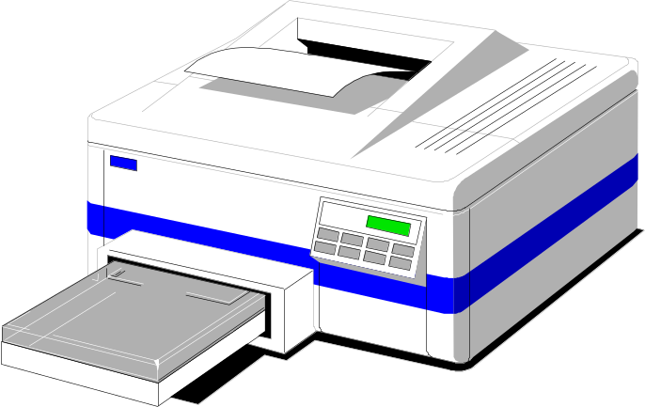
Attacking the No Preemption Condition
This is not a viable option
Consider a process given the printer
  halfway through its job
  now forcibly take away printer
  !!??

Slide 74
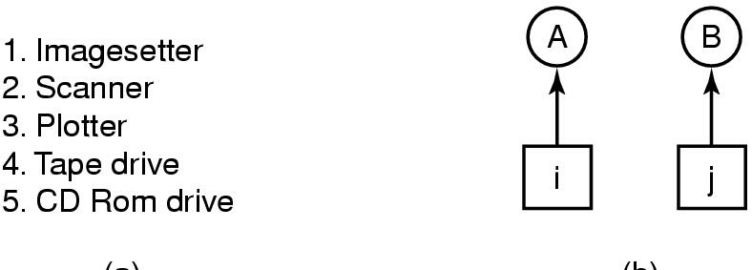
Attacking the Circular Wait Condition
(a) (b)
(a) Normally ordered resources
(b) A resource graph

Slide 75
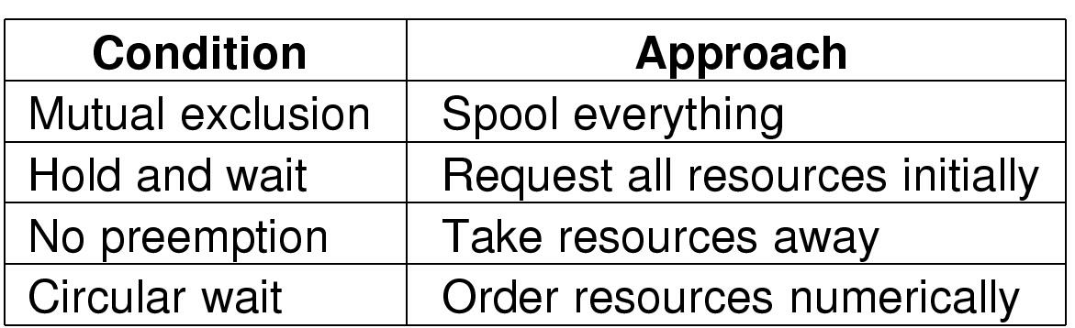
Approaches to Deadlock Prevention
Summary of approaches to deadlock prevention

Slide 76
Combined Approach to Deadlock Handling
Combine the three basic approaches
  Prevention
  Avoidance
  Detection
allowing the use of the optimal approach for each class of resources in the system.
Partition resources into hierarchically ordered classes.
Use most appropriate technique for handling deadlocks within each class.

Slide 77
Other Issues
Two-phase locking
Nonresource deadlocks
Communication deadlocks
Livelock
Starvation

Slide 78
Two-Phase Locking
Phase One
  process tries to lock all records it needs, one at a time
  if needed record found locked, start over
  (no real work done in phase one)
If phase one succeeds, it starts second phase,
  performing updates
  releasing locks
Note similarity to requesting all resources at once
Algorithm works where programmer can arrange
  program can be stopped, restarted

Slide 79
Nonresource Deadlocks
Possible for two processes to deadlock
  each is waiting for the other to do some task
Can happen with semaphores
  each process required to do a down() on two semaphores (mutex and another)
  if done in wrong order, deadlock results

Slide 80
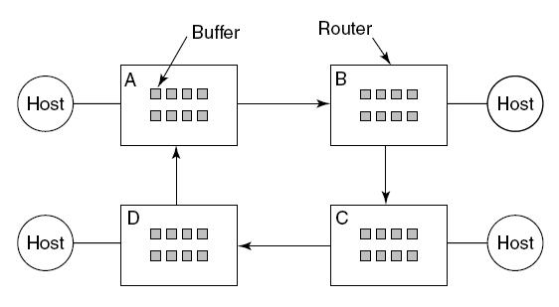
Communication Deadlocks
A resource deadlock in a network.

Slide 81
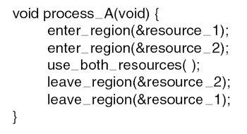
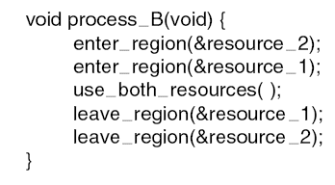
Livelock
Busy waiting that can lead to livelock.

Slide 82
Starvation
Algorithm to allocate a resource
  may be to give to shortest job first
Works great for multiple short jobs in a system
May cause long job to be postponed indefinitely
  even though not blocked
Solution:
  First-come, first-serve policy

Slide 83
Summary
Resources
  Preemptable resources
  Non-preemptable resources
  Resources allocation
What is a deadlock?
  Background
  Deadlock Conditions
Deadlock prevention
Deadlock avoidance
Deadlock prediction
Starvation
Notes:
Chapter 3 Summary

Slide 84
Next Lecture
Memory Management

Slide 85
References
Andrew S. Tanenbaum, Herbert Bos, Modern Operating Systems 4th Global Edition, Pearson, 2015
William Stallings, Operating Systems: Internals and Design Principles, 9th Global Edition, Pearson, 2017

