Slide 1
CSE202 Database Management Systems
Lecture #3
Prepared & Presented by Asst. Prof. Dr. Samsun M. BAŞARICI

Slide 2
Learning Objectives
Understand SQL data definition and data types
Specify constraints in SQL
Describe SQL as a relational data manipulation language.
Explain that you can create and update relational tables using SQL.
Write SQL SELECT commands to retrieve relational data using a variety of operators, including GROUP BY, ORDER BY, and the built-in functions of AVG, SUM, MAX, MIN, and COUNT.
Write SQL SELECT commands that join relational tables.
Write SQL SELECT subqueries.
Describe a strategy for writing SQL SELECT statements.
Describe the principles of how a relational query optimizer works.
Specifying constraints as assertions and actions as triggers
Creating views (Virtual Tables) in SQL
Using schema change statements in SQL

Slide 3
Outline
Data definition vs. data manipulation
SQL as DDL
SQL as DML
  Creating and updating relational tables
  Joining tables
  Subqueries
Complex SQL queries
Constraints as assertions and triggers
Views
Schema changes

Slide 4
Part 1
Basic SQL

Slide 5
Data Management
Data Definition
Data Manipulation

Slide 6
Data Management:
Data Definition
Operationalized with a data definition language (DDL).
Instructs the DBMS software on what tables will be in the database, what attributes will be in the tables, which attributes will be indexed, etc.

Slide 7
Data Management:
Data Manipulation
Refers to the four basic operations that can and must be performed on data stored in any DBMS.
  Data retrieval
  Data update
  Insertion of new records
  Deletion of existing records
Requires data manipulation language (DML)

Slide 8
SQL
Structured Query Language
Incorporates both DDL and DML features.
Very heavily used in practice today.

Slide 9
Basic SQL
SQL language
  Considered one of the major reasons for the commercial success of relational databases
SQL
  Structured Query Language
  Statements for data definitions, queries, and updates (both DDL and DML)
  Core specification
  Plus specialized extensions

Slide 10
SQL Data Definition and Data Types
Terminology:
  Table, row, and column used for relational model terms relation, tuple, and attribute
CREATE statement
  Main SQL command for data definition

Slide 11
Schema and Catalog Concepts in SQL
SQL schema
  Identified by a schema name
  Includes an authorization identifier and descriptors for each element
Schema elements include
  Tables, constraints, views, domains, and other constructs
Each statement in SQL ends with a semicolon

Slide 12
Schema and Catalog Concepts in SQL (cont.)
CREATE SCHEMA statement
  CREATE SCHEMA COMPANY AUTHORIZATION ‘Jsmith’;
Catalog
  Named collection of schemas in an SQL environment
SQL environment
  Installation of an SQL-compliant RDBMS on a computer system

Slide 13
Building the Data Structure
Base tables - actual physical tables in which the data will be stored on the disk.
Created using the CREATE TABLE command.
Deleted using the DROP TABLE command.

Slide 14
Logical View
Also just called a view.
May consist of a subset of the columns of a single table, a subset of the rows of a single table, or both.
May also be the join of two or more base tables.
A mapping onto the base table(s).
Created using the CREATE VIEW command.

Slide 15
Data Manipulation Operations
UPDATE - used for updating existing data.
INSERT - used for inserting new rows in tables.
DELETE - used for deleting existing rows in tables.

Slide 16
The CREATE TABLE Command in SQL
Specify a new relation
  Provide name
  Specify attributes and initial constraints
Can optionally specify schema:
  CREATE TABLE COMPANY.EMPLOYEE ...
  or
  CREATE TABLE EMPLOYEE ...

Slide 17
The CREATE TABLE Command in SQL (cont.)
Base tables (base relations)
  Relation and its tuples are actually created and stored as a file by the DBMS
Virtual relations
  Created through the CREATE VIEW statement

Slide 18
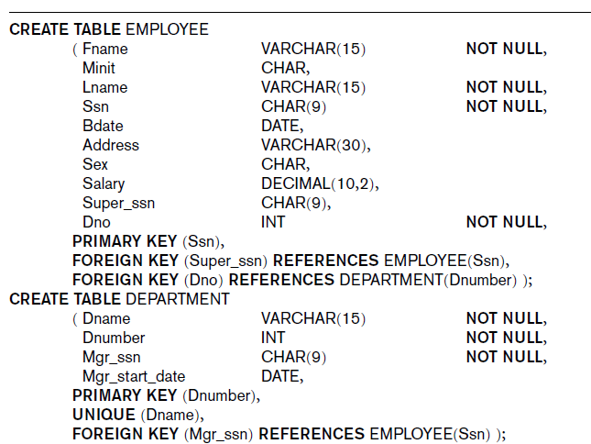
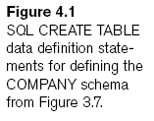

Slide 19
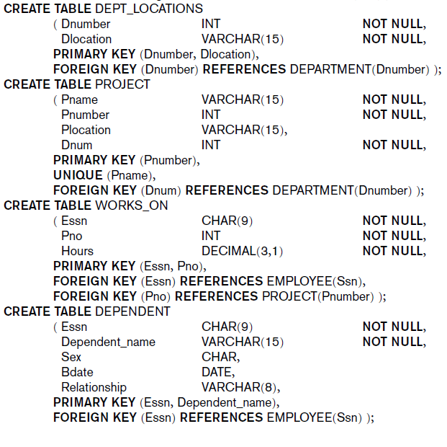

Slide 20
The CREATE TABLE Command in SQL (cont.)
Some foreign keys may cause errors
  Specified either via:
    Circular references
    Or because they refer to a table that has not yet been created

Slide 21
Attribute Data Types and Domains in SQL
Basic data types
  Numeric data types
    Integer numbers: INTEGER, INT, and SMALLINT
    Floating-point (real) numbers: FLOAT or REAL, and DOUBLE PRECISION
  Character-string data types
    Fixed length: CHAR(n), CHARACTER(n)
    Varying length: VARCHAR(n), CHAR VARYING(n), CHARACTER VARYING(n)

Slide 22
Attribute Data Types and Domains in SQL (cont.)
  Bit-string data types
    Fixed length: BIT(n)
    Varying length: BIT VARYING(n)
  Boolean data type
    Values of TRUE or FALSE or NULL
  DATE data type
    Ten positions
    Components are YEAR, MONTH, and DAY in the form YYYY-MM-DD

Slide 23
Attribute Data Types and Domains in SQL (cont.)
Additional data types
  Timestamp data type (TIMESTAMP)
    Includes the DATE and TIME fields
    Plus a minimum of six positions for decimal fractions of seconds
    Optional WITH TIME ZONE qualifier
  INTERVAL data type
    Specifies a relative value that can be used to increment or decrement an absolute value of a date, time, or timestamp

Slide 24
Attribute Data Types and Domains in SQL (cont.)
Domain
  Name used with the attribute specification
  Makes it easier to change the data type for a domain that is used by numerous attributes
  Improves schema readability
  Example:
    CREATE DOMAIN SSN_TYPE AS CHAR(9);

Slide 25
Specifying Constraints in SQL
Basic constraints:
  Key and referential integrity constraints
  Restrictions on attribute domains and NULLs
  Constraints on individual tuples within a relation

Slide 26
Specifying Attribute Constraints and Attribute Defaults
NOT NULL
  NULL is not permitted for a particular attribute
Default value
  DEFAULT <value>
CHECK clause
  Dnumber INT NOT NULL CHECK (Dnumber > 0 AND Dnumber < 21);

Slide 27
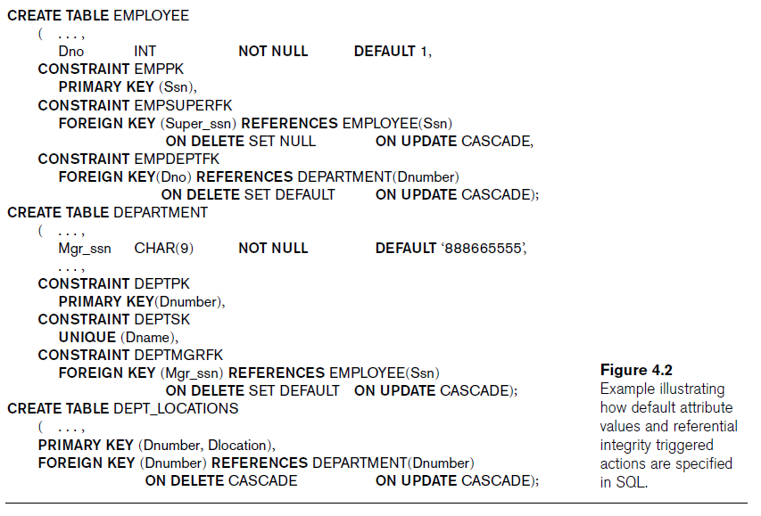

Slide 28
Specifying Key and Referential Integrity Constraints
PRIMARY KEY clause
  Specifies one or more attributes that make up the primary key of a relation
  Dnumber INT PRIMARY KEY;
UNIQUE clause
  Specifies alternate (secondary) keys
  Dname VARCHAR(15) UNIQUE;

Slide 29
Specifying Key and Referential Integrity Constraints (cont.)
FOREIGN KEY clause
  Default operation: reject update on violation
  Attach referential triggered action clause
    Options include SET NULL, CASCADE, and SET DEFAULT
    Action taken by the DBMS for SET NULL or SET DEFAULT is the same for both ON DELETE and ON UPDATE
    CASCADE option suitable for “relationship” relations

Slide 30
Giving Names to Constraints
Keyword CONSTRAINT
  Name a constraint
  Useful for later altering

Slide 31
Specifying Constraints on Tuples Using CHECK
CHECK clauses at the end of a CREATE TABLE statement
  Apply to each tuple individually
  CHECK (Dept_create_date <= Mgr_start_date);

Slide 32
Introduction: SQL SELECT
Used for data retrieval.
You specify what data you are looking for rather than provide a logical sequence of steps that guide the system in how to find the data.
Can be run in either a query or an embedded mode.
Command will work with Oracle, MS Access, SQL Server, DB2, Informix, etc.

Slide 33
The Basic SQL SELECT
SELECT <columns>
FROM <table>
WHERE <predicates identifying rows to be included>;

Slide 34
Basic Retrieval Queries in SQL
SELECT statement
  One basic statement for retrieving information from a database
SQL allows a table to have two or more tuples that are identical in all their attribute values
  Unlike relational model
  Multiset or bag behavior

Slide 35
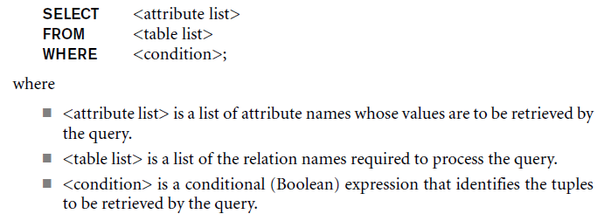
The SELECT-FROM-WHERE Structure of Basic SQL Queries
Basic form of the SELECT statement:

Slide 36
The SELECT-FROM-WHERE Structure of Basic SQL Queries (cont.)
Logical comparison operators
  =, <, <=, >, >=, and <>
Projection attributes
  Attributes whose values are to be retrieved
Selection condition
  Boolean condition that must be true for any retrieved tuple

Slide 37
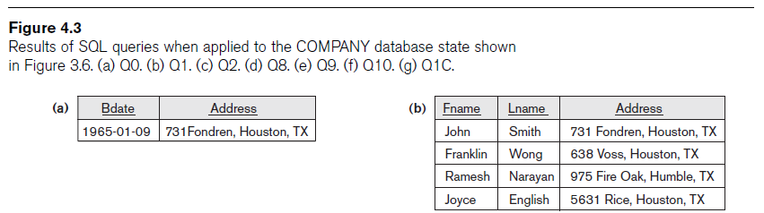
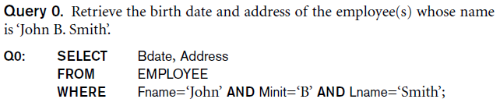
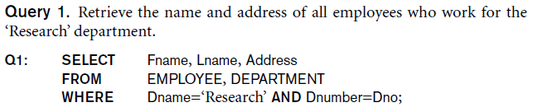

Slide 38

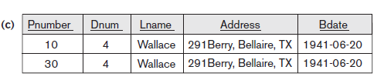
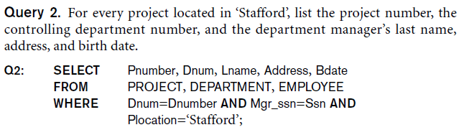

Slide 39

Ambiguous Attribute Names
Same name can be used for two (or more) attributes
  As long as the attributes are in different relations
  Must qualify the attribute name with the relation name to prevent ambiguity

Slide 40
Aliasing, Renaming, and Tuple Variables
Aliases or tuple variables
  Declare alternative relation names E and S
  EMPLOYEE AS E(Fn, Mi, Ln, Ssn, Bd, Addr, Sex, Sal, Sssn, Dno)

Slide 41
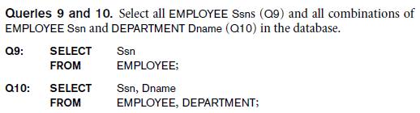
Unspecified WHERE Clause and Use of the Asterisk
Missing WHERE clause
  Indicates no condition on tuple selection
CROSS PRODUCT
  All possible tuple combinations

Slide 42
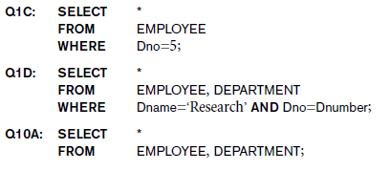
Unspecified WHERE Clause and Use of the Asterisk (cont.)
Specify an asterisk (*)
  Retrieve all the attribute values of the selected tuples

Slide 43
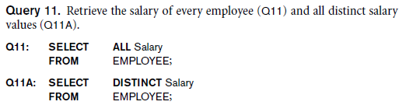
Tables as Sets in SQL
SQL does not automatically eliminate duplicate tuples in query results
Use the keyword DISTINCT in the SELECT clause
  Only distinct tuples should remain in the result

Slide 44
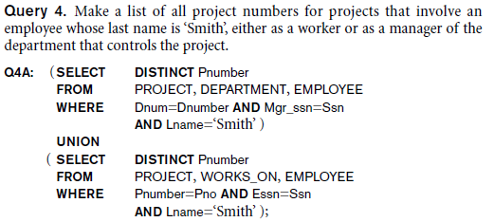
Tables as Sets in SQL (cont.)
Set operations
  UNION, EXCEPT (difference), INTERSECT
  Corresponding multiset operations: UNION ALL, EXCEPT ALL, INTERSECT ALL)

Slide 45
Substring Pattern Matching and Arithmetic Operators
LIKE comparison operator
  Used for string pattern matching
  % replaces an arbitrary number of zero or more characters
  underscore (_) replaces a single character
Standard arithmetic operators:
  Addition (+), subtraction (–), multiplication (*), and division (/)
BETWEEN comparison operator

Slide 46
Ordering of Query Results
Use ORDER BY clause
  Keyword DESC to see result in a descending order of values
  Keyword ASC to specify ascending order explicitly
  ORDER BY D.Dname DESC, E.Lname ASC, E.Fname ASC

Slide 47
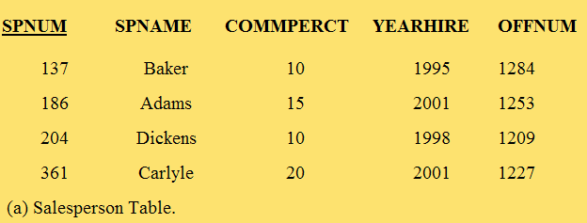
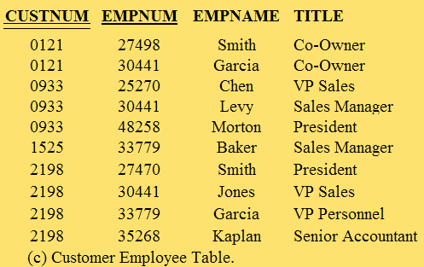
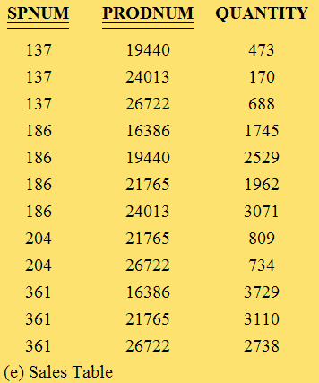
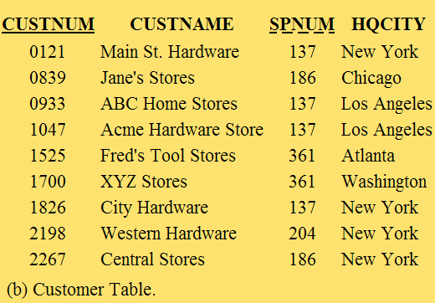
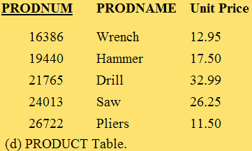
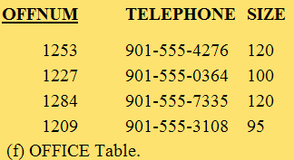
General Hardware Company Database (Modified)

Slide 48

General Hardware Company SQL Query Example
“Find the commission percentage and year of hire of salesperson number 186.”
SELECT COMMPERCT, YEARHIRE FROM SALESPERSON
WHERE SPNUM=186;
The desired attributes are listed in the SELECT clause.
The required table is listed in the FROM clause.
The restriction (predicate) indicating which row(s) is involved is shown in the WHERE clause in the form of an equation.

Slide 49

General Hardware Company SQL Query Example, *
“Retrieve the entire record for salesperson 186.”
SELECT *
FROM SALESPERSON
WHERE SPNUM=186;
The “*” indicates that all attributes of the selected row are to be retrieved.

Slide 50
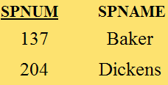
General Hardware Company SQL Query Example
“List the salesperson numbers and salesperson names of those salespersons who have a commission percentage of 10.”
SELECT SPNUM, SPNAME
FROM SALESPERSON
WHERE COMMPERCT=10;
The search argument is nonunique in this query.

Slide 51
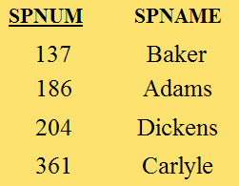
General Hardware Company SQL Query Example, No WHERE
“List the salesperson number and salesperson name of all of the salespersons.”
SELECT SPNUM, SPNAME
FROM SALESPERSON;
For a Relational Algebra Project operation, there is no need for a WHERE clause to limit which rows of the table are included.

Slide 52
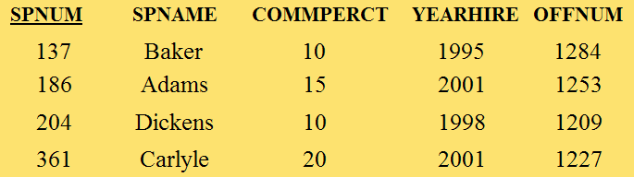
General Hardware Company SQL Query Example, *
“Retrieve all of the Salespersons.”
SELECT *
FROM SALESPERSON;
Retrieves an entire table, that is, the query places no restrictions on either the rows or the attributes.

Slide 53
Comparisons
In addition to equal (=), the standard comparison operators can be used in the WHERE clause.
  Greater than (>)
  Less than (<)
  Greater than or equal to (>=)
  Less than or equal to (<=)
  Not equal to (<>)

Slide 54
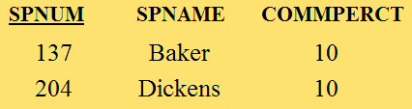
General Hardware Company SQL Query Example, <
“List the salesperson numbers, salesperson names, and commission percentages of the salespersons whose commission percentage is less than 12.”
SELECT SPNUM, SPNAME, COMMPERCT
FROM SALESPERSON
WHERE COMMPERCT < 12;

Slide 55
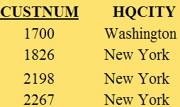
General Hardware Company SQL Query Example, >=
“List the customer numbers and headquarters cities of the customers that have a customer number of at least 1700.”
SELECT CUSTNUM, HQCITY
FROM CUSTOMER
WHERE CUSTNUM >= 1700;

Slide 56
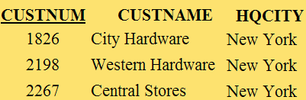
General Hardware Company SQL Query Example: AND
“List the customer numbers, customer names, and headquarters cities of the customers that are headquartered in New York and that have a customer number higher than 1500.”
SELECT CUSTNUM, CUSTNAME, HQCITY
FROM CUSTOMER
WHERE HQCITY=’New York’
AND CUSTNUM>1500;
With the AND operator, both conditions have to be satisfied to be included in the result.

Slide 57
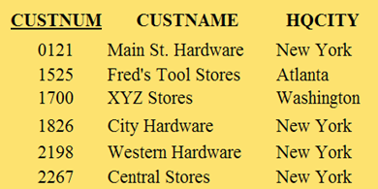
General Hardware Company SQL Query Example: OR
“List the customer numbers, customer names, and headquarters cities of the customers that are headquartered in New York or that have a customer number higher than 1500.”
SELECT CUSTNUM, CUSTNAME, HQCITY
FROM CUSTOMER
WHERE HQCITY=’New York’
OR CUSTNUM>1500;
The OR operator really means one or the other or both.

Slide 58
General Hardware Company SQL Query Example: AND, OR
AND is said to be “higher in precedence” than OR.
So all ANDs are considered before any ORs are considered.
“List the customer numbers, customer names, and headquarters cities of the customers that are headquartered in New York or that satisfy the two conditions of having a customer number higher than 1500 and being headquartered in Atlanta.”

Slide 59
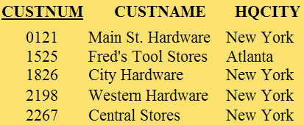
General Hardware Company SQL Query Example: AND, OR
“List the customer numbers, customer names, and headquarters cities of the customers that are headquartered in New York or that satisfy the two conditions of having a customer number higher than 1500 and being headquartered in Atlanta.”
SELECT CUSTNUM, CUSTNAME, HQCITY
FROM CUSTOMER
WHERE HQCITY=’New York’
OR CUSTNUM>1500
AND HQCITY=’Atlanta’;

Slide 60

General Hardware Company SQL Query Example: AND, OR
If you really wanted the OR to be considered first, you could force it by writing the query as:
SELECT CUSTNUM, CUSTNAME, HQCITY
FROM CUSTOMER
WHERE (HQCITY=’New York’
OR CUSTNUM>1500)
AND HQCITY=’Atlanta’;

Slide 61

General Hardware Company SQL Query Example: BETWEEN
SELECT *
FROM CUSTOMER
WHERE (CUSTNUM>=1000 AND CUSTNUM<=1700);
“Find the customer records for those customers whose customer numbers are between 1000 and 1700, inclusive.”
SELECT *
FROM CUSTOMER
WHERE CUSTNUM BETWEEN 1000 AND 1700;
Allows you to specify a range of numeric values in a search.

Slide 62
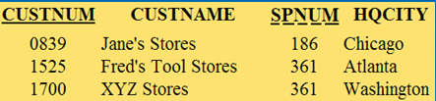
General Hardware Company SQL Query Example: IN
“Find the customer records for those customers headquartered in Atlanta, Chicago, or Washington.”
SELECT *
FROM CUSTOMER
WHERE (HQCITY=’Atlanta’
OR HQCITY=’Chicago’
OR HQCITY=’Washington’);
SELECT *
FROM CUSTOMER
WHERE HQCITY IN (‘Atlanta’, ‘Chicago’, ‘Washington’);

Slide 63

General Hardware Company SQL Query Example: LIKE
“Find the customer records for those customers whose names begin with the letter “A”.”
SELECT *
FROM CUSTOMER
WHERE CUSTNAME LIKE ‘A%’;
“%” character used as a “wildcard” to represent any string of characters.

Slide 64

General Hardware Company SQL Query Example: LIKE
“Find the customer records for those customers whose names have the letter “a” as the second letter of their names.”
SELECT *
FROM CUSTOMER
WHERE CUSTNAME LIKE ‘_a%’;
The single “_” character in the operator LIKE “_a%” specifies that there will be one character followed by “a.”

Slide 65
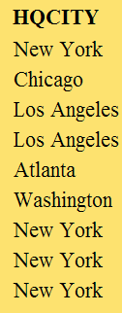
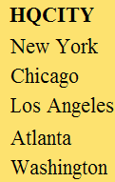
General Hardware Company SQL Query Example: DISTINCT
“Which cities serve as headquarters cities for General Hardware customers?”
SELECT HQCITY
FROM CUSTOMER;
SELECT DISTINCT HQCITY
FROM CUSTOMER;
Eliminate duplicate rows in a query result.

Slide 66
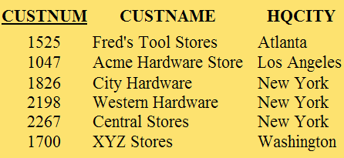
General Hardware Company SQL Query Example: ORDER BY
“Find the customer numbers, customer names, and headquarters cities of those customers with customer numbers greater than 1000. List the results in alphabetic order by headquarters cities.”
SELECT CUSTNUM, CUSTNAME, HQCITY
FROM CUSTOMER
WHERE CUSTNUM>1000
ORDER BY HQCITY;
Orders the results of an SQL query by one or more specified attributes.

Slide 67
General Hardware Company SQL Query Example: ORDER BY
The default order for ORDER BY is ascending.
The clause can include the term ASC at the end to make ascending explicit.
The clause can include DESC for descending order.

Slide 68

General Hardware Company SQL Query Example: AVG
“Find the average number of units of the different products that Salesperson 137 has sold (i.e., the average of the quantity values in the first three records of the SALES table).”
SELECT AVG(QUANTITY)
FROM SALES
WHERE SPNUM=137;
AVG is a built-in function of SQL.

Slide 69

General Hardware Company SQL Query Example: SUM
“Find the total number of all products that Salesperson 137 has sold.”
SELECT SUM(QUANTITY)
FROM SALES
WHERE SPNUM=137;
SUM is a built-in function of SQL.

Slide 70

General Hardware Company SQL Query Example: MAX
“What is the largest number of units of Product Number 21765 that any individual salesperson has sold?”
SELECT MAX(QUANTITY)
FROM SALES
WHERE PRODNUM=21765;
MAX is a built-in function of SQL.

Slide 71

General Hardware Company SQL Query Example: MIN
“What is the smallest number of units of Product Number 21765 that any individual salesperson has sold?”
SELECT MIN(QUANTITY)
FROM SALES
WHERE PRODNUM=21765;
MIN is a built-in function of SQL.

Slide 72

General Hardware Company SQL Query Example: COUNT
“How many salespersons have sold Product Number 21765?”
SELECT COUNT(*)
FROM SALES
WHERE PRODNUM=21765;
COUNT counts the number of rows that satisfy a set of criteria.

Slide 73
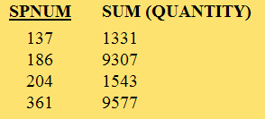
General Hardware Company SQL Query Example: GROUP BY
“Find the total number of units of all products sold by each salesperson.”
SELECT SPNUM, SUM(QUANTITY) FROM SALES
GROUP BY SPNUM;
Used when calculations are to be made on several different groups of rows.

Slide 74

General Hardware Company SQL Query Example: HAVING
“Find the total number of units of all products sold by each salesperson whose salesperson number is at least 150. Only include salespersons whose total number of units sold is at least 5000.”
SELECT SPNUM, SUM(QUANTITY) FROM SALES
WHERE SPNUM>=150
GROUP BY SPNUM
HAVING SUM(QUANTITY)>=5000;
HAVING limits the results of a GROUP BY based on the values calculated for each group with the built-in functions.

Slide 75
The Join
SQL SELECT allows you to join two or more tables.
Two specifications must be made in the SELECT statement.
  The tables to be joined must be listed in the FROM clause.
  The join attributes in the tables being joined must be declared and matched to each other in the WHERE clause.
A table name qualifier is required when different tables have an attribute with the same name.

Slide 76

General Hardware Company SQL Query Example: Join
“Find the name of the salesperson responsible for Customer Number 1525.”
SELECT SPNAME
FROM SALESPERSON, CUSTOMER
WHERE SALESPERSON.SPNUM=CUSTOMER.SPNUM AND CUSTNUM=1525;

Slide 77

General Hardware Company SQL Query Example: Join
“List the names of the products of which salesperson Adams has sold more than 2,000 units.”
SELECT PRODNAME
FROM SALESPERSON, PRODUCT, SALES
WHERE SALESPERSON.SPNUM=SALES.SPNUM
AND SALES.PRODNUM=PRODUCT.PRODNUM
AND SPNAME=’Adams’
AND QUANTITY>2000;

Slide 78
Subqueries
One SELECT statement is “nested” within another.
Nesting can go on through several levels of SELECT statements with each successive SELECT statement contained in a pair of parentheses.
The innermost SELECT statement is executed first, and its results are then provided as input to the SELECT statement at the next level up.

Slide 79
General Hardware Company SQL Query Example: Subquery
“Find the name of the salesperson responsible for Customer Number 1525.”
SELECT SPNAME
FROM SALESPERSON
WHERE SPNUM=
(SELECT SPNUM
FROM CUSTOMER
WHERE CUSTNUM=1525);
Subquery as an alternative to join.

Slide 80

General Hardware Company SQL Query Example: Subquery
“Which salespersons with salesperson numbers greater than 200 have the lowest commission percentage of any such salesperson?” (We’ll identify salespersons by their salesperson number.)
A subquery is required.
SELECT SPNUM
FROM SALESPERSON
WHERE SPNUM>200
AND COMMPERCT=
(SELECT MIN(COMMPERCT)
FROM SALESPERSON)
WHERE SPNUM>200);

Slide 81
A Strategy for Writing SQL SELECT Commands
Determine what the result of the query is to be and write the needed attributes and functions in the SELECT clause.
Determine which tables of the database will be needed for the query and write their names in the FROM clause.
If the query involves a join, begin constructing the WHERE clause by equating the join attributes from the tables that are in the FROM clause.
Continue filling in the details of the WHERE clause, the GROUP BY clause, and any subqueries.

Slide 82
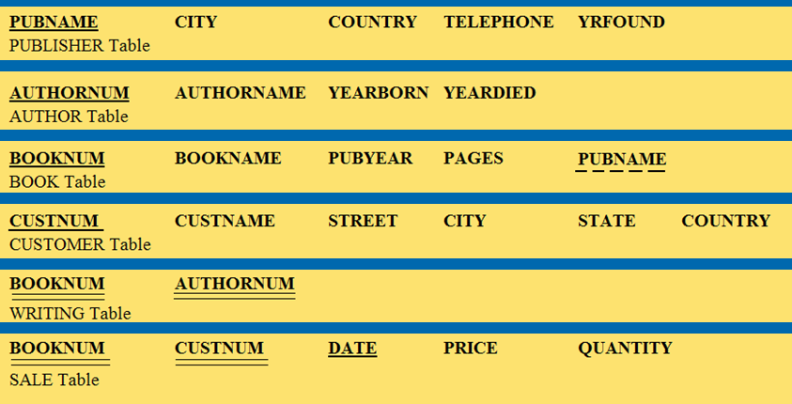
Example - Good Reading Bookstores

Slide 83
Sample Queries
“Find the book number, book name, and number of pages of all of the books published by London Publishing Ltd. List the results in order by book name.”
SELECT BOOKNUM, BOOKNAME, PAGES FROM BOOK
WHERE PUBNAME=’London Publishing Ltd.’ ORDER BY BOOKNAME;

Slide 84
Sample Queries (cont.)
“How many books of at least 400 pages does Good Reading Bookstores carry that were published by publishers based in Paris, France?”
SELECT COUNT(*)
FROM PUBLISHER, BOOK
WHERE PUBLISHER.PUBNAME=BOOK.PUBNAME AND CITY=’Paris’
AND COUNTRY=’France’
AND PAGES>=400;

Slide 85
Sample Queries (cont.)
“List the publishers in Belgium, Brazil, and Singapore that publish books written by authors who were born before 1920.”
SELECT DISTINCT PUBNAME
FROM PUBLISHER, BOOK, WRITING, AUTHOR
WHERE PUBLISHER.PUBNAME=BOOK.PUBNAME
AND BOOK.BOOKNUM=WRITING.BOOKNUM
AND WRITING.AUTHORNUM=AUTHOR.AUTHORNUM AND COUNTRY IN (‘Belgium’, ‘Brazil’, ‘Singapore’)
AND YEARBORN<1920;

Slide 86
Sample Queries (cont.)
“How many books did each publisher in Oslo, Norway; Nairobi, Kenya; and Auckland, New Zealand, publish in 2001?”
SELECT PUBNAME, CITY, COUNTRY, COUNT(*)
FROM PUBLISHER, BOOK
WHERE PUBLISHER.PUBNAME=BOOK.PUBNAME
AND ((CITY=’Oslo’ AND COUNTRY=’Norway’)
OR (CITY=’Nairobi’ AND COUNTRY=’Kenya’)
OR (CITY=’Auckland’ AND COUNTRY=’New Zealand’)) AND PUBYEAR=2001
GROUP BY PUBNAME;

Slide 87
Sample Queries (cont.)
“Which publisher published the book that has the earliest publication year among all of the books that Good Reading Bookstores carries?”
SELECT DISTINCT PUBNAME
FROM BOOK
WHERE PUBYEAR=
(SELECT MIN(PUBYEAR)
FROM BOOK);

Slide 88
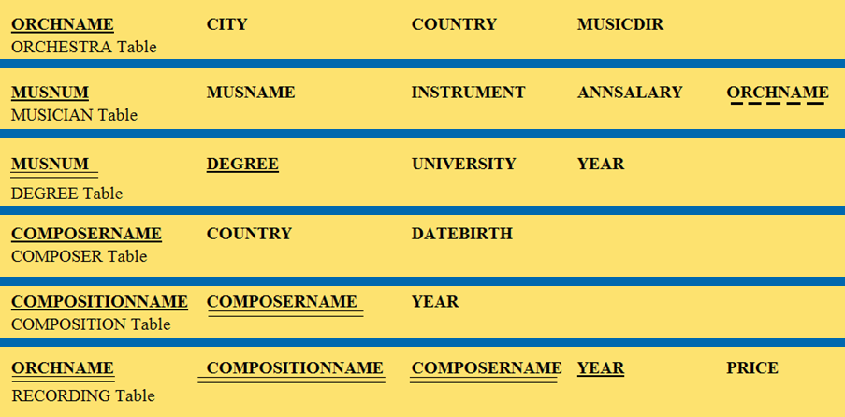
Example - World Music Association

Slide 89
Sample Queries (cont.)
“What is the total annual salary cost for all of the violinists of the Berlin Symphony Orchestra?”
SELECT SUM(ANNSALARY)
FROM MUSICIAN
WHERE ORCHNAME=’Berlin Symphony Orchestra’
AND INSTRUMENT=’Violin’;

Slide 90
Sample Queries (cont.)
“Make a single list, in alphabetic order of all of the universities attended by the cellists of India.”
SELECT DISTINCT UNIVERSITY
FROM ORCHESTRA, MUSICIAN, DEGREE
WHERE ORCHESTRA.ORCHNAME=MUSICIAN.ORCHNAME
AND MUSICIAN.MUSNUM=DEGREE.MUSNUM
AND INSTRUMENT=’Cello’
AND COUNTRY=’India’
ORDER BY UNIVERSITY;

Slide 91
Sample Queries (cont.)
“What is the total annual salary cost for all of the violinists of each orchestra located in Canada? Only include in the result those orchestras whose total annual salary for its violinists is in excess of $150,000.”
SELECT ORCHNAME, SUM(ANNSALARY)
FROM ORCHESTRA, MUSICIAN
WHERE ORCHESTRA.ORCHNAME=MUSICIAN.ORCHNAME AND COUNTRY=’Canada’
AND INSTRUMENT=’Violin’
GROUP BY ORCHNAME
HAVING SUM(ANNSALARY)>150,000;

Slide 92
Sample Queries (cont.)
“What is the name of the most highly paid pianist?”
SELECT MUSNAME
FROM MUSICIAN
WHERE INSTRUMENT=’Piano’
AND ANNSALARY=
(SELECT MAX(ANNSALARY)
FROM MUSICIAN
WHERE INSTRUMENT=’Piano’);

Slide 93
Sample Queries (cont.)
“What is the name of the most highly paid pianist of any orchestra in Australia?”
SELECT MUSNAME
FROM MUSICIAN, ORCHESTRA
WHERE MUSICIAN.ORCHNAME=ORCHESTRA.ORCHNAME
AND INSTRUMENT=’Piano’
AND COUNTRY=’Australia’
AND ANNSALARY=
(SELECT MAX(ANNSALARY)
FROM MUSICIAN, ORCHESTRA
WHERE MUSICIAN.ORCHNAME=ORCHESTRA.ORCHNAME
AND INSTRUMENT=’Piano’
AND COUNTRY=’Australia’);

Slide 94
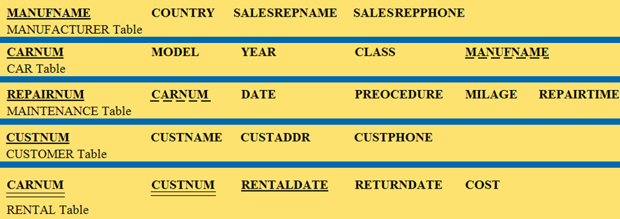
Example - Lucky Rent-A-Car

Slide 95
Sample Queries
“List the manufacturers whose names begin with the letter C or the letter D and that are located in Japan.”
SELECT MANUFNAME
FROM MANUFACTURER
WHERE (MANUFNAME LIKE ‘C%’
OR MANUFNAME LIKE ‘D%’)
AND COUNTRY=’Japan’;

Slide 96
Sample Queries (cont.)
“What was the average mileage of the cars that had tune-ups in August 2003?”
SELECT AVG(MILEAGE)
FROM MAINTENANCE
WHERE PROCEDURE=’Tune-Up’
AND DATE BETWEEN ‘AUG-01-2003’ AND ‘AUG-31-2003’;

Slide 97
Sample Queries (cont.)
“How many different car models do manufacturers in Italy make?”
SELECT COUNT(DISTINCT MODEL)
FROM MANUFACTURER, CAR
WHERE MANUFACTURER.MANUFNAME=CAR.MANUFNAME
AND COUNTRY=’Italy’;

Slide 98
Sample Queries (cont.)
“How many repairs were performed on each car manufactured by Superior Motors during the month of March 2004? Only include cars in the result that had at least three repairs.”
SELECT CAR.CARNUM, COUNT(*)
FROM CAR, MAINTENANCE
WHERE CAR.CARNUM=MAINTENANCE.CARNUM
AND MANUFNAME=’Superior Motors’
AND DATE BETWEEN ‘MAR-01-2004’ AND ‘MAR-31-2004’ GROUP BY CAR.CARNUM
HAVING COUNT(*)>=3;

Slide 99
Sample Queries (cont.)
“List the cars of any manufacturer that had an oil change in January 2004 and had at least as many miles as the highest mileage car manufactured by Superior Motors that had an oil change that same month.”
SELECT MAINTENANCE.CARNUM
FROM MAINTENANCE
WHERE PROCEDURE=’Oil Change’
AND DATE BETWEEN ‘JAN-01-2004’ AND ‘JAN-31-2004’
AND MILEAGE>=
(SELECT MAX(MILEAGE)
FROM CAR, MAINTENANCE
WHERE CAR.CARNUM, MAINTENANCE.CARNUM
AND PROCEDURE=’Oil Change’
AND DATE BETWEEN ‘JAN-01-2004’ AND ‘JAN-31-2004
AND MANUFNAME=’Superior Motors’);

Slide 100
Relational Query Optimizer
Relational DBMS Performance
Relational Query Optimizer Concepts

Slide 101
Relational Query Optimizer: Relational DBMS Performance
The speed with which the required data can be retrieved. Performance regarding joins is a particular problem.
Solutions
  Tuning of the database structure, physical database design.
  Relational query optimizer software that evaluates each SQL SELECT statement and determines an efficient way to satisfy it.

Slide 102
Relational Query Optimizer: Concepts
All major SQL processors include a query optimizer.
Using a query optimizer, SQL attempts to figure out the most efficient way of answering a query, prior to actually responding to it.
The query optimizer uses the relational catalog, an internal database.

Slide 103
Query Optimizer Considerations
Which attributes have indexes built over them?
How many rows does each table have?
Which attributes are unique?
How many records of a table are really needed for a particular join?
Which join algorithm is best for this query?

Slide 104
Join Algorithms
Nested-loop join
  A Cartesian product
  One of the two tables is selected for the outer loop and the other for the inner loop.
  Each of the records of the outer loop is chosen in succession, and, for each, the inner loop table is scanned for matches on the join attribute.

Slide 105
Join Algorithms
Merge-scan join
  More efficient than the nested-loop join.
  Can only be used if certain conditions are met.
    Each of the two join attributes has to be in sorted order, or
    Each of the two join attributes has to have an index built over it.

Slide 106
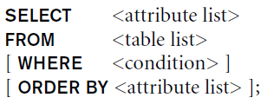
Discussion and Summary of Basic SQL Retrieval Queries

Slide 107
INSERT, DELETE, and UPDATE Statements in SQL
Three commands used to modify the database:
  INSERT, DELETE, and UPDATE

Slide 108

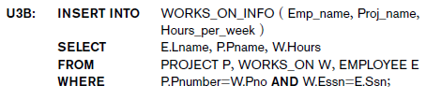
The INSERT Command
Specify the relation name and a list of values for the tuple

Slide 109
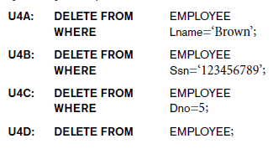
The DELETE Command
Removes tuples from a relation
  Includes a WHERE clause to select the tuples to be deleted

Slide 110

The UPDATE Command
Modify attribute values of one or more selected tuples
Additional SET clause in the UPDATE command
  Specifies attributes to be modified and new values

Slide 111
Additional Features of SQL
Techniques for specifying complex retrieval queries
Writing programs in various programming languages that include SQL statements
Set of commands for specifying physical database design parameters, file structures for relations, and access paths
Transaction control commands

Slide 112
Additional Features of SQL (cont’d.)
Specifying the granting and revoking of privileges to users
Constructs for creating triggers
Enhanced relational systems known as object-relational
New technologies such as XML and OLAP

Slide 113
Part 2
More Complex SQL Queries

Slide 114
More Complex SQL Retrieval Queries
Additional features allow users to specify more complex retrievals from database:
  Nested queries, joined tables, outer joins, aggregate functions, and grouping

Slide 115
Comparisons Involving NULL and Three-Valued Logic
Meanings of NULL
  Unknown value
  Unavailable or withheld value
  Not applicable attribute
Each individual NULL value considered to be different from every other NULL value
SQL uses a three-valued logic:
  TRUE, FALSE, and UNKNOWN

Slide 116
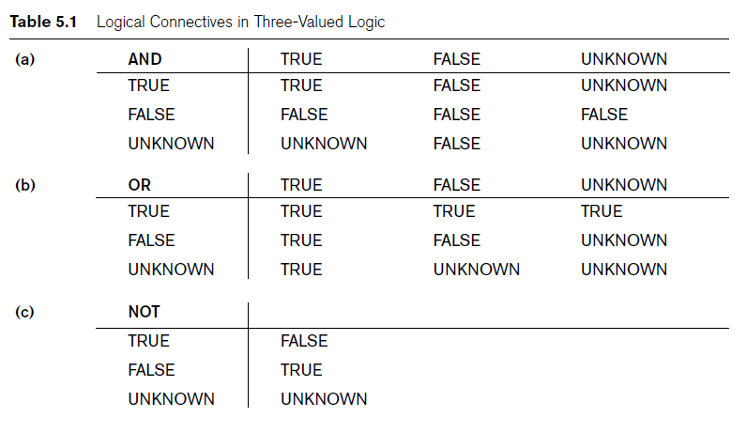
Comparisons Involving NULL and Three-Valued Logic (cont.)

Slide 117

Comparisons Involving NULL and Three-Valued Logic (cont.)
SQL allows queries that check whether an attribute value is NULL
  IS or IS NOT NULL

Slide 118
Nested Queries, Tuples, and Set/Multiset Comparisons
Nested queries
  Complete select-from-where blocks within WHERE clause of another query
  Outer query
Comparison operator IN
  Compares value v with a set (or multiset) of values V
  Evaluates to TRUE if v is one of the elements in V

Slide 119
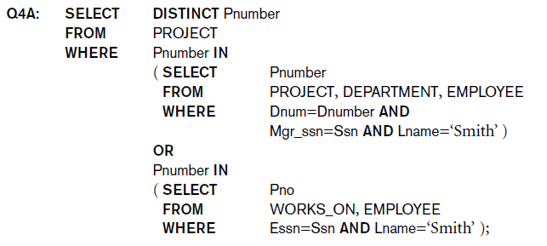
Nested Queries (cont.)

Slide 120
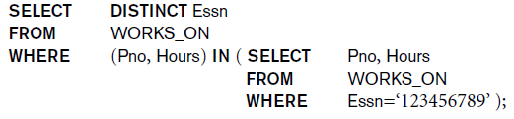
Nested Queries (cont.)
Use tuples of values in comparisons
  Place them within parentheses

Slide 121
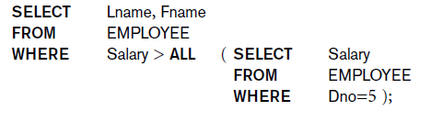
Nested Queries (cont.)
Use other comparison operators to compare a single value v
  = ANY (or = SOME) operator
    Returns TRUE if the value v is equal to some value in the set V and is hence equivalent to IN
  Other operators that can be combined with ANY (or SOME): >, >=, <, <=, and <>

Slide 122
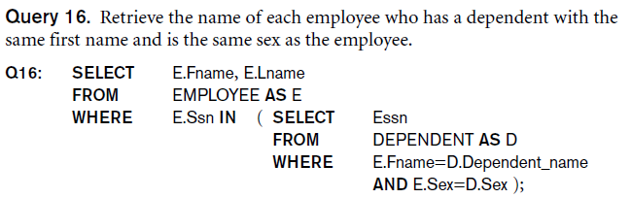
Nested Queries (cont.)
Avoid potential errors and ambiguities
  Create tuple variables (aliases) for all tables referenced in SQL query

Slide 123
Correlated Nested Queries
Correlated nested query
  Evaluated once for each tuple in the outer query

Slide 124
The EXISTS and UNIQUE Functions in SQL
EXISTS function
  Check whether the result of a correlated nested query is empty or not
EXISTS and NOT EXISTS
  Typically used in conjunction with a correlated nested query
SQL function UNIQUE(Q)
  Returns TRUE if there are no duplicate tuples in the result of query Q

Slide 125

Explicit Sets and Renaming of Attributes in SQL
Can use explicit set of values in WHERE clause
Use qualifier AS followed by desired new name
  Rename any attribute that appears in the result of a query

Slide 126

Joined Tables in SQL and Outer Joins
Joined table
  Permits users to specify a table resulting from a join operation in the FROM clause of a query
The FROM clause in Q1A
  Contains a single joined table

Slide 127
Joined Tables in SQL and Outer Joins (cont.)
Specify different types of join
  NATURAL JOIN
  Various types of OUTER JOIN
NATURAL JOIN on two relations R and S
  No join condition specified
  Implicit EQUIJOIN condition for each pair of attributes with same name from R and S

Slide 128
Joined Tables in SQL and Outer Joins (cont.)
Inner join
  Default type of join in a joined table
  Tuple is included in the result only if a matching tuple exists in the other relation
LEFT OUTER JOIN
  Every tuple in left table must appear in result
  If no matching tuple
    Padded with NULL values for attributes of right table

Slide 129
Joined Tables in SQL and Outer Joins (cont.)
RIGHT OUTER JOIN
  Every tuple in right table must appear in result
  If no matching tuple
    Padded with NULL values for the attributes of left table
FULL OUTER JOIN
Can nest join specifications

Slide 130
Aggregate Functions in SQL
Used to summarize information from multiple tuples into a single-tuple summary
Grouping
  Create subgroups of tuples before summarizing
Built-in aggregate functions
  COUNT, SUM, MAX, MIN, and AVG
Functions can be used in the SELECT clause or in a HAVING clause

Slide 131
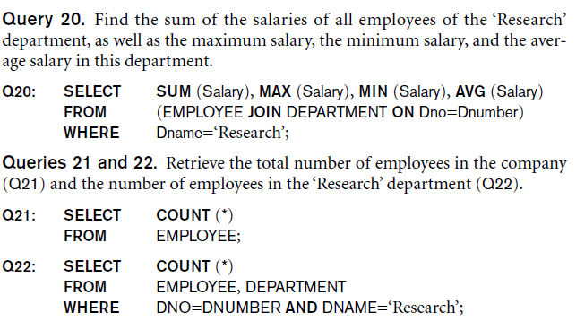
Aggregate Functions in SQL (cont.)
NULL values discarded when aggregate functions are applied to a particular column

Slide 132
Grouping: The GROUP BY and HAVING Clauses
Partition relation into subsets of tuples
  Based on grouping attribute(s)
  Apply function to each such group independently
GROUP BY clause
  Specifies grouping attributes
If NULLs exist in grouping attribute
  Separate group created for all tuples with a NULL value in grouping attribute

Slide 133
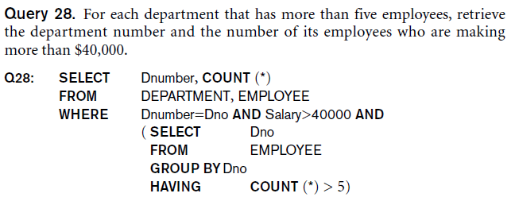
Grouping: The GROUP BY and HAVING Clauses (cont.)
HAVING clause
  Provides a condition on the summary information

Slide 134
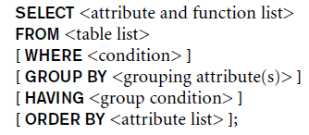
Discussion and Summary of SQL Queries

Slide 135
Specifying Constraints as Assertions and Actions as Triggers
CREATE ASSERTION
  Specify additional types of constraints outside scope of built-in relational model constraints
CREATE TRIGGER
  Specify automatic actions that database system will perform when certain events and conditions occur

Slide 136
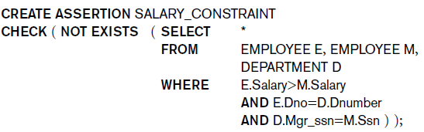
Specifying General Constraints as Assertions in SQL
CREATE ASSERTION
  Specify a query that selects any tuples that violate the desired condition
  Use only in cases where it is not possible to use CHECK on attributes and domains

Slide 137
Introduction to Triggers in SQL
CREATE TRIGGER statement
  Used to monitor the database
Typical trigger has three components:
  Event(s)
  Condition
  Action

Slide 138
Views (Virtual Tables) in SQL
Concept of a view in SQL
  Single table derived from other tables
  Considered to be a virtual table

Slide 139
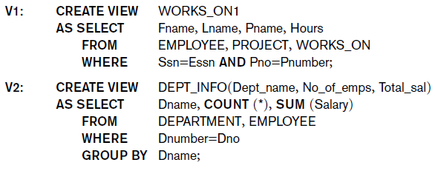
Specification of Views in SQL
CREATE VIEW command
  Give table name, list of attribute names, and a query to specify the contents of the view

Slide 140
Specification of Views in SQL (cont.)
Specify SQL queries on a view
View always up-to-date
  Responsibility of the DBMS and not the user
DROP VIEW command
  Dispose of a view

Slide 141
View Implementation, View Update, and Inline Views
Complex problem of efficiently implementing a view for querying
Query modification approach
  Modify view query into a query on underlying base tables
  Disadvantage: inefficient for views defined via complex queries that are time-consuming to execute

Slide 142
View Implementation
View materialization approach
  Physically create a temporary view table when the view is first queried
  Keep that table on the assumption that other queries on the view will follow
  Requires efficient strategy for automatically updating the view table when the base tables are updated

Slide 143
View Implementation (cont.)
Incremental update strategies
  DBMS determines what new tuples must be inserted, deleted, or modified in a materialized view table

Slide 144
View Update and Inline Views
Update on a view defined on a single table without any aggregate functions
  Can be mapped to an update on underlying base table
View involving joins
  Often not possible for DBMS to determine which of the updates is intended

Slide 145
View Update and Inline Views (cont.)
Clause WITH CHECK OPTION
  Must be added at the end of the view definition if a view is to be updated
In-line view
  Defined in the FROM clause of an SQL query

Slide 146
Schema Change Statements in SQL
Schema evolution commands
  Can be done while the database is operational
  Does not require recompilation of the database schema

Slide 147
The DROP Command
DROP command
  Used to drop named schema elements, such as tables, domains, or constraint
Drop behavior options:
  CASCADE and RESTRICT
Example:
  DROP SCHEMA COMPANY CASCADE;

Slide 148
The ALTER Command
Alter table actions include:
  Adding or dropping a column (attribute)
  Changing a column definition
  Adding or dropping table constraints
Example:
  ALTER TABLE COMPANY.EMPLOYEE ADD COLUMN Job VARCHAR(12);
To drop a column
  Choose either CASCADE or RESTRICT

Slide 149

The ALTER Command (cont.)
Change constraints specified on a table
  Add or drop a named constraint

Slide 150
Next Lecture
Entity-Relationship (ER) Model

Slide 151
References
Ramez Elmasri, Shamkant Navathe; “Fundamentals of Database Systems”, 6th Ed., Pearson, 2014.
Mark L. Gillenson; “Fundamentals of Database Management Systems”, 2nd Ed., John Wiley, 2012.
Universität Hamburg, Fachbereich Informatik, Einführung in Datenbanksysteme, Lecture Notes, 1999

