Slide 1
CSE202 Database Management Systems
Lecture #2
Prepared & Presented by Asst. Prof. Dr. Samsun M. BAŞARICI

Slide 2
Part 2
Relational Algebra & Relational Calculus

Slide 3
Learning Objectives
Understand and perform following operations:
  Unary Relational Operations: SELECT and PROJECT
  Relational Algebra Operations from Set Theory
  Binary Relational Operations: JOIN and DIVISION
  Additional Relational Operations
Explain some examples of queries in relational algebra
Understand the tuple relational calculus
Understand the domain relational calculus

Slide 4
Outline
Relational operations
  Unary operations
    Select
    Project
  Operations from Set Theory
  Binary operations
    Join
    Division
Query examples in relational algebra
Tuple relational calculus
Domain relational calculus

Slide 5
The Relational Algebra and
Relational Calculus
Relational algebra
  Basic set of operations for the relational model
Relational algebra expression
  Sequence of relational algebra operations
Relational calculus
  Higher-level declarative language for specifying relational queries

Slide 6

Unary Relational Operations:
SELECT and PROJECT
The SELECT Operation
  Subset of the tuples from a relation that satisfies a selection condition:
    Boolean expression contains clauses of the form <attribute name> <comparison op> <constant value>
    or
    <attribute name> <comparison op> <attribute name>

Slide 7
Unary Relational Operations:
SELECT and PROJECT (cont.)
Example:
<selection condition> applied independently to each individual tuple t in R
  If condition evaluates to TRUE, tuple selected
Boolean conditions AND, OR, and NOT
Unary
  Applied to a single relation

Slide 8
Unary Relational Operations:
SELECT and PROJECT (cont.)
Selectivity
  Fraction of tuples selected by a selection condition
SELECT operation commutative
Cascade SELECT operations into a single operation with AND condition

Slide 9

The PROJECT Operation
Selects columns from table and discards the other columns:
Degree
  Number of attributes in <attribute list>
Duplicate elimination
  Result of PROJECT operation is a set of distinct tuples

Slide 10


Sequences of Operations and the RENAME Operation
In-line expression:
Sequence of operations:
Rename attributes in intermediate results
  RENAME operation

Slide 11
Relational Algebra Operations from Set Theory
UNION, INTERSECTION, and MINUS
  Merge the elements of two sets in various ways
  Binary operations
  Relations must have the same type of tuples
UNION
  R ∪ S
  Includes all tuples that are either in R or in S or in both R and S
  Duplicate tuples eliminated

Slide 12
Relational Algebra Operations from Set Theory (cont.)
INTERSECTION
  R ∩ S
  Includes all tuples that are in both R and S
SET DIFFERENCE (or MINUS)
  R – S
  Includes all tuples that are in R but not in S

Slide 13
The CARTESIAN PRODUCT (CROSS PRODUCT) Operation
CARTESIAN PRODUCT
  CROSS PRODUCT or CROSS JOIN
  Denoted by ×
  Binary set operation
  Relations do not have to be union compatible
  Useful when followed by a selection that matches values of attributes

Slide 14


Binary Relational Operations:
JOIN and DIVISION
The JOIN Operation
  Denoted by
  Combine related tuples from two relations into single “longer” tuples
  General join condition of the form <condition> AND <condition> AND...AND <condition>
  Example:

Slide 15
Binary Relational Operations:
JOIN and DIVISION (cont.)
THETA JOIN
  Each <condition> of the form A_{i} θ B_{j}
  A_{i} is an attribute of R
  B_{j} is an attribute of S
  A_{i} and B_{j} have the same domain
  θ (theta) is one of the comparison operators:
    {=, <, ≤, >, ≥, ≠}

Slide 16
Variations of JOIN: The EQUIJOIN and NATURAL JOIN
EQUIJOIN
  Only = comparison operator used
  Always have one or more pairs of attributes that have identical values in every tuple
NATURAL JOIN
  Denoted by *
  Removes second (superfluous) attribute in an EQUIJOIN condition

Slide 17
Variations of JOIN: The EQUIJOIN and NATURAL JOIN (cont.)
Join selectivity
  Expected size of join result divided by the maximum size n_{R} * n_{S}
Inner joins
  Type of match and combine operation
  Defined formally as a combination of CARTESIAN PRODUCT and SELECTION

Slide 18
A Complete Set of Relational Algebra Operations
Set of relational algebra operations {σ, π, ∪, ρ, –, ×} is a complete set
  Any relational algebra operation can be expressed as a sequence of operations from this set

Slide 19
The DIVISION Operation
Denoted by ÷
Example: retrieve the names of employees who work on all the projects that ‘John Smith’ works on
Apply to relations R(Z) ÷ S(X)
  Attributes of R are a subset of the attributes of S

Slide 20
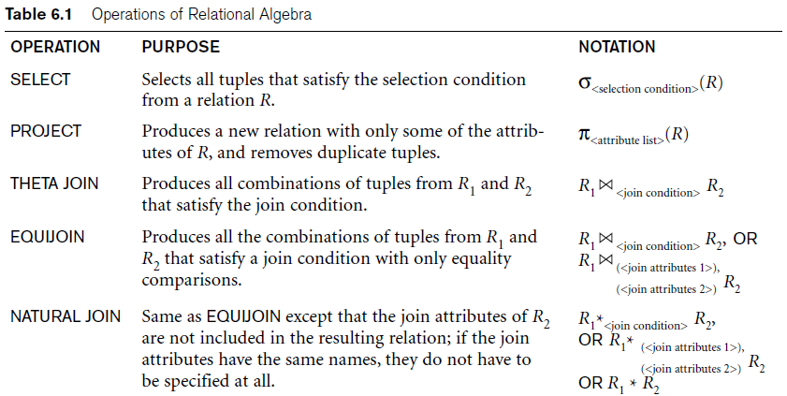
Operations of Relational Algebra

Slide 21
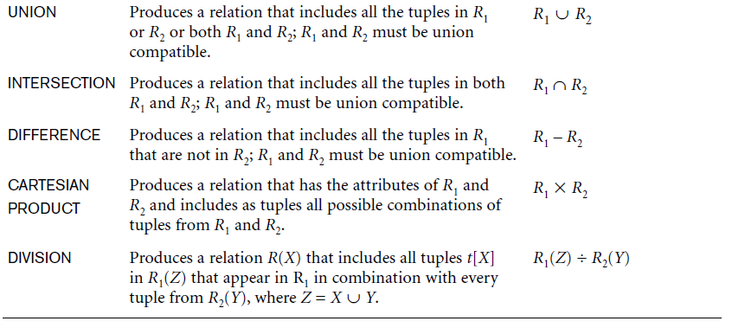
Operations of Relational Algebra (cont.)

Slide 22
Notation for Query Trees
Query tree
  Represents the input relations of query as leaf nodes of the tree
  Represents the relational algebra operations as internal nodes

Slide 23
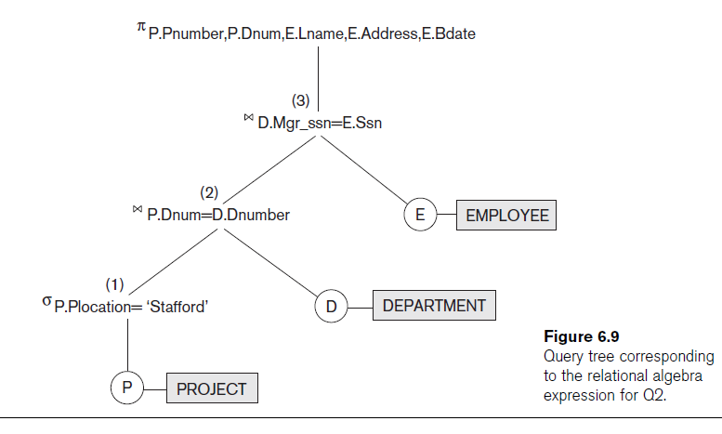

Slide 24

Additional Relational Operations
Generalized projection
  Allows functions of attributes to be included in the projection list
Aggregate functions and grouping
  Common functions applied to collections of numeric values
  Include SUM, AVERAGE, MAXIMUM, and MINIMUM

Slide 25

Additional Relational Operations (cont.)
Group tuples by the value of some of their attributes
  Apply aggregate function independently to each group

Slide 26
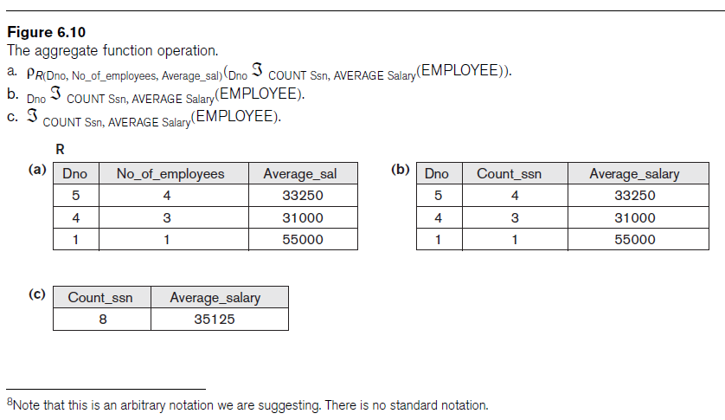

Slide 27
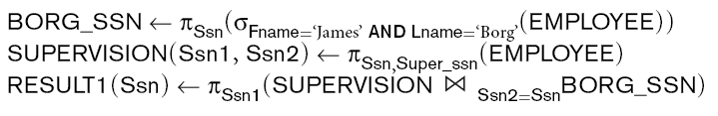
Recursive Closure Operations
Operation applied to a recursive relationship between tuples of same type

Slide 28
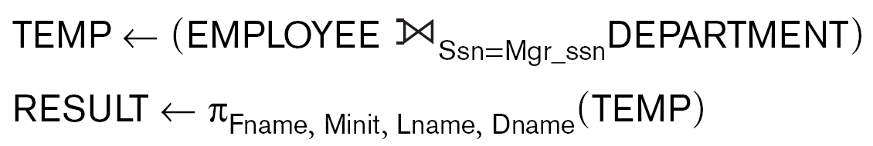
OUTER JOIN Operations
Outer joins
  Keep all tuples in R, or all those in S, or all those in both relations regardless of whether or not they have matching tuples in the other relation
  Types
    LEFT OUTER JOIN, RIGHT OUTER JOIN, FULL OUTER JOIN
  Example:

Slide 29
The OUTER UNION Operation
Take union of tuples from two relations that have some common attributes
  Not union (type) compatible
Partially compatible
  All tuples from both relations included in the result
  Tut tuples with the same value combination will appear only once

Slide 30
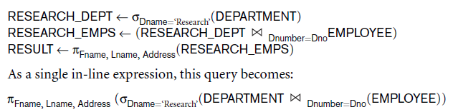
Examples of Queries in Relational Algebra

Slide 31
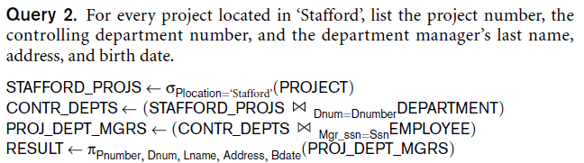
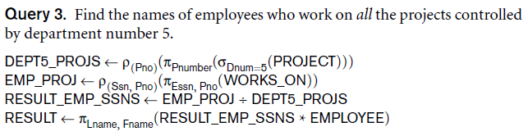
Examples of Queries in Relational Algebra (cont.)

Slide 32
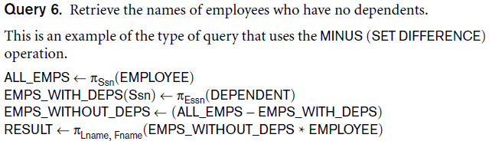
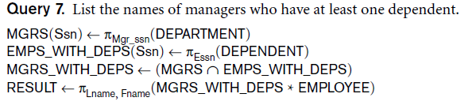
Examples of Queries in Relational Algebra (cont.)

Slide 33
The Tuple Relational Calculus
Declarative expression
  Specify a retrieval request nonprocedural language
Any retrieval that can be specified in basic relational algebra
  Can also be specified in relational calculus

Slide 34

Tuple Variables and Range Relations
Tuple variables
  Ranges over a particular database relation
Satisfy COND(t):
Specify:
  Range relation R of t
  Select particular combinations of tuples
  Set of attributes to be retrieved (requested attributes)

Slide 35
Expressions and Formulas in Tuple Relational Calculus
General expression of tuple relational calculus is of the form:
Truth value of an atom
  Evaluates to either TRUE or FALSE for a specific combination of tuples
Formula (Boolean condition)
  Made up of one or more atoms connected via logical operators AND, OR, and NOT

Slide 36
Existential and Universal Quantifiers
Universal quantifier (∀)
Existential quantifier (∃)
Define a tuple variable in a formula as free or bound

Slide 37
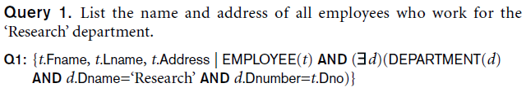
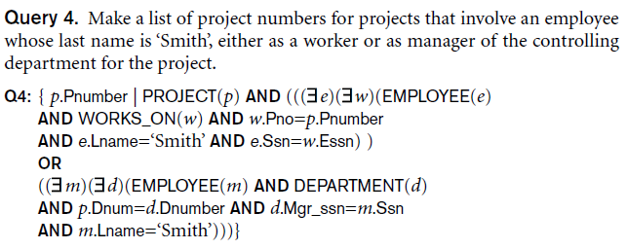
Sample Queries in Tuple Relational Calculus

Slide 38
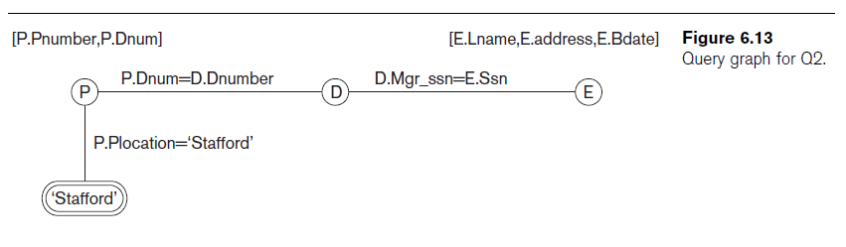
Notation for Query Graphs

Slide 39
Transforming the Universal and Existential Quantifiers
Transform one type of quantifier into other with negation (preceded by NOT)
  AND and OR replace one another
  Negated formula becomes unnegated
  Unnegated formula becomes negated

Slide 40
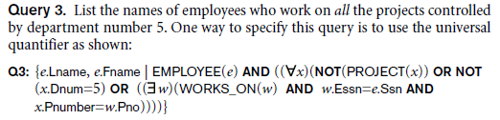

Using the Universal Quantifier in Queries

Slide 41
Safe Expressions
Guaranteed to yield a finite number of tuples as its result
  Otherwise expression is called unsafe
Expression is safe
  If all values in its result are from the domain of the expression

Slide 42
The Domain Relational Calculus
Differs from tuple calculus in type of variables used in formulas
  Variables range over single values from domains of attributes
Formula is made up of atoms
  Evaluate to either TRUE or FALSE for a specific set of values
    Called the truth values of the atoms

Slide 43

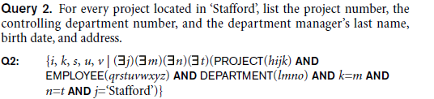
The Domain Relational Calculus (cont.)
QBE language
  Based on domain relational calculus

Slide 44
Next Lecture
Structured Query Language
SQL

Slide 45
References
Ramez Elmasri, Shamkant Navathe; “Fundamentals of Database Systems”, 6th Ed., Pearson, 2014.
Mark L. Gillenson; “Fundamentals of Database Management Systems”, 2nd Ed., John Wiley, 2012.
Universität Hamburg, Fachbereich Informatik, Einführung in Datenbanksysteme, Lecture Notes, 1999

