Slide 1
CSE202 Database Management Systems
Lecture #2
Prepared & Presented by Asst. Prof. Dr. Samsun M. BAŞARICI

Slide 2
Part 1
Data Modeling & Relational Data Model

Slide 3
Learning Objectives
Explain the concept and practical use of data modeling.
Recognize which relationships in the business environment are unary, binary, and ternary relationships.
Describe one-to-one, one-to-many, and many-to-many unary, binary, and ternary relationships.
Recognize and describe intersection data.
Model data in business environments by drawing entity-relationship diagrams that involve unary, binary, and ternary relationships.
Understand the relational data model and relational database constraints
Apply relational model constraints and relational database schemas
Understand and perform update operations, transactions, and dealing with constraint violations

Slide 4
Learning Objectives (cont.)
Explain why the relational database model became practical in about 1980.
Define such basic relational database terms as relation and tuple.
Describe the major types of keys including primary, candidate, and foreign.
Describe how one-to-one, one-to-many, and many-to-many binary relationships are implemented in a relational database.
Describe how relational data retrieval is accomplished in concept with the select, project, and join operators.
Understand how the join operator facilitates data integration in relational database.
Describe how unary and ternary relationships are implemented in a relational database.
Explain the concept of referential integrity.
Describe how the referential integrity restrict, cascade, and set-to-null delete rules operate in a relational database.

Slide 5
Outline
Data modeling
Relationships
  Unary, binary, ternary
1-1, 1-M, M-M relationships
Cardinality, modality
Intersection data, associative entity
Relational data model
Relational DB constraints
Operations
Transactions
Constraint violations
History of relational database model
Relational DB terms
  Relation, tuple
Implementing 1-1, 1-M, M-M relationships in DB
Data retrieval
  Select
  Project
  Join
Data integration
Referential integrity

Slide 6
Essence of Data Modeling
Exploring the different ways that entities can relate to each other as they always do in the real world
Devising a way of recording, of diagramming, the entities and the ways in which they interrelate in the business environment

Slide 7
Entity-Relationship (E-R) Model
A diagramming technique
Diagrams entities (with attributes) and the relationship between the entities.
There are many variations of E-R diagrams in use.

Slide 8
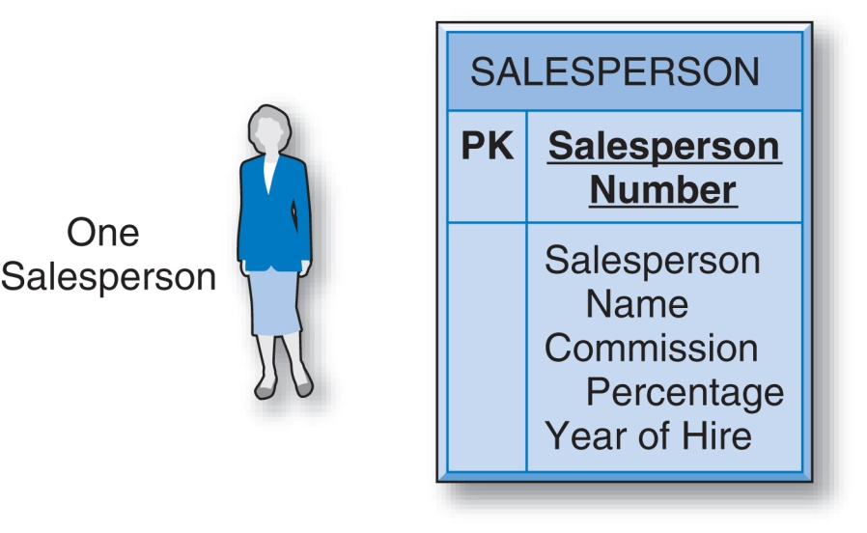
E-R Model Entity (and its attributes)
Rectangular shape
Salesperson = a type of entity
Name of entity is in caps above the separator line.

Slide 9

E-R Model Entity (and its attributes) (cont.)
Entity type’s attributes are shown below the separator line.
PK and boldface denote the attribute(s) that constitute the entity type’s unique identifier.

Slide 10
Relationships
Associations between entities
Different kinds:
  Binary relationships
  Unary relationships
  Ternary relationships

Slide 11
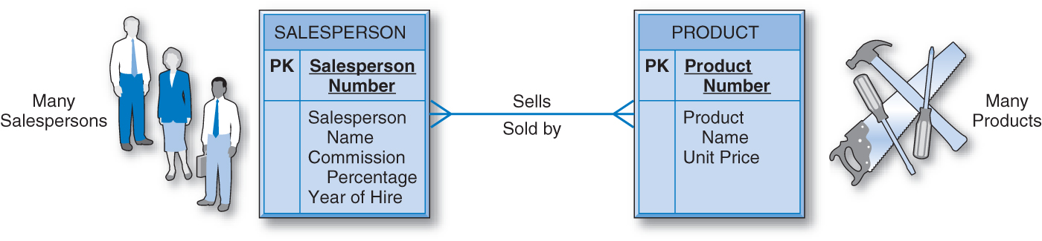
Binary Relationships
Simplest kind of relationship
Relationship between two entity types
A salesperson “sells” products or products are “sold” by salespersons

Slide 12
Cardinality
Represents the maximum number of entities that can be involved in a particular relationship.
  One-to-One Binary Relationship
  One-to-Many Binary Relationship
  Many-to-Many Binary Relationship

Slide 13
One-to-One Binary Relationship
1-1
A single occurrence of one entity type can be associated with a single occurrence of the other entity type and vice versa.

Slide 14
One-to-Many Binary Relationship
1-M
Use “crow’s foot” to represent the multiple association.
“many” = the maximum number of occurrences that can be involved, means a number that can be 1, 2, 3, ... n.

Slide 15
Many-to-Many Binary Relationship
M-M
“many” can be either an exact number or have a known maximum.

Slide 16
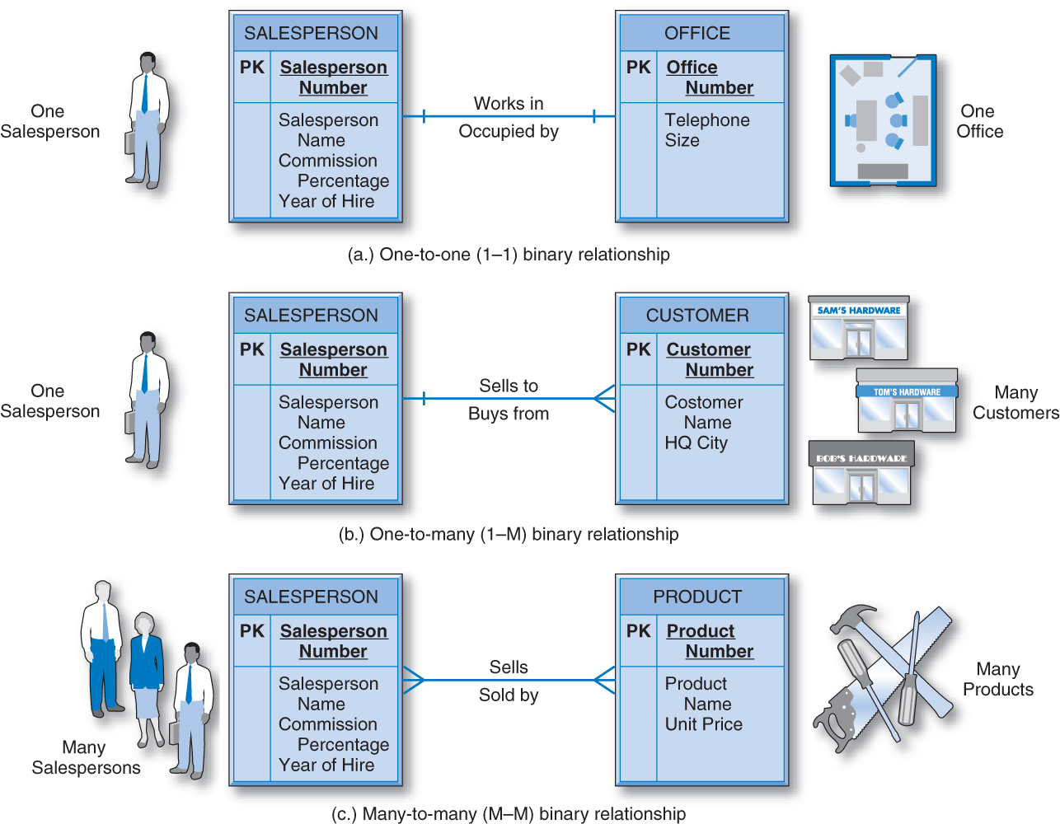
Cardinality

Slide 17
Modality
The minimum number of entity occurrences that can be involved in a relationship.
“inner” symbol on E-R diagram (“outer” symbol is cardinality)

Slide 18
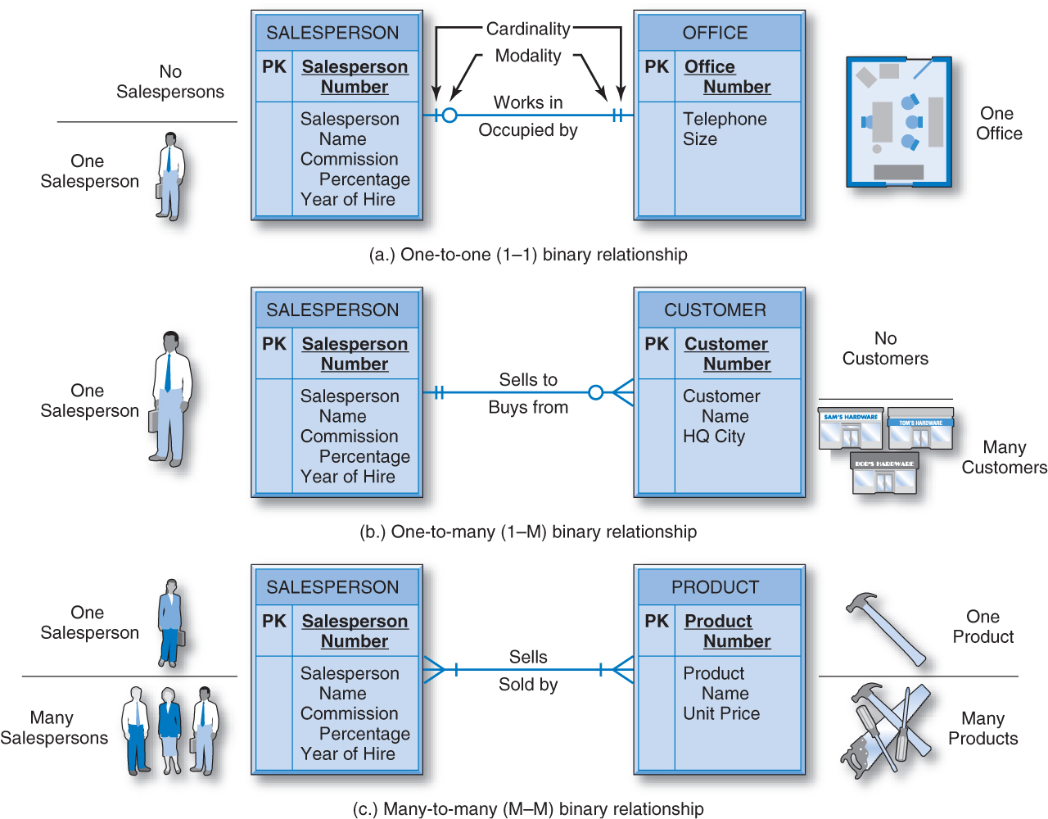
Cardinality & Modality

Slide 19
Intersection Data
Describes the relationship between two entities.
Used with many-to-many relationships.
Represented on E-R diagram as an “associative entity”

Slide 20
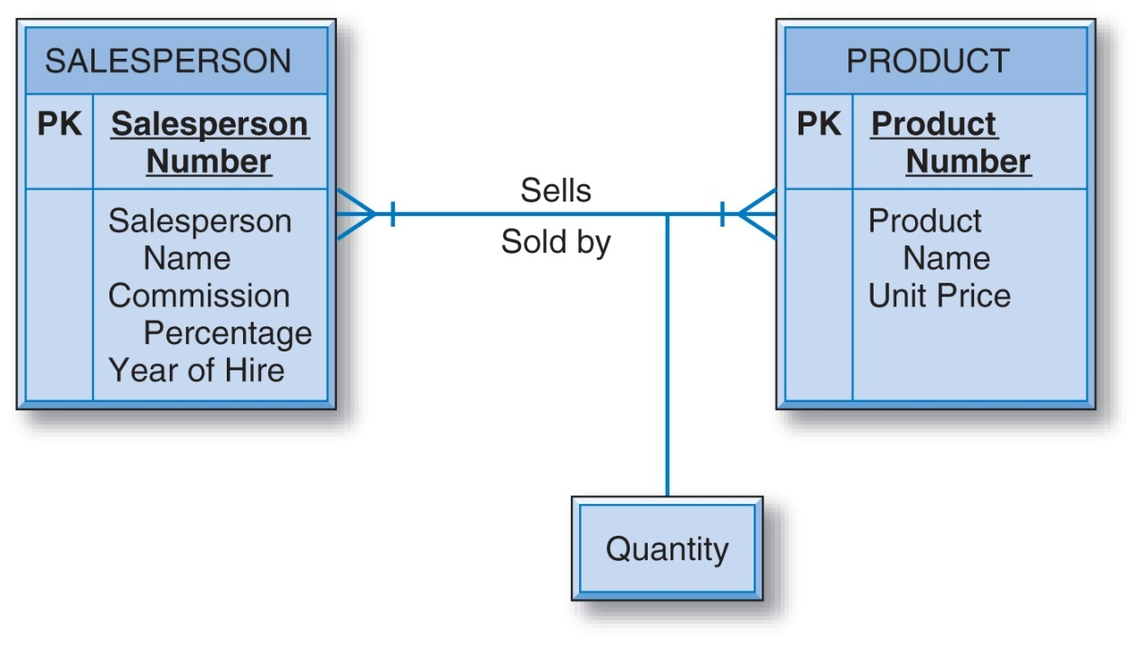
Many-to-Many Binary Relationship with Intersection Data
For example, we know not only that salesperson 137 sold some of product 24013 but also how many units of that product that salesperson sold.

Slide 21
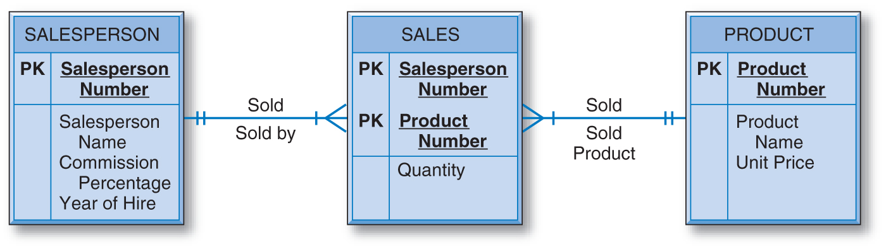
Associative Entity
Entities can have attributes; many-to-many relationships can have attributes.
Many-to-many relationship may be treated similarly to entities in an E-R diagram.

Slide 22
Associative Entity (cont.)
The unique identifier of the associative entity is usually the combination of the unique identifiers of the two entities in the many-to-many relationship.

Slide 23
Unary Relationships
Associate occurrences of an entity type with other occurrences of the same entity type.
Cardinality:
  One-to-One Unary Relationship
  One-to-Many Unary Relationship
  Many-to-Many Unary Relationship

Slide 24
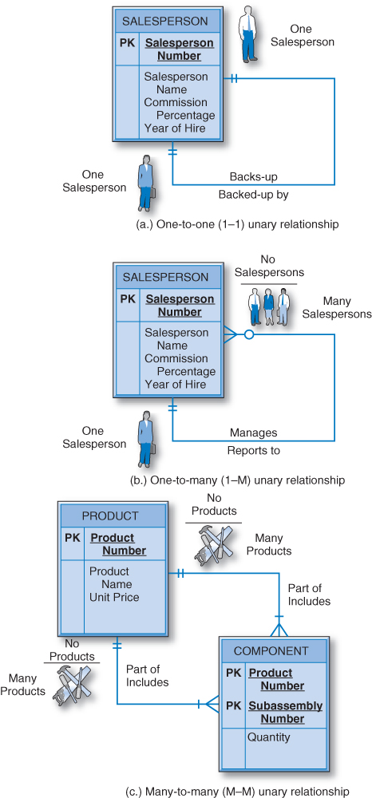
Unary Relationships (cont.)

Slide 25
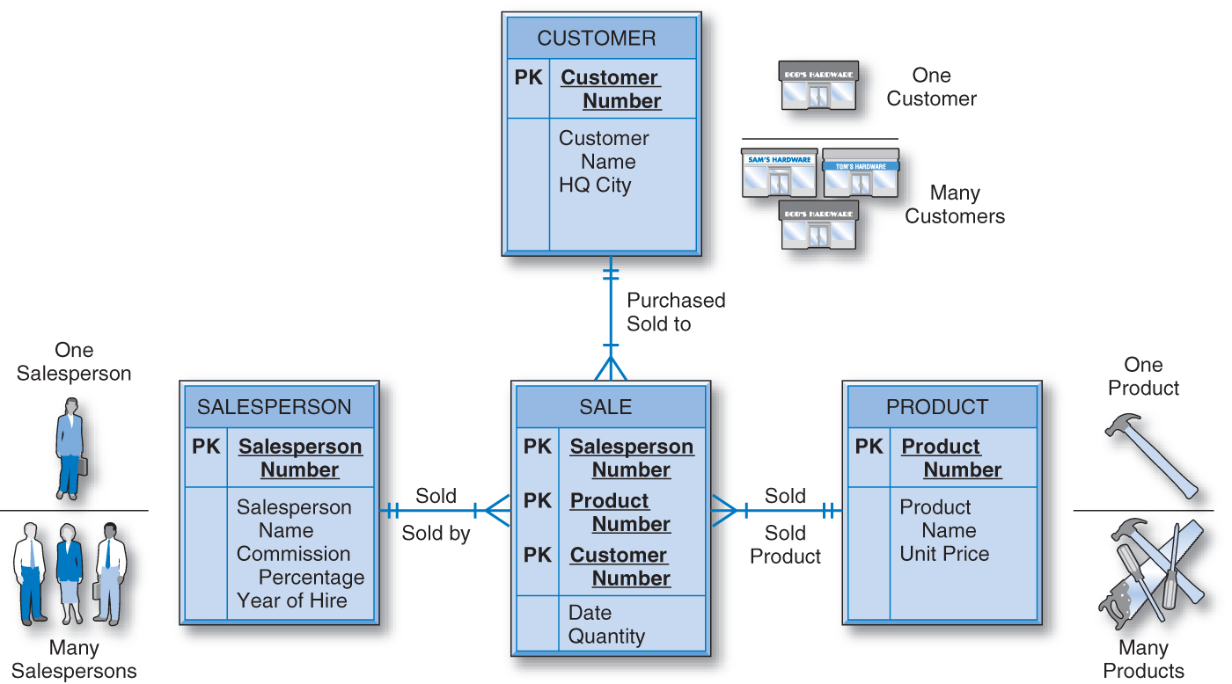
Ternary Relationship
Involves three different entity types.

Slide 26
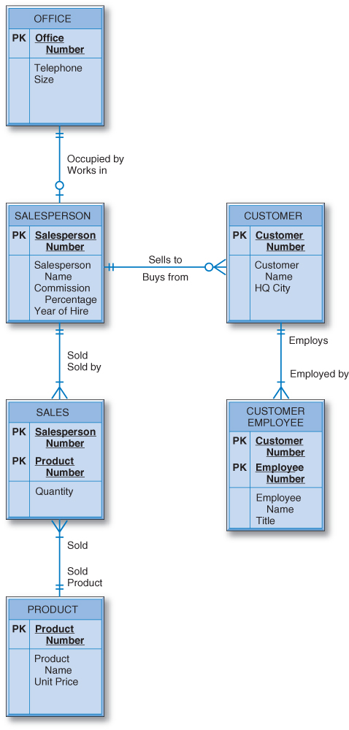
The General Hardware Company E-R Diagram
Customer Employee is a dependent entity.

Slide 27
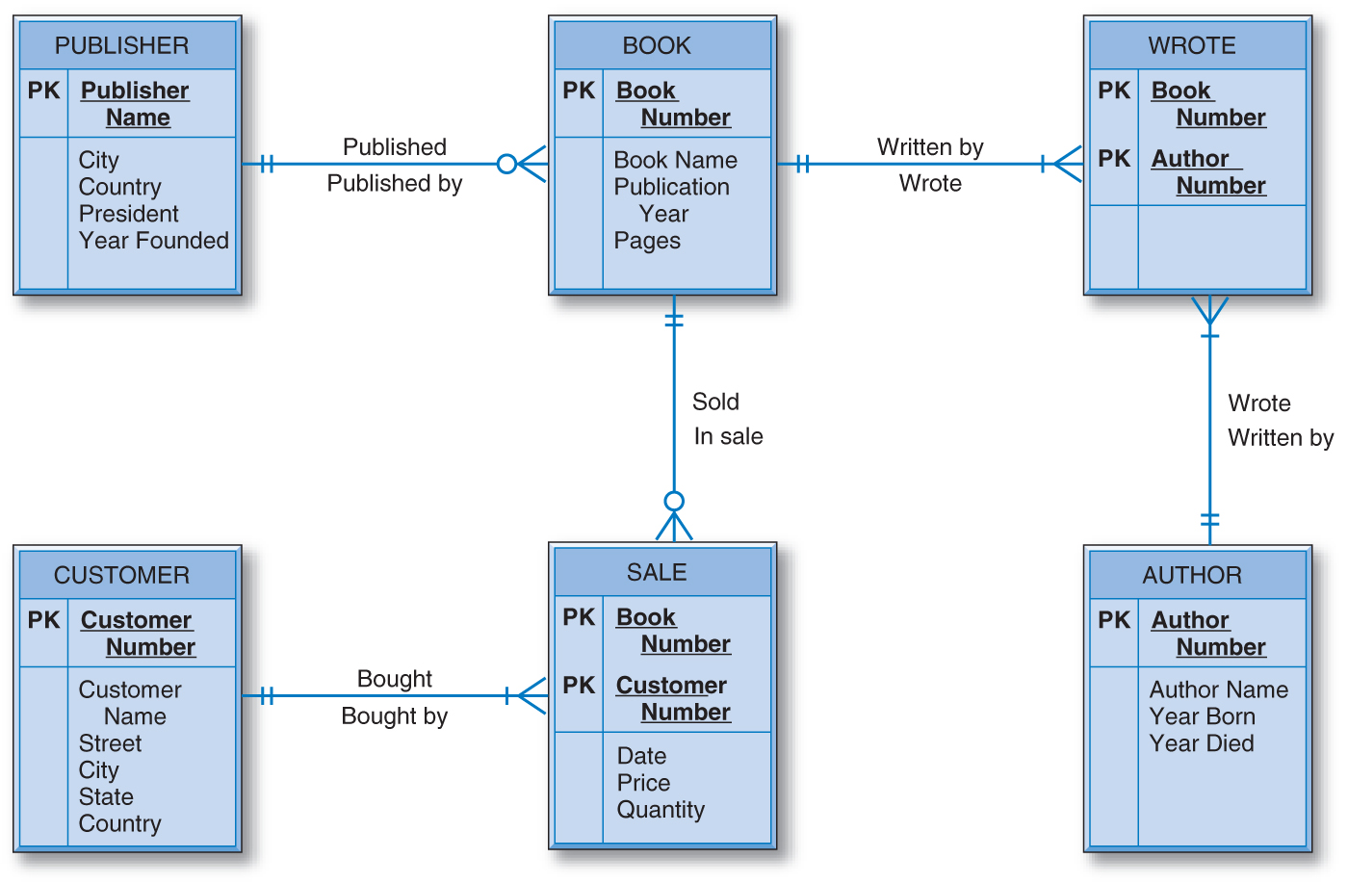
Good Reading Bookstores

Slide 28
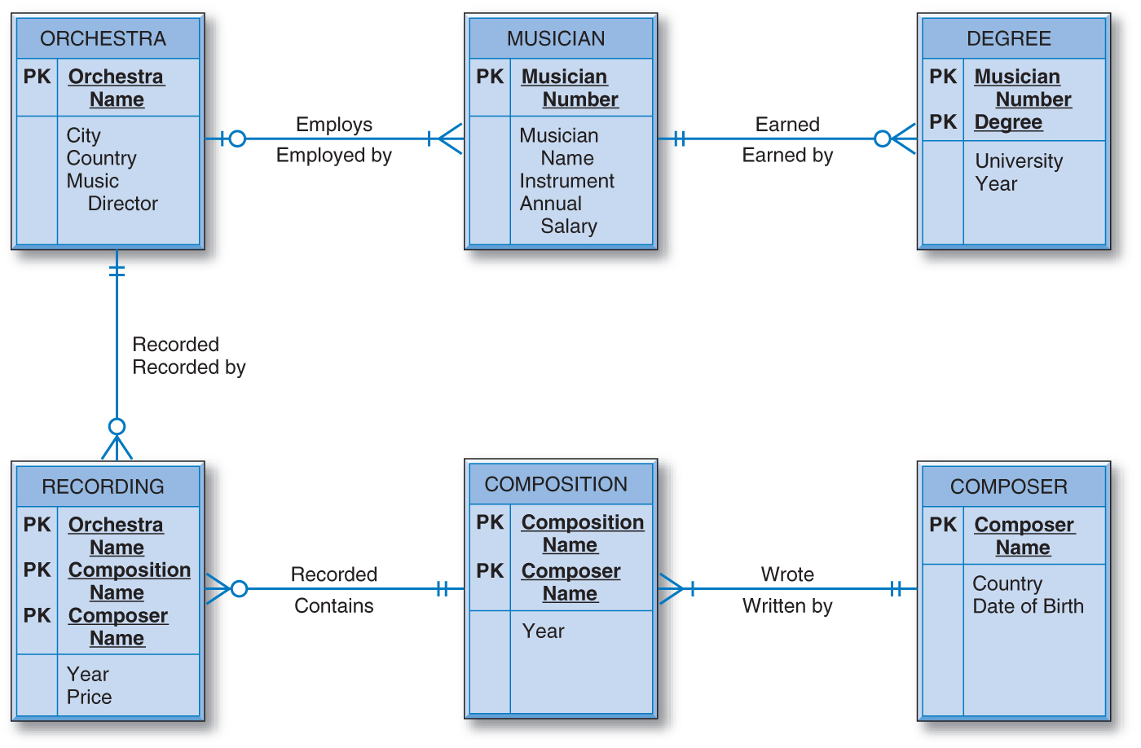
World Music Association

Slide 29
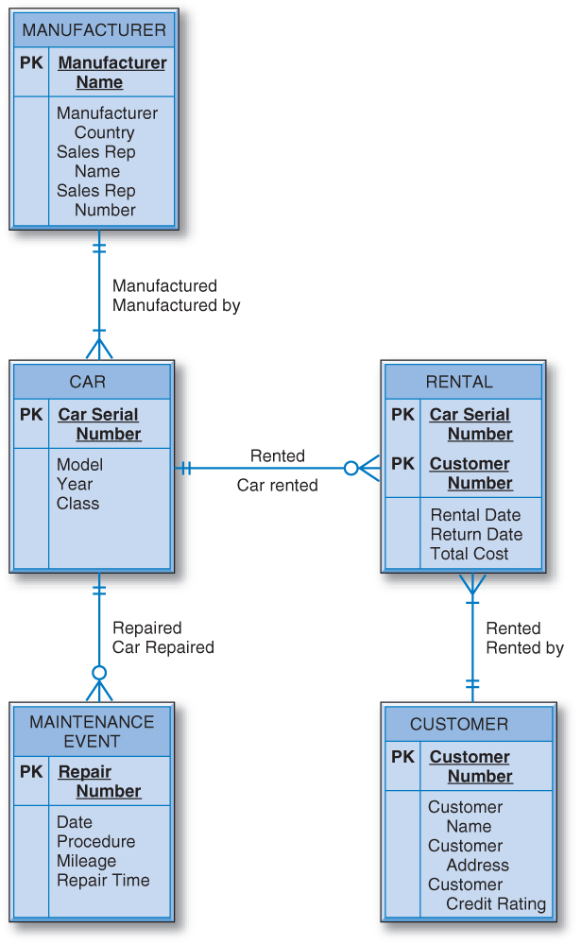
Lucky Rent-A-Car

Slide 30
The Relational Data Model and
Relational Database Constraints
Relational model
  First commercial implementations available in early 1980s
  Has been implemented in a large number of commercial system
Hierarchical and network models
  Preceded the relational model

Slide 31
Relational Model Concepts
Represents data as a collection of relations
Table of values
  Row
    Represents a collection of related data values
    Fact that typically corresponds to a real-world entity or relationship
    Tuple
  Table name and column names
    Interpret the meaning of the values in each row attribute

Slide 32
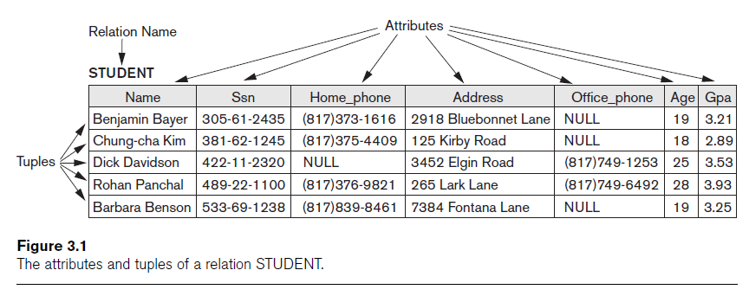
Relational Model Concepts (cont.)

Slide 33
Domains, Attributes, Tuples, and Relations
Domain D
  Set of atomic values
Atomic
  Each value indivisible
Specifying a domain
  Data type specified for each domain

Slide 34
Domains, Attributes, Tuples, and Relations (cont.)
Relation schema R
  Denoted by R(A₁, A₂, ...,A_{n})
  Made up of a relation name R and a list of attributes, A₁, A₂, ..., A_{n}
Attribute A_{i}
  Name of a role played by some domain D in the relation schema R
Degree (or arity) of a relation
  Number of attributes n of its relation schema

Slide 35
Domains, Attributes, Tuples, and Relations (cont.)
Relation (or relation state)
  Set of n-tuples r = {t₁, t₂, ..., t_{m}}
  Each n-tuple t
    Ordered list of n values t =<v₁, v₂, ..., v_{n}
    Each value v_{i}, 1 ≤ i ≤ n, is an element of dom(A_{i}) or is a special NULL value

Slide 36
Domains, Attributes, Tuples, and Relations (cont.)
Relation (or relation state) r(R)
  Mathematical relation of degree n on the domains dom(A₁), dom(A₂), ..., dom(A_{n})
  Subset of the Cartesian product of the domains that define R:
    r(R) ⊆ (dom(A₁) × dom(A₂) × ... × dom(A_{n}))

Slide 37
Domains, Attributes, Tuples, and Relations (cont.)
Cardinality
  Total number of values in domain
Current relation state
  Relation state at a given time
  Reflects only the valid tuples that represent a particular state of the real world
Attribute names
  Indicate different roles, or interpretations, for the domain

Slide 38
Characteristics of Relations
Ordering of tuples in a relation
  Relation defined as a set of tuples
  Elements have no order among them
Ordering of values within a tuple and an alternative definition of a relation
  Order of attributes and values is not that important
  As long as correspondence between attributes and values maintained

Slide 39
Characteristics of Relations (cont.)
Alternative definition of a relation
  Tuple considered as a set of (<attribute>, <value>) pairs
  Each pair gives the value of the mapping from an attribute A_{i} to a value v_{i} from dom(A_{i})
Use the first definition of relation
  Attributes and the values within tuples are ordered
  Simpler notation

Slide 40
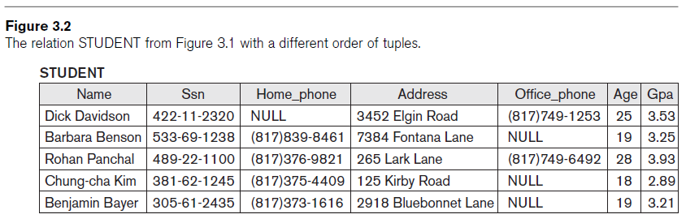
Characteristics of Relations (cont.)

Slide 41
Characteristics of Relations (cont.)
Values and NULLs in tuples
  Each value in a tuple is atomic
  Flat relational model
    Composite and multivalued attributes not allowed
    First normal form assumption
  Multivalued attributes
    Must be represented by separate relations
  Composite attributes
    Represented only by simple component attributes in basic relational model

Slide 42
Characteristics of Relations (cont.)
NULL values
  Represent the values of attributes that may be unknown or may not apply to a tuple
  Meanings for NULL values
    Value unknown
    Value exists but is not available
    Attribute does not apply to this tuple (also known as value undefined)

Slide 43
Characteristics of Relations (cont.)
Interpretation (meaning) of a relation
  Assertion
    Each tuple in the relation is a fact or a particular instance of the assertion
  Predicate
    Values in each tuple interpreted as values that satisfy predicate

Slide 44
Relational Model Notation
Relation schema R of degree n
  Denoted by R(A₁, A₂, ..., A_{n})
Uppercase letters Q, R, S
  Denote relation names
Lowercase letters q, r, s
  Denote relation states
Letters t, u, v
  Denote tuples

Slide 45
Relational Model Notation (cont.)
Name of a relation schema: STUDENT
  Indicates the current set of tuples in that relation
Notation: STUDENT(Name, Ssn, ...)
  Refers only to relation schema
Attribute A can be qualified with the relation name R to which it belongs
  Using the dot notation R.A

Slide 46
Relational Model Notation (cont.)
n-tuple t in a relation r(R)
  Denoted by t = <v₁, v₂, ..., v_{n}>
  v_{i} is the value corresponding to attribute A_{i}
Component values of tuples:
  t[A_{i}] and t.A_{i} refer to the value v_{i} in t for attribute A_{i}
  t[A_{u}, A_{w}, ..., A_{z}] and t.(A_{u}, A_{w}, ..., A_{z}) refer to the subtuple of values <v_{u}, v_{w}, ..., v_{z}> from t corresponding to the attributes specified in the list

Slide 47
Relational Model Constraints
Constraints
  Restrictions on the actual values in a database state
  Derived from the rules in the miniworld that the database represents
Inherent model-based constraints or implicit constraints
  Inherent in the data model

Slide 48
Relational Model Constraints (cont.)
Schema-based constraints or explicit constraints
  Can be directly expressed in schemas of the data model
Application-based or semantic constraints or business rules
  Cannot be directly expressed in schemas
  Expressed and enforced by application program

Slide 49
Domain Constraints
Typically include:
  Numeric data types for integers and real numbers
  Characters
  Booleans
  Fixed-length strings
  Variable-length strings
  Date, time, timestamp
  Money
  Other special data types

Slide 50
Key Constraints and Constraints on NULL Values
No two tuples can have the same combination of values for all their attributes.
Superkey
  No two distinct tuples in any state r of R can have the same value for SK
Key
  Superkey of R
  Removing any attribute A from K leaves a set of attributes K that is not a superkey of R any more

Slide 51
Key Constraints and Constraints on NULL Values (cont.)
Key satisfies two properties:
  Two distinct tuples in any state of relation cannot have identical values for (all) attributes in key
  Minimal superkey
    Cannot remove any attributes and still have uniqueness constraint in above condition hold

Slide 52
Key Constraints and Constraints on NULL Values (cont.)
Candidate key
  Relation schema may have more than one key
Primary key of the relation
  Designated among candidate keys
  Underline attribute
Other candidate keys are designated as unique keys

Slide 53
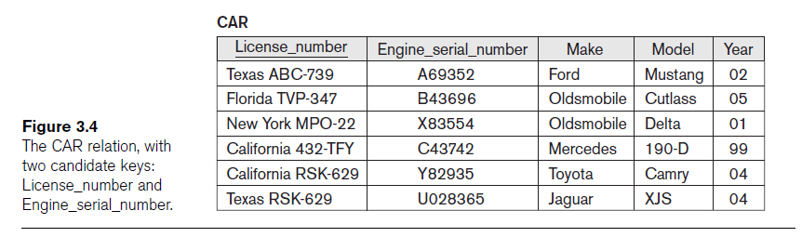
Key Constraints and Constraints on NULL Values (cont.)

Slide 54
Relational Databases and Relational Database Schemas
Relational database schema S
  Set of relation schemas S = {R₁, R₂, ..., R_{m}}
  Set of integrity constraints IC
Relational database state
  Set of relation states DB = {r₁, r₂, ..., r_{m}}
  Each r_{i} is a state of R_{i} and such that the r_{i} relation states satisfy integrity constraints specified in IC

Slide 55
Relational Databases and Relational Database Schemas (cont.)
Invalid state
  Does not obey all the integrity constraints
Valid state
  Satisfies all the constraints in the defined set of integrity constraints IC

Slide 56
Integrity, Referential Integrity, and Foreign Keys
Entity integrity constraint
  No primary key value can be NULL
Referential integrity constraint
  Specified between two relations
  Maintains consistency among tuples in two relations

Slide 57
Integrity, Referential Integrity, and Foreign Keys (cont.)
Foreign key rules:
  The attributes in FK have the same domain(s) as the primary key attributes PK
  Value of FK in a tuple t₁ of the current state r₁(R₁) either occurs as a value of PK for some tuple t₂ in the current state r₂(R₂) or is NULL

Slide 58
Integrity, Referential Integrity, and Foreign Keys (cont.)
Diagrammatically display referential integrity constraints
  Directed arc from each foreign key to the relation it references
All integrity constraints should be specified on relational database schema

Slide 59
Other Types of Constraints
Semantic integrity constraints
  May have to be specified and enforced on a relational database
  Use triggers and assertions
  More common to check for these types of constraints within the application programs

Slide 60
Other Types of Constraints (cont.)
Functional dependency constraint
  Establishes a functional relationship among two sets of attributes X and Y
  Value of X determines a unique value of Y
State constraints
  Define the constraints that a valid state of the database must satisfy
Transition constraints
  Define to deal with state changes in the database

Slide 61
Update Operations, Transactions, and Dealing with Constraint Violations
Operations of the relational model can be categorized into retrievals and updates
Basic operations that change the states of relations in the database:
  Insert
  Delete
  Update (or Modify)

Slide 62
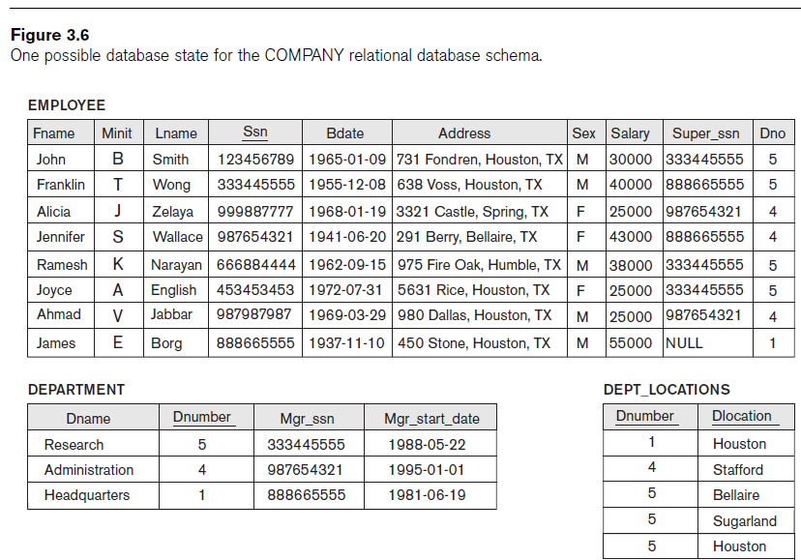

Slide 63
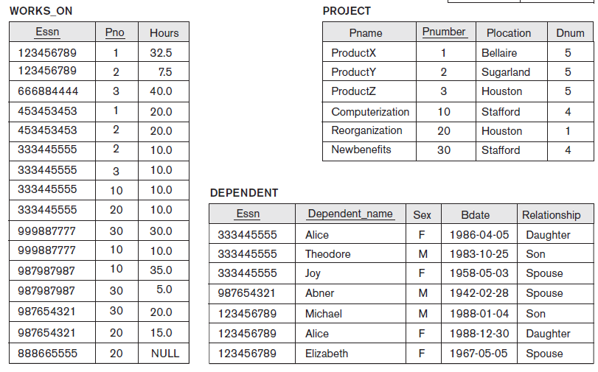

Slide 64
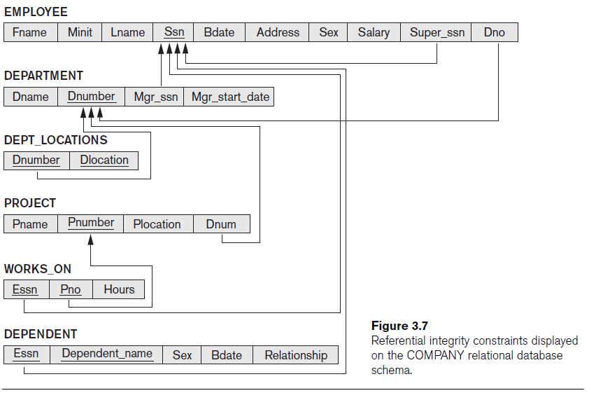

Slide 65
The Insert Operation
Provides a list of attribute values for a new tuple t that is to be inserted into a relation R
Can violate any of the four types of constraints
If an insertion violates one or more constraints
  Default option is to reject the insertion

Slide 66
The Delete Operation
Can violate only referential integrity
  If tuple being deleted is referenced by foreign keys from other tuples
  Restrict
    Reject the deletion
  Cascade
    Propagate the deletion by deleting tuples that reference the tuple that is being deleted
  Set null or set default
    Modify the referencing attribute values that cause the violation

Slide 67
The Update Operation
Necessary to specify a condition on attributes of relation
  Select the tuple (or tuples) to be modified
If attribute not part of a primary key nor of a foreign key
  Usually causes no problems
Updating a primary/foreign key
  Similar issues as with Insert/Delete

Slide 68
The Transaction Concept
Transaction
  Executing program
  Includes some database operations
  Must leave the database in a valid or consistent state
Online transaction processing (OLTP) systems
  Execute transactions at rates that reach several hundred per second

Slide 69
Relational Database Model
In 1970, E. F. Codd published “A Relational Model of Data for Large Shared Data Banks” in CACM.
In the early 1980s, commercially viable relational database management systems became available.

Slide 70
Relational Database Model (cont.)
While relational database was very tempting in concept in the 1970s, it was not easily applicable in a real-world environment for reasons related to performance.
The earlier hierarchical and network database management systems were just coming onto the commercial scene and were the focus of intense marketing efforts by the software and hardware vendors.

Slide 71
The Relational Database Concept
Data appears to be stored in what we have been referring to as simple, linear files.
Relational databases are based on mathematics.
A relational database is a collection of relations that, as a group, contain the data that describes a particular business environment.

Slide 72
Relational Terminology
Relations - what we have been referring to as simple linear files. Also called tables.
Row = record (files) = tuple (relation)
Column = field (files) = attribute (relation)

Slide 73
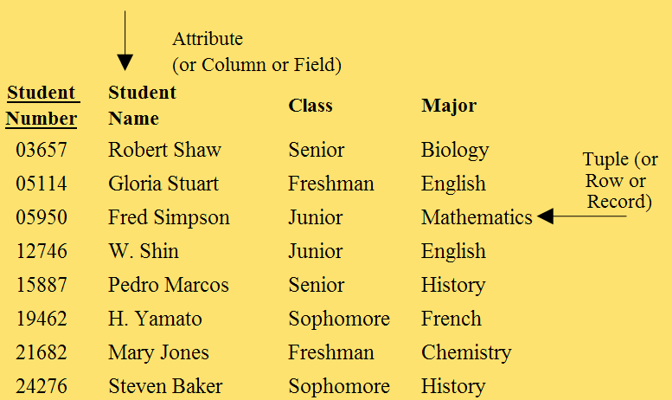
Relational Database Terminology (cont.)

Slide 74
File / Relation: Differences
The columns of a relation can be arranged in any order without affecting the meaning of the data. This is not true of a file.
The rows of a relation can be arranged in any order, which is not true of a file.

Slide 75
File / Relation: Differences (cont.)
Every row/column position (a cell) can have only a single value, which is not necessarily true in a file.
No two rows of a relation are identical, which is not necessarily true in a file.

Slide 76
Primary Key
A relation always has a unique primary key.
A primary key (also called “the key”) is an attribute or a group of attributes whose values are unique throughout all of the rows of the relation.

Slide 77
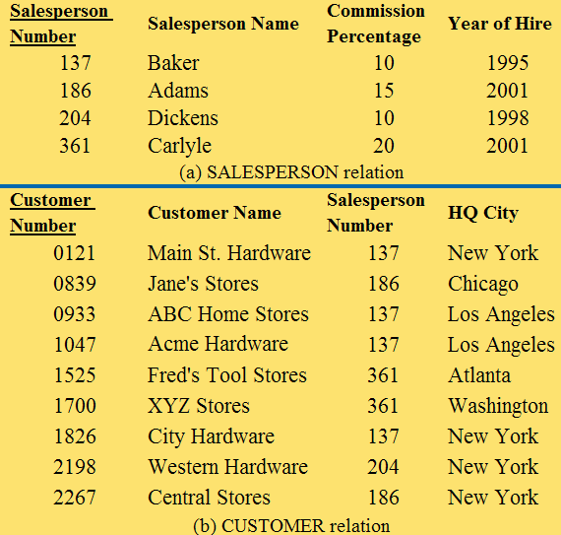
Primary Key (cont.)

Slide 78
Primary Key (cont.)
The number of attributes involved in the primary key is always the minimum number of attributes that provide the uniqueness quality.
In the worst case, all of the relation’s attributes combined could serve as the primary key.

Slide 79
Candidate Key
If a relation has more than one attribute or minimum group of attributes that represents a way of uniquely identifying the entities, then they are each called a candidate key.
When there is more than one candidate key, one of them must be chosen to be the primary key of the relation.

Slide 80
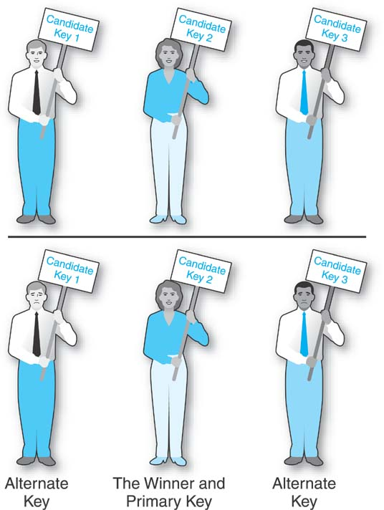
Candidate Key (cont.)
Which candidate key to pick depends on the application using the database.
Alternate key is a candidate key that was not chosen to be the primary key of the relation.

Slide 81
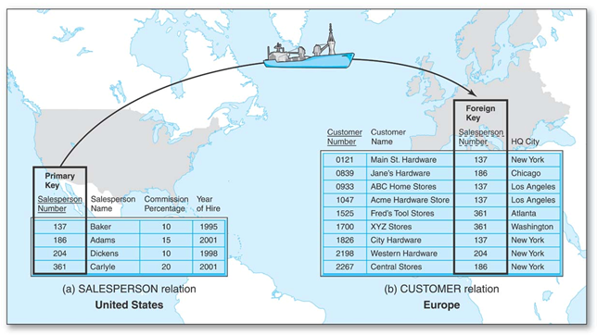
Foreign Key
An attribute or group of attributes that serves as the primary key of one relation and also appears in another relation (foreign key in this relation).

Slide 82
Foreign Key (cont.)
Crucial in relational database, because the foreign key is the mechanism that ties relations together to represent unary, binary, and ternary relationships.
Foreign key attribute must have same domain of values as Primary key attribute in other relation.

Slide 83
Domain of Values
Two attributes have the same domain of values if the attributes have values of the same type.
  e.g., Salesperson Number in SALESPERSON and in CUSTOMER - three digit whole numbers that are the identifiers for salespersons.

Slide 84
Binary Relationships
One-to-One
One-to-Many
Many-to-Many

Slide 85
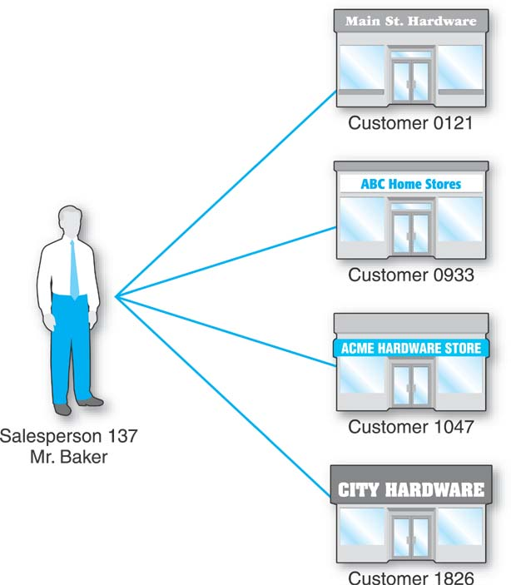
One-to-Many Binary Relationships
Salesperson
Customer
The Salesperson Number foreign key in the CUSTOMER relation effectively establishes the one-to-many relationship between salespersons and customers.

Slide 86
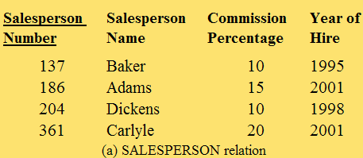
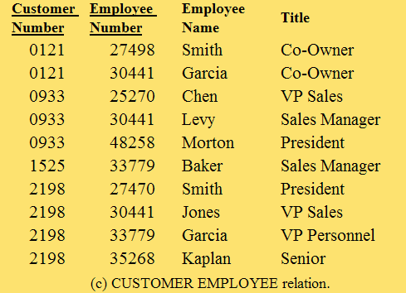
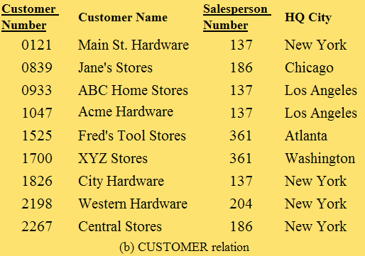
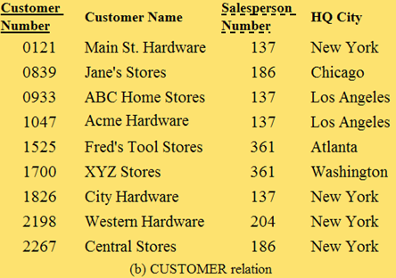
Foreign Key Can Be A Part of The Primary Key
Customer
Customer
Employee

Slide 87
General Hardware Co.

Slide 88
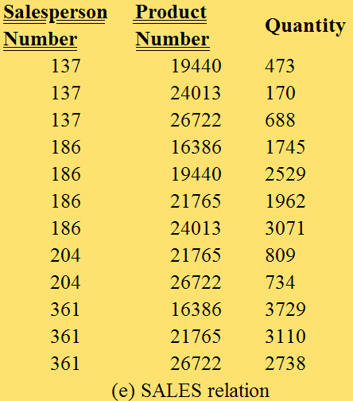
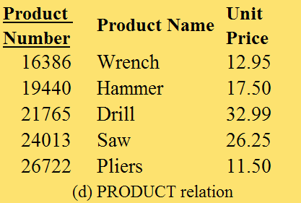
Many-to-Many Binary Relationship
Salesperson
Product

Slide 89
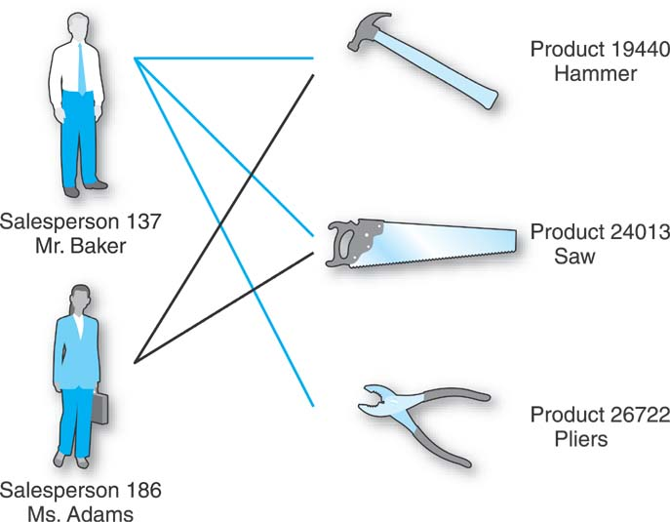
Many-to-Many Relationship

Slide 90
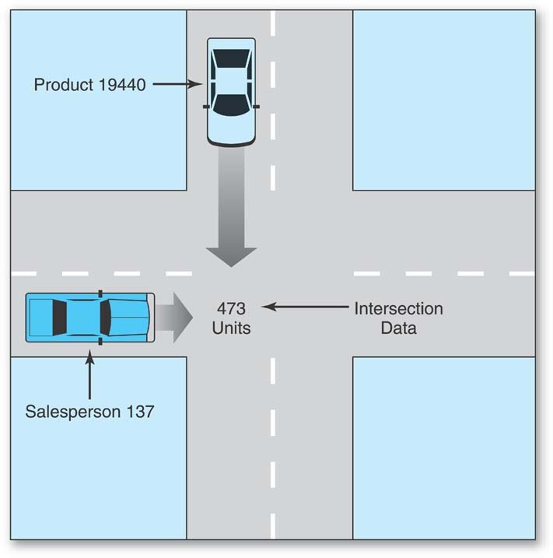
Intersection Data

Slide 91
Many-to-Many Relationship (cont.)
Has its own relation in the database.
Can have its own attributes.
It is a kind of entity -- an Associative Entity

Slide 92
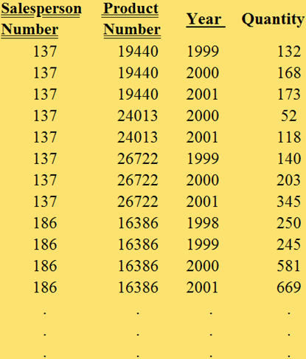
SALES Relation (modified)
A Date attribute is required if the data may be stored two or more times in a year.
A Time attribute is required if the data may be stored more than once in a day.

Slide 93
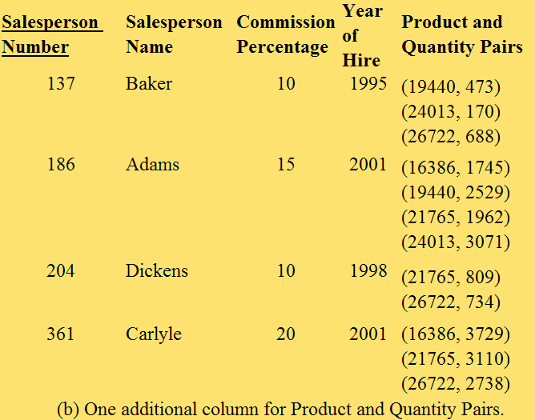
Unacceptable: Many-to-Many

Slide 94
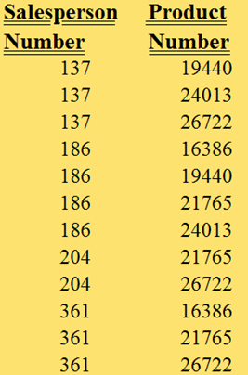
SALES Relation (without intersection data)

Slide 95
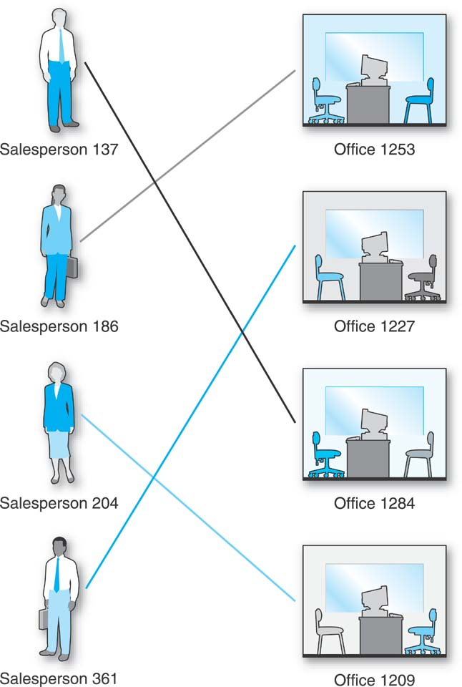
One-to-One Binary Relationship

Slide 96
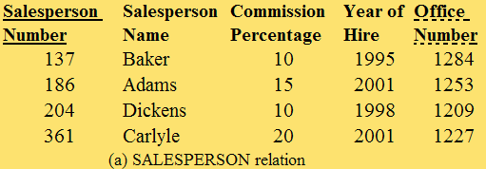

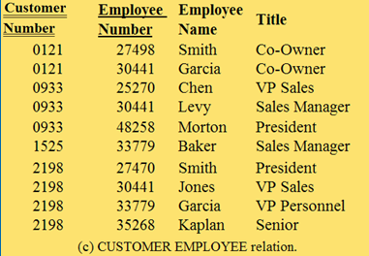
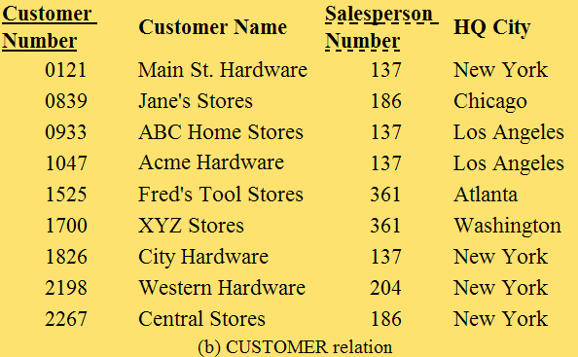
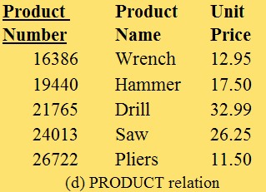
General Hardware Co. including OFFICE

Slide 97
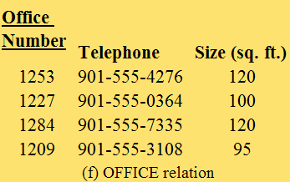
General Hardware Co. including OFFICE (cont.)
Can SALESPERSON and OFFICE be combined into one relation?

Slide 98
Data Retrieval from a Relational Database
The discussion thus far has concentrated on:
  how a relational database is structured
  loading a database with data
Let’s discuss the effort to retrieve the data in a way that is helpful and beneficial to the business organization that built the database.

Slide 99
Relational DBMS
Have the ability to accept high level data retrieval commands
Process the commands against the database’s relations
and return the desired data.

Slide 100
The Relational Select Operator
Retrieves a horizontal slice of the relation.
Select rows from the SALESPERSON relation in which Salesperson Number = 204.
The result of a relational operation will always be a relation.

Slide 101
The Relational Project Operator
Retrieves a vertical slice of the relation.
Project the Salesperson Number and Salesperson Name over the SALESPERSON relation.

Slide 102
Extracting Data Across Multiple Relations: Data Integration
A DBMS must be able to store data nonredundantly while also providing a data integration facility.
Relational DBMSs automate the cross-relation data extraction process in such a way that it appears that the data in the relations is integrated while also remaining nonredundant.

Slide 103
Data Integration
The relational algebra Join command.
Join the SALESPERSON relation and the CUSTOMER relation, using the Salesperson Number of each as the join fields.
Select rows from that result in which Customer Number = 1525.
Project the Salesperson Name over that last result.

Slide 104
Terminology
Cartesian Product - comparing every possible combination of two sets, or two relations.
Equijoin - a join where two join field values are identical.
Natural join - one of the two identical join columns is eliminated.

Slide 105
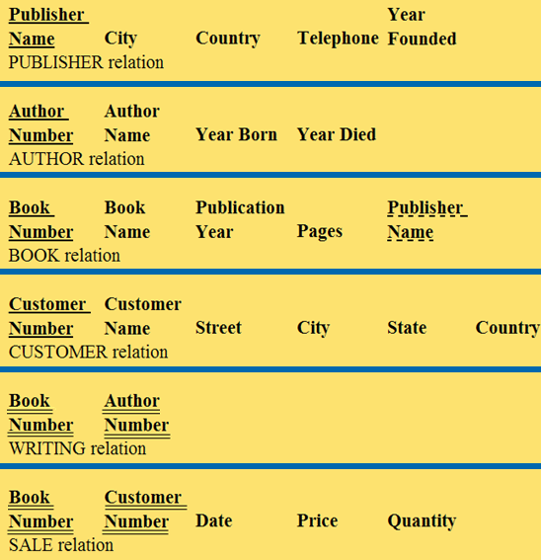
Good Reading Bookstores

Slide 106
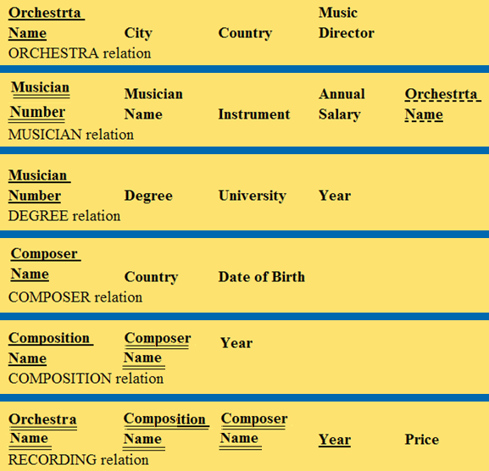
World Music Association

Slide 107
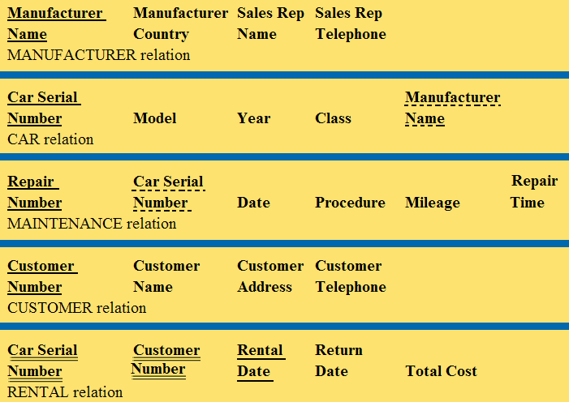
Lucky Rent-A-Car

Slide 108
General Hardware Co. including OFFICE (again)

Slide 109
General Hardware Co. including OFFICE (cont.)

Slide 110
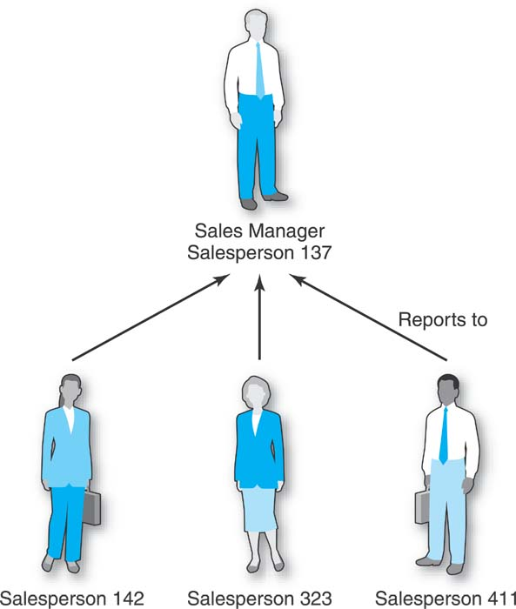
Unary One-to-Many Relationships
A salesperson reports to exactly one sales manager, but each salesperson who does serve as a sales manager typically has several salespersons reporting to him.
There is a one-to-many relationship within salespersons.
Salesperson (also a sales manager)
Salesperson

Slide 111
Unary One-to-Many Relationships (cont.)
A unary relationship because there is only one entity type involved.
A one-to-many because among the individual entity occurrences, that is, among the salespersons, a particular salesperson reports to one salesperson who is his sales manager, while a salesperson who is a sales manager may have several salespersons reporting to her.

Slide 112
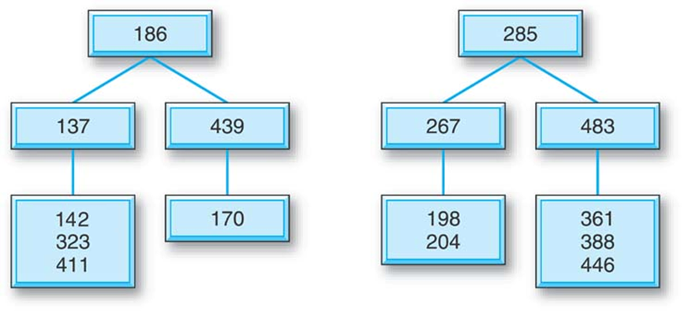
General Hardware Co. Salesperson Reporting Hierarchy

Slide 113
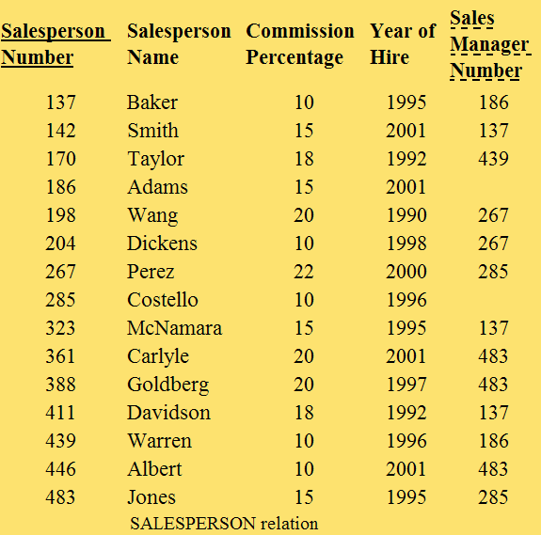
One-to-Many Unary Relationship
Requires the addition of one column to the relation representing the single entity involved in the unary relationship.

Slide 114
Unary Many-to-Many Relationships
A special case, an example of which has come to be known as the bill of materials problem.
Every entity occurrence can be related to many other occurrences.
Product
Product

Slide 115
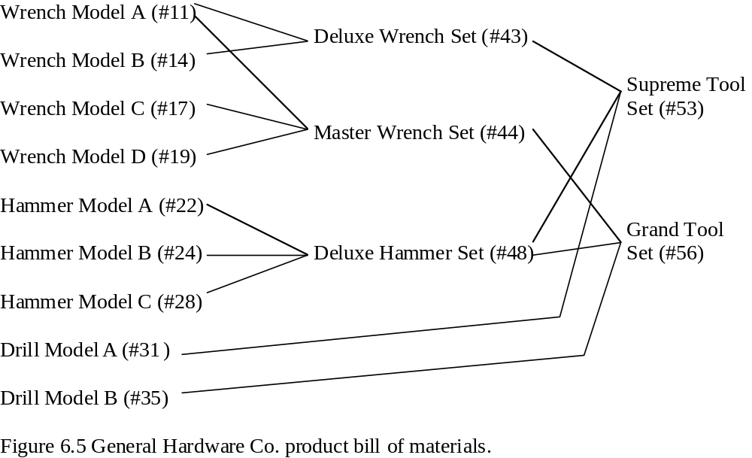
General Hardware Company’s Product Set
Tools and sets of tools are sold.
Many-to-many nature of products.

Slide 116
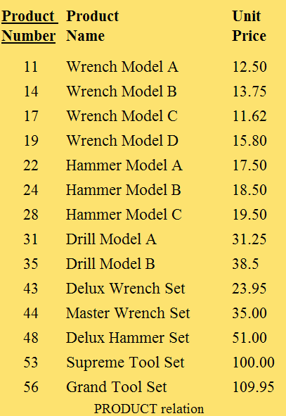
Modified Product Relation
Product Numbers have been reduced to 2 digits for simplicity.
Every individual unit item and every set of tools has its own row in the relation because every item and set is available for sale.

Slide 117
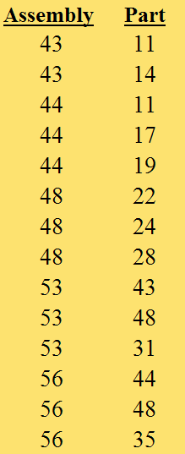
Unary Many-to-Many Relationship: New Relation
Just as a binary many-to-many relationship requires the creation of an additional relation in a relational database, so does a unary many-to-many relationship.
The domain of values of each column is that of the Product Number column of the PRODUCT relation.

Slide 118
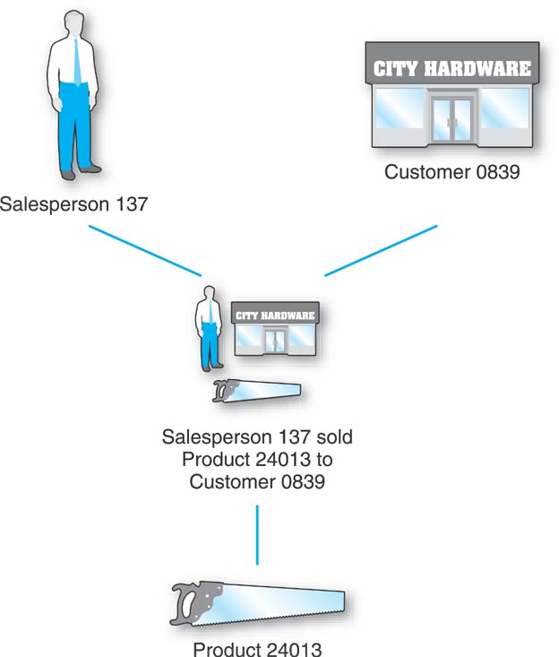

Ternary Relationships
Involves three different entity types.

Slide 119




General Hardware Co.: Ternary Relationship

Slide 120
Ternary Relationship
These new General Hardware Co. relations are all independent with no foreign keys in any of them.
The SALES relation shows how this ternary relationship is represented in a relational database.

Slide 121
Ternary Relationship (cont.)
The primary key of the additional relation (SALES) will be (at least) the combination of the primary keys of the entities involved in the relationship.

Slide 122

Ternary Relationship (cont.)
Did salesperson 137 sell product 19440 to customer 0839?

Slide 123
Database Operations
In addition to retrieving data we must be prepared to perform data maintenance operations, including:
  inserting new records
  deleting existing records
  updating existing records

Slide 124
Referential Integrity
Revolves around the circumstance of trying to refer to data in one relation in the database, based on values in another relation.

Slide 125


Referential Integrity - Record Deletion
A problem arises, e.g., because a deleted record, a salesperson record, is on the “one side” of a one-to-many relationship.

Slide 126
Referential Integrity - Insertion
Insertion - if a new record is inserted into the “one side” (SALESPERSON relation) of the one-to-many relationship, there is no problem.
If a new customer record is inserted into the “many side” (CUSTOMER relation) of the one-to-many relationship and it happens to include a salesperson number that does not have a match in the SALESPERSON relation—that would cause the same kind of problem as the deletion example.

Slide 127
Referential Integrity - Update
Updating a foreign key value.
For example, a salesperson number in the CUSTOMER relation with a new salesperson number that has no match in the SALESPERSON relation.

Slide 128
DBMS & Referential Integrity
Early relational DBMSs did not provide any control mechanisms for referential integrity.
Modern relational DBMSs provide sophisticated control mechanisms for referential integrity:
  Delete rules
  Insert rules
  Update rules

Slide 129
Three Delete Rules
Restrict
Cascade
Set-to-Null

Slide 130
Delete Rule: Restrict
If an attempt is made to delete a record on the “one side” of the one-to-many relationship, the system will forbid the delete to take place if there are any matching foreign key values in the relation on the “many side.”

Slide 131

Delete Rule: Restrict (cont.)
If an attempt is made to delete the record for salesperson 361 in the SALESPERSON relation, the system will not permit the deletion to take place because the CUSTOMER relation records for customers 1525 and 1700 include salesperson number 361 as a foreign key value.

Slide 132
Delete Rule: Cascade
If an attempt is made to delete a record on the “one side” of the relationship, not only will that record be deleted but all of the records on the “many side” of the relationship that have a matching foreign key value will also be deleted.
The deletion will cascade from one relation to the other.

Slide 133

Delete Rule: Cascade (cont.)
If an attempt is made to delete the record for salesperson 361 in the SALESPERSON relation, that salesperson record will be deleted and so too, automatically, will the records for customers 1525 and 1700 in the CUSTOMER relation because they have 361 as a foreign key value.

Slide 134
Delete Rule: Set-to-Null
If an attempt is made to delete a record on the “one side” of the one-to-many relationship, that record will be deleted and the matching foreign key values in the records on the “many side” of the relationship will be changed to null.

Slide 135

Delete Rule: Set-to-Null (cont.)
If an attempt is made to delete the record for salesperson 361 in the SALESPERSON relation, that record will be deleted, and the Salesperson Number attribute values in the records for customers 1525 and 1700 in the CUSTOMER relation will have their Salesperson Number attribute values changed from 361 to null.

Slide 136
Next Lecture
Relational Algebra & Relational Calculus

Slide 137
References
Ramez Elmasri, Shamkant Navathe; “Fundamentals of Database Systems”, 6th Ed., Pearson, 2014.
Mark L. Gillenson; “Fundamentals of Database Management Systems”, 2nd Ed., John Wiley, 2012.
Universität Hamburg, Fachbereich Informatik, Einführung in Datenbanksysteme, Lecture Notes, 1999

