Slide 1


CSE 414 Systems Analysis and Design
Lecture #2
Sources of Software & Managing Information Systems Projects
Prepared & Presented by Asst. Prof. Dr. Samsun M. BAŞARICI

Slide 2
Part 1
Sources of Software

Slide 3
Learning Objectives
Explain outsourcing.
Describe six different sources of software.
Discuss how to evaluate off-the-shelf software.
Explain reuse and its role in software development.

Slide 4
Introduction
Historically, software development for a corporate information systems department was done primarily in-house.
Now it involves use of components from external sources.
Much in-house application coding involves making the components work together.

Slide 5
Introduction (cont.)
Six sources of software:
  Information technology service firms
  Packaged software providers
  Vendors of enterprise-wide solution software
  Cloud computing
  Open-source software
  In-house development
There are ways to evaluate software from sources
Notes:
When choosing a software solution, you’ll be choosing among a number of possible types of software solutions, and for each type, there are a variety of different products and vendors to choose between. For the next several slides we’ll talk about the different possibilities and how to choose among them.

Slide 6
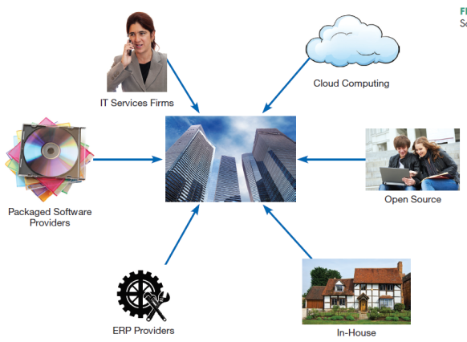
Sources of Software
Information technology services firm
Packaged software producers
Enterprise solutions software
  Enterprise Resource Planning (ERP)
Cloud computing
Open source software
In-house developers
There are ways to evaluate software from sources
FIGURE 2-1
Sources of Application Software
Notes:
A company may use any combination of these sources for their information system.
When choosing a software solution, you’ll be choosing among a number of possible types of software solutions, and for each type, there are a variety of different products and vendors to choose between. For the next several slides we’ll talk about the different possibilities and how to choose among them.
We’ll talk about each of these in more detail.

Slide 7
Systems Acquisition: Outsourcing
Outsourcing: The practice of turning over responsibility of some or all of an organization’s information systems applications and operations to an outside firm
Notes:
Chances are, your company outsources at least part of its overall corporate information system.

Slide 8
Systems Acquisition: Outsourcing (Cont.)
Outsourcing Example
  Shell Oil outsource spending: $3.2 billion (2008)
  Shell’s outsourcing vendors (2008-2011): EDS, T-Systems, AT&T, IBM, Logica, Wipro, Accenture
Notes:
For a very large operation, there may be many outsourced companies working on the project. Big corporations are one example. The U.S. government is another.

Slide 9
Outsourcing (Cont.)
Reasons to outsource
  Cost-effectiveness
  Take advantage of economies of scale
  Make up for lack of in-house knowledge
  Free up internal resources
  Reduce time to market
  Increase process efficiencies
  System development is a non-core activity for the organization
  Political reasons (e.g. labor disputes)
Notes:
These are the main motivators behind the outsourcing phenomenon in the IT economy.

Slide 10
Global Outsourcing
Top outsourcing countries: India, China, Malaysia (A.T. Kearny report 2014)
Top 10 are in Asia, Latin America, Europe, and Africa
Some U.S. firms are switching to nearshoring (same time zone, low labor costs)
Notes:
For a time in the early 2000s there was a concern that our IT would all be outsourced abroad because of lower labor costs. This hasn’t happened, although a good part of IT services provided to US companies are done abroad. Nevertheless, there’s a thriving IT sector in the US as well.

Slide 11
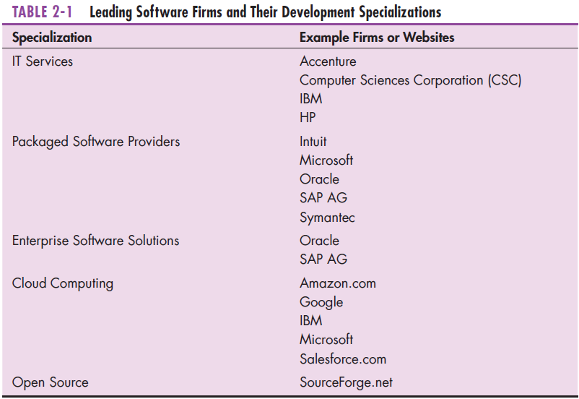
Sources of Software (Cont.)
Notes:
Software produced by IT services firms is usually custom software, for a particular client. Other sectors, like packaged software providers and ERP firms have a particular product suite and help with installing (and sometimes customizing) it at customers’ sites. Open source products are typically free of charge, and governed by General Public License (GNU) license, Cloud computing includes cloud-based storage and computing infrastructure as well as software services and platforms.

Slide 12
Information Technology (IT) Services Firms
Help companies develop custom information systems for internal use
Develop, host, and run applications for customers
Provide other services (management, accounting, auditing, financial)
Notes:
You might think of IBM as primarily a hardware provider, but it’s actually a leader in IT services as well, thanks in part to its purchase of PWC in 2002.

Slide 13
Packaged Software Producers
Serve many market segments
Provide software ranging from broad-based packages (i.e. general ledger) to niche packages (i.e. day care management)
Pre-packaged, off-the-shelf software

Slide 14
Packaged Software Producers (Cont.)
Software runs on all size computers, from microcomputers to large mainframes.
Prepackaged software is off-the-shelf, turnkey software (i.e. not customizable).
Off-the-shelf software, at best, meets 70% of organizations’ needs.
Notes:
Some off-the-shelf software systems cannot be modified to meet the specific, individual needs. These are sometimes called turnkey systems. Turnkey systems are changed only when a substantial number of users ask it. Other systems allow for modification and extension to meet more specialized needs.

Slide 15
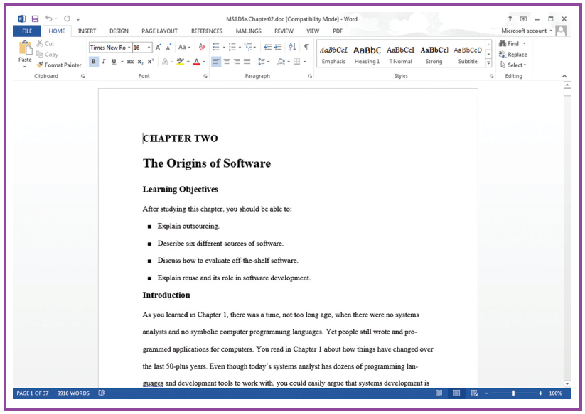
Prepackaged Software
Figure 2-2 A document created in Microsoft’s Word
(Source: Microsoft Corporation.)
Notes:
This is part of the Microsoft Office suite, which includes Excel, PowerPoint, and other applications. This is used by the general public and is sometimes called “horizontal” application. Others prepackaged software products are for more specific audiences, and these are sometimes called “vertical” applications.

Slide 16
Enterprise Solutions Software
Enterprise Resource Planning (ERP) systems integrate individual traditional business functions into modules enabling a single seamless transaction to cut across functional boundaries.
SAP AG is the leading vendor of ERP systems.
Notes:
The benefits of the enterprise solutions approach include a single repository of data for all aspects of a business process and the flexibility of the modules. A single repository ensures more consistent and accurate data, and requires less maintenance. But these are very complex systems with difficult implementations, requiring vendor support. Also, using them often requires a company to alter their business processes.

Slide 17
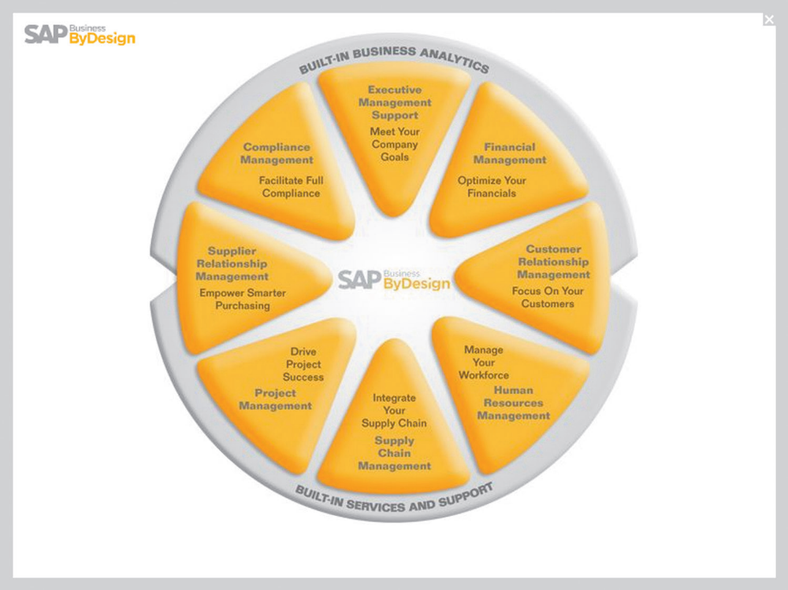
Enterprise Solutions Software (Cont.)
Figure 2-3 SAP’s Business ByDesign, a product designed for medium sized companies.
(Source: www.sap.com/usa/solutions/Sme/Businessbydesign/Flash/bsm/A1S.html. © Copyright SAP AG. All rights reserved.)
Notes:
SAP is the biggest ERP provider. They are headquartered in Germany.

Slide 18
Cloud Computing
The provision of computing resources, including applications, over the Internet, so customers do not have to invest in the computing infrastructure needed to run and maintain the resources
Pay-per-use or monthly/yearly licenses

Slide 19
Cloud Computing (Cont.)
Examples:
  Google Apps– for sharing documents, spreadsheets, and presentations
  Salesforce.com – online customer relationship management (CRM) software
    An example of software as a service (SaaS)
  Microsoft Azure platform
  Amazon.com cloud infrastructure and services
    An example of hardware as a service (HaaS)
Notes:
Google Apps is a cloud-based competitor to Microsoft Office. Actually, Microsoft has Microsoft 365, which provides cloud-based Word, Excel, and PowerPoint applications. These are for the general user audience. By contrast, Salesforce.com is for a narrower target market (sales and customer relations).

Slide 20
Cloud Computing (Cont.)
Heavy growth predicted
Benefits:
  Frees company of internal IT staff requirements
  Faster access to application than via internal development
  Lower cost than internal development
Concerns
  Security
  Reliability
  Regulation compliance
Notes:
As with every choice, the choice of cloud computing comes with its benefits and concerns.

Slide 21
Open Source Software
Freely available including source code
Developed by a community of interested people
Performs the same functions as commercial software
Examples: Linux, mySQL, Firefox
How to make money?
  Provide maintenance/services
  Sell a more featured version of the free software
Notes:
There are a huge number of open-source projects available. Some other widely-used open source software include the Apache HTTP web server, the Android operating system, the Hadoop distributed file system, and the osCommerce e-commerce platform,

Slide 22
In-House Development
If sufficient system development expertise with the chosen platform exists in-house, then some or all of the system can be developed by the organization’s own staff.
  In-house development usually leads to more maintenance burden than other approaches
Hybrid solutions involving some purchased and some in-house components are common.
Notes:
For the most part, companies’ in-house development has gone down relative to years ago, primarily because of all of the other options available. But many companies still do some in-house development, and most of the time this is combined with components and systems from other sources.

Slide 23
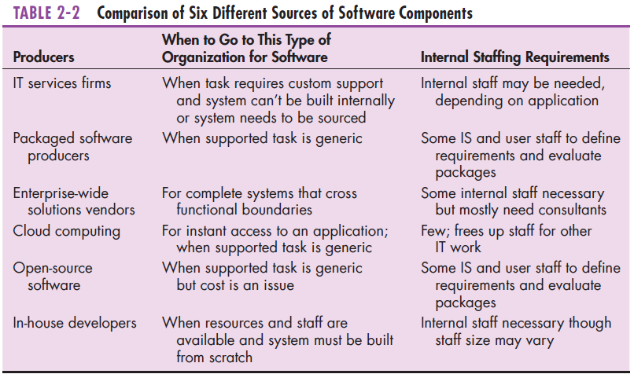
Sources of Software Components
Notes:
This gives a good overview of the types of problems and staffing requirements appropriate for each solution. Some are more appropriate for generic tasks and some for specialized. Cost has an impact on which to choose as well. And some require more internal resources than others.

Slide 24
Selecting Off-the-Shelf Software
Cost: comparing the cost of developing the same system in-house with the cost of purchasing or licensing the software package
Functionality: the tasks that the software can perform and the mandatory, essential, and desired system features
Notes:
These next few slides show factors to consider when selecting a software solution.

Slide 25
Selecting Off-the-Shelf Software (Cont.)
Vendor support: whether and how much support the vendor can provide and at what cost
Viability of vendor: can vendor continue to adapt/update software to changes in systems software and hardware

Slide 26
Selecting Off-the-Shelf Software (Cont.)
Flexibility: the ease with which software is customized
Documentation: understandable and up-to-date user’s manual and technical documentation

Slide 27
Selecting Off-the-Shelf Software (Cont.)
Response time: how long it takes the software package to respond to the user’s requests in an interactive session
Ease of installation: a measure of the difficulty of loading the software and making it operational

Slide 28
Validating Purchased Software Information
Send a request for proposal (RFP) to vendors.
  RFP – a document provided to vendors to ask them to propose hardware and system software that will meet the requirements of a new system
Use a variety of information sources:
  Collect information from vendor
  Software documentation
  Technical marketing literature
Notes:
If you are going to compare different vendors and service providers, you need a systematic way of doing this. A clearly stated RFP can help the vendor develop their proposals. You can use a variety of information sources to judge which solution is the best fit for your company’s needs.

Slide 29
Request For Proposal (RFP)
Sometimes called a Request For Quote (RFQ)
Analyst selects best candidates based on:
  vendor bids
  a variety of information sources

Slide 30
Information Sources For RFP
Vendor’s proposal
Running software through a series of tests
Feedback from other users of the vendor’s product
Independent software testing services
Customer surveys
Articles in trade publications are sometimes biased (seeded by manufacturer)
Notes:
Obviously, if you’re going to make wise purchasing decisions, you need to do some research. These are the types of information sources you’ll look at.

Slide 31
Reuse
The use of previously written software resources, especially objects and components, in new applications
Commonly applied to two different development technologies:
  Object-oriented development
  Component-based development

Slide 32
Reuse (Cont.)
Object-oriented development
  Object class encapsulates data and behavior of common organizational entities (e.g. employees)
Component-based development
  Components can be as small as objects or as large as pieces of software that handle single business functions
Notes:
Even if you do in-house development, you are reusing objects and components. For example, if you do Java programming, you are using the Java class library, which includes functionality for a wide variety of needs, including data structures, user interfaces, network and web processing, database manipulation, and a host of other services.

Slide 33
Reuse (Cont.)
Can be effective (increased productivity, less defects, reduced rework)
Technical issues – lack of methodology for component library (creating and labeling reusable components)
Organizational issues – lack of commitment, training, and organizational support; hard to measure economic benefits; legal and contractual issues

Slide 34
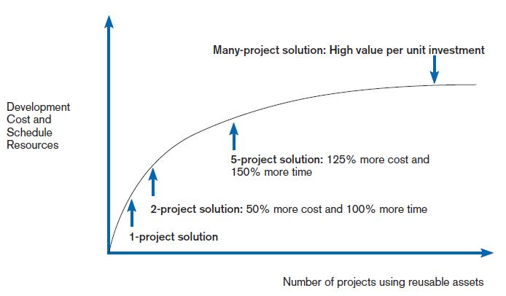
Costs and Benefits of Reuse
FIGURE 2-5
Investments necessary to achieve reusable components
(Source: Royce, Walker, Software Project Management: A Unified Framework, 1st ed.,
©1998. Reprinted and Electronically reproduced by permission of Pearson Education, Inc. Upper Saddle River, New Jersey.)
Notes:
The benefits of reuse grow as more corporate experience is gained from it, but so do the costs and the amount of resources necessary for reuse to work well.

Slide 35
3 Steps of Software Reuse
Abstraction – design of reusable piece of software
Storage – making software assets available for others
Recontextualization – making the software understandable to developers
(Grinter, 2001)
Notes:
The design could be from scratch, but very often it is based on reuse of other existing objects and components.
Storage isn’t as simple as it may seem. It requires correctly labeling and cataloguing assets so that others can find them.
Just because the software is easily accessible doesn’t mean people will use it. It needs to be easy to use and understand. That’s where recontextualization comes in. Part of that involves providing good documentation.

Slide 36
Approaches to Reuse
Ad-hoc: individuals are free to find or develop reusable assets on their own
Facilitated: developers are encouraged to practice reuse
Managed: the development, sharing, and adoption of reusable assets is mandated
Designed: assets mandated for reuse as they are being designed for specific applications
(Griss 2003)
Notes:
Recall the organizational and technical issues we talked about before. When choosing and approach to reuse, these issues will factor into the approach you choose. And the approach may evolve over time. For example, you wouldn’t use a mandated approach if there is a lot of resistance, and instead perhaps start with ad-hoc. Once it catches on, you can begin to encourage more, and only after time set up a formal framework.

Slide 37
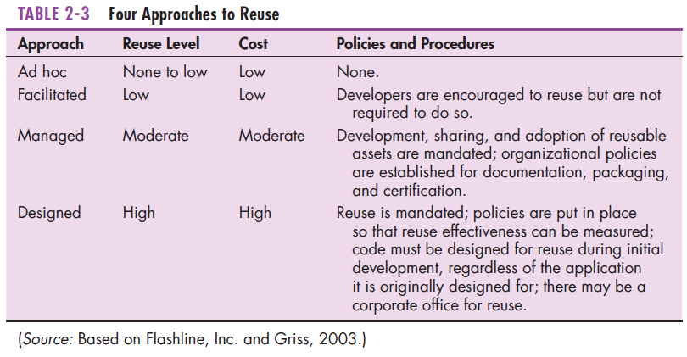
Approaches to Reuse (Cont.)
Notes:
Note the differences in terms of cost and in terms of policies and procedures. In terms of policies and procedures, you can go from completely ad hoc to something very formalized and measurable. As you get more formal and mandated about it, the level of reuse and its cost go up.

Slide 38
Summary
Now you should know be able to:
  Explain outsourcing.
  Describe six different sources of software.
  Discuss how to evaluate off-the-shelf software.
  Explain reuse and its role in software development.

Slide 39
Part 2
Managing the Information Systems Project

Slide 40
Learning Objectives
Explain the process of managing an information systems project, including project initiation, project planning, project execution, and project closedown,
Describe how to represent and schedule project plans using Gantt charts and network diagrams, and
Explain how commercial project management software packages can be used to assist in representing and managing project schedules

Slide 41
Introduction
Project management (PM) may be the most important aspect of systems development.
Effective PM helps to ensure
  The meeting of customer expectations.
  The satisfying of budget and time constraints.
The nature of projects has changed from custom development to implementing packaged software such as ERP and data warehousing.
PM needs to be able to work well with vendors and diverse user community.

Slide 42
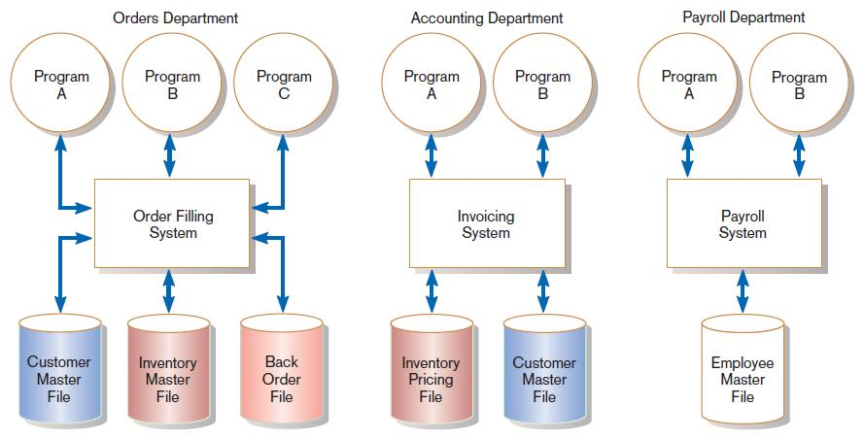
Pine Valley Application Project
FIGURE 3-1
Three computer applications at Pine Valley Furniture: order filling, invoicing, and payroll
(Source: Hoffer, Ramesh, and Topi, Modern Database Management 11th ed. 2013)
Notes:
This chapter includes several examples related to PVF, a furniture manufacturing company. This figure shows PVF’s information system prior to creating a centralized database.
Throughout this chapter, we’ll see discussion of a few projects at PVF.

Slide 43
Managing the Information Systems Project
Project
  A planned undertaking of related activities to reach an objective that has a beginning and an end
Project management
  A controlled process of initiating, planning, executing, and closing down a project

Slide 44
Managing the Information Systems Project (cont.)
Project manager
  A systems analyst with a diverse set of skills—management, leadership, technical, conflict management, and customer relationship—who is responsible for initiating, planning, executing, and closing down a project
Deliverable
  The end product of an SDLC phase
Notes:
The project manager needs to have both technical and organizational skills, and should be a good communicator with a strong sense of time management.
Each SDLC phase will have some deliverable. Planning’s deliverable is typically a feasibility report, a budget, and a preliminary schedule. The Analysis phase usually results in a set of functional requirements. Logical design results in system specifications and physical design delivers actual programs and databases. So, each phase has a deliverable.
We talked about these a bit in chapter 1, and will talk in more detail in future chapters.

Slide 45
Deciding on Systems Projects
System Service Request (SSR)
  A standard form for requesting or proposing systems development work within an organization
Feasibility study
  A study that determines whether a requested system makes economic and operational sense for an organization
Notes:
A company will often need to consider several potential projects. Not all project requests should be granted. These requests will be prioritized based on importance and feasibility. Typically, a review board judges and approves project requests. At PVF, they call this the Systems Priority Board.
The board evaluates requests based on the business problems or opportunities the system addresses and judges how the proposed project fits within the organization’s information systems architecture and long-range development plans. The board selects the projects that best meet overall organizational objectives.

Slide 46
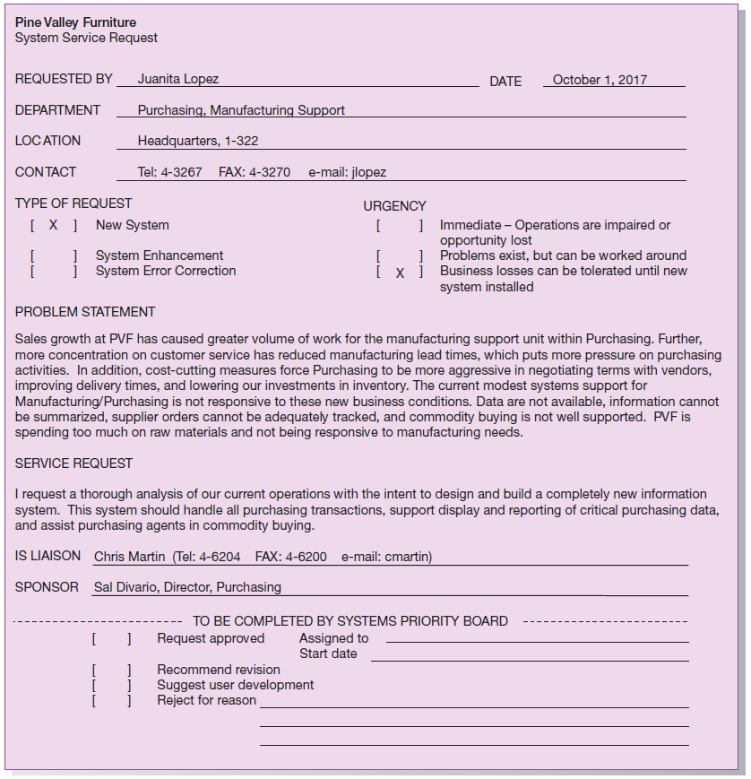
FIGURE 3-2
System Service Request for Purchasing Fulfillment System with name and contact information of the person requesting the system, a statement of the problem, and the name and contact information of the liaison and sponsor
Notes:
Here is the Purchasing Fulfillment System SSR. As you can see, Juanita Lopez identifies a business problem and a requested solution. This is a request for a new system, the biggest level request. The primary beneficiaries will be Purchasing and Manufacturing. Although it is an important project, there is recognition and acceptance that this may be a long-term project, as you can see in the “urgency” section.
Systems development projects are undertaken for two primary reasons: to take advantage of business opportunities and to solve business problems. Taking advantage of an opportunity might mean providing an innovative service to customers through the creation of a new system. Solving a business problem could involve modifying the way an existing system processes data so that more accurate or timely information is provided to users.

Slide 47
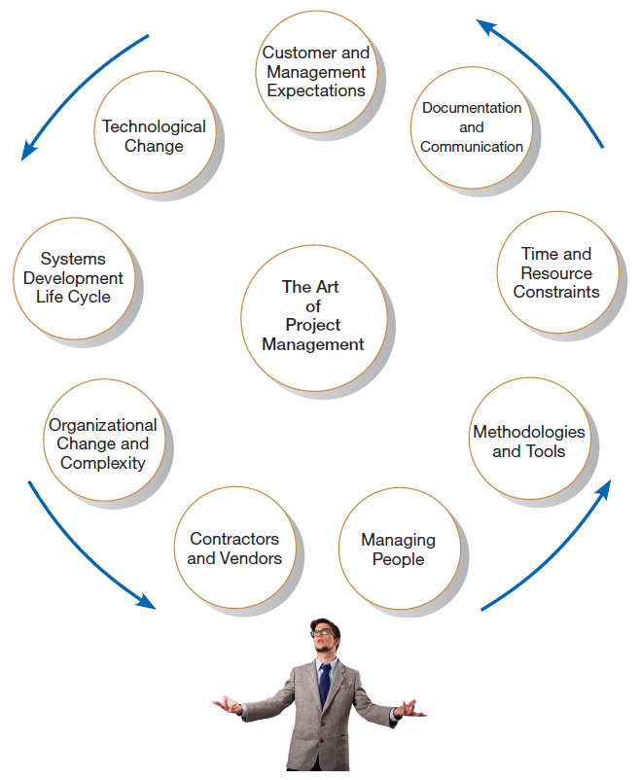
Project Management Activities
FIGURE 3-4
A project manager juggles numerous
activities
Notes:
As you can see, a project manager leads a very busy life, and needs to take into account many factors and stakeholders when making scheduling, resource, and design decisions.

Slide 48
Phases of Project Management Process
Phase 1: Initiation
Phase 2: Planning
Phase 3: Execution
Phase 4: Closedown

Slide 49
PM Phase 1: Project Initiation
Assess size, scope and complexity, and establish procedures.
Establish:
  Initiation team
  Relationship with customer
  Project initiation plan
  Management procedures
  Project management environment and workbook
  Project charter
Notes:
In the case of PVF’s purchasing fulfillment system project, initiation involved these steps:
Juanita observed problems with the existing purchasing system.
She contacted Chris from the IS department to set up an SSR.
The Systems Priority Board at PVF reviewed and approved the project request.
A steering committee was set up to oversee the project.
A detailed project plan was developed and executed.

Slide 50
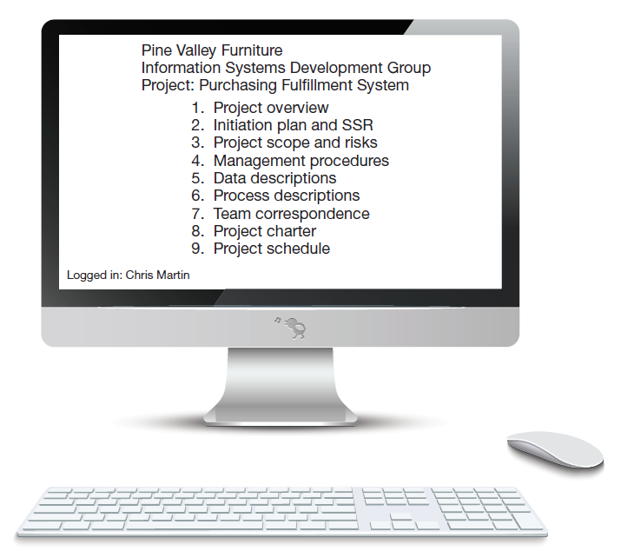
FIGURE 3-6
The project workbook for the Purchasing Fulfillment System project contains nine key elements
Project workbook
An online or hard-copy repository for all project correspondence, inputs, outputs, deliverables, procedures, and standards. Used for performing project audits, orienting new team members, communicating with management and customers, identifying future projects, and performing post-project reviews.
Notes:
The project workbook contains all of the documentation regarding the project. For example, the SSR we saw in a previous slide is contained kept in the workbook.
The project workbook will consist of a bunch of other documents that we’ll look at in the next few slides.

Slide 51
Project Charter
A short document prepared for the customer describing project deliverables and outlining the work required to complete the project
Elements:
  Title and authorization date
  Project manager name and contact information
  Customer name and contact information
  Project start and completion dates
  Key stakeholders, roles, responsibilities
  Project objectives and description
  Key assumptions
  Signatures of stakeholders
Notes:
The project charter gives a formal expression of the common understanding between the IS project team and the client. Different companies may have different formats for their project charters.
The project charter is another document that goes into the project workbook.

Slide 52
PM Phase 2: Project Planning
Define clear, discrete activities and the work needed to complete each activity. Tasks include:
Describing Project Scope, Alternatives, and Feasibility
Dividing the Project into Manageable Tasks
Estimating Resources and Creating a Resource Plan
Developing a Preliminary Schedule
Developing a Communication Plan
Determining Project Standards and Procedures
Identifying and Assessing Risk
Creating a Preliminary Budget
Developing a Project Scope Statement
Setting a Baseline Project Plan
Notes:
As you can see, project planning involves several different activities. Some of these tasks can be aided with project management software tools, like Microsoft Project. For example, MS Project directly helps with #2, 3, 4, 8, and 10.
We’ll see some MS project screenshots in future slides. These MS Project files will also be part of the project workbook.

Slide 53
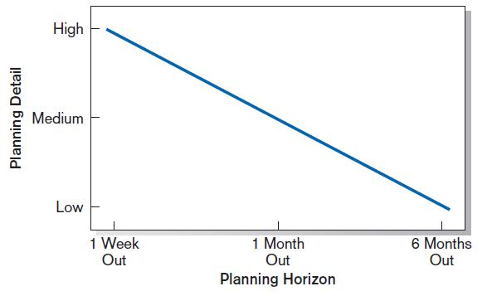
Planning Detail
FIGURE 3-8
Level of project planning detail should be high in the short term, with less detail as time goes on
Notes:
The general principal is that we need to accept the fact of uncertainty, and that things will change over time. So, although we want a detailed idea of what we’re going to do in the immediate future, we allow for more flexibility as time goes on.
This implies that planning is always going on. Plans are revisited and evolve over time.

Slide 54
Project Scope, Alternatives, and Feasibility
What problem or opportunity does the project address?
What are the quantifiable results to be achieved?
What needs to be done?
How will success be measured?
How will we know when we are finished?
Notes:
It’s important to watch out for “scope creep”, where the project requirements grow too much. To avoid this, part of the planning process is to define the expectations ahead of time.

Slide 55
Dividing Project into Manageable Tasks
Work Breakdown Structure (WBS)
  Division of project into manageable and logically ordered tasks and subtasks
Scheduling Diagrams
  Gantt chart: horizontal bars represent task durations
  Network diagram: boxes and links represent task dependencies

Slide 56
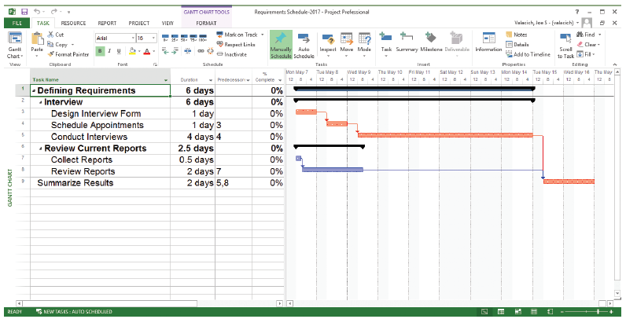
Developing a Preliminary Schedule
WBS
Gantt Chart
FIGURE 3-10
Gantt chart showing project tasks, duration times for those tasks, and predecessors
(Source: Microsoft Corporation.)
Notes:
This is a typical Microsoft Project screen. The left part of this screen is a Work Breakdown Structure (WBS), which shows the hierarchy of tasks, subtasks, sub-subtasks, etc. The boldfaced tasks are summary tasks, and their durations are based on the durations and dependencies of their subtasks. MS Project automatically calculates project duration based on how you set the task durations and dependencies.
The durations and dependencies between these tasks are shown graphically in the Gantt chart to the right. You can use either the WBS of the Gantt chart or both as you set up the project schedule.

Slide 57
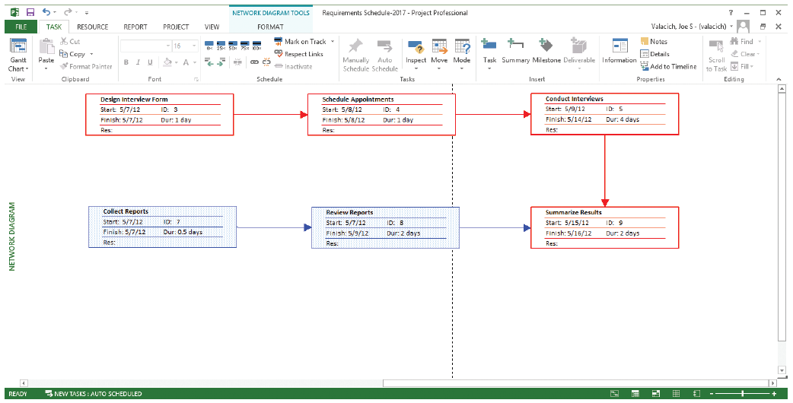
Scheduling Diagrams Network Diagram
FIGURE 3-12
A network diagram illustrating tasks with rectangles (or ovals) and the relationships and sequences of those activities with arrows
(Source: Microsoft Corporation.)
Notes:
This is another screen shot, that shows the tasks in a network diagram. You have different ways of viewing a project.

Slide 58
Estimating Resources, Creating a Resource Plan
Constructive Cost Model (COCOMO) – an automated software estimation model that uses historical project data and current/future project characteristics to estimate project costs
People are the most important and expensive resource
  Important to have a good balance between specialization and task variety
Notes:
COCOMO is a commonly used tool in software development projects. It provides an estimate of software costs.
When assigning people to tasks, you want to make sure a person’s talents, skills and interests match well with the tasks that need to be done. Some projects divide people into highly specialized roles, whereas in other projects each person gets a variety of different types of tasks. These are important interpersonal issues that a project manager is faced with.

Slide 59
Developing a Communication Plan
Who are stakeholders?
What information does each stakeholder need?
When should information be produced?
What are sources of information?
Who will collect, store and validate info?
Who will organize and document info?
Who is the contact person for each stakeholder?
What is the appropriate/best format for info?
What communication medium should be used?
Notes:
A large project may affect many groups within and outside the organization. With all these stakeholders, it is important to create and execute a workable and efficient plan for keeping everyone in the loop.

Slide 60
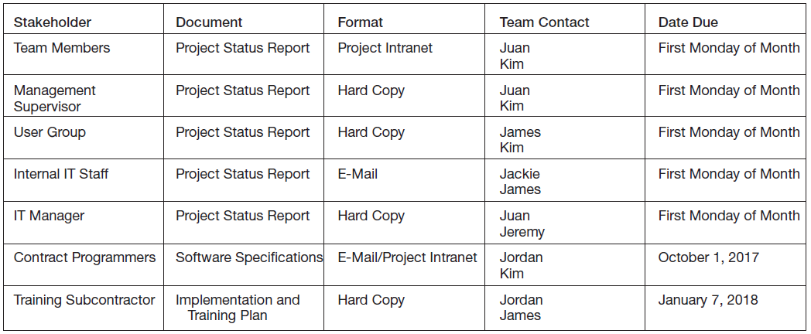
Communication Plan
FIGURE 3-13
The project communication matrix
provides a high-level summary of the
communication plan
Notes:
This grid is a good expression of the communication plan. And it would be another document to add to the project workbook.

Slide 61
Determining Project Standards and Procedures
Type of SDLC methodology
Documentation styles
Status updates
Terminology

Slide 62
Identifying and Assessing Risk
Sources of risk
Consequences of risk
Possible sources: new technology, user resistance, critical resource availability, competitive reactions, regulatory changes, team member experience

Slide 63
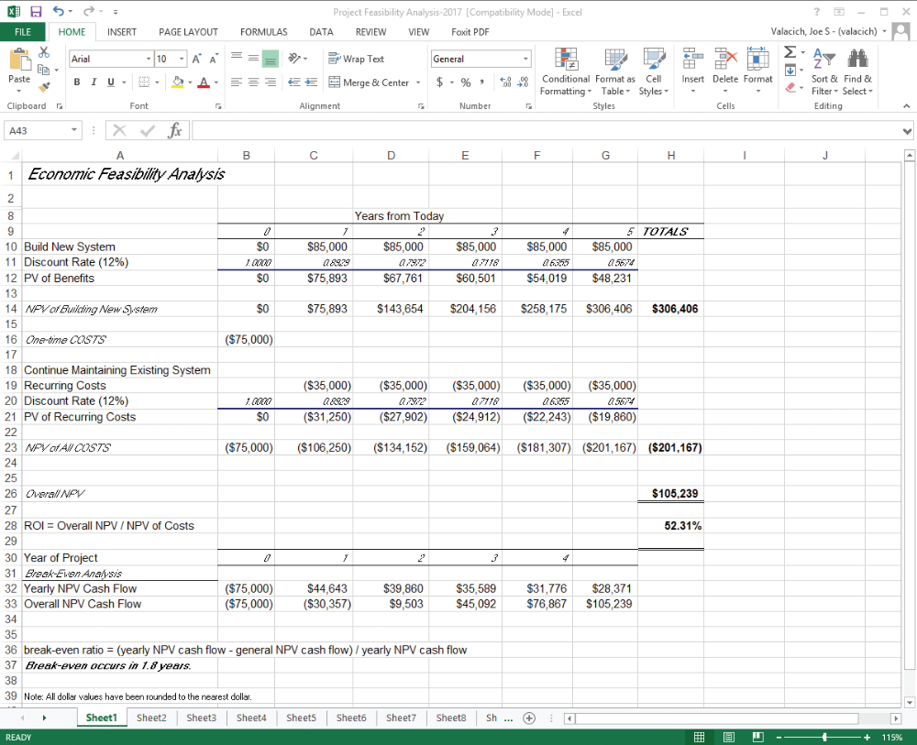
Developing a Preliminary Budget
FIGURE 3-14
A financial cost and benefit analysis for a systems development project (Source: Microsoft Corporation.)
Spreadsheet software is good for this.
Notes:
Spreadsheet software like Microsoft Excel is often used for budgeting. MS Project also provides a vehicle for budgeting, which is tied to the scheduling and resource allocation parts of the tool.
Obviously, the project budget is another important part of the overall project workbook.

Slide 64
Setting a Baseline Project Plan
A Baseline Project Plan provides an estimate of the project’s tasks and resource requirements and is used to guide the next project phase—execution. As new information is acquired during project execution, the baseline plan will continue to be updated.
Notes:
By “baseline” we mean a standard against which we’ll evaluate the project’s actual progress. The baseline is our prediction. Remember that we talked about uncertainty, which is why the project plan can’t be too detailed for the long-term future. So, it’s not surprising that the baseline plan will be modified as time goes on.
But it gives us a direction by setting goals and expectations, in terms of both time and financial cost.
Microsoft Project includes the capability to set a baseline plan and compare it to actual progress.

Slide 65
PM Phase 3: Project Execution
Plans created in prior phases are put into action.
Actions
  Execute baseline project plan.
  Monitor progress against baseline plan.
  Manage changes in baseline plan.
  Maintain project workbook.
  Communicate project status.
Notes:
Phase 2 was about planning the project. At phase 3, the activities defined in the project plan are actually tackled by the people (resources) who are assigned these tasks. While the project is being executed, the project manager monitors progress and adjusts plans, resource allocation, etc. accordingly. All the time, new documentation is added to the project workbook, and the communication channels remain open and active.

Slide 66
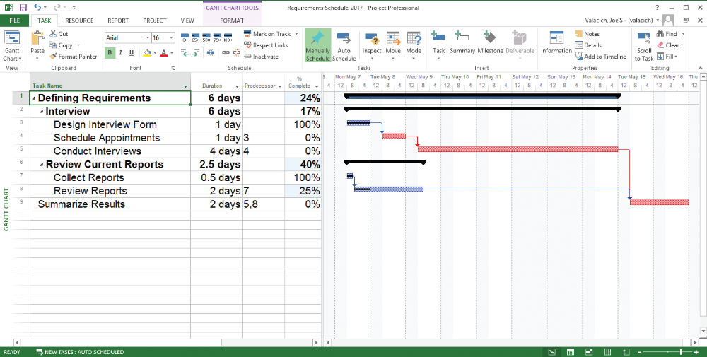
Monitoring Progress with a Gantt Chart
FIGURE 3-16
Gantt chart with tasks 3 and 7 completed and task 8 partially completed (Source: Microsoft Corporation.)
Red bars indicate critical path; lines through bars indicate percent complete.
Notes:
The red bars are the critical path, which means that these tasks cannot be delayed or lengthened without affecting the overall duration of the project. There is a precise algorithm for calculating the critical path in a project, and we’ll go through this formula shortly. Fortunately, project management tools like Microsoft Project automatically calculate critical paths.
The little black bars inside the blue bars of the Gantt chart show how much of the task is actually completed. So, here we see a case of using MS Project to monitor and track progress during project execution.

Slide 67
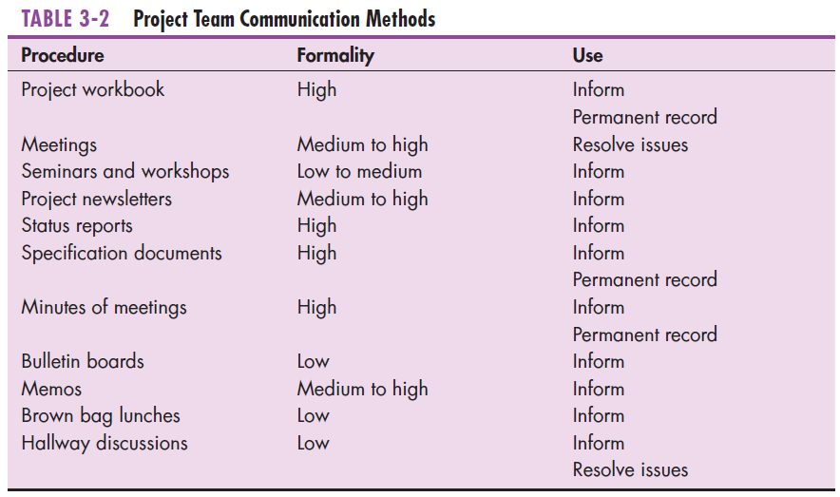
Communication Methods
Notes:
We’ve already talked about the importance of communication, and in the planning phase we discussed the construction of a communication plan. This table shows several different modes of communication that are possible among project stakeholders. Most teams will use multiple of these methods.

Slide 68
PM Phase 4: Project Closedown
Bring the project to an end.
Actions
  Close down the project.
  Conduct post-project reviews.
  Close the customer contract.
Notes:
At some point in time, the project ends. These are the three main activities of this final phase.
Closing the project involves reassigning team members to other jobs, assessing team member performance, notifying stakeholders that project has ended, and celebrating team accomplishments.
It’s important to perform post project reviews in order to benefit from reflecting on “lessons learned”. Sometimes this is called a postmortem review.
It’s important to get the agreement that the terms of the SSR have been met and the contract is complete.

Slide 69
Representing and Scheduling Project Plans
Gantt Charts
Network Diagrams
PERT Calculations
Critical Path Scheduling
Project Management Software
Notes:
We’ve already seen a few screen shots of Gantt charts and network diagrams. In the following slides, we delve a little deeper into the calculations that take place when creating project schedules.

Slide 70
Gantt Charts vs. Network Diagrams
Gantt charts
  Show task durations.
  Show time overlap.
  Show slack time in duration.
Network diagrams
  Show task dependencies.
  Do not show time overlap, but show parallelism.
  Show slack time in boxes.
Notes:
Each type of chart has its advantages. You may want to flip from one to another.

Slide 71
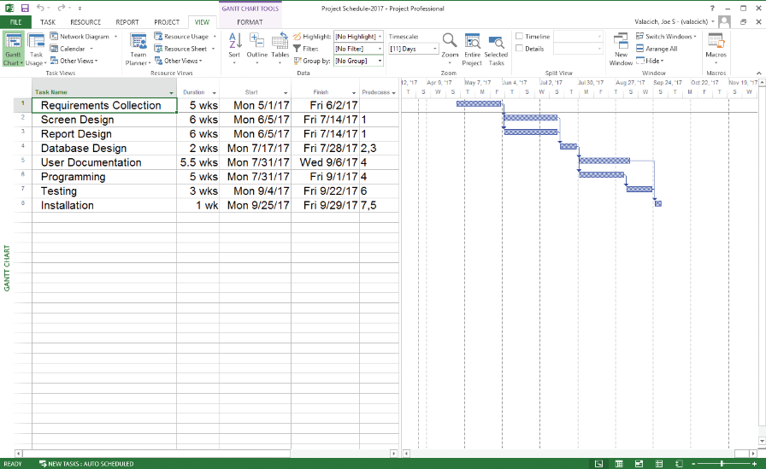
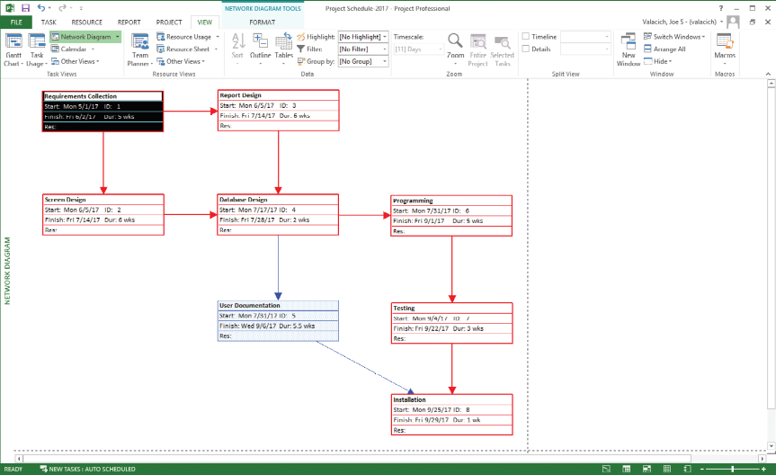
Gantt Charts vs. Network Diagrams (Cont.)
Figure 3-18
Graphical diagrams that depict project plans
(a) A Gantt chart
(b) A network diagram
(Source: Microsoft Corporation.)
Notes:
Here they are in Microsoft Project.

Slide 72
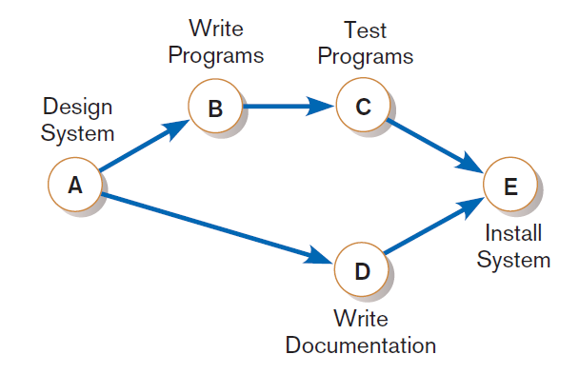
Gantt Charts vs. Network Diagrams (Cont.)
Figure 3-20
A network diagram showing activities
(represented by circles) and sequence of
those activities (represented by arrows)
Notes:
This diagram notation will be used in future slides as we manually go through the critical path calculation. This diagram shows that task D can take place at the same time that B and C are going. But B needs to complete before C can begin. And, both C and D must be completed in order for E to begin.

Slide 73
Estimating Task Duration
PERT: Program Evaluation Review Technique
Technique that uses optimistic (o), pessimistic (p), and realistic (r) time estimates to determine expected task duration
Formula for Estimated Time:
  ET = (o + 4r + p)/6
Notes:
This is a simple formula to estimate the time for a task based on our “optimistic”, “realistic”, and “pessimistic” judgments. Each of the detailed tasks in a project can be estimated this way.

Slide 74
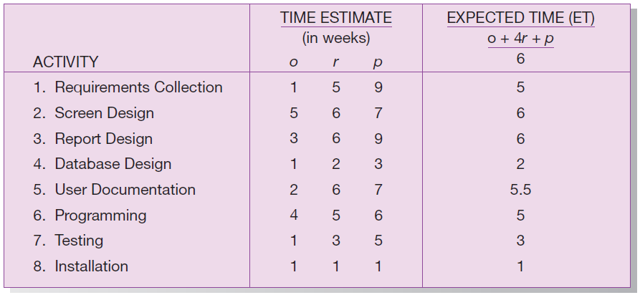
Example PERT Analysis
FIGURE 3-21
Estimated time calculations for the SPTS project
Notes:
This is a PERT analysis of the main tasks of the sales promotion tracking system project. These time estimates are based on previous experience and educated guesses. As a project manager gets more experience in more projects, he or she will get better at estimating the time it takes to complete common tasks. The project workbook helps with this, because it keeps track of history, which can then be used for making future predictions and decisions.

Slide 75
Critical Path Scheduling
A scheduling technique whose order and duration of a sequence of task activities directly affect the completion
Critical path: the shortest time in which a project can be completed
Slack time: the time an activity can be delayed without delaying the project
Notes:
The critical path is determined by the task durations and task dependencies in the project. A project will always have at least one critical path.

Slide 76
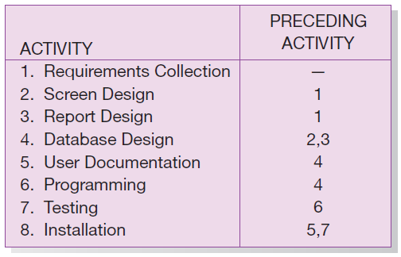
Critical Path Example
(dependencies between tasks)
PRECEDING ACTIVITIES indicate the activities that must be completed before the specified activity can begin.
FIGURE 3-22 Sequence of Activities within the SPTS project
Notes:
Here we see, for each task, the tasks that need to be completed before it can begin. As you can see, database design does not begin until screen and report design are both completed.

Slide 77
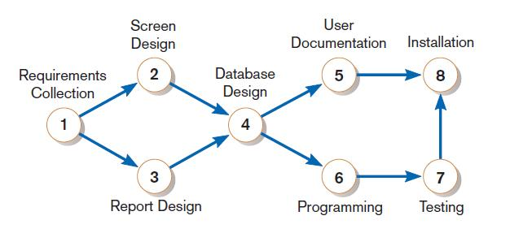
Critical Path Example (Cont.)
Network diagram shows dependencies
FIGURE 3-24
A network diagram that illustrates the activities (circles) and the sequence (arrows) of those activities
Notes:
This network diagram illustrates the dependencies that were shown in the previous slide.
Note that the start task is 1. The end task is 8. There are several paths from 1 to 8:
1,2,4,5,8
1,2,4,6,7,8
1,3,4,5,8
1,3,4,6,7,8
Which one is the critical path?

Slide 78
Determining the Critical Path
Calculate the earliest possible completion time for each activity by summing the activity times in the longest path to the activity. This gives total expected project time.
Calculate the latest possible completion time for each activity by subtracting the activity times in the path following the activity from the total expected time. This gives slack time for activities.
Critical path contains no activities with slack time.
Notes:
The key here is to determine slack time. Tasks that are not on the critical path may have some slack time, but no task on the critical path has any slack time. The critical path identifies the “bottleneck” in the project.

Slide 79
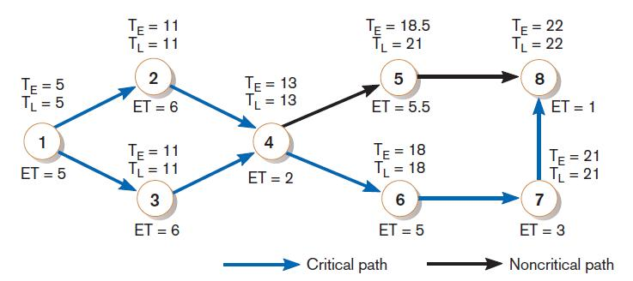
Critical Path Calculation
FIGURE 3-25
A network diagram for the SPTS project showing estimated times for each activity and the earliest and latest expected completion time for each activity
Early and late time calculations are determined and critical path established. (Note: Activity #5 can begin late without affecting project completion time.)
Notes:
The time estimates here are based on the PERT analysis from before.
You can see that the task with slack is 5 (user documentation). That makes sense, because this happens while 6 and 7 happen. The total expected duration for user documentation (task 5) is 5.5weeks whereas the total duration for programming and testing (tasks 6 and 7) is eight weeks. So, task 5 has slack and is therefore not in a critical path.
It turns out that there are two critical paths:
1,2,4,6,7,8
1,3,4,6,7,8
This was a very simple example. A real project may have dozens or even hundreds of tasks, so it’s good to have an automated way of calculating the critical path.

Slide 80
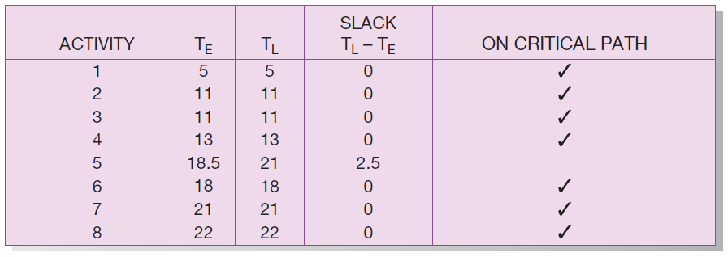
Critical Path Calculation (cont.)
FIGURE 3-26
Activity slack time calculations for the SPTS project; all activities except number 5 are on the critical path
Note the slack time in Activity #5.
Notes:
This gives the results of the CP calculation. Once you know of which tasks are critical and which are not, you can use this to make other scheduling and resource allocation decisions.

Slide 81
Using Project Management Software
Many powerful software tools exist for assisting with project management.
Example: Microsoft Project can help with
  Entering project start or end date.
  Establishing tasks and task dependencies.
  Viewing project information as Gantt or Network diagrams.
Notes:
The next couple slides show other Microsoft Project features for some common project management tasks.

Slide 82
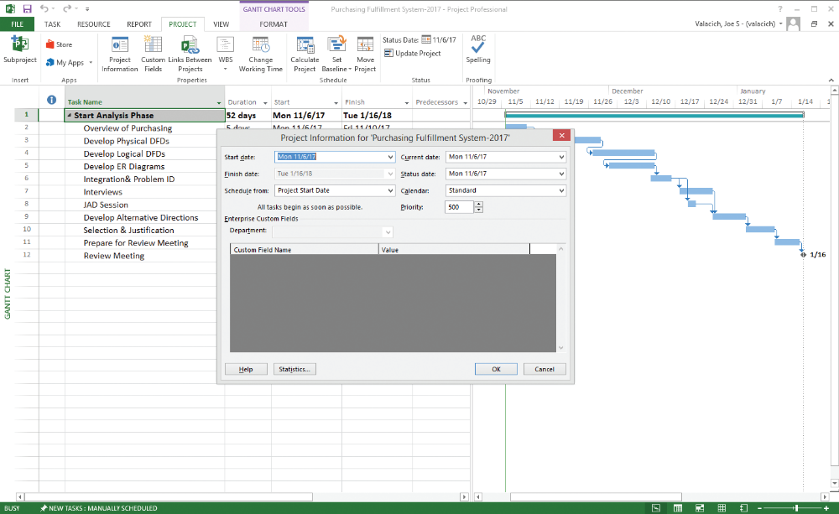
Project Start Date
FIGURE 3-27
Establishing a project starting date in Microsoft Project for Windows
(Source: Microsoft Corporation.)
Notes:
MS project allows you to specify all the task dependencies and durations, and then to change the start date if you want, which will result in a different end date for the project (as well as different dates for each of its tasks). You can also instead specify a hoped-for end date in order to determine the latest that a project can start,

Slide 83
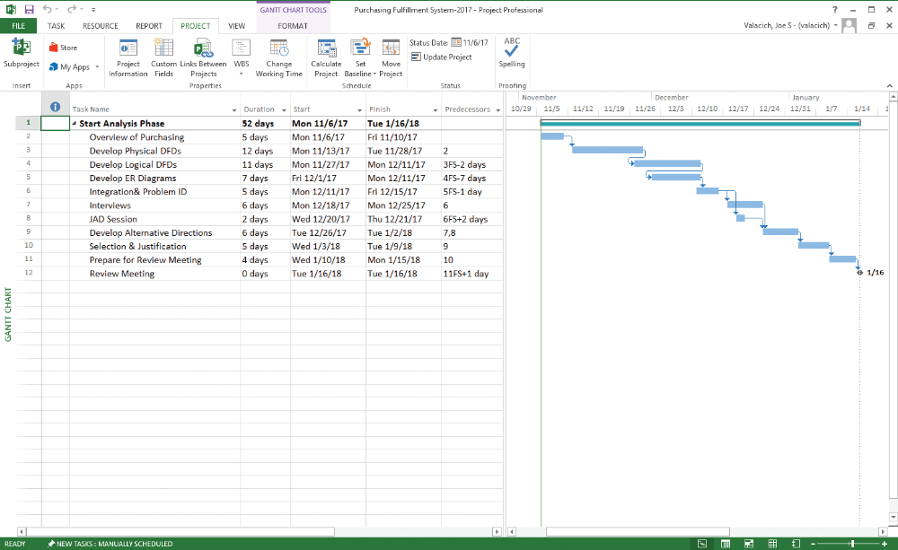
Entering Tasks
FIGURE 3-29
Entering tasks and assigning task relationships in Microsoft project
for Windows (Source: Microsoft Corporation.)
Notes:
In the work breakdown structure on the left, you can see many properties of each task in the project plan. Here, we see duration, start and finish dates, and predecessors. There are many other properties you could see if you wanted, and there are a variety of WBS “themes”.

Slide 84
Summary
Now you learned how to:
  explain the process of managing an information systems project, including project initiation, project planning, project execution, and project closedown,
  describe how to represent and schedule project plans using Gantt charts and network diagrams, and
  explain how commercial project management software packages can be used to assist in representing and managing project schedules

Slide 85
Next Lecture
Identifying and Selecting Systems Development Projects

Slide 86
References
Joseph S. Valacich, Joey F. George, Modern Systems Analysis and Design, 8th Global Edition, Pearson, 2016

