Slide 1


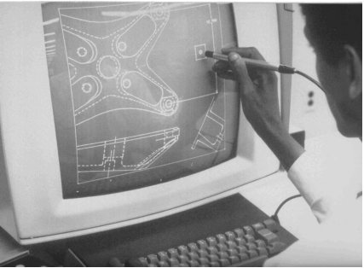
CSE 411
Computer Graphics
Lecture #2 Mathematical Foundations
Prepared & Presented by Asst. Prof. Dr. Samsun M. BAŞARICI

Slide 2
Objectives
HB Appendix A
Brief, informal review of some of the mathematical tools
  Geometry (2D, 3D)
  Trigonometry
  Vector spaces
    Points, vectors, and coordinates
  Dot and cross products
  Linear transforms and matrices
  Complex numbers

Slide 3
2D Geometry
Remember high school geometry:
  Total angle around a circle is 360° or 2π radians
  When two lines cross:
    Opposite angles are equivalent
    Angles along line sum to 180°
  Similar triangles:
    All corresponding angles are equivalent

Slide 4
Trigonometry
(x, y)
θ
Sine: “opposite over hypotenuse”
Cosine: “adjacent over hypotenuse”
Tangent: “opposite over adjacent”
Unit circle definitions:
  sin (θ) = y
  cos (θ) = x
  tan (θ) = y/x
  Etc…

Slide 5
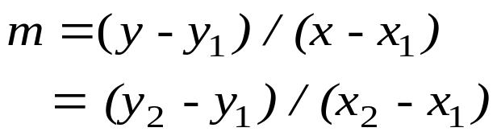

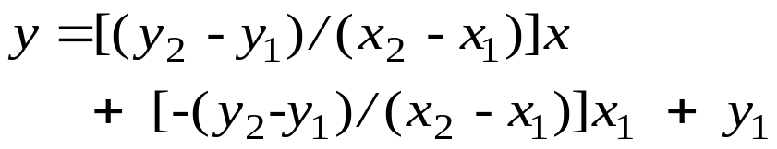

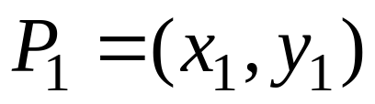
Slope-intercept Line Equation
Slope:
Solve for y:
or:
y = mx + b
y
x

Slide 6
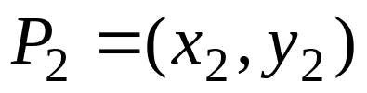
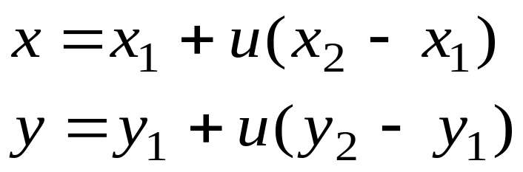


2D-Parametric Line Equation
Given points and
When:
  u=0, we get
  u=1, we get
  (0<u<1), we get points
  on the segment between
  and
y
x

Slide 7


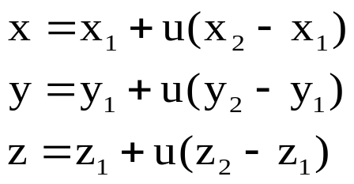


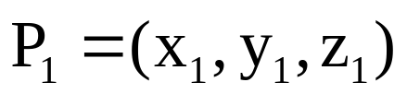


3D-Parametric Line Equation
Given points
When:
  u=0, we get
  u=1, we get
  (0<u<1), we get points
  on the segment between
  and
y
x

Slide 8
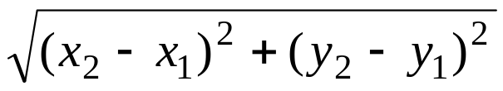
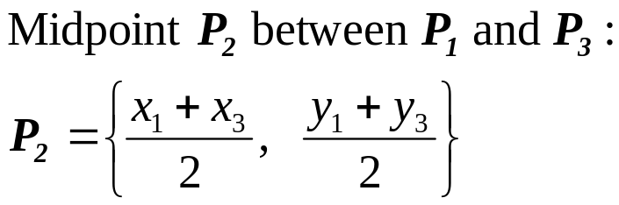

Other helpful formulas
Length =
Two lines perpendicular if:
Cosine of the angle between them is 0.

Slide 9
Coordinate Systems
2D systems
 Cartesian system
 Polar coordinates
3D systems
 Cartesian system
1) Right-handed
2) Left handed
  Curvilinear systems
   Cylindiric system
   Spherical system

Slide 10
Coordinate Systems (cont.)
2D Cartesian and polar systems
y-axis
(x, y)
x=r cos(θ)
y=r sin(θ)
(x,y) (r,θ)
y
r
θ
x-axis
x
Right triangle with: hypotenuse r , sides x and y , an interior angle θ.
Relationship between polar and Cartesian coordinates

Slide 11
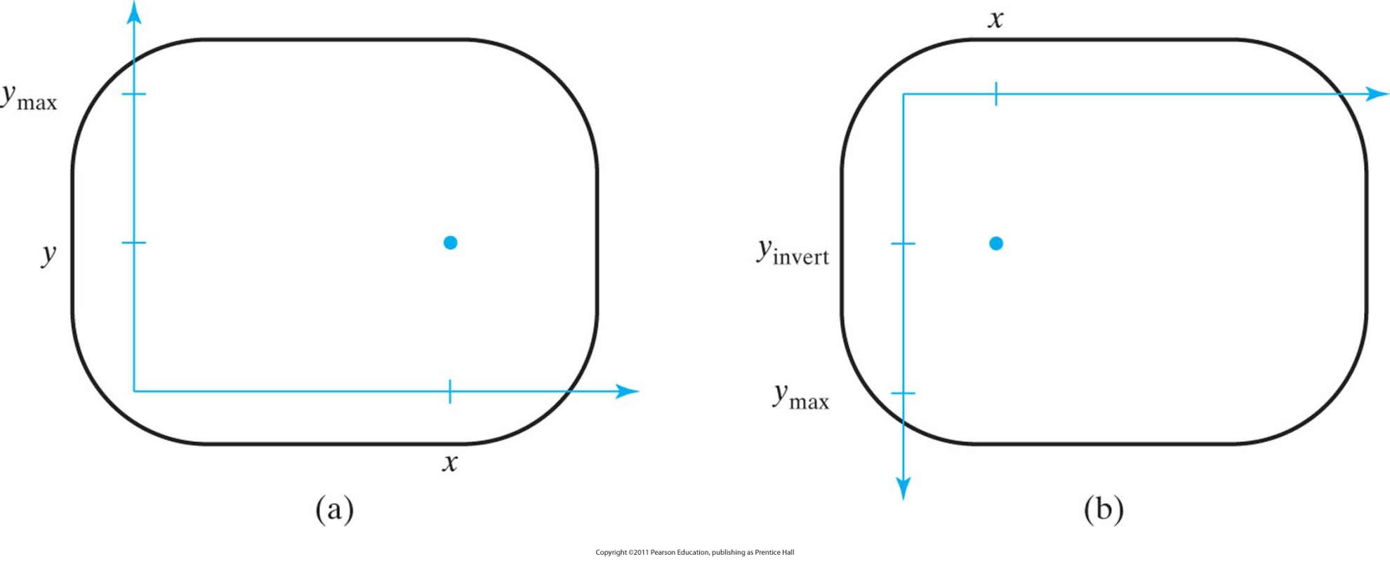
Cartesian screen-coordinate positions
Referenced with respect to the lower-left screen corner (a) and the upper-left screen corner (b).
Notes:
11

Slide 12
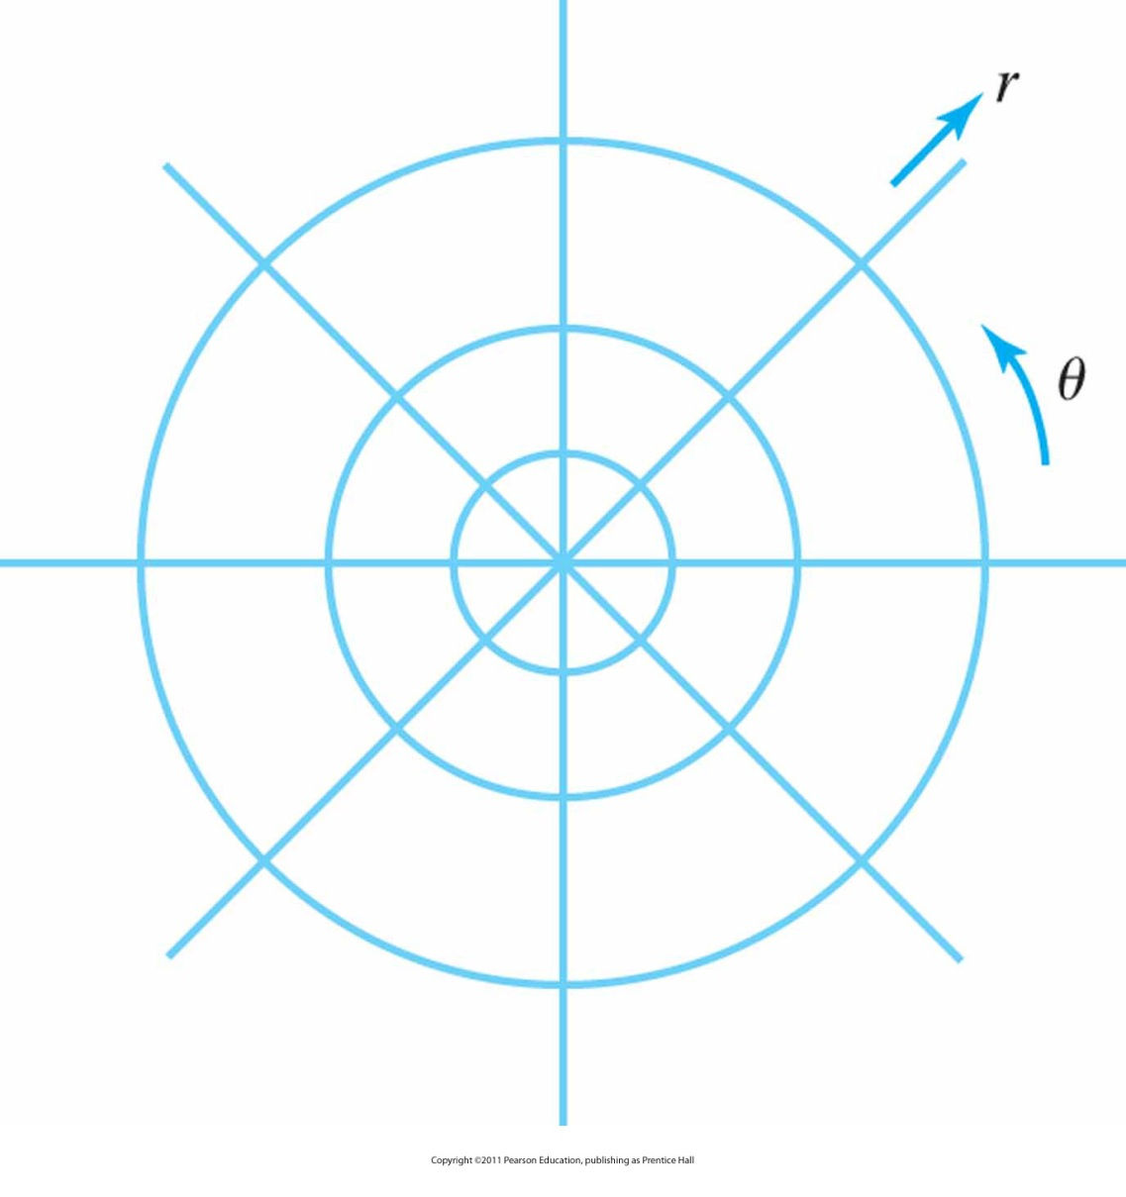
Polar-coordinate reference frame
Formed with concentric circles and radial lines
Notes:
12

Slide 13
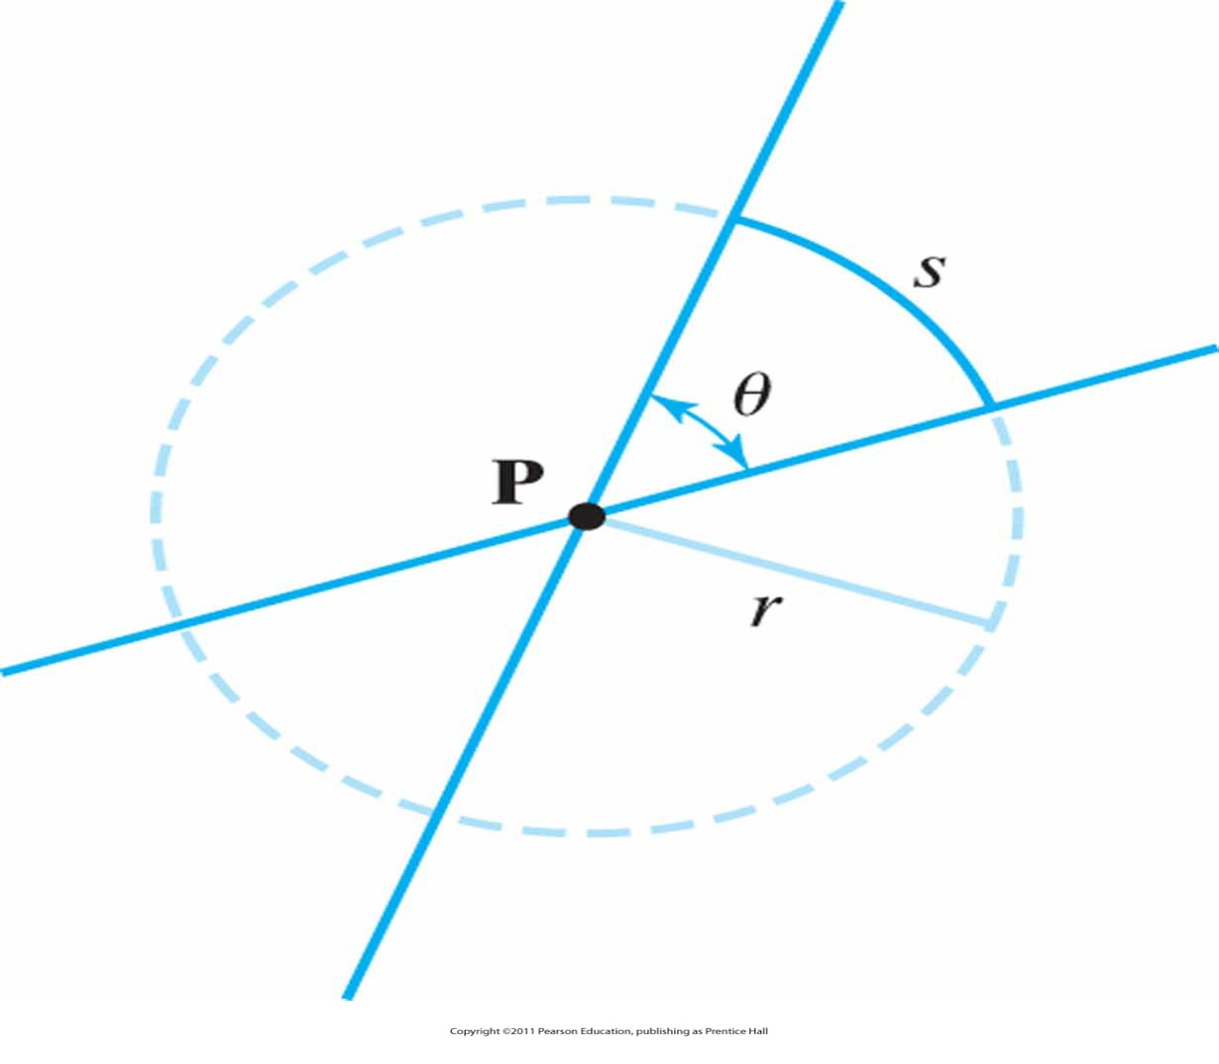
Radian
An angle θ subtended by a circular arc of length s and radius r
Notes:
13

Slide 14
Coordinate Systems (3D)
3D Cartesian
system
Grasp z-axis with hand
Roll fingers from positive x-axis towards positive y-axis
Thumb points in direction of z-axis
Y
Y
Z
X
X
Right-handed
Left-handed
coordinate
coordinate
Z
system
system

Slide 15
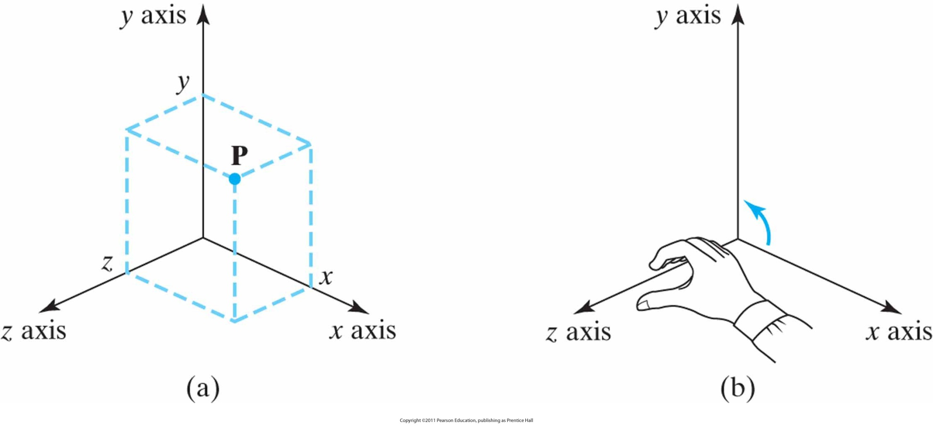
Point in 3D (right handed)
Coordinate representation for a point P at position (x, y, z) in a standard right-handed Cartesian reference system.
Notes:
15

Slide 16
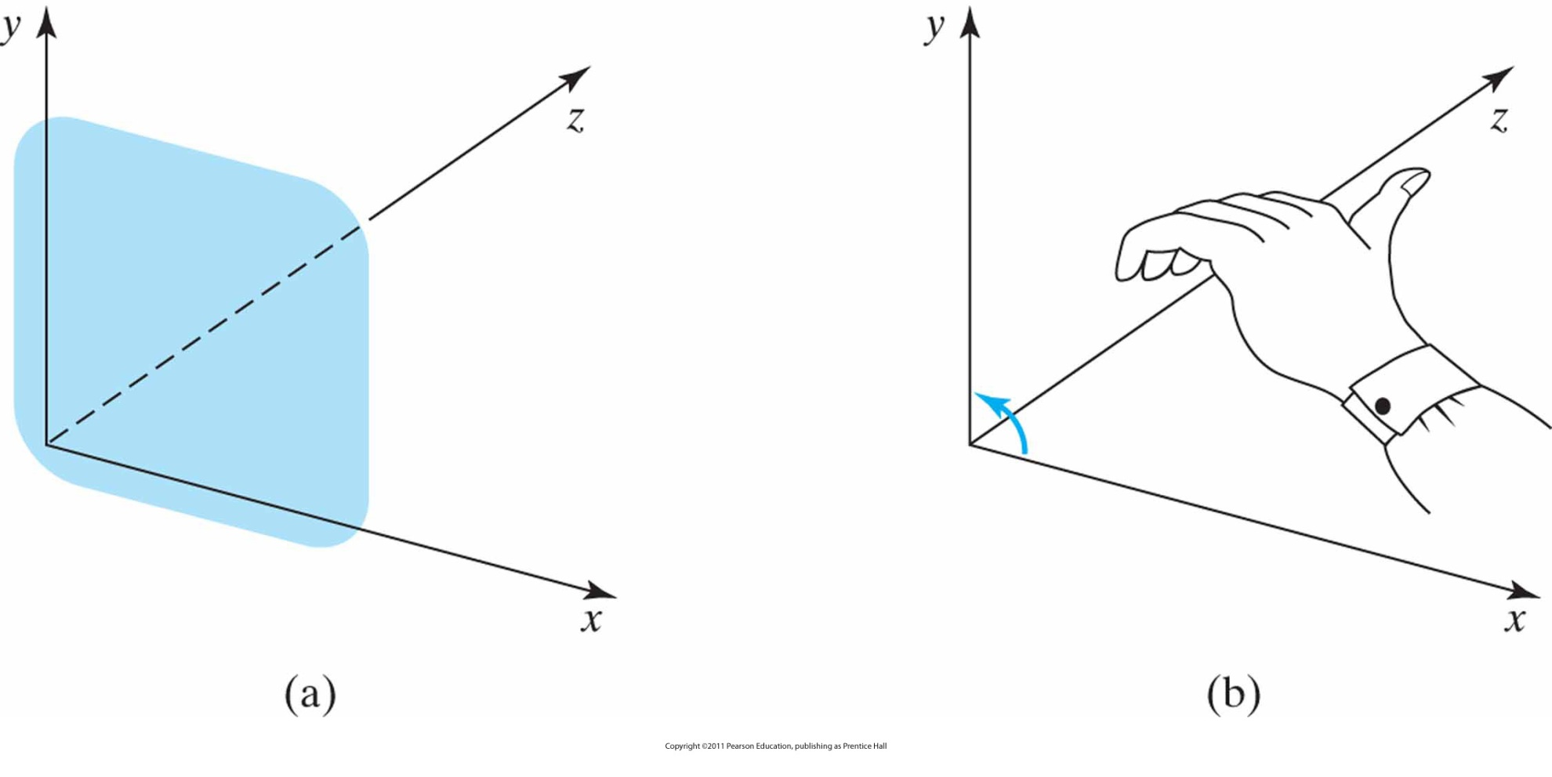
Point in 3D (left handed)
Left-handed Cartesian coordinate system superimposed on the surface of a video monitor
Notes:
16

Slide 17
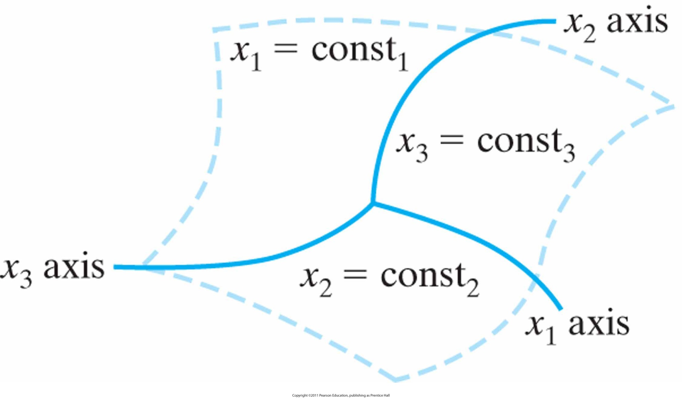
General curvilinear-coordinate reference frame
Notes:
17

Slide 18
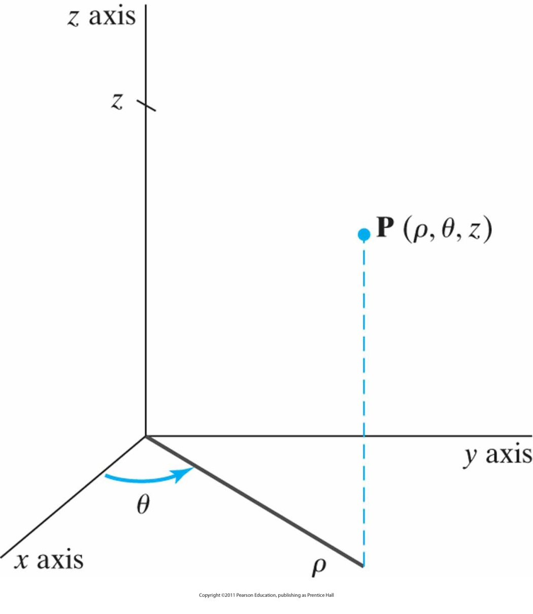
Cylindrical coordinates.
ρ, θ, and z
Notes:
18

Slide 19
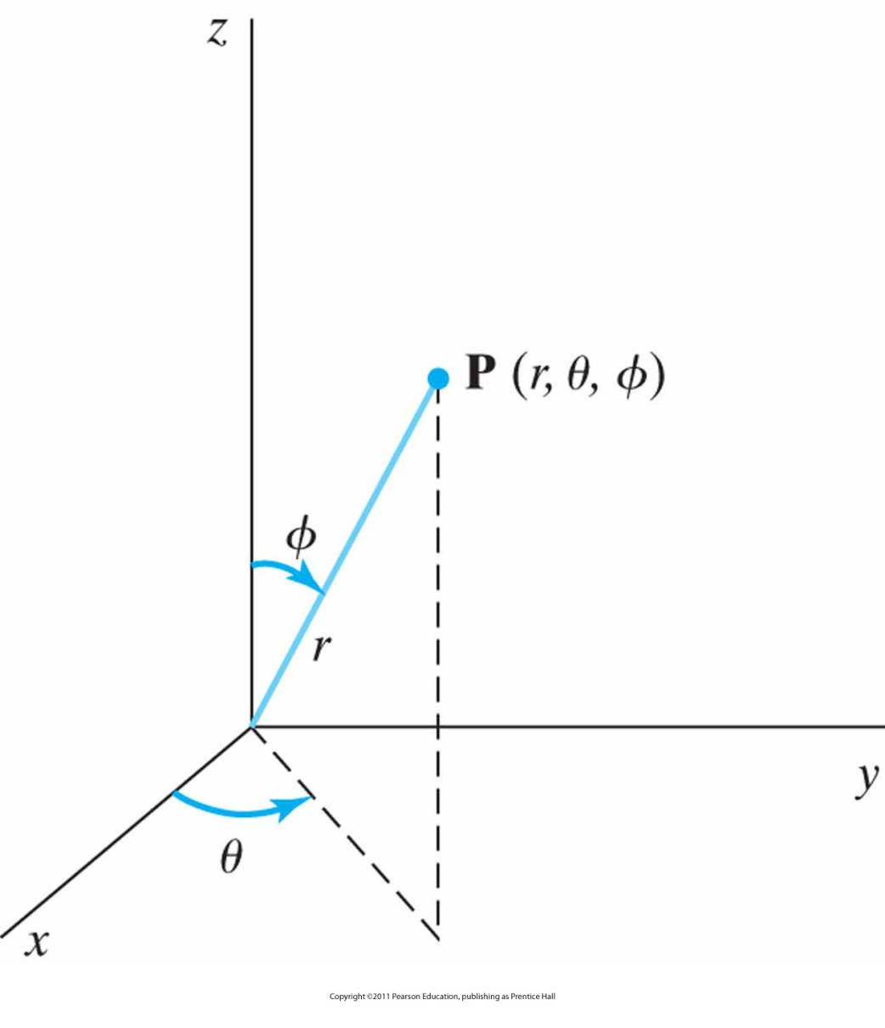
Spherical coordinates
r, θ, and Φ
Notes:
19

Slide 20
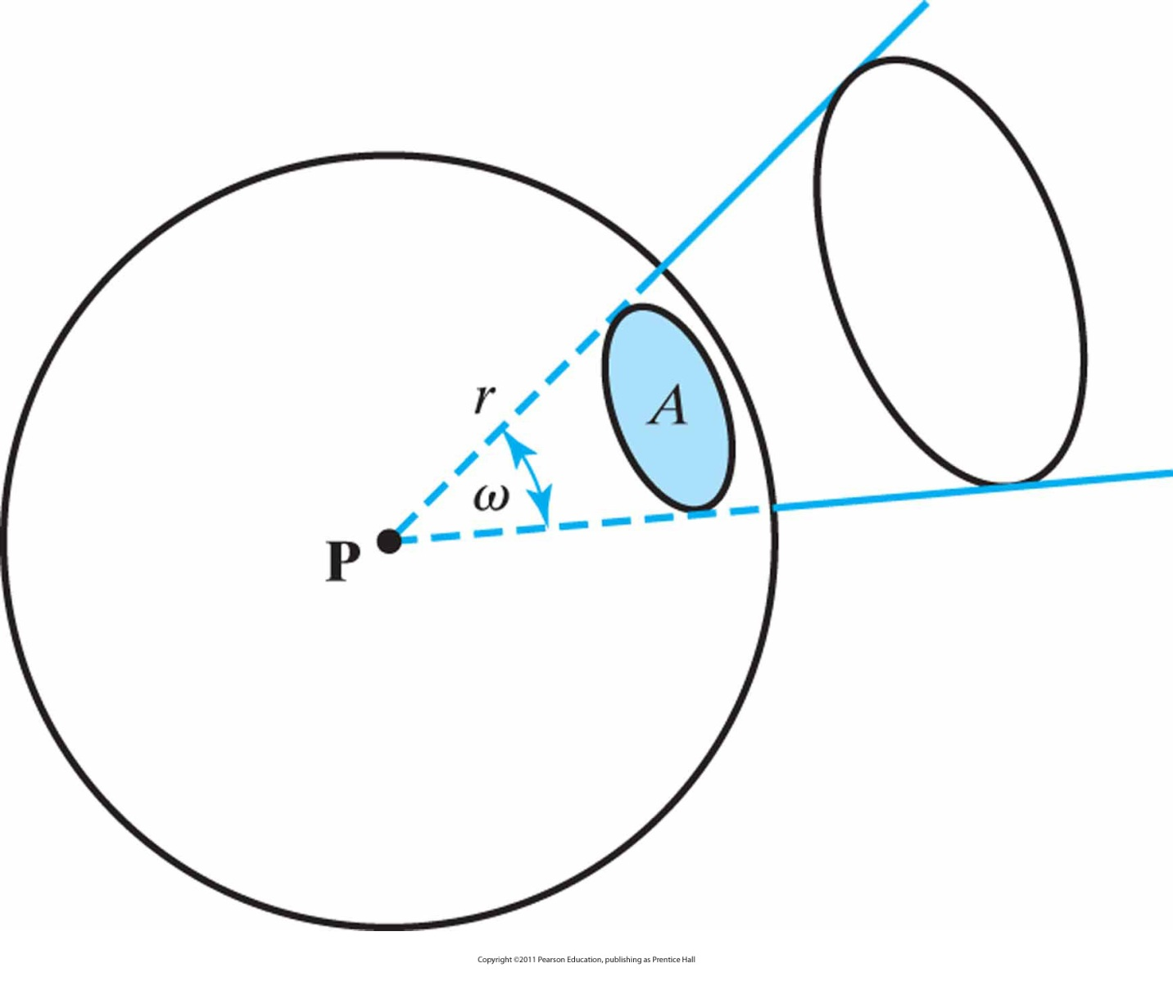
Solid Angle
A solid angle ω subtended by a spherical surface patch with area A and radius r
Notes:
20

Slide 21
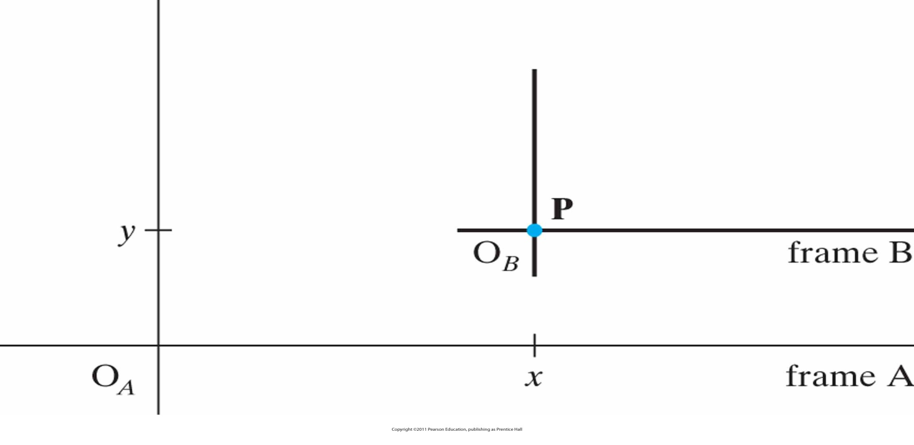
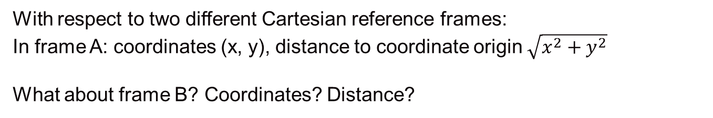
Coordinates for a point position P
Notes:
21

Slide 22
Points
Points support these operations:
  Point-point subtraction: P₂ – P₁= v =(x₂-x₁, y₂-y₁)
    Result is a vector pointing from P₁ to P₂
  Vector-point addition: P + v = Q
    Result is a new point
  Note that the addition of two points
  is not defined
P₂=(x₂, y₂)
v
P₁=(x₂, y₂)

Slide 23
Vectors
We commonly use vectors to represent:
  Points in space (i.e., location)
  Displacements from point to point
  Direction (i.e., orientation)

Slide 24
Vector Spaces
Two types of elements:
  Scalars (real numbers): α, β, γ, δ, …
  Vectors (n-tuples): u, v, w, …
Operations:
  Addition
  Subtraction
  Dot Product
  Cross Product
  Norm

Slide 25
Vector Addition/Subtraction
  operation u + v, with:
    Identity 0 v + 0 = v
    Inverse - v + (-v) = 0
  Vectors are “arrows” rooted at the origin
  Addition uses the “parallelogram rule”:
u+v
y
y
v
v
u
u
x
x
-v
u-v

Slide 26
Scalar Multiplication
  Scalar multiplication:
    Distributive rule: α(u + v) = α(u) + α(v)
    (α + β)u = αu + βu
  Scalar multiplication “streches” a vector, changing its length (magnitude) but not its direction

Slide 27
Dot Product
The dot product or, more generally, inner product of two vectors is a scalar:
  v₁ • v₂ = x₁x₂ + y₁y₂ + z₁z₂ (in 3D)
Norm of a vector
  Computing the length (Euclidean Norm) of a vector: length(v) = ||v|| = sqrt(v • v)
  Normalizing a vector, making it unit-length: v = v / ||v||
  Computing the angle between two vectors:
    u • v = ||u|| ||v|| cos(θ)
  Checking two vectors for orthogonality
    u • v = 0
v
θ
u

Slide 28
Dot Product?
u=(2,4)
θ=45º
v=(3,1)
(0,0)

Slide 29
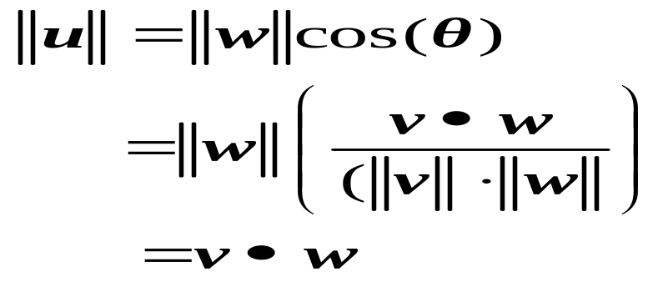
Dot Product
Projecting one vector onto another
  If v is a unit vector and we have another vector, w
  We can project w perpendicularly onto v
  And the result, u, has length w • v
w
v
u

Slide 30
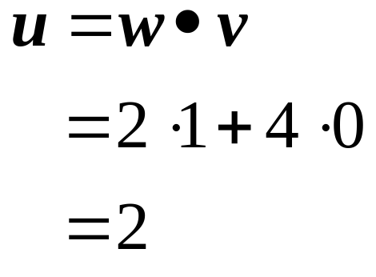
Dot Product
Example:
w=(2,4), v=(1,0)
w=(2,4)
(0,0)
u
v=(1,0)

Slide 31
Dot Product
Is commutative
  u • v = v • u
Is distributive with respect to addition
  u • (v + w) = u • v + u • w

Slide 32
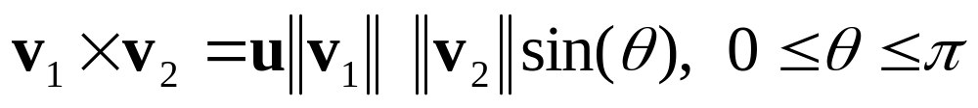
Cross Product
The cross product or vector product of two vectors is a vector:
where u is a unit vector that is prependicular to both
v₁ and v₂.

Slide 33
Cross Product
The cross product or vector product of two vectors can be expressed as:
The cross product of two vectors is orthogonal to both
Right-hand rule dictates direction of cross product

Slide 34
Cross Product
The direction for u is determined by the right-hand rule.
We grasp an axis that is prependicular to the plain containing v₁ and v₂ so that the fingers of the right hand curl from v₁ to v₂ .
Vector u is then in the direction of the right hand thumb.

Slide 35




Cross Product
The cross product of two vectors is a vector in a direction prependicular to the two original vectors and with a magnitude equal to the area of the shaded parallelogram

Slide 36

Cross Product

Slide 37
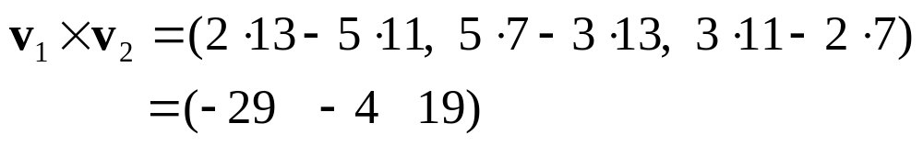
Cross Product
Example
v₁=(3 2 5)
v₂=(7 11 13)

Slide 38



Cross Product: Properties
The cross product of any two parallel vectors is 0.
The cross product is not commutative, it is anticommutative, i. e.
The cross product is not associative, i. e.
The cross product is distributive, that is

Slide 39
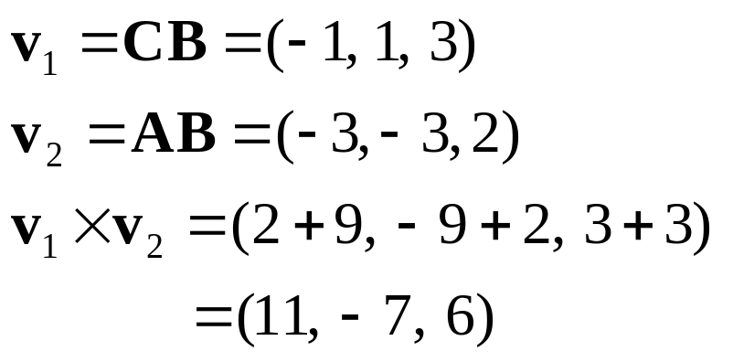
Finding a unit normal to a plane
Find a unit normal to the plane containing the points A(-1, 0,1), B(2, 3, -1), C(1, 4, 2)
C
A
B
N

Slide 40
Triangle Arithmetic
b
Consider a triangle, (a, b, c)
  a,b,c = (x,y,z) tuples
Surface area = s_{a} = ½ * ||(b –a) X (c-a)||
Unit normal = (1/2s_{a}) * (b-a) X (c-a)
a
c

Slide 41
Vector Spaces
A linear combination of vectors results in a new vector:
  v = α₁v₁ + α₂v₂ + … + α_{n}v_{n}
If the only set of scalars such that
α₁v₁ + α₂v₂ + … + α_{n}v_{n} = 0
is α₁ = α₂ = … = α₃ = 0
then we say the vectors are linearly independent
The dimension of a space is the greatest number of linearly independent vectors possible in a vector set
For a vector space of dimension n, any set of n linearly independent vectors form a basis

Slide 42
Vector Spaces: Basis Vectors
Given a basis for a vector space:
  Each vector in the space is a unique linear combination of the basis vectors
  The coordinates of a vector are the scalars from this linear combination
  If basis vectors are orthogonal and unit length:
    Vectors comprise orthonormal basis
  Best-known example: Cartesian coordinates
  Note that a given vector v will have different coordinates for different bases

Slide 43
Matrices
Matrix addition
Matrix multiplication
Matrix transpose
Determinant of a matrix
Matrix inverse

Slide 44
Complex numbers
A complex number z is an ordered pair of real numbers
z = x+iy
z = (x,y), x = Re(z), y = Im(z)
Addition, substraction and scalar multiplication of complex numbers are carried out using the same rules as for two-dimensional vectors.
Multiplication is defined as
(x₁ , y₁ )(x₂, y₂) = (x₁ x₂ – y₁ y₂ , x₁y₂+ x₂ y₁)

Slide 45
Complex numbers(cont.)
Real numbers can be represented as
x = (x, 0)
It follows that (x₁ , 0 )(x₂ , 0) = (x₁ x₂ ,0)
i = (0, 1) is called the imaginary unit.
We note that i² = (0, 1) (0, 1) = (-1, 0).

Slide 46
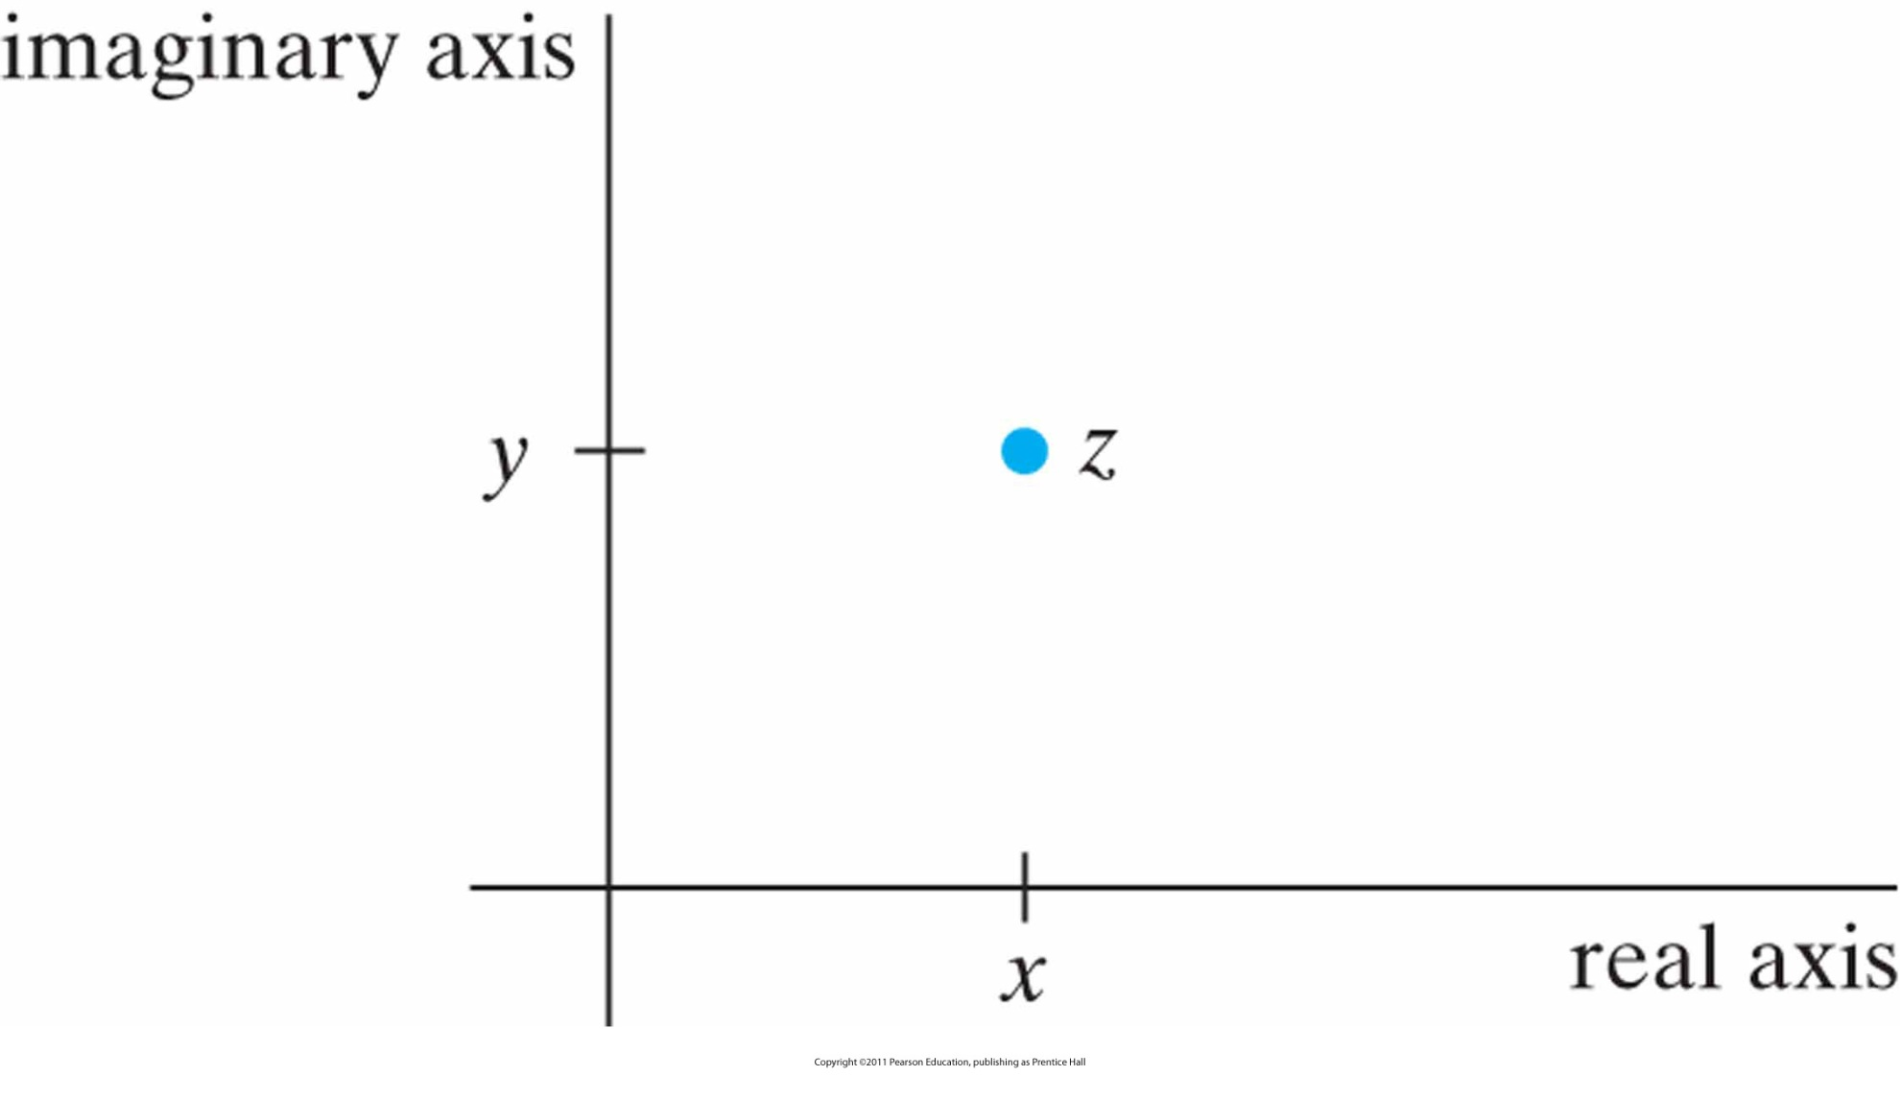
Complex numbers (cont.)
Real and imaginary components for a point z in the complex plane.
Notes:
46

Slide 47
Complex numbers(cont.)
Using the rule for complex addition, we can write any complex number as the sum
z = (x,0) + (0, y)
= x + iy
which is the usual form used in practical applications.

Slide 48
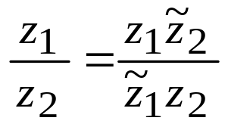
Complex numbers(cont.)
The complex conjugate is defined as
z̃ = x -iy
Modulus or absolute value of a complex number is
|z| = z z̃ = √ (x² +y²)
Division of of complex numbers:

Slide 49
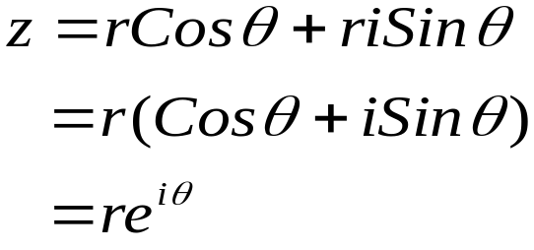
Complex numbers(cont.)
Polar coordinate representation

Slide 50
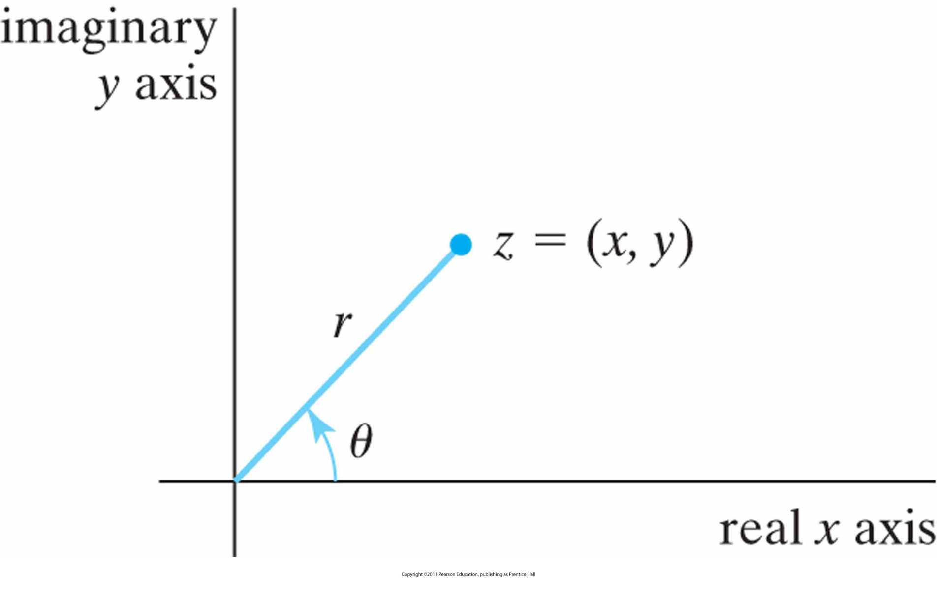
Complex numbers (cont.)
Polar-coordinate parameters in the complex plane
Notes:
50

Slide 51
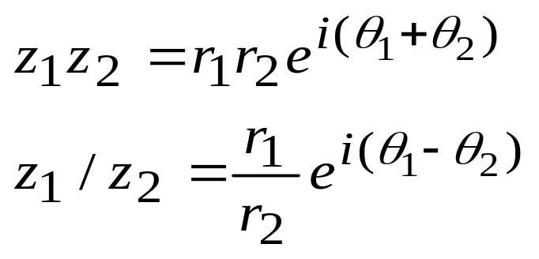
Complex numbers(cont.)
Complex multiplication

Slide 52

Next Lecture
Graphics Output Primitives

Slide 53
References
Donald Hearn, M. Pauline Baker, Warren R. Carithers, “Computer Graphics with OpenGL, 4th Edition”; Pearson, 2011

