Slide 1


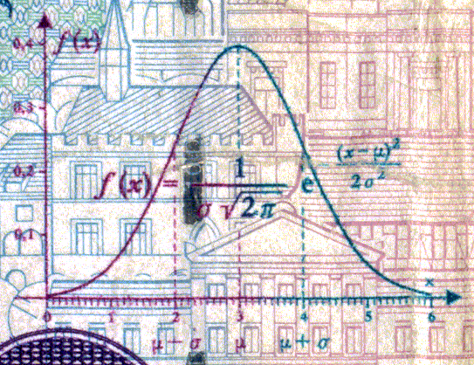
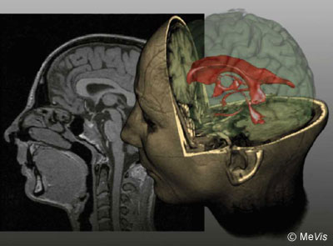
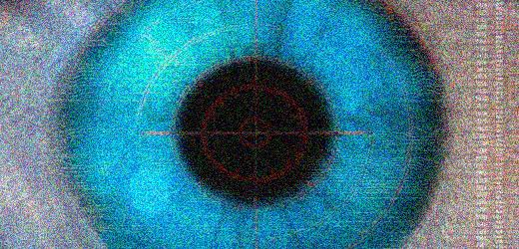
CSE 307
Basics of Image Processing
Lecture #2 The Fundamentals
Prepared & Presented by Asst. Prof. Dr. Samsun M. BAŞARICI

Slide 2


Objectives
Human Vision System (HVS): Structure and function
Light and electromagnetic spectrum
How is a digital image represented and stored in memory?
What are the main types of digital image representation?
What are the main parameters involved in the design of an image acquisition solution?

Slide 3
Objectives (cont.)
How do contemporary image sensors work?
What is image digitization and what are the main parameters that impact the digitization of an image?
What is sampling?
What is quantization?
What are the most popular image file formats?
What are the most common types of image processing operations and how do they affect pixel values?

Slide 4
Objectives (cont.)
What do geometric operations do to an image and what are they used for?
What are the techniques used to enlarge/reduce a digital image?
What are the main interpolation methods used in association with geometric operations?
What are affine transformations and how can they be performed using MATLAB?
What is image registration and where is it used?

Slide 5
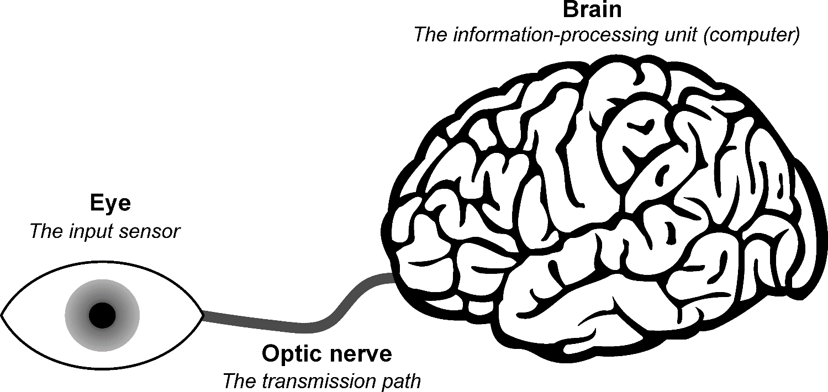
The human eye
Simplified view of the connection from the eye to the brain via the optic nerve.

Slide 6
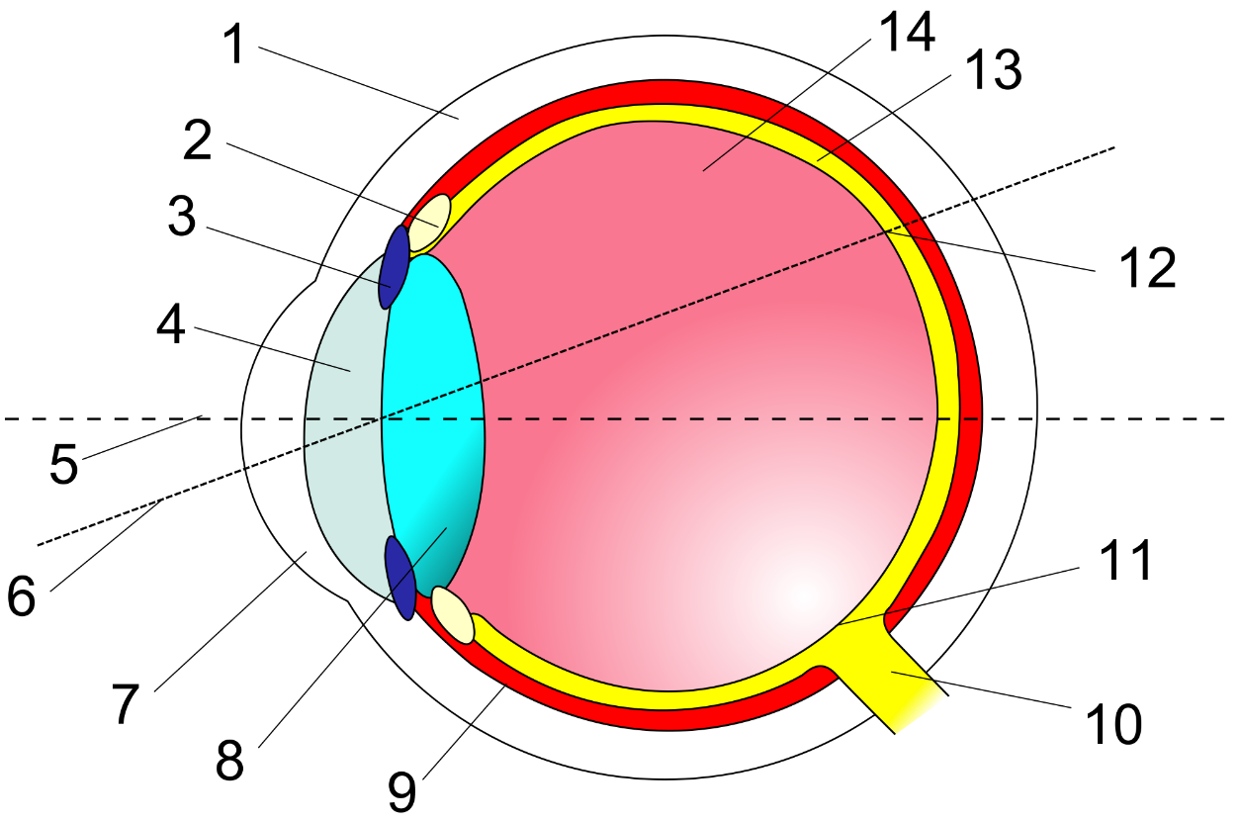
The human eye: Anatomy
The eye: a cross section view.
    1 - sclera;
    2 - ciliary body;
    3 - iris;
    4 - pupil, and anterior chamber filled with aqueous humor;
    5 - optical axis;
    6 - line of sight;
    7 - cornea;
    8 - crystalline lens;
    9 - choroid;
    10 - optic nerve;
    11 - optic disc;
    12 - fovea;
    13 - retina;
    14 - vitreous humor.

Slide 7
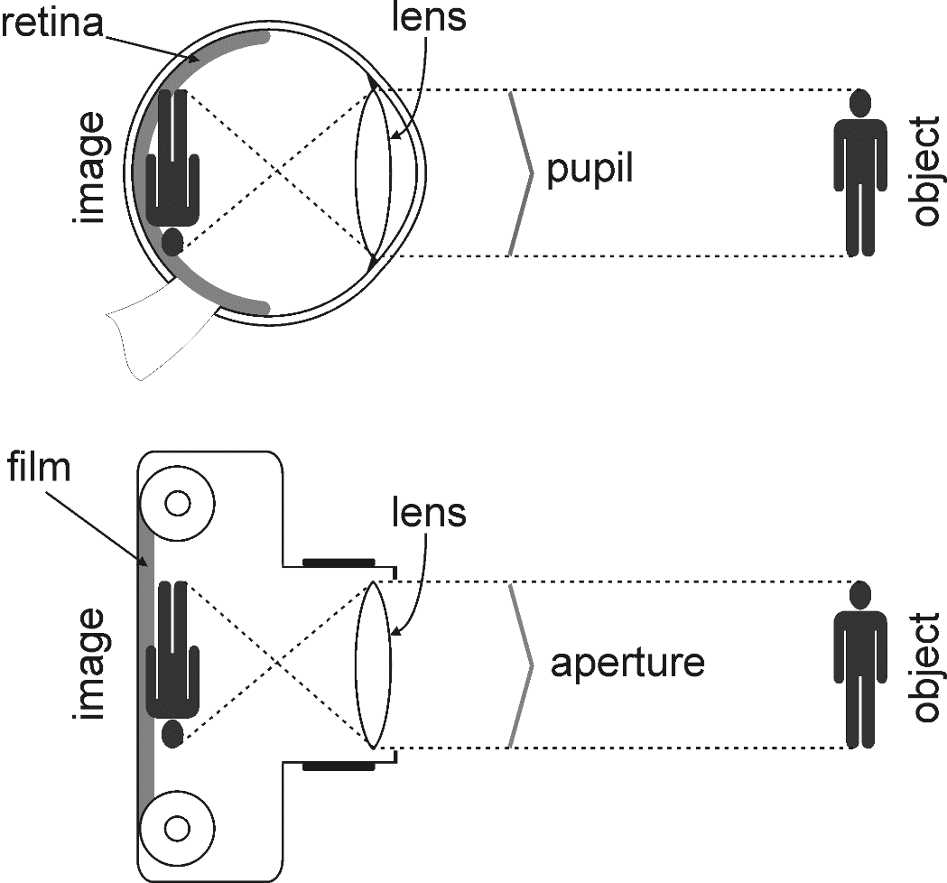
The human eye: Analogy
The eye-camera analogy.

Slide 8
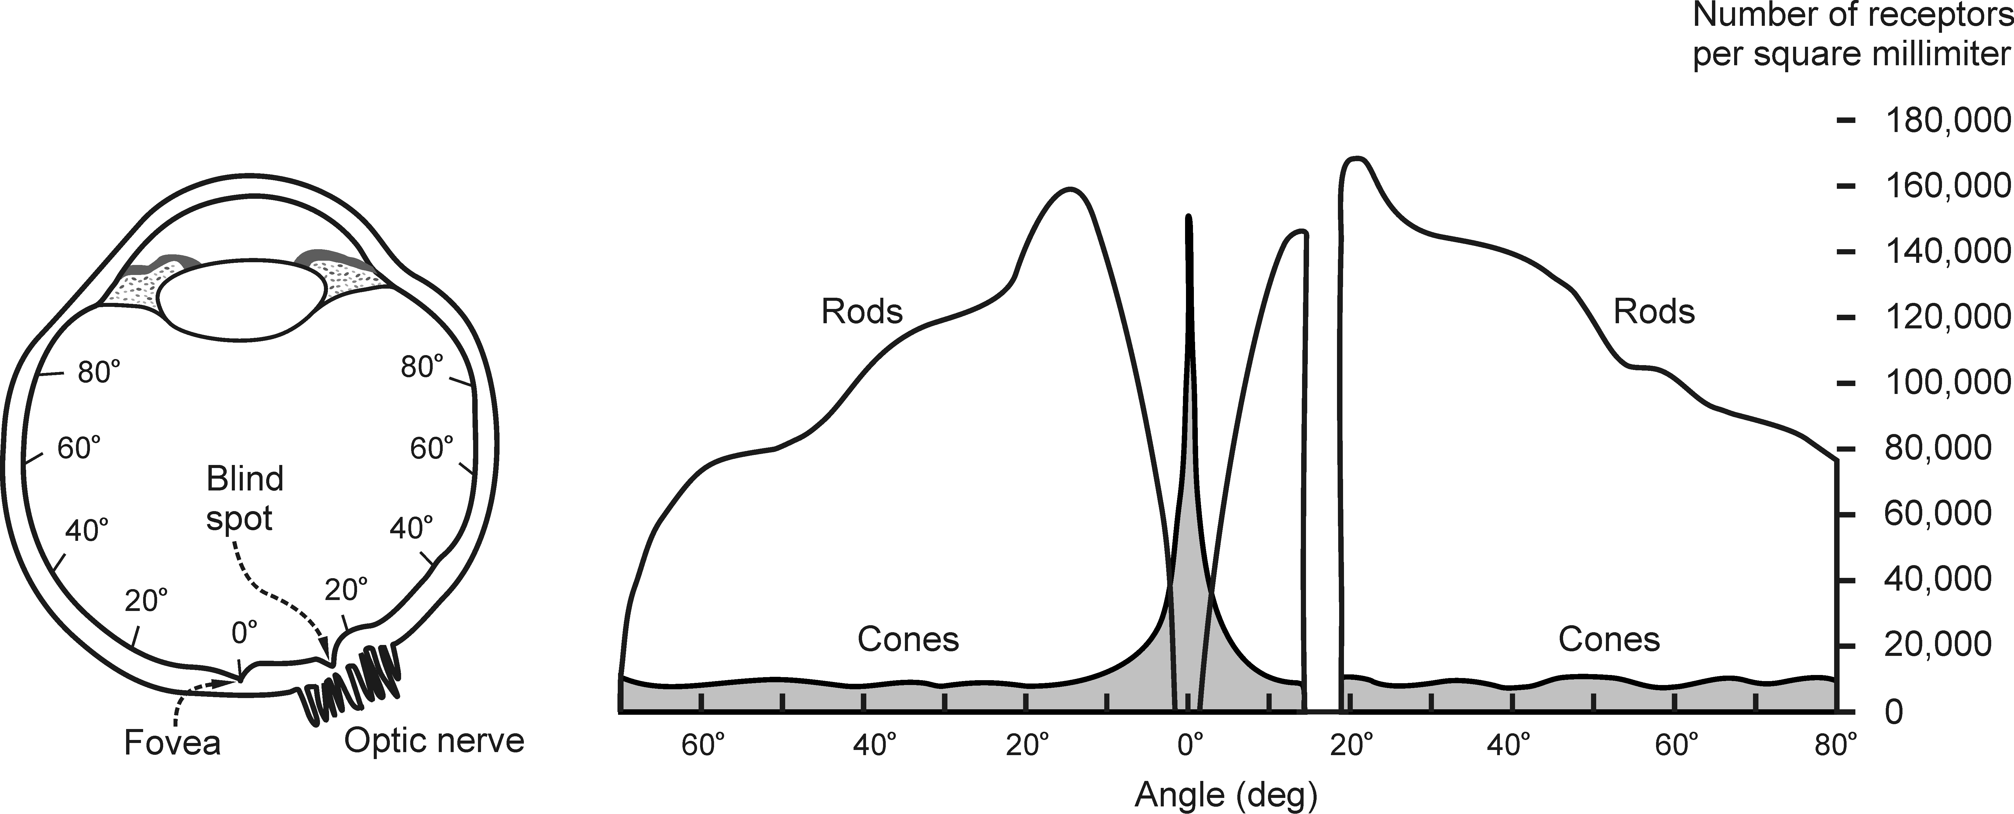
The human eye: Rods & Cones
Distribution of rods and cones in the human retina for the right eye (seen from the bottom)

Slide 9
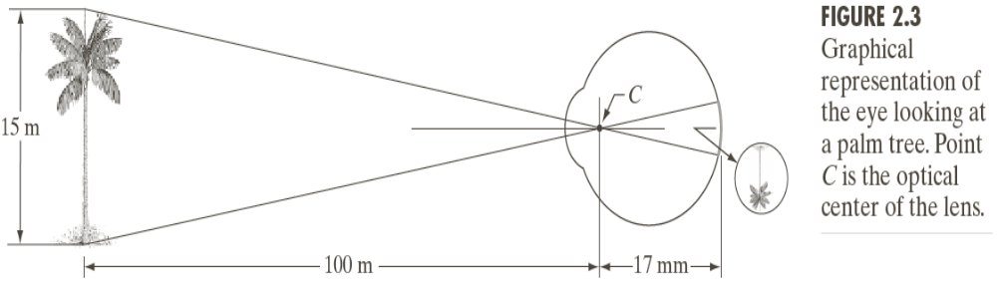
Image formation in the eye

Slide 10
Light and the electromagnetic spectrum
In 1666, Newton discovered that a spectrum of light is developed when a beam of sun light is passed through a glass prizm.
The range of colors we perceive represents only a small portion of the electromagnetic spectrum.

Slide 11
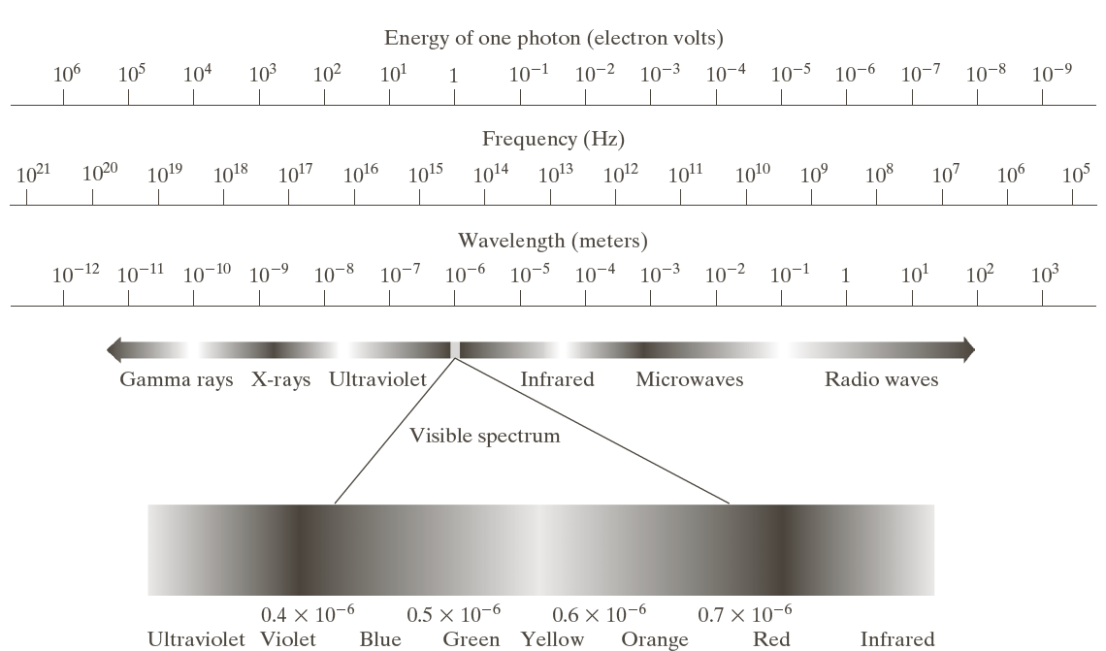
Light and the electromagnetic spectrum (cont.)

Slide 12
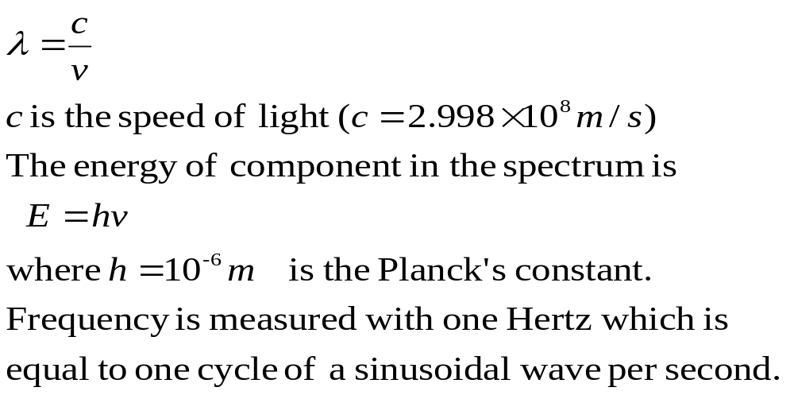
Light and the electromagnetic spectrum (cont.)
Relationship between wavelength λ and frequency v :

Slide 13
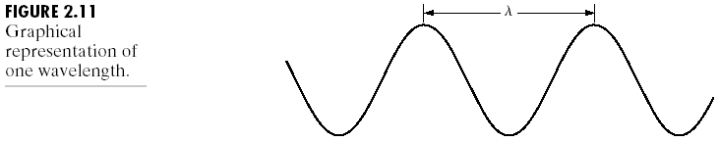
Light and the electromagnetic spectrum (cont.)
Waves can be visualised as propagating sinusoidal wave with wavelength λ and with a speed of light.

Slide 14
Light and the electromagnetic spectrum (cont.)
The visible spectrum is the color spectrum which is divided into six regions:
  Violet, Blue, Green, Yellow, Orange and Red
The color of an object is the light reflected by that object.
Light with no color is called monochromatic light.
The main attribute of monochromatic light is its intensity.
The monochromatic light is perceived to vary from black to white with different tones of gray.
Intensity of light determines the corresponding level of gray.

Slide 15
Light and the electromagnetic spectrum (cont.)
Chromatic or color light spans the spectrum in the range 0.43x10⁻⁶ to 0.79x10⁻⁶ m.
The quality of a chromatic light is described by three basic quantities:
  Radiance:The total amount of energy emitted from a light source (measured in watts).
  Luminance: Amount of energy an observer. perceives from a light source(measured in lumens).
  Brightness: A subjective descriptor of light perception.

Slide 16
Light and the electromagnetic spectrum (cont.)
Gamma radiation is used in medical, astronomical and nuclear imaging.
Hard X-rays are used in industrial applications.
Soft X-rays are used for dental and chest radiograpy.
Infrared band radiates heat (radars, microwave ovens).
The radio wave band (TV, Radio astronomical observations)

Slide 17
Implications and applications
The HVS is more sensitive to high contrast than low contrast regions within an image, which means that regions with large luminance variations (such as edges) are perceived as particularly important and should therefore be detected, preserved and/or enhanced.

Slide 18
Implications and applications (cont.)
The HVS is more sensitive to low spatial frequencies (i.e., luminance changes over a large area) than high spatial frequencies (i.e., rapid changes within small areas), which is an often-exploited aspect of most image and video compression techniques.
  Discarding redundant low spatial frequency contents (while preserving edges) leads to computational savings.

Slide 19
Implications and applications (cont.)
The HVS is more sensitive to image features that persist for a long duration, which means that it is important to employ techniques that minimize temporally persistent disturbances or artifacts in an image.

Slide 20
Implications and applications (cont.)
HVS responses vary from one individual to the next, which means that subjective evaluations of image and video systems must be conducted with a large number of subjects.
  This aspect also reinforces the need to find quantitative measures of image and video quality that can be automatically calculated from the pixel data and yet reflect the subjective notion of perceived quality.

Slide 21
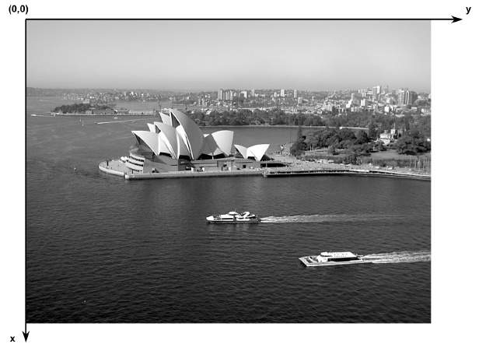
Digital image representation
Image coordinate convention (not valid for MATLAB!)
NB: There is no universally accepted convention or notation. Always check carefully!

Slide 22
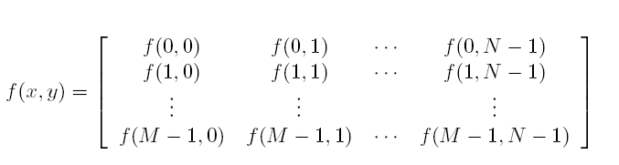
Digital image representation (cont.)
Mathematical notation

Slide 23
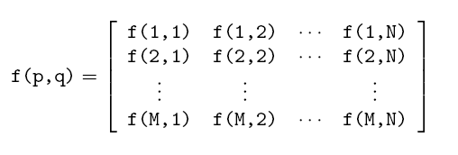
Digital image representation (cont.)
MATLAB representation

Slide 24
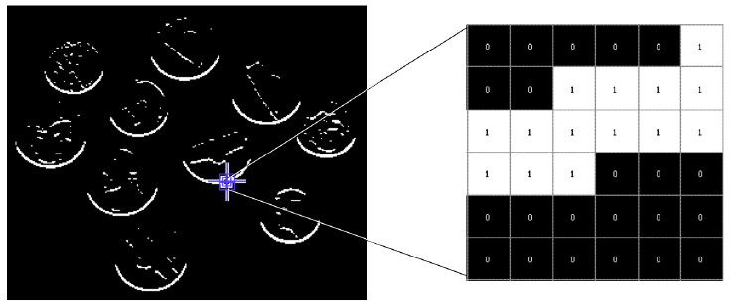
Digital image representation (cont.)
Binary (1-bit) images
  2D array, one bit per pixel, a 0 usually means “black” and a 1 means “white”.
  In MATLAB: binary images are represented using a logical array of 0s and 1s.

Slide 25
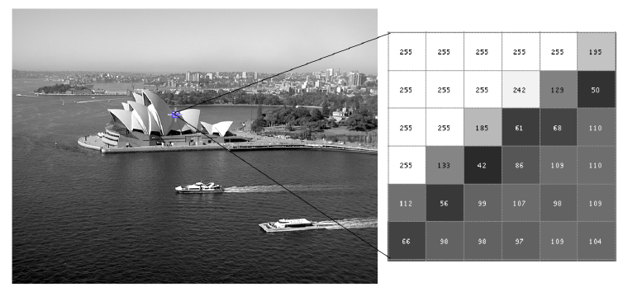
Digital image representation (cont.)
Gray-level (8-bit) images
  2D array, 8 bits per pixel, a 0 usually means “black” and a 255 means “white”.
  In MATLAB: intensity images can be represented using different data types (or classes): uint8, uint16, or double.

Slide 26
Digital image representation (cont.)
Color images
  RGB representation: each pixel is usually represented by a 24-bit number containing the amount of its Red (R), Green (G), and Blue (B) components
  Indexed representation: a 2D array contains indices to a color palette (or look-up table, LUT).

Slide 27
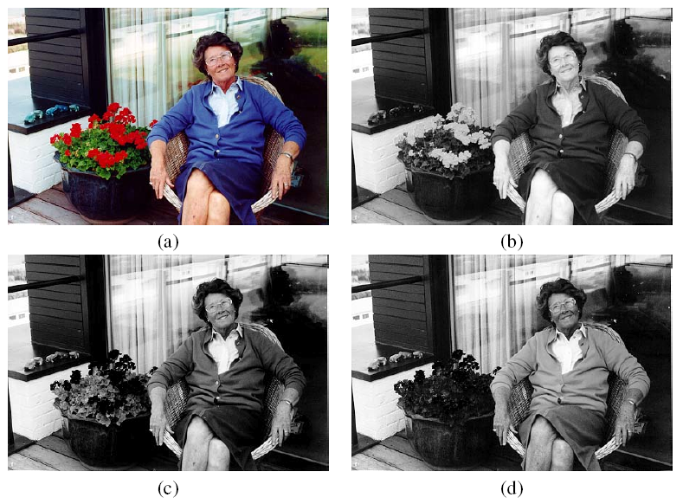
Digital image representation (cont.)
24-bit (true color) RGB images

Slide 28
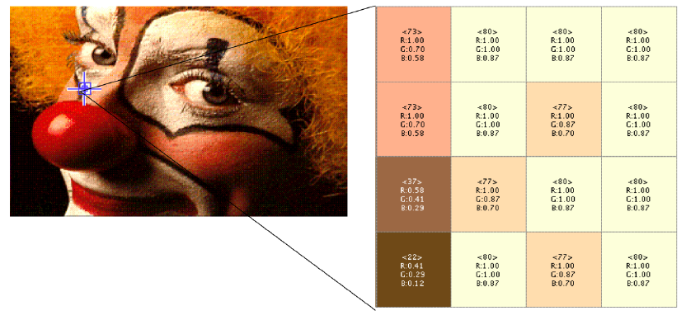
Digital image representation (cont.)
Indexed color images

Slide 29
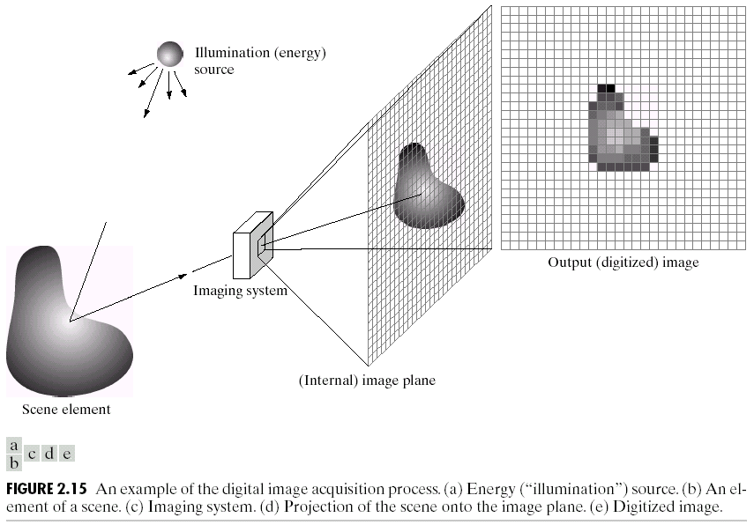
A simple image formation model

Slide 30
A simple image formation model (cont.)
An image is defined by a 2D function f(x, y) where (x, y) represents the spatial coordinates.
0 < f(x, y) < ∞
The function f is defined by the source illumination (i) and reflectance (r) components as
f(x, y) = i(x, y) r(x, y)
where 0 < i(x, y), r(x, y) < ∞

Slide 31
Image sampling and quantization
Generally, images are generated by certain sensors.
The output of most sensors is a continuos voltage wave form.
We need to covert the continuos data into digital form to create digital images.
Such process consists of sampling and quantization processes.

Slide 32
Image sampling and quantization: Basic concepts
Typically an image is continuous with respect to x, y and f.
The image is sampled in both coordinates and in amplitude f.
Digitizing the coordinate values is called sampling.
Digitizing the amplitude values is called quantization.

Slide 33
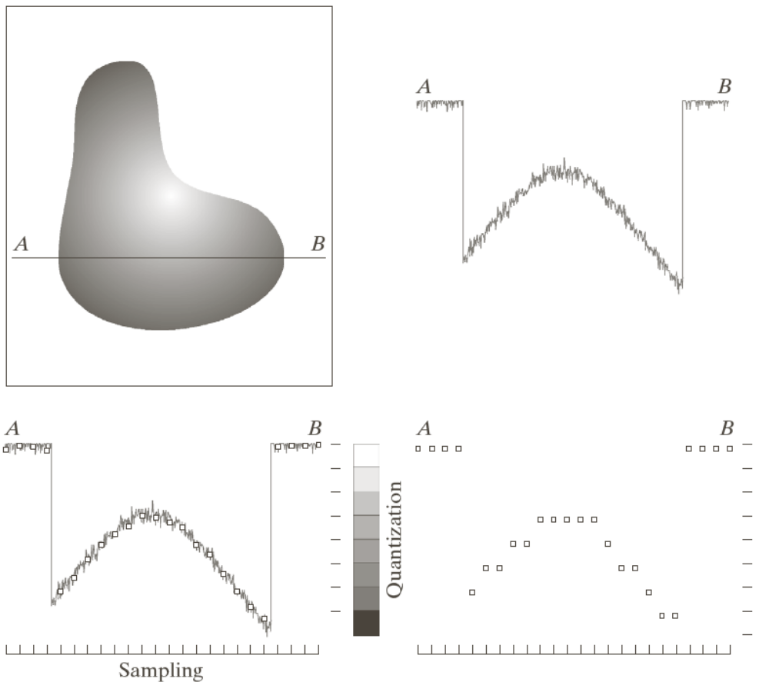
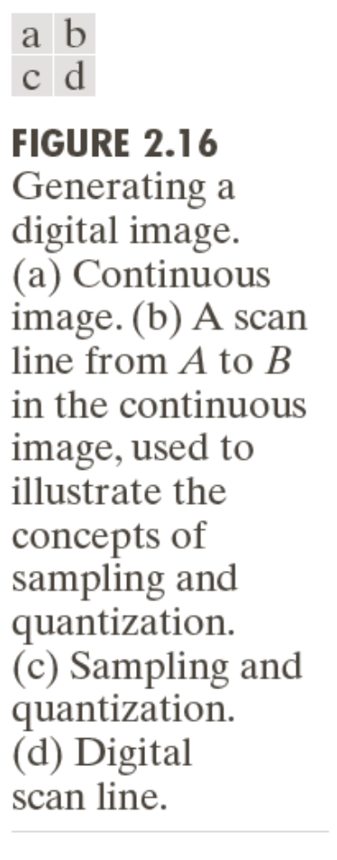
Image sampling and quantization: Basic concepts (cont.)

Slide 34
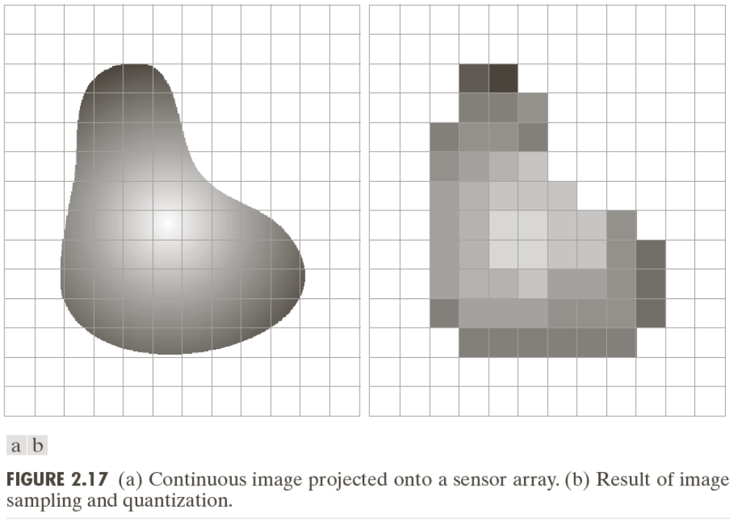
Image sampling and quantization: Basic concepts (cont.)

Slide 35
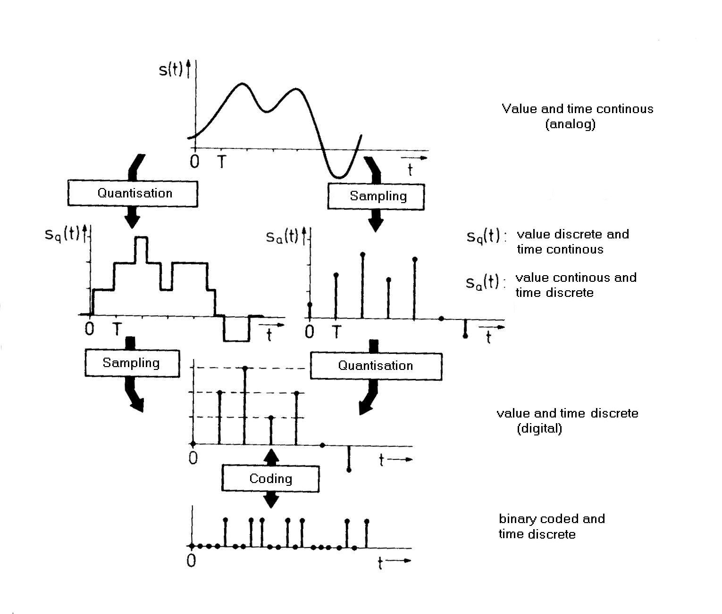
Signal Processing and Sampling

Slide 36
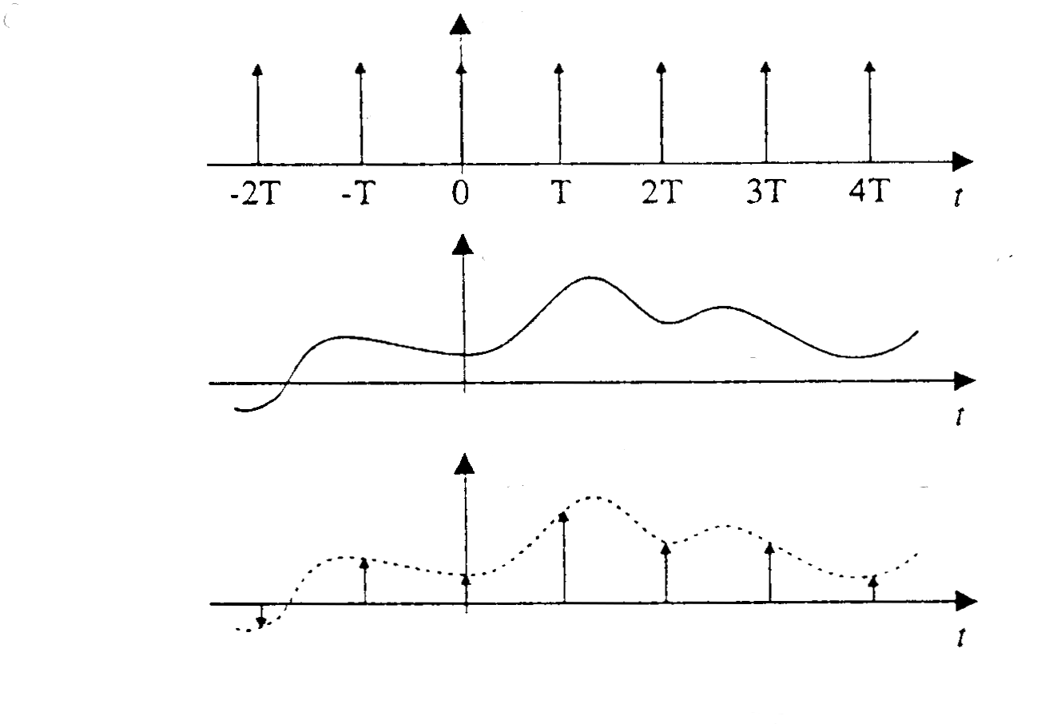
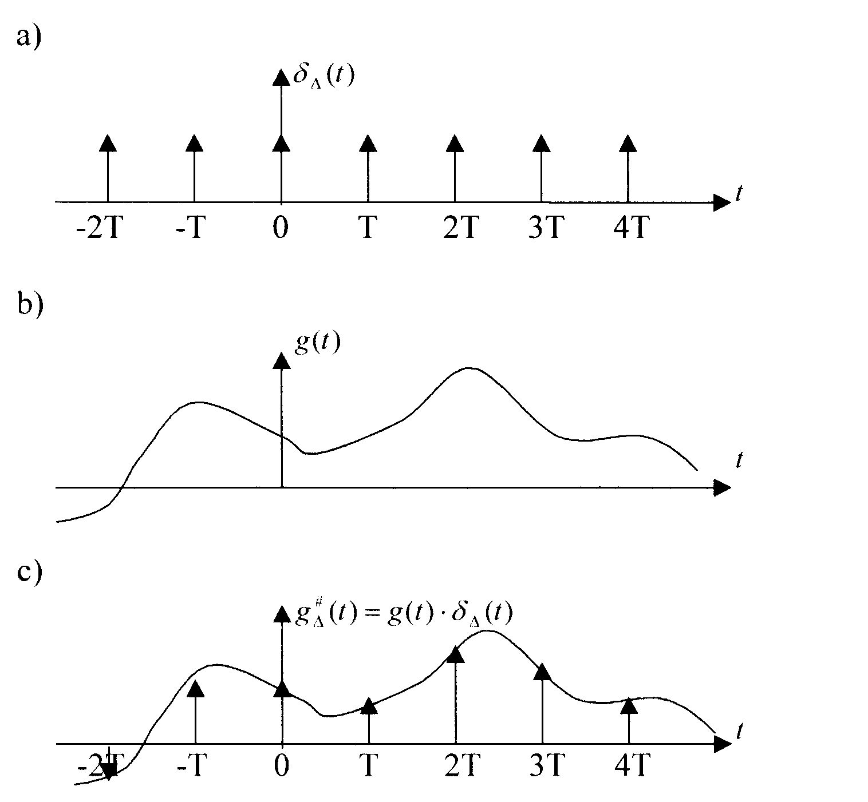
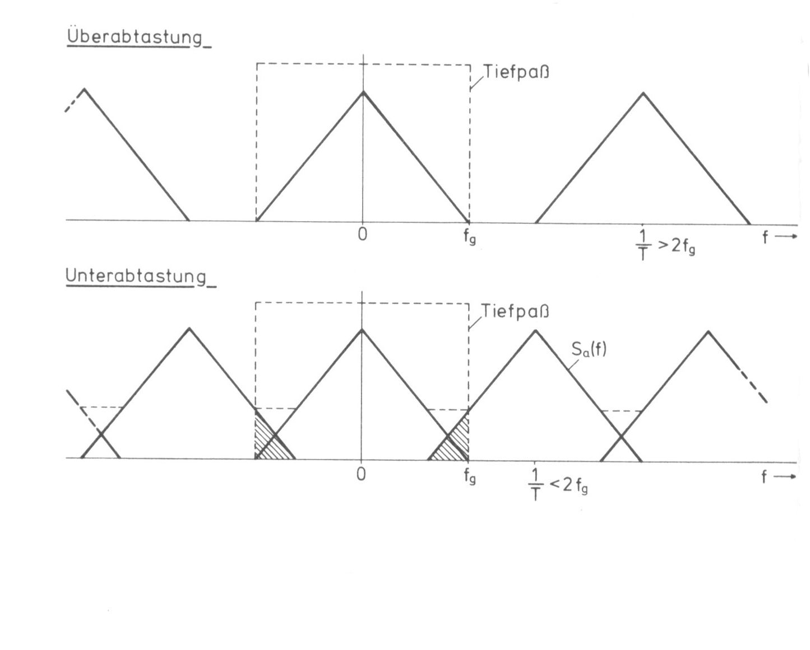
Signal Processing and Sampling (cont.)

Slide 37
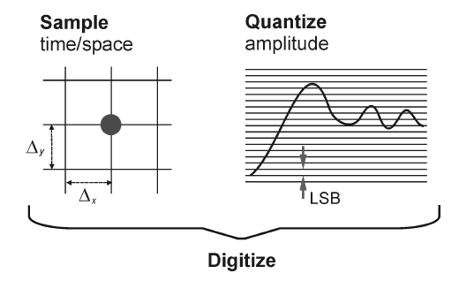
Image digitization
Digitization = sampling + quantization

Slide 38
Sampling
The process of measuring the value of a 2D function at discrete intervals along the x and y dimensions.
Parameters:
  Sampling rate: number of samples across the height and width of the image.
  Sampling pattern: physical arrangement of the samples.

Slide 39
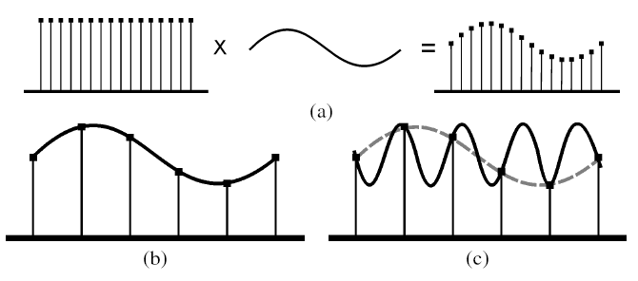
Sampling (cont.)
Aliasing and Nyquist theorem

Slide 40
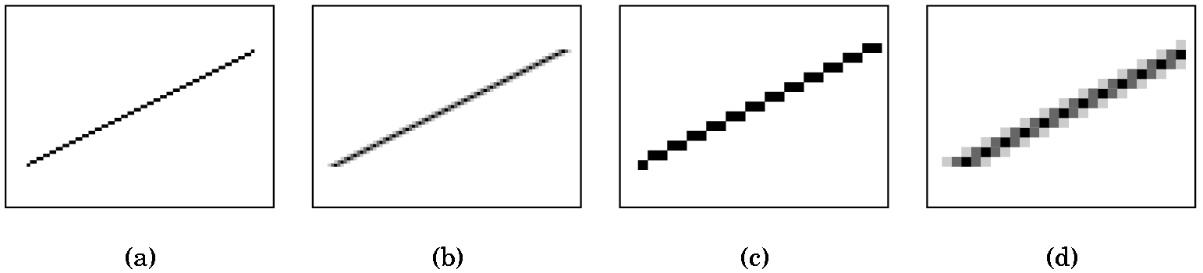
Antialiasing
Aliasing
Information loss due to low-frequency sampling
Jagged or stair-step appearance

Slide 41
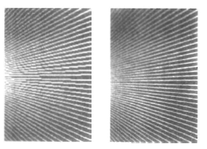
Antialiasing (cont.)
Used to improve the appearance of lines.

Slide 42
Nyquist?
Harry Nyquist: 7. February 1889 in Nilsby, Sweden; † 4. April 1976 in Harlingen, Texas
Claude Elwood Shannon: 30. April 1916 in Petoskey, Michigan; † 24. Februar 2001 in Medford, Massachusetts
Nyquist-Shannon-Sample Theorem: Set the sampling frequency to at least twice that of the highest frequency occurring in the object
Nyquist sampling frequency: f_{s} = 2f_{max}
Nyquist sampling interval: ∆x = ∆x_{cycle} / 2

Slide 43
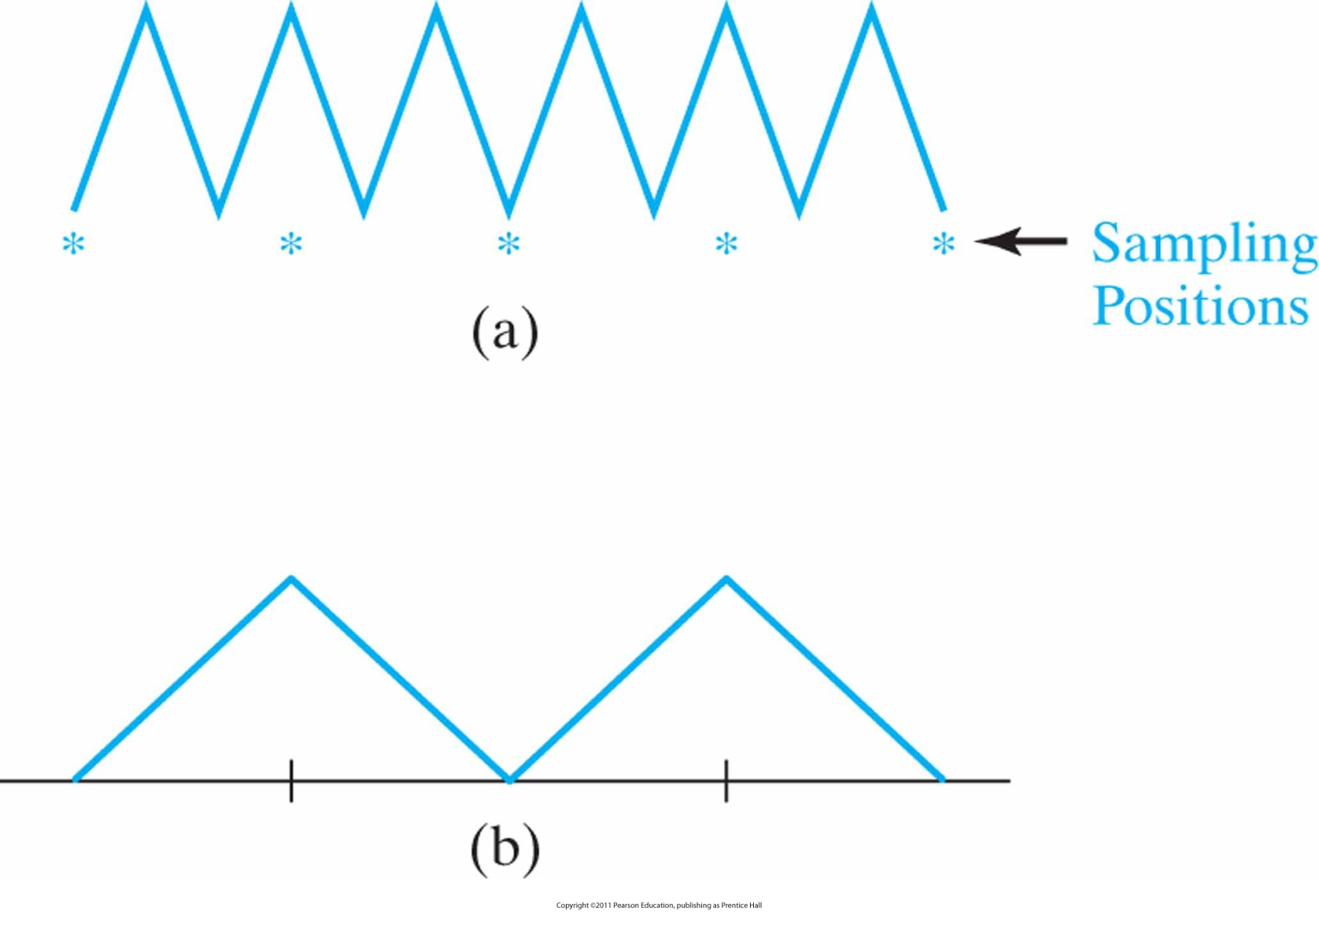
Sampling
Sampling the periodic shape in (a) at the indicated positions produces the aliased lower-frequency representation in (b).

Slide 44
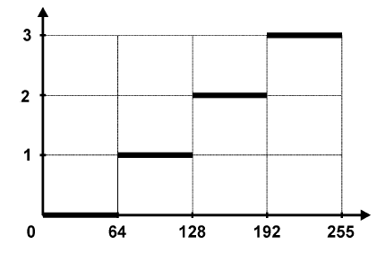
Quantization
The process of replacing a continuously varying function with a discrete set of quantization levels.

Slide 45
Representing digital images
Suppose that an image represented by a continuous function f(s, t) of continuous variables s and t.
Suppose also that this image is sampled into a 2d array containing M rows and N columns.
For convenience we use integer values for the discrete coordinates as
x: 0, 1, 2, ..., M-1
y: 0, 1, 2, ..., N-1

Slide 46
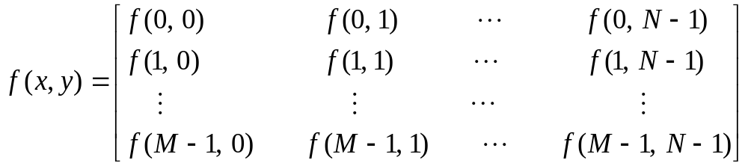
Representing digital images (cont.)
Thus we can represent an MxN digital image by a matrix.
Each element of this matrix is called image element, picture element, pixel or pel.

Slide 47
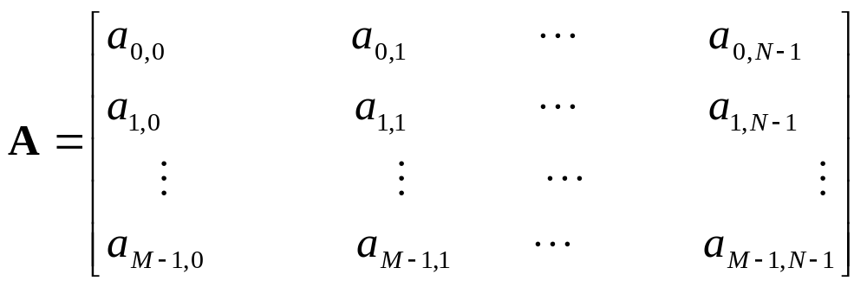
Representing digital images (cont.)
A common notation for the previous representation is also used

Slide 48
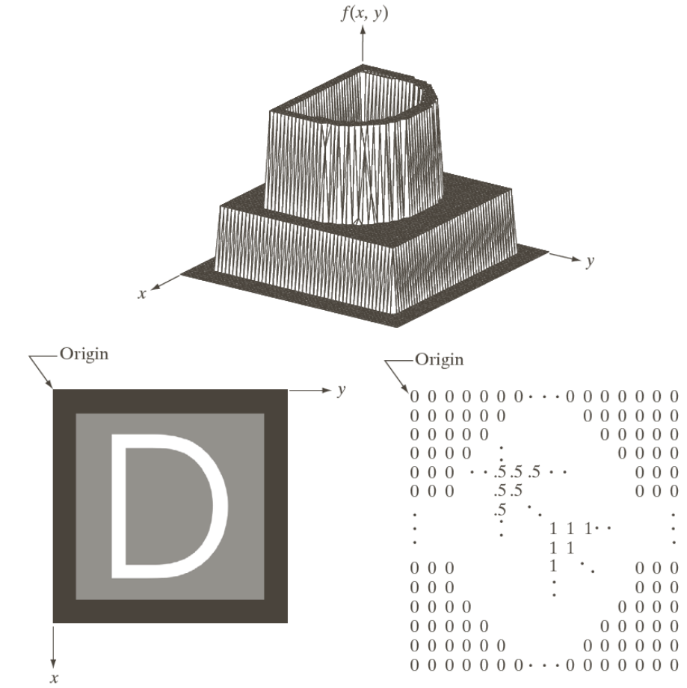
Basic concepts

Slide 49
Representing digital images (cont.)
Mathematical formulation of a digital image:
Let Z and R denote a set of integers and real numbers respectively.
The sampled image may be viewed as a partitioned xy plane into a grid with the coordinates of the center of each cell being a pair of elements from Z². That is (z_{i}, z_{j})ϵZ².

Slide 50
Representing digital images (cont.)
f(x, y) is considered to be digital image if (x_{i}, y_{j}) are integers from Z² and the function f assigns an intensity value.
If the intensity levels also are integers, then a digital image becomes a 2D function whose coordinates and amplitude values are integers.

Slide 51
Representing digital images (cont.)
Let L denote the number of discrete intensity levels.
In a digitization process we need to decide on the choices for the values of M, N and L.
Commonly, L is chosen to be an integer power of 2 that is
L=2^{k}
and the discrete levels are uniformly spaced in the interval [0, L-1].
The number of bits required to store a digitized image is
b=MNk

Slide 52
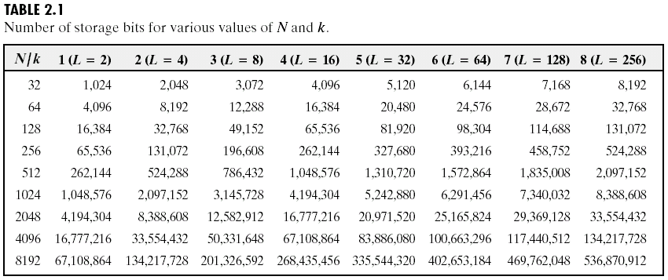
Representing digital images (cont.)

Slide 53
Representing digital images (cont.)
The ratio of the maximum measurable intensity to the minimum measurable intensity is refered as dynamic range.
In an image, the upper limit is determined by saturation and the lower limit is determined by noise.
The difference between the maximum end minimum intensities is defined as image contrast. The higher the dynamic range the higher the contrast.

Slide 54
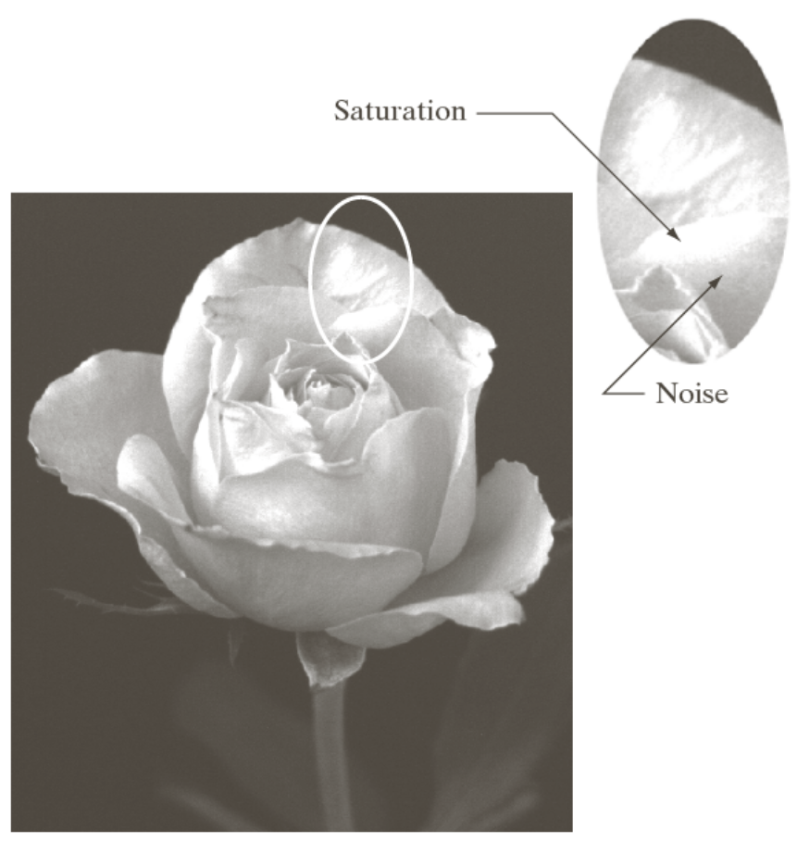
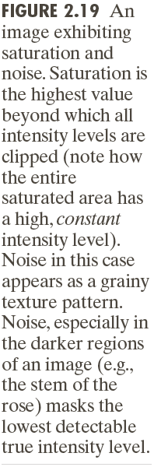
Representing digital images (cont.)

Slide 55
Spatial and Intensity resolution
Spatial resolution is defined as dots (pixels) per unit distance or shortly dpi. (This definition is used in printing industry)
Another definition: The largest number of discernible line pairs per unit distance). (This definition commonly used in image resolution)
Examples: Newspapers are printed with a resolution at 75 dpi
Magzines are printed with a resolution at 133 dpi
Glossy brochures at 175 dpi

Slide 56
Spatial and Intensity resolution (cont.)
A way of expressing the density of pixels in an image using units such as dots per inch (dpi).
The greater the spatial resolution, the more pixels are used to display the image within a certain fixed physical size.
Artifacts associated with poor spatial resolution:
  Pixelation
  Jaggedness
  Loss of detail
  Moiré patterns

Slide 57
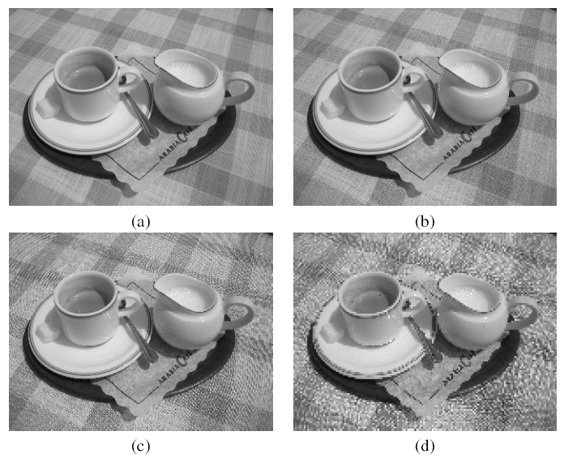
Spatial and Intensity resolution (cont.)

Slide 58
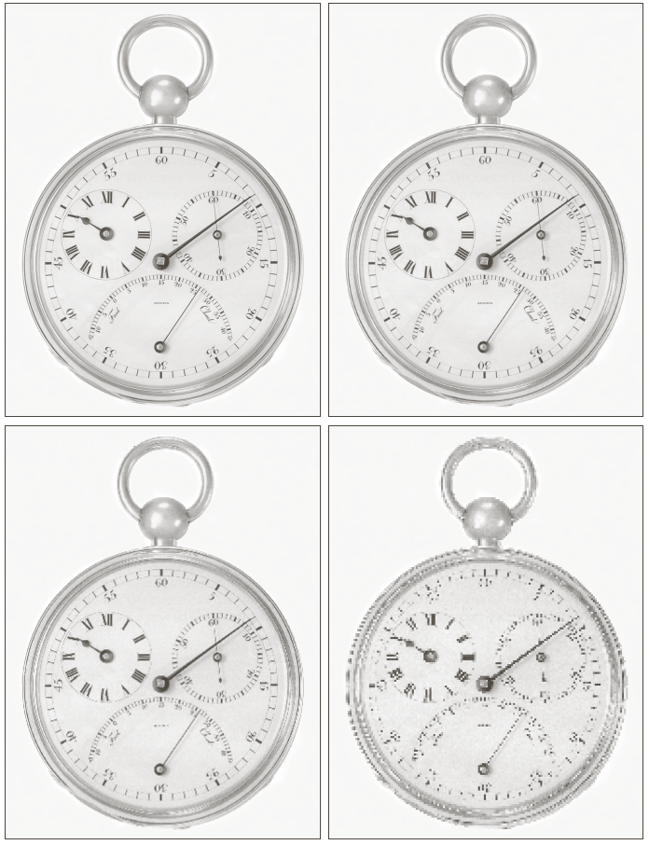
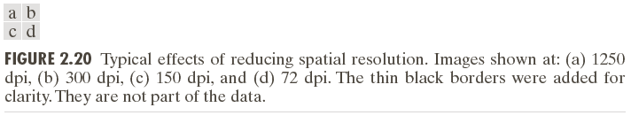
Spatial and Intensity resolution (cont.)

Slide 59
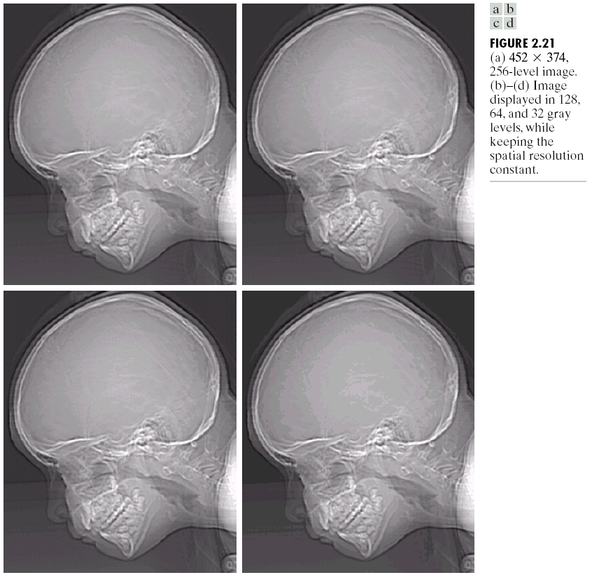
Spatial and Intensity resolution (cont.)
Effects of varying intensity levels in a digital image

Slide 60
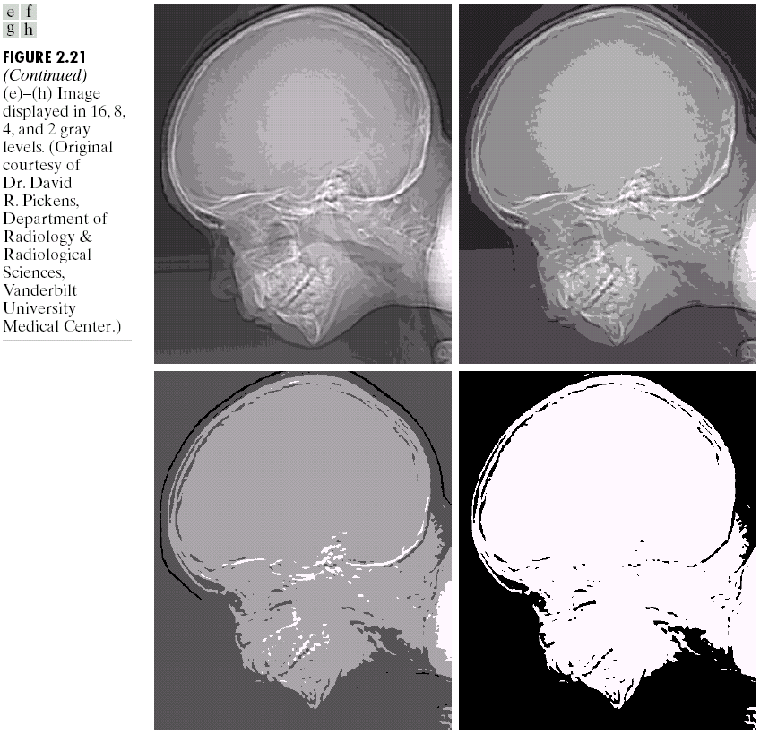
Spatial and Intensity resolution (cont.)

Slide 61
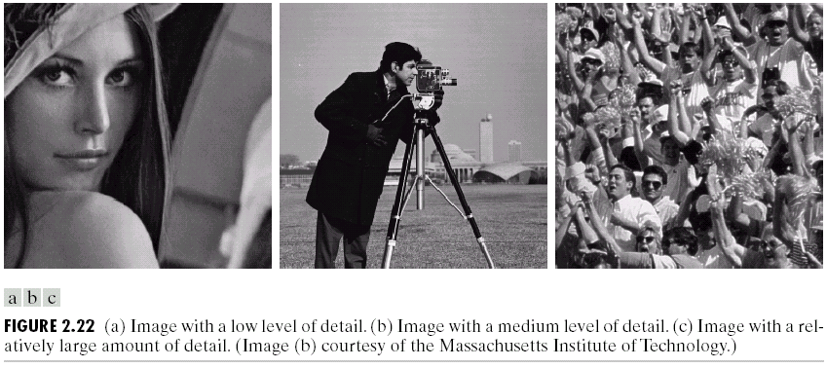
Spatial and Intensity resolution (cont.)

Slide 62
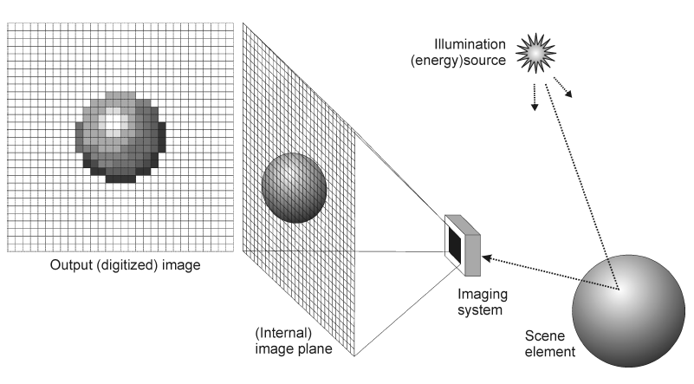
Image acquisition

Slide 63
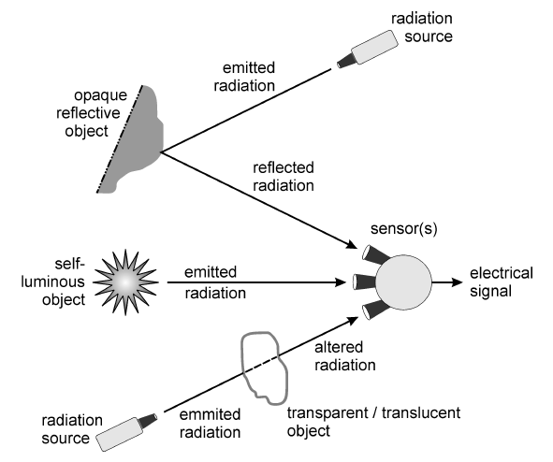
Types of images
Reflection images
Emission images
Absorption images

Slide 64
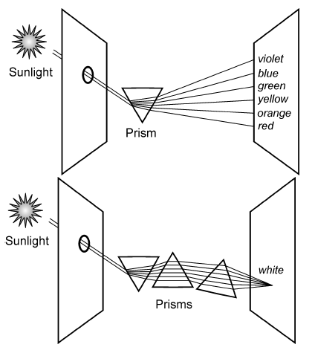
Newton’s prism

Slide 65
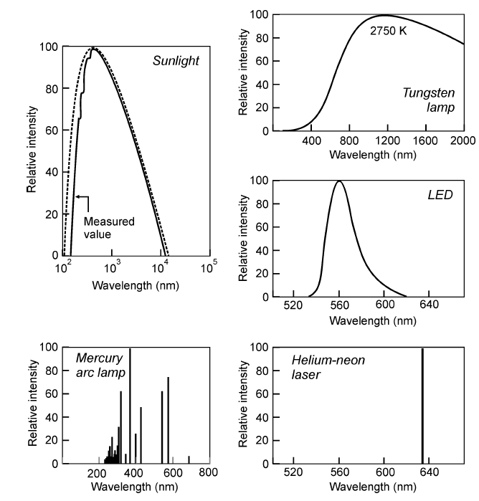
Spectral Power Distribution (SPD) for common light sources

Slide 66
Color properties
Brightness
  subjective perception of luminous intensity, or “the attribute of a visual sensation according to which an area appears to emit more or less light”.
Hue
  “the attribute of a visual sensation according to which an area appears to be similar to one of the perceived colors, red, yellow, green and blue, or a combination of two of them”.
  the dominant wavelength of an SPD.

Slide 67
Image sensors
Goal: to convert EM energy into electrical signals that can be processed, displayed and/or interpreted as images.
Common technologies:
  CCDs (charge-coupled devices)
  CMOS (complementary metal oxide semiconductor)

Slide 68
CCD image sensors
Digital cameras typically use 2D (area) CCD sensors.
Flat-bed scanners employ 1D (line) CCDs that move across the image as each row is scanned.
A CCD sensor is made up of an array of light-sensitive cells called photosites, manufactured in silicon, each of which produces a voltage proportional to the intensity of light falling on them.

Slide 69
CCD image sensors
The nominal resolution of a CCD sensor is the size of the scene element that images to a single pixel on the image plane.
  Example, if a 20 cm square sheet of paper is imaged to form a 500×500 digital image, then the nominal resolution of the sensor is 0.04 cm.
The field of view (FOV) is a measure of how much of a scene it can see, e.g. 10 cm × 10 cm.
  Since this may vary with depth, it is often more meaningful to refer to the angular field of view, e.g. 55° × 40°.

Slide 70
CCD image sensors (cont.)
A CCD camera sometimes plugs into a computer board, called frame buffer, which contains fast access memory (typically 0.1 ms per image) for the images captured by the camera.
After being captured and temporarily stored in the frame buffer, images can be processed or copied to a long-term storage device, e.g., a hard drive.
Fast standardized digital interfaces include Firewire (IEEE 1394), Camera Link, or fast Ethernet.
  Such interfaces are already digital, and therefore do not require a frame grabber.

Slide 71
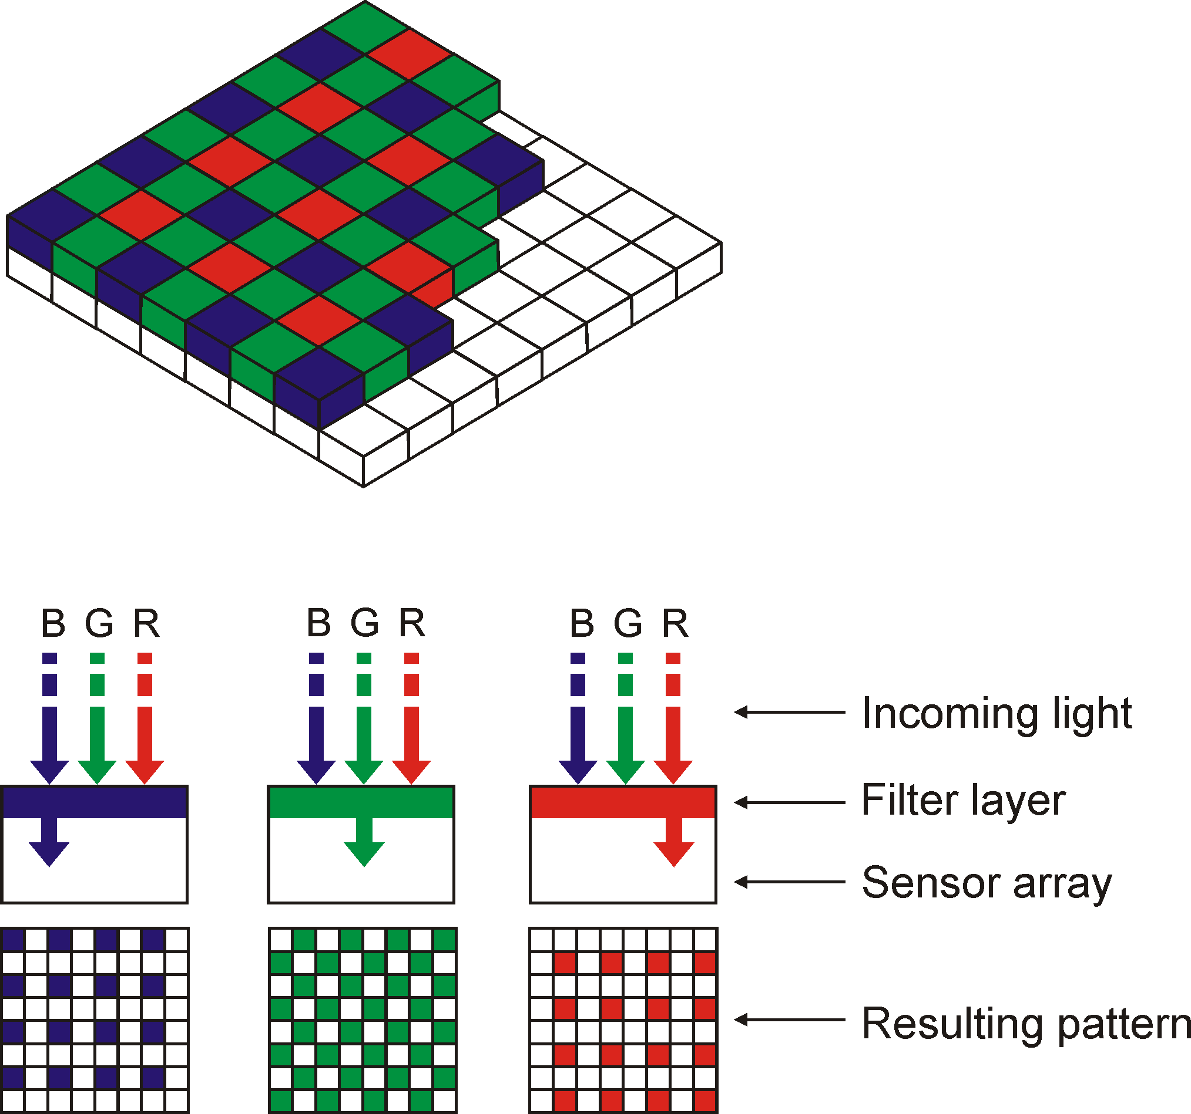
Color CCD cameras
Bayer pattern (single-CCD cameras)

Slide 72
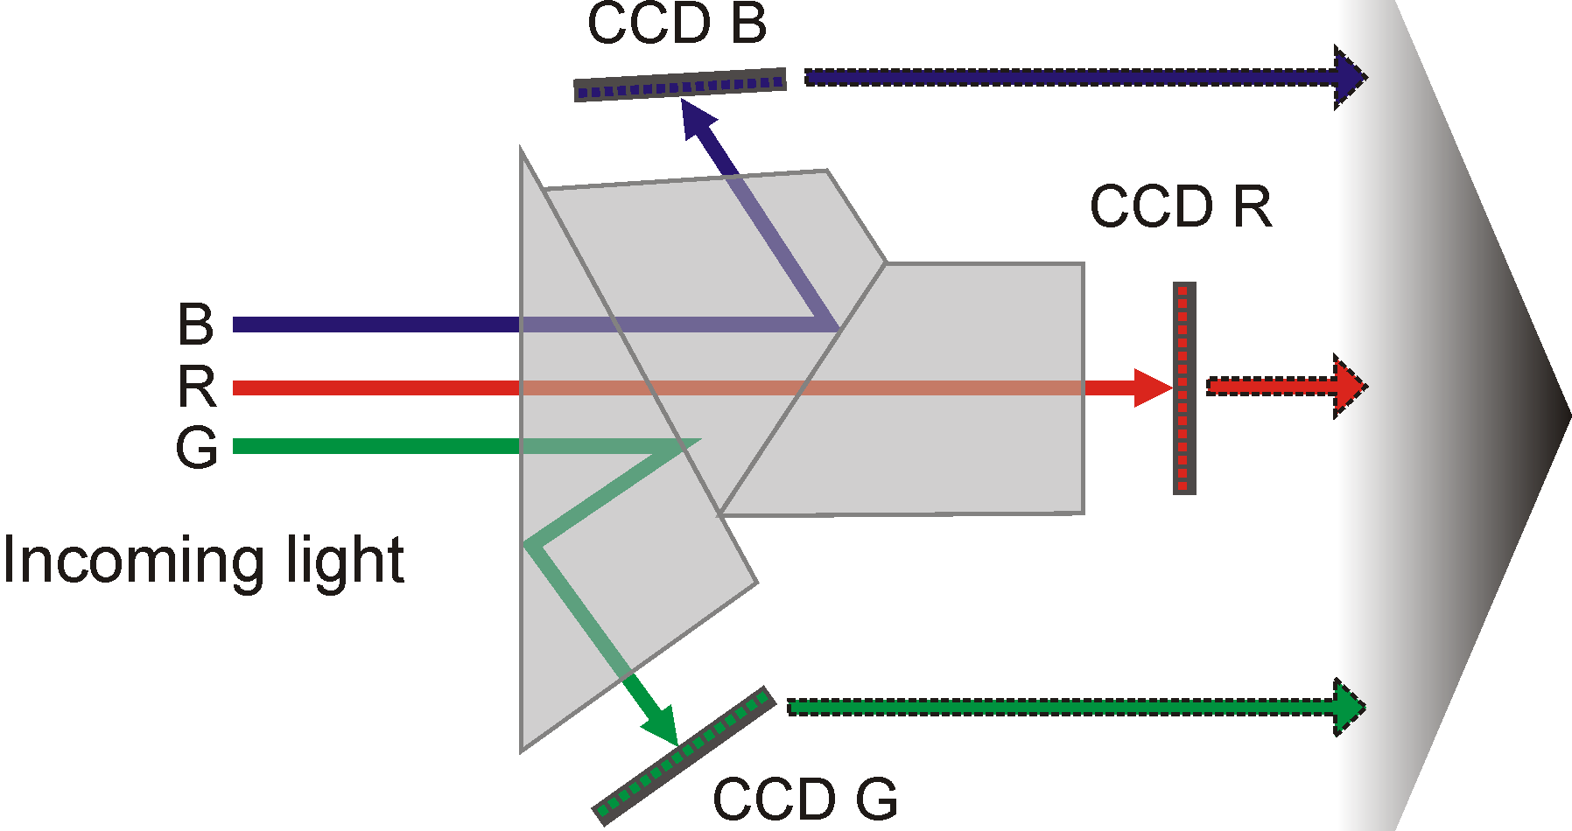
Color CCD cameras (cont.)
Beam splitter (three-CCD cameras)

Slide 73

Color CCD cameras (cont.)
X3 color sensor (Foveon)

Slide 74




Camera optics

Slide 75

Camera optics (cont.)
Aberrations
  (a) Pincushion
  (b) Barrel

Slide 76

MATLAB Image Acquisition Toolbox

Slide 77

Pixel arrays of several imaging standards

Slide 78
Compression
Most image file formats employ some type of compression.
Compression methods can be:
  Lossy: a tolerable degree of deterioration in the visual quality of the resulting image is acceptable.
  Lossless: the image is encoded in its full quality.
As a general guideline:
  lossy compression should be used for general purpose photographic images;
  lossless compression should be used for line art, drawings, facsimiles, or images in which no loss of detail may be tolerable (e.g., space images and medical images).

Slide 79
Image file formats
Image file contents:
  File header
  Pixel data (often compressed)
Most common file types:
  BIN, PPM, PBM, PGM, PNM, BMP, JPEG, GIF, TIFF, PNG
From a MATLAB perspective, it doesn’t really matter much...

Slide 80

Basic terminology
Image topology
  The investigation of fundamental image properties (usually done on binary images and with the help of morphological operators), such as: number of occurrences of a particular object, number of separate (not connected) regions, number of holes.
Neighborhood
  The pixels surrounding a given pixel. Most neighborhoods used in image processing algorithms are small square arrays with an odd number of pixels.

Slide 81

Basic terminology (cont.)
Neighborhood
  In the context of image topology, neighborhood has a different meaning:
    4-neighborhood
    Diagonal neighborhood
    8-neighborhood

Slide 82

Neighbors?
4-connected area
8-connected area
Hollow circles represent pixels to be tested from the current test position, shown as a solid color.

Slide 83
4-connected vs. 8-connected
_{Start point}
4-connected
8-connected

Slide 84
Basic terminology (cont.)
Adjacency
  2 pixels p and q are 4-adjacent if they are 4-neighbors of each other and 8-adjacent if they are 8-neighbors of one another.
  A third type of adjacency (m-adjacency) is often used to eliminate ambiguities that may arise when 8-adjacency is used.
Paths
  A 4-path between two pixels p and q is a sequence of pixels starting with p and ending with q such that each pixel in the sequence is 4-adjacent to its predecessor in the sequence.
  Similarly, an 8-path indicates that each pixel in the sequence is 8-adjacent to its predecessor.
Connectivity
  If there is a 4-path between pixels p and q, they are said to be 4-connected.
  Similarly, the existence of an 8-path between them means that they are 8-connected.

Slide 85
Basic terminology (cont.)
Components
  A set of pixels which are connected to each other is called a component.
  If the pixels are 4-connected, the expression 4-component is used; if the pixels are 8-connected, the set is called an 8-component.
  Components are often labeled in a unique way, resulting in a labeled image, L(x, y) whose pixel values are symbols of a chosen alphabet.
    The symbol value of a pixel typically denotes the outcome of a decision made for that pixel, in this case, the unique number of the component to which it belongs.

Slide 86
Basic terminology (cont.)
Components in MATLAB: bwlabel and label2rgb
I = imread('test_bw_label.png');
J = logical(I);
L1 = bwlabel(J,4);
L1_color = label2rgb(L1, 'lines', 'w');
L2 = bwlabel(J,8);
L2_color = label2rgb(L2, 'lines', 'w');
imshow(I)
figure, imshow(L1_color)
figure, imshow(L2_color)

Slide 87



Basic terminology (cont.)
Components in MATLAB: bwlabel and label2rgb
Result

Slide 88

Basic terminology (cont.)
Distances
between
pixels
Important! The distance between two pixels depend only on their coordinates, not their values.
  Exception: the D_{m} distance, defined as “the shortest m-path between two m-connected pixels.”

Slide 89
Overview of image processing operations
Spatial domain
  Global (point) operations
  Neighborhood-oriented (local) (area) operations
  Operations combining multiple images
Transform domain

Slide 90


Global (point) operations
Point operations apply the same mathematical function (transformation function) to all pixels, regardless of their location in the image or the values of their neighbors.

Slide 91


Global (point) operations (cont.)
Example:
s = r/2

Slide 92
Neighborhood-oriented operations
Neighborhood-oriented operations consist of determining the resulting pixel value at coordinates (x,y) as a function of its original value and the value of (some of) its neighbors, using a convolution operation.
The convolution of a source image with a small 2D array (mask or kernel) produces a destination image in which each pixel value depends on its original value and the value of (some of) its neighbors.
The convolution mask determines which neighbors are used as well as the relative weight of their original values.

Slide 93

Neighborhood-oriented operations (cont.)
Masks are normally 3×3.
Each mask coefficient can be interpreted as a weight.

Slide 94
Weighting Subpixels
Multiply each pixel with a weighted mask
₁
₂
₁
₂
₄
₂
₁
₂
₁
_{Subpixel}
_{weighting}
_{mask}

Slide 95

Operations combining multiple images
There are many image processing application that combine two images, pixel-by-pixel, using an arithmetic or logical operator, resulting in a third image, Z:
  X opn Y = Z

Slide 96

Operations in a transform domain
A transform is a mathematical tool that allows the conversion of a set of values to another set of values, creating, therefore, a new way of representing the same information.

Slide 97
Mathematical tools
In this section we introduce several mathematical tools which will be used through the course.

Slide 98

Matrix representation of an image
An MxN image can be viewed as an MxN matrix. Images A and B can be represented by matrix notation as

Slide 99


Matrix representation of an image (cont.)
Two different operations:
The array product of these images:
The matrix product:

Slide 100

Arithmetic operations
Let f and g denote two funcions for images A and B of size MxN respectively. The four arithmetic operations are

Slide 101


Arithmetic operations (cont.)
Example: Let g(x,y) denote a corrupted image formed by addition of noise η (x,y) to a noiseless image g(x,y). This can be expressed as
If noises are independently distributed with mean zero then taking the average of both side for K images we get

Slide 102

Addition
Used to blend the pixel contents from two images or to add a constant value to an image's pixel values.
Example 1 (blending two images):

Slide 103

Addition (cont.)
Example 2 (additive image offset):

Slide 104

Addition (cont.)
Example 3 (additive noise):

Slide 105

Subtraction
Used to used to detect differences between two images, decrease its overall brightness, or obtain its negative.
Example 1 (subtractive image offset):

Slide 106

Subtraction (cont.)
Example 2 (negative of an image):

Slide 107

Set operations

Slide 108


Set operations (cont.)

Slide 109


Set operations (cont.)

Slide 110
Logic operations
Performed in a bit-wise fashion on the binary contents of each pixel value.
  AND, XOR and OR require two or more arguments.
  NOT operator only requires only one argument.
Here we use the convention: 1 (true) for white pixels; 0 (false) for black pixels.

Slide 111


Logic operations (cont.)

Slide 112

Logic operations (cont.)
Examples using binary test images

Slide 113

Logic operations on monochrome images
Example 1 (AND)

Slide 114

Logic operations on monochrome images (cont.)
Example 2 (OR)

Slide 115

Logic operations on monochrome images (cont.)
Example 3 (XOR)

Slide 116

Logic operations on monochrome images (cont.)
Example 4 (NOT)

Slide 117
Spatial pixel operations
These operations ar performed on the pixels of the image.
Types of operations:
  Single pixel operations
  Neighbour Operations
  Geometric spatial transformations

Slide 118


Spatial pixel operations (cont.)
Single pixel operation:
s=T(z)
  z: intensity of a pixel in the original image
  s: intensity of a pixel in the transformed image

Slide 119


Spatial pixel operations (cont.)
Neighbour Operations:

Slide 120

Spatial pixel operations (cont.)
Geometric spatial transformations :
(x, y)=T(v, w)
  (v, w): pixel coordinates in the original image
  (x, y): pixel coordinates in the transformed image
Example: Affine transformation in homogeneous coordinate system:

Slide 121

Spatial pixel operations (cont.)

Slide 122

Examples of geometric operations

Slide 123
Geometric Operations…
Modify the geometry of an image by repositioning pixels in a constrained way.
Modify the spatial relationships between groups of pixels representing features or objects of interest within the image.
Are used for different purposes:
  Correction of geometric distortions introduced during the image acquisition process;
  Special effects (e.g., twirling, bulging, or squeezing);
  As part of image registration

Slide 124
Geometric Operations…
Two basic components:
  mapping function, specified using a set of spatial transformation equations (and a procedure to solve them)
  and
  interpolation methods, used to compute the new value of each pixel in the spatially transformed image.

Slide 125



Mapping and Affine Transformations

Slide 126




Mapping and Affine Transformations (cont.)

Slide 127

Mapping and Affine Transformations (cont.)

Slide 128
Affine transform using MATLAB
maketform and imtransform functions
Example:
filename = 'any image of your choice'
I = imread(filename);
% Rotation
Ta = maketform('affine', [cosd(30) -sind(30) 0; ...
sind(30) cosd(30) 0; 0 0 1]');
Ia = imtransform(I,Ta);
%Scaling
Tb = maketform('affine',[3.5 0 0; 0 3.5 0; 0 0 1]');
Ib = imtransform(I,Tb);
% Translation
xform = [1 0 25; 0 1 15; 0 0 1]';
Tc = maketform('affine',xform);
Ic = imtransform(I,Tc, 'XData', ...
[1 (size(I,2)+xform(3,1))], 'YData', ...
[1 (size(I,1)+xform(3,2))],'FillValues', 128 );
% Shearing
Td = maketform('affine',[1 3 0; 2 1 0; 0 0 1]');
Id = imtransform(I,Td);

Slide 129

Interpolation methods
Forward mapping

Slide 130

Interpolation methods (cont.)
Backward mapping

Slide 131

Interpolation methods (cont.)
Zero-order (nearest neighbor) interpolation
First-order (bilinear) interpolation
Higher-order interpolations (e.g., bicubic)

Slide 132
Geometric operations using MATLAB
Resizing / zooming: imresize
Translation: maketform and imtransform
Rotation: imrotate
Cropping: imcrop
Flipping: flipud and fliplr

Slide 133

Other geometric operations and applications
Warping: the “transformation of an image by reparameterization of the 2D plane”
Quadratic warp:
Usually specified using control points in the source image and mapping them to specified locations in the destination image.
  Control points are usually associated with key locations and features in the image, such as corners of objects.

Slide 134
Nonlinear image transformations
Twirling
  Causes an image to be rotated around an anchor point of coordinates (x_{c}, y_{c}) with a space-variant rotation angle.
  The angle has a value of α at the anchor point and decreases linearly with the radial distance from the center.
  The effect is limited to a region within the maximum radius r_{max}. All pixels outside this region remain unchanged.

Slide 135



Nonlinear image transformations (cont.)
Twirling - inverse mapping function:
  and
  where:

Slide 136
Nonlinear image transformations (cont.)
Rippling
  The ripple transformation causes a local wave-like displacement of the image along both directions, x and y.
  The parameters for this mapping function are the (nonzero) period lengths L_{x}, L_{y} (in pixels) and the associated amplitude values A_{x}, A_{y}.

Slide 137

Nonlinear image transformations (cont.)
Image deformations using Photo Booth:

Slide 138
Other geometric operations
Morphing
  Geometric transformation technique that gradually converts an image into another.
  The idea is to produce a visible metamorphosis effect as intermediate images are being displayed.
  Image morphing was quite popular in TV, movies, and advertisements in the 1980s and 1990s, but has lost impact since then.

Slide 139
Other geometric operations (cont.)
Morphing
  Modified version of piecewise warping, in which the user specifies control points in both the initial and final images.
    These control points are then used to generate two meshes (one from each image).
    Affine transformations relate the resulting meshes.
  Important aspect of morphing: the warp is computed incrementally, one small step at a time, in combination with a dissolve effect from the initial image to the final one.

Slide 140
Other geometric operations (cont.)
Seam carving
  Recently proposed (2007) image operator for content-aware image resizing.
  Basic idea: to find seams* in the original image and use that information to either:
    (i) reduce the image size by removing (“carving out”) the seams that contribute the least to the image's contents; or
    (ii) enlarge the image by inserting additional seams.
  *A seam is an “optimal 8-connected path of pixels on a single image from top to bottom, or left to right, where optimality is defined by an image energy function”

Slide 141

Other geometric operations (cont.)
Seam carving
  By applying these operators in both directions the image can be retargeted to a new size with very little loss of meaningful contents.
  Example:

Slide 142

Image registration
Image registration is used to align two or more images of the same scene.
The imput and output images are known but the transformaion is unknown.
The input image: The image we want to transform.
The ouput (reference) image: The image on which we want to register the input.
Example: Transformation equations for input (x, y) and reference (v, w) images

Slide 143

Image registration using MATLAB

Slide 144
Summary
You should now know
  The structure and function of HVS
  The electromagnetic spectrum and how it is related to IP
  How digital images are represented and stored in memory
  The main types of digital image representations
  How to design an image acquisition system
  How image sensors work

Slide 145
Summary (cont.)
You should now know
  How images are digitized
  What sampling and quantization is
  The popular digital image formats
  The main image processing operations
  What geometric operations are and how to perform them
  What affine transformations are and how to perform them

Slide 146
Next Lecture
Intensity transformations and spatial filtering

Slide 147
References
Rafael C. Gonzalez, Richard E. Woods “Digital Image Processing, 4th Ed.”; Pearson, 2018, (DIP)
Rafael C. Gonzalez, Richard E. Woods, Steven L. Eddins “Digital Image Processing Using MATLAB”; Pearson, 2004, (DIPUM)
Oge Marques, “Practical Image and Video Processing Using MATLAB”; Wiley, 2011, (PIVPUM)
Chris Solomon, Toby Breckon “Fundamentals of Digital Image Processing: A Practical Approach with Examples in MATLAB”; Wiley, 2011

