Slide 1


CSE310 Human-Computer Interaction
Lecture #2
The Computer
Prepared & Presented by Asst. Prof. Dr. Samsun M. BAŞARICI

Slide 2
Learning Objectives
Recall computer I/O, processing and storage device
Understand the impact of computer hard/software on HCI

Slide 3
The Computer
a computer system is made up of various elements
each of these elements affects the interaction
  input devices – text entry and pointing
  output devices – screen (small&large), digital paper
  virtual reality – special interaction and display devices
  physical interaction – e.g. sound, haptic, bio-sensing
  paper – as output (print) and input (scan)
  memory – RAM & permanent media, capacity & access
  processing – speed of processing, networks

Slide 4

Interacting with computers
to understand human–computer interaction
… need to understand computers!
what goes in and out
devices, paper,
sensors, etc.
what can it do?
memory, processing,
networks

Slide 5
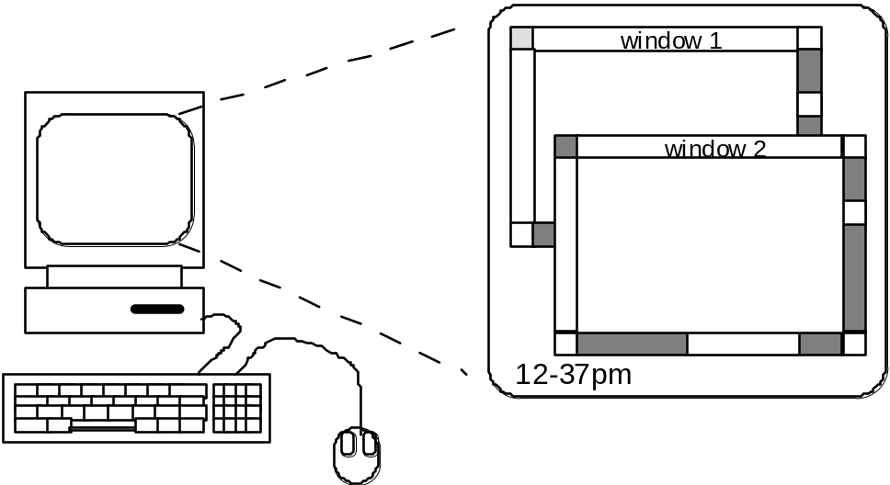
A ‘typical’ computer system
?
screen, or monitor, on which there are windows
keyboard
mouse/trackpad
variations
  desktop
  laptop
  PDA
the devices dictate the styles of interaction that the system supports
If we use different devices, then the interface will support a different style of interaction

Slide 6

How many …
computers in your house?
  hands up, …
  … none, 1, 2 , 3, more!!
computers in your pockets?
are you thinking …
… PC, laptop, PDA ??

Slide 7
How many computers …
in your house?
  PC
  TV, VCR, DVD, HiFi, cable/satellite TV
  microwave, cooker, washing machine
  central heating
  security system
  can you think of more?
in your pockets?
  PDA
  phone, camera
  smart card, card with magnetic strip?
  electronic car key
  USB memory
  try your pockets and bags

Slide 8
Interactivity?
Long ago in a galaxy far away … batch processing
  punched card stacks or large data files prepared
  long wait ….
  line printer output
  … and if it is not right …
Now most computing is interactive
  rapid feedback
  the user in control (most of the time)
  doing rather than thinking …
Is faster always better?

Slide 9
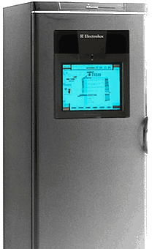

Richer interaction
sensors
and devices
everywhere

Slide 10
text entry devices
keyboards (QWERTY et al.)
chord keyboards, phone pads
handwriting, speech

Slide 11
Keyboards
Most common text input device
Allows rapid entry of text by experienced users
Keypress closes connection, causing a character code to be sent
Usually connected by cable, but can be wireless

Slide 12
layout – QWERTY
Standardised layout
but …
  non-alphanumeric keys are placed differently
  accented symbols needed for different scripts
  minor differences between UK and USA keyboards
QWERTY arrangement not optimal for typing
– layout to prevent typewriters jamming!
Alternative designs allow faster typing but large social base of QWERTY typists produces reluctance to change.

Slide 13
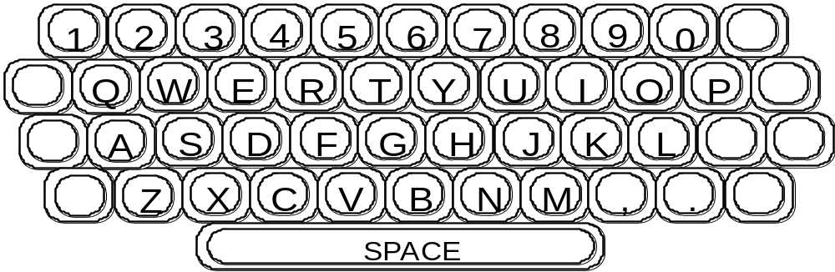
QWERTY (cont.)

Slide 14
alternative keyboard layouts
Alphabetic
  keys arranged in alphabetic order
  not faster for trained typists
  not faster for beginners either!
Dvorak
  common letters under dominant fingers
  biased towards right hand
  common combinations of letters alternate between hands
  10-15% improvement in speed and reduction in fatigue
  But - large social base of QWERTY typists produce market pressures not to change

Slide 15
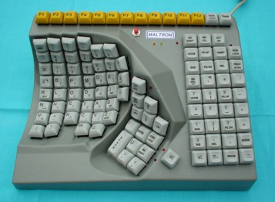
special keyboards
designs to reduce fatigue for RSI
for one handed use
  e.g. the Maltron left-handed keyboard

Slide 16
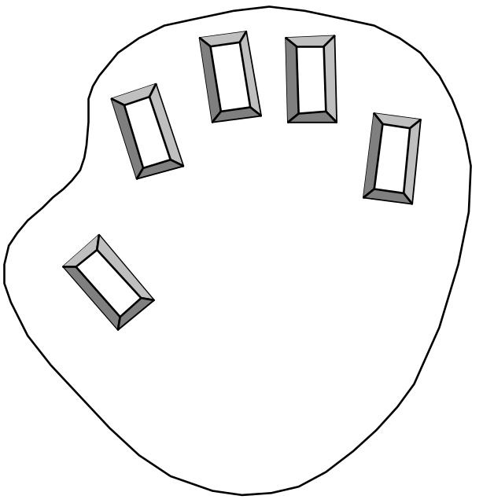
Chord keyboards
only a few keys - four or 5
letters typed as combination of keypresses
compact size
– ideal for portable applications
short learning time
– keypresses reflect letter shape
fast
– once you have trained
BUT - social resistance, plus fatigue after extended use
NEW – niche market for some wearables

Slide 17
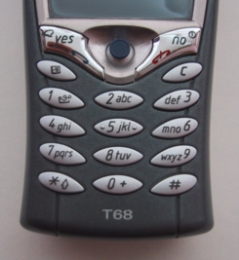
phone pad and T9 entry
use numeric keys with
multiple presses
  2 – a b c 6 - m n o
  3 - d e f 7 - p q r s
  4 - g h i 8 - t u v
  5 - j k l 9 - w x y z
hello = 4433555[pause]555666
surprisingly fast!
T9 predictive entry
  type as if single key for each letter
  use dictionary to ‘guess’ the right word
  hello = 43556 …
  but 26 -> menu ‘am’ or ‘an’

Slide 18
Handwriting recognition
Text can be input into the computer, using a pen and a digesting tablet
  natural interaction
Technical problems:
  capturing all useful information - stroke path, pressure, etc. in a natural manner
  segmenting joined up writing into individual letters
  interpreting individual letters
  coping with different styles of handwriting
Used in PDAs, and tablet computers …
… leave the keyboard on the desk!

Slide 19
Speech recognition
Improving rapidly
Most successful when:
  single user – initial training and learns peculiarities
  limited vocabulary systems
Problems with
  external noise interfering
  imprecision of pronunciation
  large vocabularies
  different speakers

Slide 20

Numeric keypads
for entering numbers quickly:
  calculator, PC keyboard
for telephones
not the same!!
ATM like phone
1
2
3
7
8
9
4
5
6
4
5
6
7
8
9
1
2
3
*
0
#
0
.
=
telephone
calculator

Slide 21
positioning, pointing and drawing
mouse, touchpad
trackballs, joysticks etc.
touch screens, tablets
eyegaze, cursors

Slide 22
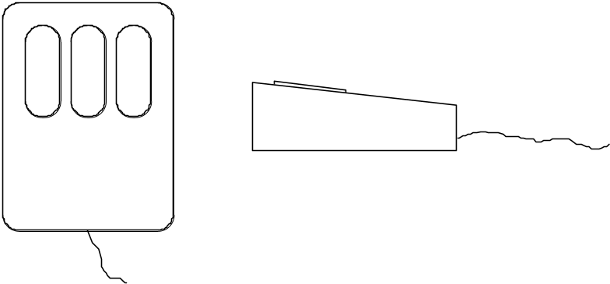
the Mouse
Handheld pointing device
  very common
  easy to use
Two characteristics
  planar movement
  buttons
    (usually from 1 to 3 buttons on top, used for making a selection, indicating an option, or to initiate drawing etc.)

Slide 23
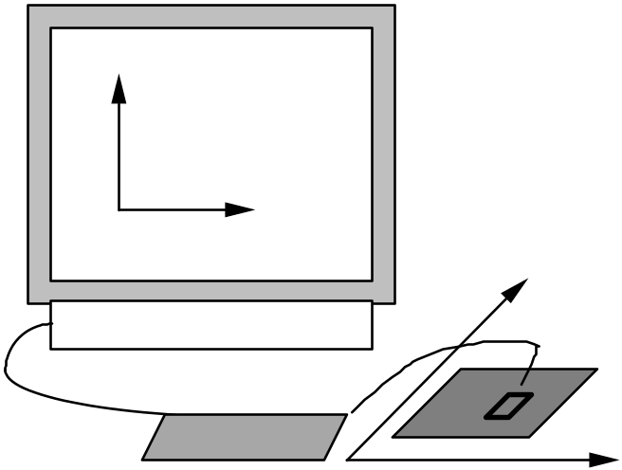
the mouse (cont.)
Mouse located on desktop
  requires physical space
  no arm fatigue
Relative movement only is detectable.
Movement of mouse moves screen cursor
Screen cursor oriented in (x, y) plane,
mouse movement in (x, z) plane …
… an indirect manipulation device.
  device itself doesn’t obscure screen, is accurate and fast.
  hand-eye coordination problems for novice users

Slide 24
How does it work?
Two methods for detecting motion
Mechanical
  Ball on underside of mouse turns as mouse is moved
  Rotates orthogonal potentiometers
  Can be used on almost any flat surface
Optical
  light emitting diode on underside of mouse
  may use special grid-like pad or just on desk
  less susceptible to dust and dirt
  detects fluctuating alterations in reflected light intensity to calculate relative motion in (x, z) plane

Slide 25
Even by foot …
some experiments with the footmouse
  controlling mouse movement with feet …
  not very common :-)
but foot controls are common elsewhere:
  car pedals
  sewing machine speed control
  organ and piano pedals

Slide 26
Touchpad
small touch sensitive tablets
‘stroke’ to move mouse pointer
used mainly in laptop computers
good ‘acceleration’ settings important
  fast stroke
    lots of pixels per inch moved
    initial movement to the target
  slow stroke
    less pixels per inch
    for accurate positioning

Slide 27
Trackball and thumbwheels
Trackball
  ball is rotated inside static housing
    like an upsdie down mouse!
  relative motion moves cursor
  indirect device, fairly accurate
  separate buttons for picking
  very fast for gaming
  used in some portable and notebook computers.
Thumbwheels …
  for accurate CAD – two dials for X-Y cursor position
  for fast scrolling – single dial on mouse

Slide 28
Joystick and keyboard nipple
Joystick
  indirect
  pressure of stick = velocity of movement
  buttons for selection
  on top or on front like a trigger
  often used for computer games
  aircraft controls and 3D navigation
Keyboard nipple
  for laptop computers
  miniature joystick in the middle of the keyboard

Slide 29
Touch-sensitive screen
Detect the presence of finger or stylus on the screen.
  works by interrupting matrix of light beams, capacitance changes or ultrasonic reflections
  direct pointing device
Advantages:
  fast, and requires no specialised pointer
  good for menu selection
  suitable for use in hostile environment: clean and safe from damage.
Disadvantages:
  finger can mark screen
  imprecise (finger is a fairly blunt instrument!)
    difficult to select small regions or perform accurate drawing
  lifting arm can be tiring

Slide 30
Stylus and light pen
Stylus
  small pen-like pointer to draw directly on screen
  may use touch sensitive surface or magnetic detection
  used in PDA, tablets PCs and drawing tables
Light Pen
  now rarely used
  uses light from screen to detect location
BOTH …
  very direct and obvious to use
  but can obscure screen

Slide 31
Digitizing tablet
Mouse like-device with cross hairs
used on special surface
- rather like stylus
very accurate
- used for digitizing maps

Slide 32
Eyegaze
control interface by eye gaze direction
  e.g. look at a menu item to select it
uses laser beam reflected off retina
  … a very low power laser!
mainly used for evaluation (ch x)
potential for hands-free control
high accuracy requires headset
cheaper and lower accuracy devices available
sit under the screen like a small webcam

Slide 33
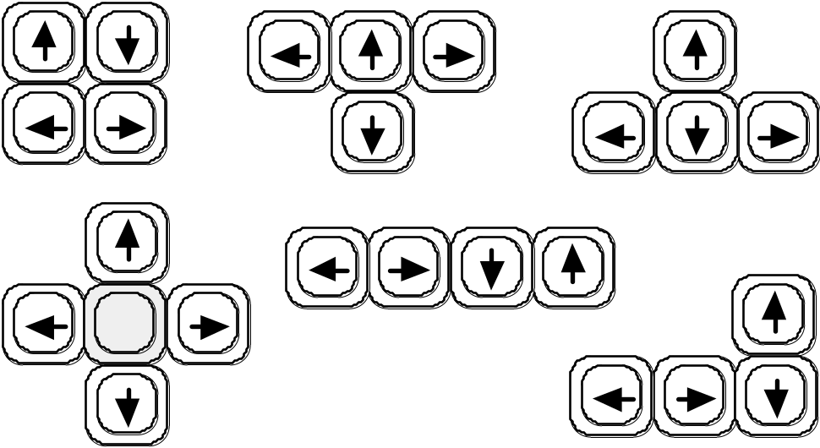
Cursor keys
Four keys (up, down, left, right) on keyboard.
Very, very cheap, but slow.
Useful for not much more than basic motion for text-editing tasks.
No standardised layout, but inverted “T”, most common

Slide 34
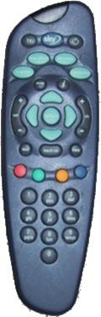
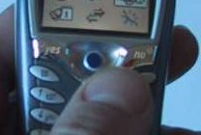
Discrete positioning controls
in phones, TV controls etc.
  cursor pads or mini-joysticks
  discrete left-right, up-down
  mainly for menu selection

Slide 35
display devices
bitmap screens (CRT & LCD)
large & situated displays
digital paper

Slide 36
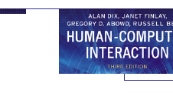


bitmap displays
screen is vast number of coloured dots

Slide 37
resolution and colour depth
Resolution … used (inconsistently) for
  number of pixels on screen (width x height)
    e.g. SVGA 1024 x 768, PDA perhaps 240x400
  density of pixels (in pixels or dots per inch - dpi)
    typically between 72 and 96 dpi
Aspect ratio
  ration between width and height
  4:3 for most screens, 16:9 for wide-screen TV
Colour depth:
  how many different colours for each pixel?
  black/white or greys only
  256 from a pallete
  8 bits each for red/green/blue = millions of colours

Slide 38


anti-aliasing
Jaggies
  diagonal lines that have discontinuities in due to horizontal raster scan process.
Anti-aliasing
  softens edges by using shades of line colour
  also used for text

Slide 39
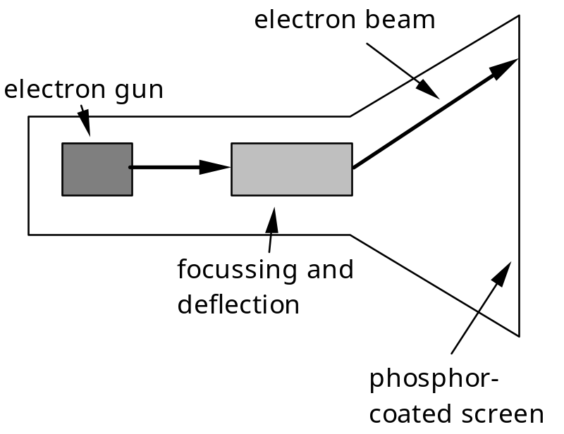
Cathode ray tube
Stream of electrons emitted from electron gun, focused and directed by magnetic fields, hit phosphor-coated screen which glows
used in TVs and computer monitors

Slide 40
Health hazards of CRT !
X-rays: largely absorbed by screen (but not at rear!)
UV- and IR-radiation from phosphors: insignificant levels
Radio frequency emissions, plus ultrasound (~16kHz)
Electrostatic field - leaks out through tube to user. Intensity dependant on distance and humidity. Can cause rashes.
Electromagnetic fields (50Hz-0.5MHz). Create induction currents in conductive materials, including the human body. Two types of effects attributed to this: visual system - high incidence of cataracts in VDU operators, and concern over reproductive disorders (miscarriages and birth defects).

Slide 41
Health hints …
do not sit too close to the screen
do not use very small fonts
do not look at the screen for long periods without a break
do not place the screen directly in front of a bright window
work in well-lit surroundings
Take extra care if pregnant.
but also posture, ergonomics, stress

Slide 42
Liquid crystal displays
Smaller, lighter, and … no radiation problems.
Found on PDAs, portables and notebooks,
… and increasingly on desktop and even for home TV
also used in dedicted displays:
digital watches, mobile phones, HiFi controls
How it works …
  Top plate transparent and polarised, bottom plate reflecting.
  Light passes through top plate and crystal, and reflects back to eye.
  Voltage applied to crystal changes polarisation and hence colour
  N.B. light reflected not emitted => less eye strain

Slide 43
special displays
Random Scan (Directed-beam refresh, vector display)
  draw the lines to be displayed directly
  no jaggies
  lines need to be constantly redrawn
  rarely used except in special instruments
Direct view storage tube (DVST)
  Similar to random scan but persistent => no flicker
  Can be incrementally updated but not selectively erased
  Used in analogue storage oscilloscopes

Slide 44
large displays
used for meetings, lectures, etc.
technology
  plasma – usually wide screen
  video walls – lots of small screens together
  projected – RGB lights or LCD projector
    hand/body obscures screen
    may be solved by 2 projectors + clever software
  back-projected
    frosted glass + projector behind

Slide 45
situated displays
displays in ‘public’ places
  large or small
  very public or for small group
display only
  for information relevant to location
or interactive
  use stylus, touch sensitive screem
in all cases … the location matters
  meaning of information or interaction is related to the location

Slide 46
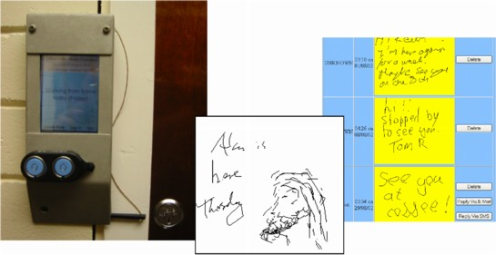
Hermes a situated display
small displays
beside
office doors
handwritten
notes left
using stylus
office owner
reads notes
using web interface

Slide 47
Digital paper
appearance
what?
  thin flexible sheets
  updated electronically
  but retain display
how?
  small spheres turned
  or channels with coloured liquid
  and contrasting spheres
  rapidly developing area
cross
section

Slide 48
virtual reality and 3D interaction
positioning in 3D space
moving and grasping
seeing 3D (helmets and caves)

Slide 49
positioning in 3D space
cockpit and virtual controls
  steering wheels, knobs and dials … just like real!
the 3D mouse
  six-degrees of movement: x, y, z + roll, pitch, yaw
data glove
  fibre optics used to detect finger position
VR helmets
  detect head motion and possibly eye gaze
whole body tracking
  accelerometers strapped to limbs or reflective dots and video processing

Slide 50
pitch, yaw and roll
yaw
roll
pitch

Slide 51
3D displays
desktop VR
  ordinary screen, mouse or keyboard control
  perspective and motion give 3D effect
seeing in 3D
  use stereoscopic vision
  VR helmets
  screen plus shuttered specs, etc.

Slide 52

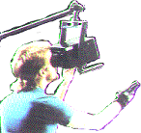

VR headsets
small TV screen for each eye
slightly different angles
3D effect

Slide 53
VR motion sickness
time delay
  move head … lag … display moves
  conflict: head movement vs. eyes
depth perception
  headset gives different stereo distance
  but all focused in same plane
  conflict: eye angle vs. focus
conflicting cues => sickness
  helps motivate improvements in technology

Slide 54



simulators and VR caves
scenes projected on walls
realistic environment
hydraulic rams!
real controls
other people

Slide 55
physical controls, sensors etc.
special displays and gauges
sound, touch, feel, smell
physical controls
environmental and bio-sensing

Slide 56
dedicated displays
analogue representations:
  dials, gauges, lights, etc.
digital displays:
  small LCD screens, LED lights, etc.
head-up displays
  found in aircraft cockpits
  show most important controls
  … depending on context

Slide 57
Sounds
beeps, bongs, clonks, whistles and whirrs
used for error indications
confirmation of actions e.g. keyclick
        also see chapter 10

Slide 58
Touch, feel, smell
touch and feeling important
  in games … vibration, force feedback
  in simulation … feel of surgical instruments
  called haptic devices
texture, smell, taste
  current technology very limited

Slide 59
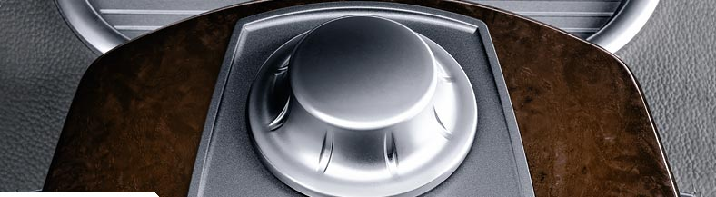
BMW iDrive
for controlling menus
feel small ‘bumps’ for each item
makes it easier to select options by feel
uses haptic technology from Immersion Corp.

Slide 60
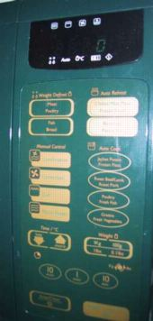
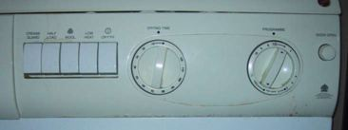
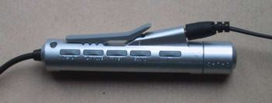
physical controls
specialist controls needed …
  industrial controls, consumer products, etc.
easy-clean
smooth buttons
multi-function
control
large buttons
clear dials
tiny buttons

Slide 61
Environment and bio-sensing
sensors all around us
  car courtesy light – small switch on door
  ultrasound detectors – security, washbasins
  RFID security tags in shops
  temperature, weight, location
… and even our own bodies …
  iris scanners, body temperature, heart rate, galvanic skin response, blink rate

Slide 62
paper: printing and scanning
print technology
fonts, page description, WYSIWYG
scanning, OCR

Slide 63
Printing
image made from small dots
  allows any character set or graphic to be printed,
critical features:
  resolution
    size and spacing of the dots
    measured in dots per inch (dpi)
  speed
    usually measured in pages per minute
  cost!!

Slide 64
Types of dot-based printers
dot-matrix printers
  use inked ribbon (like a typewriter
  line of pins that can strike the ribbon, dotting the paper.
  typical resolution 80-120 dpi
ink-jet and bubble-jet printers
  tiny blobs of ink sent from print head to paper
  typically 300 dpi or better .
laser printer
  like photocopier: dots of electrostatic charge deposited on drum, which picks up toner (black powder form of ink) rolled onto paper which is then fixed with heat
  typically 600 dpi or better.

Slide 65
Printing in the workplace
shop tills
  dot matrix
  same print head used for several paper rolls
  may also print cheques
thermal printers
  special heat-sensitive paper
  paper heated by pins makes a dot
  poor quality, but simple & low maintenance
  used in some fax machines

Slide 66
Fonts
Font – the particular style of text
Courier font
Helvetica font
Palatino font
Times Roman font
♣×∝≡↵ℜ ⊗↵∼ (special symbol)
Size of a font measured in points (1 pt about 1/72”)
(vaguely) related to its height
This is ten point Helvetica
This is twelve point
This is fourteen point
This is eighteen point
and this is twenty-four point

Slide 67


Fonts (cont.)
Pitch
  fixed-pitch – every character has the same width
    e.g. Courier
  variable-pitched – some characters wider
    e.g. Times Roman – compare the ‘i’ and the “m”
Serif or Sans-serif
  sans-serif – square-ended strokes
    e.g. Helvetica
  serif – with splayed ends (such as)
    e.g. Times Roman or Palatino

Slide 68
Readability of text
lowercase
  easy to read shape of words
UPPERCASE
  better for individual letters and non-words
  e.g. flight numbers: BA793 vs. ba793
serif fonts
  helps your eye on long lines of printed text
  but sans serif often better on screen

Slide 69
Page Description Languages
Pages very complex
  different fonts, bitmaps, lines, digitised photos, etc.
Can convert it all into a bitmap and send to the printer
… but often huge !
Alternatively Use a page description language
  sends a description of the page can be sent,
  instructions for curves, lines, text in different styles, etc.
  like a programming language for printing!
PostScript is the most common

Slide 70
Screen and page
WYSIWYG
  what you see is what you get
  aim of word processing, etc.
but …
  screen: 72 dpi, landscape image
  print: 600+ dpi, portrait
can try to make them similar
but never quite the same
so … need different designs, graphics etc, for screen and print

Slide 71
Scanners
Take paper and convert it into a bitmap
Two sorts of scanner
  flat-bed: paper placed on a glass plate, whole page converted into bitmap
  hand-held: scanner passed over paper, digitising strip typically 3-4” wide
Shines light at paper and note intensity of reflection
  colour or greyscale
Typical resolutions from 600–2400 dpi

Slide 72
Scanners (cont.)
Used in
  desktop publishing for incorporating photographs and other images
  document storage and retrieval systems, doing away with paper storage
  special scanners for slides and photographic negatives

Slide 73
Optical character recognition
OCR converts bitmap back into text
different fonts
  create problems for simple “template matching” algorithms
  more complex systems segment text, decompose it into lines and arcs, and decipher characters that way
page format
  columns, pictures, headers and footers

Slide 74
Paper-based interaction
paper usually regarded as output only
can be input too – OCR, scanning, etc.
Xerox PaperWorks
  glyphs – small patterns of /\\//\\\
    used to identify forms etc.
    used with scanner and fax to control applications
more recently
  papers micro printed - like wattermarks
    identify which sheet and where you are
  special ‘pen’ can read locations
    know where they are writing

Slide 75
memory
short term and long term
speed, capacity, compression
formats, access

Slide 76
Short-term Memory - RAM
Random access memory (RAM)
  on silicon chips
  100 nano-second access time
  usually volatile (lose information if power turned off)
  data transferred at around 100 Mbytes/sec
Some non-volatile RAM used to store basic set-up information
Typical desktop computers:
64 to 256 Mbytes RAM

Slide 77
Long-term Memory - disks
magnetic disks
  floppy disks store around 1.4 Mbytes
  hard disks typically 40 Gbytes to 100s of Gbytes
  access time ~10ms, transfer rate 100kbytes/s
optical disks
  use lasers to read and sometimes write
  more robust that magnetic media
  CD-ROM
  - same technology as home audio, ~ 600 Gbytes
  DVD - for AV applications, or very large files

Slide 78
Blurring boundaries
PDAs
  often use RAM for their main memory
Flash-Memory
  used in PDAs, cameras etc.
  silicon based but persistent
  plug-in USB devices for data transfer

Slide 79
speed and capacity
what do the numbers mean?
some sizes (all uncompressed) …
  this book, text only ~ 320,000 words, 2Mb
  the Bible ~ 4.5 Mbytes
  scanned page ~ 128 Mbytes
    (11x8 inches, 1200 dpi, 8bit greyscale)
  digital photo ~ 10 Mbytes
    (2–4 mega pixels, 24 bit colour)
  video ~ 10 Mbytes per second
    (512x512, 12 bit colour, 25 frames per sec)

Slide 80
virtual memory
Problem:
  running lots of programs + each program large
  not enough RAM
Solution - Virtual memory :
  store some programs temporarily on disk
  makes RAM appear bigger
But … swapping
  program on disk needs to run again
  copied from disk to RAM
  s l o w s t h i n g s d o w n

Slide 81
Compression
reduce amount of storage required
lossless
  recover exact text or image – e.g. GIF, ZIP
  look for commonalities:
    text: AAAAAAAAAABBBBBCCCCCCCC 10A5B8C
    video: compare successive frames and store change
lossy
  recover something like original – e.g. JPEG, MP3
  exploit perception
    JPEG: lose rapid changes and some colour
    MP3: reduce accuracy of drowned out notes

Slide 82
Storage formats - text
ASCII - 7-bit binary code for to each letter and character
UTF-8 - 8-bit encoding of 16 bit character set
RTF (rich text format)
- text plus formatting and layout information
SGML (standardized generalised markup language)
- documents regarded as structured objects
XML (extended markup language)
- simpler version of SGML for web applications

Slide 83
Storage formats - media
Images:
  many storage formats :
  (PostScript, GIFF, JPEG, TIFF, PICT, etc.)
  plus different compression techniques
  (to reduce their storage requirements)
Audio/Video
  again lots of formats :
  (QuickTime, MPEG, WAV, etc.)
  compression even more important
  also ‘streaming’ formats for network delivery

Slide 84
methods of access
large information store
  long time to search => use index
  what you index -> what you can access
simple index needs exact match
forgiving systems:
  Xerox “do what I mean” (DWIM)
  SOUNDEX – McCloud ~ MacCleod
access without structure …
  free text indexing (all the words in a document)
  needs lots of space!!

Slide 85
processing and networks
finite speed (but also Moore’s law)
limits of interaction
networked computing

Slide 86
Finite processing speed
Designers tend to assume fast processors, and make interfaces more and more complicated
But problems occur, because processing cannot keep up with all the tasks it needs to do
  cursor overshooting because system has buffered keypresses
  icon wars - user clicks on icon, nothing happens, clicks on another, then system responds and windows fly everywhere
Also problems if system is too fast - e.g. help screens may scroll through text much too rapidly to be read

Slide 87
Moore’s law
computers get faster and faster!
1965 …
  Gordon Moore, co-founder of Intel, noticed a pattern
  processor speed doubles every 18 months
  PC … 1987: 1.5 Mhz, 2002: 1.5 GHz
similar pattern for memory
  but doubles every 12 months!!
  hard disk … 1991: 20Mbyte : 2002: 30 Gbyte
baby born today
  record all sound and vision
  by 70 all life’s memories stored in a grain of dust!
/e3/online/moores-law/

Slide 88
the myth of the infinitely fast machine
implicit assumption … no delays
an infinitely fast machine
what is good design for real machines?
good example … the telephone :
  type keys too fast
  hear tones as numbers sent down the line
  actually an accident of implementation
  emulate in deisgn

Slide 89
Limitations on interactive performance
Computation bound
  Computation takes ages, causing frustration for the user
Storage channel bound
  Bottleneck in transference of data from disk to memory
Graphics bound
  Common bottleneck: updating displays requires a lot of effort - sometimes helped by adding a graphics co-processor optimised to take on the burden
Network capacity
  Many computers networked - shared resources and files, access to printers etc. - but interactive performance can be reduced by slow network speed

Slide 90
Networked computing
Networks allow access to …
  large memory and processing
  other people (groupware, email)
  shared resources – esp. the web
Issues
  network delays – slow feedback
  conflicts - many people update data
  unpredictability

Slide 91
The internet
history …
  1969: DARPANET US DoD, 4 sites
  1971: 23; 1984: 1000; 1989: 10000
common language (protocols):
  TCP – Transmission Control protocol
    lower level, packets (like letters) between machines
  IP – Internet Protocol
    reliable channel (like phone call) between programs on machines
  email, HTTP, all build on top of these

Slide 92
Next Lecture
The Interaction

Slide 93
References
Alan Dix, Janet Finlay, Gregory D. Abowd, Russell Beale, “Human-Computer Interaction, 3rd Edition”, Prentice Hall, 2004, ISBN: 0-13-046109-1
Samsun M. Başarıcı, Erkan Özefe; “Visuelle Programmierung für die Bildverarbeitung”, VDM Verlag Dr. Müller, 2013

Slide 94
Additional Material:
History of Computers

Slide 95
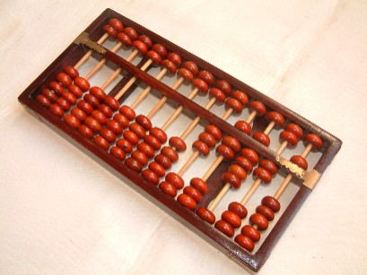
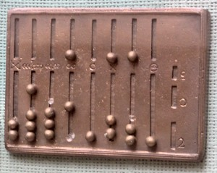
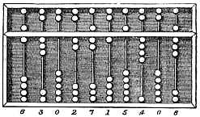
First machines
≈ 2400 BC Babylon
Chinese
Greeks
Romans
etc.
Addition, substraction, multiplication, square root, cube root

Slide 96
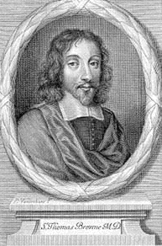
Computer ?
Term „Computer“:
  1646: Sir Thomas Browne (1605-1682)
  Author
  Medicine
  Religion
  Science
  Esoteric

Slide 97
Computers?
3 Lines
  Formalization
  Calculization
  Mechanization

Slide 98
Ages of Automata
17th Century
France
Clocks, watches, etc.

Slide 99
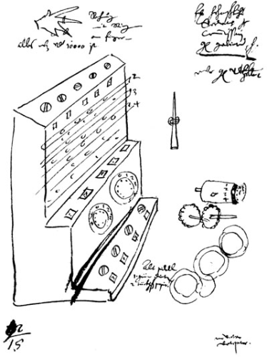
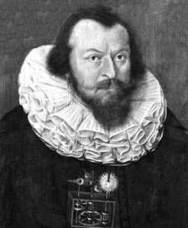
Upcoming of mechanical machines
1623: Wilhelm Schickard (1592-1635)
  German professor for biblical languages
  Mathematics
  Astronomy
  First draft of a „computer“

Slide 100
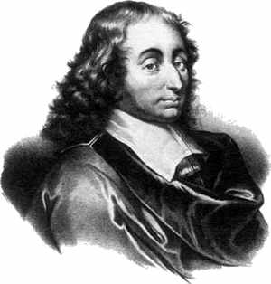
Upcoming of mechanical machines
1642: Blaise Pascal (1623-1662)
  French inventor, mathematician, physicist, religious philosopher
  First mechanical machine for computing: Pascaline

Slide 101
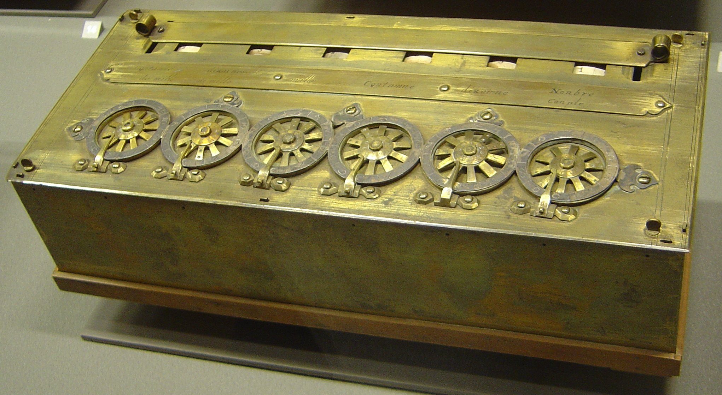
Pascaline
2 coupled sets of each 6 dials
Each dial with 10 digits (0,…,9)
Correct handling of carry
Only addition and substraction

Slide 102
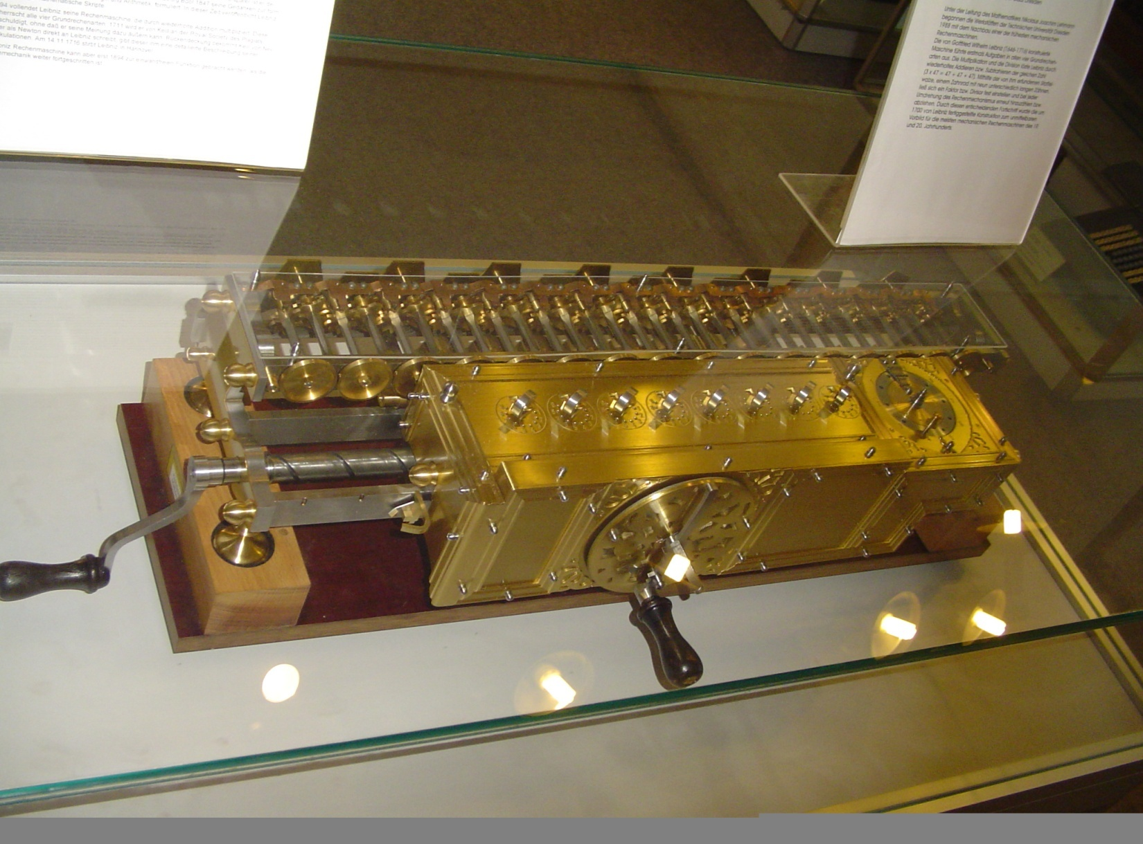
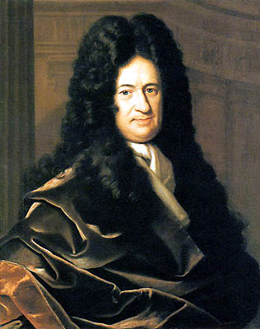
Upcoming of mechanical machines
1671: Gottlieb Wilhelm Freiherr von Leibniz (1646-1716)
  German philosopher, scientist, mathematician, physicist, etc.
  Improvement of Pascaline

Slide 103
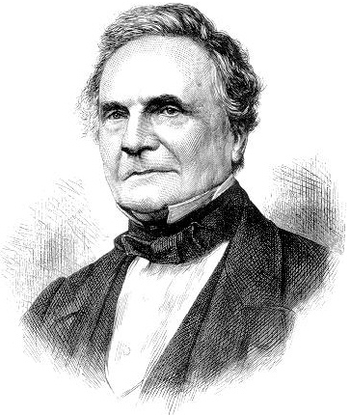
Big Improvements
Charles Babbage (1792-1871)
  English mathematician, philosopher, mechanical engineer

Slide 104
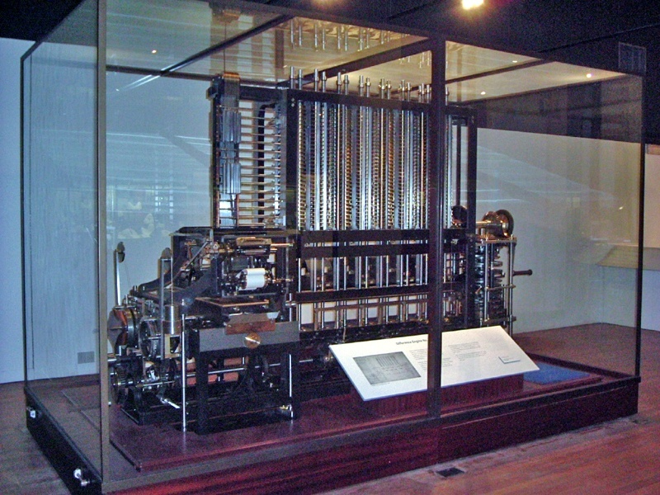
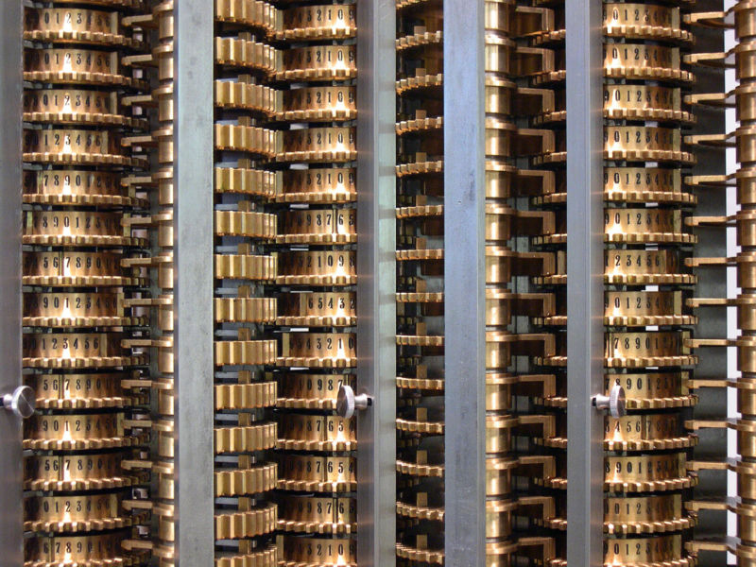
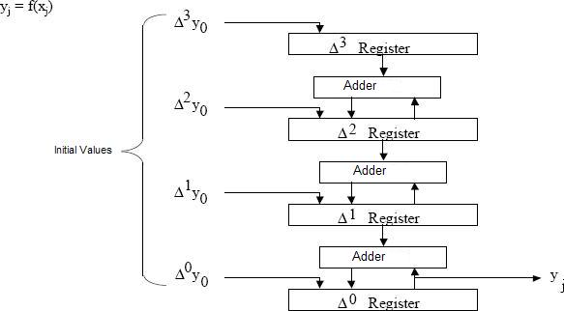
Difference Engine (1823)
Calculating tables for navigation
Solving polynomials

Slide 105
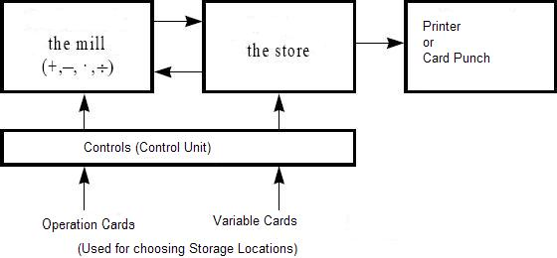
Analytical Engine (1834)
Designed to perform any mathematical operation
  Mill (ALU)
  Control unit
  Output Unit

Slide 106
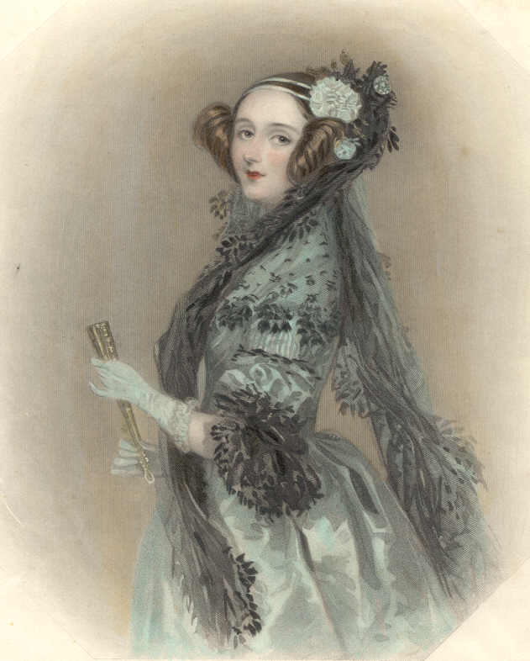
Analytical Engine (1834)
Branching
  Jumping forward/backward
Programming
  First Programmer: Ada Byron Lovelace

Slide 107
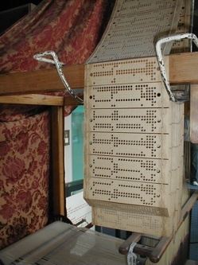
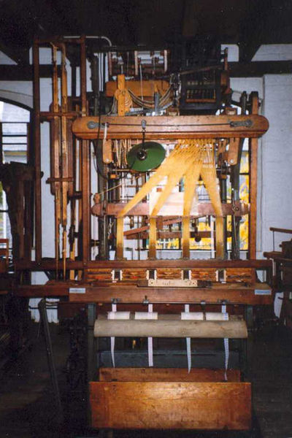
Programming?
Idea (1805): Weaving loom of Joseph-Marie Jacquard (1752-1834)

Slide 108
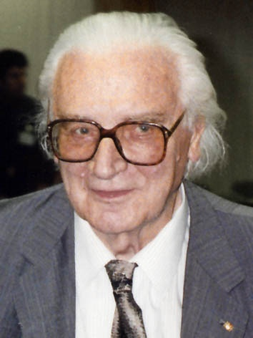
New Age
Z1 (1934): Konrad Zuse (1910-1995)

Slide 109
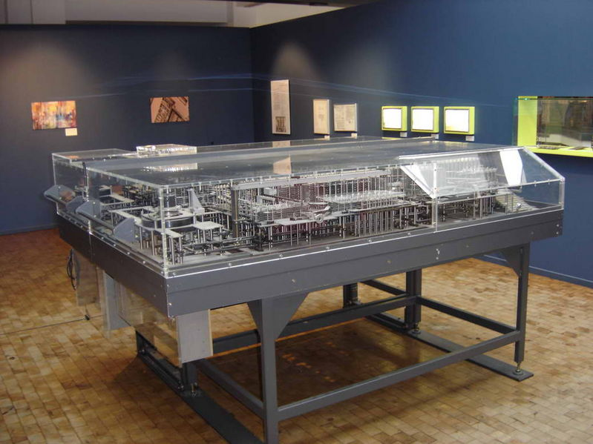
New Age
Z1 (1934): Konrad Zuse (1910-1995)
  First try

Slide 110
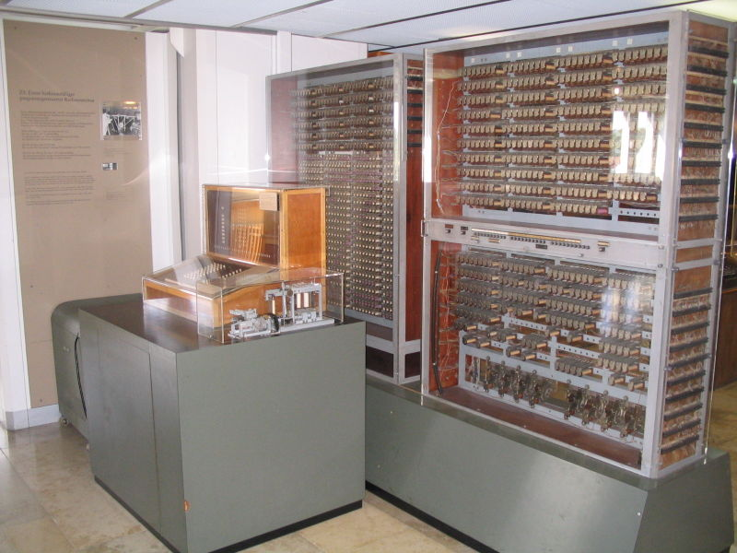
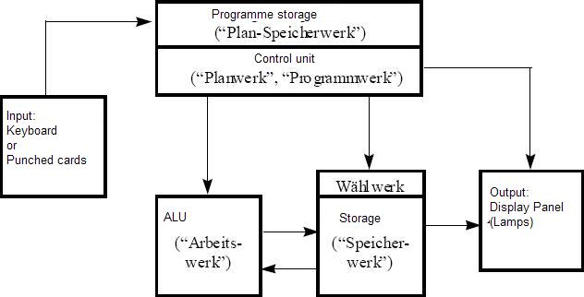
New Age
Z3 (1941): First Computer of the world
  Binary represantation of commands and numbers
  Binary switching elements for storage and processing
  Usage of predicate calculus (AND, OR,NOT)
  Floating point represantation of numbers
  Electromagnetical relays (600 for ALU, 1400 for storage units, 64 for 22 bit words)
  Program-controlled (8 channel punch stripes)
  Speed:
    3 seconds for multiplication, division, root extraction

Slide 111
New Age
Z3 (1941): First Computer of the world
  Binary represantation of commands and numbers
  Binary switching elements for storage and processing
  Usage of predicate calculus (AND, OR,NOT)
  Floating point represantation of numbers
  Electromagnetical relays (600 for ALU, 1400 for storage units, 64 for 22 bit words)
  Program-controlled (8 channel punch stripes)
  Speed:
    3 seconds for multiplication, division, root extraction

Slide 112
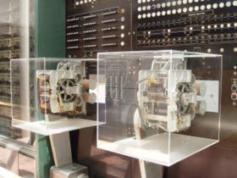
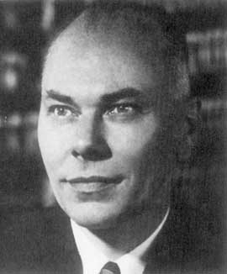
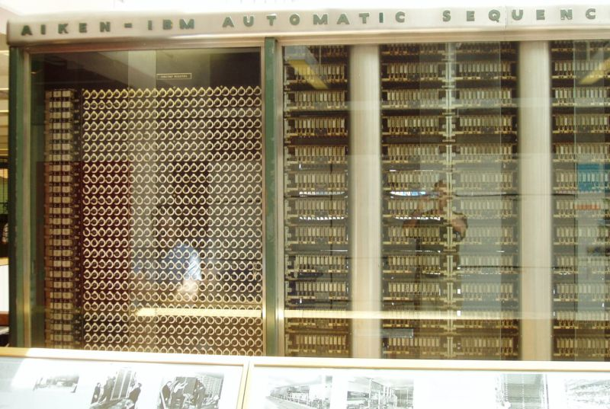
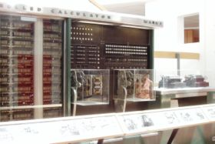
New Age
Harvard Mark I-Automatic Sequence Controlled Computer ASCC (1944): Howard Hathaway Aiken (1900-1973) at Harvard University Cambridge/Massachusets
  17 m
  5 tons
  Similar Z3 but output also on punched cards

Slide 113
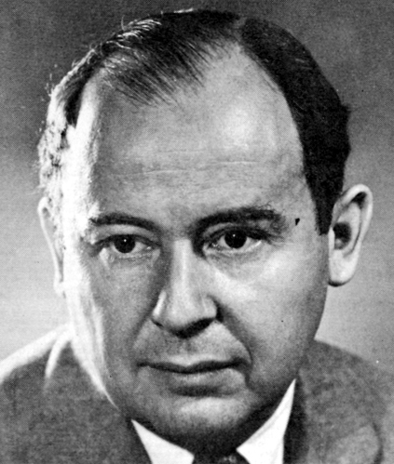
John von neumann (1903-1957)
1945
  “First Draft of a Report on the EDVAC”
  Concepts of Modern Computer Architecture (von Neumann Architecture):
    ALU
    CU
    Storage
    I/O

Slide 114
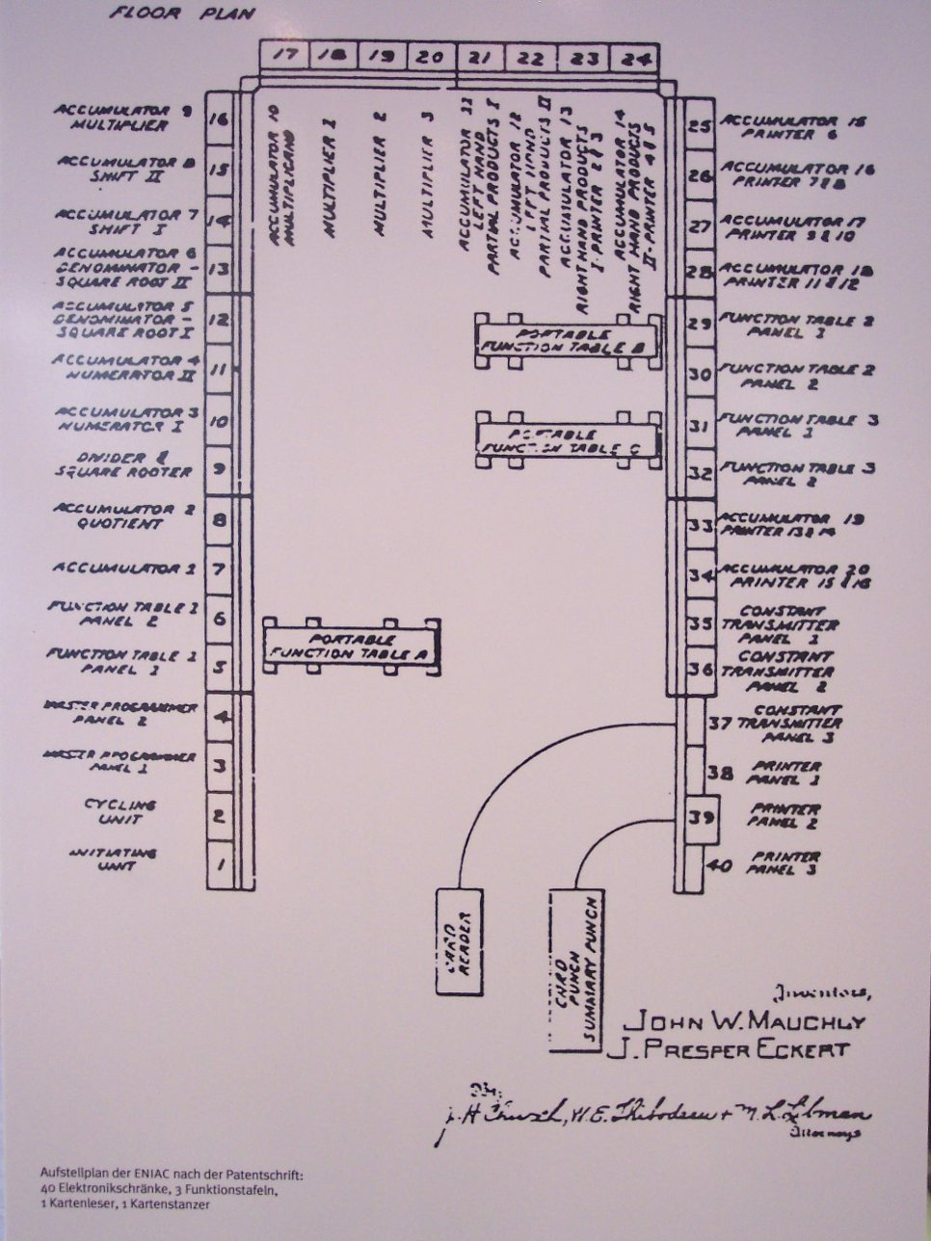

ENIAC
Electronic Numerical Integrator and Computer (1946)
  Build by: John Presper Eckert (1919-1995) and John William Mauchly (1907-1980)
    Vacuum tubes instead of mechanical storage elements
    1000 times faster than MARK I
    3 m. high
    300 m²
    Tubes has to be changed every 2-3 days

Slide 115
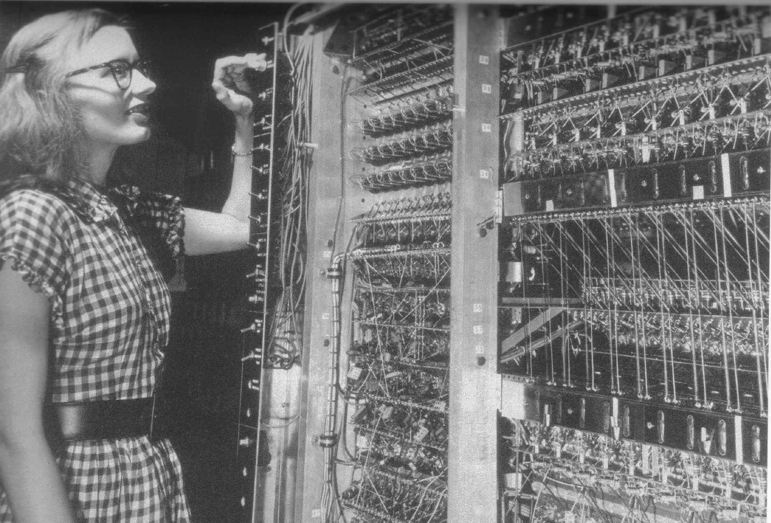
ENIAC
Programming ENIAC:
  6000 switches
  Organize wire connections
  Run a while
  Stop computer
  Reorganize wire connections
  ENIAC-Girls

Slide 116
ENIAC
Main features of ENIAC:
  17468 vacuum tubes
  1500 relays
  174 kW power
  30 t weight
  0.2 ms addition time
  2.8 ms multiplication time

Slide 117
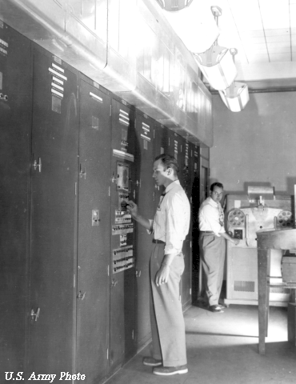
EDVAC (1945)
Electronic Discrete Variable Automatic Computer
Build by John von Neumann
  Modified ENIAC
  Data and programs in same storage

Slide 118
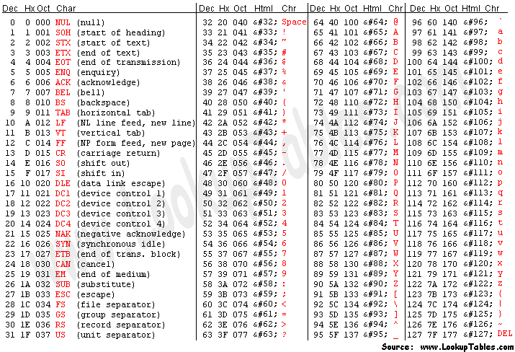

Small steps
1951: First commercial computer by Eckert and Mauchly (Rand Corp.)
  UNIVAC „Universal Automatic Computer“
1954: IBM introduced FORTRAN „Formula Translator“ developed by J. W. Backus
1963: ASCII „American Standard Code for Information Interchange“

Slide 119
A New Era
1958 and 1959: Jack Kilby (1923-2005) (Texas Instruments) and Robert Noyce (1927-1990) (Fairchild Semiconductors) developed independently the integrated circuits IC
1968: Gordon Moore (1929-) and Robert Noyce (both from Fairchild Semiconductors) incorporated Intel (Integrated Electronics) Corporation

Slide 120



A New Era
1969: Datapoint Co. ordered Intel to build an IC for Datapoint 2200 screen controller
1971: Intel 4004 (predecessor of all Pentium processors)

Slide 121




A New Era
1972: Intel 8008
  Successor of 4004
  8 bit data bus
  14 bit adress bus
  Commands for addition, substraction, and logic commands implemented

Slide 122
A New Era
1974: Many different 8 bit processors with 64 kByte address space
  Intel 8080
  Motorola MC 6800
  Intel 8085
  Zilog Z80
  etc.
Modern processors
  32 or 64 bit data and address bus

Slide 123

Typical PC system

Slide 124



History of Computing Hardware
First Generation (Mechanical/Electromechanical) | Calculators | Antikythera mechanism, Difference Engine, Norden bombsight
 | Programmable Devices | Jacquard loom, Analytical Engine, Harvard Mark I, Z3
Second Generation (Vacuum Tubes) | Calculators | Atanasoff – Berry Computer, IBM 604, UNIVAC 60, UNIVAC 120
 | Programmable Devices | ENIAC, EDSAC, EDVAC, UNIVAC I, IBM 701, IBM 702, IBM 650, Z22

Slide 125




History of Computing Hardware
Third Generation (Discrete transistors and SSI, MSI, LSI Integrated circuits) | Mainframes | IBM 7090, IBM 7080, System/360, BUNCH
 | Minicomputer | PDP-8, PDP-11, System/32, System/36
Fourth Generation (VLSI integrated circuits) | Minicomputer | VAX, AS/400
 | 4-bit microcomputer | Intel 4004, Intel 4040
 | 8-bit microcomputer | Intel 8008, Intel 8080, Motorola 6800, Motorola 6809, MOS Technology 6502, Zilog Z80
 | 16-bit microcomputer | 8088, Zilog Z8000, WDC 65816/65802
 | 32-bit microcomputer | 80386, Pentium, 68000, ARM architecture
 | 64-bit microcomputer | x86-64, PowerPC, MIPS, SPARC
 | Embedded computer | 8048, 8051
 | Personal computer | Desktop computer, Home computer, Laptop computer, Personal digital assistant (PDA), Portable computer, Tablet computer, Wearable computer
Theoretical/experimental | Quantum computer, Chemical computer, DNA computing, Optical computer, Spintronics based computer

