Slide 1


CSE306 Operating Systems
Lecture #2
Processes & Threads
Prepared & Presented by Asst. Prof. Dr. Samsun M. BAŞARICI

Slide 2
Topics covered
Processes
  What is a process?
  Elements of a process
  Process modeling
  Process creation, termination
  Process states
Threads
  Thread modeling
  Single vs. multithreads
Interprocess communication (IPC)
  Race & Critical Regions
  Mutual exclusion
  Semaphors
  Monitors
  Sleeping Barber
  Dining philosophers
Scheduling

Slide 3
OS Management of Application Execution
Resources are made available to multiple applications
The processor is switched among multiple applications so all will appear to be progressing
The processor and I/O devices can be used efficiently
Notes:
Now that we have the concepts of applications, system software, and resources,
we are in a position to discuss how the OS can, in an orderly fashion, manage the
execution of applications so that
• Resources are made available to multiple applications.
• The physical processor is switched among multiple applications so all will
appear to be progressing.
• The processor and I/O devices can be used efficiently.
The approach taken by all modern operating systems is to rely on a model in
which the execution of an application corresponds to the existence of one or more
processes.

Slide 4
Processes and Threads
Resource Ownership
Scheduling/Execution
  Process includes a virtual address space to hold the process image
    The OS performs a protection function to prevent unwanted interference between processes with respect to resources
  Follows an execution path that may be interleaved with other processes
    A process has an execution state (Running, Ready, etc.) and a dispatching priority, and is the entity that is scheduled and dispatched by the OS
Notes:
The discussion so far has presented the concept of a process as embodying two
characteristics:
• Resource ownership: A process includes a virtual address space to hold the
process image; recall from Chapter 3 that the process image is the collection of
program, data, stack, and attributes defined in the process control block. From
time to time, a process may be allocated control or ownership of resources,
such as main memory, I/O channels, I/O devices, and files. The OS performs a
protection function to prevent unwanted interference between processes with
respect to resources.
• Scheduling/execution: The execution of a process follows an execution path
(trace) through one or more programs (e.g., Figure 1.5). This execution may
be interleaved with that of other processes. Thus, a process has an execution
state (Running, Ready, etc.) and a dispatching priority and is the entity that is
scheduled and dispatched by the OS.

Slide 5
Processes and Threads (cont.)
The unit of dispatching is referred to as a thread or lightweight process
The unit of resource ownership is referred to as a process or task
Multithreading - The ability of an OS to support multiple, concurrent paths of execution within a single process
Notes:
Some thought should convince the reader that these two characteristics are
independent and could be treated independently by the OS. This is done in a number
of operating systems, particularly recently developed systems. To distinguish the two characteristics, the unit of dispatching is usually referred to as a thread or lightweight process , while the unit of resource ownership is usually referred to as a process or task .
Multithreading refers to the ability of an OS to support multiple, concurrent paths of execution within a single process.

Slide 6
Processes
Process is a program in execution
  Program code
  Data section
  Execution context: Program counter, registers, stack
Process has thread(s) of control
Many processes “run” concurrently: Process scheduling
  Fair allocation of CPU and I/O bound processes
    Context switch

Slide 7
Process Elements
Two essential elements of a process are:
    when the processor begins to execute the program code, we refer to this executing entity as a process
Program code
which may be shared with other processes that are executing the same program
A set of data associated with that code
Notes:
Recall from Chapter 2 that we suggested several definitions of the term process ,
including
• A program in execution
• An instance of a program running on a computer
• The entity that can be assigned to and executed on a processor
• A unit of activity characterized by the execution of a sequence of instructions,
a current state, and an associated set of system resources
We can also think of a process as an entity that consists of a number of elements.
Two essential elements of a process are program code (which may be shared with
other processes that are executing the same program) and a set of data associated
with that code. Let us suppose that the processor begins to execute this program
code, and we refer to this executing entity as a process.

Slide 8
Process Elements (cont.)
While the program is executing, this process can be uniquely characterized by a number of elements, including:
Identifier
State
Priority
Program counter
Memory pointers
Context data
I/O status information
Accounting information
Notes:
At any given point in time,
while the program is executing , this process can be uniquely characterized by a
number of elements, including the following:
• Identifier: A unique identifier associated with this process, to distinguish it
from all other processes.
• State: If the process is currently executing, it is in the running state.
• Priority: Priority level relative to other processes.
• Program counter: The address of the next instruction in the program to be
executed.
• Memory pointers: Includes pointers to the program code and data associated
with this process, plus any memory blocks shared with other processes.
• Context data: These are data that are present in registers in the processor
while the process is executing.
• I/O status information: Includes outstanding I/O requests, I/O devices (e.g.,
disk drives) assigned to this process, a list of files in use by the process, and
so on.
• Accounting information: May include the amount of processor time and clock
time used, time limits, account numbers, and so on.

Slide 9
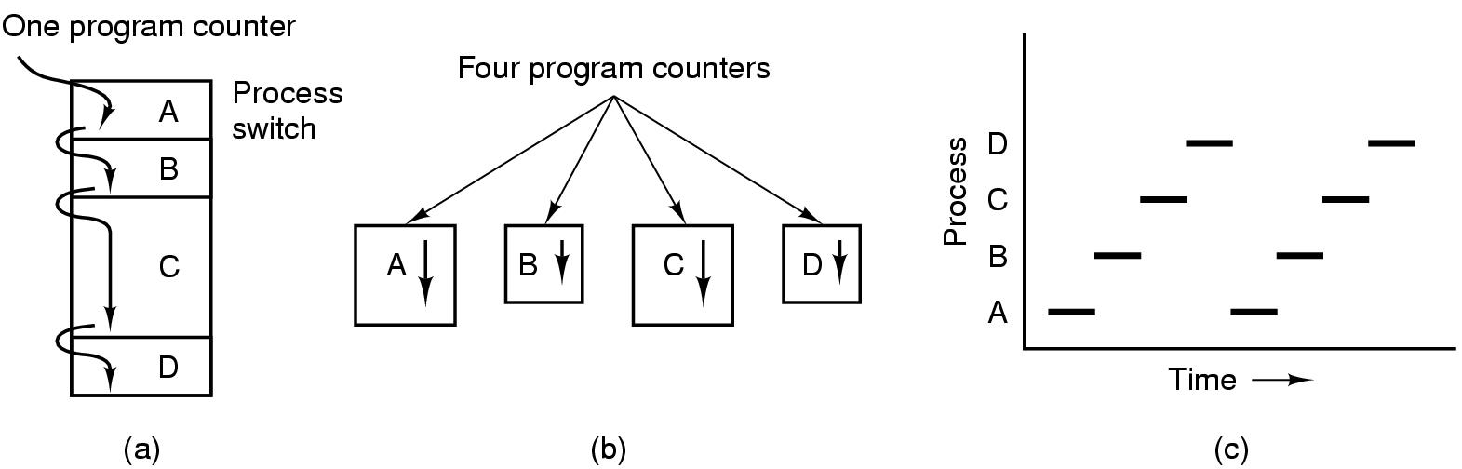
The Process Model
Multiprogramming of four programs
Conceptual model of 4 independent, sequential processes
Only one program active at any instant

Slide 10
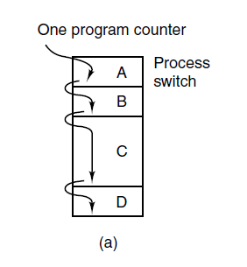
The Process Model (1)
Figure 2-1. (a) Multiprogramming of four programs (T)

Slide 11
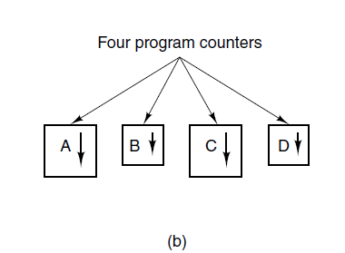
The Process Model (2)
Figure 2-1. (b) Conceptual model of
four independent, sequential processes.

Slide 12
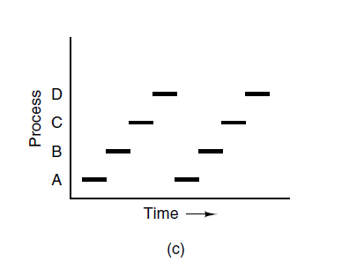
The Process Model (3)
Figure 2-1. (c) Only one program is active at once.

Slide 13
Process Creation
Creating new processes is expensive
  Resource allocation issue
Fork mechanism: UNIX, Windows NT
  Duplicate the parent process
  Shares file descriptors, memory is copied
  Exec to create different process
  Various optimizations to avoid copying the entire parent context (Copy on write (COW), etc..)
Exec mechanism: VMS, Windows NT
  New process is specifically loaded

Slide 14
Process Creation
Four principal events that cause processes to be created:
System initialization.
Execution of a process creation system call by a running process.
A user request to create a new process.
Initiation of a batch job.

Slide 15
Process Creation
Process spawning
When the OS creates a process at the explicit request of another process
Parent process
Is the original, creating, process
Child process
Is the new process
Notes:
As another example,
a server process (e.g., print server, file server) may generate a new process for each
request that it handles. When the OS creates a process at the explicit request of
another process, the action is referred to as process spawning .
When one process spawns another, the former is referred to as the parent
process , and the spawned process is referred to as the child process . Typically, the
“related” processes need to communicate and cooperate with each other. Achieving
this cooperation is a difficult task for the programmer; this topic is discussed in
Chapter 5 .

Slide 16
Process Termination
Conditions which terminate processes
Normal exit (voluntary)
Error exit (voluntary)
Fatal error (involuntary)
Killed by another process (involuntary)

Slide 17
Process Creation
Once the OS decides to create a new process it:
Assigns a unique process identifier to the new process
Allocates space for the process
Initializes the process control block
Sets the appropriate linkages
Creates or expands other data structures
Notes:
Once the OS decides, for whatever reason ( Table 3.1 ), to create a new process,
it can proceed as follows:
1. Assign a unique process identifier to the new process. At this time, a new entry
is added to the primary process table, which contains one entry per process.
2. Allocate space for the process. This includes all elements of the process image.
Thus, the OS must know how much space is needed for the private user address
space (programs and data) and the user stack. These values can be assigned by
default based on the type of process, or they can be set based on user request
at job creation time. If a process is spawned by another process, the parent
process can pass the needed values to the OS as part of the process-creation
request. If any existing address space is to be shared by this new process, the
appropriate linkages must be set up. Finally, space for a process control block
must be allocated.
3. Initialize the process control block. The process identification portion contains
the ID of this process plus other appropriate IDs, such as that of the parent
process. The processor state information portion will typically be initialized
with most entries zero, except for the program counter (set to the program
entry point) and system stack pointers (set to define the process stack boundaries).
The process control information portion is initialized based on standard
default values plus attributes that have been requested for this process. For
example, the process state would typically be initialized to Ready or Ready/
Suspend. The priority may be set by default to the lowest priority unless an
explicit request is made for a higher priority. Initially, the process may own
no resources (I/O devices, files) unless there is an explicit request for these or
unless they are inherited from the parent.
4. Set the appropriate linkages. For example, if the OS maintains each scheduling
queue as a linked list, then the new process must be put in the Ready or
Ready/Suspend list.
5. Create or expand other data structures. For example, the OS may maintain
an accounting file on each process to be used subsequently for billing and/or
performance assessment purposes.

Slide 18
Process Termination
There must be a means for a process to indicate its completion
A batch job should include a HALT instruction or an explicit OS service call for termination
For an interactive application, the action of the user will indicate when the process is completed (e.g. log off, quitting an application)
Notes:
Any computer system must provide a means for a process to indicate its
completion. A batch job should include a Halt instruction or an explicit OS service
call for termination. In the former case, the Halt instruction will generate an interrupt
to alert the OS that a process has completed. For an interactive application, the action
of the user will indicate when the process is completed. For example, in a time-sharing
system, the process for a particular user is to be terminated when the user logs off or
turns off his or her terminal. On a personal computer or workstation, a user may quit
an application (e.g., word processing or spreadsheet). All of these actions ultimately
result in a service request to the OS to terminate the requesting process.

Slide 19
Process Hierarchies
Parent creates a child process, child processes can create its own process
Forms a hierarchy
  UNIX calls this a "process group"
Windows has no concept of process hierarchy
  all processes are created equal

Slide 20
Process States
Trace
The behavior of an individual process by listing the sequence of instructions that execute for that process
The behavior of the processor can be characterized by showing how the traces of the various processes are interleaved
Dispatcher
Small program that switches the processor from one process to another
Notes:
As just discussed, for a program to be executed, a process, or task, is created for
that program. From the processor’s point of view, it executes instructions from its
repertoire in some sequence dictated by the changing values in the program counter
register. Over time, the program counter may refer to code in different programs
that are part of different processes. From the point of view of an individual program,
its execution involves a sequence of instructions within that program.
We can characterize the behavior of an individual process by listing the
sequence of instructions that execute for that process. Such a listing is referred to
as a trace of the process. We can characterize behavior of the processor by showing
how the traces of the various processes are interleaved.

Slide 21
Process States (1)
Three states a process may be in:
Running (actually using the CPU at that instant).
Ready (runnable; temporarily stopped to let another process run).
Blocked (unable to run until some external event happens).

Slide 22
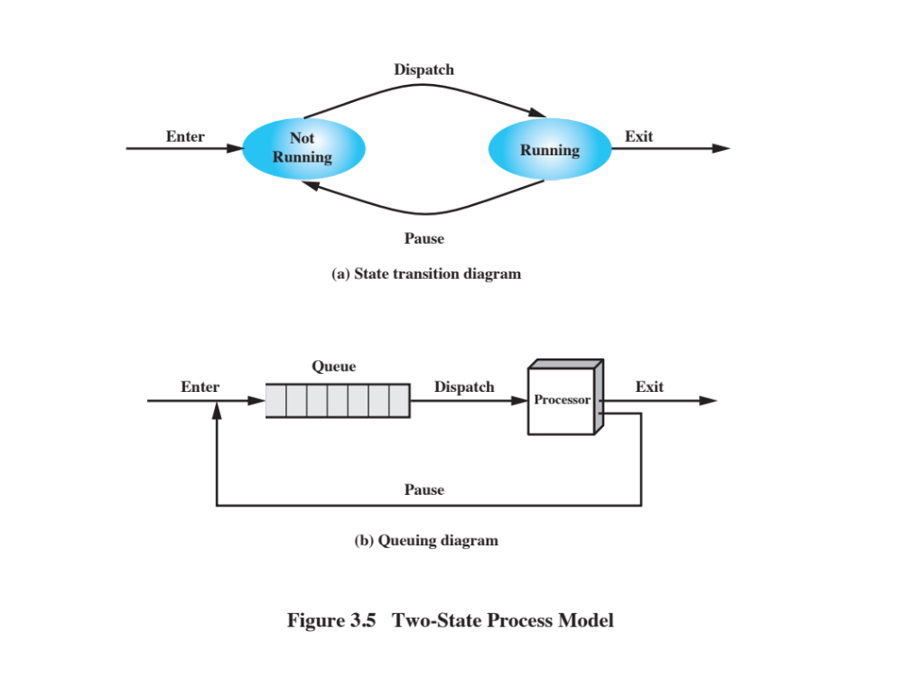
Two-State Process Model
Notes:
The operating system’s principal responsibility is controlling the execution of
processes; this includes determining the interleaving pattern for execution and allocating
resources to processes. The first step in designing an OS to control processes
is to describe the behavior that we would like the processes to exhibit.
We can construct the simplest possible model by observing that, at any time, a
process is either being executed by a processor or not. In this model, a process may
be in one of two states: Running or Not Running, as shown in Figure 3.5a . When
the OS creates a new process, it creates a process control block for the process and
enters that process into the system in the Not Running state. The process exists,
is known to the OS, and is waiting for an opportunity to execute. From time to
time, the currently running process will be interrupted and the dispatcher portion
of the OS will select some other process to run. The former process moves from the
Running state to the Not Running state, and one of the other processes moves to
the Running state.

Slide 23
Notes:
From this simple model, we can already begin to appreciate some of the design
elements of the OS. Each process must be represented in some way so that the OS
can keep track of it. That is, there must be some information relating to each process,
including current state and location in memory; this is the process control block.
Processes that are not running must be kept in some sort of queue, waiting their turn
to execute. Figure 3.5b suggests a structure. There is a single queue in which each
entry is a pointer to the process control block of a particular process. Alternatively,
the queue may consist of a linked list of data blocks, in which each block represents
one process; we will explore this latter implementation subsequently.
We can describe the behavior of the dispatcher in terms of this queuing
diagram. A process that is interrupted is transferred to the queue of waiting processes.
Alternatively, if the process has completed or aborted, it is discarded (exits
the system). In either case, the dispatcher takes another process from the queue to
execute.

Slide 24
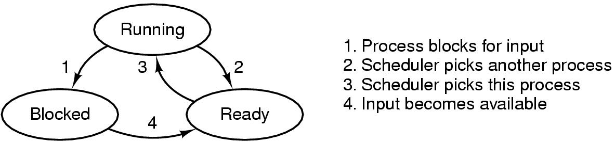
Process States (1)
Possible process states
  running
  blocked
  ready
Transitions between states shown

Slide 25
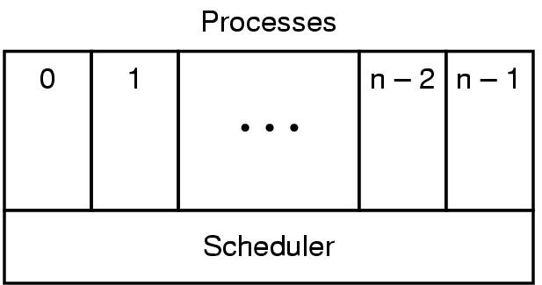
Process States (2)
Lowest layer of process-structured OS
  handles interrupts, scheduling
Above that layer are sequential processes

Slide 26
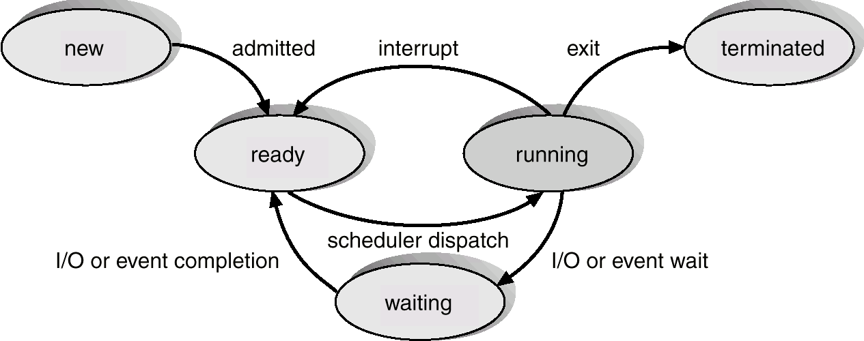
Process States (3)

Slide 27

Suspended Processes
  Swapping
    Involves moving part of all of a process from main memory to disk
    When none of the processes in main memory is in the Ready state, the OS swaps one of the blocked processes out on to disk into a suspend queue
        This is a queue of existing processes that have been temporarily kicked out of main memory, or suspended
        The OS then brings in another process from the suspend queue or it honors a new-process request
        Execution then continues with the newly arrived process
    Swapping, however, is an I/O operation and therefore there is the potential for making the problem worse, not better. Because disk I/O is generally the fastest I/O on a system, swapping will usually enhance performance
Notes:
Recall that the reason for all of this elaborate machinery is that I/O activities
are much slower than computation and therefore the processor in a uniprogramming
system is idle most of the time. But the arrangement of Figure 3.8b does not entirely
solve the problem. It is true that, in this case, memory holds multiple processes and
that the processor can move to another process when one process is blocked. But the
processor is so much faster than I/O that it will be common for all of the processes in
memory to be waiting for I/O. Thus, even with multiprogramming, a processor could
be idle most of the time.
What to do? Main memory could be expanded to accommodate more processes.
But there are two flaws in this approach. First, there is a cost associated with
main memory, which, though small on a per-byte basis, begins to add up as we get
into the gigabytes of storage. Second, the appetite of programs for memory has
grown as fast as the cost of memory has dropped. So larger memory results in larger
processes, not more processes.
Another solution is swapping, which involves moving part or all of a process
from main memory to disk. When none of the processes in main memory is in the
Ready state, the OS swaps one of the blocked processes out on to disk into a suspend
queue. This is a queue of existing processes that have been temporarily kicked
out of main memory, or suspended. The OS then brings in another process from the
suspend queue, or it honors a new-process request. Execution then continues with
the newly arrived process.
Swapping, however, is an I/O operation, and therefore there is the potential
for making the problem worse, not better. But because disk I/O is generally the
fastest I/O on a system (e.g., compared to tape or printer I/O), swapping will usually
enhance performance.

Slide 28
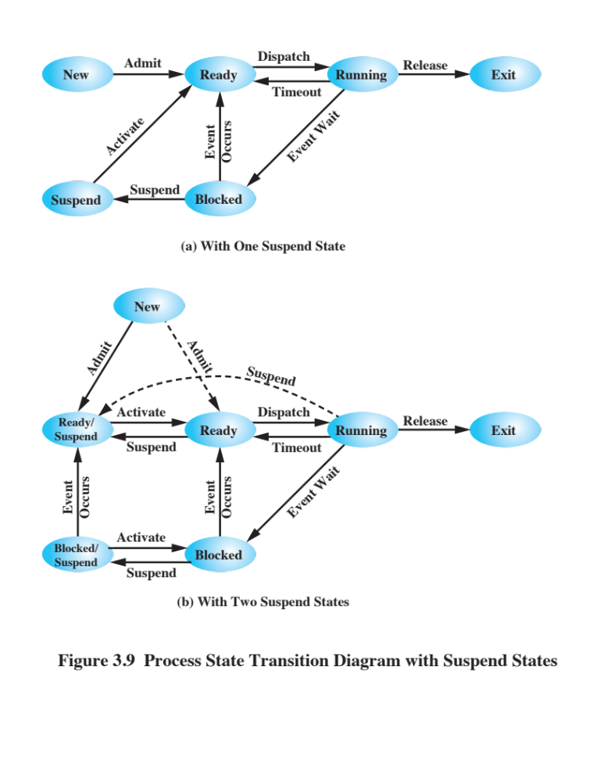
Notes:
With the use of swapping as just described, one other state must be added to
our process behavior model ( Figure 3.9a ): the Suspend state. When all of the processes
in main memory are in the Blocked state, the OS can suspend one process by
putting it in the Suspend state and transferring it to disk. The space that is freed in
main memory can then be used to bring in another process.
When the OS has performed a swapping-out operation, it has two choices for
selecting a process to bring into main memory: It can admit a newly created process
or it can bring in a previously suspended process. It would appear that the preference
should be to bring in a previously suspended process, to provide it with service
rather than increasing the total load on the system.
But this line of reasoning presents a difficulty. All of the processes that have
been suspended were in the Blocked state at the time of suspension. It clearly would
not do any good to bring a blocked process back into main memory, because it is
still not ready for execution. Recognize, however, that each process in the Suspend
state was originally blocked on a particular event. When that event occurs, the process
is not blocked and is potentially available for execution.
Therefore, we need to rethink this aspect of the design. There are two independent
concepts here: whether a process is waiting on an event (blocked or not) and
whether a process has been swapped out of main memory (suspended or not). To
accommodate this 2 X 2 combination, we need four states:
• Ready: The process is in main memory and available for execution
• Blocked: The process is in main memory and awaiting an event.
• Blocked/Suspend: The process is in secondary memory and awaiting an event.
• Ready/Suspend: The process is in secondary memory but is available for execution
as soon as it is loaded into main memory.
Before looking at a state transition diagram that encompasses the two new suspend
states, one other point should be mentioned. The discussion so far has assumed
that virtual memory is not in use and that a process is either all in main memory
or all out of main memory. With a virtual memory scheme, it is possible to execute
a process that is only partially in main memory. If reference is made to a process
address that is not in main memory, then the appropriate portion of the process can
be brought in. The use of virtual memory would appear to eliminate the need for
explicit swapping, because any desired address in any desired process can be moved
in or out of main memory by the memory management hardware of the processor.
However, as we shall see in Chapter 8, the performance of a virtual memory system
can collapse if there is a sufficiently large number of active processes, all of which
are partially in main memory. Therefore, even in a virtual memory system, the OS
will need to swap out processes explicitly and completely from time to time in the
interests of performance.

Slide 29
Notes:
Let us look now, in Figure 3.9b , at the state transition model that we have
developed. (The dashed lines in the figure indicate possible but not necessary transitions.)
Important new transitions are the following:
• Blocked : Blocked/Suspend: If there are no ready processes, then at least
one blocked process is swapped out to make room for another process that
is not blocked. This transition can be made even if there are ready processes
available, if the OS determines that the currently running process or a ready
process that it would like to dispatch requires more main memory to maintain
adequate performance.
• Blocked/Suspend : Ready/Suspend: A process in the Blocked/Suspend state
is moved to the Ready/Suspend state when the event for which it has been
waiting occurs. Note that this requires that the state information concerning
suspended processes must be accessible to the OS.
• Ready/Suspend : Ready: When there are no ready processes in main memory,
the OS will need to bring one in to continue execution. In addition, it
might be the case that a process in the Ready/Suspend state has higher priority
than any of the processes in the Ready state. In that case, the OS designer may
dictate that it is more important to get at the higher-priority process than to
minimize swapping.
• Ready : Ready/Suspend: Normally, the OS would prefer to suspend a
blocked process rather than a ready one, because the ready process can now
be executed, whereas the blocked process is taking up main memory space
and cannot be executed. However, it may be necessary to suspend a ready
process if that is the only way to free up a sufficiently large block of main
memory. Also, the OS may choose to suspend a lower–priority ready process
rather than a higher–priority blocked process if it believes that the blocked
process will be ready soon.
Several other transitions that are worth considering are the following:
• New - Ready/Suspend and New - Ready: When a new process is created, it
can either be added to the Ready queue or the Ready/Suspend queue. In either
case, the OS must create a process control block and allocate an address space
to the process. It might be preferable for the OS to perform these housekeeping
duties at an early time, so that it can maintain a large pool of processes that are
not blocked. With this strategy, there would often be insufficient room in main
memory for a new process; hence the use of the (New S- Ready/Suspend)
transition. On the other hand, we could argue that a just-in-time philosophy of
creating processes as late as possible reduces OS overhead and allows that OS
to perform the process creation duties at a time when the system is clogged with
blocked processes anyway.
• Blocked/Suspend - Blocked: Inclusion of this transition may seem to be poor
design. After all, if a process is not ready to execute and is not already in main
memory, what is the point of bringing it in? But consider the following scenario:
A process terminates, freeing up some main memory. There is a process in the
(Blocked/Suspend) queue with a higher priority than any of the processes in
the (Ready/Suspend) queue and the OS has reason to believe that the blocking
event for that process will occur soon. Under these circumstances, it would
seem reasonable to bring a blocked process into main memory in preference
to a ready process.
• Running - Ready/Suspend: Normally, a running process is moved to the
Ready state when its time allocation expires. If, however, the OS is preempting
the process because a higher-priority process on the Blocked/Suspend queue
has just become unblocked, the OS could move the running process directly to
the (Ready/Suspend) queue and free some main memory.
• Any State - Exit: Typically, a process terminates while it is running, either
because it has completed or because of some fatal fault condition. However, in
some operating systems, a process may be terminated by the process that created
it or when the parent process is itself terminated. If this is allowed, then a
process in any state can be moved to the Exit state.

Slide 30
Characteristics of a Suspended Process
The process is not immediately available for execution
The process may or may not be waiting on an event
The process was placed in a suspended state by an agent: either itself, a parent process, or the OS, for the purpose of preventing its execution
The process may not be removed from this state until the agent explicitly orders the removal
Notes:
We can generalize the concept of a suspended process. Let us define a
suspended process as having the following characteristics:
1. The process is not immediately available for execution.
2. The process may or may not be waiting on an event. If it is, this blocked condition
is independent of the suspend condition, and occurrence of the blocking
event does not enable the process to be executed immediately.
The process was placed in a suspended state by an agent: either itself, a parent
process, or the OS, for the purpose of preventing its execution.
4. The process may not be removed from this state until the agent explicitly
orders the removal.

Slide 31
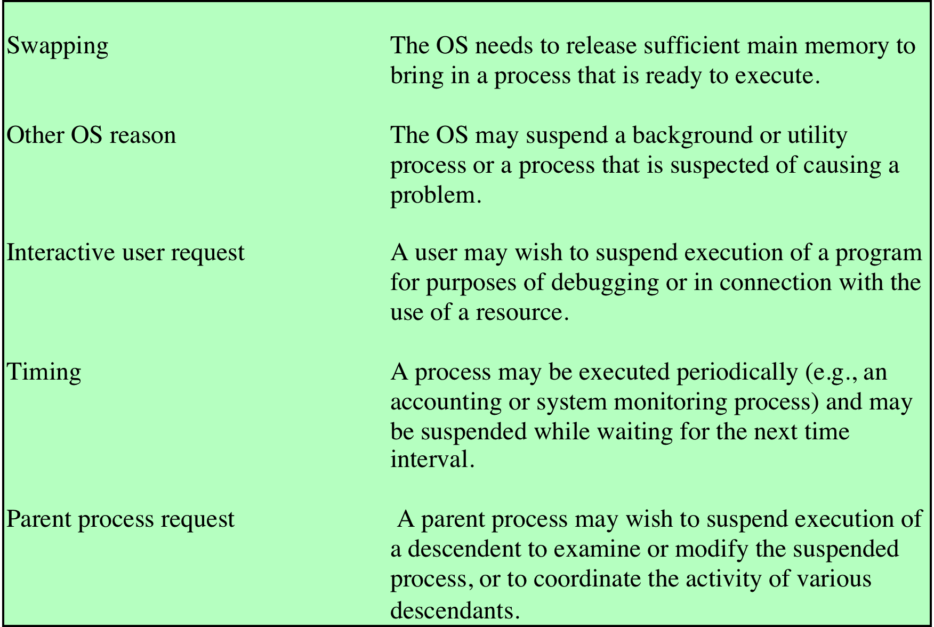
Reasons for Process Suspension
Notes:
Table 3.3 lists some reasons for the suspension of a process. One reason that
we have discussed is to provide memory space either to bring in a Ready/Suspended
process or to increase the memory allocated to other Ready processes. The OS may
have other motivations for suspending a process. For example, an auditing or tracing
process may be employed to monitor activity on the system; the process may
be used to record the level of utilization of various resources (processor, memory,
channels) and the rate of progress of the user processes in the system. The OS,
under operator control, may turn this process on and off from time to time. If the
OS detects or suspects a problem, it may suspend a process. One example of this
is deadlock, which is discussed in Chapter 6 . As another example, a problem is
detected on a communications line, and the operator has the OS suspend the process
that is using the line while some tests are run.
Another set of reasons concerns the actions of an interactive user. For example, if
a user suspects a bug in the program, he or she may debug the program by suspending
its execution, examining and modifying the program or data, and resuming execution.
Or there may be a background process that is collecting trace or accounting statistics,
which the user may wish to be able to turn on and off.
Timing considerations may also lead to a swapping decision. For example, if a
process is to be activated periodically but is idle most of the time, then it should be
swapped out between uses. A program that monitors utilization or user activity is
an example.
Finally, a parent process may wish to suspend a descendent process. For example,
process A may spawn process B to perform a file read. Subsequently, process B
encounters an error in the file read procedure and reports this to process A. Process
A suspends process B to investigate the cause.
In all of these cases, the activation of a suspended process is requested by the
agent that initially requested the suspension.

Slide 32
Memory Tables
Used to keep track of both main (real) and secondary (virtual) memory
Processes are maintained on secondary memory using some sort of virtual memory or simple swapping mechanism
Must include:
Allocation of main memory to processes
Allocation of secondary memory to processes
Protection attributes of blocks of main or virtual memory
Information needed to manage virtual memory
Notes:
Memory tables are used to keep track of both main (real) and secondary
(virtual) memory. Some of main memory is reserved for use by the OS; the
remainder is available for use by processes. Processes are maintained on secondary
memory using some sort of virtual memory or simple swapping mechanism. The
memory tables must include the following information:
• The allocation of main memory to processes
• The allocation of secondary memory to processes
Any protection attributes of blocks of main or virtual memory, such as which
processes may access certain shared memory regions
• Any information needed to manage virtual memory
We examine the information structures for memory management in detail in Part
Three.

Slide 33
I/O Tables
Used by the OS to manage the I/O devices and channels of the computer system
At any given time, an I/O device may be available or assigned to a particular process
If an I/O operation is in progress, the OS needs to know:
The status of the I/O operation
The location in main memory being used as the source or destination of the I/O transfer
Notes:
I/O tables are used by the OS to manage the I/O devices and channels of the
computer system. At any given time, an I/O device may be available or assigned to a
particular process. If an I/O operation is in progress, the OS needs to know the status
of the I/O operation and the location in main memory being used as the source or
destination of the I/O transfer. I/O management is examined in Chapter 11 .

Slide 34
File Tables
These tables provide information about:
Existence of files
Location on secondary memory
Current status
Other attributes
Information may be maintained and used by a file management system
    In which case the OS has little or no knowledge of files
    In other operating systems, much of the detail of file management is managed by the OS itself
Notes:
The OS may also maintain file tables . These tables provide information about
the existence of files, their location on secondary memory, their current status, and
other attributes. Much, if not all, of this information may be maintained and used by
a file management system, in which case the OS has little or no knowledge of files.
In other operating systems, much of the detail of file management is managed by the
OS itself. This topic is explored in Chapter 12.

Slide 35
Process Tables
Must be maintained to manage processes
There must be some reference to memory, I/O, and files, directly or indirectly
The tables themselves must be accessible by the OS and therefore are subject to memory management
Notes:
Finally, the OS must maintain process tables to manage processes. The
remainder of this section is devoted to an examination of the required process
tables. Before proceeding to this discussion, two additional points should be made.
First, although Figure 3.11 shows four distinct sets of tables, it should be clear that
these tables must be linked or cross-referenced in some fashion. Memory, I/O, and
files are managed on behalf of processes, so there must be some reference to these
resources, directly or indirectly, in the process tables. The files referred to in the file
tables are accessible via an I/O device and will, at some times, be in main or virtual
memory. The tables themselves must be accessible by the OS and therefore are subject
to memory management.
Second, how does the OS know to create the tables in the first place? Clearly,
the OS must have some knowledge of the basic environment, such as how much main
memory exists, what are the I/O devices and what are their identifiers, and so on. This
is an issue of configuration. That is, when the OS is initialized, it must have access to
some configuration data that define the basic environment, and these data must be
created outside the OS, with human assistance or by some auto configuration software.

Slide 36
Process Control Structures
To manage and control a process the OS must know:
Where the process is located
The attributes of the process that are necessary for its management
Notes:
Consider what the OS must know if it is to manage and control a process. First, it
must know where the process is located; second, it must know the attributes of the
process that are necessary for its management (e.g., process ID and process state).

Slide 37
Process Control Structures (cont.)
Process Location
Process Attributes
  A process must include a program or set of programs to be executed
  A process will consist of at least sufficient memory to hold the programs and data of that process
  The execution of a program typically involves a stack that is used to keep track of procedure calls and parameter passing between procedures
  Each process has associated with it a number of attributes that are used by the OS for process control
  The collection of program, data, stack, and attributes is referred to as the process image
  Process image location will depend on the memory management scheme being used
Notes:
Before we can deal with the questions of where a process is
located or what its attributes are, we need to address an even more fundamental
question: What is the physical manifestation of a process? At a minimum, a process
must include a program or set of programs to be executed. Associated with these
programs is a set of data locations for local and global variables and any defined
constants. Thus, a process will consist of at least sufficient memory to hold the
programs and data of that process. In addition, the execution of a program typically
involves a stack (see Appendix P) that is used to keep track of procedure calls and
parameter passing between procedures. Finally, each process has associated with it
a number of attributes that are used by the OS for process control.
The location of a process image will depend on the memory management
scheme being used. In the simplest case, the process image is maintained as a
contiguous, or continuous, block of memory. This block is maintained in secondary
memory, usually disk. So that the OS can manage the process, at least a small portion
of its image must be maintained in main memory. To execute the process, the entire
process image must be loaded into main memory or at least virtual memory. Thus,
the OS needs to know the location of each process on disk and, for each such process
that is in main memory, the location of that process in main memory. We saw
a slightly more complex variation on this scheme with the CTSS OS, in Chapter 2 .
With CTSS, when a process is swapped out, part of the process image may remain in
main memory. Thus, the OS must keep track of which portions of the image of each
process are still in main memory.
Modern operating systems presume paging hardware that allows noncontiguous
physical memory to support partially resident processes. At any given time, a
portion of a process image may be in main memory, with the remainder in secondary
memory. Therefore, process tables maintained by the OS must show the location
of each page of each process image.

Slide 38
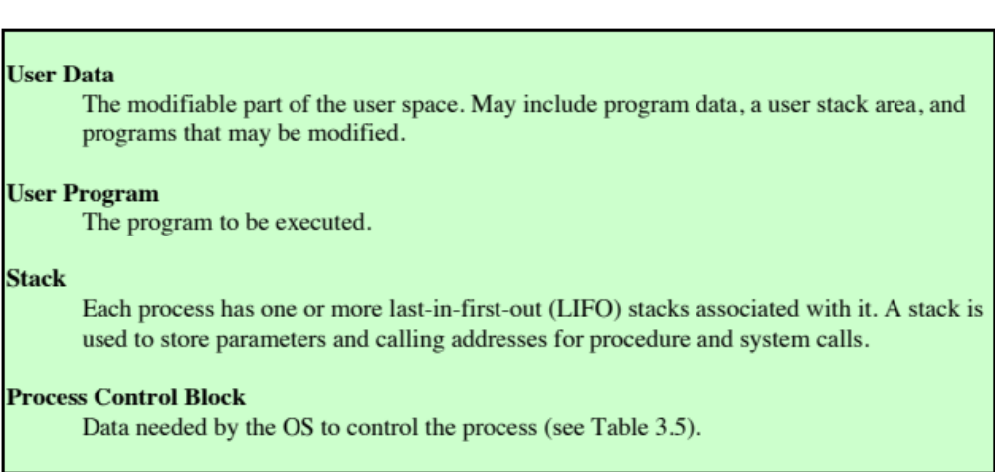
Typical Elements of a Process Image
Notes:
Typically, the collection of attributes is referred to as a process control block. We can refer to this
collection of program, data, stack, and attributes as the process image ( Table 3.4 ).

Slide 39
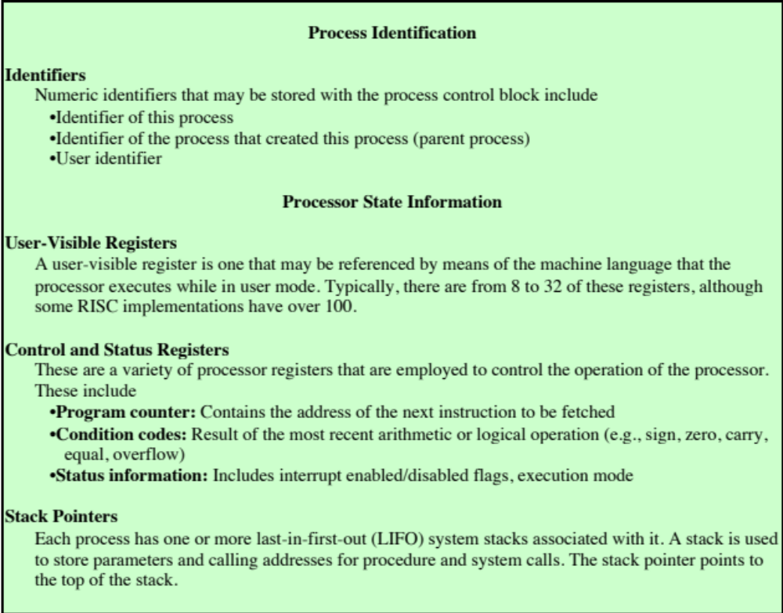
Typical Elements of a Process Control Block
(page 1 of 2)
(Table is located
on page 125 in the textbook (Stallings))
Notes:
A sophisticated multiprogramming system requires a great
deal of information about each process. As was explained, this information can be
considered to reside in a process control block. Different systems will organize this
information in different ways, and several examples of this appear at the end of this
chapter and the next. For now, let us simply explore the type of information that
might be of use to an OS without considering in any detail how that information is
organized.
Table 3.5 lists the typical categories of information required by the OS for each
process. You may be somewhat surprised at the quantity of information required.
As you gain a greater appreciation of the responsibilities of the OS, this list should
appear more reasonable.
We can group the process control block information into three general
categories:
• Process identification
• Processor state information
• Process control information

Slide 40
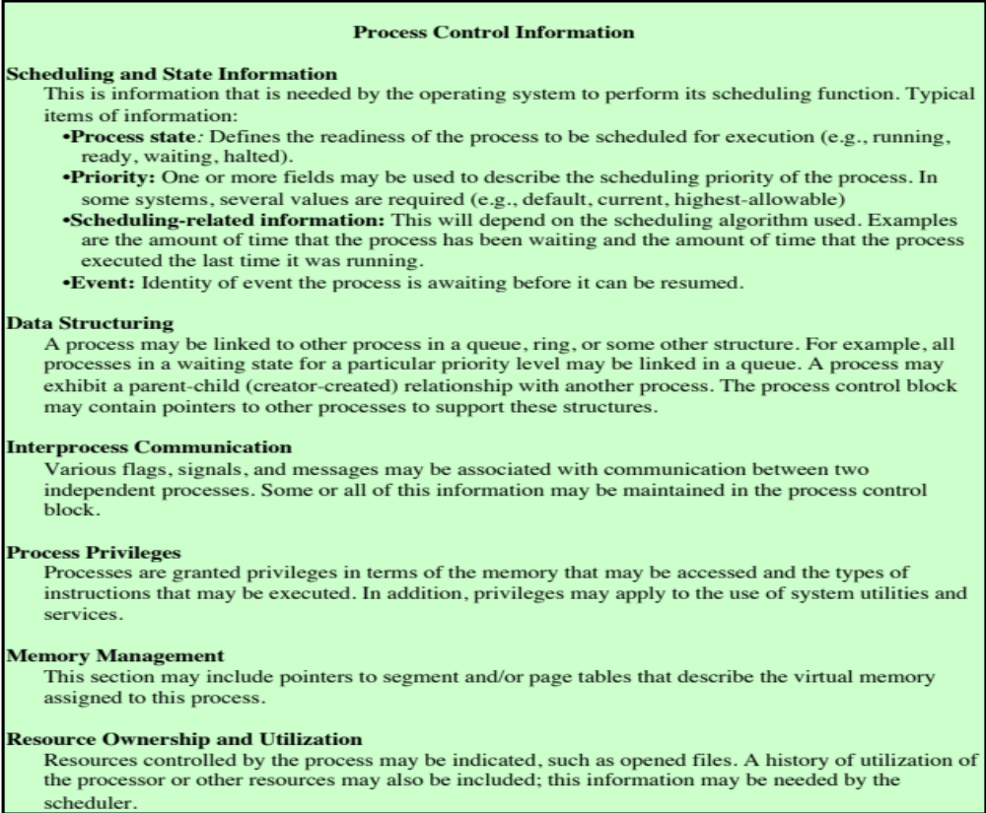
Typical Elements of a Process Control Block
(page 2 of 2)
Notes:
A sophisticated multiprogramming system requires a great
deal of information about each process. As was explained, this information can be
considered to reside in a process control block. Different systems will organize this
information in different ways, and several examples of this appear at the end of this
chapter and the next. For now, let us simply explore the type of information that
might be of use to an OS without considering in any detail how that information is
organized.
Table 3.5 lists the typical categories of information required by the OS for each
process. You may be somewhat surprised at the quantity of information required.
As you gain a greater appreciation of the responsibilities of the OS, this list should
appear more reasonable.
We can group the process control block information into three general
categories:
• Process identification
• Processor state information
• Process control information

Slide 41
Process Identification
Memory tables may be organized to provide a map of main memory with an indication of which process is assigned to each region
  Similar references will appear in I/O and file tables
When processes communicate with one another, the process identifier informs the OS of the destination of a particular communication
When processes are allowed to create other processes, identifiers indicate the parent and descendents of each process
Each process is assigned a unique numeric identifier
  Otherwise there must be a mapping that allows the OS to locate the appropriate tables based on the process identifier
Many of the tables controlled by the OS may use process identifiers to cross-reference process tables
Notes:
With respect to process identification , in virtually all operating systems, each
process is assigned a unique numeric identifier, which may simply be an index into
the primary process table ( Figure 3.11 ); otherwise there must be a mapping that
allows the OS to locate the appropriate tables based on the process identifier. This
identifier is useful in several ways. Many of the other tables controlled by the OS
may use process identifiers to cross-reference process tables. For example, the
memory tables may be organized so as to provide a map of main memory with an
indication of which process is assigned to each region. Similar references will appear
in I/O and file tables. When processes communicate with one another, the process
identifier informs the OS of the destination of a particular communication. When
processes are allowed to create other processes, identifiers indicate the parent and
descendents of each process.
In addition to these process identifiers, a process may be assigned a user identifier
that indicates the user responsible for the job.

Slide 42
Processor State Information
Consists of the contents of processor registers
User-visible registers
Control and status registers
Stack pointers
Program status word (PSW)
Contains condition codes plus other status information
EFLAGS register is an example of a PSW used by any OS running on an x86 processor
Notes:
Processor state information consists of the contents of processor registers.
While a process is running, of course, the information is in the registers. When a
process is interrupted, all of this register information must be saved so that it can
be restored when the process resumes execution. The nature and number of registers
involved depend on the design of the processor. Typically, the register set will
include user-visible registers, control and status registers, and stack pointers. These
are described in Chapter 1 .
Of particular note, all processor designs include a register or set of registers,
often known as the program status word (PSW), that contains status information.
The PSW typically contain condition codes plus other status information. A good
example of a processor status word is that on Intel x86 processors, referred to as the
EFLAGS register (shown in Figure 3.12 and Table 3.6 ). This structure is used by
any OS (including UNIX and Windows) running on an x86 processor.

Slide 43
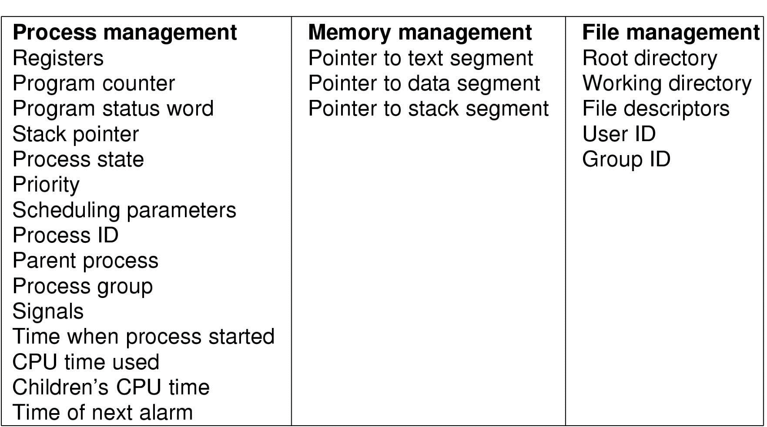
Implementation of Processes (1)
Fields of a process table entry

Slide 44
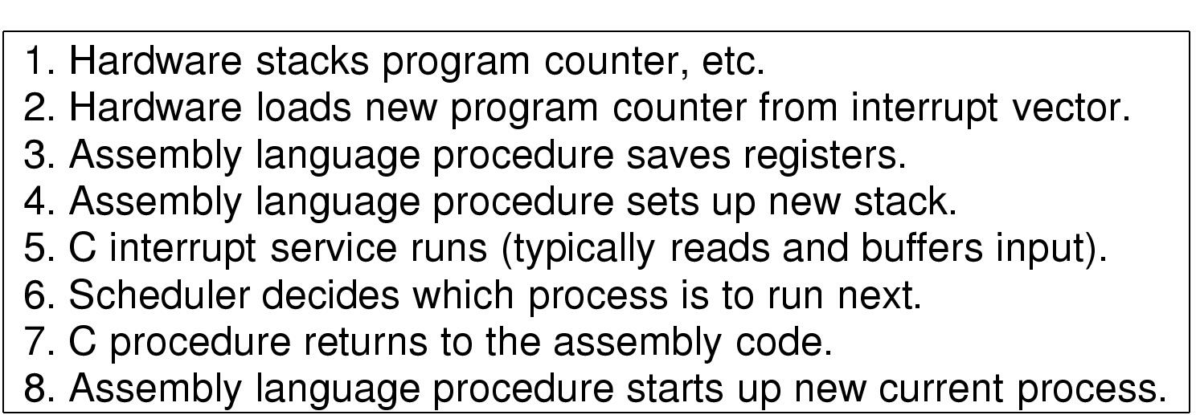
Implementation of Processes (2)
Skeleton of what lowest level of OS does when an interrupt occurs

Slide 45
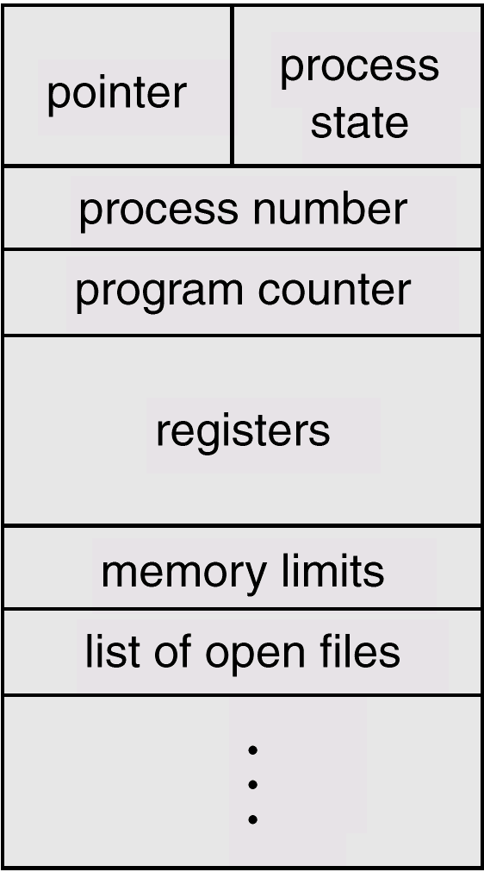
Process Control Block

Slide 46
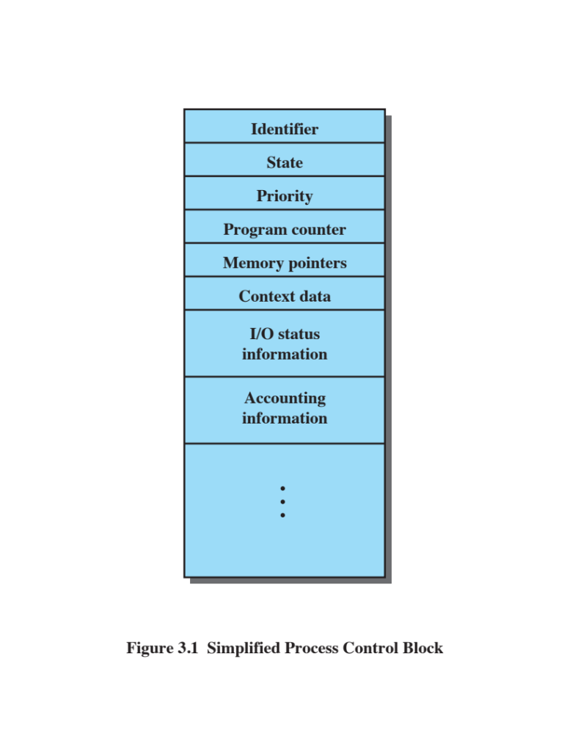
Process Control Block
Contains the process elements
It is possible to interrupt a running process and later resume execution as if the interruption had not occurred
Created and managed by the operating system
Key tool that allows support for multiple processes
Notes:
The information in the preceding list is stored in a data structure, typically
called a process control block ( Figure 3.1 ), that is created and managed by the OS.
The significant point about the process control block is that it contains sufficient
information so that it is possible to interrupt a running process and later resume
execution as if the interruption had not occurred. The process control block is
the key tool that enables the OS to support multiple processes and to provide for
multiprocessing. When a process is interrupted, the current values of the program
counter and the processor registers (context data) are saved in the appropriate fields
of the corresponding process control block, and the state of the process is changed
to some other value, such as blocked or ready (described subsequently). The OS is
now free to put some other process in the running state. The program counter and
context data for this process are loaded into the processor registers and this process
now begins to execute.
Thus, we can say that a process consists of program code and associated data
plus a process control block. For a single-processor computer, at any given time, at
most one process is executing and that process is in the running state.

Slide 47
Role of the Process Control Block
The most important data structure in an OS
  Contains all of the information about a process that is needed by the OS
  Blocks are read and/or modified by virtually every module in the OS
  Defines the state of the OS
Difficulty is not access, but protection
  A bug in a single routine could damage process control blocks, which could destroy the system’s ability to manage the affected processes
  A design change in the structure or semantics of the process control block could affect a number of modules in the OS
Notes:
The process control block is the
most important data structure in an OS. Each process control block contains all
of the information about a process that is needed by the OS. The blocks are read
and/or modified by virtually every module in the OS, including those involved with
scheduling, resource allocation, interrupt processing, and performance monitoring
and analysis. One can say that the set of process control blocks defines the state of
the OS.
This brings up an important design issue. A number of routines within the OS
will need access to information in process control blocks. The provision of direct
access to these tables is not difficult. Each process is equipped with a unique ID, and
this can be used as an index into a table of pointers to the process control blocks.
The difficulty is not access but rather protection. Two problems present themselves:
• A bug in a single routine, such as an interrupt handler, could damage process
control blocks, which could destroy the system’s ability to manage the affected
processes.
• A design change in the structure or semantics of the process control block
could affect a number of modules in the OS.
These problems can be addressed by requiring all routines in the OS to go
through a handler routine, the only job of which is to protect process control blocks,
and which is the sole arbiter for reading and writing these blocks. The trade-off in
the use of such a routine involves performance issues and the degree to which the
remainder of the system software can be trusted to be correct.

Slide 48
Modes of Execution
User Mode
System Mode
  Less-privileged mode
  User programs typically execute in this mode
  More-privileged mode
  Also referred to as control mode or kernel mode
  Kernel of the operating system
Notes:
Before continuing with our discussion of the way in which the OS manages processes,
we need to distinguish between the mode of processor execution normally
associated with the OS and that normally associated with user programs. Most
processors support at least two modes of execution. Certain instructions can only
be executed in the more-privileged mode. These would include reading or altering
a control register, such as the program status word; primitive I/O instructions;
and instructions that relate to memory management. In addition, certain regions of
memory can only be accessed in the more-privileged mode.
The less-privileged mode is often referred to as the user mode , because user
programs typically would execute in this mode. The more-privileged mode is referred
to as the system mode , control mode , or kernel mode . This last term refers to the
kernel of the OS, which is that portion of the OS that encompasses the important
system functions.

Slide 49
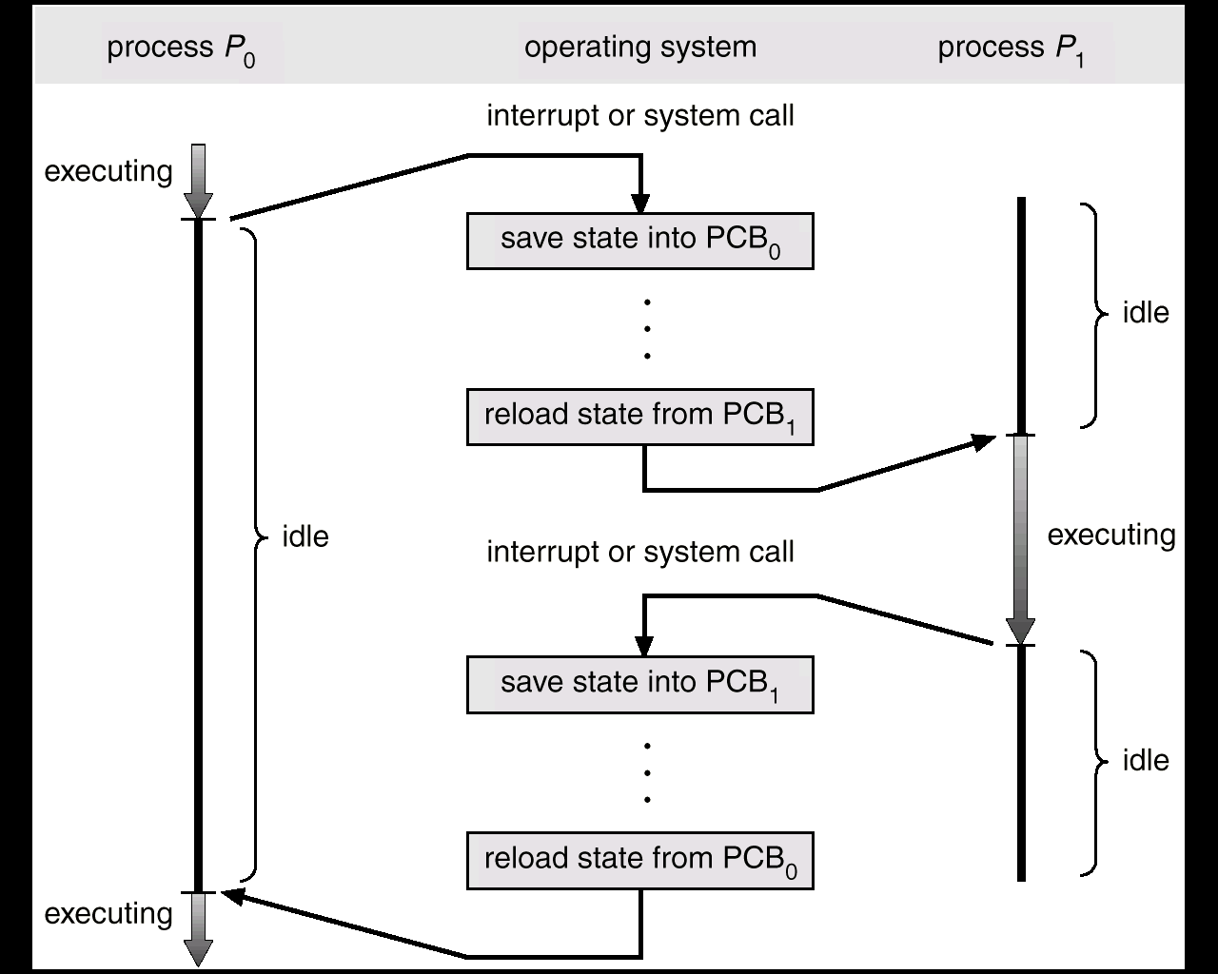
Process Context Switch

Slide 50
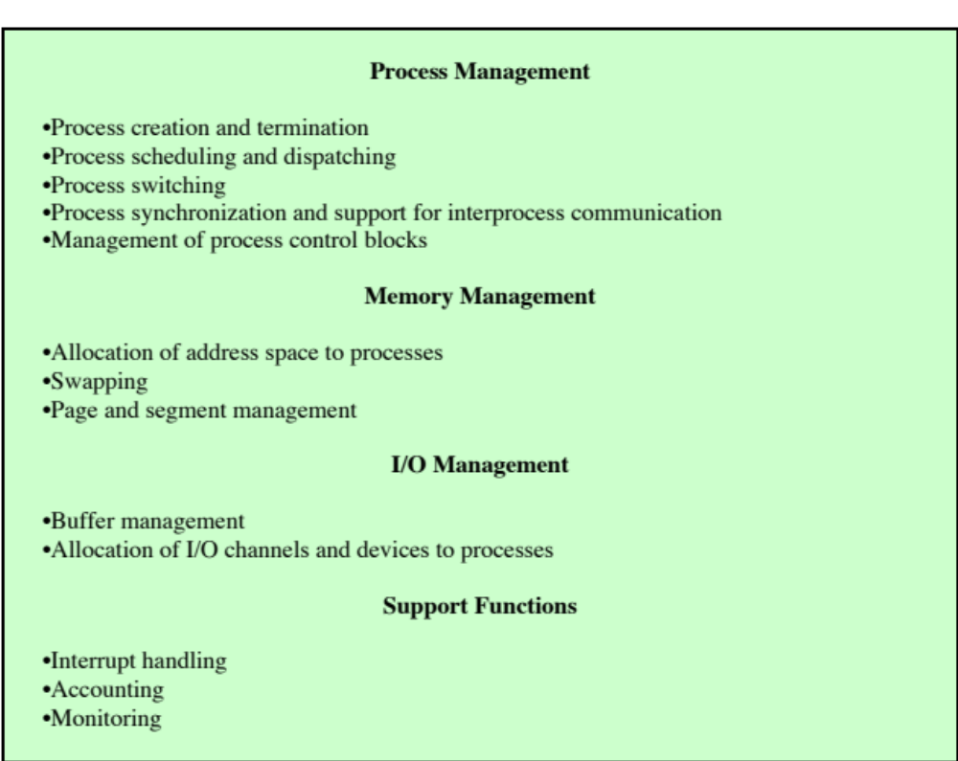

Typical Functions of an OS Kernel
Notes:
Table 3.7 lists the functions typically found in the kernel of an OS.

Slide 51
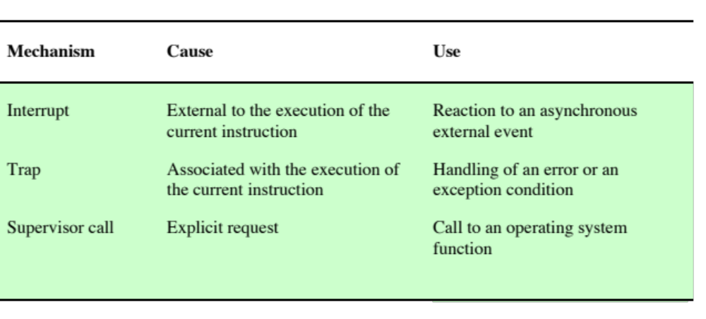
Mechanisms for Interrupting the Execution of a Process
Notes:
A process switch may occur any time that the OS has
gained control from the currently running process. Table 3.8 suggests the possible
events that may give control to the OS.

Slide 52
System Interrupts
Interrupt
Trap
    Due to some sort of event that is external to and independent of the currently running process
      Clock interrupt
      I/O interrupt
      Memory fault
    Time slice
      The maximum amount of time that a process can execute before being interrupted
    An error or exception condition generated within the currently running process
    OS determines if the condition is fatal
      Moved to the Exit state and a process switch occurs
      Action will depend on the nature of the error the design of the OS
Notes:
First, let us consider system interrupts. Actually, we can distinguish, as many
systems do, two kinds of system interrupts, one of which is simply referred to as an
interrupt, and the other as a trap. The former is due to some sort of event that is
external to and independent of the currently running process, such as the completion
of an I/O operation. The latter relates to an error or exception condition generated
within the currently running process, such as an illegal file access attempt. With an
ordinary interrupt , control is first transferred to an interrupt handler, which does
some basic housekeeping and then branches to an OS routine that is concerned with
the particular type of interrupt that has occurred. Examples include the following:
• Clock interrupt: The OS determines whether the currently running process
has been executing for the maximum allowable unit of time, referred to as a
time slice . That is, a time slice is the maximum amount of time that a process
can execute before being interrupted. If so, this process must be switched to a
Ready state and another process dispatched.
• I/O interrupt: The OS determines what I/O action has occurred. If the I/O
action constitutes an event for which one or more processes are waiting,
then the OS moves all of the corresponding blocked processes to the Ready
state (and Blocked/Suspend processes to the Ready/Suspend state). The OS
must then decide whether to resume execution of the process currently in
the Running state or to preempt that process for a higher-priority Ready
process.
• Memory fault: The processor encounters a virtual memory address reference
for a word that is not in main memory. The OS must bring in the block
(page or segment) of memory containing the reference from secondary memory
to main memory. After the I/O request is issued to bring in the block of
memory, the process with the memory fault is placed in a blocked state; the
OS then performs a process switch to resume execution of another process.
After the desired block is brought into memory, that process is placed in the
Ready state.
With a trap , the OS determines if the error or exception condition is fatal.
If so, then the currently running process is moved to the Exit state and a process
switch occurs. If not, then the action of the OS will depend on the nature of
the error and the design of the OS. It may attempt some recovery procedure or
simply notify the user. It may do a process switch or resume the currently running
process.

Slide 53
Mode Switching
If no interrupts are pending the processor:
Proceeds to the fetch stage and fetches the next instruction of the current program in the current process
If an interrupt is pending the processor:
Sets the program counter to the starting address of an interrupt handler program
Switches from user mode to kernel mode so that the interrupt processing code may include privileged instructions
Notes:
In Chapter 1 , we discussed the inclusion of an interrupt stage as
part of the instruction cycle. Recall that, in the interrupt stage, the processor checks
to see if any interrupts are pending, indicated by the presence of an interrupt signal.
If no interrupts are pending, the processor proceeds to the fetch stage and fetches
the next instruction of the current program in the current process. If an interrupt is
pending, the processor does the following:
1. It sets the program counter to the starting address of an interrupt handler
program.
2. It switches from user mode to kernel mode so that the interrupt processing
code may include privileged instructions.
The processor now proceeds to the fetch stage and fetches the first instruction of
the interrupt handler program, which will service the interrupt. At this point, typically,
the context of the process that has been interrupted is saved into that process
control block of the interrupted program.
One question that may now occur to you is, What constitutes the context that
is saved? The answer is that it must include any information that may be altered by
the execution of the interrupt handler and that will be needed to resume the program
that was interrupted. Thus, the portion of the process control block that was
referred to as processor state information must be saved. This includes the program
counter, other processor registers, and stack information.
Does anything else need to be done? That depends on what happens next. The
interrupt handler is typically a short program that performs a few basic tasks related
to an interrupt. For example, it resets the flag or indicator that signals the presence
of an interrupt. It may send an acknowledgment to the entity that issued the interrupt,
such as an I/O module. And it may do some basic housekeeping relating to the
effects of the event that caused the interrupt. For example, if the interrupt relates
to an I/O event, the interrupt handler will check for an error condition. If an error
has occurred, the interrupt handler may send a signal to the process that originally
requested the I/O operation. If the interrupt is by the clock, then the handler will
hand control over to the dispatcher, which will want to pass control to another process
because the time slice allotted to the currently running process has expired.
What about the other information in the process control block? If this interrupt
is to be followed by a switch to another process, then some work will need to be
done. However, in most operating systems, the occurrence of an interrupt does not
necessarily mean a process switch. It is possible that, after the interrupt handler has
executed, the currently running process will resume execution. In that case, all that
is necessary is to save the processor state information when the interrupt occurs and
restore that information when control is returned to the program that was running.
Typically, the saving and restoring functions are performed in hardware.

Slide 54
Change of Process State
The steps in a full process switch are:
Save the context of the processor
Update the process control block of the process currently in the Running state
Move the process control block of this process to the appropriate queue
Select another process for execution
Update the process control block of the process selected
Update memory management data structures
Restore the context of the processor to that which existed at the time the selected process was last switched out
If the currently running process is to be moved to another state (Ready, Blocked, etc.), then the OS must make substantial changes in its environment
Notes:
It is clear, then, that the mode switch is a concept
distinct from that of the process switch. A mode switch may occur without
changing the state of the process that is currently in the Running state. In that case,
the context saving and subsequent restoral involve little overhead. However, if the
currently running process is to be moved to another state (Ready, Blocked, etc.),
then the OS must make substantial changes in its environment. The steps involved
in a full process switch are as follows:
1. Save the context of the processor, including program counter and other
registers.
2. Update the process control block of the process that is currently in the
Running state. This includes changing the state of the process to one of the
other states (Ready; Blocked; Ready/Suspend; or Exit). Other relevant fields
must also be updated, including the reason for leaving the Running state and
accounting information.
3. Move the process control block of this process to the appropriate queue
(Ready; Blocked on Event i ; Ready/Suspend).
4. Select another process for execution; this topic is explored in Part Four.
5. Update the process control block of the process selected. This includes changing
the state of this process to Running.
6. Update memory management data structures. This may be required, depending
on how address translation is managed; this topic is explored in Part Three.
7. Restore the context of the processor to that which existed at the time the
selected process was last switched out of the Running state, by loading in the
previous values of the program counter and other registers.
Thus, the process switch, which involves a state change, requires more effort than a
mode switch.

Slide 55
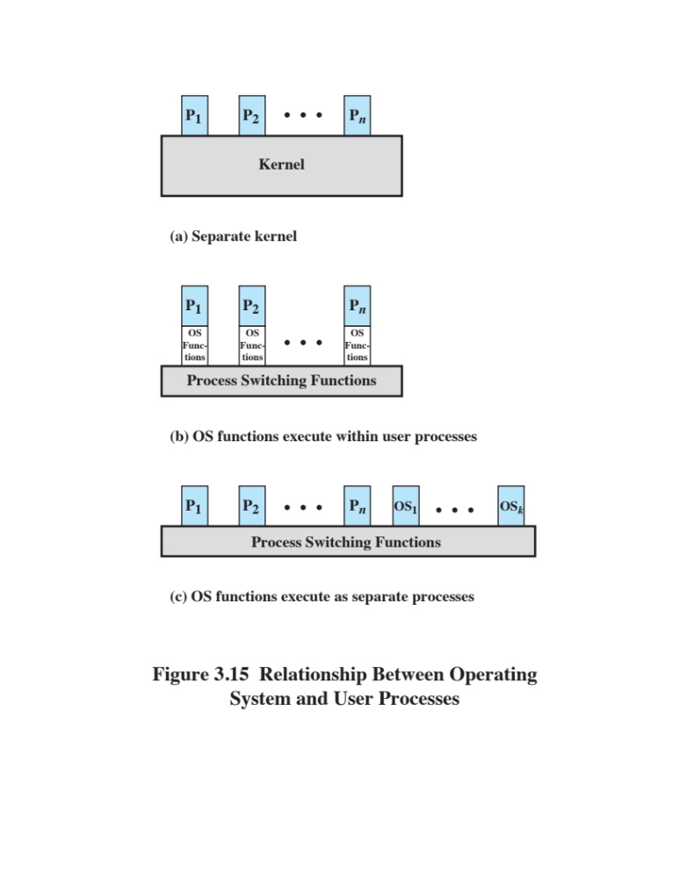
Execution of the
Operating System
Notes:
One traditional approach, common on many older operating systems, is to execute
the kernel of the OS outside of any process ( Figure 3.15a ). With this approach,
when the currently running process is interrupted or issues a supervisor call, the
mode context of this process is saved and control is passed to the kernel. The OS has
its own region of memory to use and its own system stack for controlling procedure
calls and returns. The OS can perform any desired functions and restore the context
of the interrupted process, which causes execution to resume in the interrupted
user process. Alternatively, the OS can complete the function of saving the environment
of the process and proceed to schedule and dispatch another process. Whether
this happens depends on the reason for the interruption and the circumstances at
the time.
In any case, the key point here is that the concept of process is considered to
apply only to user programs. The operating system code is executed as a separate
entity that operates in privileged mode.
Execution within User Processes
An alternative that is common with operating systems on smaller computers (PCs,
workstations) is to execute virtually all OS software in the context of a user process.
The view is that the OS is primarily a collection of routines that the user calls to
perform various functions, executed within the environment of the user’s process.
This is illustrated in Figure 3.15b . At any given point, the OS is managing n process
images. Each image includes not only the regions illustrated in Figure 3.13 , but also
program, data, and stack areas for kernel programs.
Process-Based Operating System
Another alternative, illustrated in Figure 3.15c , is to implement the OS as a collection
of system processes. As in the other options, the software that is part of the
kernel executes in a kernel mode. In this case, however, major kernel functions are
organized as separate processes. Again, there may be a small amount of process switching
code that is executed outside of any process.
This approach has several advantages. It imposes a program design discipline
that encourages the use of a modular OS with minimal, clean interfaces between the
modules. In addition, some noncritical operating system functions are conveniently
implemented as separate processes. For example, we mentioned earlier a monitor
program that records the level of utilization of various resources (processor, memory,
channels) and the rate of progress of the user processes in the system. Because
this program does not provide a particular service to any active process, it can only
be invoked by the OS. As a process, the function can run at an assigned priority
level and be interleaved with other processes under dispatcher control. Finally,
implementing the OS as a set of processes is useful in a multiprocessor or multicomputer
environment, in which some of the operating system services can be shipped
out to dedicated processors, improving performance.

Slide 56
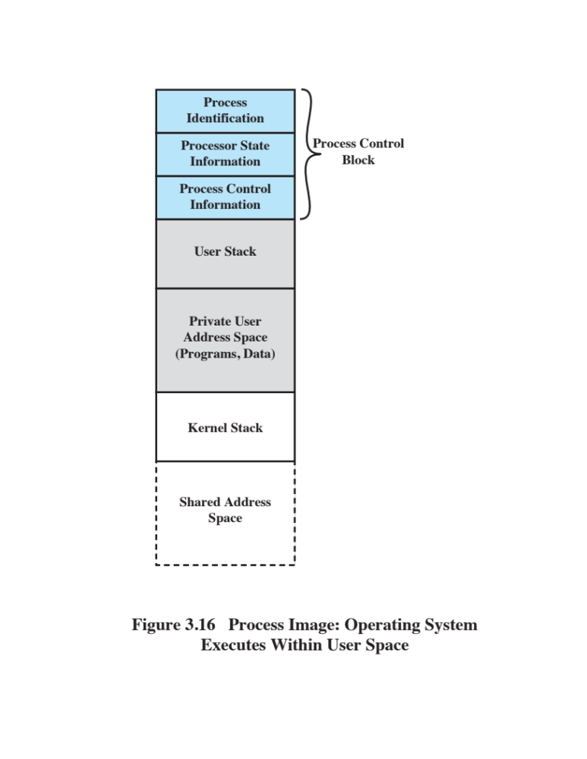
Execution
Within
User
Processes
Notes:
Figure 3.16 suggests a typical process image structure for this strategy. A separate
kernel stack is used to manage calls/returns while the process is in kernel mode.
Operating system code and data are in the shared address space and are shared by
all user processes.
When an interrupt, trap, or supervisor call occurs, the processor is placed in
kernel mode and control is passed to the OS. To pass control from a user program
to the OS, the mode context is saved and a mode switch takes place to an operating
system routine. However, execution continues within the current user process. Thus,
a process switch is not performed, just a mode switch within the same process.
If the OS, upon completion of its work, determines that the current process
should continue to run, then a mode switch resumes the interrupted program within
the current process. This is one of the key advantages of this approach: A user
program has been interrupted to employ some operating system routine, and then
resumed, and all of this has occurred without incurring the penalty of two process
switches. If, however, it is determined that a process switch is to occur rather than
returning to the previously executing program, then control is passed to a process-
switching routine. This routine may or may not execute in the current process,
depending on system design. At some point, however, the current process has to be
placed in a nonrunning state and another process designated as the running process.
During this phase, it is logically most convenient to view execution as taking place
outside of all processes.
In a way, this view of the OS is remarkable. Simply put, at certain points in
time, a process will save its state information, choose another process to run from
among those that are ready, and relinquish control to that process. The reason this
is not an arbitrary and indeed chaotic situation is that during the critical time, the
code that is executed in the user process is shared operating system code and not
user code. Because of the concept of user mode and kernel mode, the user cannot
tamper with or interfere with the operating system routines, even though they are
executing in the user’s process environment. This further reminds us that there is
a distinction between the concepts of process and program and that the relationship
between the two is not one to one. Within a process, both a user program and
operating system programs may execute, and the operating system programs that
execute in the various user processes are identical.

Slide 57
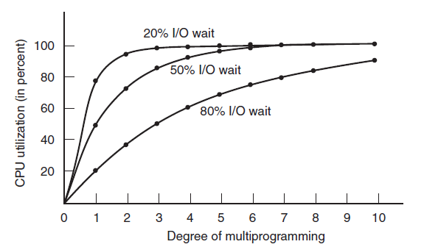

Modeling Multiprogramming
Figure 2-6. CPU utilization as a function of the number of processes in memory (T)

Slide 58
Unix SVR4
Uses the model where most of the OS executes within the environment of a user process
System processes run in kernel mode
  Executes operating system code to perform administrative and housekeeping functions
User Processes
  Operate in user mode to execute user programs and utilities
  Operate in kernel mode to execute instructions that belong to the kernel
  Enter kernel mode by issuing a system call, when an exception is generated, or when an interrupt occurs
Notes:
UNIX System V makes use of a simple but powerful process facility that is highly
visible to the user. UNIX follows the model of Figure 3.15b , in which most of the OS
executes within the environment of a user process. UNIX uses two categories of processes:
system processes and user processes. System processes run in kernel mode and
execute operating system code to perform administrative and housekeeping functions,
such as allocation of memory and process swapping. User processes operate
in user mode to execute user programs and utilities and in kernel mode to execute
instructions that belong to the kernel. A user process enters kernel mode by issuing a
system call, when an exception (fault) is generated, or when an interrupt occurs.

Slide 59
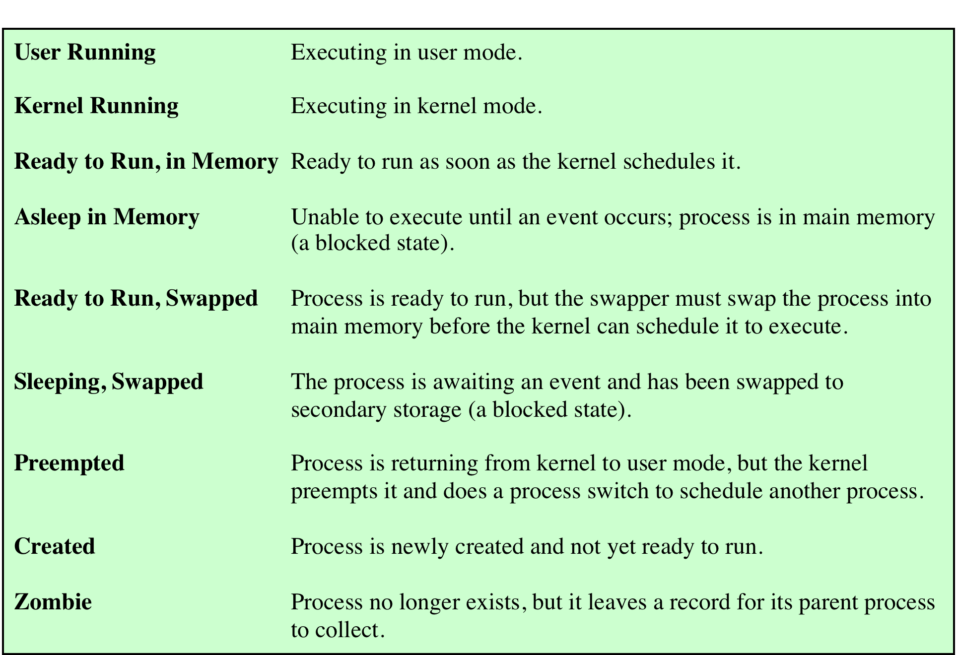
UNIX Process States
Notes:
A total of nine process states are recognized by the UNIX SVR4 operating system;
these are listed in Table 3.9

Slide 60
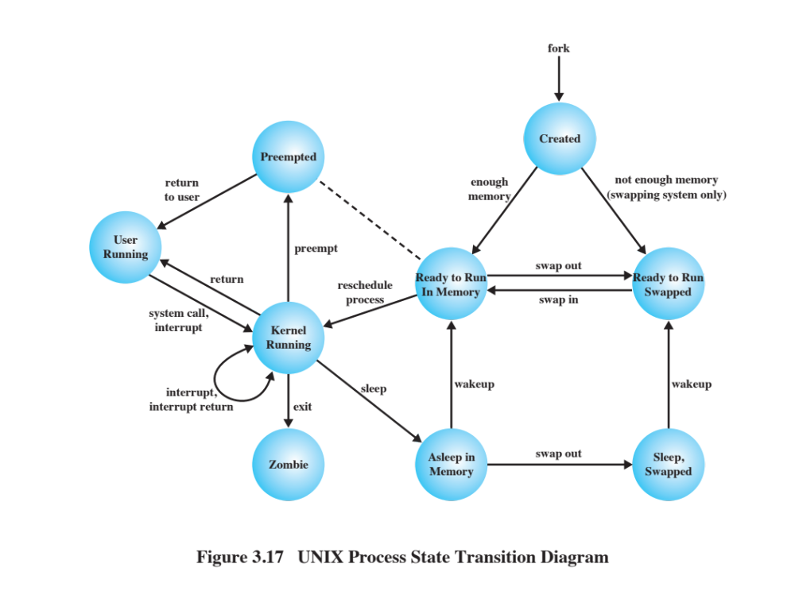
Notes:
UNIX Process State Transition Diagram
This figure is similar to Figure 3.9b , with the two
UNIX sleeping states corresponding to the two blocked states. The differences are
as follows:
• UNIX employs two Running states to indicate whether the process is executing
in user mode or kernel mode.
• A distinction is made between the two states: (Ready to Run, in Memory) and
(Preempted). These are essentially the same state, as indicated by the dotted
line joining them. The distinction is made to emphasize the way in which the
preempted state is entered. When a process is running in kernel mode (as a
result of a supervisor call, clock interrupt, or I/O interrupt), there will come
a time when the kernel has completed its work and is ready to return control
to the user program. At this point, the kernel may decide to preempt the current
process in favor of one that is ready and of higher priority. In that case,
the current process moves to the preempted state. However, for purposes of
dispatching, those processes in the Preempted state and those in the (Ready to
Run, in Memory) state form one queue.
Preemption can only occur when a process is about to move from kernel mode
to user mode. While a process is running in kernel mode, it may not be preempted.
This makes UNIX unsuitable for real-time processing. Chapter 10 discusses the
requirements for real-time processing.
Two processes are unique in UNIX. Process 0 is a special process that is created
when the system boots; in effect, it is predefined as a data structure loaded
at boot time. It is the swapper process. In addition, process 0 spawns process 1,
referred to as the init process; all other processes in the system have process 1 as
an ancestor. When a new interactive user logs on to the system, it is process 1 that
creates a user process for that user. Subsequently, the user process can create child
processes in a branching tree, so that any particular application can consist of a
number of related processes.

Slide 61
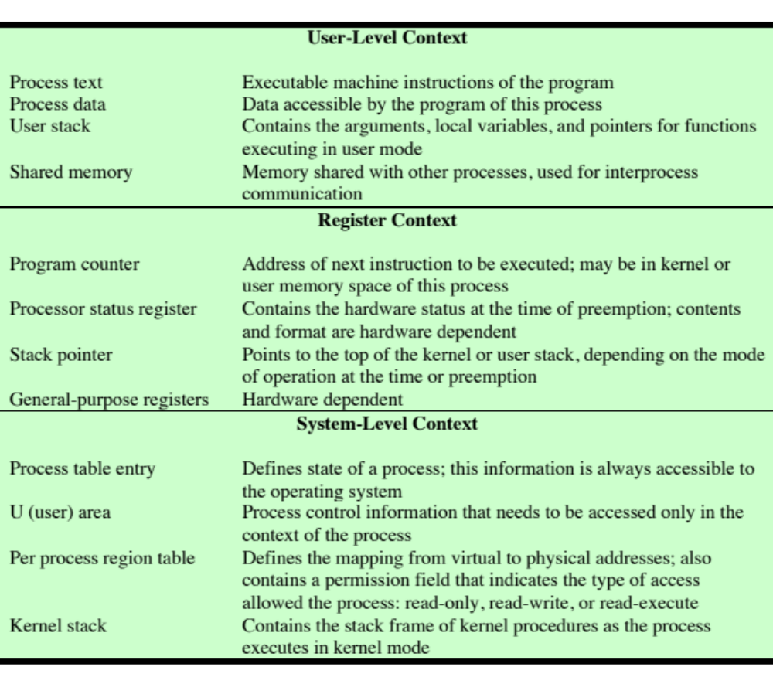
UNIX Process Image
(Table is located on page 140 in the textbook (S))
Notes:
A process in UNIX is a rather complex set of data structures that provide the OS
with all of the information necessary to manage and dispatch processes. Table 3.10
summarizes the elements of the process image, which are organized into three parts:
user-level context, register context, and system-level context.
The user-level context contains the basic elements of a user’s program and
can be generated directly from a compiled object file. The user’s program is separated
into text and data areas; the text area is read-only and is intended to hold
the program’s instructions. While the process is executing, the processor uses the
user stack area for procedure calls and returns and parameter passing. The shared
memory area is a data area that is shared with other processes. There is only one
physical copy of a shared memory area, but, by the use of virtual memory, it appears
to each sharing process that the shared memory region is in its address space. When
a process is not running, the processor status information is stored in the register
context area.
The system-level context contains the remaining information that the OS
needs to manage the process. It consists of a static part, which is fixed in size and
stays with a process throughout its lifetime, and a dynamic part, which varies in
size through the life of the process. One element of the static part is the process
table entry. This is actually part of the process table maintained by the OS, with
one entry per process. The process table entry contains process control information
that is accessible to the kernel at all times; hence, in a virtual memory system, all
process table entries are maintained in main memory. Table 3.11 lists the contents
of a process table entry. The user area, or U area, contains additional process control
information that is needed by the kernel when it is executing in the context of
this process; it is also used when paging processes to and from memory. Table 3.12
shows the contents of this table.
The distinction between the process table entry and the U area reflects the
fact that the UNIX kernel always executes in the context of some process. Much
of the time, the kernel will be dealing with the concerns of that process. However,
some of the time, such as when the kernel is performing a scheduling algorithm
preparatory to dispatching another process, it will need access to information about
other processes. The information in a process table can be accessed when the given
process is not the current one.
The third static portion of the system-level context is the per process region
table, which is used by the memory management system. Finally, the kernel stack is
the dynamic portion of the system-level context. This stack is used when the process
is executing in kernel mode and contains the information that must be saved and
restored as procedure calls and interrupts occur.

Slide 62
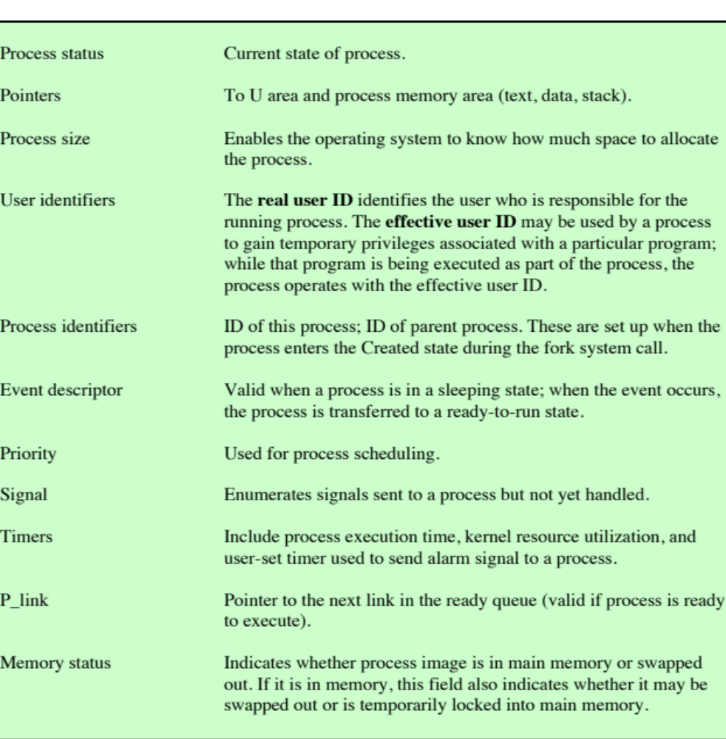
UNIX Process Table Entry
(Table is located on page 141 in the textbook)
Notes:
Table 3.11 lists the contents
of a process table entry. The user area, or U area, contains additional process control
information that is needed by the kernel when it is executing in the context of
this process; it is also used when paging processes to and from memory.

Slide 63
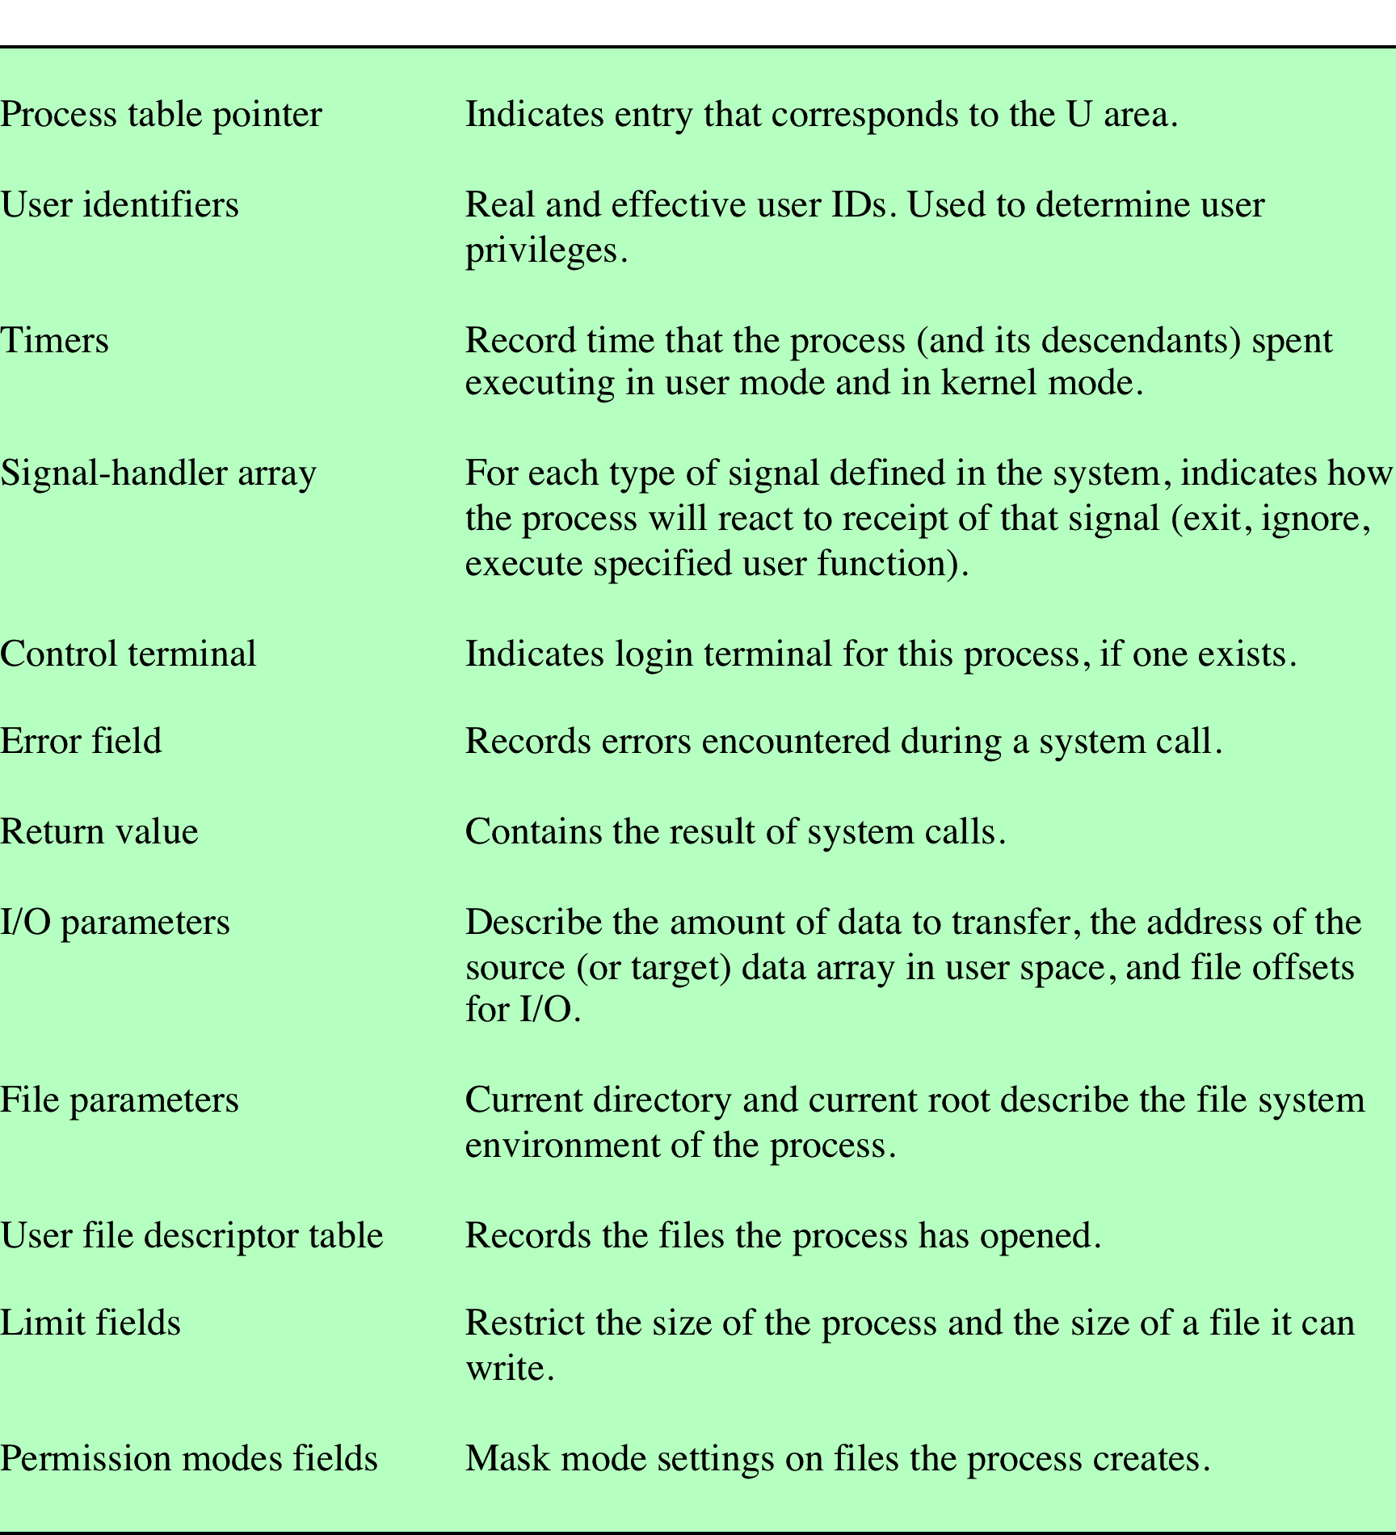
UNIX U Area
(Table is located on page 142 in the textbook)
Notes:
The user area, or U area, contains additional process control
information that is needed by the kernel when it is executing in the context of
this process; it is also used when paging processes to and from memory. Table 3.12
shows the contents of this table.

Slide 64
Process Control
Process creation is by means of the kernel system call, fork()
When a process issues a fork request, the OS performs the following functions:
1
Allocates a slot in the process table for the new process
2
Assigns a unique process ID to the child process
3
Makes a copy of the process image of the parent, with the exception of any shared memory
4
5
6
Increments counters for any files owned by the parent, to reflect that an additional process now also owns those files
Assigns the child process to the Ready to Run state
Returns the ID number of the child to the parent process, and a 0 value to the child process
Notes:
Process creation in UNIX is made by means of the kernel system call, fork( ). When
a process issues a fork request, the OS performs the following functions [BACH86]:
1. It allocates a slot in the process table for the new process.
2. It assigns a unique process ID to the child process.
3. It makes a copy of the process image of the parent, with the exception of any
shared memory.
4. It increments counters for any files owned by the parent, to reflect that an
additional process now also owns those files.
5. It assigns the child process to the Ready to Run state.
6. It returns the ID number of the child to the parent process, and a 0 value to
the child process.

Slide 65
After Creation
After creating the process the Kernel can do one of the following, as part of the dispatcher routine:
  Stay in the parent process. Control returns to user mode at the point of the fork call of the parent.
  Transfer control to the child process. The child process begins executing at the same point in the code as the parent, namely at the return from the fork call.
  Transfer control to another process. Both parent and child are left in the Ready to Run state.
Notes:
When the kernel has completed these functions it can do one of the following, as part of
the dispatcher routine:
• Stay in the parent process. Control returns to user mode at the point of the fork call of the parent.
• Transfer control to the child process. The child process begins executing at the same point in the code as the parent, namely at the return from the fork call.
• Transfer control to another process. Both parent and child are left in the Ready to Run state.

Slide 66
Processes and Threads
Resource Ownership
Scheduling/Execution
  Process includes a virtual address space to hold the process image
    The OS performs a protection function to prevent unwanted interference between processes with respect to resources
  Follows an execution path that may be interleaved with other processes
    A process has an execution state (Running, Ready, etc.) and a dispatching priority, and is the entity that is scheduled and dispatched by the OS
Notes:
The discussion so far has presented the concept of a process as embodying two
characteristics:
• Resource ownership: A process includes a virtual address space to hold the
process image; recall from Chapter 3 that the process image is the collection of
program, data, stack, and attributes defined in the process control block. From
time to time, a process may be allocated control or ownership of resources,
such as main memory, I/O channels, I/O devices, and files. The OS performs a
protection function to prevent unwanted interference between processes with
respect to resources.
• Scheduling/execution: The execution of a process follows an execution path
(trace) through one or more programs (e.g., Figure 1.5). This execution may
be interleaved with that of other processes. Thus, a process has an execution
state (Running, Ready, etc.) and a dispatching priority and is the entity that is
scheduled and dispatched by the OS.

Slide 67
Processes and Threads (cont.)
The unit of dispatching is referred to as a thread or lightweight process
The unit of resource ownership is referred to as a process or task
Multithreading - The ability of an OS to support multiple, concurrent paths of execution within a single process
Notes:
Some thought should convince the reader that these two characteristics are
independent and could be treated independently by the OS. This is done in a number
of operating systems, particularly recently developed systems. To distinguish the two characteristics, the unit of dispatching is usually referred to as a thread or lightweight process , while the unit of resource ownership is usually referred to as a process or task .
Multithreading refers to the ability of an OS to support multiple, concurrent paths of execution within a single process.

Slide 68
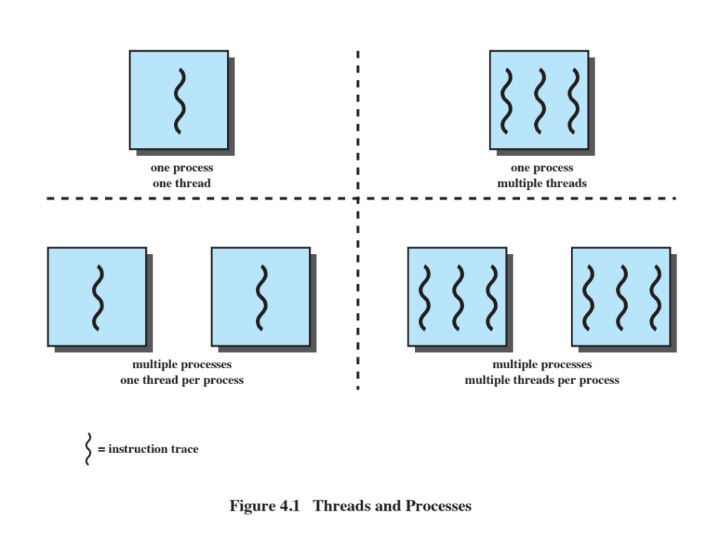
Single Threaded Approaches
A single thread of execution per process, in which the concept of a thread is not recognized, is referred to as a single-threaded approach
MS-DOS is an example
Notes:
The traditional approach of a single thread of execution per process, in which the concept of a thread is not recognized, is referred to as a single-threaded approach. The two arrangements shown in the left half of Figure 4.1 are single-threaded approaches. MS-DOS is an example of an OS that supports a single user process and a single thread.

Slide 69
Multithreaded Approaches
The right half of Figure 4.1 depicts multithreaded approaches
A Java run-time environment is an example of a system of one process with multiple threads
Notes:
Other operating systems, such
as some variants of UNIX, support multiple user processes, but only support one
thread per process. The right half of Figure 4.1 depicts multithreaded approaches.
A Java runtime environment is an example of a system of one process with multiple
threads. Of interest in this section is the use of multiple processes, each of which
supports multiple threads. This approach is taken in Windows, Solaris, and many
modern versions of UNIX, among others. In this section, we give a general description
of multithreading; the details of the Windows, Solaris, and Linux approaches will
be discussed later in this chapter.

Slide 70
Process
Defined in a multithreaded environment as “the unit of resource allocation and a unit of protection”
Associated with processes:
    A virtual address space that holds the process image
    Protected access to:
    Processors
    Other processes (for interprocess communication)
    Files
    I/O resources (devices and channels)
Notes:
In a multithreaded environment, a process is defined as the unit of resource allocation and a unit of protection. The following are associated with processes:
• A virtual address space that holds the process image
• Protected access to processors, other processes (for interprocess communication), files, and I/O resources (devices and channels)

Slide 71
One or More Threads in a Process
Each thread has:
An execution state (Running, Ready, etc.)
A saved thread context when not running
An execution stack
Some per-thread static storage for local variables
Access to the memory and resources of its processes, shared with all other threads in that process
Notes:
Within a process, there may be one or more threads, each with the following:
• A thread execution state (Running, Ready, etc.)
• A saved thread context when not running; one way to view a thread is as an independent program counter operating within a process
• An execution stack
• Some per-thread static storage for local variables
• Access to the memory and resources of its process, shared with all other threads in that process

Slide 72
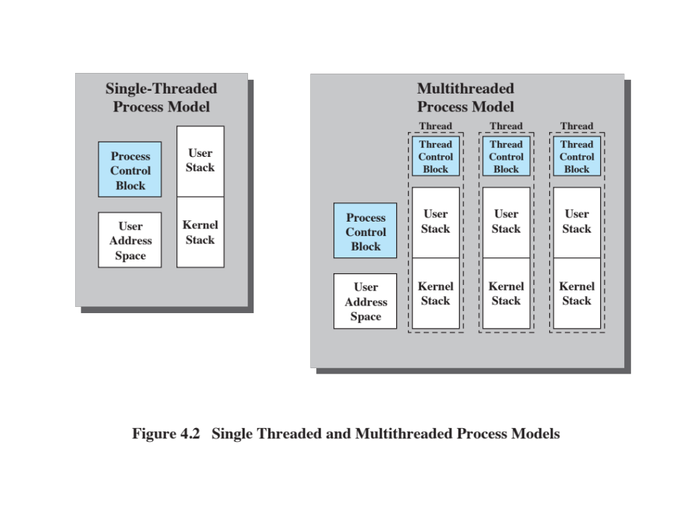
Notes:
Figure 4.2 illustrates the distinction between threads and processes from the point of view of process management. In a single-threaded process model (i.e., there is no distinct concept of thread), the representation of a process includes its process control block and user address space, as well as user and kernel stacks to manage the call/return behavior of the execution of the process. While the process is running, it controls the processor registers. The contents of these registers are saved when the process is not running. In a multithreaded environment, there is still a single process control block and user address space associated with the process, but now there are separate stacks for each thread, as well as a separate control block for each thread containing register values, priority, and other thread-related state information.

Slide 73
Key Benefits of Threads
Takes less time to create a new thread than a process
Less time to terminate a thread than a process
Switching between two threads takes less time than switching between processes
Threads enhance efficiency in communication between programs
Notes:
Thus, all of the threads of a process share the state and resources of that process. They reside in the same address space and have access to the same data. When one thread alters an item of data in memory, other threads see the results if and when they access that item. If one thread opens a file with read privileges, other threads in the same process can also read from that file.
The key benefits of threads derive from the performance implications:
1. It takes far less time to create a new thread in an existing process than to
create a brand-new process. Studies done by the Mach developers show that
thread creation is ten times faster than process creation in UNIX [TEVA87].
2. It takes less time to terminate a thread than a process.
3. It takes less time to switch between two threads within the same process than to switch between processes.
4. Threads enhance efficiency in communication between different executing programs. In most operating systems, communication between independent processes requires the intervention of the kernel to provide protection and the mechanisms needed for communication. However, because threads within the same process share memory and files, they can communicate with each other without invoking the kernel.
Thus, if there is an application or function that should be implemented as a set of related units of execution, it is far more efficient to do so as a collection of threads rather than a collection of separate processes.

Slide 74
Thread Use in a Single-User System
Foreground and background work
Asynchronous processing
Speed of execution
Modular program structure
Notes:
[LETW88] gives four examples of the uses of threads in a single-user multiprocessing system:
• Foreground and background work: For example, in a spreadsheet program,
one thread could display menus and read user input, while another thread executes user commands and updates the spreadsheet. This arrangement often increases the perceived speed of the application by allowing the program to prompt for the next command before the previous command is complete.
• Asynchronous processing: Asynchronous elements in the program can be
implemented as threads. For example, as a protection against power failure, one can design a word processor to write its random access memory (RAM) buffer to disk once every minute. A thread can be created whose sole job is periodic backup and that schedules itself directly with the OS; there is no need for fancy code in the main program to provide for time checks or to coordinate input and output.
• Speed of execution: A multithreaded process can compute one batch of data
while reading the next batch from a device. On a multiprocessor system, multiple threads from the same process may be able to execute simultaneously. Thus, even though one thread may be blocked for an I/O operation to read in a batch of data, another thread may be executing.
• Modular program structure: Programs that involve a variety of activities or a
variety of sources and destinations of input and output may be easier to design and implement using threads.

Slide 75
Threads
Most of the state information dealing with execution is maintained in thread-level data structures
In an OS that supports threads, scheduling and dispatching is done on a thread basis
  Suspending a process involves suspending all threads of the process
  Termination of a process terminates all threads within the process
Notes:
In an OS that supports threads, scheduling and dispatching is done on a thread basis; hence, most of the state information dealing with execution is maintained in thread-level data structures. There are, however, several actions that affect all of the threads in a process and that the OS must manage at the process level. For example, suspension involves swapping the address space of one process out of main memory to make room for the address space of another process. Because all threads in a process share the same address space, all threads are suspended at the same time. Similarly, termination of a process terminates all threads within that process.

Slide 76
Thread Execution States
Thread operations associated with a change in thread state are:
      Spawn
      Block
      Unblock
      Finish
The key states for a thread are:
      Running
      Ready
      Blocked
Notes:
As with processes, the key states for a thread are Running, Ready, and Blocked. Generally, it does not make sense to associate suspend states with threads because such states are process-level concepts. In particular, if a process is swapped out, all of its threads are necessarily swapped out because they all share the address space of the process. There are four basic thread operations associated with a change in thread state [ANDE04]:
• Spawn: Typically, when a new process is spawned, a thread for that process is also spawned. Subsequently, a thread within a process may spawn
another thread within the same process, providing an instruction pointer and arguments for the new thread. The new thread is provided with its own register context and stack space and placed on the ready queue.
• Block: When a thread needs to wait for an event, it will block (saving its user registers, program counter, and stack pointers). The processor may now turn to the execution of another ready thread in the same or a different process.
• Unblock: When the event for which a thread is blocked occurs, the thread is moved to the Ready queue.
• Finish: When a thread completes, its register context and stacks are deallocated.

Slide 77
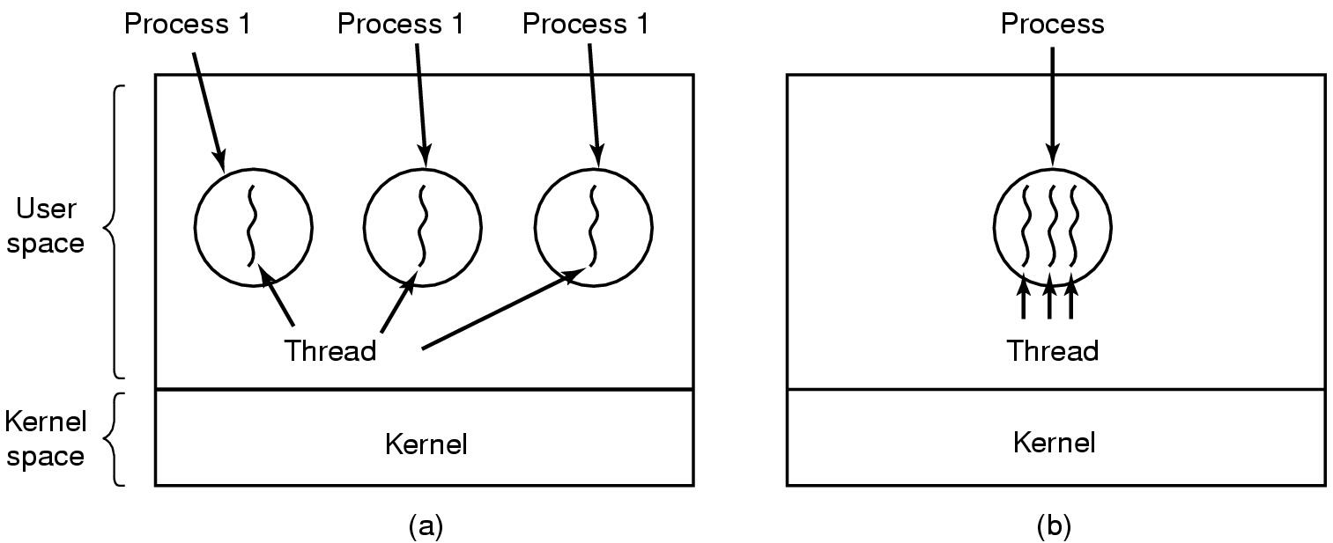
The Thread Model (1)
(a) Three processes each with one thread
(b) One process with three threads

Slide 78
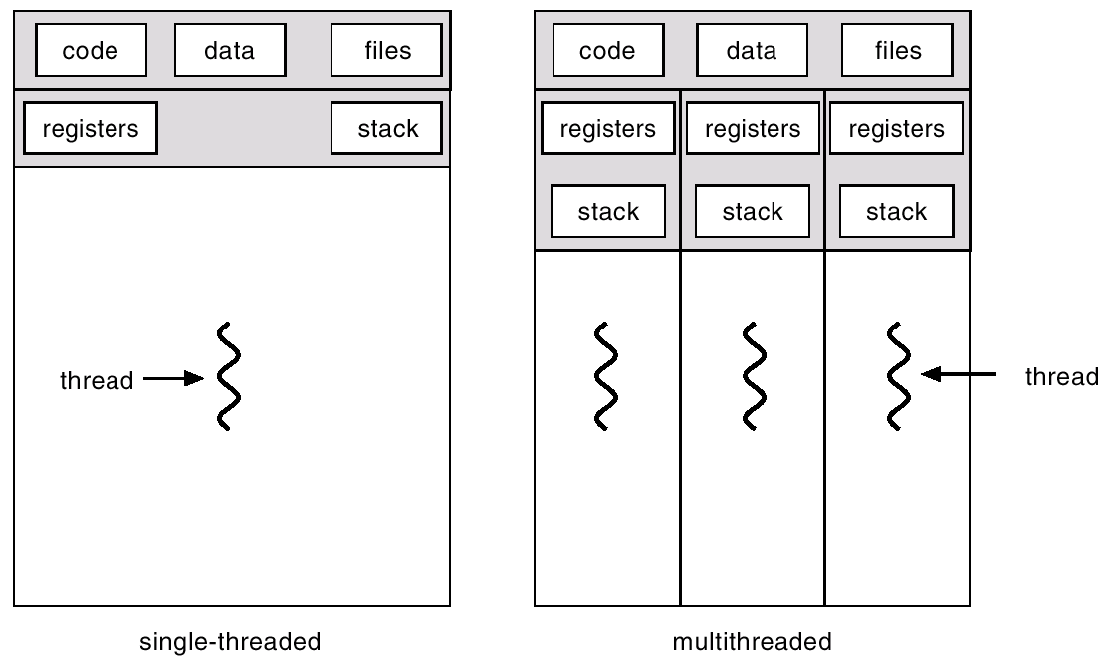
The Thread Model (2):
A Closer Look

Slide 79

The Thread Model (3)
Items shared by all threads in a process
Items private to each thread

Slide 80
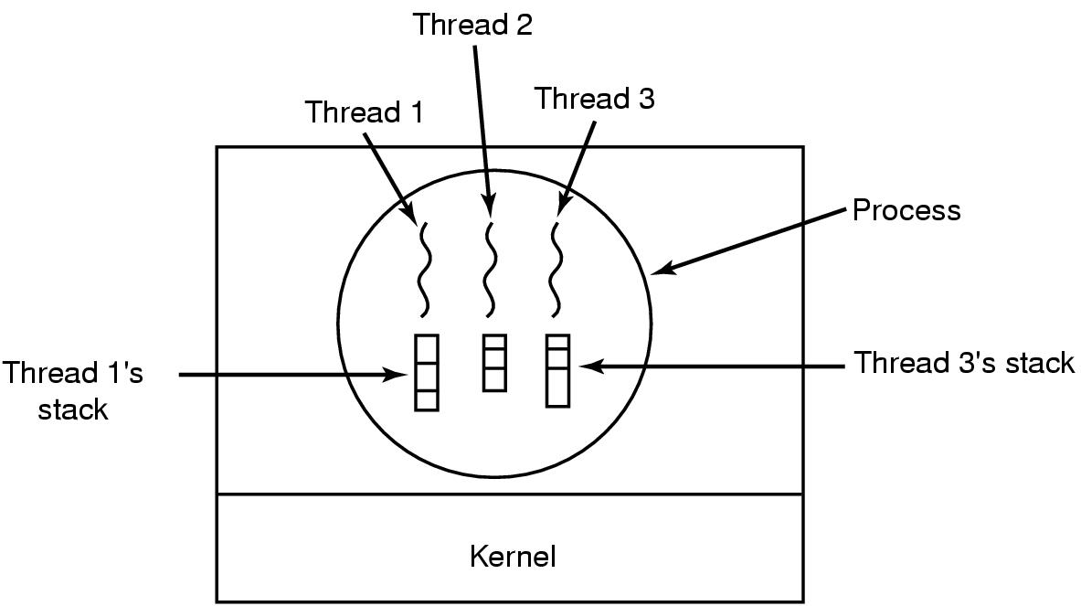
The Thread Model (4)
Each thread has its own stack

Slide 81
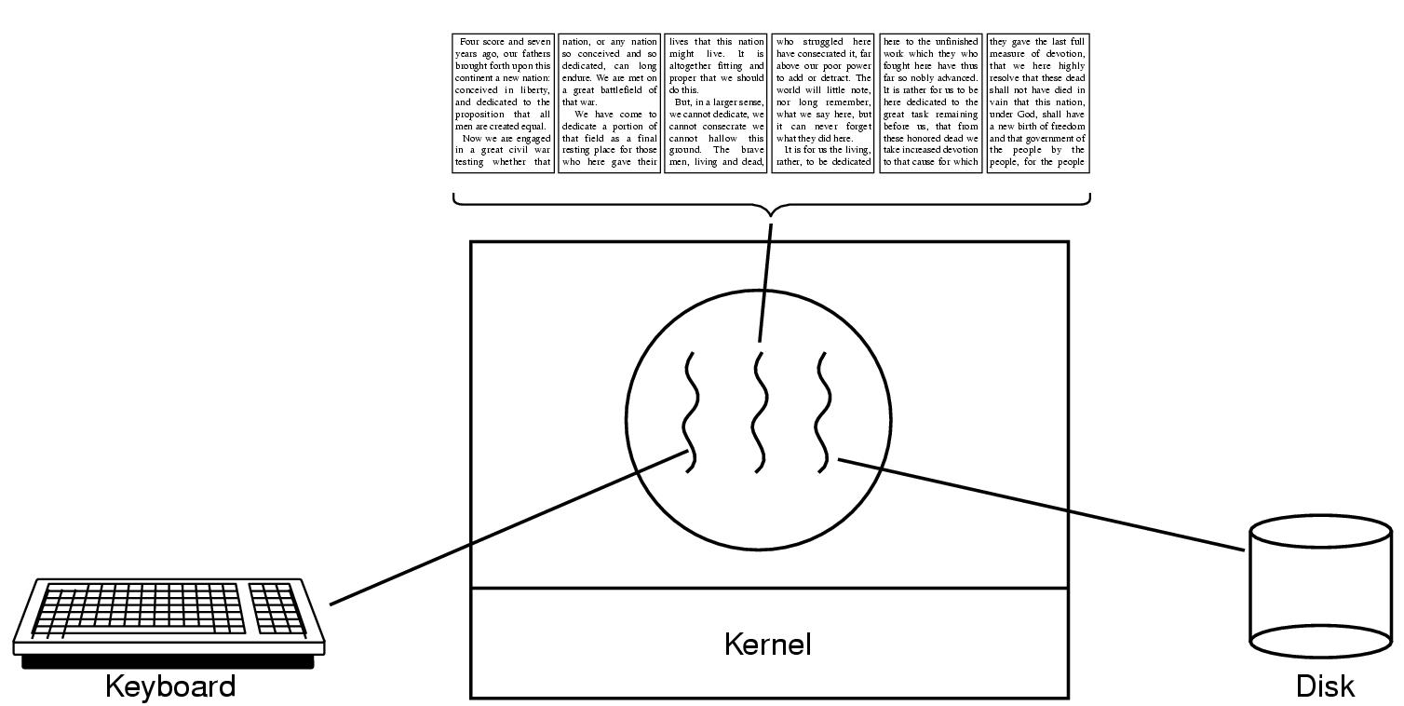
Thread Usage (1)
A word processor with three threads

Slide 82
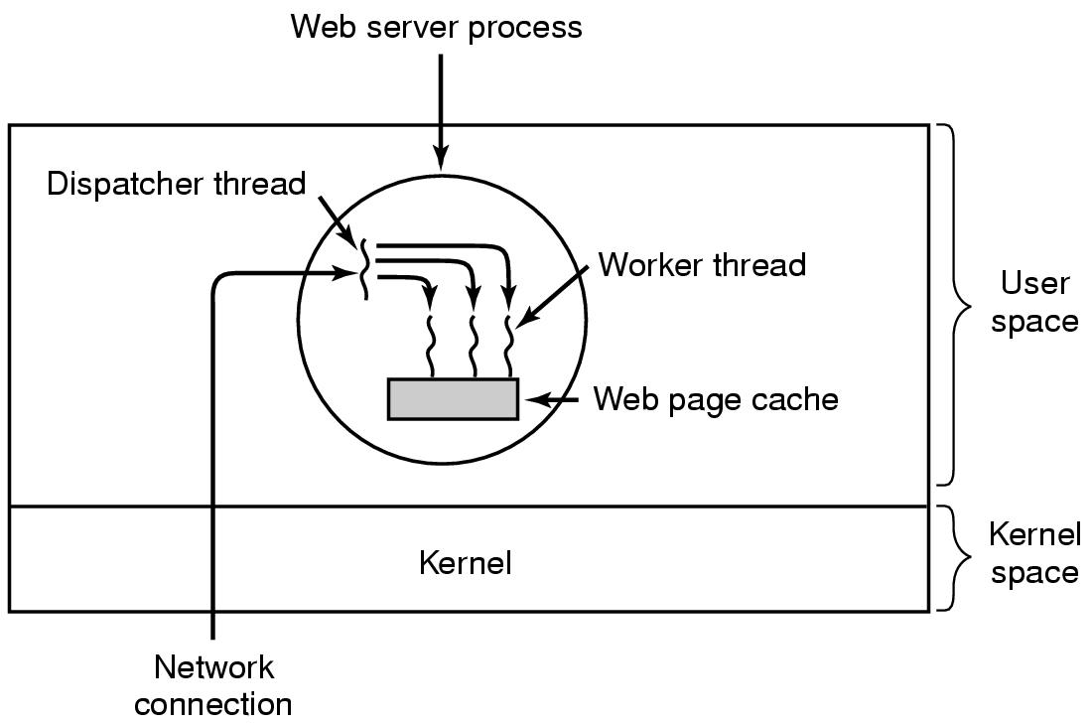
Thread Usage (2)
A multithreaded Web server

Slide 83
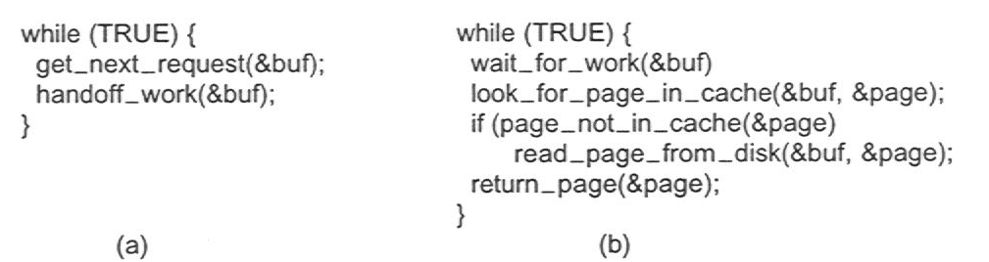
Thread Usage (3)
Rough outline of code for previous slide
  (a) Dispatcher thread
  (b) Worker thread

Slide 84
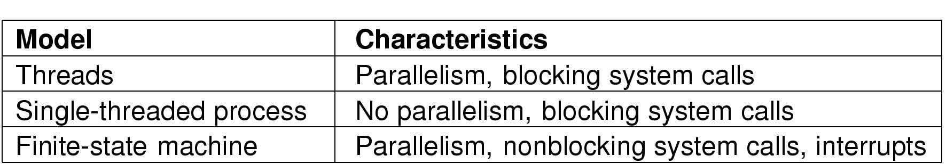
Thread Usage (4)
Three ways to construct a server

Slide 85
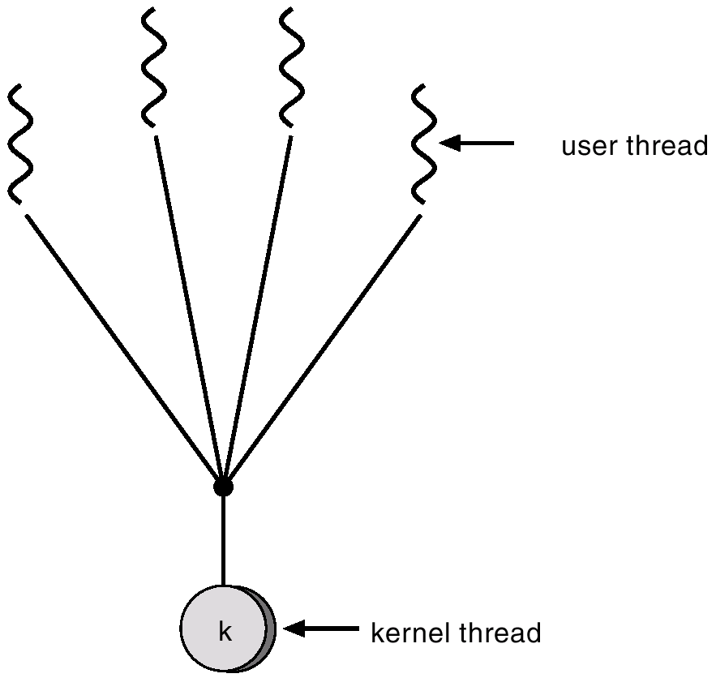
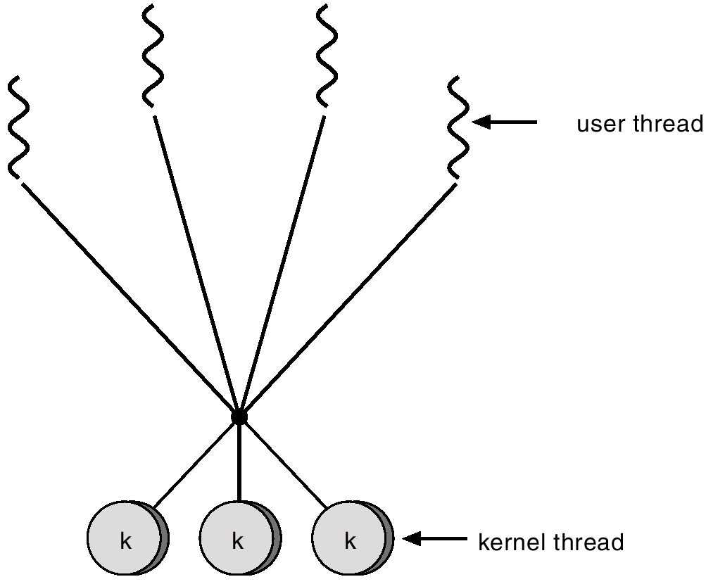
Threading Models
One to One model
  Map each user thread to one kernel thread
Many to one model
  Map many user threads to a single kernel thread
  Cannot exploit multiprocessors
Many to many
  Map m user threads to n kernel threads

Slide 86
Thread Synchronization
It is necessary to synchronize the activities of the various threads
      All threads of a process share the same address space and other resources
      Any alteration of a resource by one thread affects the other threads in the same process
Notes:
All of the threads of a process share the same address space and other resources, such as open files. Any alteration of a resource by one thread affects the environment of the other threads in the same process. It is therefore necessary to synchronize the activities of the various threads so that they do not interfere with each other or corrupt data structures. For example, if two threads each try to add an element to a doubly linked list at the same time, one element may be lost or the list may end up malformed.
The issues raised and the techniques used in the synchronization of threads are, in general, the same as for the synchronization of processes. These issues and techniques are the subject of Chapters 5 and 6 .

Slide 87
Types of Threads
User Level Thread (ULT)
Kernel level Thread (KLT)
Notes:
There are two broad categories of thread implementation: user-level threads (ULTs) and kernel-level threads (KLTs). The latter are also referred to in the literature as kernel-supported threads or lightweight processes.

Slide 88
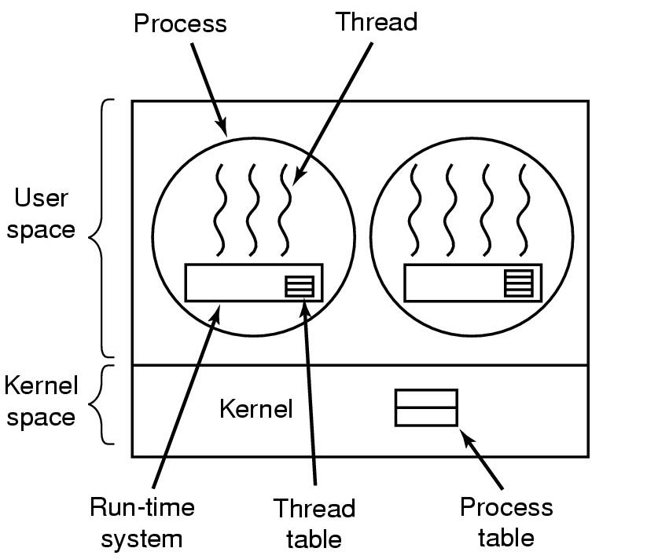
Implementing Threads in User Space
A user-level threads package

Slide 89
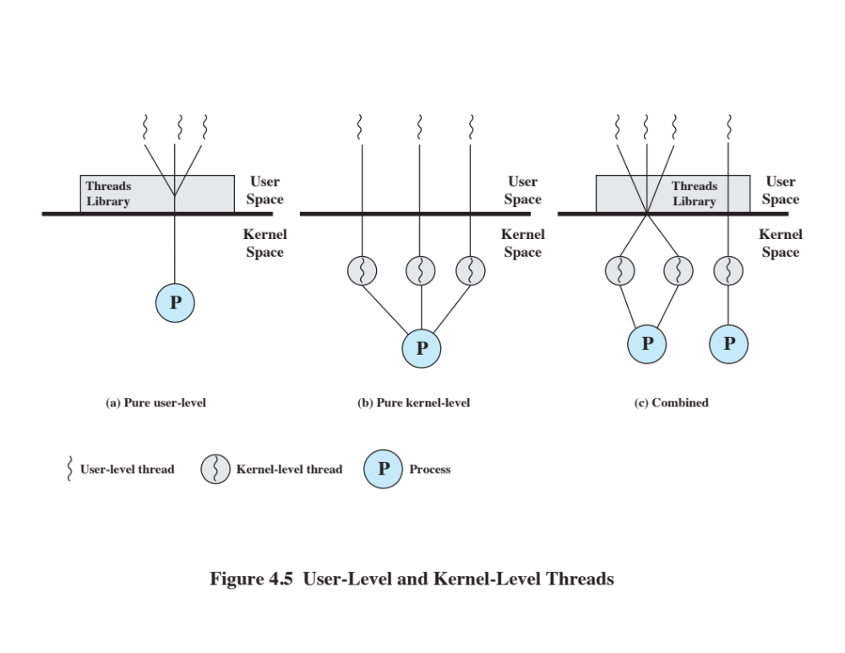
User-Level Threads (ULTs)
All thread management is done by the application
The kernel is not aware of the existence of threads
Notes:
In a pure ULT facility, all of the work of thread management is done by the application and the kernel is not aware of the existence of threads. Figure 4.5a illustrates the pure ULT approach. Any application can be programmed to be multithreaded by using a threads library, which is a package of routines for ULT management. The threads library contains code for creating and destroying threads, for passing messages and data between threads, for scheduling thread execution, and for saving and restoring thread contexts.
By default, an application begins with a single thread and begins running in that thread. This application and its thread are allocated to a single process managed by the kernel. At any time that the application is running (the process is in the Running state), the application may spawn a new thread to run within the same process. Spawning is done by invoking the spawn utility in the threads library. Control is passed to that utility by a procedure call. The threads library creates a data structure for the new thread and then passes control to one of the threads within this process that is in the Ready state, using some scheduling algorithm. When control is passed to the library, the context of the current thread is saved, and when control is passed from the library to a thread, the context of that thread is restored. The context essentially consists of the contents of user registers, the program counter, and stack pointers.

Slide 90

Notes:
All of the activity described in the preceding paragraph takes place in user space and within a single process. The kernel is unaware of this activity. The kernel continues to schedule the process as a unit and assigns a single execution state (Ready, Running, Blocked, etc.) to that process. The following examples should clarify the relationship between thread scheduling and process scheduling. Suppose that process B is executing in its thread 2; the states of the process and two ULTs that are part of the process are shown in Figure 4.6a . Each of the following is a possible occurrence:
1. The application executing in thread 2 makes a system call that blocks B. For
example, an I/O call is made. This causes control to transfer to the kernel. The kernel invokes the I/O action, places process B in the Blocked state, and switches to another process. Meanwhile, according to the data structure maintained by the threads library, thread 2 of process B is still in the Running state. It is important to note that thread 2 is not actually running in the sense of being executed on a processor; but it is perceived as being in the Running state by the threads library. The corresponding state diagrams are shown in Figure 4.6b .
2. A clock interrupt passes control to the kernel and the kernel determines
that the currently running process (B) has exhausted its time slice. The kernel places process B in the Ready state and switches to another process. Meanwhile, according to the data structure maintained by the threads library, thread 2 of process B is still in the Running state. The corresponding state diagrams are shown in Figure 4.6c .
3. Thread 2 has reached a point where it needs some action performed by thread
1 of process B. Thread 2 enters a Blocked state and thread 1 transitions from Ready to Running. The process itself remains in the Running state. The corresponding state diagrams are shown in Figure 4.6d .
Note that each of the three preceding items suggests an alternative event starting
from diagram (a) of Figure 4.6. So each of the three other diagrams (b, c, d) shows
a transition from the situation in (a). In cases 1 and 2 ( Figures 4.6b and 4.6c ), when the kernel switches control back to process B, execution resumes in thread 2. Also note that a process can be interrupted, either by exhausting its time slice or by being preempted by a higher priority process, while it is executing code in the threads library. Thus, a process may be in the midst of a thread switch from one thread to another when interrupted. When that process is resumed, execution continues within the threads library, which completes the thread switch and transfers control to another thread within that process.

Slide 91
Advantages of ULTs
Thread switching does not require kernel mode privileges
Scheduling can be application specific
ULTs can run on any OS
Notes:
There are a number of advantages to the use of ULTs instead of KLTs, including the following:
1. Thread switching does not require kernel mode privileges because all of the
thread management data structures are within the user address space of a single process. Therefore, the process does not switch to the kernel mode to do thread management. This saves the overhead of two mode switches (user to kernel; kernel back to user).
2. Scheduling can be application specific. One application may benefit most
from a simple round-robin scheduling algorithm, while another might benefit from a priority-based scheduling algorithm. The scheduling algorithm can be tailored to the application without disturbing the underlying OS scheduler.
3. ULTs can run on any OS. No changes are required to the underlying kernel
to support ULTs. The threads library is a set of application-level functions shared by all applications.

Slide 92
Disadvantages of ULTs
In a typical OS many system calls are blocking
    As a result, when a ULT executes a system call, not only is that thread blocked, but all of the threads within the process are blocked as well
In a pure ULT strategy, a multithreaded application cannot take advantage of multiprocessing
    A kernel assigns one process to only one processor at a time, therefore, only a single thread within a process can execute at a time
Notes:
There are two distinct disadvantages of ULTs compared to KLTs:
1. In a typical OS, many system calls are blocking. As a result, when a ULT
executes a system call, not only is that thread blocked, but also all of the threads within the process are blocked.
2. In a pure ULT strategy, a multithreaded application cannot take advantage
of multiprocessing. A kernel assigns one process to only one processor at a time. Therefore, only a single thread within a process can execute at a time. In effect, we have application-level multiprogramming within a single process. While this multiprogramming can result in a significant speedup of the application, there are applications that would benefit from the ability to execute portions of code simultaneously.

Slide 93
Overcoming ULT Disadvantages
Jacketing
Purpose is to convert a blocking system call into a non-blocking system call
Writing an application as multiple processes rather than multiple threads
However, this approach eliminates the main advantage of threads
Notes:
There are ways to work around these two problems. For example, both problems can be overcome by writing an application as multiple processes rather than multiple threads. But this approach eliminates the main advantage of threads: Each switch becomes a process switch rather than a thread switch, resulting in much greater overhead.
Another way to overcome the problem of blocking threads is to use a technique referred to as jacketing . The purpose of jacketing is to convert a blocking system call into a non-blocking system call. For example, instead of directly calling a system I/O routine, a thread calls an application-level I/O jacket routine. Within this jacket routine is code that checks to determine if the I/O device is busy. If it is, the thread enters the Blocked state and passes control (through the threads library) to another thread. When this thread later is given control again, the jacket routine checks the I/O device again.

Slide 94
Kernel-Level Threads (KLTs)
  Thread management is done by the kernel
      There is no thread management code in the application level, simply an application programming interface (API) to the kernel thread facility
    Windows is an example of this approach
Notes:
In a pure KLT facility, all of the work of thread management is done by the kernel. There is no thread management code in the application level, simply an application programming interface (API) to the kernel thread facility. Windows is an example of this approach.
Figure 4.5b depicts the pure KLT approach. The kernel maintains context information for the process as a whole and for individual threads within the process.

Slide 95
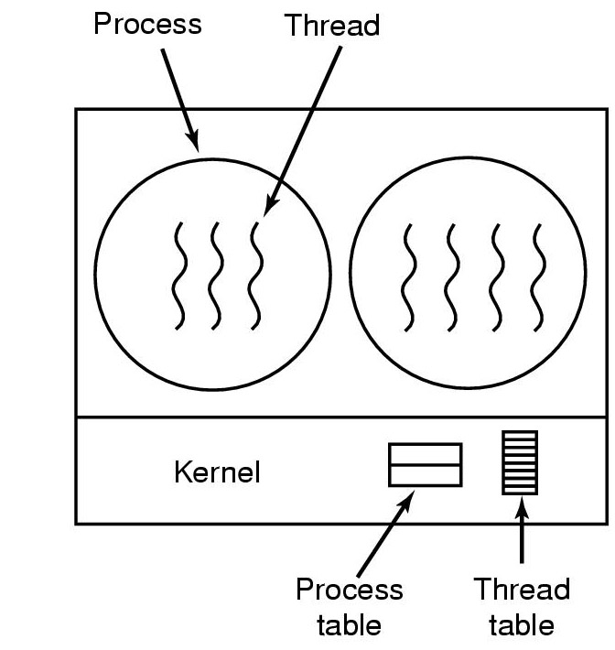
Implementing Threads in the Kernel
A threads package managed by the kernel

Slide 96
Advantages of KLTs
The kernel can simultaneously schedule multiple threads from the same process on multiple processors
If one thread in a process is blocked, the kernel can schedule another thread of the same process
Kernel routines themselves can be multithreaded
Notes:
Scheduling by the kernel is done on a thread basis. This approach overcomes the two principal drawbacks of the ULT approach. First, the kernel can simultaneously schedule multiple threads from the same process on multiple processors. Second, if one thread in a process is blocked, the kernel can schedule another thread of the same process. Another advantage of the KLT approach is that kernel routines themselves can be multithreaded.

Slide 97
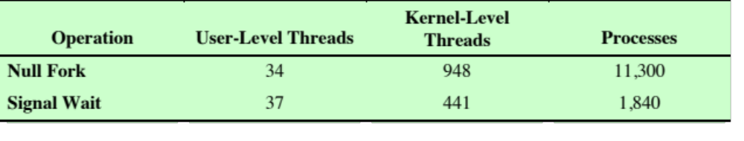
Disadvantage of KLTs
The transfer of control from one thread to another within the same process requires a mode switch to the kernel
Table 4.1
Thread and Process Operation Latencies (μs) (S)
Notes:
The principal disadvantage of the KLT approach compared to the ULT approach is that the transfer of control from one thread to another within the same process requires a mode switch to the kernel. To illustrate the differences, Table 4.1 shows the results of measurements taken on a uniprocessor VAX computer running a UNIX-like OS. The two benchmarks are as follows: Null Fork, the time to create, schedule, execute, and complete a process/thread that invokes the null procedure (i.e., the overhead of forking a process/thread); and Signal-Wait, the time for a process/thread to signal a waiting process/thread and then wait on a condition (i.e., the overhead of synchronizing two processes/threads together). We see that there is
an order of magnitude or more of difference between ULTs and KLTs and similarly between KLTs and processes.

Slide 98
Combined Approaches
Thread creation is done completely in the user space, as is the bulk of the scheduling and synchronization of threads within an application
Solaris is a good example
Notes:
Some operating systems provide a combined ULT/ KLT facility ( Figure 4.5c ). In a combined system, thread creation is done completely in user space, as is the bulk of the scheduling and synchronization of threads within an application. The multiple ULTs from a single application are mapped onto some (smaller or equal) number of KLTs. The programmer may adjust the number of KLTs for a particular application and processor to achieve the best overall results.
In a combined approach, multiple threads within the same application can run in parallel on multiple processors, and a blocking system call need not block the entire process. If properly designed, this approach should combine the advantages of the pure ULT and KLT approaches while minimizing the disadvantages.
Solaris is a good example of an OS using this combined approach. The current Solaris version limits the ULT/KLT relationship to be one-to-one.

Slide 99
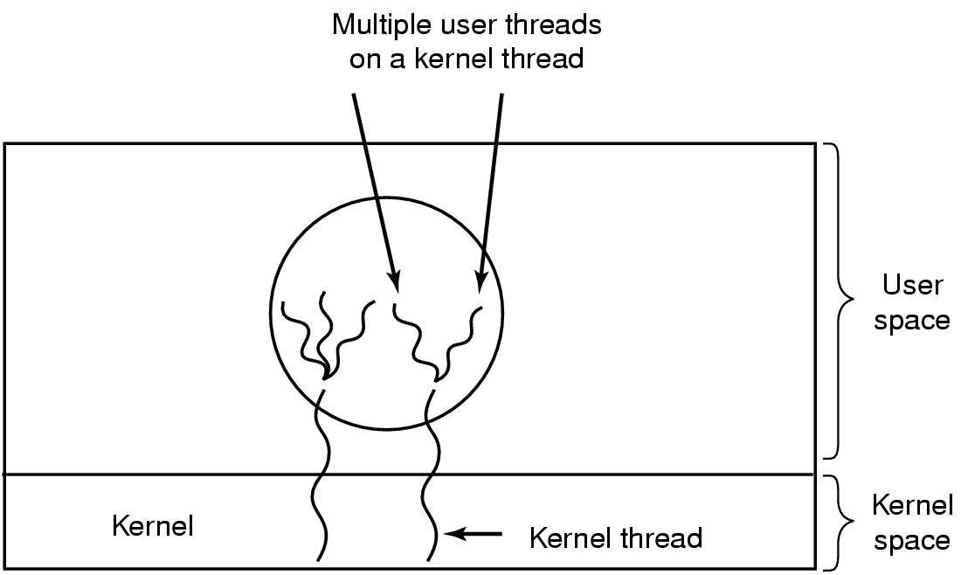
Hybrid Implementations
Multiplexing user-level threads onto kernel- level threads

Slide 100
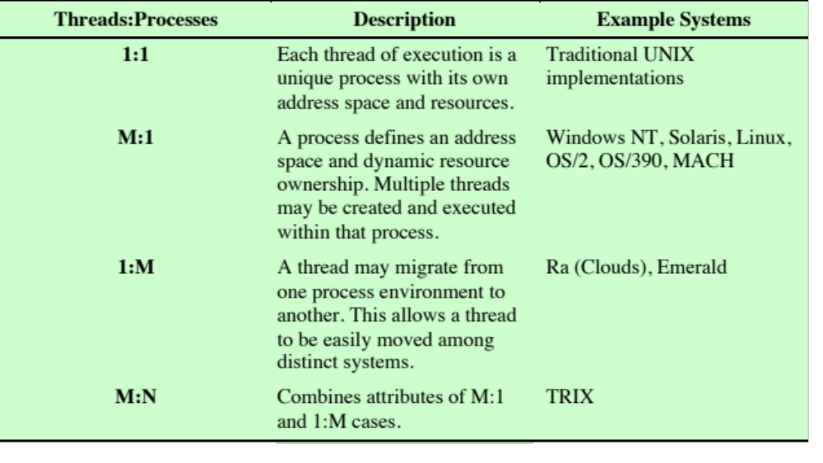
Table 4.2
Relationship between Threads and Processes
Notes:
As we have said, the concepts of resource allocation and dispatching unit have traditionally been embodied in the single concept of the process—that is, as a 1 : 1 relationship between threads and processes. Recently, there has been much interest in providing for multiple threads within a single process, which is a many-to-one relationship. However, as Table 4.2 shows, the other two combinations have also been investigated, namely, a many-to-many relationship and a one-to-many relationship.
The idea of having a many-to-many relationship between threads and processes has been explored in the experimental operating system TRIX [PAZZ92, WARD80]. In TRIX, there are the concepts of domain and thread. A domain is a static entity, consisting of an address space and “ports” through which messages may be sent and received. A thread is a single execution path, with an execution stack, processor state, and scheduling information.
As with the multithreading approaches discussed so far, multiple threads may execute in a single domain, providing the efficiency gains discussed earlier. However, it is also possible for a single user activity, or application, to be performed in multiple domains. In this case, a thread exists that can move from one domain to another.

Slide 101
Scheduler Activations
Goal – mimic functionality of kernel threads
  gain performance of user space threads
Avoids unnecessary user/kernel transitions
Kernel assigns virtual processors to each process
  lets runtime system allocate threads to processors
Problem:
Fundamental reliance on kernel (lower layer)
calling procedures in user space (higher layer)

Slide 102
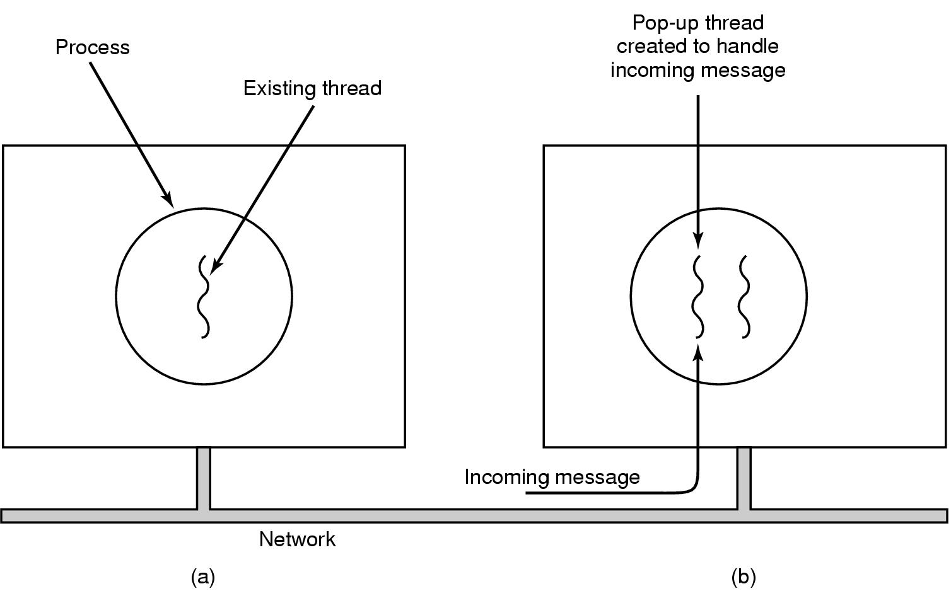
Pop-Up Threads
Creation of a new thread when message arrives
  (a) before message arrives
  (b) after message arrives

Slide 103
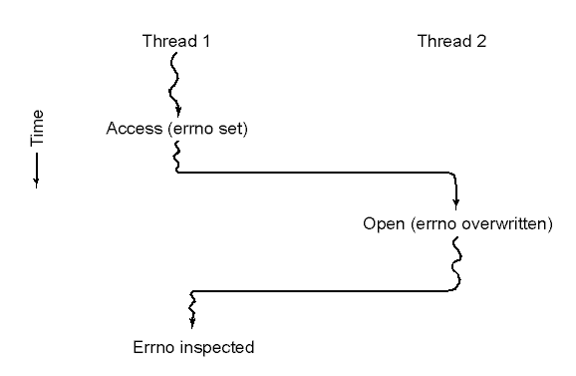
Making Single-Threaded Code Multithreaded (1)
Conflicts between threads over the use of a global variable

Slide 104
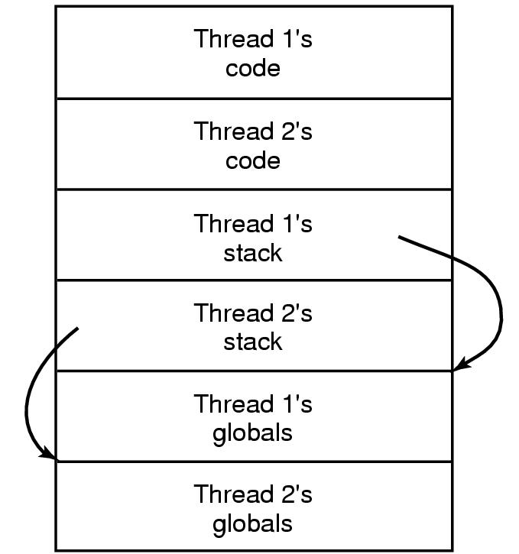
Making Single-Threaded Code Multithreaded (2)
Threads can have private global variables

Slide 105
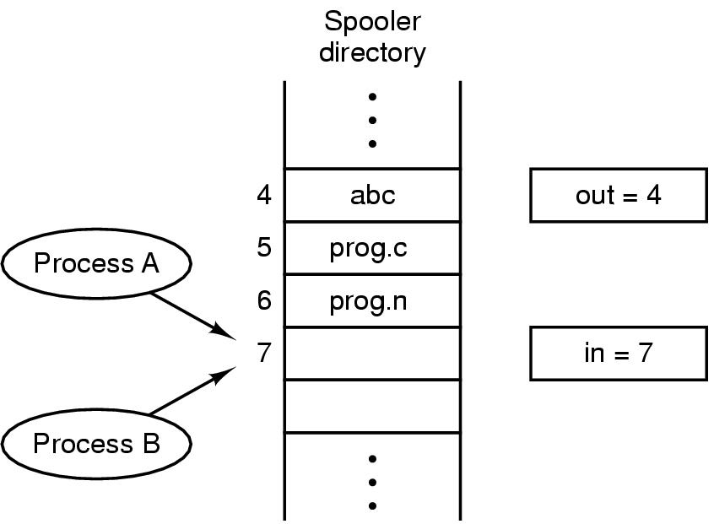
Interprocess Communication
Race Conditions
Two processes want to access shared memory at same time

Slide 106
Critical Regions (1)
Four conditions to provide mutual exclusion
No two processes simultaneously in critical region
No assumptions made about speeds or numbers of CPUs
No process running outside its critical region may block another process
No process must wait forever to enter its critical region

Slide 107
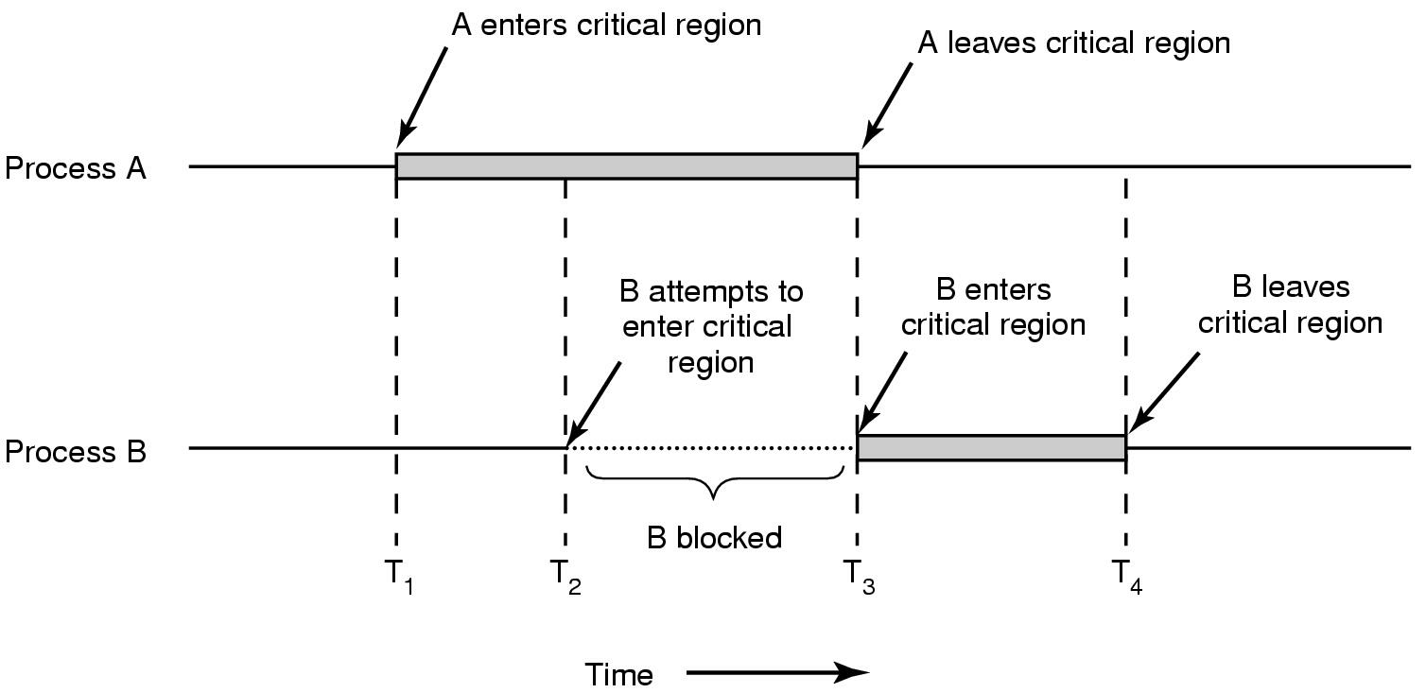
Critical Regions (2)
Mutual exclusion using critical regions

Slide 108

Mutual Exclusion with Busy Waiting (1)
Proposed solution to critical region problem
  (a) Process 0. (b) Process 1.

Slide 109

Mutual Exclusion with Busy Waiting (2)
Peterson's solution for achieving mutual exclusion

Slide 110

Mutual Exclusion with Busy Waiting (3)
Entering and leaving a critical region using the
TSL instruction

Slide 111

Sleep and Wakeup
Producer-consumer problem with fatal race condition

Slide 112

Semaphores
The producer-consumer problem using semaphores

Slide 113

Mutexes
Implementation of mutex_lock and mutex_unlock

Slide 114

Monitors (1)
Example of a monitor

Slide 115

Monitors (2)
Outline of producer-consumer problem with monitors
  only one monitor procedure active at one time
  buffer has N slots

Slide 116

Monitors (3)
Solution to producer-consumer problem in Java (part 1)

Slide 117

Monitors (4)
Solution to producer-consumer problem in Java (part 2)

Slide 118

Message Passing
The producer-consumer problem with N messages

Slide 119

Barriers
Use of a barrier
  processes approaching a barrier
  all processes but one blocked at barrier
  last process arrives, all are let through

Slide 120

Dining Philosophers (1)
Philosophers eat/think
Eating needs 2 forks
Pick one fork at a time
How to prevent deadlock

Slide 121

Dining Philosophers (2)
A nonsolution to the dining philosophers problem

Slide 122

Dining Philosophers (3)
Solution to dining philosophers problem (part 1)

Slide 123
Dining Philosophers (4)
Solution to dining philosophers problem (part 2)

Slide 124

The Readers and Writers Problem
A solution to the readers and writers problem

Slide 125

The Sleeping Barber Problem (1)

Slide 126

The Sleeping Barber Problem (2)
Solution to sleeping barber problem.

Slide 127

Scheduling
Introduction to Scheduling (1)
Bursts of CPU usage alternate with periods of I/O wait
  a CPU-bound process
  an I/O bound process

Slide 128

Introduction to Scheduling (2)
Scheduling Algorithm Goals

Slide 129
CPU Scheduling - Classical algorithms
First come, first served (FCFS)
  Convoy effect (all processes get bunched up behind long process)
Shortest job first (shortest next CPU burst)
  “Optimal”.
  Need oracle to predict next duration: prediction based on history
Priority: Choose higher priority tasks
  Priority inversion: High priority tasks wait for lower priority tasks holding critical resources
  Starvation: Low priority tasks never get their chance
Round robin
Multilevel queue: Different schemes for background, interactive tasks
Multilevel feedback queue scheduling
Multiprocessor scheduling
  Gang scheduling, Non Uniform Memory Access, Processor affinity
Real-Time scheduling
  Hard and soft real time systems

Slide 130

Scheduling in Batch Systems (1)
An example of shortest job first scheduling

Slide 131

Scheduling in Batch Systems (2)
Three level scheduling

Slide 132

Scheduling in Interactive Systems (1)
Round Robin Scheduling
  list of runnable processes
  list of runnable processes after B uses up its quantum

Slide 133

Scheduling in Interactive Systems (2)
A scheduling algorithm with four priority classes

Slide 134

Scheduling in Real-Time Systems
Schedulable real-time system
Given
  m periodic events
  event i occurs within period P_{i} and requires C_{i} seconds
Then the load can only be handled if

Slide 135
Policy versus Mechanism
Separate what is allowed to be done with how it is done
  a process knows which of its children threads are important and need priority
Scheduling algorithm parameterized
  mechanism in the kernel
Parameters filled in by user processes
  policy set by user process

Slide 136

Thread Scheduling (1)
Possible scheduling of user-level threads
50-msec process quantum
threads run 5 msec/CPU burst

Slide 137

Thread Scheduling (2)
Possible scheduling of kernel-level threads
50-msec process quantum
threads run 5 msec/CPU burst

Slide 138
Summary
What is a process?
  Background
  Processes and process control blocks
Process states
  Two-state process model
  Creation and termination
  Five-state model
  Suspended processes
Process description
  Operating system control structures
  Process control structures
Process control
  Modes of execution
  Process creation
  Process switching
Execution of the operating system
  Nonprocess kernel
  Execution within user processes
  Process-based operating system
UNIX SVR4 process management
  Process states
  Process description
  Process control
Notes:
Chapter 3 Summary

Slide 139
Summary
Processes and threads
  Multithreading
  Thread functionality
Types of threads
  User level and kernel level threads
Multicore and multithreading
  Performance of Software on Multicore
Interprocess Communication (IPC)
  Race Conditions
  Critical Regions
  Mutex
  Producer-Consumer
  Readers & writers
  Dining Philosophers
  Sleep
  Sleeping Barber
  Etc.
Scheduling
Notes:
Chapter 4 summary.

Slide 140
Next Lecture
Deadlocks

Slide 141
References
Andrew S. Tanenbaum, Herbert Bos, Modern Operating Systems 4th Global Edition, Pearson, 2015
William Stallings, Operating Systems: Internals and Design Principles, 9th Global Edition, Pearson, 2017

